Slide 1
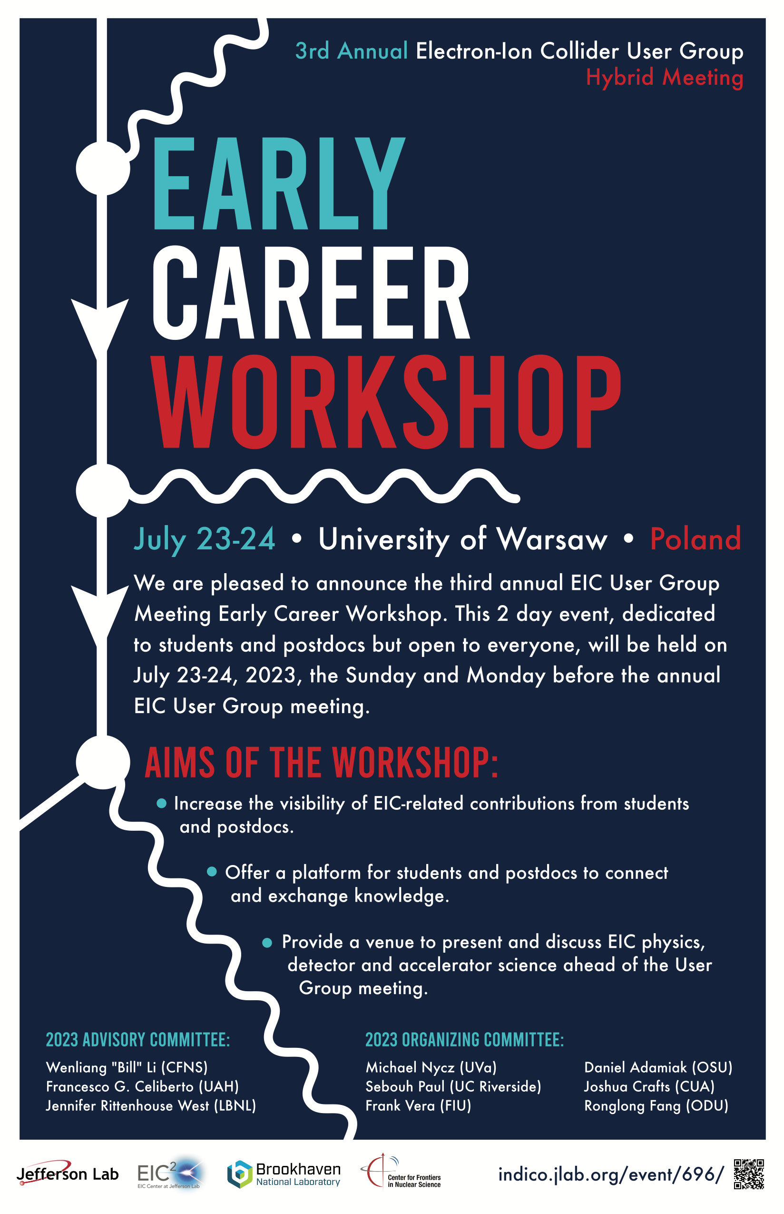
Welcome!
2023 EIC UG Meeting: Early Career Workshop
Indico page: https://indico.jlab.org/event/696/
Zoom link: https://events.zoom.us/ev/AuwybhF2_k-7z1_JLWtLYDq6_VQSTj6c6GIkketXK6COu6qcW9wK~AggLXsr32QYFjq8BlYLZ5I06Dg

Slide 2
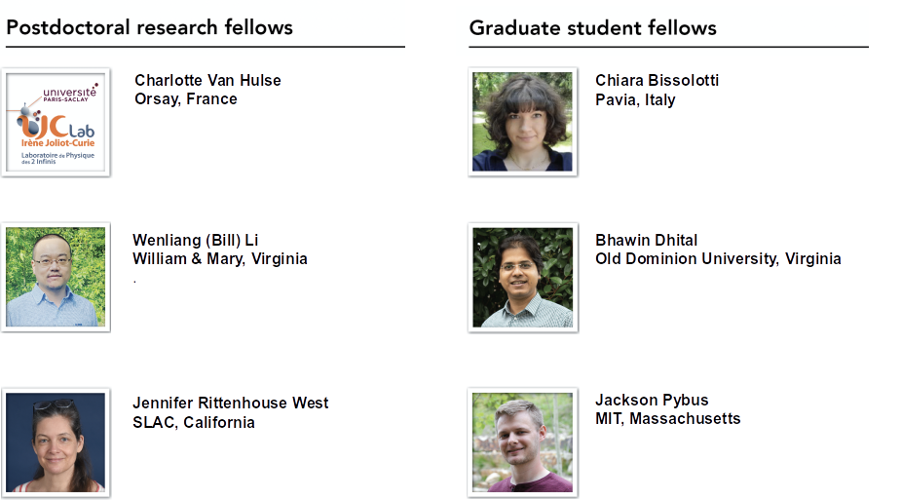
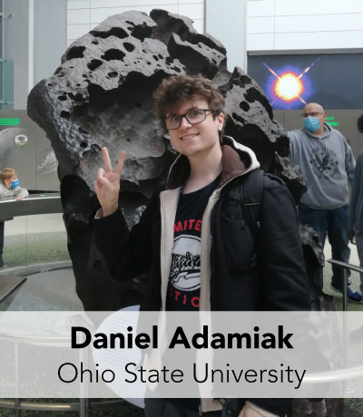
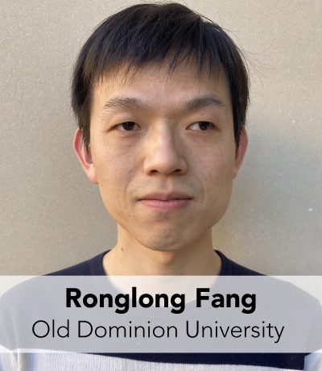
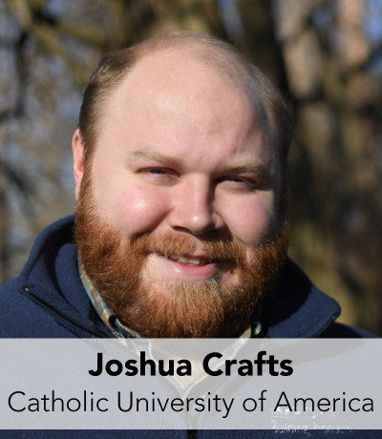
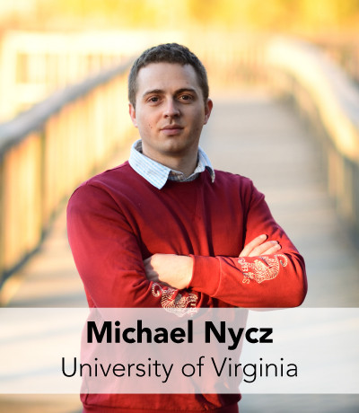
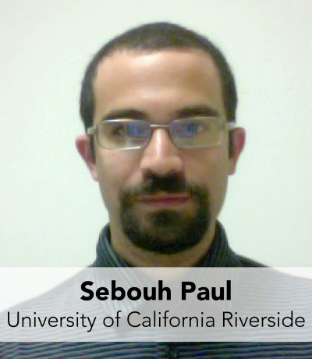
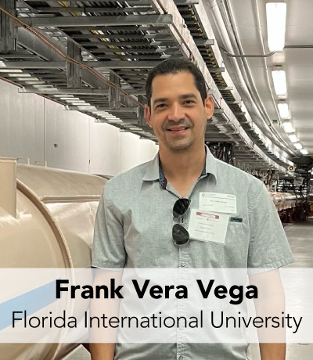
Event Organizing committee:
2023 Research Fellows
Advisors
Wenliang (Bill) Li
Stony Brook, USA
Jennifer Rittenhouse West
LBNL, Berkeley, USA
Francesco Giovanni Celiberto
UAH Madrid, Spain
Senior Scientist
Douglas Higinbotham
Jefferson Lab, USA

Slide 3
General Info:
24 Talks
4 Keynote speakers (Andrea Signori, Rolf Ent, Frank Maas, Stefano Forte)
36 in person participants, 5 online
Workshop Code of Conduct:
Adopted: https://indico.jlab.org/event/696/page/345-code-of-conduct

Slide 4
Student Prize Competition
The Best Student Presentation
3 prizes
$150 prize each
Judges: Daniel Adamiak, Joshua Crafts, Sebouh Paul, Frank Vera
Decision will be presented: Tuesday during EICUG 17:00pm
Judges will contest winners tonight
Winners will present at the EICUG

Slide 5
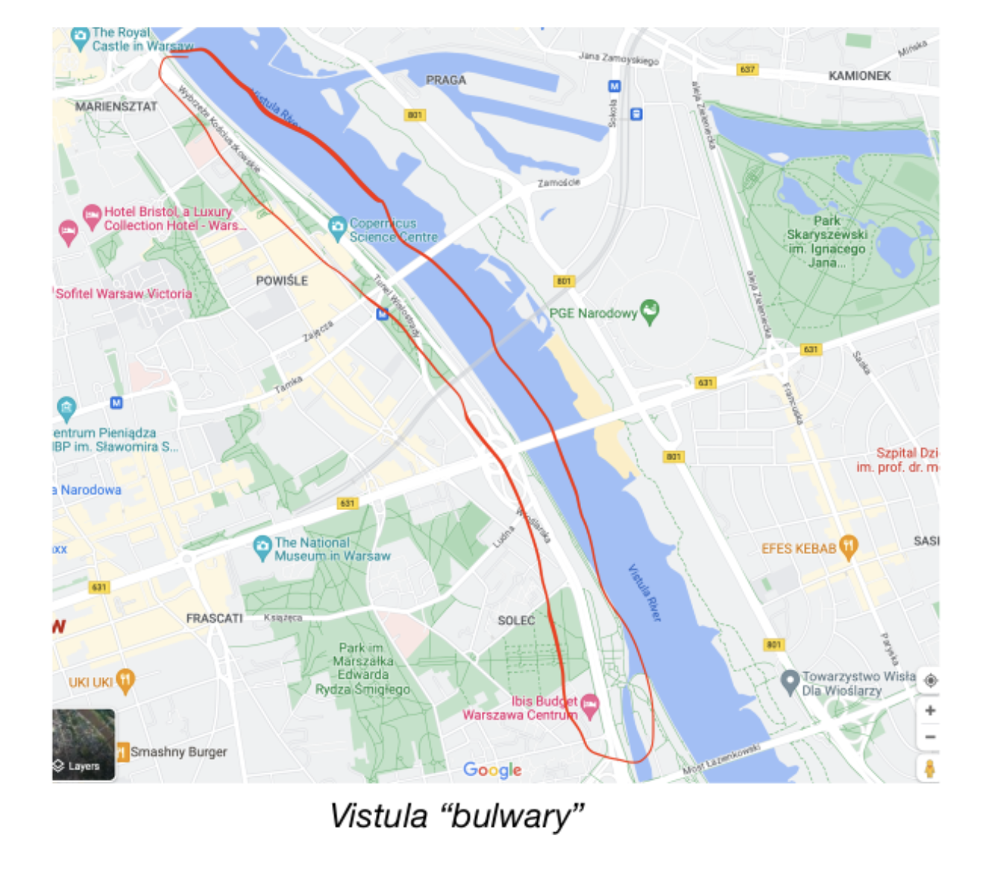
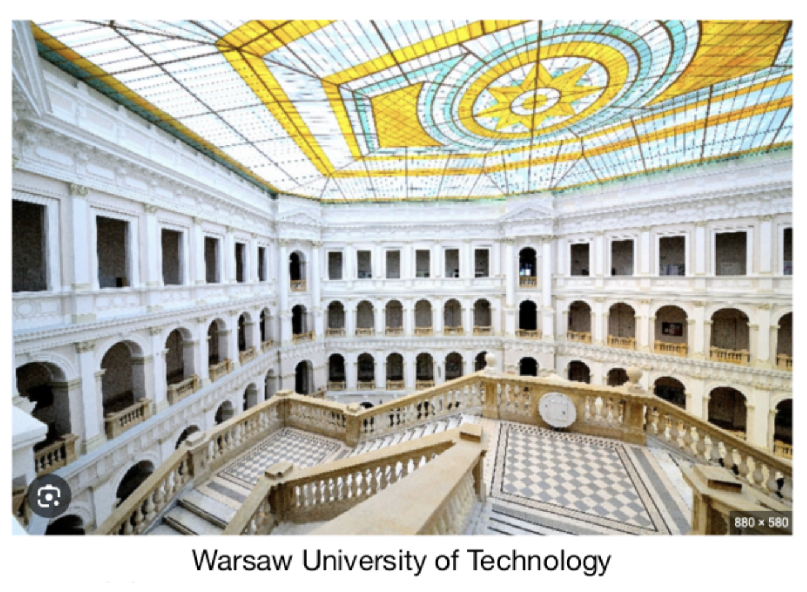
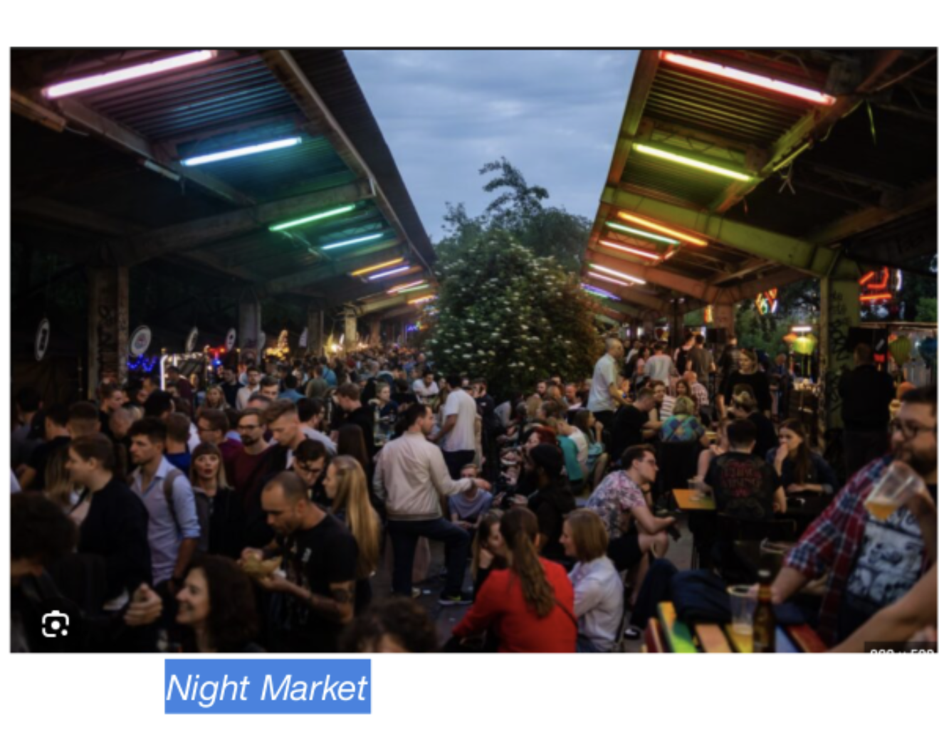
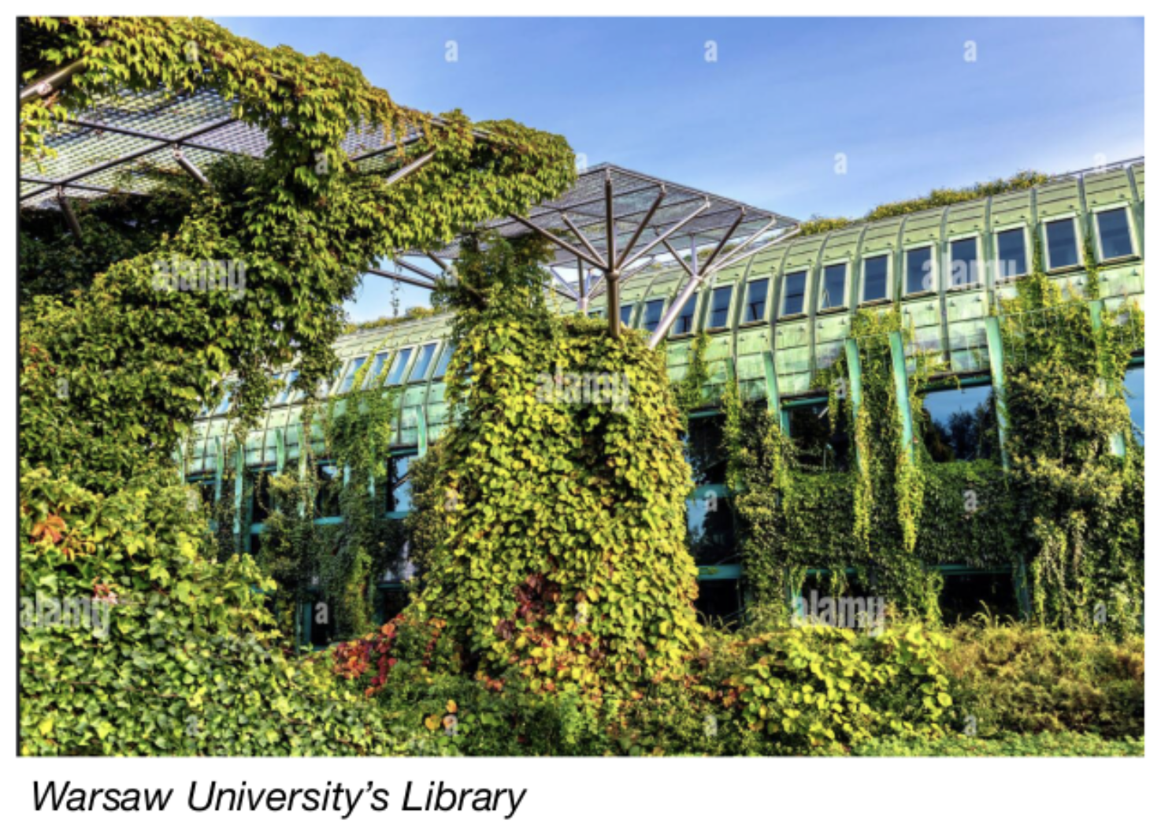
Maria's Tour Guide around Warsaw
Check it out here: https://indico.jlab.org/event/696/page/373-marias-tour-guide-around-warsaw

Slide 6
Gratitude
Special thanks for the support from the JLab EIC Center and the EIC User Group!
Thanks to all Workshop presenters and conveners!
Most importantly, thanks to all participants!

Slide 7
Any Questions before we end?

