Slide 1
SiPMs characterisation
Luisa occhiuto,
universiTy of calabria& INFN COSENZA, july 2023

Slide 2
and the dual -RICH(dRICH)

Slide 3
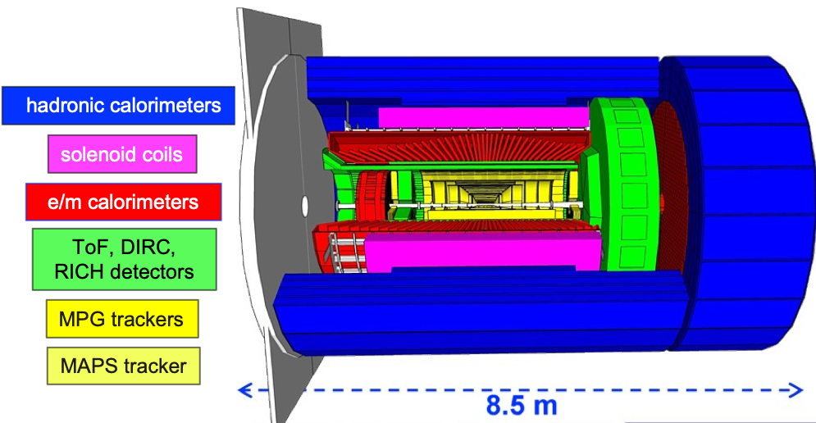
The ePIC detector will be located at the IP6 interaction region, where electron and ion beams collide. It will include many subcomponents such as tracking and vertexing systems based on silicon sensors and gaseous detectors.
The Particles ID in the forward region is ensured by the dual Ring Imaging Cerenkov detector (dRICH).

Slide 4
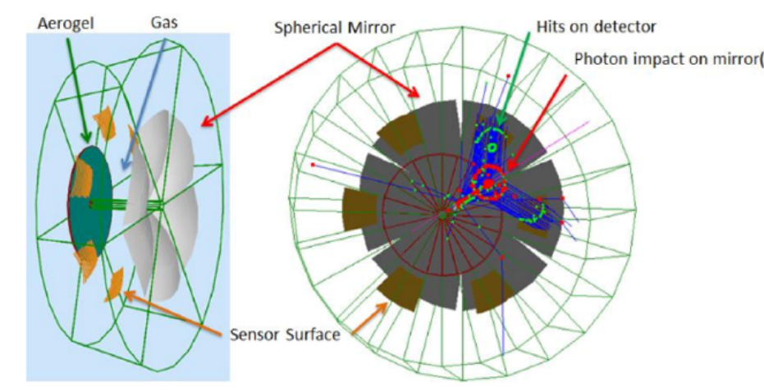
Two radiator: aerogel ($n \sim 1.02$), C2F6($n \sim 1.008$)
Mirrors: 6 large open sectors
Sensors: 3x3 $mm^{2}$ pixel, 0.5 $m^{2}$ / sector:
Single photon detection;
The sensors of choice are SiPMs;

Slide 5
SiPM sensors

Slide 6
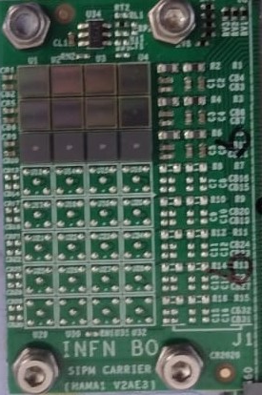
A silicon photomultiplier (SiPM) consists of an array of independent SPAD (single-photon avalanche diodes) sensors, each connected to its own quenching resistor.
These SPADs operate in Geiger mode and are connected on a common silicon substrate. A photodiode operating in this regime is a reverse-biased avalanche photodiode with a voltage higher than the breakdown voltage.
The value of the breakdown voltage (Vbd) depends on the internal structure of the diode and on the temperature. Vbd increases with the thickness of the depletion region.

Slide 7
S13360-3050
PRO:
Cheap;
High Photon Detection Efficiency;
Good time resolution;
Insensitive to magnetic field;
Cons:
Different sources of noise, such as dark count rate and crosstalk;
Sensitive to radiation;
S13360-3075
S14160-3050
We focused our attention on three types of Hamamatsu-produced SiPMs [S13360-3050, S13360-3075, and S14160-3050]. For simplicity let’s recall the first one as sensors A, the second as sensors B and the third sensors C.

Slide 8
The main source of SiPM noise is due to the thermal generation of electron-lacuna pairs in the depletion region, which can generate carrier avalanches. The results are a signal identical to the one produced by the incident photons.
Since this type of signal is thermal in nature, it can be observed in the absence of photon beam. For this reason, their counting in the unit of time is called the dark count rate.

Slide 9
Experimental setup

Slide 10
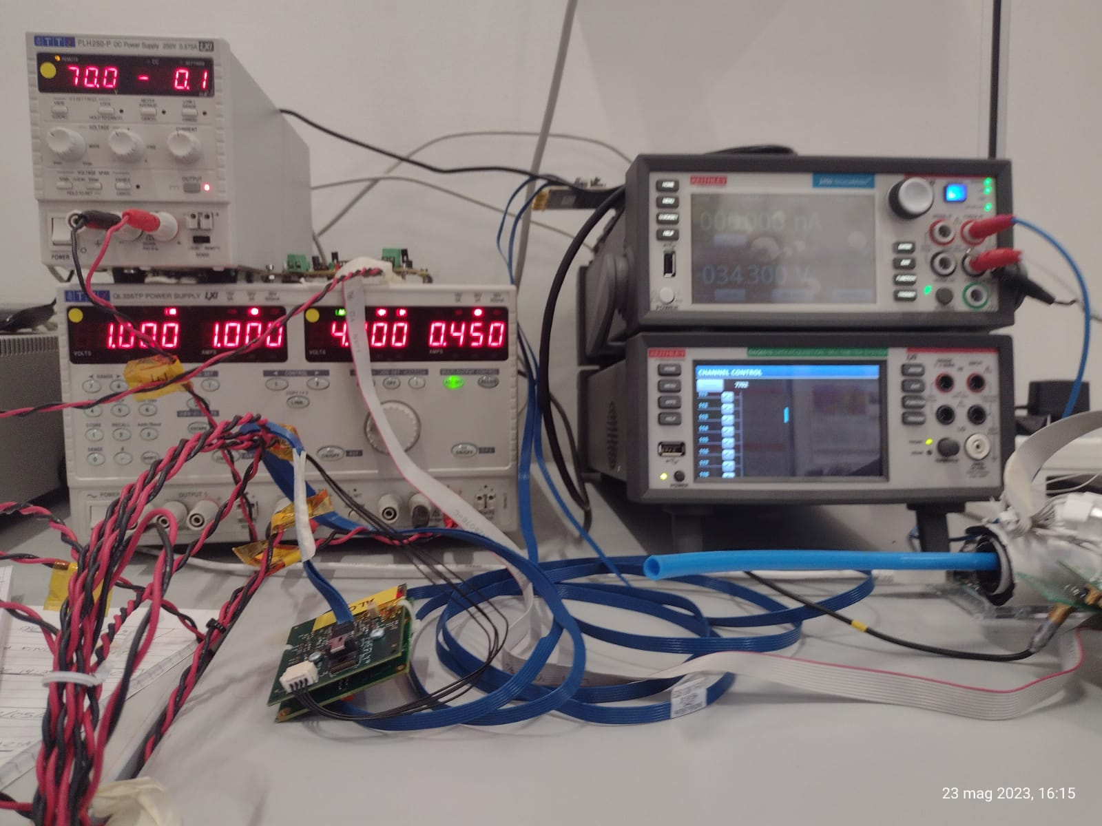
EXPERIMENTAL SETUP AT THE CALABRIA U.
We take 2 types of measurements:
We use a setup specifically designed for measuring dark count rate (DCR) as a function of reverse bias voltage.
We perform measurements of dark current as a function of reverse bias voltage.

Slide 11
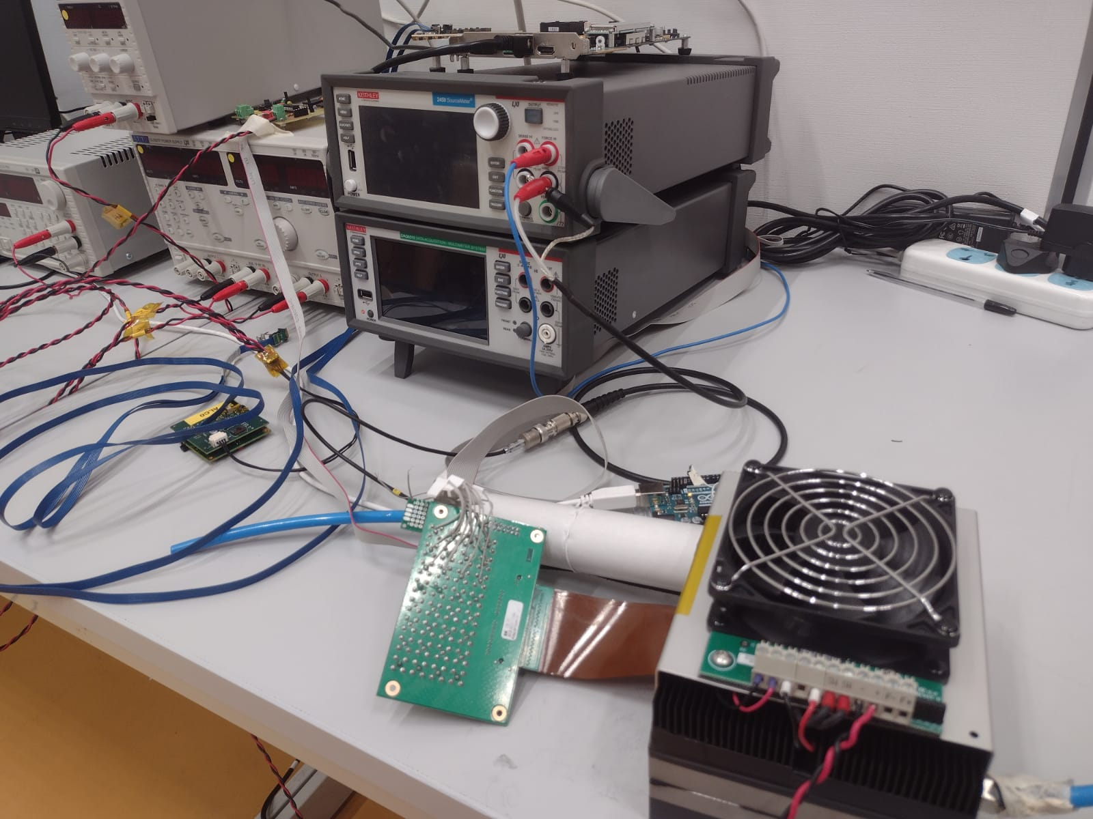
EXPERIMENTAL SETUP AT THE CALABRIA U.
We want to conduct 2 types of of measurements:
We use a setup specifically designed for measuring dark count rate (DCR) as a function of reverse bias voltage.
We perform measurements of dark current as a function of reverse bias voltage.

Slide 12
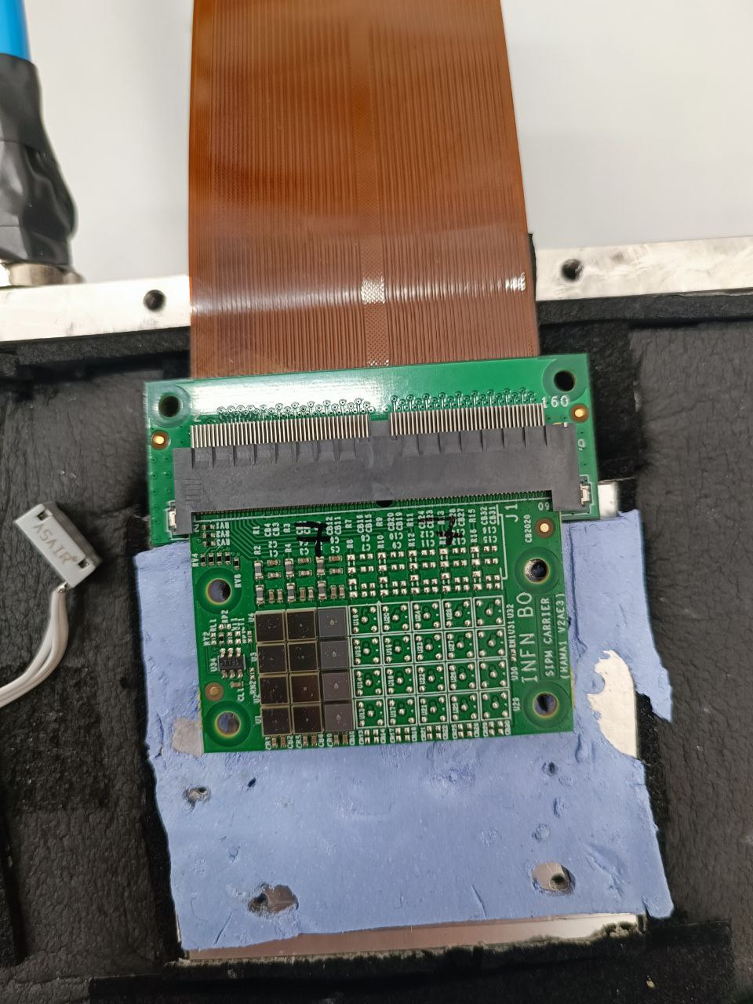
1) DCR setup
5 Boards on which SiPMs are mounted
Custom made portable Peltier box
Ultra pure Air tanks used to control the humidity in the inner box
1 Adapter board to regulate the voltage supplied to the SiPMs
1 ALCOR board for the data acquisition
A digital-output relative humidity and temperature sensor DHT11, readout by an Arduino board
A Master Logic board for communication with the Adapter board
A FPGA to program and read the ALCOR data
PLH250-P power supply used to bring the high voltage to the sensors
QL355TP power supply for the front-end boards
TSX1820P power supply used to bring power to the Peltier elements

Slide 13
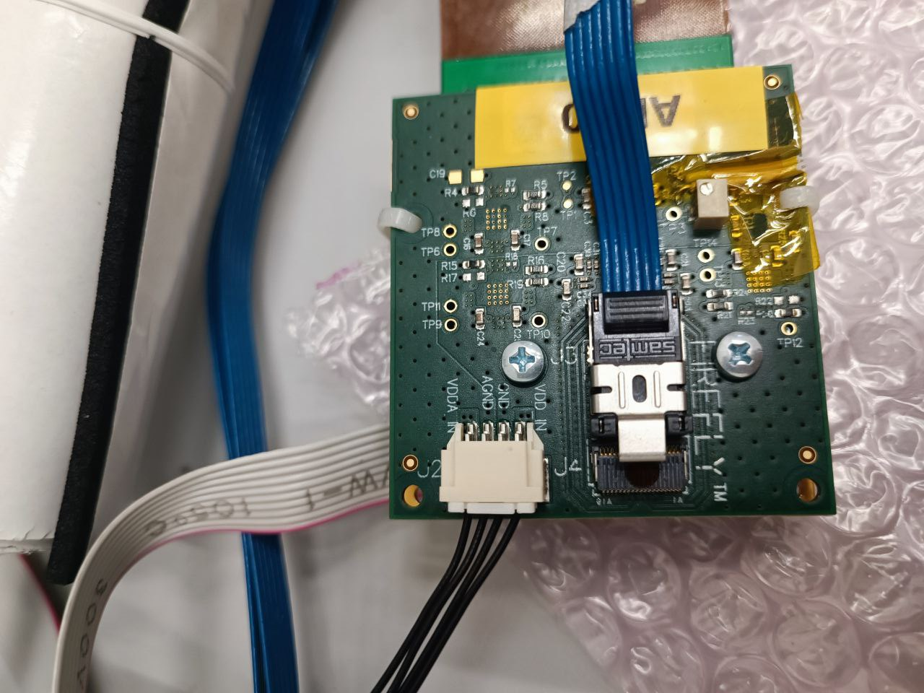
1) DCR setup
7 Boards on which SiPMs are mounted
Custom made portable Peltier box
Ultra pure Air tanks used to control the humidity in the inner box
1 Adapter board to regulate the voltage supplied to the SiPMs
1 ALCOR board for the data acquisition
A digital-output relative humidity and temperature sensor DHT11, readout by an Arduino board
A Master Logic board for communication with the Adapter board
A FPGA to program and read the ALCOR data
PLH250-P power supply used to bring the high voltage to the sensors
QL355TP power supply for the front-end boards
TSX1820P power supply used to bring power to the Peltier elements

Slide 14
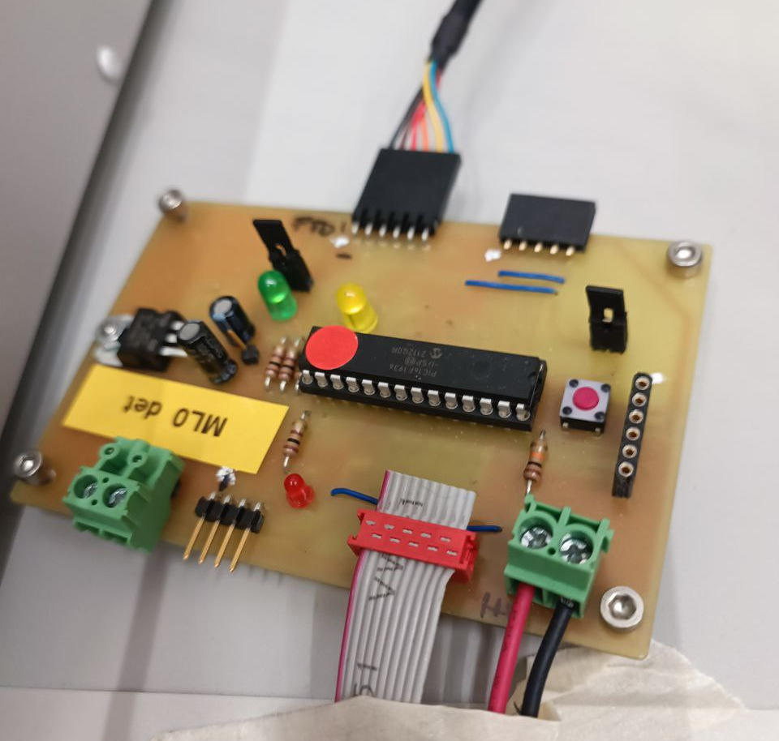
1) DCR setup
7 Boards on which SiPMs are mounted
Custom made portable Peltier box
Ultra pure Air tanks used to control the humidity in the inner box
1 Adapter board to regulate the voltage supplied to the SiPMs
1 ALCOR board for the data acquisition
A digital-output relative humidity and temperature sensor DHT11, readout by an Arduino board
A Master Logic board for communication with the Adapter board
A FPGA to program and read the ALCOR data
PLH250-P power supply used to bring the high voltage to the sensors
QL355TP power supply for the front-end boards
TSX1820P power supply used to bring power to the Peltier elements

Slide 15
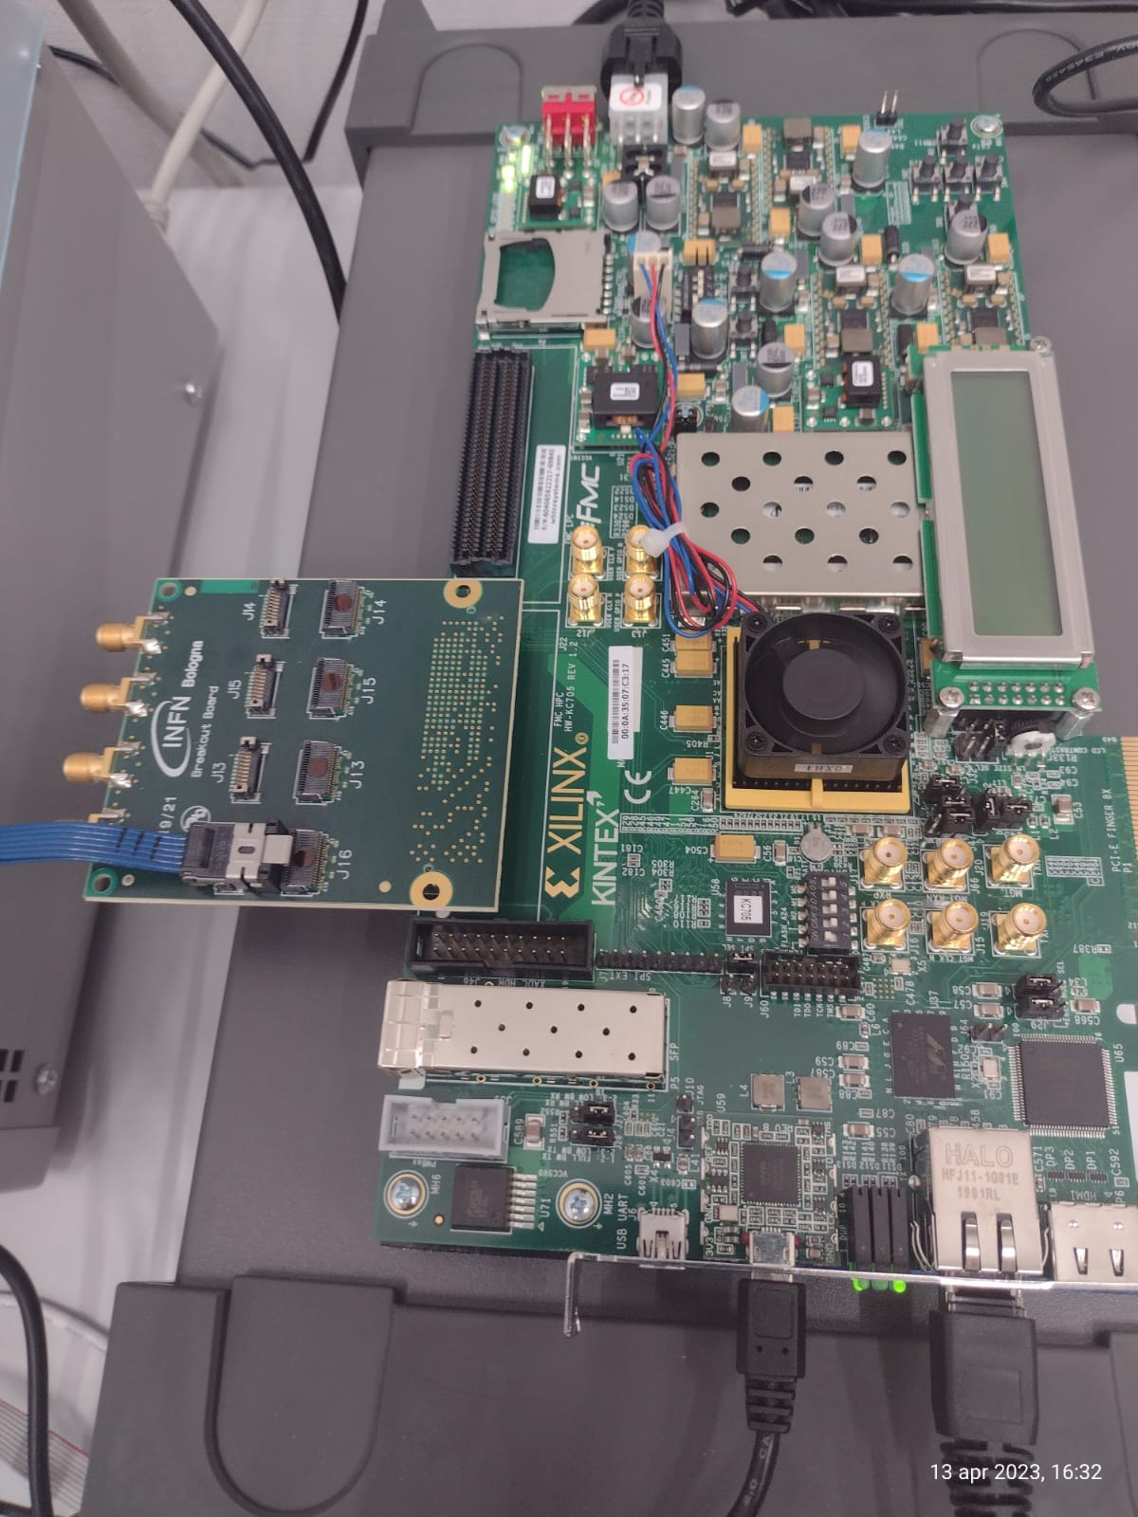
1) DCR setup
7 Boards on which SiPMs are mounted
Custom made portable Peltier box
Ultra pure Air tanks used to control the humidity in the inner box
1 Adapter board to regulate the voltage supplied to the SiPMs
1 ALCOR board for the data acquisition
A digital-output relative humidity and temperature sensor DHT11, readout by an Arduino board
A Master Logic board for communication with the Adapter board
A FPGA to program and read the ALCOR data
PLH250-P power supply used to bring the high voltage to the sensors
QL355TP power supply for the front-end boards
TSX1820P power supply used to bring power to the Peltier elements

Slide 16
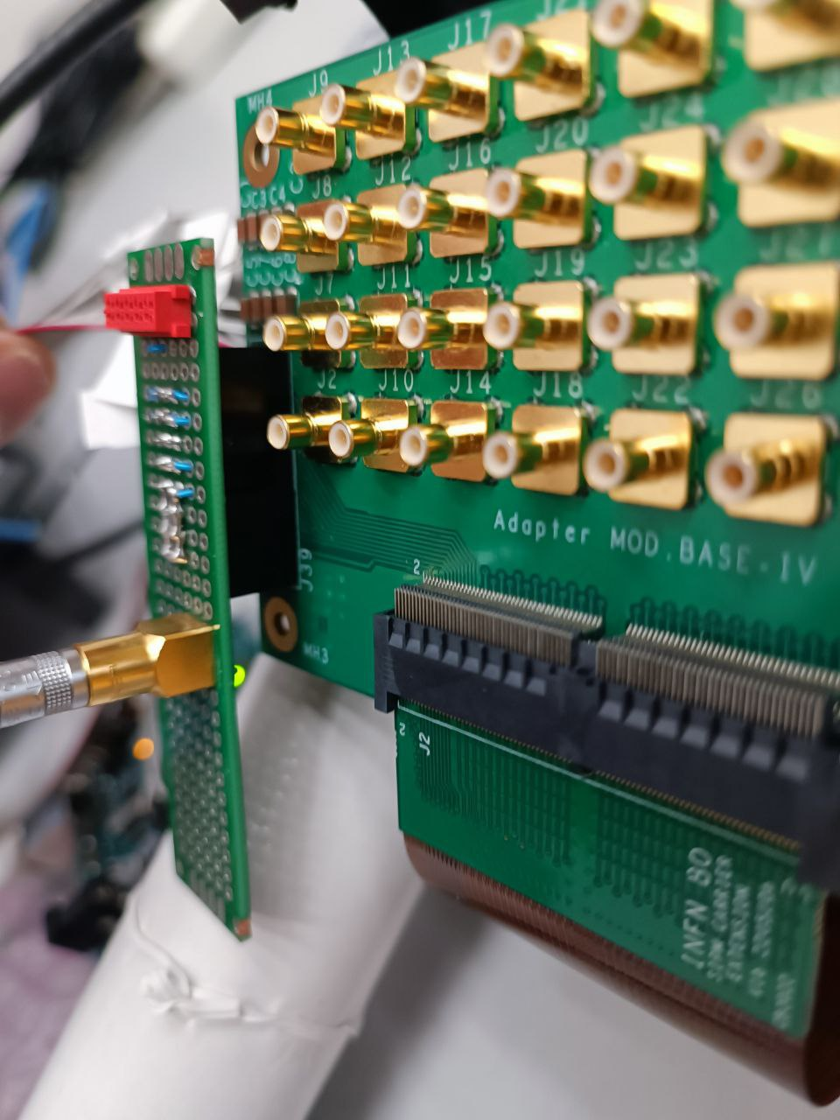
2) I-V scan setup
PLH250-P power supply used to bring the high voltage to the sensors
TSX1820P power supply used to bring power to the Peltier elements
An Adapter board used to enable IV scans
A DAQ with a multiplexer for the automatization of the measurements
A precision Source meter that performs IV scans
The Grafana web application to monitor the system

Slide 17
2) I-V scan setup
PLH250-P power supply used to bring the high voltage to the sensors
TSX1820P power supply used to bring power to the Peltier elements
An Adapter board used to enable IV scans
A DAQ with a multiplexer for the automatization of the measurements
A precision Source meter that performs IV scans
The Grafana web application to monitor the system

Slide 18
Results

Slide 19
SANITY CHECK – COMPARISON WITH BOLOGNA
To test our setup, we compared the I-V scan measurements with ones taken in Bologna using a climatic chamber at the same temperature. This yielded fully compatible results.

Slide 20
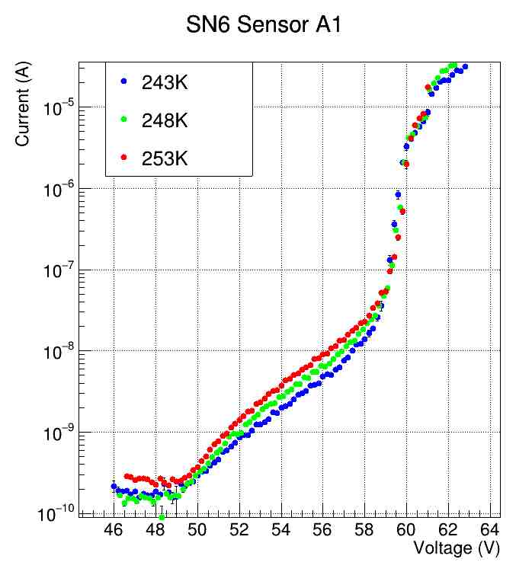
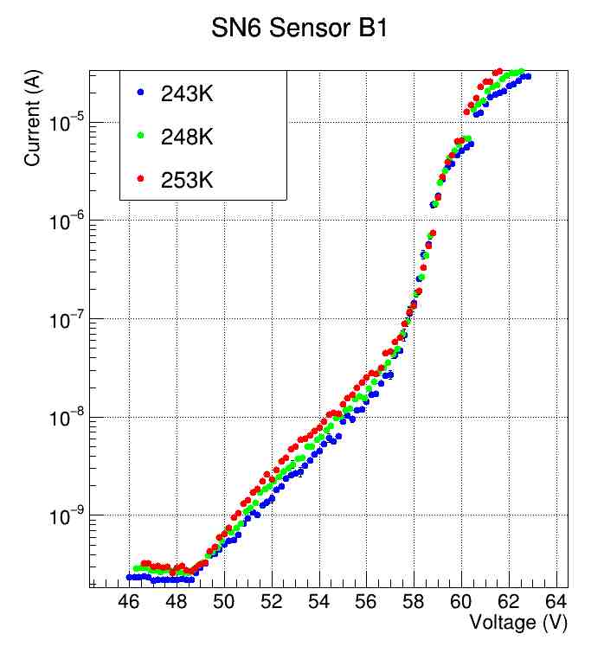
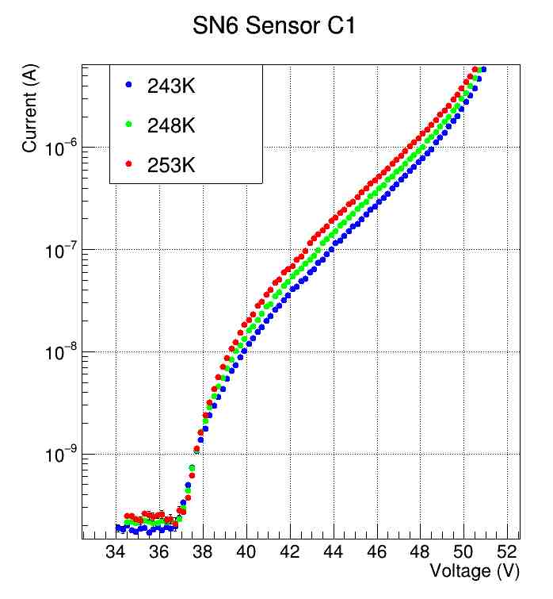
TEMPERATURE SCAN
At this point we focus our attention to scan I-V for these 3 types of Hamamatsu-produced SiPMs, under three different temperature conditions: 253 K, 248 K, and 243 K. The temperature dependence is shown in the Figures.

Slide 21
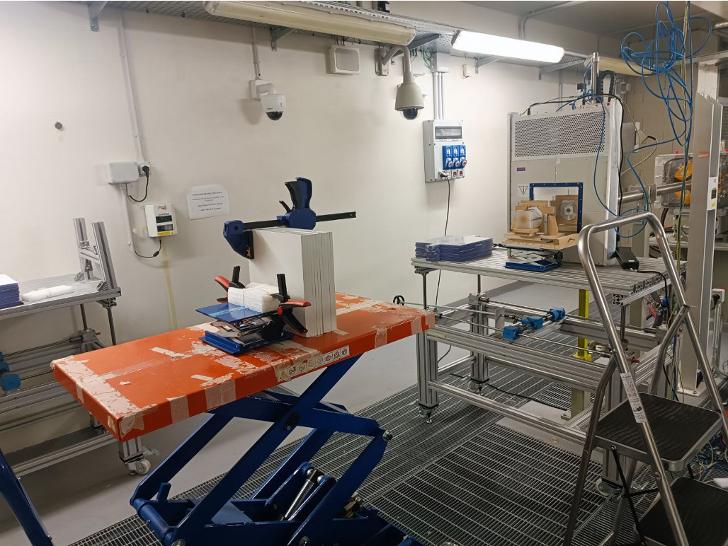
IRRADIATION TEST
Then, we started investigating the radiation damage by hadronic particles at fixed temperatures. We have irradiated each carrier board and sensors using 145 MeV proton beams at the TIFPA facility in Trento.
In order to lower the energy and perform an energy scan, we used the “solid water” energy degraders available at TIFPA.
Such degraders are made of IBA Solid Plate Phantom (RW3), with a composition:
98% polystyrene + 2% TiO_{2;}
a density: 1.045 g/cm3;
and a minimum thickness of 1 mm.
The purpose of this study is to test radiation damage at the following proton energies: 145, 75, 45, 25, and 18 MeV, at fluence of ${10}^{9}\frac{p}{cm^{2}}$ .

Slide 22
IRRADIATION PARAMETERS
# Board | Energy scan (MeV) | Fluence $cm^{−2}$ | K factor*
5 | 145 | $${10}^{9}p$$ | 1.11
6 | 75 | $${10}^{9}p$$ | 1.5
8 | 45 | $${10}^{9}p$$ | 2.0
9 | 25 | $${10}^{9}p$$ | 2.5
10 | 18 | $${10}^{9}p$$ | 3.0
*) Hardness factor K

Slide 23
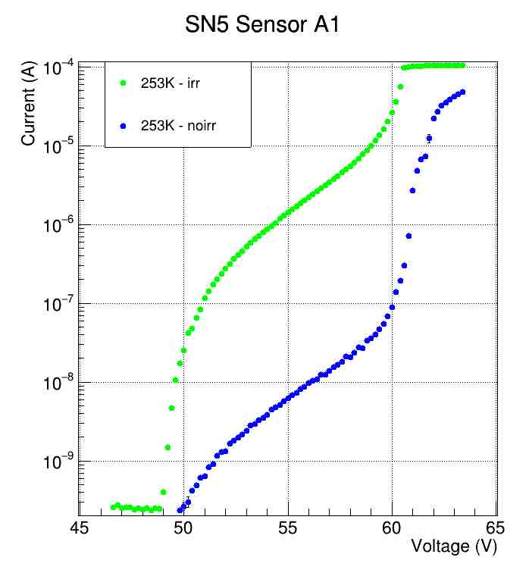
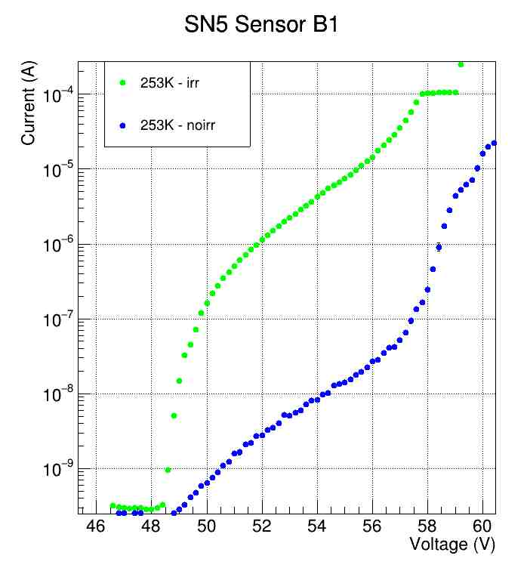
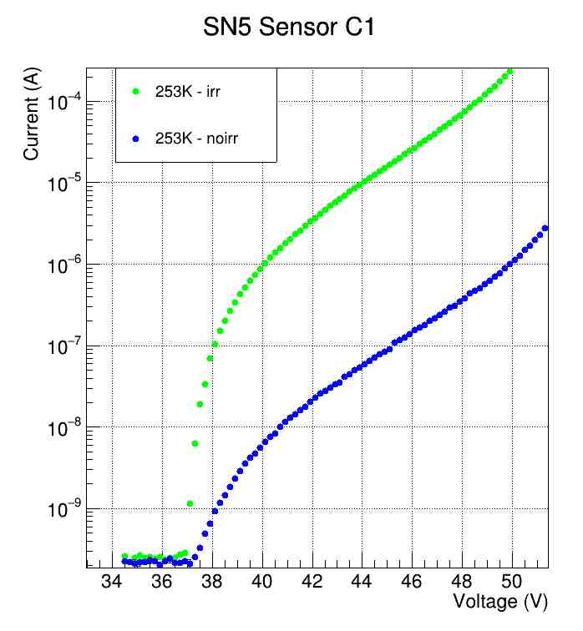
I-V scan characterization: carrier board 5 (sn5) before and after irradiation

Slide 24
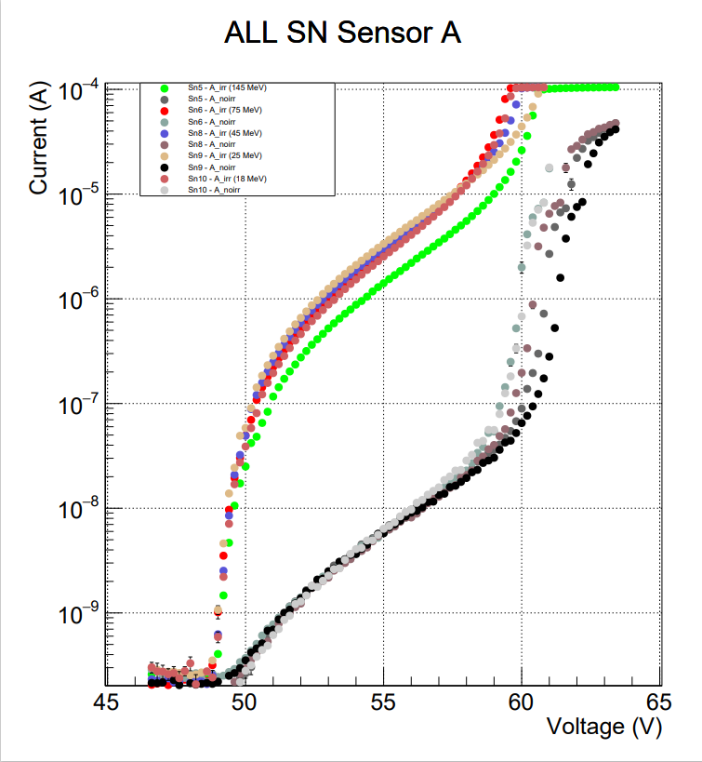
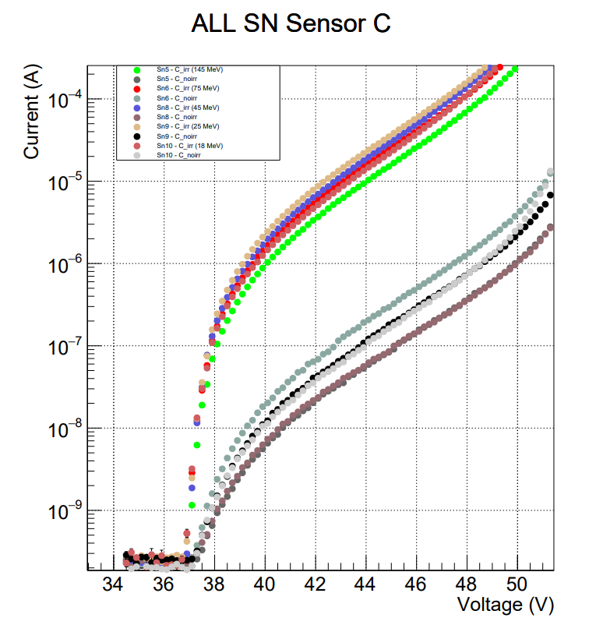
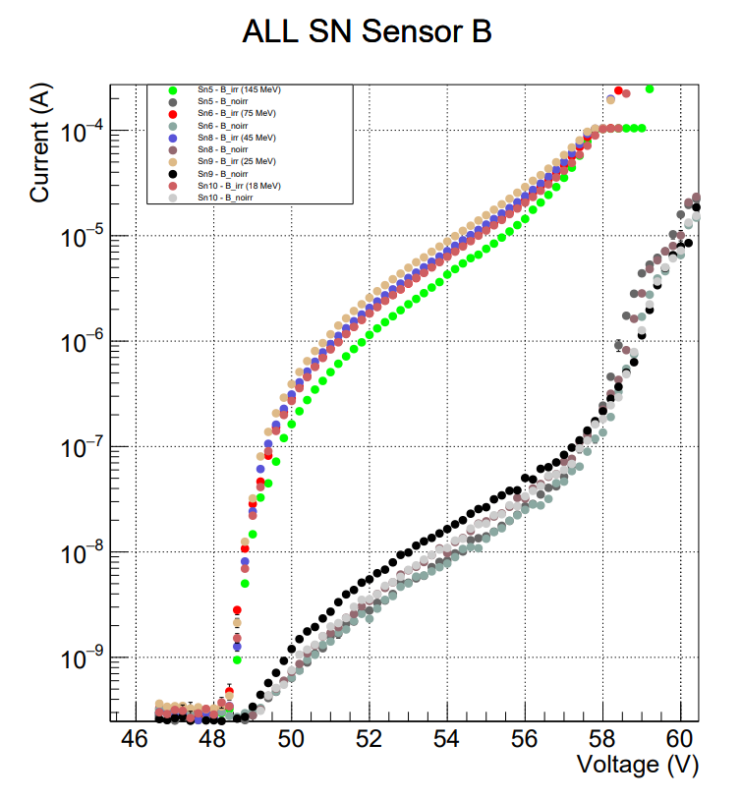
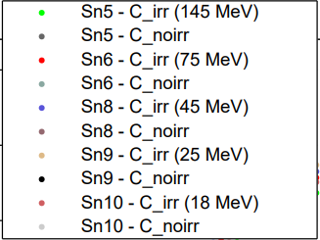
IRRADIATED VS NOT IRRADIATED: ENERGY SCAN

Slide 25
Calculation of Breakdown voltage (Vbd)

Slide 26
Calculation of breakdown voltage (Vbd)
The breakdown voltage is found analitically through the intersection of:
$$y=mx+q$$
$$y=ax^{2}+bx+c$$
But this is not particularly useful in the case of non-irradiated boards, in which the breakdown value is not as evident as in irradiated boards.

Slide 27
Calculation of breakdown voltage (Vbd)
We can use this new function:
$$\left(0.5−0.5∙\operatorname{erf}\left(\frac{x−t}{s}\right)\right)∙pol_{1}\left(m,q\right)+\left(0.5+0.5∙\operatorname{erf}\left(\frac{x−t}{s}\right)∙pol_{2}\left(a,b,c\right)\right)$$

Slide 28
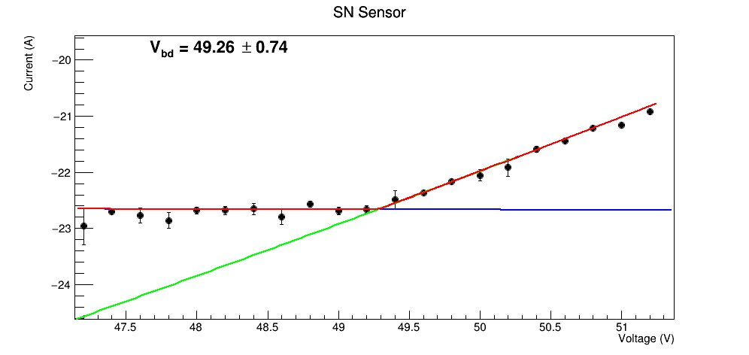
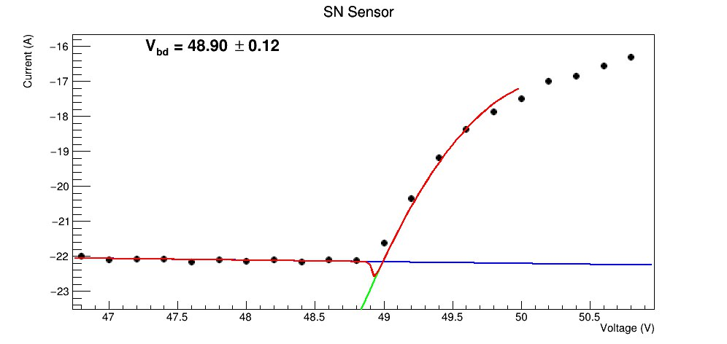
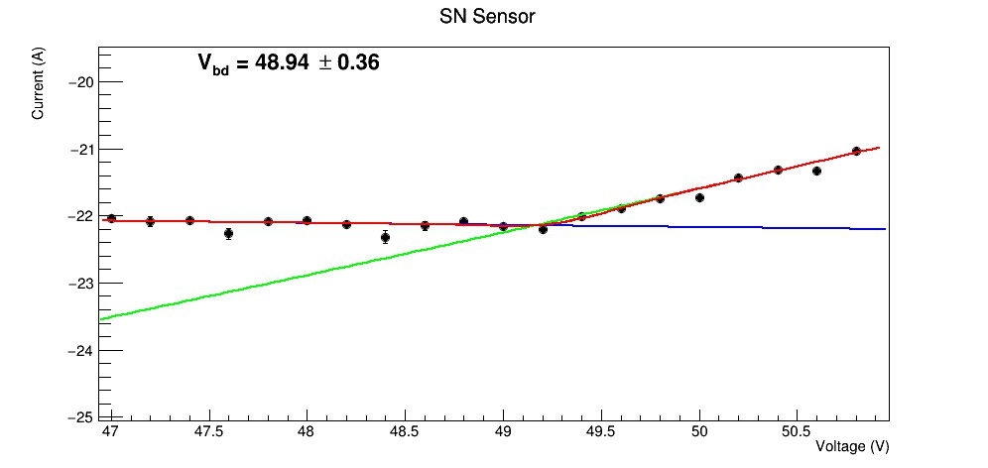
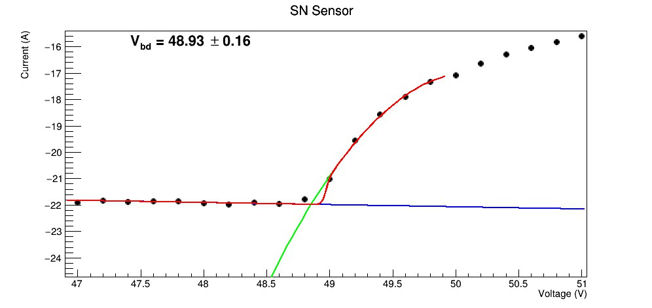
Not irradiated
Irradiated
A1
A1
A2
A2

Slide 29
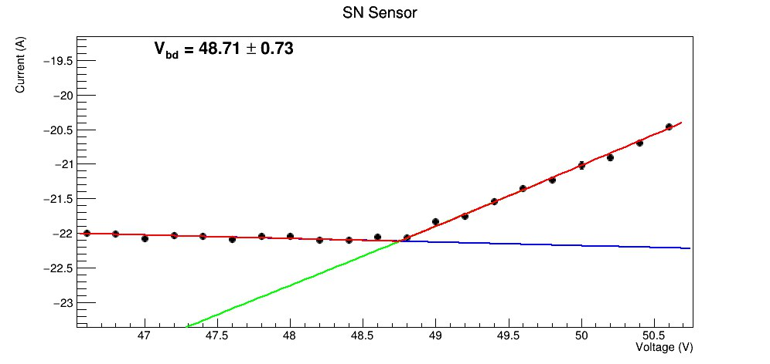
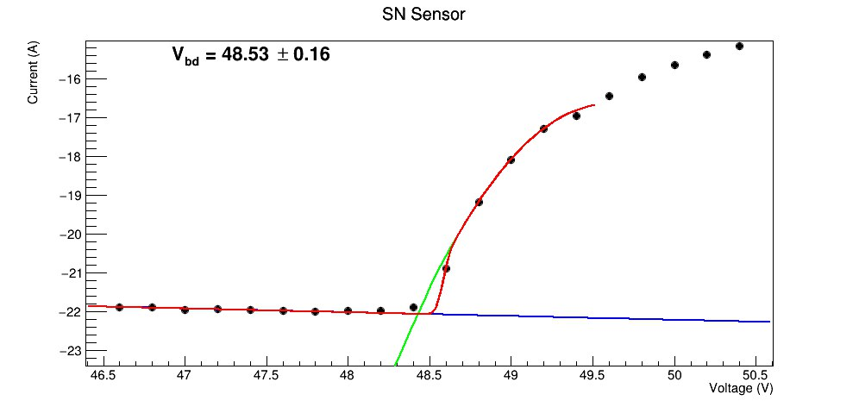
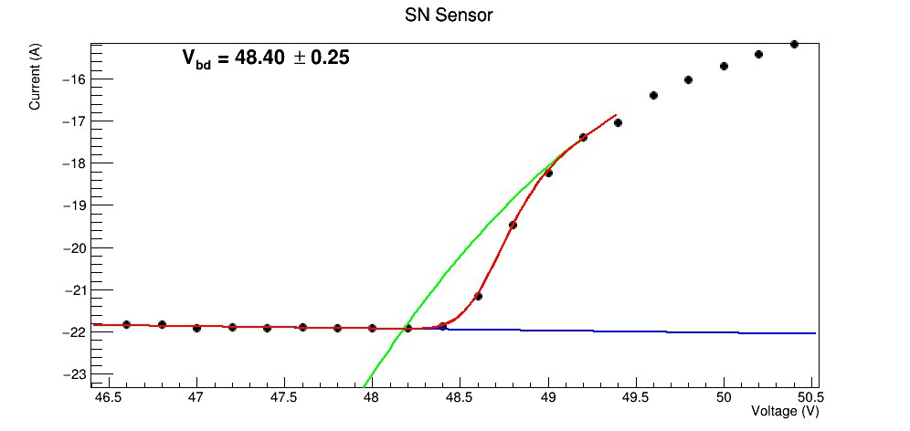
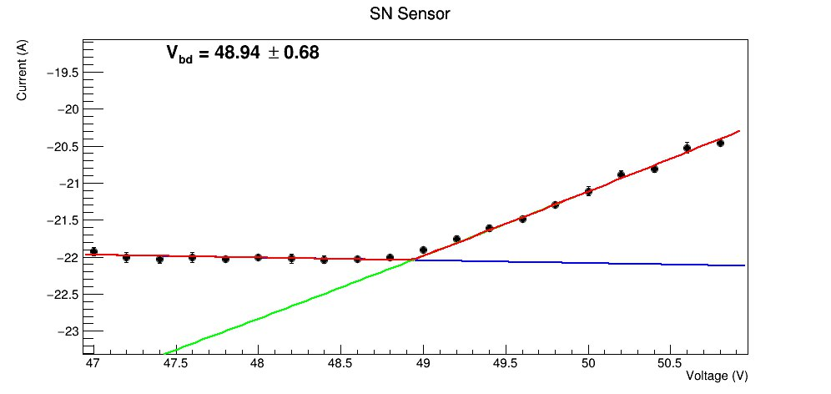
Not irradiated
Irradiated
B2
B2
B3
B3

Slide 30
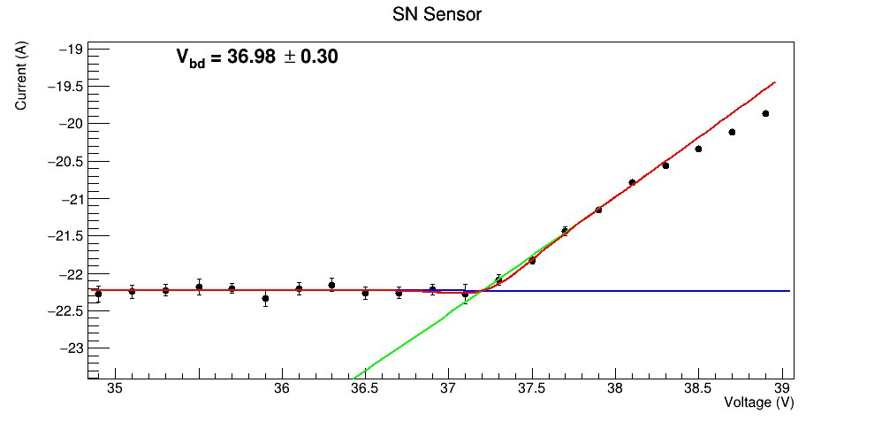
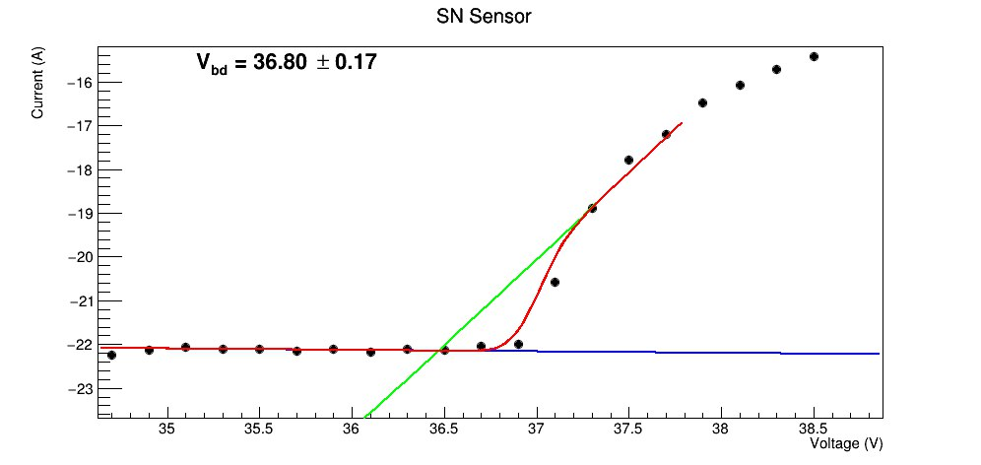
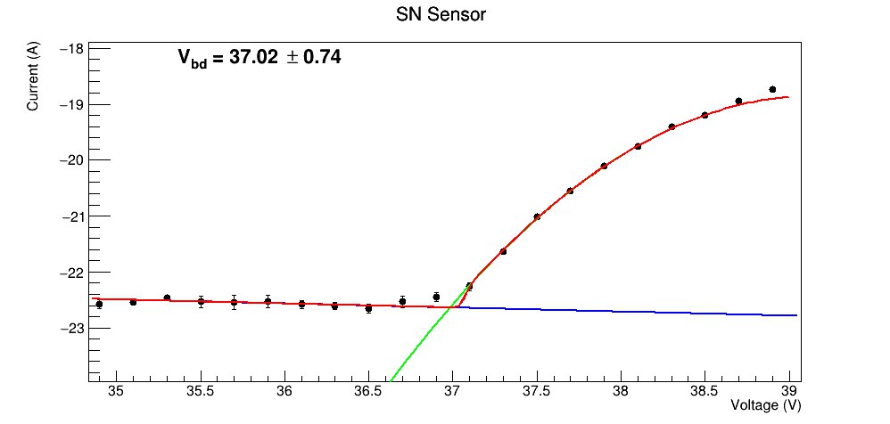
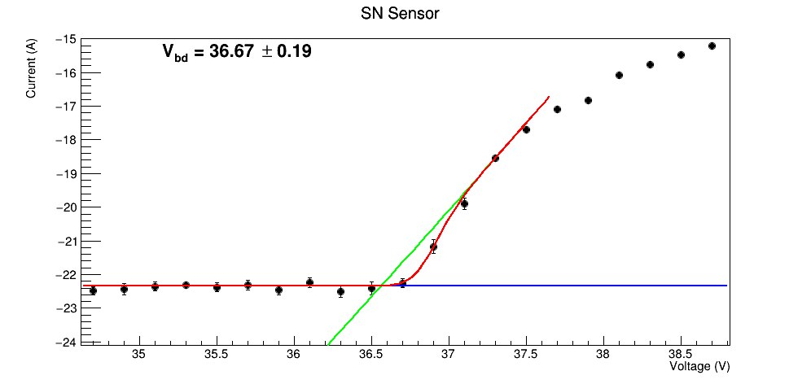
Not irradiated
Irradiated
C1
C1
C4
C4

Slide 31
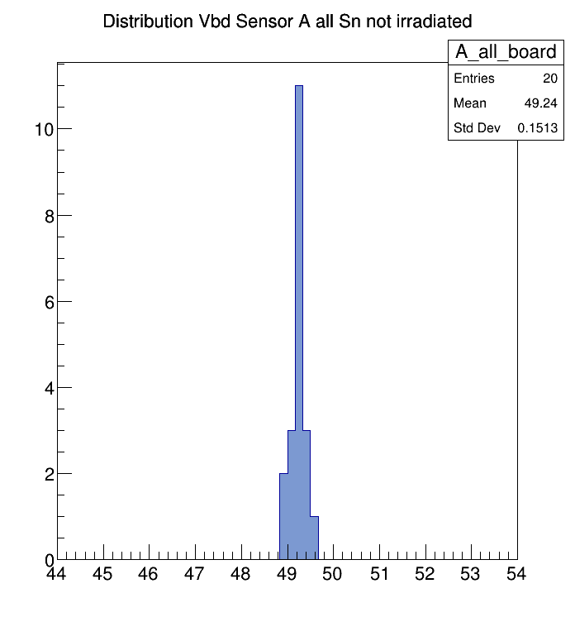
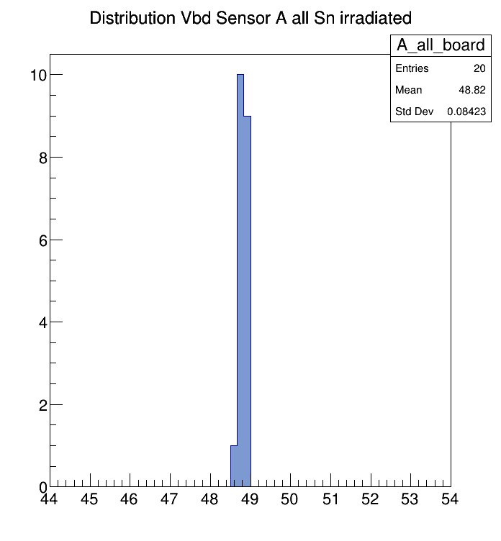
Distribution of Vbd on Sensor A in all board (Not irradiated)
Distribution of Vbd on Sensor A in all board (irradiated)

Slide 32
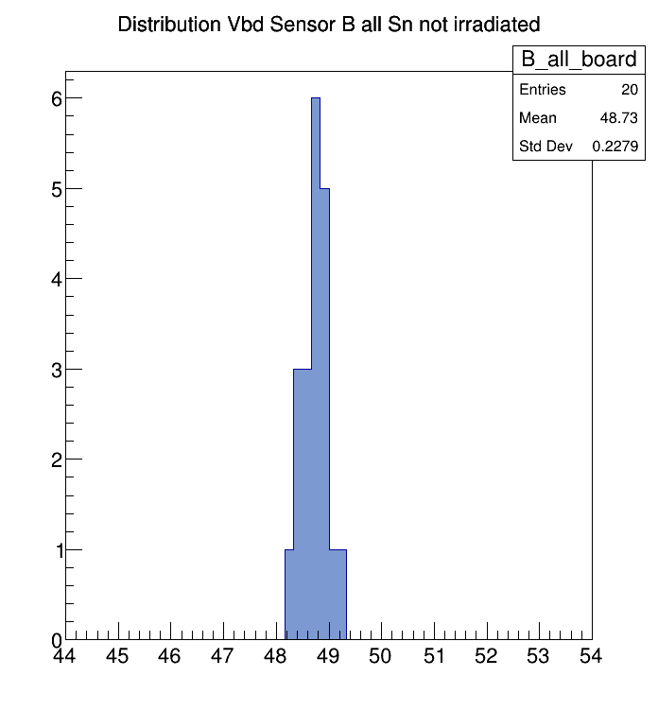
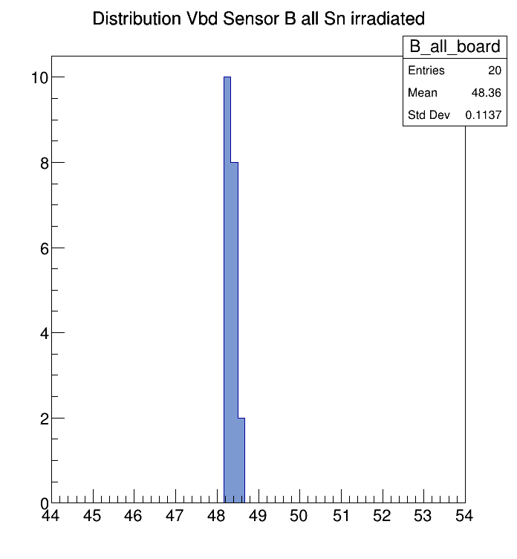
Distribution of Vbd on Sensor in sn5 board (Not irradiated)
Distribution of Vbd on Sensor in sn5 board (irradiated)

Slide 33
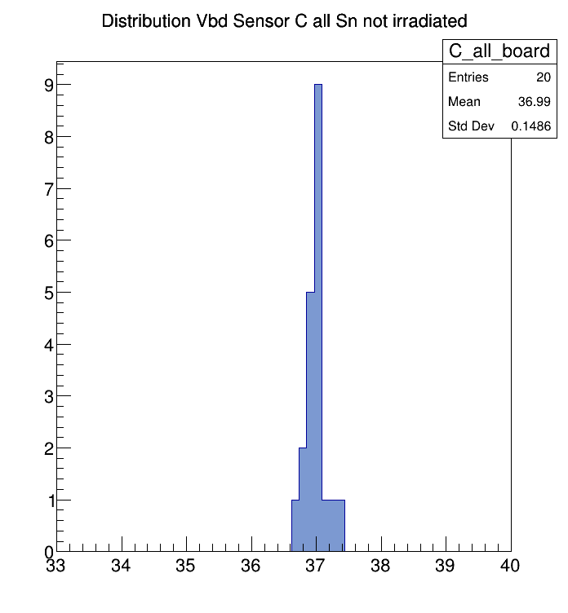
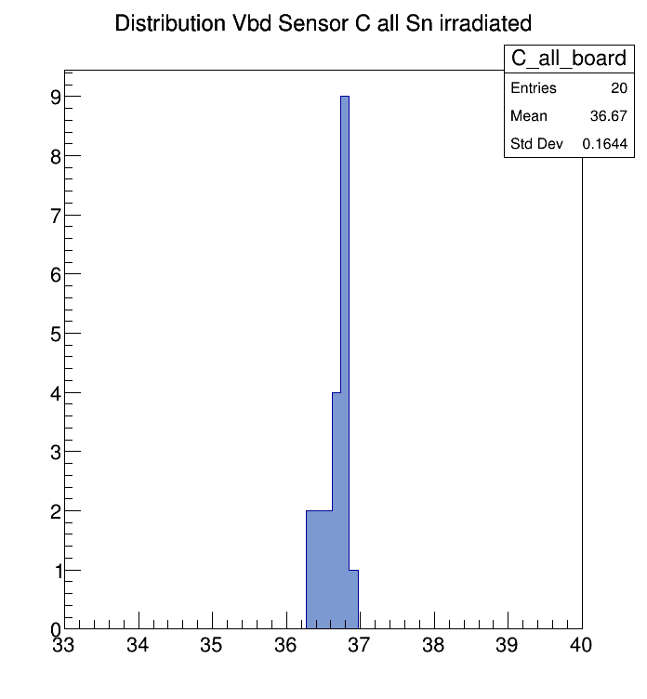
Distribution of Vbd on Sensor in sn5 board (Not irradiated)
Distribution of Vbd on Sensor in sn5 board (irradiated)

Slide 34
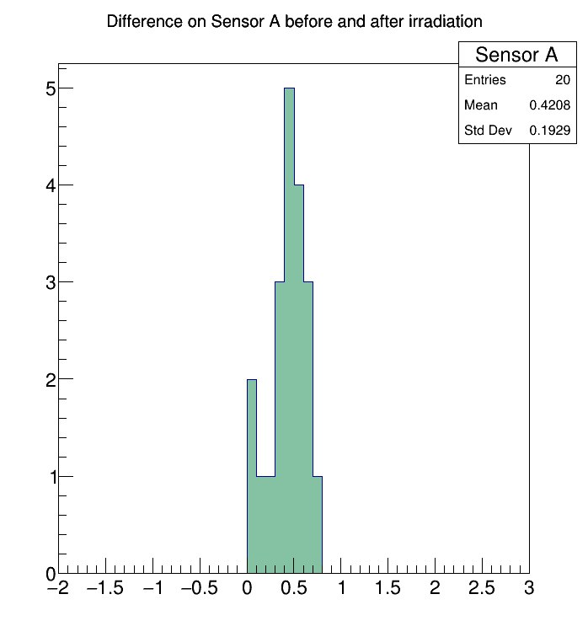
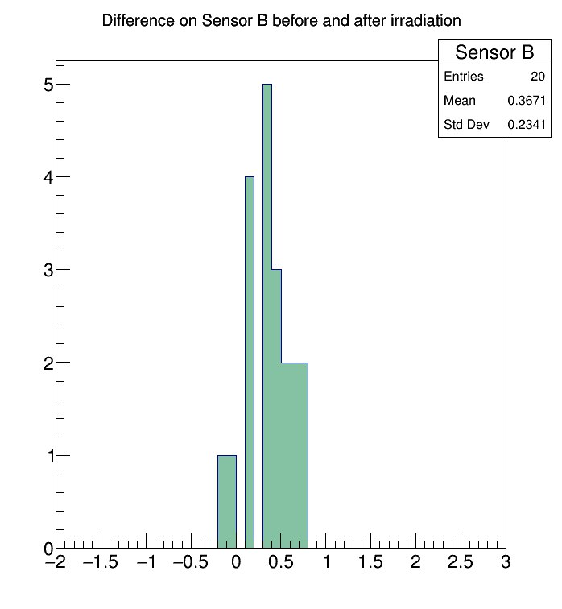
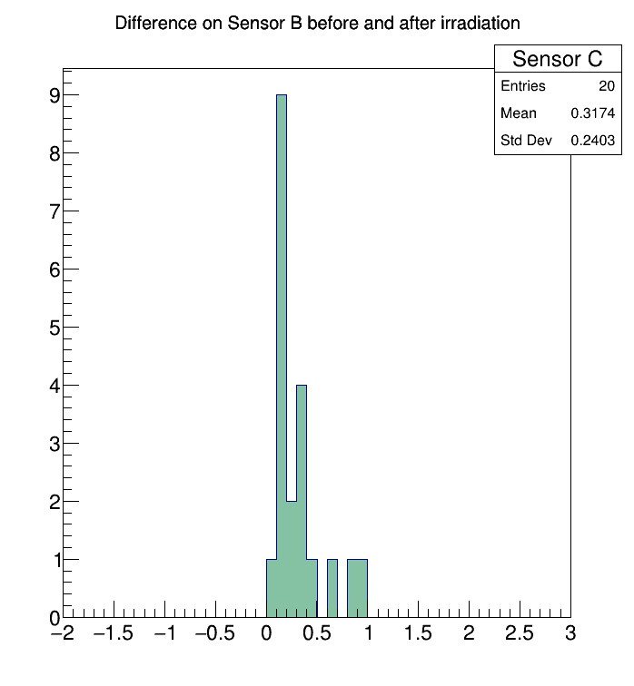
Distribution of difference of Vbd before and after irradiation

Slide 35
IS THIS EXPECTED?
As we said previously, the fluence of the irradiation beam is of the order of ${10}^{9}p/cm^{2}.$
However, at this level we did not expect to observe any kind of shift in the value of the breakdown voltage.
Literature shows that, to have significant shifts in the breakdown voltage, it is necessary to get to an order of ${\sim 10}^{12}p/cm^{2}$, where the radiation damage becomes so high that significantly modifies the silicon structure.
Then, why do we observe a $\sim 0.5$V difference?

Slide 36
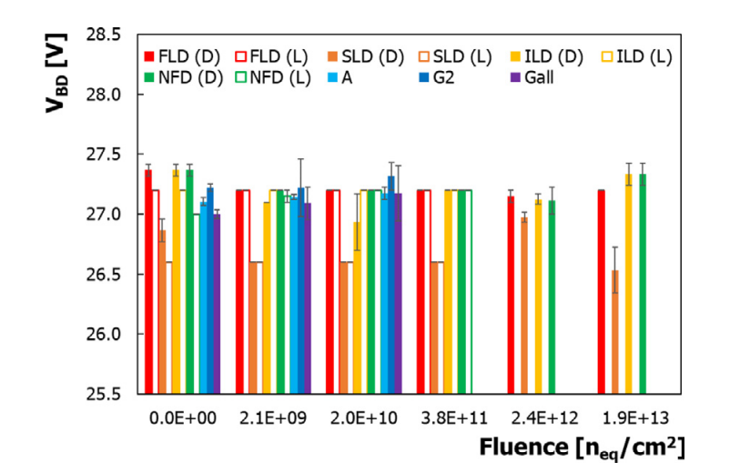
Help in solving the puzzle comes from the work by A. R. Altamura, Acerbi, et al. [NIMA 1040 (2022) 167284]
In the following graph: for FLD (D) and FLD (L) the breakdown value is different for fluence equal to zero (not irradiated), in 2.1E+09 instead the Breakdown value in light and in dark are equal.
There is a difference between the Vbd in dark conditions and in light conditions, and this is problematic whatever method is used.
This is due to the fact that in the dark conditions the increasing in current post Vbd is too low to have a well defined curve and, consequently, is difficult to estimate the real Vbd.

Slide 37
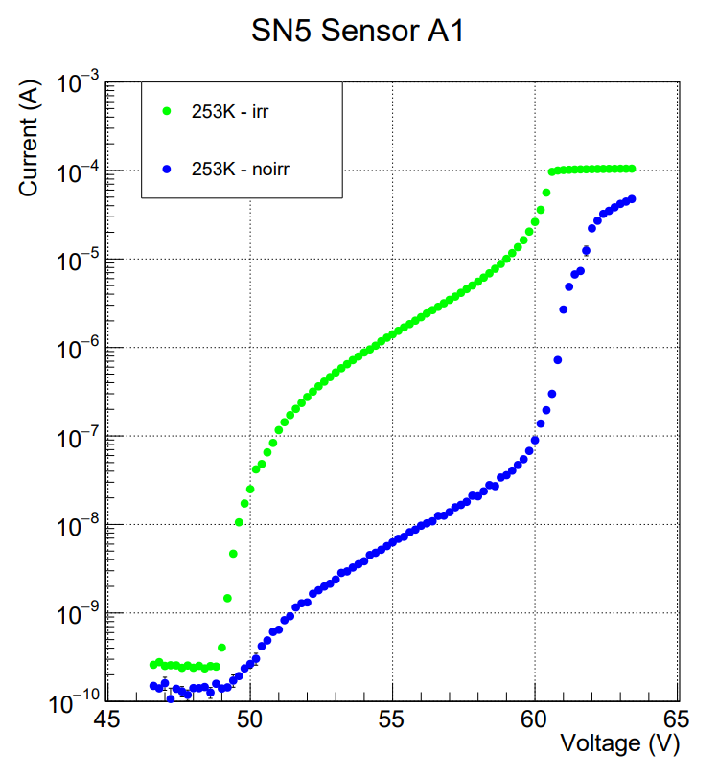
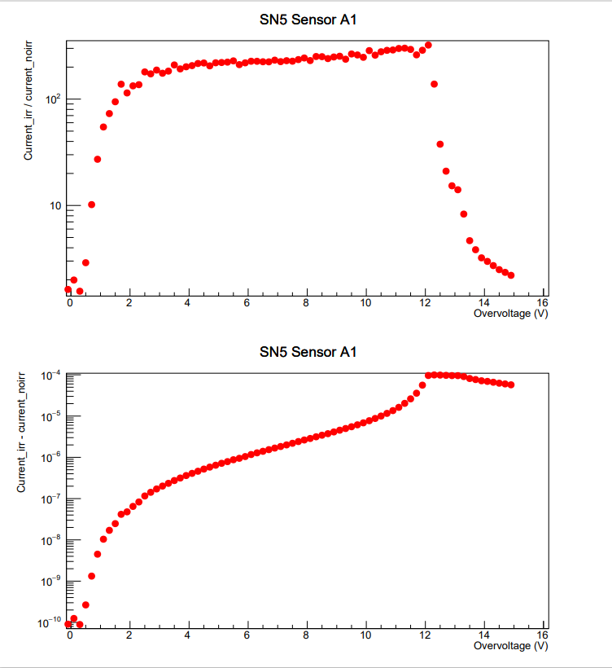
An example of I-V scan characterization: sn5 board, current increasing

Slide 38
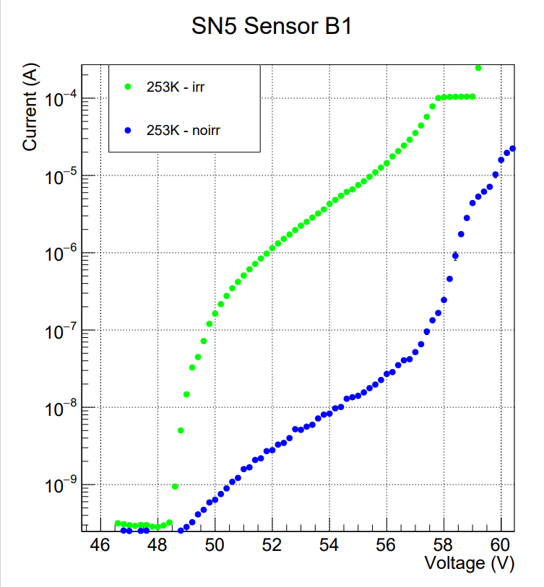
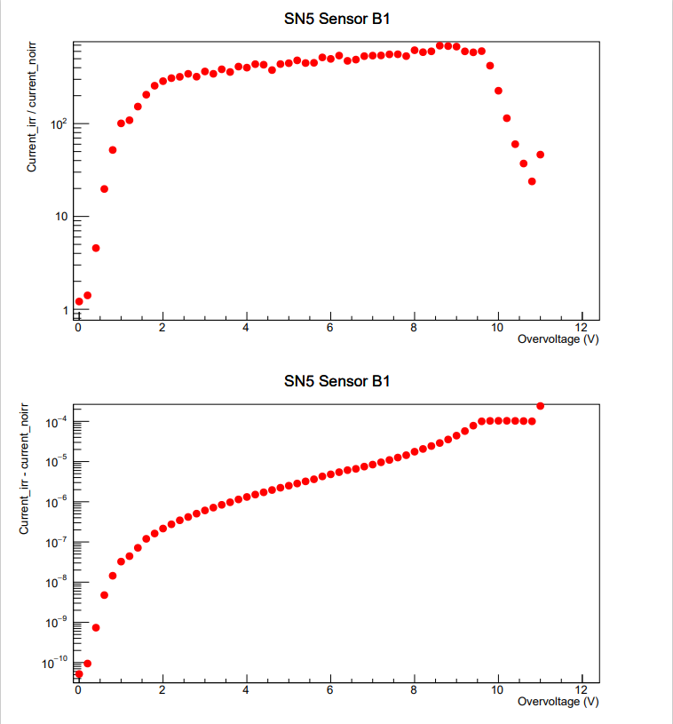
An example of I-V scan characterization: sn5 board, current increasing

Slide 39
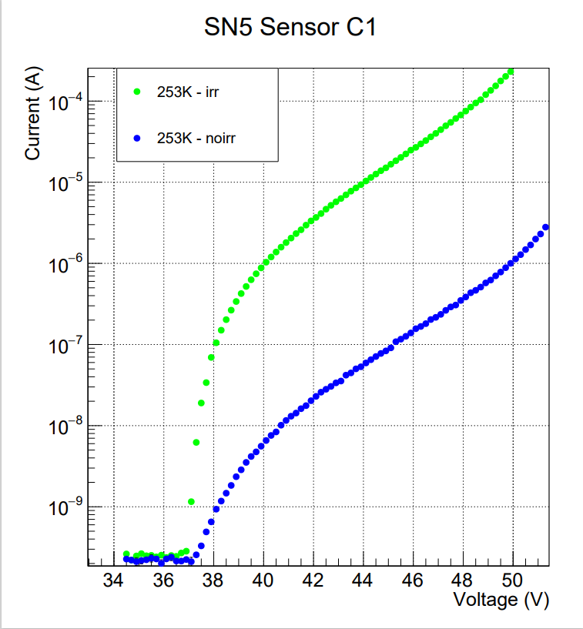
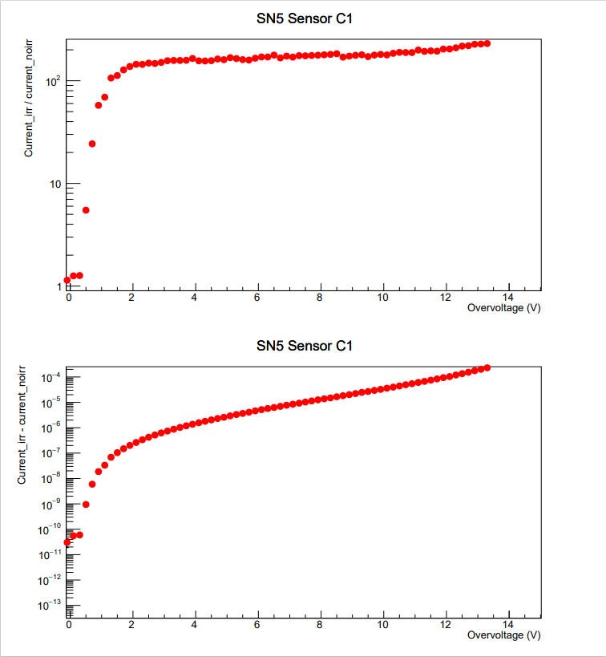
An example of I-V scan characterization: sn5 board, current increasing

Slide 40
CONCLUSION AND OUTLOOK
We performed several characterization measurements of SiPMs at different temperatures and after irradiating them at different energy of proton beams;
In order to verify the accuracy of the breakdown voltage estimate, it is necessary to carry out other studies in light conditions, from which it should therefore result that there is no significant difference between the pre- and post-irradiation breakdown estimate for a fluence of ${10}^{9}p/cm^{2}$;
Studies are now ongoing in order to investigate and understand the energy dependence of the radiation damage.
Data analysis of data from irradiation with protons at TIFPA (Trento) is ongoing
Irradiation tests using neutrons are scheduled at the Legnaro INFN facility (early August)
Irradiation with high energy gammas at the GIF facility (CERN) being also considered for next year

Slide 41
THANKS!

