Slide 1
Simulations of the X(3872) Exotic Meson Candidate
Eric Kirchner
In association with Abhay Deshpande and Wenliang Bill Li
Stony Brook University
10,000 simulated J/𝚿π⁺π⁻ events and their acceptance in the Electron-Ion Collider Detector

Slide 2
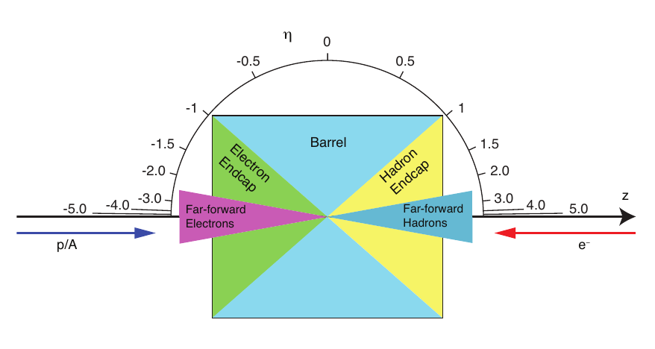
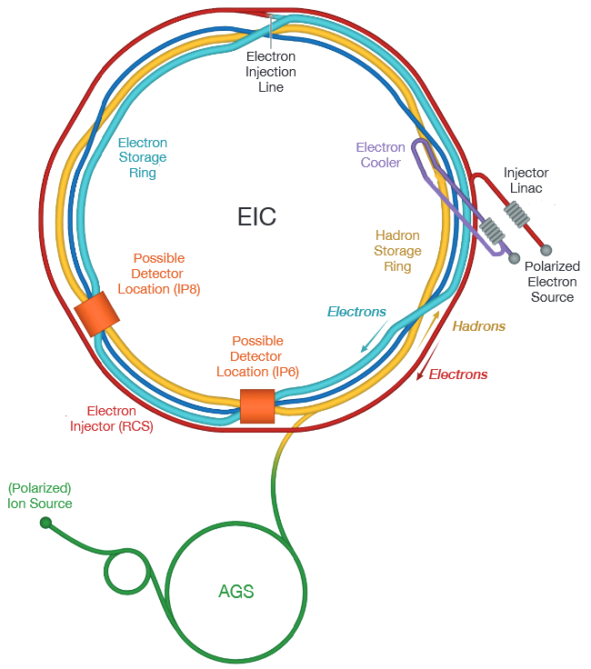
BNL
EIC Detector Schematics for Pseudorapidity [1]
The Electron-Ion Collider will be completed in early 2030s in Long Island, United States [1].
The Electron-Ion Collider User Group is composed of over 1,450 members, 250 institutions, and 33 countries. Their goal is to develop a deeper understanding of spin and spatial structures for protons, neutrons, and light ions [1].
The EIC will be capable of colliding high-energy particle beams, specifically 275 GeV proton and 18 GeV electron beams together [1].
Pseudorapidity is a coordinate for the angle between a particle and its respective beam axis.
Q² is the virtuality of the exchanged photon in photon exchange approximation. Given q is the four-momentum of the virtual photon, Q² = -q².
The Bjorken scaling variable x is the inelastic scattering cross-section.
t is the square of the four-momentum transfer.
EIC Schematic [1]

Slide 3
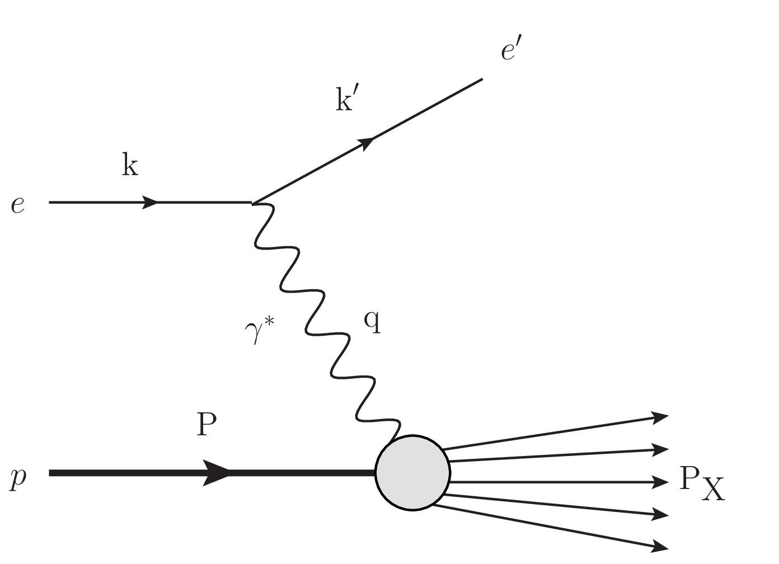
X(3872) Background
c
cࠡ
u
uࠡ
Quark Composition of X(3872)
We wanted to investigate the X(3872) exotic meson candidate and if further exploration of it at the future EIC would be viable.
X(3872) is believed to possibly contain 4 quarks, an anomaly of the Standard Model, but requires further investigation.
To investigate how X(3872) may behave at the future EIC, we simulated Deep Inelastic Scattering [1].
At last year’s Hadron Spectroscopy with CEBAF Energy Update, Derek Glazier and Justin Stevens presented research on X(3872) including production rates, branch ratios, and photoproduction cross sections. [2]
Deep Inelastic Scattering for
X(3872) Production

Slide 4
Fun4All and Other Applications
Fun4All is a data simulation & analysis framework. It was originally developed for the sPHENIX collaboration.
We used Oracle VM VirtualBox, a virtual machine optimized for the Ubuntu 20.04.LTS operating system.
We used the Singularity container and within that container used PYTHIA, elSpectro, and ROOT.
Singularity logo
Oracle VM Virtualbox logo

Slide 5
Fun4All and Other Applications, cont.
PYTHIA is a program capable of simulating high energy collisions of particles.
elSpectro is an event generator framework for applying spectroscopy into electroproduction and photoproduction reactions.
ROOT is used for high-energy physics problems as an open-source analysis framework using C++.
PYTHIA
logo
ROOT logo

Slide 6
Setup
We would like to study the acceptance of X(3872)’s decay in the ECCE detector proposal, so we generated 10,000 events.
X(3872) has a width of 3871.68±0.17MeV and quantum numbers J^{PC} = 1⁺⁺ [3].
We focused on the X(3872)→J/𝚿π⁺π⁻ decay channel.
c
cࠡ
c
cࠡ
u
uࠡ
π⁺
π⁻
The X(3872)→J/𝚿π⁺π⁻ decay

Slide 7
Setup
c
cࠡ
A J/𝚿π⁺π⁻ event occurs in our detector if e⁺, e⁻, π⁺, and π⁻ are detected.
This is because ECCE detector is capable of measuring e⁺e⁻ and identifying π⁺π⁻ in the central arm. Additionally, (5.94±0.06)% of J/𝚿, J/𝚿→e⁺e⁻ [4].
Given the beam width is σ, with σ_{x} = 1.25 cm, σ_{y} = 0.5 cm, the proton signal is located in the Roman Pot cut with a boundary cut of 10σ. |x| < 12.5 cm, |y| < 5.0 cm.
The EIC detectors are located in the |η|<3.5 region.
e⁺
e⁻
The J/𝚿→e⁺e⁻ decay

Slide 8
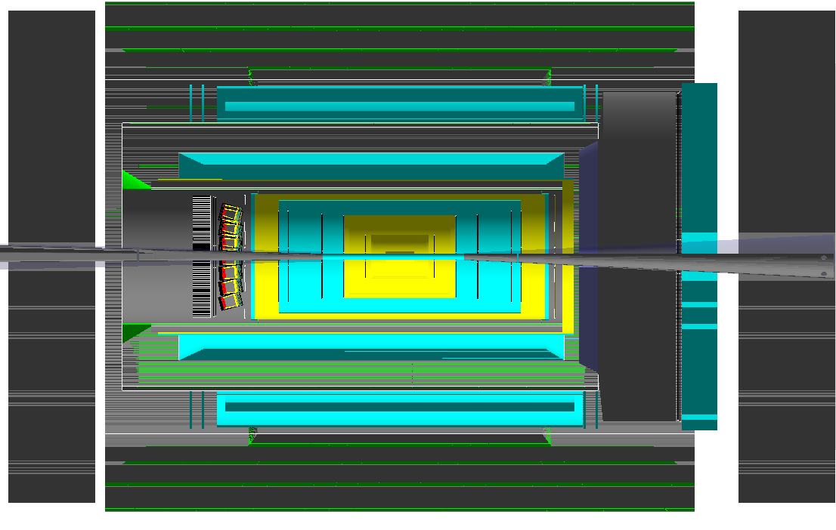
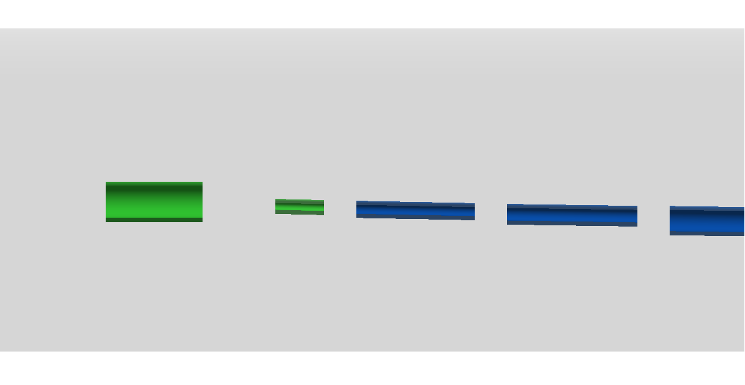
e⁺
[e⁺ and e⁻ are the decay products of J/𝚿]
e⁻
Central Barrel
e′
H End Cap
e
p
e End Cap
p′
𝜋⁻
𝜋⁺

Slide 9
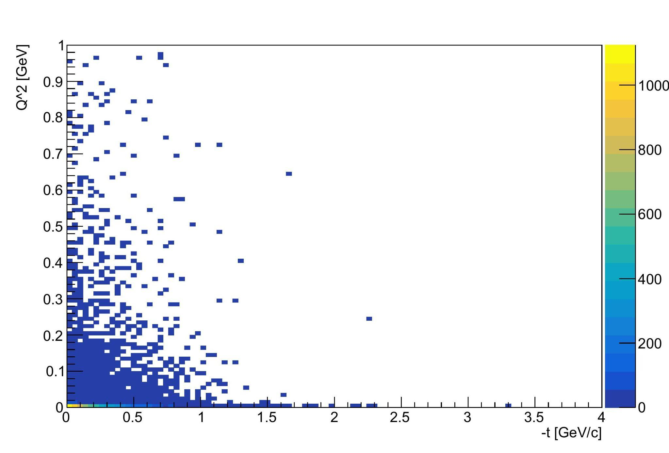
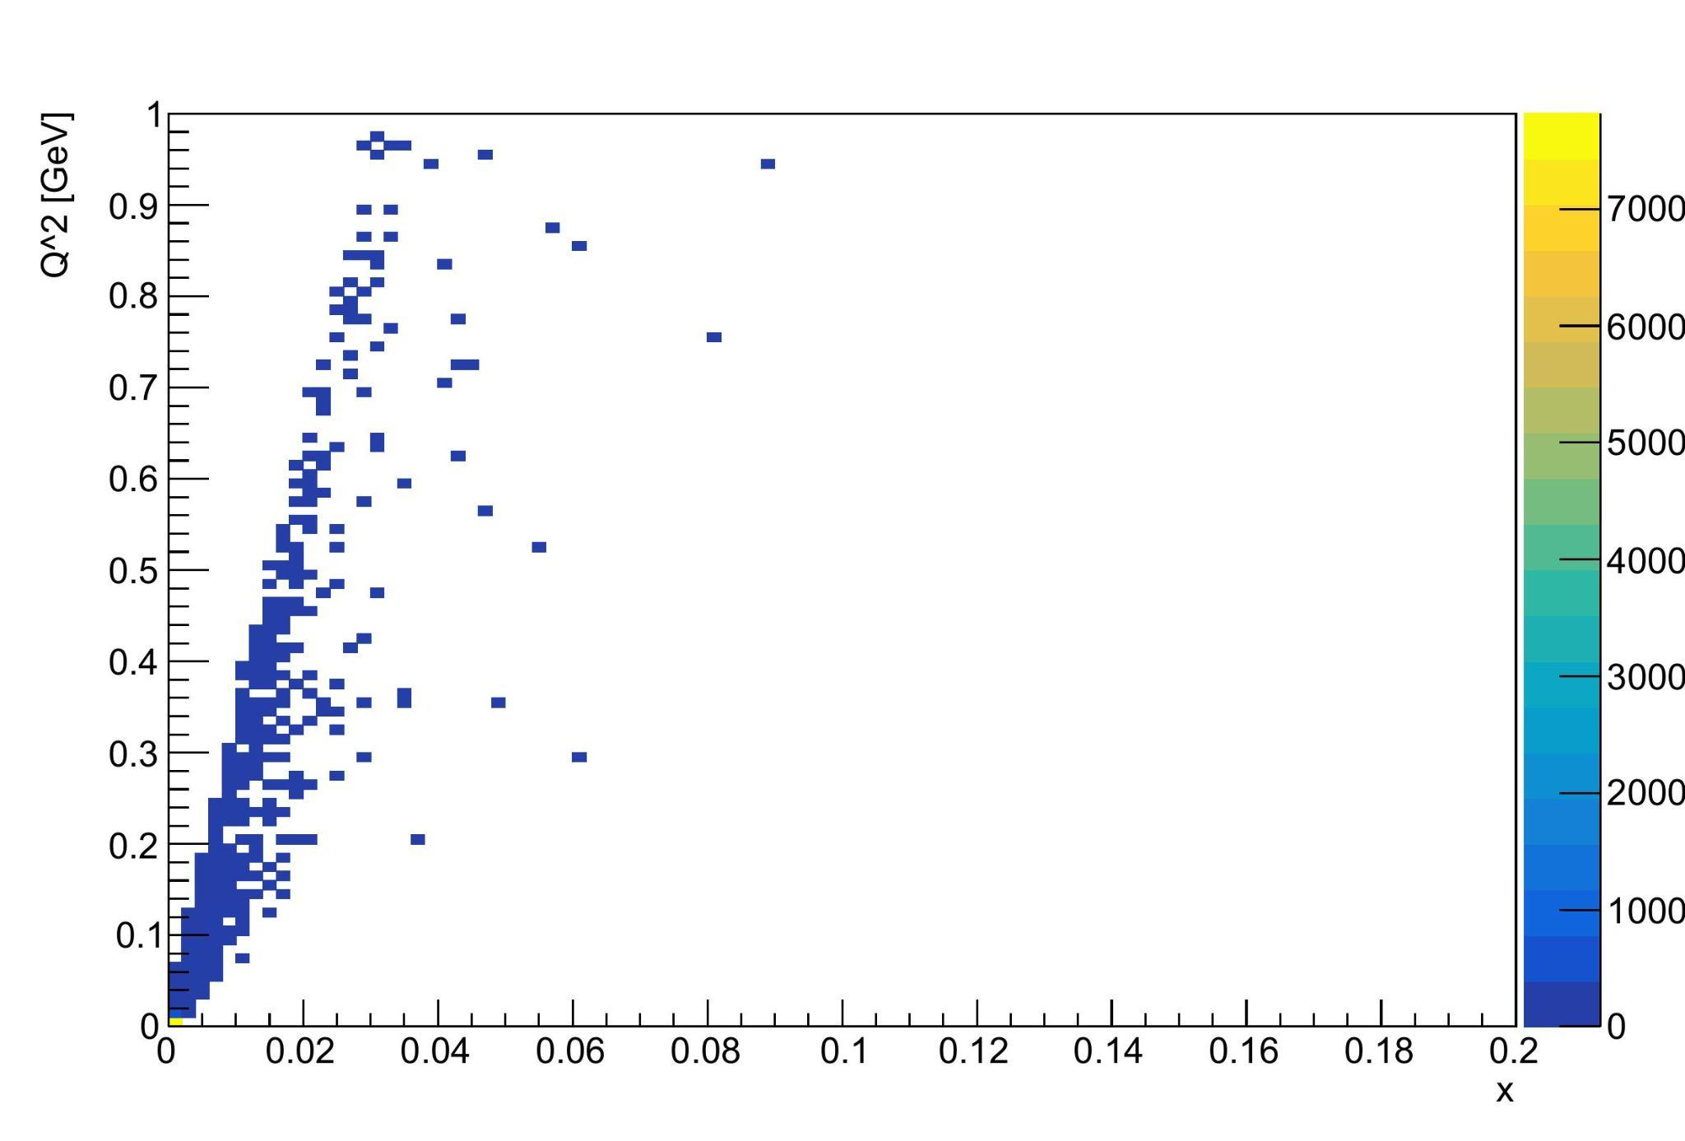
Results
The yield appears to be highest when Q² and -t are at their lowest values. The same can be said for Q² and x.
As the value of x increases, the value of Q² increases.
2D plot comparing -t and Q² for J/𝚿π⁺π⁻ yields
2D plot comparing x and Q² for J/𝚿π⁺π⁻ yields

Slide 10
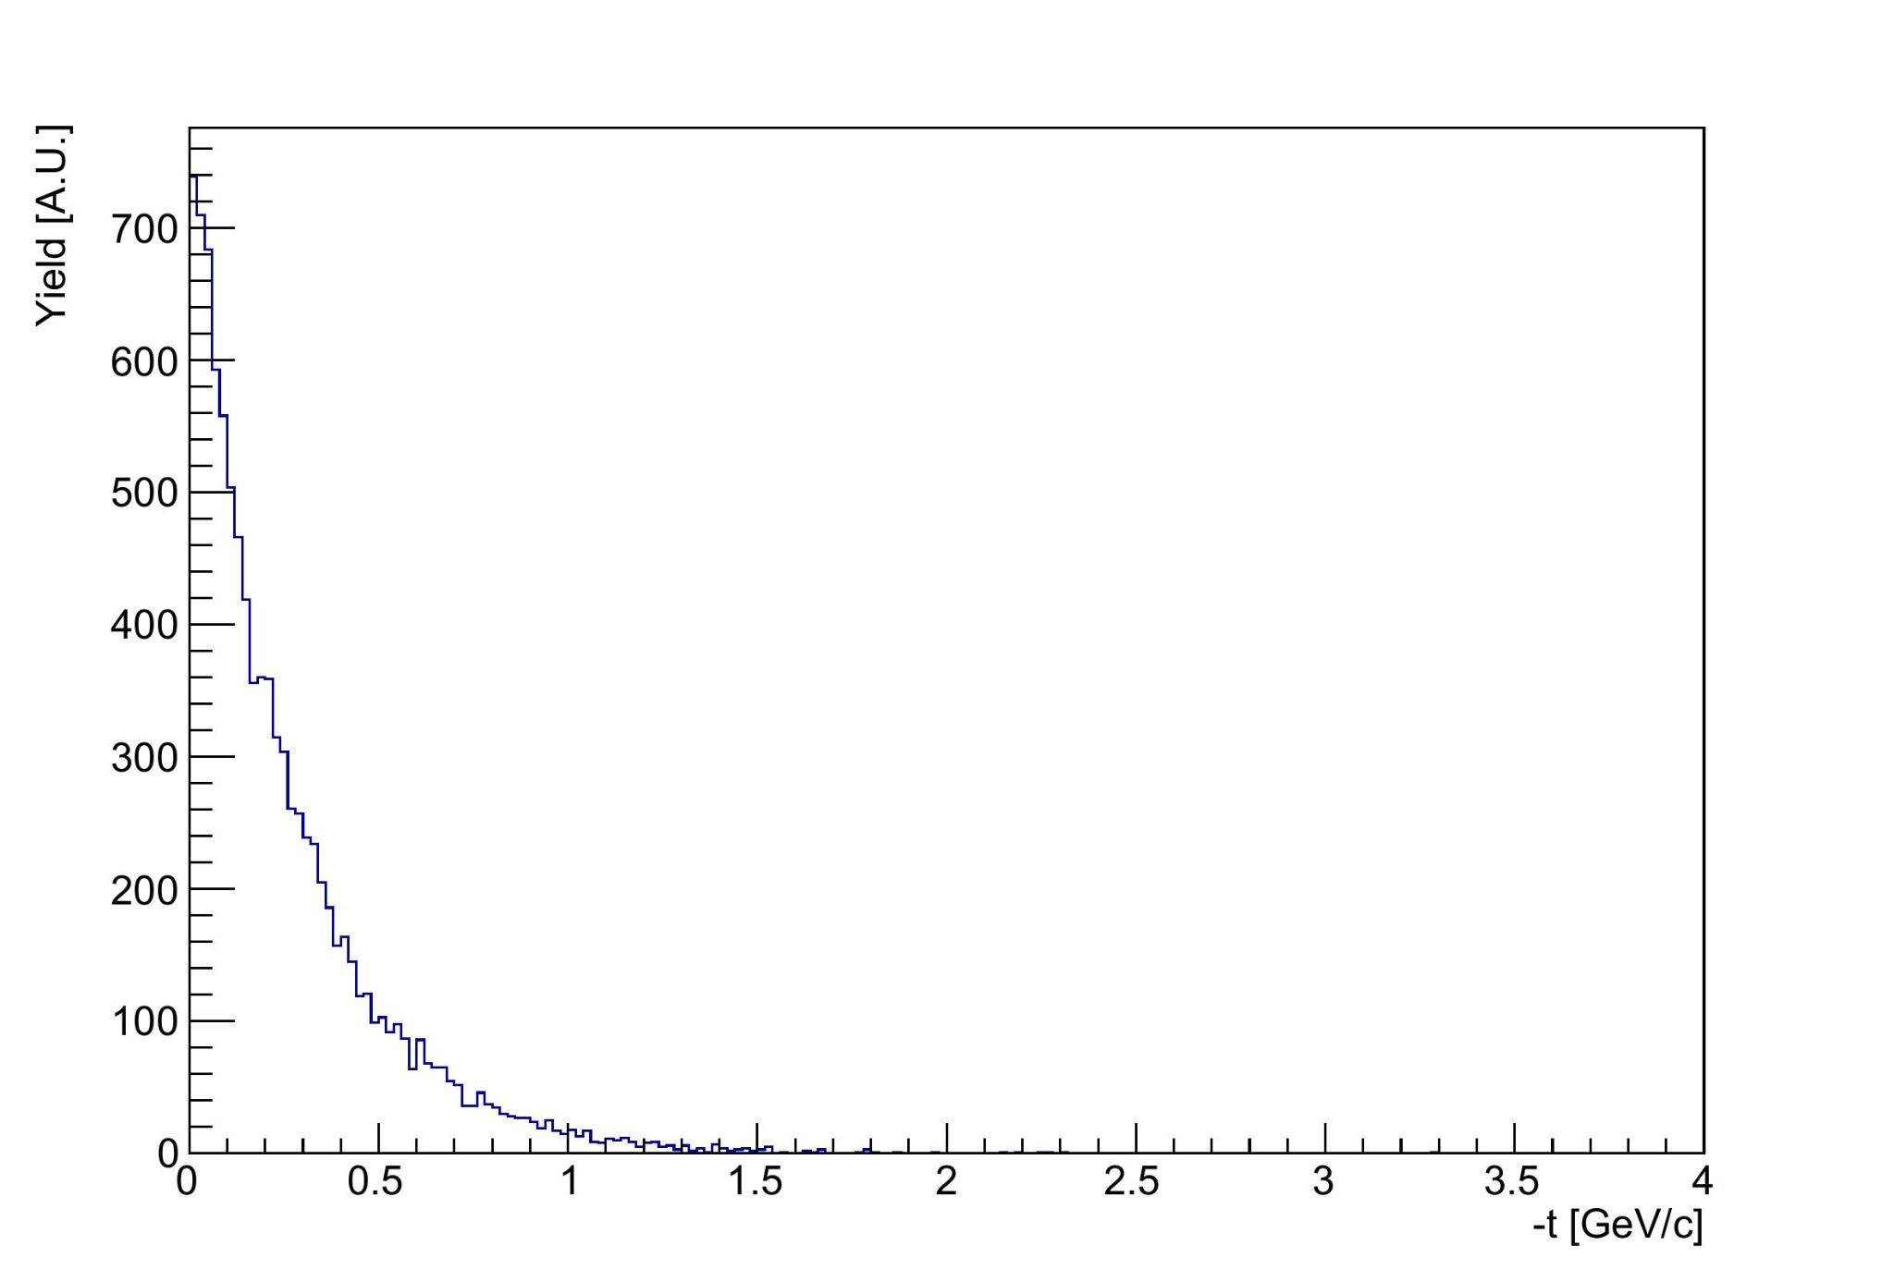
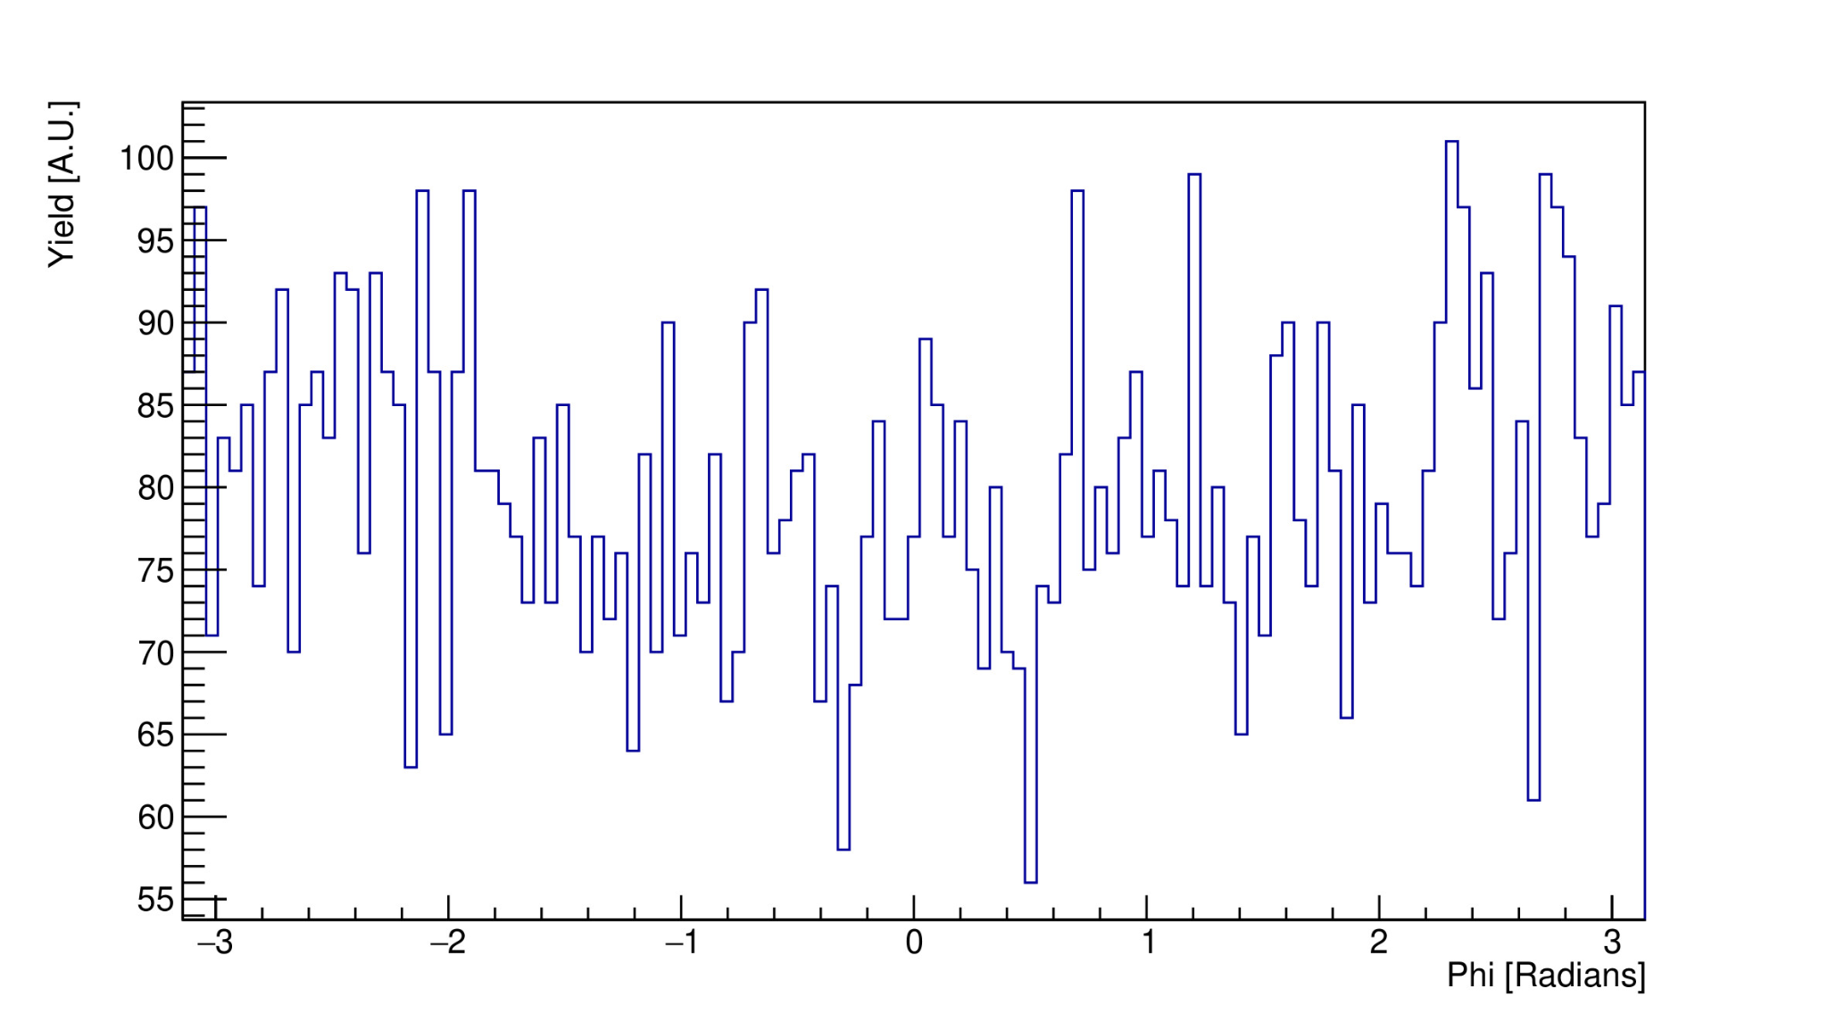
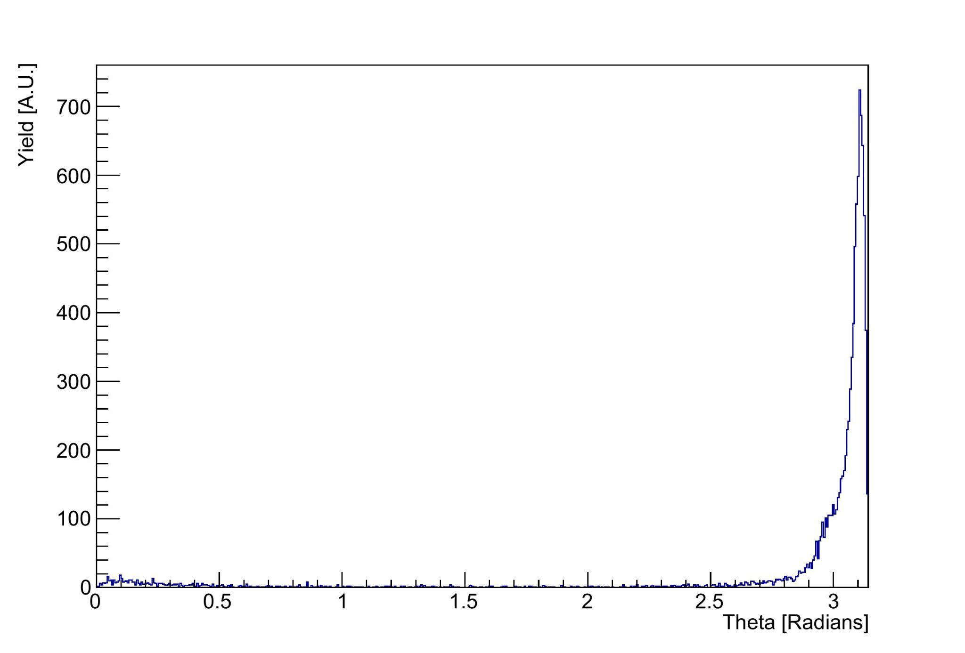
Results
Mandelstam variable -t yield for J/𝚿π⁺π⁻
Yield exponentially decays as -t increases.
Yield increases exponentially as the polar angle approaches roughly π.
Azimuthal angle yield distribution for J/𝚿π⁺π⁻
Polar angle yield distribution for J/𝚿π⁺π⁻

Slide 11
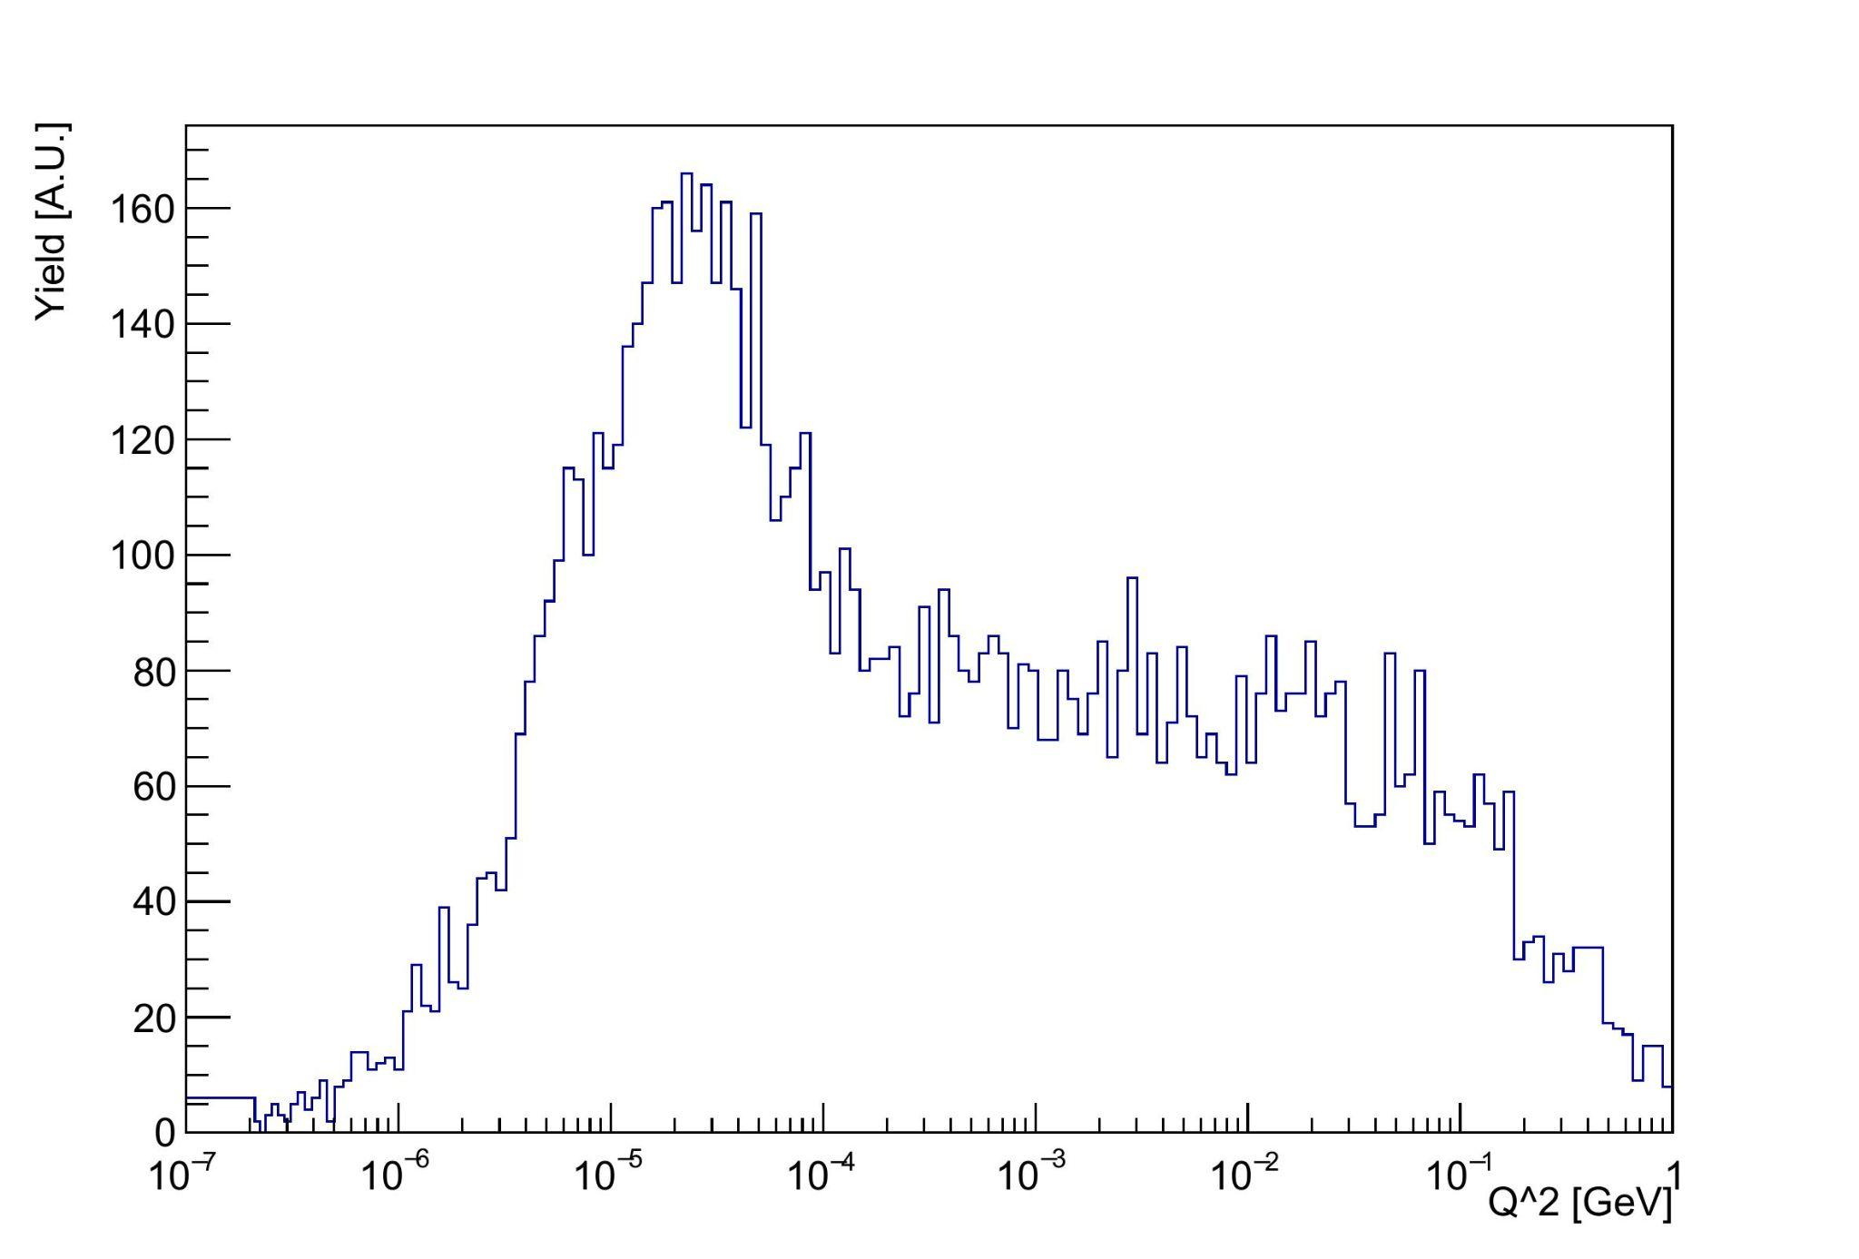
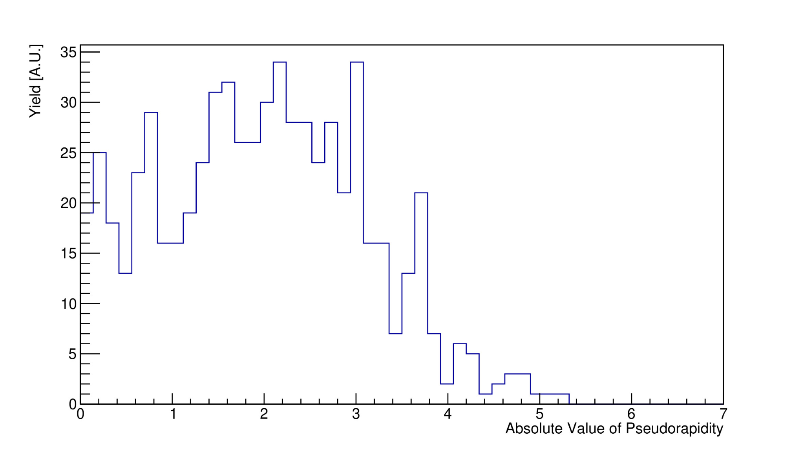
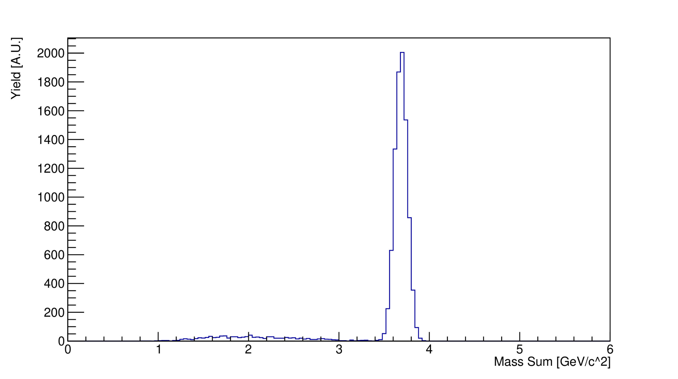
Results
Q² yield for J/𝚿π⁺π⁻ with logarithmic binning
Pseudorapidity yield distribution for J/𝚿π⁺π⁻
To study particle smearing, we took each event’s mass sum and multiplied it by the sum of 1 and a random Gaussian distribution with a mean of 0 and a standard distribution of 0.07.
When accounting for smearing, the J/𝚿π⁺π⁻ width yield peak is located in the 3.6 < Mass Sum < 3.8 GeV.
Nearly all events are Q² < 0.1GeV, the peak is located in the 10⁻⁵<Q²<10⁻⁴ GeV region. This generally agrees with the 4-momentum squared expectations of elSpectro.
From the original 10,000 events, 715 resulted in J/𝚿→e⁺e⁻. Of those 715, 649 J/𝚿π⁺π⁻ events are in the |η|<3.5 region, and the rest are in the |η|>3.5 region.
Mass sum yield for J/𝚿π⁺π⁻ while accounting for smearing

Slide 12
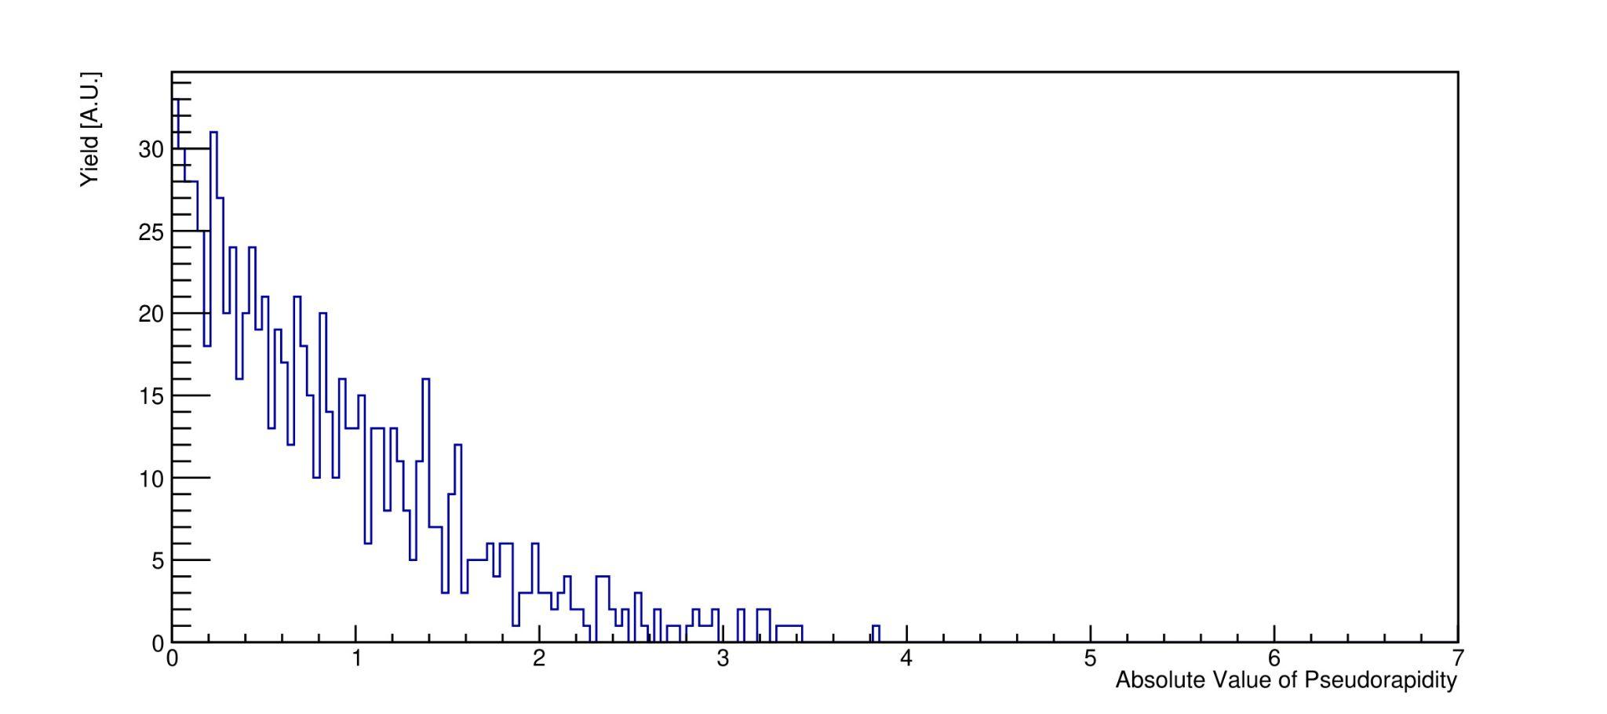
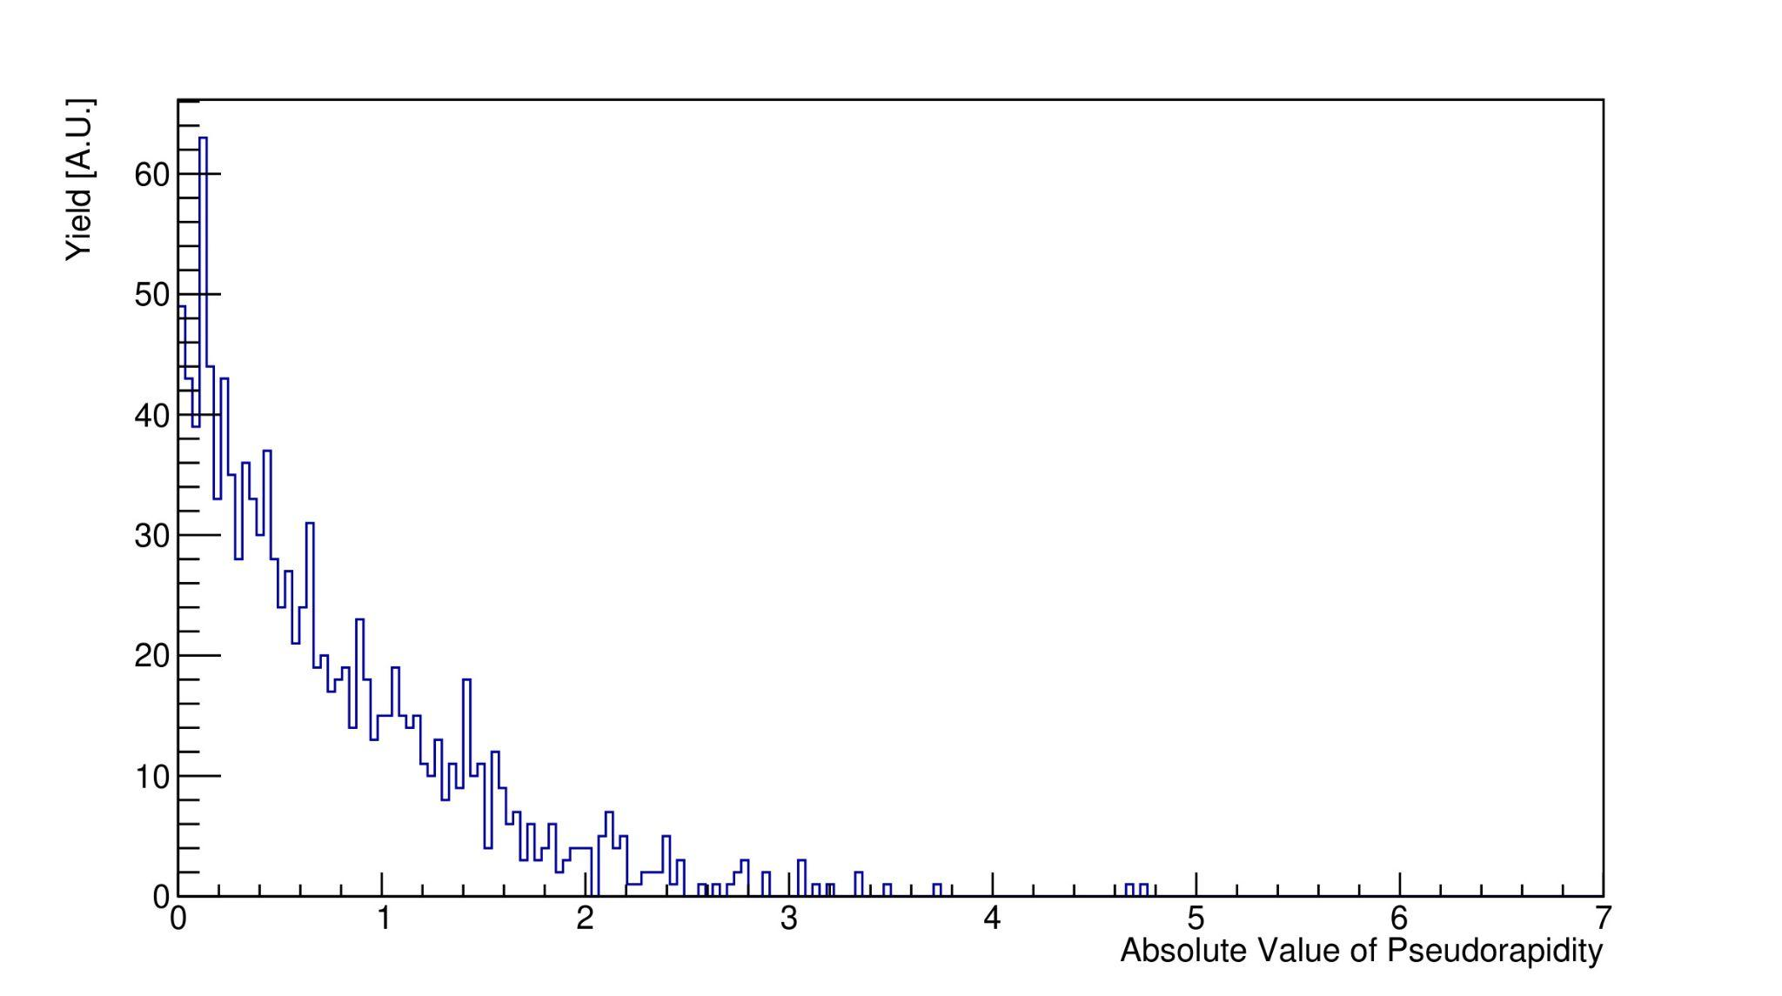
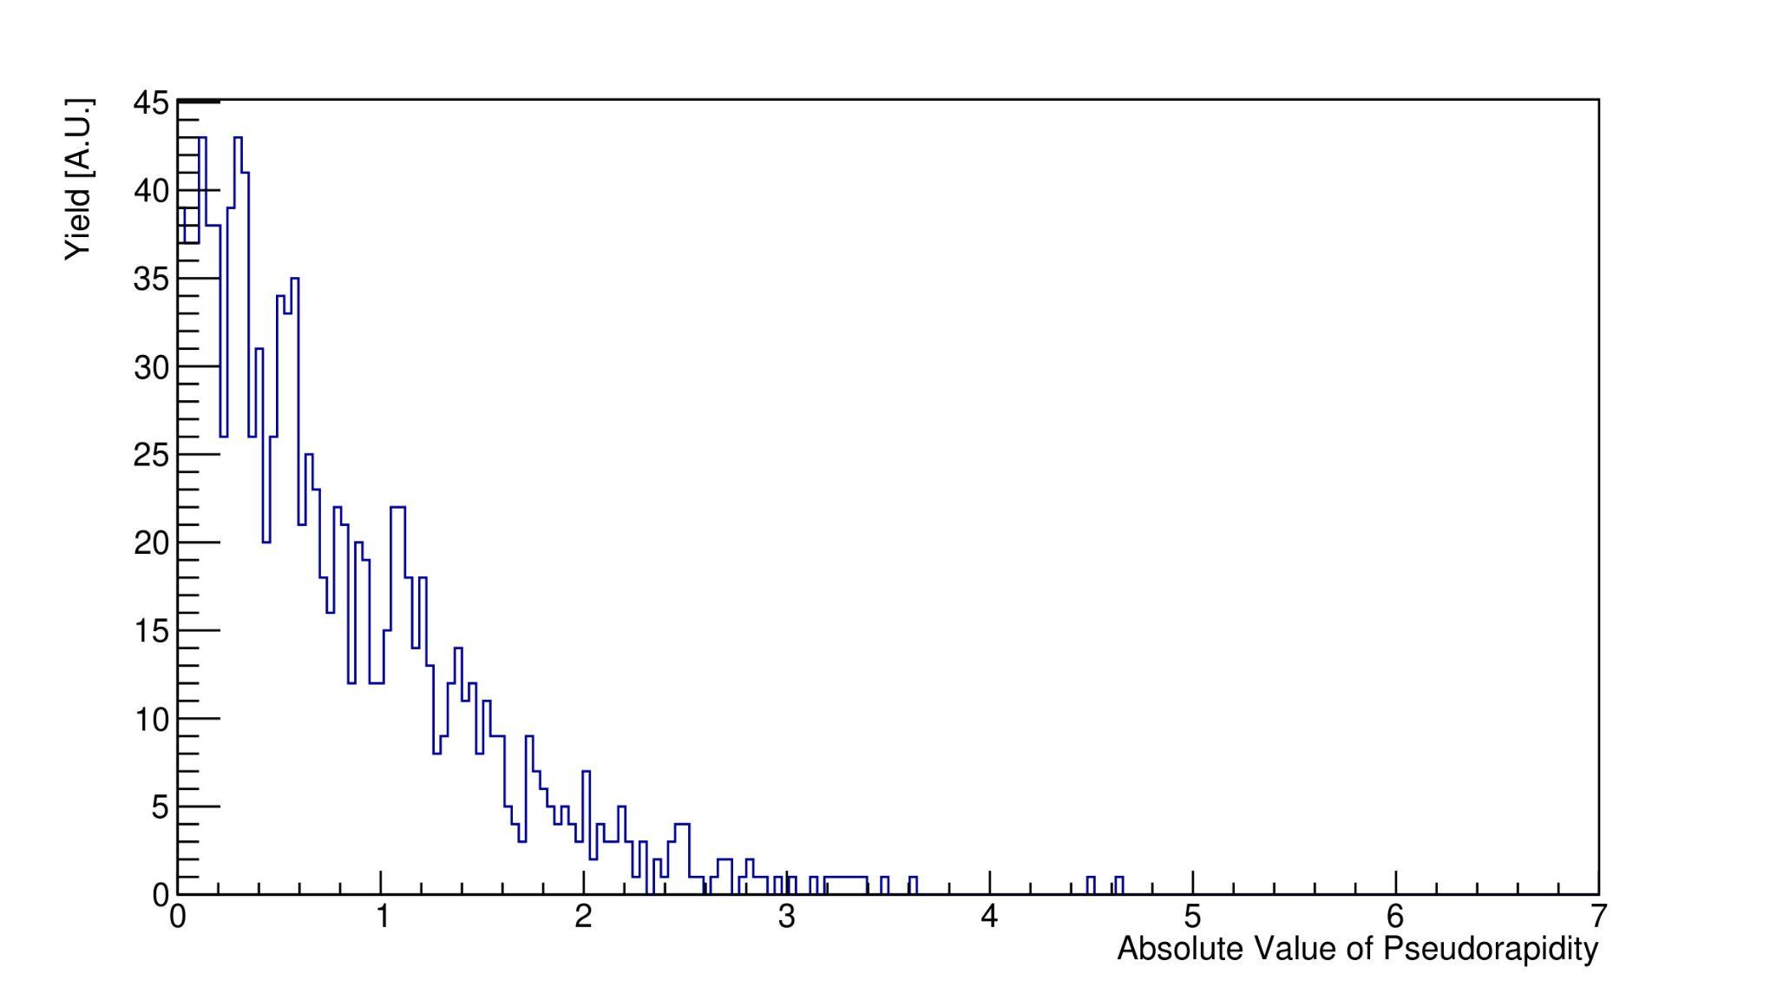
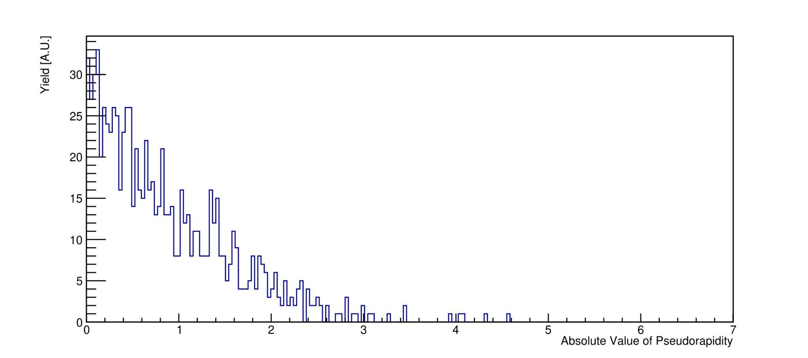
Results
Pseudorapidity yield distribution for π⁻
Pseudorapidity yield distribution for e⁻
The e⁺, e⁻, π⁻, and π⁺ distributions are concentrated in the central barrel region, as indicated by |η|<1.0.
If XYZ meson decays, the EIC detector is capable of detecting it because e⁺, e⁻, π⁻, and π⁺ are are accepted by the detector in the central barrel region.
Pseudorapidity yield distribution for e⁺
Pseudorapidity yield distribution for π⁺

Slide 13
Conclusions
Dielectron decay (J/Psi) channel detects 2 electrons and 2 pions. Acceptance and cross section depends on efficiency of far back detector stack Q² < 1GeV. This was studied in the EIC environment.
From the original 10,000 X(3872) events, 715 resulted in J/𝚿→e⁺e⁻. Of those 715, 649 J/𝚿π⁺π⁻ events are in the |η|<3.5 region, and the rest are in the |η|>3.5 region.
It will require more studies to study the detector response and determine whether the EIC will collect enough statistics to quantify the quantum numbers of X(3872).

Slide 14
References
[1] R. Abdul Khalek et al. Science Requirements and Detector Concepts for the Electron-Ion Collider: EIC Yellow Report. 2021. DOI: 10.48550/ARXIV.2103.05419. URL: https://arxiv.org/abs/2103.05419.
[2] Derek Glazier and Justin Stevens. Charmonium(like) spectroscopy with Energy upgraded CLAS12. Hadron Spectroscopy with a CEBAF Energy Upgrade. 2022. URL: https://indico.jlab.org/event/528/contributions/10014/.
[3] Olsen and Stephen Lars. “XYZ Meson Spectroscopy”. In: (2015). DOI: 10.48550/ARXIV.1511.01589. URL: https://arxiv.org/abs/1511.01589.
[4] K. Nakamura and (Particle Data Group). “Review of Particle Physics”. In: Journal of Physics G: Nuclear and Particle Physics 37.7A (2010), p. 075021. DOI: 10.1088/0954-3899/37/7A/075021. URL: https://dx.doi.org/10.1088/0954-3899/37/7A/075021.

