Slide 1
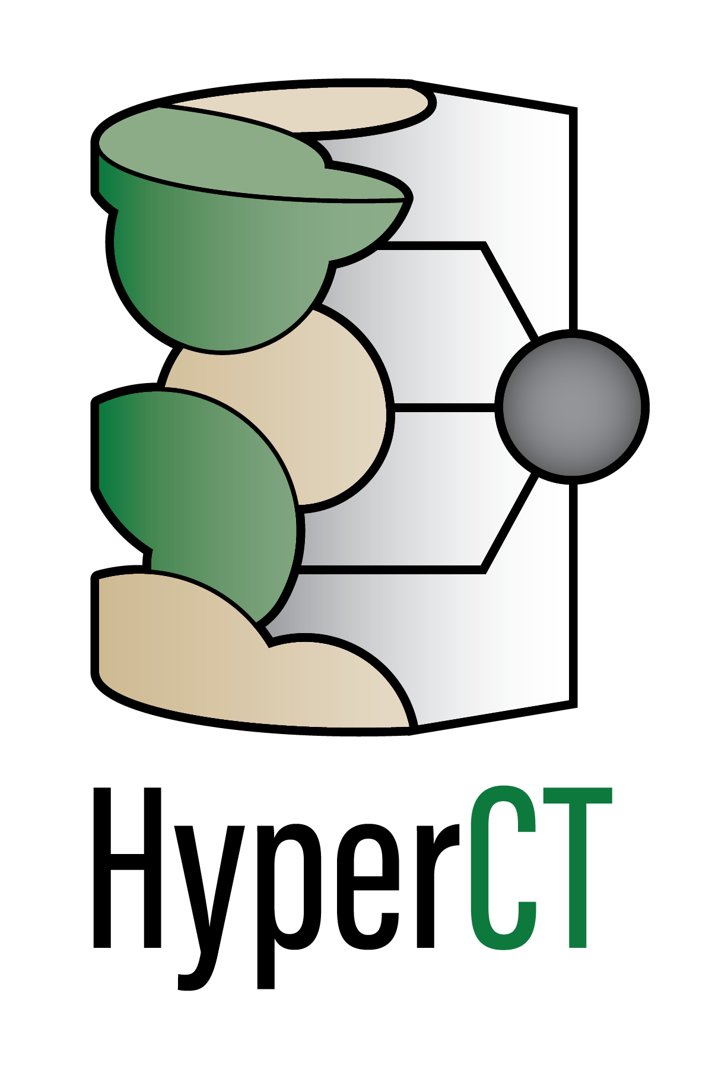

HyperCT: Hyperspectral Neutron Computed Tomography
Shimin Tang, Ph.D (tangs@ornl.gov)
PI: Hassina Bilheux
Materials Engineering Group, Neutron Scattering Division
Oak Ridge National Laboratory

Slide 2
Neutrons interact uniquely with matters
Neutron
Non-destructive
High penetration depth
Sensitive to light elements (H, Li, etc.)
Isotopic contrast
X-ray
https://www.psi.ch/en/niag/what-is-neutron-imaging

Slide 3
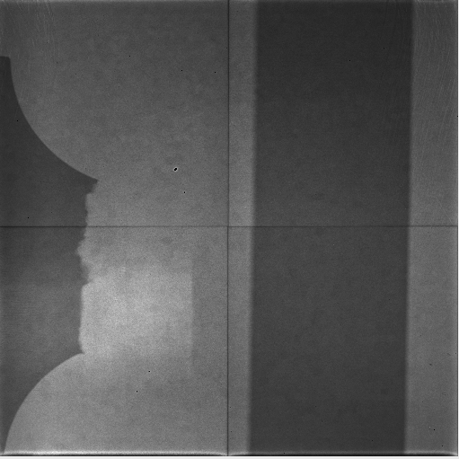
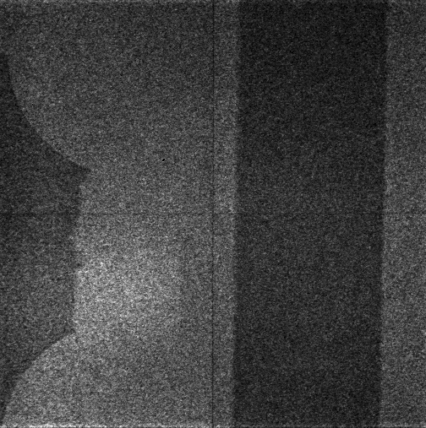
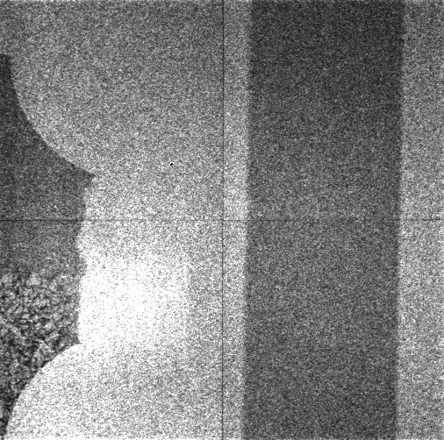
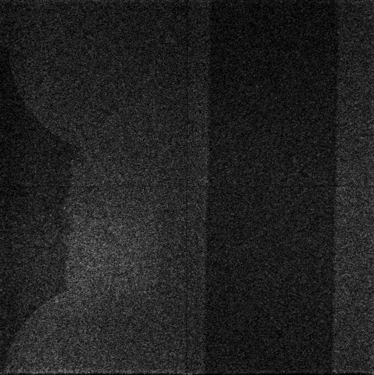

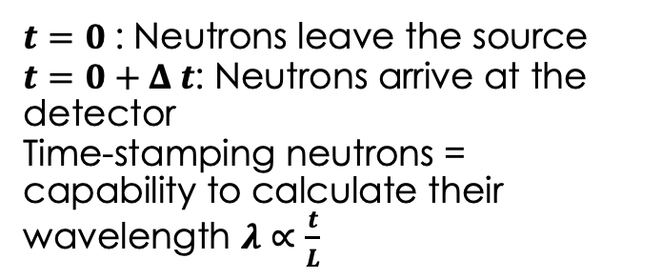

Continuous and Pulsed Neutron Sources
One radiograph
Wavelength or energy dependent = hyperspectral
Continuous Source (reactor)
Pulsed Source (spallation source)
Source
Source
Detector
Detector
Pulses of neutrons
$$t=0$$
$$t=0+Δ t$$
$t=0$: Neutrons leave the source
$t=0+Δ t$: Neutrons arrive at the detector
Time-stamping neutrons = capability to calculate their wavelength $λ∝\frac{t}{L}$
Continuous stream of neutrons with a mixture of multiple wavelength
Up to 3000 radiographs (low signal-to-noise)

Slide 4
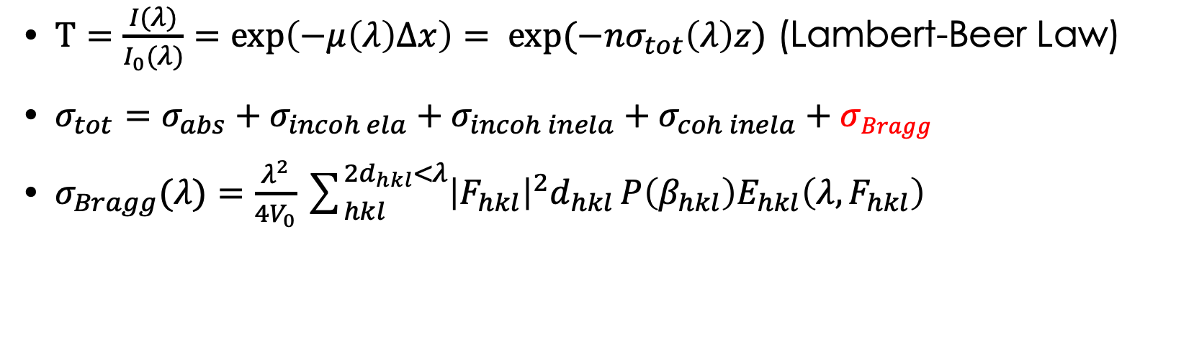
Hyperspectral Feature
Two-dimensional TOF neutron radiograph
Bragg-edges
Transmitted neutron (I₁)
“Hyperspectral”
Extract crystallographic information from the Bragg-edge spectrum
Incident neutron (I₀)
Transmitted neutron (I₂)
$T=\frac{I(λ)}{I_{0}(λ)}=exp\left(−μ\left(λ\right)∆x\right)= exp(−nσ_{tot}\left(λ\right)z)$ (Lambert-Beer Law)
$σ_{tot}=σ_{abs}+σ_{incoh ela}+σ_{incoh inela}+σ_{coh inela}+σBragg$
$σ_{Bragg}(λ)=\frac{λ^{2}}{{4V}_{0}}\sum_{hkl}^{{2d}_{hkl}<λ}{{\left|F_{hkl}\right|}^{2}d_{hkl}}P\left(β_{hkl}\right)E_{hkl}\left(λ,F_{hkl}\right)$
Depends on the crystallite size along the beam direction
E. Fermi, W. Sturm, R. Sachs. The transmission of slow neutrons through microcrystalline materials, Physical Review 71 (1947) 589.

Slide 5
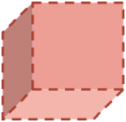






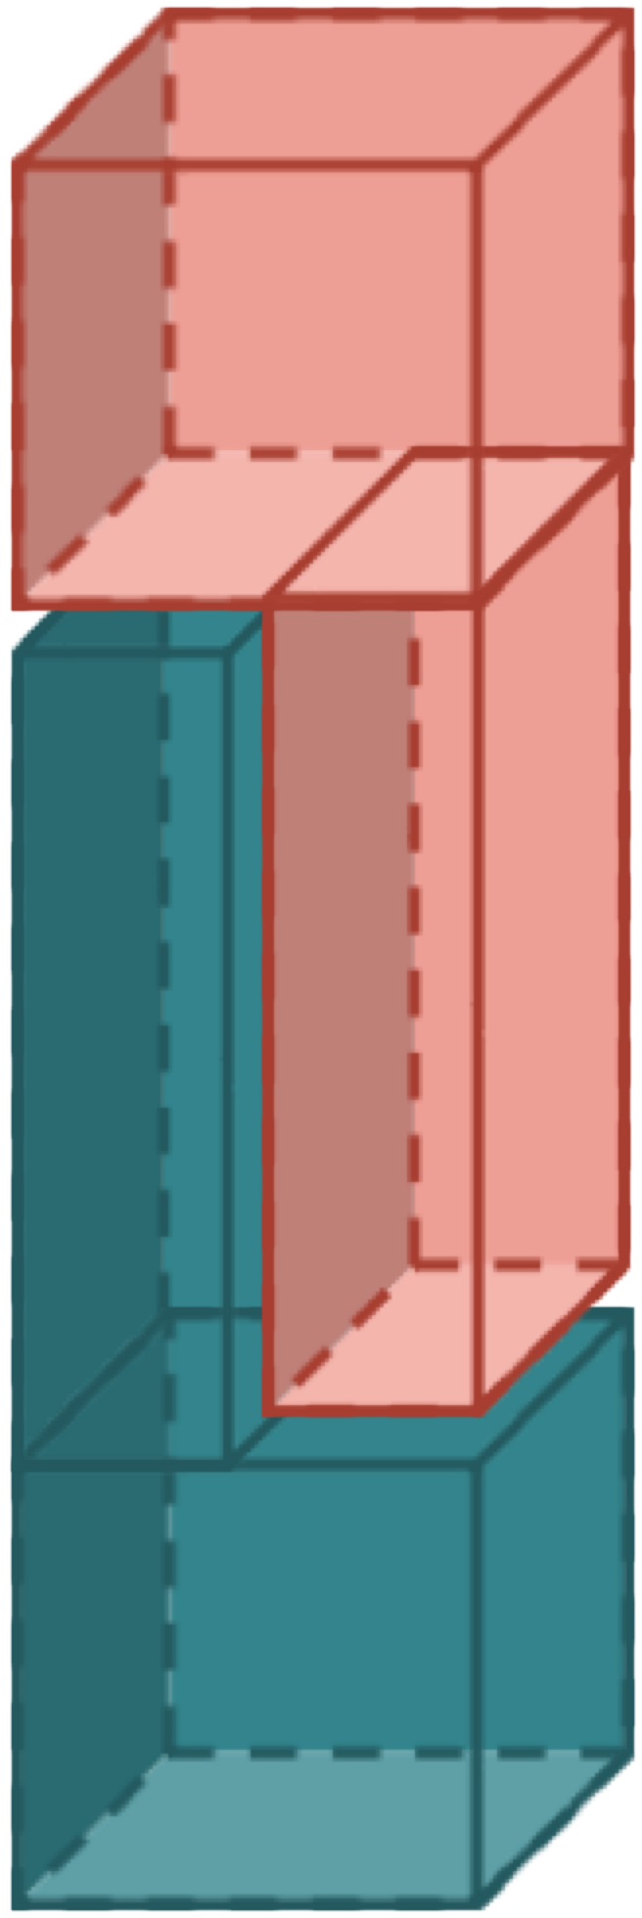
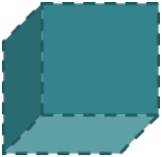
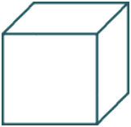
Hyperspectral Neutron CT
Data Acquisition
Slit System
Sample
Sinogram
CT Reconstruction Algorithm
MCP detector
Neutron Source
Pulsed Neutron Beam

Slide 6
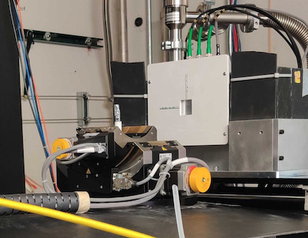


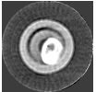
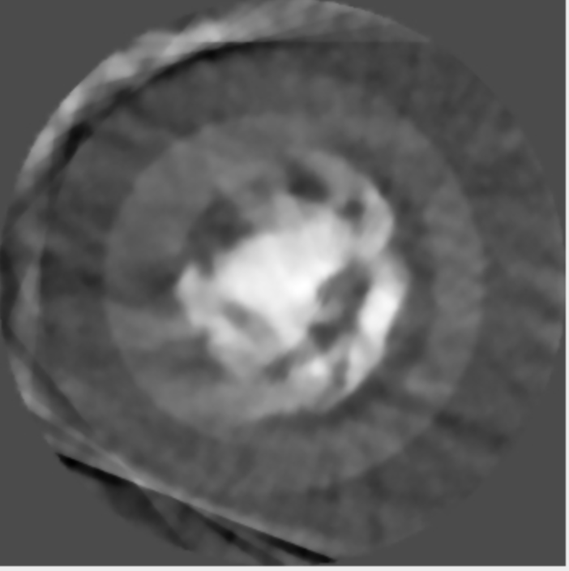


Hyperspectral Neutron CT has longer measurement time
API serves new scan angles to EPICS
Detector
Sample
Start/Stop
Scan Angles
Acquisition starts with new scan angle and pCharge
Radiography
* courtesy of George Nelson
SNS analysis server
Neutron CT reconstruction
ADARA archives raw data
ADARA triggers auto reduction
AI-based system
Instrument scientists / Users
Script monitors reduced data
After 5-day measurement
After one-day measurement
*svmbir, 2020, SVMBIR Development Team, Super-Voxel Model Based Iterative Reconstruction (SVMBIR), Software library available from https://github.com/cabouman/svmbir

Slide 7
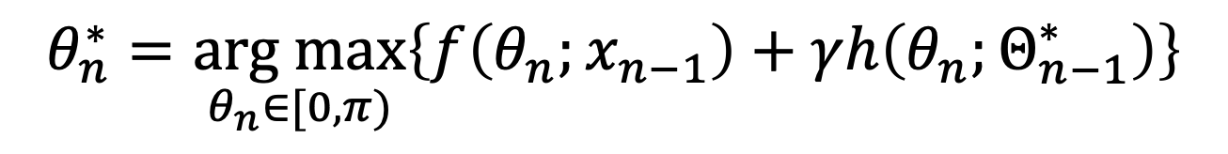
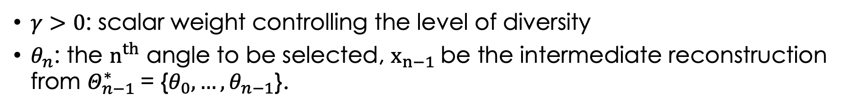
Optimized Sample-Shape Adaptive Angle Selection via Reconstruction Understanding*
Projection angles that are aligned with longest edges of the object of interest are important.
$$θ_{n}^{∗}=\underset{θ_{n}∈[0,π)}{arg max}\left\{f\left(θ_{n};x_{n−1}\right)+γh\left(θ_{n};Θ_{n−1}^{∗}\right)\right\}$$
Find the longer dimension
Keep diversity
$γ>0$: scalar weight controlling the level of diversity
$θ_{n}$: the $n^{th}$ angle to be selected, $x_{n−1}$be the intermediate reconstruction from $Θ_{n−1}^{∗}$= {$θ_{0},…,θ_{n−1}$}.
*Shimin Tang, Yang, Diyu, Singanallur V. Venkatakrishnan, Mohammad SN Chowdhury, Yuxuan Zhang, Hassina Z. Bilheux, Gregery T. Buzzard, and Charles A. Bouman. "An Edge Alignment-based Orientation Selection Method for Neutron Tomography." arXiv preprint arXiv:2212.00647 (2022).

Slide 8

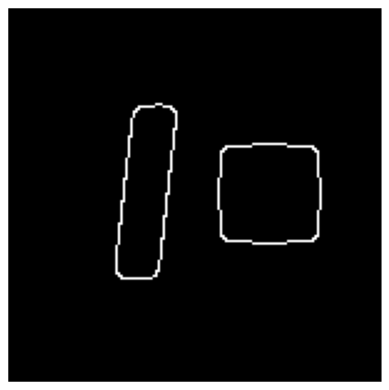
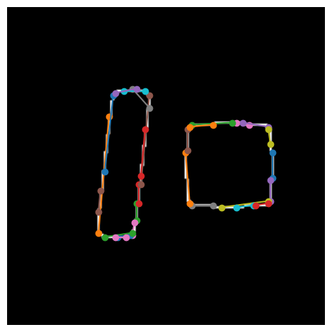
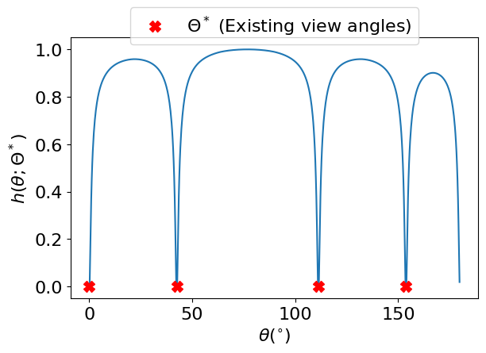

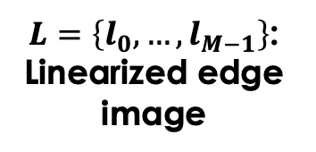
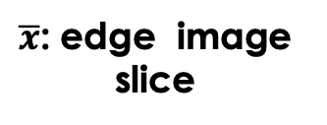
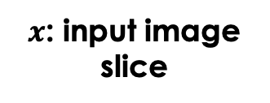
Edge alignment from data fitting $f\left(θ_{n};x_{n−1}\right)$
$$b(m)$$
1
2
$x$: input image slice
$\overline{x}$: edge image slice
$L=\left\{l_{0},…,l_{M−1}\right\}$:
Linearized edge image
Cost Function $h\left(θ;Θ_{n−1}^{∗}\right)$
Normalized angle spacing cost function w.r.t. view angles.
Red mark shows the values of existing view angles.
Notes:
Obtain edge image with Canny Edge Detection algorithm
Obtain linearized edge image $L$ with Probabilistic Hough Transform
For each rotate to angle 𝜃 in $L$,a segment $l_{i}$ is extended to cover all rows and count the number of overlapping pixels on the edge image

Slide 9
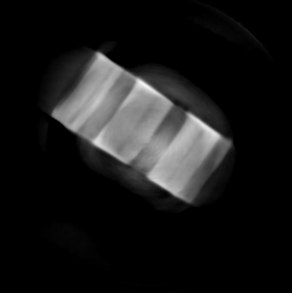
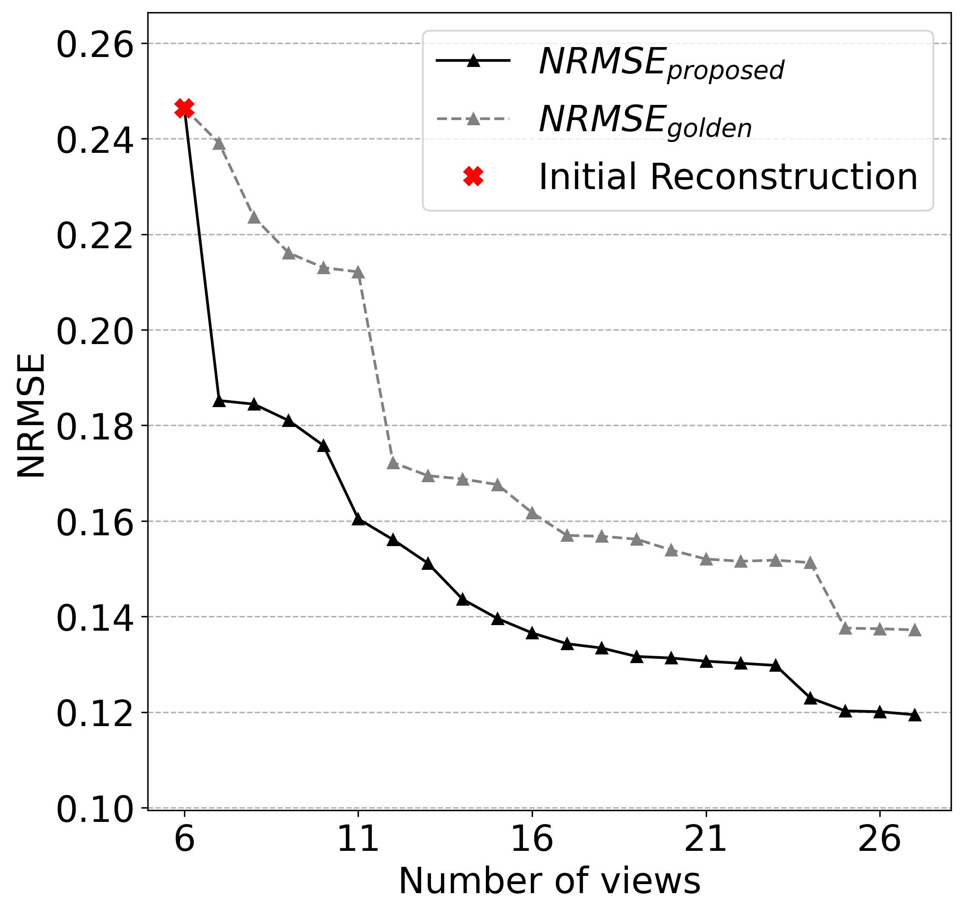
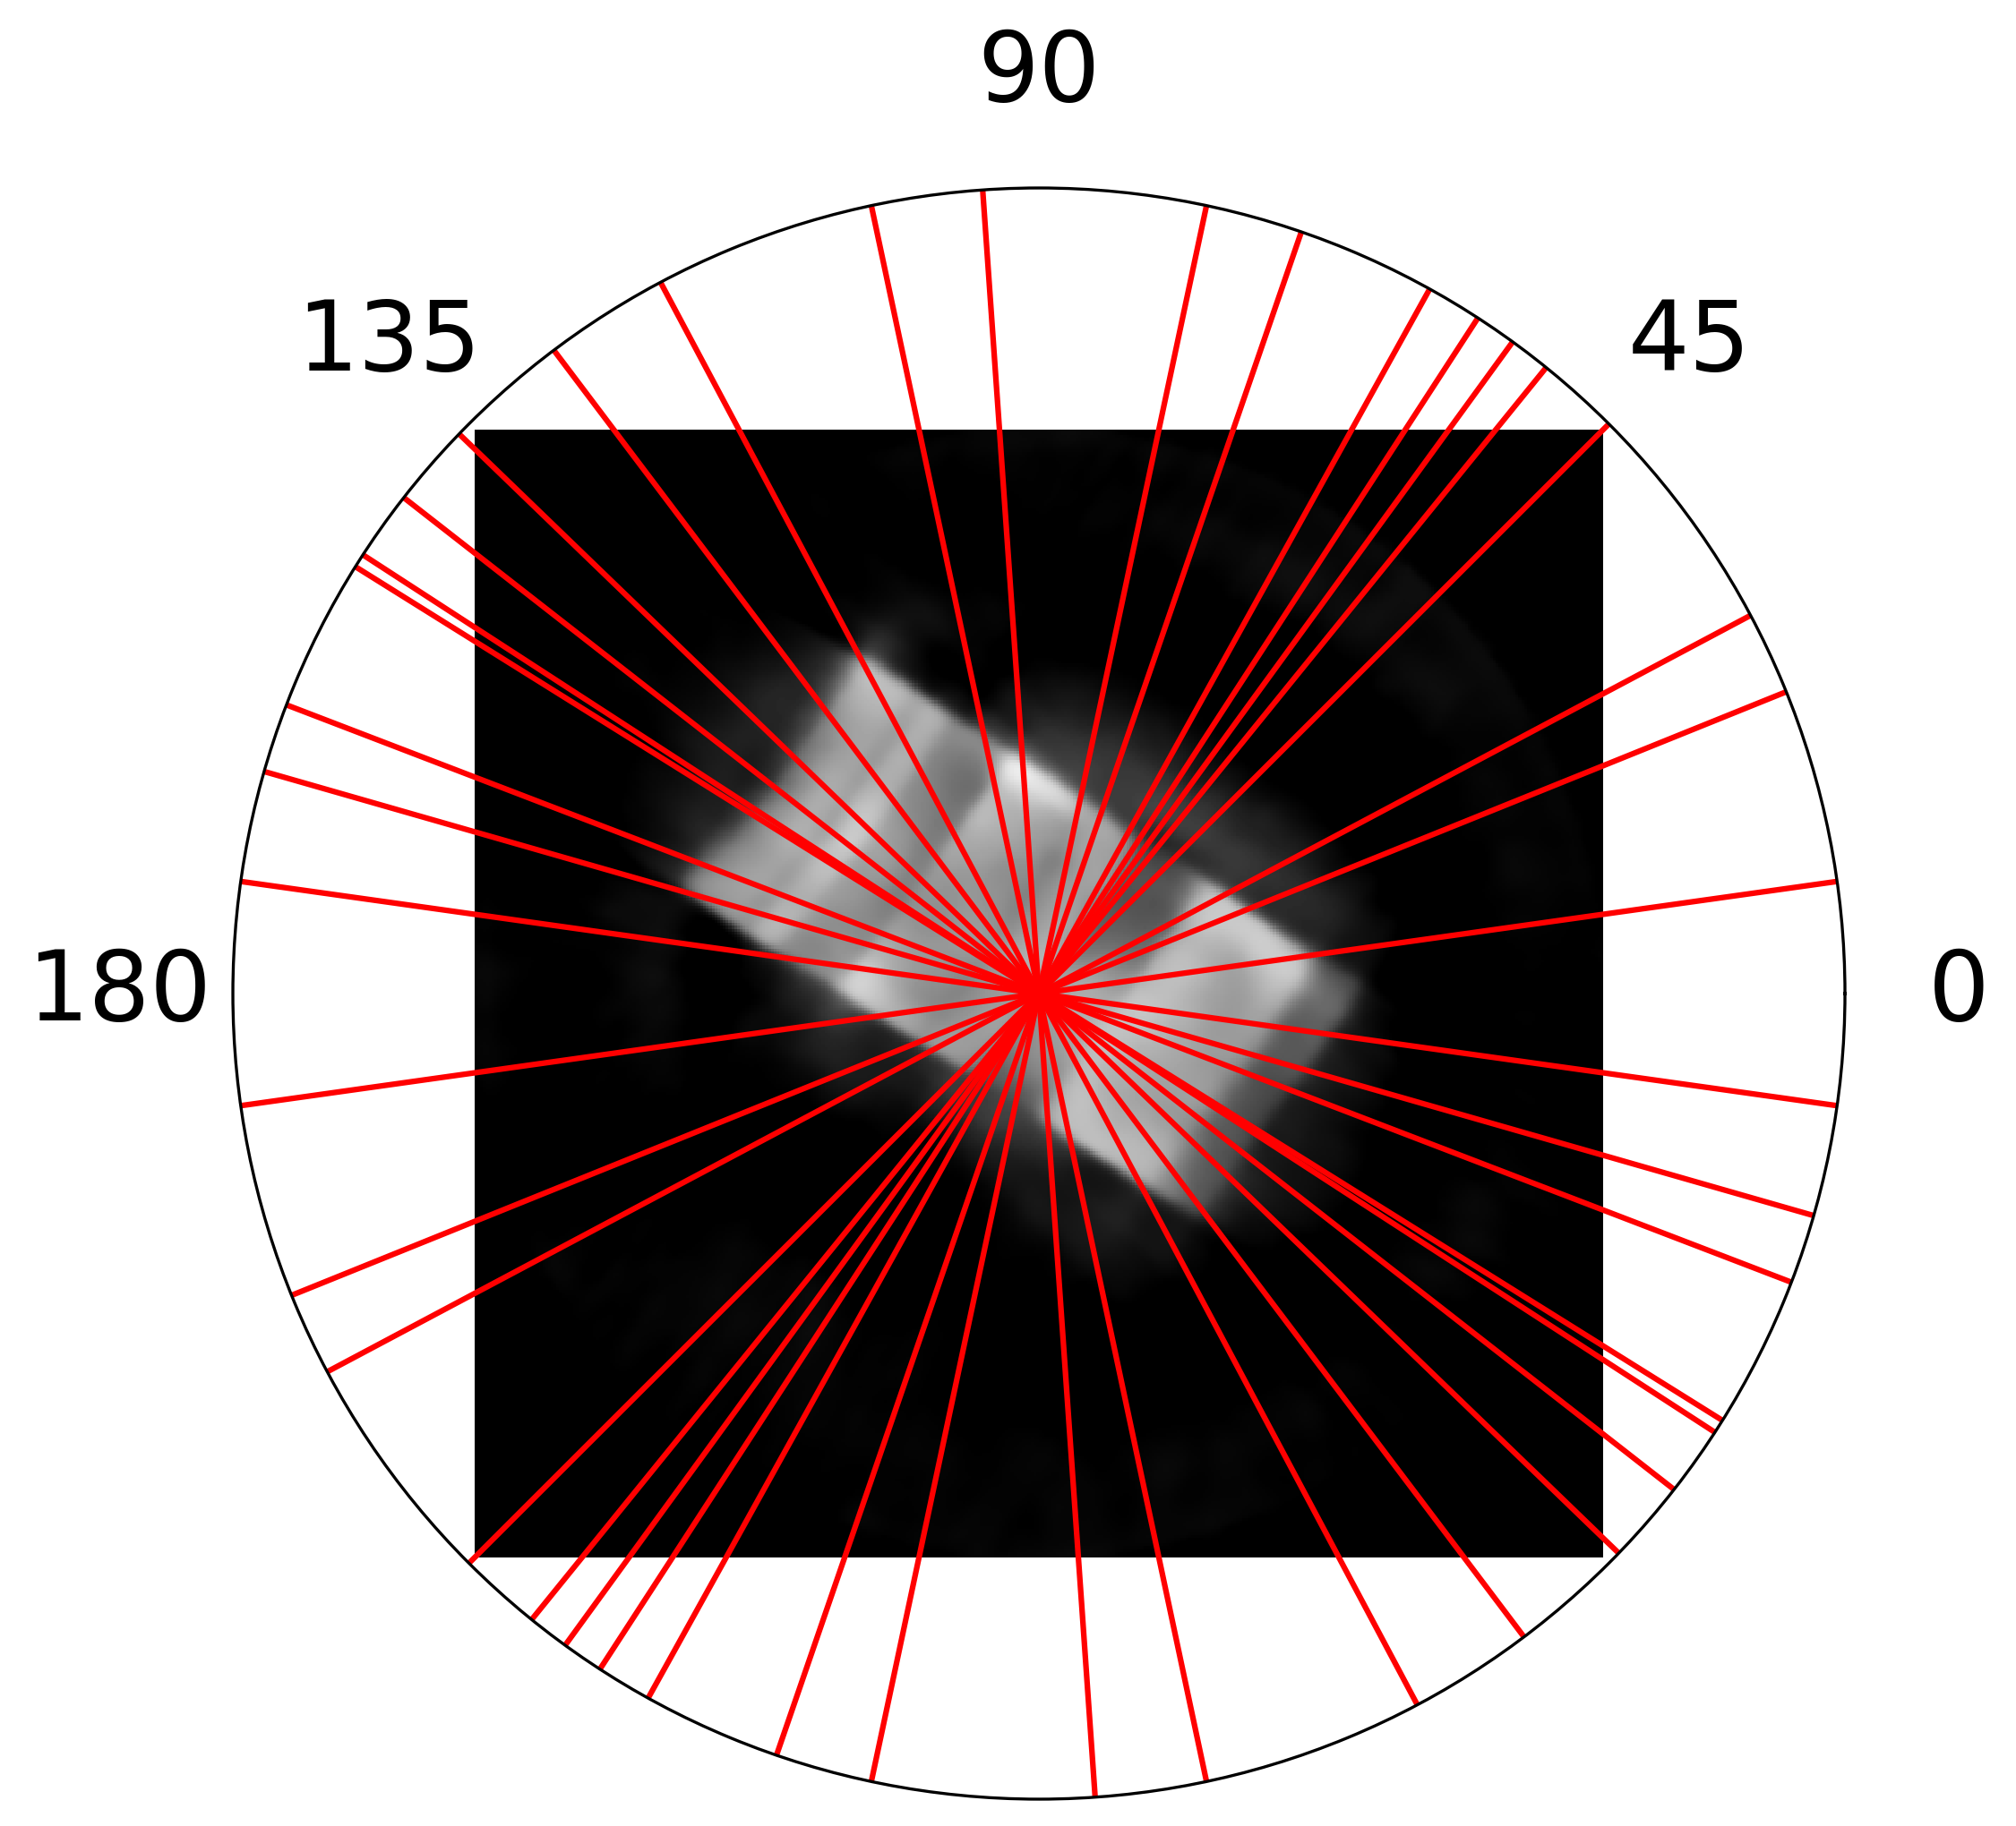
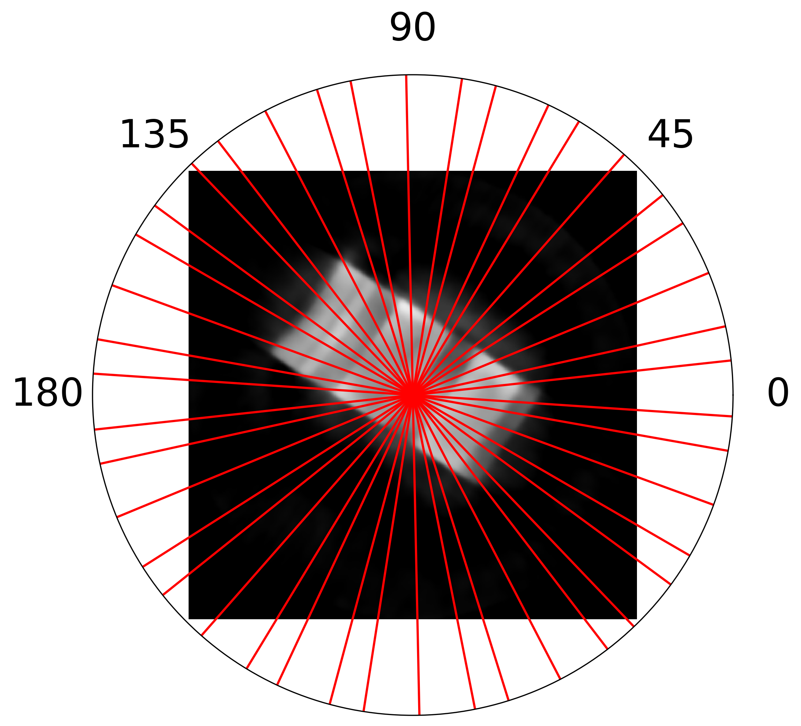
Obtain better reconstruction with less scans
Reference image
Recon with angle selection
NRMSE Plot
Proposed algorithm
Golden-angle
Better quality
* Courtesy of Yuxuan Zhang

Slide 10
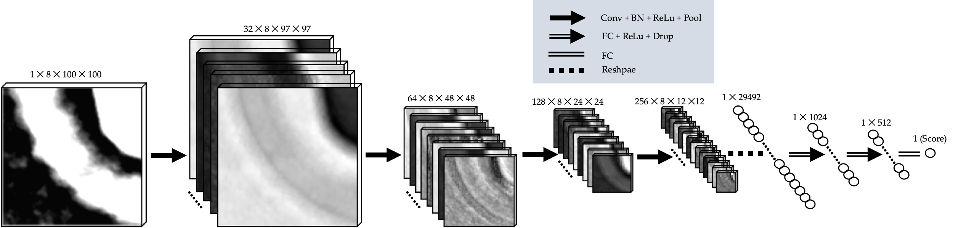
CNN based streaming neutron computed tomography (nCT) reconstruction quality evaluation
Data Augmentation
Subjectively assign the quality scores
3D CNN model

Slide 11
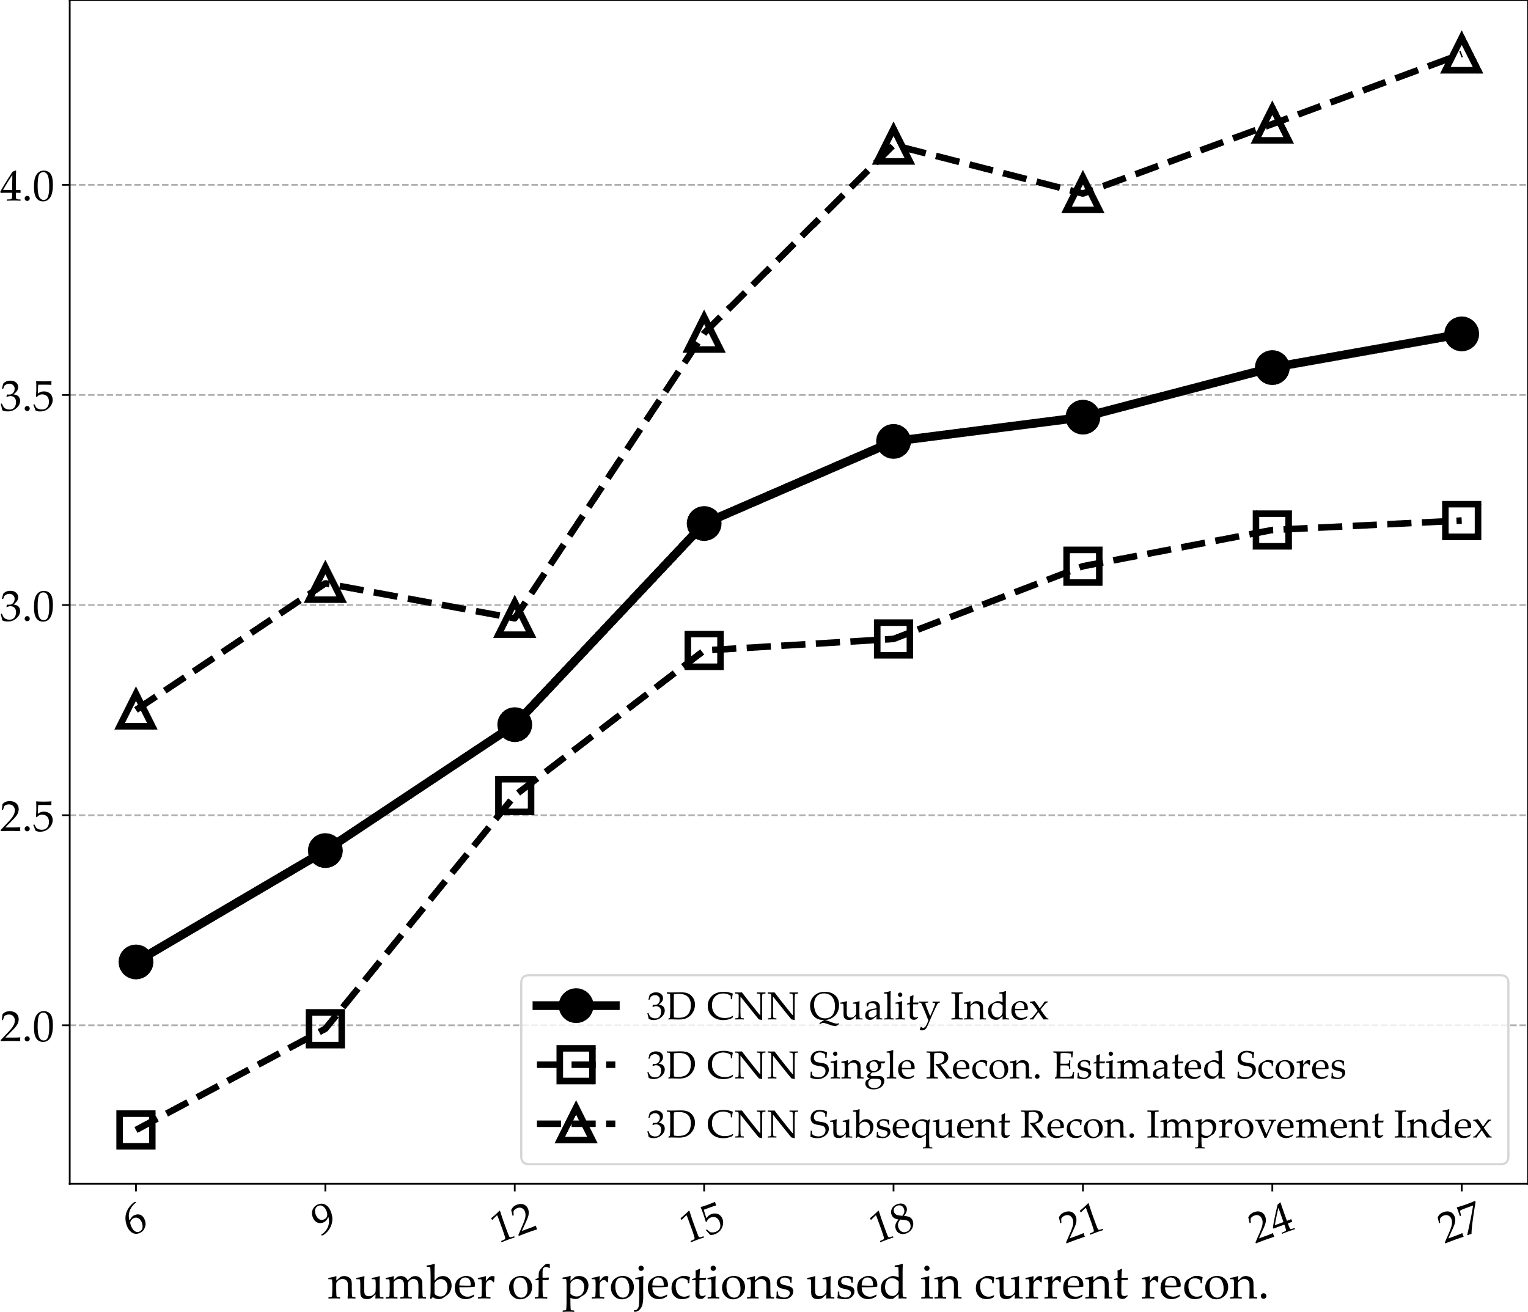
Streaming nCT quantity quality index (QI)
$$QI= α∙{\overline{q}}_{k}+β∙f(s_{k;k−3}, m_{k;k−3})$$
Single Reconstruction Score
Subsequent Improvement Index
The comprehensive streaming-quality index (1-5) → stopping reference
Streaming Time-Line
6 hours
12 hours
18 hours
24 hours
30 hours
36 hours
42 hours
48 hours
52 hours
Notes:
User can set

Slide 12
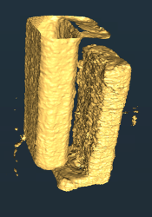
AI-based Autonomous Neutron Imaging System
The autonomous system consists of (1) Artificial Intelligence (AI) based 3D reconstruction quality assessment and (2) Automatic subsequent angle selection.
Angle Selection
Recon. Edge Detection
Edge Alignment Angle Selection
Commands
Next Angle
AI Quality Evaluation
Continue
AI Reconstruction Quality Score
Quality Index
Decision Making
Reconstruction
Stop
Reconstruction Improvement

Slide 13

First completely autonomous neutron experiment at ORNL
API serves new scan angles to EPICS
Detector
Sample
Start
Goniometers
Acquisition starts with new scan angle and pCharge
Radiography
New Angle
SNS analysis server
Users can access the reconstructed data and change criteria setting via ThinLinc
Continue
ADARA archives raw data
ADARA triggers auto reduction
Stop
AI-driven HSnCT system
@ Edge Node
Making Decision
Script monitors reduced data and triggers
AI-driven HSnCT system
Reconstruction
AI Quality Evaluation
Reduced Data
Propose Next Scan Angle
CT Reconstruction
(SVMBIR*)
Automatically stopped after ~27 projection angles, which is ~10 times faster than a naïve scan*.
*A. C. Kak and M. Slaney, Principles of computerized tomographic imaging. SIAM, 2001.

Slide 14
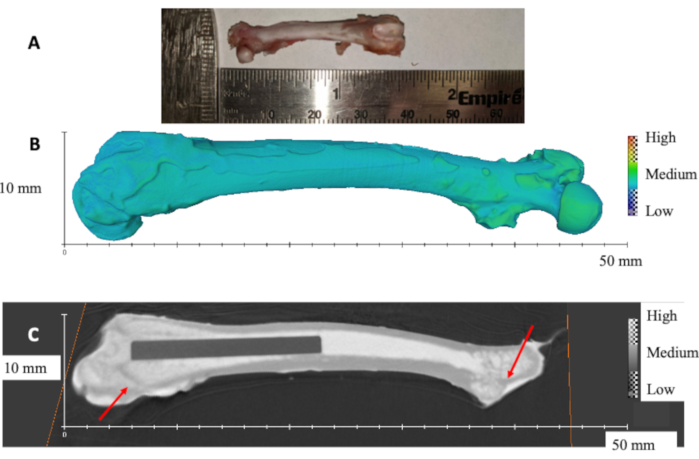
Unique Contrast Mechanisms for Biomaterials
Bone/metal implant interfaces
  Bone porosity/both growth
  Strain of implant on bone
  Bone/implant behavior under stress
Application portfolio is immense:
  orthopedic (joint implants, cements, fillers, scaffolds), cardiovascular (stents), dental restorative materials (composites, cements)
Cancer in bones
*Rat femur with titanium implant. (A) Photograph of a representative rat femur. (B) 3D rendered volume of rat femur obtained from nCT. (C) Diagonal slice showing the titanium rod inside the femur. Red arrows show the trabecular bone. The scale bars are presented by the x and y axes, respectively.
At ORNL, we have both conventional neutron imaging (MARS@HFIR) and hyperspectral neutron imaging (VENUS@SNS)
*Bilheux HZ, Cekanova M, Warren JM, Meagher MJ, Ross RD, Bilheux JC, Venkatakrishnan S, Lin JYY, Zhang Y, Pearson MR, Stringfellow E. Neutron Radiography and Computed Tomography of Biological Systems at the Oak Ridge National Laboratory's High Flux Isotope Reactor. J Vis Exp. 2021 May 7;(171). doi: 10.3791/61688. PMID: 34028436.

Slide 15
Takeaways
Neutron images have unique contrast mechanisms for biomaterials
Upcoming VENUS (Hyperspctral) will bring more wavelength-relative details
AI-based autonomous imaging system reduced the HyperCT’s time costing
ORNL will provide the advanced neutron imaging studies via 3-Source Strategy (Details can find in poster)
HFIR
MARS enables real-time 3D tomography of objects
SNS (Aug. 2023)
VENUS will leverage time-of-flight capabilities of the pulsed-beam accelerator for unique insights via Bragg-edge imaging
STS (2033)
The high volume of specialized
cold neutrons at STS will enable kinetic measurements

Slide 16


Acknowledgement
A portion of this research used resources at the High Flux Isotope Reactor and Spallation Neutron Source, DOE Office of Science User Facilities operated by the Oak Ridge National Laboratory. Oak Ridge National Laboratory is managed by UT-Battelle, LLC, for the U.S. DOE under contract DE- AC05-00OR22725.

Slide 17
Our team (present and past contributors)
Aaron Hanks, Amy Jones, Amy Byrd, John Cristy, Molly , Ian Turnbull, Matthew Balafas, Tim Lessard, Ryan Mangus, Bill McHargue, Harley Skorpenske, Mary-Ellen Donnelly, Dave Conner, Jean Bilheux, Mark Lyttle, Tena Graben-Galyon, Steve Chae, Wendy Cain, Scott Helus, Matt Kyte, Franz Gallmeier, Irina Popova, Wei Lu, Thomas Huegle, Georg Ehlers, Bogdan Vacaliuc, Greg Guyotte, Alex Koldys, Rich Crompton, Matt Bedynek, Steven Mellard, Saul Kaminskas, Bino Vasquez, Robert Marrs, Jerry Stockton, Christ Stone, Rob Knudson, Bhargavi Krishna, George Rennich, Scott Keener, Andre Parizzi, Randy Williams, Patrick Thornton, Xiaosong Gang, Yuxuan Zhang, Erik Stringfellow, Jamie Molaison, Steve Hicks, Richard Ibberson, Tommy Thomasson, Venkat Venkatakrishnan, Shimin Tang, Su-Ann , Natalie Hogan, Mariano Ruiz-Rodriguez, and my apologies for the names I forgot to list.

Slide 18


VENUS
MARS

Slide 19
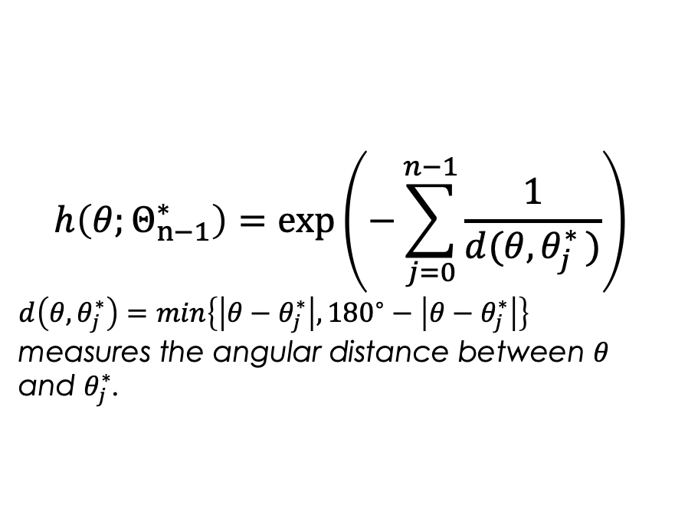
Cost Function $h\left(θ;Θ_{n−1}^{∗}\right)$
$$h\left(θ;Θ_{n−1}^{∗}\right)=\exp\left(−\sum_{j=0}^{n−1}{\frac{1}{d(θ,θ_{j}^{∗ })}}\right)$$
$d\left(θ,θ_{j}^{∗}\right)=\min\left\{\left|θ−θ_{j}^{∗}\right|,{180}^{∘}−\left|θ−θ_{j}^{∗}\right|\right\}$ measures the angular distance between $θ$ and $θ_{j}^{∗}$.
Normalized angle spacing cost function w.r.t. view angles.
Red mark shows the values of existing view angles.

Slide 20
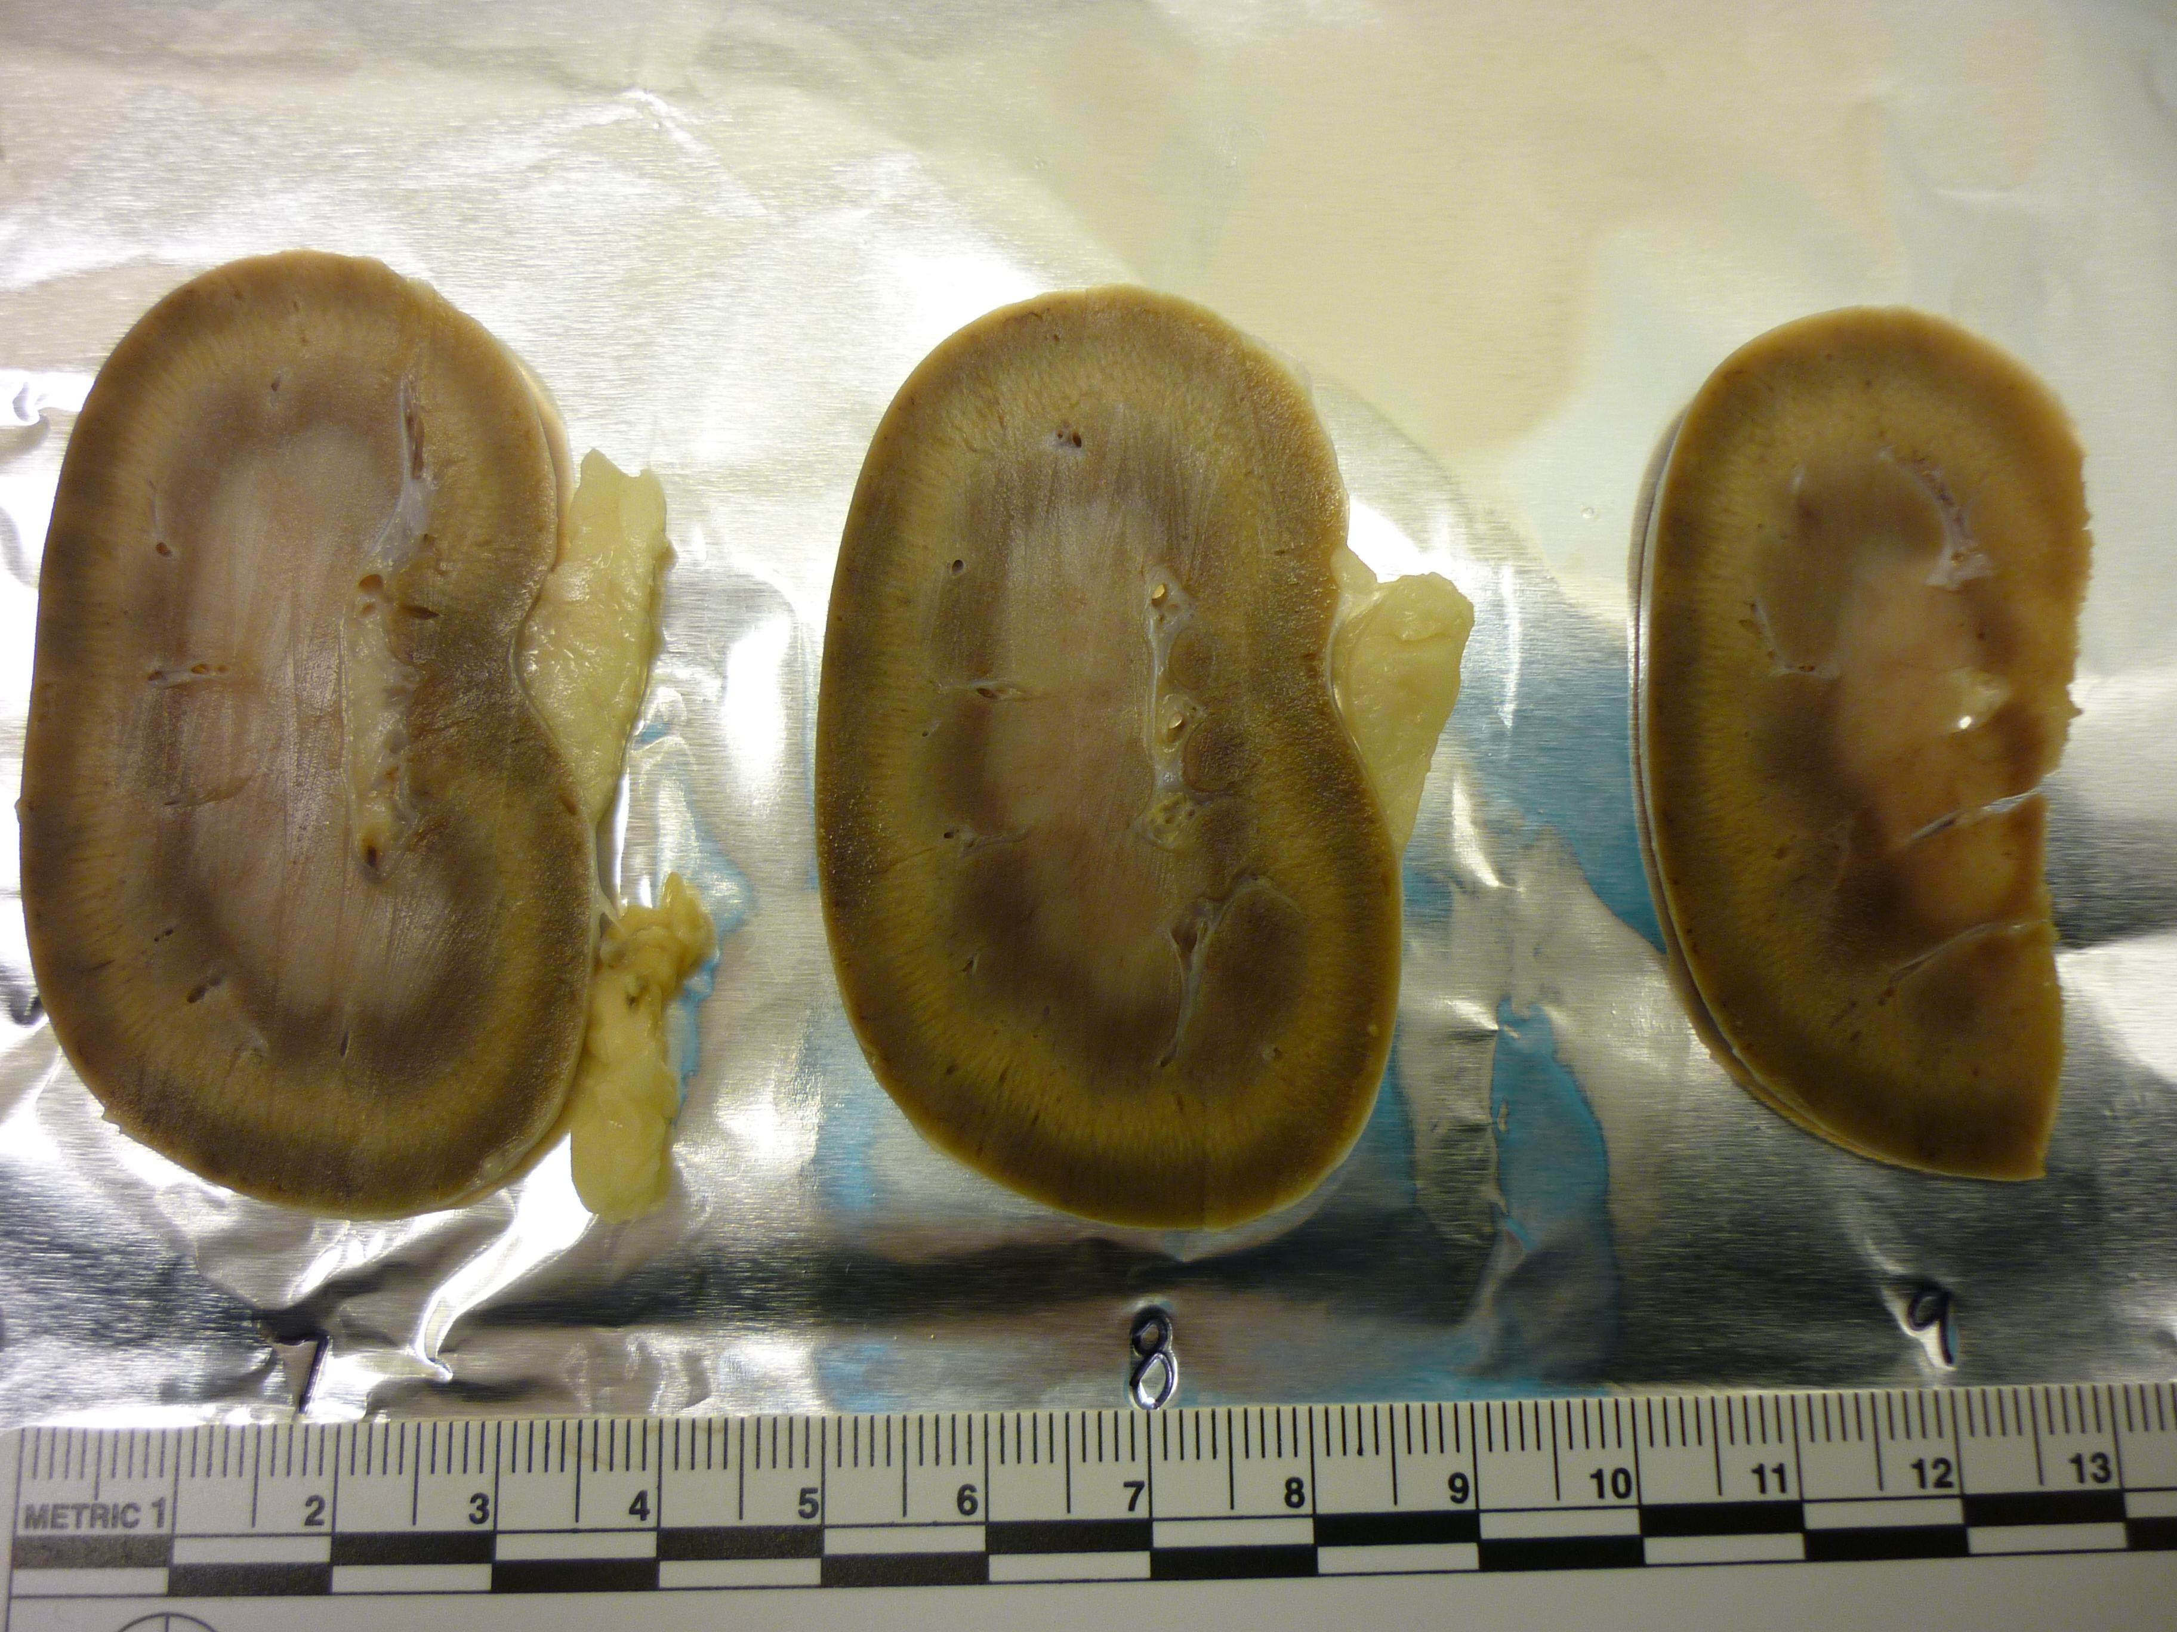
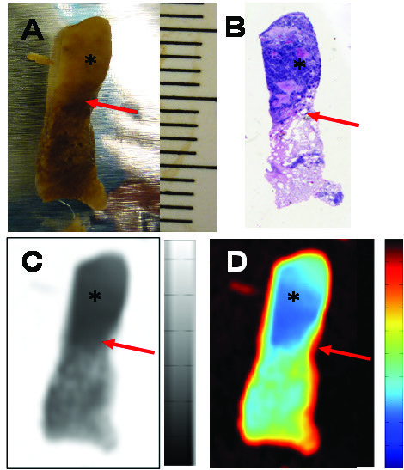
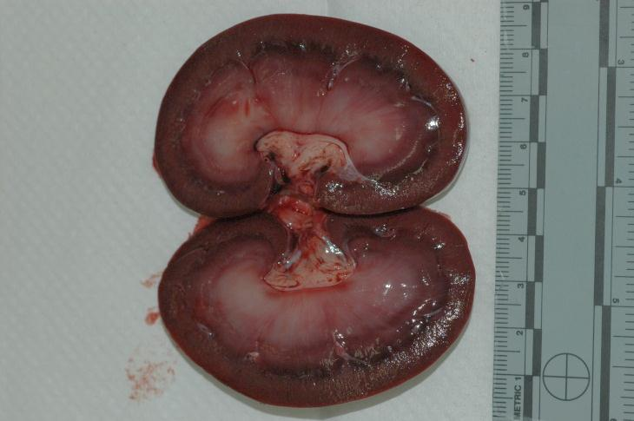
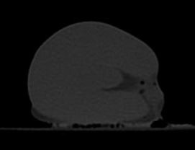
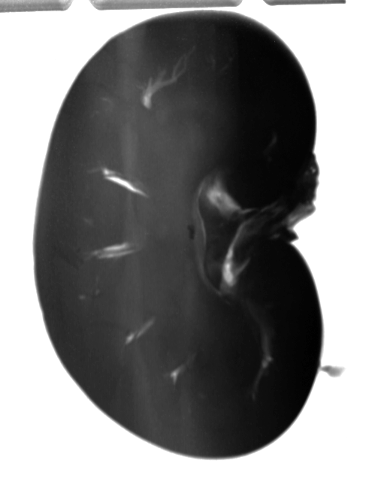
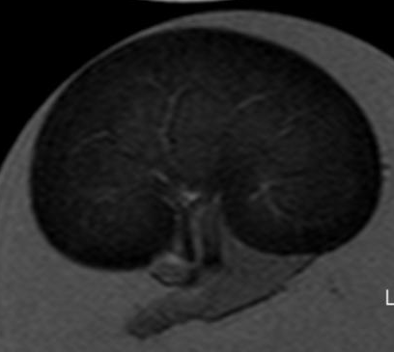
HFIR | MARS (CG-1D)
Medulla
Cortex
Capsule
A
B
Fat in the renal sinus
Renal Pelvis
X-CT
C
D
*Neutron radiograph of feline metastatic breast cancer in lungs. (A) Photograph, (B) H&E stained section, (C) neutron radiograp in grey scale, and (D) neutron radiograph in color scale of 2-mm thick feline metastatic breast cancer in lungs. Grey and color scale bars represent neutron transmission in scale 0-100% .
MRI
NR
NR
*M. Cekanova, R. Donnell, H. Bilheux and J. -C. Bilheux, "Neutron imaging: Detection of cancer using animal model," Proceedings of the 2014 Biomedical Sciences and Engineering Conference, Oak Ridge, TN, USA, 2014, pp. 1-4, doi: 10.1109/BSEC.2014.6867752.
Notes:
Hydrogen nuclei scatter cold neutrons stronger than any other atomic nuclei; therefore hydrogen is a primary contributor to neutron contrast in biological specimens.
The limitations of neutron imaging for biological samples have been overcome by the introduction of digital CCD cameras, increased spatial resolution (100μm) and increased neutron flux (1×107 neutrons/cm²/s).

Slide 21
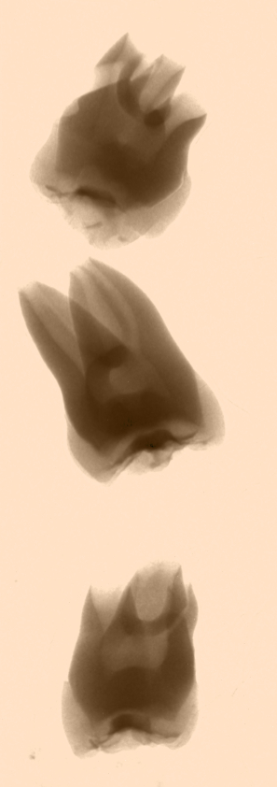
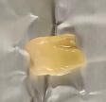
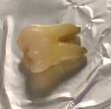
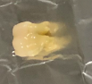

  Neutron Computed Tomography of Human Cadaver Teeth
First human teeth were measured at CG-1D (IPTS-23792) December 24-25, 2019. Neutrons may shed some light into the mineralization levels of tissues surrounding metal restoration. This research is done in collaboration with Dr. F.L. Esteban Florez at the Univ. of Oklahoma.
40 s radiograph of 3 extracted cadaver teeth (left) and respective photographs (right). The two bottom teeth have TiO₂ implants.
Anxiously waiting for SNS|VENUS →we can measure the residual strain on the bone due to the implant.

Slide 22
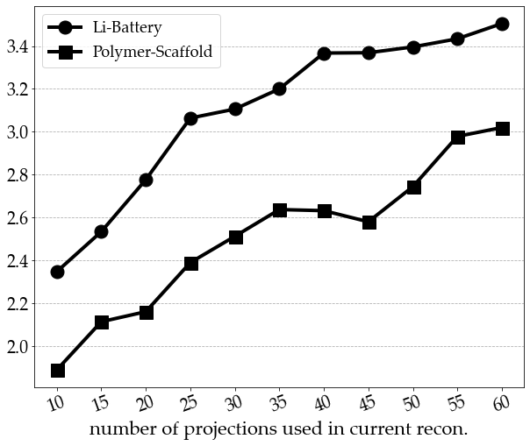
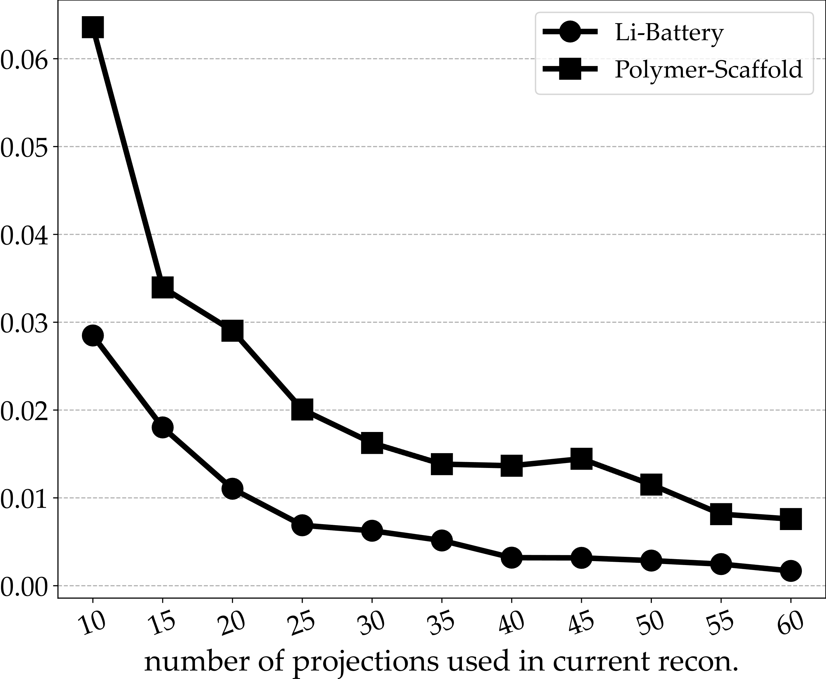
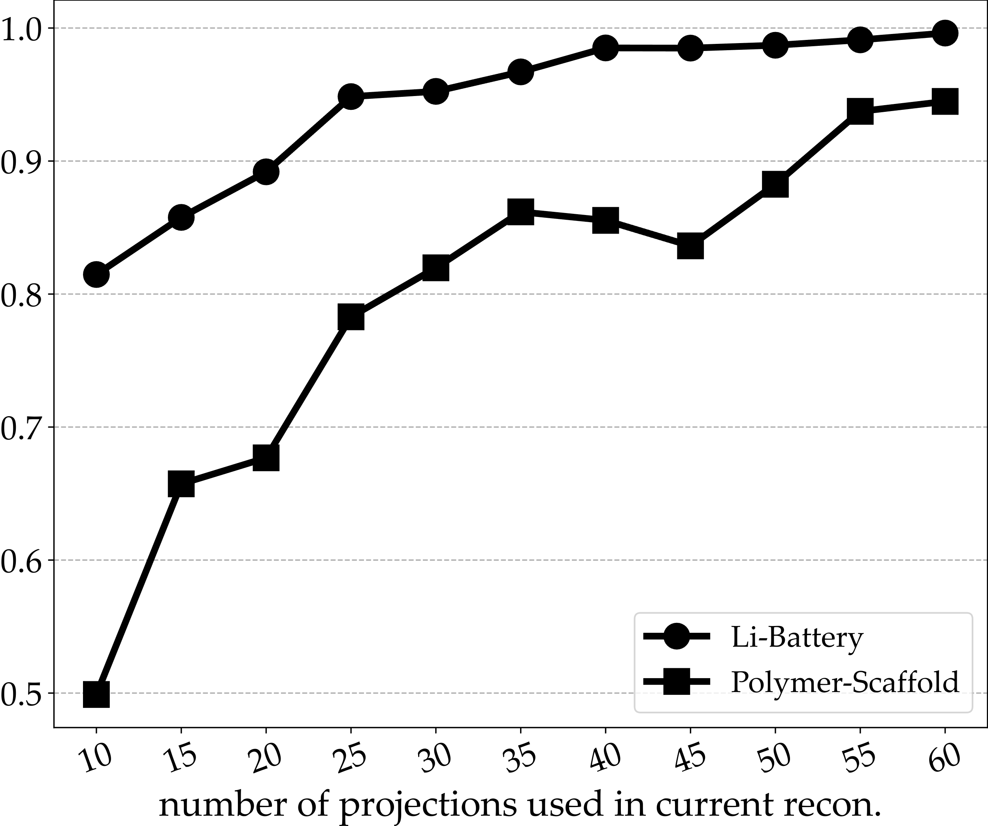
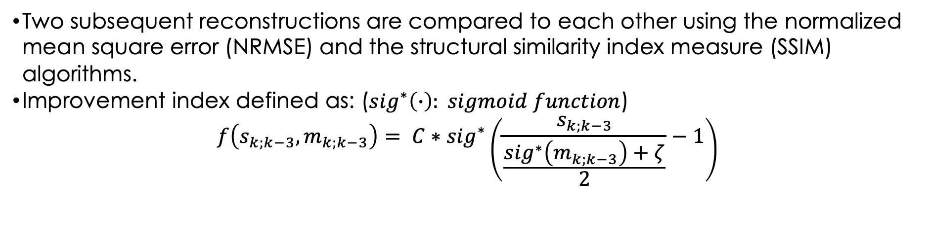
Subsequent reconstructions comparison
Two subsequent reconstructions are compared to each other using the normalized mean square error (NRMSE) and the structural similarity index measure (SSIM) algorithms.
Improvement index defined as: (${sig}^{∗}\left(∙\right): sigmoid function$)
$$f\left(s_{k;k−3}, m_{k;k−3}\right)= C∗{sig}^{∗}\left(\frac{s_{k;k−3}}{\frac{{sig}^{∗}\left(m_{k;k−3}\right)+ζ}{2}}−1\right)$$
Better quality
Higher scaled score
Better quality
SSIM
NRMSE
Notes:
extracts the point wise statistics of local normalized luminance signals and measures image naturalness (or lack there of) based on measured deviations from a natural image model

Slide 23
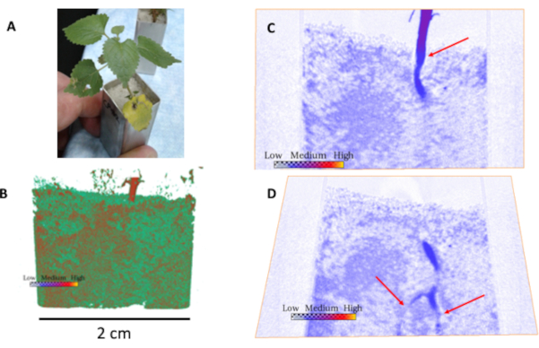
Rat femur with titanium implant. (A) Photograph of a representative rat femur. (B) 3D rendered volume of rat femur obtained from nCT. (C) Diagonal slice showing the titanium rod inside the femur. Red arrows show the trabecular bone. The scale bars are presented by the x and y axes, respectively.
Neutron computed tomography and slices through the plant root/soil system. (A) Photograph of plant sample. (B) 3D rendered volume from neutron computed tomography of the plant showing the stem above ground, and the soil system with water (in red). (C) and (D) are cuts through the sample angled to show the stem and roots in the soil (red arrows). Darker blue areas in the soil indicate the presence of water
Rat femur with titanium implant. (A) Photograph of a representative rat femur. (B) 3D rendered volume of rat femur obtained from nCT. (C) Diagonal slice showing the titanium rod inside the femur. Red arrows show the trabecular bone. The scale bars are presented by the x and y axes, respectively.

Slide 24
VENUS
VENUS is an imaging beamline that can measure unique materials properties based on their crystalline structures and isotopic content using two techniques:
    Bragg-edge imaging – quantitative interpretation of total cross-section provides crystalline structure characterization (cold neutrons ~ meV)
    Resonance imaging – isotopic-sensitive spatially-resolved spectroscopy technique (epithermal neutrons ~ eV)
VENUS can also penetrate thicker samples using:
    Epithermal imaging – higher energy neutrons provide higher penetration through thick samples (epithermal neutrons ~ eV)
We are developing hyperspectral reconstruction algorithms using machine learning algorithms (due to low signal-to-noise ratio)
An AI-based Autonomous Neutron Imaging System is under developing also.

