Slide 1
Deep Learning for Data Corrections in PET and SPECT
Chi Liu, PhD
Associate Professor
Radiology and Biomedical Engineering
Yale University

Slide 2
Outline
Attenuation correction
Scatter Correction
Motion correction
Partial volume correction
Impact of noise reduction on data correction
  PET motion correction
  Positron range correction for Rb-82 cardiac PET

Slide 3
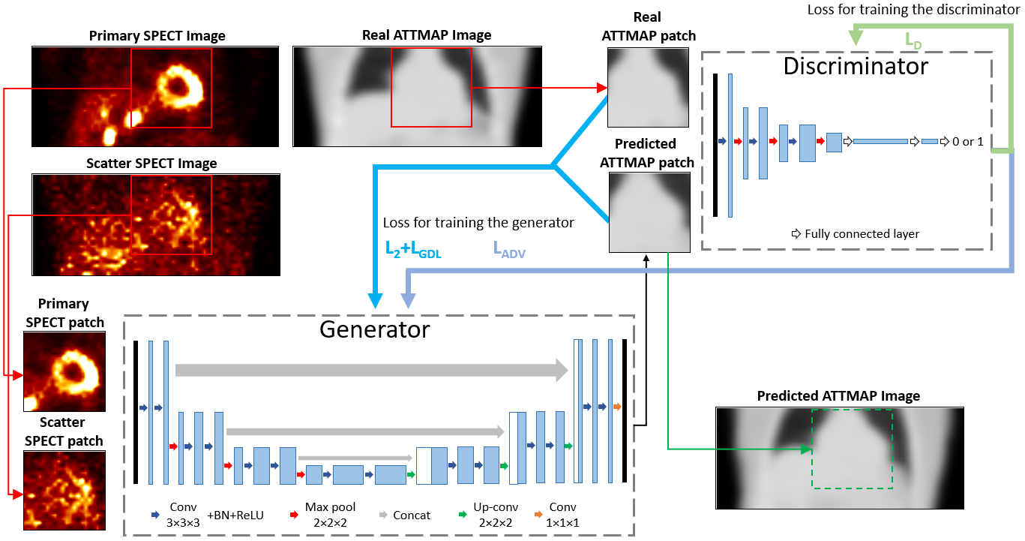
Using GAN for SPECT Attenuation Map Generation
L. Shi, et al. EJNMMI, Vol. 47 Issue 10, p2383-2395, 2020

Slide 4
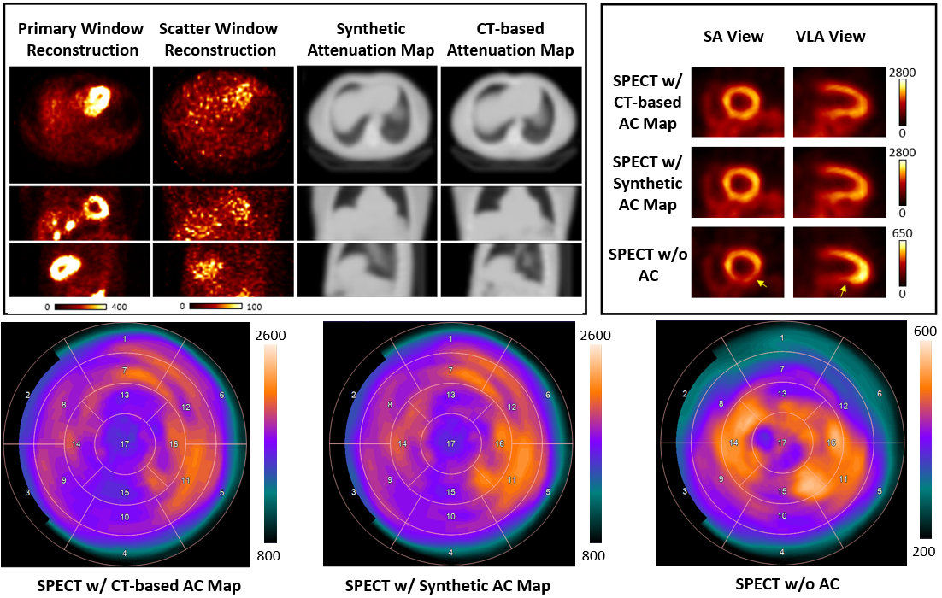
CT-less SPECT Attenuation Map Generation
L. Shi, et al. EJNMMI, Vol. 47 Issue 10, p2383-2395, 2020

Slide 5
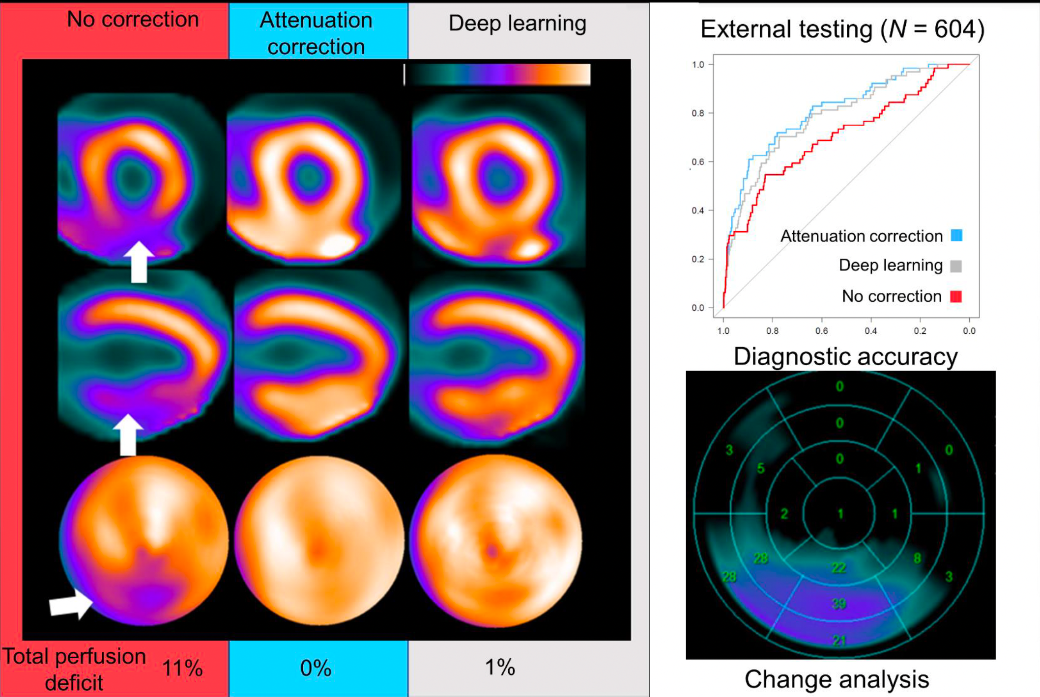
Improvement of Diagnostic Accuracy using Direct DL-AC
Shanbhag A, et al. Journal of Nuclear Medicine, 2022

Slide 6
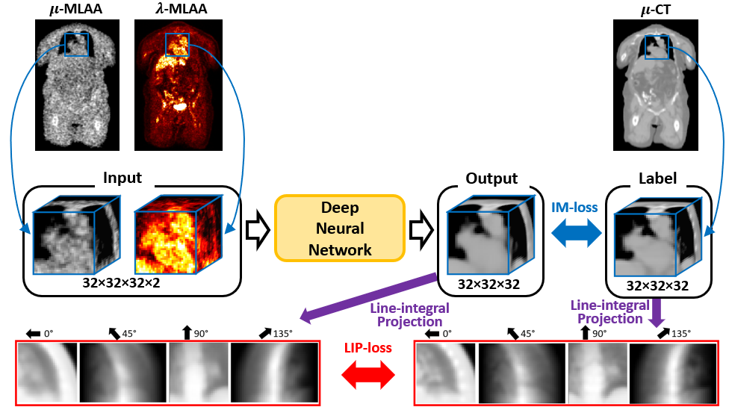
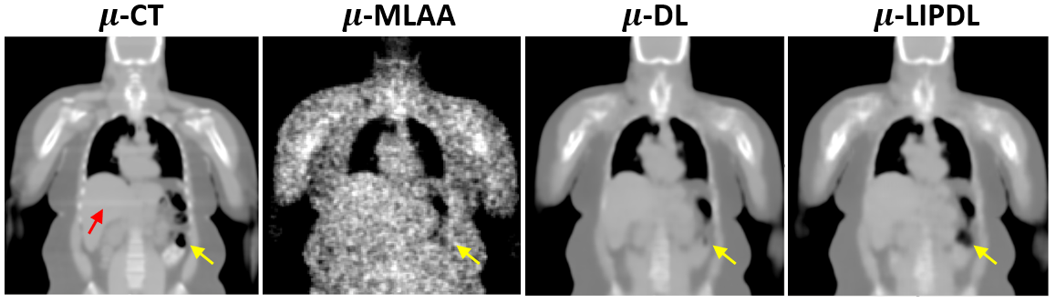
“Physics-Informed” Attenuation map generation from MLAA PET using Deep Learning
Luyao Shi, et al. A Novel Loss Function Incorporating Imaging Acquisition Physics for PET Attenuation Map Generation Using Deep Learning. MICCAI 2019

Slide 7
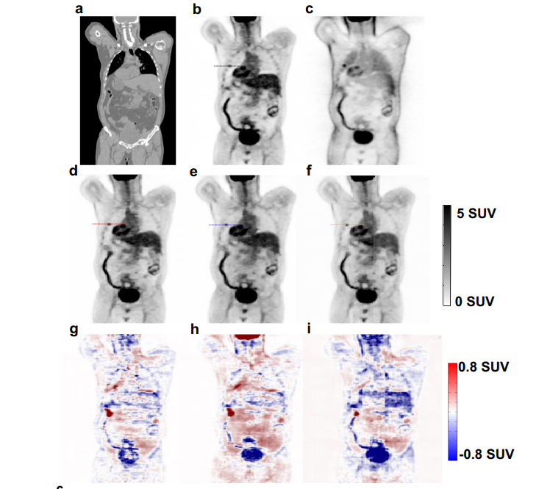
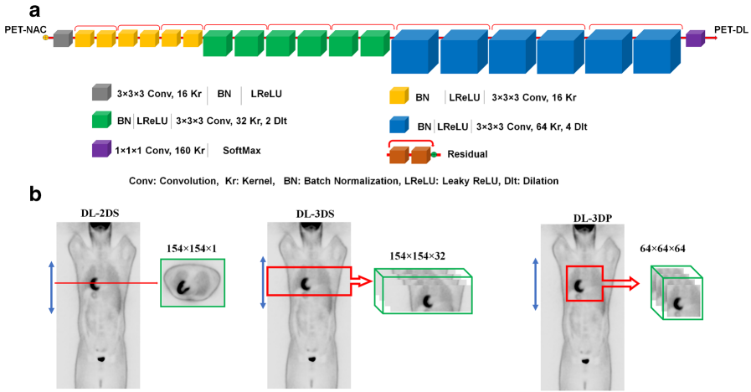
Direct Prediction of Attenuation&Scatter-Corrected PET from Uncorrected PET
From whole-body ¹⁸F-FDG PET_{NAC} to PETCT-ASC (joint attenuation and scatter correction) using ResNet
CT
CTAC
NAC
Deep Learning
(A) Architecture of the deep residual network (Deep-JASC). (B) The training of the network was repeated three times. 2D successive slices (DL-2DS), 3D slices (DL-3DS) and 3D patches (DL-3DP).
Shiri, Isaac, et al. "Deep-JASC: joint attenuation and scatter correction in whole-body 18F-FDG PET using a deep residual network." European journal of nuclear medicine and molecular imaging 47.11 (2020): 2533-2548.

Slide 8
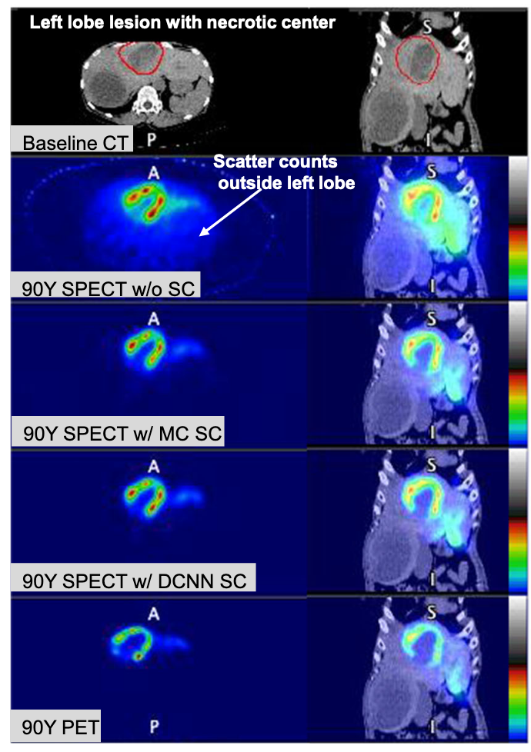
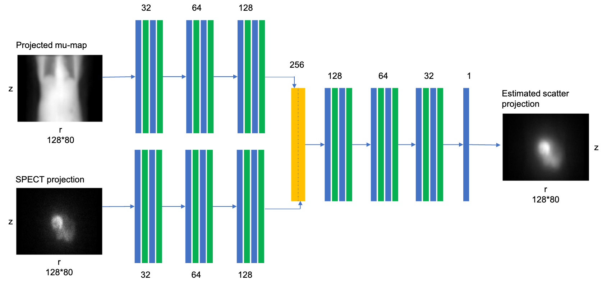
Deep Learning Scatter Estimation for Y-90 SPECT
~40 min
~40 s
Xiang H, et al. EJNMMI2020; 47(13):2956–67.

Slide 9
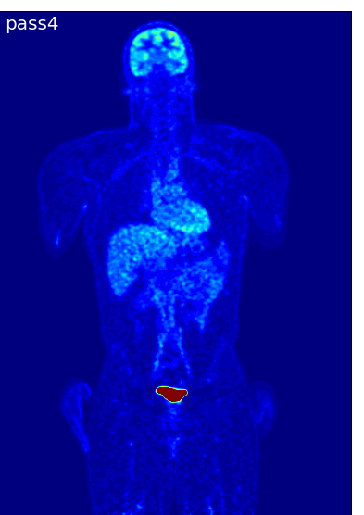
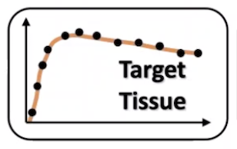
Problem: Body motion in dynamic PET hinders accurate parametric image estimation

Slide 10
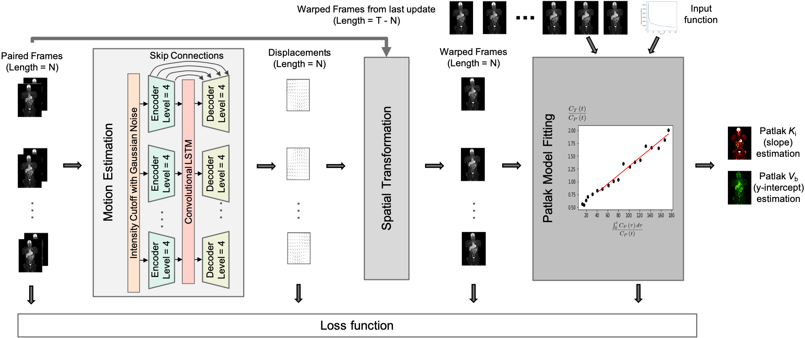
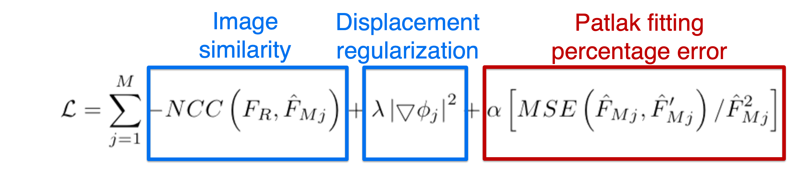
“Biology-Informed” Network: Jointly optimize kinetic parameter estimation and motion estimation
Loss function
Xueqi Guo, et al.
MICCAI 2022

Slide 11
Results showed improved frame alignment and further decrease in parametric model fitting error
Overlaid K_{i}/V_{b}
Voxel-wise error map
Overlaid K_{i}/V_{b}
Voxel-wise error map
Xueqi Guo, et al.
MICCAI 2022

Slide 12
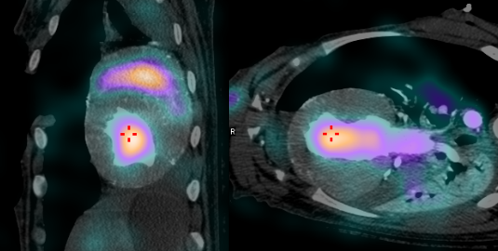
Partial Volume Effect of ^{99m}Tc-RBC
Microvasculature – Intramyocardial blood volume
  Microcirculation damage precedes contraction/deformation change (EF drop)
  Anti-angiogenesis drugs result in microvascular injury
  Increasing anti-angiogenesis drugs
The fraction of myocardium volume that is occupied by blood
SPECT imaging of ^{99m}Tc-labeled red blood cell (RBC)
  IMBV = C_{Myocardium}/C_{Blood Pool}
Challenges: High blood pool activity
  Motion
  Partial Volume Effect

Slide 13

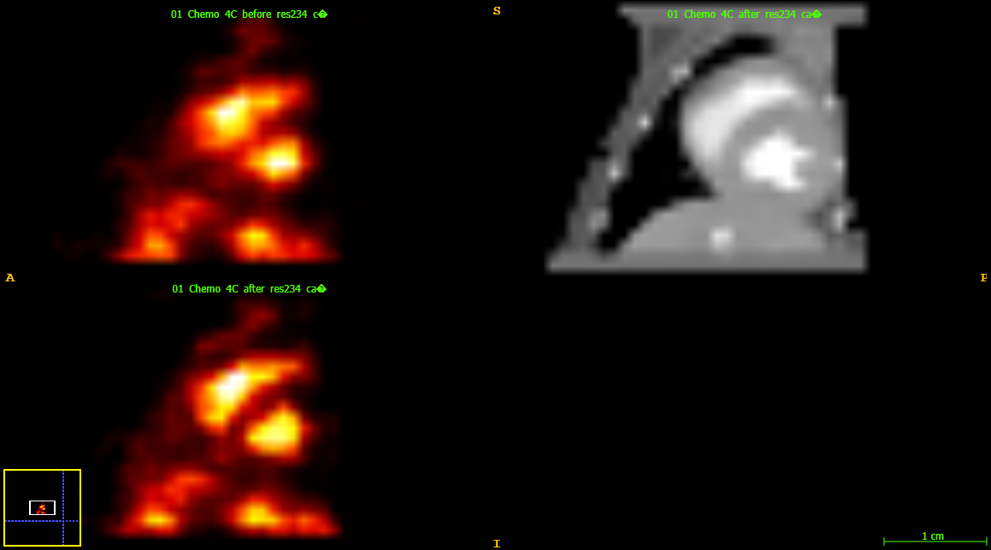

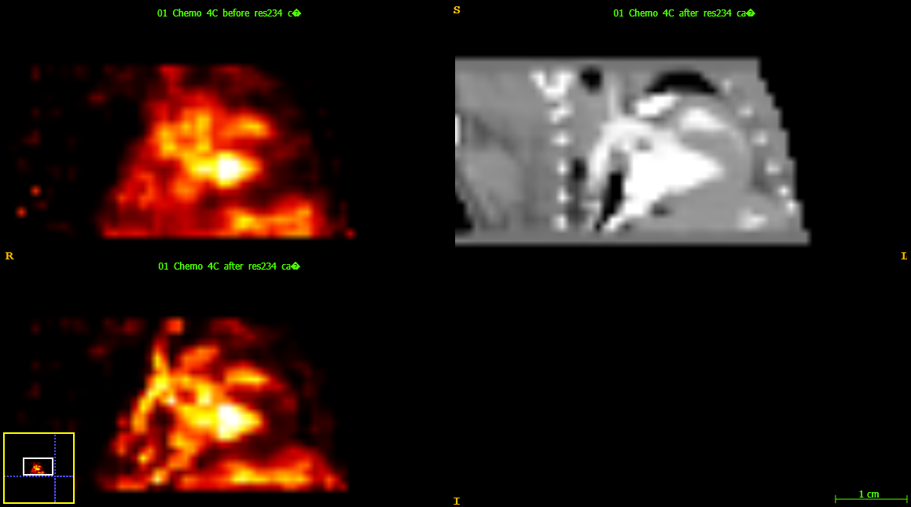
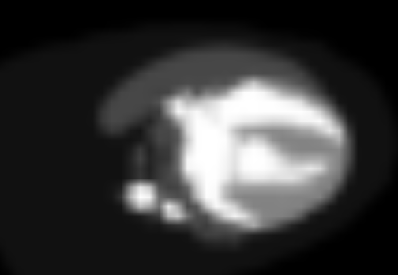
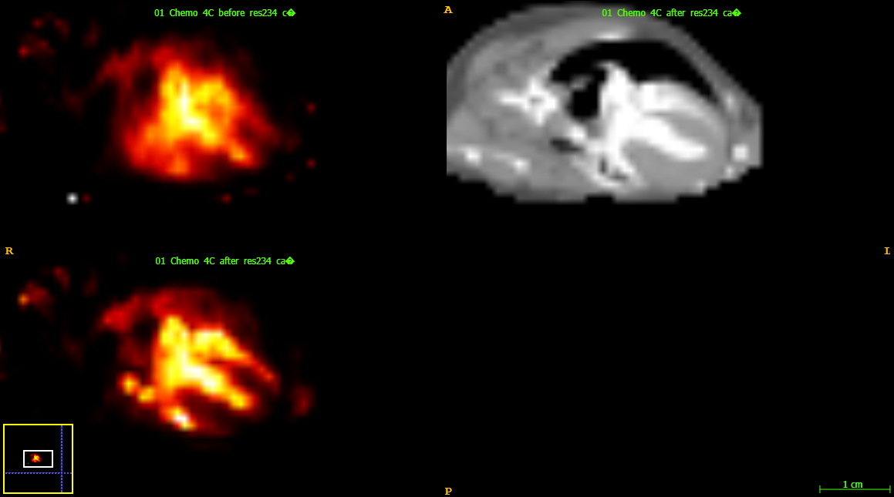


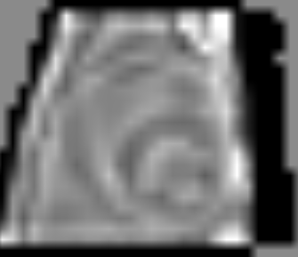
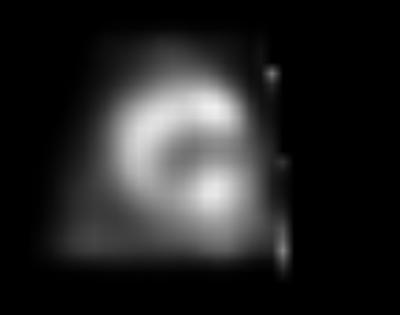

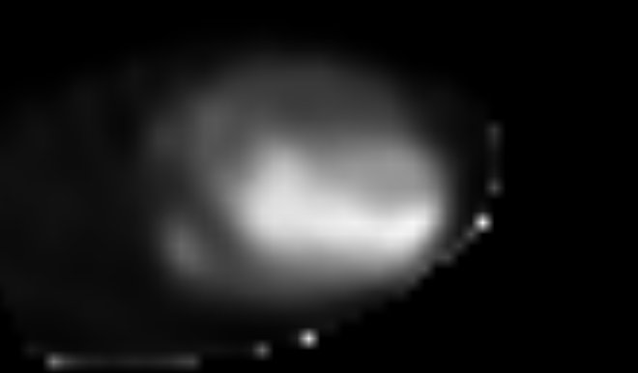
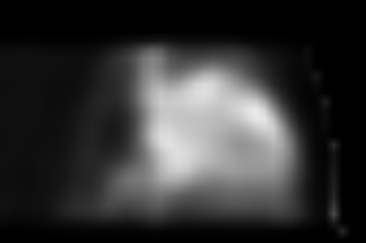
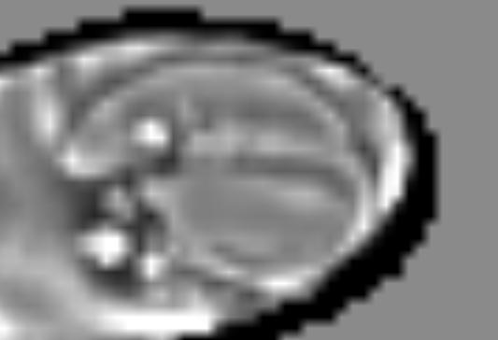

^{99m}Tc-labeled red blood cell
Iterative-Yang’s (iY) Method
Registration &
Segmentation
Multiply means in each organ
…
Contrast CT
SPECT
segmented templates
Forward project and recon
SPECT template
Apply to SPECT & Iterate
$$\frac{SPECT template}{Recon template}$$
Correction factor
Recon template
H. Xie et al., “Segmentation-free PVC for Cardiac SPECT using a Densely-connected Multi-dimensional Dynamic Network,” IEEE Trans Med Imaging., 2022.

Slide 14
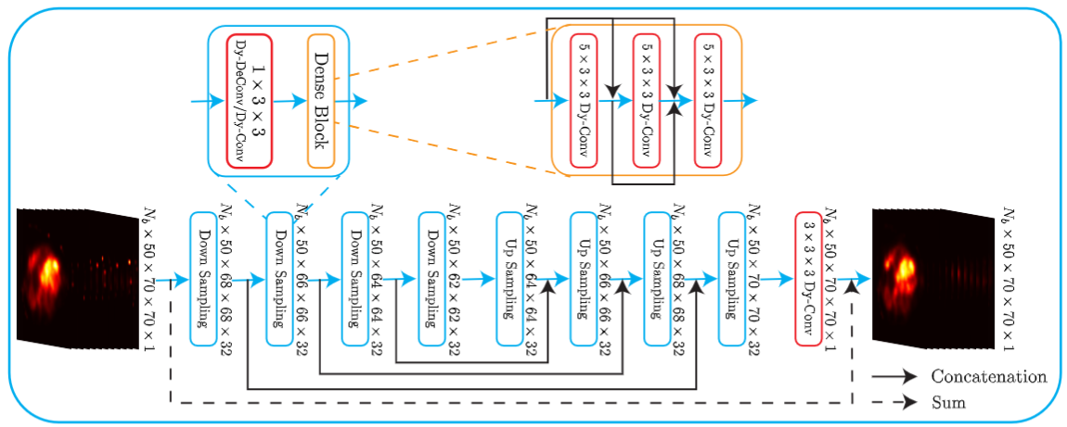
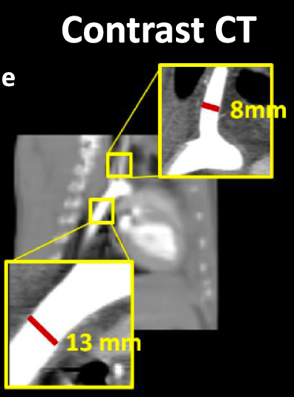
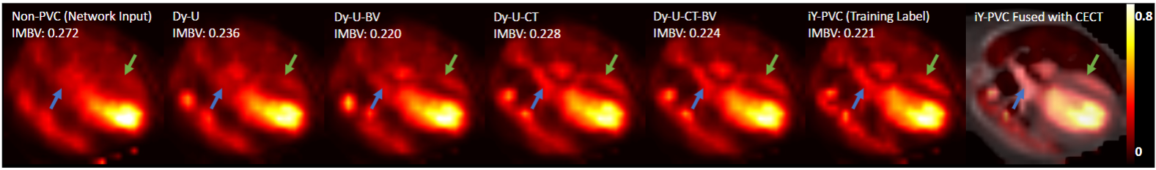
Direct PVC using dynamic convolutional network
Xie H, et al. IEEE Tran Med Imaging, 2022
w/ CTA
Ground truth
w/o CTA

Slide 15
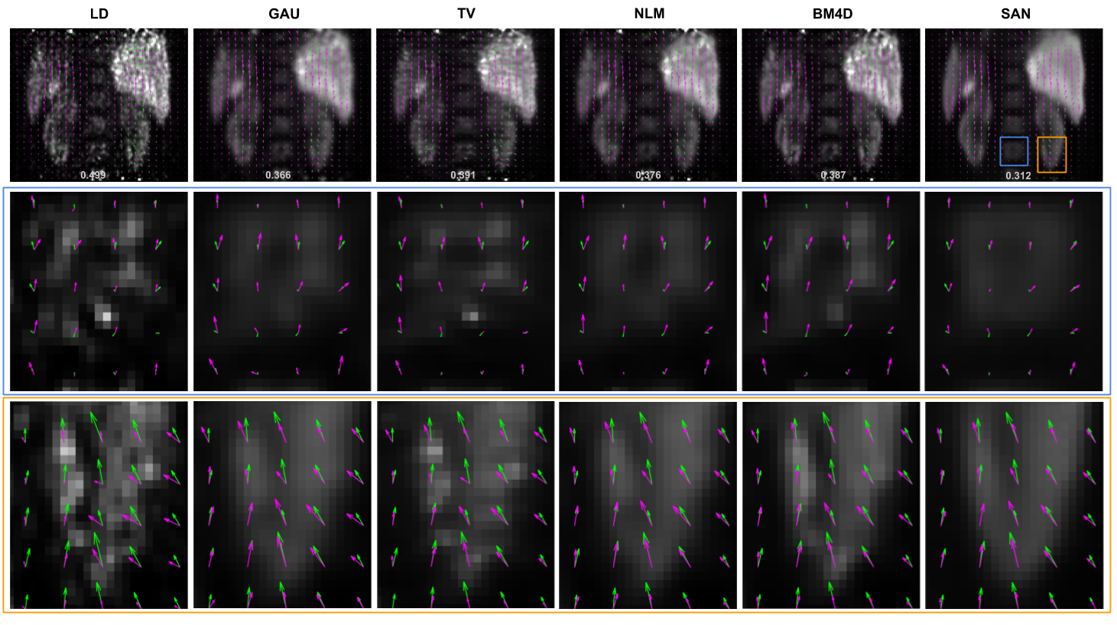
Motion Estimation from Low-Count PET
Zhou B, et al. MICCAI 2020, IEEE TMI 2021
Notes:
Change arrow color

Slide 16
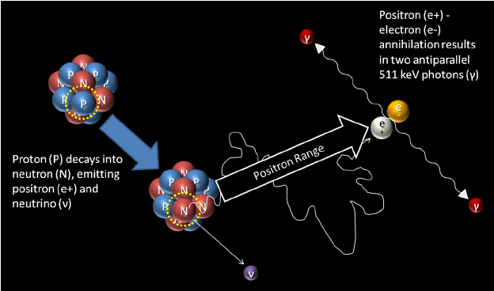
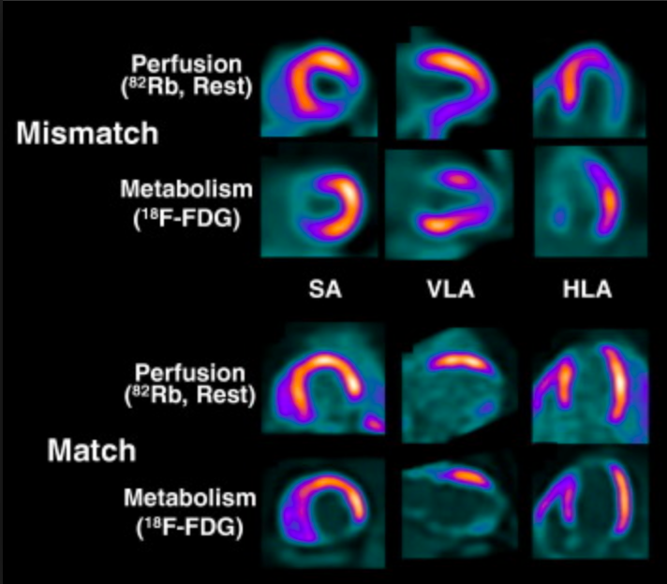
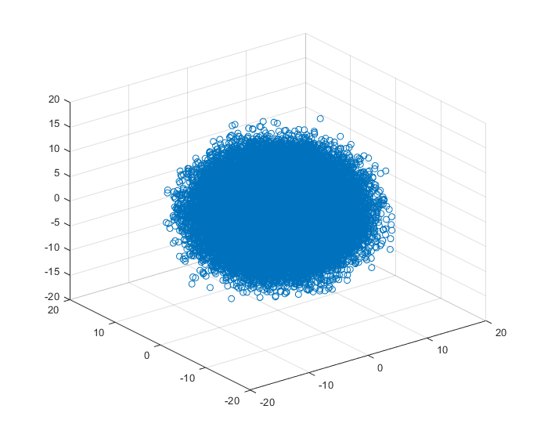
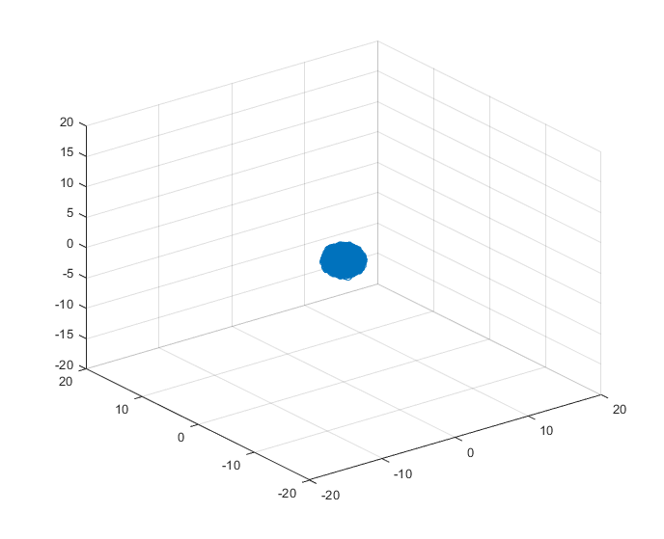
Positron Range
Rb-82 (~2.6 mm)
F-18 (~0.7 mm)

Slide 17
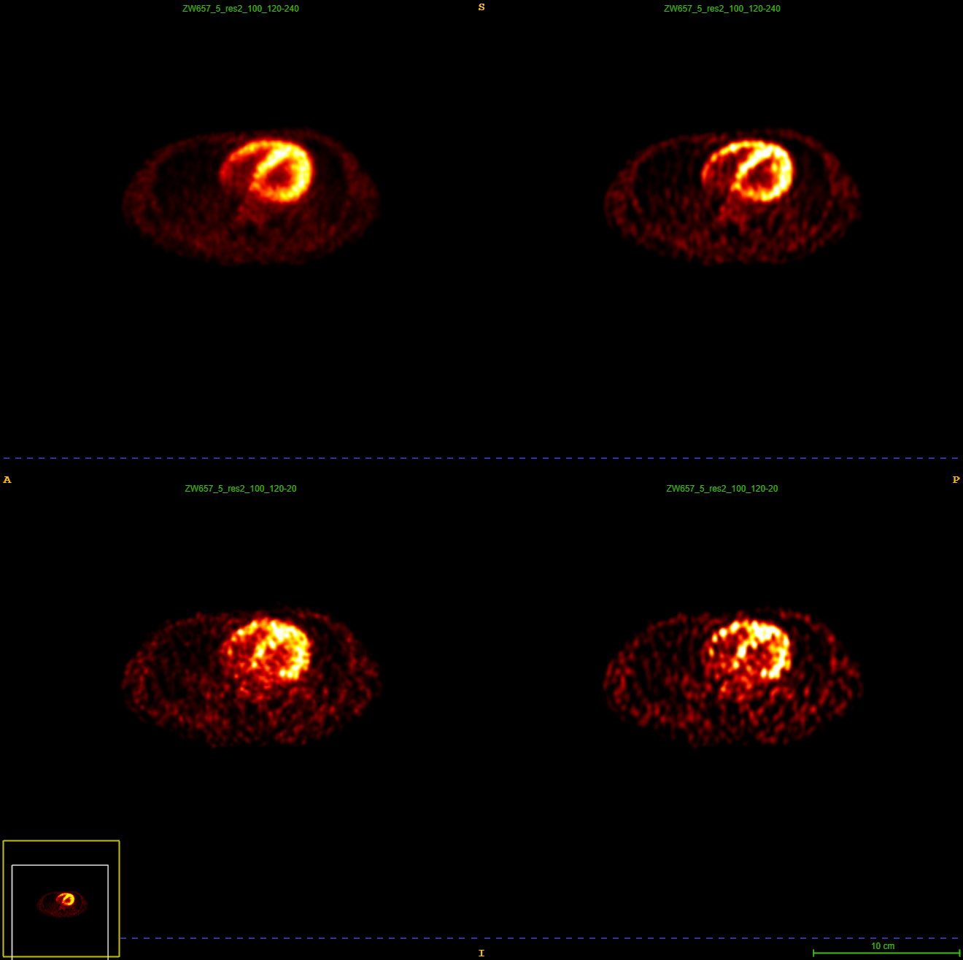
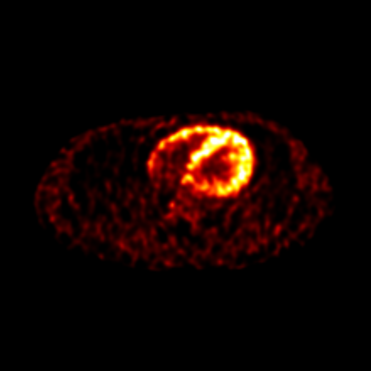
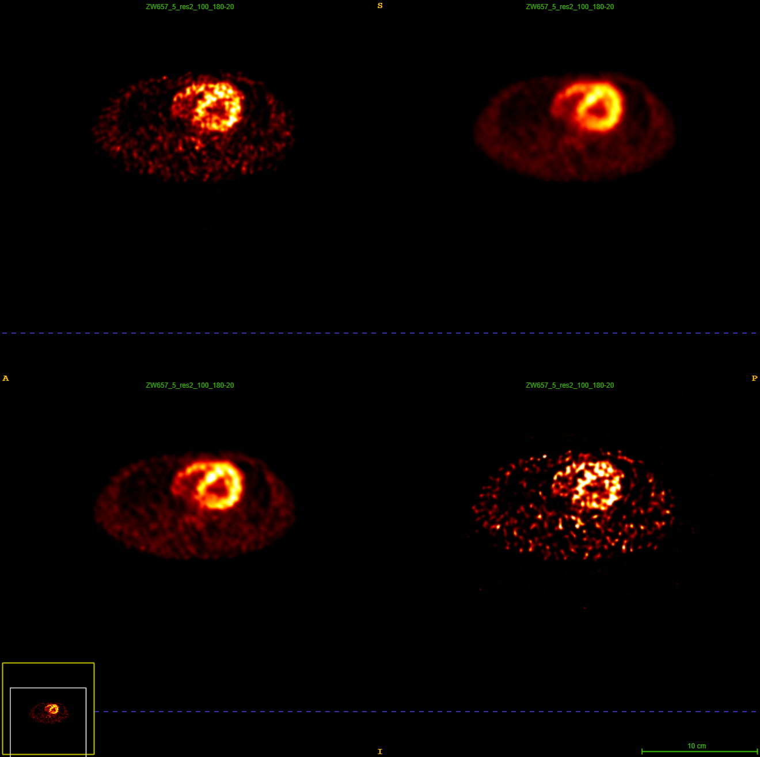
Rb-82 Cardiac PET
2-min static frame
Richardson-lucy
Network for Positron Range Correction
20-s dynamic frame
Richardson-lucy
Network for Positron Range Correction
Network combining Positron Range Correction and denoising
Xie H. et al. SNMMI 2023

Slide 18
Summary
Attenuation correction
  Examples in cardiac SPECT – address the needs of SPECT-only scanners without CT
  Examples in PET: CT-less correction for dose reduction
Scatter correction
  Speed up
Motion correction
  Example of biology-informed AI models taking tracer kinetics into account for wholebody dynamic PET
Partial volume correction
  Example of cardiac SPECT/CT: using AI to address the unavailability of CT and contrast-CT angiography
Impact of noise reduction on data correction
  Example of noise reduction to facilitate motion vector estimation for PET motion correction
  Example of noise reduction to facilitate positron range correction for Rb-82 cardiac PET

Slide 19
Acknowledgement
R01EB025468 R01CA224140
R01HL154345 R01HL123949
Thank You!

