Slide 1

Image Reconstruction and Processing for Alpha Emitters
Yong Du. Ph.D.
Department of Radiology, Johns Hopkins University

Slide 2
Conflict of Interest Disclosure
Under a licensing agreement between the Radiopharmaceutical Imaging and Dosimetry, LLC and the Johns Hopkins University, Yong Du is entitled to a share of royalty received by the University on sales of iterative reconstruction software used to obtain some results in this presentation.
This interest has been disclosed and is being managed by the Johns Hopkins University in accordance with its conflict-of-interest policies.

Slide 3
Radiopharmaceutical Therapy (RPT)
Radiopharmaceutical therapy (RPT)
  Beta: ¹³¹I, ¹⁷⁷Lu-DOTATATE, ¹⁷⁷Lu-PSMA, ⁹⁰Y …
    10³ to 10⁴ tracks to kill cell
    DNA damage is repaired
  Alpha: ²²⁵Ac-PSMA, ²²³Ra-Xafigo, …
    2 to 3 tracks kill cell
    Irreparable DNA damage
Optimal use of RPT requires patient-specific dosimetry
Sgouros, G., et al. Nat Rev Drug Discov 19, 589–608 (2020).

Slide 4


Dosimetry for RPT
$$D\left(r_{T}\right)=\sum_{r_{S}}{\tilde{A}\left(r_{S}\right)∙S\left(r_{T}←r_{S}\right)}$$
Activity A(t) (MBq)
$\tilde{A}$ = $\int{A(t)ⅆt}$
Time integrated activity (TIA)
Time t (hours to days)

Slide 5

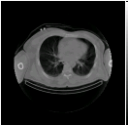
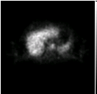

Quantitative SPECT Activity Estimation
SPECT
CT
0 hr
Measurement
Estimate
Sum
Activity in
VOI
4 hr
SPECT
Proj.
SPECT Reconstruction & Convert to Activity
24 hr
Total
Liver
Activity
72 hr
CT
144 hr

Slide 6
SPECT TIA Estimation
SPECT
Proj.
CT
0 hr
SPECT
Activity
Estimation
4 hr
24 hr
Curve Fitting
72 hr
Time-integrated Activity
144 hr

Slide 7
Challenges with SPECT Imaging of Alpha-Emitter
Complicated decay schemes with multiple daughters
Daughter with long half live could have different distribution
Multiple gamma and x-ray emissions with low abundances
Presence of high energy photons
Small administered activities

Slide 8
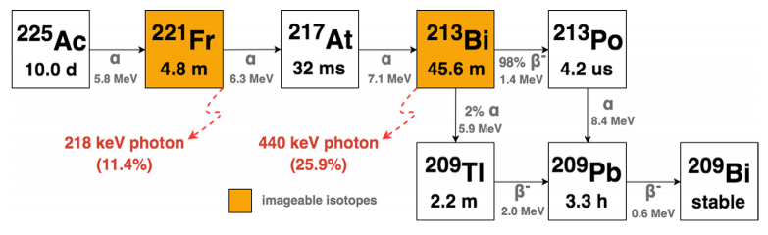
Alpha Emitter Example: Ac-225
Measured spectrum of ²²⁵Ac point source in air (blue line) and ²²⁵Ac activity uniformly distributed inside a 6 cm diameter sphere in a 22 cm diameter water cylinder (yellow line). The important photopeaks and their abundance are marked with dotted line.

Slide 9
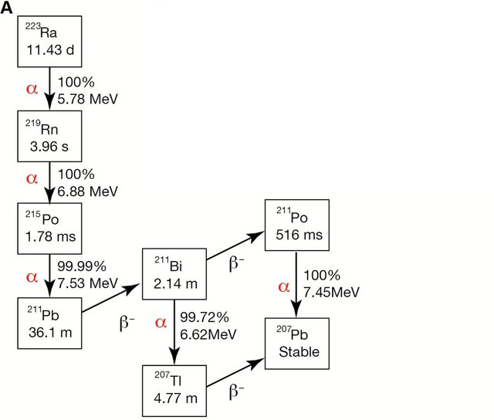
Ra-223

Slide 10
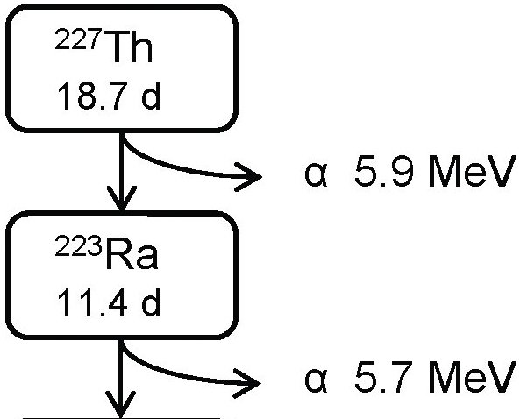
Th-227
Imageable Photons
E ≥ 50 keV
Abundance ≥ 10%
Energy (keV) | Abundance (%) | RN
81.4 | 15.7 | Ra-223
84.1 | 25.9 | Ra-223
236.0 | 12.9 | Th-227
269.5 | 13.9 | Ra-223
271.2 | 10.8 | Rn-219
351.1 | 12.9 | Bi-211

Slide 11
Solutions for Imaging Alpha Emitters
Optimize imaging protocol
Developed advanced reconstruction algorithms
  Compensation for imaging physics
  Multiple radionuclide reconstruction
Developed next generation SPECT cameras
  Semiconduction detector → energy resolution
  New collimator → sensitivity and spatial resolution

Slide 12
Model-Based Reconstruction with Crosstalk Compensation
Ra-223 Projection image
Ra win
Ra-223 Activity Distribution
Ra-223 Crosstalk Estimate in Th win
Final
Ra-223
Image
Recon I
(A,D,S)*
Ra win
Project
(A,D,S)
Th win
Recon II
(A,D,S,Crosstalk)*
Ra win
Recon III
(A,D,S,Crosstalk)
Ra win
No
Converge?
Yes
Recon II
(A,D,S,Crosstalk)*
Th win
Recon III
(A,D,S,Crosstalk)
Th win
Th-227 Projection image
Th win
Th-227 Activity Distribution
Project
(A,D,S)
Ra win
Th-227 Crosstalk Estimate in Ra win
Final
Th-227
Image
Recon I
(A,D,S)*
Th win
*A: Attenuation, D: Collimator-Detector response, S: Scatter

Slide 13
Simultaneous Reconstruction
154 keV energy window projections
²²⁷Th images
236 keV energy window projections
Simultaneous multiple energy window multiple radionuclide OS-EM
²²³Ra images
269 keV energy window projections

Slide 14
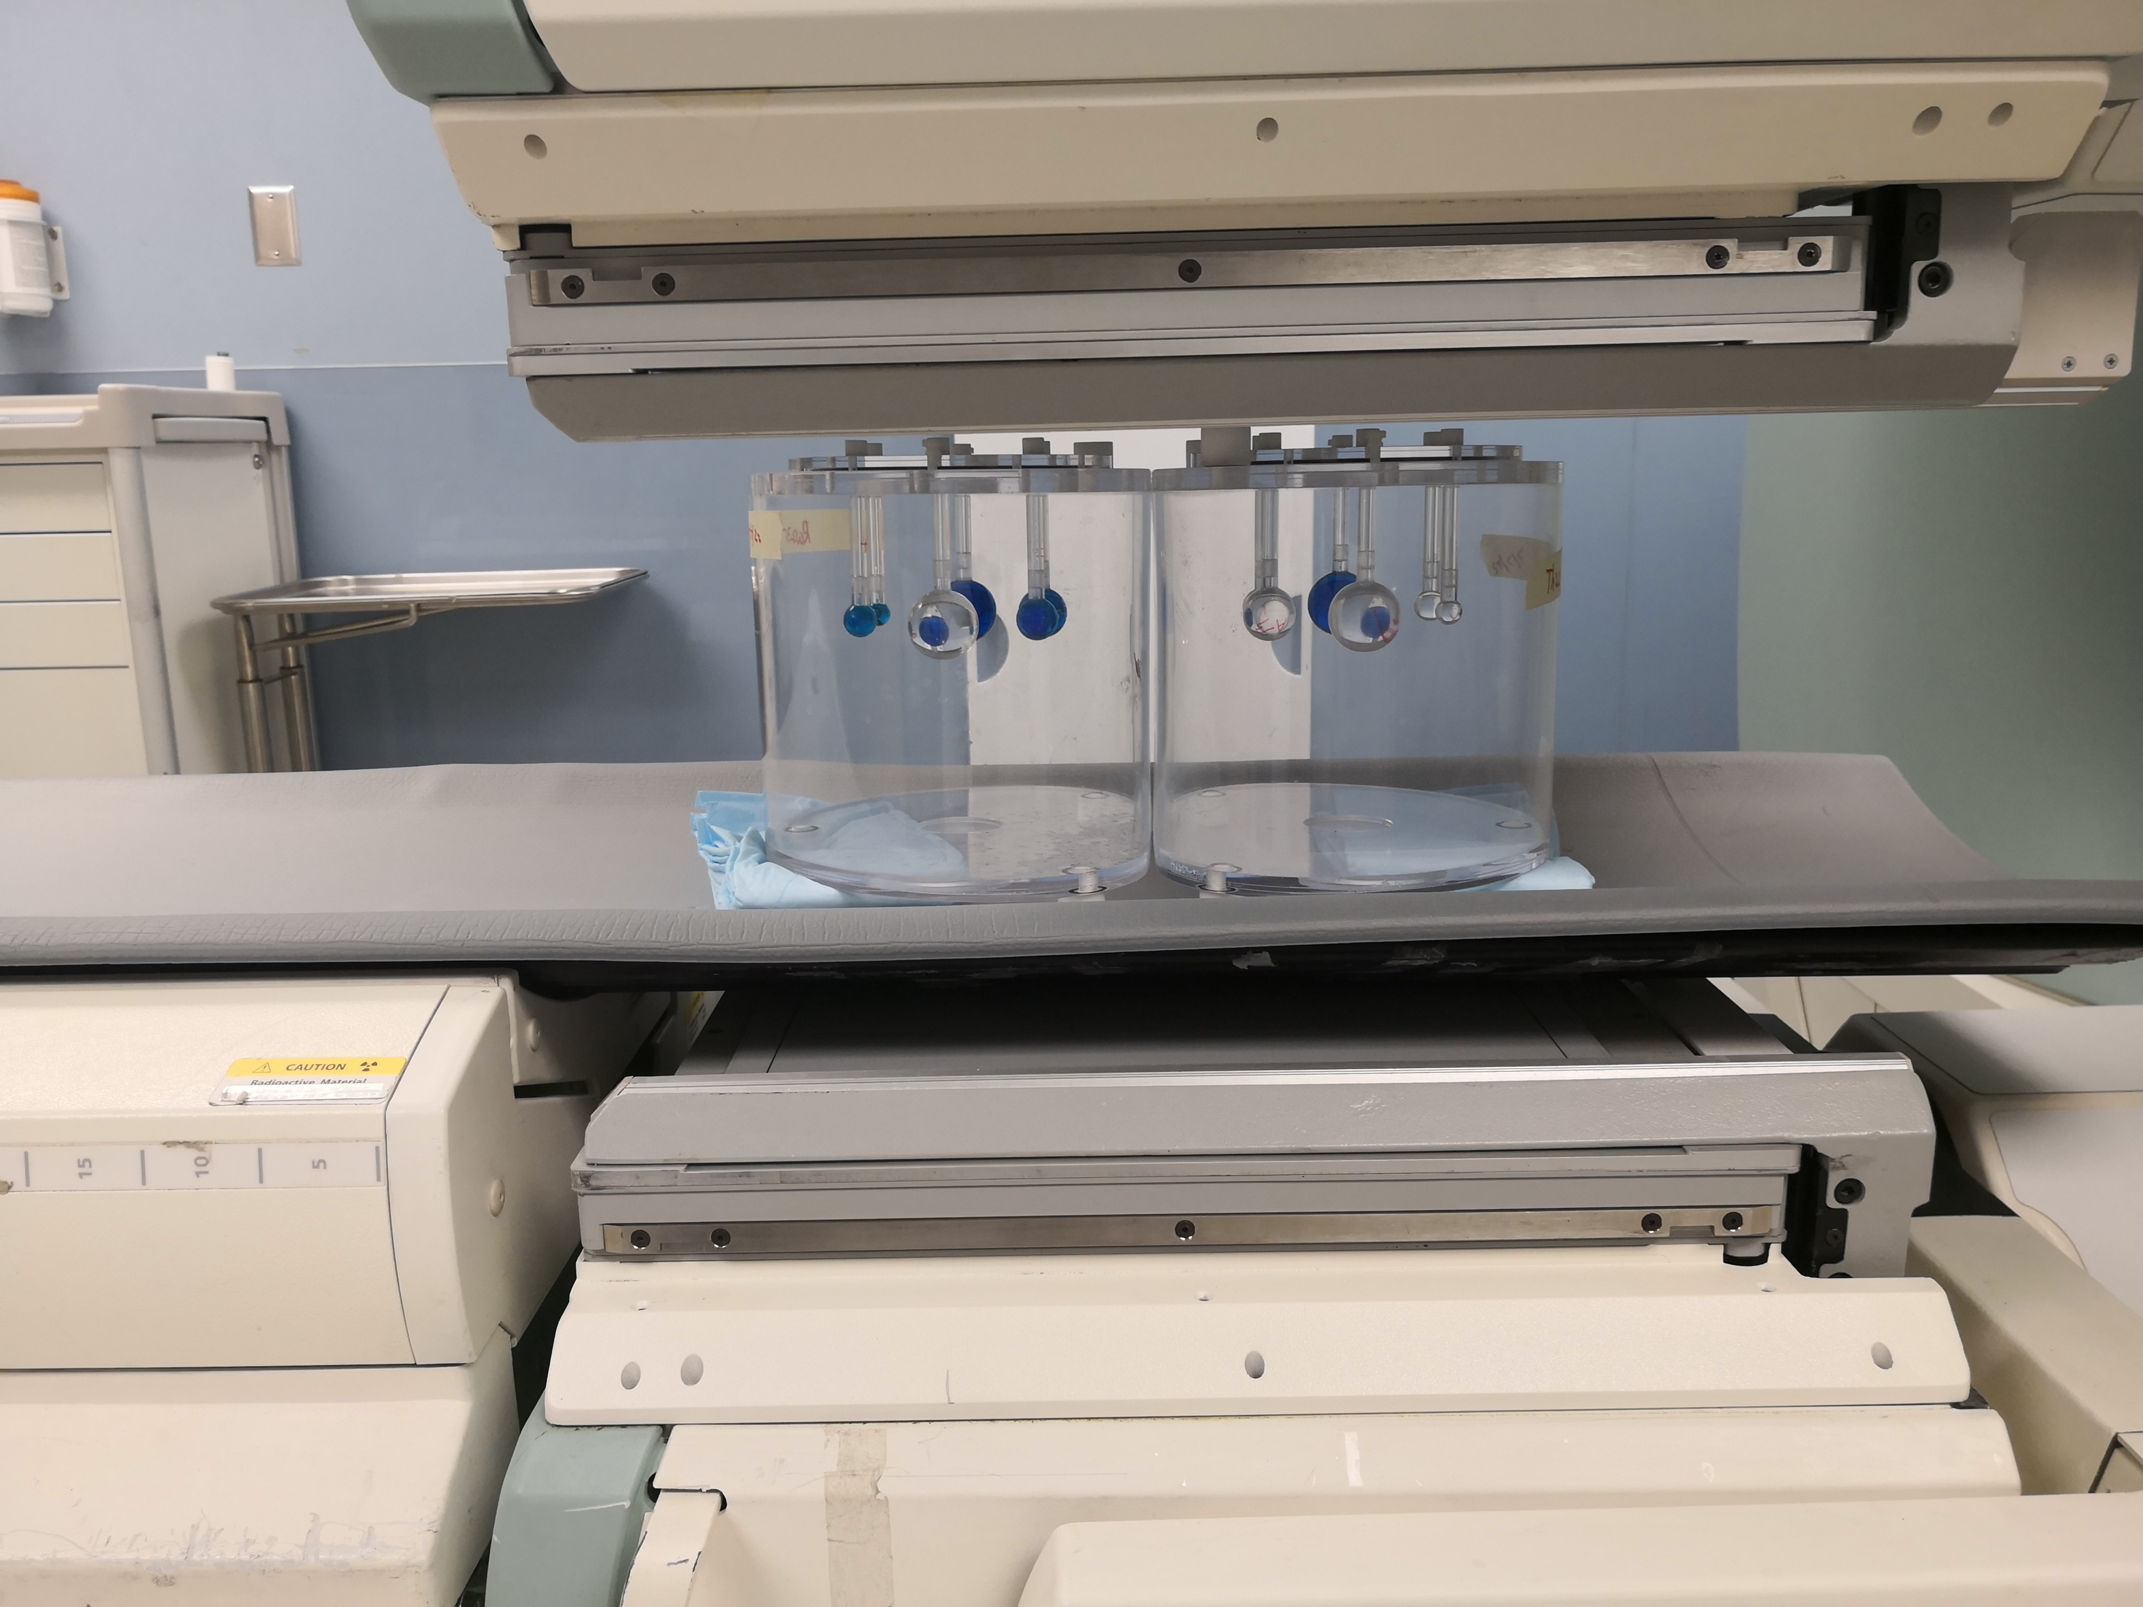
Th-227/Ra-223 Phantom Study
Blue spheres contain ²²³Ra.
Clear spheres contain ²²⁷Th.
Background filled with water
Siemens Symbia SPECT/CT system, ME collimator
In collaboration with Bayer

Slide 15


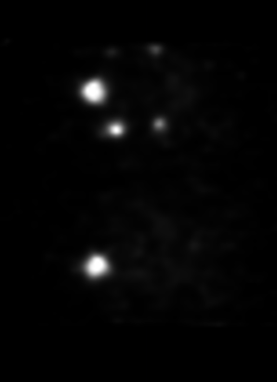
Day 1
reference
²²⁷Th images
²²³Ra images
²²⁷Th
²²⁷Th
²²⁷Th
²²³Ra
²²⁷Th
²²⁷Th
²²³Ra
²²³Ra
²²⁷Th
²²³Ra
²²³Ra
²²³Ra
ME collimator, 10 seconds acquisition, 2 iterations 12 subsets, no post recon filtering

Slide 16
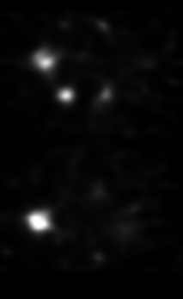

Day 14
reference
²²⁷Th images
²²³Ra images
²²⁷Th
²²⁷Th
²²⁷Th
²²³Ra
²²⁷Th
²²⁷Th
²²³Ra
²²³Ra
²²⁷Th
²²³Ra
²²³Ra
²²³Ra
ME collimator, 10 seconds acquisition, 2 iterations 12 subsets, no post recon filtering

Slide 17
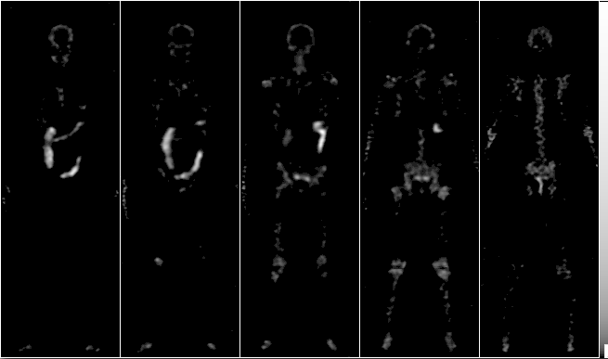
Ra-223 Reconstructed Images
5 coronal slices, 144 h, 5 iterations, 12 subsets per iteration, logarithmic grayscale
Simulation study using XCAT phantom and SIMIND Monte Carlo simulation program

Slide 18
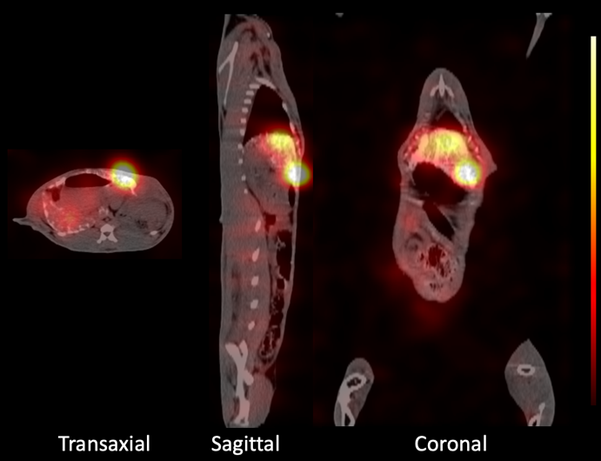
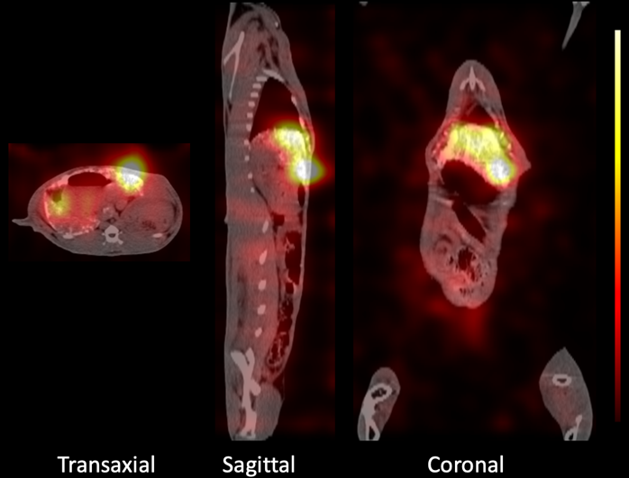
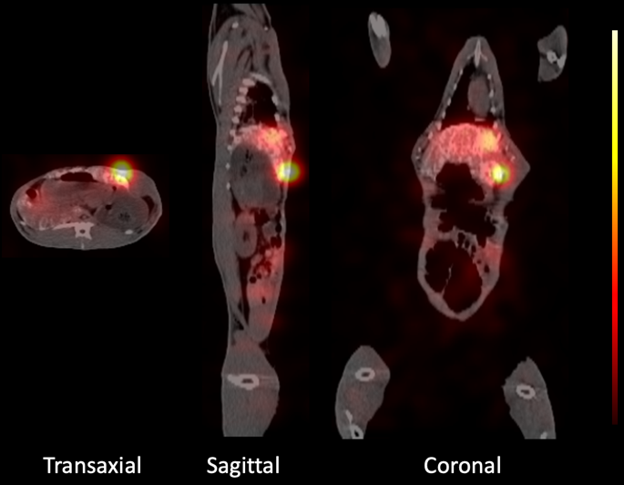
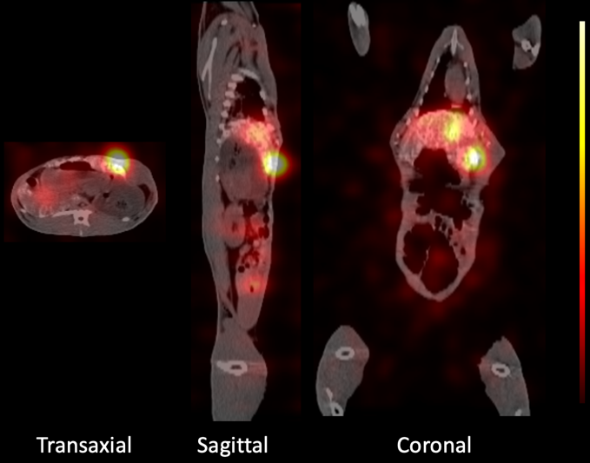
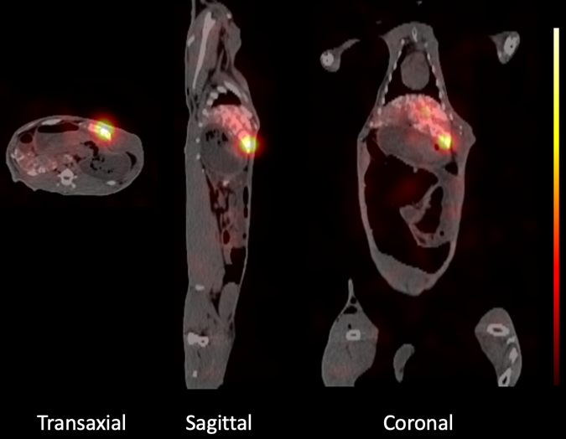
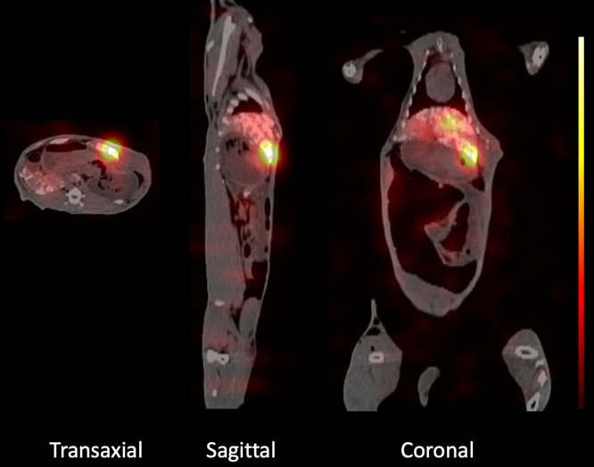
Animal Studies
Francium-221
Bismuth-213
24 h
24 h
²²¹Fr
72 h
72 h
Fused SPECT/CT images of rabbit with a VX2 hepatic tumor at 24, 72 and 144-hours post-injection of 50 uCi [²²⁵Ac]Ac-DOTA-TDA/Lipiodol emulsion. Left Panel represents the Francium-221 energy window. Right panels Represent the Bismuth-213 energy window. (Du, et al, PLoS ONE 17(1) e0261982)
144 h
144 h
Image acquired on a Siemens Symbia T16 SPECT/CT

Slide 19
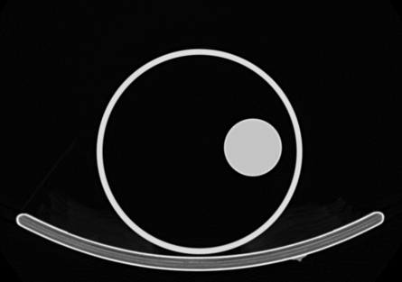
Ac-225 Phantom Experiment
22 cm
  Goal: Assess Accuracy
  6 cm diameter sphere
  Cold background
  4.76 Mbq of Ac-225 in sphere (at equilibrium)
  22 cm diameter cylindrical phantom
  60 views at 150 s per view (75 min)
  Siemens Symbia Scanner
  HEGP Collimator
  Fr-221 and Bi-213 energy windows

Slide 20
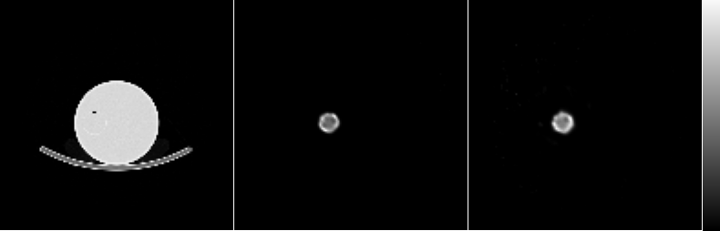
Ac-225 Phantom Experiment: Accuracy
Reconstructed images (20 iterations)
Fr-221 Bi-213
Radionuclide | Error (%)
Fr-221 | -8%
Bi-213 | 1%

Slide 21
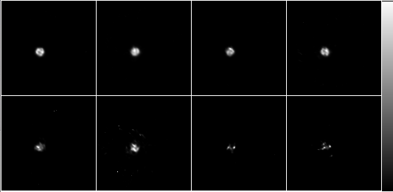
Ac-225: Precision of Activity Estimates
0.60 MBq
0.24 MBq
0.12 MBq
0.02 MBq
Coefficient of Variation
Fr-221
Activity (MBq) | Fr-221 | Bi-213
0.60 | 1.84% | 1.52%
0.24 | 2.85% | 2.39%
0.12 | 5.97% | 5.38%
0.02 | 16.24% | 12.16%
Bi-213
6 iterations, 12 subsets
30s/view, 120 projections, 50 noise realizations

Slide 22
Conclusion
SPECT imaging of alpha emitting radionuclides
  Feasible with current clinical systems
  Requires careful attention to modeling the imaging physics
  Accuracy ~10% for organ-sized object
  Can provide information about distribution of daughter radionuclides

Slide 23
Acknowledgements
R01 EB031023
U01 EB031798
U01 CA140204
R01 CA239041
Eric Frey, Ph.D.
George Sgouros, Ph.D.
Martin Pomper, M.D. , Ph.D.
Ling-Jian Meng, Ph.D
Jessie Nedrow, Ph.D.
Rebecca Krimins, Ph.D.
Rob Hobbs, Ph.D.
Dara Kraitchman, Ph.D.
Bin He, Ph.D.
Michael Ghaly, Ph.D.
Stavroula Sofou, Ph.D.
Remco Bastiaannet, Ph.D.
Ioanna Liatsou , Ph.D.
Junyu Chen, Ph.D.
…

Slide 24
Thank you!

