Slide 1
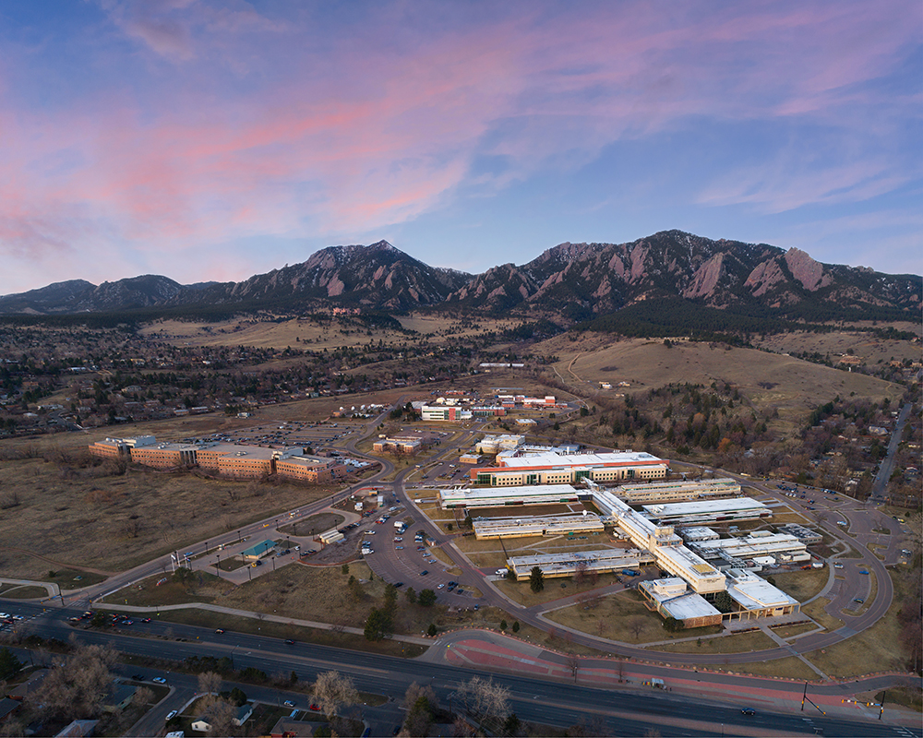


Superconducting Sensors for Radiation Measurements
Galen O’Neil
National Institute of Standards and Technology, Boulder, CO
galen.oneil@nist.gov
Quantum Sensors Group

Slide 2
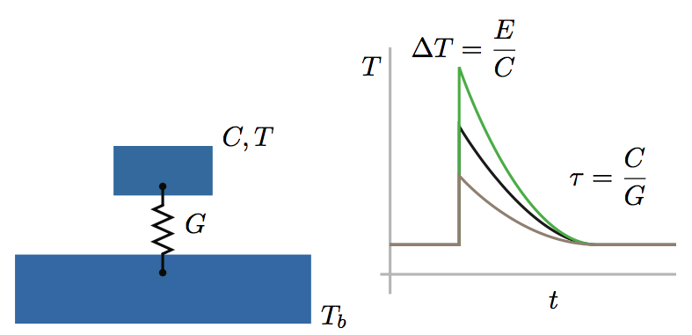



Superconducting sensors
Low Temperature Thermal Sensors
Deposit energy -> Temperature increase
Energy resolution enabled by low thermal noise below 100 mK
Thermometer element enabled by superconductor physics
Flexible coupling to incident radiation/energy
  Near 100% Quantum Efficiency for huge parts of electromagnetic spectrum
Temperature rise
energy
heat capacity
Thermal conductivity
time
bath temperature

Slide 3
Superconducting sensors
Superconducting sensors are advancing measurement capabilities across the entire electromagnetic spectrum
NIST superconducting sensor applications:
basic science, applied science, industry, and security
bolometers
calorimeters
Also: neutrino mass, alpha particles, exotic atoms, …

Slide 4
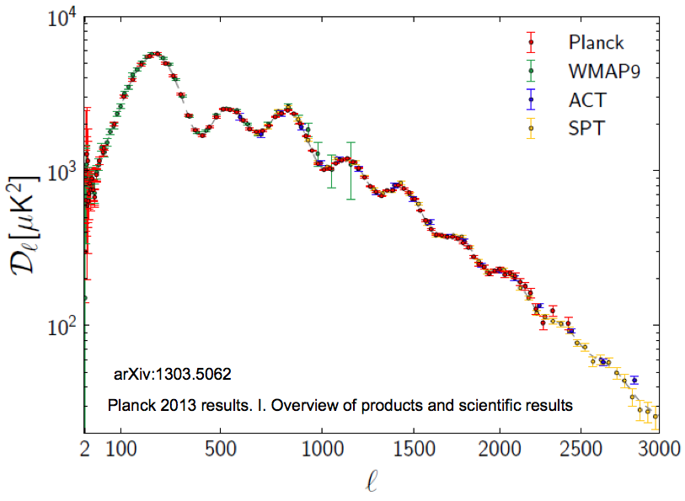
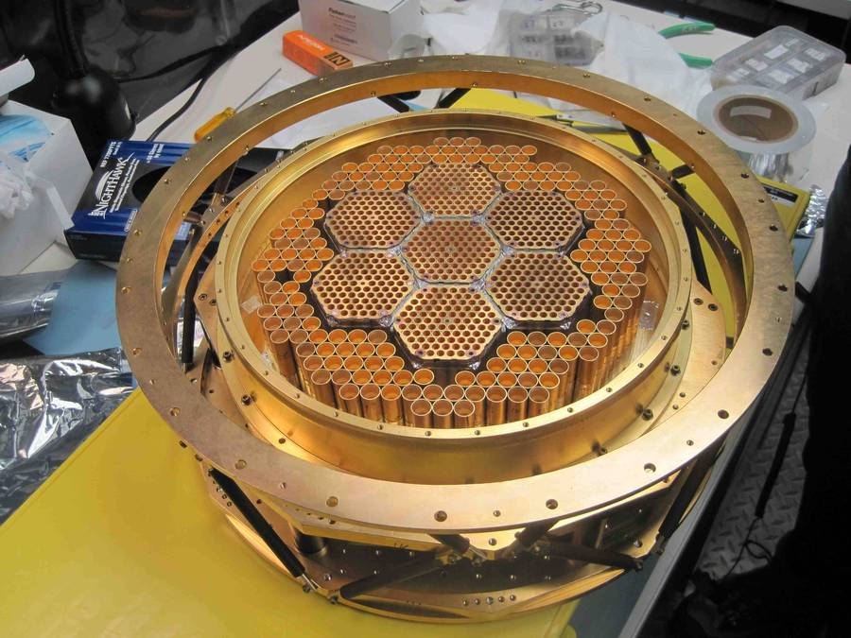
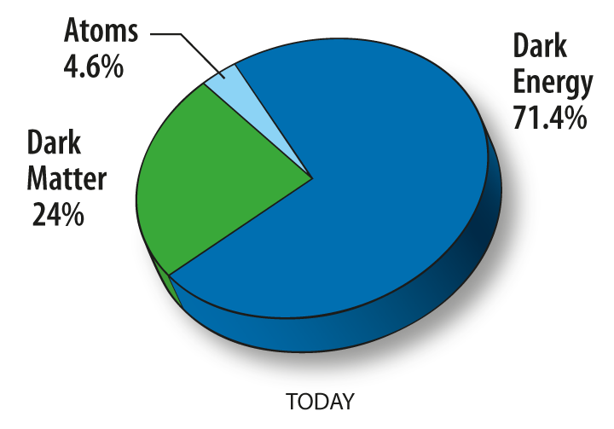
Cosmic Microwave Background Telescopes
NIST: advancing measurement capabilities for science, technology, industry, and security
SPTPol receiver:
588 polarimeters @ 150 GHz (NIST),
~200 polarimeters @ 90 GHz (Argonne)
CMB and astrophysics surveys
bolometers
calorimeters
Also: neutrino mass, alpha particles, exotic atoms, …

Slide 5
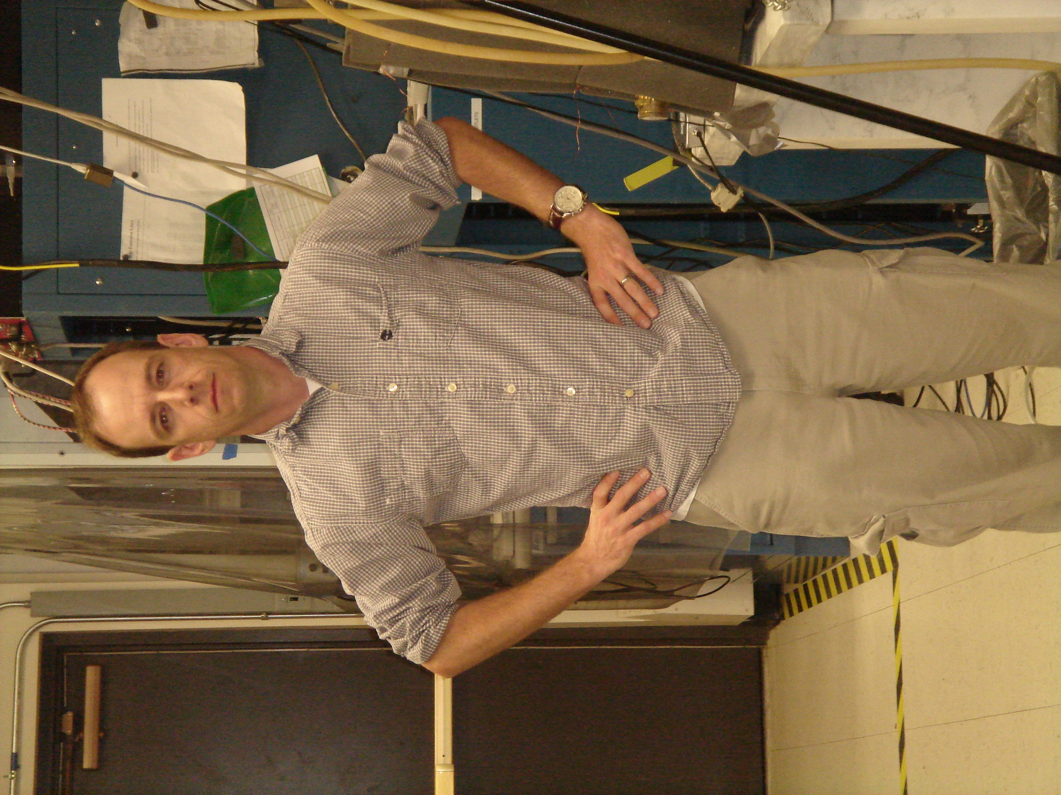
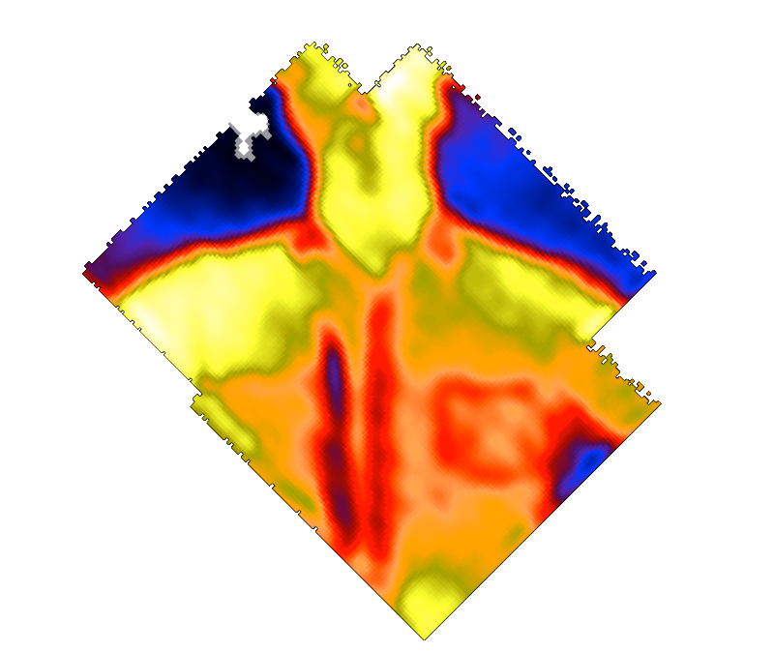
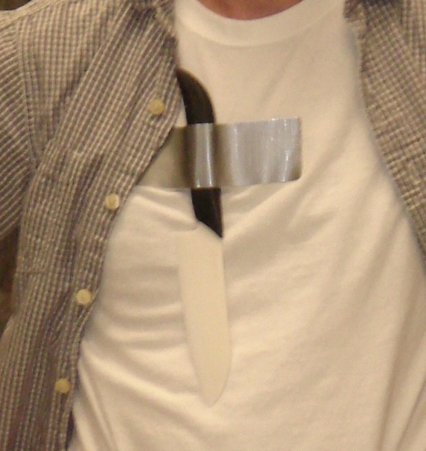
THz imaging through clothes
NIST: advancing measurement capabilities for science, technology, industry, and security
250 pixels @ 350 GHz
Passive Imager
bolometers
calorimeters
Also: neutrino mass, alpha particles, exotic atoms, …

Slide 6
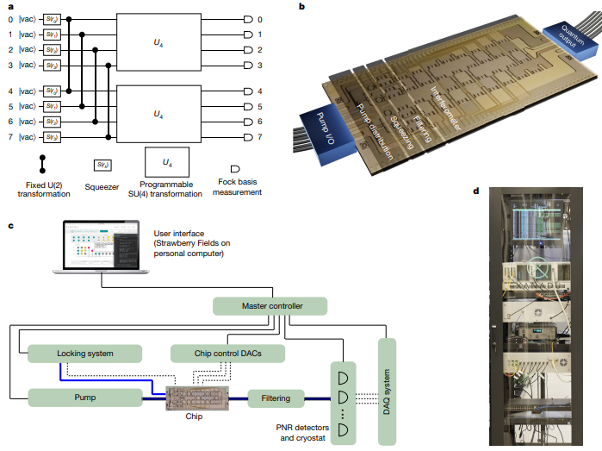
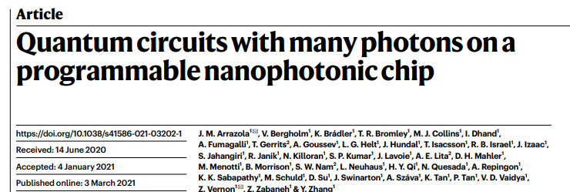
Quantum Optics
NIST: advancing measurement capabilities for science, technology, industry, and security
Quantum Optics
bolometers
calorimeters
Also: neutrino mass, alpha particles, exotic atoms, …

Slide 7
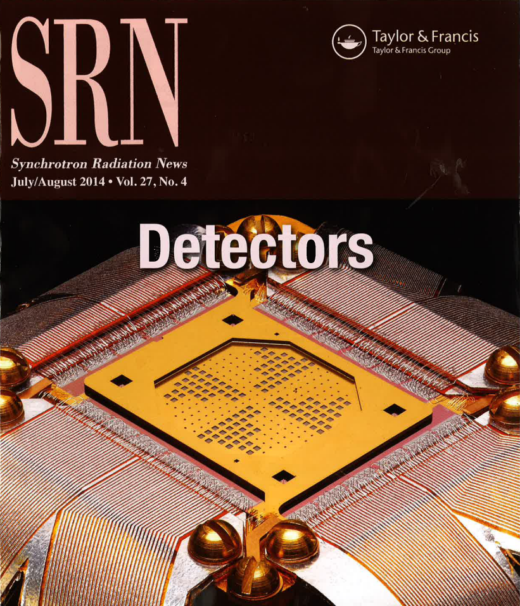
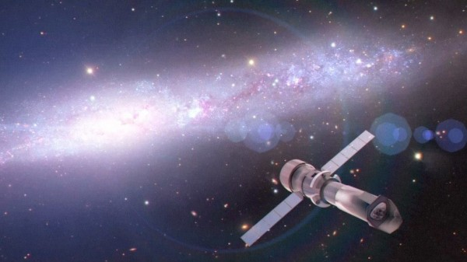
Low dose x-ray spectroscopy
NSLS x-ray spectrometer
240 pixels @ 1 keV
ATHENA x-ray satellite (ESA): launch in 2028
~4000 pixels @ 7 keV
Artist’s concept: Athena project team
x-ray materials analysis and x-ray astrophysics
bolometers
calorimeters
Also: neutrino mass, alpha particles, exotic atoms, …

Slide 8
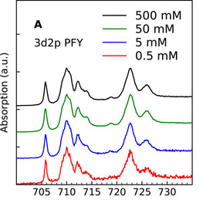
Low dose x-ray spectroscopy
NSLS x-ray spectrometer
240 pixels @ 1 keV
ATHENA x-ray satellite (ESA): launch in 2028
~4000 pixels @ 7 keV
X-ray spectroscopy with:
Biologically relevant concentrations
Low x-ray dose for damage sensitive samples
E.g. chemical bonding in Hemoglobin
Incident x-ray energy (eV)
Fe L-edge absorption spectroscopy
Artist’s concept: Athena project team
x-ray materials analysis and x-ray astrophysics
bolometers
calorimeters
Also: neutrino mass, alpha particles, exotic atoms, …

Slide 9
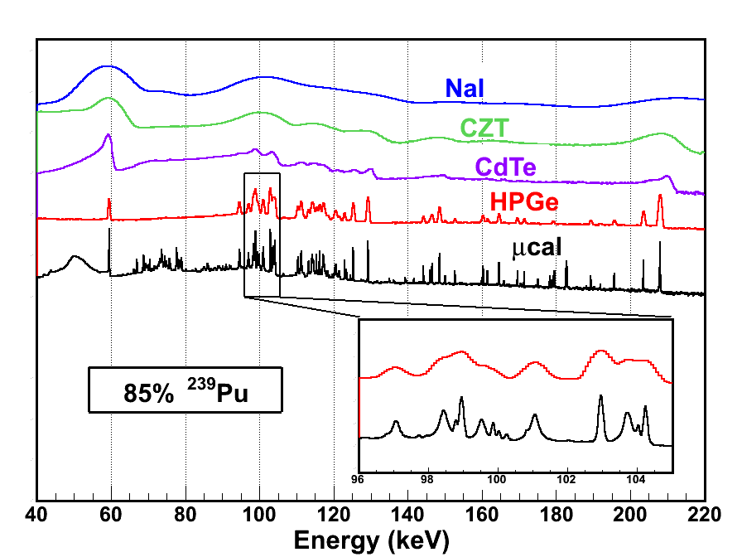
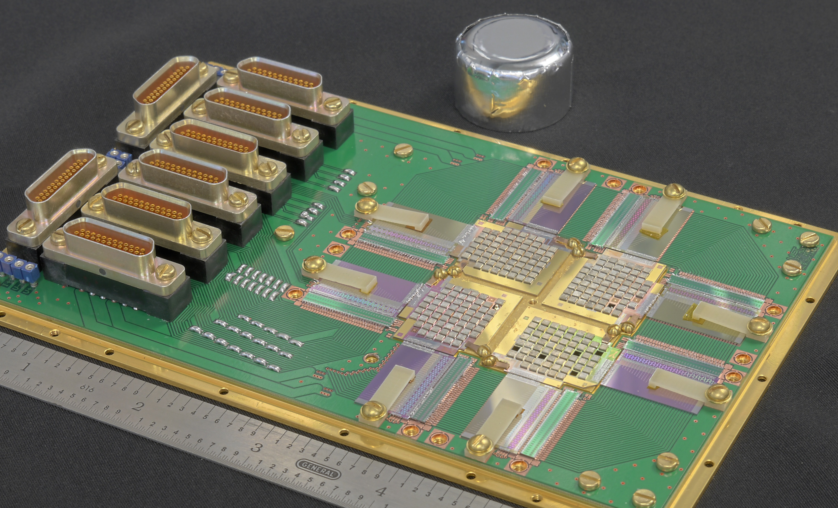
Gamma ray spectroscopy for nuclear safeguards
NIST: advancing measurement capabilities for science, technology, industry, and security
LANL gamma ray spectrometer
256 pixels @ 220 keV
²³⁹Pu
²⁴⁰Pu
nuclear materials analysis, non-proliferation and treaty verification
bolometers
calorimeters
Also: neutrino mass, alpha particles, exotic atoms, …

Slide 10
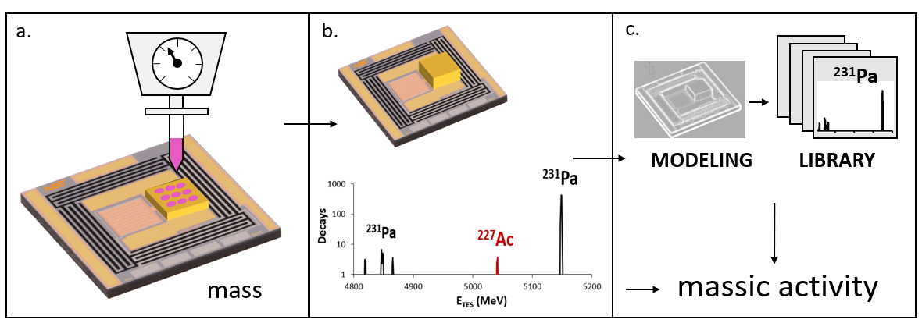
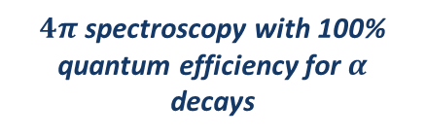
Redefining Radioactivity Standards
NIST is redefining how we measure the becquerel (decays/s).
Deposit SI linked mass of sample liquid with radioisotopes
$4π$ spectroscopy with 100% quantum efficiency for $α$ decays
Result: SI traceable Bq/g of sample liquid for EVERY radioisotope
Future of medical isotope standards.
Want challenging test cases.

Slide 11
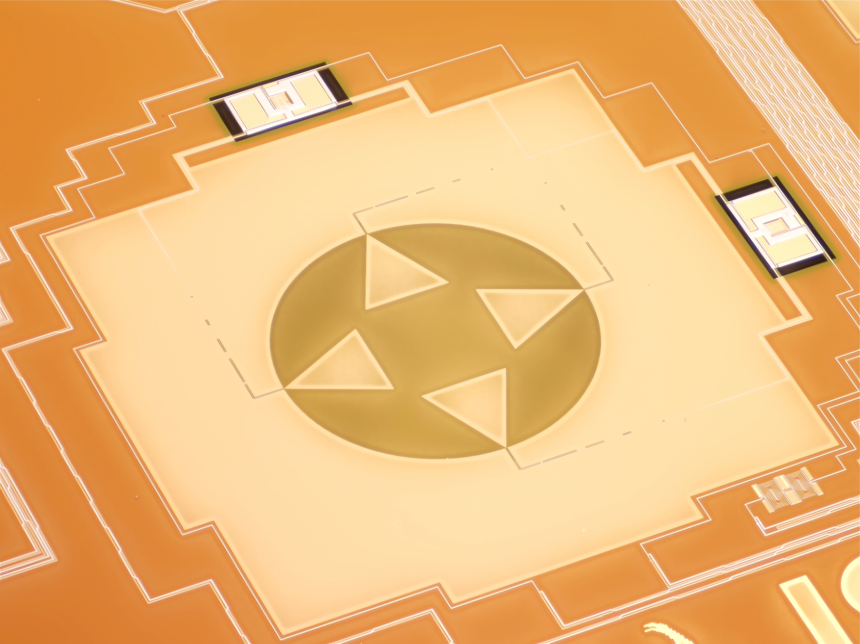
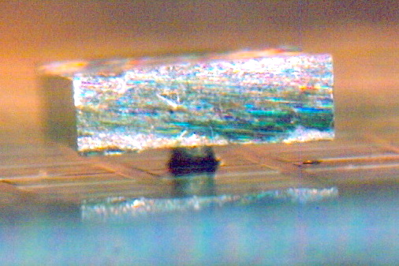
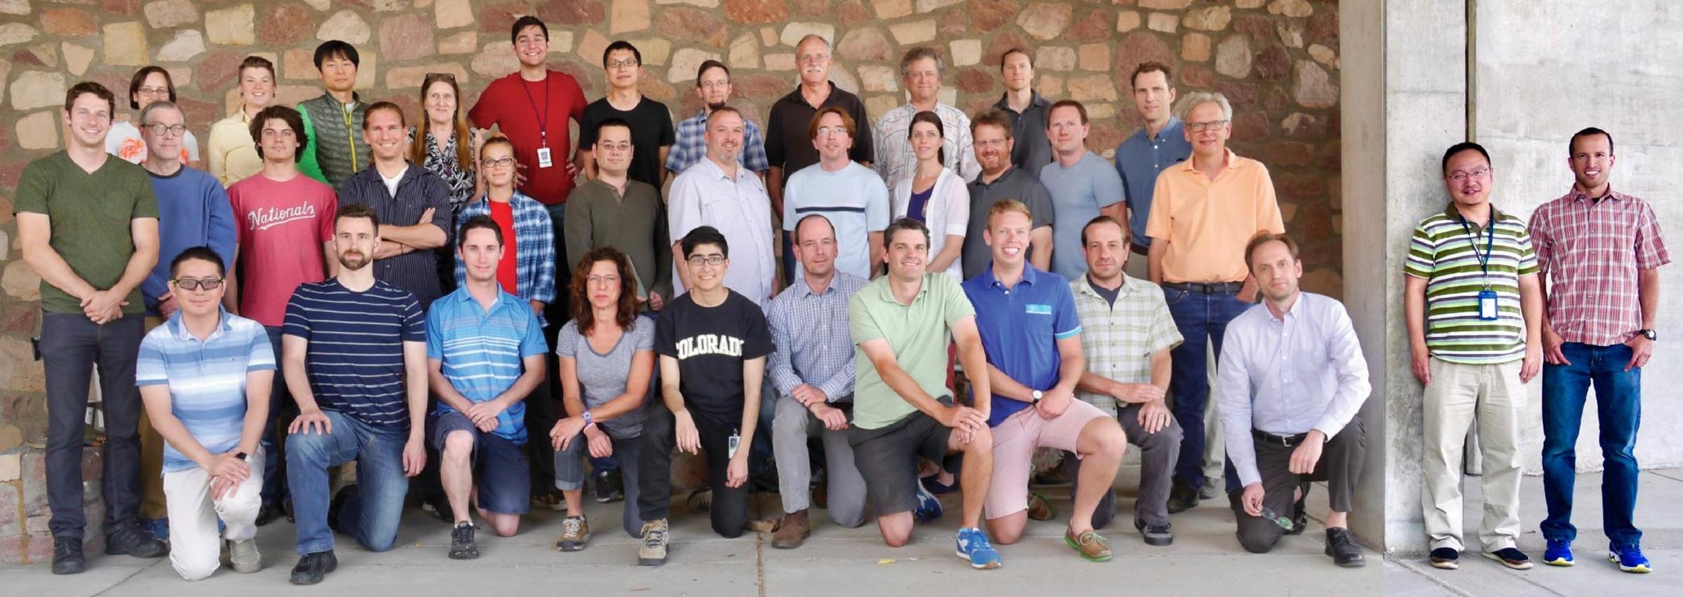
NIST Superconducting Sensors
NIST: advancing measurement capabilities for science, technology, industry, and security
Coordinated team effort:
applications
fabrication
electronics
cryogenics
CMB polarimeter
gamma-ray TES

Slide 12
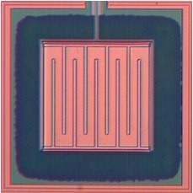
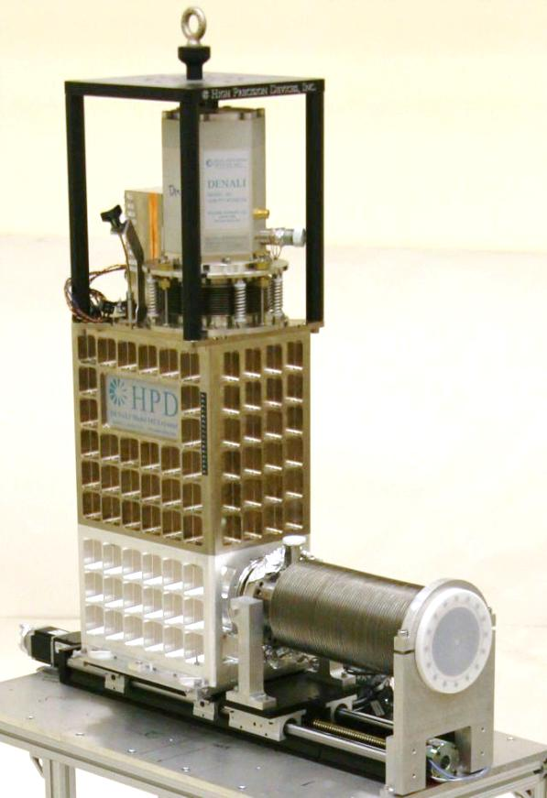
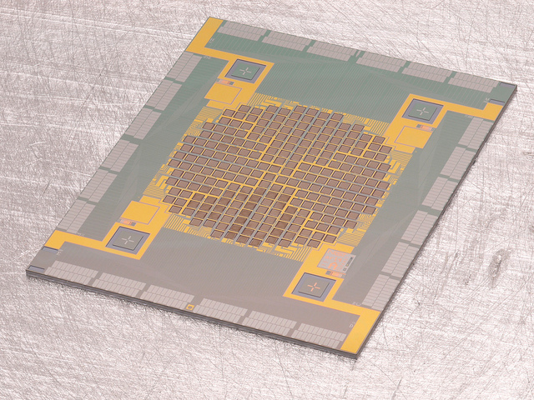
Superconducting Sensor Instrument
256 pixel x-ray spectrometer
TES pixel
1 m
compact 50 mK refrigerator
no liquid cryogens
pulse tube cooled adiabatic demagnetization refrigerator
x-rays
commercially available system
cryogenics made easy

Slide 13
Conclusions
When to consider superconducting sensors
  Need high efficiency and high resolution simultaneously
  Photon starved measurements
  Hyperspectral imaging: spatial image for every photon color
  Timing, picosecond jitter possible
We are hiring post-docs, mid-career scientists, research software engineer.
We love to talk about potential applications
galen.oneil@nist.gov
Low dose spectroscopy.
Incident x-ray energy (eV)
Fe L-edge absorption spectroscopy
Future of medical isotope standards.

