Slide 1
Dose Verification Detectors (Proton Therapy)
ASU-Mayo Clinic collaboration
Results obtained with the Mayo Clinic proton beams
New Concept for Experimental Dose Verification using GEANT4
Joint DOE / NIH Workshop - Advancing Medical Care through Discovery in the Physical Sciences Workshop Series: Radiation Detection
Ricardo Alarcon, Arizona State University
March 16-17, 2023 Jefferson Laboratory

Slide 2
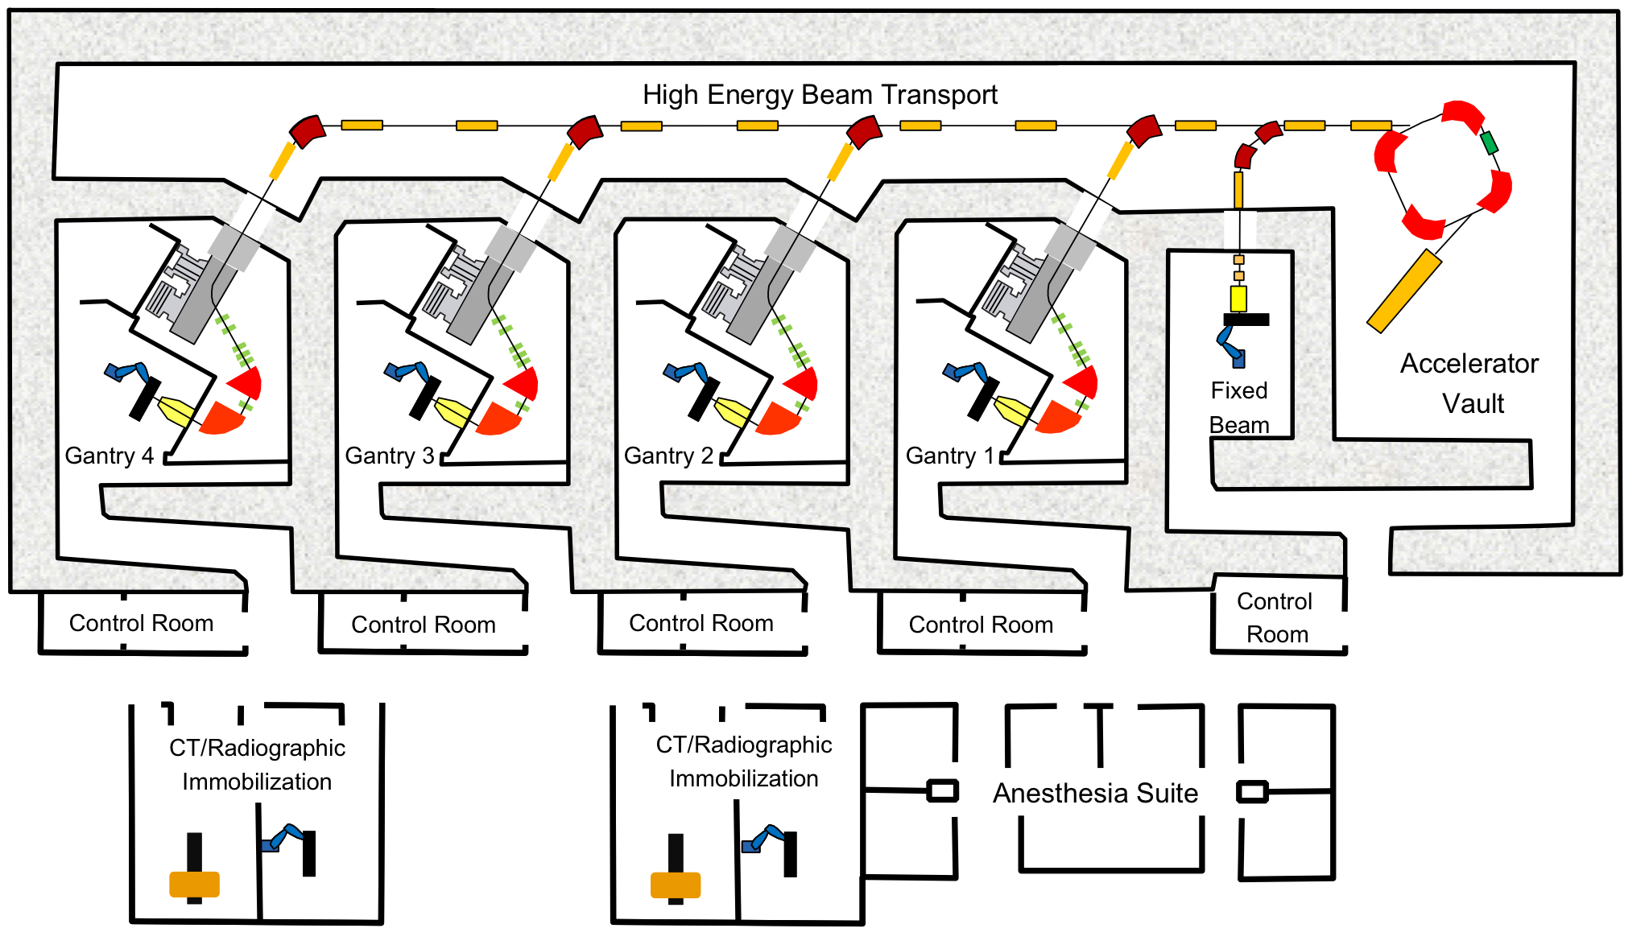
Facility Layout: Mayo Clinic Arizona
Hitachi PROBEAT proton therapy system. The scanning technique employs pencil beam scanning with magnetic beam positioning. Full Cancer Treatments began in 2017
2

Slide 3
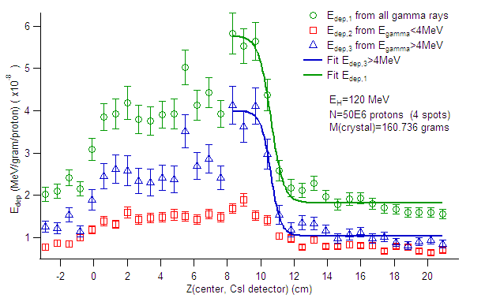
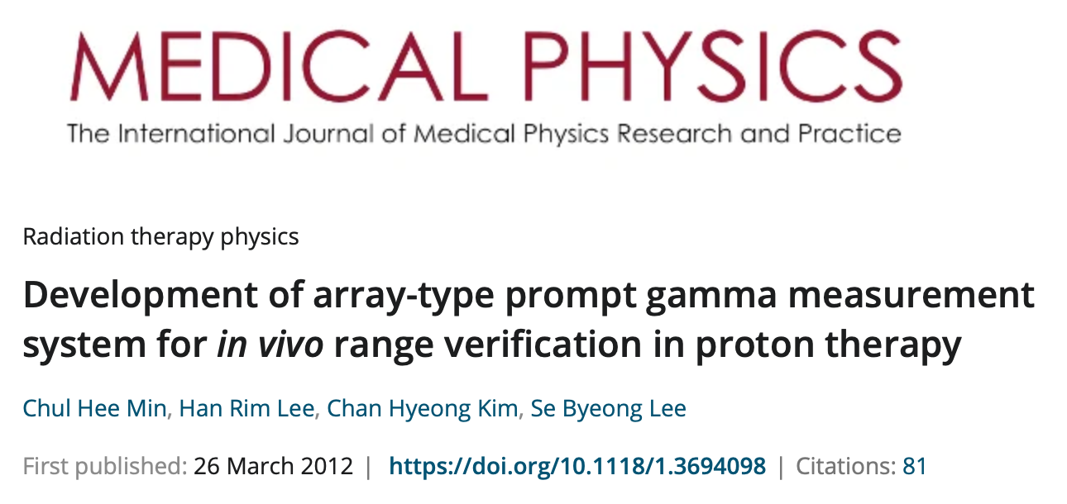
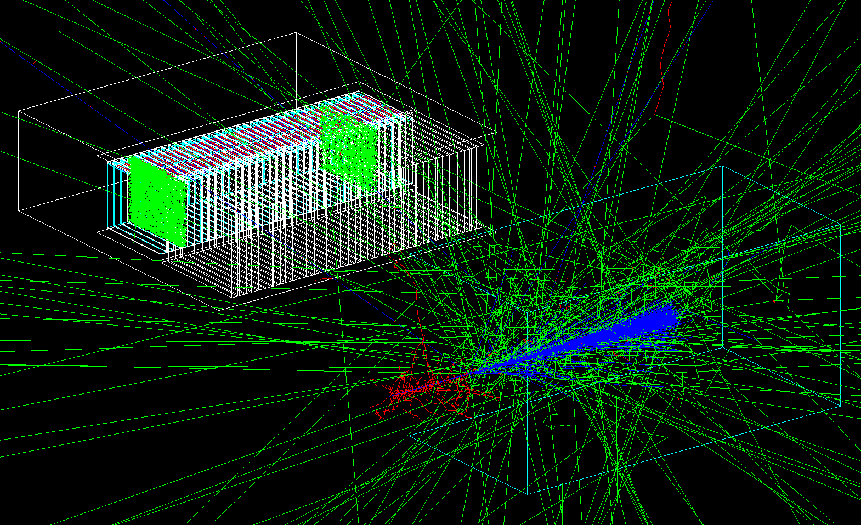
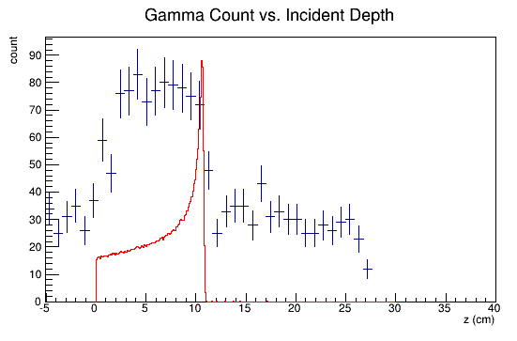
MCNPX
2015: ASU-Mayo Funds ($20k)
GEANT4
2017: Grant to built a Prototype Detector (Marley Foundation, $50k)

Slide 4
The Range Detector
16 Cs crystals 6 mm x 70 mm x 120 mm
Each CsI read out by 32 MPPCs (15º temp)
Electronic & DAQ PCB designed at ASU and built commercially
Tungsten Collimator (30 channels)
The detector scans the collimator

Slide 5
Measurement Procedure

Slide 6
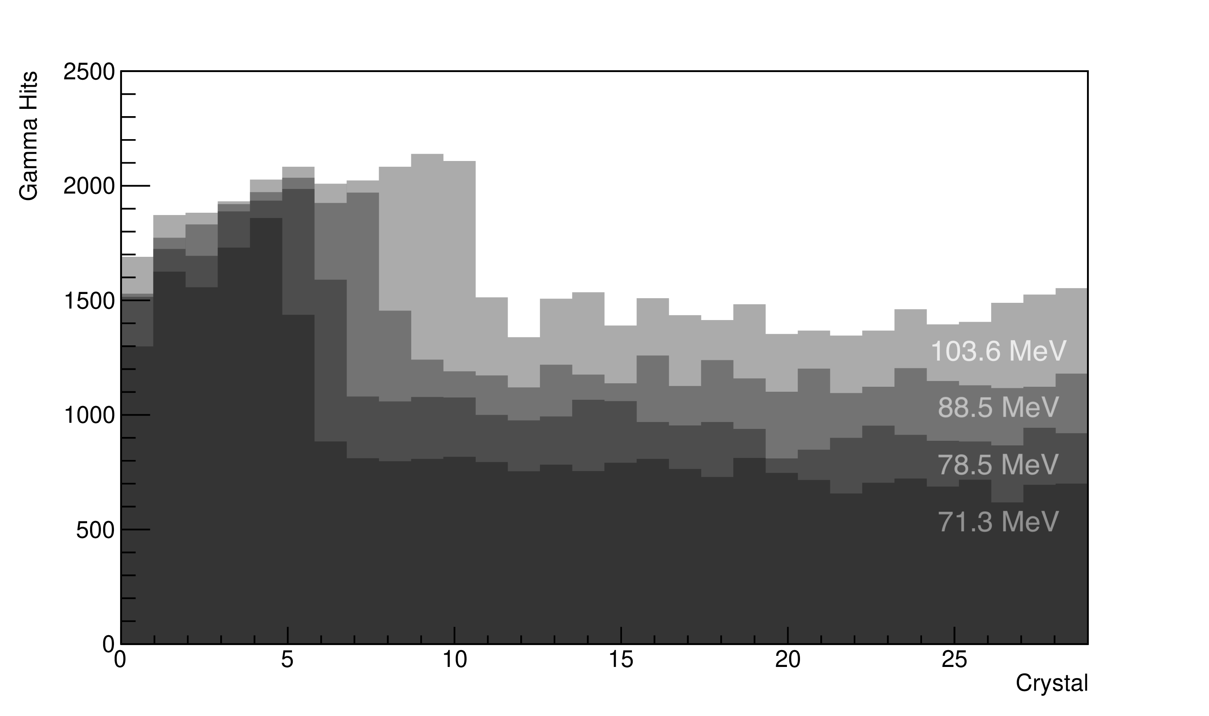
Detector Response vs Beam Energy
Gamma Events versus Crystal Number overlaid for beam energies of 71.3 MeV, 78.5 MeV, 88.5 MeV, and 103.6 MeV, the result of shooting 3 x 10⁹ protons into the phantom in each case.
Jason Holmes, Ph.D. thesis, Arizona State University, 2019

Slide 7
Single Crystal Response vs GEANT4
Jason Holmes, Ph.D. thesis, Arizona State University, 2019

Slide 8
Range Determinations
Jason Holmes, Ph.D. thesis, Arizona State University, 2019

Slide 9
Conclusions and Outlook
Using proton beam energies 70-140 MeV the prototype Range Detector measured the radiation from two phantoms (acrylic, water) using a collimated scintillator array.
The measured energy spectrum by the scintillators of the array agrees with that modeled using Geant4 and the measurements were used to determine the range of the proton beams with mm accuracy.
The collimation array is not scalable to be useful in a clinical setting.
The ability of Geant4 to reproduce the results is not surprising, it is the physics standard for calculating dose delivery by medium energy protons.
The path forward calls for scaling the capabilities of Geant4 to be used in the generation of treatment plans. The response of strategically located radiation detectors is used to double check the dose calculation ensuring patient quality assurance.

Slide 10
Online in-vivo Dose Monitoring
phynix.tech
David Blyth, Ph.D. 2017, ASU
Jason Holmes, Ph.D. 2019 , ASU

Slide 11
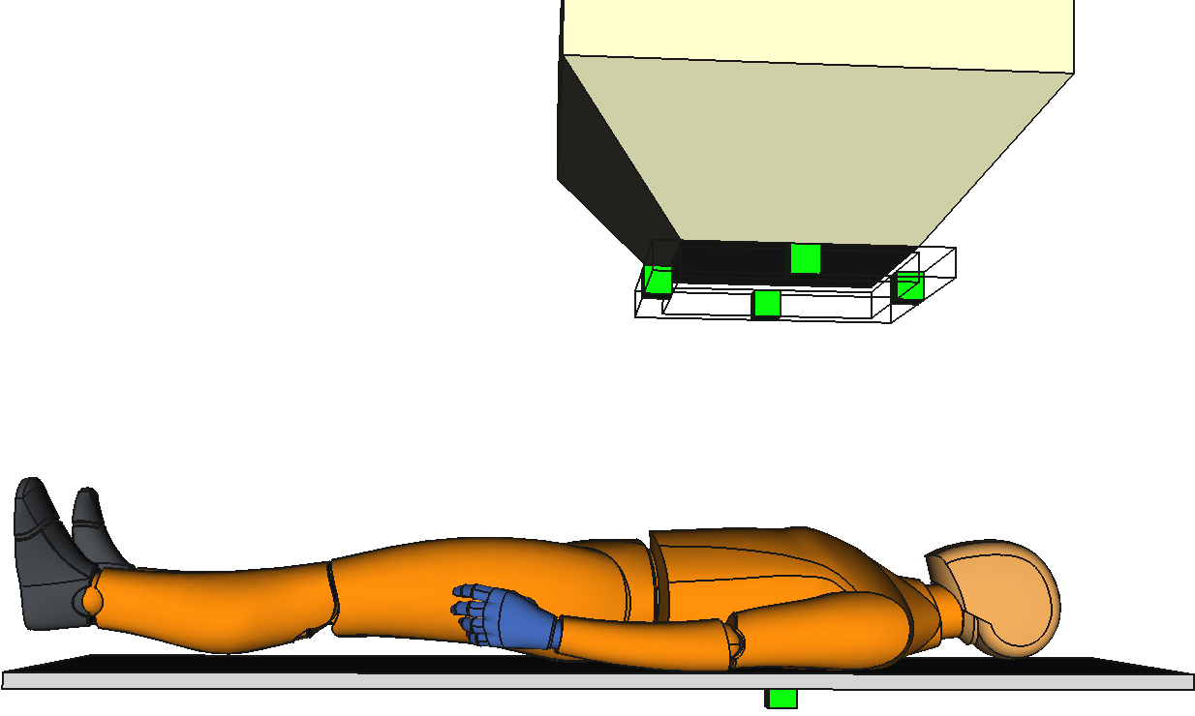
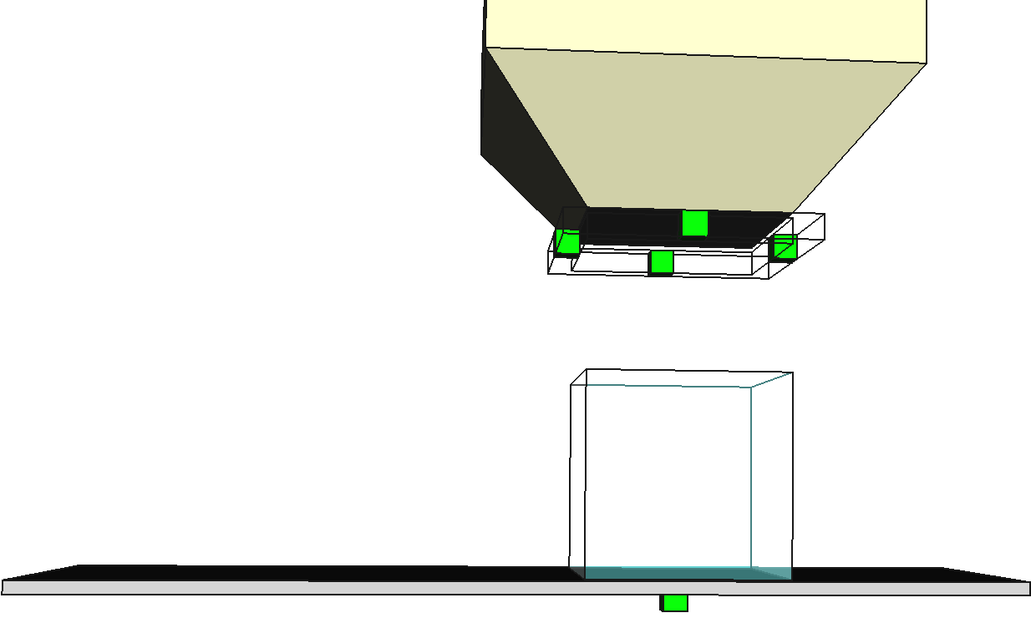
Dose Verification Concept
During irradiation of the patient or water phantom, prompt gamma-rays and neutrons are produced, which subsequently emit isotropically.
Detectors are spread around the patient to measure the intensity of the emitted particles.

Slide 12
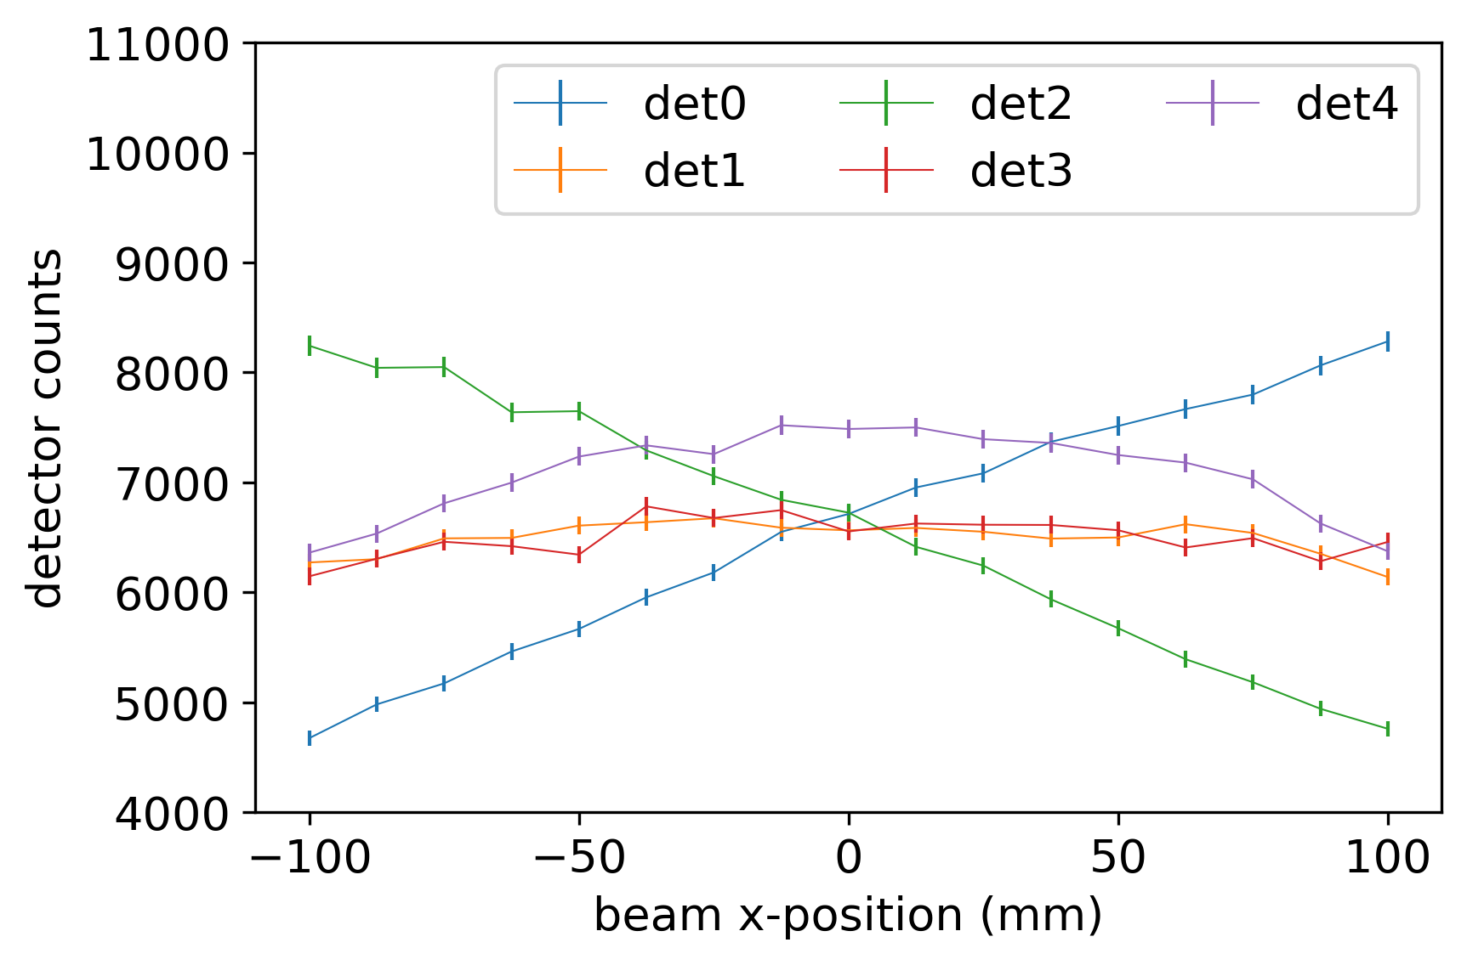
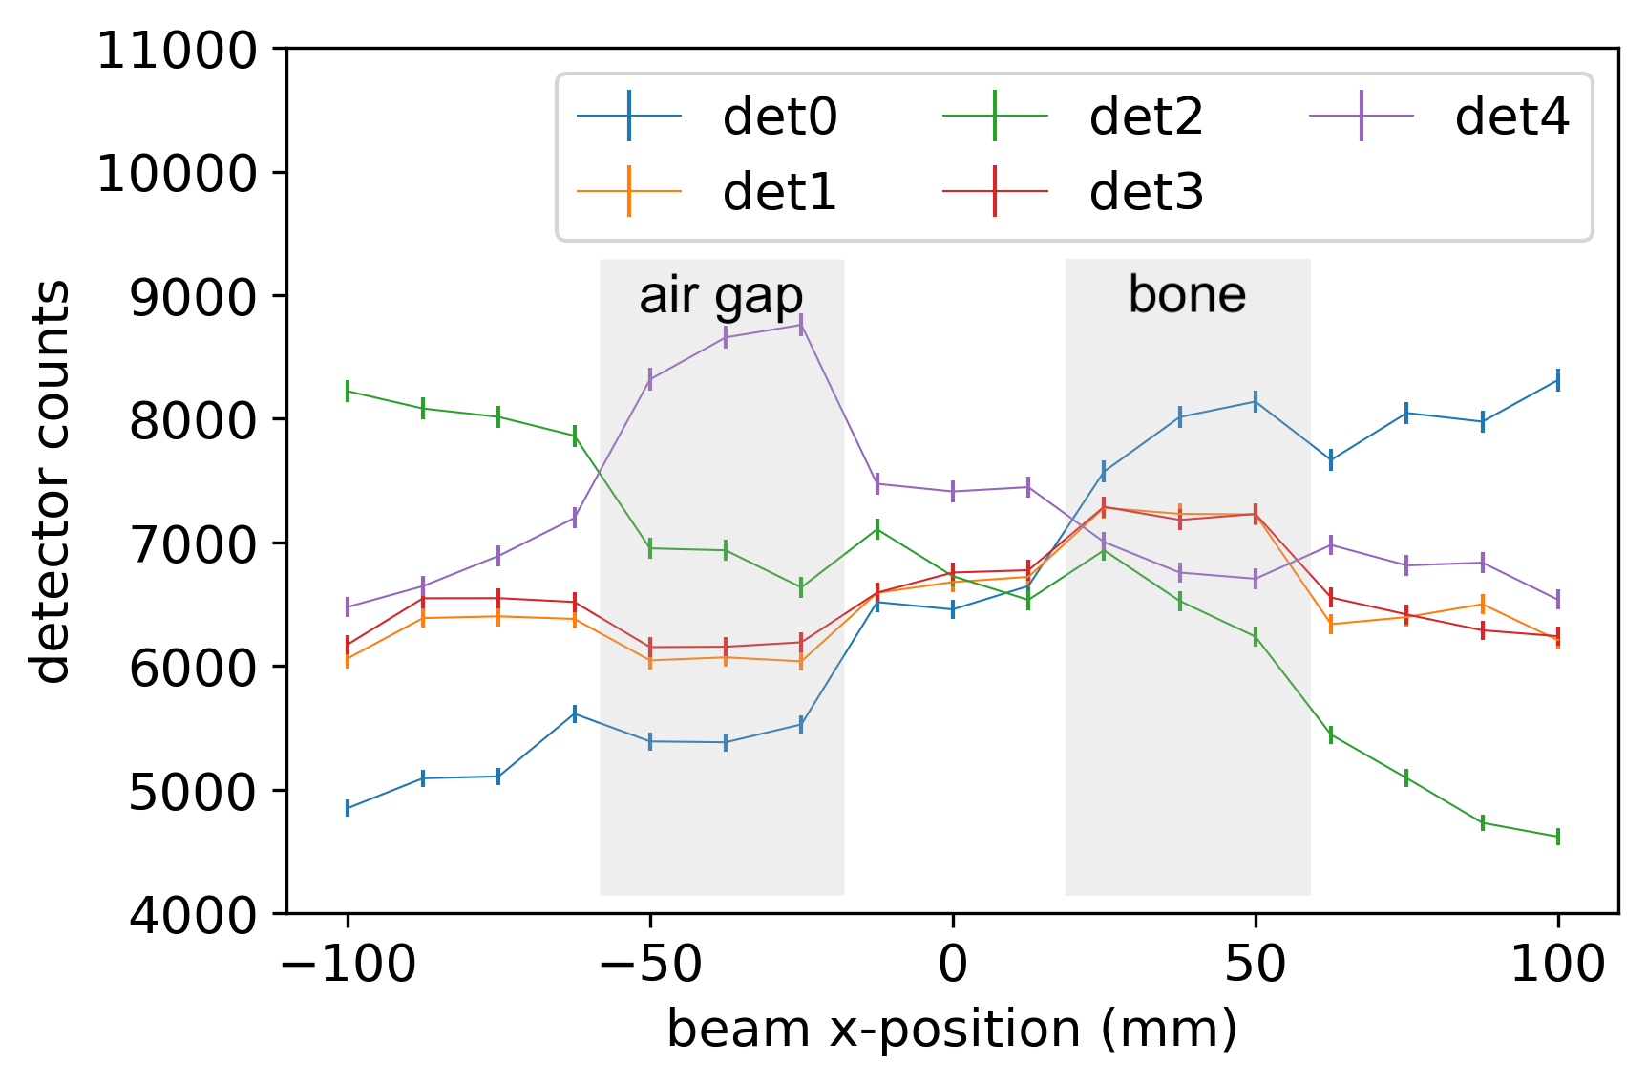
Dose Verification Concept: Geant4 Results
(top) A proton beam is scanned along the x-dimension in a water phantom (10⁷ protons used at each position). The corresponding detector counts demonstrate the detector sensitivity to x-y beam translation.
(bottom) To measure range sensitivity, the detector was scanned identically as the top figure, however with ~2 cm air gap and ~ 2 cm bone introduced into the water phantom. The results demonstrate a significant range sensitivity.

Slide 13
Ultra-fast Geant4 Dose Calculation
In order to interpret the detector results, we need to calculate the expected detector signal
During treatment, the expected response is compared to the actual response
However, simulating billions of protons using Geant4 could take weeks or months.
Why not use a different radiation simulation software? Answer: Nothing is as accurate, especially for predicting gamma-rays or neutrons
We need to make Geant4 ultra-fast!

Slide 14
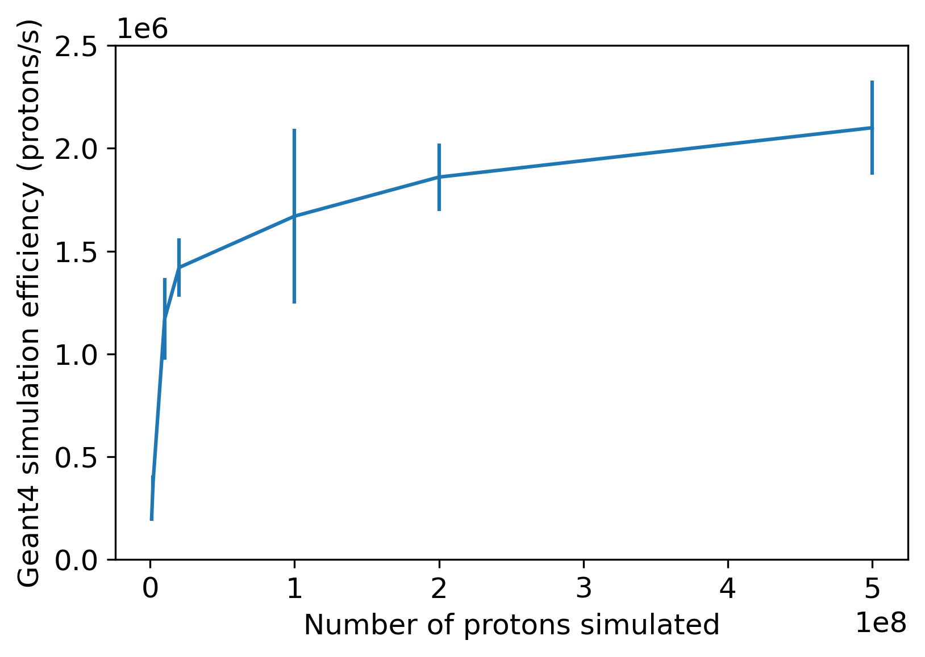
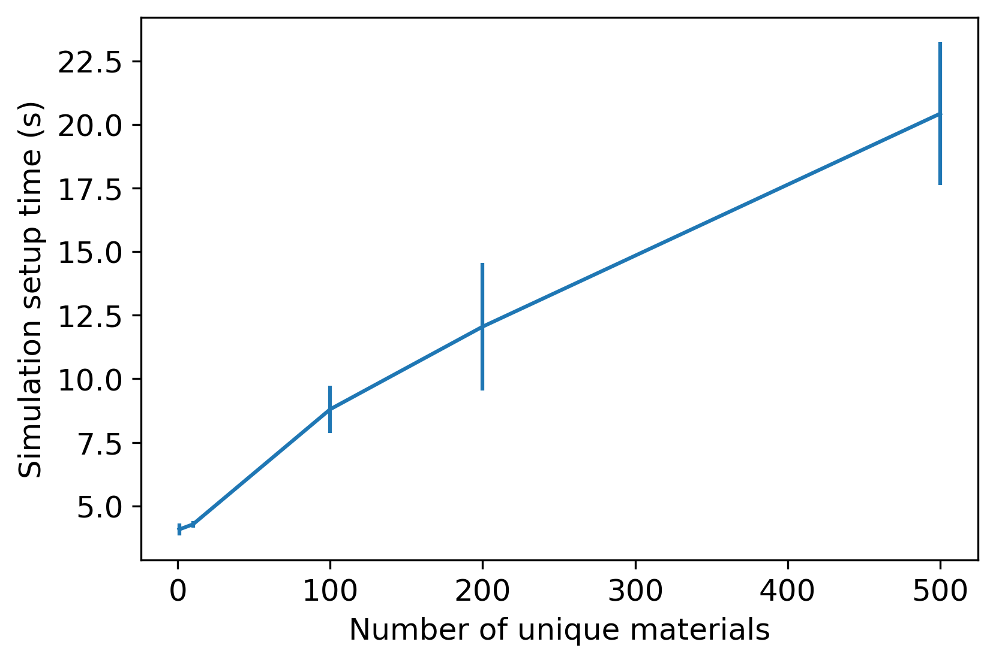
Ultra-fast Geant4 Results
We have implemented Geant4 in Google Cloud
1000s of computers working together simultaneously to perform the calculation
Server-less design keeps costs very low (servers are spun up only when needed)
Among fastest proton-based Monte-Carlo simulations - using full-blown Geant4!

