Slide 1
Wearable Detectors in Nuclear Medicine
Robert Miyaoka, PhD
Deparment of Radiology
University of Washington
rmiyaoka@uw.edu
Notes:
Hello, I am Robert Miyaoka from the Department of Radiology at the University of Washington. I would like to thank the organizers of this symposium for inviting me to speak on Wearable Detectors in Nuclear Medicine.

Slide 2
Disclosures
Co-Founder of Precision Sensing, LLC
Joint research grant with General Electric Global Research (within last 2 years)
Notes:
My disclosures are listed on this slide. I would like to highlight that I am a co-founder of Precision Sensing, LLC and that Precision Sensing is working on trying to commercialize the PRRT technology that I describe in this talk.

Slide 3
Wearable Detectors in Nuclear Medicine
We have been using wearable detectors in nuclear medicine for a long time!
Notes:
When it comes to nuclear medicine, we actually have been using wearable detector technology for years. I am sure that all of you that work around radiation have to wear a radiation badge and those of you that regularly handle radiation have to wear a ring badge. These are certainly examples of wearable technology. And they are a good starting point as we think about what are potential applications for wearable detectors and what are some of the requirements for wearable detectors.
For example, does the detector need to provide real time feedback? Does the detector need to produce an image? How localized is the activity that the detector needs to monitor? What level of training is required of the user? Does use of the device need to be in a medical setting or can it be in remote environments?

Slide 4
Examples of Wearable Detectors in Nuclear Medicine
Wearable neuroPET imaging systems
Extravasation and input functions (in clinic)
Dosimetry
  Patient and room monitoring
  Thyroid collar
Example for PRRT
  PRRT Vest
  PRRT PODD
Notes:
On this slide I list some of the different types of wearable detector technologies that exist today. Due to time constraints I will only discuss a few of these technologies.

Slide 5
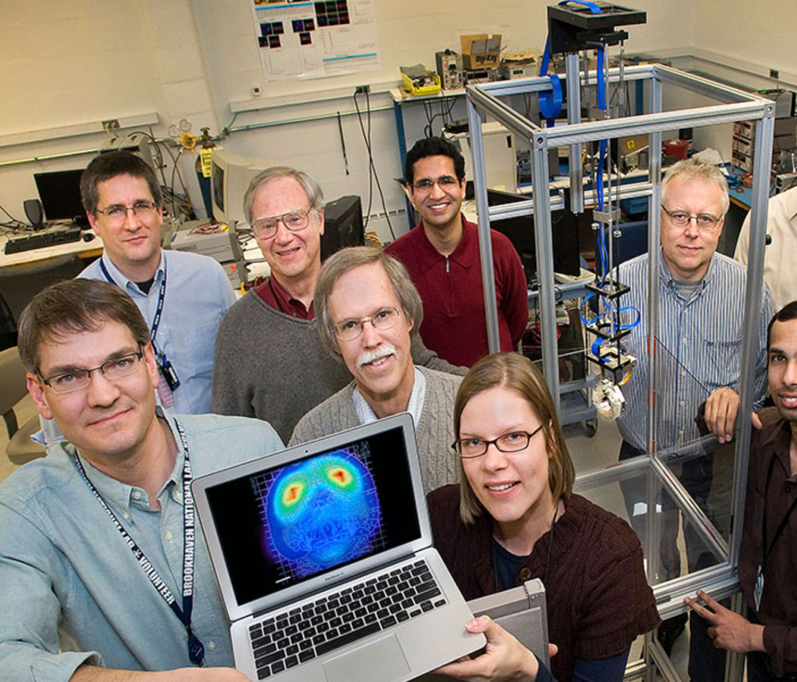
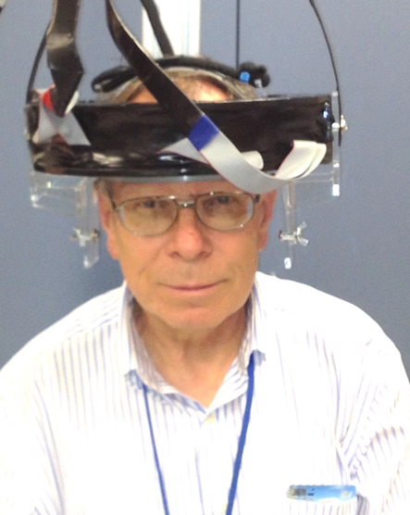

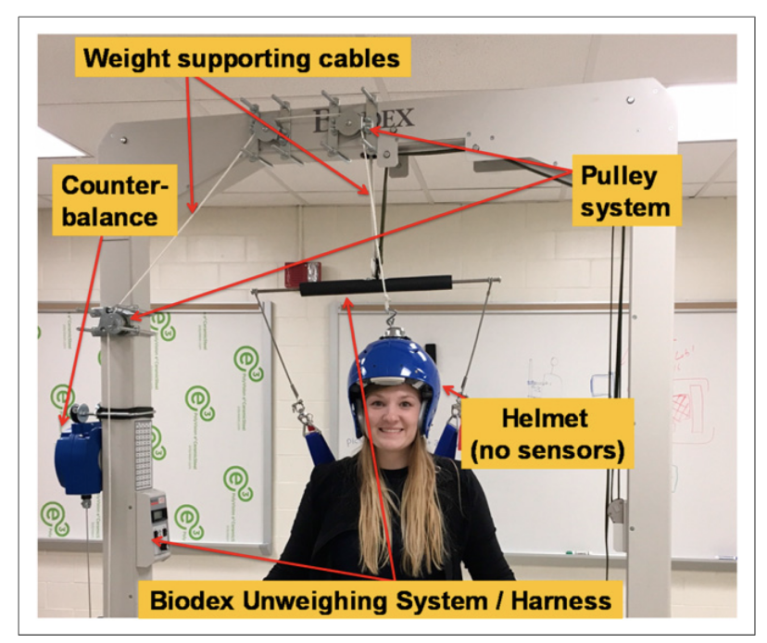
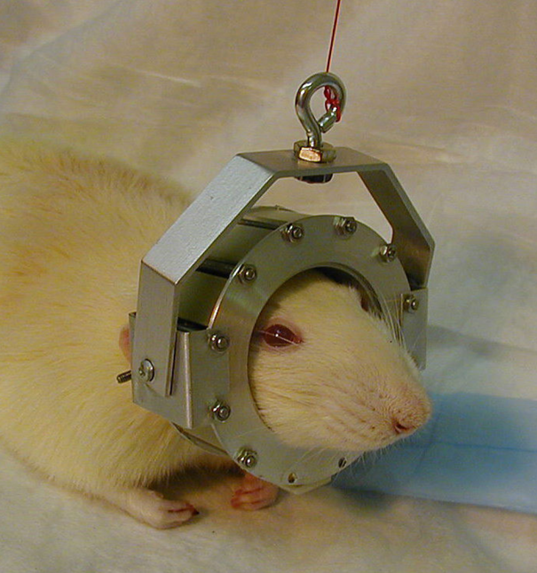
Ambulatory PET
Vaska, et al., IEEE TNS, vol. 51(5), 2004
Noble, JNMT, vol.47(4), 2019
https://www.bnl.gov/newsroom/news.php?a=212139
https://www.neurofleximaging.com/single-post/2015/01/23/wearable-brain-scanner-measures-activity-on-the-go
Notes:
One of the first “wearable” nuclear medicine imaging systems is also one of the most advanced with regards to technical achievement. It was the RatCap, shown in the bottom center picture. The RatCap was a miniature wearable PET imaging system to image the brains of conscious rats. In addition to a very miniature PET system the designers developed a sophisticaled counter balance assembly that allowed the rat to wear the device and walk around without having to physically support the device with its neck. This was quite an accomplishment and allowed for PET imaging to be done on awake rats to study neuroimaging tracers.
The idea of a wearable PET detector for neuro imaging was then proposed for human applications. While people can be instructed to remain still what having a PET scan, the attractive feature about a wearable PET system was that individuals could be studied doing a variety of tasks and in a variety of environments. Specifically there was a lot of interest in understanding the parts of the brain that are activated during walking, expecially for individuals that have had a stroke or other neuro trauma. The device was called AmPET for ambulatory PET. A prototype detector ring was developed and I believe that there is continuing efforts to best design the external structures to allow for ambulatory imaging.
These two projects were some of the earliest wearable detectors and still represent some of the most advanced and ambitious applications for wearable detector technology.

Slide 6
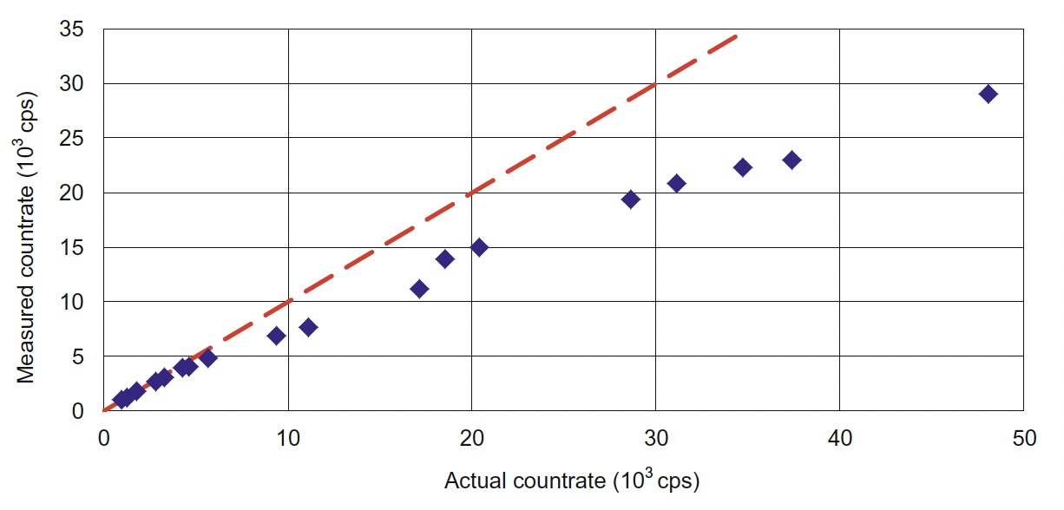
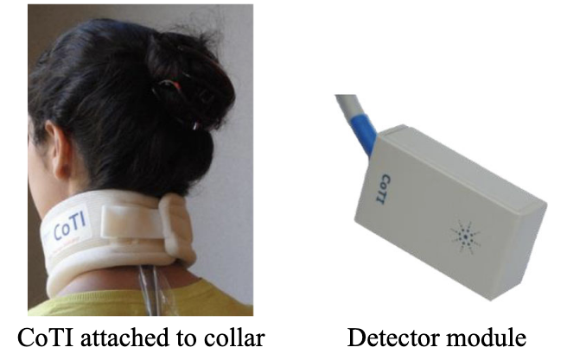
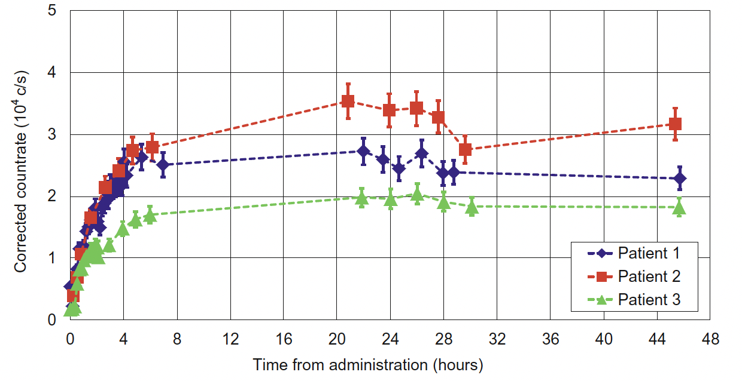
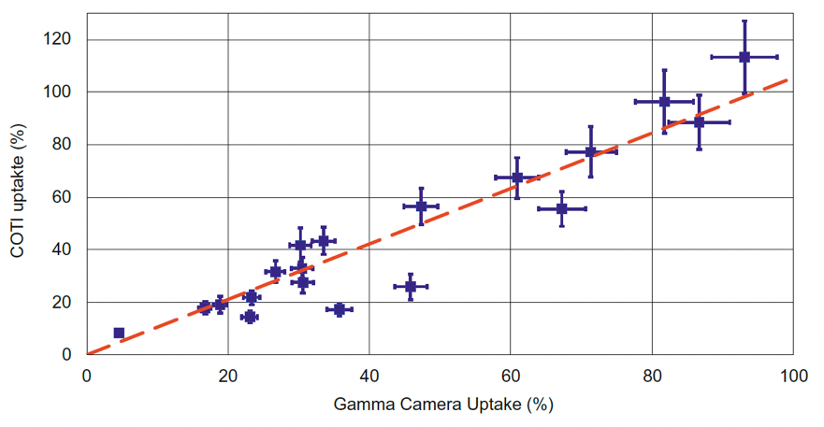
I-131 Thyroid Radiotherapy
Thyroid collar
Results
3 minute measurement time
Patients could place collar
Wearing too long uncomfortable
Feasible for thyroid uptake curves
Discussion
Reproducible for individual patient
Results variable between patients
  Thyroid size
  Hot and cold nodules
Variation addressed through individual calibration
Need to improve linearity of detectors
Need to add energy discrimination
No study of effect of scatter counts
Appears feasible for at home use
Brinks, et al., EJNMMI (2017) 44:935-940
Notes:
Researchers have built a collar that can house up to 4 small detectors to measure the uptake of radioactivity to the patient’s thryroid when they are receiving I-131 therapy. The device is called the Collar Therapy Indicator (CoTI). The radiation detecors are 3x3 mm2 CsI(Tl) crystals individually coupled to a SiPM device. The electronics in the detector module read and condition the signals from the detector and return the number of counts per second to the CoTI’s control unit. The information is then wirelessly sent to the CoTI handheld tablet, which collects and displays the data. In the initial implementation no energy discrimination was applied to the collected signals other than to eliminate SiPM noise. Data could be collected as a single mearuement for a fixed time period or as a series of measruements with set time intervals between measurements. The unit is battery powered with enough power to operate for 48 hours which is the typical length of time the patient will remain at the hospital before discharge.
The results were that 3 minutes was a good length for acquisition time.
Patients could reproducibly put on the collar.
Wearing the collar for long periods of time was uncomfortable.
The device demonstrated that it was feasible to collect thyroid uptake curves.
Other outcomes were that the results were reproducible for an individual patient but not between patients because of variability between patients’ thyroids. Variability could be address via calibration. There was a need to improve the count rate capabilities fo the detector and also to add energy discrimination. It appears to be simple enough to use for at home measurements.

Slide 7
Peptide Receptor Radionuclide Therapy (PRRT) for Neuroendocrine Tumor (NET) Patients
¹⁷⁷Lu DOTATATE is part of a theranostic pairing for progressive NET
In the US, NET patient receive a standardized treatment protocol
  Four 200 mCi doses at 8 week intervals
Standardized treatment is safe for vast majority of patients
Standardized treatment is sub-optimal for majority of patients
Personalization based upon dose to patient’s organs at risk (OARs)
Personalized therapies significantly increase OS and PFS^{1,2}
Long term goal of our research is to enable cost effective, patient friendly, personalized therapies based upon measurements for NET patients.
¹A. Yordanova et al., EJNMMI, vol. 44, no. 7, pp. 1207-1214, 2017 JUL.
²U. Garske-Roman et al., EJNMMI, vol. 45, no. 6, pp. 970-988, 2018 JUN.
Notes:
Peptide receptor radionuclide therapy or PRRT is part of a theranostic pairing for the treatment of patients with neuroendocrine canceer.
The patients are treated using Lu-177 DOTATATE. DOTATATE is a peptide that targets somatastatin receptor 2 which is found on many neuroendocrine tumors.
In the US, neuroendocrine tumor patients receive a standardized treatment protocol of four 200 mci doses at 8 week intervals.
This standardize treatment is safe for a vast majority of patients.
However this standardized treatment is also sub-optimal for a majority of patients. More than 50% of patients can safely receive more than 4 therapy doses. Many patients can safetly receive 8,9 or 10 doses. Further when doses are personalized patients have long progression free survival and overall survival. Thus the long term goal of this project is to develop cost effective, patient friendly technology to enable personalized therapies for NET patients. Current gold standard is to take 3-4 SPECT/CT scans over 7 day period. Expensive, lots of return visits to medical center for patient. Ideally do after each treatment. All other streamlined techniques require approximations or population averages.
Further, since we started this work there is now an approved Lu-177 PSMA agent for treatment of prostate cancer and the basic technology that we are developing for NET patients can also be used for postate cancer patients.

Slide 8
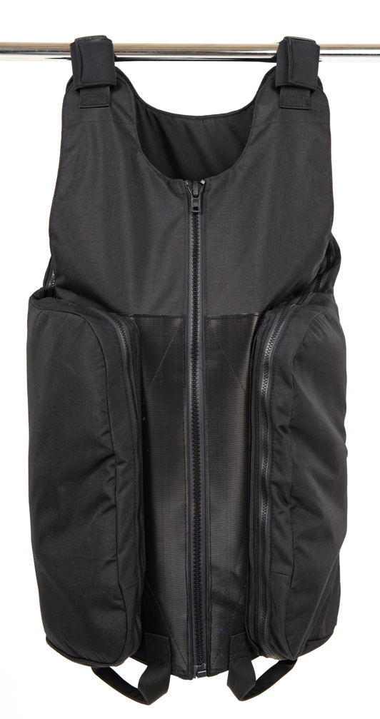
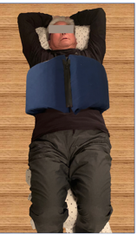
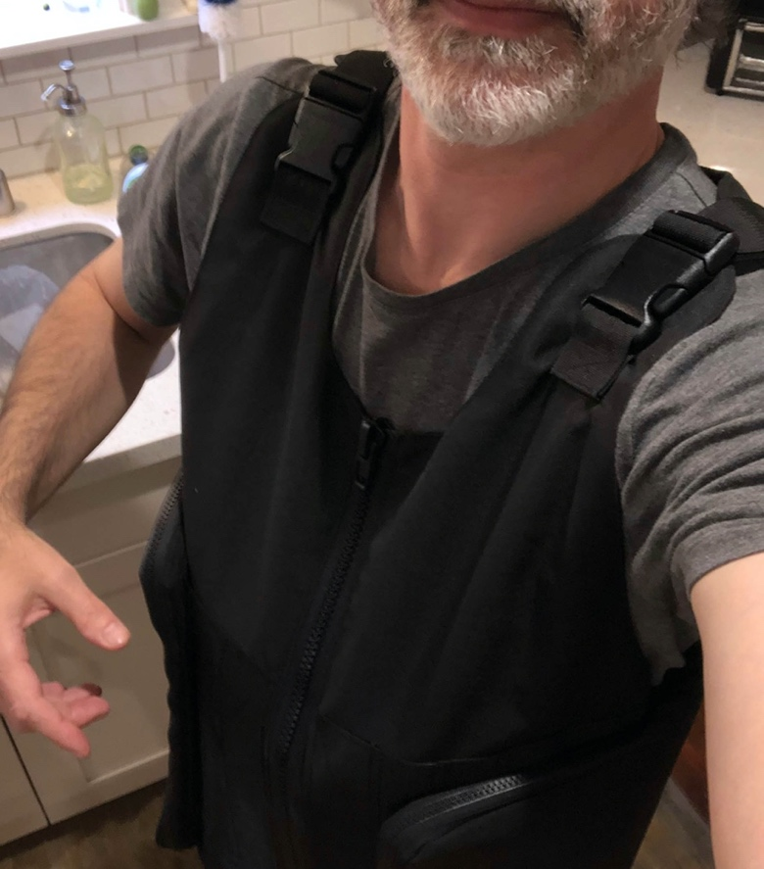
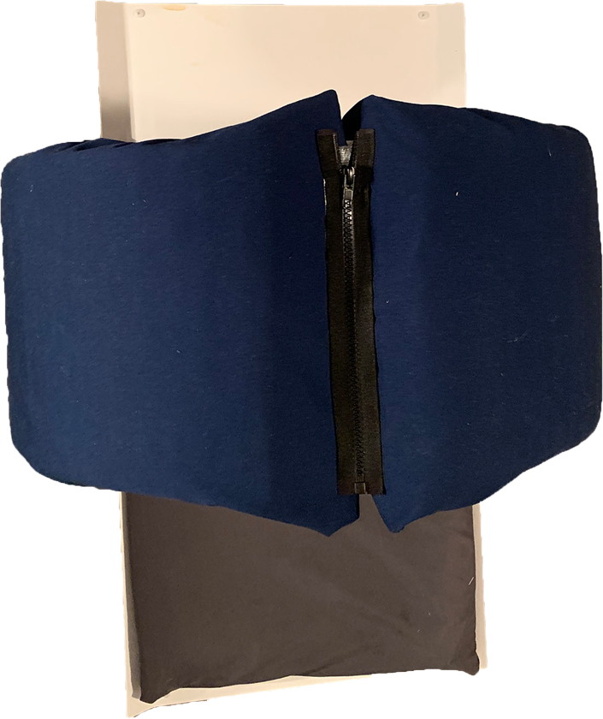
Personalized Remote Radiation Tracking (PRRT) Vest
Personalized Remote Radiation Tracking Portable Organ Dosimetry Device (PRRT PODD)
Notes:
I have previously talked about the PRRT Vest shown on the left. We are still developing that technology; however, for this talk I am going to be describing an alternative design which we call the PRRT PODD.
Both devices should perform similarly, it am going to provide some initial results for the PODD, just because we are slightly further along in its testing.

Slide 9
Personalized Remote Radiation Tracking (PRRT) Devices
Personalized devices to monitor washout of ¹⁷⁷Lu DOTATATE from OAR
Houses 10-16+ small detectors
Worn 2-5 minutes daily for 7-10 days (7+ measurements, vs 3-4)
Electronic data transfer for remote monitoring
Battery operated
Primary focus is kidney dosimetry
¹⁷⁷Lu PSMA-617, Pluvicto (kidney is also one of the primary OAR)
Notes:
What are some of the characteristics of the current PRRT devices.
They are personalized to monitor the washout of 177-Lu DOTATATE from the patients organs at risk.
They will house 10-16 small radiation detectors.
The idea is to have the patient take daily measurements with the device. There measurements should last 5 minutes or less.
Once the data is collected it will be sent electronically to a remote server for monitoring and quality control checking.
The device can run off of battery power or while plugged into a wall outlet. The battery is identicaly to that used in a cell phone.
The main focus for the devices is to provide accurate washout information enable accurate dosimetry for the patient’s organs ar risk, with the kidney being the main organ at risk for a majority of patients.
The kidneys are also one of the main organs at risk for Lu-177 PSMA-617. So the basic PRRT device designs will also work for the 177-Lu PSMA

Slide 10
PRRT Device Protocol
Patient will wear device (without detectors or electronics) during their therapy qualifying DOTATATE PET/CT study to register device to internal organs of interest
DOTATATE PET/CT images and Monte Carlo tools are used to simulate ¹⁷⁷Lu gamma photon transport from organs and tumors of interest to an array of detectors encircling the patient’s torso
Optimization tools are used to select the best subset of detectors to estimate the activity in each of the OARs and tumors
One SPECT/CT image taken at 24 hrs post ¹⁷⁷Lu DOTATATE administration for quantitative organ and tumor uptake information
Notes:
So how does the protocol work.
Patients will wear the device without detectors or electronics during their Ga-68 or Cu-64 DOTATATE PET/CT study to register the device to their internal organs of interest. Kidneys, liver, spleen.
Using the DOTATATE PET/CT images, Monte Carlo tools are used to simulat Lu-177 gamma photon transport from organs at risk and other structures of interest (e.g., tumors) to a virtual 2D array of detectors encircling the patient’s torse.
Optimization tools are used to select the best placement for a subset of detectors to estimate the activity in each of the OARs.
The detectors are then specifically placed in the PODD according to the locations specified by the optimization software.
One spect/CT image is taken 24 hours after the patient receives a Lu-177 DOTATATE administration to get quantitative organ (and tumor) uptake information.

Slide 11
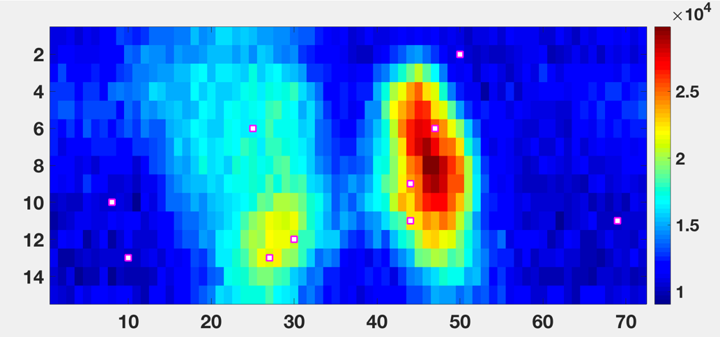
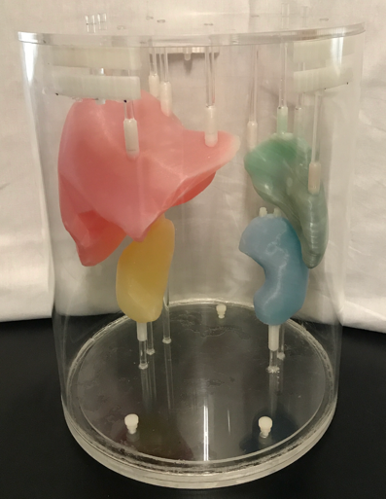
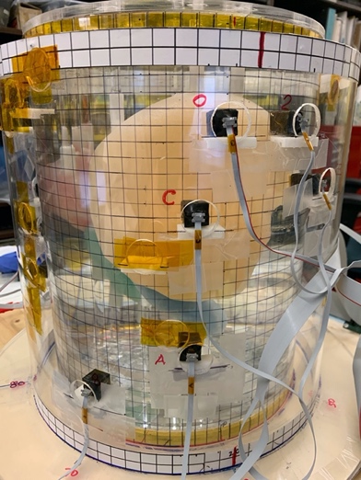
Initial PRRT Device Experimental Results
Phantom simulation
 | True decay rate | Experimental results | % error
Right Kidney | 48 hrs | 46.9 ± 0.3 | 2.3%
Left Kidney | 45 hrs | 44.9 ± 0.1 | <1%
Liver | 67 hrs | 65.7 ± 0.1 | 1.9%
Spleen | 74 hrs | 74.7 ± 0.02 | <1%
Backgrnd | 95 hrs | 95.2 ± 0.2 | <1%
Notes:
The way the PRRT vest will work is outlined on this slide.
The patient will wear a vest without detectors during their Ga DOTATATE or Cu DOTATATE PET/CT scan. The CT and PET images will registrer the vest to the patient’s internal organs a risk.
Next using the PET/CT images, Monte Carlo simulation tools will be used to generate a sensitivity matrix between each of the organs at risk and a simulated 2D array of virtual detectors surrounding the torso of the patient. An example of what that sensitivity matrix looks like is shown in the upper right figure. The figure represents the number of counts each detector from a 72x15 array wrapped around the patient would see if there were activity in the patient’s kidneys, liver, spleen and background. We have an algorithm that then selects the best subset of detectors of use to track activity in each of the organs of interest. The white squares with red borders desginate the locations that our software told us to place detectors for this simulated patient. Our technique currently required a single quantitative SPECT/CT image to be acquired at 24 hours post Lu-177 DOTATATE administration to get the organ uptake information. The vest will then be sent home with the patient to take daily measurements to determine the washout kinetics from the patient’s organs at risk.
We 3D printed an anthropomorphic phantom to test out our methodology. The phantom was wrapped with CT grid material and a CT scan was taken, Monte Carlo simulations were run and our software recommended placement of 12 detector modules. We then individually filled the different organs to get the sensivity relationship between each organ and each of the detectors. Using that information, we were able to simulate different uptake and washout kinetic values for each of the organs at risk. Using proper noise statistics we then simulated what the measured count rate would be for each of the detectors from 2-minute daily data acquisitions.
From the collected data, we then used our software to estimate the washout kinetics for each of the organs based upon the computed measurements.

Slide 12
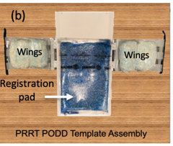
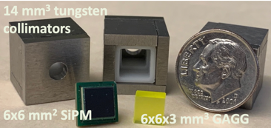
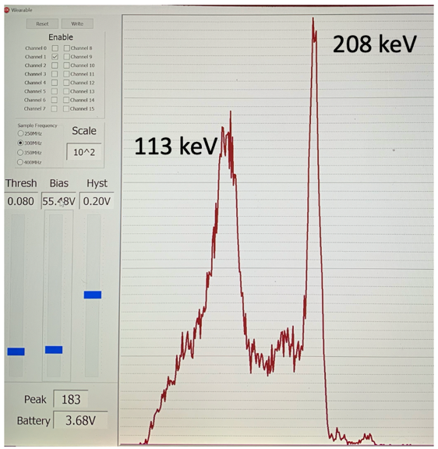
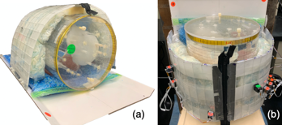
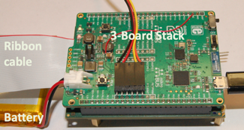
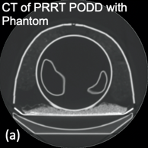
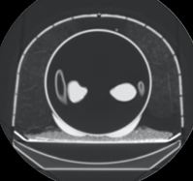
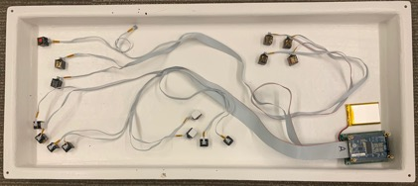
Personalized Remote Radiation Tracking Precision Organ Dosimetry Device (PRRT PODD)
Electronics
PRRT PODD Experimental Setup
PRRT PODD Template
PODD w/ detectors
 | % error
Right Kidney¹ | 5.3%
Left Kidney¹ | -2.7%
Liver | 5%
Spleen | 5.7%
CT image
PODD wings and base unit were too big for phantom.
¹Kidney results using measurements for first five days.

Slide 13
Wearable Technologies for Nuclear Medicine:
Areas for National Laboratory Collaborations
Miniature, low power detector and data acquisition electronics (e.g., ASIC development)
Miniature detectors (possibly with imaging capability)
Notes:
One of the biggest challenges in research is to clearly define the problem. Once you define the problem you can come up with novel solutions. When developing wearable technology for nuclear medicine especially for at home or non-medical center setting, I believe some of the most important design considerations are ease of use; length of time of use; ruggedness and fail safes; and finally cost.

Slide 14
Acknowledgements and References
PRRT Vest and PODD
Larry Pierce, PhD
Robert Harrison, MS
Don DeWitt, MS, PE EE, PE ME
Hubert Vesselle, MD, PhD
William Harris, MD
Robert Stewart, PhD
References:
Vaska, et al., IEEE TNS, vol. 51(5), 2004
https://www.bnl.gov/newsroom/news.php?a=212139
Noble, JNMT, vol.47(4), 2019
https://www.neurofleximaging.com/single-post/2015/01/23/wearable-brain-scanner-measures-activity-on-the-go
Knowland, Med. Phys. 46 (6), June 2019
Lattanze, et al, Frontiers in Medicine, Vol. 5(303) 2018
Gallicchio, et al., IEEE JTEHM, Dec 2020
Brinks, et al., EJNMMI (2017) 44:935-940
Santhanam, et al., nature.com/scientific reports (2021) 11:18479
Funding sources for PRRT Vest and PODD:
NIH R21 CA237788
NIH R41 CA243982
UW CoMotion STEP Award
UW Bridge Fund
Notes:
Thank for your attention. I would like to acknowledge the inviduals that have been helping to develop the PRRT Vest and PODD technology and our funding sources. In addition, I have provided a list of refereces for some of the other wearable technology discussed in this presentation.

Slide 15
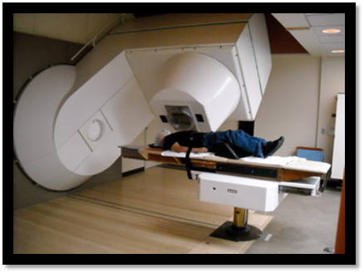
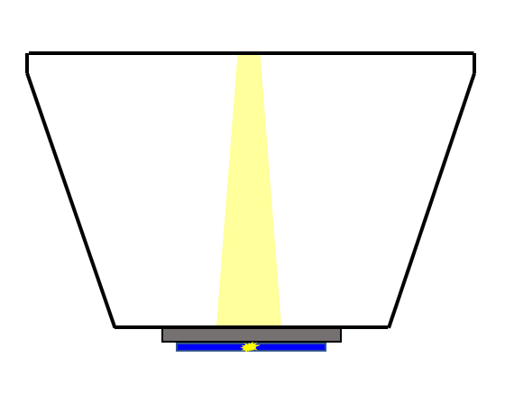
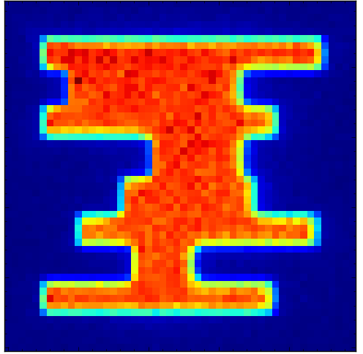
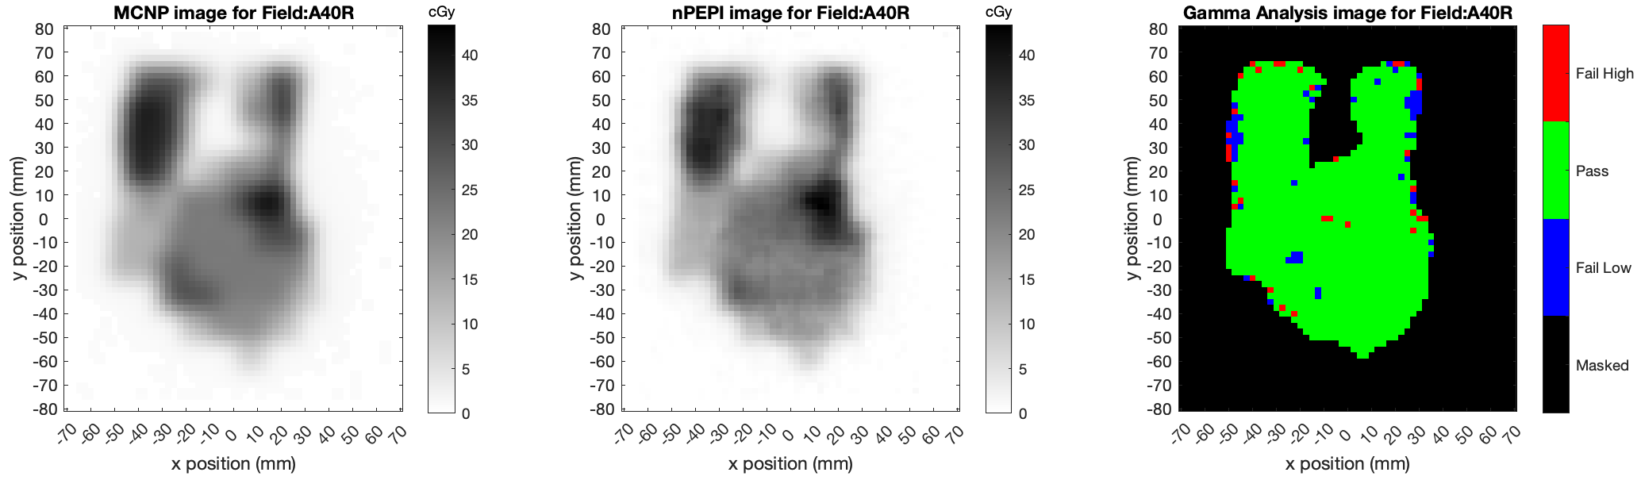
nPEPI Implementation: Using Portal PET Imaging for Intensity Modulated Neutron Therapy QA
Treatment Head
MCNP
nPEPI PET
IMNT neutrons
Irradiate polyethene plate with fast neutrons
Measure induced positron activity in nPEPI scanner
Compare reconstructed and Monte Carlo simulated activity maps
University of Washington Clinical Neutron Therapy System (CNTS)
IMNT Thyroid Plan (Dose contours)
Gamma Analysis:
5% in 5 mm example
Joint project between UW Radiation Oncology and UW Radiology
A Lehnert, M Kranz, D DeWitt, S St James, D Argento, G Moffitt, AG Montoro, E Liang, R Emery, R Miyaoka, R Stewart

