Slide 1

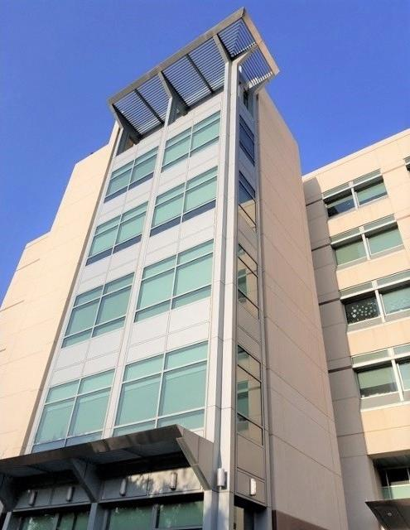

DOE/NIH workshop: Advancing Medical Care through Discovery in the Physical Sciences 2023
UCD Health Medical Center, Sacramento
¹Radiology
UC Davis
²Biomedical Engineering
Cameras and detectors for radiopharmaceutical therapy:
State-of-the-art, Challenges and Emerging Technologies
Emilie Roncali^{1,2}
Notes:
Focus on radio-theranostics and nuclear imaging

Slide 2
Outline
Radiopharmaceutical therapy and dosimetry
The need for quantitative imaging for personalized treatment
Challenges and solutions for image-based dosimetry
Notes:
My talk focuses on radio theranostics applications and not so much on EBRT but this will be discussed in the session

Slide 3
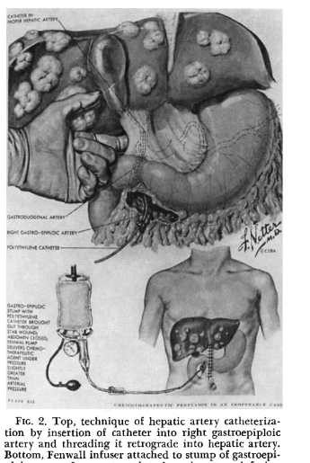
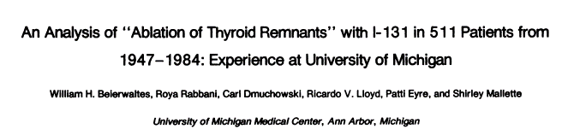
Radiopharmaceutical Therapy: Definitions
Locally delivered radiation therapy through biological targeting
At the interface of chemistry, radiobiology, immunology, physics, diagnostics imaging, pharmacology
Not new!
Also called…
Targeted Radionuclide Therapy (TRT)
Molecular Radiotherapy (MRT)
I.M. Ariel and G.T. Pack, Cancer, 1967

Slide 4
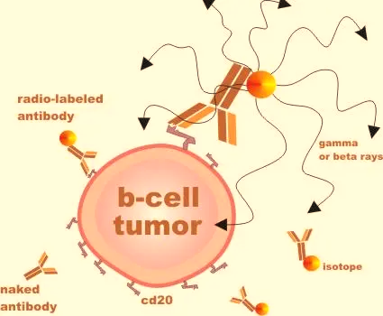
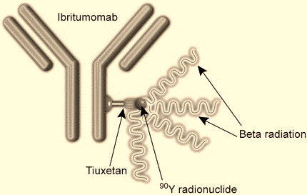
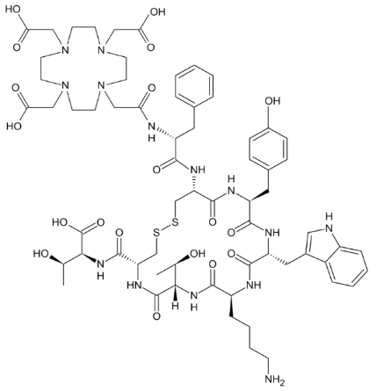
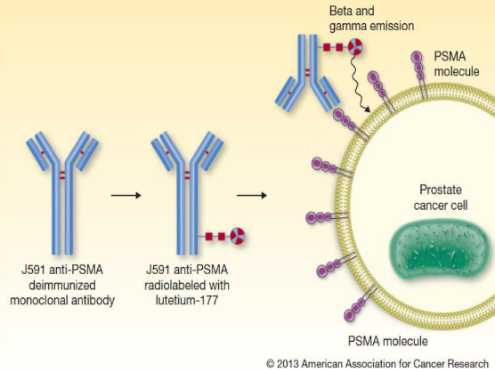
RPT and Targeting
RPT now indicated in 35% new cancers (33% deaths)
Antibody targeting
β emitter, with small positron emission
Image with bremsstrahlung SPECT or PET
⁹⁰Y Ibritumomab tiuxetan
Peptide Receptor Targeting
¹⁷⁷Lu
Prostate-specific Membrane Antigen
β emitter with 2 γ emissions
Image with SPECT
FDA-approved 2002
B-cell non-Hodgkin lymphoma
¹⁷⁷Lu-PSMA-617
β emitter with 2 γ emissions
Image with SPECT
¹⁷⁷Lu-Dotatate
FDA-approved 2018
gNETs
FDA-approved 2022
mCRPC
Notes:
Radionuclide therapy can be targeted in the same manner as other pharmaceuticals
¹³¹I- Sodium Iodide 1971 with Iodine 131
- ¹³¹I Tositumomab Bexxar 2003-2014 or Y90 ibritumomab are antibody targeting. Bexxar used for B-cell lymphoma and tiuexetan (Y90) used for B non-Hodgkin lymphoma. Murine monoclonal antibody selectively binding to B-lymphocyte antigen CD20 on surface of B lymphocytes
- Ra-223 Xofigo 2013- is radium dichloride, bone-seeking Ca mimetic that targets areas with bone turnovers, such as mets. Alpha emitter 82 keV
Y-90 spheres
PSMA is an enzyme overexpressed in prostate cancer and mets castrate-resistant cancer
Lu-DOTATATE gastro entero pancreatic neuroendocrine tumors (GEP-NETs) that are positive for the hormone receptor somatostatin, including GEP-NETs in the foregut, midgut, and hindgut.
Reminder: Antigens can be proteins, peptides (amino acid chains), polysaccharides (chains of monosaccharides/simple sugars), lipids, or nucleic acids

Slide 5
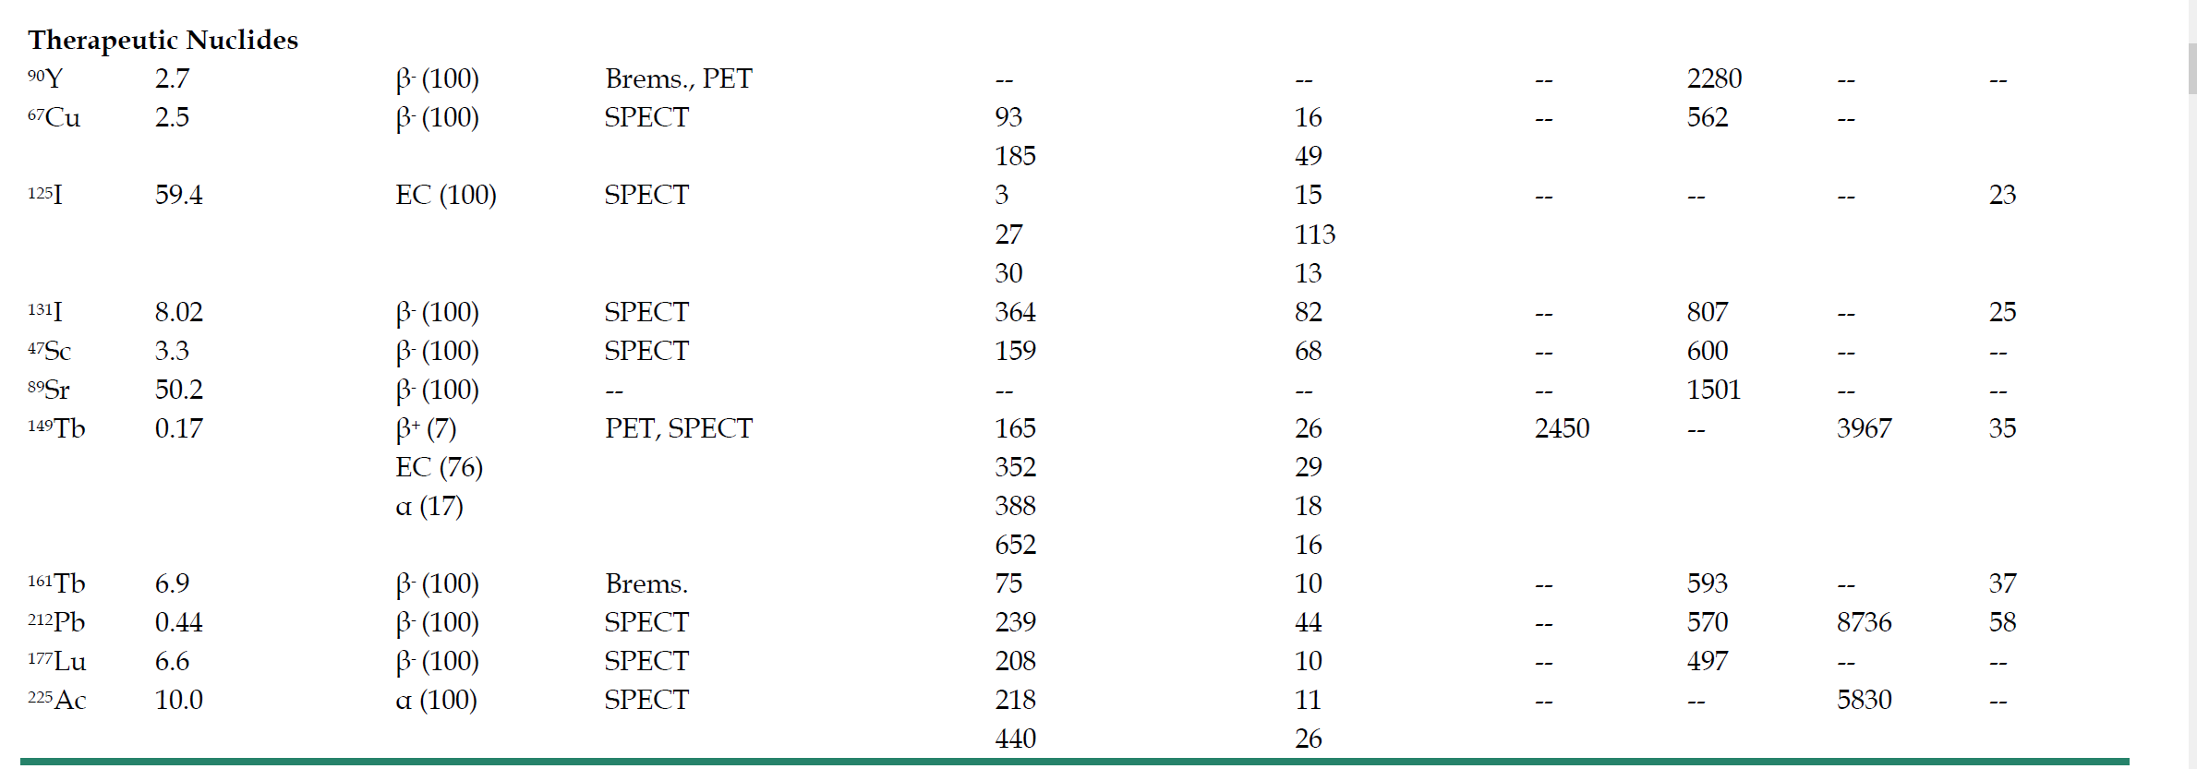







Radionuclide Therapy emitters
$α ,β,γ$ emitters
PET, SPECT, Bremsstrahlung
 | ¹⁵³Sm | 1.95 d | β- | SPECT | 103 | 30 | 810
 | ¹⁶⁶Ho | 26.8 h | β- | MRI, Brems. | 81 | 7 | 1850
 | ²¹³Bi | 45.6 min | Β-, α | SPECT | 440 | 16.4 |  | 8.4
 | ²²³Ra | 11.4 d | β-,α | SPECT | 82 | 20 |  | 5.97
Role of theranostic imaging and dosimetry?
C. Miller, J. Rousseau, C. F. Ramogida, A. Celler, A. Rahmim and C. F. Uribe. “Implications of physics, chemistry and biology for dosimetry calculations using theranostic pairs”, Theranostics 2022
Notes:
α decay:
Short range attractive for targeted therapy (tens of microns)
Radium-223 dichloride FDA approved for metastatic prostate cancer (bone)
Ra-223 (Xofigo)
Alpha-particle emitter (~80 µm range in tissue; 11.8 day half-life)
²²³RaCl – calcium analog; concentrates in rapidly proliferating bone
55kBq (1.49 µCi)/kg every 4 weeks for 6 cycles → 2 month survival improvement
Protocol to image patients by quantitative SPECT/CT after 1st and last cycle
Ac-225, At-211, Bi-213 in development
β- decay
Lu-177
Lu-177 dotatate for gastro entero pancreatic neuroendocrine tumors
Lu-177 PSMA for metastatic prostate cancer
Energy βmax = 479 keV, max range 2.7 mm, 2 useful photons for SPECT (112 keV and 208 keV)
Y-90 DOTATE or Y-90 microspheres for liver radioembolization
Energy βmax =2.28 MeV, max range 11mm
Can be imaged through Bremsstrahlung emission (SPECT) or low positron emission (PET)

Slide 6
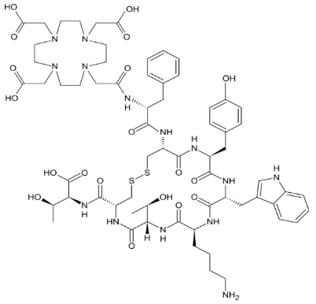
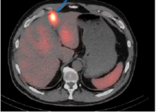
Quantitative nuclear imaging and dosimetry for radiotheranostics
Theranostics is redesigning the nuclear medicine landscape
Ideal plan for each patient:
We see → we plan → we treat → we monitor response → we adjust and retreat
Quantitative imaging at the core of dosimetry
Radionuclide therapy
Dosimetry
¹⁷⁷Lu
Technological gaps to support this paradigm create opportunities for new developments
¹⁷⁷Lu- PRRT
FDA-approved 2018
Uribe et al JNM 2021
Notes:
We see= diagnostic imaging, typically SPECT or PET/CT
We plan – predict the dose in OAR and tumors if possible
We treat = we deliver the RPT in 1 cycle, typically several cycles are planned based on FDA approved molecules
We monitor response = we assess the dose in OAR and tumors. This is where imaging plays a big role, we need PET/CT or SPECT/CT again
We re-adjust the dosimetry planning to respect toxicity and tumor dose (do we know the limits?)
Real integration of imaging and therapy for cancer!

Slide 7
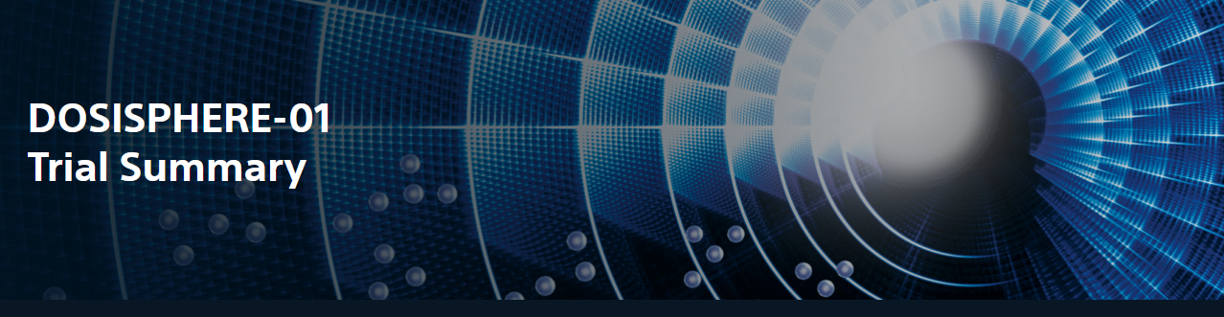

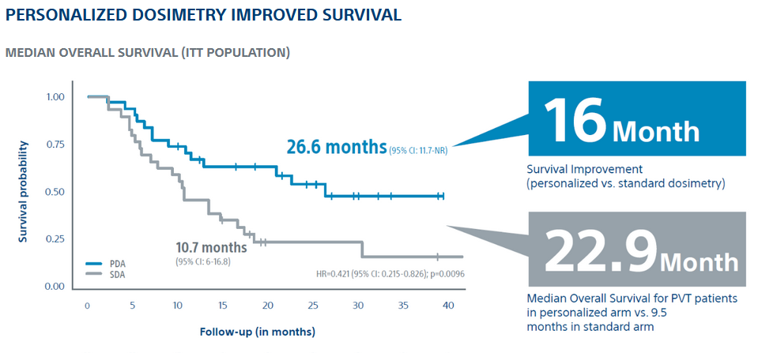
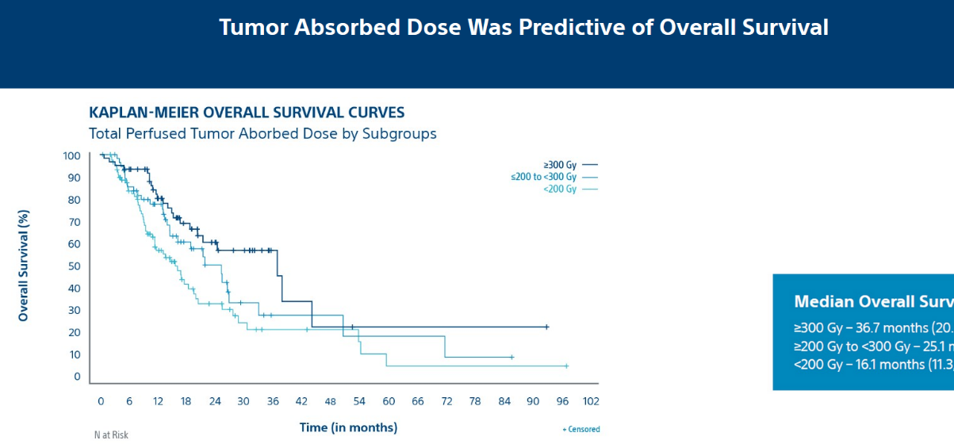
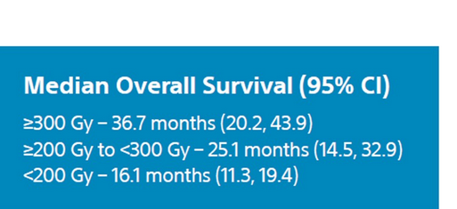
Dosimetry improves patient outcome:
Y-90 DOSISPHERE-01 trial and TARGET Study
Personalized dosimetry improves patient outcome
Tumor dose correlates with response
Notes:
A randomized, multicenter, investigator sponsored phase II trial comparing the clinical outcomes of SIRT with TheraSphere in patients with intermediate/advanced HCC using two pre-treatment dosimetry determination methods: (1) Standard, single-compartment dosimetry (SDA); defined as a uniform distribution of absorbed dose within the perfused volume – both tumor and normal liver or (2) Personalized dosimetry (PDA); defined as multi-compartment Y-90 distribution of absorbed dose within the perfused volume that accounts for preferential blood flow into the tumor compared with normal parenchyma.
Median OS 26.6 months with personalized instead of 10.7 months standard multicompartment dosimetry
Personalized means 205 Gy to tumor and 120 Gy rest liver instead of 120 Gy global

Slide 8
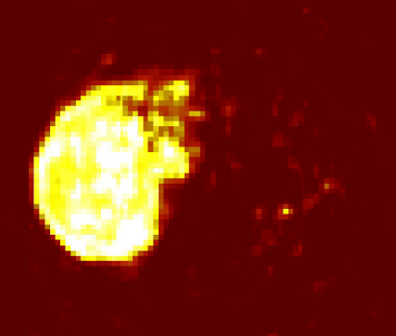
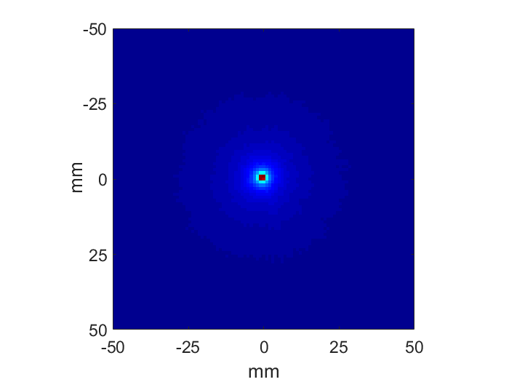
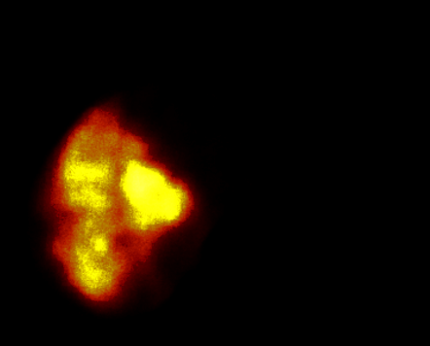
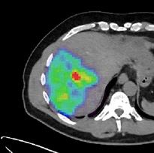
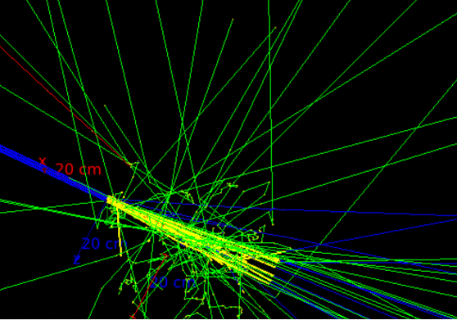
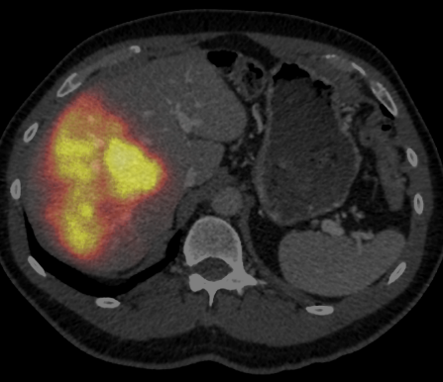



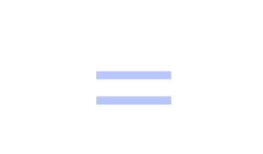

Image-based dosimetry
Total activity
Dose Point Kernel
Absorbed dose
-50
$$⨂$$
$$=$$
0
50
-50
0
50
How do we quantify the total activity?
mm
Total activity + anatomy (CT, MRI)
Radiation transport model
Absorbed dose
$$=$$
$$=$$
$$+$$
Notes:
Typically calculated in average dose in shells
Dose point kernel, or specific absorbed dose point kernel, relates to the energy deposited at any distance from the source
DPK depend on electron range
CSDA= continuously slowing down approximation:
= path length that an electron would traverse when slowing down from its original energy E. to a stop, if its rate of energy loss along the track were equal to the mean rate of energy loss.

Slide 9
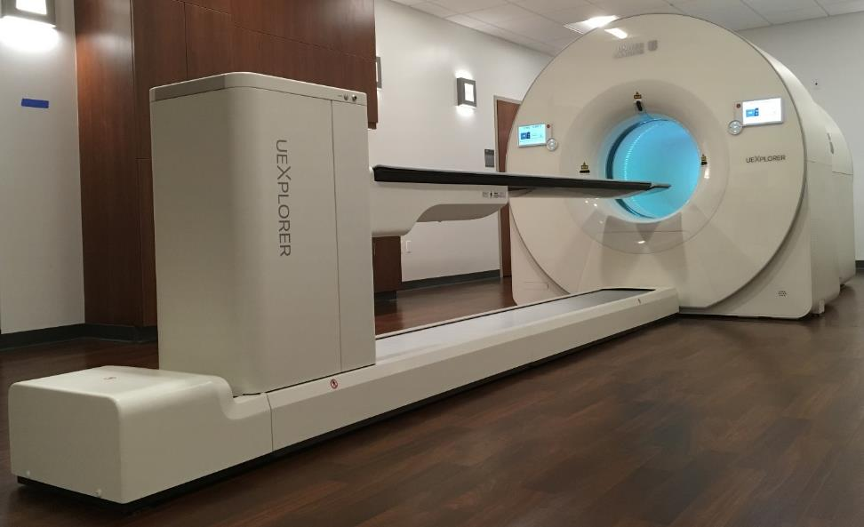
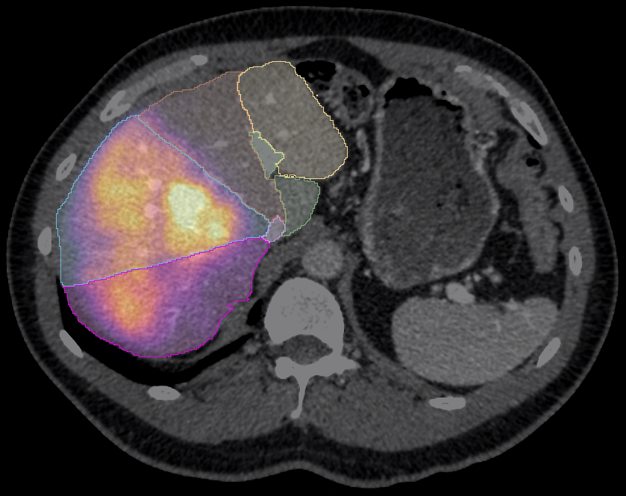
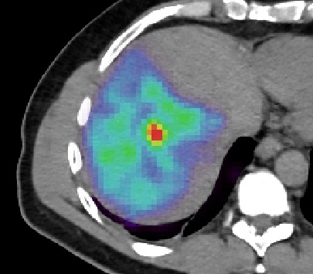
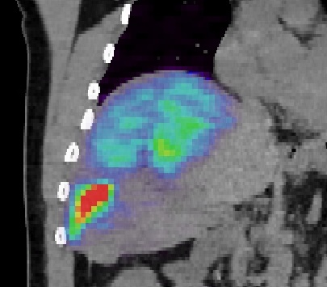
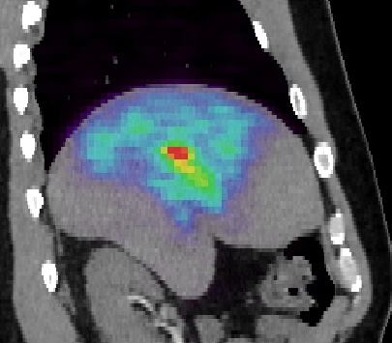
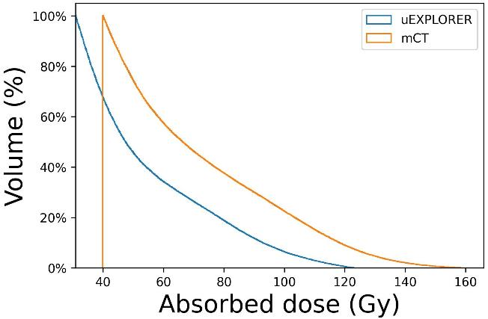
Post –treatment ⁹⁰Y Imaging with Total-body PET
uEXPLORER (UIH), 194 cm axial FOV
Liver segmental dosimetry
275.3 Gy
gNET patient: (3.36 GBq ⁹⁰Y)
30 min scan 5 hours after administration
275.0 Gy
Costa et al. Journal of Nuclear Medicine 2021
Notes:
3 injections to right lobe
uEXPLORER 4 mm isotropic voxels, PSF on, no smoothing
Y-90 PET shows microspheres in liver segments 5,6,7, & 8 where lesions are
Segment tumor volume to build tumor and nontumoral liver dose volume histograms
Introduce Yuni’s talk on dosimetry

Slide 10
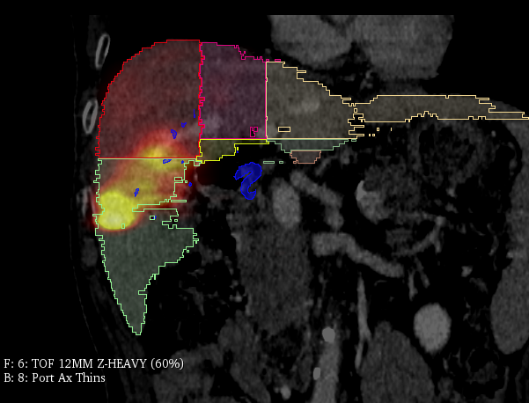
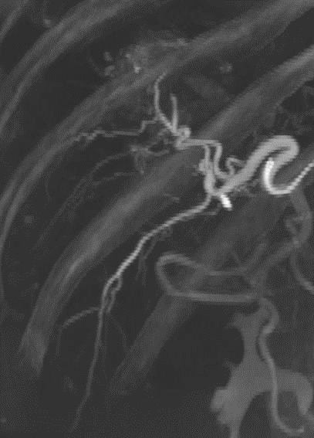
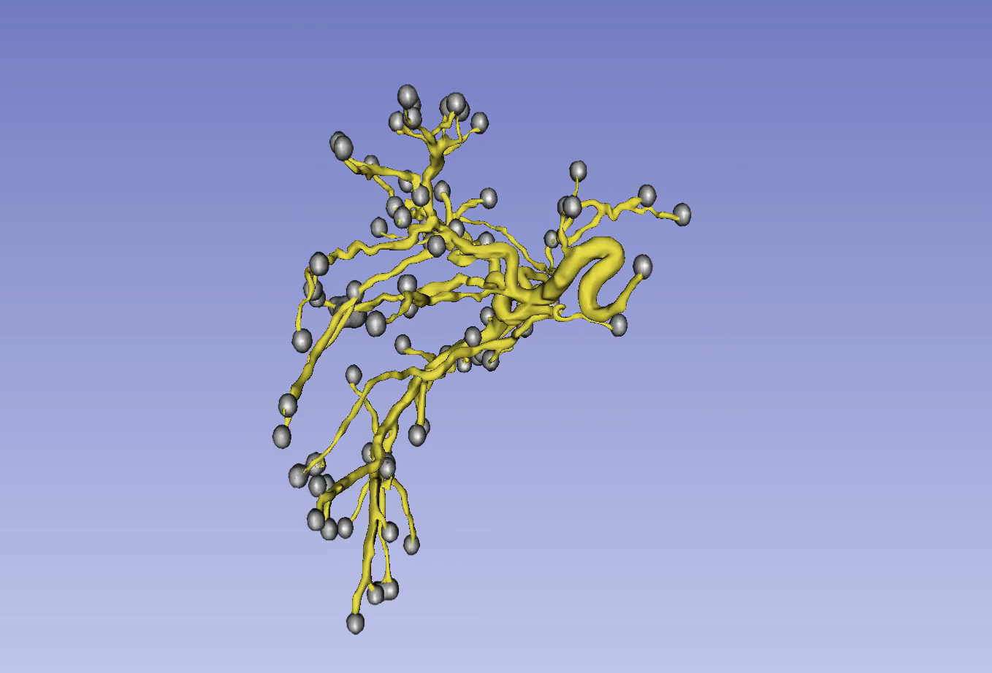
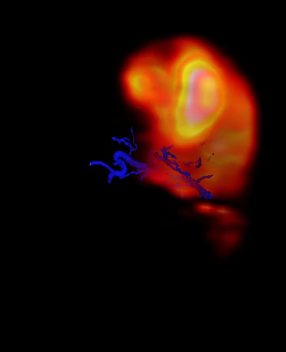
Challenge: dose heterogeneity in liver ⁹⁰Y radioembolization
Y-90 PET/CT + CBCT + CECT
CBCT
Simulation of microsphere distribution
Y-90 PET/CT and arterial tree
Heterogeneity comes from microsphere distribution in hepatic artery
Notes:
Add that with Y-90 DOTATATE we have low activities which are also challenging

Slide 11



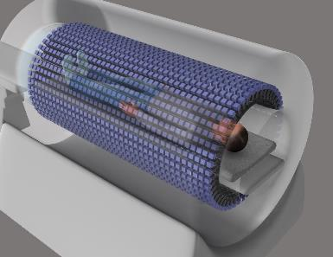
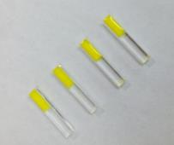


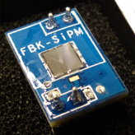

Looking forward: How can we improve image-based dosimetry?
Current clinics future technology
Activity
⊗
Dose kernel
Improve image quantification & dosimetry
(computational)
Improve imaging systems
(hardware)
Improve technology
Design new instruments
High resolution
High sensitivity
Fast imaging / long axial field of view
Portability
Work with Radiation Oncology
Work with Engineering (BME, ECE…)
Notes:
A multidisciplinary challenge
team effort
TB PET, app specific PET and better collim, energy res to reject scatter in SPECT
I frame this in the context of personalized q Dosimetry but there are other important aspects (AI , kinetic modelling, image reconstruction)
A lot of the tech I am discussing next is for PET but some applies to SPECT

Slide 12
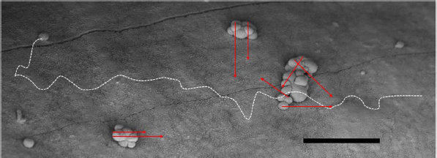
High resolution imaging for multiscale dosimetry
Ra-223 SPECT/CT Reconstructed Images
Micrometastases from ovarian cancer in peritoneal lining
α range ~50–70 μm
β range ~700 μm
100 μm
Elgqvist J, et al.. The potential and hurdles of targeted alpha therapy - clinical trials and beyond. Front Oncol. 2014
Courtesy George Sgouros, Eric Frey
Several orders of magnitude differences… How can clinical scans inform on α dosimetry?
Notes:
Alpha-emitter imaging is challenging. Some have deemed it impossible
Very high potency - > low administered activity ->very low count rate/noisy projections
Eric Frey quantitative recon method: models and compensates for image degrading effects
– no photon left behind– implemented in Rapid recon algorithm
Alpha SPECT challenges
Complicated decay schemes with multiple daughters
Multiple gamma and x-ray emissions
Presence of high energy photons
Small administered activities (Ra-233 =55kBq/kg x 70 kg →1 mCi vs 200 mCi for beta-emiters e.g. PSMA-617)
Need spectrometry
Micromets figure
Left: range of the α-particles can hardly reach the surrounding normal healthy cells other than possibly the mesothelium and its sub-layer. cannot reach the epithelial cells of the intestinal lining

Slide 13
High-sensitivity and fast imaging for dosimetry
Field of view for Lu-177 PRRT SPECT/CT is neck to pelvis, or head to pelvis → 2-3 bed positions
Depending on uncertainty and time point post injection (7 days) scan time can be >1h, repeated 5 times per cycle
High sensitivity or fast imaging needed
Solutions for high-sensitivity:
Direct conversion with semiconductors CdZnTe detectors
Crystal NaI(Tl)
Collimator-less imaging
Collimator
Notes:
2-3 bed positions takes time to acquire enough counts in each projection, typically at least 60 proj and 5s per project
Mention stationary scanners based on CZT

Slide 14
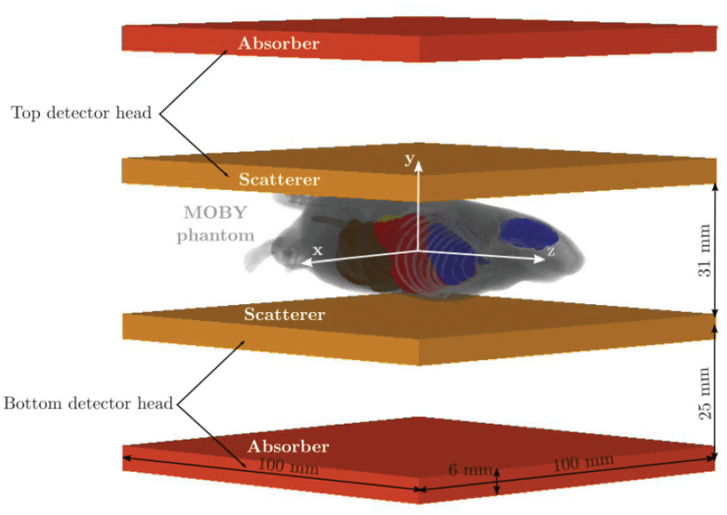
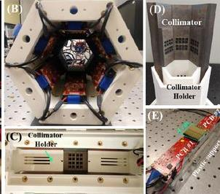
High-sensitivity SPECT
Compton imaging
Alpha SPECT mini
Caravaca J, et al. Compton and proximity imaging of ²²⁵Ac in vivo with a CZT gamma camera: a proof of principle with simulations. IEEE TRPMS. 2022 R01 EB026331
L. Cai et al. An Ultrahigh Energy Resolution SPECT System for Quantitative Hyperspectral Imaging of Targeted Alpha Therapy.
JNM June 2022, 63 (supplement 2) 3305;
Notes:
Proximity imaging higher sensitivity Compton can perform better than conventional SPECT
Can be used for alpha
Alpha SPECT has 24 modules spectrometers with multi readout circuitry and hyperspectral. Collimator has 96 knife-edge pinholes of 1mm diameter
Will support research as well.

Slide 15
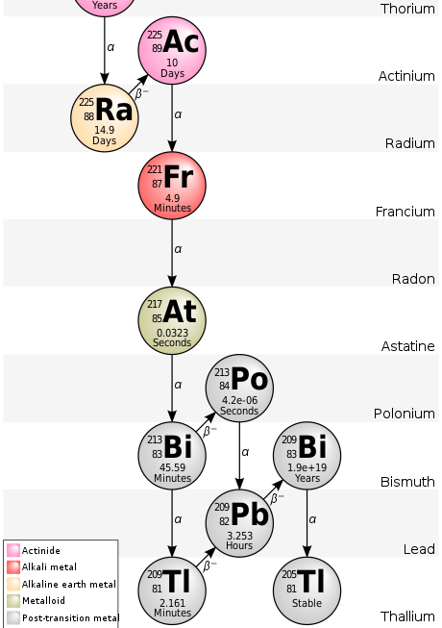
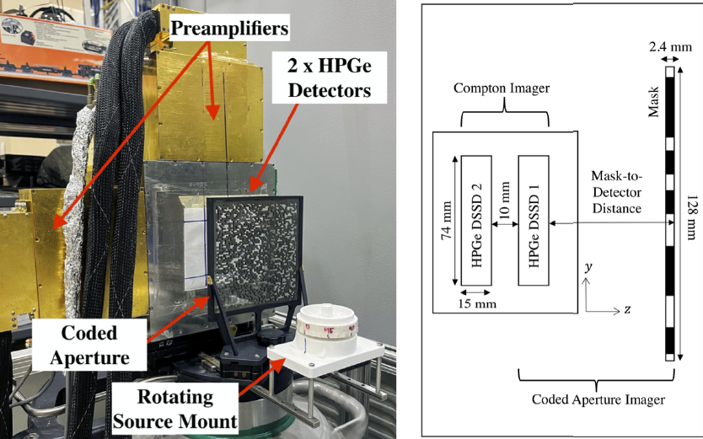
Targeted Alpha therapy imaging (Ac-225)
Dual modality imager Coded aperture + Compton
γ 218 keV
→ coded aperture
γ 440 keV
→ Compton imaging
E. A. Frame et al.. Coded Aperture and Compton Imaging for the Development of Targeted Alpha-Particle Therapy. arXiv preprint arXiv:2212.07631 2022 DE-NA0003180
Notes:
3D position-sensitive high-purity germanium (HPGe) double-
sided strip detectors (DSSDs)
planar
- HPGe crystal with an active volume of 74 74 15 mm3
- coded aperture is fabricated from 2:4-mm-thick tungsten, which ensures
roughly 90% attenuation at 250 keV. The mask consists of 64 64 square elements
with each individual element having a 2 2 mm2 face to match the detector pixel size
and limit collimation eects
- coded aperture combined with the front detector constitutes the coded aperture
imager, while the front and back detectors collectively form the Compton camera

Slide 16
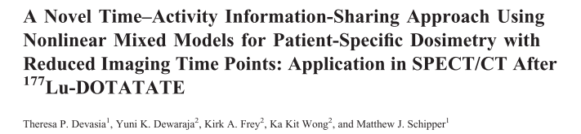
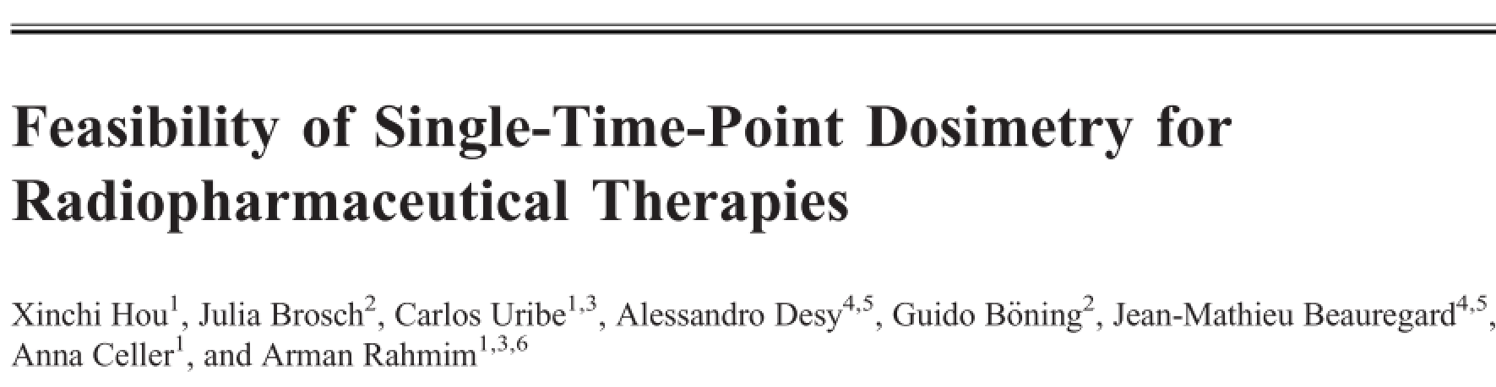
Imaging for dosimetry: how many time points are needed?
Single time point imaging using population data to estimate the organ clearance
Kidney dosimetry in gNETs treated with ¹⁷⁷Lu-DOTATATE
Mixed models demonstrate potential with 1-2 scans
2021
Not there yet for other organs…
Poor accuracy in bone marrow and tumors for ¹⁷⁷Lu PSMA
2021
How to acquire multiple scans in a simpler, more cost-effective way?
Notes:
Madsen:
Simulations were performed using both exponential models where the rate constants and associated parameters were randomly sampled from distributions with a known mean. The actual total integrated activity for each random sample was compared with the estimated total integrated activity using the mean value of the parameters. Retrospective analysis of 90Y DOTATOC data from a clinical trial provided a comparison of actual kidney dose with the estimated kidney dose using the single time point approach.
Conclusion: When there is prior knowledge about the population averages of kinetic parameters, these results suggest that the single time point approach can be used to estimate the total integrated activity and dose with sufficient accuracy to manage radionuclide therapy. This will make personalized dosimetry much easier to perform and more available to the community
Devasia: to evaluate a novel method for joint kidney time–activity estimation based on a statistical mixed model,
A prior 10 gNETs patients with complete time–activity data,
Only 1or 2 imaging points for new patients was compared with previously proposed single-time-point methods in virtual and clinical patient data.
Conclusion: Mixed models based on a historical cohort of patients with complete time–activity data and new patients with only 1 or 2 SPECT/CT scans demonstrate less bias on average and significantly fewer outliers when estimating kidney TIA, compared with popular reduced-time point methods.
Use of mixed models allows for reduction of the imaging burden while maintaining accuracy, which is crucial for clinical implementation of dosimetry-based treatment.
Hou 2021: large error several folds in bone marrow
Although there’s a lot of work done in improving STP dosimetry what alternative do we have? SEND the patient home!

Slide 17
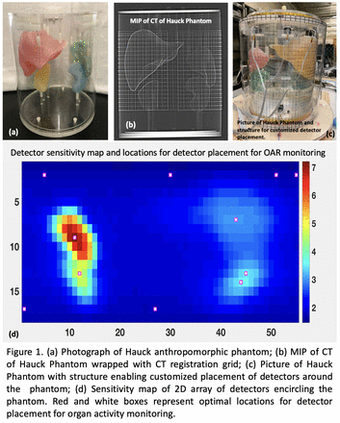
At-home dosimetry: Remote radiation tracking
Wearable dosimetry
Collect real-time dosimetry for days without serial hospital visits
Requirements
Design and Initial Performance Characterization of a Personalized Remote Radiation Tracking Portable Organ Dosimetry Device (PRRT PODD) IEEE MIC 2022, R. S. Miyaoka, L. A. Pierce, R. L. Harrison, D. Q. DeWitt, H. Vesselle
Notes:
Cost effective, user friendly personalized dosimetry for Lu-177 DOTATE therapy
Miniaturized system 10-15 small modules
Rugged registration
Body positioning
Portable electronics

Slide 18
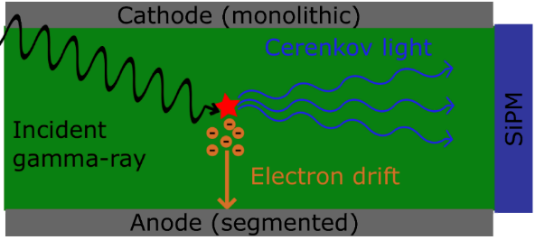
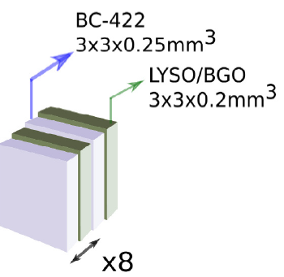
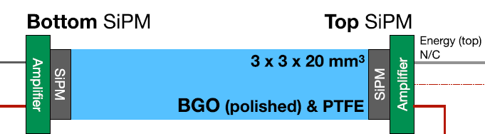

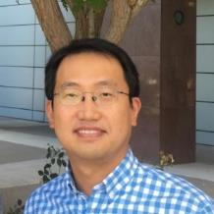
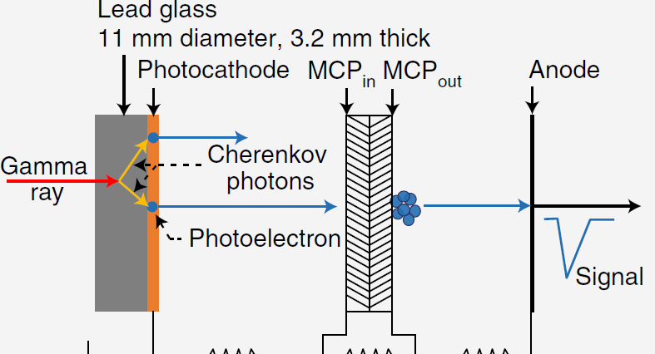
Novel detectors
DOI and timing
Metascintillators
Cerenkov-based detectors
Cerenkov BGO detector 280 ps
Cerenkov Charge Induced TlBr detector 330 ps
Kwon et al BPEX (2019)
LYSO/BC422 76 ps
Ariño-Estrada et al PMB (2019)
Turtos et al PMB (2019)
Cerenkov MC-PMT detector 32 ps
Applications:
PET imaging
proton gamma imaging
new SPECT detectors
Kwon et al Nature Photonics (2021)
Notes:
Mention material design

Slide 19
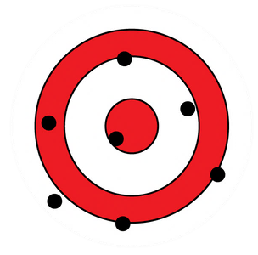
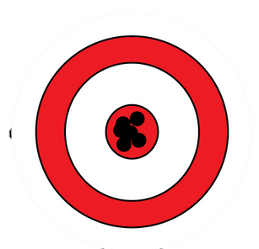
Conclusions
Quantitative nuclear medicine has made tremendous progress!
Integration of imaging and therapy is a strong driver of technological and computational innovation
Many exciting opportunities ahead of us to deliver robust quantification accuracy!
  Technology
  Standardization
  Image processing

Slide 20
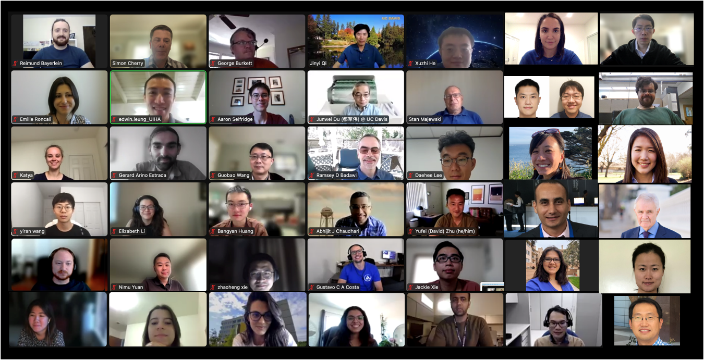



Acknowledgments
Radiology
Ramsey Badawi, Ph.D.
Denise Caudle, CNMT
Cameron Foster, M.D.
Heather Hunt, CNMT
Negar Omidvari, Ph.D.
Rex Pillai, M.D.
Benjamin Spencer, Ph.D.
Catherine Vu, M.D.
Biomedical Engineering
Gustavo Costa, Ph.D.
Carlos Ruvalcaba, Ph.D
Amirtaha Taebi, Ph.D.
Carlotta Trigila , Ph.D.
Gerard Ariño-Estrada, Ph.D.
Sun-Il Kwon, Ph.D.
Simon Cherry, Ph.D.
MIPET group
Julie Sutcliffe, Ph.D.
Radiation Oncology
Stanley Benedict, Ph.D.
R01 EB027130
R21 CA237686
DDCF

