Slide 1
The Cancer Moonshot
Douglas R. Lowy, M.D.
Principal Deputy Director, National Cancer Institute
Joint DOE/NIH Workshop on Radiation Detection
March 16, 2023
@NCIDirector ​
@TheNCI​
Notes:
Association of American Cancer Institutes (AACI) and Cancer Center Administrators Forum (CCAF) Annual Meeting

Slide 2
Today’s Talk
Current Cancer Moonshot (1.0)
New Phase of Cancer Moonshot (2.0)
Some NCI budget considerations

Slide 3
2016:Blue Ribbon Panel Recommendations
Network for
Patient Engagement
Immuno- therapy
Network
Overcome
Drug Resistance
Cancer Data Ecosystem
GOALS:
Accelerate progress in our understanding of cancer
Enhance data sharing
Encourage greater cooperation & collaboration
Intensify Research on Childhood Cancers
Symptom Management
Prevention & Detection Strategies
Retrospective Analysis of Biospecimens
Human Tumor Atlases
New Cancer Technologies
Partnerships

Slide 4

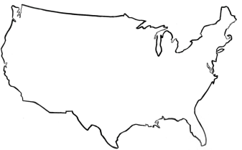
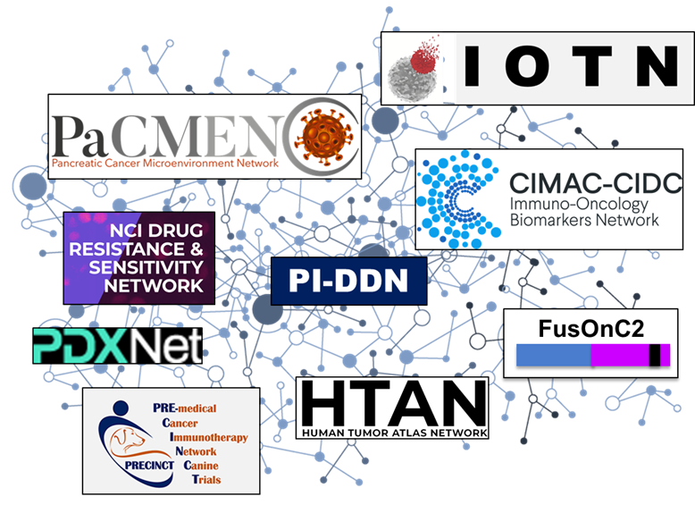
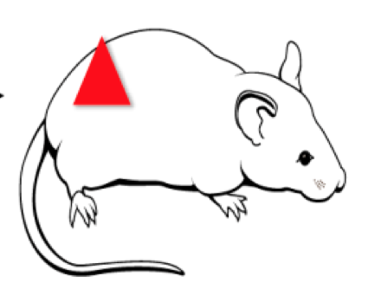
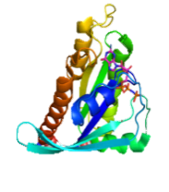
GOAL 3
Encourage greater cooperation & collaboration
Collaborative Meetings
Partnerships
NCI-DOE Collaboration
Pilot 3: Population Information Integration, Analysis, and Modeling for Precision Cancer Surveillance
Pilot 1: Predictive Modeling for Pre-Clinical Screening
Population cancer models
Pilot 2: RAS Biology on Membranes
Multiple distinct cancer models
Single mechanism

Slide 5

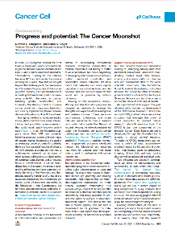
Cancer Cell July 12, 2021
Progress and Potential: The Cancer Moonshot
Norman E. Sharpless
Dinah S. Singer

Slide 6
Moonshot Publications Are High Impact
More Moonshot supported publications are of high citation impact compared to other NCI supported research
Data Source: Dimensions for NIH, data extracted on 12/14/2020 for publications between 2017 and 2020.
NCI comparison group: Includes publications from 2017 - 2020 that acknowledge NCI funding from a subset of activity codes used in the Moonshot: P01, P50, R00, R01, R21, R33, U01, U19, U24, U2C, U54, UG3, UH3, UM1, and Zs.
Bibliometric percentile: Percentile rank within the PubMed publication set by descending order of total citations, taking into account publication type, RCDC category, and year.
NCI Center for Research Strategy

Slide 7

President Biden has reignited the
Cancer Moonshot
and set a new national goal:
If we work together, we can
cut the death rate from cancer by at least 50% over the next 25 years
and improve the experience of people and their families living with and surviving cancer.
We can make real progress toward
ending cancer as we know it.
It will take all of us doing our part. Join us.
  https://www.whitehouse.gov/cancermoonshot/

Slide 8





Accomplishing the New Cancer Moonshot Goals
Invest in pipeline of new interventions (e.g., drugs) for cancer prevention, interception, and treatment
Increase implementation research to ensure equitable delivery of current and new standards of care
Expand clinical trials to speed evaluation of candidate interventions in diverse populations (racial, ethnic, geographic, comorbidities)
Increase diversity of cancer research and care workforce to resemble the communities we serve

Slide 9
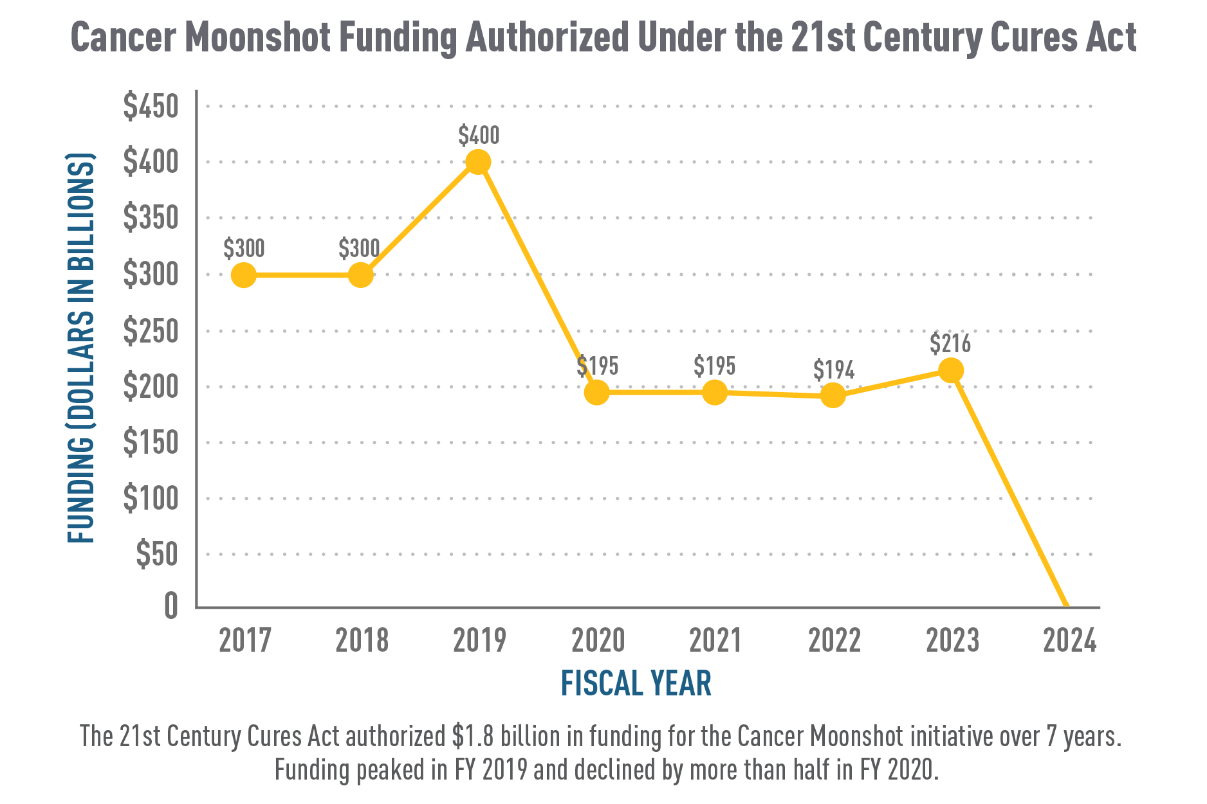
Cancer MoonshotSM Funding
Authorized Under the 21st Century Cures Act (dollars in millions)
Notes:
Vanderbilt Medicine Grand Rounds 11.19.20
The 21st Century Cures Act authorized $1.8 billion in funding for the Cancer Moonshot initiative over 7 years.
Funding peaks in FY 2019 and declines by more than half in FY 2020.
Regarding the orange bars on the previous graph, here is what that Cancer Moonshot funding pattern looks like through FY 2023. As you can see, the first few years were intentionally higher as new programs were developed and stood up – and those projects are now well underway.
In fact, as we approach a mid-point for many of the Cancer Moonshot initiatives

Slide 10
President’s NCI Budget for Fiscal Year 2024
$7.8B
$716M
For Cancer Moonshot as no-year funds
Total President’s budget proposal for NCI for FY 2024
$216M
Included for “Year 8” of 21st Century Cures Act Cancer Moonshot
+$502.9M
$500M
Total NCI budget increase for FY 2024
Cancer Moonshot increase (relative to FY 2023 enacted level of $216M)
The Biden Administration is proposing a further increase of $1.45 billion in mandatory budget authority for FY25 and FY26.

Slide 11
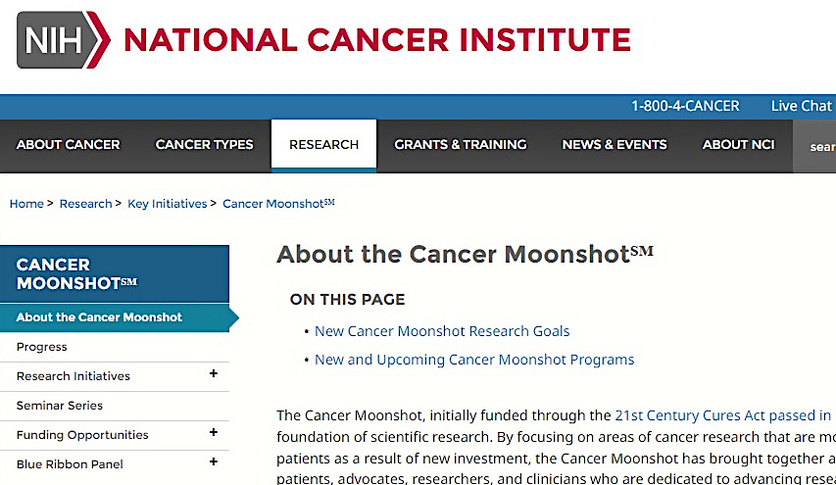

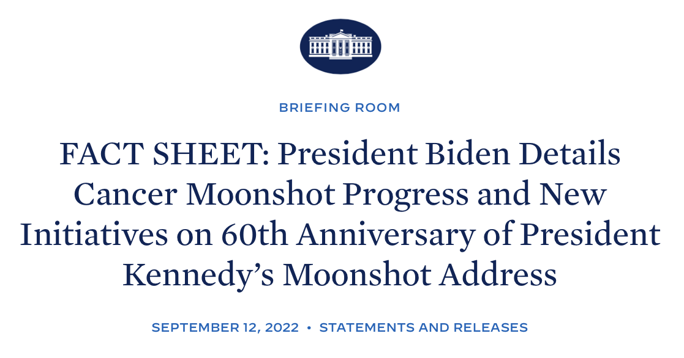



Cancer Moonshot Next Phase
Jumpstarting Three Programs
CANCER MOONSHOT SCHOLARS
TELEHEALTH
MULTI-CANCER DETECTION
Learn more: cancer.gov/moonshot
Notes:
Refer audience to cancer.gov/moonshot – which has more details about the three programs.

Slide 12

www.cancer.gov
www.cancer.gov/espanol
1-800-4-CANCER
NCIinfo@nih.gov
@NCIDirector
@TheNCI
Thank you!

