Slide 1
Organizing Committee
Tatjana Atanasijevic (NIBIB) Jeff Buchsbaum (NCI) Jacek Capala (NCI) Cynthia Keppel (DOE) Ceferino Obcemea (NCI) Behrouz Shabestari (NIBIB) Drew Weisenberger (DOE)
The second workshop in this series brings together DOE scientists, NIH scientists and extramural staff and NIH grantees to identify opportunities for DOE and NIH (NIBIB and NCI) communities to collaborate on projects based on existing state-of-the-art DOE technologies. Multiple sessions focus on various topics in radiation detection, such as cameras and detectors, data acquisition and image reconstruction, and applications of AI.

Slide 2
Welcome
Stuart Henderson, Director
March 16, 2023

Slide 3
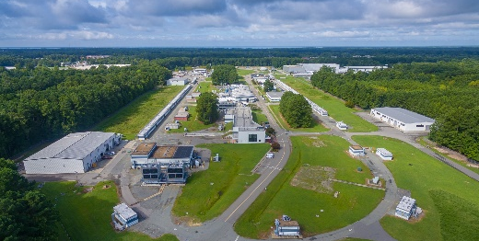
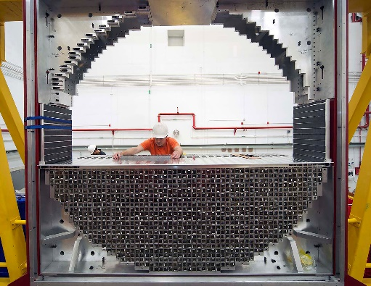
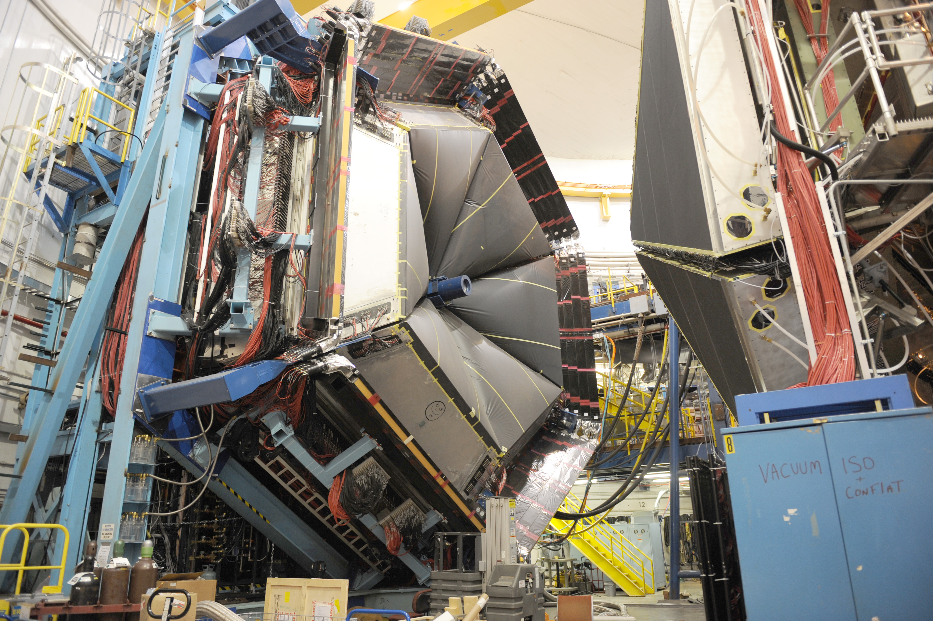
The Thomas Jefferson National Accelerator Facility
Department of Energy National Lab focused on fundamental Nuclear Physics
World’s most powerful and precise electron microscope to study the fundamental constituents of protons, neutrons and nuclei
Leaders in development of detector and accelerator technology, and computation for nuclear physics
Three decade history of deploying nuclear physics technology to applications in health and medicine working with medical researchers

Slide 4
Jefferson Lab by the Numbers

Slide 5
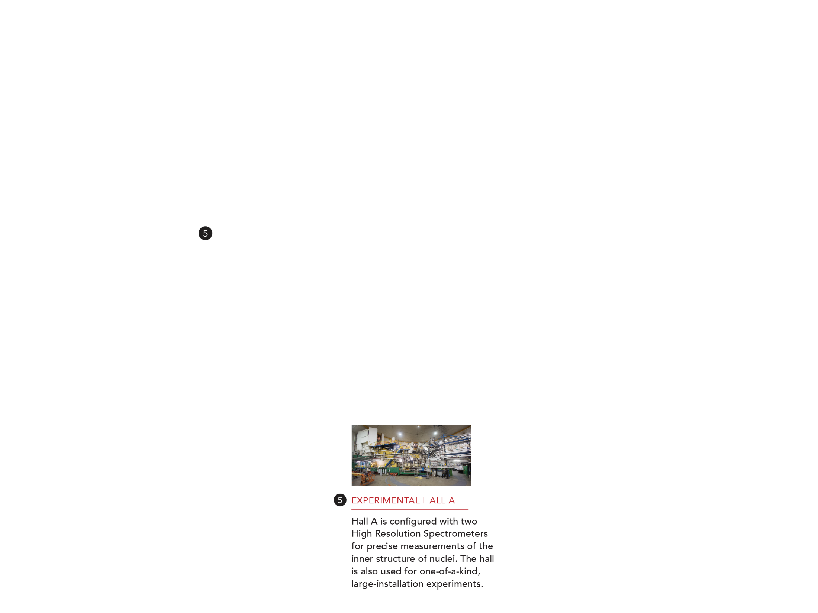
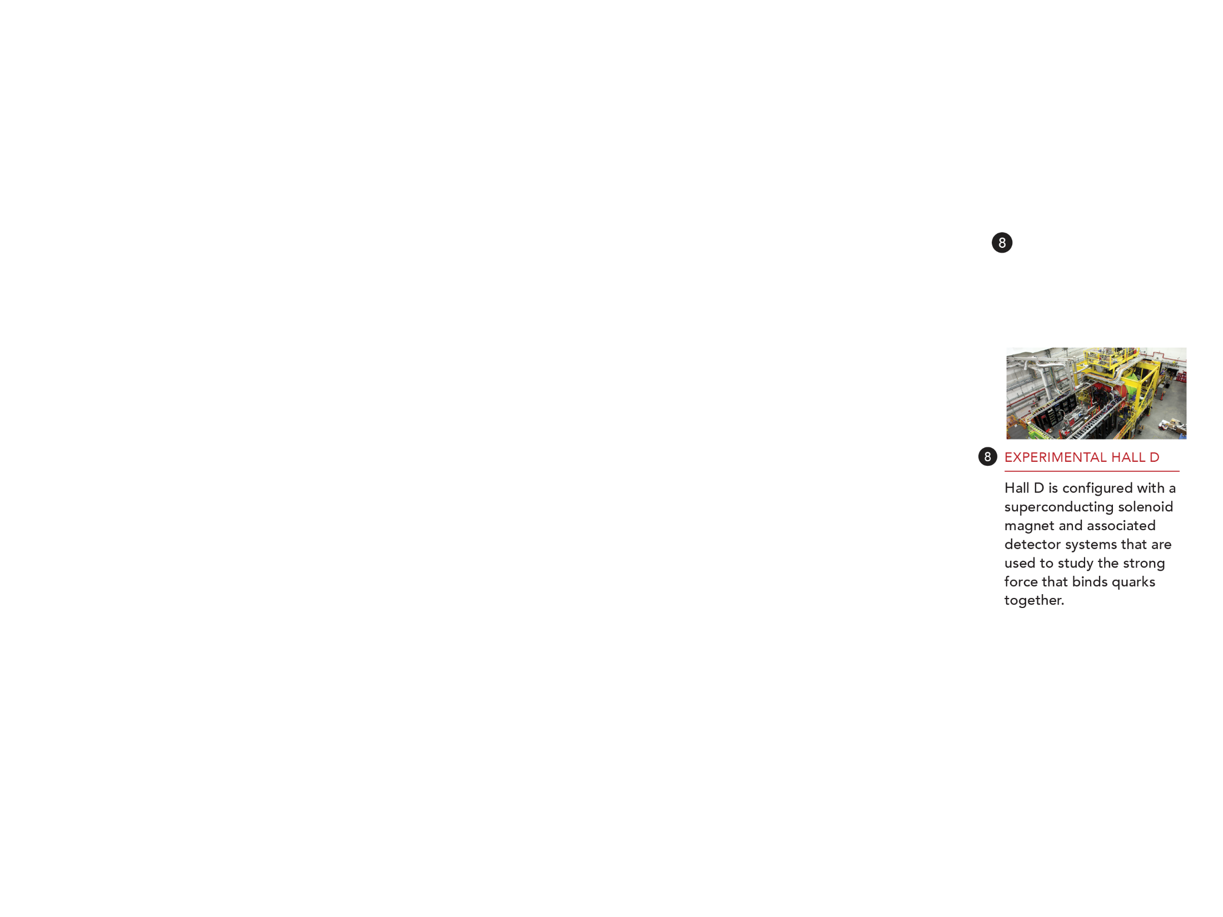

Slide 6
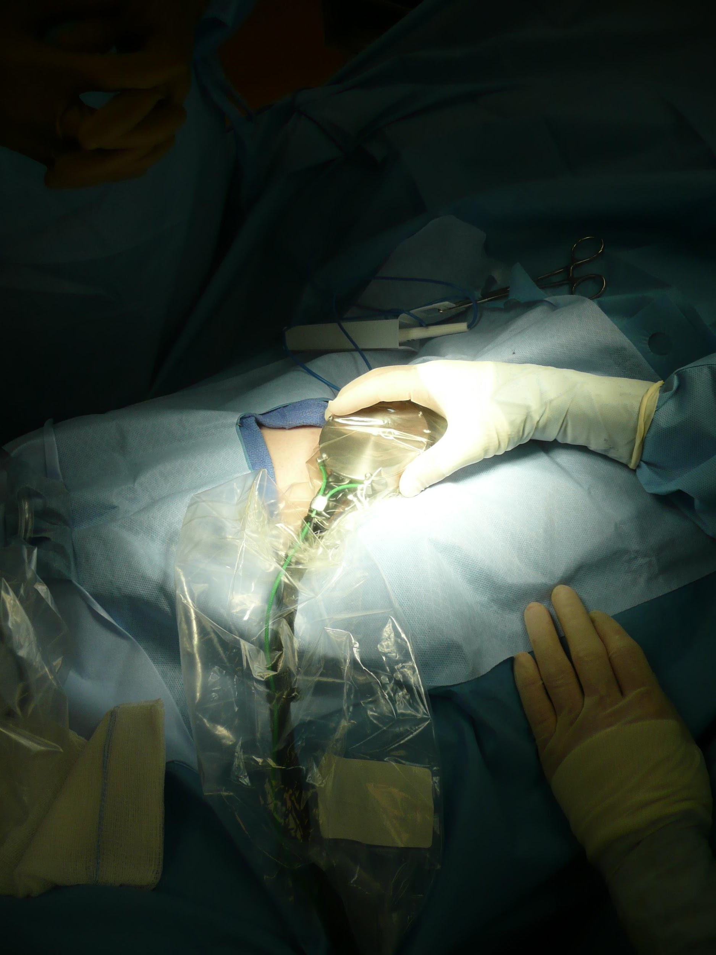
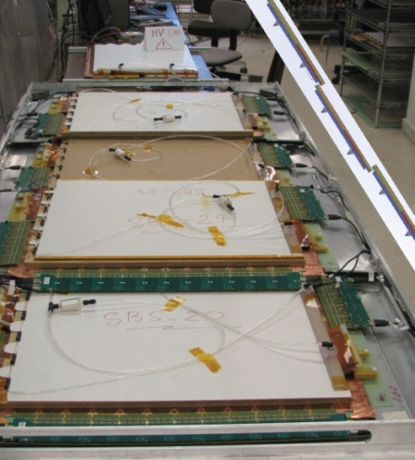
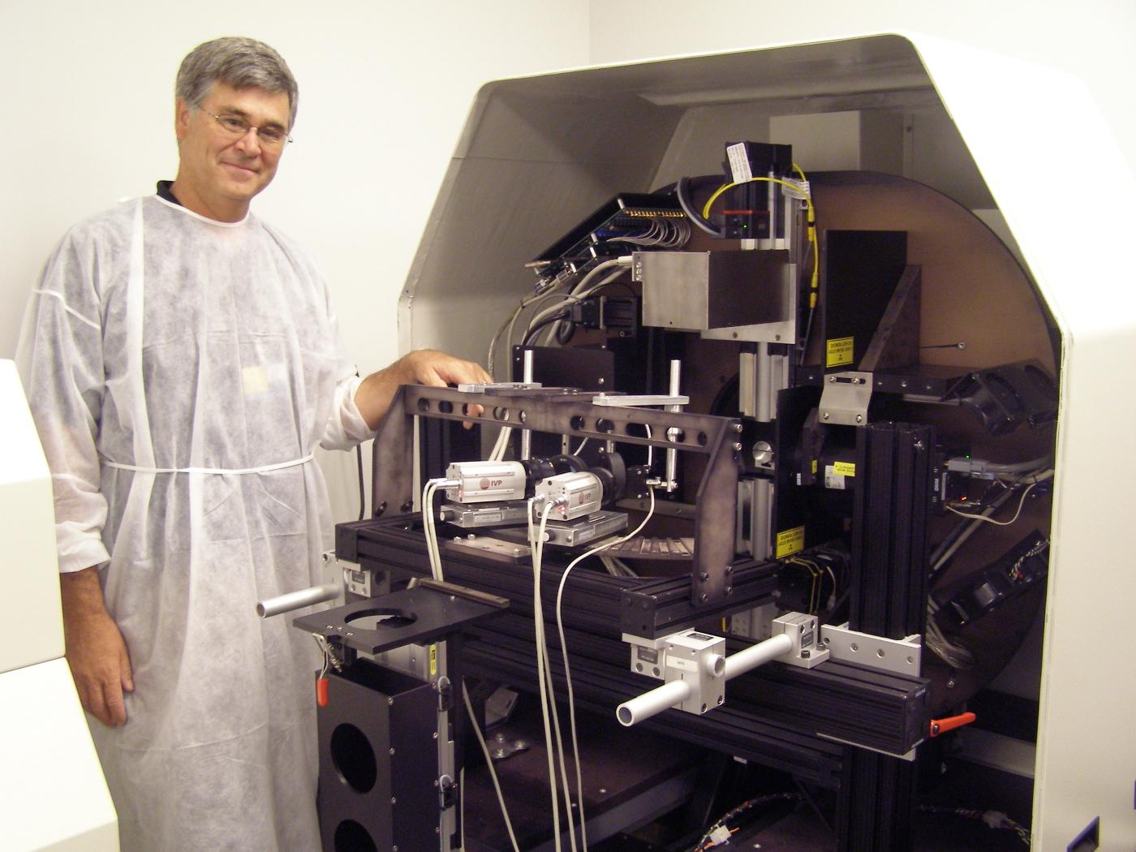
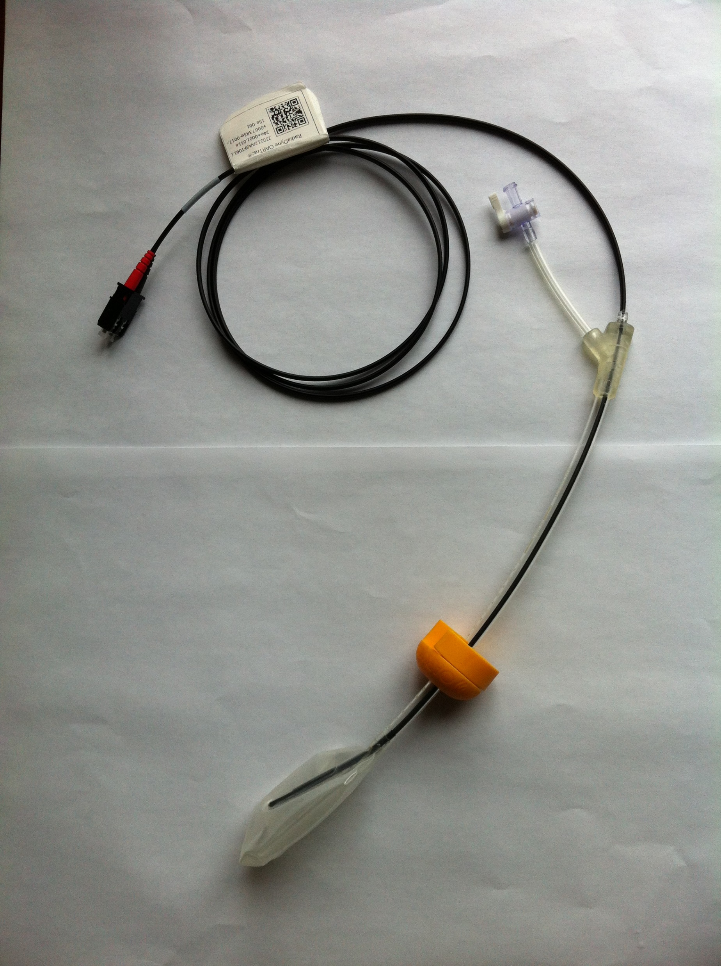
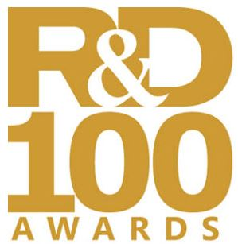
Exploiting Developments in Nuclear Science Instrumentation, Computing and Technology to Advance Health and Medicine: Examples from Jefferson Lab
Molecular Breast Imaging
Hand-held Gamma Camera
Active Catheter Development for Brachytherapy
Compact gamma camera for breast cancer detection based on JLab detector technology
Device to guide surgeons in the operating room, based on Si PM, under development
In-vivo dose measurements would allow for real time evaluation of dose delivered to patient
Real time dosimetry monitoring for radiotherapy treatment
Advancing Brain Imaging Technologies
Proton Beam Characterization and Dosimetry
Developed by Jefferson Lab and Hampton University scientists; licensed to Radiadyne; R&D100 award, MedTech Breakthrough award
AwakeSPECT System for functional mouse brain imaging; Jefferson Lab, ORNL, Johns Hopkins, U. Maryland
Gas Electron Multiplier Detectors for physics experiments: Potentially excellent tool for pencil beam scanning delivery

Slide 7
This Workshop
This workshop is about opportunities: bringing communities together to explore where advances in the physical sciences may be able to advance health and medicine with a special focus on radiation detection
This workshop is meant to:
Identify topics and projects of mutual interest to the NIH and DOE communities, that can advance goals of both
Provide a forum in which NIH researchers can hear about DOE technologies and DOE researchers can hear about NIH challenges and the state-of-the-art
Introduce people and establish a dialog between these communities
Outcomes:
The outcome of this workshop is a white paper outlining these areas of opportunity
This meeting provides a unique and valuable opportunity for members of these communities to meet and engage in person, and Jefferson Lab is proud to serve as host

Slide 8
Welcome!

