Slide 1
SRF / RF / Cryo Workshop
2L10 (C50-11)
Summary
Michael Drury
SRF Operations Support
Jefferson Lab
Notes:
Good Morning, I’m Michael Drury.
I’m from the SRF Institute at Jefferson Lab and I test Cryomodules.
I would like to talk about the C100 Upgrade Cryomodule which is a key component of the 12 GeV Upgrade Project.

Slide 2
C50-11 Summary
Cavity | QextFPC | Emax | Limit | 1 Hr Run | Final Emaxop | Qo at Emaxop | RF Heat Load (W) | FE Onset
1 | 6.6e6 | 14.2 | klystron Pwr | 14.0 | 13.5 | 5.0E+09 | 18.9 | 9.2
2 | 4.1e6 | 13.3 | CWWT | 12.7 | 12.7 | 6.3E+09 | 13.3 | 9.9
3 |  | 0.0 | bad tuner | 0.0 | 0.0
4 | 5.2e6 | 13.1 | klystron pwr | 12.7 | 12.7 | 6.2E+09 | 13.6 | N/A
5 | 6.0e6 | 10.7 | quench | 10.0 | 10.0 | 4.6E+09 | 11.4 | 7.2
6 | 6.7e6 | 10.5 | cwwt | 9.5 | 9.5 | 4.6E+09 | 10.3 | N/A
7 | 1.2e7 | 17.1 | quench | 16.5 | 13.5 | 3.6E+09 | 26.1 | 8.1
8 | 8.5e6 | 10.0 | quench | 9.6 | 9.6 | 4.5E+09 | 10.8 | N/A
 |  |  |  | Energy Gain | 40.8 | (MV) | 104.4 | (W)

Slide 3
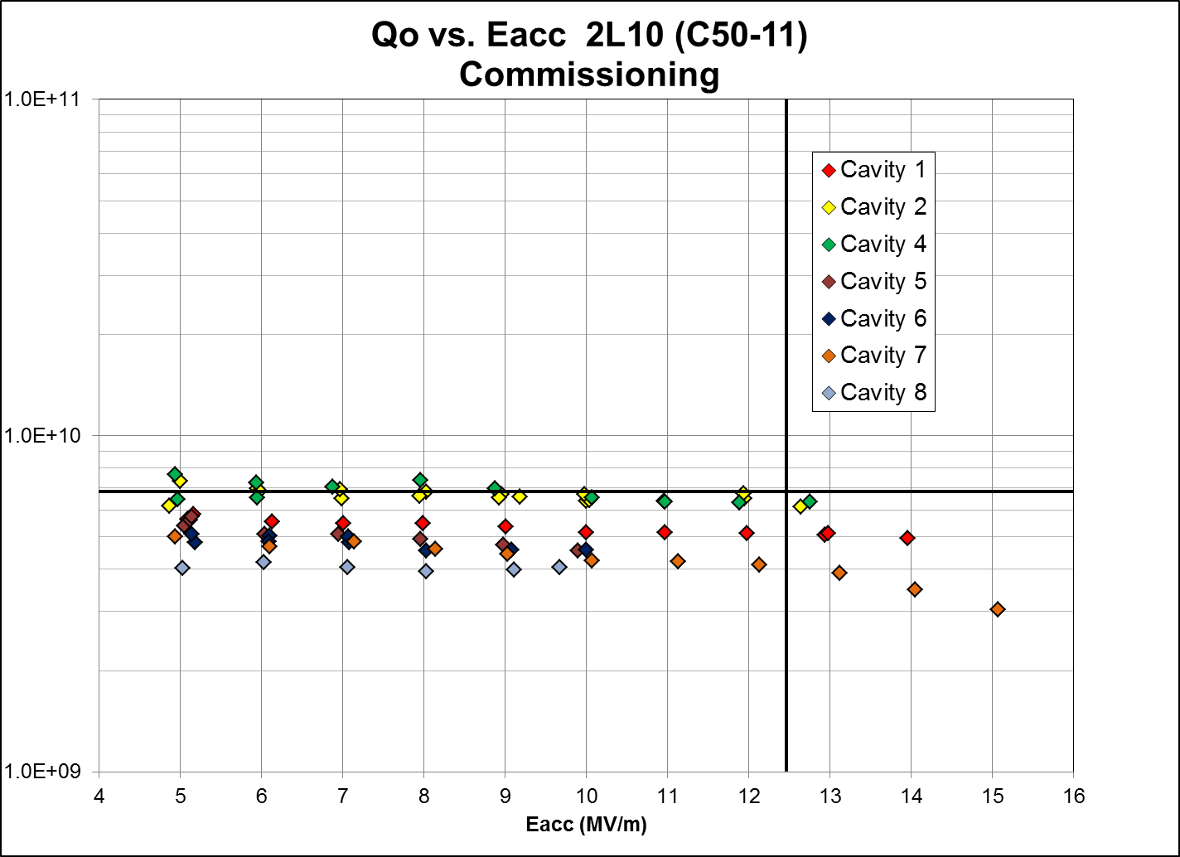
C50-11 Qo

