Slide 1
Hpernuclear DAQ
Alexandre Camsonne
March 3rd 2023

Slide 2
Outline
Experiment overview
Channel count
Overview pipelined electronics
Trigger overview
To do
Conclusion

Slide 5
Channel count

Slide 6
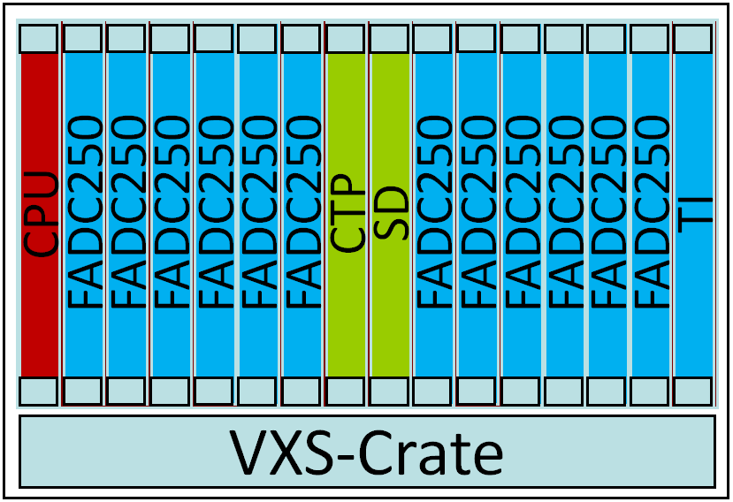
Level 1 & Trigger Distribution
Global Trigger Crate
Trigger Distribution Crate
CPU
SSP
SSP
SSP
SSP
SSP
SSP
VTP
SD
SSP
SSP
SSP
SSP
SSP
SSP
TI
CPU
TD
TD
TD
TD
TD
TD
SD
TD
TD
TD
TD
TD
TD
TS
trigger decisions
VXS-Crate
VXS-Crate
Fiber Optic
Data Links
L1 Subsystem Data Streams (hits & energy)
Clock, Trigger, Sync, & Busy
Front-End Crates
VME Readout to Gigabit Ethernet
Up to 128 front-end crates

Slide 7
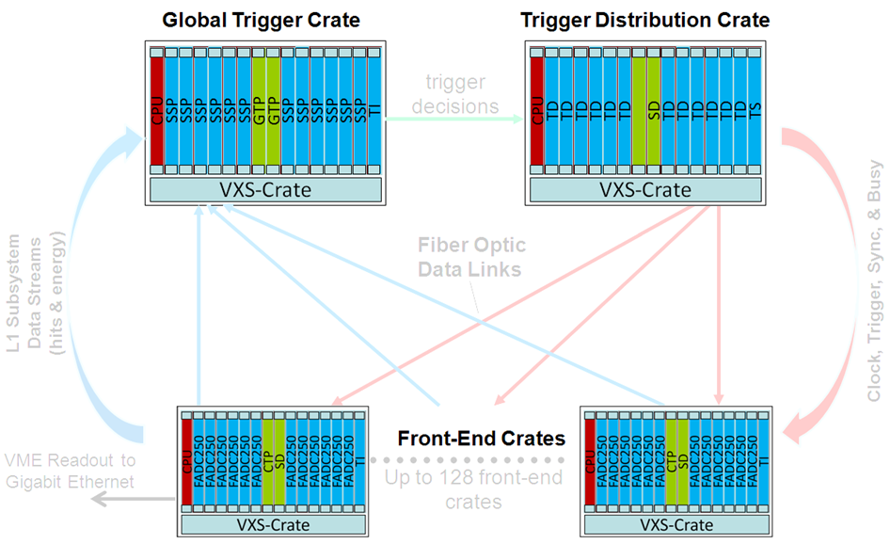
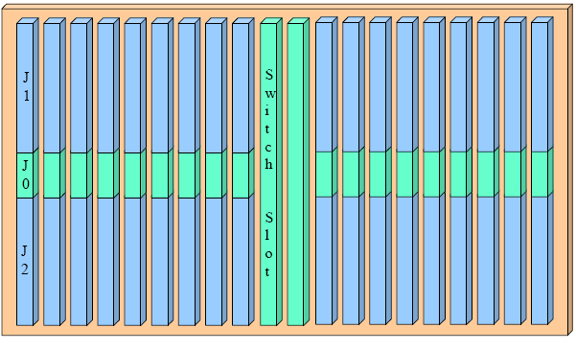
Crate Level – Signal Distribution
VXS Based, 20 Slot Redundant Star Backplane
VME64x backplane w/VXS (VITA 41 Standard) provides standard with high speed serial extension (new J0 connector)
18 Payload slots w/VME64x, 2 Switch slots
Each payload slot has 8 high speed capable links (10Gbps each) to both switch slots
VXS Backplane Physical Layout:
Crate Level Use:
  VME64x used for event readout
  VXS: Low jitter clock & trigger distribution
  VXS: Gigabit serial transmission for L1 data streams to switch slot for processing
VXS (VITA 41 standard)
VME64x + high speed
serial fabric on J0

Slide 8
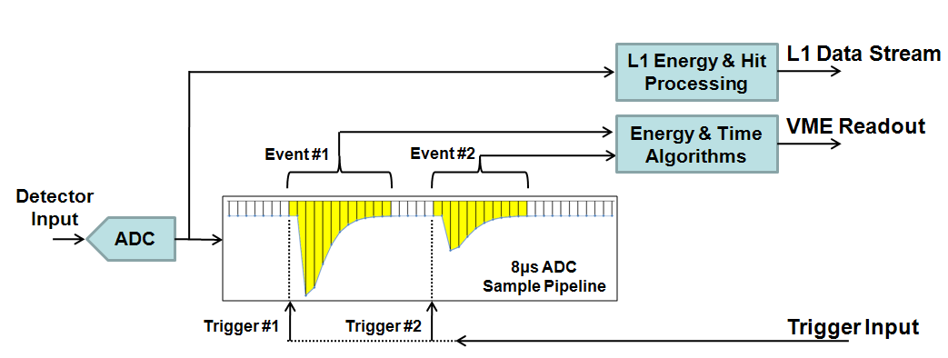
Capturing the Pulses…
Expensive, bulky delay cable
dispersive & attenuates
Non-pipelined electronics guarantee dead-time
(conversion time)
Existing System:
Gate
Delay line
detector
signal
to primitive
trigger logic
Very limited channel resolution used in trigger
QDC
Splitter
Discriminator
TDC
New System:
multiple modules for
time & energy
CLAS TOF has >150,000ft delay line!
(for timing >500ps)
detector
signal
Time, energy, trigger output in 1 module
to smart
trigger logic
FADC250
Pipelined sampling, readout, & trigger -> no dead-time
Digitization retains original signal integrity
Long pipeline allow more time for complex triggers

Slide 9
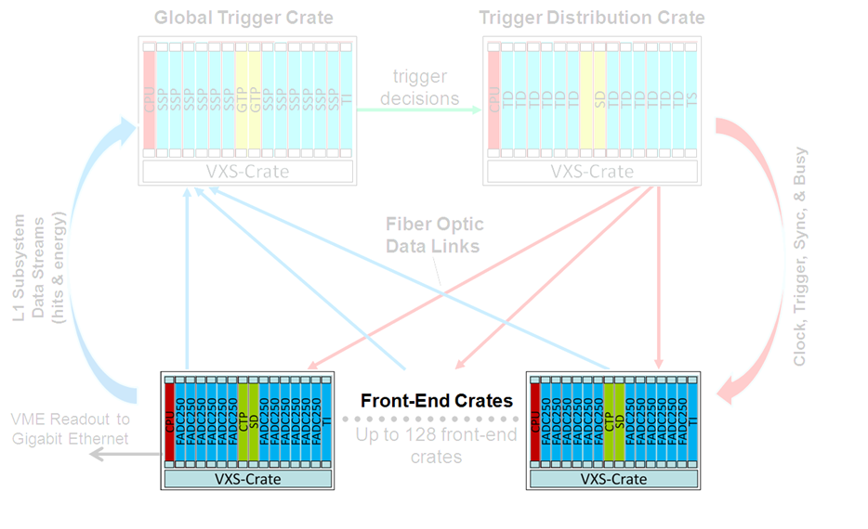
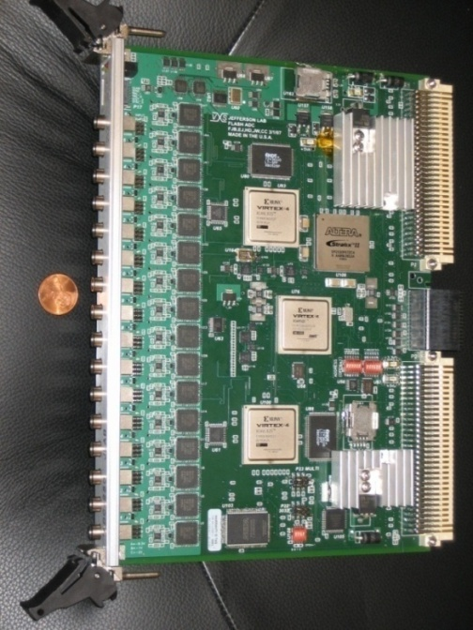
Front-End Electronics: fADC250
16 Channel 12bit, 250Msps Flash ADC
8µs raw sample pipeline, >300kHz sustained trigger rate (bursts @ ~15MHz)
Post-processing in customizable firmware to extract time, charge, and other parameters minimizing event size
Module supports 2eSST VME transfers at 200MB/s transfer rate
Large event block sizes (>100) to minimize CPU interrupt handling
VXS P0/J0 outputs 5Gbps L1 data stream (hit patterns & board sum)
JLab-FADC250:
Used in existing 6GeV program:
  Hall A BigBite
  Upgraded Hall A Moller Polarimeter

Slide 10
Channel count
FADC = 88 + 42 +48 +116 = 294 channels = 19 FADCs = 2 VXS crates
V1190 = 2268 channels = 18 V1190 = 1 VME64X crate
TOF = 204 channels = 7 V1290 = 8 F1 = 3 VETROC
If not running with SBS or NPS most likely enough FADCs
Can use HMS electronics
BPM rasters : 2 FADC

Slide 11
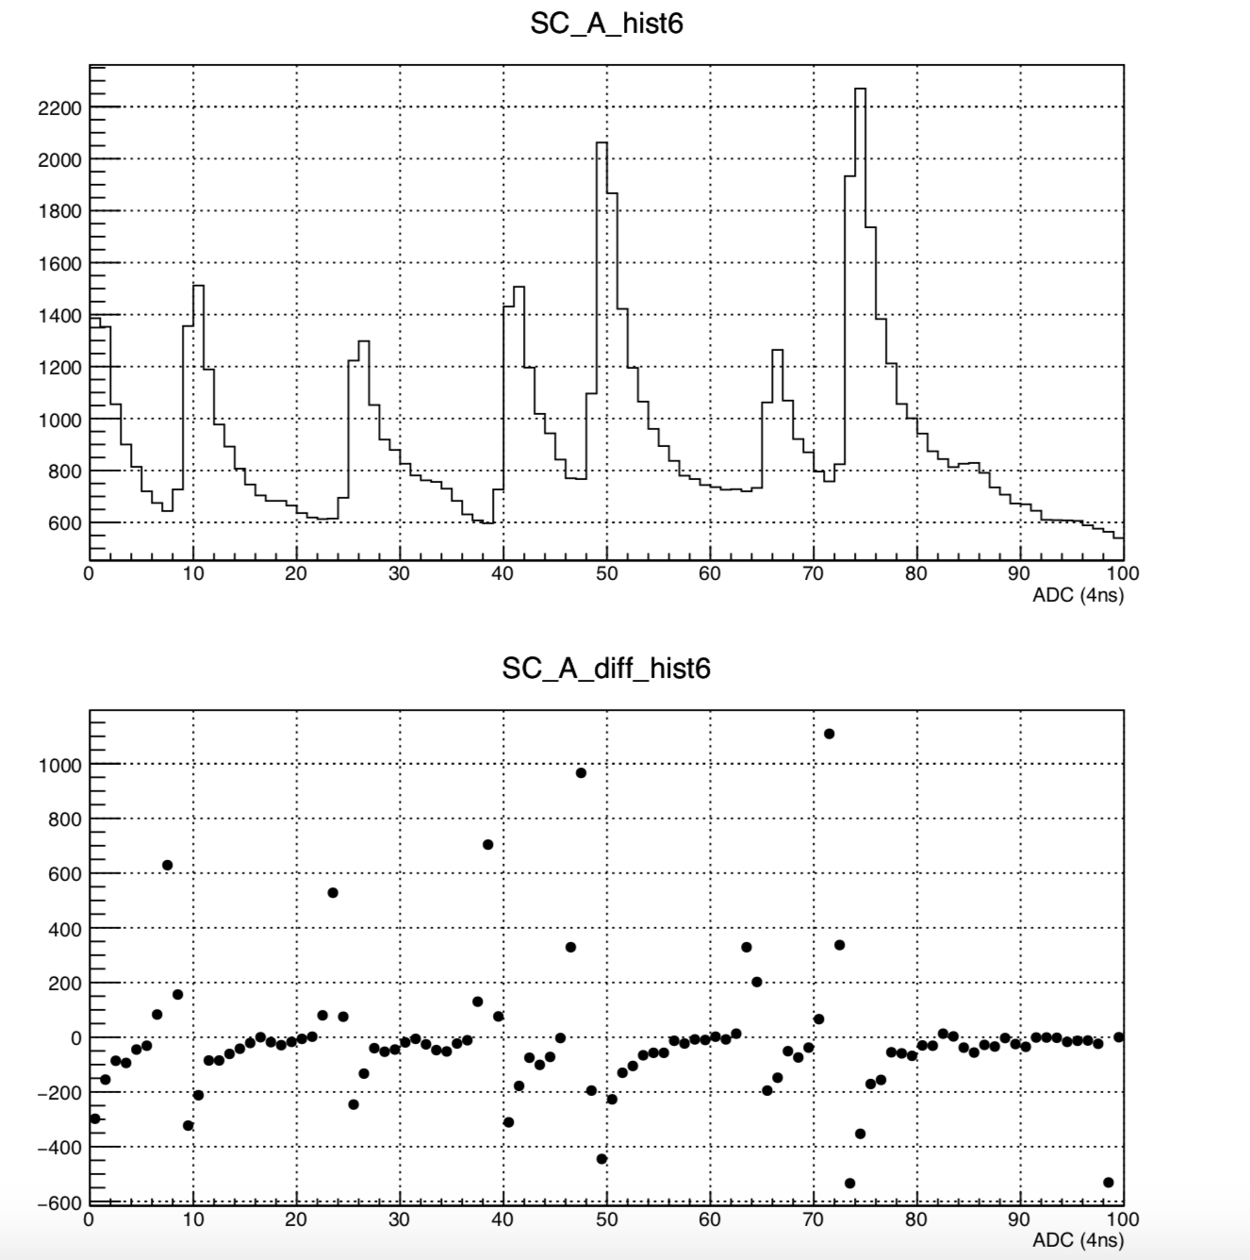
Data rates
Rough estimates
  HKS = 1 MHz
  HES = 1 MHz
  Coincidence = 1MHz x 1 MHz x 20 ns = 2 KHz
Plan for up to 20 KHz desirable
Using CODA3 and event blocking should be doable ( similar to CLAS12) will be tested during NPS
Need to evaluate detector occupancies
If useful can record full FADC waveforms
Example scintillator SoLID beam test

Slide 12
Trigger
HKS
HES
FADC
FADC
VTP
TI
FADC
FADC
VTP
TI
VETROC
VETROC
VETROC
VETROC
V1190
TI
Can program VTP for coincidences between scintillators
If use VETROC instead of V1190 could add Drift Chamber to trigger

Slide 13
Additionnal electronics
Beamline info
  Target BPM
  Raster
  1C12 BPM cabling

Slide 14
To do / Testing
Bench testing and testing with detector VETROC
Setup FADC trigger with VTP
Setup testing in ESB

Slide 15
Additionnal detectors
MCP PMTs
MRPC
Would need dedicated new electronics

Slide 16
Conclusion
HKS and HES
  FADC = 88 + 42 +48 +116 = 294 channels = 19 FADCs = 2 VXS crates
  V1190 = 2268 channels = 18 V1190 = 1 VME64X crate
  TOF = 204 channels = 7 V1290 = 8 F1 = 3 VETROC
  Could use HMS/NPS/SBS hardware
CODA3 with event blocking should allow 20 kHz trigger rate
Digital trigger using FADC and VTP
If use VETROC instead of V1190 can include in L1 trigger ( High res TOF and Drift Chamber )

Slide 17
Backup

Slide 18
CLAS12 Trigger
Detector | Can be in trigger? | Will be in trigger? | Trigger Algorithm
ECAL/PCAL | Yes | Yes | U/V/W Clustering
DC | Yes | Yes | Segment Position/Angle Finding
CTOF/FTOF | Yes | Yes | Hit based
HTCC/LTCC | Yes | Yes | Hit based
FT | Yes | Yes | 3x3 Clustering
CND | Yes | No | N/A
SVT | Yes | No | N/A
RICH | Yes | No | N/A
MicroMegas | No | No | N/A
CLAS12 triggering will support geometric matching (e.g. drift chamber segment points to clusters, etc…)

Slide 19
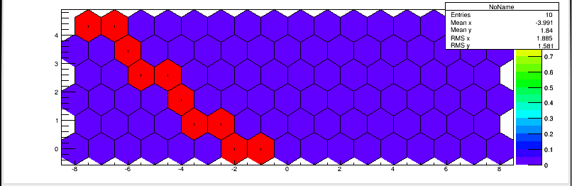
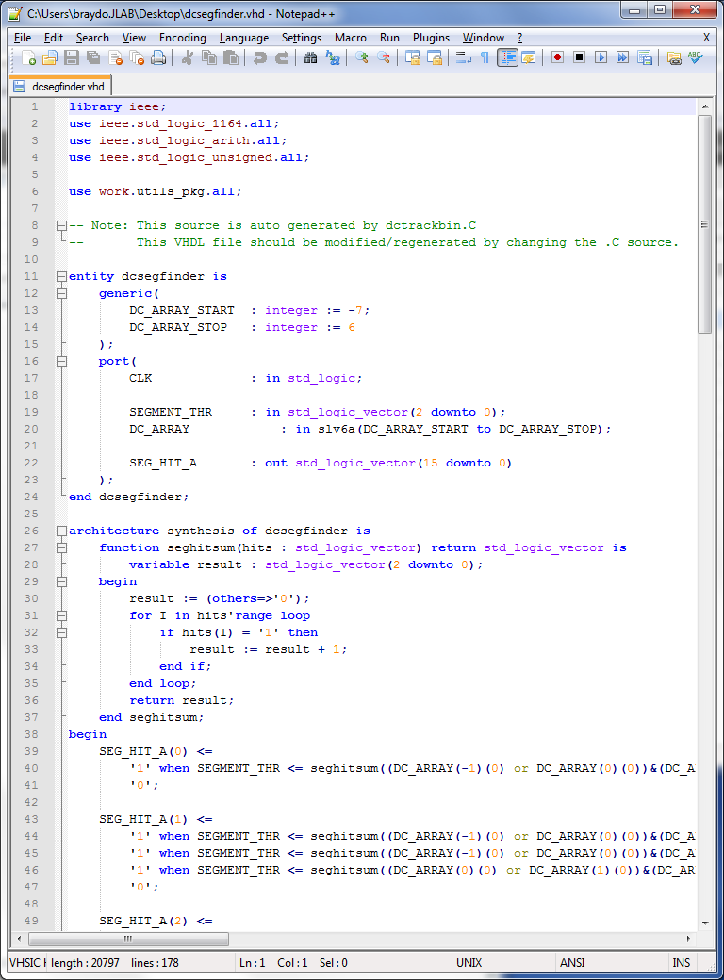
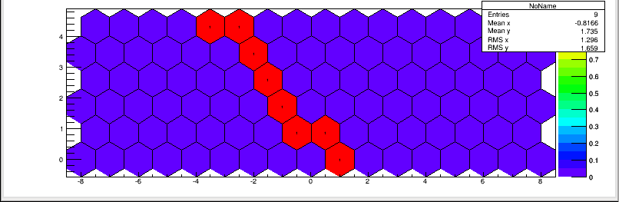
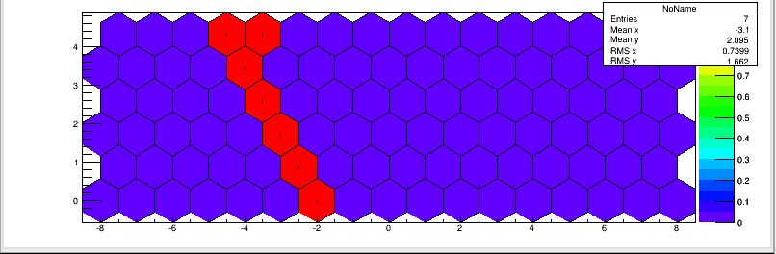
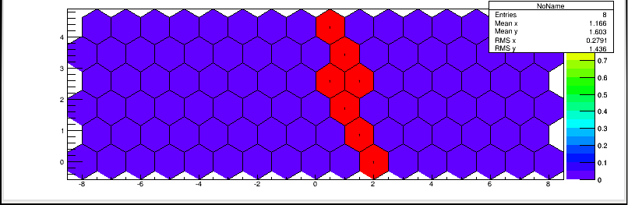
Drift Chamber Segment Finder Example
sweeps angle and wire offset:
valid segments are binned into common angle, VHDL file w/equations auto-generated:

Slide 20
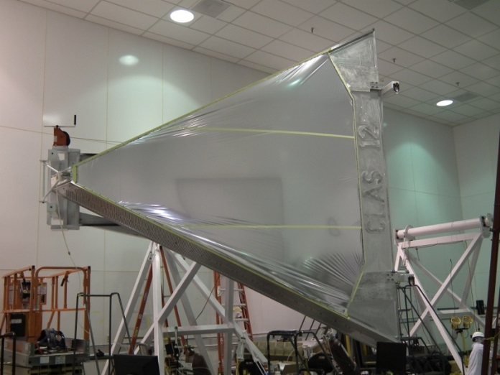
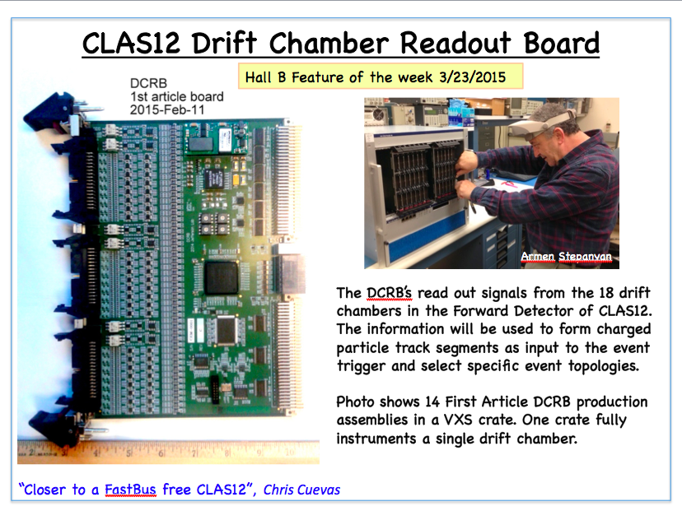
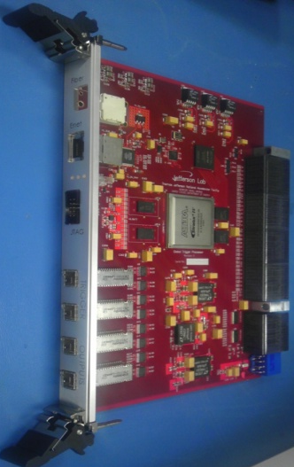
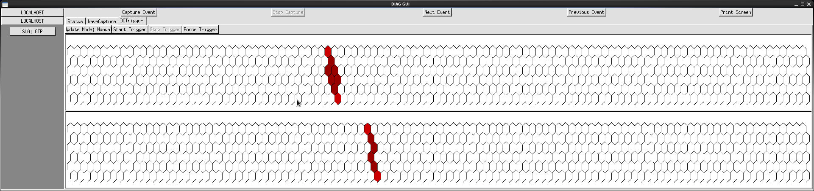
Drift Chamber Segment Finding Trigger
GTP:
prototype VXS concentrator card
Receives all DC hits from DCRB
Searches for track segments and reports position/angle to next trigger stage
VTP (mentioned later in talk) with be used in CLAS12
x14 DCRB
70Gbps
(DC Hits)
Scope like interface on GTP allows real-time display of found segments by trigger logic
  Cosmic event shown where only 1 segment was the trigger condition

