Slide 1
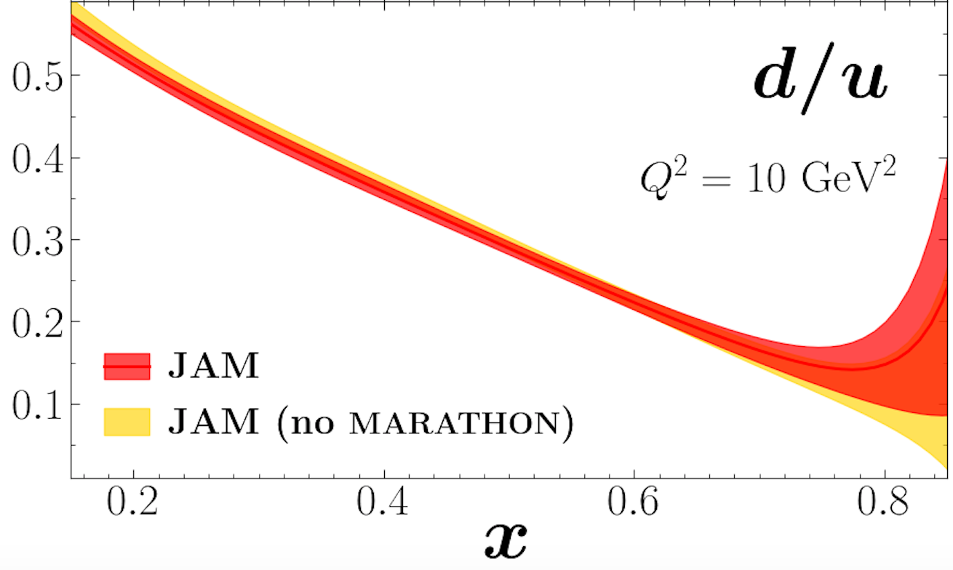
JLab@12 GeV d/u
Sebastian Kuhn
NSAC 2015 LRP
Marathon
PhysRevLett.128.132003
BONuS12:
Dark Symbols: W* > 2 GeV (x* up to 0.8, bin centered x* = 0.76)
Open Symbols: “Relaxed cut” W* > 1.8 GeV (x* up to 0.83)
…also: Additional data from ALERT and TDIS
Courtesy Arun Tadepalli
Notes:
Left: LRP expected, right Marathon published, bottom right TDIS

Slide 2
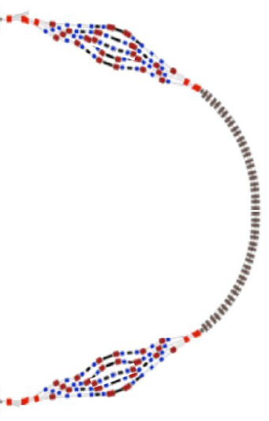
Future: JLab at 20+ GeV?
Sebastian Kuhn
J-FUTURE Workshop
Jefferson Lab / Messina University
Alex Bogacz
Halve distance to x = 1, higher Q²: Definite determination of asymptotic limit… ^{*)}
…AND to x = 0 => Study “valence” sea quarks (pion cloud)
Increase Q² range for all x -> DGLAP => Study “valence” gluon helicity
Even for same x, Q²: higher energy -> higher rates -> better statistics
(Super)Rosenbluth – expand range in ε for fixed x, Q² => R, g₂, A₂
Extend flavor tagging with SIDIS to higher x, Q²:
Issues: Still need to deal with nuclear uncertainties.
^{*)} Higher Q²: Suppress higher twist, study logarithmic resummation
Notes:
Higher rates because of higher E’ that enters as square in Mott cross section; 12 GeV covers only 74% of x-range, 24 GeV nearly 90%

Slide 3
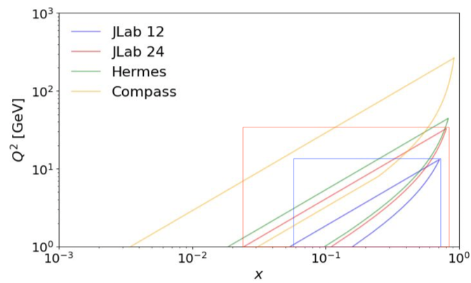
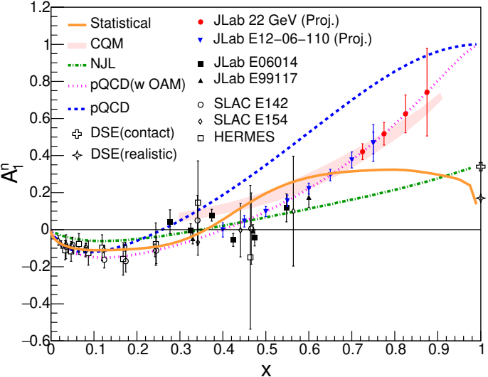
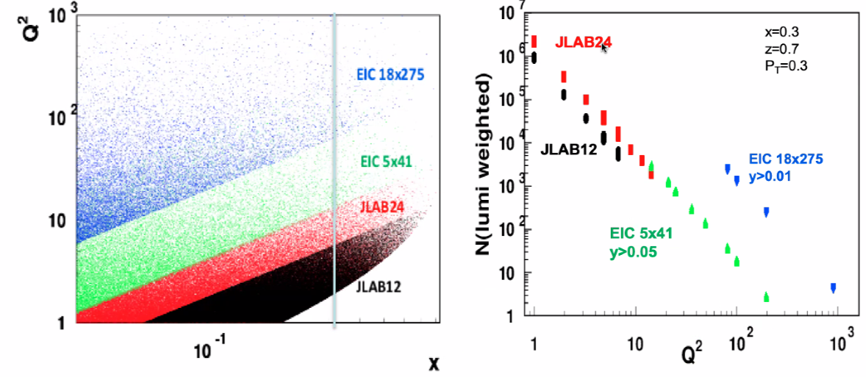
From 12 to 24 GeV
Signori
U. of Pavia, INFN
J-FUTURE Messina 3/28/22
Figure credit: HUGS2021
Cameron Cotton (UVA)
David Flay (JLab)
Thanks to X. Zheng

Slide 4
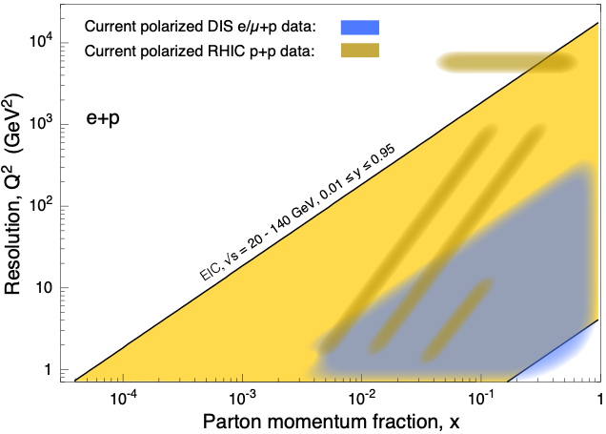
Summary: Completing the Collinear Picture
Q²
RHIC
EIC
Enormous Progress on understanding Collinear PDFs fueled by large new data sets and sophisticated phenomenology. Still, some questions remain:
JLab 24
JLab 12
x
d/u, Δu/u and Δd/d at highest x ?
Nuclear effects on nucleon structure
Understanding the sea – Δs, u - d, Δu - Δd
Axial and Tensor charges of the nucleon
Gluon helicity distribution at large x AND at small x?
What is the integral ΔG?
Total contribution of parton helicity to proton spin?
What happens at really small x << 0.01?
JLab @ 12 -> 24 GeV
JLab, FNAL, RHIC, AMBER, LHC
COMPASS, JLab
EIC
JLab + DGLAP, RHIC, COMPASS

