Slide 1
Photoproduction and the nature of XYZ states
Alessandro Pilloni
JLab, January 23rd, 2023

Slide 2
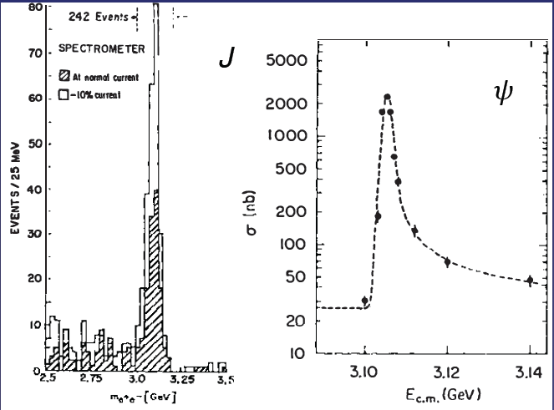
Quarkonium orthodoxy
$$Q$$
$$\overline{Q}$$
Potential models
(meaningful when $M_{Q}→∞$)
$$V\left(r\right)=−\frac{C_{F}α_{s}}{r}+σr$$
(Cornell potential)
$$α_{s}\left(M_{Q}\right)∼0.3$$
(perturbative regime)
OZI-rule, QCD multipole
Solve NR Schrödinger eq. → spectrum
Effective theories
(HQET, NRQCD, pNRQCD...)
Heavy quark spin flip suppressed by quark mass, approximate heavy quark spin symmetry (HQSS)
Integrate out heavy DOF
↓
(spectrum), decay & production rates
A. Pilloni – Photoproduction and the nature of XYZ states
Notes:
2 slides su Zc, a Bes e a Belle
2 slide su tetraquark model: dall’hamiltoniana di Jaffe al calcolo delle masse
1 slide su molecular models, dove sono i carichi? (non in Tornqvist, si in Hanhart, vedere Braaten, citare Nefediev)
2 slides su decay channels, dove si dovrebbe vedere, e a seconda del modello, vedere qualche plot
1 slide su Y(4260), tetraquark? C’è lo strano (si vede la f0)
1 slide su Zc a cleo (anche il neutro)

Slide 3
Multiscale system
Systematically integrate out the heavy scale,
$$m_{Q}≫Λ_{QCD}$$
$$m_{Q}≫m_{Q}v≫m_{Q}v^{2}$$
$$m_{b}∼5 \text{GeV}, m_{c}∼1.5 \text{GeV}$$
$$v_{b}^{2}∼0.1, v_{c}^{2}∼0.3$$
Full QCD
NRQCD
pNRQCD
Factorization (to be proved) of universal LDMEs
Good description of many production channels, some known puzzles (polarizations)
A. Pilloni – Photoproduction and the nature of XYZ states
Notes:
2 slides su Zc, a Bes e a Belle
2 slide su tetraquark model: dall’hamiltoniana di Jaffe al calcolo delle masse
1 slide su molecular models, dove sono i carichi? (non in Tornqvist, si in Hanhart, vedere Braaten, citare Nefediev)
2 slides su decay channels, dove si dovrebbe vedere, e a seconda del modello, vedere qualche plot
1 slide su Y(4260), tetraquark? C’è lo strano (si vede la f0)
1 slide su Zc a cleo (anche il neutro)

Slide 4
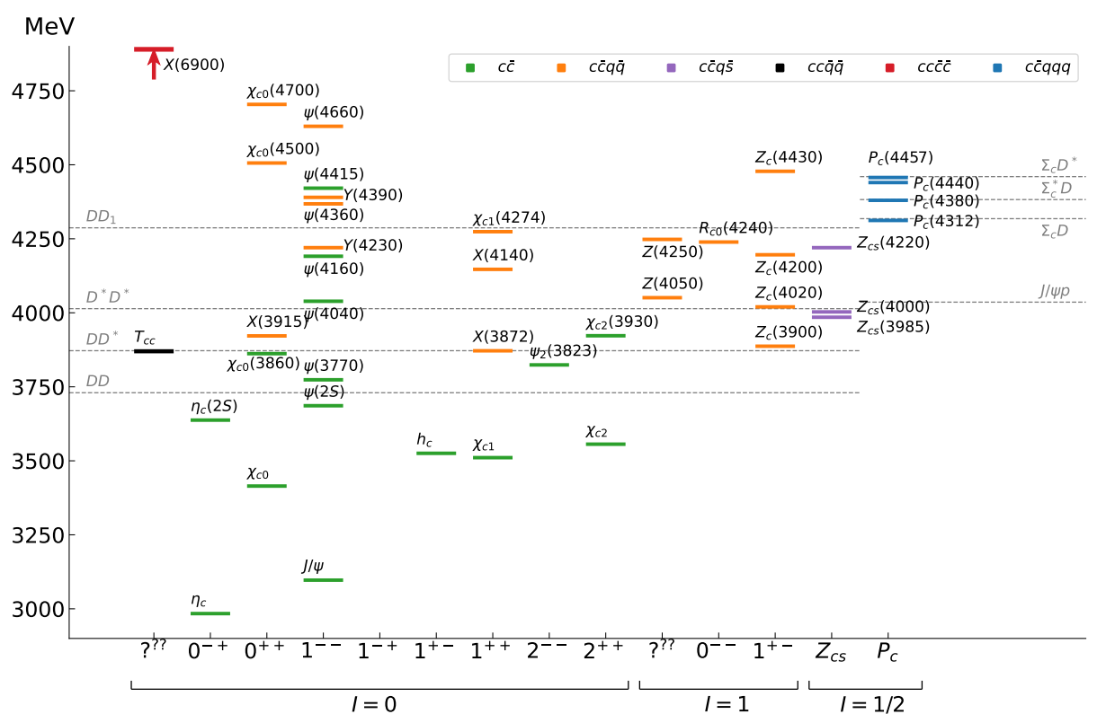
Exotic landscape in $c\overline{c}$
Esposito, AP, Polosa, Phys.Rept. 668
JPAC, arXiv:2112.13436
A host of unexpected resonances have appeared
decaying mostly into charmonium + light Hardly reconciled with usual $q\overline{q}$ pheno
A. Pilloni – Photoproduction and the nature of XYZ states
Notes:
2 slides su Zc, a Bes e a Belle
2 slide su tetraquark model: dall’hamiltoniana di Jaffe al calcolo delle masse
1 slide su molecular models, dove sono i carichi? (non in Tornqvist, si in Hanhart, vedere Braaten, citare Nefediev)
2 slides su decay channels, dove si dovrebbe vedere, e a seconda del modello, vedere qualche plot
1 slide su Y(4260), tetraquark? C’è lo strano (si vede la f0)
1 slide su Zc a cleo (anche il neutro)

Slide 5
What makes XYZ exotics?
Quantum numbers:
Charged $Z$, open flavor, pentaquarks
Decay pattern/resonance properties:
$X\left(3872\right)$, resonances in $J/ψ φ$
Supernumerary states:
$Y(4230)$, $Y(4260)$, $Y(4390)$…
A. Pilloni – Photoproduction and the nature of XYZ states

Slide 6
Exotic landscape
Broad mesons seen in $b$ decay:
$X(4140)$, $Z(4430)$, $Z_{cs}(4000)$...
Narrow structures seen in $b$ decay:
$X\left(3872\right), P_{c(s)}$
Scarce consistency between various production mechanisms
Narrow structures seen in $e^{+}e^{−}$:
$X(3872)$, $Y(4260)$, $Z_{c,b}^{(′)}$
A. Pilloni – Photoproduction and the nature of XYZ states

Slide 7
Models
Compact
Hybrids
Containing gluonic degrees of freedom
Multiquark
Several (cluster) of valence quarks
Hadroquarkonium
Heavy core interacting with a light cloud via Van der Waals forces
$$π$$
$$π$$
$$J/ψ$$
$$π$$
Rescattering effects
Structures generated by cross-channel rescattering, very process-dependent
Molecule
Bound or virtual state generated by long-range exchange forces
Extended
A. Pilloni – Photoproduction and the nature of XYZ states

Slide 8
Two extreme antagonists
Tetraquarks: 4 constituent quarks bound via color forces Typical size of ordinary hadrons $O(1 \text{fm}\text{)}$
Tetraquarks: 4 constituent quarks bound via color forces Typical size of ordinary hadrons $O(1 \text{fm}\text{)}$
$$c$$
$${\overline{3}}_{c}$$
$$\overline{c}$$
Fair understanding of existing spectrum ✓
A full nonet for each level is expected ✗
Proximity to threshold accidental ✗
$$3_{c}$$
$$q$$
$$\overline{q}$$
Maiani, Piccinini, Polosa, Riquer PRD71 014028 Maiani, Polosa, Riquer PLB 778, 247
Tornqvist, Z.Phys. C61, 525
Braaten and Kusunoki, PRD69 074005
Swanson, Phys.Rept. 429 243-305
Each state is mostly unrelated to others ✗
Proximity to threshold natural ✓
$$[Qq]$$
$$[\overline{Q}\overline{q}]$$
Molecules: 2 well separated hadrons bound via inter-hadron potential Typical size of nuclei $O(10 \text{fm}\text{)}$
Phenomenology of $X,Z^{(′)}$ states requires a double well potential between diquarks, with a repulsive barrier in between
$$D^{0}$$
$$π^{0}$$
$$\overline{D^{0∗}}$$
1.3 fm
A. Pilloni – Photoproduction and the nature of XYZ states
Notes:
Y(4260), M=4263 +- 5, Gamma = 95+-14
D_1(2420)^0, M=2421.3 ±0.6, Gamma =27.1 ±2.7
D_1(2420)^+-, M=2423.4 ±3.1, Gamma =25 ±6
I D_1 hanno J^P = 1^+
La molecola D_1 D sta 22 MeV sotto
Se la Y è D_1 D, il pione lega fortemente, come fa la Y a essere così larga?
Come funziona lo scambio del pione???
Close propone che la Y è D_1 D^* col pione scambiato in onda S,
La Y però non va in Ds come se fosse tetraquark

Slide 9
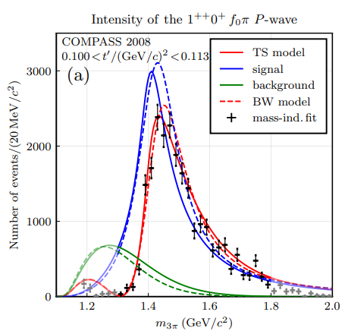
Triangle singularity
In multibody decays, rescattering diagrams as this one can occur
In special kinematical conditions,
this amplitude develops an extra singularity in the physical region, that can simulate a resonant behavior
$$π$$
$$D_{1}$$
$$Y(4260)$$
$$D^{∗}$$
$$π$$
$$\overline{D}$$
$$J/ψ$$
This is critically production-dependent, looking for other production mechanisms is of key importance
An example from COMPASS, PRL 127, 082501
A. Pilloni – Photoproduction and the nature of XYZ states

Slide 10
Why photoproduction?
It’s new: no XYZ state has been uncontroversially seen so far
It is free from rescattering mechanisms that could mimic resonances in multibody decays
The framework is (relatively) clean from a theory point of view
Radiative decays offer another way of discerning the nature of the states: probing the short-range properties of the wave function and compare with model predictions
Once seen, $Q^{2}$ of transition form factors will give new observables crucial to assess the nature of these exotics
A. Pilloni – Photoproduction and the nature of XYZ states

Slide 11
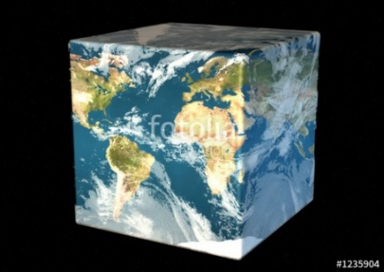
Complementarity with LQCD
Experiment
Lattice QCD
$$Z_{c}(3900)!$$
$$Z_{c}(3900)!$$
Exotic!
$$Z_{c}(3900)!$$
Experiments study the QCD excited spectrum with EW probes, while Lattice QCD can (will) measure directly scattering observables
This complementarity is key to assess the nature of signals unambiguously seen in data
Kinematic!
$$Z_{c}(3900)!$$
No radiative!
Triangle!
A. Pilloni – Photoproduction and the nature of XYZ states

Slide 12
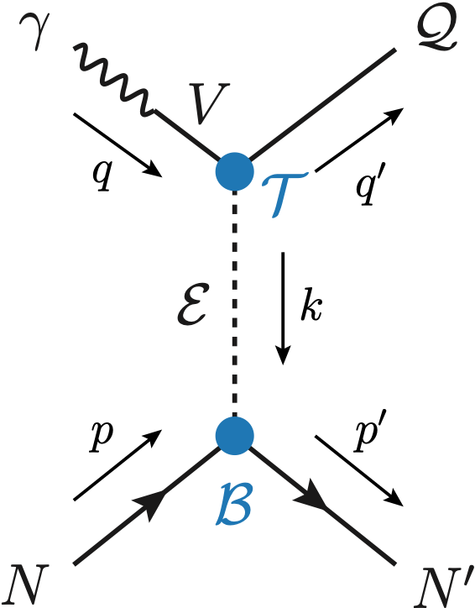
Exclusive (quasi-real) photoproduction
We study near-threshold (LE) and high energies (HE)
At this stage, we need yields to assess the feasibility of an observation
Couplings extracted from data as much as possible, not relying on the nature of XYZ
M. Albaladejo et al. [JPAC], PRD
$$<λ_{𝒬}λ_{N}^{′}|T|λ_{γ}λ_{N}>=\underset{V,ℰ}{∑}\frac{ef_{V}}{m_{V}}𝒯_{λ_{V}=λ_{γ},λ_{𝒬}}^{α_{1}⋯α_{j}}𝒫_{α_{1}⋯α_{j};β_{1}⋯β_{j}}ℬ_{λ_{N}λ_{N}^{′}}^{β_{1}⋯β_{j}}$$
Bottom vertex from standard photoproduction pheno, exponential form factors to further suppress large t
VMD is used to couple the incoming photon to a vector quarkonium V
Top vertex from measured $𝒬→Vℰ$ decay width
Different propagator at LE (fixed-spin) or HE (Regge)
Stronger model assumption, justified by $χ_{c2}$ decays
A. Pilloni – Photoproduction and the nature of XYZ states

Slide 13
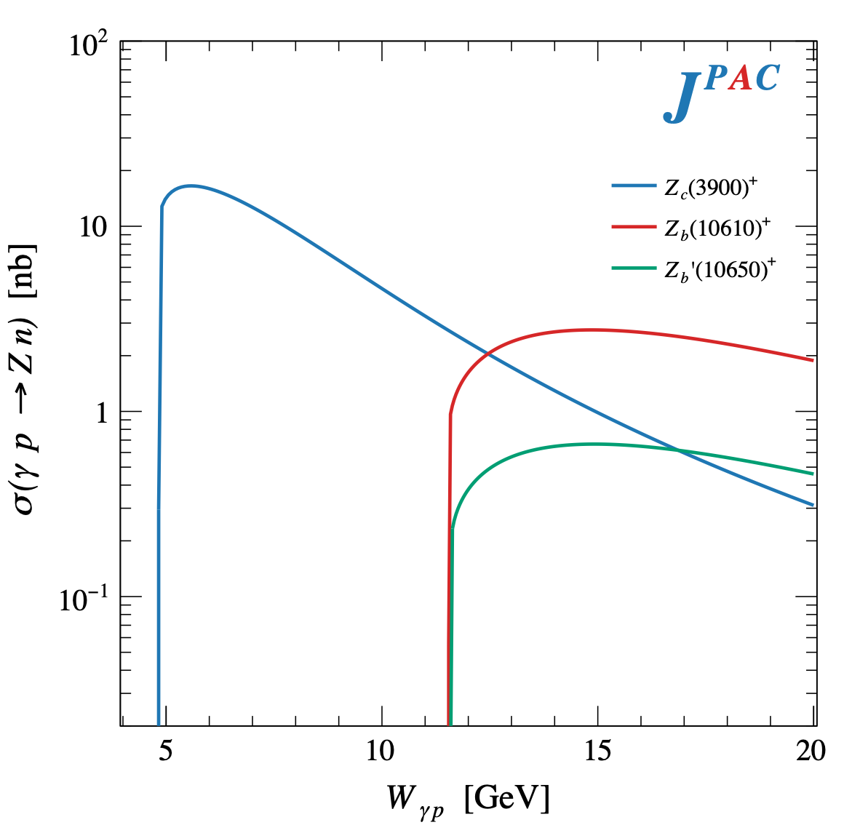
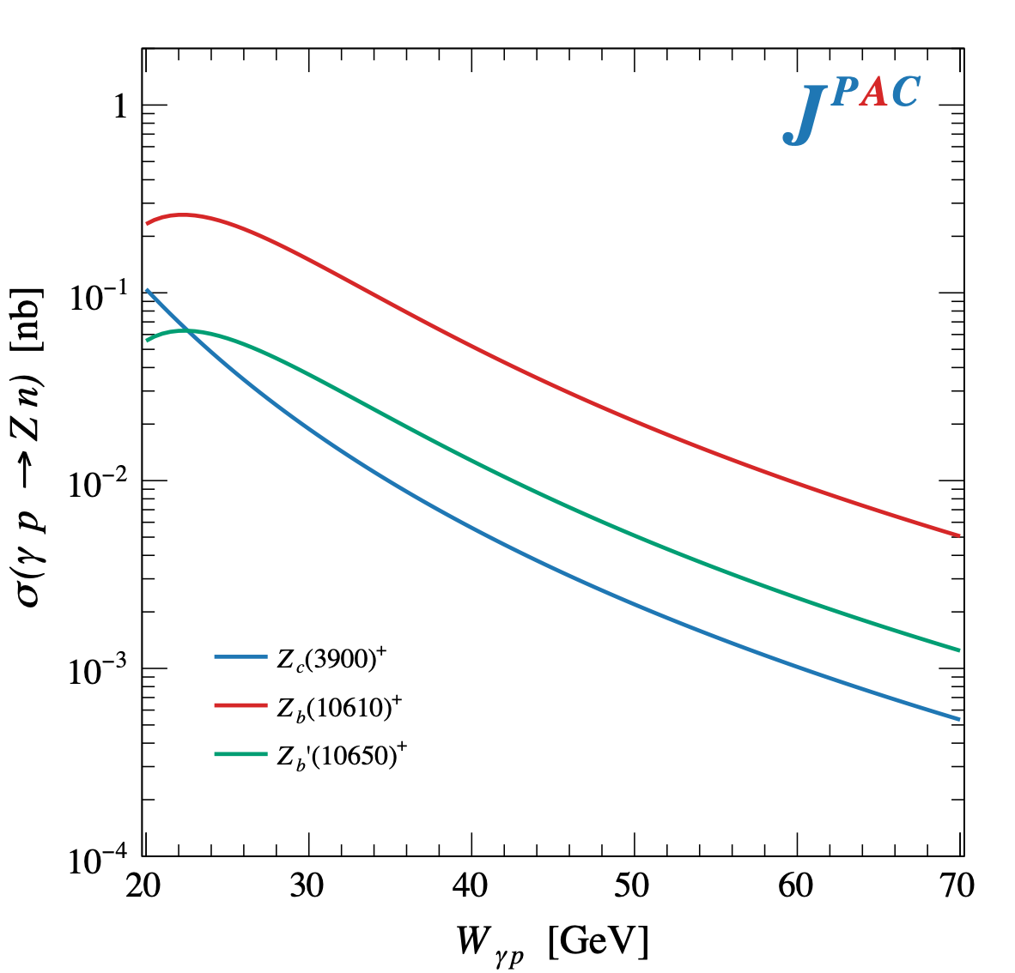
$Z$ photoproduction
The $Zs$ are charged charmoniumlike $1^{+−}$ states close to open flavor thresholds
Focus on $Z_{c}{\left(3900\right)}^{+}→J/ψ π^{+}$, $Z_{b}{\left(10610\right)}^{+},Z_{b}^{′}{\left(10650\right)}^{+}→Υ(nS) π^{+}$
The pion is exchanged in the $t$-channel
A. Pilloni – Photoproduction and the nature of XYZ states

Slide 14
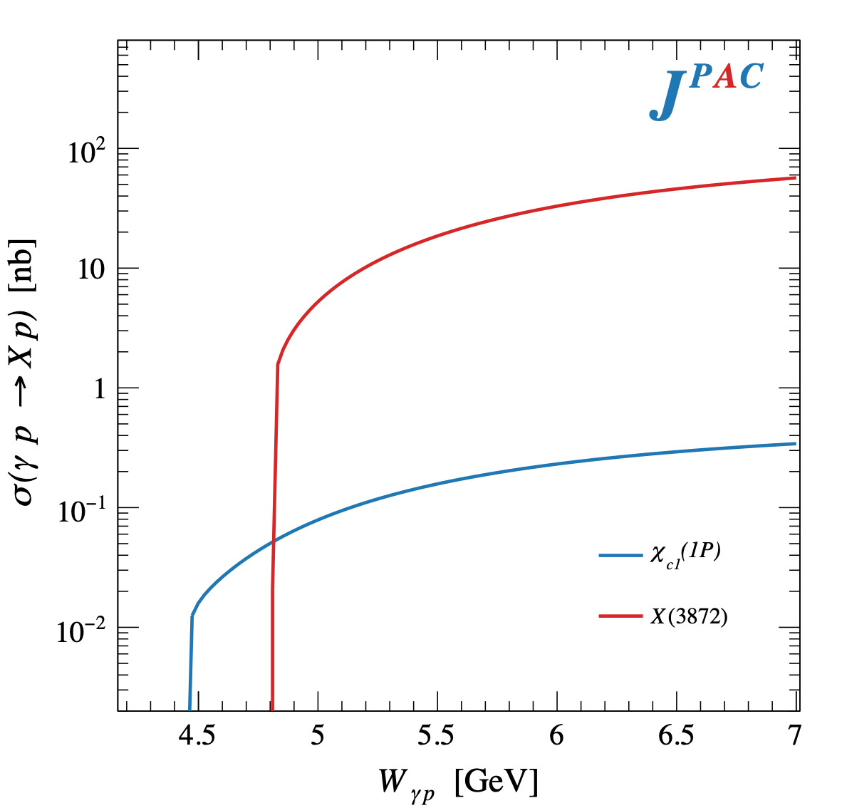
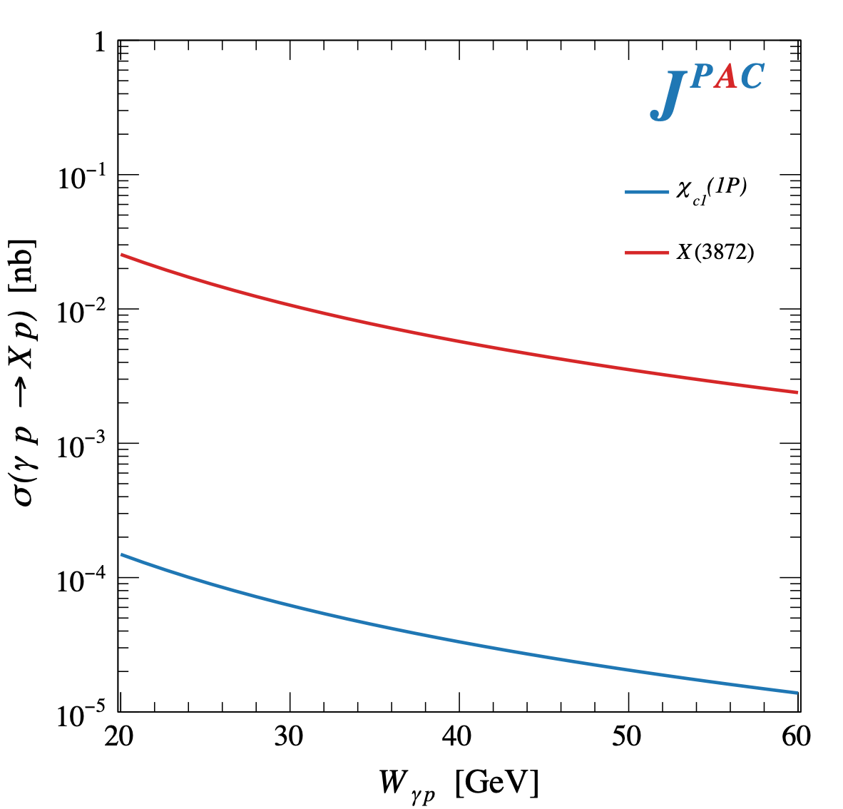
$X$ photoproduction
Focus on the famous $1^{++} X\left(3872\right)→J/ψ ρ,ω$
𝛚 and 𝛒 exchanges give main contributions:
Large theory uncertainty in the intermediate region
A. Pilloni – Photoproduction and the nature of XYZ states

Slide 15
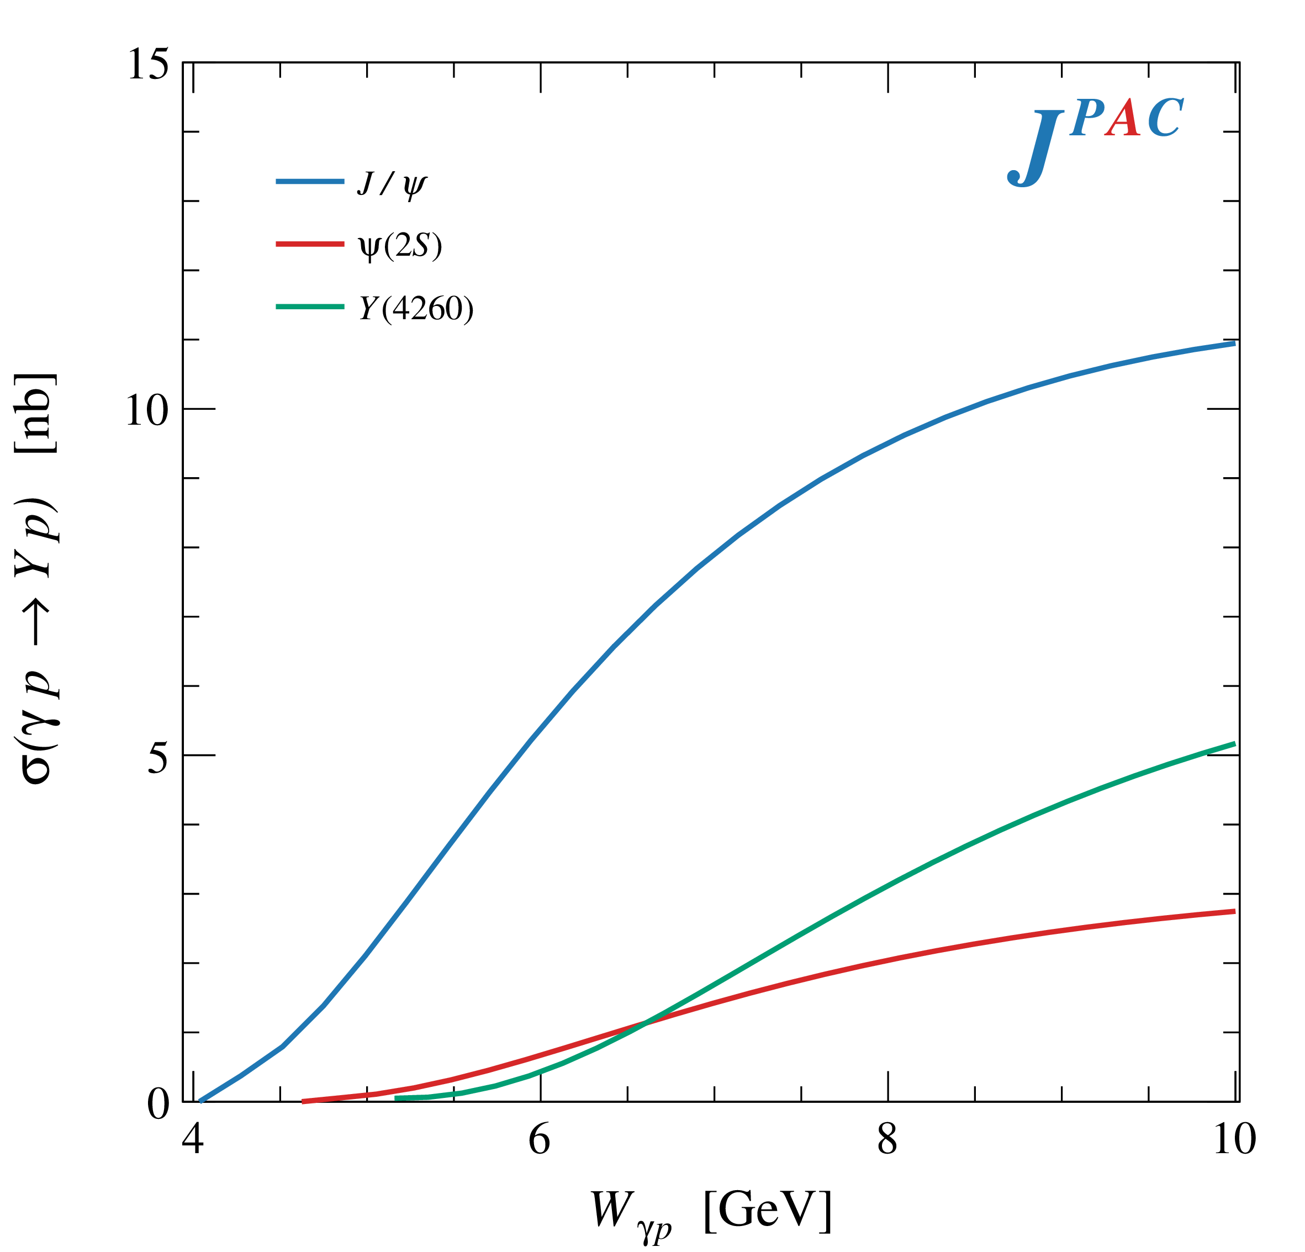
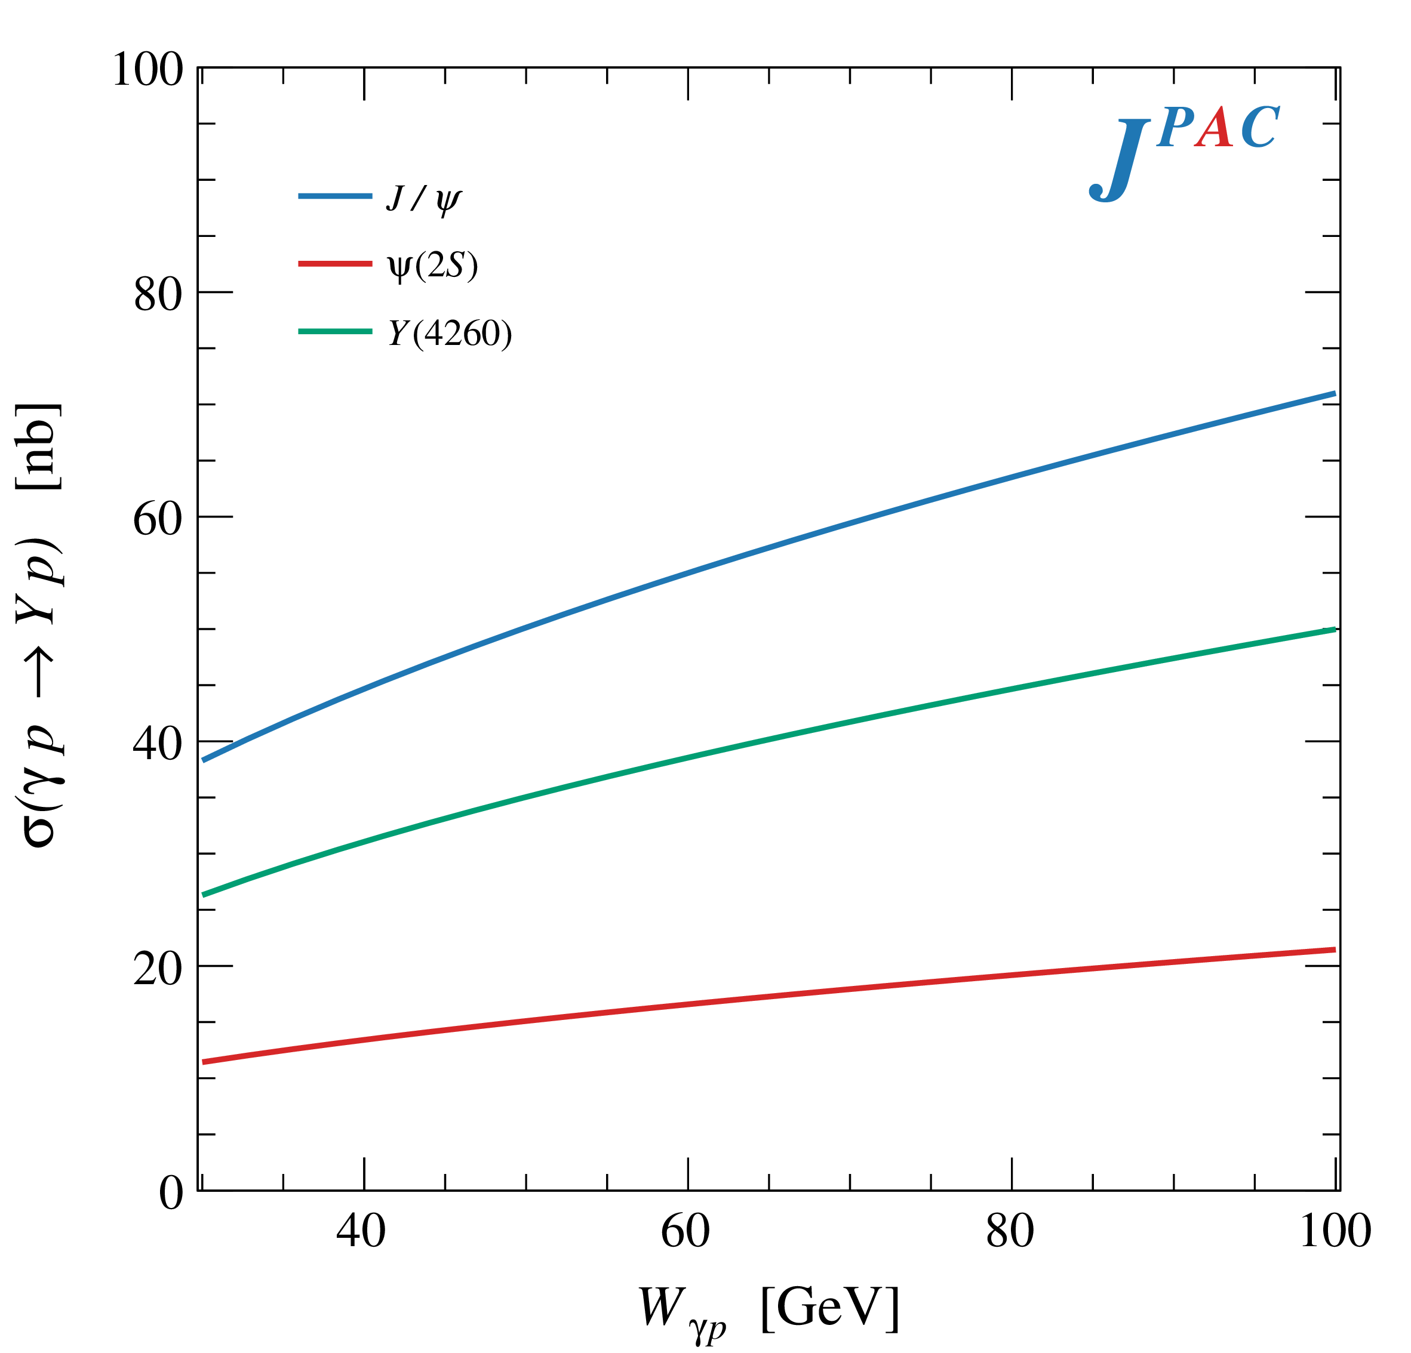
$Y$ (vector) photoproduction
Rule-of-thumb rescaling of soft matrix elements
Diffractive production, dominated by Pomeron (2-gluon) exchange
$$R_{Y}=\frac{ef_{ψ}}{m_{ψ}}\sqrt{\frac{g^{2}(Y→ψππ)}{g^{2}(ψ→γgg)}\frac{g^{2}(ψ^{′}→ψgg)}{g^{2}(ψ^{′}→ψππ)}}$$
Diffractive processes benefit from higher energies
A. Pilloni – Photoproduction and the nature of XYZ states

Slide 16
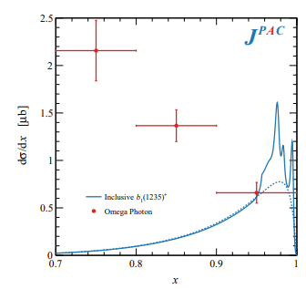
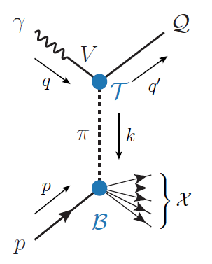
Semi-inclusive photoproduction
Semi-inclusive cross sections are typically larger
For small $t$ and large $x$, one can assume the process to be dominated by pion exchange
The bottom vertex depends on the (known) pion-proton total cross section
The pion is exchanged in the $t$-channel
Model benchmarked on $b_{1}$ production
Model underestimates lower bins, conservative estimates
The model is expected to hold in the highest bin
A. Pilloni – Photoproduction and the nature of XYZ states

Slide 17
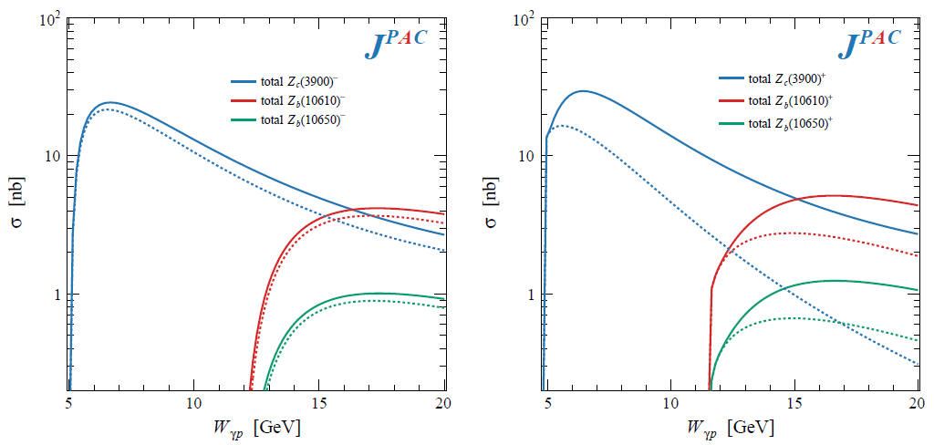
Semi-inclusive photoproduction
For the $Z_{c}^{+}$, the inclusive cross section is sizably larger than the exclusive process
$$Z_{c}^{−}Δ^{++}$$
$$Z_{c}^{+}n$$
A. Pilloni – Photoproduction and the nature of XYZ states

Slide 18
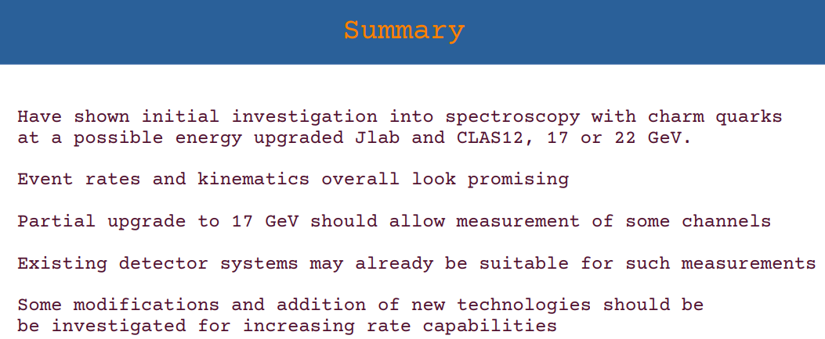
In practice
Cross sections generally larger relatively close to threshold, high intensity $≫$ high energy
D. Glazier,
Workshop @ECT*
Sep ‘22
A. Pilloni – Photoproduction and the nature of XYZ states

Slide 19
Conclusions
After 20 years of XYZ, still lots of questions wait for an answer
Photoproduction is a new valuable tool to study exotic states
Complementary infomation to other production mechanisms, as well as to LQCD calculations
An upgraded JLab facility to study photoproduction at low energies would be ideal to pursue this program
Thank you!
A. Pilloni – Photoproduction and the nature of XYZ states
Notes:
2 slides su Zc, a Bes e a Belle
2 slide su tetraquark model: dall’hamiltoniana di Jaffe al calcolo delle masse
1 slide su molecular models, dove sono i carichi? (non in Tornqvist, si in Hanhart, vedere Braaten, citare Nefediev)
2 slides su decay channels, dove si dovrebbe vedere, e a seconda del modello, vedere qualche plot
1 slide su Y(4260), tetraquark? C’è lo strano (si vede la f0)
1 slide su Zc a cleo (anche il neutro)

Slide 20
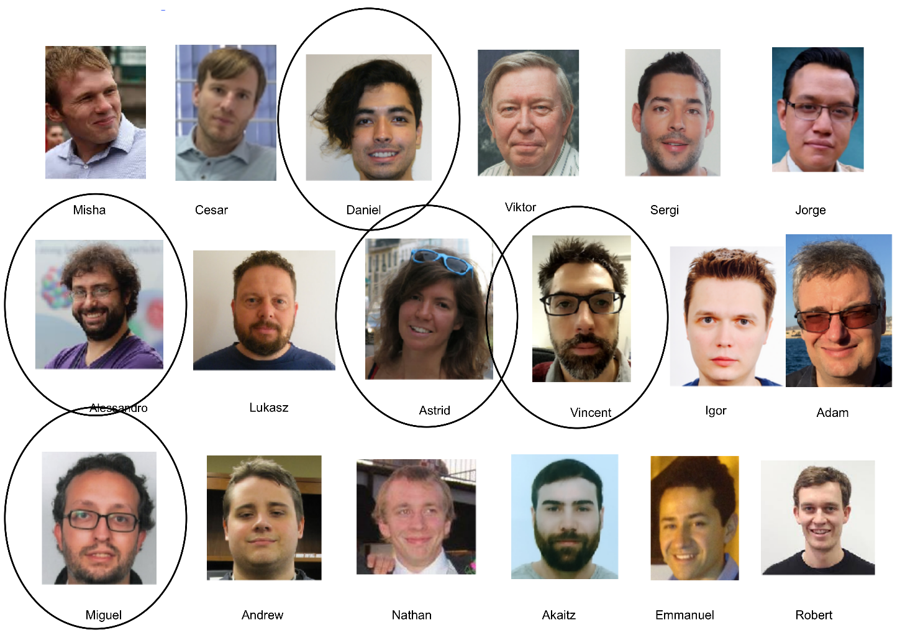
Joint Physics Analysis Center
Exclusive reactions: 2008.01001
Inclusive reactions: 2209.05882
Code available on https://github.com/ dwinney/jpacPhoto
A. Pilloni – Photoproduction and the nature of XYZ states

Slide 21
Backup

Slide 22
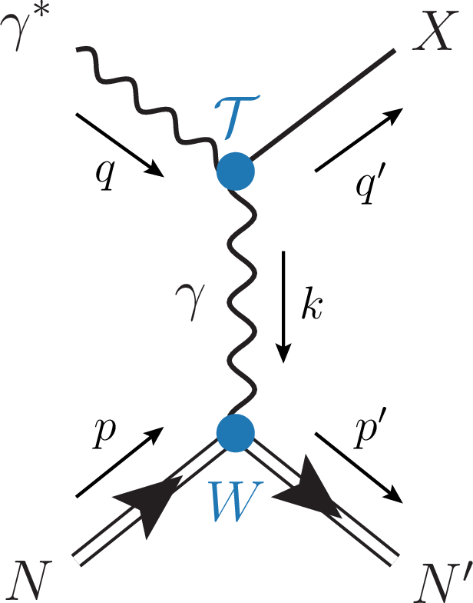
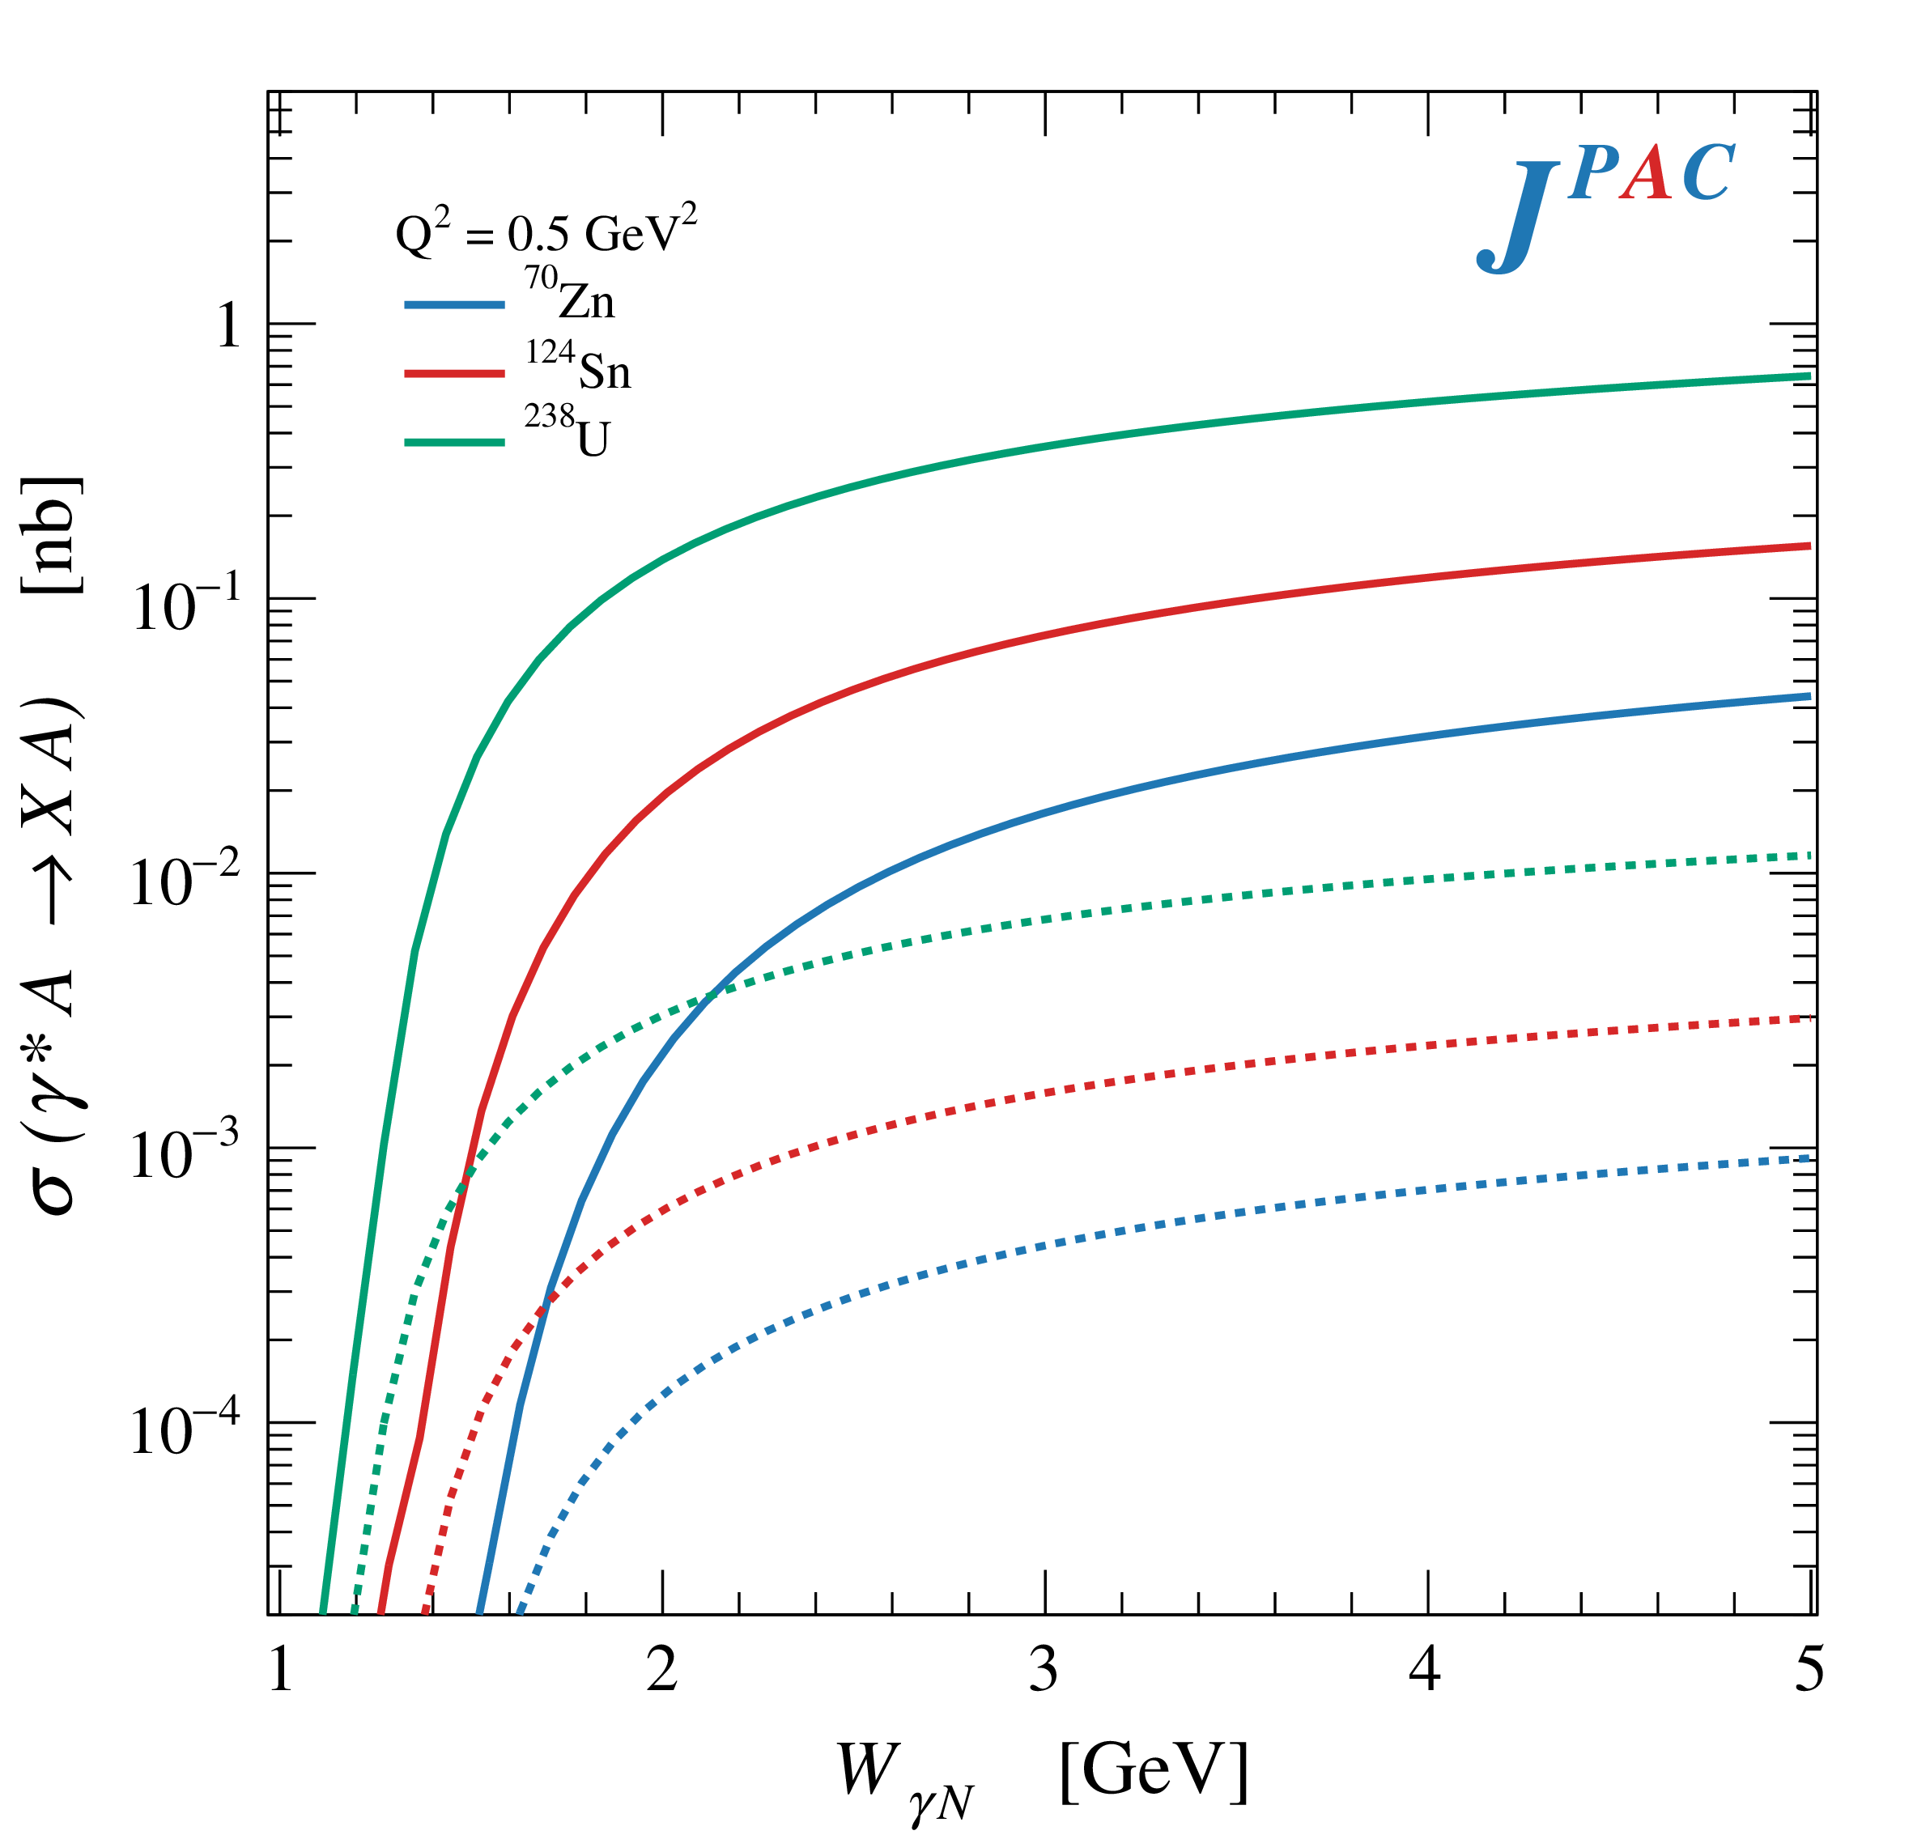
Primakoff X photoproduction
Using measurement of $Γ(X→γγ^{∗})$ from Belle, one can get predictions for Primakoff
Makes use of ion beams, enhancement of cross sections as $Z^{2}$
W. Schafer
$$X(3872)$$
$$X(6900)$$
A. Pilloni – Photoproduction and the nature of XYZ states

Slide 23
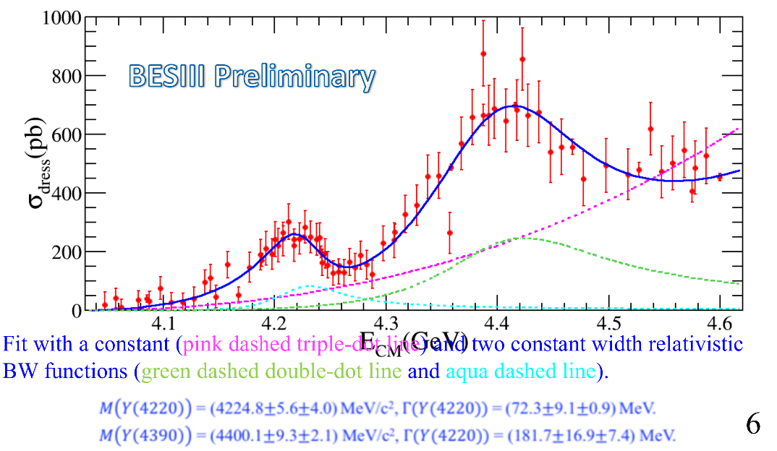
Vector $Y$ states in BESIII
BESIII, PRL118, 092002 (2017)
BESIII, PRL118, 092001 (2017)
$$e^{+}e^{−}→J/ψ ππ$$
New BESIII data show a peculiar lineshape for the $Y(4260)$
The state appear lighter and narrower, compatible with the ones in $h_{c}ππ$ and $χ_{c0}ω$
A broader old-fashioned $Y(4260)$ is appearing in $\overline{D}D^{∗}π$, maybe indicating a ${\overline{D}D}_{1}$
dominance
$$e^{+}e^{−}→π^{+}D^{0}D^{∗−}$$
A. Pilloni – Photoproduction and the nature of XYZ states
Notes:
Y(4260), M=4263 +- 5, Gamma = 95+-14
D_1(2420)^0, M=2421.3 ±0.6, Gamma =27.1 ±2.7
D_1(2420)^+-, M=2423.4 ±3.1, Gamma =25 ±6
I D_1 hanno J^P = 1^+
La molecola D_1 D sta 22 MeV sotto
Se la Y è D_1 D, il pione lega fortemente, come fa la Y a essere così larga?
Come funziona lo scambio del pione???
Close propone che la Y è D_1 D^* col pione scambiato in onda S,
La Y però non va in Ds come se fosse tetraquark

Slide 24
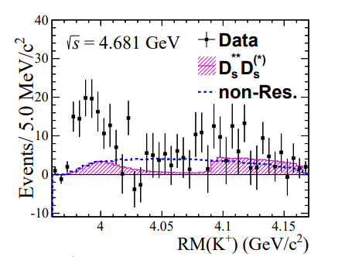
A Strange partner : $Z_{cs}\left(3985\right)$
A strange partner of the $Z_{c}\left(3900\right)$seems to appear in open charm decays
$$e^{+}e^{−}→Z_{cs}{\left(3985\right)}^{+}K^{−}→D_{s}^{+}\overline{D^{∗0}}{ K}^{−}$$ $M={3982.5}_{−2.6}^{+1.8}±2.1$MeV, $Γ={12.8}_{−4.4}^{+5.3}±3.0$ MeV
A. Pilloni – Photoproduction and the nature of XYZ states
Notes:
Y(4260), M=4263 +- 5, Gamma = 95+-14
D_1(2420)^0, M=2421.3 ±0.6, Gamma =27.1 ±2.7
D_1(2420)^+-, M=2423.4 ±3.1, Gamma =25 ±6
I D_1 hanno J^P = 1^+
La molecola D_1 D sta 22 MeV sotto
Se la Y è D_1 D, il pione lega fortemente, come fa la Y a essere così larga?
Come funziona lo scambio del pione???

Slide 25
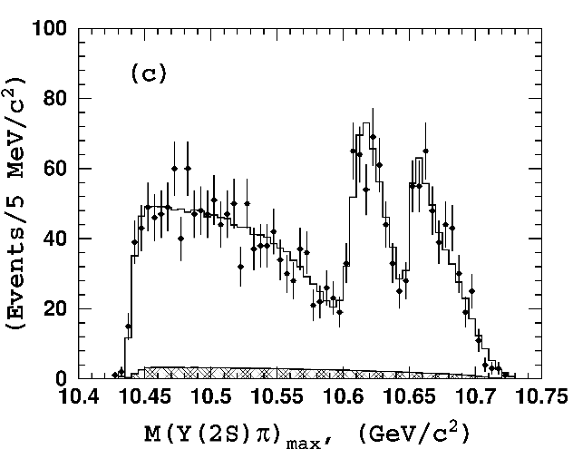
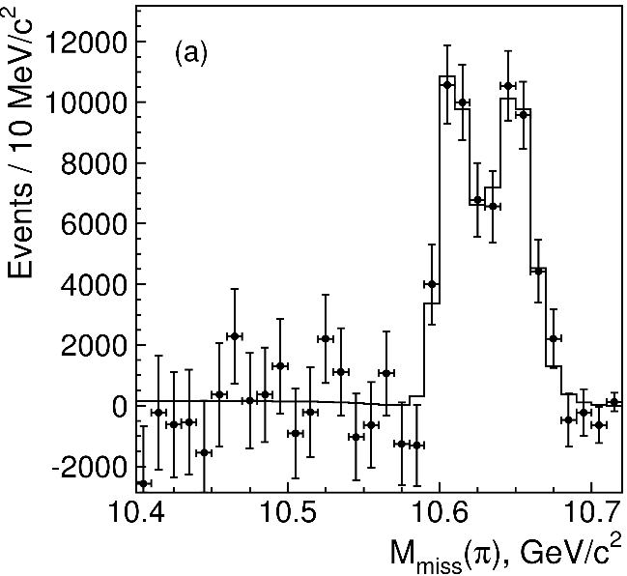
Charged $Z$ states: $Z_{b}\left(10610\right), Z_{b}^{′}(10650)$
Anomalous dipion width in $Υ\left(5S\right)$,
2 orders of magnitude larger than $Υ\left(nS\right)$
Moreover, observed $Υ\left(5S\right)→h_{b}\left(nP\right)ππ$ which violates HQSS
$Υ\left(5S\right)→Z_{b}{\left(10610\right)}^{+}π^{−}→Υ\left(nS\right){ π}^{+}π^{−},h_{b}\left(nP\right){ π}^{+}π^{−}$ and $→{\left(BB^{∗}\right)}^{+}π^{−}$ $M=10607.2±2.0$MeV, $Γ=18.4±2.4$ MeV
$Υ\left(5S\right)→Z_{b}^{′}{\left(10650\right)}^{+}π^{−}→Υ\left(nS\right){ π}^{+}π^{−},h_{b}\left(nP\right){ π}^{+}π^{−}$ and $→{\overline{B}}^{∗0}B^{∗+}π^{−}$
$M=10652.2±1.5$MeV, $Γ=11.5±2.2$ MeV
2 twin resonances!
A. Pilloni – Photoproduction and the nature of XYZ states
Notes:
Y(4260), M=4263 +- 5, Gamma = 95+-14
D_1(2420)^0, M=2421.3 ±0.6, Gamma =27.1 ±2.7
D_1(2420)^+-, M=2423.4 ±3.1, Gamma =25 ±6
I D_1 hanno J^P = 1^+
La molecola D_1 D sta 22 MeV sotto
Se la Y è D_1 D, il pione lega fortemente, come fa la Y a essere così larga?
Come funziona lo scambio del pione???

Slide 26
Broad exotics in $B$ decays
Lots of new exotics have been seen by LHCb with multidimensional amplitude analyses of $B→$ 3+ body
Most of these are broad, and the precise determination can crucially depend on the amplitude model, so that the resonant nature cannot be assessed with the same strong statements as for the narrow guys
A. Pilloni – Photoproduction and the nature of XYZ states
Notes:
Y(4260), M=4263 +- 5, Gamma = 95+-14
D_1(2420)^0, M=2421.3 ±0.6, Gamma =27.1 ±2.7
D_1(2420)^+-, M=2423.4 ±3.1, Gamma =25 ±6
I D_1 hanno J^P = 1^+
La molecola D_1 D sta 22 MeV sotto
Se la Y è D_1 D, il pione lega fortemente, come fa la Y a essere così larga?
Come funziona lo scambio del pione???

Slide 27
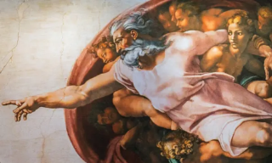
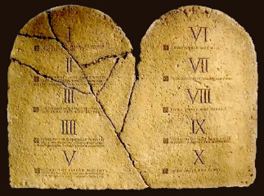
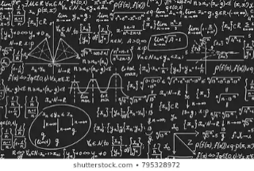
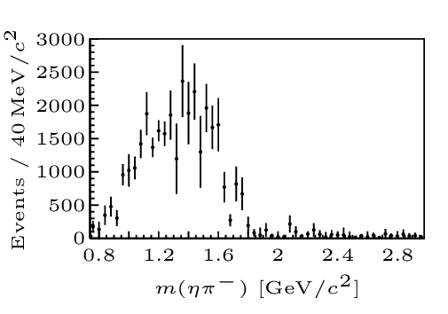
How to proceed?
Top-down: you study models, and verify predictions
Bottom-up: you study data (lineshapes), and try and infer the physics
$$f(s)$$
A. Pilloni – Photoproduction and the nature of XYZ states
Notes:
Y(4260), M=4263 +- 5, Gamma = 95+-14
D_1(2420)^0, M=2421.3 ±0.6, Gamma =27.1 ±2.7
D_1(2420)^+-, M=2423.4 ±3.1, Gamma =25 ±6
I D_1 hanno J^P = 1^+
La molecola D_1 D sta 22 MeV sotto
Se la Y è D_1 D, il pione lega fortemente, come fa la Y a essere così larga?
Come funziona lo scambio del pione???

Slide 28
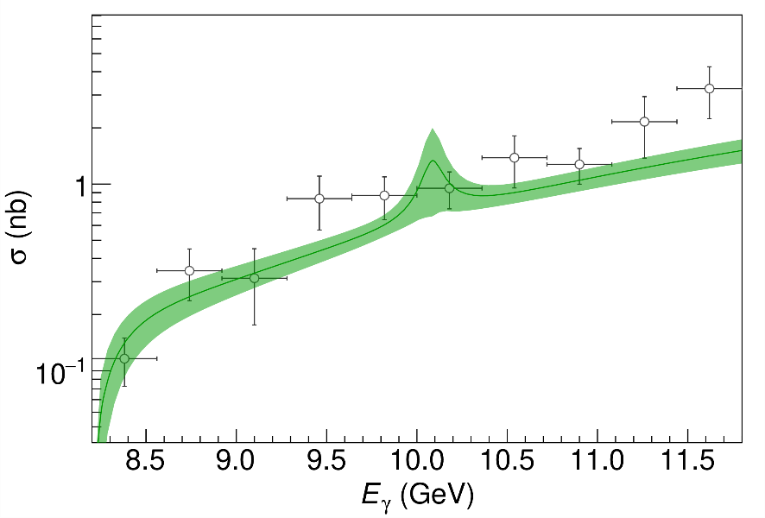
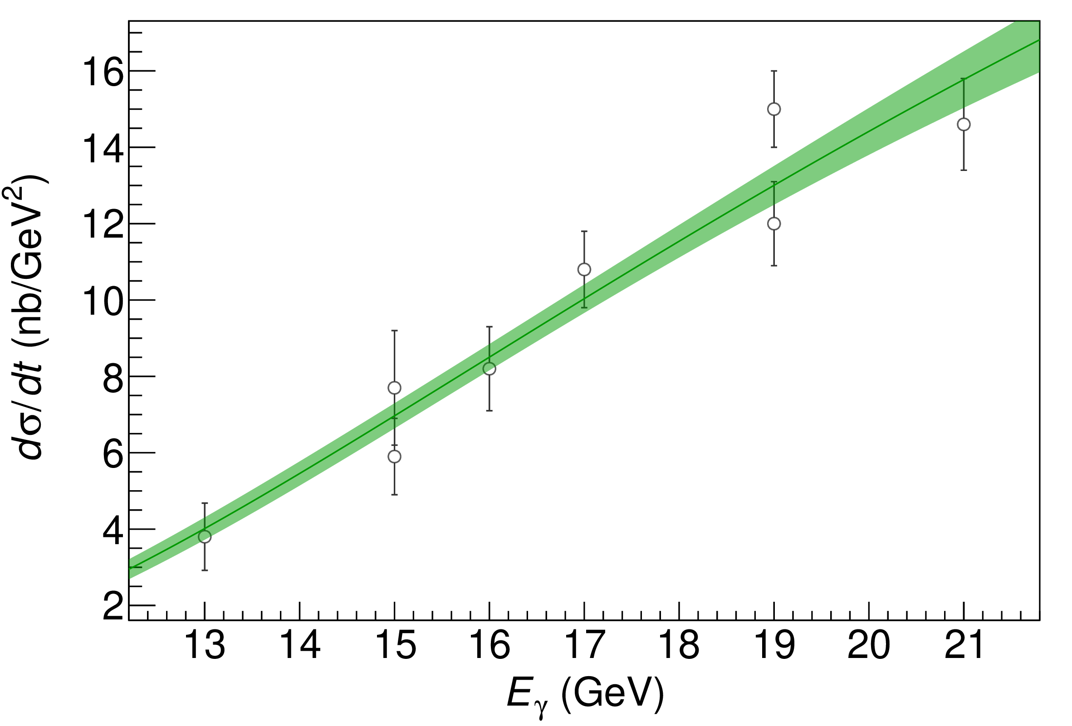
$P_{c}$ photoproduction
Karliner & Rosner, PLB752, 329
Hiller Blin, AP et al. (JPAC), PRD94, 034002
D. Winney, C. Fanelli, AP et al. (JPAC) PRD100, 034019
The background is described via an Effective Vector Pomeron
Vector meson dominance relates radiative width to hadronic one
Fit the model to GlueX and SLAC data, upper limit $BR_{J/ψp}<4.3\%$ for $J^{P}={\frac{3}{2}}^{−}$
A. Pilloni – Photoproduction and the nature of XYZ states
Notes:
Controlla la parte su Regge

Slide 29
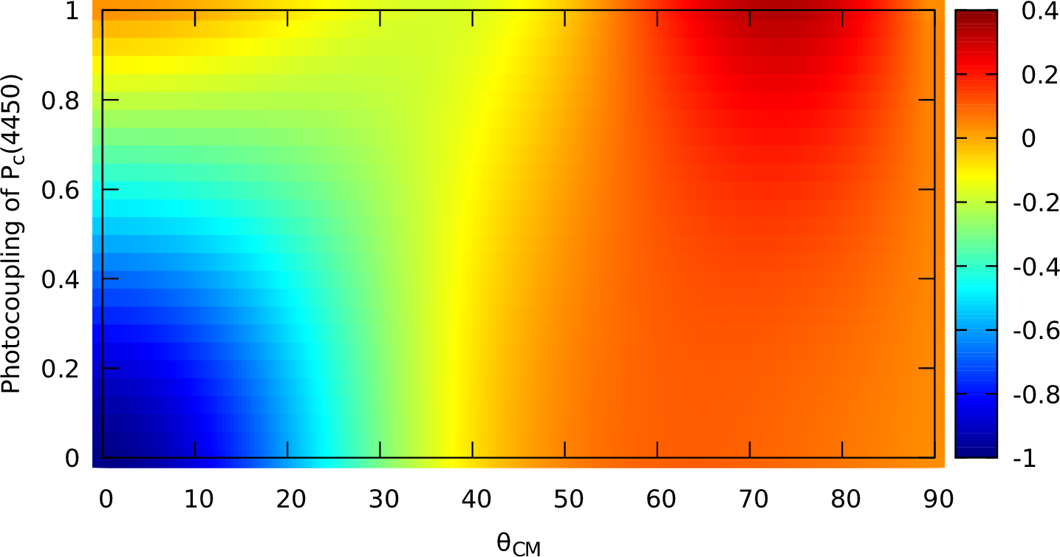
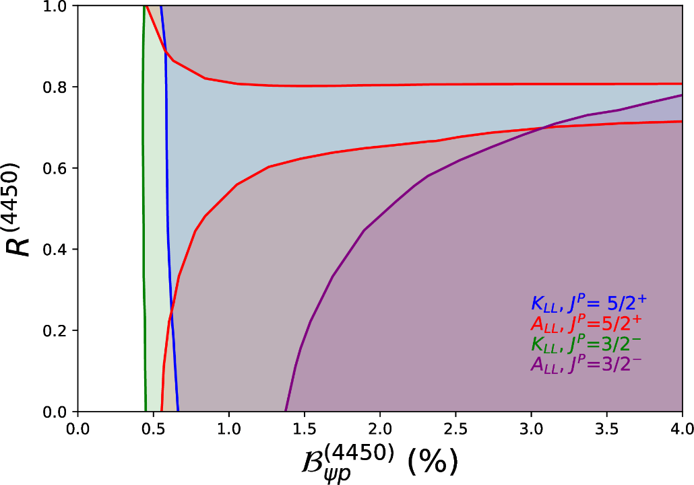
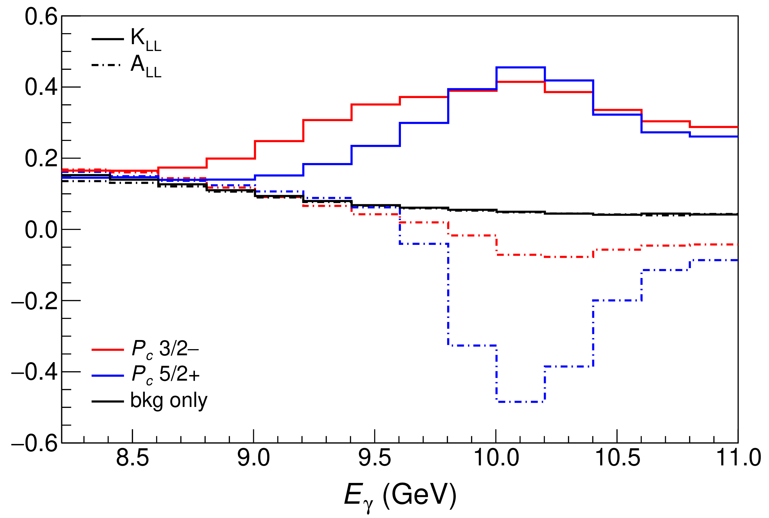
Polarization observables
One can take advantage of the polarized beam at Jlab Need polarized target ($A_{LL}$) or polarization of recoiling proton ($K_{LL}$)
$$K_{LL}$$
(in SBS acceptance)
A. Pilloni – Heavy quark Spectroscopy
Notes:
Controlla la parte su Regge

Slide 30
Threshold vs. high energy
Fixed-spin exchanges expected to hold in the low energy region
$t$ channel grows as $s j$, exceeding unitarity bound, Regge physics kicks in: Reggeized tower of particles with arbitrary spin at HE
$$s^{j}⟶s^{α_{0}+α^{′}t }$$
Holds at low energy, fixed spin
Holds at high energy, resummation of leading $s$ power
If $ε≠$IP, $α_{0}<1$, $dσ/dt$ decreases with energy
Exchange of heavy particles further suppressed
A. Pilloni – Photoproduction and the nature of XYZ states

Slide 31
$Y$ (vector) photoproduction
Focus on the $1^{−−} Y\left(4260\right)→J/ψ π^{+}π^{−}$, check with $ψ′→J/ψ π^{+}π^{−}$
Diffractive production, dominated by Pomeron (2-gluon) exchange
Good candidates for EIC: diffractive production increases with energy!
We have $γψ$-pomeron coupling from our analyses 1606.08912, 1907.09393
How to rescale from $J/ψ$ to $ψ′$ ?
$$R_{ψ^{′}}=\sqrt{\frac{g^{2}(ψ^{′}→γgg)}{g^{2}(ψ→γgg)}}∼0.55$$
$$g^{2}(ψ→γgg)=\frac{6m_{ψ}ℬ(ψ→γgg)Γ_{ψ}}{PS(ψ→γgg)}$$
A. Pilloni – Photoproduction and the nature of XYZ states

Slide 32
$Y$ (vector) photoproduction
Focus on the $1^{−−} Y\left(4260\right)→J/ψ π^{+}π^{−}$, check with $ψ′→J/ψ π^{+}π^{−}$
Diffractive production, dominated by Pomeron (2-gluon) exchange
Good candidates for EIC: diffractive production increases with energy!
We have $γψ$-pomeron coupling from our analyses 1606.08912, 1907.09393
How to rescale from $J/ψ$ to $Y(4260)$ ?
We assume VMD and $g^{2}\left(Y→ψππ\right)=g^{2}\left(Y→ψgg\right)×g^{2}(gg→ππ)$ (Novikov & Shifman)
$$R_{Y}=\frac{ef_{ψ}}{m_{ψ}}\sqrt{\frac{g^{2}(Y→ψππ)}{g^{2}(ψ→γgg)}\frac{g^{2}(ψ^{′}→ψgg)}{g^{2}(ψ^{′}→ψππ)}}$$
Caveat : $BR(Y→ψππ)$ only known times the leptonic width $Γ_{ee}^{Y}$
A. Pilloni – Photoproduction and the nature of XYZ states

Slide 33
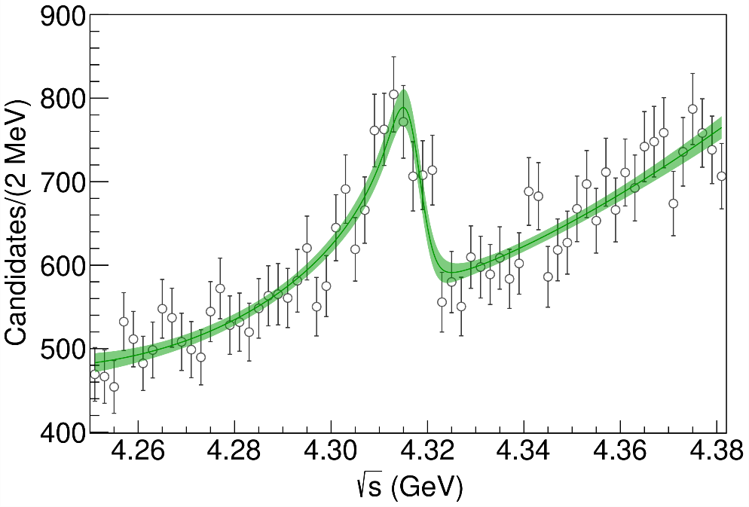
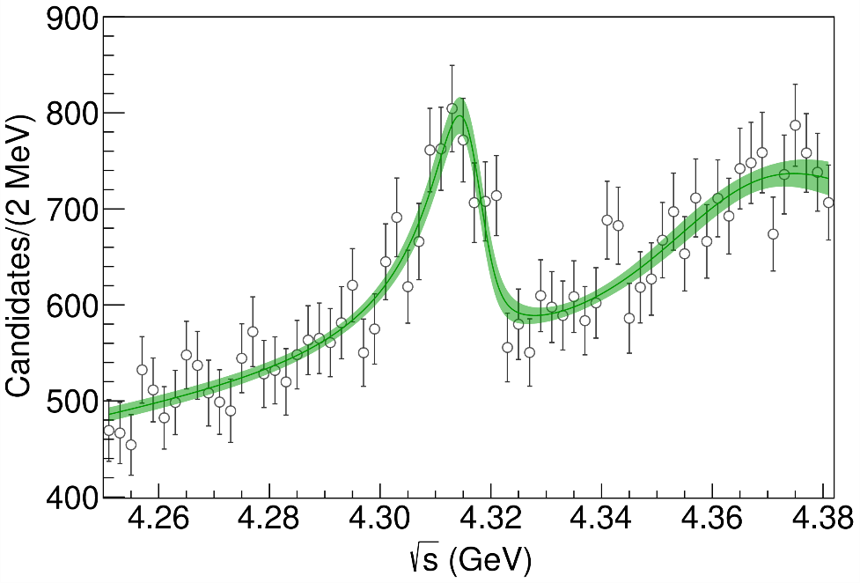
Minimal(istic) model for $P_{c}(4312)$
( data)
Fernandez-Ramirez, AP et al. (JPAC), PRL 123, 092001
Effective range expansion We can set $c_{ii}=0$ to reduce to the scattering length approximation
$$c_{ii}=0$$
Finite $c_{ii}$
A. Pilloni – Photoproduction and the nature of XYZ states
Notes:
2 slides su Zc, a Bes e a Belle
2 slide su tetraquark model: dall’hamiltoniana di Jaffe al calcolo delle masse
1 slide su molecular models, dove sono i carichi? (non in Tornqvist, si in Hanhart, vedere Braaten, citare Nefediev)
2 slides su decay channels, dove si dovrebbe vedere, e a seconda del modello, vedere qualche plot
1 slide su Y(4260), tetraquark? C’è lo strano (si vede la f0)
1 slide su Zc a cleo (anche il neutro)

Slide 34
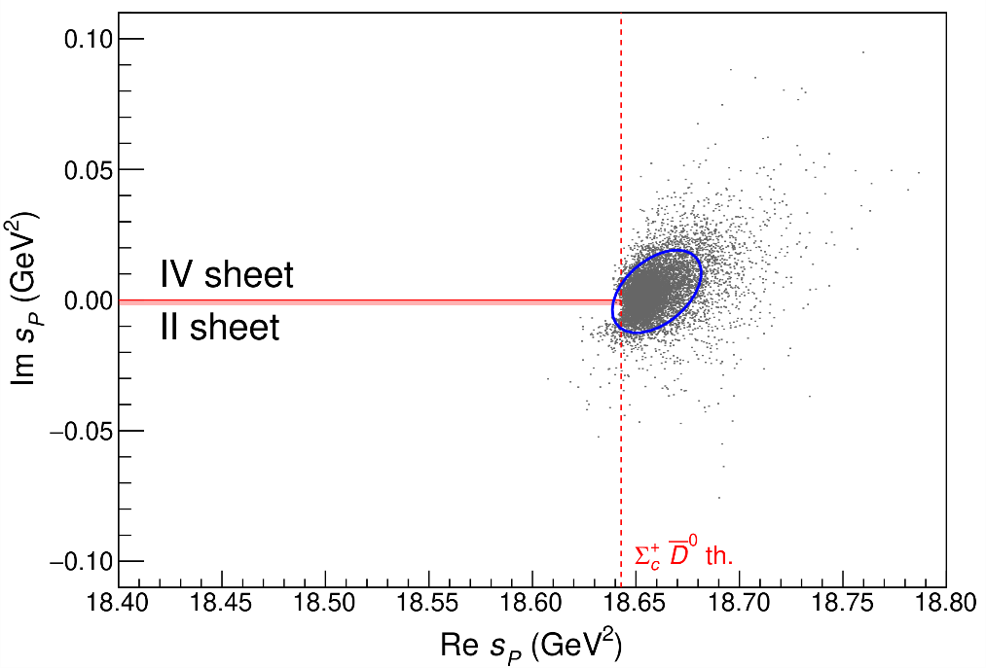
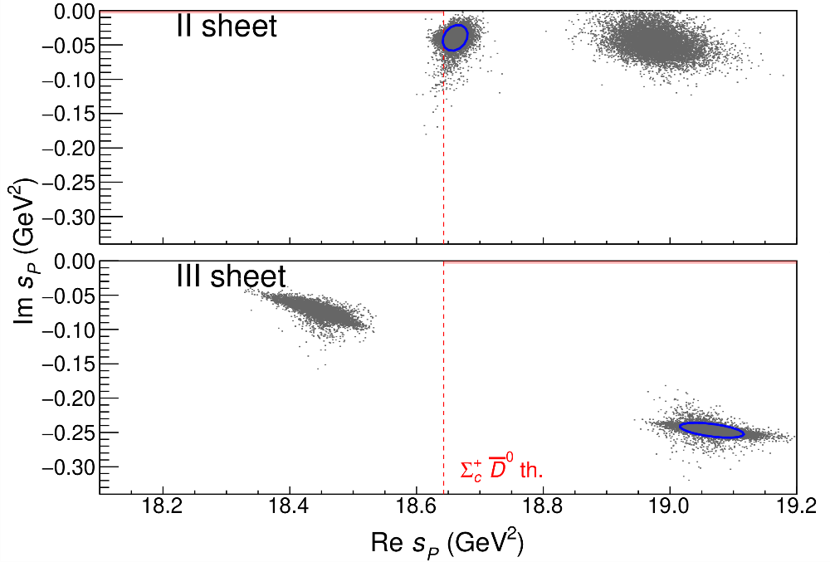
Minimal(istic) model for $P_{c}(4312)$
Effective range expansion We can set $c_{ii}=0$ to reduce to the scattering length approximation
$$c_{ii}=0$$
Finite $c_{ii}$
A. Pilloni – Photoproduction and the nature of XYZ states
Notes:
2 slides su Zc, a Bes e a Belle
2 slide su tetraquark model: dall’hamiltoniana di Jaffe al calcolo delle masse
1 slide su molecular models, dove sono i carichi? (non in Tornqvist, si in Hanhart, vedere Braaten, citare Nefediev)
2 slides su decay channels, dove si dovrebbe vedere, e a seconda del modello, vedere qualche plot
1 slide su Y(4260), tetraquark? C’è lo strano (si vede la f0)
1 slide su Zc a cleo (anche il neutro)

Slide 35
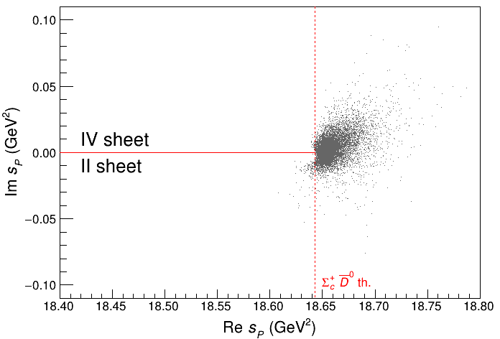
Minimal(istic) model for $P_{c}(4312)$
Effective range expansion We can set $c_{ii}=0$ to reduce to the scattering length approximation
Points to a virtual state
$$c_{ii}=0$$
Finite $c_{ii}$
A. Pilloni – Photoproduction and the nature of XYZ states
Notes:
2 slides su Zc, a Bes e a Belle
2 slide su tetraquark model: dall’hamiltoniana di Jaffe al calcolo delle masse
1 slide su molecular models, dove sono i carichi? (non in Tornqvist, si in Hanhart, vedere Braaten, citare Nefediev)
2 slides su decay channels, dove si dovrebbe vedere, e a seconda del modello, vedere qualche plot
1 slide su Y(4260), tetraquark? C’è lo strano (si vede la f0)
1 slide su Zc a cleo (anche il neutro)

Slide 36
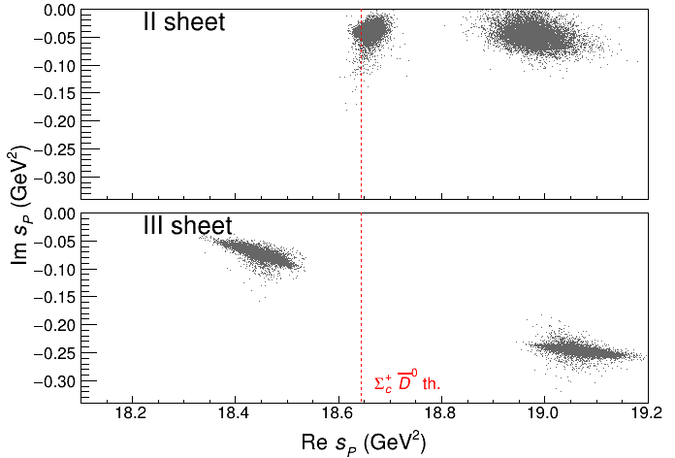
Minimal(istic) model for $P_{c}(4312)$
Effective range expansion We can set $c_{ii}=0$ to reduce to the scattering length approximation
Points to a virtual state
Doesn’t point to a resonance
$$c_{ii}=0$$
Finite $c_{ii}$
A. Pilloni – Photoproduction and the nature of XYZ states
Notes:
2 slides su Zc, a Bes e a Belle
2 slide su tetraquark model: dall’hamiltoniana di Jaffe al calcolo delle masse
1 slide su molecular models, dove sono i carichi? (non in Tornqvist, si in Hanhart, vedere Braaten, citare Nefediev)
2 slides su decay channels, dove si dovrebbe vedere, e a seconda del modello, vedere qualche plot
1 slide su Y(4260), tetraquark? C’è lo strano (si vede la f0)
1 slide su Zc a cleo (anche il neutro)

Slide 37
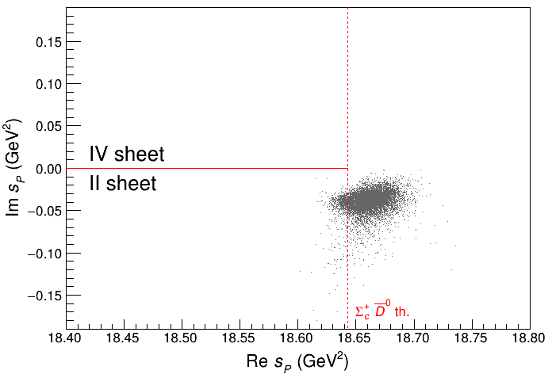
Minimal(istic) model for $P_{c}(4312)$
Effective range expansion We can set $c_{ii}=0$ to reduce to the scattering length approximation
Points to a virtual state
Doesn’t point to a resonance
$$c_{ii}=0$$
Finite $c_{ii}$
A. Pilloni – Photoproduction and the nature of XYZ states
Notes:
2 slides su Zc, a Bes e a Belle
2 slide su tetraquark model: dall’hamiltoniana di Jaffe al calcolo delle masse
1 slide su molecular models, dove sono i carichi? (non in Tornqvist, si in Hanhart, vedere Braaten, citare Nefediev)
2 slides su decay channels, dove si dovrebbe vedere, e a seconda del modello, vedere qualche plot
1 slide su Y(4260), tetraquark? C’è lo strano (si vede la f0)
1 slide su Zc a cleo (anche il neutro)

