Slide 1
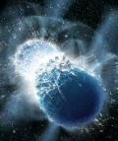
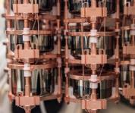
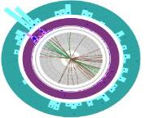
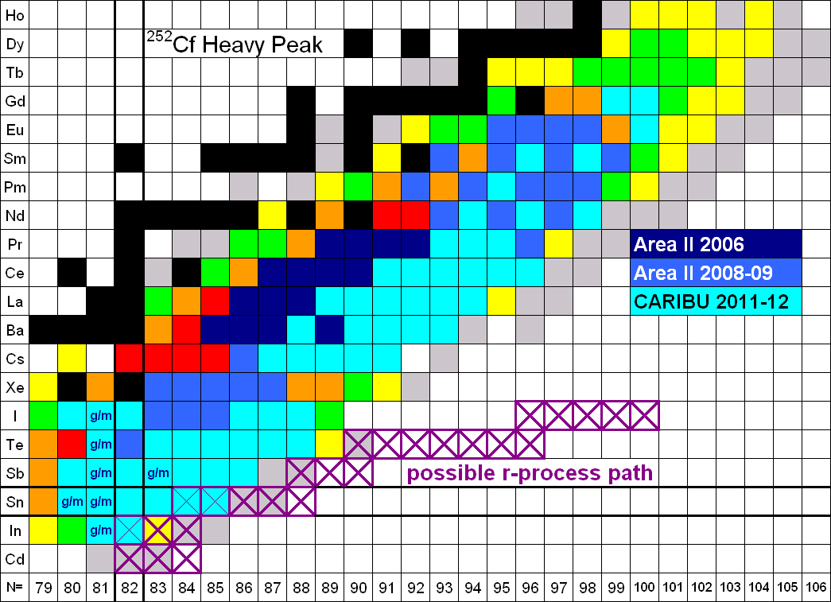
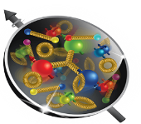
Perspectives from DOE Nuclear Physics
APS Topical Group on Hadron Physics
April 12, 2023
Dr. T. J. Hallman
Associate Director of the Office of Science
for Nuclear Physics

Slide 2
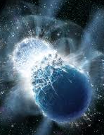
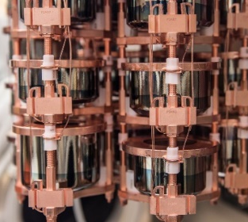
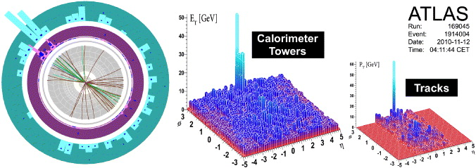
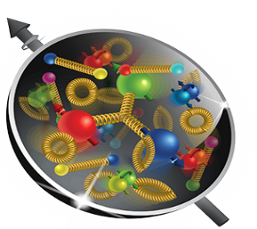
Nuclear Physics
Discovering, exploring, and understanding all forms of nuclear matter
      Understanding why matter takes on the specific forms observed in nature and how that knowledge can benefit energy, commerce, medicine, and national security, by:
  Mapping the quantum cosmos inside the proton using the future Electron-Ion Collider
  Discovering the properties of the novel quark-gluon plasma RHIC, LHC
  Exploring the mechanism underlying the confinement of quarks and gluons via CEBAF and RHIC
  Searching for new exotic particles and violations of nature’s symmetries at CEBAF, FRIB, ATLAS
  Determining the limits of nuclear existence and how are heavy elements made via FRIB and ATLAS
  Discovering if the neutrino its own anti-particle or if the neutron’s precise properties point to new physics via Neutrino-less Double Beta Decay and Neutron Electric dipole Moment
  Exploring the strong force in many-body systems via SciDAC, Core Research, QIS/QC, AI/ML
  Advancing Nuclear Data for Space, Energy, and Research through Nuclear Data and AI/ML

Slide 3
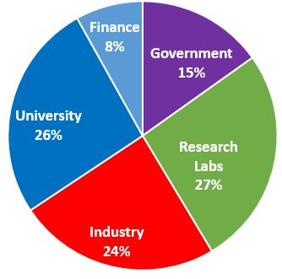
NP is the Federal Steward of U.S. Nuclear Physics Research
NP supports ~ 95% of the nation’s investment in basic research in nuclear physics in the U.S.
It is responsible for Strategic Planning, Funding, and Implementation
Where NP PHDs go
Goals and Deliverables:
  Knowledge
  Leadership class facilities
  New technology
  A highly-trained, diverse workforce capable of supporting DOE & other missions
U.S. science, commerce, medicine, defense —all benefit, in part, from a stable level of sustained competence, capability, capacity, and leadership in nuclear physics; NP is the U.S. steward responsible for reliably delivering that benefit.

Slide 4

The High-Level NP Work Plan
Operate and get science out from the Relativistic Heavy Ion Collider (RHIC),the Continuous Electron Beam Accelerator Facility (CEBAF), the Argonne Tandem Linac Accelerator System (ATLAS) and the Facility for Rare Isotope Beams (FRIB)
Make progress on a U.S.-led ton-scale neutrino-less double beta decay experiment.
Start construction of a high-energy high-luminosity polarized electron-ion collider (EIC)
Implement smaller scale instrumentation to take advantage of facility capabilities
The work plan centers on NP’s mission to understand all forms of nuclear matter to benefit energy, commerce, medicine, and national security. A new Long Range Plan is in development by NSAC.

Slide 5
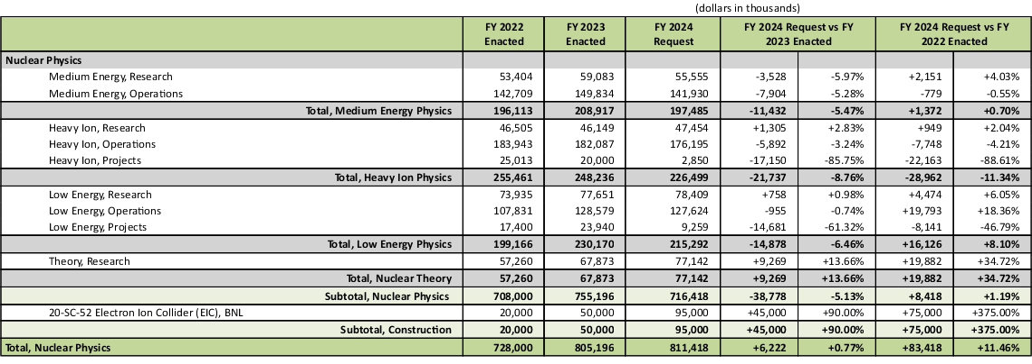
NP - FY 2024 President's Request
The FY 2024 Request for $811.4 million supports high priority efforts and capabilities in fundamental nuclear physics research; operations, maintenance, and upgrades of scientific user facilities; and projects

Slide 6
The Nuclear Physics Program Supports…
Ground-breaking research and discoveries
  E.g., First observation of the direction production of matter/anti-matter from an intense electro-magnetic field; discovery that natural radiation frustrates quantum coherence time essential for quantum computing
Safe and highly efficient operation of four world-leading national user facilities with complimentary capabilities to maintain U.S. leadership in Nuclear Physics
The construction of new tools (e.g. the Electron-Ion Collider) to maintain U.S. dominance in nuclear physics and a trained nuclear/accelerator physics workforce through the century
Pioneering programs in RENEW, FAIR, EPSCOR to ensure the future NP workforce is fully capable of leveraging the entirety of diverse intellectual capital in the United States
Applications critical for national needs through Nuclear Data, ACCELERATE, QIS, AI/ML, and Microelectronics

Slide 7
FY 2024 President's Request Highlights - NP
FRIB begins its third year of science research studying atomic number nuclei near the limit for nuclear existence, and initiating a world leading campaign of fundamental symmetries measurements
NP User Facilities (RHIC, CEBAF, ATLAS, and FRIB) are all at or above 90% optimal budget
The Electron-Ion Collider vets a list of CD3a long lead procurements and makes finalizes preparations for CD-2 Review, Approve Performance Baseline. EIC A/E design is begun subject to funding.
sPHENIX continues science research at RHIC to determine the novel properties of the quark-gluon plasma
LEGEND-200 continues initial search for new physics via the slowest rare decay ever attempted
A ton-scale neutrino-less double beta decay experiment finalizes preparation for a CD-1 review, “Approve Alternatives Selection and Cost Range”
The Gamma Ray Energy Tracking Array (GRETA) MIE and MOLLER are fully funded at the FY 2023 Request, and construction continues in accordance with their technically driven schedules
The High Rigidity Spectrometer for FRIB continues construction
NP investment in the AI/ML cross-cutting research continues and RENEW and EPSCOR investment increases
NP makes highly impactful awards in the new cross-cutting initiatives in Funding for Accelerated Inclusive Research (FAIR) and Accelerate Innovations in Emerging Technologies (Accelerate)

Slide 8
Planned FY 2024 NP Research Horizons
Search for anomalous atomic electric-dipole moments at FRIB as a signal of new physics using laser trapped isotopes
Search for anomalous parity violation in electron scattering as a signal of new physics using MOLLER at JLAB
Search for the next superheavy nucleus (A = 120) at the LBNL 88 inch cyclotron
Understanding the equation of state of the quark-gluon plasma using sPHENIX at RHIC
Expanding the boundary of present knowledge of how heavy elements are produced in the cosmos via never-before-produced heavy neutron-rich nuclei at FRIB
Discovering ways to suppress the effects of natural radiation on quantum coherence times
Quantum step improvement in rare search capability via AI/ML pattern recognition software
Significantly advancing imaging technology for the physical sciences.
Reducing the limit on the neutrino mass by a factor of 5.

Slide 9
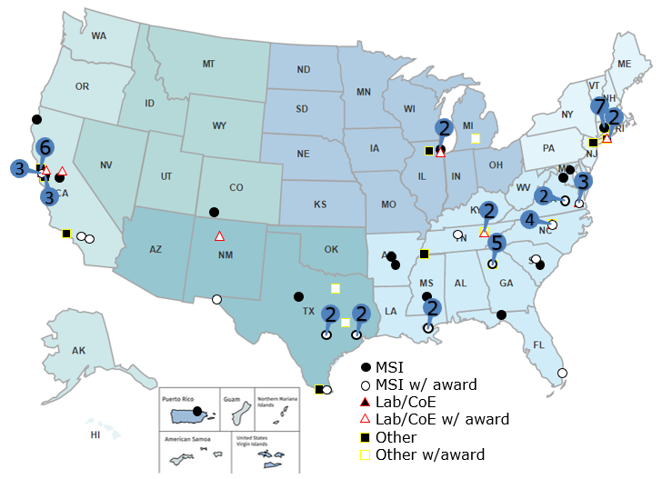
NP Helped Pioneer An Early Initiative As Part of SC’s Development of RENEW
110 NP traineeship award recipients include:
  18 MSIs,
  10 other colleges/universities,
  5 DOE laboratories
MSI award recipients include:
  9 Hispanic Serving Institutions (HSIs),
  8 HBCUs,
  5 Asian/Native American, and Pacific Islander Serving Institutions (AANAPISI),
  1 Predominantly Black Institution (PBI)
Other institutions on the map are involved in the traineeship program as recruitment sites (38), Co-Is (9), and/or hosts (7).
Of the funds awarded, ∼ 70% went to MSIs, MSI faculty, or MSI students. About 50% of trainees awarded continued on to Graduate Programs in Science or Engineering

Slide 10
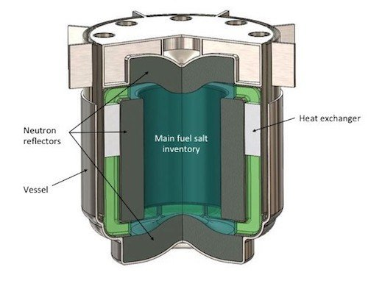


NP Broader Impacts & Applications For Other Missions:
Nuclear Data
NP is providing new and updated nuclear data to existing customers
  Working to identify impactful nuclear data needs and leverage resources
    Ex: Data for next generation molten salt reactors with DOE/NE, ARPA-E
NP is reaching out to new nuclear data application customers
  Electronics protection (NASA, Missile Defense Agency, Federal Aviation Administration)
  Human safety (NASA [spaceflight], NIH [ion beam therapy])
  Advanced reactors (ARPA-E, NASA)
NP is exploring a mechanism for Rapid Response Nuclear Data
  Many federal agencies have projects with nuclear data shortfalls
  USNDP is investigating a process where performers can submit requests for urgent, high impact nuclear data needs

Slide 11
Summary of 2024 PR Changes Relative to FY 2023 Enacted
Research
FY 2022 Enacted | FY 2023 Enacted | FY 2024 PR
Core research in Medium Energy, Heavy Ions, and Theory is increased by 7.5% from FY21 Enacted. The Fundamental Symmetries and Nuclear Structure and Nuclear Astrophysics portfolios are increased by 10.5% over FY21 Enacted. | Core Research in Medium Energy, Heavy Ions, Nuclear Theory, Fundamental Symmetries and Nuclear Structure and Nuclear Astrophysics is ~6.1% above the FY22 Enacted Level. | Core Research in Medium Energy, Heavy Ions, Nuclear Theory, Fundamental Symmetries and Nuclear Structure and Nuclear Astrophysics is ~flat with the FY23 Enacted Level.
LHC M&O commitments are met. | LHC M&O commitments are met. | LHC M&O commitments are met.
FRIB Research is increased. | FRIB Research is increased. | FRIB Research is increased.
nEDM supported significantly below planned profile. | nEDM is supported below the planned profile at $1M for the GPP effort for minor construction. | nEDM is supported below the planned profile at $1M for the GPP effort for minor construction.
SciDAC funding is increased to support SciDAC-5 (+$600k). | SciDAC is modestly reduced by from the FY22 Enacted. | SciDAC is modestly increased from the FY23 Request to support SciDAC-5 activities.
Nuclear Data increased $2.8M from FY21 Enacted to support the expansion of experimental efforts. | Nuclear Data is flat with the FY22 Enacted level. | Nuclear Data is modestly increased above the FY23 Enacted level.
Accelerator R&D held flat with the FY21 Enacted level. | Accelerator R&D is reduced by 4.5% from the FY22 Enacted. | Accelerator R&D is flat with the FY23 Enacted.

Slide 12
Summary of 2024 PR Changes Relative to FY 2023 Enacted
Initiatives
FY 2022 Enacted | FY 2023 Enacted | FY 2024 PR
QIS increased to $10.9M. | QIS is flat with FY22 Enacted. | QIS is flat with FY23 Enacted ($10.9M).
AI/ML Initiative support flat with FY21 Enacted ($4M). | AI/ML is increased to $8M (+$4M) | AI/ML is flat with the FY23 Enacted ($8M).
Three new initiatives are supported: Reaching a New Energy Sciences Workforce (RENEW) - $3M Accelerator Science and Technology - $1M Microelectronics - $518k | Two of the FY22 Enacted new initiatives are supported in FY 2023: Reaching a New Energy Sciences Workforce (RENEW) - $6M (+$3M) Microelectronics - $518k Accelerator Science and Technology Initiative is paused | Initiatives are continued in FY 2024: Accelerate Innovations in Emerging Technologies - $4M Microelectronics - $518k Accelerator Science and Technology Initiative is paused
 | Two new cross cutting initiatives are supported: Funding to Accelerated, Inclusive Research (FAIR) - $2M Accelerate Innovations in Emerging Technologies - $4M | The FAIR and RENEW initiatives are increased: Reaching a New Energy Sciences Workforce (RENEW) - $11.5M (+$5.5M) Funding to Accelerated, Inclusive Research (FAIR) - $5M (+$3M)

Slide 13
Summary of 2024 PR Changes Relative to FY 2023 Enacted
Facility Operations and Projects
FY 2022 Enacted | FY 2023 Enacted | FY 2024 PR
Facility operations supported at >90% of optimal. RHIC operates 20 weeks (90 % maximum) CEBAF operates 31 weeks (90 % optimal) ATLAS operates 39 weeks (93 % optimal) FRIB operates 12 weeks (100% of optimal) | All NP user facilities operate at >90% of optimal in FY 2023. RHIC operates 25 weeks (96 % optimal) CEBAF operates 33 weeks (96 % optimal) ATLAS operates 40 weeks (96 % optimal) FRIB operates 26 weeks (99% of optimal) | All NP user facilities operate at roughly 90% of optimal funding in FY 2024. RHIC operates 20 weeks (94 % optimal funding) CEBAF operates 27 weeks (88 % optimal funding) ATLAS operates 39 weeks (94 % optimal funding) FRIB operates 24 weeks (91% of optimal funding)
FRIB Operations increased, but still slightly below planned levels ($77M in PR vs $82M planned) | FRIB Operations increased to near optimal level. | FRIB Operations slightly reduced, and below optimal levels ($96.2M in Request vs $102.4M optimal)
EIC construction at TEC of $20M and OPC of $24.8M in annual appropriation, and TEC of $128.24M and OPC of $10M in the Inflation Reduction Act. | EIC construction at TEC of $50M and OPC of $20M | EIC construction at TEC of $95M and OPC of $2.9M
Ongoing Major Items of Equipment are supported with both the annual appropriation and Inflation Reduction Act funds: GRETA above baseline level ($16.7M) sPHENIX at baseline level in final year ($0.2M) MOLLER above planned level ($36.2M) TSNLDBD at $8.4M HRS at $34.84M | Ongoing Major Items of Equipment: GRETA at optimal level, providing the project with the final year of funding ($15.5M) MOLLER receives the final $4M of planned TEC funding TSNLDBD at $1.44M TEC HRS at $3M TEC | Ongoing Major Items of Equipment: GRETA and MOLLER at received full TPC amount in FY 23 Request. Progress continues, but no new funding requested in FY24. TSNLDBD at $3M TEC HRS at $6.3M TEC

Slide 14
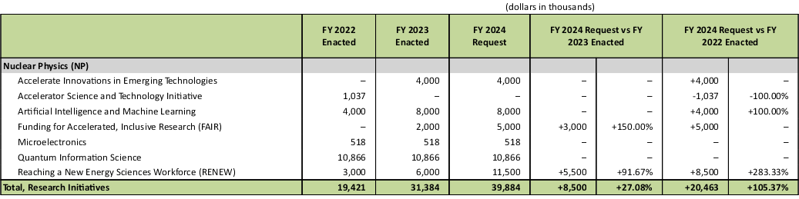
NP - Research Initiatives

Slide 15
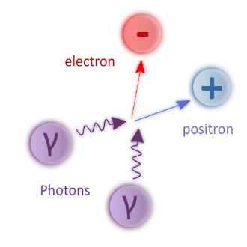
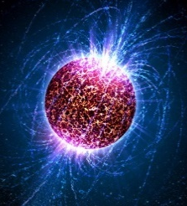
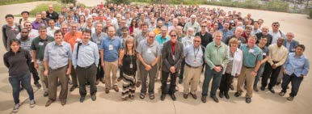
Recent Impactful Accomplishments
Discovery that ionizing radiation reduces coherence time for entangled quantum states
  Need new quantum materials or/and underground Quantum Computing
First known observation of the Breit-Wheeler two-photon process at RHIC
  Confirmation of Quantum Electro-Dynamic (QED) process; possibility of e⁺e⁻ pair production via lasers
Discovery that heavy nuclei have a neutron skin (CEBAF)
  New constraints on neutron star radii and their equation of state
Implementation of dynamical fermions and the real pion mass in Lattice QCD
  Major advance in fidelity of Lattice Quantum Chromodynamics calculations
Initiation of the FRIB science program
  Opening a new frontier to understand heavy element
  production in cosmos
Integration of AI technology at CEBAF to make it more fault tolerant
  Test-bed for use of Artificial Intelligence in accelerator control and optimization

Slide 16
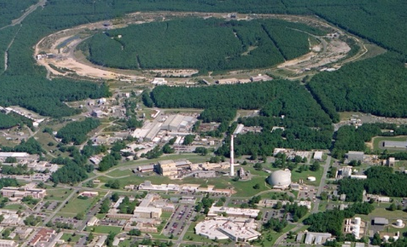
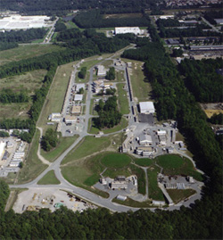
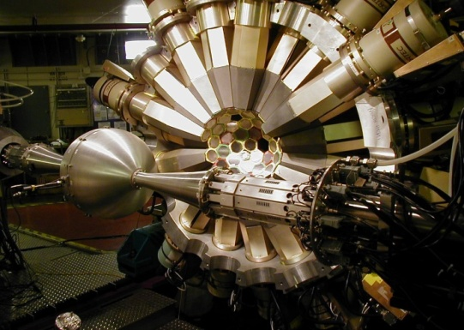
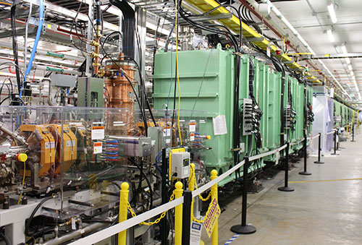
The Four World-Leading National User Facilities NP Stewards
ALS 1993
Relativistic Heavy Ion Collider
Continuous Electron Beam Accelerator Facility
CEBAF
Argonne Tandem Linac System
Facility for Rare Isotope Beams
Are “Microscopes” with Complementary Resolving Power

Slide 17
The Newest SC User Facility: the Facility for Rare Isotope Beams
FRIB construction started in 2013 and finished in 2022, on cost and ahead of schedule
FRIB was constructed by DOE ($635M) and Michigan State University ($94.5M) under a unique Cooperative Agreement
Now complete, FRIB provides access to 80% of all isotopes predicted to exist in nature
ALS 1993
Facility for Rare Isotope Beams
 | PYs | FY 2017 | FY 2018 | FY 2019 | FY 2020 | FY 2021 | DOE Total | MSU | TOTAL
FRIB Funding Profile | 318,000 | 100,000 | 97,200 | 75,000 | 40,000 | 5,300 | 635,500 | 94,500 | 730,000
Secretary Granholm and MSU President Stanley “Cut the Ribbon” declaring FRIB open for scientific research on May 2, 2022
On May 19, 2022, first scientific results on isotopes never-before produced in sufficient quantity for scientific study are awaiting publication
CEBAF

Slide 18
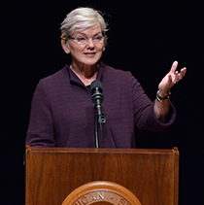
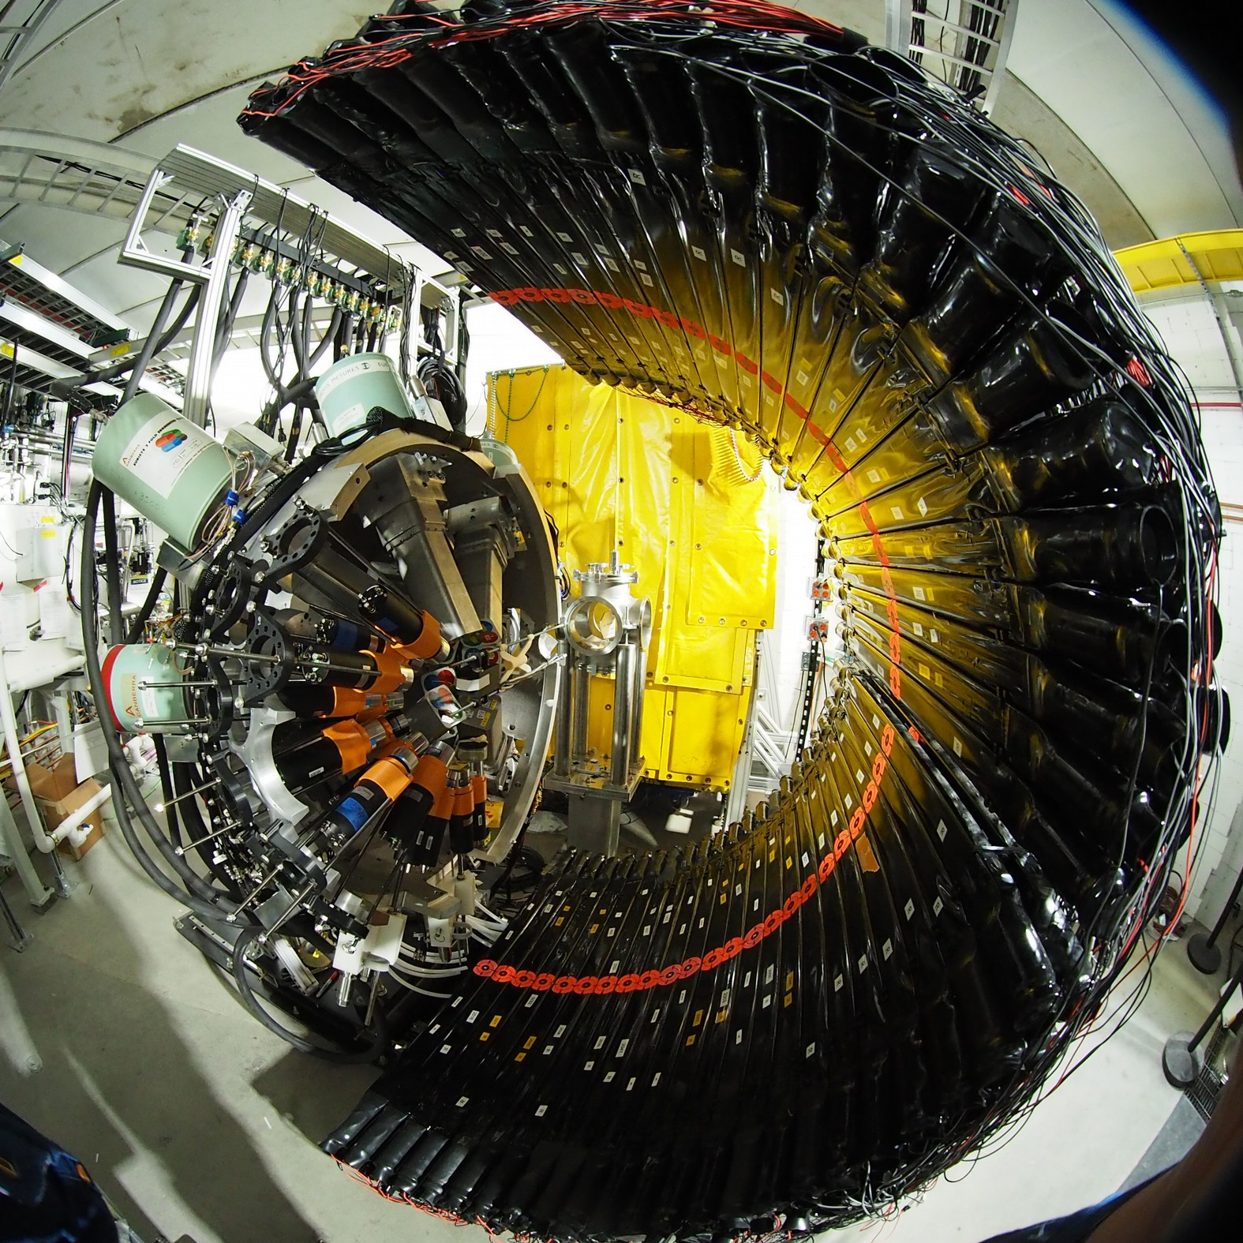
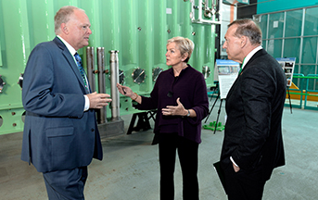
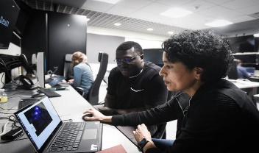
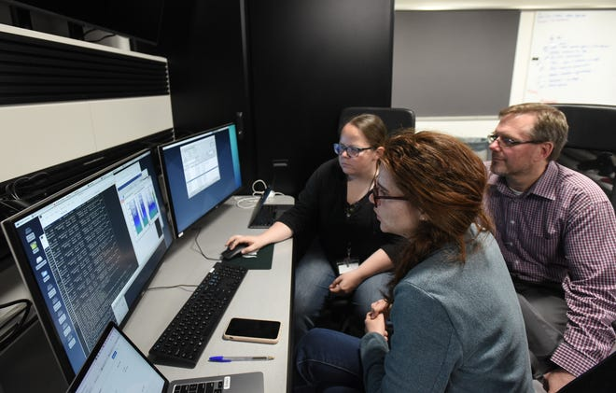
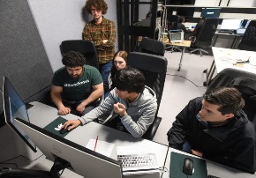
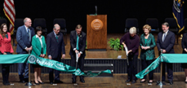
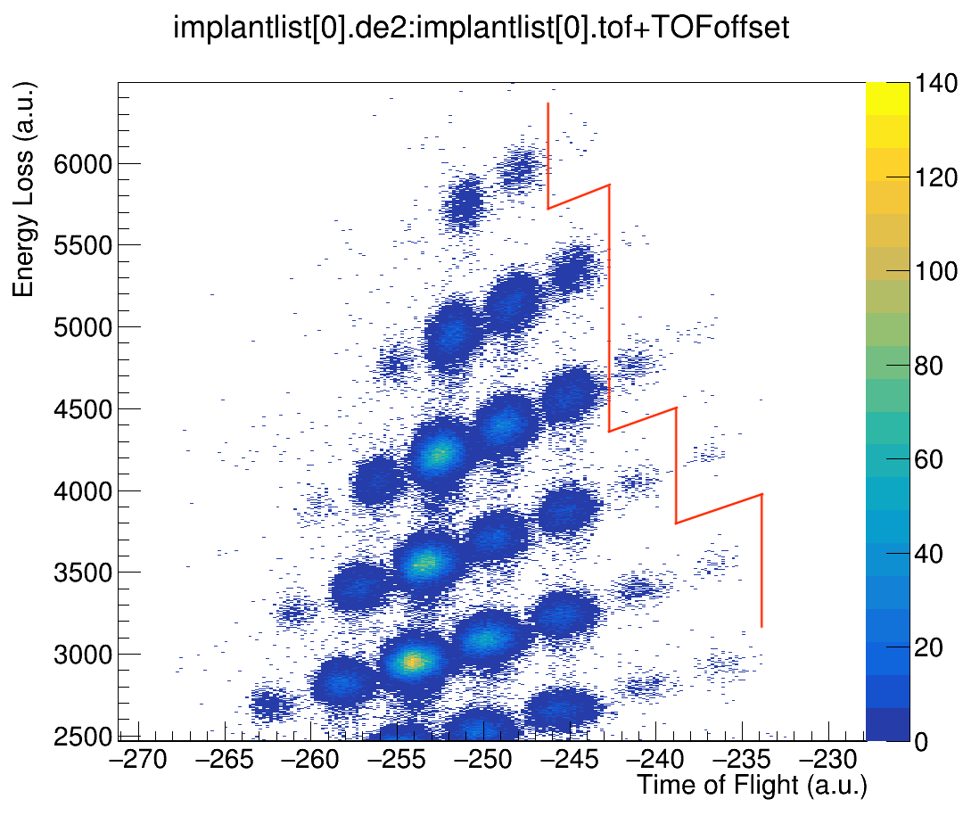
NP Highlight: The Opening of a New Horizon for Scientific Discovery
Secretary Granholm at the FRIB Ribbon Cutting
FRIB Experiment E21062
Spokespersons: J. Allmond (ORNL), H. Crawford (LBNL), B. Crider (Mississippi State University), R. Grzywacz (University of Tennessee Knoxville) and V. Tripathi (Florida State University)
May 2, 2022
May 19, 2022
The “never-been-done–before” line.: isotopes to the right of this line have never before been available for study
Multiple papers with first FRIB science now published

Slide 19
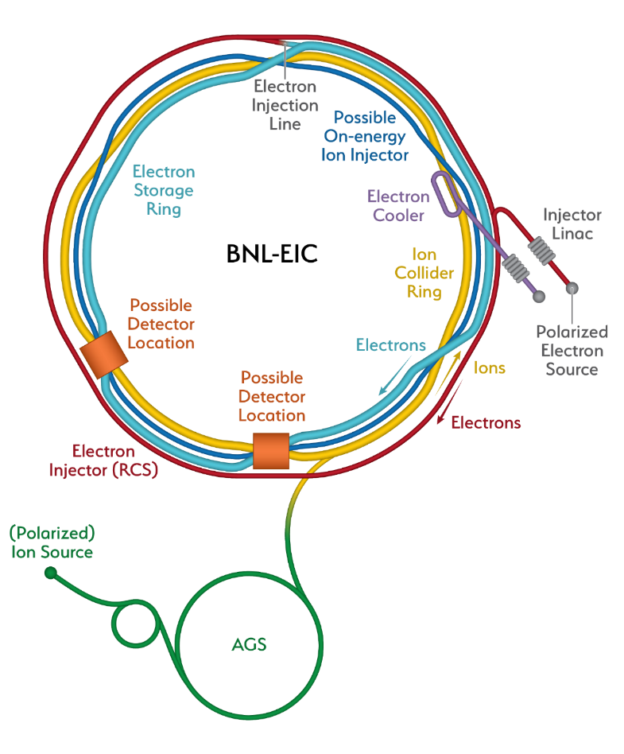
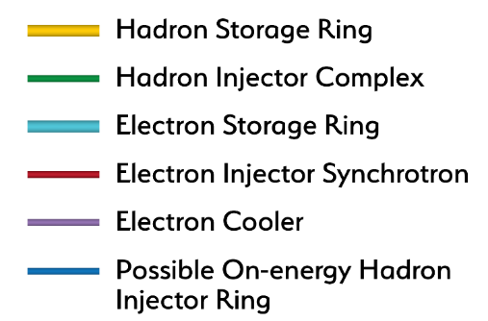
Constructing Capability to Maintain World Leadership Throughout The Century: the Electron-Ion Collider
Recent Progress
Successful OPA Progress Review 1/ 2023
Significant Project staffing increases via IRA
Pursuing Long Lead (CD3a) followed by CD-2
Project Detector Location
The EIC will be the most advanced accelerator in the world and the only new collider built for decades. It will keep US capability in accelerators physics number one
19

Slide 20
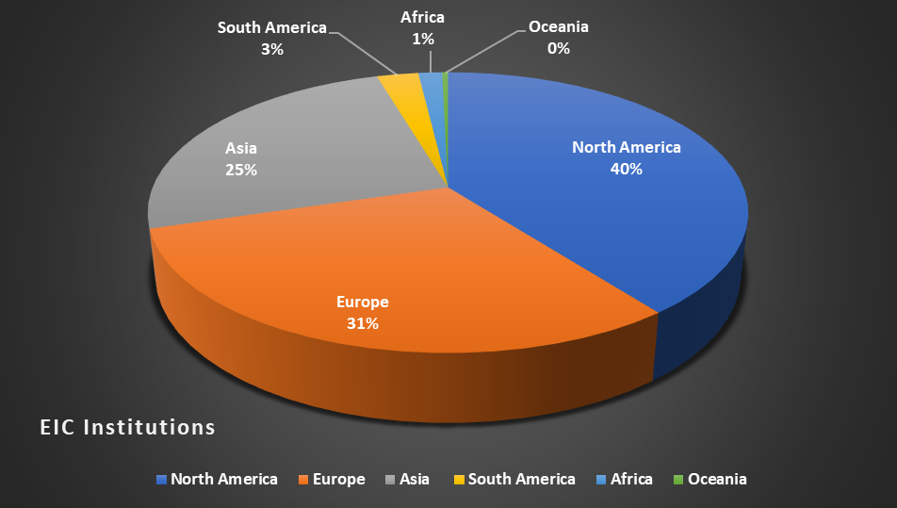
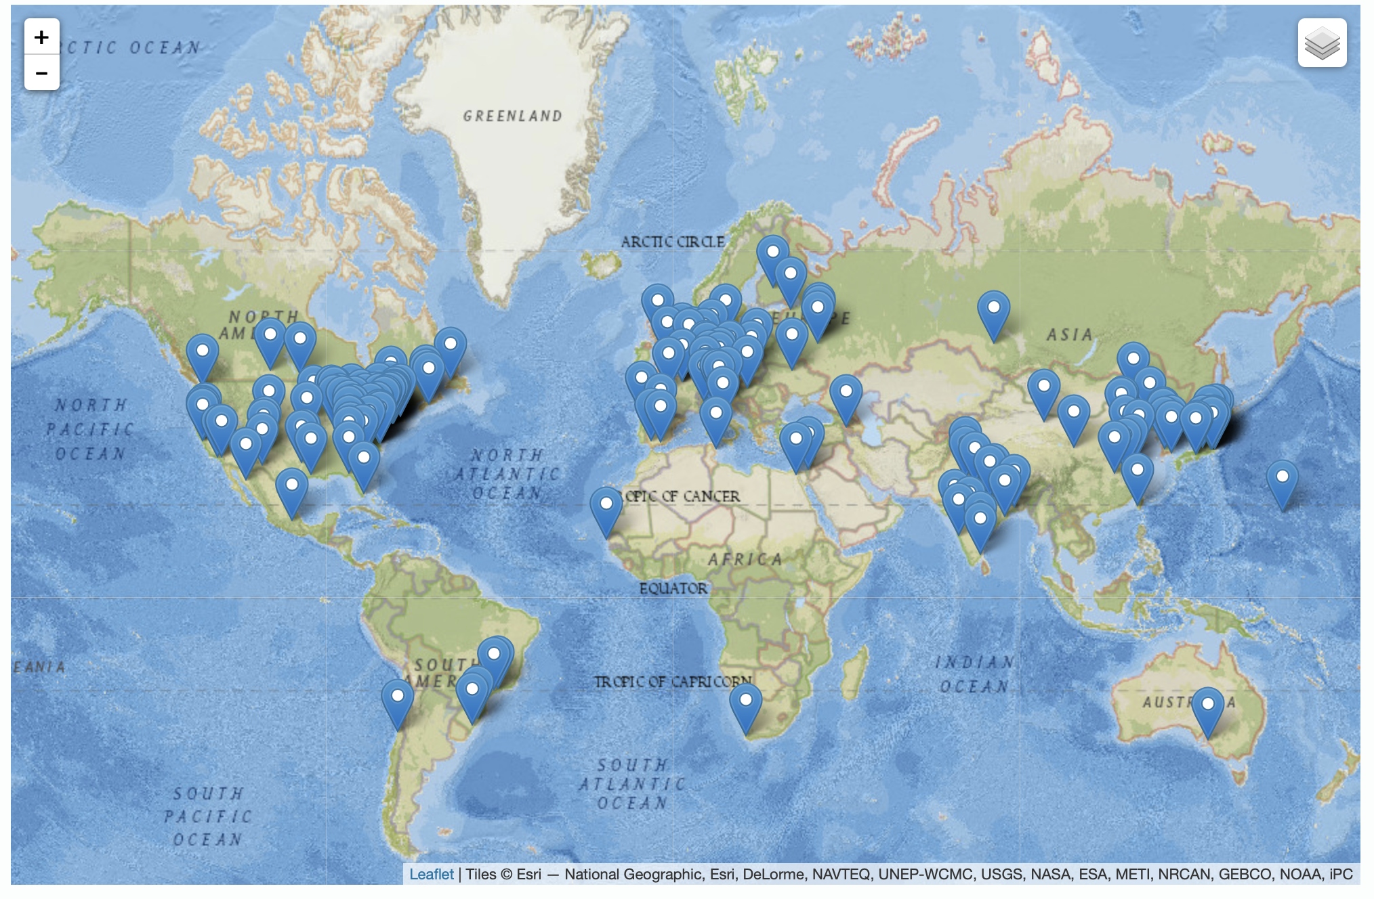
20
The EIC is International At Its Core
EIC Users Group Formed in 2016
EICUG.ORG
Status January 2023:
Collaborators 1379
Institutions 269
Countries 36

Slide 21
And the Governance is Being Envisioned Accordingly
The EIC Advisory Board
Name | Affiliation
Stuart Henderson, Chair | TJNAF, USA
Diego Bettoni | INFN, Italy
Paul Kearns | ANL, USA
Mike Lamont | CERN, Switzerland
Reynald Pain | IN2P3/CNRS, France
Franck Sabatié | CEA, France
Nigel Smith | TRIUMF, Canada
Mark Thomson | STFC, United Kingdom
Mike Witherell | LBNL, USA
Laboratory and National Program Leaders from Around the World
21

Slide 22
International Contributions to the Electron-Ion Collider
The EIC Project is also envisioning international contributions to the EIC detector of approximately $100M, and contributions to the accelerator of approximately $50M
  About half of these contributions have already been notionally identified by international collaborators
The body being established to coordinate such contributions in analogy with the way this is handled at CERN is a Resource Review Board (RRB), the first meeting of which will occur next month (April 2023)

Slide 23
First EIC Resource Review Board To Discuss International Contributions
Name | Affiliation | Country | Funding Agency/PI
Hayotsyan, Sargis | State Science Committee of Armenia | Armenia | Funding Agency
Samson, Claire | Canada Foundation for Innovation (CFI) | Canada | Funding Agency
Vyšinka ,Marek | Ministry of Education, Youth and Sports | Czech Republic | Funding Agency
Sabatie, Franck | Institut de Recherche sur les Lois Fondamentales de l’Univers (Irfu-SPhN), CEA-Saclay | France | Funding Agency
Grasso, Marcella | IN2P3/CNRS | France | Funding Agency
Lucotte, Arnaud | IN2P3/CNRS | France | Funding Agency
Bettoni, Diego | Instituto Nazionale de Fisica Nucleare (INFN) | Italy | Funding Agency
Nania, Rosario | Instituto Nazionale de Fisica Nucleare (INFN) | Italy | Funding Agency
Moon, Young Kun | Research Promotion Division at the Ministry of Science and ICT | Korea | Funding Agency
Gaczyński, Mateusz | Department of Innovation and Development, Ministry of Science and Higher Education | Poland | Funding Agency
Ka, Oumar | Cheikh Anta Diop University | Senegal | N/A
Nxomani, Clifford | National Research Foundation | South Africa | Funding Agency
Blaire, Grahme | UK Science and Technology Facilities Council (STFC) | United Kingdom | Funding Agency
Hiscock, Jenny | UK Science and Technology Facilities Council (STFC) | United Kingdom | Funding Agency
Hallman, Timothy | DOE Office of Nuclear Physics | United States | Funding Agency

Slide 24
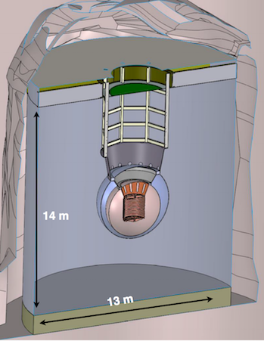
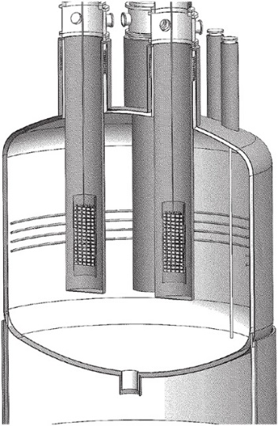
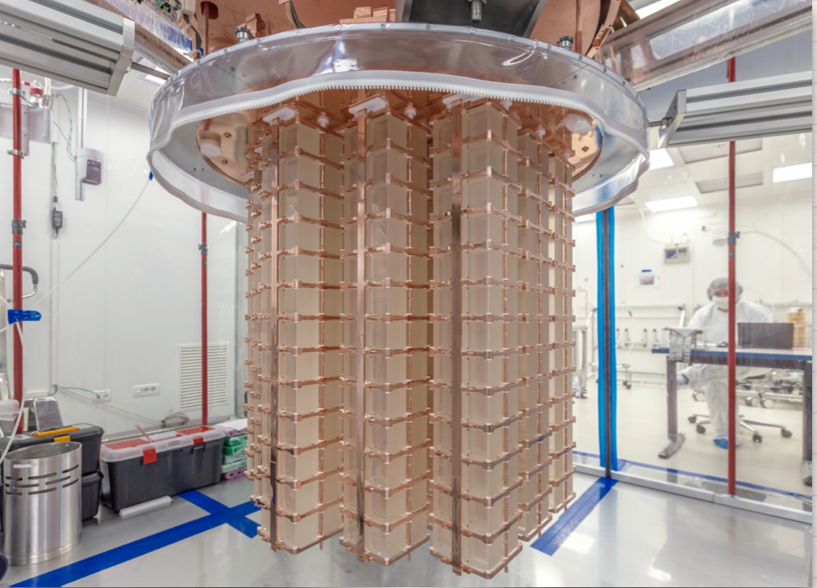
Status of The Other Priority of the 2015 Long Range Plan for Nuclear Science: Neutrinoless Double Beta Decay
Between IRA funding and NP Program Funding, approximately $12.8 M allocated to the three technologies being explored LEGEND 1000, nEXO, and CUPID since FY 2020.
Additional resources provided by international partners
Inability to procure isotopes from Russia is having a severe, existential impact
The next DBD international summit is April 27, 2023 at SNOLab in Canada.
NP is thinking about options to demonstrate a proof-of-principle isotope procurement test
Three Proposed Technologies
  Scintillating bolometry (CUPID, ¹⁰⁰Mo enriched Li₂Mo₄ crystals)
  Enriched ⁷⁶Ge crystals (LEGEND-1000, drifted charge, point contact detectors)
  Liquid Xenon TPC (nEXO, light via SiPM, drifted ionization)
TeO₂ Crystals from CUORE
Potential Partners:
Italy, Canada, and Germany

Slide 25
Snapshot of the Status of NP Projects
Project | Location | Status | Cost | CPI | SPI | CD-4 | Operation cost plan
Construction Projects
Facility for Rare Isotope Beams (FRIB) * | MSU | CD-4 | $730M | 1.00 | 1.00 | 6/2022 | Included in NP budget formulation
Electron-Ion Collider (EIC) | BNL | CD-1 | $1.7B to $2.8B |  |  | Q4 FY33 | RHIC operations funds redirected to EIC project recovered for EIC operations
Major Items of Equipment
Gamma Ray Energy Tracking Array (GRETA) ^{FF} | LBNL | CD-2/3 | $58.3M | 1.00 | 1.01 | 4/2028 | Mostly covered by host laboratory operations experimental support
Super Pioneering High Energy Nuclear Interaction Experiment (sPHENIX) * | BNL | PD-4 | $26.5M | 1.00 | 1.00 | 12/2022 | Covered by RHIC operations experimental support
Measurement of Lepton-Lepton Electroweak Reactions (MOLLER) ^{FF} | TJNAF | CD-1 | $45.8M to $56.6M |  |  | Q4 FY27 | Covered by TJNAF operations experimental support
High Rigidity Spectrometer (HRS) | MSU | CD-1 | $85.0M to $111.4M |  |  | Q2 FY29 | Covered by FRIB operations experimental support
Ton Scale Neutrinoless Double Beta Decay (TS-NLDBD) | TBD | CD-0 | $215M to $250M |  |  | TBD | TBD
Blue (*) indicates “Completed”, green (^{FF}) “Fully Funded”, and purple italic “Substantially Funded”
Smaller NP Projects are being “cleared off the books”

Slide 26
NP Outlook
In FY 2024, NP continues stewardship of a world-leading program in nuclear physics that delivers new science, operates unique leadership user facilities, supports and enhances a diverse workforce, and delivers impactful applications
The EIC Project is making steady progress, towards CD3a (Long Lead Procurement), and the next DOE gateway CD-2 (Approve Performance Baseline). Although not yet baselined, increased support from annual appropriations is essential to enable timely progress and a smooth transition of workforce from the Relativistic Heavy Ion Collider in FY 2025.
The FY 2024 Request is greatly appreciated, allowing NP National User Facilities to operate at or above 90% of optimal funding
NP Research funding allows for a compelling program of science but continues to be constrained due to the priority of increased funding for FRIB Operations and EIC construction

Slide 27
Additional Information

Slide 28
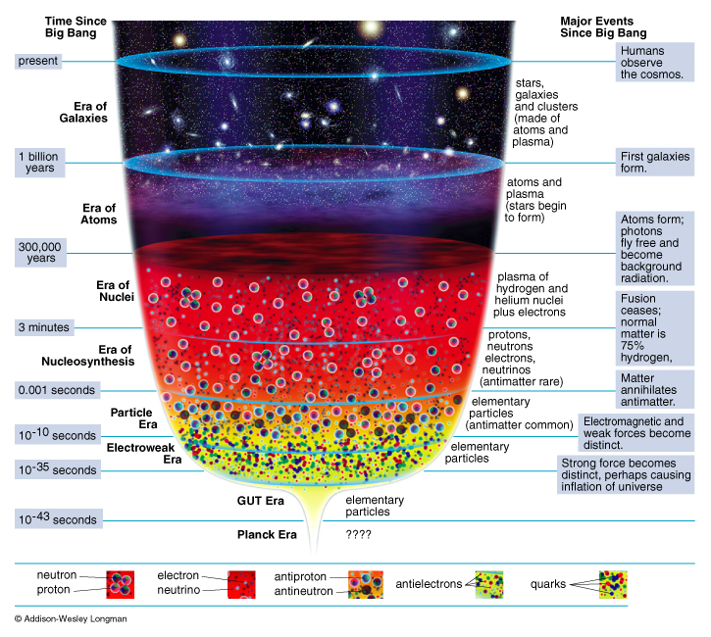
The Reason Complementary Capabilities are Required
Present Day
Evolution of the Universe
Present
Galaxies
NP
Discovery
Horizon
Atoms
Nuclei
Nucleo-Synthesis
Particles
The vast range of time (μsec to 13.8B years) and physical scales (quarks to galaxies) requires “microscopes” of varying, complementary resolving “powers”

