Slide 1

Towards Trapped-Ion Analog Simulation of Lattice Gauge Theories
Guido Pagano
14th April 2023
GHP Workshop 2023

Slide 2
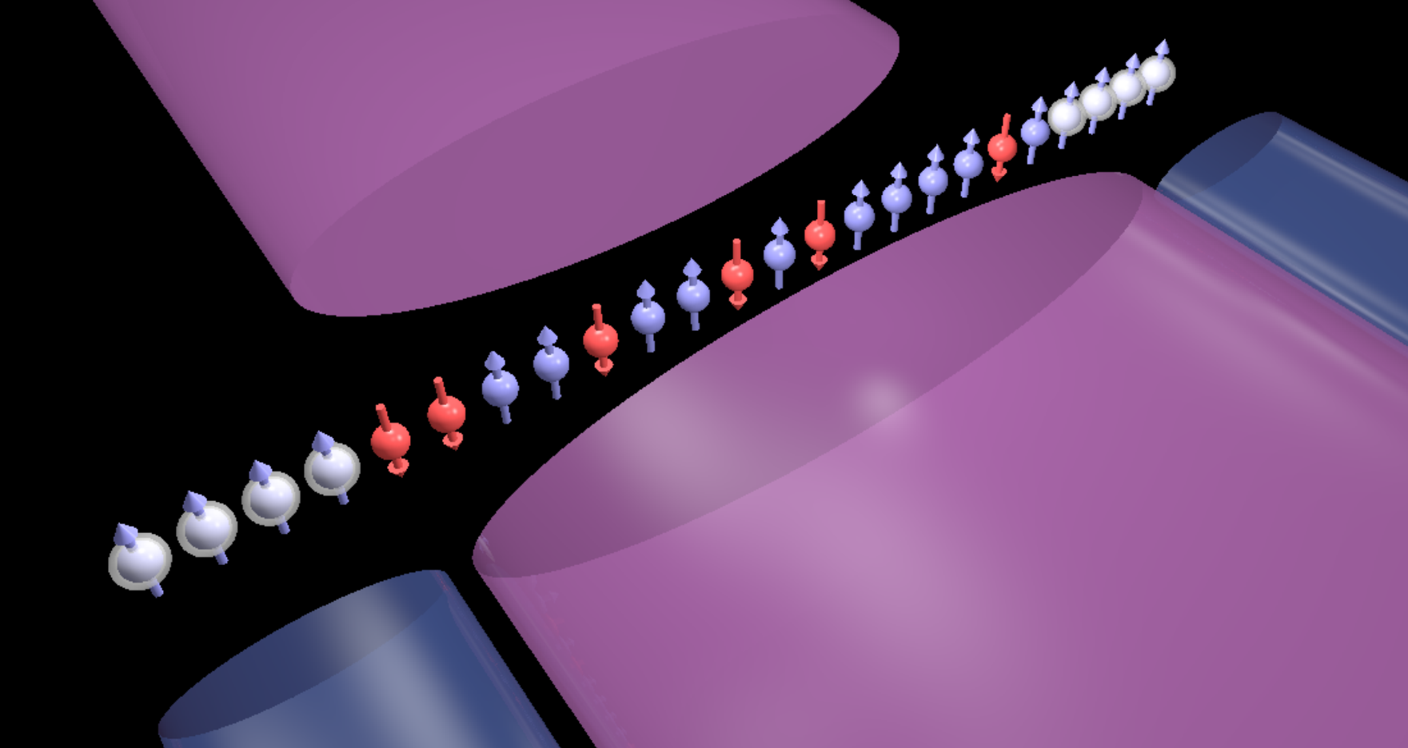
Outline
Introduction:
Trapped-Ion Quantum systems
Trapped-Ion Quantum Simulation of LGTs
Digital realizations of Schwinger model (2016, 2022)
Analog route: Three-spin interactions, B. Andrade et al., QST 7 034001, (2022)
Hybrid Analog-Digital simulations, Z. Davoudi et al., PRR 7 034001, (2022)
Outlook and Perspectives
Experimental progress at Rice University

Slide 3
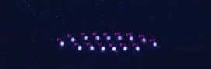
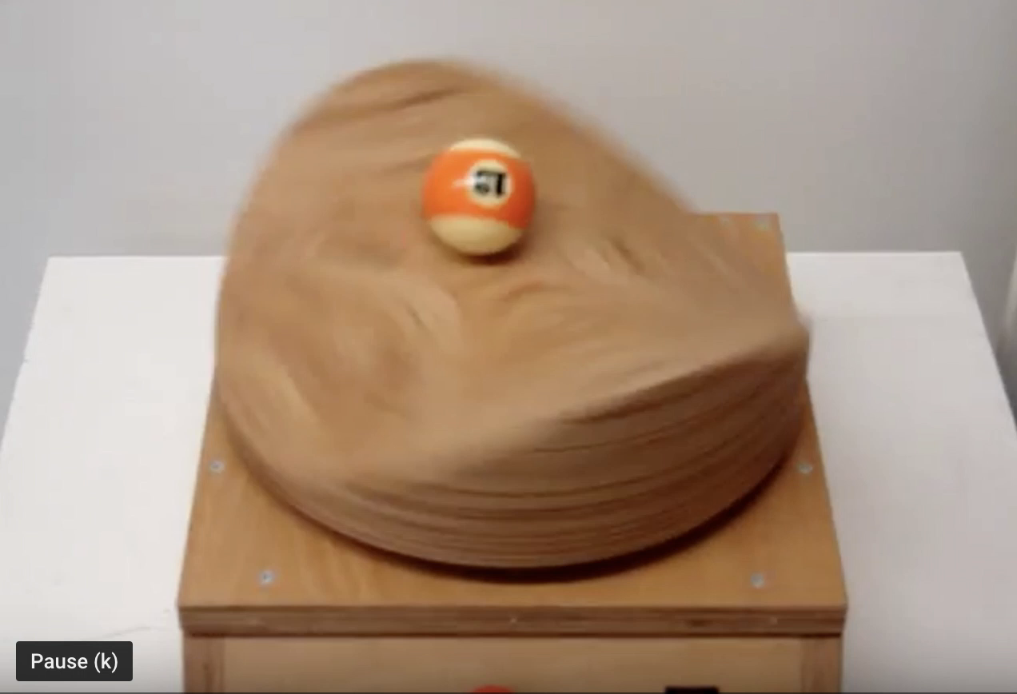
Self-organized Ion crystals
N ions
3N normal modes
Mechanical Paul trap, https://www.youtube.com/watch?v=pG1TcnpsY_8
Axial
modes
Transverse
modes
ω

Slide 4
A many-body system assembled atom by atom
¹⁷¹Yb⁺ Clock states qubit
²P_{1/2}
F=0
F=0
Coherence time: T₂>10 minutes [1]
²P_{1/2}
F=0
High fidelity state preparation: > 99.9% in ~ 10 µs
355 nm
High speed readout: > 99.9% in ~ 100 µs
High Fidelity one (>99% in 1 µs) and two qubit gates (~99% in 500 µs)
F=1
12.6 GHz
²S_{1/2}
[1] P. Wang et al., Nat. Comm. 12, 233 (2021)
F=0

Slide 5
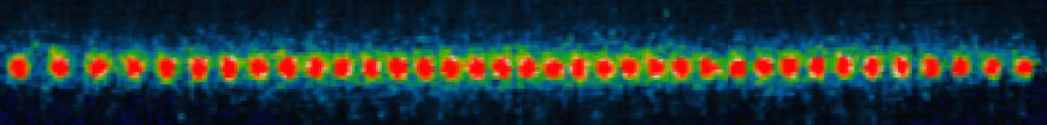
Wiring Trapped-ion Qubits with Laser beams
r
~2 μm
d ~10 nm
Spin dependent force
Cirac & Zoller (1995)
Molmer & Sorensen (1999)
Solano, et al. (1999)
Milburn, et al. (2000)

Slide 6
Generating Spin Hamiltonians
Carrier
ω
Transverse
modes
Transverse
modes
ω+ω_{HF}±μ
+μ
-μ
Beatnote frequency
33 THz
²P_{1/2}
ω
ω+ω_{HF} ±μ
|↑_{z}⟩
²S_{1/2}
|↓_{z} ⟩

Slide 7
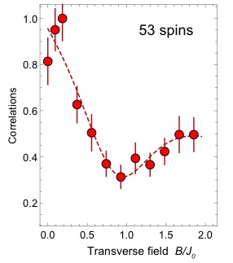
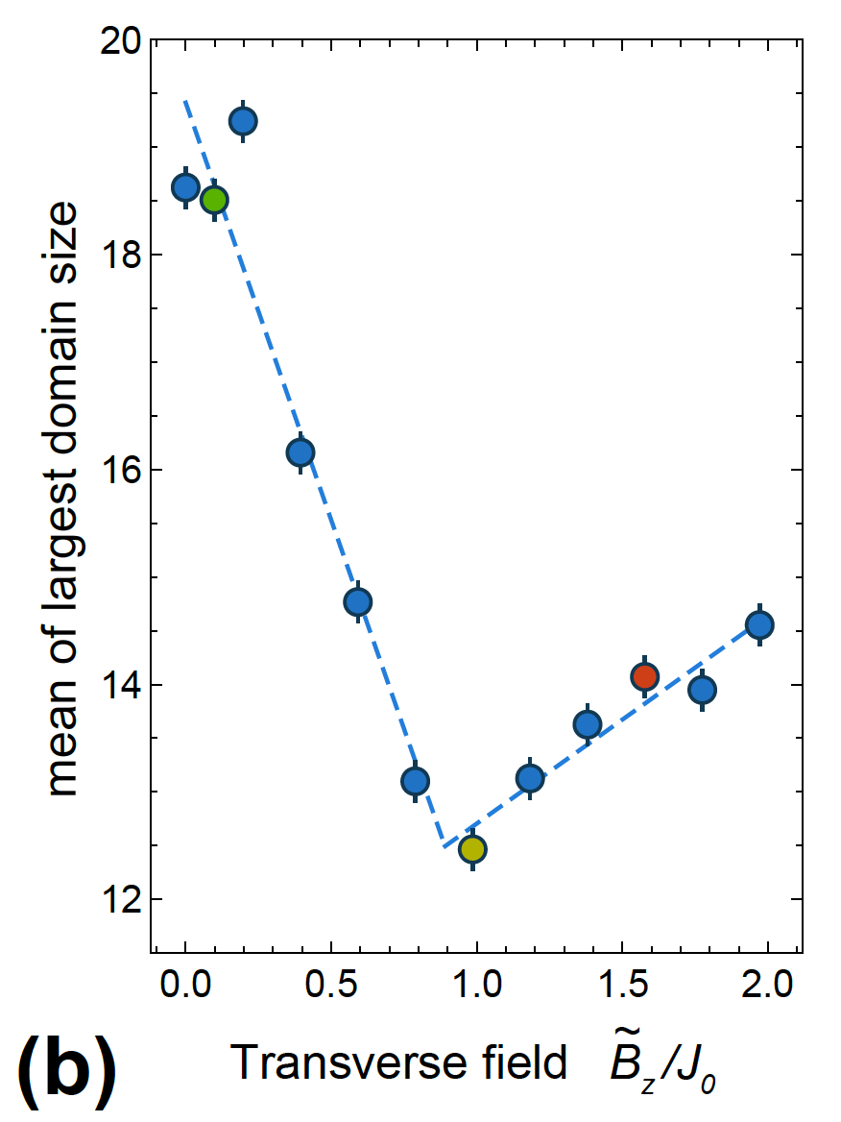
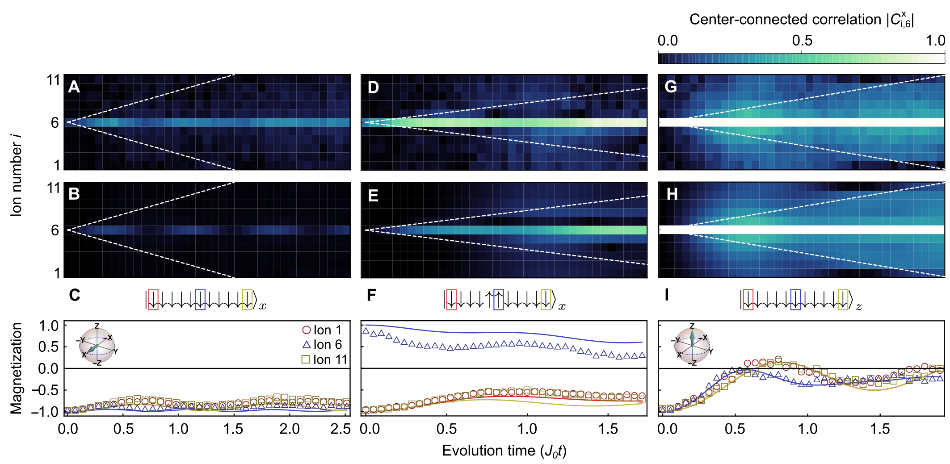
Non-Equilibrium Studies with Trapped Ions
Long-Range Transverse Field Ising Model
Breaks Integrability
Theoretically Challenging
Model for quantum systems in nature
Reviews:
C. Monroe, et al., RMP 93 025001 (2021)
N. Defenu, et al., RMP in press (2023)
Quantum quenches and Thermalization in Spin LR Systems
Many-Body Localization [1,2]
[1] Smith et al., (Nature Phys. 2016)
[2] Bridges et al., (Science 2019)
Domain wall size
probability
Dynamical Phase transition [3,4]
[3] Zhang, GP, et al., Nature (2017)
[4] Jurcevic, et al., PRL (2017)
Confinement of Domain Walls [5]
[5] Tan, Becker, et al., Nature Phys. (2021)

Slide 8
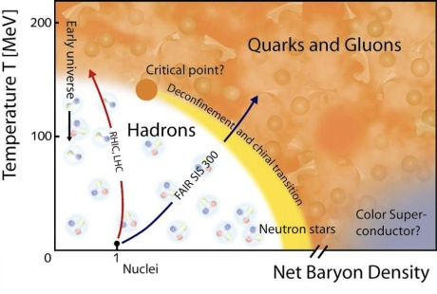
From Spin models to NP and HEP models
Solving QCD on a lattice:
Phase diagram largely unexplored
MonteCarlo has sign problem
Roadblock for both Real-time dynamics
and equilibrium calculations

Slide 9
From Spin models to NP and HEP models
Kogut – Susskind staggered fermions
+
Jordan-Wigner Transformation
Two Challenges:
Engineering three-body interactions
2) Preserve Gauss Law
Notes:
While following naturally in Lagrangian dynamics, the Gauss’s Law constraint relating the electric flux entering and leaving a closed surface to the electric charge contained in that surface is imposed “by hand” in the Hamiltonian formulation. Approaching the strong coupling limit, in which x → 0, the vacuum of the theory is perturbatively close to an anti-ferromagnetic phase with the e− and e+ qubits anti-aligned, without energy in the electric field.
The Hamiltonian is gauss law preserving.
Say three fields not three body.

Slide 10
1+1D Schwinger model with trapped ions
Implementation with long range interactions
Particle-antiparticle hopping
Mass
term
Gauge field
E. Martinez, et al., Nature 534, 516 (2016)
C. Mushik, et al., NJP 19, 103020 (2017)

Slide 11
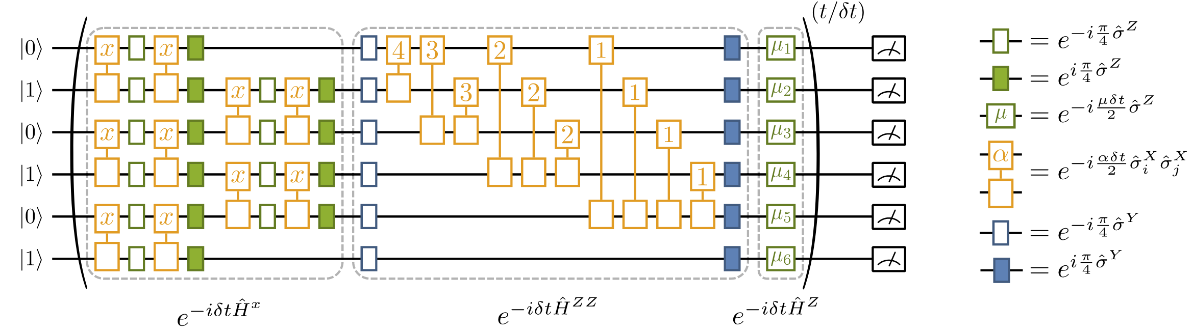
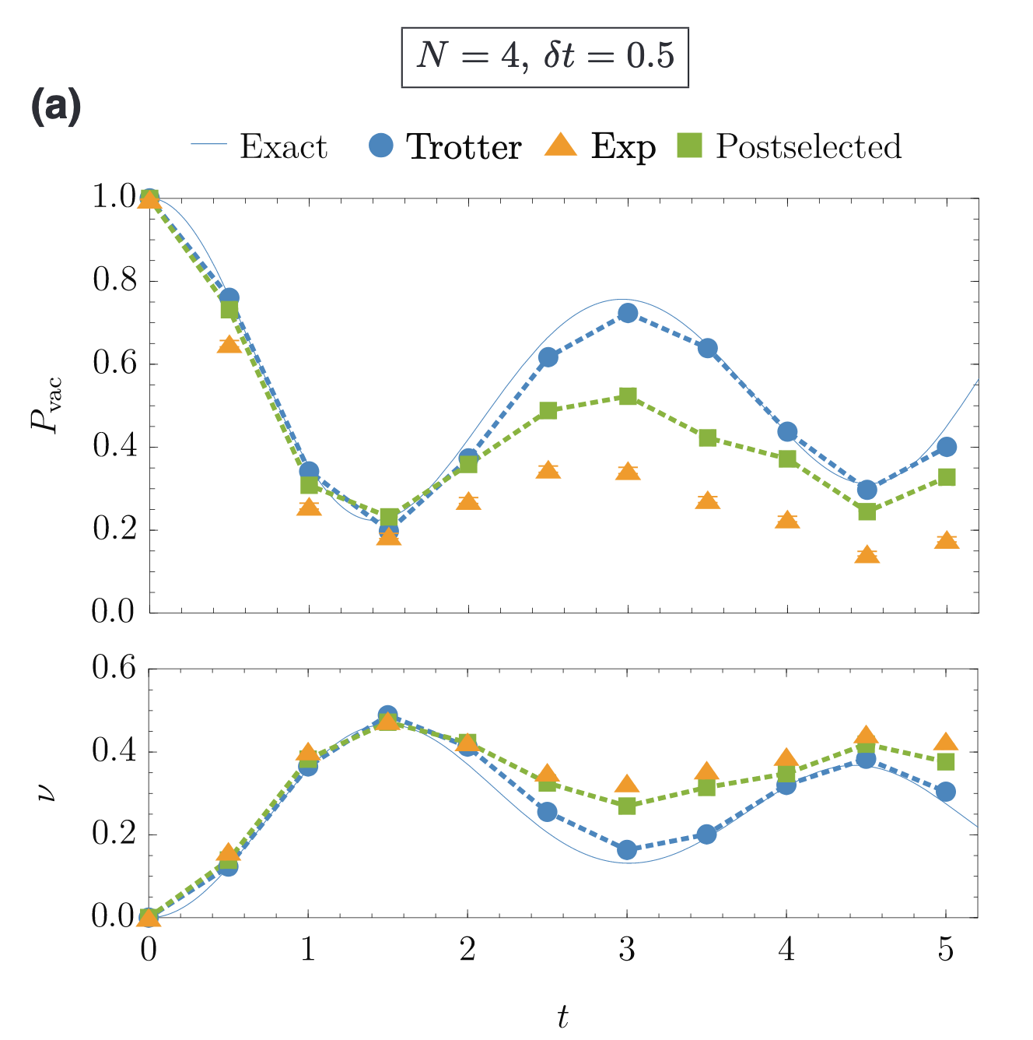
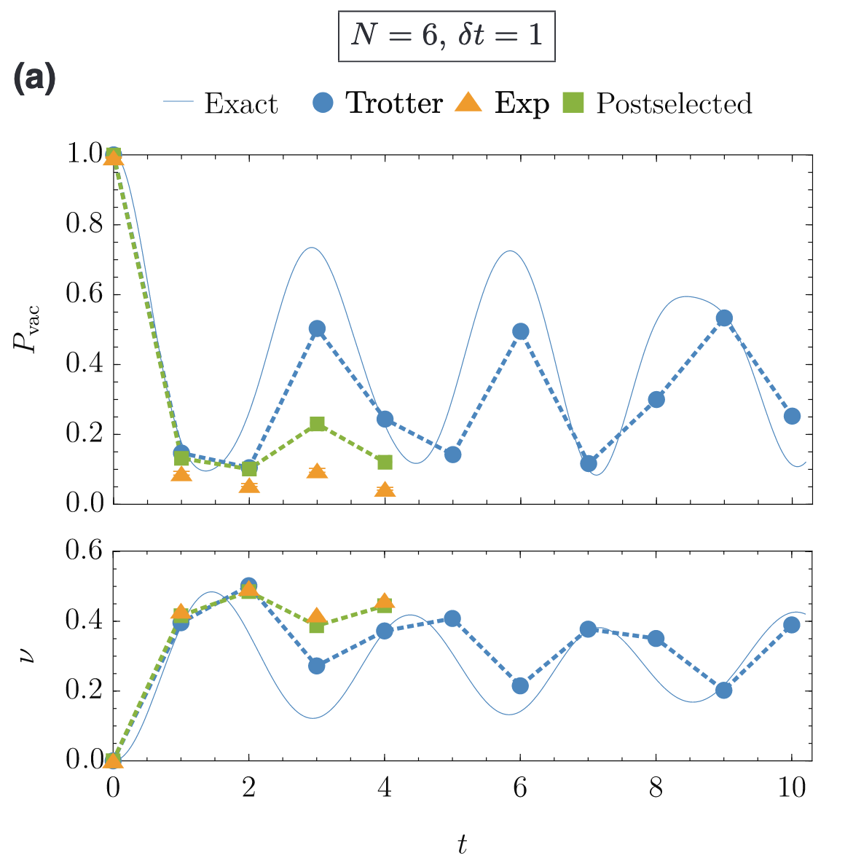
1+1D Schwinger model: digital approach
N=4
E. Martinez, et al., Nature 534, 516 (2016)
N. Nhung, et al., PRXQ 3, 020324 (2022)

Slide 12

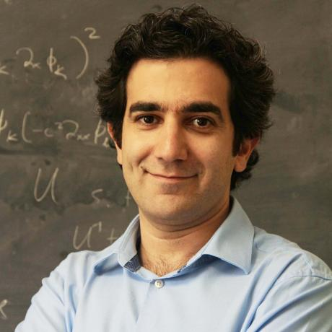

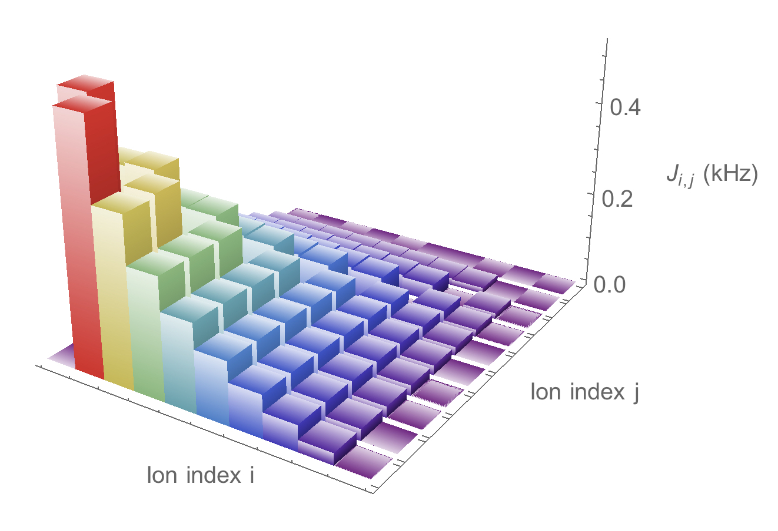


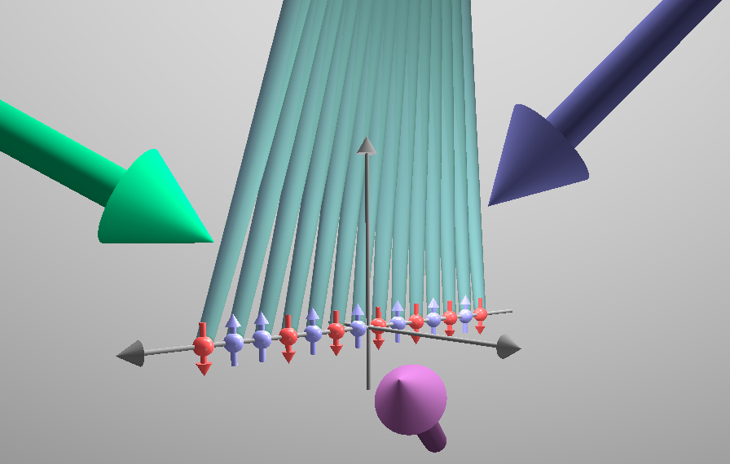
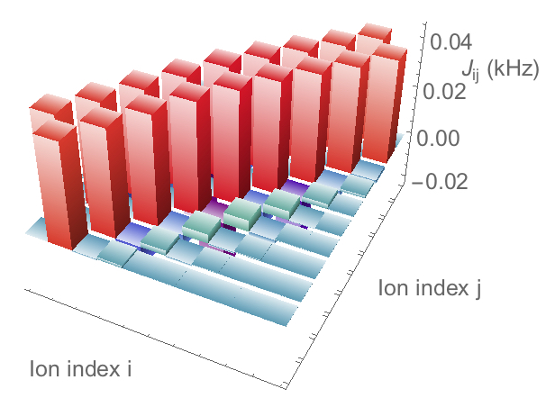
Analog proposal for the 1+1D Schwinger model
Particle-antiparticle hopping
Mass
Gauge field
Z. Davoudi
A. Seif
M. Hafezi
Transverse
modes
Beatnote frequency
A. N. Shaw
C. Monroe
Axial
modes
Axial
modes
Beatnote frequency
Z. Davoudi et al., PRR 2, 023015 (2020)

Slide 13
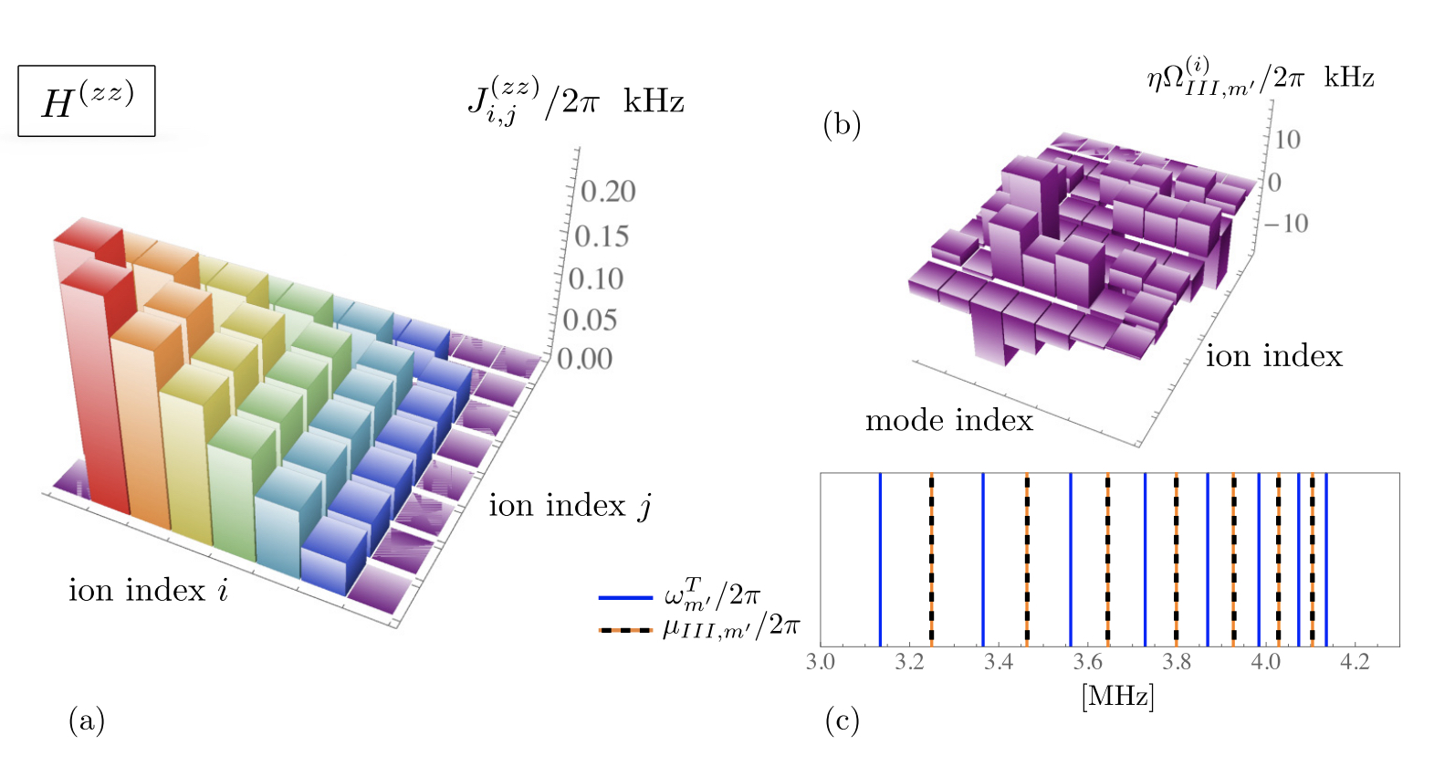
Analog proposal for the 1+1D Schwinger model
Multi-amplitude and multi-frequency Optimization with full magnus expansion:
        Residual spin-phonon coupling
        Cross-talk between orthogonal normal modes
        Higher order processes
Z. Davoudi et al., PRR 2, 023015 (2020)

Slide 14
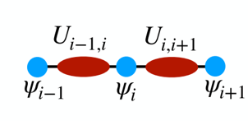
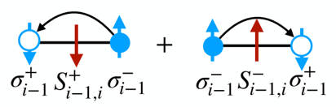
The higher-order interaction route
hopping
field
mass
Quantum Link formulation
XXX gate, O. Katz et al., arXiv:2209.05691 (2022)

Slide 15
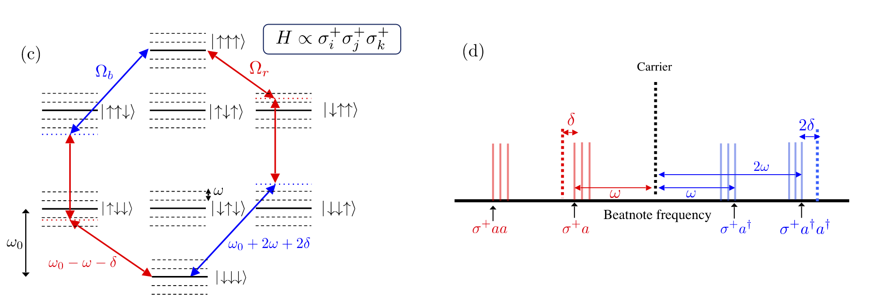


Generalized Molmer-Sorensen scheme
Z. Davoudi
M. Hafezi
B. Andrade
A. Seif
T. Grass
B. Andrade et al., QST 7 034001, (2022)

Slide 16

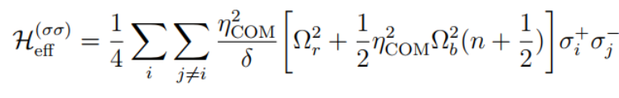
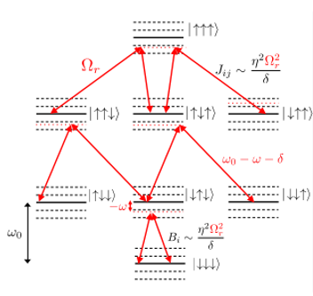
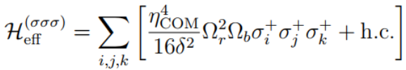
Generalized Molmer-Sorensen scheme
Effective Hamiltonian in single mode approximation:
ODD
ODD
EVEN
B. Andrade et al., QST 7 034001, (2022)

Slide 17


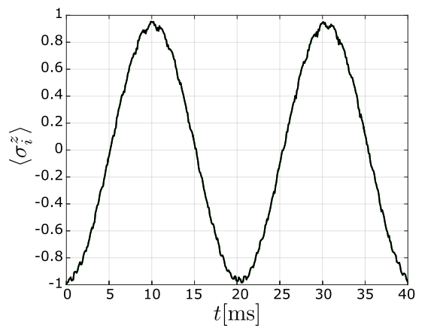
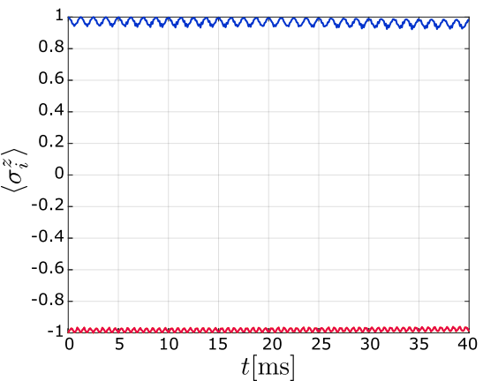



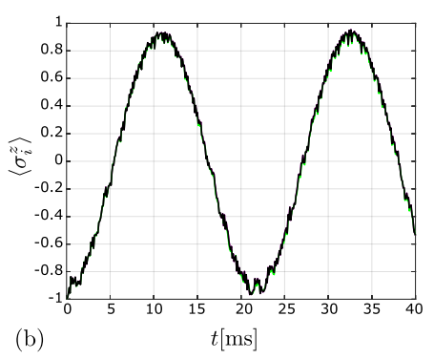
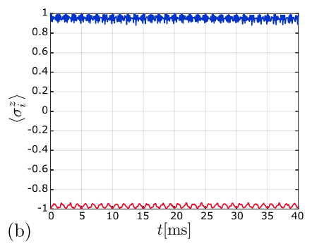

Two-body term suppression
Multifrequency drive to suppress unwanted
2-body interactions
Single phonon
mode
Beatnote
frequency
Three phonon
modes
B. Andrade et al., QST 7 034001, (2022)

Slide 18
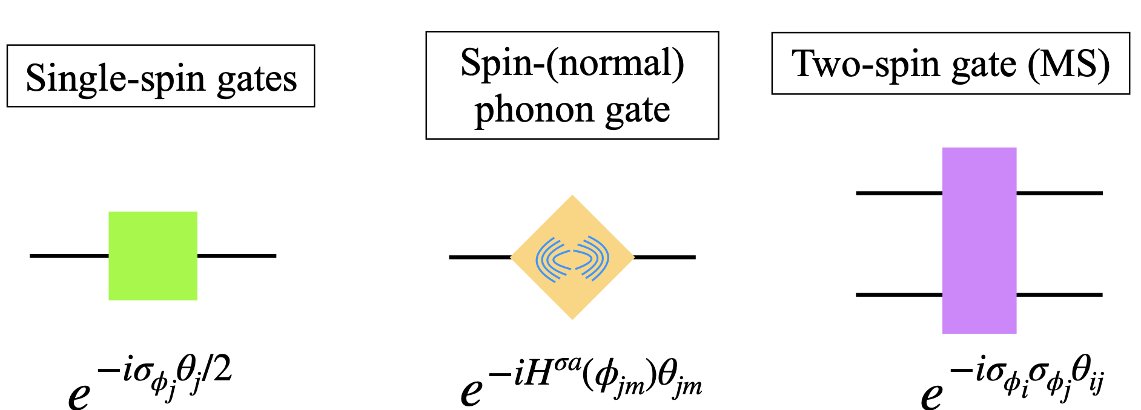

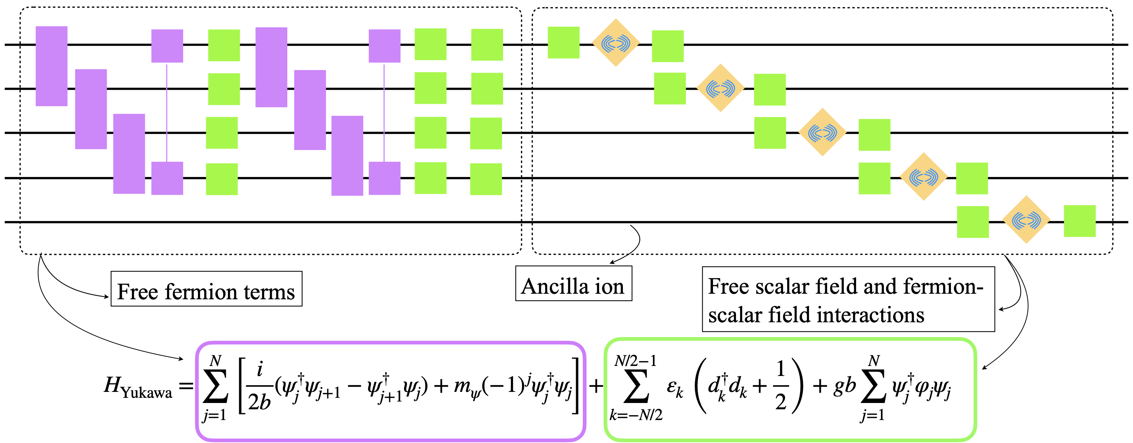
Hybrid Analog-Digital simulation of Yukawa model
Spin → Fermions
Z. Davoudi
N. M. Linke
Collective modes → scalar bosons
Z. Davoudi, et al., PRR 3, 043072 (2021)

Slide 19
Spin-phonon realization of Schwinger model
Gauge bosons local in space
with
Rotor algebra≠phonon algebra
HOBM
highly occupied bosonic mode, PRA 94,052321 (2016)

Slide 20
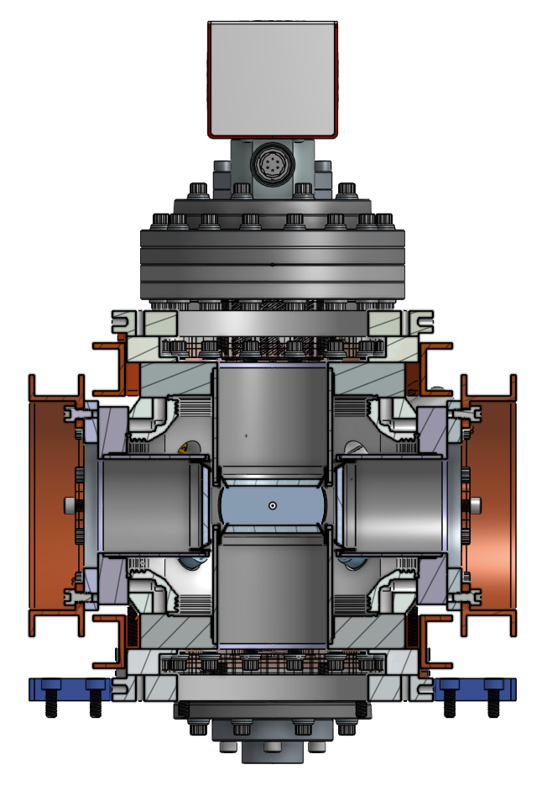
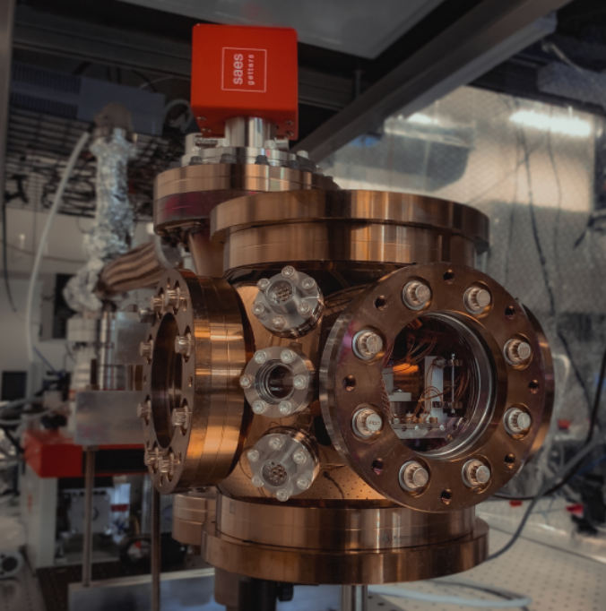
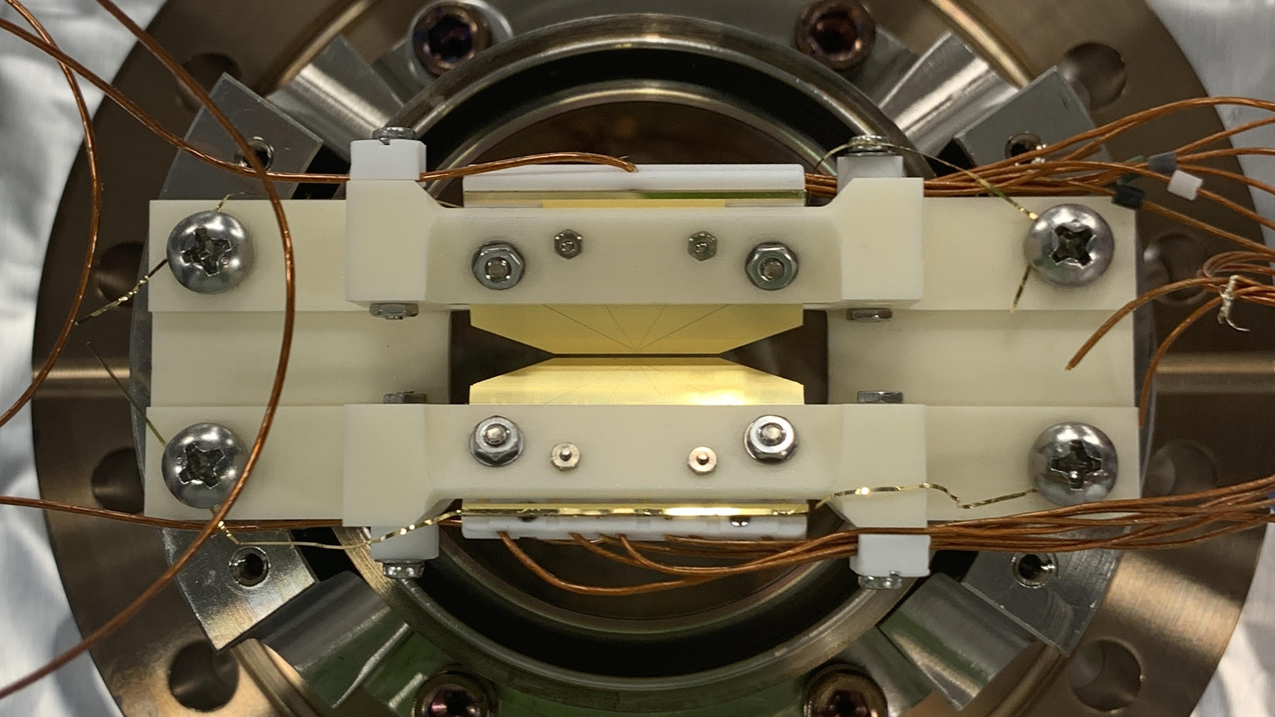
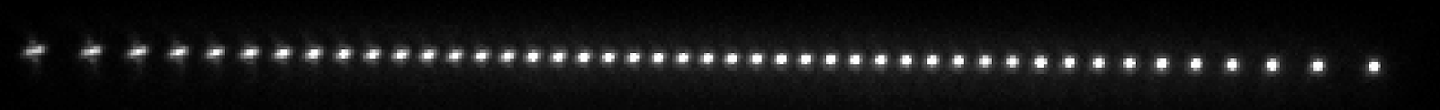
Experimental System at Rice
NA0.6
NA0.3
NA0.3
NA0.6

Slide 21
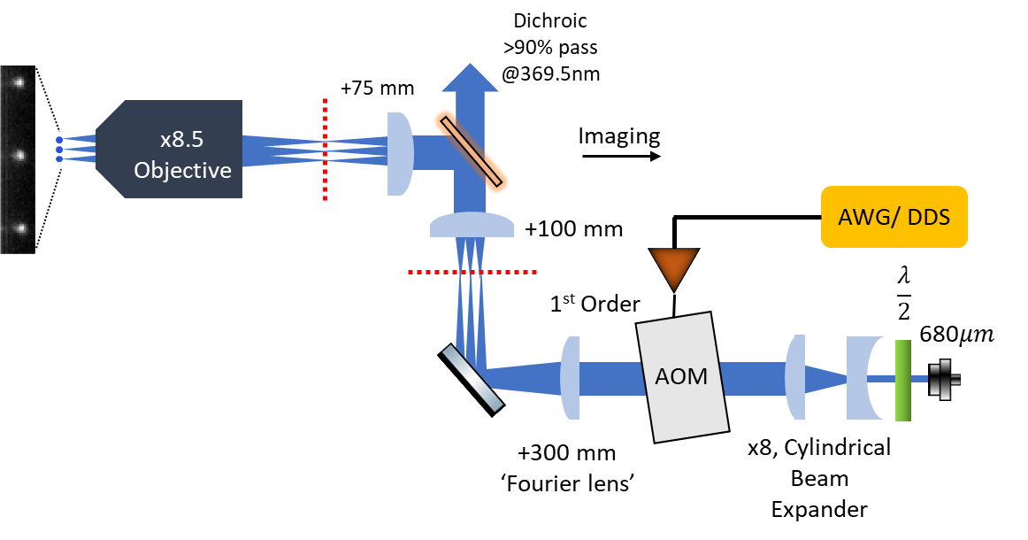
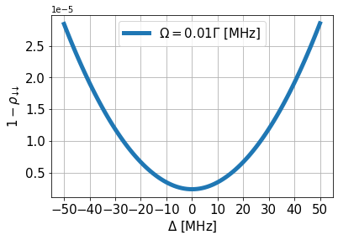
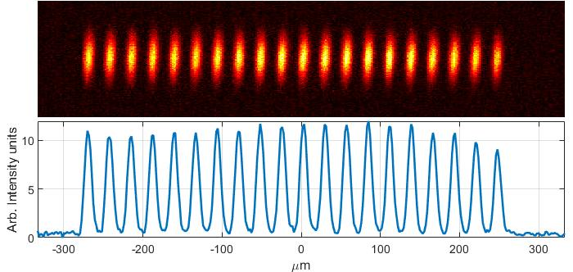
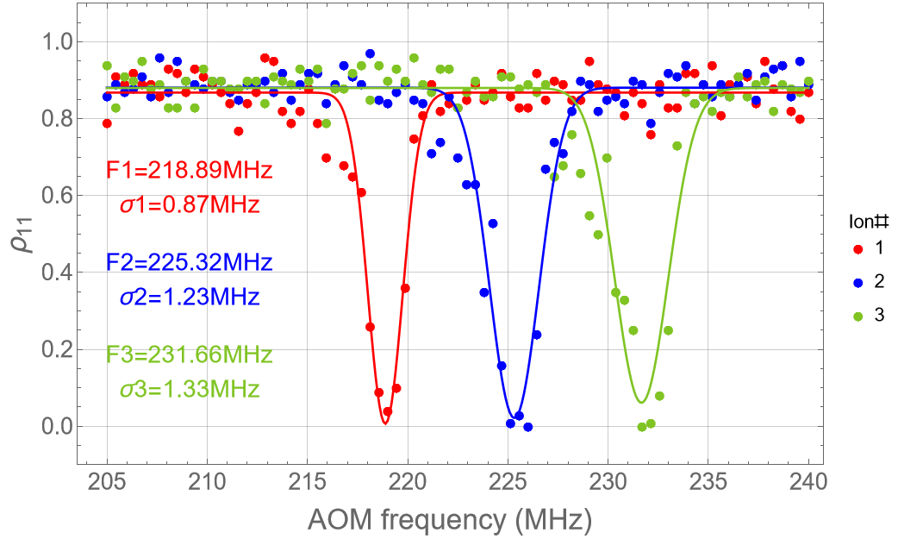
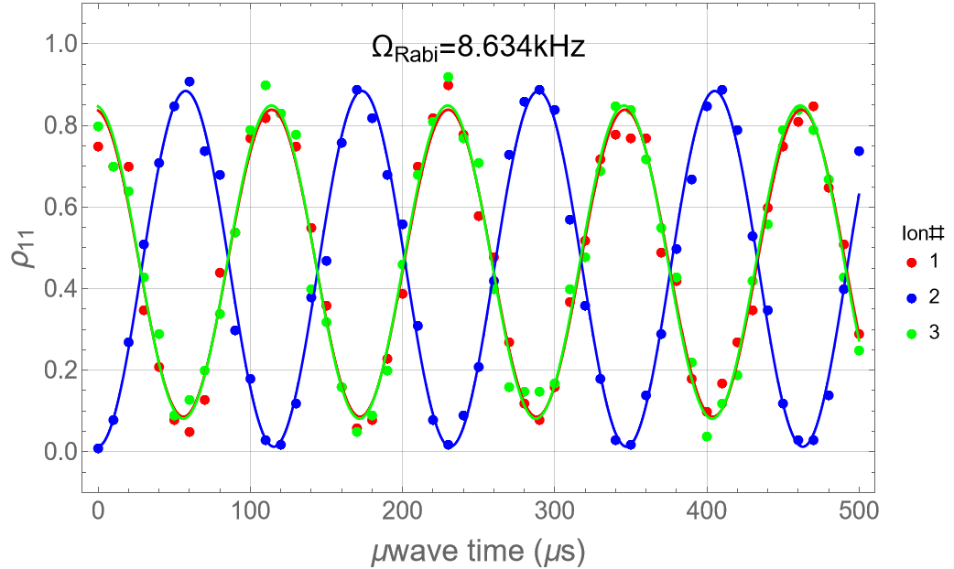
Individual Optical pumping
OP weakly dependent
on frequency
BW = 30 MHz
Beam waist @ions ~1.23 µm
Simple Tweezer array
approach based on
Elliptical beams

Slide 22

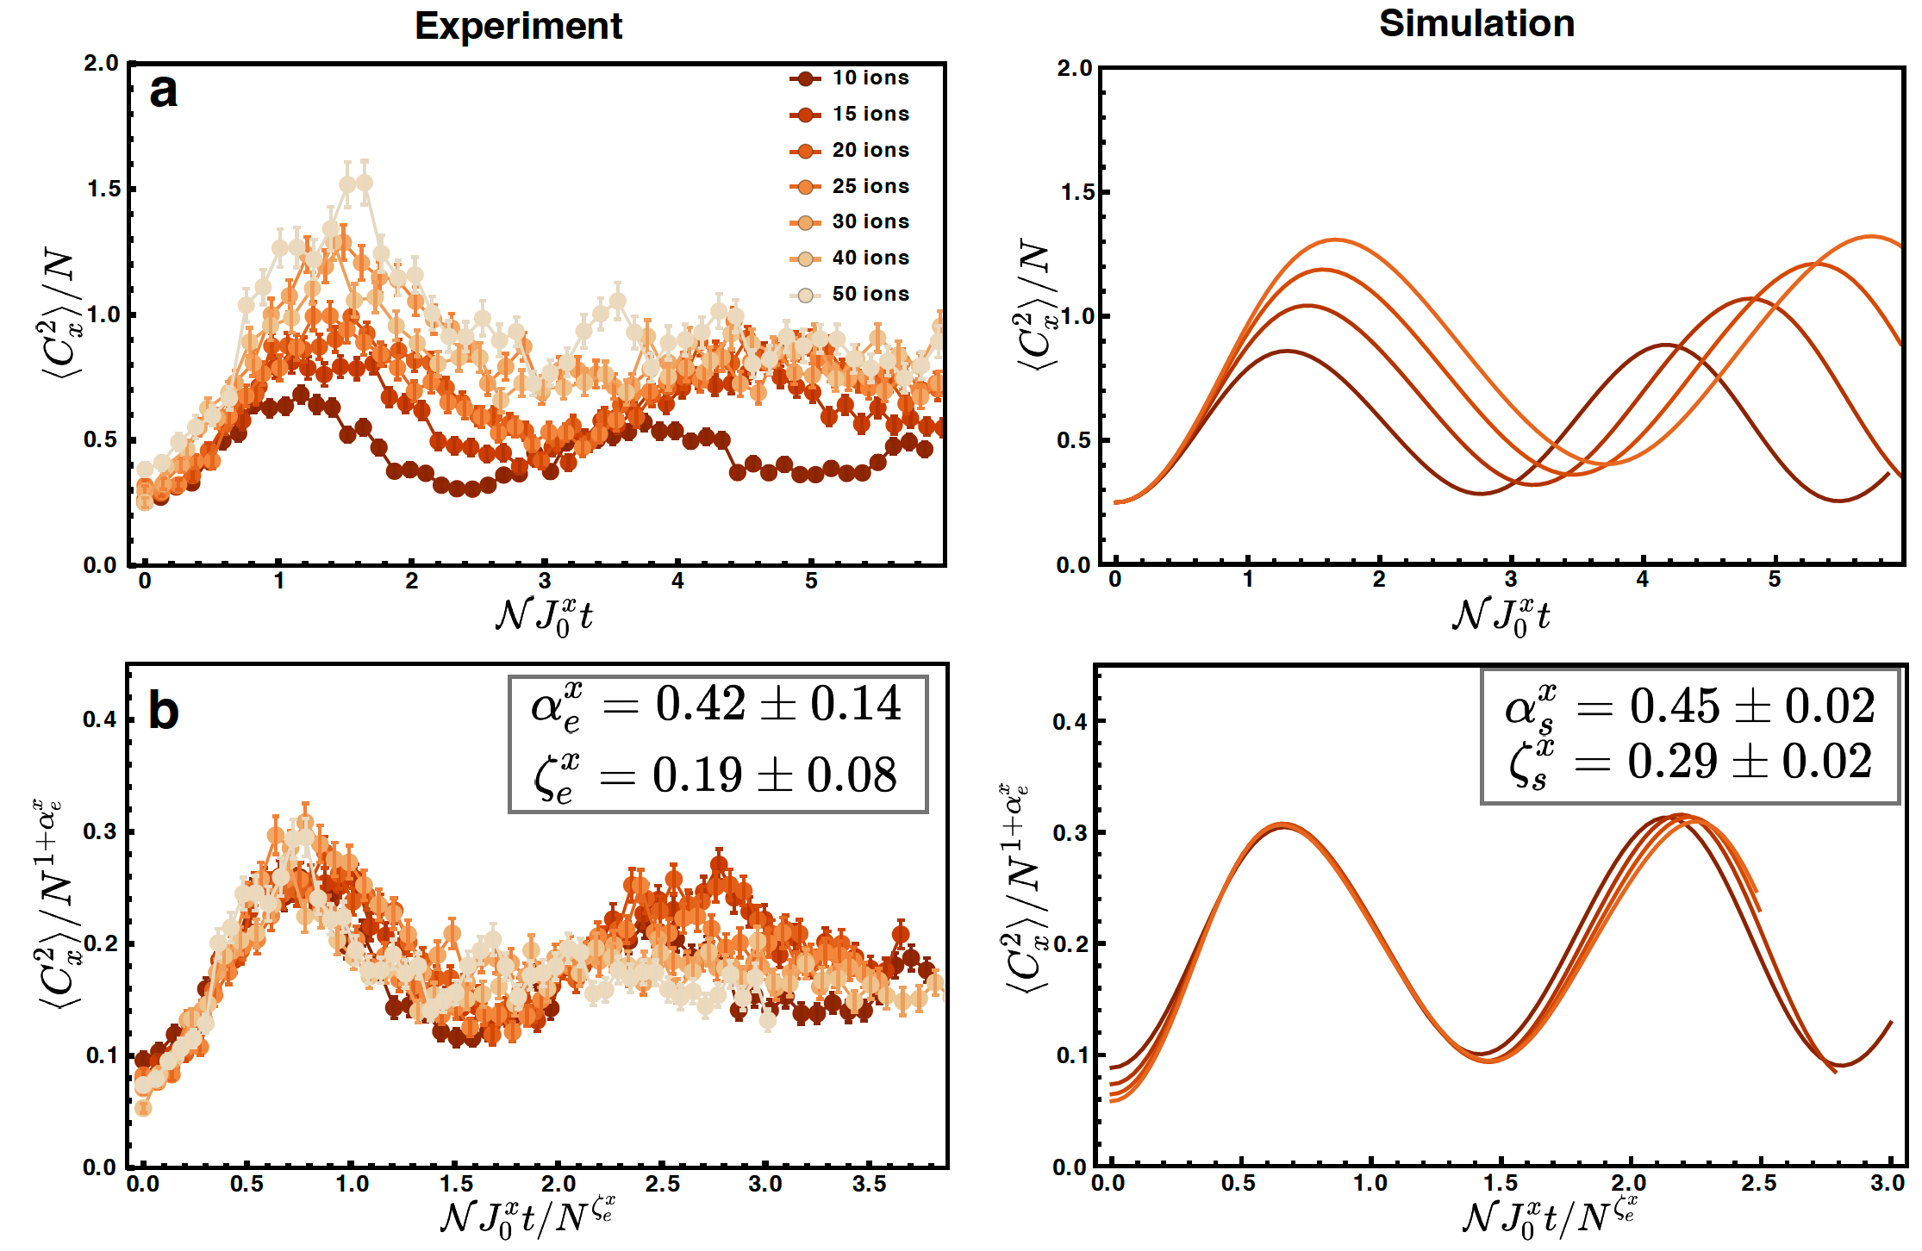


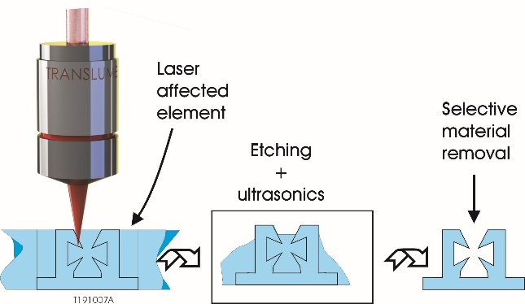
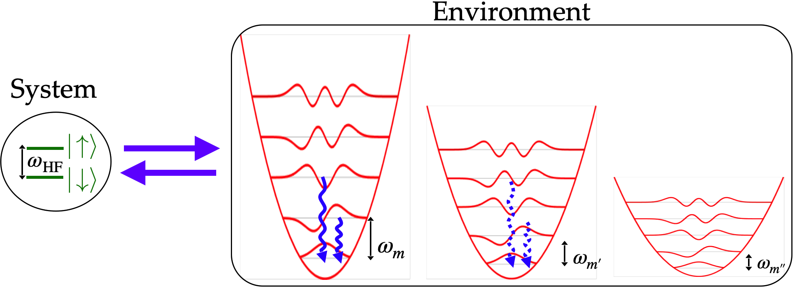

Other Directions
Critical non-equilibrium dynamics
M. Maghrebi
C. Monroe
W. Morong
A. De
Quantum Chemistry/Electron transfer
Ion Trapping made easy: Monolithic trap
P. Wolynes
N. M. Linke + Translume

Slide 23
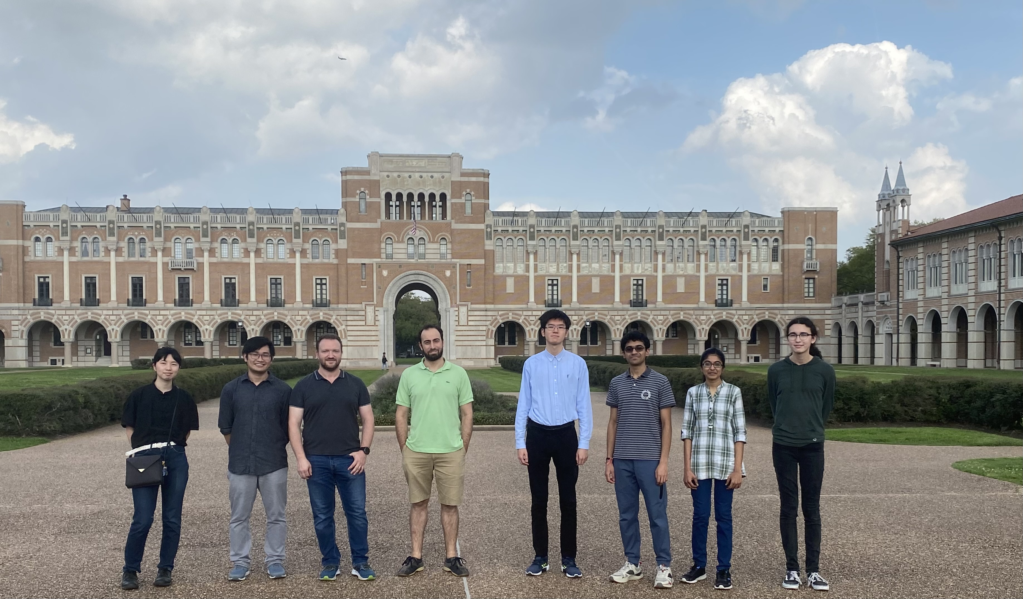






Acknowledgments
M. Zhu (U)
M. Sughanti (G)
V. So (G)
A. Tanaka (U)
R. Zhuravel (P)
A. Menon (G)
A. Sheffield (U)

Slide 24
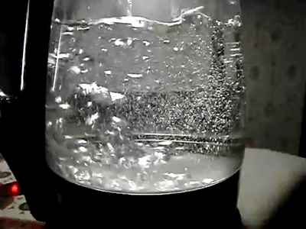
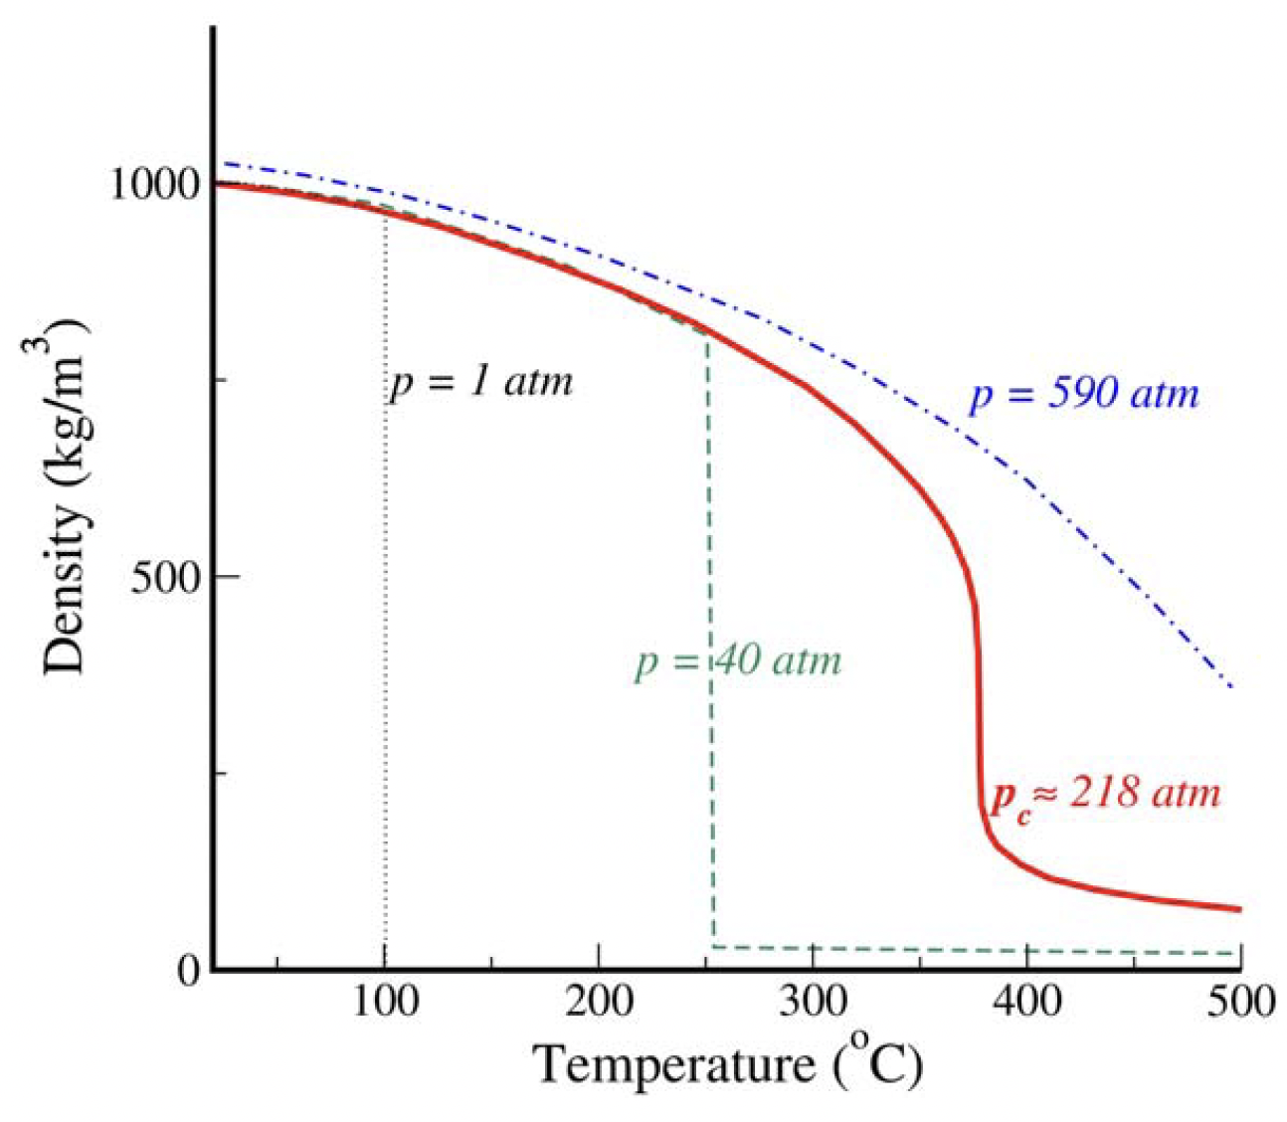
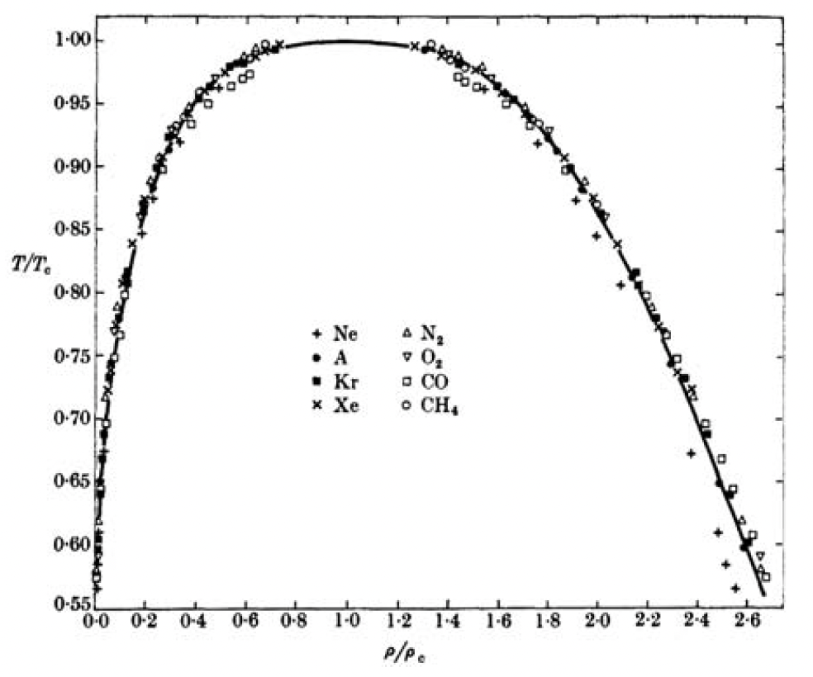
Phase transitions and criticality
At 218 atm and 374⁰C water and vapor co-exists. Critical point for the phase transition.
Density and Temperatures for different systems scaled with a “critical exponent” to collapse → “Universal properties” of phase transition.
Can we find universal scaling in non-equilibrium quantum systems?
E A Guggenheim, J. Chem.
Phys.,Vol.13, 253, 1945
Notes:
I would start with a very simple example of phase transition: boiling of water. At 1atm and 100c density of water rapidly changes from liquid to gas phase. However, at 218 atm and 374 c, there is no rapid change of density and water and vapor coexists. This is called the critical point of the liquid-gas phase transition of water. This phenomena can be observed in many different materials, and the density and temperatures of these materials, at the critical point, can be scaled with certain exponents to make them collapse with each other. These exponents indicate the universal properties of the phase transition. This example is in a classical system, however, such universal behavior this can be generalized to a broader range of quantum systems. In this work, we probe such behavior in an Ising type model.

Slide 25

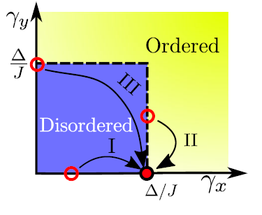


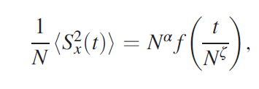


Non equilibrium criticality in quench dynamics
Prototype model for long-range interaction: Lipkin-Meshkov-Glick model (LMG)
(a.k.a. “all-to-all” interactions)
Order Parameters:
Observables:
Paraj Titum, Mohammad F. Maghrebi, Phys. Rev. Lett. 125, 040602. (2020)
Notes:
Now that I have introduced the quantum simulator, I would next introduce the model that we simulate. We are going to probe nonequilibrium phenomena in the Lipkin-Meshkov-Glick (LMG model), which has both XX and YY interaction with a transverse magnetic field. The order parameter of the phase transition is in plane magnetization, and we would focus on the fluctuation of the total magnetization and how it scales both in amplitude and dynamics. Here is the phase diagram with the critical boundary shown in dash. If we focus on the one of the axes, we have Jx and Jy, and along these axes we recover the usual ising model. Our collborators have identified three different types of quenches to the critical point, type1: where we prepare in a disordered phase and quench to the critical point, and the other two types are prepared in a critical state and then quenched to the critical point.

Slide 26
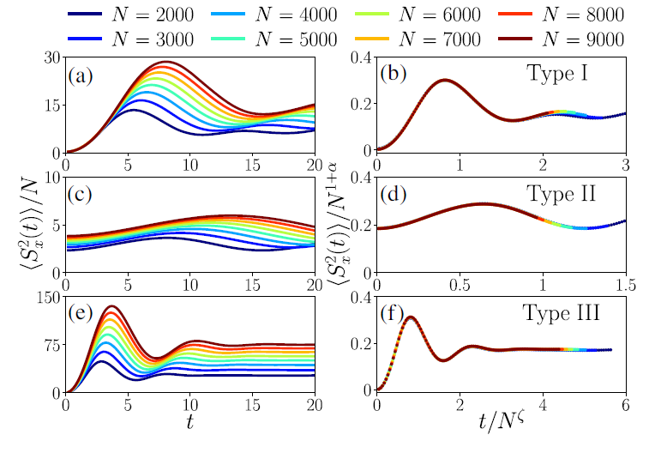
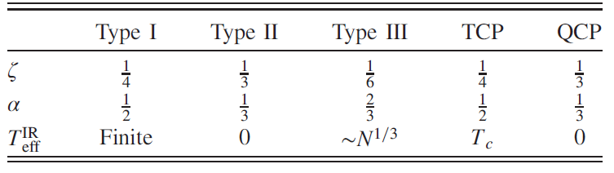
Depending on the initial state, the LMG dynamics scales with
different exponents
Adiabatically preparing a critical state is experimentally expensive.
Notes:
Depending on the type of quench, the fluctuations scale with different exponent, which are characteristic of classical, quantum and nonequilibrium phase transition. Here we want to observe the nonequilibrium phenomena, but it is hard since we have to prepare a critical state and then evolve the quench dynamics, this would be limited by finite coherence time.

Slide 27
Double Quench Approach
Notes:
Instead, we take a different approach, where we first quench to a critical point and then apply a second quench to another critical point. And then observe how the fluctuations grow with system size.

Slide 28

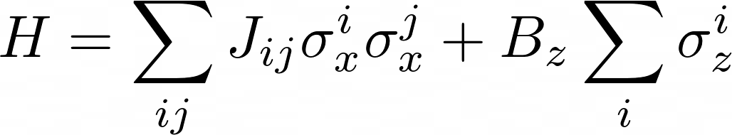

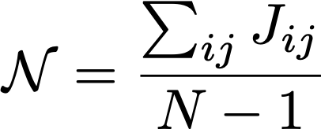
Type I quench
Critical exponents consistent with a thermal phase transition
Notes:
We first perform a single quench, where we prepare in disordered state and apply the XX Hamiltonian and measure the fluctuation of total spin along X. We do this for different magnetic fields around the predicted critical value. This is what the fluctuations look like for 10 ion system. Note that the fluctuations get smaller and faster as B is increased.

Slide 29






Double quench
(T1)
Unscaled critical fluctuation after type 1 quench
Time of first quench (T1)
Notes:
Once we have identified one critical point, we then do a second quench. So we evolve the type1 quench until the fluctuations are maximized, then we apply a second YY+Bz Hamiltonian, and measure total spin along Y.

Slide 30

Critical scaling behavior after double quench with 10-50 ions
Critical exponents consistent with a non-equilibrium phase transition.
Notes:
Similarly, we now have critical fluctuations after double quench and we scale them with predicted exponents. As you can see the amplitude collapse doesn’t work as good, however, the dynamic scaling still seem to work quite nicely. mainly because In the double quench scheme, we have to evolve the system for longer and we suffer more from decoherence with larger system sizes. All of the collapse that I have mentioned is “by eye”. We are currently developing techniques to quantify such collapses and possibly get better estimates of the exponents.

Slide 31


Hierarchy of quenches
One can keep doing multiple quenches.
There are different universality classes for different sequence of quenches
The scaling exponents are related by recursive relations
Notes:
To conclude I would like to point out that one can keep doing such quenches and can still observe distinct nonequilibrium exponents.

Slide 32














Acknowledgments
A. De
W. Morong→AWS
C. Monroe
M. Maghrebi
P. Cook
D. Paz
W. L. Tan → IonQ
A. V. Gorshkov
P. Titum

Slide 33


New Opportunities in Quantum Simulation
QAOA, PNAS 117 (41), 25396 (2020)
MB Dephasing, PRL 125, 120605 (2020)
Confinement, Nature Phys. 17, 742 (2021)
Global Interaction Control
One set of normal modes
Quantum magnetism models
Optimization problems
Quantum Spin glasses
High Energy Physics
Driven-Dissipative quantum systems

Slide 34


Dissipative Many-body Systems
Quantum System
Environment
Dissipative Phase Transitions (DPT)
Measurement-induced phase transitions
(MIPT)
Properties of the Average state
Entanglement Entropy
L. M. Sieberer, et al., Rep. Prog. in Phys. 79, 096001 (2016).
T. E. Lee, et al., Phys. Rev. Lett.110, 257204 (2013).
J. Jin, et al., Phys. Rev. X 6, 031011 (2016).
M. F. Maghrebi, et al., Phys. Rev. B 93, 014307 (2016) ….
Nahum, et al., Phys. Rev. X 7, 031016 (2017)
Y. Li, et al., Phys. Rev. B 98, 205136 (2018)
Y. Li, et al., Phys. Rev. B 100, 134306 (2019) …

Slide 35
Dissipative Floquet Systems
,
DPT
Order-Disorder ?
MIPT
Volume-Area law ?
P. Sierant et. al., Quantum 6, 638 (2022)
Notes:
Fundamental Question: in this model long range interactions with local dissipation, can we observe a Dissipative phase transition? Can we observe a MIPT? And What is the interplay between them?

Slide 36
Dissipative and Measurement-induced PTs
Questions:
Are these transitions present in a Hamiltonian system with long-range interactions?
Are they connected or exclusive?
Mutual information
Binder Cumulant
MIPT
DPT

Slide 37

Experimental Considerations
DPT:
Global Long-range Interactions
+
Local Optical Pumping
MIPT:
1) Detecting $S(ρ_{A})$
2) Postselection→$2^{pLT}$ measurements
3) Detect individual qubits with negligible crosstalks
P. Sierant et. al., Quantum 6, 638 (2022)
Notes:
Optical pumping

Slide 38





Acknowledgments
Roman Zhuravel
(Postdoc)
Visal So
(Grad Student)
Abhishek Menon
(Grad Student)
Midhuna D. Sughanti
(Grad Student)
April Sheffield
(Undergraduate)
Collaborators :
Marcello Dalmonte
Rosario Fazio
Piotr Sierant
Giuliano Chiriacò
Federica Surace
Xhek Turkeshi
Zohreh Davoudi
Mohammad Hafezi
Tobias Grass
Barbara Andrade
Alireza Seif
Norbert Linke

Slide 39


Experimental Considerations
1) Detecting $S(ρ_{A})$ of an entangled Ancilla
M. J. Gullans and D. A. Huse, PRL 125 (2020)
C. Noel et al., arXiv:2106.05881 (2021)
2) $2^{pLT}$ overhead manageable if
$α$ and, therefore, $p_{c}$ is decreased
3) Qubit hiding to avoid crosstalks
during measurements
H.-X- Yang at al., arXiv:2106.14906 (2021)

Slide 40


Participation Entropies
The scaling with L of S_{q} distinguishes if wave functions that are delocalized,
multifractal and localized.
Notes:
Fig. 12 c), d) show the coefficient a∞q calculated for participation entropies with q = 1, 2, 3 in the Z basis using data before the resetting (the results in the X
basis are analogous). The coefficients a∞q are vanishing in the purifying regime at large p in the model with α = 0.5, showing that the state is indeed localized in
the Z basis. For smaller values of p at α = 0.5, as well as for the entire interval of resetting probabilities for
α = 2, we observe that the values of a∞q lie between 0 and ln 2 and are not-equal to each other. This suggests that the steady states in the kicked Ising model
with resetting are either fully localized in the Hilbert space or possess a multi-fractal structure for p > pc. The situation is less clear cut in the volume-law phase.
For p < pc the coefficients a∞q are quite close to ln 2 for α = 2 and it is unclear whether the wave function becomes fully delocalized over the Hilbert space in
the thermodynamic limit. In contrast, for p < pc the coefficients a∞q are significantly smaller that ln 2 for
α = 0.5 which is a signature of the long-range order in the kicked Ising model with resetting.
Bottom line: in the volume law at alpha=2, wavefunction seems delocalized because all values approach log2. In the case of alpha=0.5 the wavefunction is likely to be more localized (or maybe multifractal?) because values further below log2.
The long-range order present in the system at alpha = 0.5 puts certain constraints on the wave function and prevents full delocalization of
the wave function over the whole Hilbert space. Such mechanism is expected to be absent for alpha=2, when there is no long-range order in the system.
Interestingly, the process of decrease of $a^{\infty}_{q=1}$ with $p$ does not occur in the same way for $\alpha=0.5$ and for $\alpha=2$. For the latter case, the difference between $a^{\infty}_{q=1}$ before and after the resetting is increasing with $p$. A single cycle of the unitary time evolution noticeably delocalizes the state even at large $p$ resulting in $a^{\infty}_{q=1}$ to be significantly above $0$.
In contrast, for the longer-range of interactions ($\alpha=0.5$) the difference between scaling of participation entropy before and after the resetting starts to diminish around $p\approx0.5$, and, in the regime of large $p$, $a^{\infty}_{q=1}\approx 0$ both for the wave function before and after the resetting.

Slide 41



Dissipative Symmetry-Breaking Phase transition
Magnetization
Binder cumulant
Cluster mean field
for $α=0$
Exact Diagonalization $α>0$

Slide 42

Self-organized Ion crystals
Transverse
Y modes
Transverse
Z modes
Fluorescence (arb)
2.5 3.0 3.5 4.0
Raman beatnote frequency (MHz)

Slide 43
From Spin models to HEP models

Slide 44
Laser-ion interactions
1
0.8
0.6
0.4
0.2
0
0
50
100
150
200
250
300
350
400
τ (μs)

