Slide 1
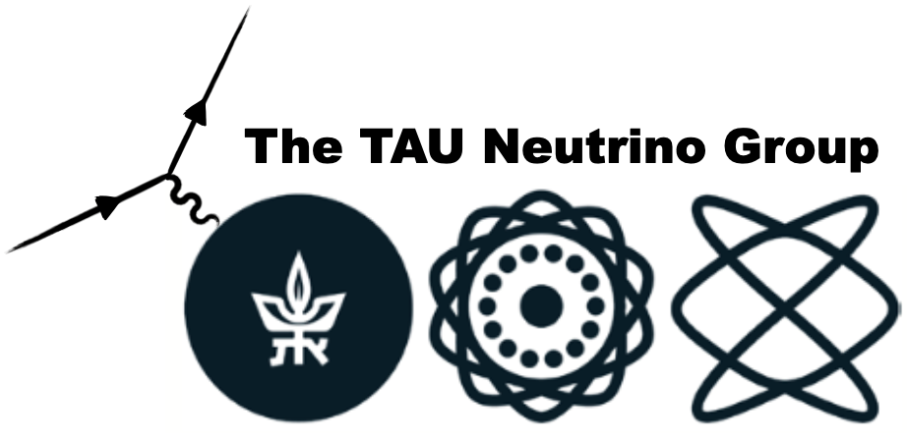
An Introduction to Neutrino-Nucleus Interactions An Event Generator Perspective Or “Bridges Over Troubled Waters”
April 14th, 2023
10th Workshop of the APS Topical Group on Hadronic Physics
by J. L. Barrow
MIT & TAU
Zuckerman Postdoctoral Scholar

Slide 2
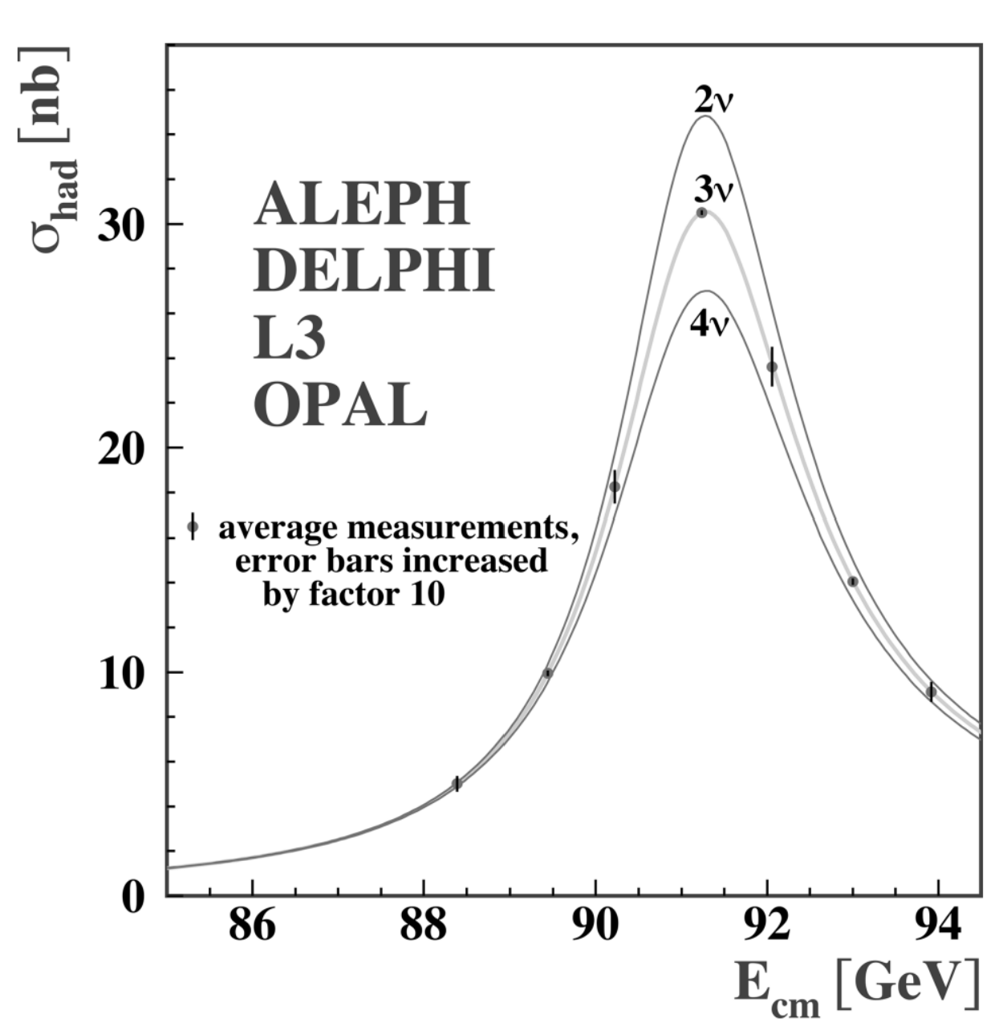
Neutrino Properties and Types
No strong interactions
Neutral
Only weak interaction
Affect the $Z^{0}$ decay
$Z^{0}→invisibles$
Studied extensively at Large Electron-Positron Collider, Standard Linear Collider
Measurements consistent with three active neutrinos
As predicted by the SM
$m_{ν}=0$ was expected…
Says nothing of “sterile” (non-EW-interacting) types
Precision electroweak measurements on the Z resonance
Adapted from P. Machado and M. Ross-Lonergan

Slide 3
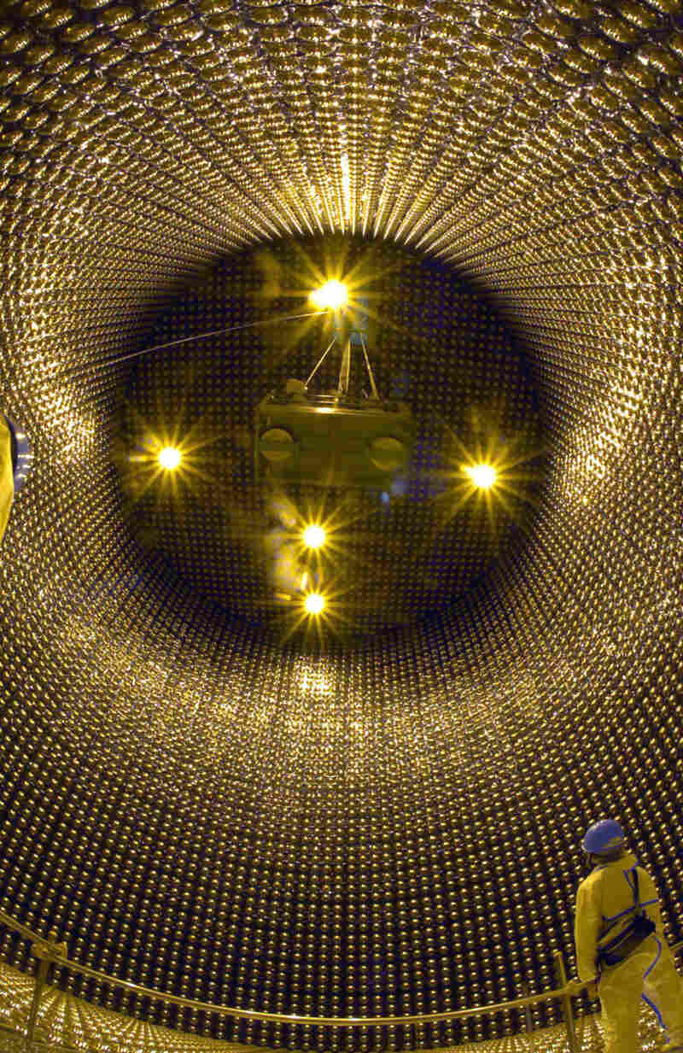
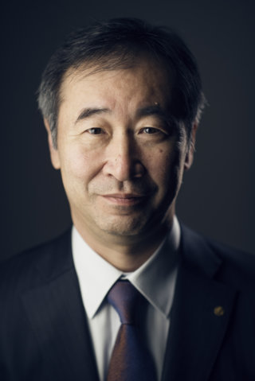
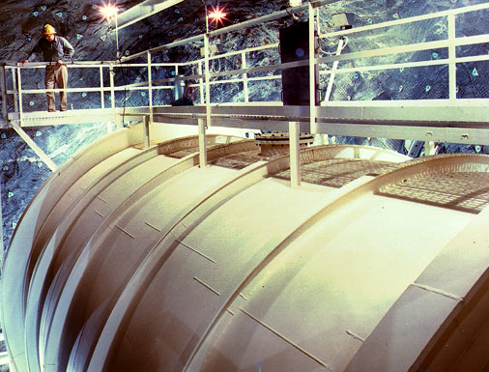
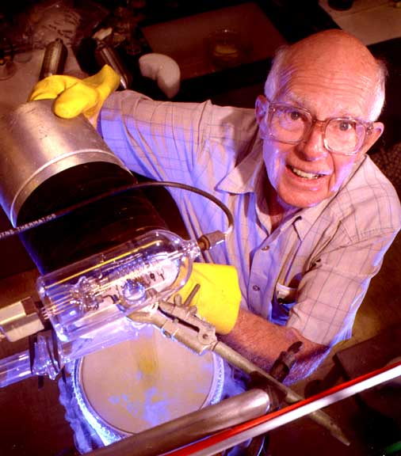
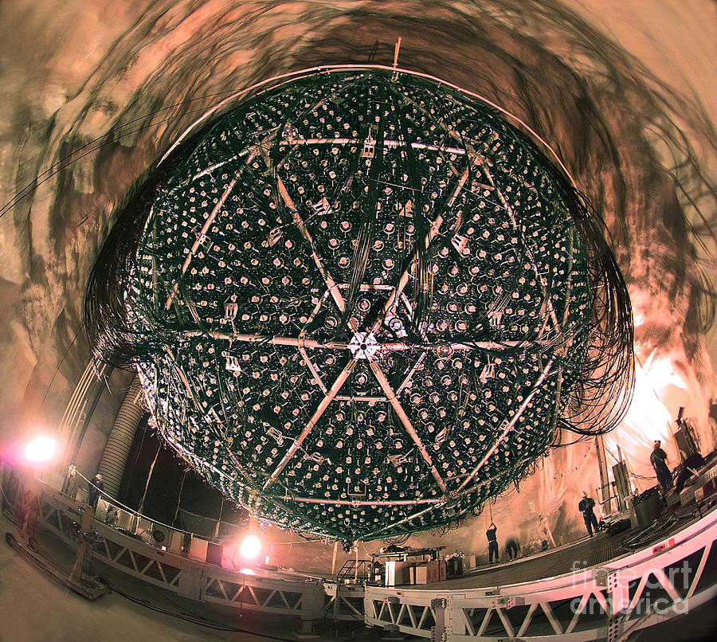
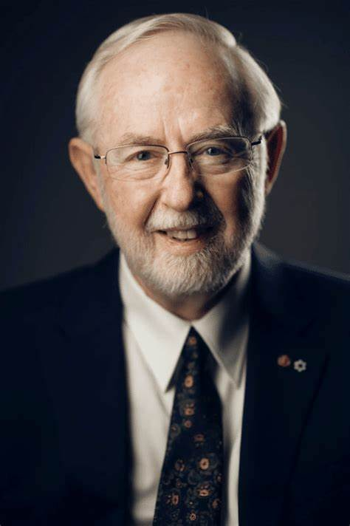
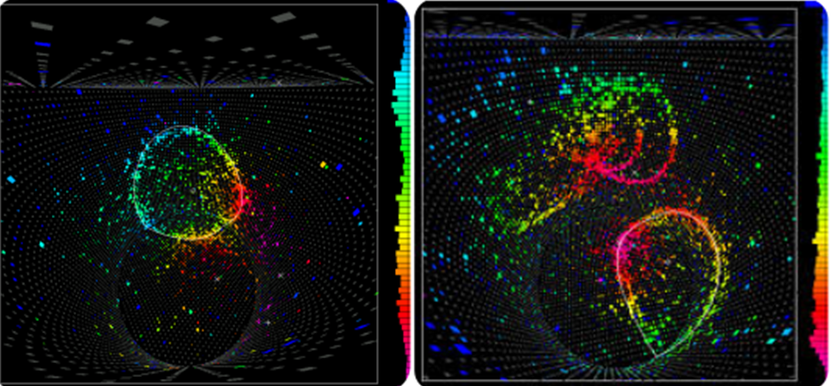
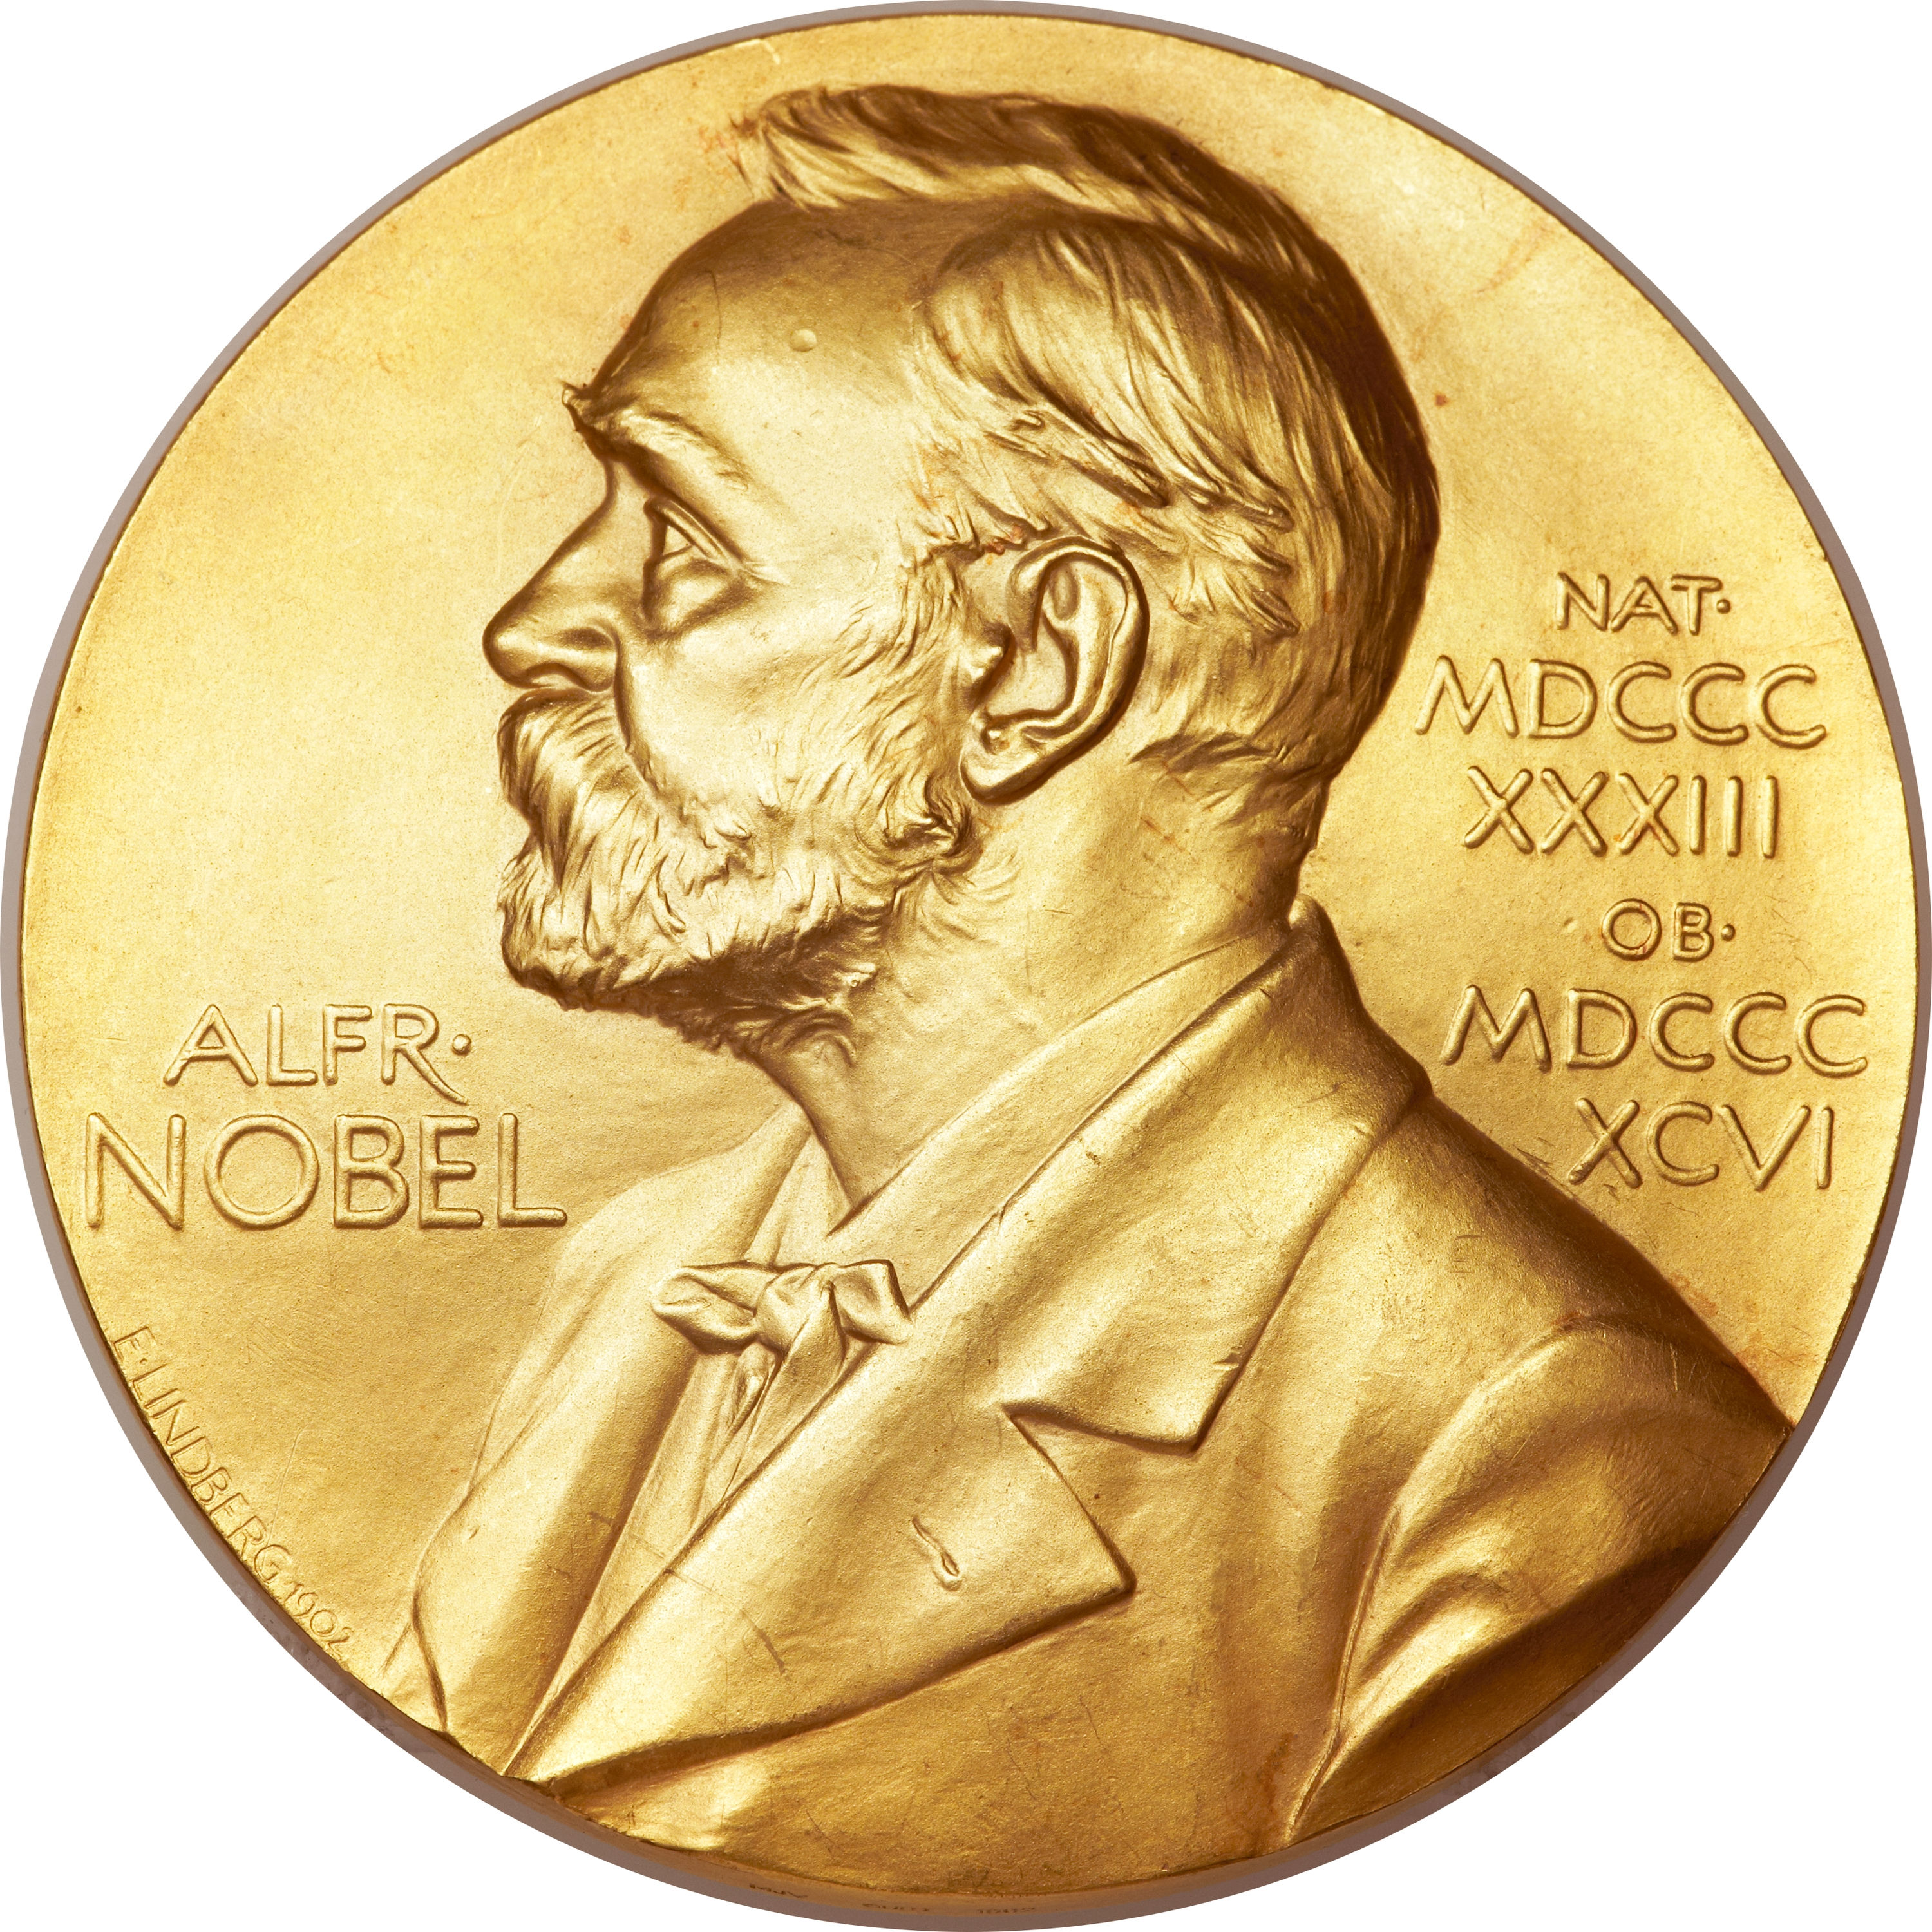
Neutrino Oscillations
Super-Kamiokande
Homestake Detector $$ν_{e}+{}_{}^{37}{Cl}→{}_{}^{37}{Ar}+e^{−}$$
2002 Nobel Prize in Physics 2015 Nobel Prize in Physics
Sudbury Neutrino Observatory

Slide 4
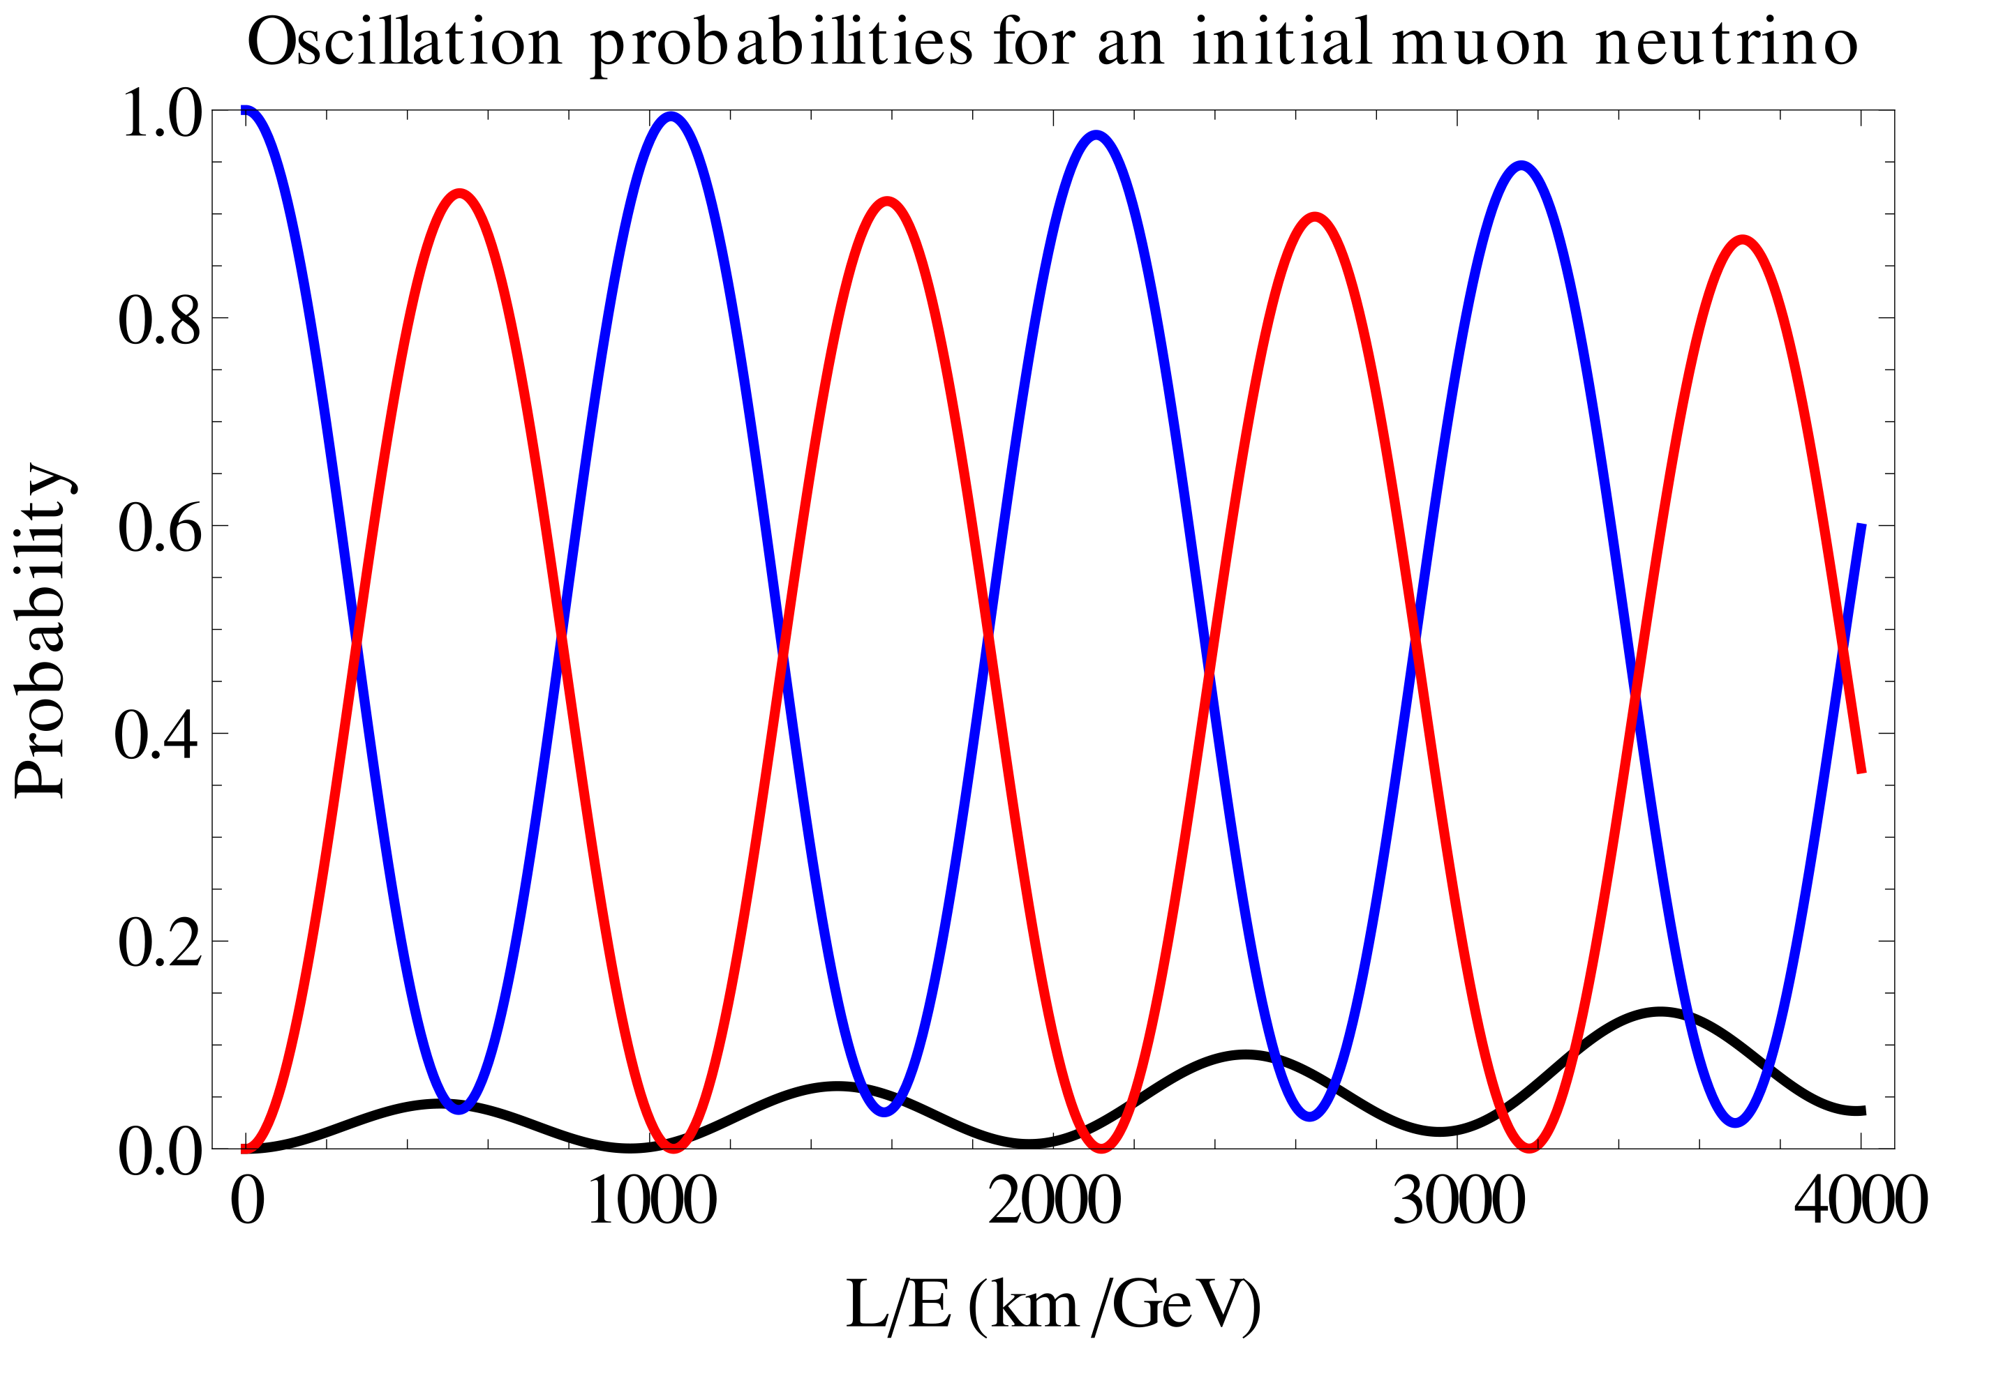
$$P_{ν_{α}→ν_{β}}\left(E_{ν, true},L\right)≈\sin^{2}\left(2θ\right)\sin^{2}\left(\frac{Δm^{2}L}{4E_{ν, true}}\right)$$
$$ν_{e}$$
$$ν_{μ}$$
$$ν_{τ}$$
Wiki

Slide 5
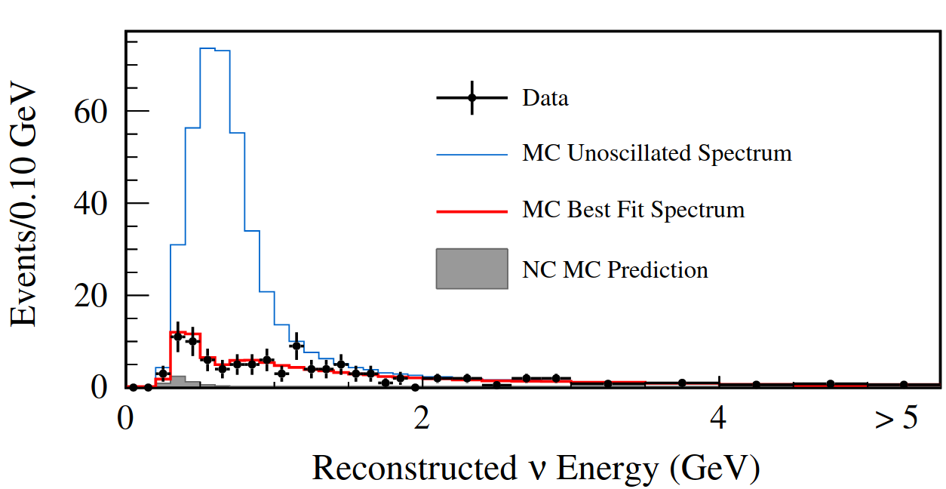
How do we measure oscillation parameters?
Measure $ν$ interaction counts in our detectors…
Must use an interaction model to deconvolute the 𝜈 flux
$$N_{α}\left(E_{rec},L\right)=\sum_{i=Nucleus Type}^{I}{\sum_{j=1}^{Nuclei}{\int{Φ_{α}\left(E_{true},L\right){σ_{α}}_{i}\left(E_{true}\right)R_{{σ_{α}}_{i}}\left(E_{true},E_{rec}\right)dE_{true}}}}$$
Required!
measured
interaction model
𝜈 flux
Near detector constraint
$$Φ_{α}\left(E_{true},L\right)∝\left[1−P_{ν_{α}→ν_{β}}\left(E_{true},L\right)\right]Φ_{α}\left(E_{true},\sim 0\right)$$
$∝$Oscillation parameters!
Near detector
Far detector
Adapted from A. Papadopoulou
Phys. Rev. D 91, 072010 (2015)

Slide 6
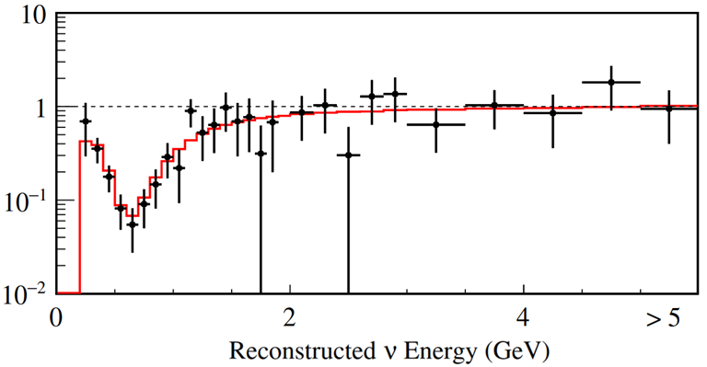
How do we measure oscillation parameters?
$$P_{ν_{α}→ν_{β}}\left(E_{true},L\right)≈\sin^{2}\left(2θ\right)\sin^{2}\left(\frac{Δm^{2}L}{E_{true}}\right)$$
Near detector
Take a ratio!
$$θ$$
Far detector
Far detector
$$Δm^{2}$$
Near detector
$$R_{σ_{i}}\left(E_{true},E_{rec}\right)$$
Adapted from A. Papadopoulou
Phys. Rev. D 91, 072010 (2015)

Slide 7
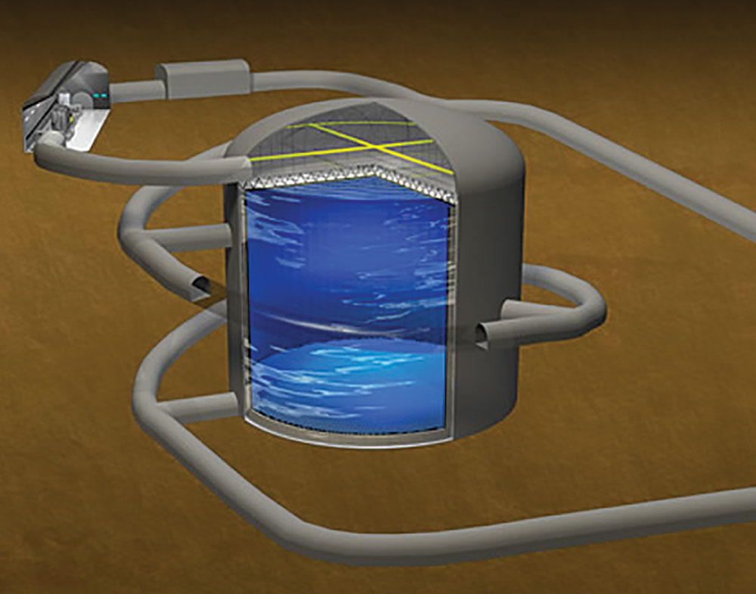
Future Experimental $ν$ Physics
Goal:
Extract $ν$ oscillation parameters
Implications
Leptogenesis, cross sections, $τ$ production, BSM, Non-Standard Interactions
Challenges
Broadband $ν$ spectra
Unknown initial $ν$ energy

Slide 8
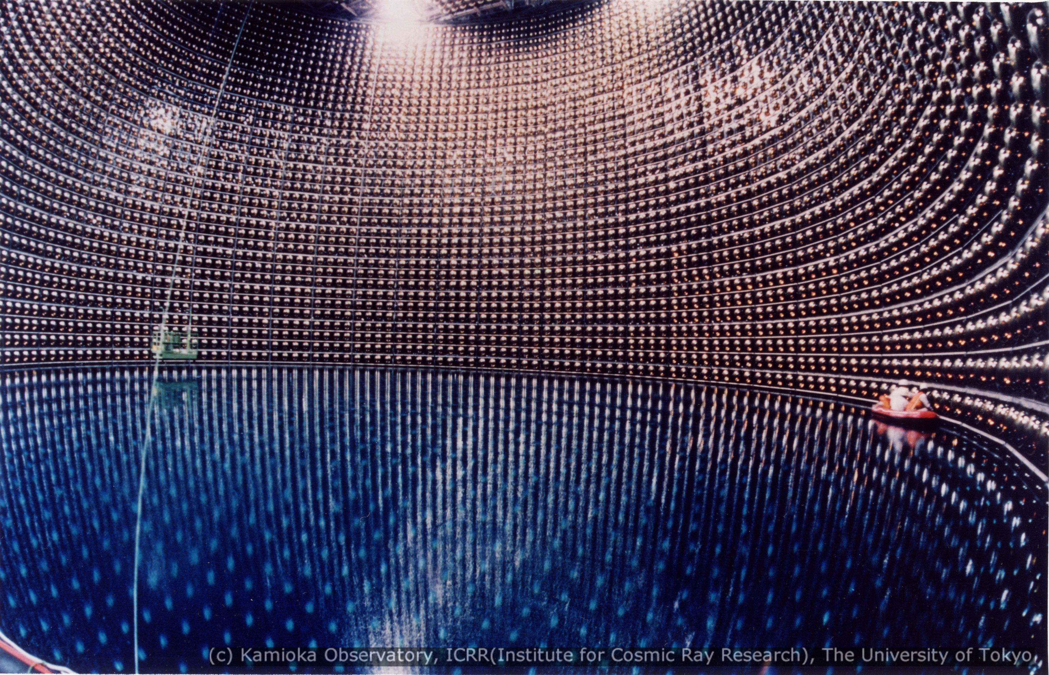
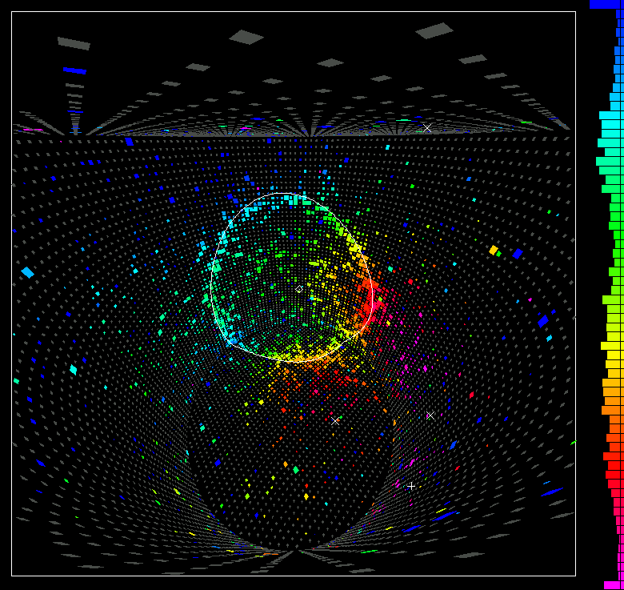
Water Cherenkov Detectors
Super & Hyper-Kamiokande’s technology
Well understood, battle tested
Huge masses, statistics
Oxygen as main nuclear target
“Simple” symmetric nucleus
Reconstruct particle momenta from Cherenkov rings
High proton thresholds
Lack of $γ/e$ separation power

Slide 9
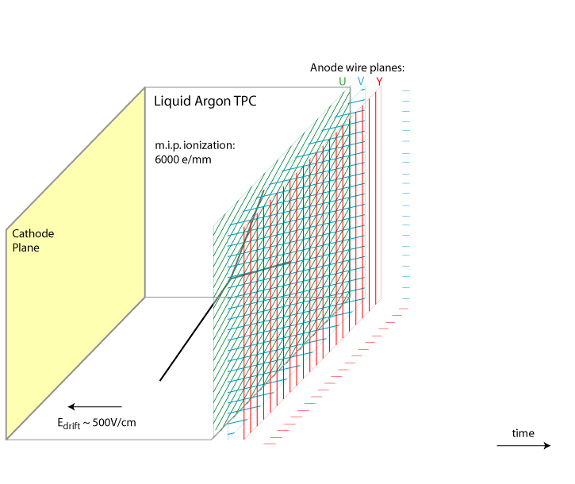
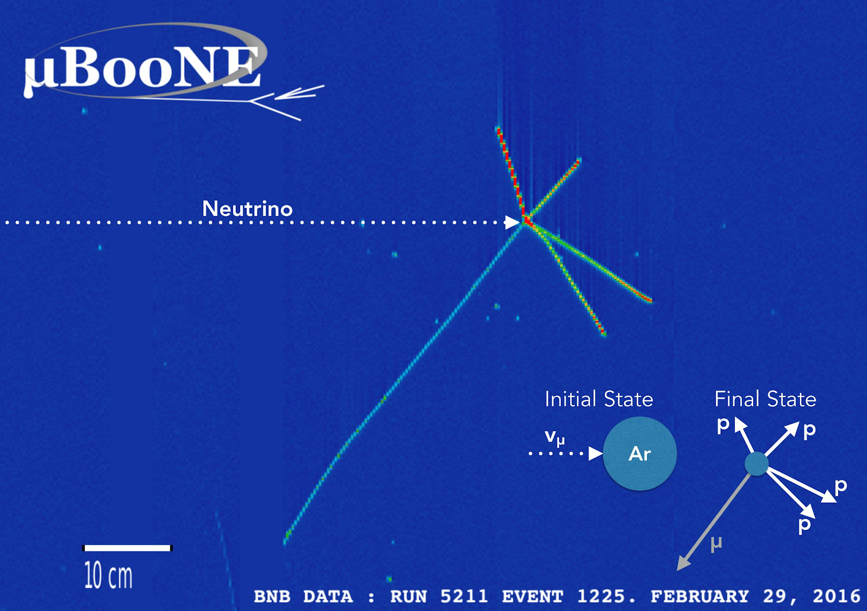
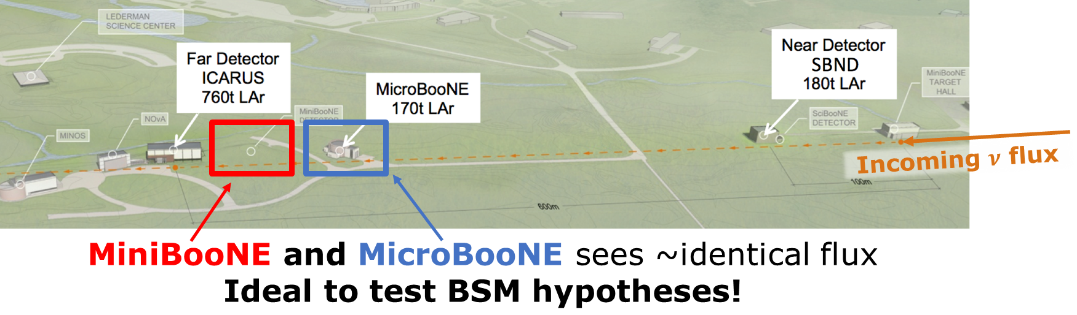
Liquid Argon Time Projection Chambers
ICARUS, SBND, & DUNE’s technology
MicroBooNE being decommissioned
Argon as target
Complex nucleus
Ionization of LAr for track reconstruction
Low $p$ thresholds
$dQ/ds\sim dE/ds$ for calorimetry
$γ/e$ separation power
Animation from Bo Yu (BNL)
Notes:
Bold text?

Slide 10
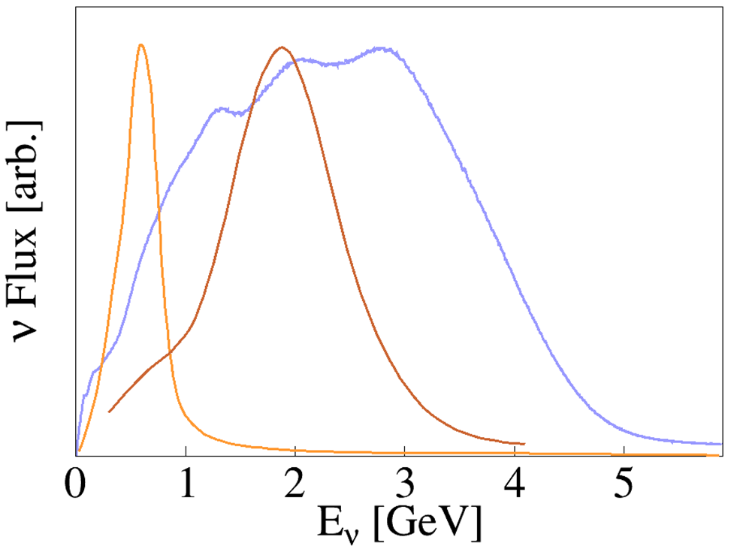
Why Precision Cross Section Models?
$ν_{ℓ}$ are detected via $ν_{ℓ}A$-scattering
Cross sections feed directly into oscillation parameters extraction
Many known unknowns…
Fermi motion
Multinucleon effects
Final state interactions
Constrain using near-detector & $e4ν$ data
$$Φ_{ν_{μ}}^{DUNE}\left(E,L=0\right)$$
$$Φ_{ν_{μ}}^{NOνA}\left(E,L=0\right)$$
$$Φ_{ν_{μ}}^{T2K}\left(E,L=0\right)$$
Notes:
Crunch time on e4nu—point to Afro’s talk, limit mentions

Slide 11
$$Φ_{α}\left(E_{true},L\right)$$

Slide 12
Improving Discrete Aspects of Modeling $$⟹Φ_{α}\left(E_{true},L\right)σ_{i}\left(E\right)R_{σ_{i}}\left(E,E_{rec}\right)$$
DUNE is special
Very broadband!
Will require many processes to be reconstructed precisely
$$ω$$
$$E_{ν}$$

Slide 13
Improving Discrete Aspects of Modeling $$⟹σ_{i}\left(E\right)R_{σ_{i}}\left(E,E_{rec}\right)$$
DUNE is special
Very broadband!
Will require many processes to be reconstructed precisely
$$ω$$
Quasielastic (QE)
Meson Exchange Current (MEC)
Resonance (RES)
Deep Inelastic Scattering (DIS)

Slide 14
$$⟹σ_{i}\left(E\right)R_{σ_{i}}\left(E,E_{rec}\right)$$
$$ω$$

Slide 15
What to Do with Event Generators? Bridges Over Troubled Waters…
Bridge the gap between theory & experiment
Encapsulate theory calculations $⟹$ approximate!
Practical tool for experimental simulations
Produce full final-state predictions
Four-momenta, interaction vertices, etc.
$E_{ν}$ reconstruction, efficiency & background estimations, etc.
Experiments need events! Not distributions!
Must understand reconstruction
Experiments want to save on computation!
Can’t rerun detector simulations all the time!
Experiments need (xsec.) uncertainties!
Usually reweighting events is necessary
Range of free parameters $⟹$ estimate!
15

Slide 16
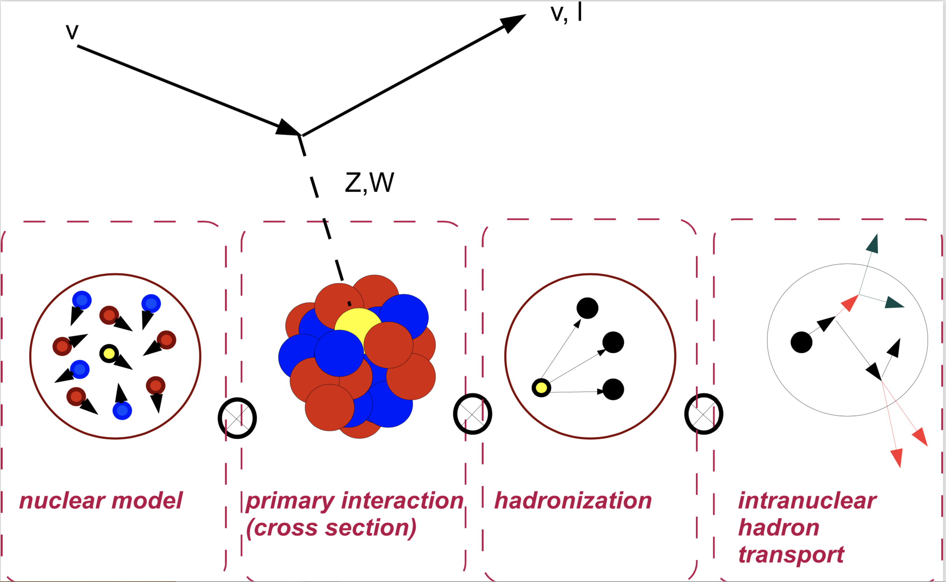
Summary of Approximations of Relevant Physics
Fermi gas model of initial nuclear state
No/little shell structure, correlations, etc.
Neutrino scatters on a single bound nucleon
Two-nucleon contributions important!
Support for some models only beginning…
Interference between processes neglected
Intranuclear cascade for hadron transport
GiBUU more sophisticated…
16

Slide 17
(Overly) Generalized Factorization Scheme

Slide 18
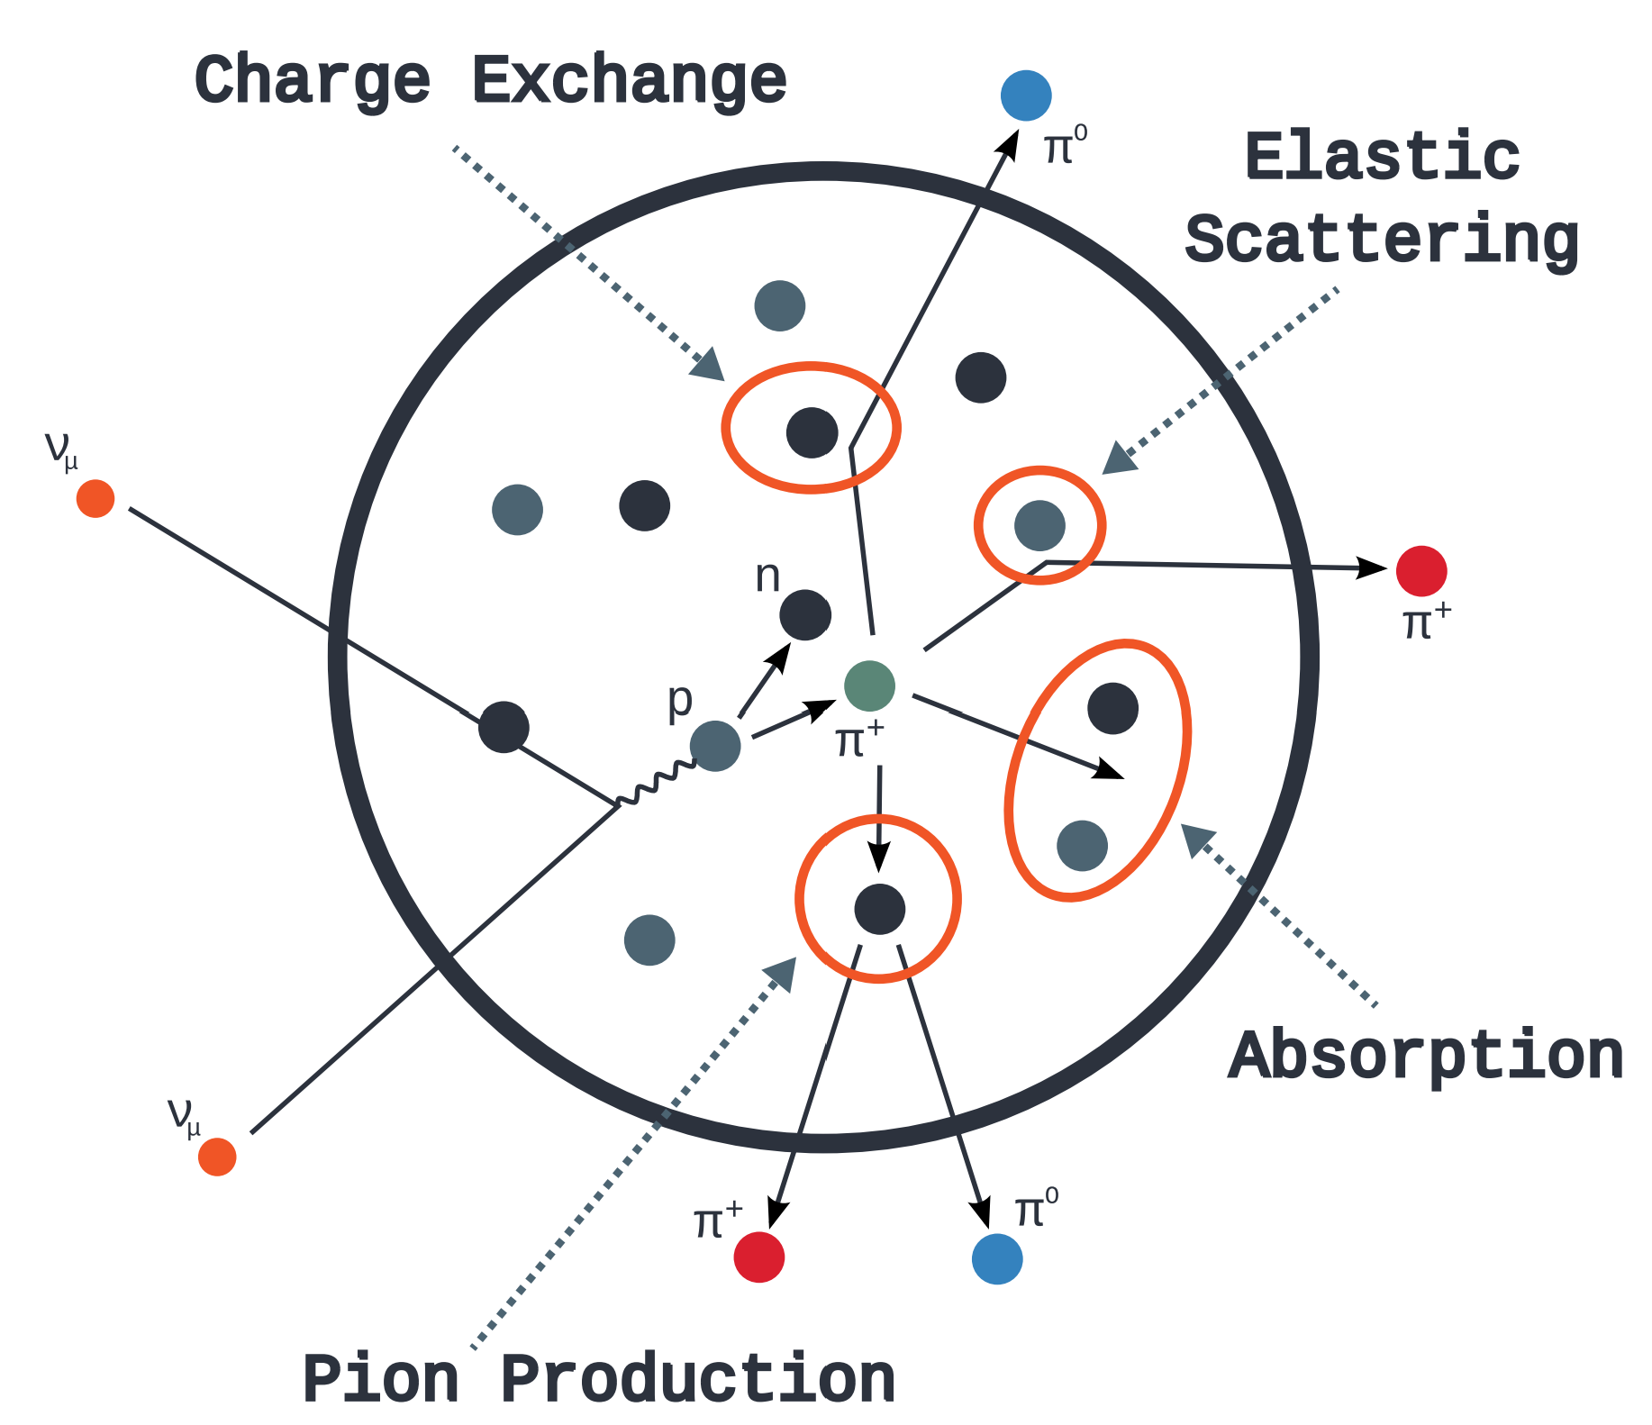
Final State Interactions …the Intranuclear Cascade
Most quasi-classical part of generators
All rely on many hadron cross section libraries
Types:
Fully stochastic approach
Most “realistic”—billiard balls
Largely non-reweightable
Techniques within Professor?
Single effective interaction (SEI) approach
Largely table-based method
Ease of reweighting for uncertainty estimations
What is inside MC generators...and why it is wrong, Tomasz Golan
"Global" picture of FSI, Steve Dytman

Slide 19
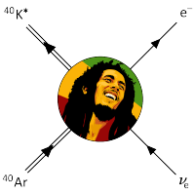
Many Generators, Many Assumptions
$$∗$$
NEUT
$$∗$$
$$∗$$
Model differences arise from various
physics approximations
Assuming different models of Nature ($σ_{i}\left(E\right)$) can lead to ill-understanding of $R(E_{true},E_{rec})$!

Slide 20
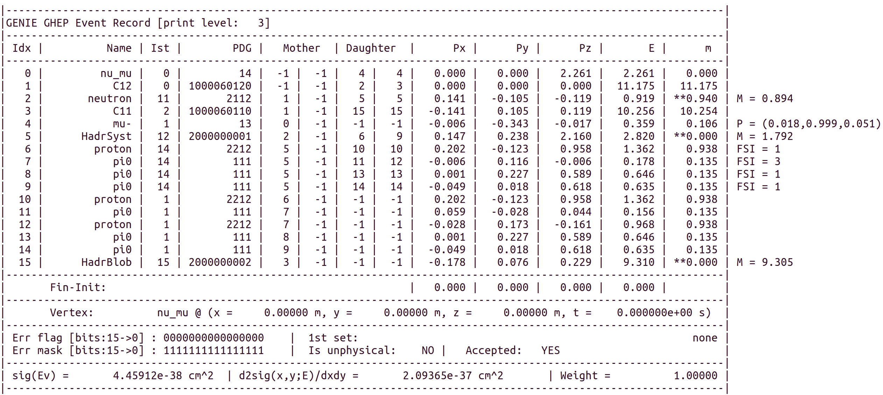
GENIE Model Overview
Generator of choice within Fermilab-associated experiments
Largest development group—but still rather small
Arguably slow, but very well maintained—perfect for exp. production
Code base: C++, XML configuration files
Hopes to become a universal generator platform—but hard for theorists
Cross sections from pheno./emp. models as splines
Explicit dependence on models of Fermi motion (“nuclear model”)
Can now run electrons as well! (NuWro can some, too)
Final state interactions: SEI & stochastic (hA and hN Intranuke)
Tunes: fit parameters to cross section data
Assume specific comprehensive model configurations
genie-mc.org

Slide 21
Many Generators, Many Assumptions
NEUT
Model differences arise from various
physics approximations
Assuming different models of Nature ($σ_{i}\left(E\right)$) can lead to ill-understanding of $R(E_{true},E_{rec})$!

Slide 22
GiBUU Model Overview
Claim: “GiBUU is Nature”, U. Mosel, apocryphal
Code base: Fortran
Arguably most theoretically focused/motivated
Very few free parameters, uncertainties difficult
Step-wise propagation of all interacting particles
Very slow, but well motivated
Multiparticle interactions and evolution
Can run most any particle interaction
Primarily focused on hadrons
Highly advanced FSI modeling
Effectively hydrodynamical
GiBUU – Hepforge
GiBUU @ NuSTEC17, Kai Gallmeister

Slide 23
Many Generators, Many Assumptions
NEUT
Model differences arise from various
physics approximations
Assuming different models of Nature ($σ_{i}\left(E\right)$) can lead to ill-understanding of $R(E_{true},E_{rec})$!

Slide 24
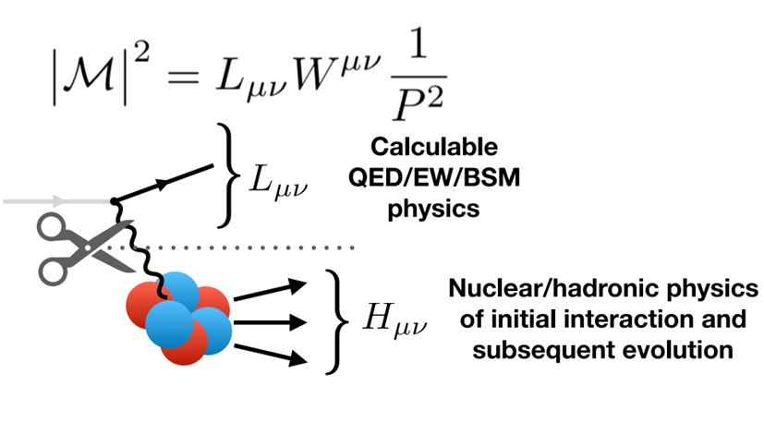
ACHILLES Model Overview
Code base: C++, Mathematica
Burgeoning! New kid on the block!
Adopt many philosophies, tools of LHC
High-level of theory driven development
Current: include only SF QE cross section
Independent implementation of QMC FSI
ACHILLES @ Fermilab 2023, William Jay
Novel event generator for the automated simulation of neutrino scattering

Slide 25
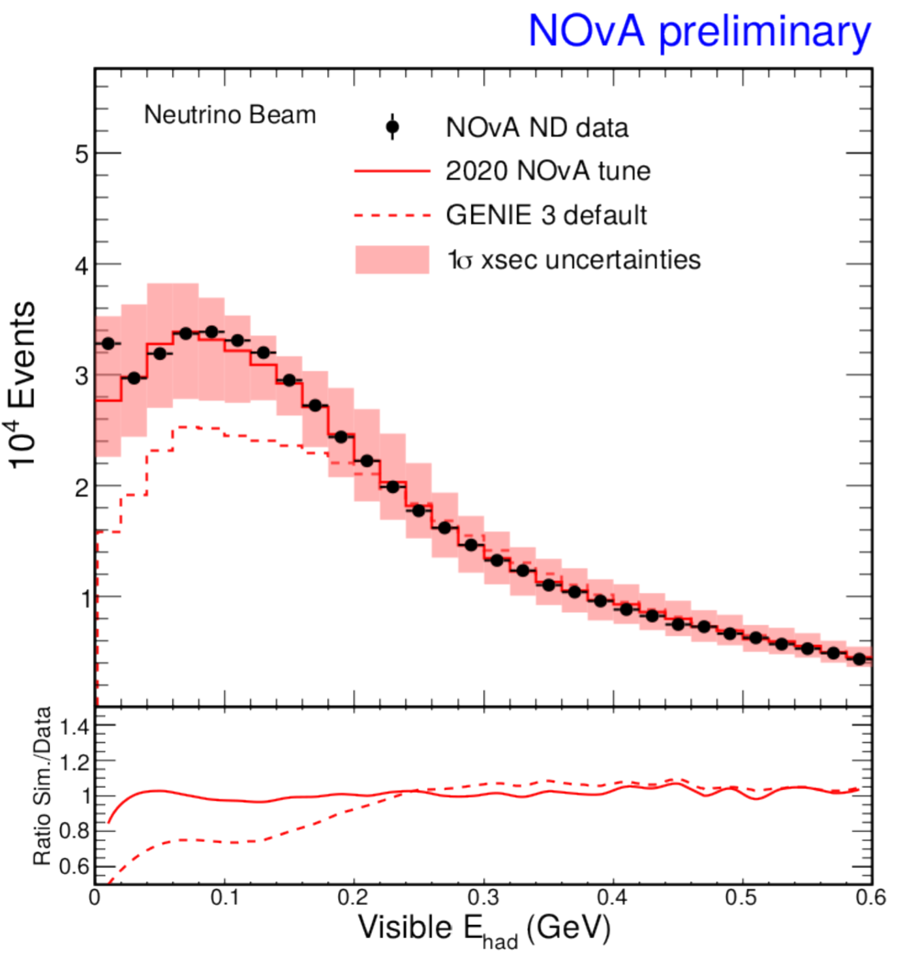
Assessing Model Uncertainties in Generators
Well-motivated interaction model uncertainties are key
Complicated by poor out-of-the-box performance
Ad hoc tuning common…
Methods improving!
Professor+GENIE tools, J. Tena-Vidal
Full simulations (beam + generator + detector) needed…
Computationally expensive
Reweight existing events via parameter variations
Experiments can and will "make up" tunes and uncertainties to meet their needs
Shrinking the error bands in a responsible way will be crucial for precision measurements
Theory guidance on this topic valuable
Need more of it!
Upcoming workshop at INT on theory-driven uncertainties
From Tomas Nosek, Neutrino2020
25

Slide 26
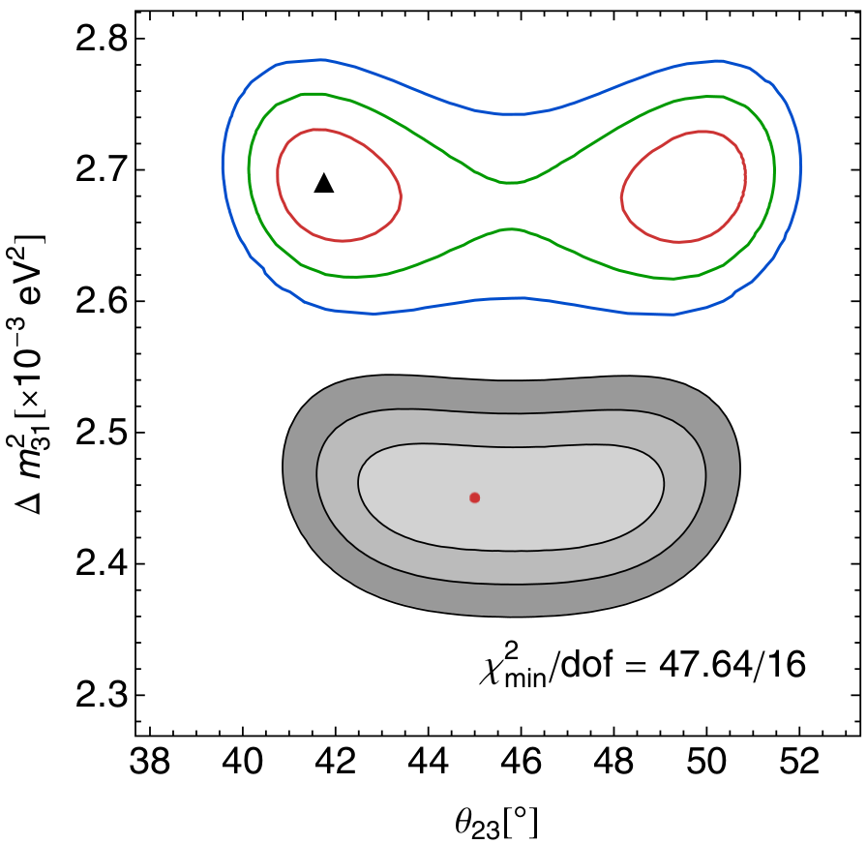
Implications of Mismodeling
Adapted from A. Papadopoulou
Generate w/GiBUU, Reconstruct w/GENIE
Leads to misreconstruction
Misinterpretations of experimental results!
Bad oscillation parameters
Fake systematic effects?
New physics?
Best fit!
Generate w/GiBUU, Reconstruct with GiBUU
True input point
$${}_{8}^{16}O$$
Phys. Rev. D 89, 073015 (2014)
Notes:
Even if one considers a 5% energy reconstruction (energy scale) uncertainty entered as a nuisance parameter to assess a fake “calibration error” the best fit remains >1sigma outside these contours

Slide 27
Summary
Generators: maps between theory & experiment
Many models cobbled together (factorized)
Fermi motion
Interactions across wide range of energy
Final state interactions
Tuning free parameters currently necessary
Theory improvements slow, but coming
Reweighing to produce uncertainties
Much recent discussion!
How to improve generators?
Perspectives from across & beyond the field
NuSTEC whitepaper
Report on Common Event Generator Tools Workshop
Workshops at ECT* and Fermilab 2020 and Fermilab 2023
Snowmass whitepapers galore
27

Slide 28
Thank-you for your attention! Questions?

