Slide 1
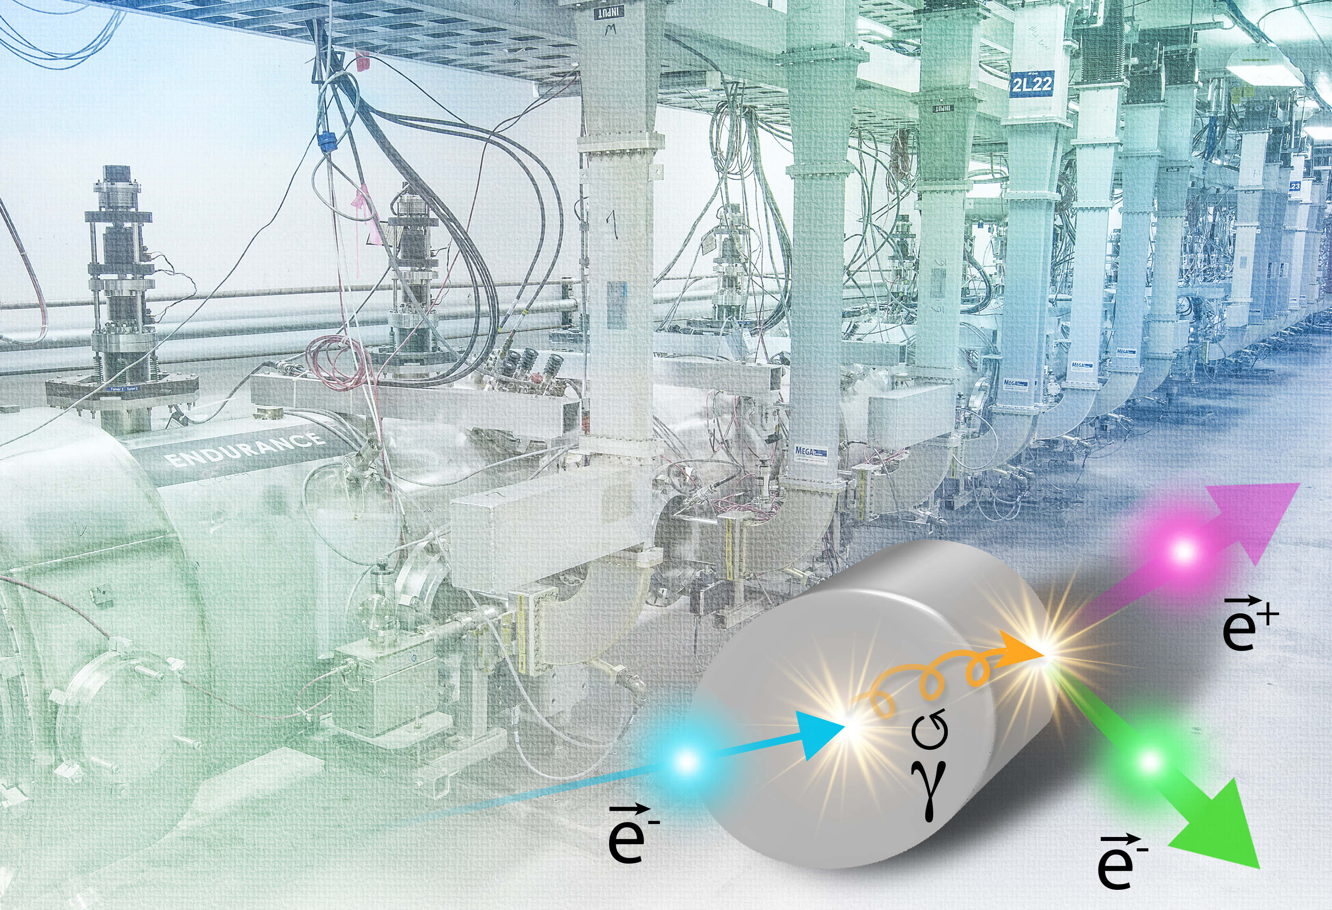
Jefferson Lab Positron Program
New 12 GeV science experiments enabled by adding a positron source to the CEBAF accelerator.

Slide 2
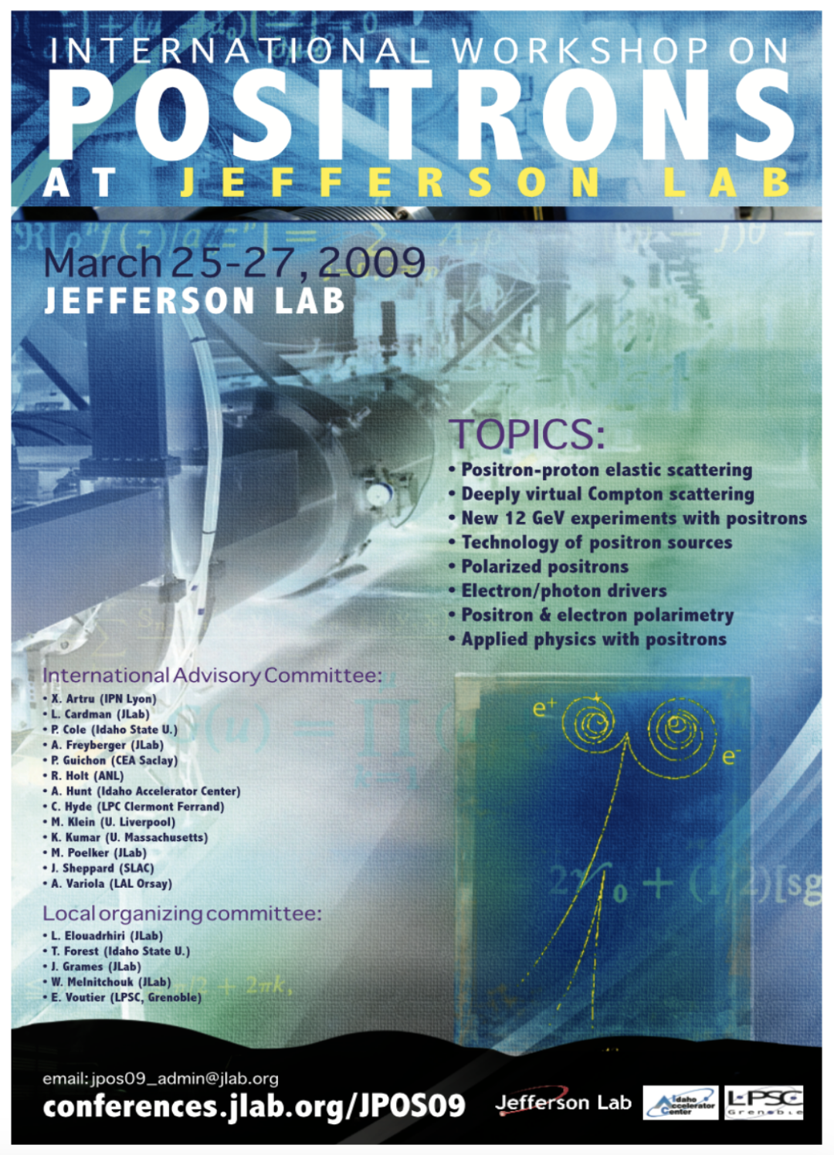

Polarized Electrons for Polarized Positrons (PEPPo)
https://doi.org/10.1103/PhysRevLett.116.214801
Photo of the PEPPo setup in the injector area of CEABF.

Slide 3
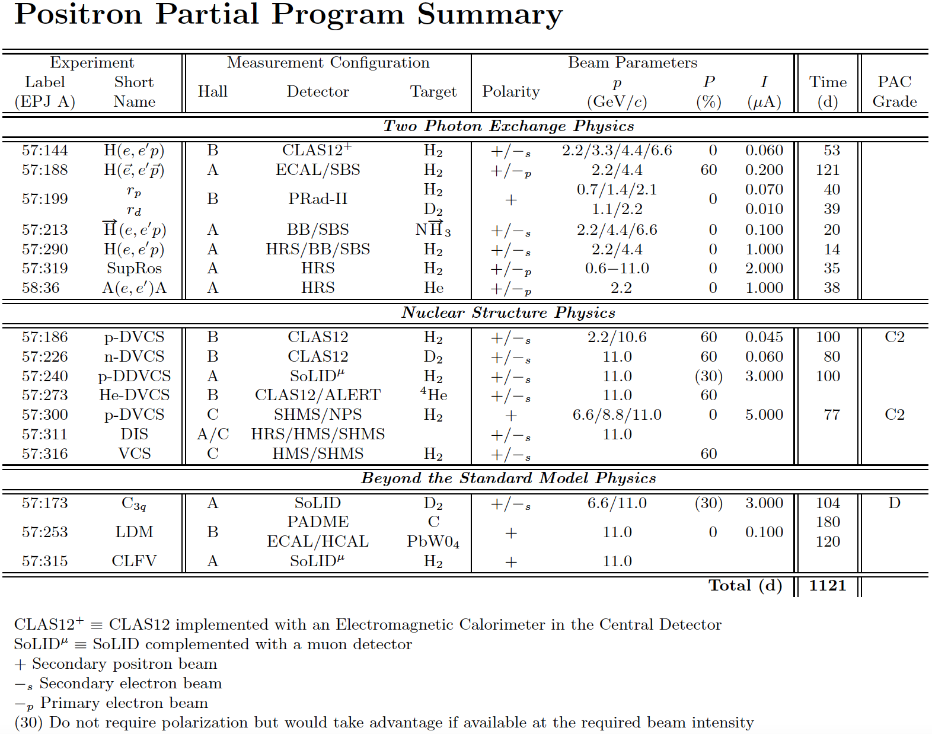
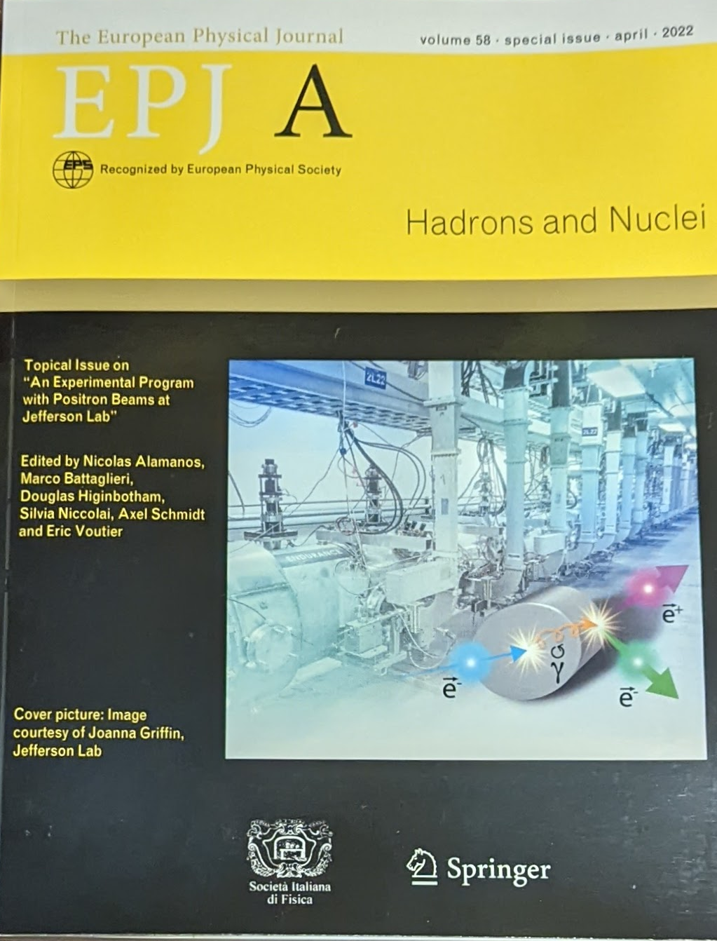
Positron Program White Paper Published 2022
https://doi.org/10.1140/epja/s10050-022-00699-6

Slide 4
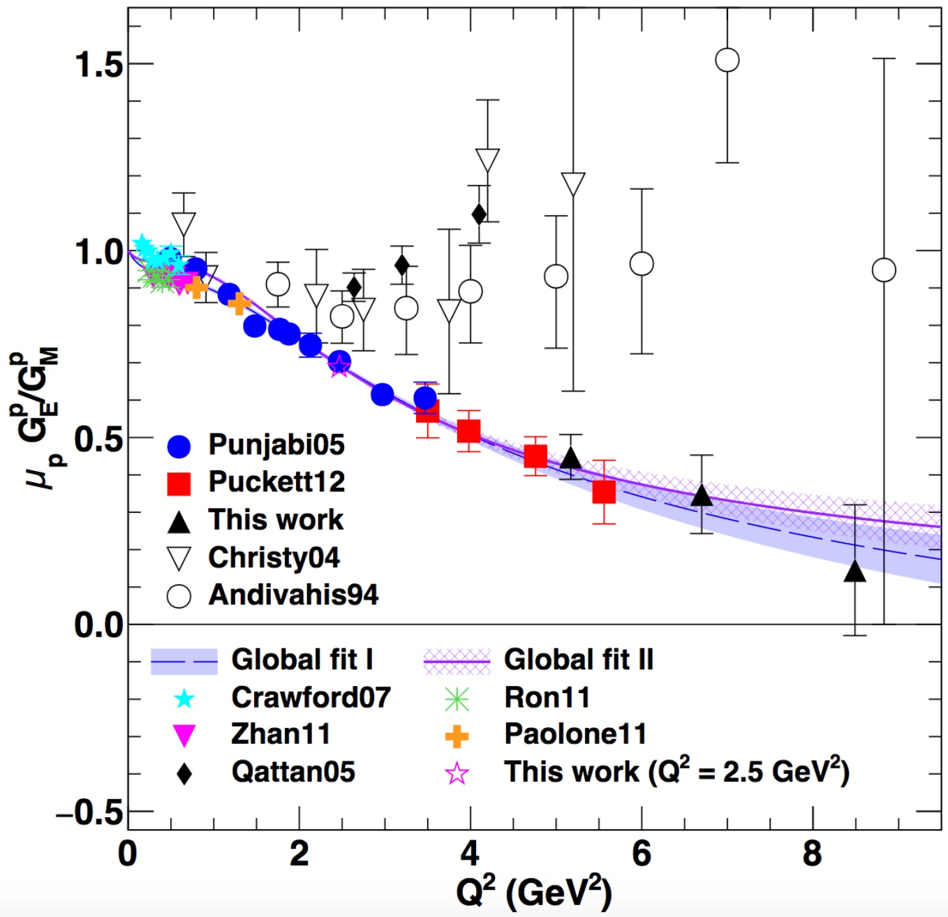
One Detailed Example: Understanding Two Photo Exchange
P.A.M. Guichon, M. Vanderhaeghen, PRL 91 (2003) 142303 P.G. Blunden, W. Melnitchouk, J.A. Tjon, PRL 91 (2003) 142304
Measurements of polarization transfer observables in electron elastic scattering off protons question the validity of the 1γ exchange approximation of the electromagnetic interaction.
A.J.R. Puckett et al. PRC 96 (2017) 055203
Two-photon exchange (TPE) is likely the cause of the form factor discrepancy at high Q².
Q² (GeV²)
e⁺ @ JLab has a the unique opportunity to bring a definitive answer about TPE.

Slide 5
12 GeV CEBAF vs. Ce⁺BAF
Machine Parameter | Electrons | Positrons
Hall Multiplicity | 4 | 1 or more
Max. Energy (ABC/D) | 11/12 GeV | 11/12 GeV
Beam Repetition | 249.5/499 MHz | 249.5/499/1497 MHz
Duty Factor | 100% cw | 100% cw
Unpolarized Intensity | 170 μA | > 1 μA
Polarized Intensity | 170 μA | > 50 nA
Beam Polarization | > 85% | > 60%
Fast/Slow Helicity Reversal | 1920 Hz/Yes | 1920 Hz/Yes

Slide 6
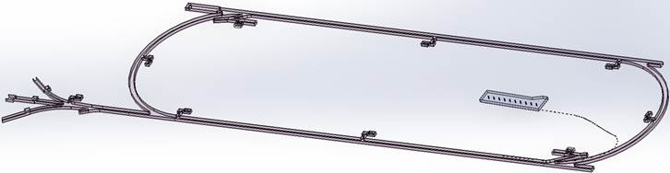

Low Energy Recirculator Facility (LEFRF) As The New Injector Facility for CEBAF
123 MeV e+
(650 MeV e-)
Inject e⁺ into North Linac to usual 12 GeV (w/ magnets reversed)
Build e⁺ injector at the LERF
Build new LERF to CEBAF tunnel
123 MeV e+
(650 MeV e-)
Build new transport line along South Linac and West Arc

Slide 7
Likely Proposals and Letters of Intent In Preparation for the JLab PAC51
Jefferson Lab has an annual Program Advisory Committee to review experimental proposals. https://www.jlab.org/physics/PAC
Likely Positron Proposals
  p-DVCS @ NPS (point of contact Carlos Munoz Camacho [CNRS/IN2P3] )
  p-DVCS @ CLAS12 (point of contact Eric Voutier [CNRS/IN2P3] )
  TPE @ CLAS12 (point of contact Axel Schmidt [GWU] )
  Super Rosenbluth TPE (point of contact John Arrington [LBNL] )
  A1 search (Bogdan Wojtsekhowski [JLab] )
  Coulomb corrections in DIS (point of contact Dave Gaskell [JLab] )
Likely Letters of Intent
  Axial Form Factor (point of contact Dipangkar Dutta [MSU] )
  p-VCS (point of contact Nikos Sparveris [Temple] )
Ideas presented at March 2023 Positron Workshop: https://indico.jlab.org/event/680/

Slide 8
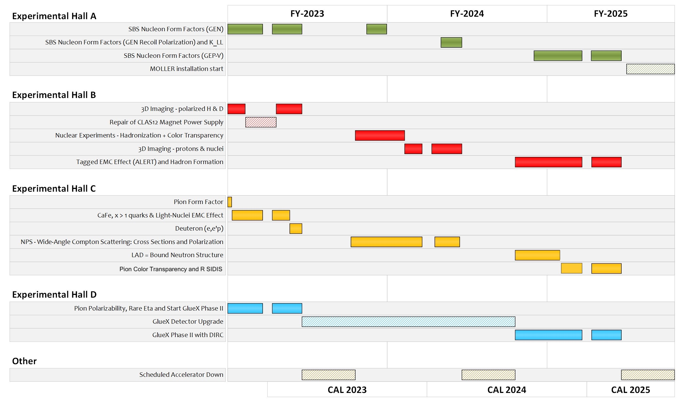
Current Jefferson Lab Two Year Schedule
Jefferson Lab’s user community is ~1900 people strong, but made up of many collaborations doing lots of different nuclear physics.
SBS Nucleon Form Factors (GEN)
SBS Nuclear Form Factors (GEN Recoil Polarization and K_LL
SBS Nucleon Form Factors (GEP-V)
MOLLER Installation Start
3D Imaging – polarized H & D
Repair of CLAS12 Magnet Power Supply
Nuclear Experiments – Hadronization + Color Transparency
3D Imaging – protons & nuclei
Tagged EMC Effect (ALERT) and Hadron Formation
Pion Form Factor
Café, x>1, super-fast quarks & light-nuclei EMC Effect
Deuteron (e,e’p)
Neutral Particle Spectrometer: Cross Sections and Polarization
LAD - Bound Neutron Structure
Pion Color Transparency and R SIDIS
Pion Polarizability, Rare Eta and Start GlueX Phase II
GlueX Detector Upgrade
GlueX Phase II with DIRC
Scheduled CEBAF Accelerator Down

Slide 9
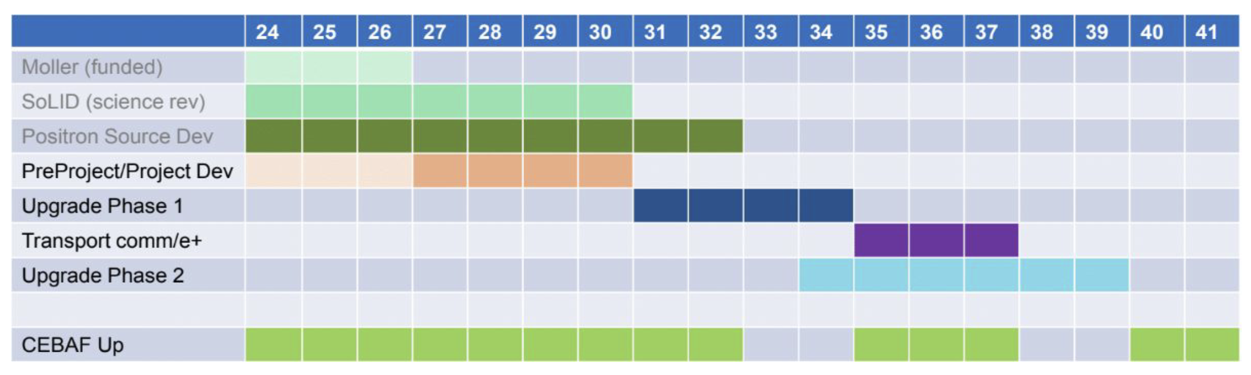
VERY ROUGH Timeline for Positrons and the 22 GeV Upgrade
Gantt chart made by David Dean to give a rough idea when these project could become a reality.
Phase 1 includes building the positron source and the tunnel & beamline connecting the source to main machine.
Phase 2 includes the new permanent magnets to allow 22 GeV within current CEBAF footprint.
NOTE: Plan was formulated so that these projects are ramping up as the EIC project cost is ramping down.

Slide 10
Summary
Positrons are an exciting addition to the Jefferson Lab 12 GeV program
Current plans look to make use of the FEL/LERF building and infrastructure to make the positron beam (including polarization)
Will require the construction of a tunnel between the FEL/LERF and CEBAF.
LERF and tunnel would also be used as the 22GeV electron injector.
A full conceptional design and cost estimates are in preparation.
Circa 2035-2038 for Ce⁺BAF experiments.

Slide 11
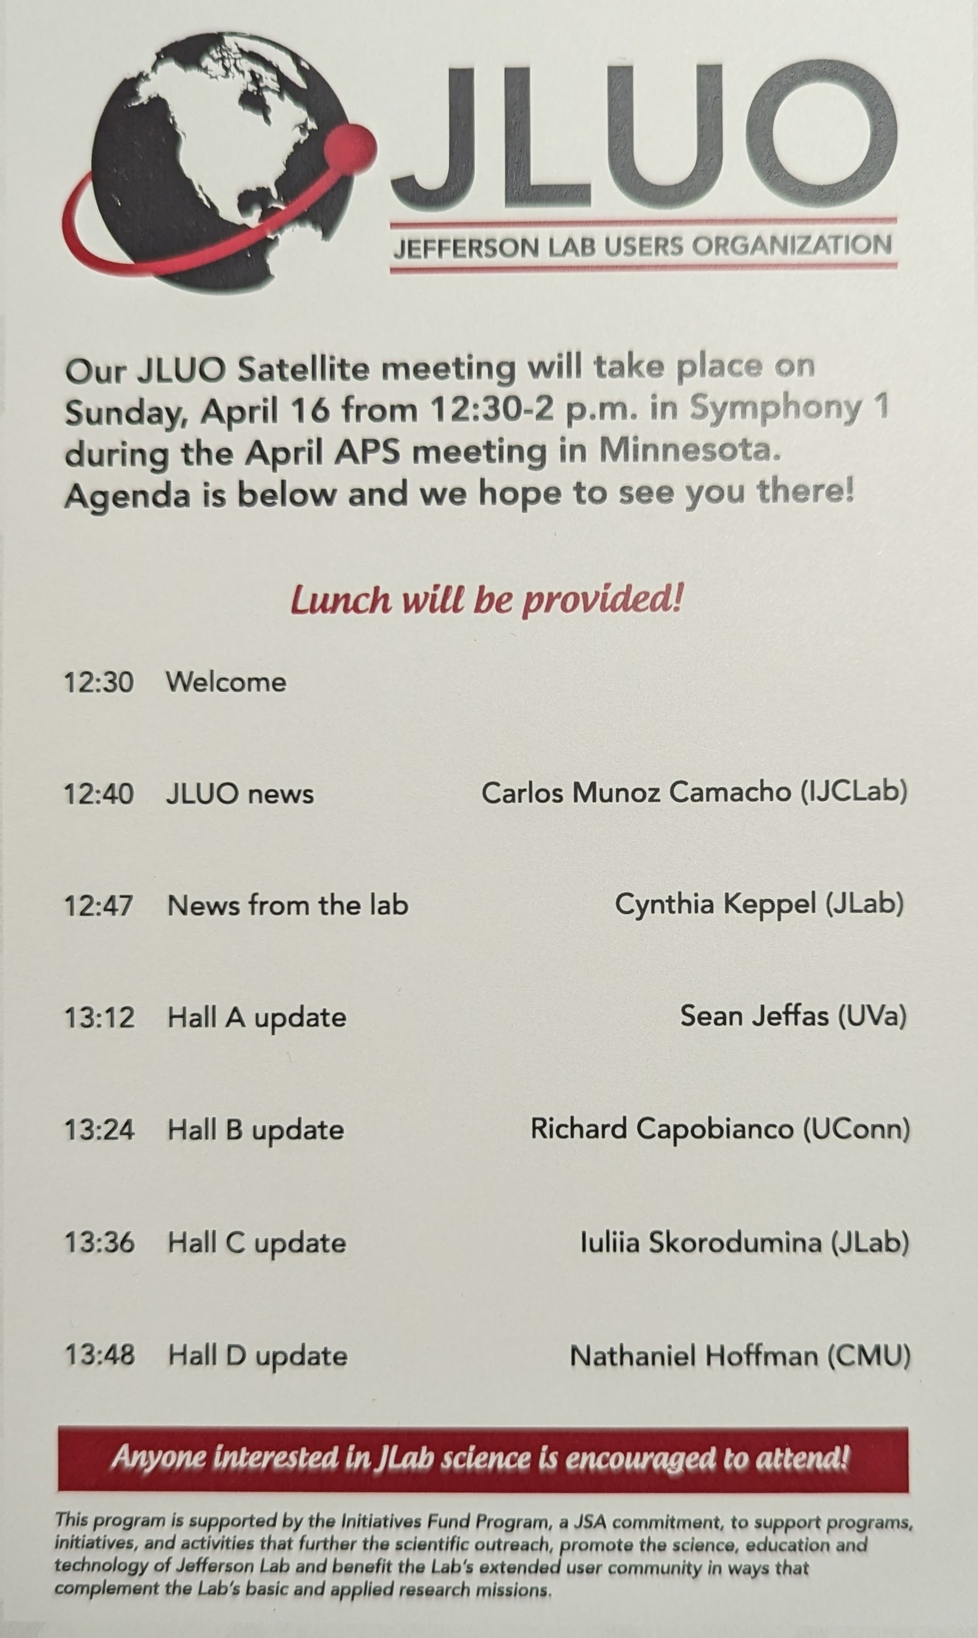
Jefferson Lab Users Organization Meeting
April 16th 12:30 to 2pm
Symphany 1
Lunch Provided
Anyone interested in JLab Science is encouraged to attend!

