Slide 1
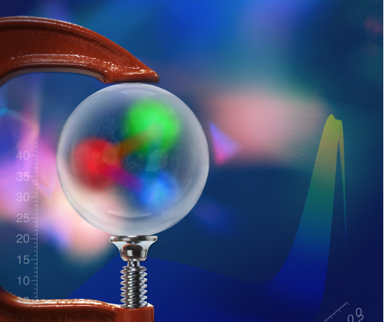
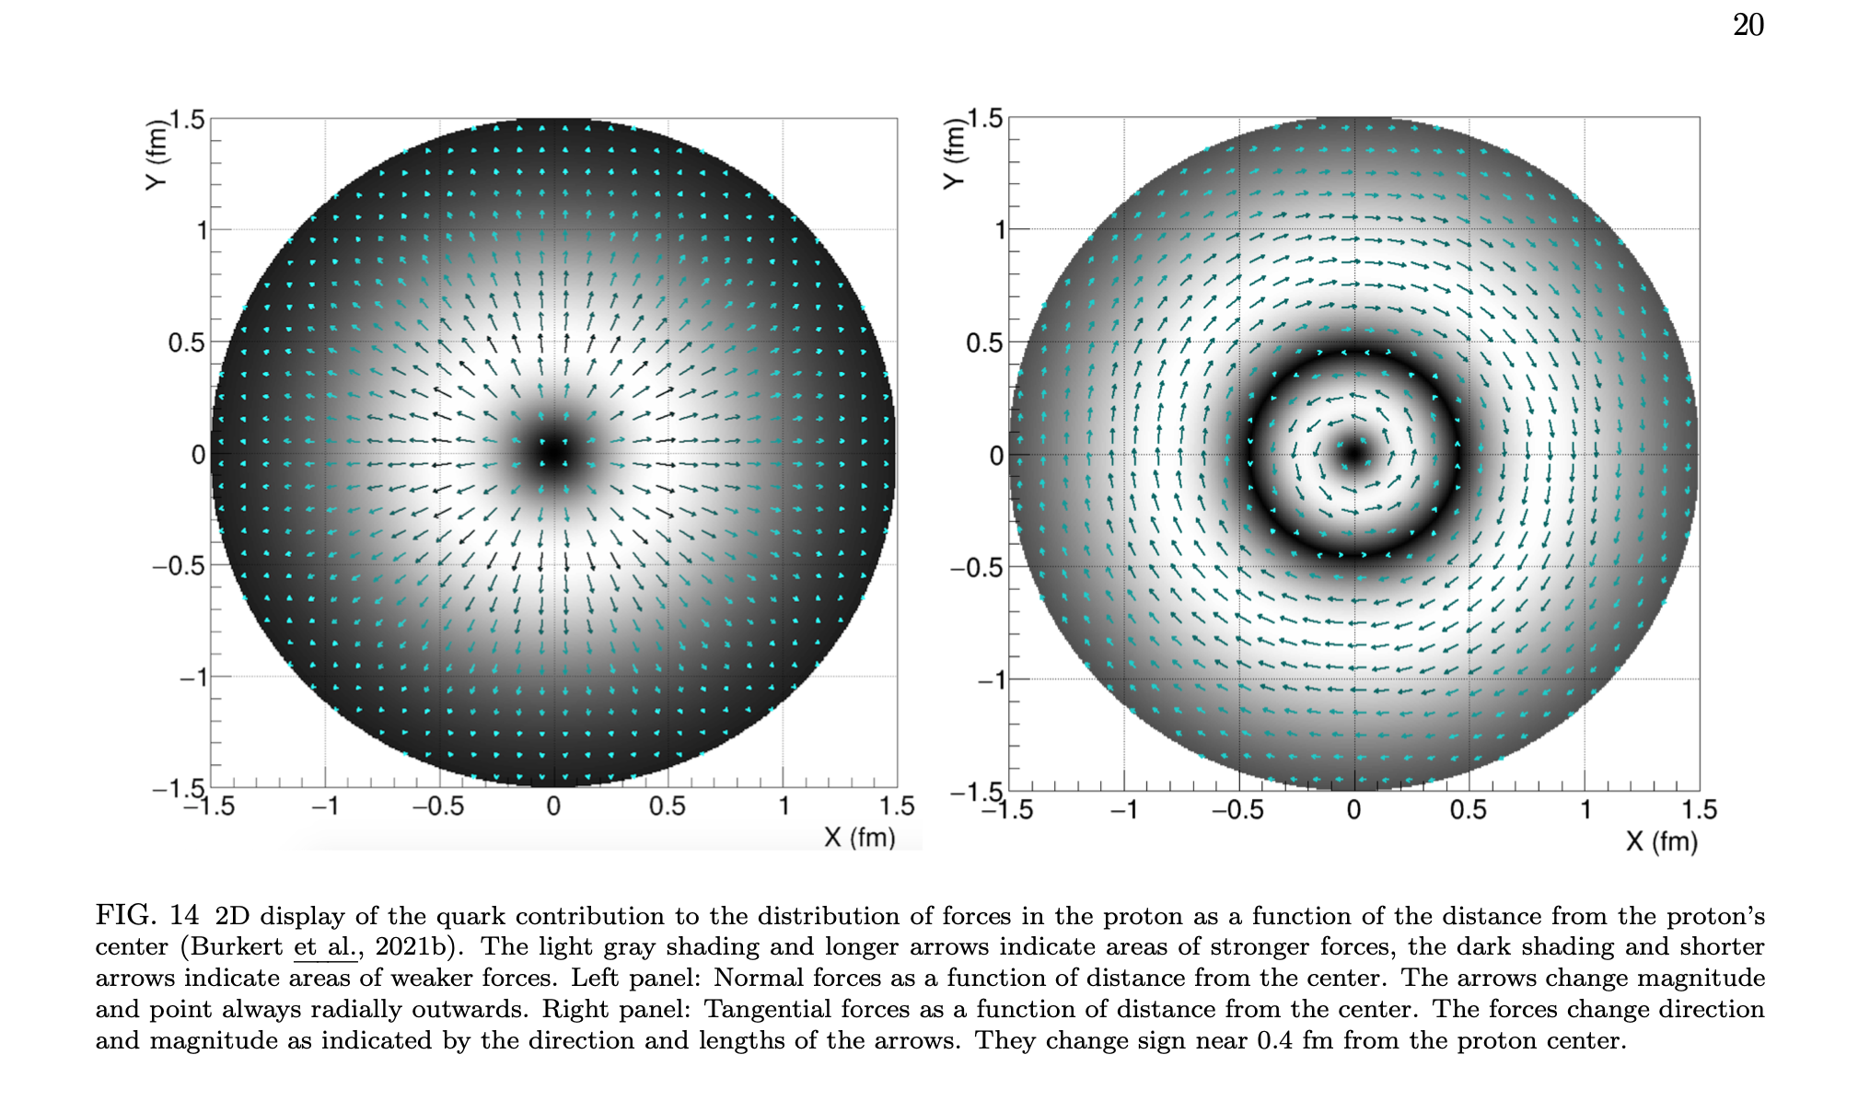
Gravitational form factors and mechanical properties of the proton
Hadron Physics Beyond Tomography
Latifa Elouadrhiri
Jefferson Laboratory
&
Center of Nuclear Femtography
10th workshop of the APS Topical Group on Hadronic Physics - April 14, 2023
V. Burkert., L. Elouadrhiri, F.X. Girod
Nature 557 (2018) no.7705, 396-399
Colloquium: Submitted to RMP

Slide 2
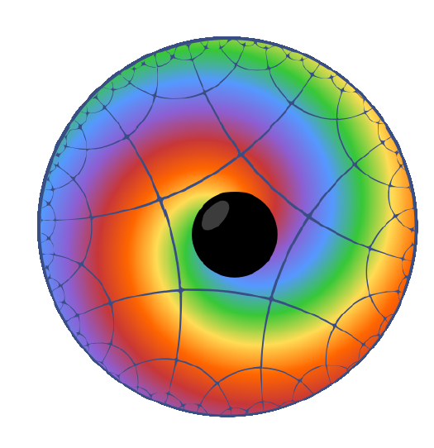
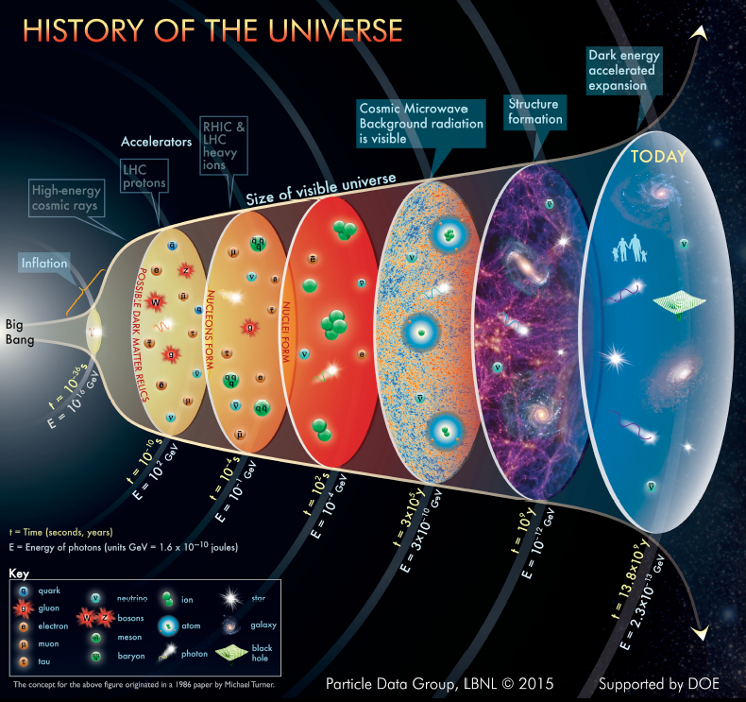
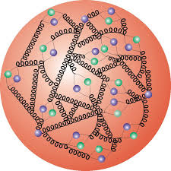
Basic questions about the proton
Proton’s make up nearly 90% of the (normal) matter in the universe. Elementary valence quarks contribute only few percent to the proton mass. What is the origin of its mass?
How did quarks hadronize and form protons as the universe cooled below the Hagedorn temperature? What is the origin of confinement ?
How are the strong forces distributed in space to keep quarks confined and make protons stable particles.

Slide 3
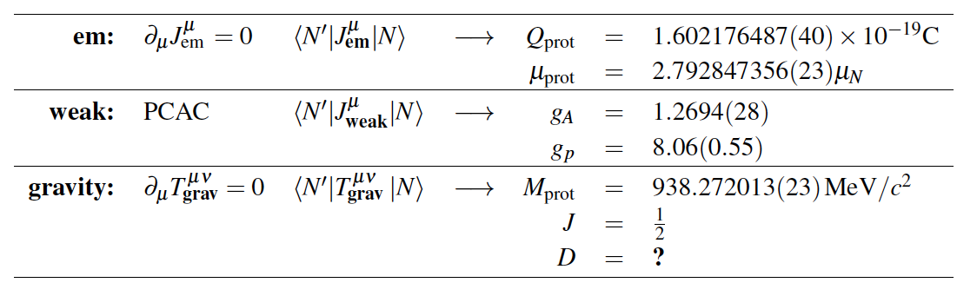
Fundamental global properties of the proton
The structure of strongly interacting particles can be probed by means of the other fundamental forces: electromagnetic, weak, and (in principle) gravity.
vector
axial
tensor
P. Schweitzer et al., arXiv:1612.0672, 2016.
The D-term is the “last unknown global property” of the nucleon

Slide 4
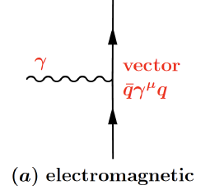
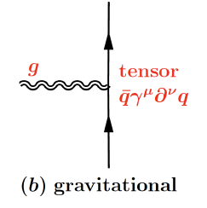
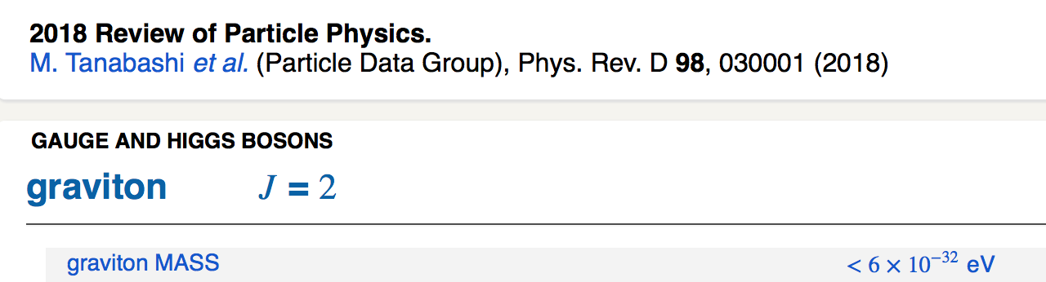
Probing basic properties of the proton
Electromagnetic properties: probed with photons
  Charge - electromagnetic form factors, inelastic structure functions, proton charge radius, charge densities and current densities for N & N*
  Magnetic moment - helicity densities
Gravitational properties: probed with gravitons
  - Mass: energy and mass densities
  Spin: angular momentum distribution
  D-term: dynamical stability, normal and shear forces, pressure distribution
F₁(t) F₂(t)
M₂(t)
J(t)
d₁(t)

Slide 5
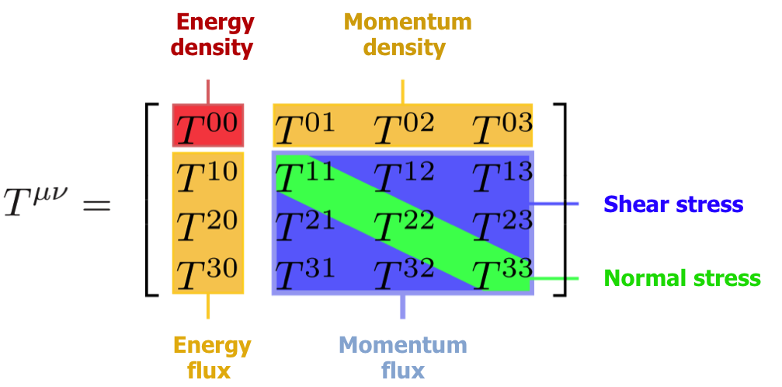

Probing mechanical properties of the proton?
Gravitational Interaction of Fermions
Yu. Kobzarev and L.B. Okun, JETP 16, 5 (1963)
Energy-Momentum Structure Form Factors of Particles Heinz Pagels, Phys. Rev. 144 (1966) 1250-1260
“….. , there is very little hope of learning anything about the detailed mechanical structure of a particle, because of the extreme weakness of the gravitational interaction” ( H. Pagels)

Slide 6
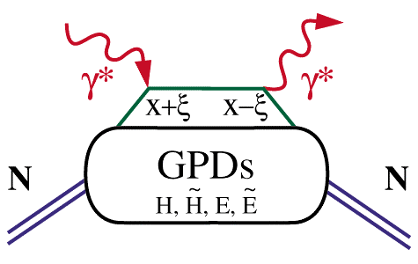
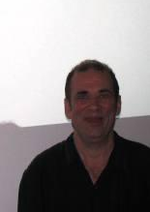


Generalized Parton Distributions (GPDs)
Deeply virtual Compton scattering (DVCS)
x_{B}
hard scattering
ξ =
2 - x_{B}
factorization
(in the Bjorken regime)
soft part
P
P
GPD: H(x,ξ, t), …
t
Proton stays intact
D. Müller (1994) X. Ji (1996) A.Radyushkin (1996)
D. Müller et al., F.Phys. 42,1994
X. Ji, PRL 78, 610, 1997
A. Radyushkin, PLB 380, 1996

Slide 7
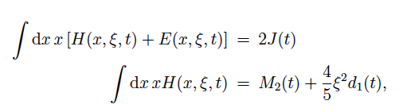
GPDs – GFFs Relations
Nucleon matrix element of the Energy-Momentum Tensor contains three scalar form factors and can be written as:
M₂(t) : Mass/energy distribution inside the nucleon
J (t) : Angular momentum distribution
d₁(t) : Forces and pressure distribution
Graviton – proton scattering
p
Gp => p
GPDs
GFFs
J=2
G
p
DVCS
p
γ
J=2
γγp => p
γ
X. Ji, Phys. Rev. D55, 7114 (1997)
p

Slide 8
GPD – GFF correspondence
Wikipedia:
“It can be shown that any massless spin-2 field would give rise to a force indistinguishable from gravitation, because a massless spin-2 field would couple to the stress–energy tensor in the same way that gravitational interactions do.”

Slide 9

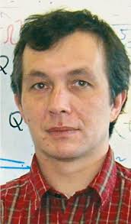
GPDs & Compton Form Factors
GPDs cannot directly be determined from current DVCS measurements alone.
We can determine the Compton Form Factor H(ξ, t)
H(ξ, t) is related to the corresponding GPD H(x,ξ,t) through an integral over the quark longitudinal momentum fraction x.
M. Polyakov (2003)
To determine the complex CFF H(ξ, t) we exploit the interference of the DVCS amplitude with the Bethe-Heitler amplitude that results in a polarized beam spin asymmetry.
M. Polyakov, Phys. Lett. B555 (2003) 57

Slide 10
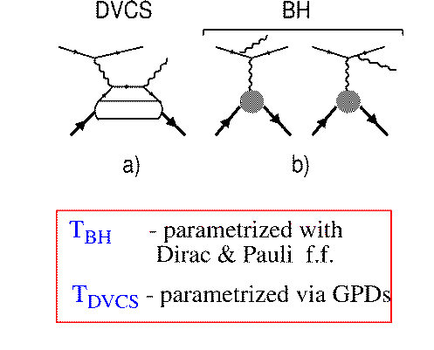
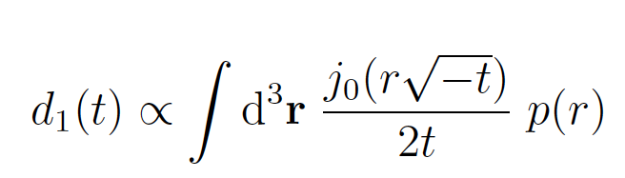
From GPD to GFF d₁(t) to s(r) and p(r)
DVCS
BH
e⁻
e⁻
γ
F₁, F₂
GPDs
p
p
F₁: Dirac FF; F₂: Pauli FF
Polarized beam, unpolarized target:
Δσ_{LU} ~ sinφ Im{F₁H + ..}
H(ξ,t)
d₁(t)
Bessel Integral relates d₁(t)
to the pressure distribution

Slide 11
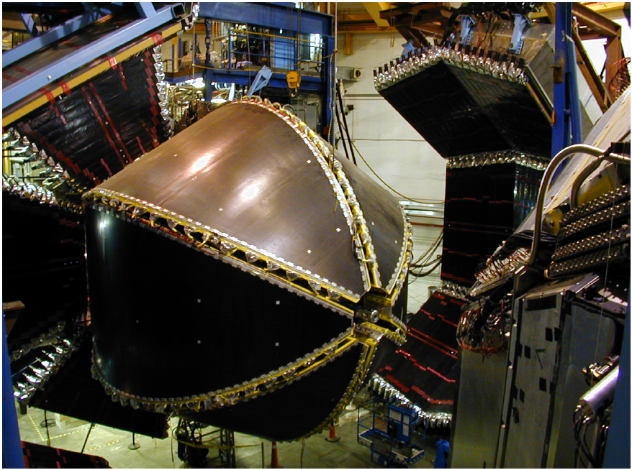
CLAS Experiment
In operation 1997 – 2012

Slide 12

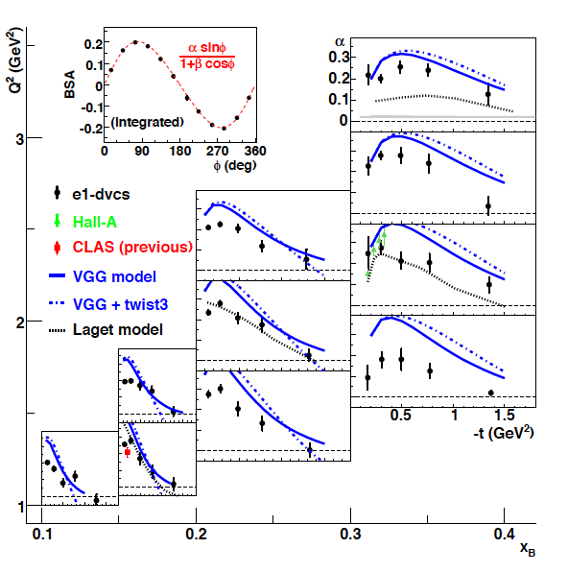

DVCS Beam Spin Asymmetry
Precision in a large phase space Q², x_{B}, t
F.X. Girod et al. Phys.Rev.Lett. 100 162002 (2008)

Slide 13
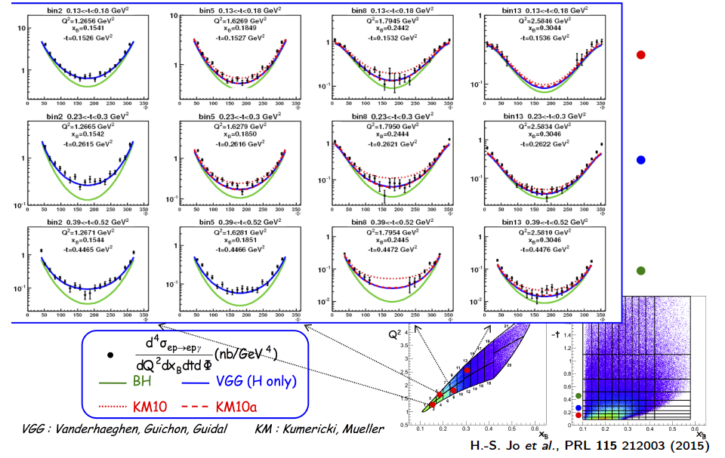
DVCS Unpolarized Cross-Sections
H.S. Jo et al., Phys.Rev.Lett. 115 (2015)

Slide 14
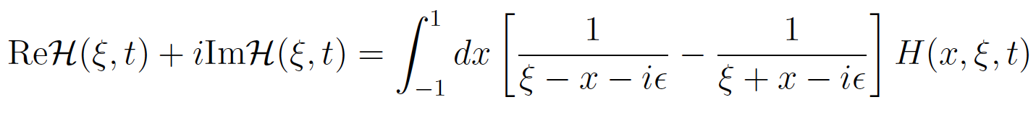
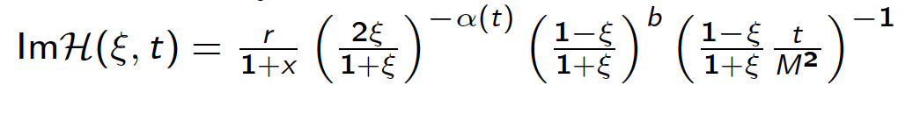
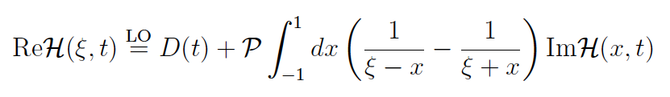
Dispersion Relation Analysis and Global Fits
Compton Form Factor H
Beam Spin Asymmetries
ξ
K. Kumericki, D. Müller, Nucl. Phys. B 841, 1-58, 2010
D. Müller, T. Lautenschlager, K, Passek-Kumericki, G. Schaefer, Nucl.B. 884, 438, 2014
Unpolarized cross sections
Use Dispersion Relations:
M. Polyakov , C. Weiss, Phys.Rev. D60 (1999) 114017

Slide 15
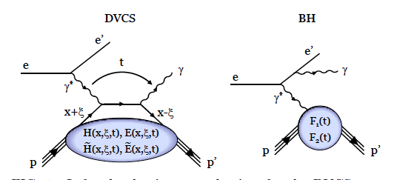
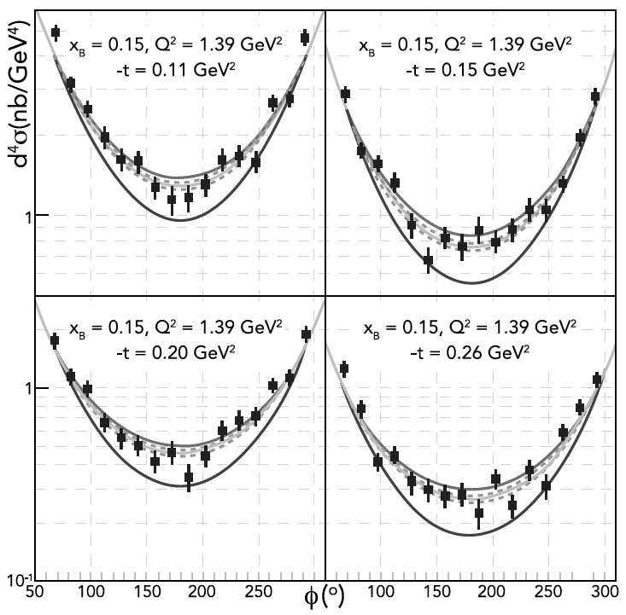
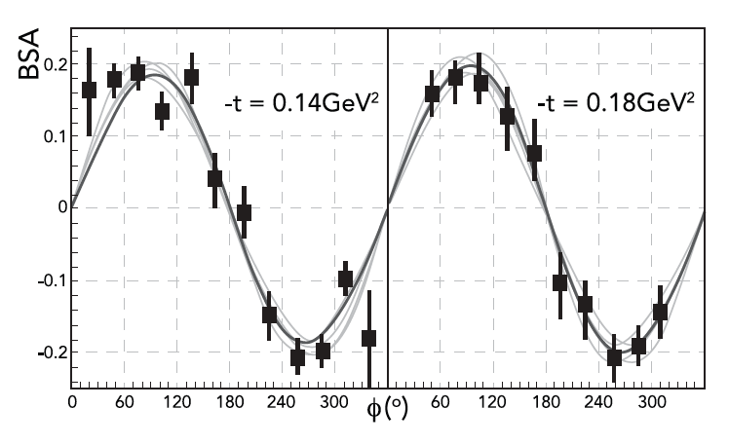
Fit to DVCS data to determine D-Term
Samples of differential cross sections with fits
Samples of Beam Spin Asymmetry
DVCS - BSA
F.X. Girod et al., Phys.Rev.Lett. 100 (2008) 162002 ; H.S. Jo et al., Phys.Rev.Lett. 115 (2015) 212003,

Slide 16
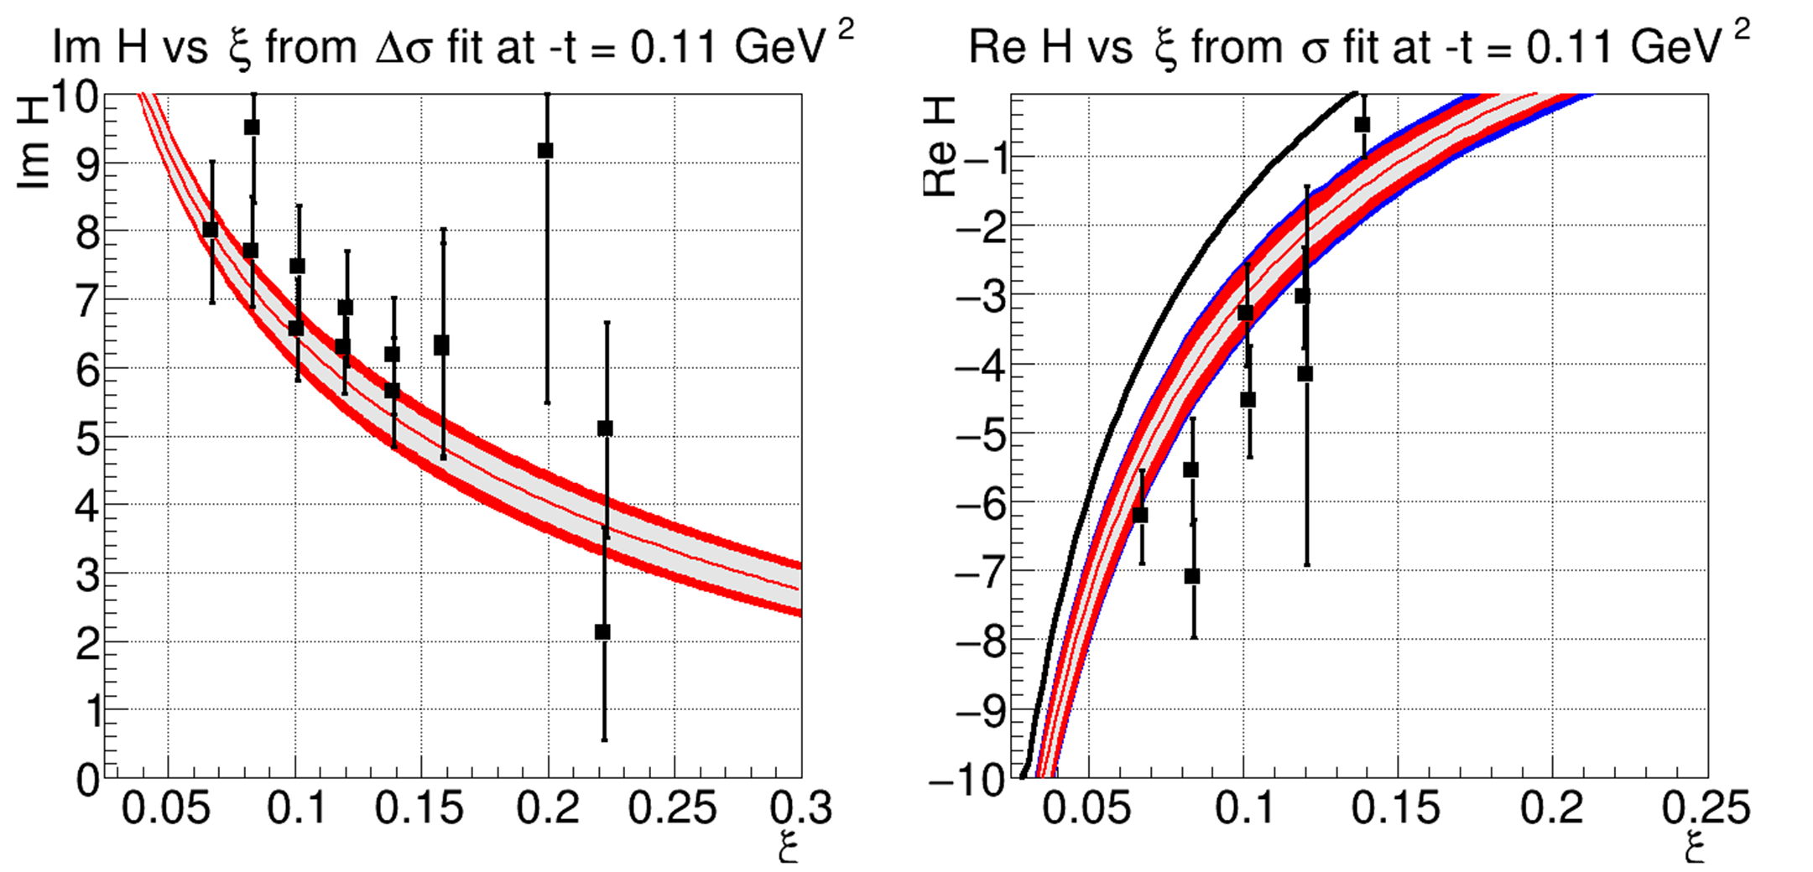
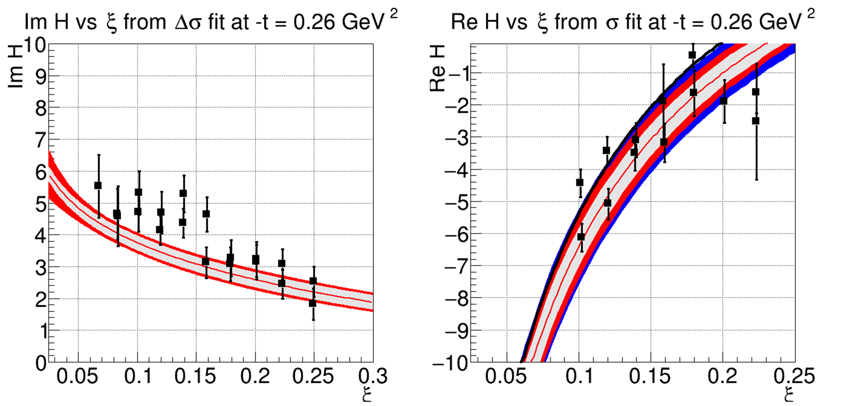
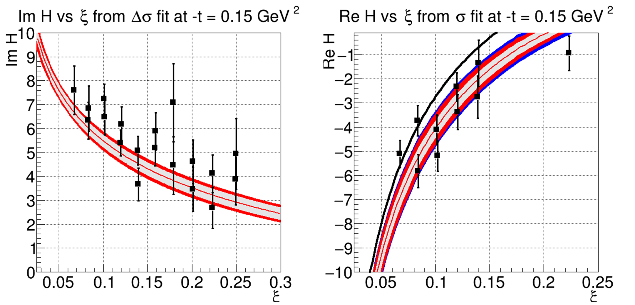
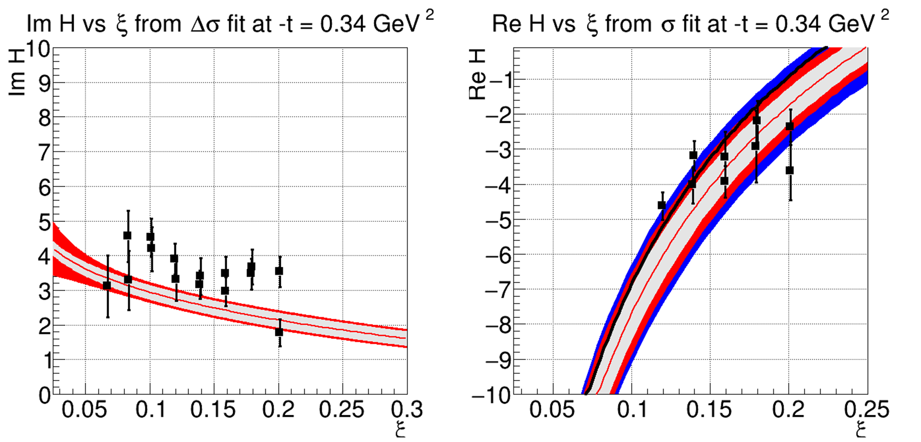
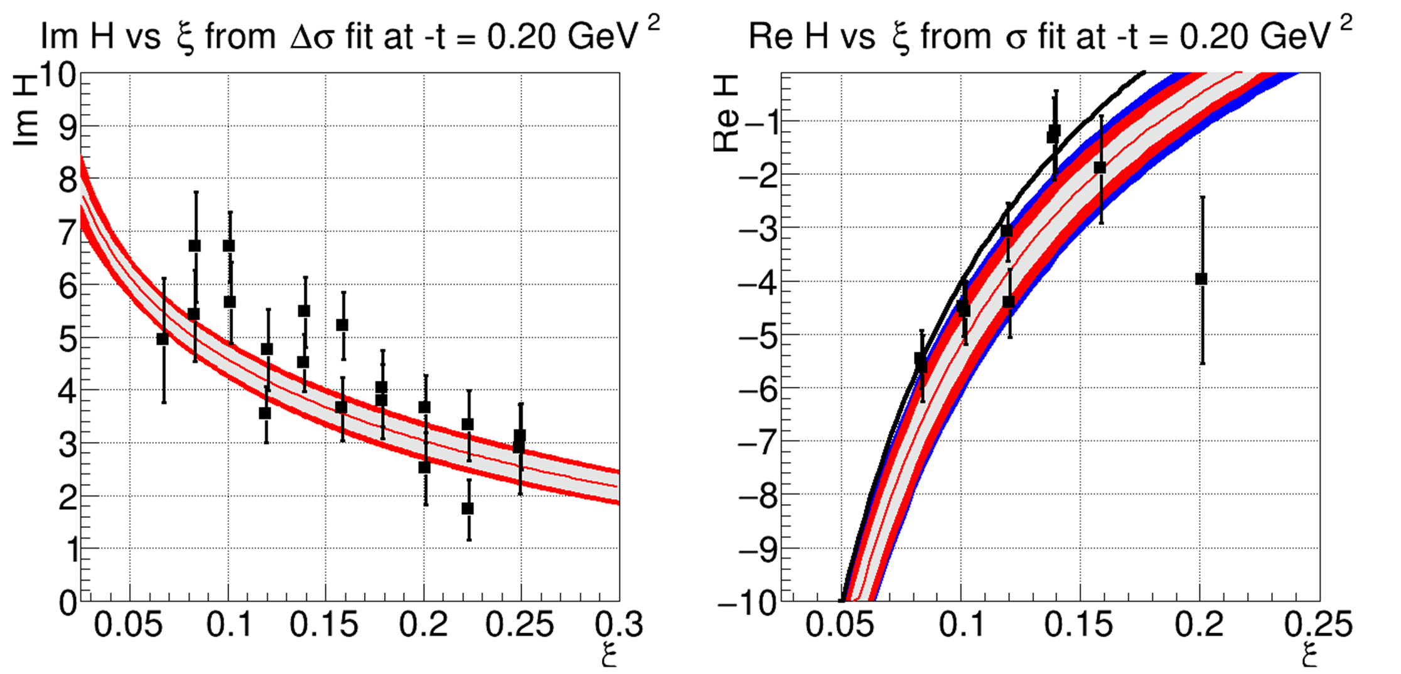
Extraction of Compton Form Factor H(ξ,t)
-t=0.26GeV²
-t=0.11GeV²
-t=0.34GeV²
-t=0.15GeV²
The Real and Imaginary parts of Compton FF H(ξ,t) for different ξ and t values, resulting from the fit to the BSA and cross section data.
-t=0.20GeV²

Slide 17
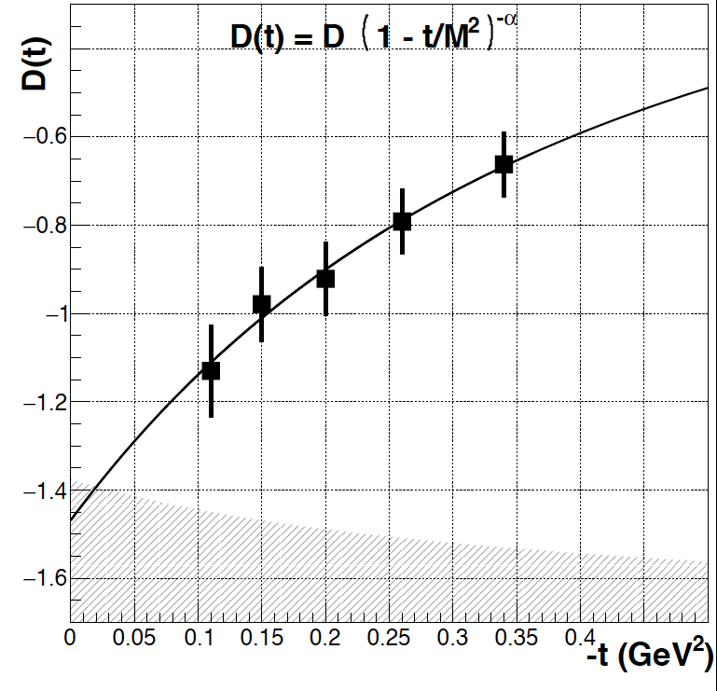
Extraction of D^{q} (t) for quark distribution
D(t) from CLAS 6 GeV data
D^{Q}(0) = -1.47 ± 0.10 ± 0.24
M² = 1.06 ± 0.10 ± 0.15
α = 2.76 ± 0.25 ± 0.50

Slide 18
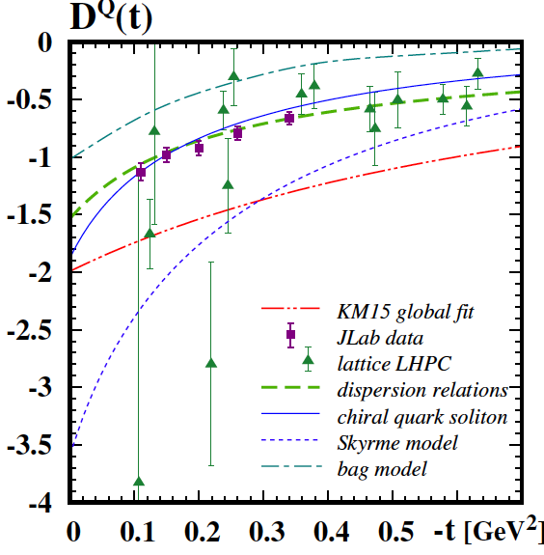
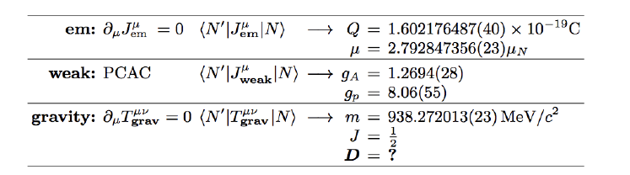
Comparison of D^{Q}(t) with models
Chiral Quark Soliton Model
Dispersion Relations, normalized at t=0.
Lattice QCD LHPC, no disconnected diagrams
Global fit – K.L.M. EPJ A52 (2016) 6 , 157
M.V. Polyakov, P. Schweitzer
Int. J. Mod. Phys. A 33 (26), 1830025, arXiv:1805.06596 [hep-ph].

Slide 19
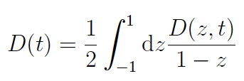
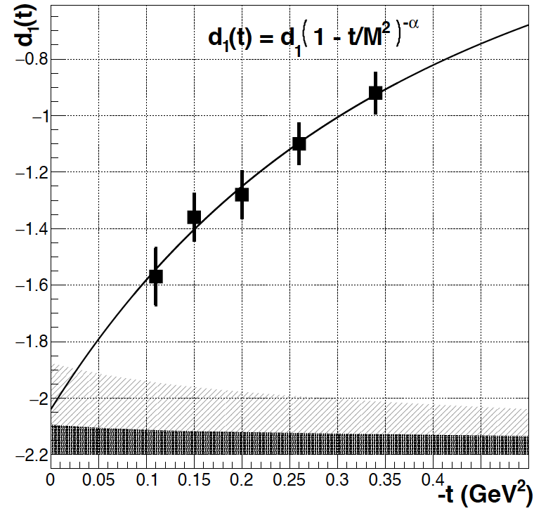
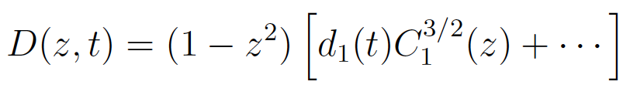
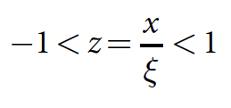
d^{Q}₁(t) - Gravitational Form Factor
Expansion in Gegenbauer polynomials
with
d₁(0) < 0 dynamical stability of bound state
d^{Q}₁(0) = -2.04 ± 0.14 ± 0.33
First determination of new fundamental quantity.

Slide 20
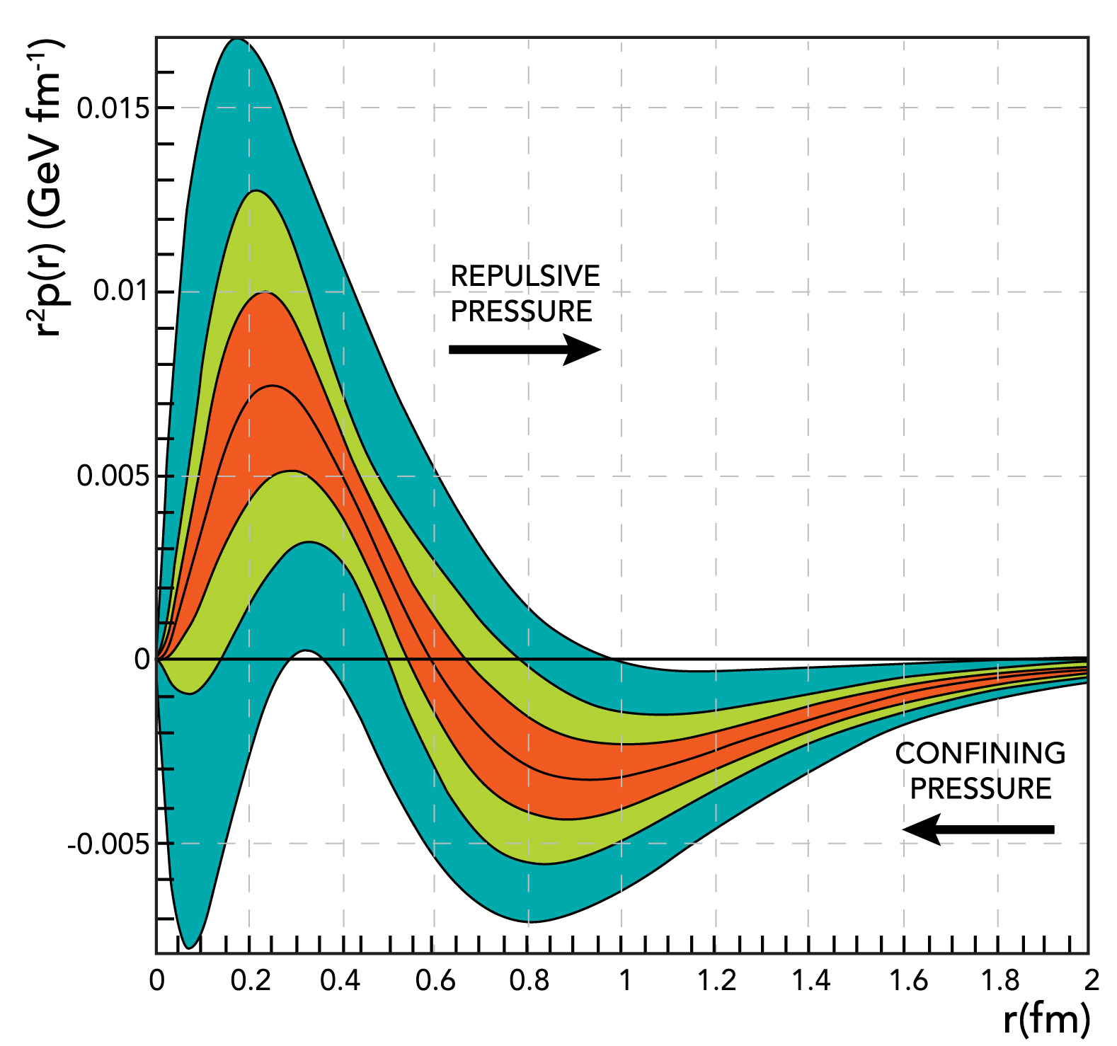

The pressure distribution inside the proton
World data
CLAS data
CLAS12 proj.
Repulsive pressure near center
p(r=0) = 10³⁵ Pa
Confining pressure at r > 0.6 fm
(in χQSM due to the pion field)
Atmospheric pressure: 10⁵ Pa
Pressure in the center of neutron stars ≤ 10³⁴ Pa
V.B., L. Elouadrhiri, F.X. Girod
Nature 557 (2018) no.7705, 396-399
A new direction in experimental nuclear/hadronic physics.

Slide 21
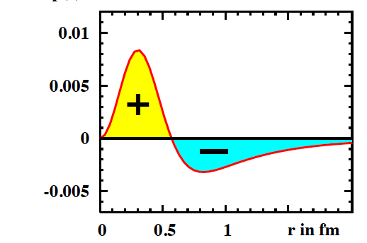
Comparison with χQSM
Gravitational form factors may be computed in Lattice QCD. No results exist for p(r).
In the chiral quark-soliton model (χQSM) the proton is modeled as a chiral soliton with the constituent quarks bound by a self-consistent pion field.
K. Goeke et al, Phys.Rev. D75 (2007) 094021
World data
χQSM
CLAS data
CLAS12 proj.
r²p(r) (GeV fm⁻¹)
Int(r²p(r)dr = 0
The d₁(t=0) < 0 is rooted in the spontaneous chiral symmetry breaking (χSB).
In the χQSM the pion field provides the confining pressure at the proton’s periphery.

Slide 22
Distribution of forces in the proton
Colloquium: Gravitational Form Factors of the Proton (submitted to RMP)
V. D. Burkert, L. Elouadrhiri, F. X. Girod,1 C. Lorc ́e, P. Schweitzer, and P. E. Shanahan

Slide 23
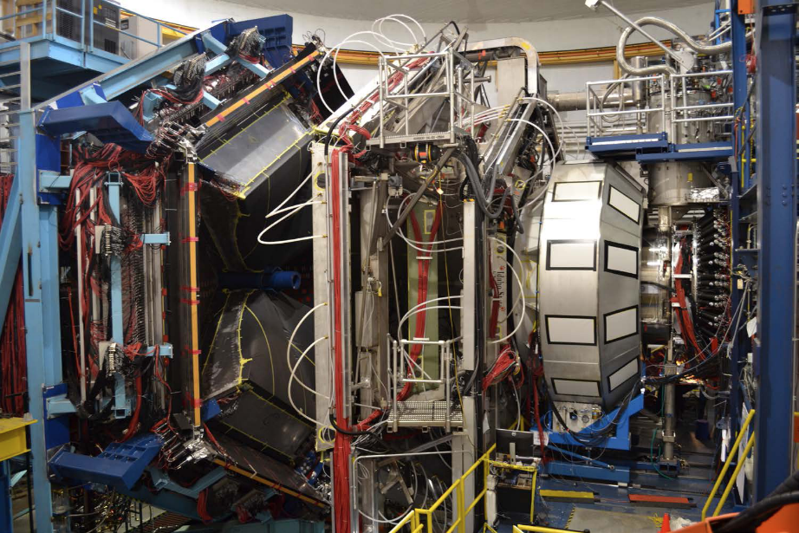
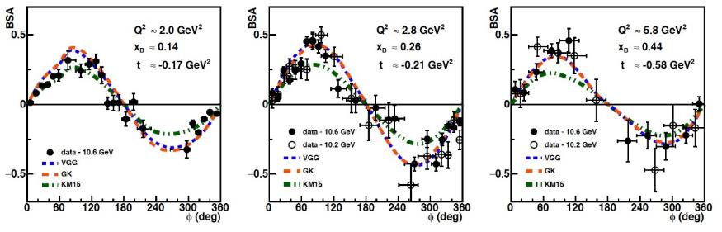
DVCS Beam-Spin Asymmetries in Extended Valence Region with CLAS12
[V.D. Burkert, L. Elouadrhiri, et al., Nuclear Inst. and
Methods in Physics Research, A 959 (2020) 163419]
G. Christiaens to be submitted to PRL

Slide 24
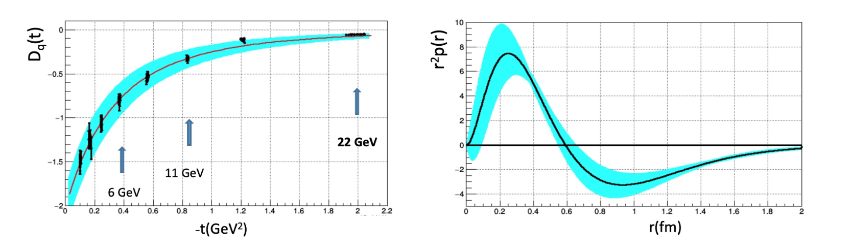
Gravitational Structure of the proton with JLab 22GeV

Slide 25
Summary and Outlook
A new perspective on experimental exclusive reaction physics
First determination of the proton Gravitational Form Factor D^{Q}(t)
Determination of the last unknown global property of the proton D.
Opens a new avenue to test Confinement Mechanism
Access the Partonic Energy Momentum Tensor
New CLAS12 DVCS data double the t-range
Exciting times at with the 12 GeV high precision era
Program essential part of the Jefferson Lab 22 GeV, Jefferson Lab science program with positron beam and EIC program as well

