Slide 1
Possible Existence of Universal Limit for
Valence PDFs
Misak Sargsian*
Florida International University, Miami
* In collaboration with Chris Leon
10th workshop of the APS Topical Group on Hadronic Physics.
12-14 April, 2023, Minneapolis, Minnesota

Slide 2
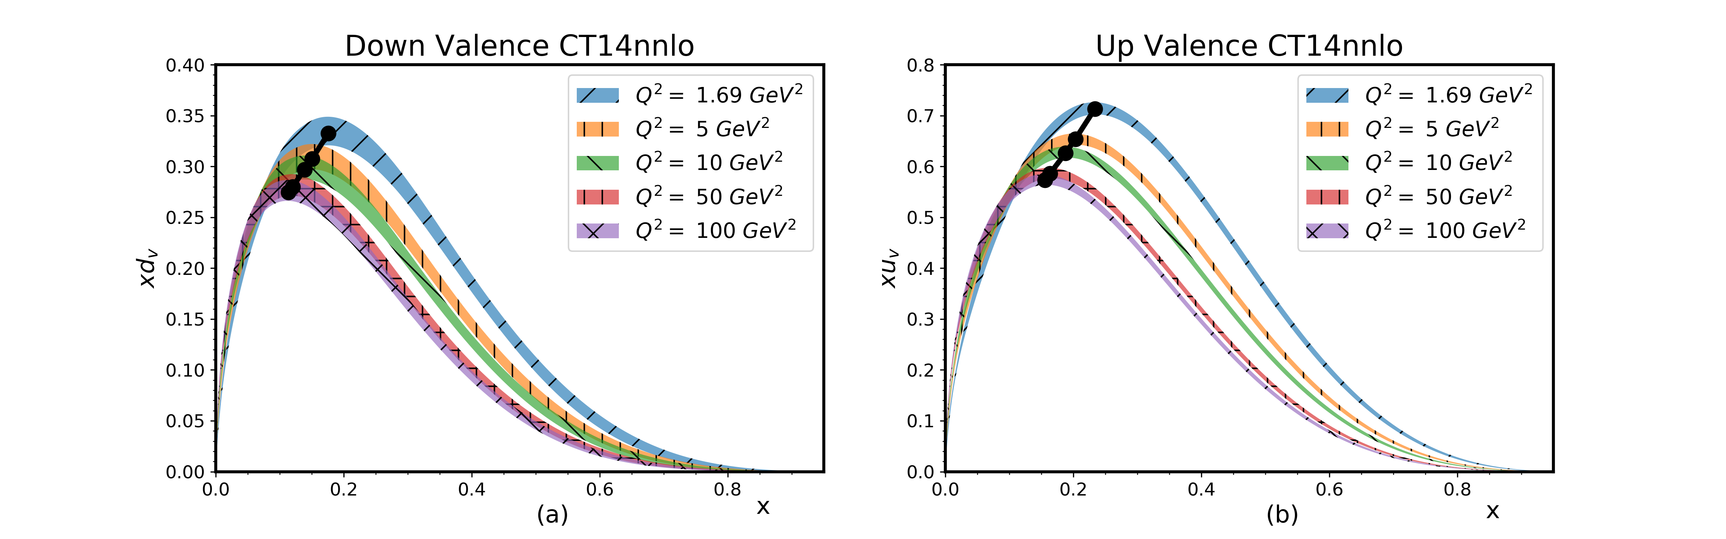

Slide 3
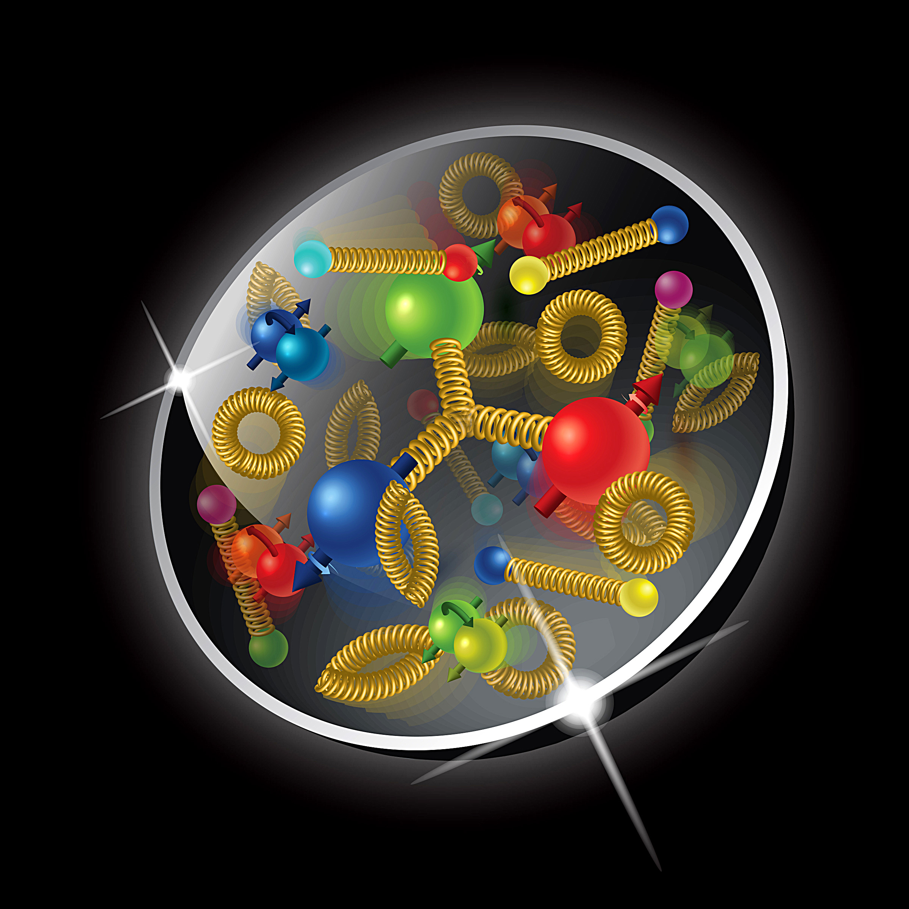
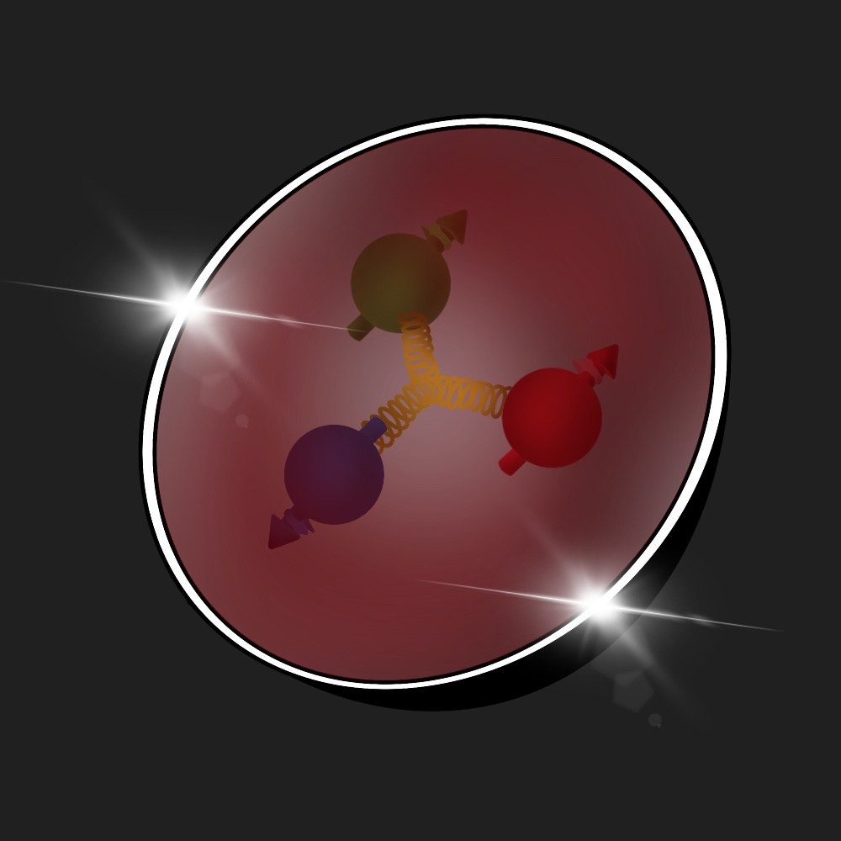
Valence quarks in the nucleon
at medium to high x: 0.1 < x < 1
Mean Field
Mean Field
Mean Field

Slide 4
Motivation: Valence quarks in the nucleon and nucleus
Valence quarks play a unique role in QCD dynamics of the nucleon
- They define baryonic number of the nucleon:
- They represent effective “three fermion” system with complex interaction
among themselves and with nucleon environment
- Because of their conserved number the concept of mean-field interaction
can be introduce to discuss their interaction with the nucleon environment
Quantum mechanically, this becomes a problem of fermions in the
strong external field – (see e g. Migdal Fermions in the Strong Field)
Short range interaction among three valence quarks responsible to
the generation of high x distribution of PDFs

Slide 5
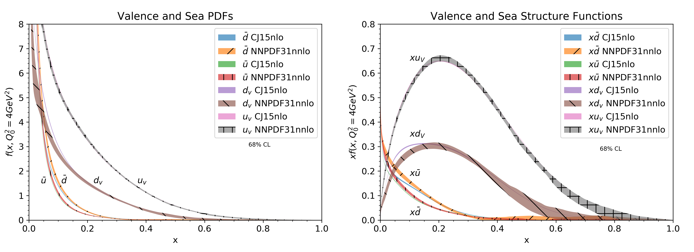
ty
Treating the height of the peak h(x_{p},Q²) and position of the peak x_{p} as “physical observables”:
h(x,Q2) = x_{p}q_{v}
x_{p}(Q²)

Slide 6
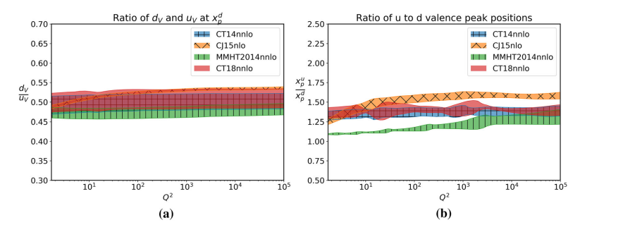
ty
Treating the height of the peak h(x_{p},Q²) and position of the peak x_{p} as “physical observables”:

Slide 7
“New Approaches” in modeling valence quark dynamics
In general the peaking property of bound Fermi-system is a hallmark for
mean-field dynamics
Our assumption is that the peaking feature of valence quark distributions
is due to interaction of valence quarks in the strong mean field generated by
“residual nucleon system”
We introduce concept of “residual nucleon system” as as composite part
of the light-front wave function of valence quarks

Slide 8
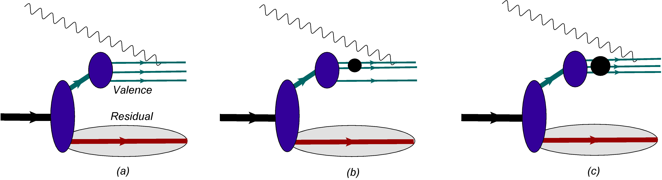
ty
h(x,Q2) = x_{p}q_{v}
x_{p}(Q²)

Slide 9
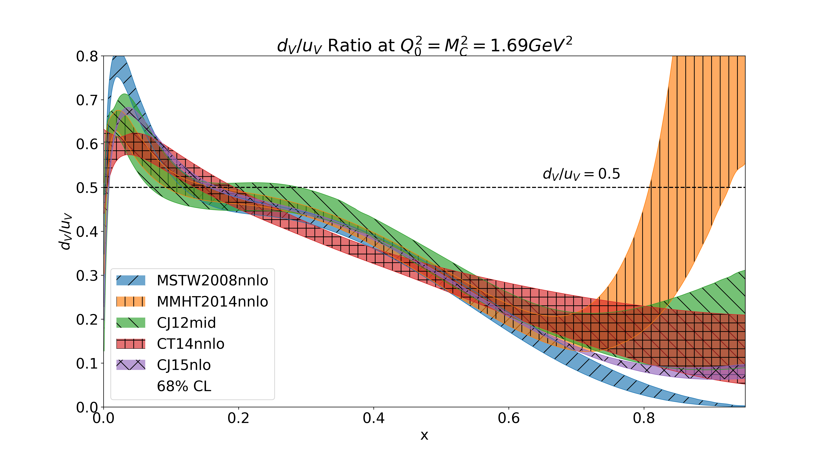

Slide 10
Main assumptions of the model
Dynamics: The main assumption is that the mean field, two- and three- quark short-range correlations define the dynamics of the valence quarks in the range of
0.1 ≤ x ≤ 1.

Slide 11
Valence Quarks in the Nucleon:
- The model assumes an existence of almost massless valence three-quark cluster V
in the nucleon.
- The cluster is compact with the transverse separation between any qq, b_{qq} ≾ 0.3 Fm.
- Valence quark system defines the baryonic number but not necessarily the total
isospin of the nucleon. It can have total total isospin, I_{V} = 1/2 or 3/2 each of them
corresponding to the different excitations or masses of the residual nucleon system.
(For the lowest mass of the recoil system one expects the 3q system to have the same
isospin and its projection that the considered nucleon has.)

Slide 12
Residual Structure:
- Introducing residual structure of the nucleon with the spectrum of mass, m_{R} -
spectral function formalism in the description of the nucleon structure.
- The model assumes a certain universality of the residual structure, R, entering in
all three mechanisms of generation of valence quark distribution.
- This universality is reflected in the fact that one can fix its main properties within
mean field and apply it in the calculation of 2q- and 3q- correlation contributions.
-The mass spectrum of the residual system is continuous and effectively depends
on whether u- or d- valence quarks are probed.
For proton:

Slide 13
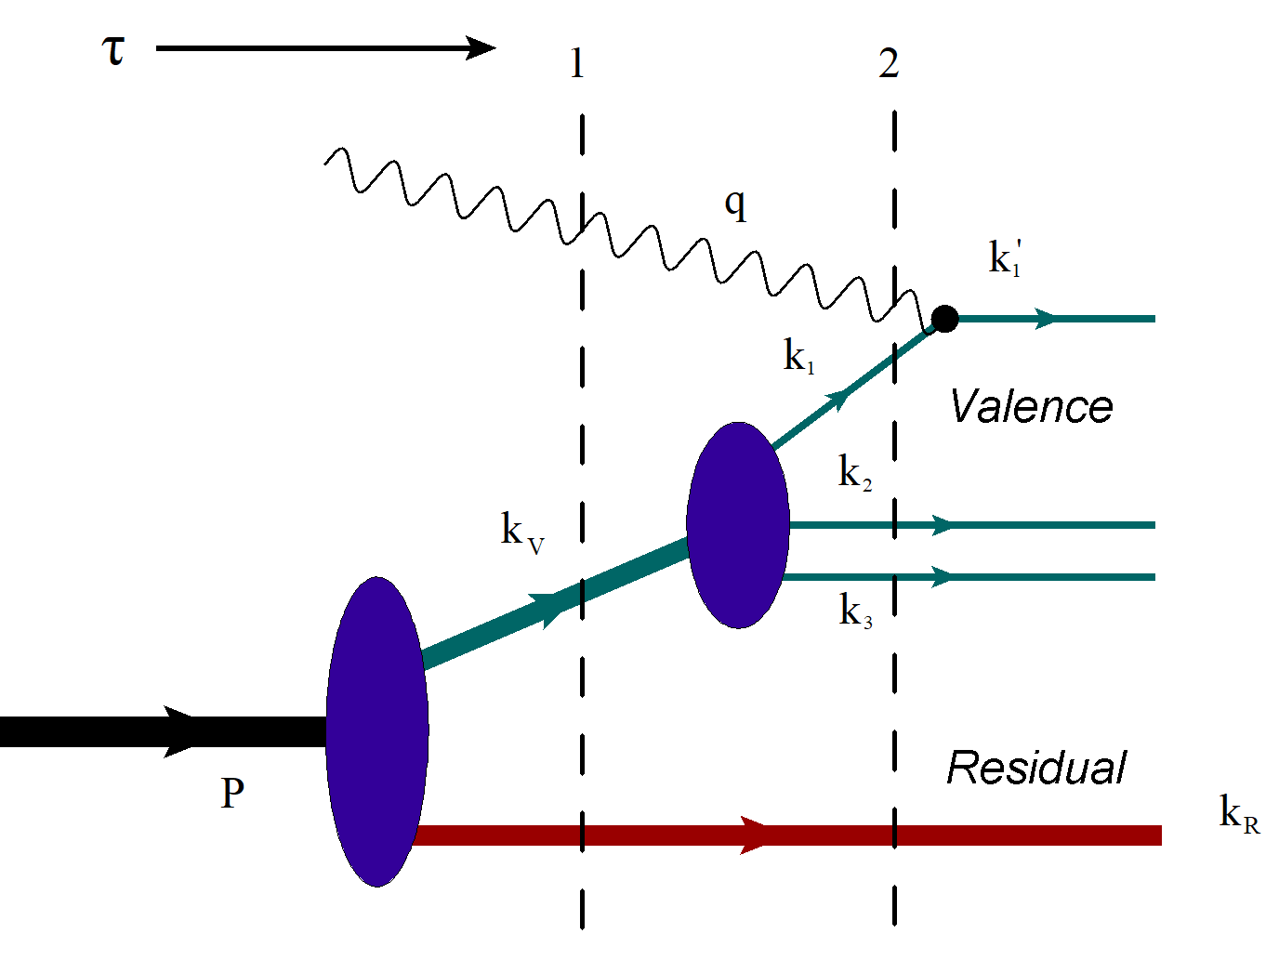
Mean-Field Model of Valence Quark Distributions
- The valence 3q system occupies a region of ~0.6Fm and is described by mutually coupled
three-dimensional harmonic oscillators, thus satisfying confinement condition.
- The valence system does not define the total radius of the nucleon.
- Valence quarks are almost massless with the invariant energy of 3q system contributing
to the nucleon mass.
- The residual system generates the mean field and occupies a volume less or equal to
the nucleon volume.

Slide 14
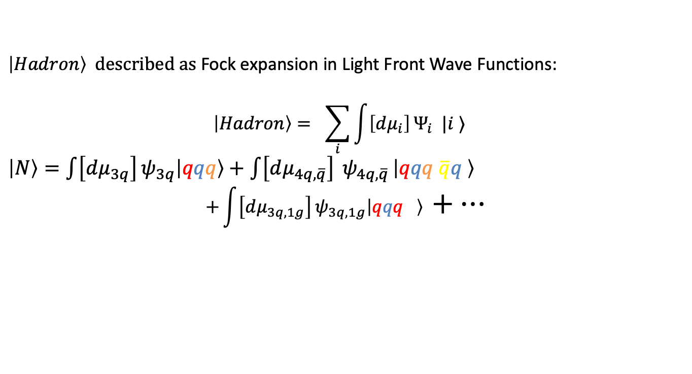
Light-Front Wave Functions
$\left|Hadron\right\rangle$ described as Fock expansion in Light Front Wave Functions:
$$\left|Hadron\right\rangle = \sum_{i}{\int{\left[dμ_{i}\right]}Ψ_{i} |i ⟩}$$
$\left|N\right\rangle =\int{\left[dμ_{3q}\right]}ψ_{3q}\left|qqq\right\rangle +$ $\int{\left[dμ_{4q, \overline{q}}\right]} ψ_{4q, \overline{q} }\left|qqq \overline{q}q \right\rangle$
$${+\int{\left[dμ_{3q,1g}\right]}ψ}_{3q,1g}\left|qqq \right\rangle +…$$
Infinite set of coupled integral equations

Slide 15
Phenomenological Light-Front Wave Functions

Slide 16
Reference Frame, Kinematics and Structure Function

Slide 17
Calculation of the scattering amplitude

Slide 18
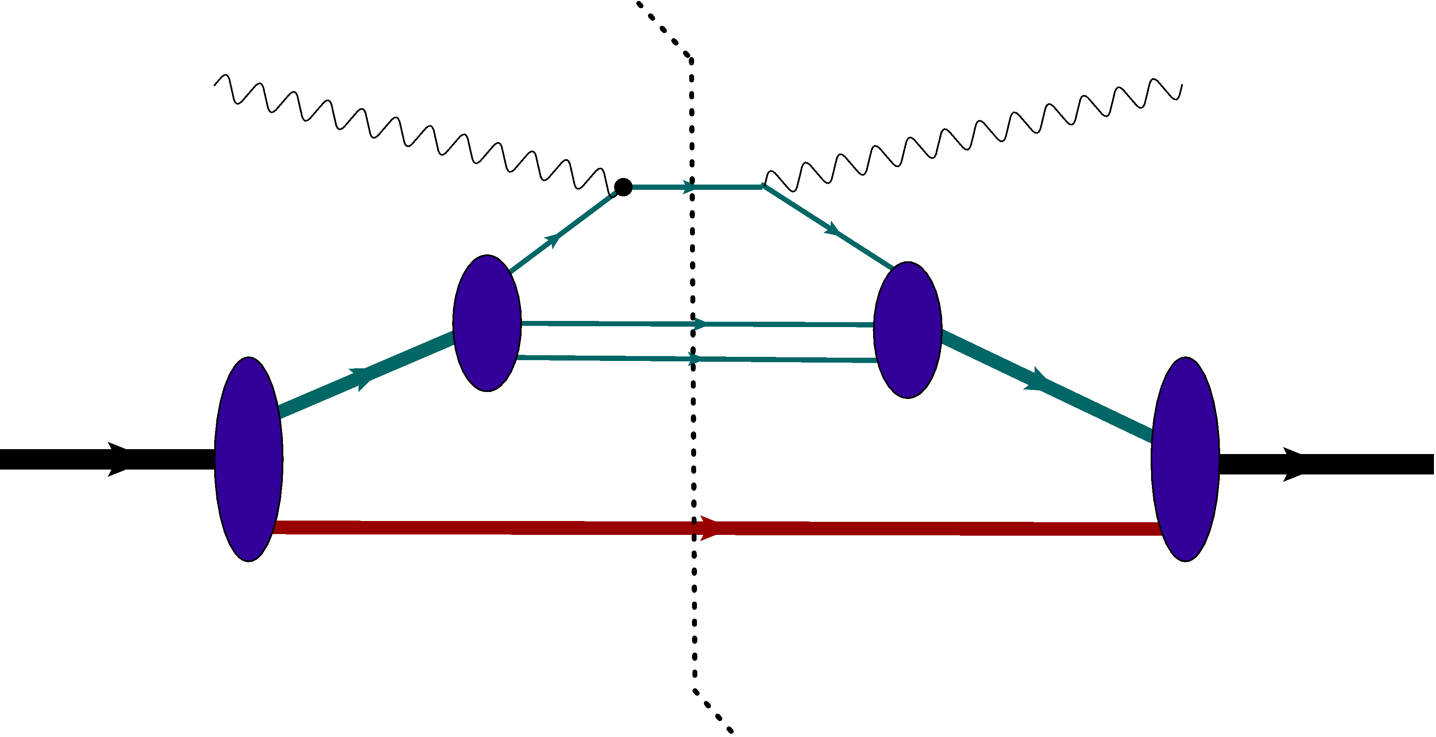
Calculation of the Structure Function

Slide 19
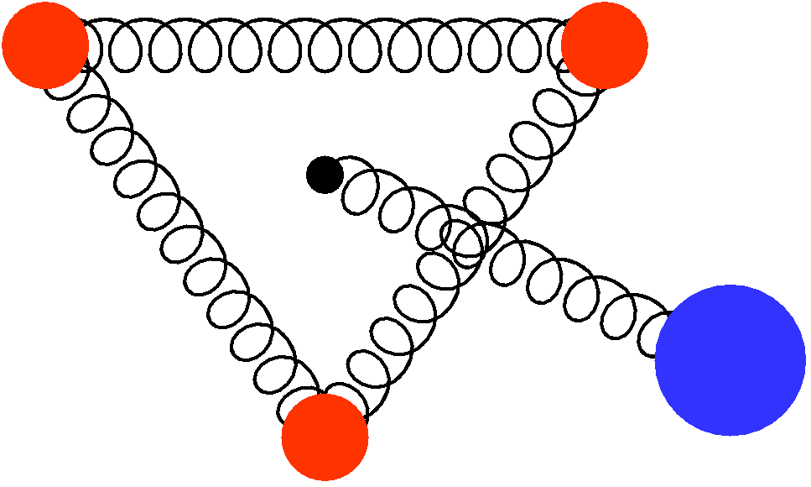
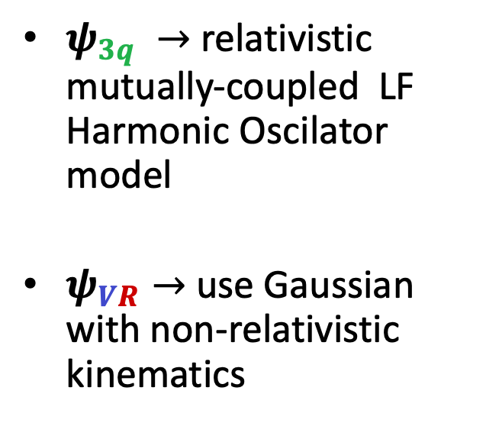
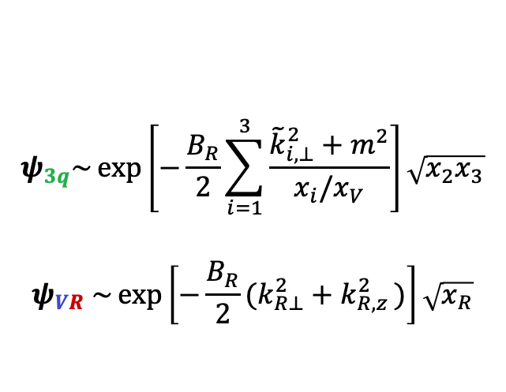
Model – Light Front Wave Functions
q
q
$ψ_{3q} →$relativistic mutually-coupled LF Harmonic Oscilator model
$ψ_{VR}→$ use Gaussian with non-relativistic kinematics
R
q
$$ψ_{3q}\sim \exp\left[−\frac{B_{R}}{2}\sum_{i=1}^{3}{\frac{{\tilde{k}}_{i, ⊥}^{2}+m^{2}}{x_{i}/x_{V}}}\right]\sqrt{x_{2}x_{3}}$$
$$ψ_{VR} \sim \exp\left[−\frac{B_{R}}{2}(k_{R⊥}^{2}+k_{R,z }^{2})\right]\sqrt{x_{R}}$$

Slide 20
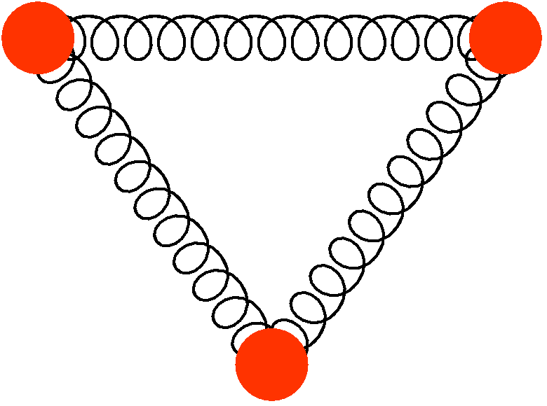
Modeling Wave Functions
Wave function of 3q valence system:
Relativistic coupled Harmonic Oscillator

Slide 21
Modeling Cluster-Residual Nucleon Wave Functions
Wave function of V-R system:
Model in a Gaussian form
x_{R} – light-cone momentum fraction of the recoil system
p_{R} – relative momentum between CMs of V and R system
- Considering a non-relativistic approximation for recoil system p_{R} <m_{R}

Slide 23
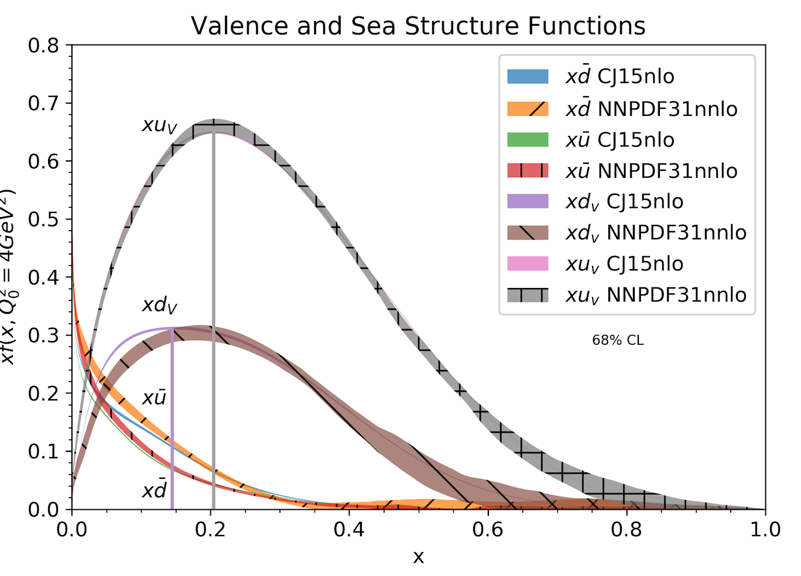
Qualitative Features of the Model
- Evaluating the integral at the maximum of exponent:
In this case
which peaks at
In the model: m_{R}(u) < m_{R}(d):

Slide 24
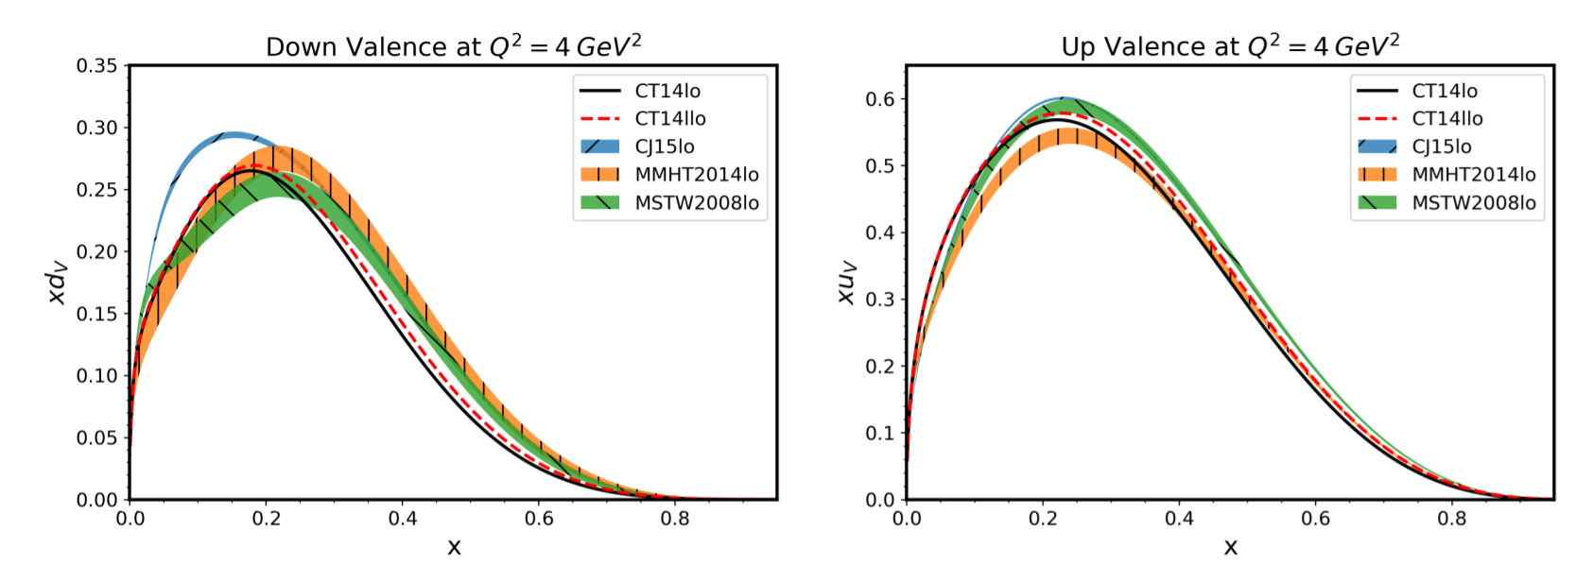
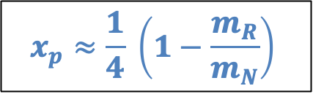

Nucleon - Peak
For $m_{R}≈m_{π}$ $→$ $x_{p}≈0.2$
Massless valence quarks
Different from diquark (Close & Thomas (1988)):
$x_{p}=1−\frac{m_{dq}}{m_{N}}$
$m_{dq}≈800 MeV$, $x_{p}≤1$
$$x_{p}≈\frac{1}{4} \left(1−\frac{m_{R}}{m_{N}}\right)$$

Slide 25
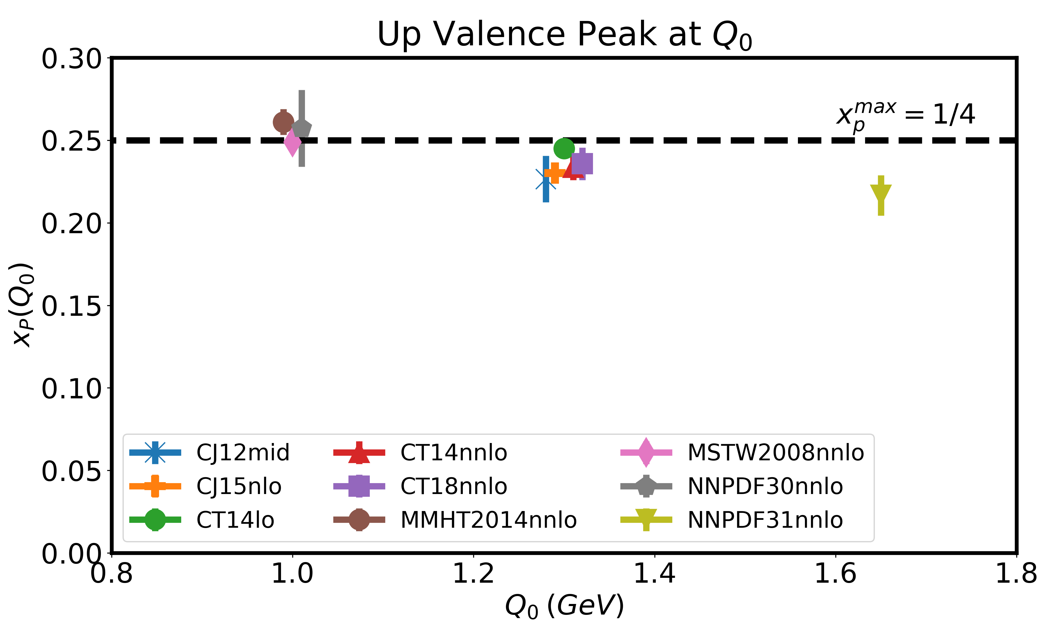
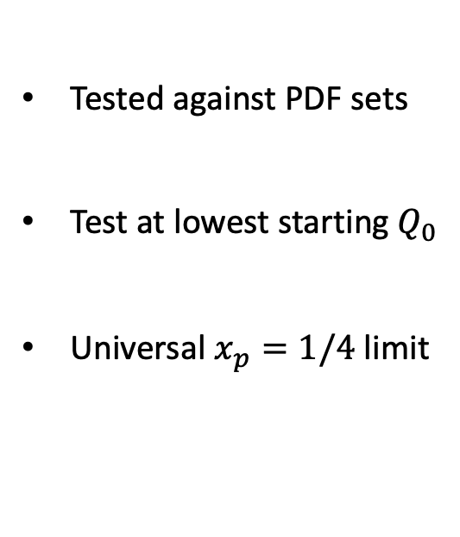

Possible Universal Limit
Universal $x_{p}=1/4$ limit
Tested against PDF sets
Test at lowest starting $Q_{0}$
Universal $x_{p}=1/4$ limit
Leon, C. and Sargsian, M. Eur. Phys. J. C 82, 309 (2022)
Notes:
Goes to smallest possible Q_0
Lowest case 1 GeV when partonic model suspicious
Whenever partonic
Q_0 once low that partonic model is valid ratio
Universal number: ¼
System for
Check at smallest. Seems universal
IF ask: ¼ from residual

Slide 26
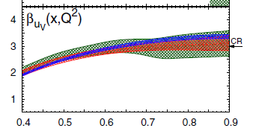
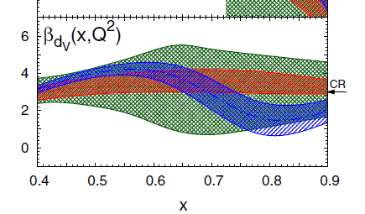
Qualitative Features of the Model
- One can also evaluate the analytic behavior of at x_{B} → 1:
Ball et al. Eur. Phys. J. C 76, 7 (2016

Slide 27
Numerical Estimates:
choosing the parameters of the model
the model has five parameters A_{V,} B_{V}, A_{R}, B_{R} and m_{R}.

Slide 28
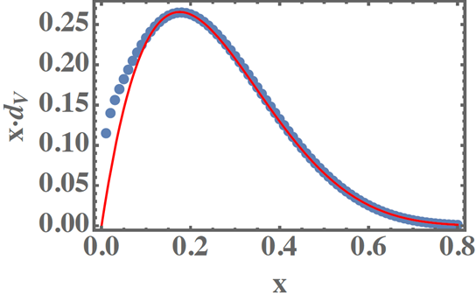
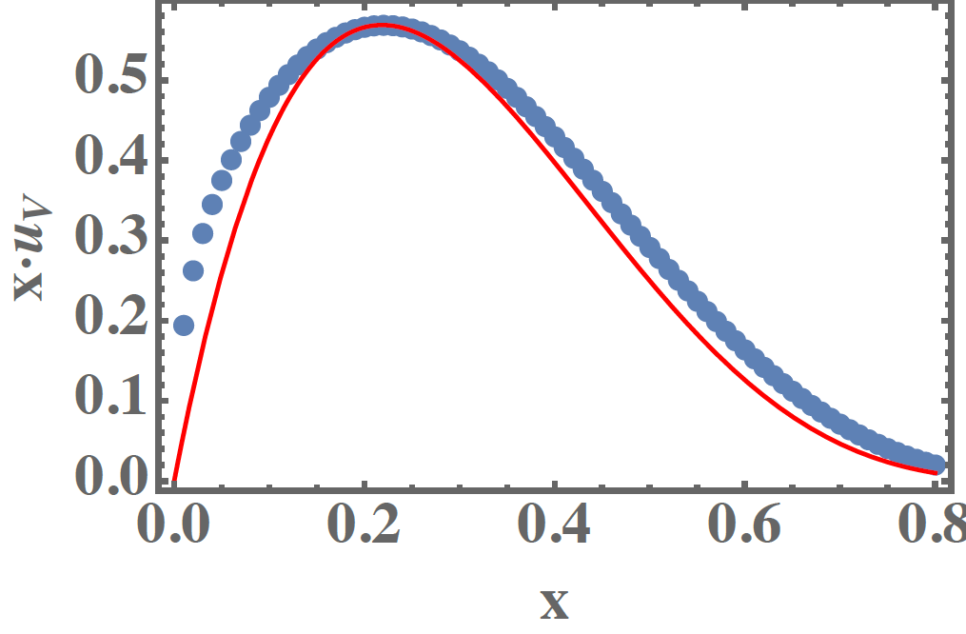
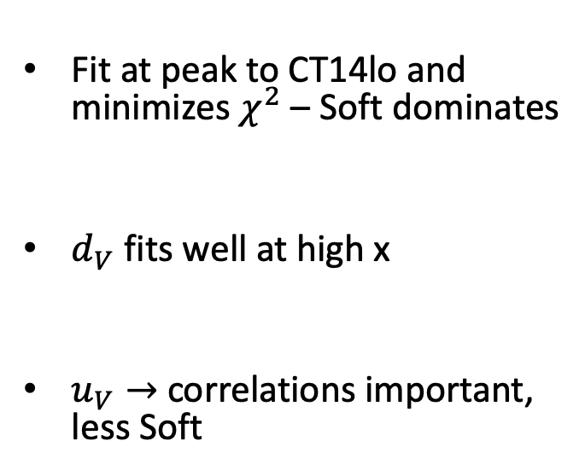
Nucleon - Fitting Results
- CT14lo
- Model
Fit at peak to CT14lo and minimizes $χ^{2}$ – Soft dominates
$d_{V}$ fits well at high x
$u_{V}→$correlations important, less Soft
Leon, C. and Sargsian, M. Eur. Phys. J. C 82, 309 (2022)

Slide 29
Once parameters are fixed we can evaluate the strength of the missing high momentum
component

Slide 30
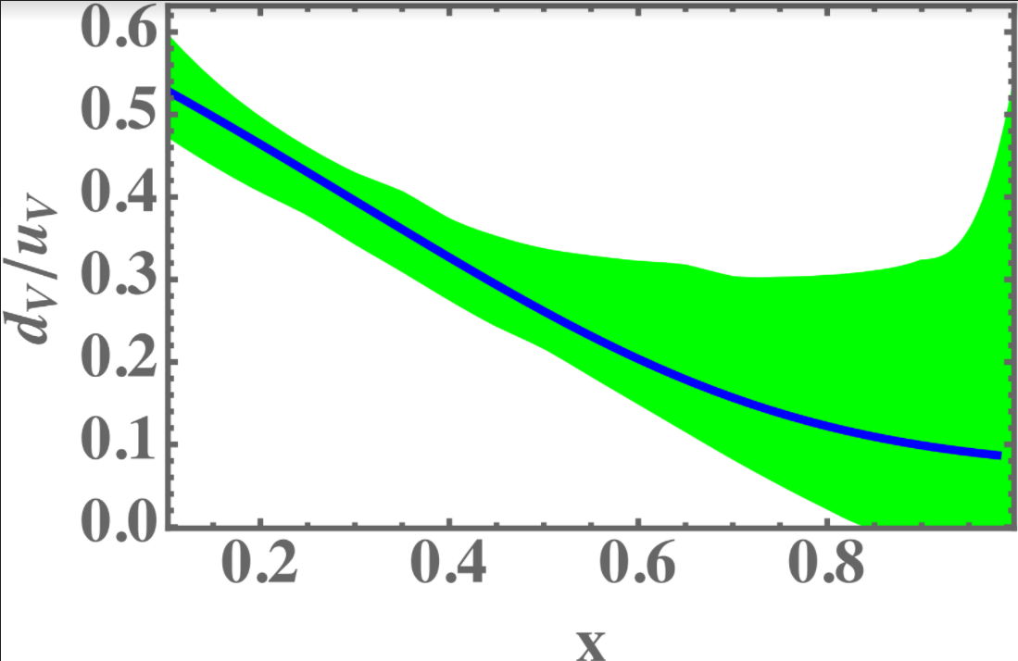
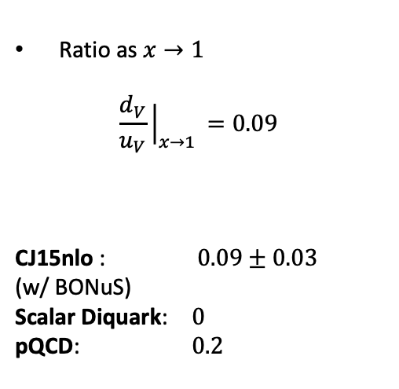
Predication of d/u ratio at xB→1
Ratio as $x→1$
$$\frac{d_{V}}{u_{V}}{\left.​\right|}_{x→1 }=0.09$$
CJ15nlo : $0.09±0.03$
(w/ BONuS)
Scalar Diquark: $0$
pQCD: $0.2$
The reason of d/u fall-off is m_{R}(u) < m_{R}(d)

Slide 31
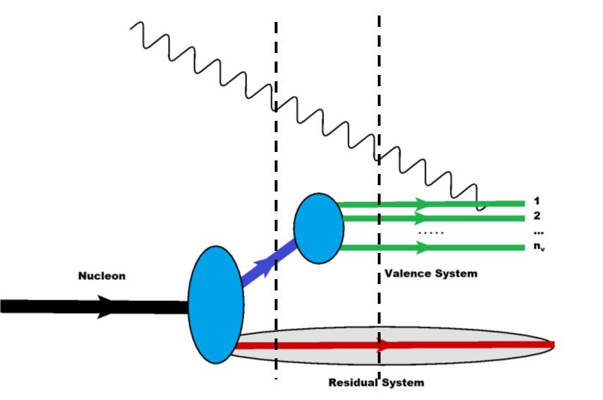
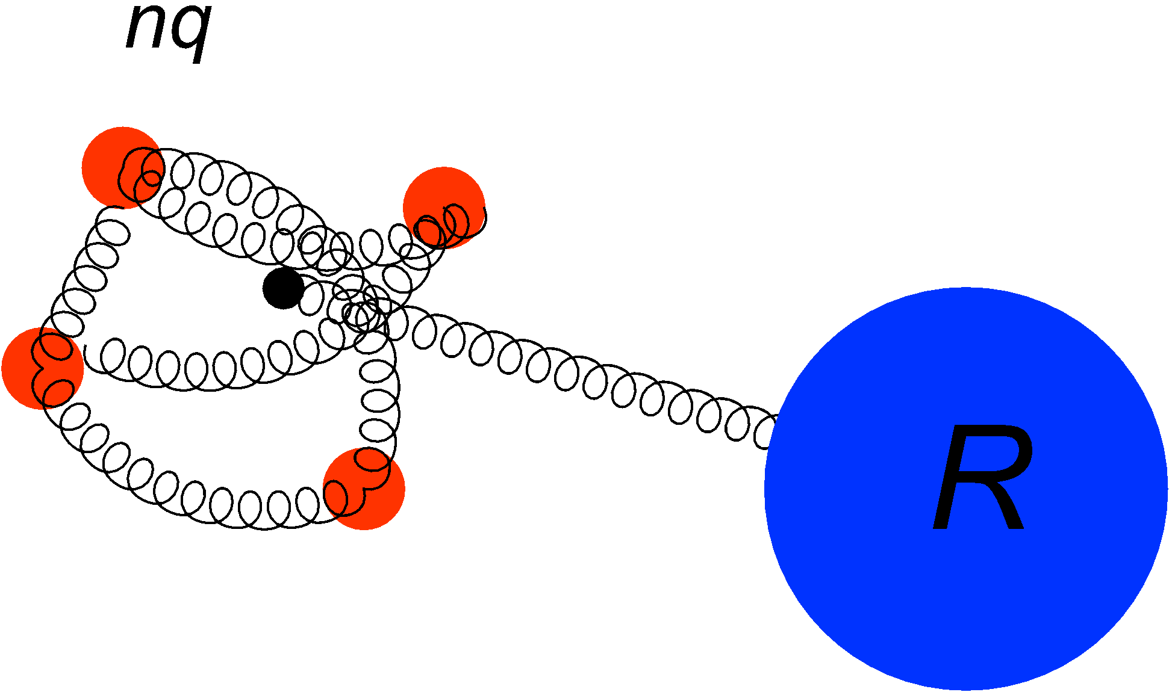

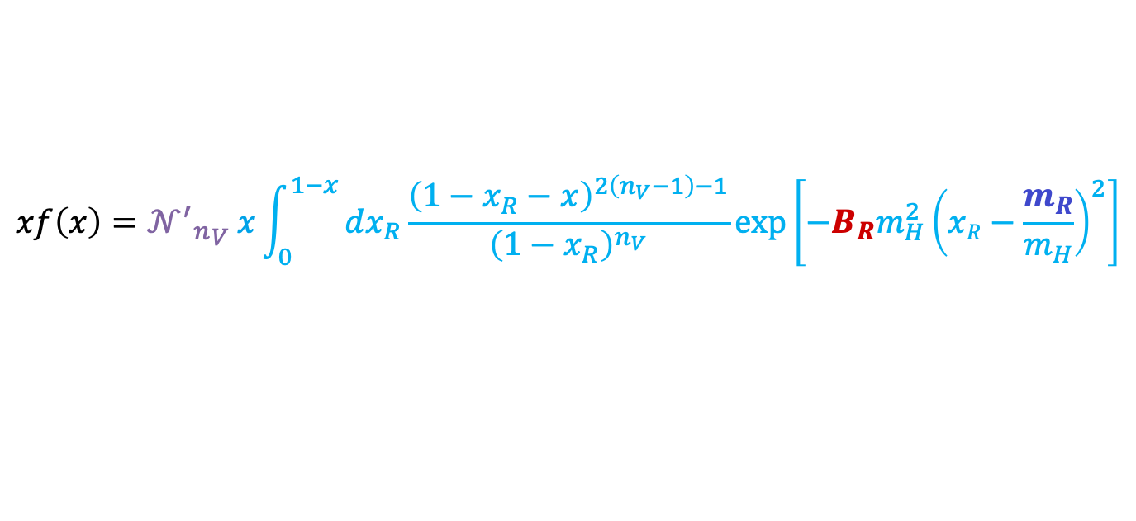
General $n_{V}$ PDF Expression
$$xf\left(x\right)={{𝒩^{′}}_{n}}_{V} x\int_{0}^{1−x}{dx_{R}\frac{{\left(1−x_{R}−x\right)}^{2\left(n_{V}−1\right)−1}}{{\left(1−x_{R}\right)}^{n_{V}}}}\exp\left[−B_{R}m_{H}^{2}{\left(xR−\frac{m_{R}}{m_{H}}\right)}^{2}\right]$$
Leon & Sargsian, ArXiV 2022
Notes:
In principle for n_V

Slide 32

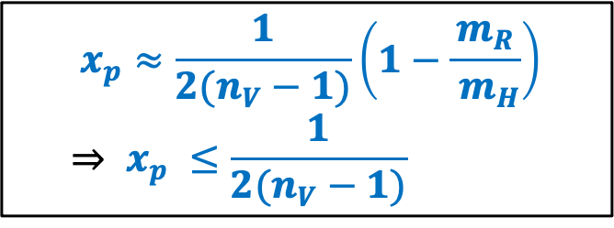
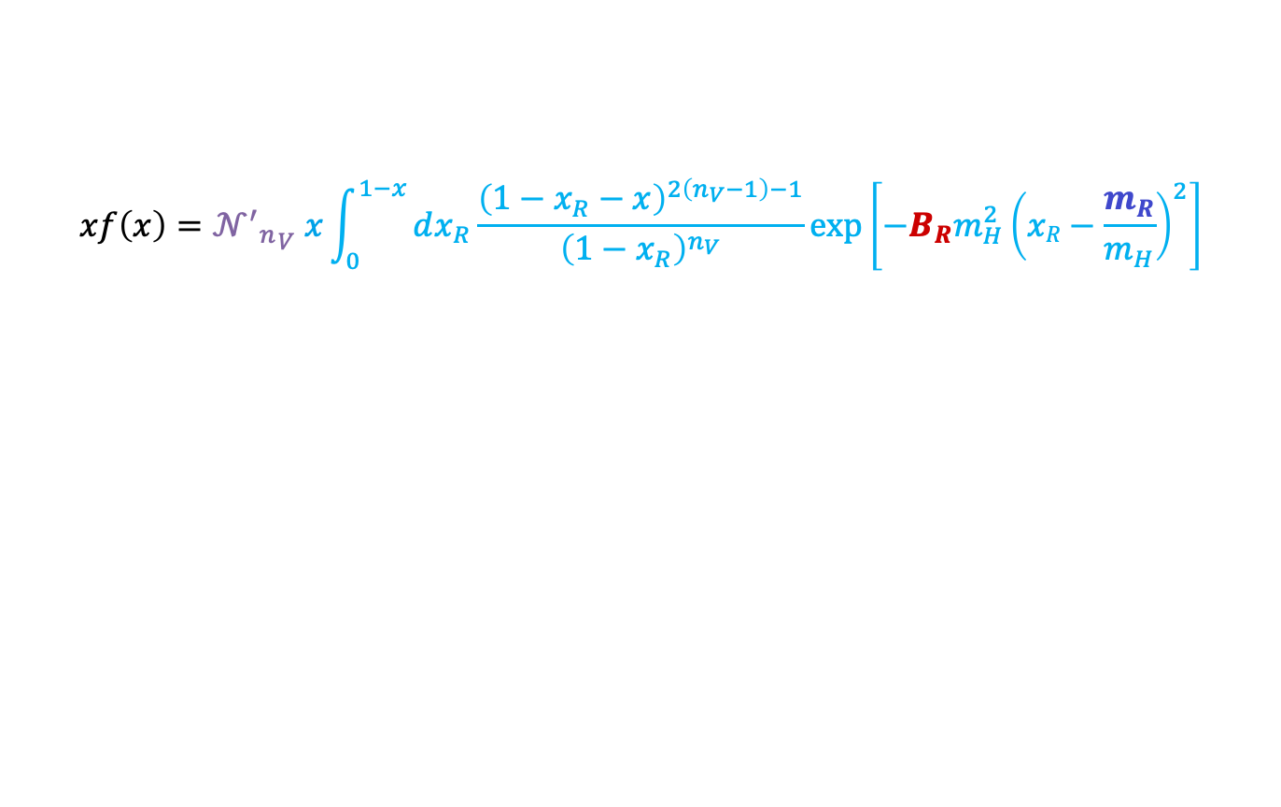
General $n_{V}$ PDF Expression
$$xf\left(x\right)={{𝒩^{′}}_{n}}_{V} x\int_{0}^{1−x}{dx_{R}\frac{{\left(1−x_{R}−x\right)}^{2\left(n_{V}−1\right)−1}}{{\left(1−x_{R}\right)}^{n_{V}}}}\exp\left[−B_{R}m_{H}^{2}{\left(xR−\frac{m_{R}}{m_{H}}\right)}^{2}\right]$$
$$x_{p}≈\frac{1}{2(n_{V}−1)}\left(1−\frac{m_{R}}{{ m}_{H}}\right) \\ ⇒ x_{p} ≤\frac{1}{2(n_{V}−1)}$$
Momentum sharing is defined by the degrees of freedom of non-interacting quarks in the
wave function of the valence cluster
Notes:
RF soft counting rule,
Say peak position

Slide 33

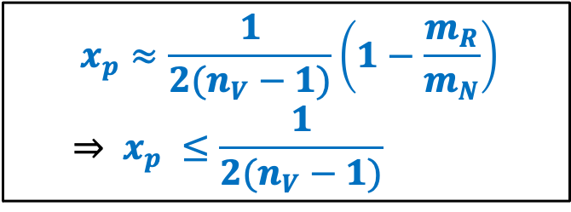
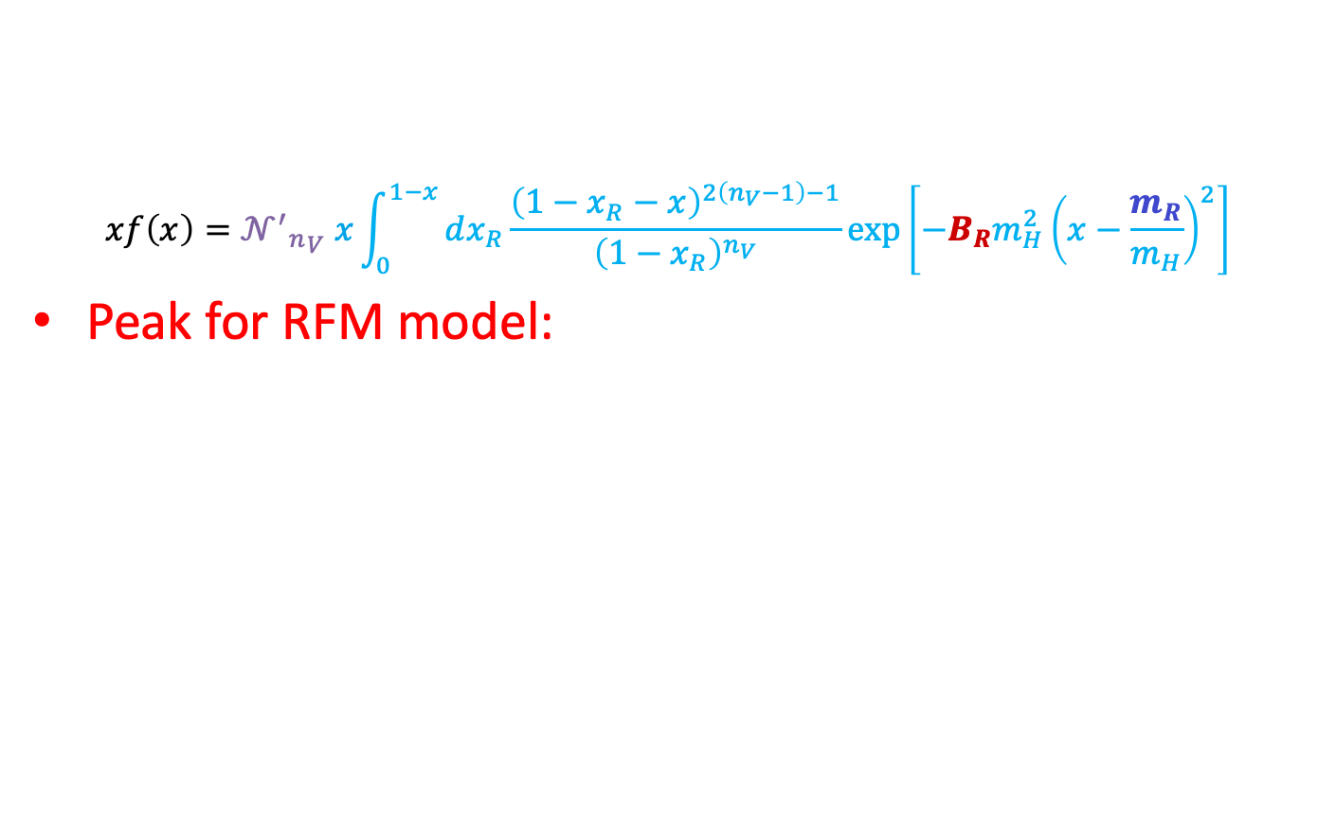
General $n_{V}$ PDF Expression
$$xf\left(x\right)={{𝒩^{′}}_{n}}_{V} x\int_{0}^{1−x}{dx_{R}\frac{{\left(1−x_{R}−x\right)}^{2\left(n_{V}−1\right)−1}}{{\left(1−x_{R}\right)}^{n_{V}}}}\exp\left[−B_{R}m_{H}^{2}{\left(x−\frac{m_{R}}{m_{H}}\right)}^{2}\right]$$
Peak for RFM model:
$$x_{p}≈\frac{1}{2(n_{V}−1)}\left(1−\frac{m_{R}}{m_{N}}\right) \\ ⇒ x_{p} ≤\frac{1}{2(n_{V}−1)}$$
Momentum sharing is defined by the degrees of freedom of non-interacting quarks in the
wave function of the valence
Notes:
RF soft counting rule,
Say peak position

Slide 34
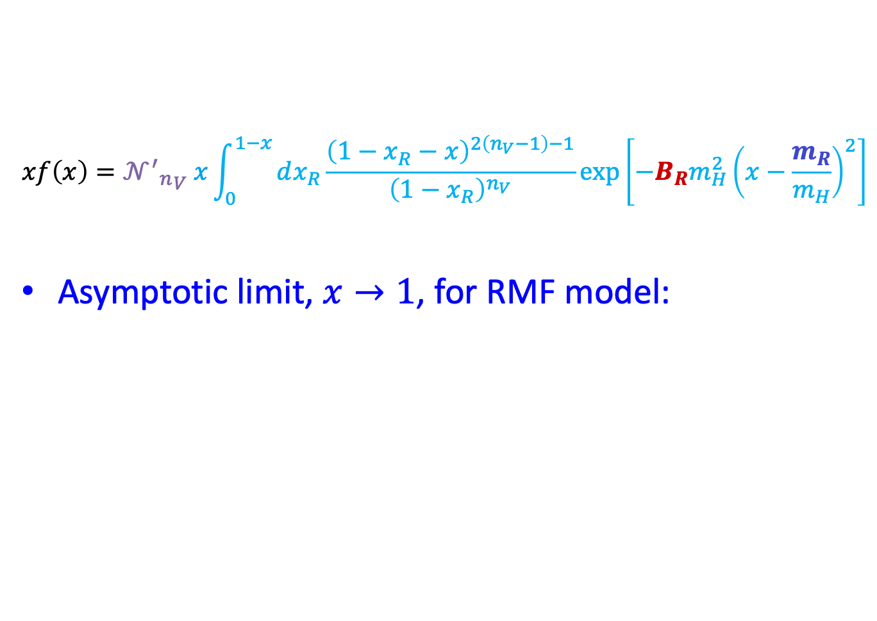
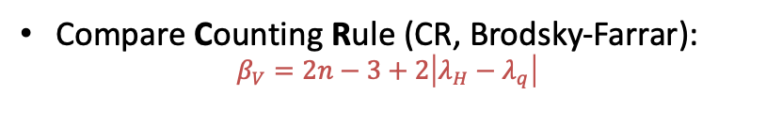
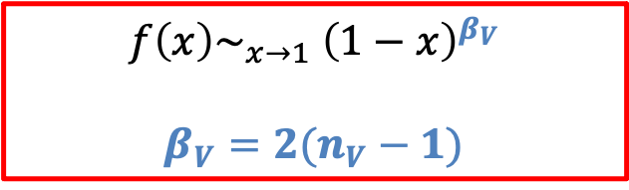
$$xf\left(x\right)={{𝒩^{′}}_{n}}_{V} x\int_{0}^{1−x}{dx_{R}\frac{{\left(1−x_{R}−x\right)}^{2\left(n_{V}−1\right)−1}}{{\left(1−x_{R}\right)}^{n_{V}}}}\exp\left[−B_{R}m_{H}^{2}{\left(x−\frac{m_{R}}{m_{H}}\right)}^{2}\right]$$
Asymptotic limit, $x→1$, for RMF model:
$$f\left(x\right)\sim _{x→1} {\left(1−x\right)}^{β_{V}}$$
$$β_{V}=2(n_{V}−1)$$
Compare Counting Rule (CR, Brodsky-Farrar):
$$β_{V}=2n−3+2\left|λ_{H}−λ_{q}\right|$$

Slide 35
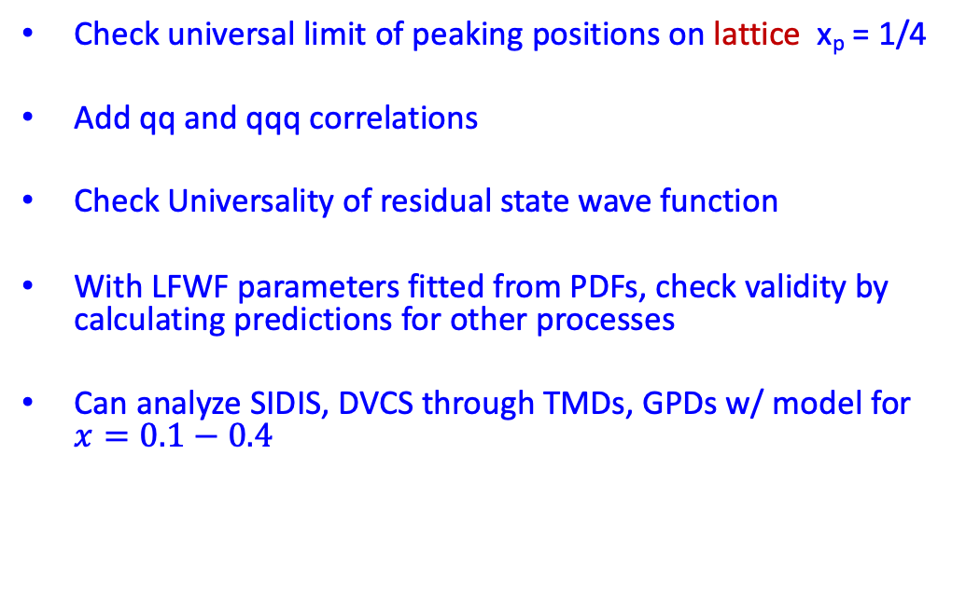
Outlook
Possible universality of not PDF’s but phenomenological wave functions
Check universal limit of peaking positions on lattice x_{p} = 1/4
Add qq and qqq correlations
Check Universality of residual state wave function
With LFWF parameters fitted from PDFs, check validity by calculating predictions for other processes
Can analyze SIDIS, DVCS through TMDs, GPDs w/ model for $x=0.1−0.4$

Slide 36
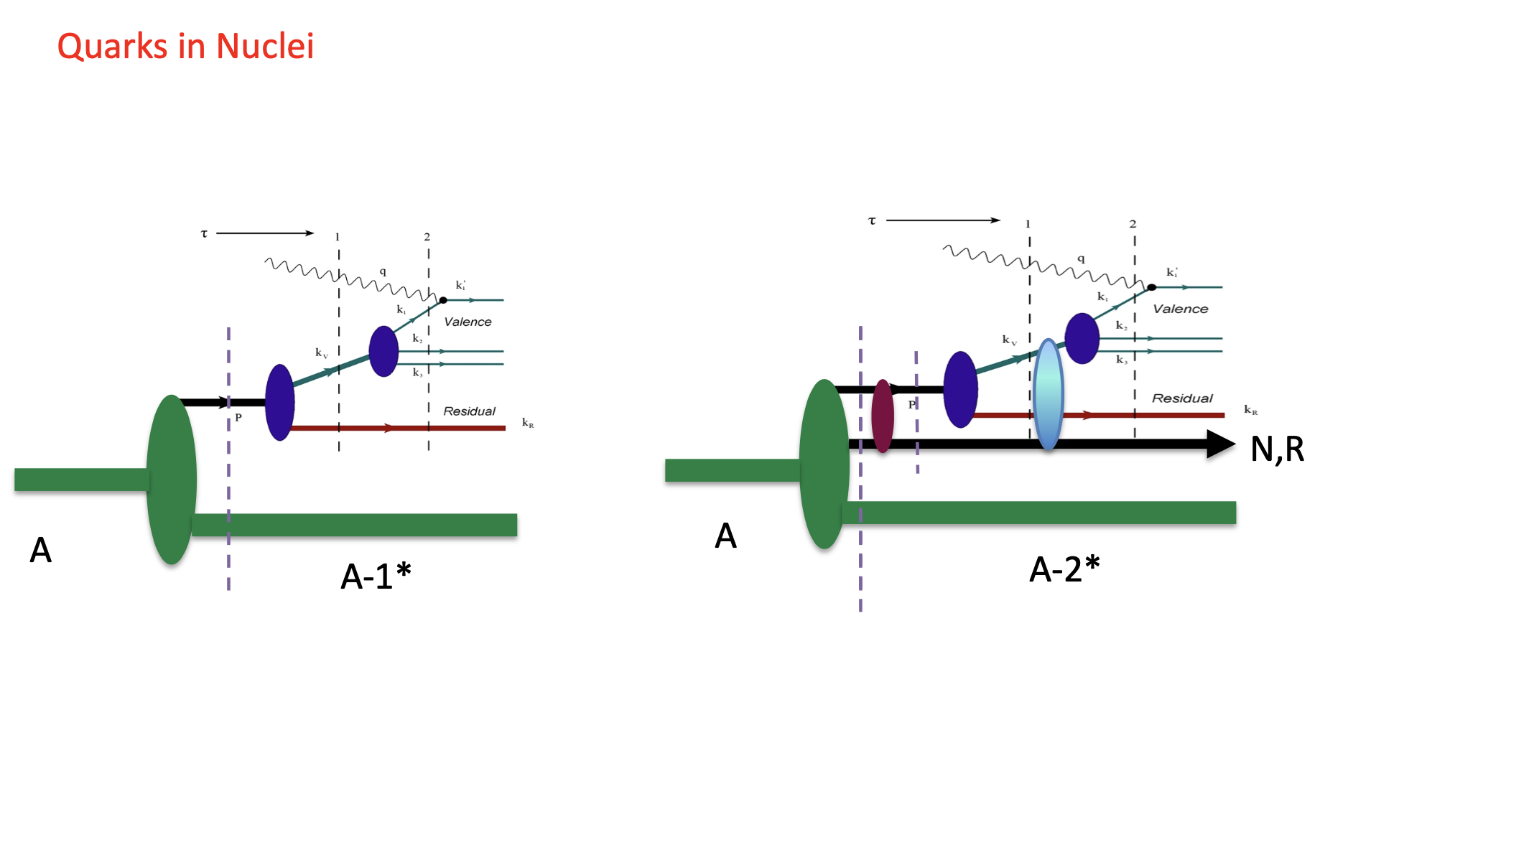
Medium Modification in Nuclei Can be Calculated Self-Consistently

Slide 37
