Slide 1
Potential Model Calculations of Proton Mass Radius with Constrained Charge Radius
Daniel Gallimore
Dr. Jinfeng Liao
Dr. Adam Szczepaniak
Dept. of Physics, Indiana University Bloomington, USA

Slide 2
Charge Radius
Mass Radius
0.831 fm
0.833 fm
0.834 fm
0.841 fm
0.842 fm
0.848 fm
0.875 fm
0.877 fm
0.879 fm
(PRad 2019)
(Bezginov 2019)
(Beyer 2017)
(Antognini 2013)
(CREMA 2010)
(Grinin 2020)
(Zhan 2011)
(Fleurbaey 2018)
(Bernauer 2010)
0.5 fm
0.5 fm
0.5$−$0.75 fm
0.7$−$0.8 fm
0.8$−$0.9 fm
1.0$−$1.1 fm
(Kharzeev 2021 )
(Giacalone 2022)
(Duran 2023)
(Mamo 2021)
(Parkkila 2021,2022)
(JETSCAPE 2021)

Slide 3
Charge Radius
Mass Radius
0.831 fm
0.833 fm
0.834 fm
0.841 fm
0.842 fm
0.848 fm
0.875 fm
0.877 fm
0.879 fm
(PRad 2019)
(Bezginov 2019)
(Beyer 2017)
(Antognini 2013)
(CREMA 2010)
(Grinin 2020)
(Zhan 2011)
(Fleurbaey 2018)
(Bernauer 2010)
0.5 fm
0.5 fm
0.5$−$0.75 fm
0.7$−$0.8 fm
0.8$−$0.9 fm
1.0$−$1.1 fm
(Kharzeev 2021 )
(Giacalone 2022)
(Duran 2023)
(Mamo 2021)
(Parkkila 2021,2022)
(JETSCAPE 2021)

Slide 4
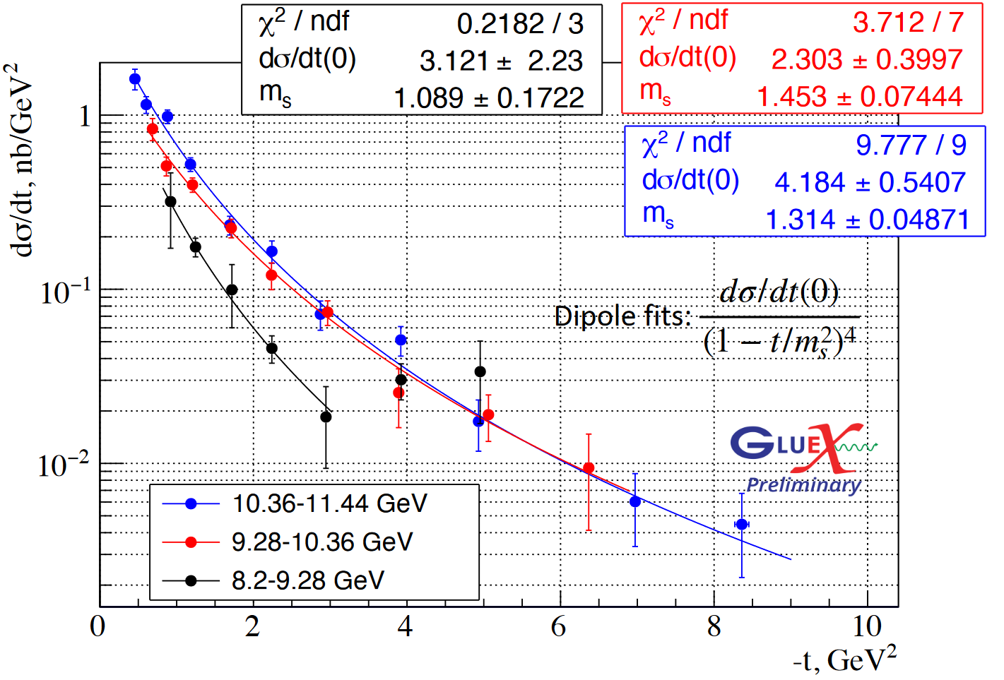
$$γp→J/ψp$$
$$G\left(t\right)=\frac{M}{{\left(1−\frac{t}{m_{s}^{2}}\right)}^{2}}$$
$$\left\langle R_{m}^{2}\right\rangle =\frac{6}{M}{\left.\frac{dG}{dt}\right|}_{t=0}=\frac{12}{m_{s}^{2}}$$
Beam Energies
$$r_{m}=\text{0.518 +/− 0.019 }\text{fm}$$
$$r_{m}=\text{0.471 +/− 0.024 }\text{fm}$$
$$r_{m}=\text{0.630 +/− 0.100 }\text{fm}$$

Slide 5
Quark Potential Models
$$\left(\sum_{i}{m_{i}}+T+V\right)ψ=Mψ$$
$$V_{q\overline{q}}=−\frac{κ}{r}+σr−V_{0}$$
$$V_{qq}=\frac{1}{2}V_{q\overline{q}}$$
One-gluon exchange at short range
Linear confinement at long range
Accurate for calculating ground state properties
Easy to visualize energy distribution

Slide 6
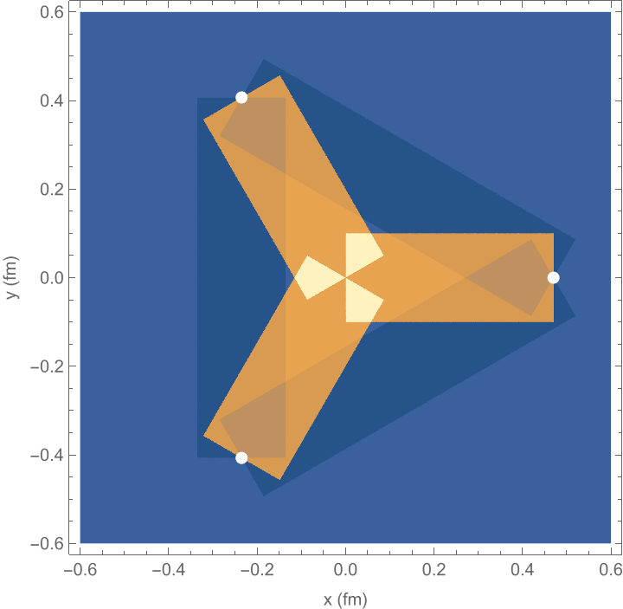
$$V_{Δ}=−\frac{κ}{2}\sum_{i<j}{\frac{1}{\left|r_{i}−r_{j}\right|}}+\frac{σ}{2}\sum_{i<j}{\left|r_{i}−r_{j}\right|}$$
$$V_{Y}=−\frac{κ}{2}\sum_{i<j}{\frac{1}{\left|r_{i}−r_{j}\right|}}+σ\min_{P}{\sum_{i}{\left|r_{i}−P\right|}}$$
$$\frac{GeV}{fm^{3}}$$

Slide 7
Diquark Clustering
u
$$V_{ q\overline{q}}=−κ\sum_{i<j}{\frac{1}{\left|r_{i}−r_{j}\right|}}+σ\sum_{i<j}{\left|r_{i}−r_{j}\right|}$$
d
$$\overline{3}$$
u
$$3$$

Slide 8
Relativistic Corrections
Spin-Spin: $\frac{8α_{s}}{9m^{2}r^{2}}\left(S_{1}⋅S_{2}\right)δ\left(r\right)$
Spin-Orbit: $\left(\frac{2α_{s}}{m^{2}r^{3}}−\frac{σ}{2m^{2}r}\right)\left(L⋅S\right)$
Tensor: $\frac{α_{s}}{3m^{2}r^{3}}S_{12}$
Dynamical: $\sqrt{p^{2}+m^{2}}$

Slide 9
Relativistic Corrections
Spin-Spin: $\frac{8α_{s}}{9m^{2}r^{2}}\left(S_{1}⋅S_{2}\right)δ\left(r\right)$
Spin-Orbit: $\left(\frac{2α_{s}}{m^{2}r^{3}}−\frac{σ}{2m^{2}r}\right)\left(L⋅S\right)$
Tensor: $\frac{α_{s}}{3m^{2}r^{3}}S_{12}$
Dynamical: $\sqrt{p^{2}+m^{2}}$
Can mostly be absorbed by the offset $V_{0}$!
$$\left\langle \frac{p^{2}/2m}{m}\right\rangle \sim \frac{1}{2}$$

Slide 10
Foldy-Wouthuysen (FW) Transform
$$H_{D}=βm+ℰ+𝒪→β\sqrt{m^{2}+𝒪^{2}}=H_{FW}$$
$H_{FW}$ is energy-separating
FW variables satisfy Poincaré algebra ($\left\{ ∙,∙ \right\}→−i[ \hat{∙},\hat{∙} ]$)
Necessary to write relativistic quantum wave theory in FW representation before taking Schrödinger approximation to maintain probabilistic interpretation of the wave function

Slide 11
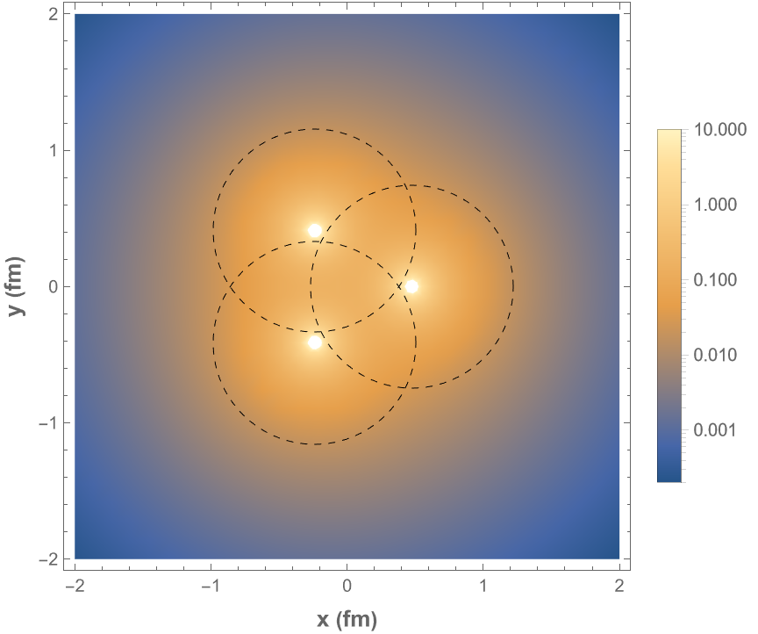
Foldy-Wouthuysen Smearing
$$ψ_{FW}\left(r\right)=\int{d^{3}r^{′} K\left(r,r^{′}\right)ψ_{D}\left(r^{′}\right)}$$
$$K\left(r,r^{′}\right)≠δ\left(r−r^{′}\right)$$
Point-like objects smeared over a radius $\sim 1/m$
May be significant overlap between smeared distributions!
$$fm^{−3}$$

Slide 12
$Δ$-Model Parameters
 | With Smearing | Without Smearing
$$m$$ | $$0.265 GeV$$ | $$0.230 GeV$$
$$κ$$ | $$0.42$$ | $$0.10$$
$$σ$$ | $$0.208 GeV^{2}$$ | $$0.069 {GeV}^{2}$$
$$V_{0}$$ | $$1.2 GeV$$ | $$0.5 GeV$$
Constrained wave function without smearing too extended, inconsistent with standard model parameters,
charge radius fixed at 0.84 fm

Slide 13
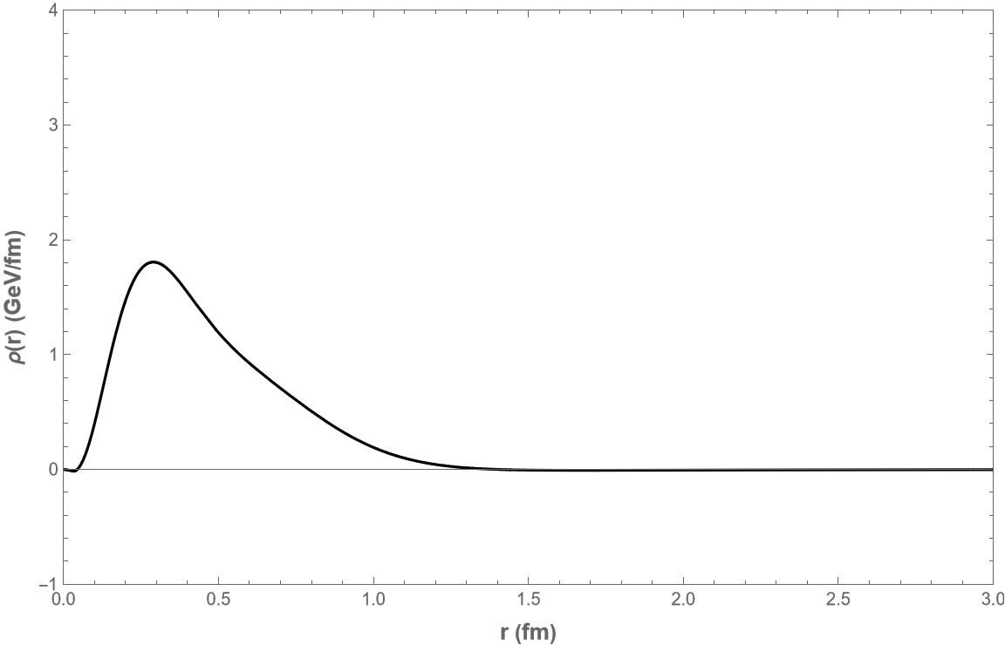
$Δ$-Model Quark-Distributed Offset
Mass Radius
0.47 fm

Slide 14
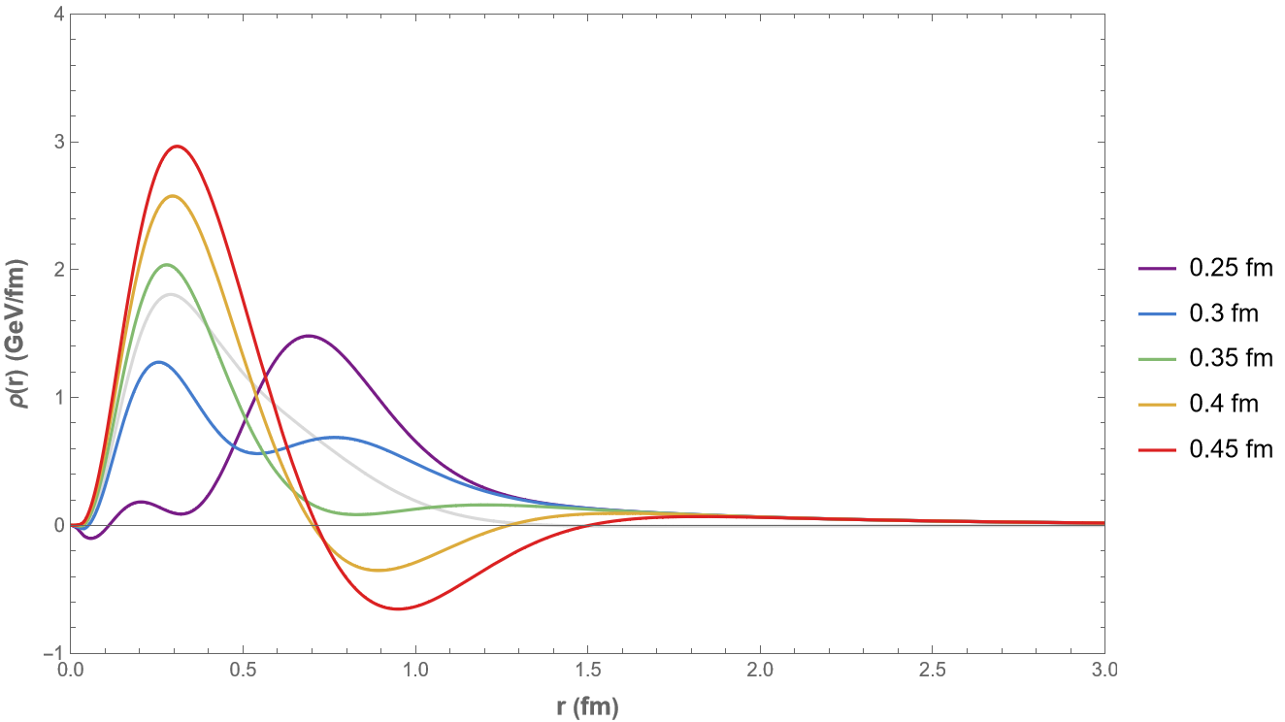
$Δ$-Model Gaussian Offset
Mass Radius
0.47 fm
1.05 fm
0.97 fm
0.87 fm
0.73 fm
0.53 fm
Width

Slide 15
$Y$-Model Parameters
 | With Smearing | Without Smearing
$$m$$ | $$0.265 GeV$$ | $$0.230 GeV$$
$$κ$$ | $$0.42$$ | $$0.10$$
$$σ$$ | $$0.180 GeV^{2}$$ | $$0.060 GeV^{2}$$
$$V_{0}$$ | $$1.2 GeV$$ | $$0.5 GeV$$
Charge radius fixed at 0.84 fm

Slide 16
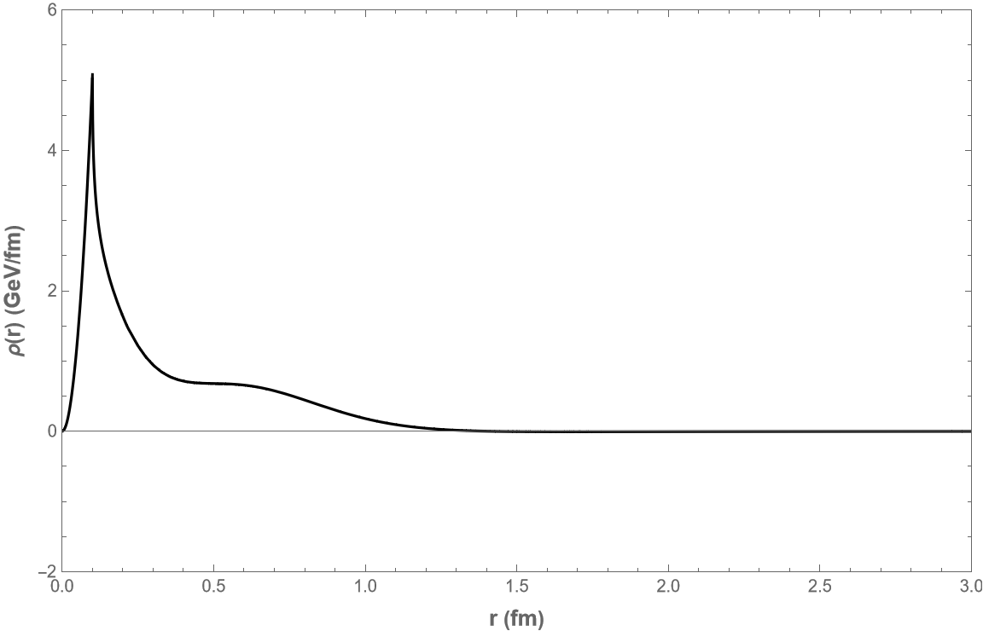
$Y$-Model Quark-Distributed Offset
Mass Radius
0.39 fm

Slide 17
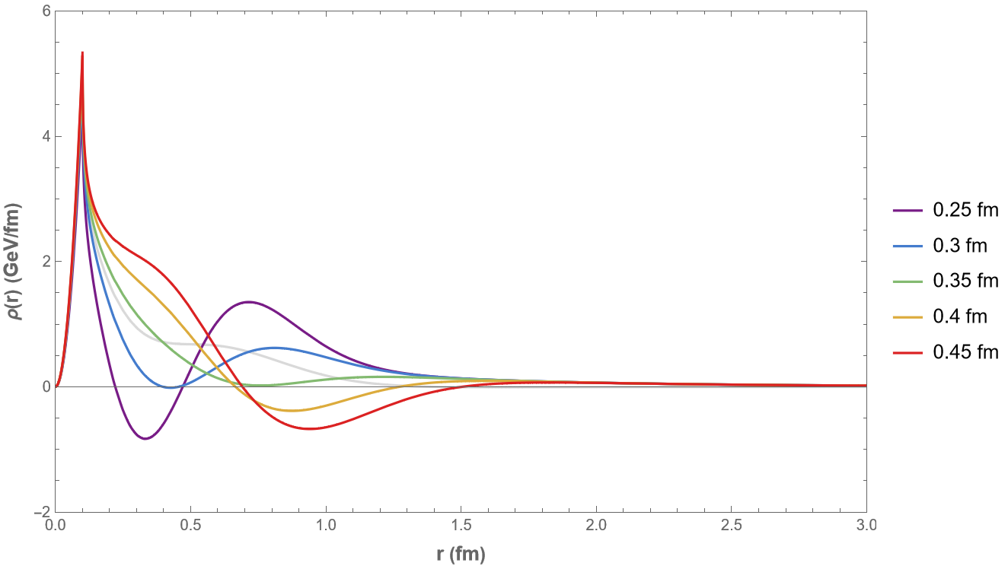
$Y$-Model Gaussian Offset
Mass Radius
0.39 fm
1.00 fm
0.92 fm
0.82 fm
0.68 fm
0.46 fm
Width

Slide 18
Summary
Proton mass radius is poorly understood
Ground state properties of proton well-described by Schrödinger potential model
Charge radius used to constrain Hamiltonian parameters
Foldy-Wouthuysen smearing crucial for fixing realistic light quark parameters
Ambiguity remains in how offset energy is distributed

Slide 19
Acknowledgements
Funding for this research was provided by the National Science Foundation and the Exotic Hadrons Topical Collaboration. We also acknowledge financial support from The Gordon and Betty Moore Foundation and the American Physical Society to present this work at the GHP 2023 workshop.

