Slide 1

Ce⁺BAF : Positron Injector for CEBAF 12 GeV
  12 GeV e+ Capability
  R&D Topics
  Participation, Logistics, Timeline
Joe Grames

Slide 2
Expands 12 GeV capability with e+
Build two new injectors…
  10 mA polarized e- injector
  100 kW positron target
Two beam sources for CEBAF
  Retains original 4-hall polarized e- injector
  Adds new pair (e-/e+) and limited pol e- injector
Prioritizes
  Multi-hall capability (alt. is <4 halls)
  cw operation (alt. is pulsed <100% DF)
Timeline
  Ce+BAF capability happens after Moller
  Demonstration of e+ beams happens before this
Production of Highly Polarized Positrons Using Polarized Electrons at MeV Energies, D. Abbott et al., Phys. Rev. Lett. 116 (2016) 214801

Slide 3
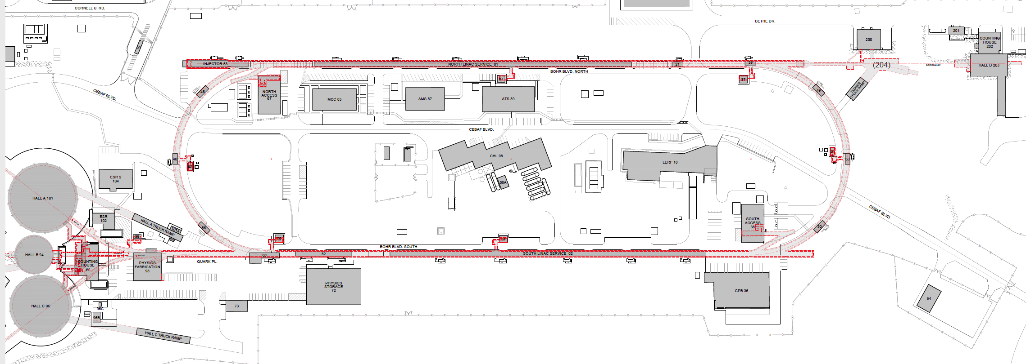
An electron/positron injector vault is required for 12 GeV e+ and 22 GeV e-
Existing FEL + long beam line
123 MeV e+ for 12 GeV CEBAF
650 MeV e- for Energy Upgrade
Green option is presently more cost effective and provides options for staging positron and energy upgrade

Slide 4

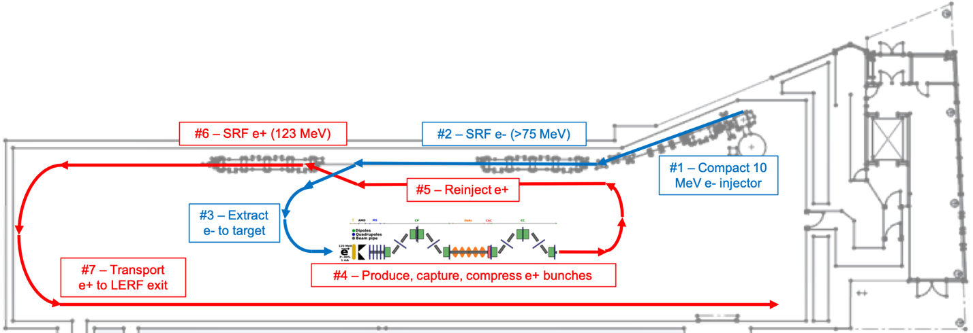
PEPPo II : Polarized e⁺ Prototype Experiment
Next, we want to build a scalable polarized positron injector at LERF to demonstrate beam
  300 kV polarized gun + Wien filter, demonstrate > 1kC lifetime at milliamp current
  Build up the SRF e- injector 50 – 100 MeV
  Ramp up efforts for high power target 50 – 100 kW, e+ collection and compression
  Complete start-to-end concept in FY23
4

Slide 5
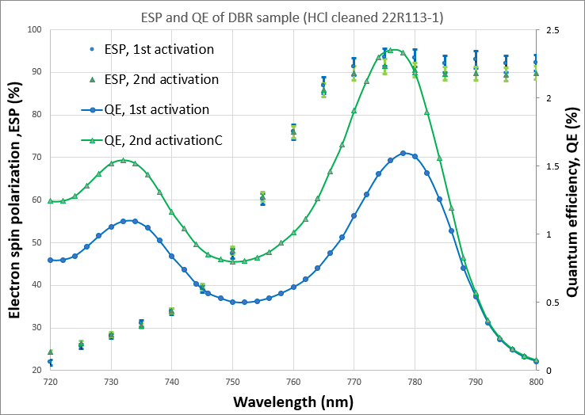
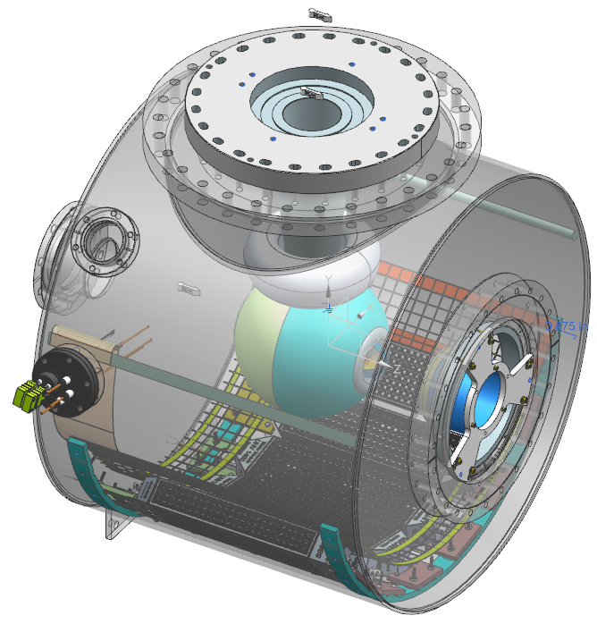
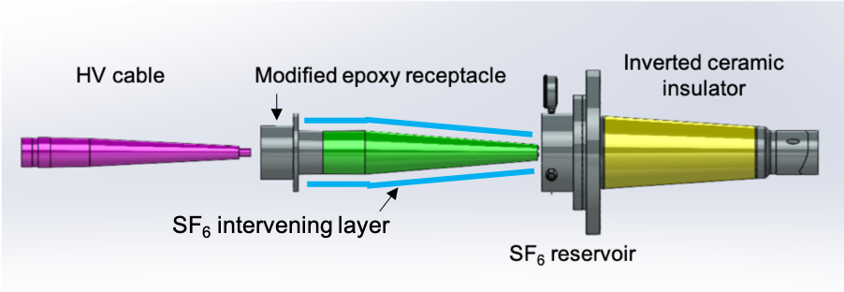
Electron Injector (selected R&D)
LERF photo-gun will likely need to operate at a voltage greater than the CEBAF 200 kV Upgrade Gun.
  studies are evaluating new ceramic/receptacle >350 kV
  vacuum must be in the 10⁻¹² Torr range (like CEBAF)
  and no Field Emission (like CEBAF)
July 2022 (unpublished) results of collaboration between Old Dominion University, Brookhaven National Lab and Jefferson Lab
Matt Poelker
Carlos Hernandez-Garcia

Slide 6
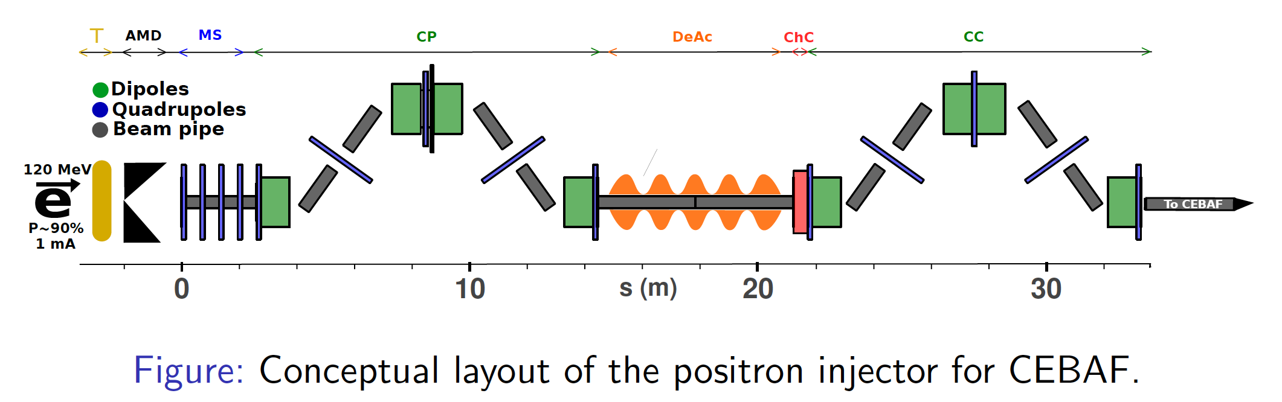
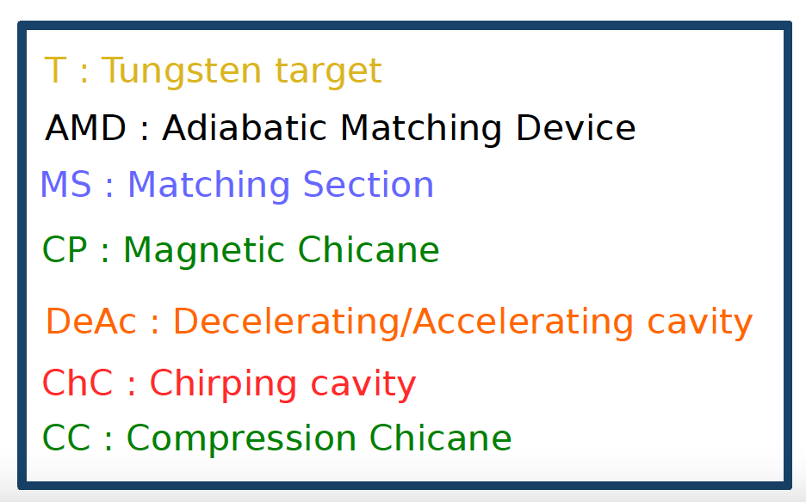
Positron Injector (selected R&D)
Positron injector at LERF is a composite of systems,
  ”source” is integrated set of technologies; high power target, high field solenoid, RF capture
  CW operation will be unique, developing strategy for collection – capture - compression
PhD work of S. Habet (U. Paris)
SuperKEKB
Pulsed e+
Source

Slide 7
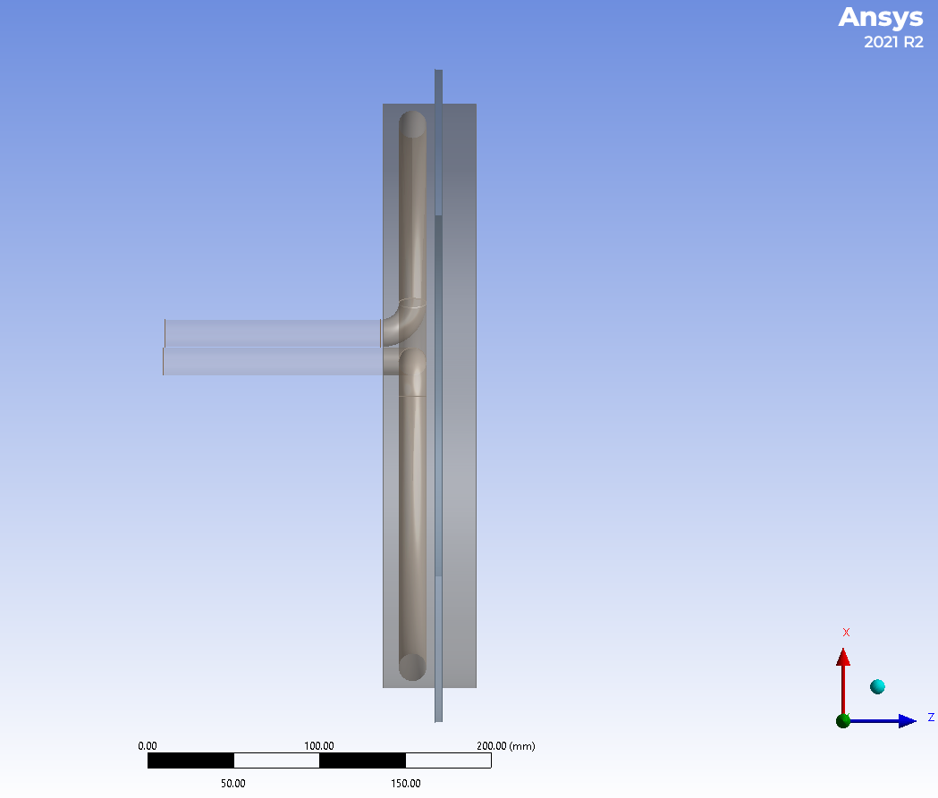
Positron Target Development (selected R&D)
Building up team of target experts to study various target materials & geometries
  prototype/proof-of-principle (3-4 kW)
  full power design (17-20 kW)
Thermal Cycle
Silviu Covrig
Beam axis
Cu frame
Heating Phase
Water pipe
  Rotating W target in a Cu frame cooled with RT water
Andriy Ushakov

Slide 8
US-Japan Cooperation – e-/e+ Injectors (planned DOE HEP 3-year)
  400 kV Polarized Electron Source
    Design and fabrication of commercial insulator (KEK/Kyocera) and (JLAB/MPF)
    Assembly and operational HV cathode test (JLAB) with large area electrode for improved space charge limit and photocathode lifetime
    Electrostatic modeling and design of compatible Wien Filter (JLAB)
  Positron Target Concept Development
    Liquid Xe target (SLAC), CFD thermodynamics calculations (KEK, JLAB) and evaluation of spin polarization (JLAB)
    Design and fabrication of 15 kW fixed target prototype (JLAB)
  Solid Target Fatigue Studies
    Beam irradiation (MAMI/JLAB, KEK) and thermal cycling (JLAB, KEK) of W-Cu and W crystal and alloys
    Target material evaluation of composition at PETRA light source (JLAB) and Old Dominion University Nanoprobe (JLAB)
  Positron Collection Technology
    Design and fabrication of e+ capture cavity (SLAC)
    Evaluation of pulsed flux concentrator vs. dc solenoid (KEK, JLAB)
  Electron and Positron Injector Beam Dynamics
    Simultaneous transports of low and high intensity bunch charges (KEK)
    Modeling and simulation of tunable polarized positron injector for CEBAF 12 GeV (JLAB)
Carlos Hernandez-Garcia
Gabriel Palacios-Serrano
Silviu Covrig
Sandeesh Gopinath
Andriy Ushakov
Md Mamun
KEK – Yoshinori Enomoto
SLAC – Spencer Gessner
JLAB – Joe Grames
Probir Ghoshal
Reza Kazimi
Alicia Hofler
Sami Habet
Andriy Ushakov

Slide 9

GaInSn Liquid Metal e+ Target (pending DOE SBIR Phase 1 proposal)
Material GaInSn PbBi
Composition 67Ga 20.5In 12.5Sn vol% 44.5Pb 55.5Bi at%
Melting Point -19 to 10.5 ºC 123.5 ºC
Vapor Pressure <E-08 Torr@500 ºC 7.5E-09 Torr@250 ºC
Density 6.44 g/cm³@ 20 ºC 10.44 g/cm³
Radiation Length Xo 1.470 cm 0.606 cm
Thermal Conductivity 16.6 W/m-K 10.89 W/m-K (130 ºC)
Dynamic viscosity 2.4E-3 Pa-s 3.3E-3Pa-s
Val Kolstroun
Karl Smolenski
Joe Conway

Slide 10

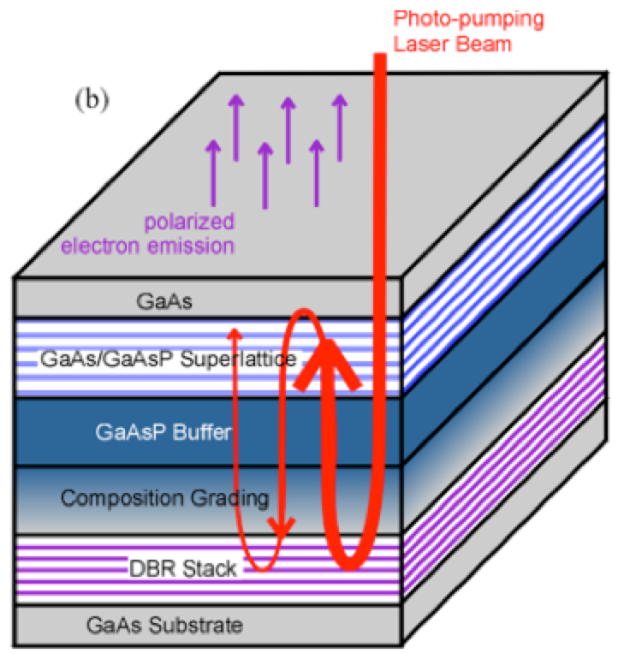
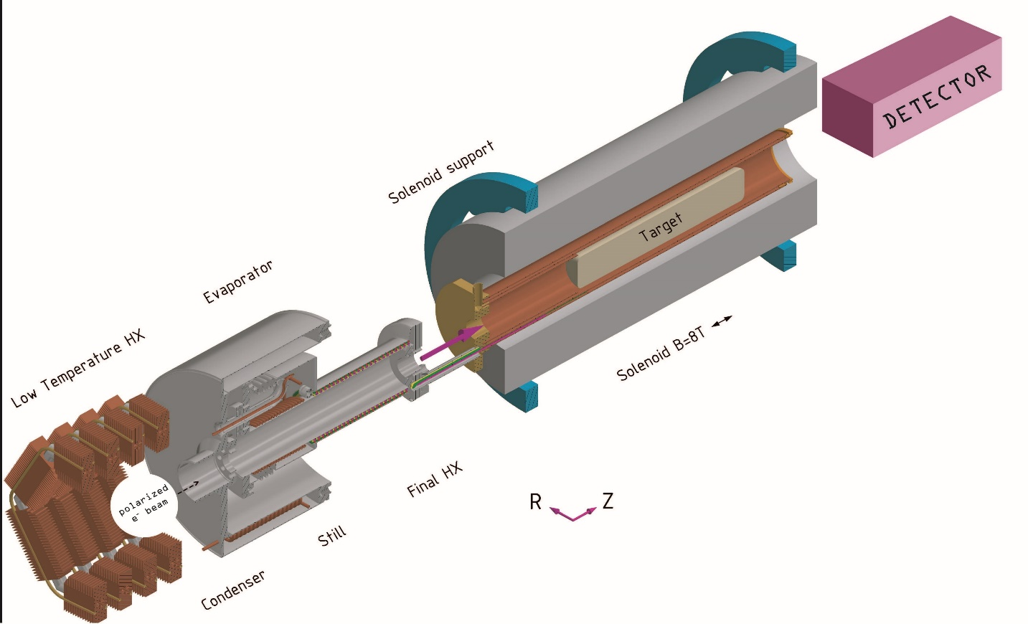
Polarized Electrons, Positrons, and Polarimetry (P3E @ STRONG 2020)
Purpose : pushing further intensity frontiers of polarized electron sources, the intensity frontier of low energy polarized positron sources, and the precision frontier of electron polarimetry
Development of high quantum
effciency and long live-time photocathodes
Jlab
Application of the PEPPo technique to hadronic physics accelerator
IJClab
Jlab
Hamburg University
Mainz University
Hydro-Møller polarimeter for on-line polarimetry at 100 MeV at P2@MESA
Mainz University

Slide 11
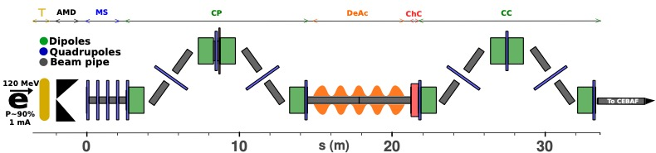
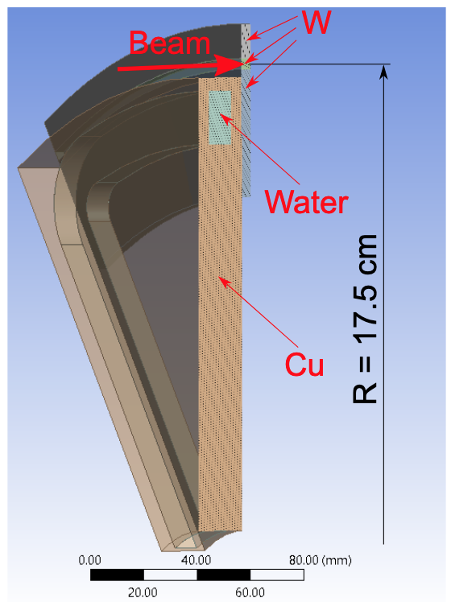
Polarized Electrons, Positrons, and Polarimetry (P3E @ STRONG 2020)
Josh Yoskowitz, Joe Grames, Geoff Krafft
Sami Habet, Andriy Ushakov et al.
Niklaus Berger et al.
Development of HV-MAPS pixel detectors
(2x2 cm²)
Design of a positron injector for CE+BAF
With a >400 C lifetime we could operate at 3 mA for about 3 days
Evaluation of positron production targets

Slide 12
2022 LDRD – degraded electrons (A. Sy, CASA)
Goals: evaluate CEBAF acceptance and compare to simulation; evaluate machine limits on positron beam size and current; transport positrons through parts of the CEBAF injector
How? Build a bypass beamline in the CEBAF injector to degrade electron beams through multiple scattering in thin target foils
  Phase space range between nominal CEBAF parameters and positron distribution posited in JLAB-TN-21-043
In FY23, we will design the bypass beamline and procure components
Amy Sy
Yes Roblin
Dennis Turner
Cristhian Valerio
Victor Lizarraga
Beamline concept at 5D line in CEBAF injector
5D Dipole
Dipole
…
To CEBAF
Quarter cryomodule
e- beam with large emittance and momentum spread
Dipole
Target
Collimators
Dipole

Slide 13
Opportunities for participation
Areas where we have people working, but welcome participation…
  Beam optics (Yves, Dennis)
  Polarized electron source (Carlos, Gabriel)
  Electron injector design & modeling (Reza, Alicia, Max)
  Accelerating cavities (SRF, RF)
  Positron injector design (Andriy, Sami)
  High field solenoid magnets (Probir)
  Positron target development (Silviu, Andriy, Eric+, Val+)
  Spin rotator design (Fanglei)
Areas where I think we benefit from growing participation…
  Radiation shielding calculations & modeling
  Electron and positron polarimetry
  Materials calculations and evaluation (targets and collimators)
  Your new idea or interest

Slide 14
Logistics and Timeline
Participation
  Completely new suggestion, folded into the R&D plan, or…
  Teaming up with an existing senior topical PI
    Scientist, Engineer, Post-doc, Technician
    Grad student plus an involved supervisor
2023 Goals
  February 1 – define 5 year milestones for LERF e+ development and CEBAF integration
  Produce a start-to-end conceptual design and technical report
    April 1 – IPAC’23 contributions status of R&D development
    June 1 – distribute outline and writing assignments
    September 1 – first drafts due at +3 months
    December 1 – final material due at +6 months

