Slide 1
The Neutron Electric Dipole Moment (nEDM) Experiment at Los Alamos National Laboratory (LANL)
Douglas Wong

Slide 2
LANL nEDM Collaboration
Los Alamos National Laboratory (LANL)
S. Cirigliano, S. Clayton, C. Cude-Woods, S. Currie, T. Hassan,
L. Lommel, T. Ito, M. Makela, C. Morris, C. O’Shaughnessy,
W. Uhrich
University of Kentucky
B. Plaster, A. Tewsley-Booth, J. Brewington, P. A. Palamure,
D. Buskirk
University of Michigan
T. Chupp, F. Hills, A. Tewsley-Booth
University of Illinois Urbana-Champaign
J. Burdine, J. Chen, C.-Y. Liu, J. Long
Indiana University
W. Snow, D. Wong
East Tennessee State University
R. Pattie Jr.
Tennessee Technological University
A. Holley, A. Reid
Valparaiso University
S. Stanislaus
University of Washington
T. J. Bowles and B. Heckel
Yale University
S. K. Lamoreaux
Joint Institute of Nuclear Research
E. Sharapov

Slide 3
Background

Slide 4

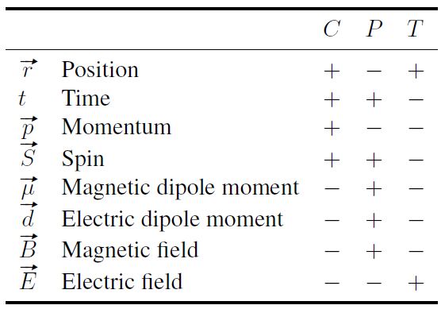
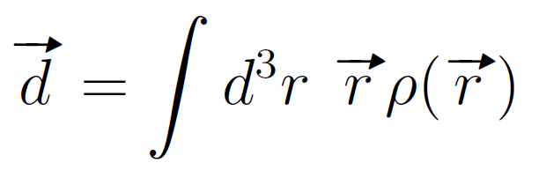

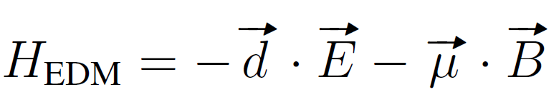
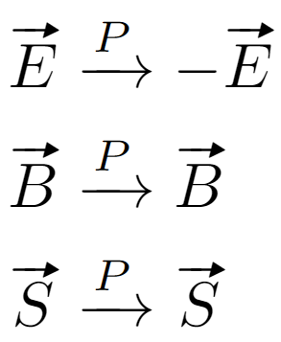
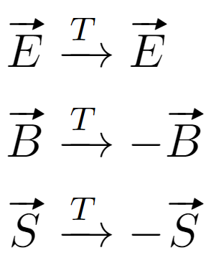


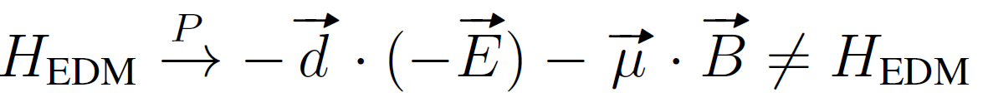
EDM and discrete symmetries
An electric dipole moment (EDM) = asymmetry in a charge distribution
For a neutral particle, it may be considered as two point charges +q and –q separated by some distance r
Consider how the interaction Hamiltonian changes
under Parity and Time reversal
Polar vector
Static charges
Axial vector
Moving charges
Axial vector
The CPT theorem arises from Lorentz invariance and locality;
the Lorentz-invariant Hamiltonian must be invariant under the operations C, P , and T combined.
Therefore, an nEDM measurement is a test of CP violation
4
Notes:
Charge conjugation transforms all charge quantum numbers of a particle. This includes electrical
charge, color charge, lepton or baryon number, etc. C converts a particle into its anti-particle
Parity is spatial inversion, changes the sign of all cartesian coordinates.

Slide 5
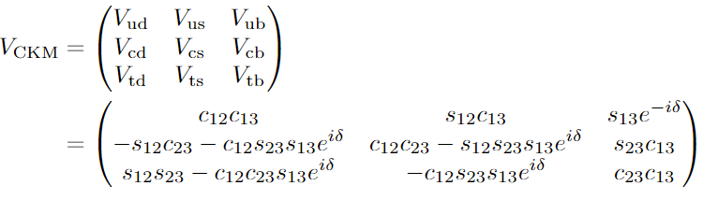




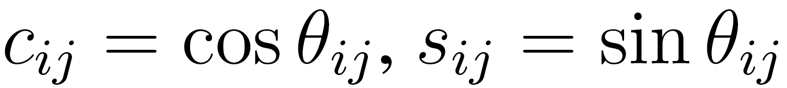
CP Violation in the Standard Model
Cabbibo-Kobayashi-Maskawa (CKM) matrix
Strong CP Problem
Electroweak sector
QCD Lagrangian term (CP violating)
Describes a rotation between weak eigenstates and flavor eigenstates, as observed in charge current weak decay processes
which given current experimental limits implies
(as far as we know)
For a 3 x 3 unitary matrix, the 9 elements V_{ij} may be reduced to 3 real numbers and one complex phase, e^{i𝛿}, which is CP violating
An arbitrarily small number!
One proposed solution: introduce a Peccei-Quinn symmetry, with a Goldstone boson called the axion, a dark matter candidate
where
Posepelov and Ritz
doi: 10.1016/j.aop.2005.04.002
5
Notes:
CKM matrix describes mixing of quark flavors and other weak interaction amplitudes

Slide 6

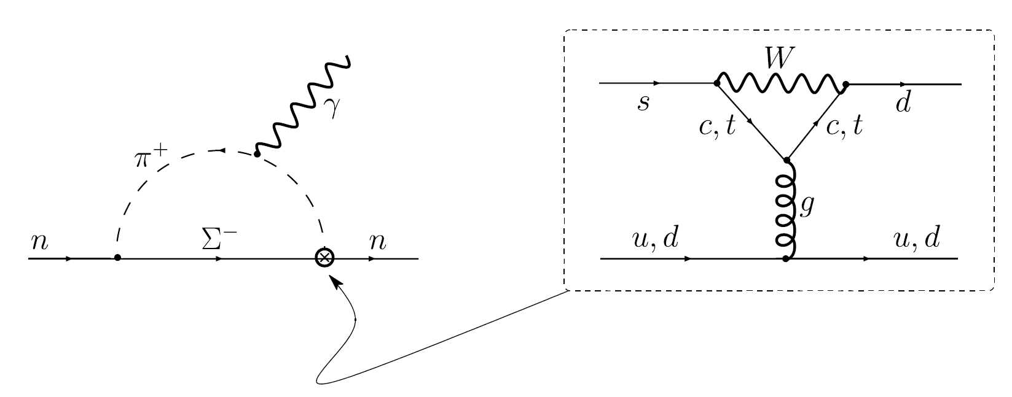
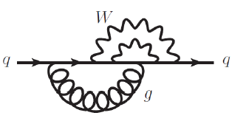


nEDM Standard Model prediction
The largest Standard Model contribution to d_{n} does not come from quark EDMs, but from a 4-quark operator generated by the so-called “strong penguin” diagram. This is enhanced by long distance effects, namely the pion loop, and it has been estimated that this gives
The quark EDM appears at 3 loop level in the Standard model, with the largest effect from exchange of two W bosons and one gluon
Valence model estimation:
Aiming for 10⁻²⁷ e cm is a good test for beyond Standard Model (BSM) physics!
Czarnecki and Krause
doi: 10.1103/PhysRevLett.78.4339
6

Slide 7
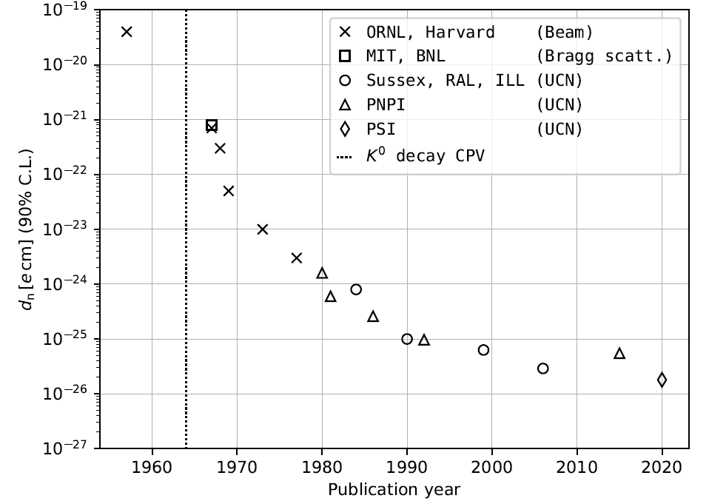
nEDM searches and Baryon Asymmetry
Baryon asymmetry (Sakharov requirements)
  Baryon number violation
  C and CP violation
  Departure from thermodynamic equilibrium
If CP is conserved, any process producing a particle must have a counterpart reaction producing the charge-conjugate particle at the same rate → no net baryon number
Estimates based on the Standard Model of the expected baryon matter/anti-matter asymmetry in the universe (BAU) is 8 orders of magnitude smaller than the baryon-to-photon ratio observed using the cosmic microwave background (CMB)
Current nEDM limit is at 10⁻²⁶ e cm, the LANL nEDM search is aiming for 3 x 10⁻²⁷ e cm (90% C.L.)
Dubbers and Schmidt
doi: 10.1103/RevModPhys.83.1111
7
Notes:
1. Baryon number violation: For some initial baryon number B = 0 there must be some inter-
action that violates baryon number to proceed to a universe with a net B > 0.
2. C and CP violation: If C and CP are exact symmetries, then the probability of converting
matter to antimatter is the same as the reverse process, resulting in B = 0.
3. Breaking of thermal equilibrium: At thermal equilibrium, there is no preferred direction for
time and CP T invariance prevents baryon excess, negating the effect of any CP violating
processes

Slide 8
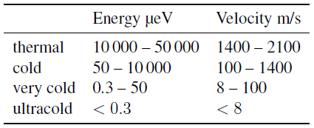
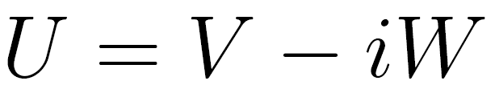
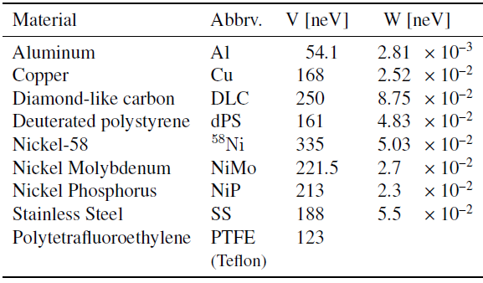

Ultracold neutrons (UCN)
May be contained by material bottles at all angles of incidence, depending on an optical potential (pseudo potential)
Long lifetimes (~880 s)
Low enough kinetic energy to be affected by gravity (~100 neV / m)
Magnetic moment of the neutron interacts with magnetic field
Usain Bolt: 10.44 m/s
μ ~ 60 neV / T
For high-field seeking UCN, V_{B} < 0. For low-field seeking UCN, V_{B} > 0
A population of UCN may be treated as an ideal gas, with caveats:
  Elastic and mostly specular wall collisions
  Negligible UCN—UCN collisions
  UCN gas density decreases with height increase
  UCN gas density in a closed storage volume decreases over time from wall collisions and beta decay
Gyromagnetic ratio γ_{n} ~ 30 MHz / T
8

Slide 9


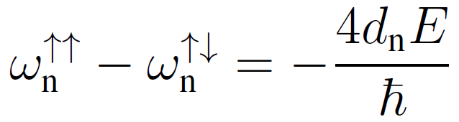
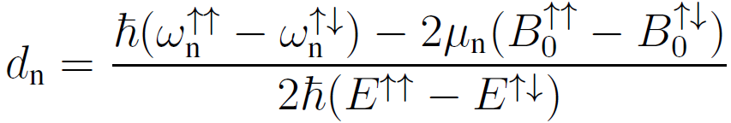
Measuring the nEDM
Stark splitting, from E field applied parallel/antiparallel to a vertical B₀ field
If E and B₀ changes between configurations
How do we measure ω?
Ramsey method of oscillatory fields
9

Slide 10
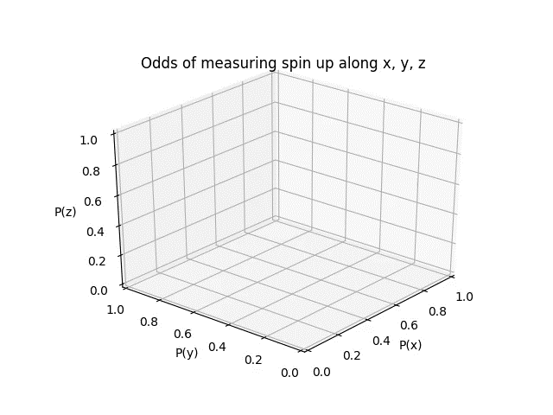


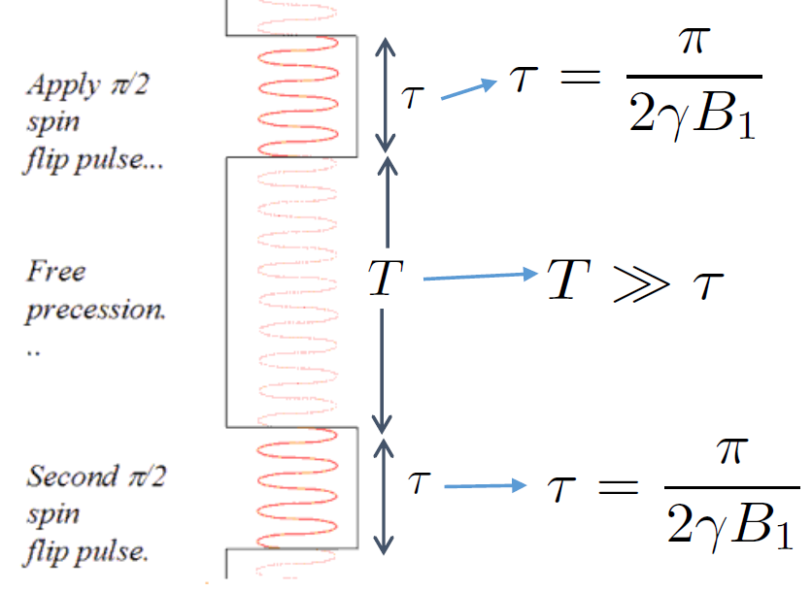
Ramsey method: On-resonance sequence
Neutron starts spin up at t = 0
Above: Plot of the “tip” of the semiclassical neutron spin vector. Origin of the vector is at
P(x),P(y), P(z) = (0.5, 0.5, 0.5)
Note: this is just for demonstration purposes, the animation skips lots of precession time
10

Slide 11

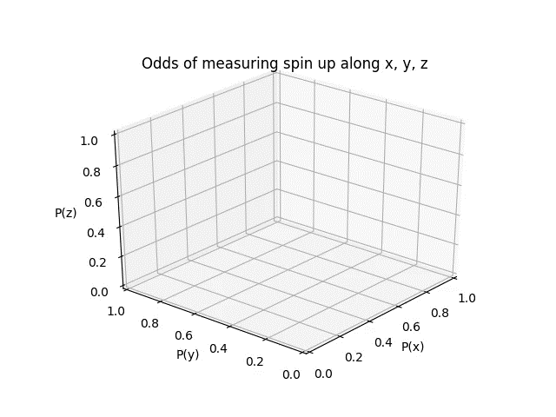
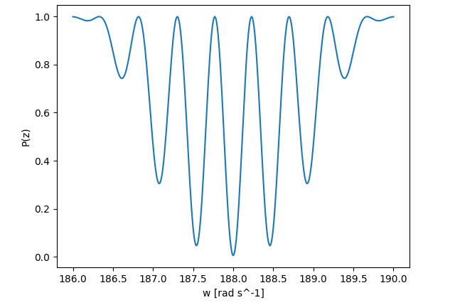
Ramsey method: Making a fringe
Off-resonance
On-resonance
Also off-resonance
In experiment it is unnecessary to make the whole fringe. Pick 4 points along the central peak along which the slope is fastest changing, and extrapolate resonant frequency from that
Each point on the fringe comes from one Ramsey sequence. Experimentally, to make this fringe, all you need to do is to apply a Ramsey sequence (for various RF frequencies) on a population of neutrons, and count the number of spin up neutrons at the end.
Note: this is just for demonstration purposes, the animation skips lots of precession time, and the Ramsey fringe was made with different parameters
11

Slide 12
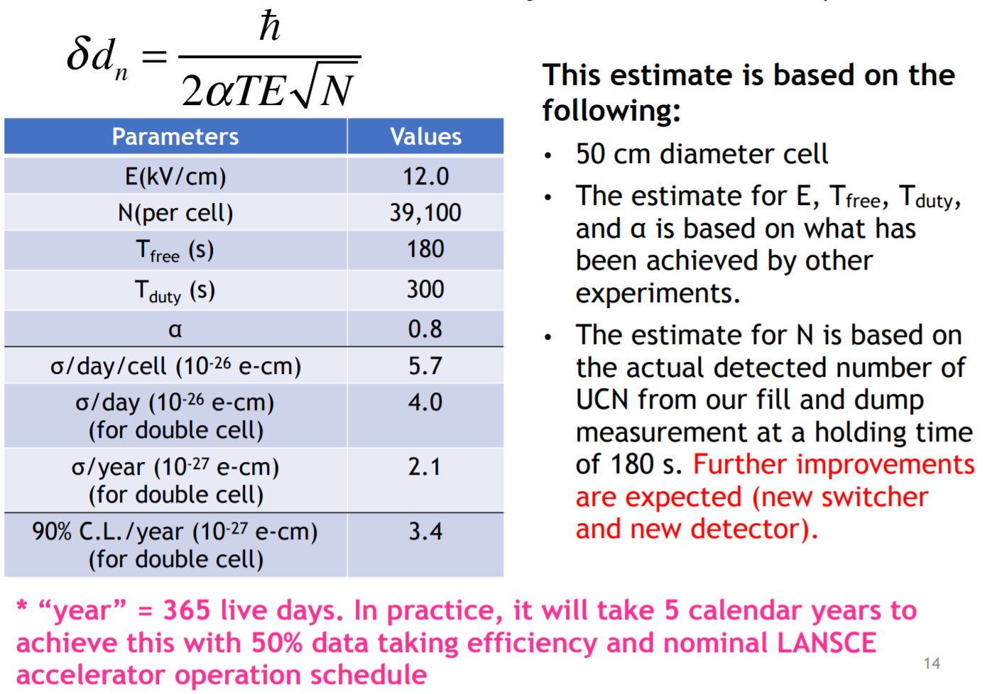
Statistical Requirements of a Counting Experiment
12
Notes:
40k measured previously, but on the final beamline have seen as high as 60k, so this is a conservative estimate

Slide 13
nEDM Search at LANL

Slide 14
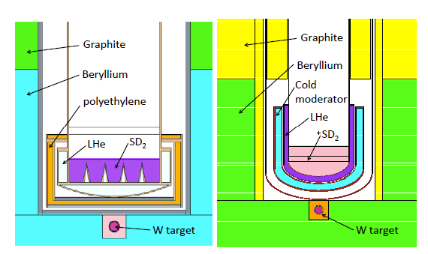
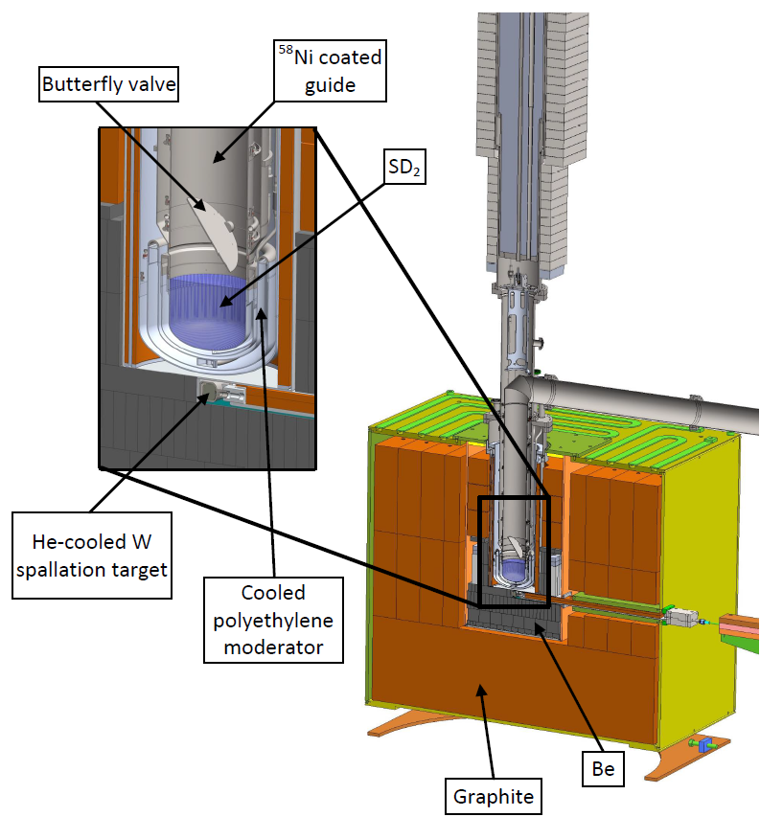
LANL Source Upgrade 2017
Old
New
Spallation neutrons produced by 800 MeV proton beam on a tungsten target
Moderated by beryllium, graphite, and polyethylene beads
Cold neutrons downscattered to ultracold neutrons (UCN) with a solid deuterium crystal
Neutrons directed upwards 1m along a Ni⁵⁸ guide to compensate for the boost from leaving the optical potential of the deuterium source
Upgrades
  New source insert, with optimized SD2 and cold moderator geometries
  Improved UCN transport in the vertical to horizontal transition
  Minimization of UCN loss in source volume
  Improved UCN guide quality
UCN density measured at the exit of biological shield measured to be 184(32) UCN/cm³
39(7) UCN/cm³ stored in an external chamber, sufficient for a nEDM measurement with uncertainty 3 x 10⁻²⁷ e cm (90% CL)
Ito et al doi:10.1103/PhysRevC.97.012501
14

Slide 15
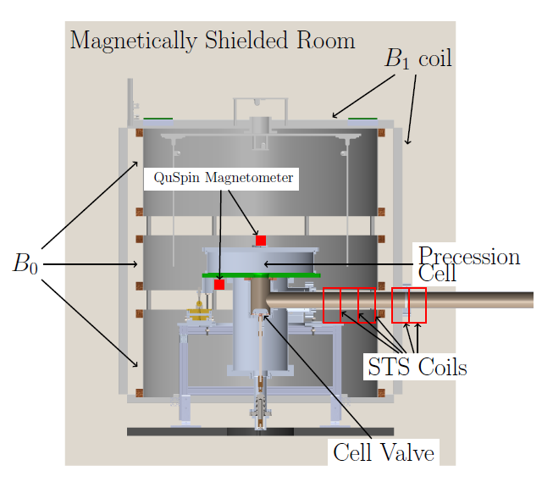
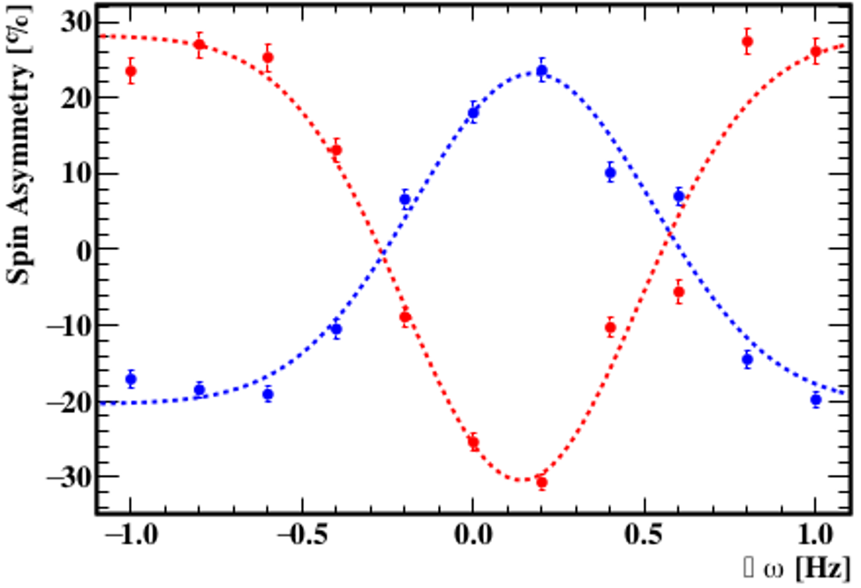
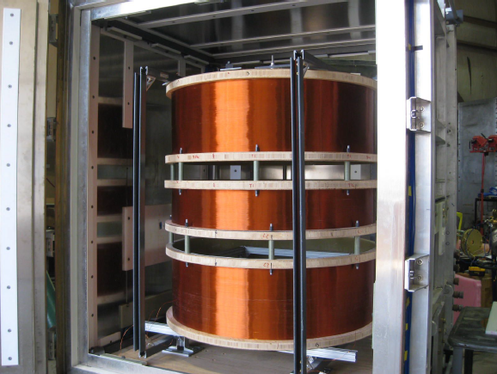
Prototype apparatus demonstration 2017
Crude Ramsey fringes created successfully at the end of 2017
  Cell densities were to be <5 UCN/cc
B0 coil prototype made from a segmented solenoid
Ramsey fringes (T1 = 30 sec)
15

Slide 16
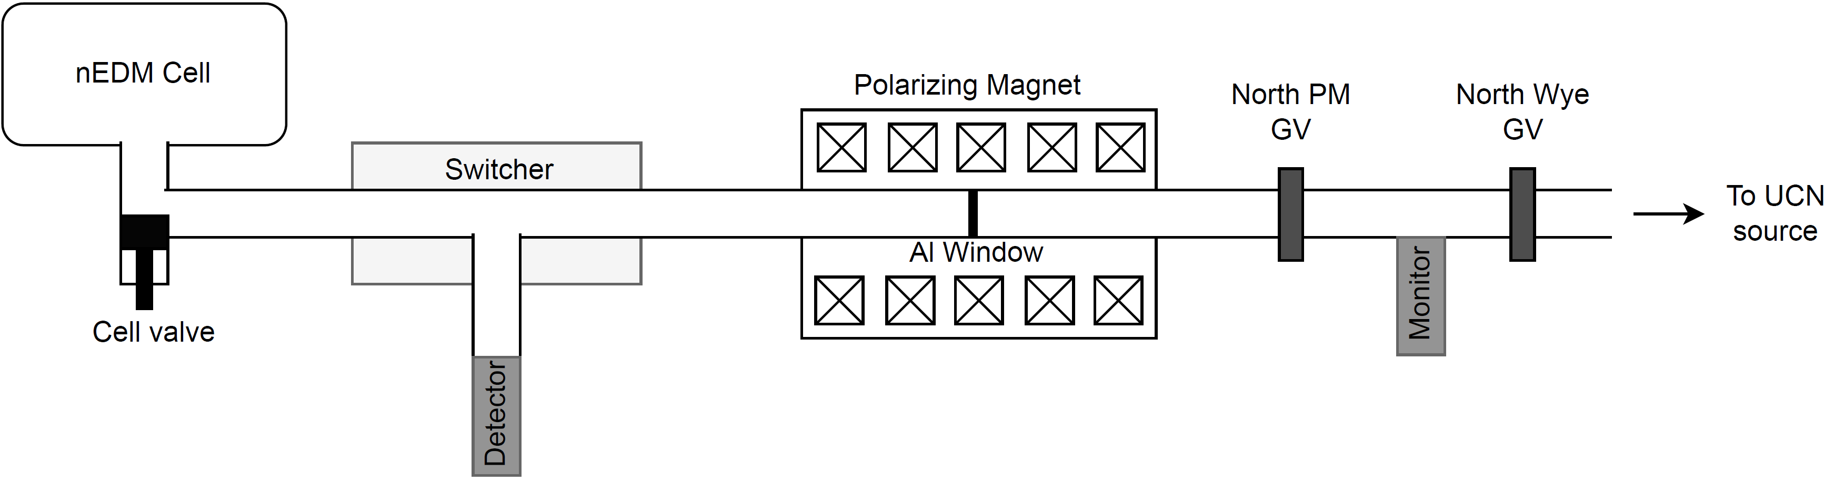
North Beamline Characterization Measurements
16

Slide 17
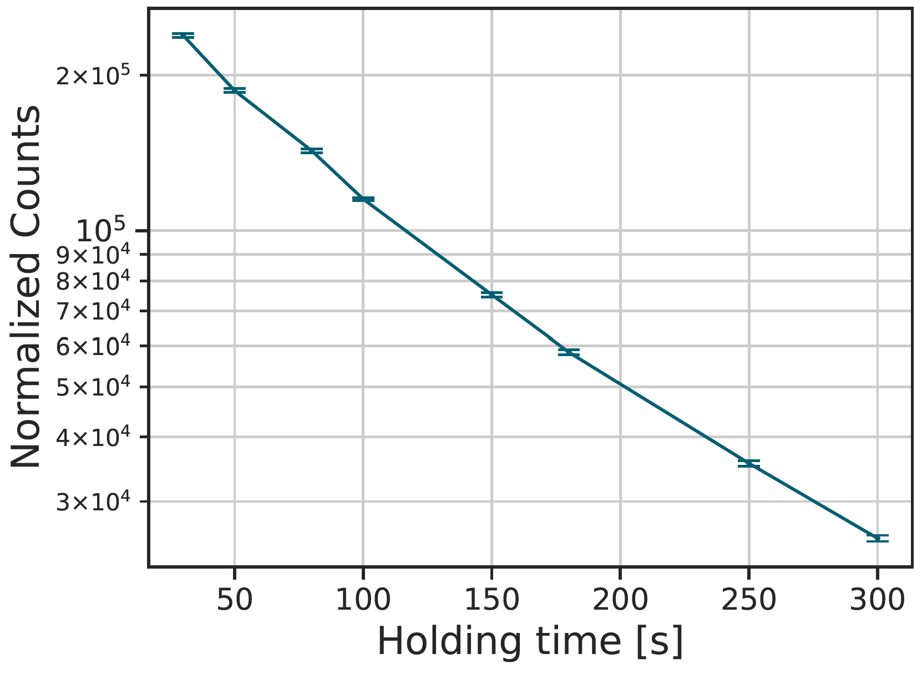
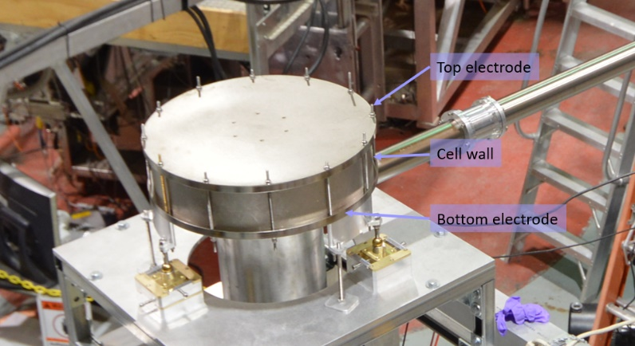
North Beamline Characterization Measurements
60,000 UCN counted in a prototype cell after 180 s of storage
doi: 10.1016/j.nima.2023.168105
17

Slide 18
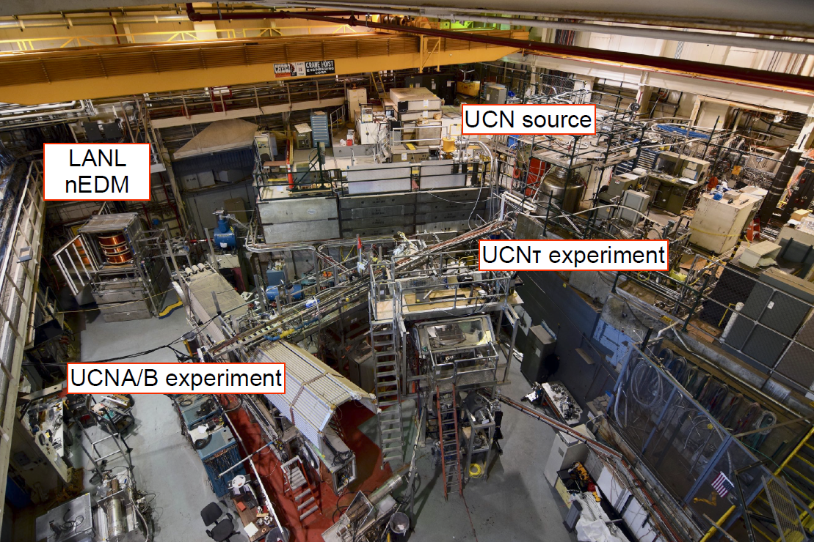
Experimental Area 2017
Ito 2022
18

Slide 19
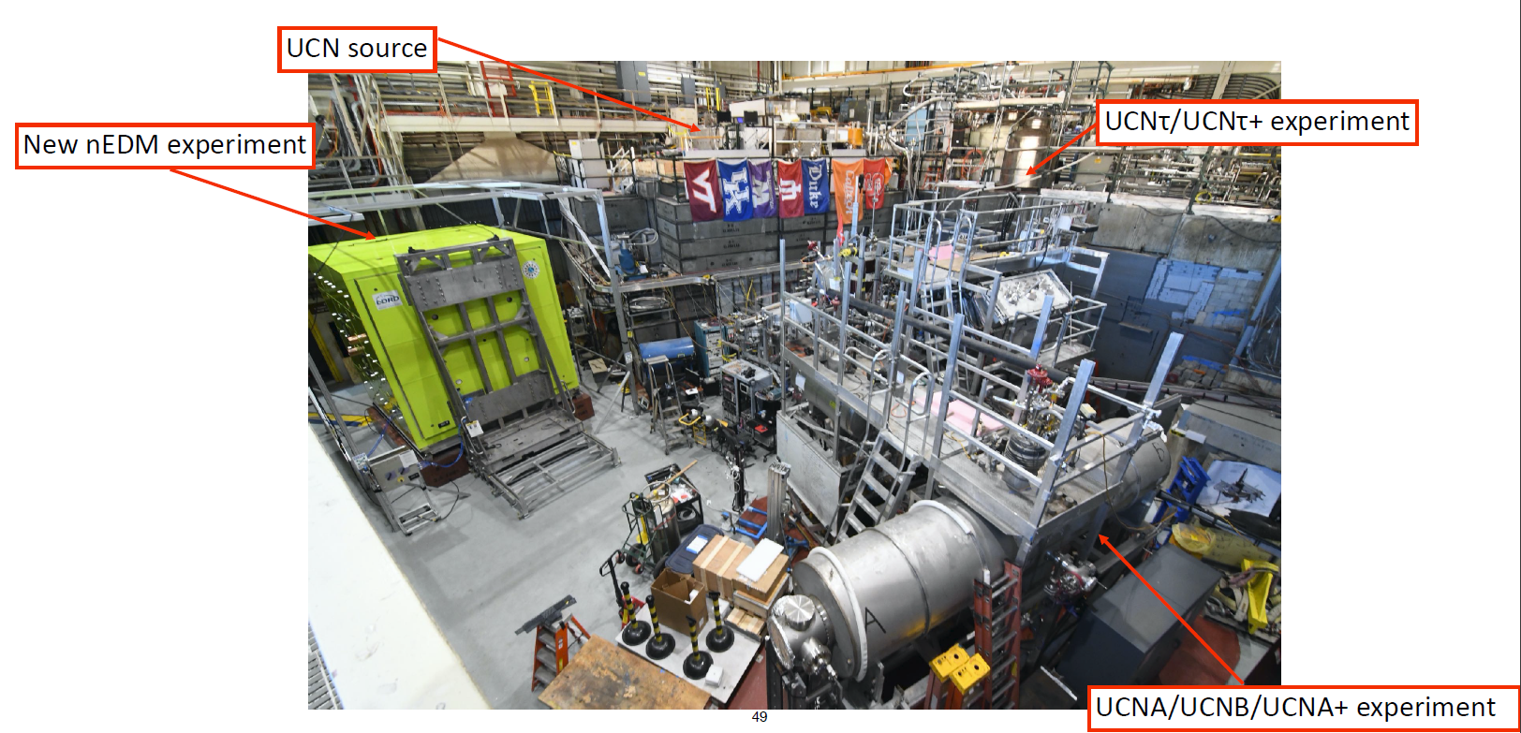
Experimental Area 2022
Ito 2022
19

Slide 20
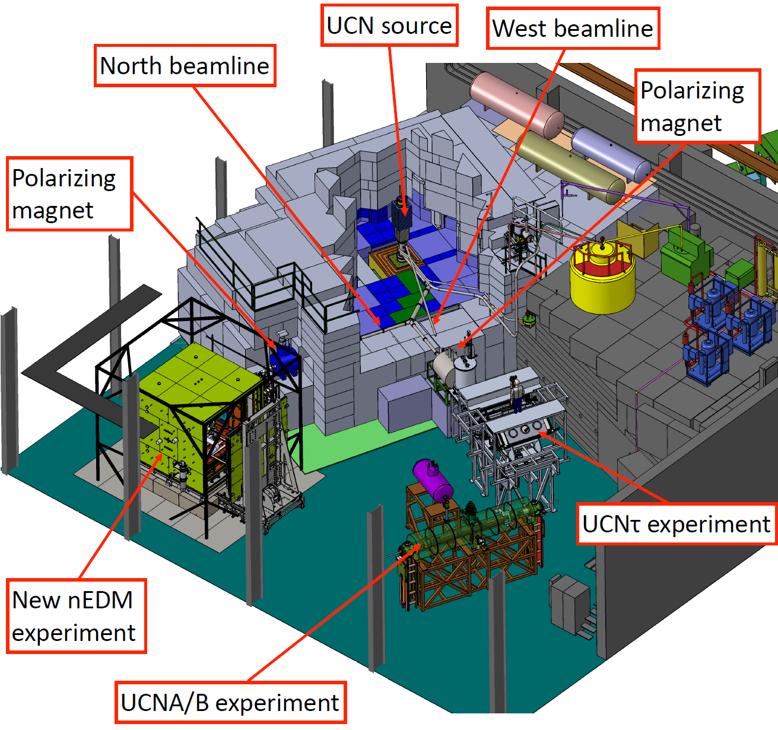
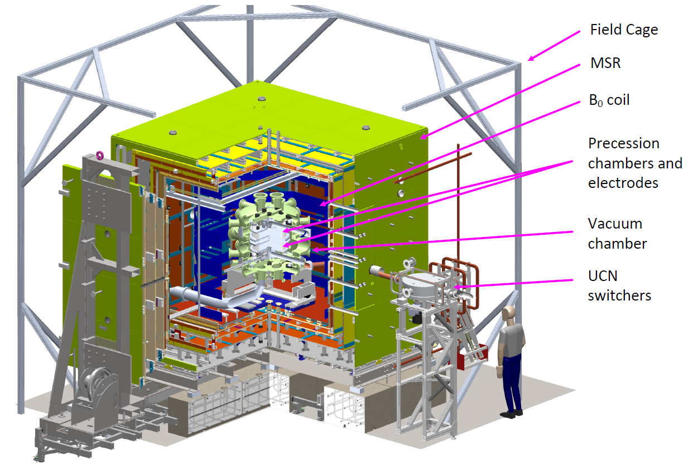
Experimental Area 2022
Ito 2022
20

Slide 21


Experimental Features
Double precession chambers
Simultaneous spin analyzers
External array of optically pumped magnetometers
¹⁹⁹Hg comagnetometer
¹⁹⁹Hg external magnetometers
External Magnetometers
$${\vec{E}}_{top}$$
TOP
HV
Central magnetometers
B₀ Coil
$${\vec{E}}_{bot}$$
BOTTOM
A
External Magnetometers
Chupp 2022
21

Slide 22
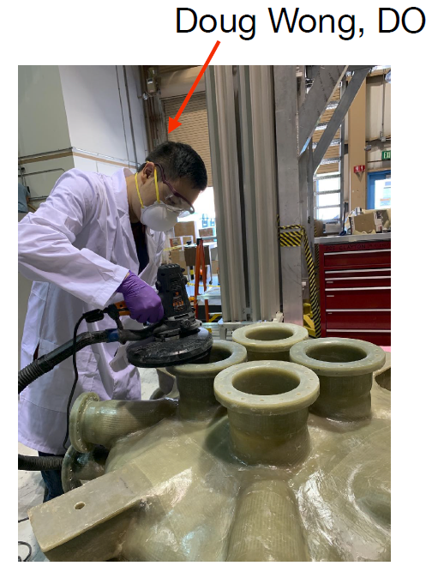
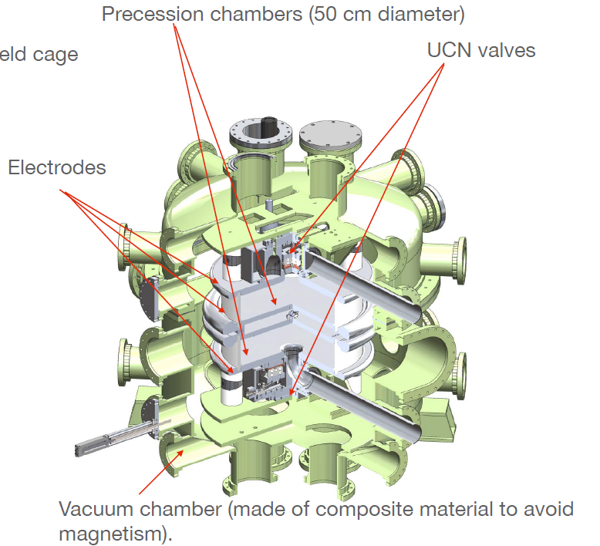
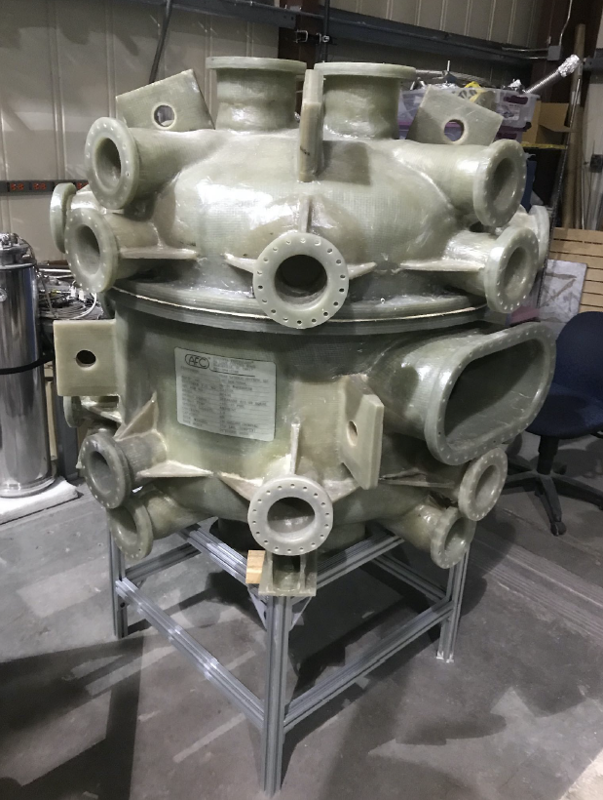
Non-magnetic Vacuum chamber
Me
Ito 2022
22

Slide 23
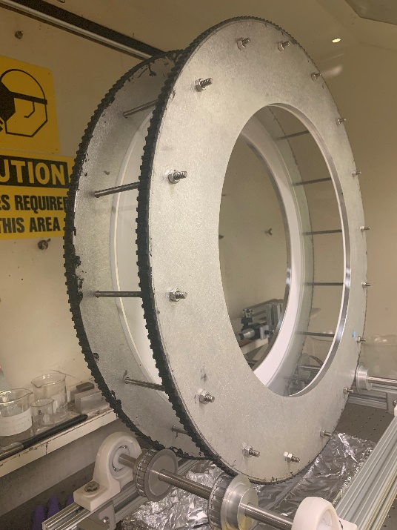
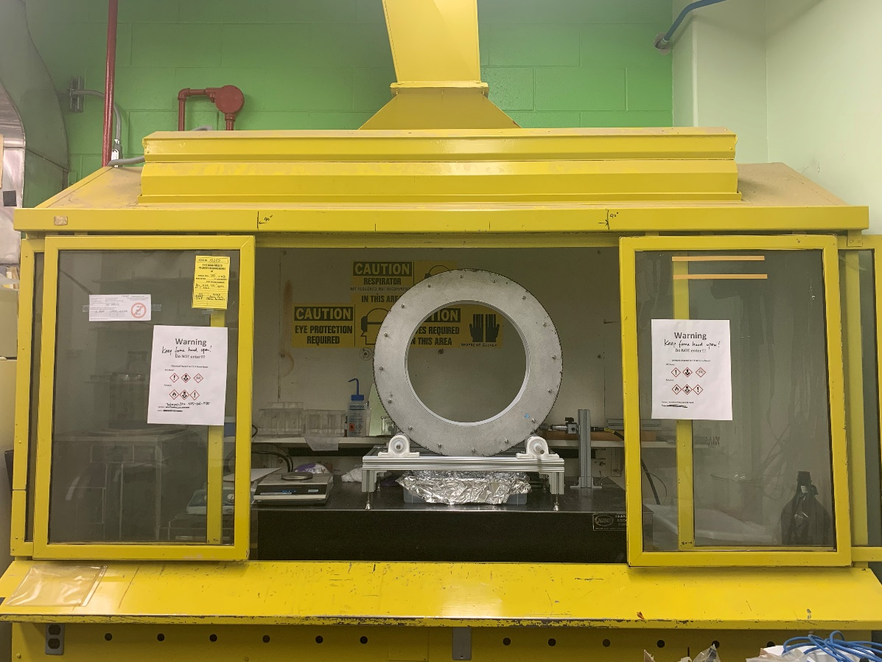
Precession chamber wall coating jig
Precession chamber wall coated with deuterated polystyrene (dPS).
A polystyrene solution in d-toluene is applied to the inner surface of a PMMA cylinder.
6 um dPS coating
23

Slide 24
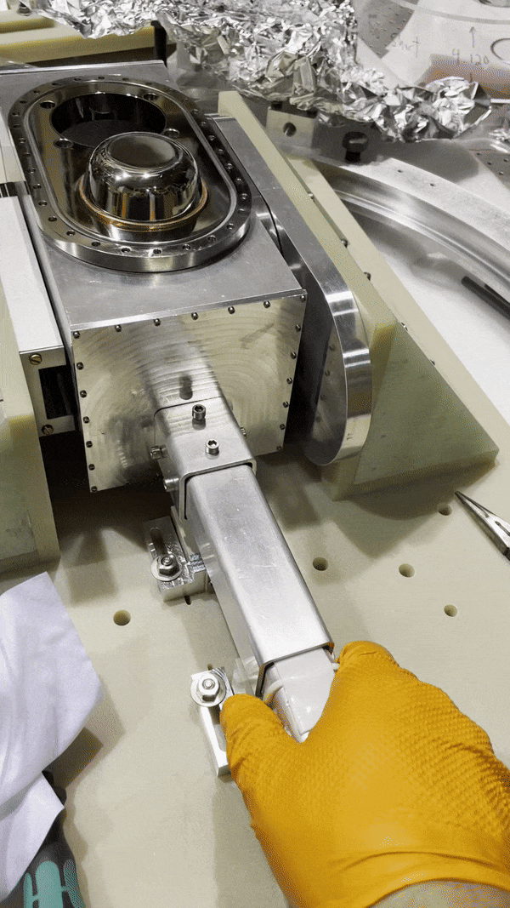
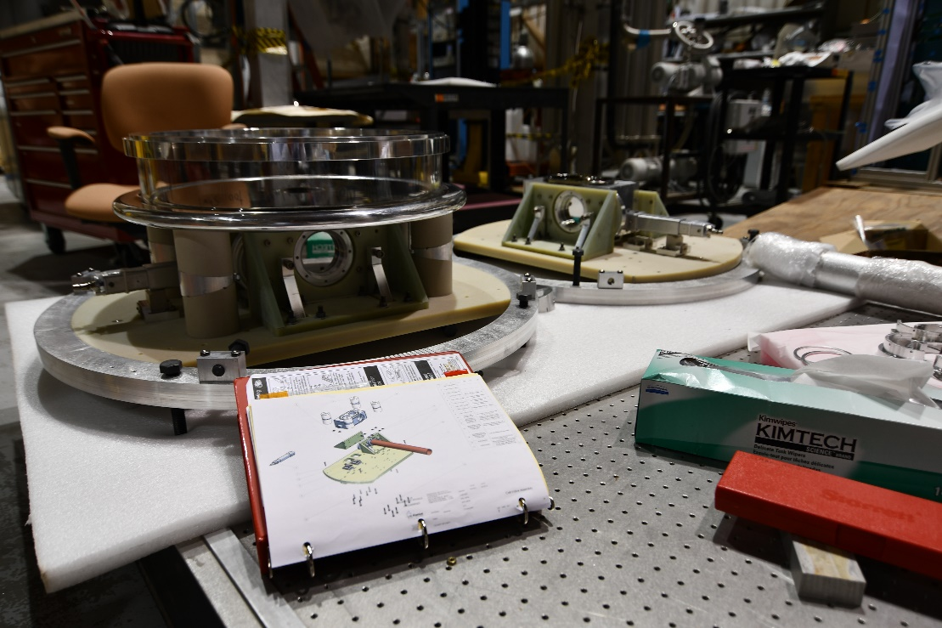
Cell Valve
24

Slide 25
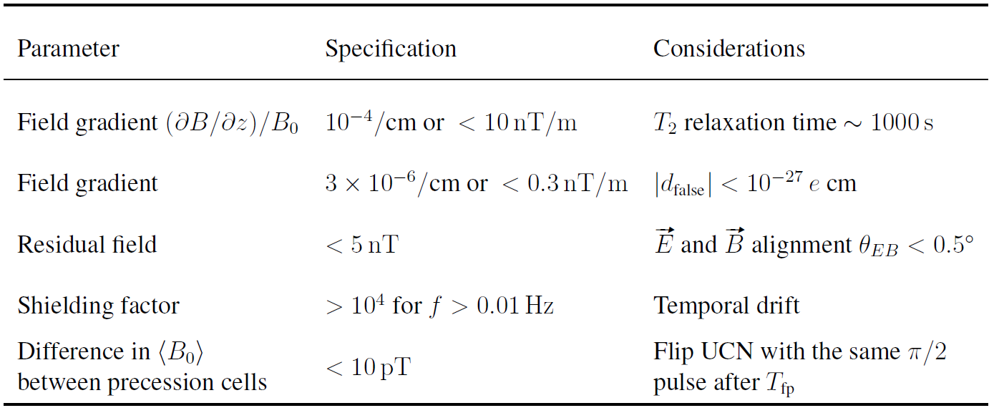
Magnetic field uniformity and stability requirements
25

Slide 26
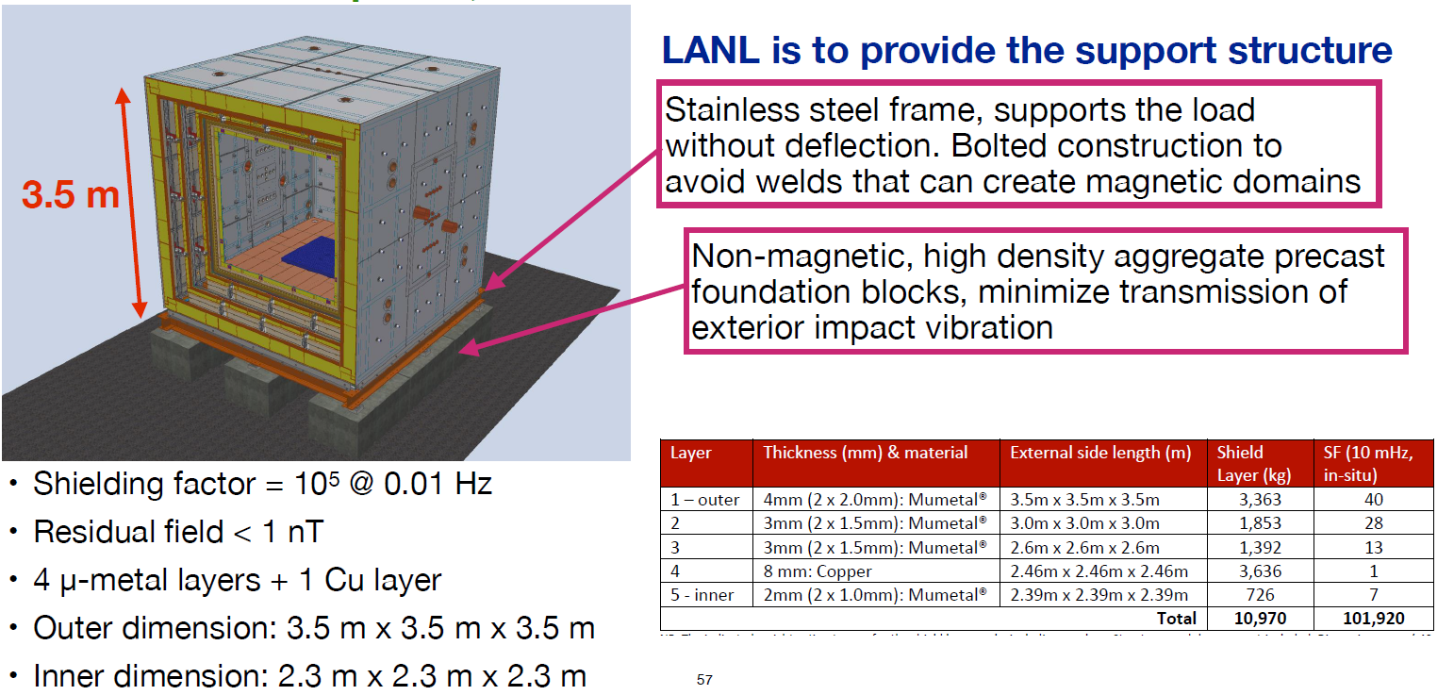
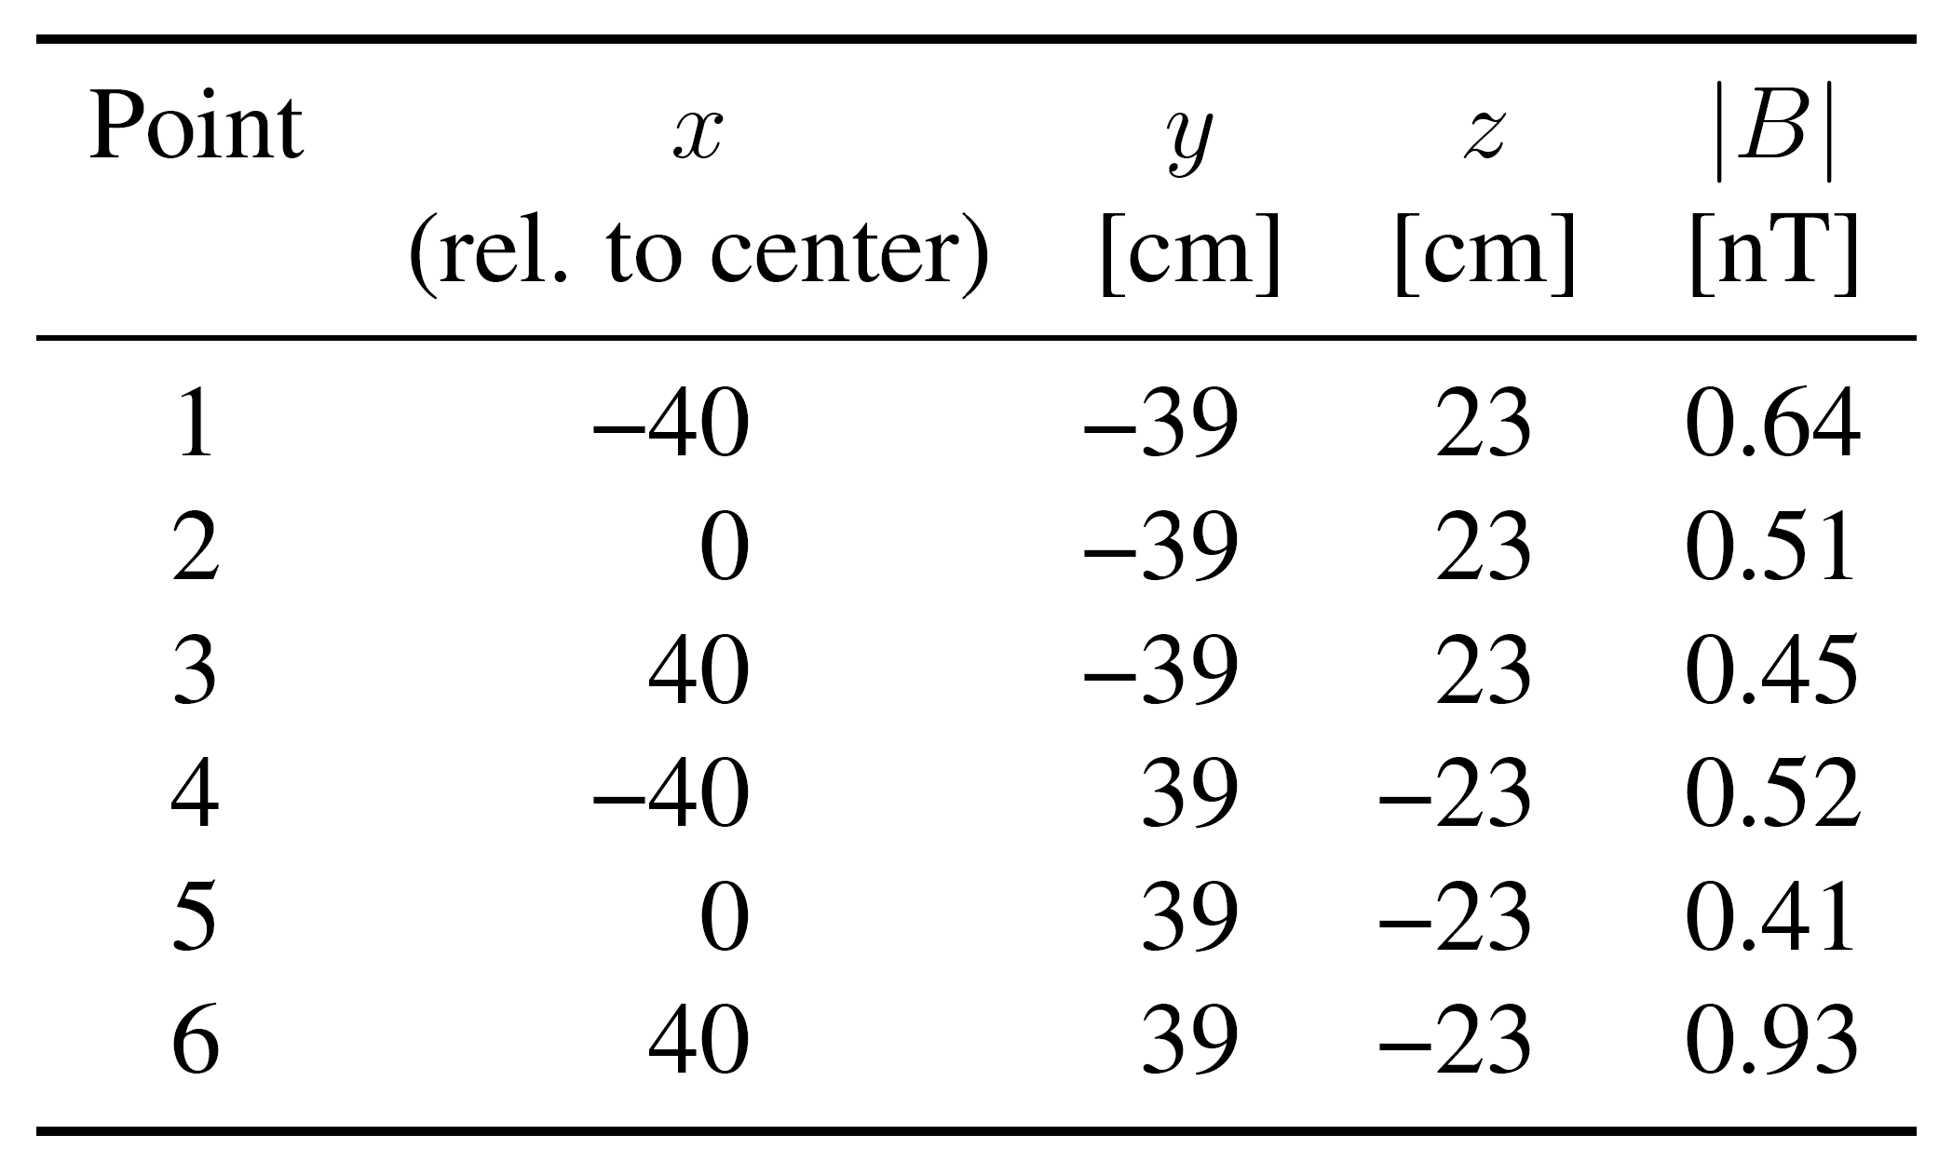

Magnetically Shielded Room (MSR)
0.5 nT
Ito 2022
26
Notes:
For improved shielding performance, the ferromagnetic layers are degaussed periodically. Degaussing
is done by applying an alternating field with large amplitude, which drives the material to
saturation, and then slowly decreasing the amplitude to zero

Slide 27
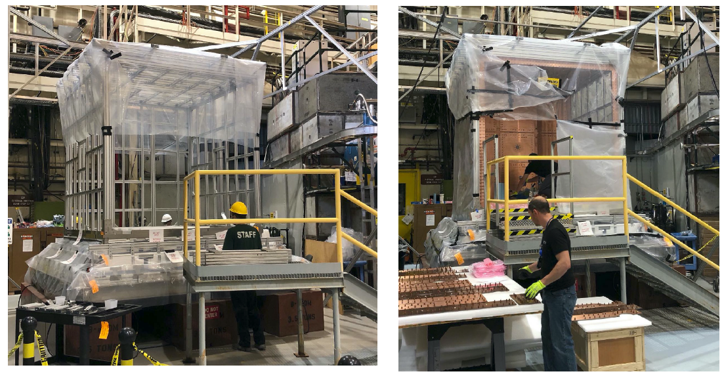
Magnetically Shielded Room (MSR)
Ito 2022
27

Slide 28
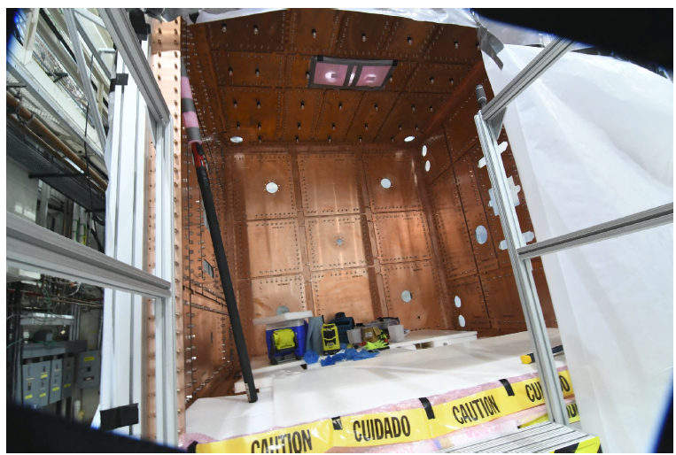
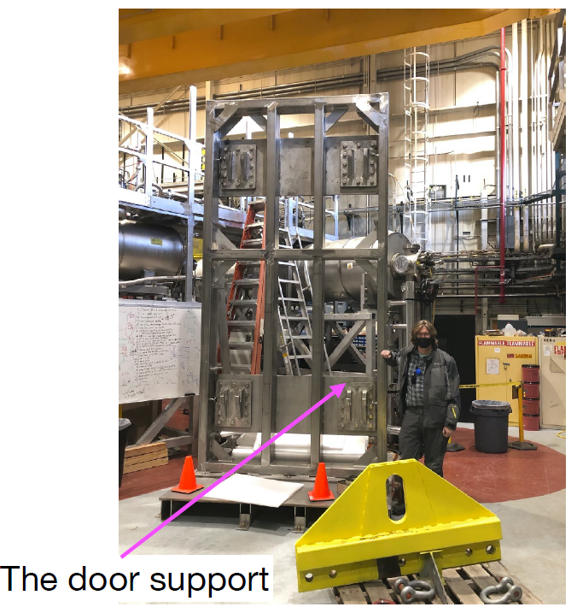
Magnetically Shielded Room (MSR)
Ito 2022
28

Slide 29
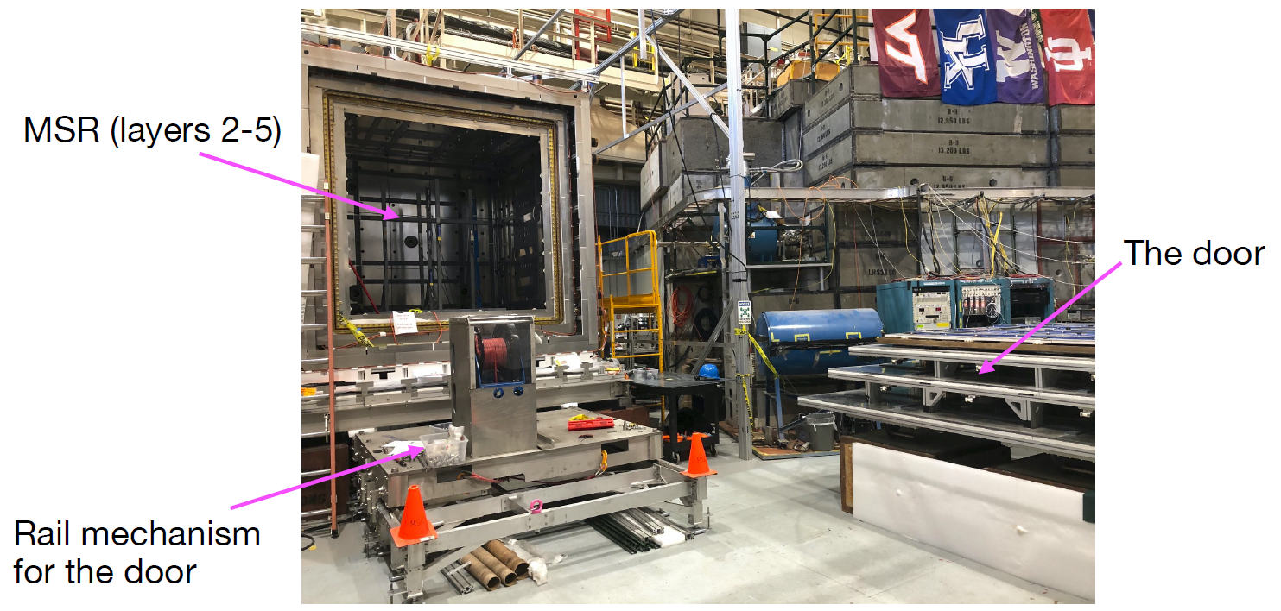
Magnetically Shielded Room (MSR)
Ito 2022
29

Slide 30
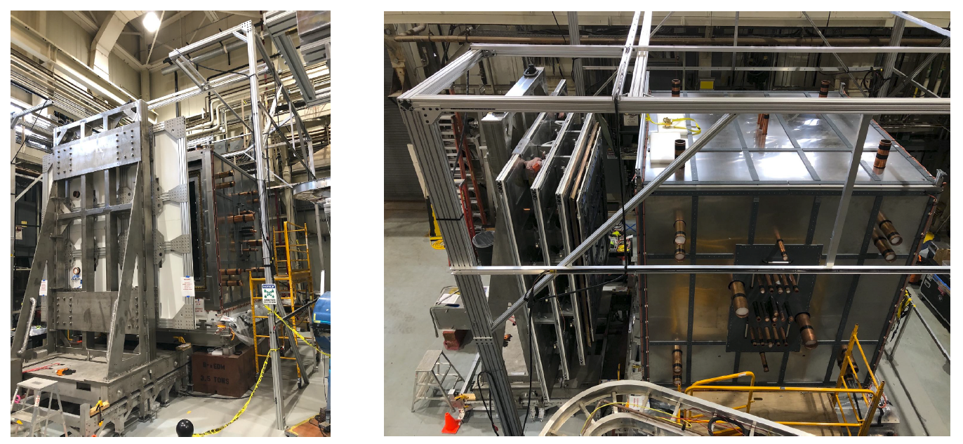
Magnetically Shielded Room (MSR)
Ito 2022
30

Slide 31
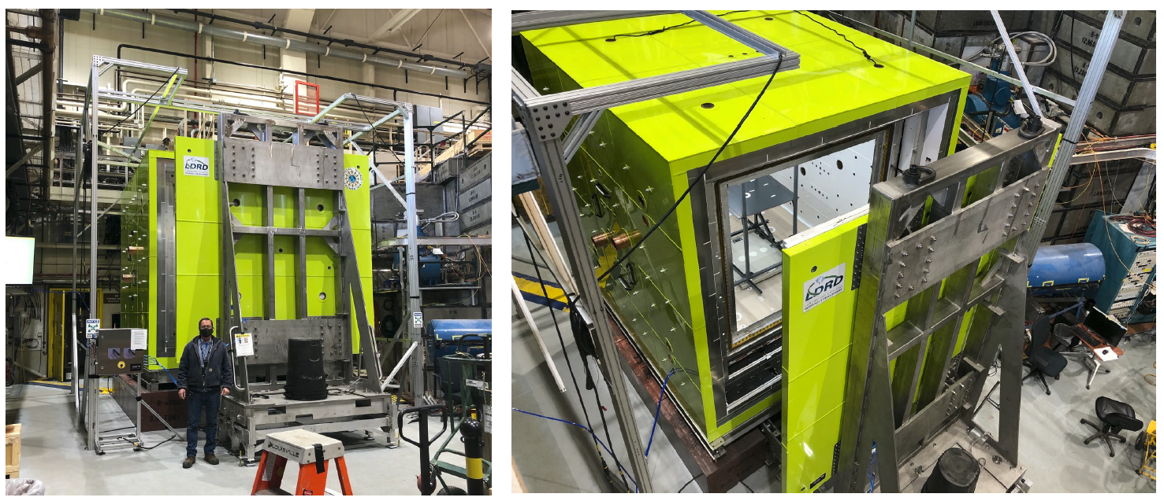
Magnetically Shielded Room (MSR)
Ito 2022
31

Slide 32
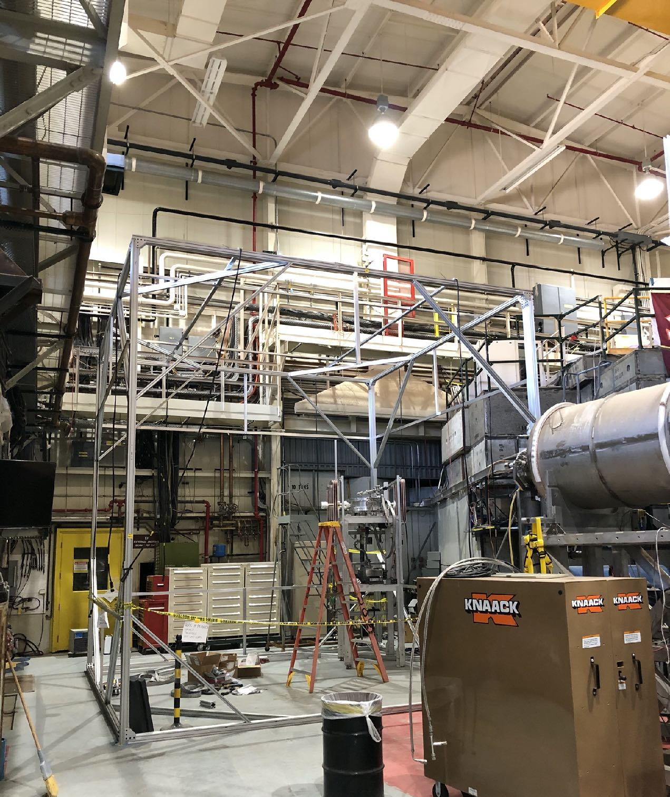
Field cage
(for MSR Evaluation and external field cancellation)
Chupp 2022
32
Notes:
1 uT for up to 1 Hz, 10 uT for 1 Hz, and 30 uT for 10 – 1000 Hz
Field cage is capable of generating 30 uT of offset

Slide 33


B₀ Coil Design
33
Notes:
Uses mumetal as flux return

Slide 34


B₀ Coil (Full scale)
34

Slide 35

Double layer cosine θ transport coil
Piya Amara Palamure 2023
35

Slide 36



Magnetic Impurity Scanner
Two QuSpin Total Field magnetometers (< 1 pT / Hz^{1/2} in 0.1 to 100 Hz range) in a gradiometer configuration, held above a sample
Sample is moved on a turntable in a small MSR. Motor located outside MSR
~0.1 nT sensitivity. Can be improved with better ambient noise control and setup characterization
Contamination can be treated as a magnetic dipole and fitted to calculate impact on gradient in the precession chamber
36

Slide 37

Rotary switcher
37

Slide 38


Adiabatic fast passage spin flipper with spin analyzers
38

Slide 39



Simultaneous spin analyzers
39

Slide 40
Current experimental status
Large MSR with a shielding factor of 10⁵ and residual fields < 0.5 nT assembled and installed
UCN in excess of 40 000 have been stored in a prototype chamber on the north beamline, sufficient to achieve 3.4 x 10⁻²⁷ e cm (90% CL) in 5 calendar years of production running
First iteration of the central nEDM apparatus (fiberglass vacuum chamber, NiP-coated electrodes, cell valves, dPS-coated cell walls) has been fabricated and installed in the MSR
Two UCN switchers for UCN transport have been tested and installed on the North beamline
B0 and MSR feed-through transport coils have been installed
We have developed a magnetic impurity scanner with ~0.1 nT resolution has scanned all installed experimental components
A simultaneous spin analyzer was fabricated and tested with polarized UCN. It has since then been upgraded and a second SSA has been built
40

