Slide 1

The PREFER collaboration/projects
Giuseppe Ciullo & University of Ferrara
on behalf of the
COLLABORATION
Group (Responsible) | Institute
R. Engels et al. | IKP - FZJ @ Jülich
M. Büscher et al. | PGI - FZJ @ Jülich ILPP- HH University @ Düsseldorf
G. Ciullo et al. | INFN & University @ Ferrara
T.P. Rakitzis et al. | IESL-FORTH & University @ Crete

Slide 2
Fusion of Nuclear Polarized Fuel
From the point of view of the nuclear physics, the use of polarized fuel can help fusion reactions thanks to:
enhancement of cross sections,
control of angular distribution of the reaction products,
possible neutron lean reactors.
Its use is now under test in order to overcome open questions:
higher polarization and higher density (few orders of magnitude more than available in nuclear polarized targets).
Preparation and Manipulation of fuel for fusion environments.
Survival of polarization in fusion environments.
See W.W. Heidbrink
plenary session 0n monday
It’s a challenging deal providing polarized fuel for the purposes of testing it in FUSION environments : by product we’ll gain in “better” targets.
G. Ciullo et al. Nuclear Fusion with Polarized Fuel - Springer Proc. in Phys. 187 (2016)

Slide 3

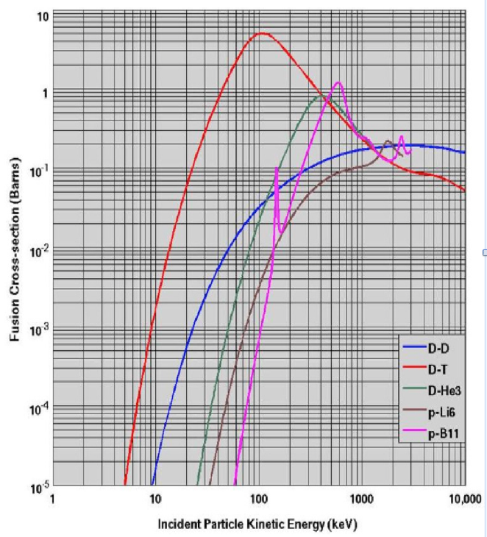
Nuclear Fusion with Polarized Fuel
Reaction generations sorted according to the relative energy (temperature) of reactants for nuclear fusion.
Generation: D + T → ⁴He + n
1.a) Increase of total cross section!
1.b) differential cross section: angular distrib. f(θ) therefore better control!!
2. Generation: D + D → T + p or ³He + n
Fuel available (30 g m⁻³ in ocean water)
2.a) Increase of total cross section ?
2.b) differential cross-section and angular distrib.?
Still missing data for a complete description.
2.c) Possibility to suppress the reaction ³He + n
(QSF Quintet Suppression Factor)?
3. Generation: ³He + D → ⁴He + p
3.a) and 3.b) expected like 1.a) and 1.b)
3.c) Possibility of Neutron lean reactor if
D+D → ⁴He* → ³He + n suppressed
Missing DD spin dependent σ e dσ/dΩ data.
Challenge objectives
for PREFER
Missing polarized fuel for fusion tests.

Slide 4
Challenge objectives of PREFER
  @IKP-FZJ - Production of polarized fuel: from pABS, and a renewed proposal.
  @ IESL-FORTH – Production polarized fuel by Laser IR-Quantum Beat (QB) excitation and Ultra Violet (UV) dissociation.
  @PGI-FZJ/HHDU - Laser Induced Plasma LIP: production, acceleration and reaction studies.
  @FE Magnets for holding, manipulating and transporting polarized fuel .

Slide 5

Challenge objectives of PREFER
  @IKP-FZJ - Production of polarized fuel: from pABS, and a renewed proposal.
  @ IESL-FORTH – Production polarized fuel by Laser IR-Quantum Beat (QB) excitation and Ultra Violet (UV) dissociation.
  @PGI-FZJ/HHDU - Laser Induced Plasma LIP: production, acceleration and reaction studies.
  @FE Magnets for holding, manipulating and transporting polarized fuel .

Slide 6
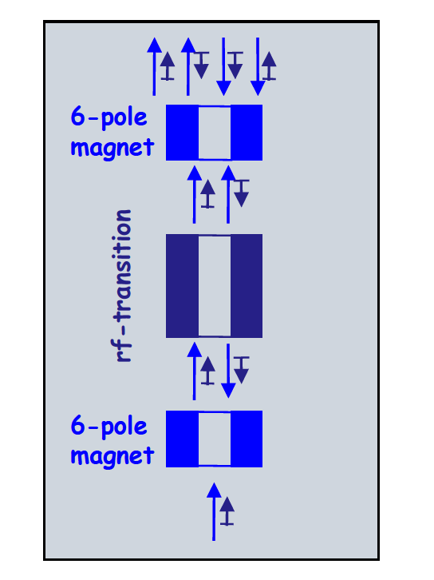
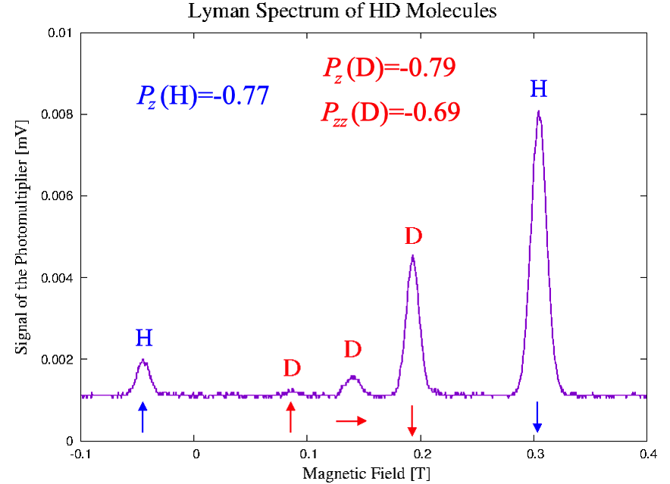
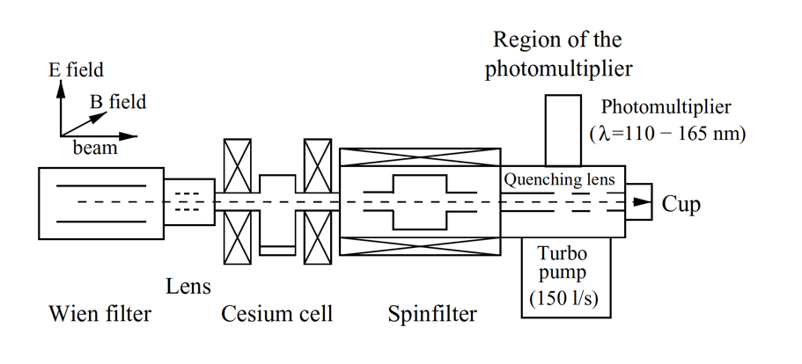
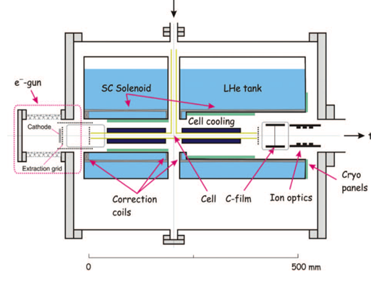
@IKP-FZJ Hyperpolarized molecules from pABS
Production
recombination
Analysis
R. Engels et al. «Production of HD molecules in definite hyperfine substates» Phys. Rev. Lett. 124 (2020) 113003

Slide 7
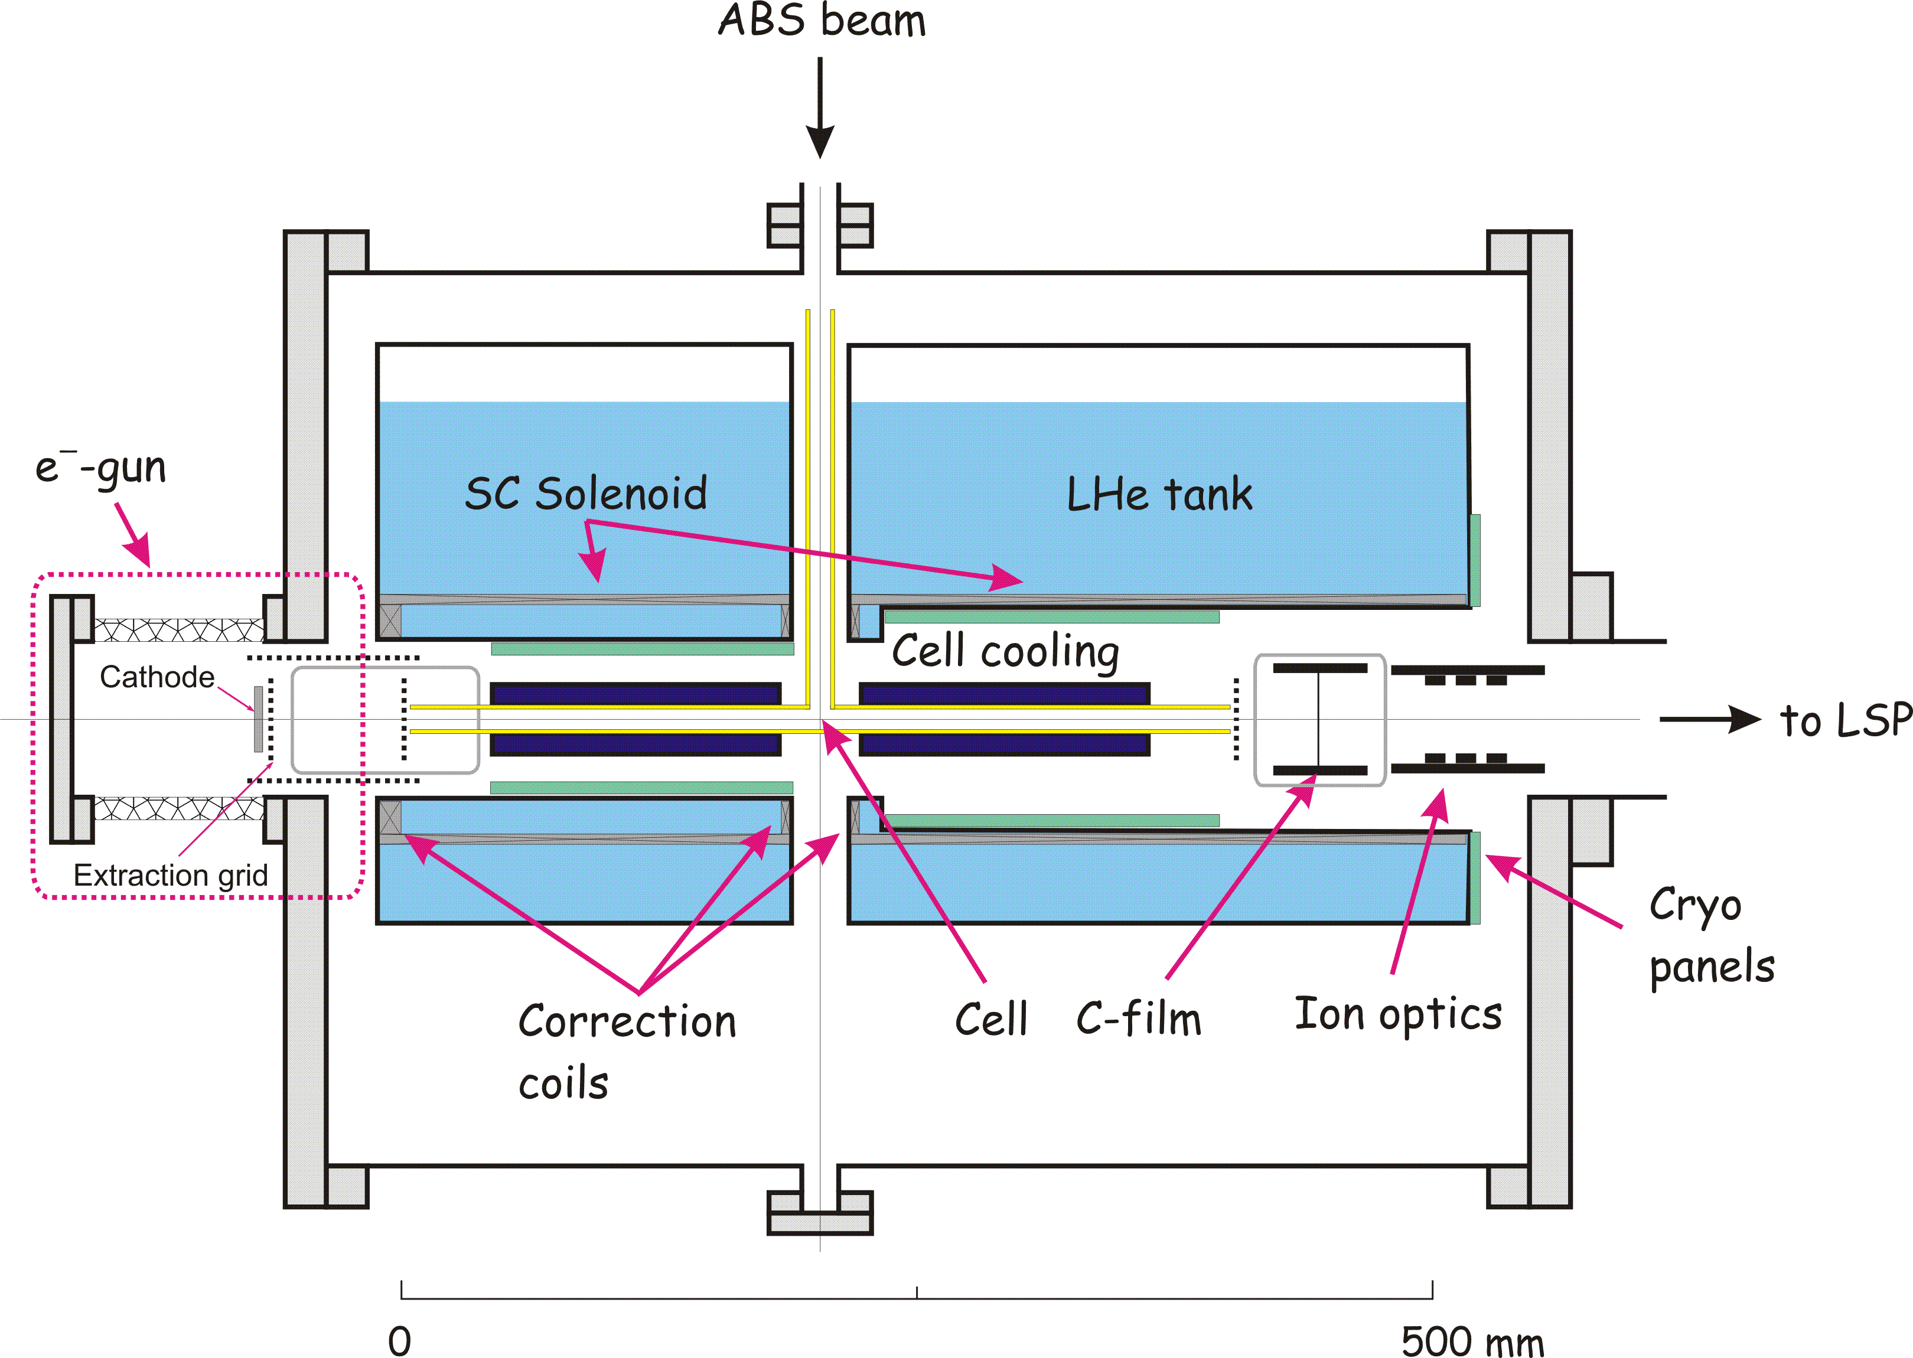
Condensation & transp. of pol. fuel
Connection with
magnetic field
@ FE
Production of 1 day
(>10²¹ molecules) is enough to feed a Tokamak for seconds,
pellet or test in ICF !!
Cold
Head
T= 3-10K
D₂ ice
Target useful
for LIP fusion
@PGI-FZJ/HHDU
H₂, D₂, and HD hyperpolarized molecules can be produced with polarization of P ~ 0.8 ! For HD any spin combination is possible !
HD is a perfect training ground for the handling of TD !
The condenser is surrounded by a SC MgB₂ cylinder,
which provides the holding field also for transportation.

Slide 8
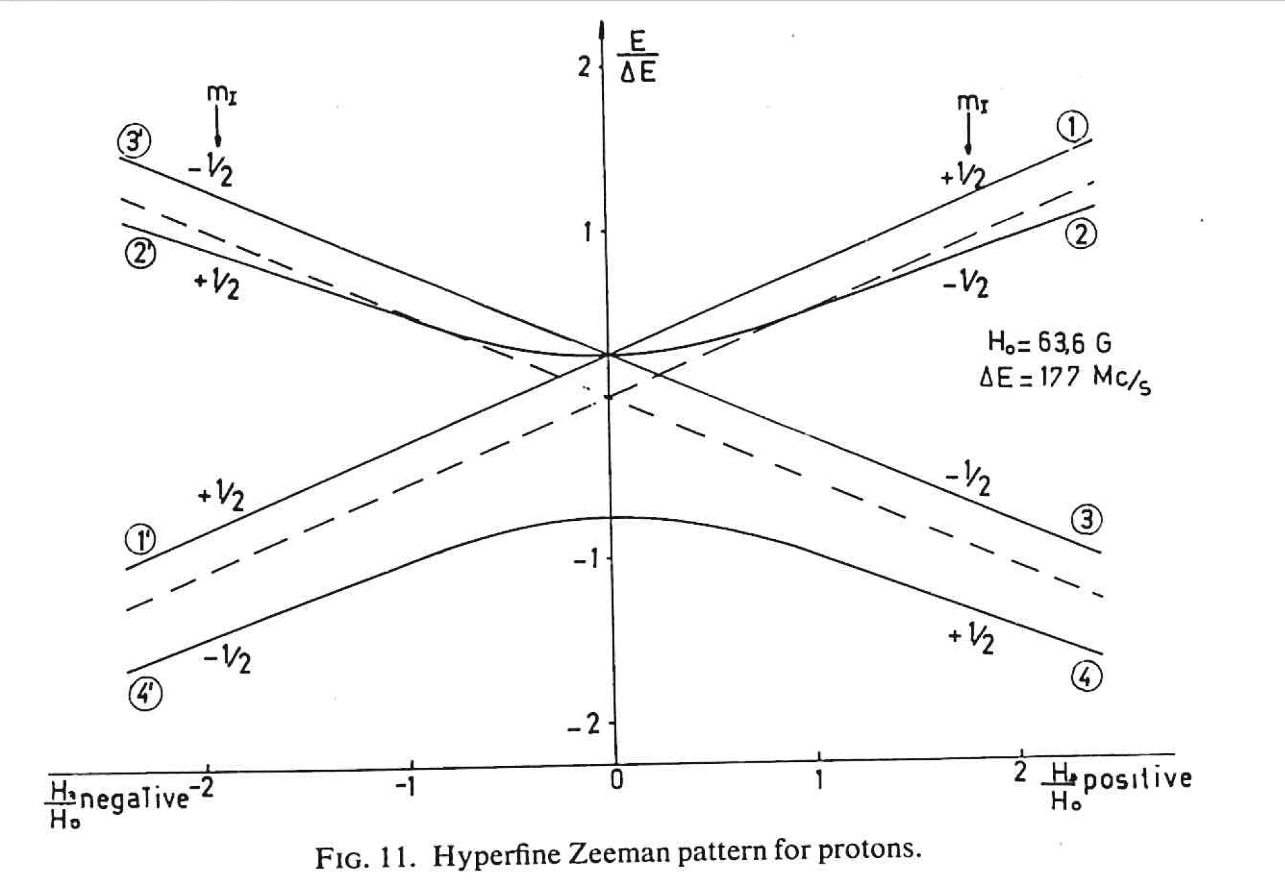
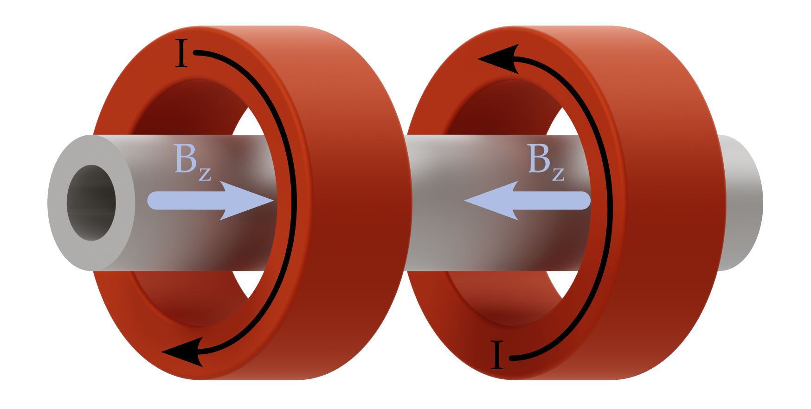
@IKP-FZJ – exploring and exploiting Sona Transitions
P_{z}=0
H, T
by a fast passage
of a beam in the
states 1 and 2,
through a zero field
crossing will go in
the states 1’ and 2’
The nuclear
polarization P_{z}=1
P_{z}=1
Beam direction
P. G. Sona Laboratori CISE Milano
_{Energia Nucleare 14 (1967) 295}

Slide 9
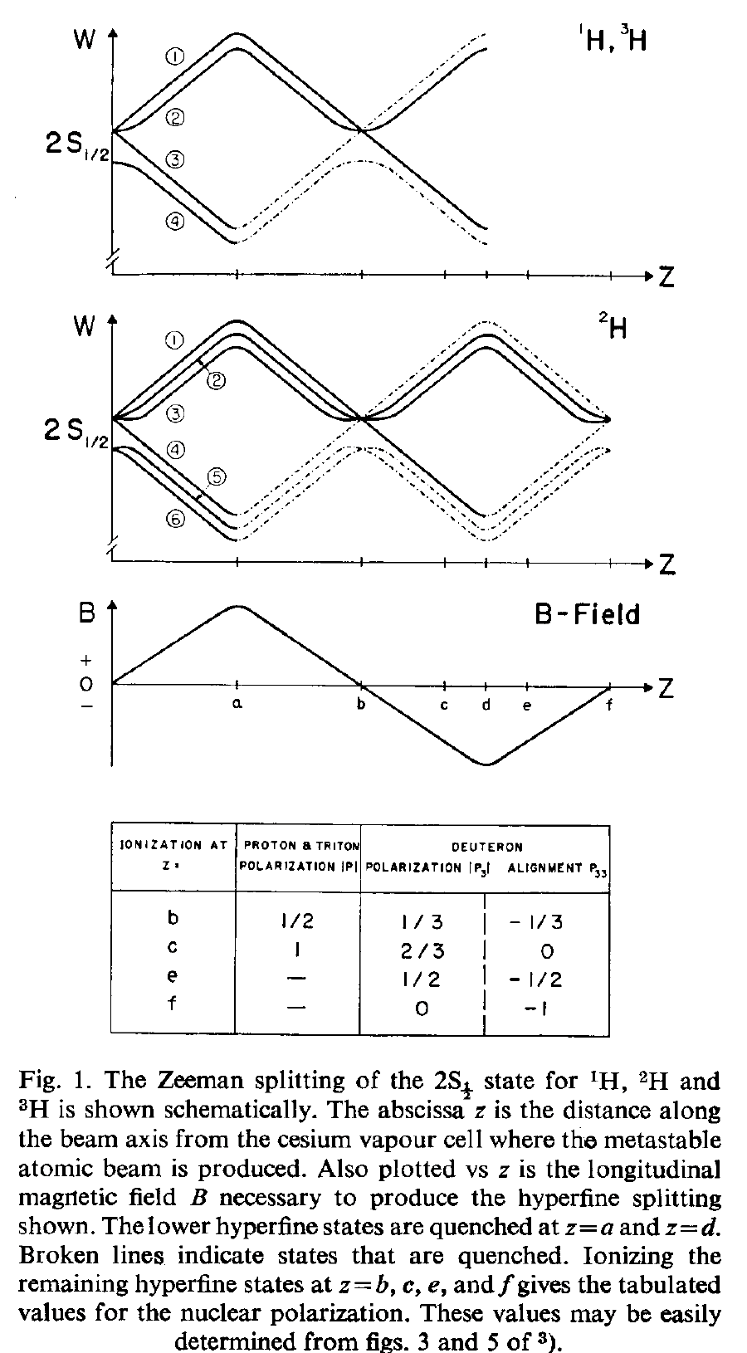
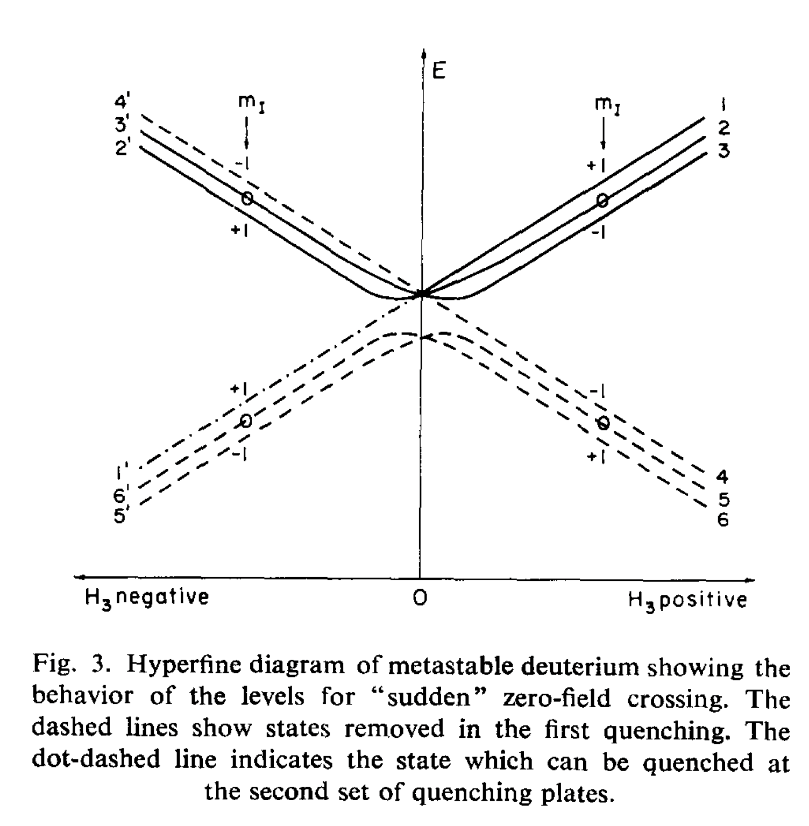
Sona idea used soon
T.B. Clegg et al NIM 62 (1968) 343
MADISON LS source
G. MICHEL et la NOTRE DAME LAMB-SHIFT POLARISED ION SOURCE*
NIM 78 (1970) 261.

Slide 10
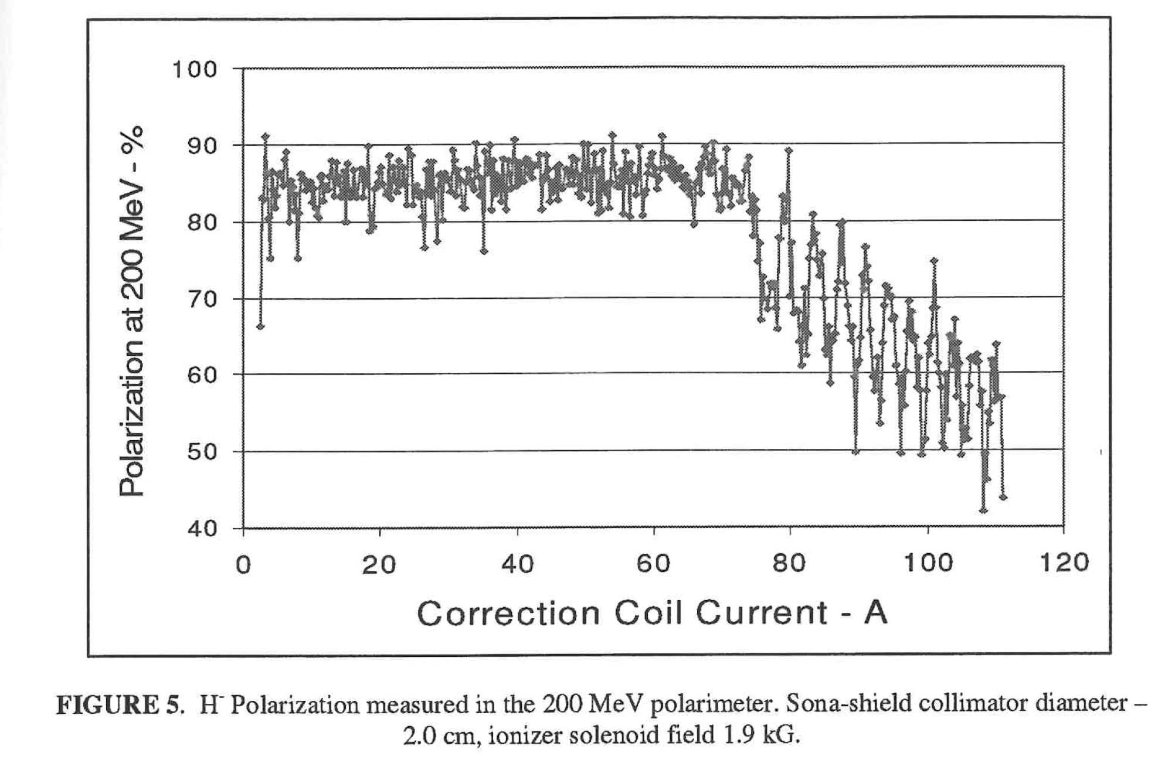
Avoiding adiabaticity in Sona Transitions ...
Interest in
preserving
diabatic transition,
solution by
reducing tranverse
component of magnetic
fields,
which can induce
adiabatic transitions.
Preliminary explanation
of the resonant behavior
Zelenski et al. « The RHIC optically-pumped polarized H⁻ ion source» in
PSTP 2007 AIP Conf. Proc. 980 (2008) 221.
Kronou et al. «Sona Transition Studies in the RICH OPPIS»
E. P. Antishev andf A. S. Belov «Study of Adiabaticity of Hydrogen Atoms Spin Motion in Changing» Magnetic Fields

Slide 11
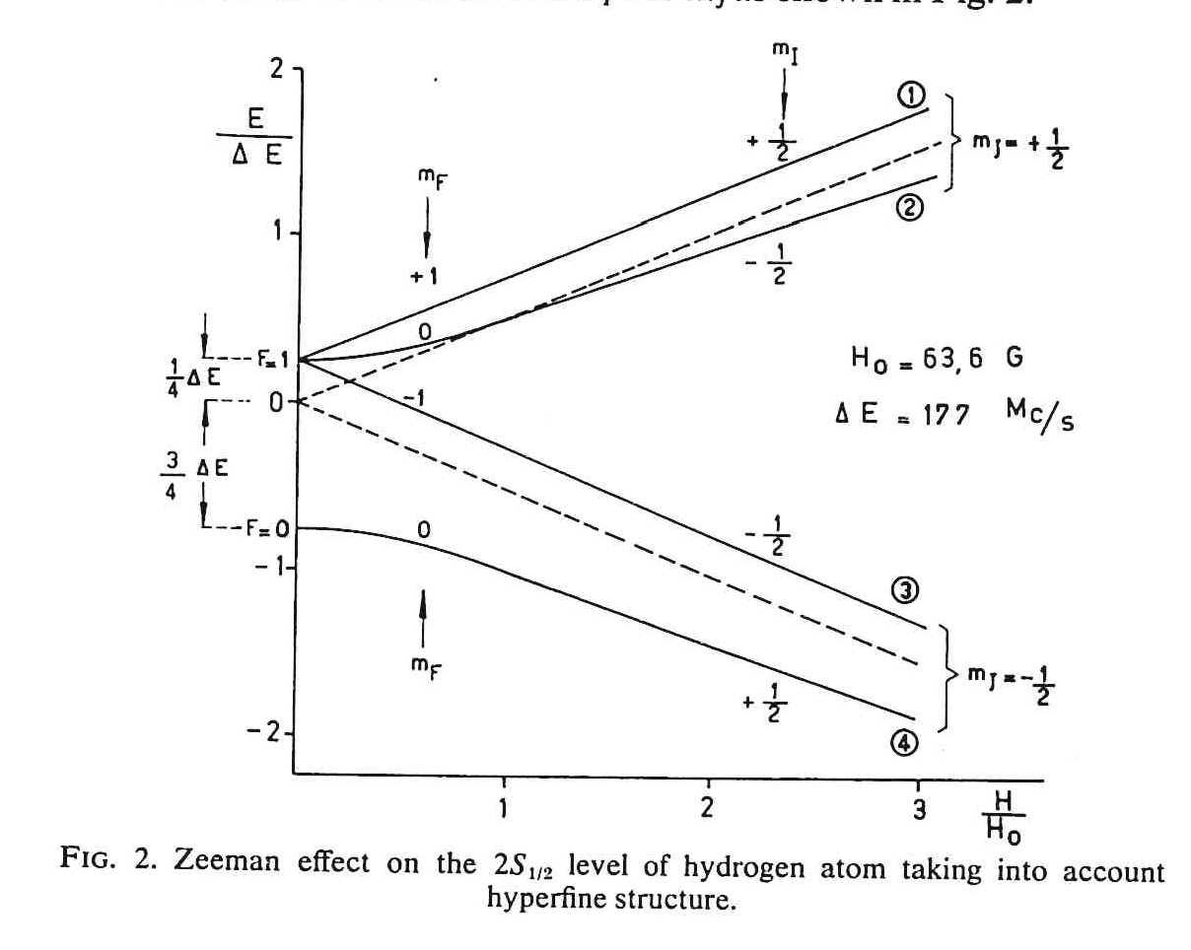
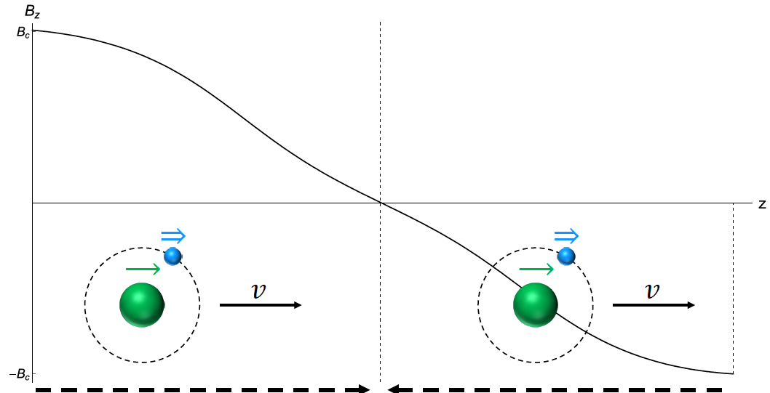
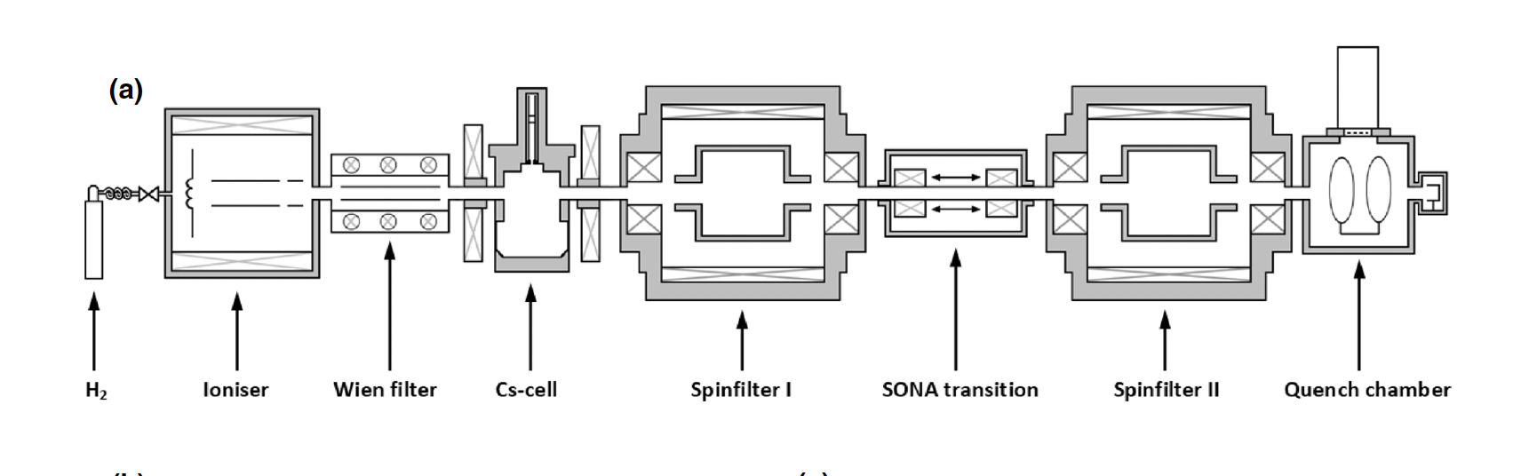
@IKP-FZJ – exploring and exploiting Sona Transitions
|𝑚_{𝐽},𝑚_{𝐼}⟩
Diabatic Sona transition
|𝛼₁>=|⇑,↑>
|𝛼₁>=|⇑,↑> to |𝛽₃>=|⇓,↓>
|𝛼₂>=|⇑,↓>
|𝛽₃>=|⇓,↓>
|𝛽₄>=|⇓,↑>

Slide 12
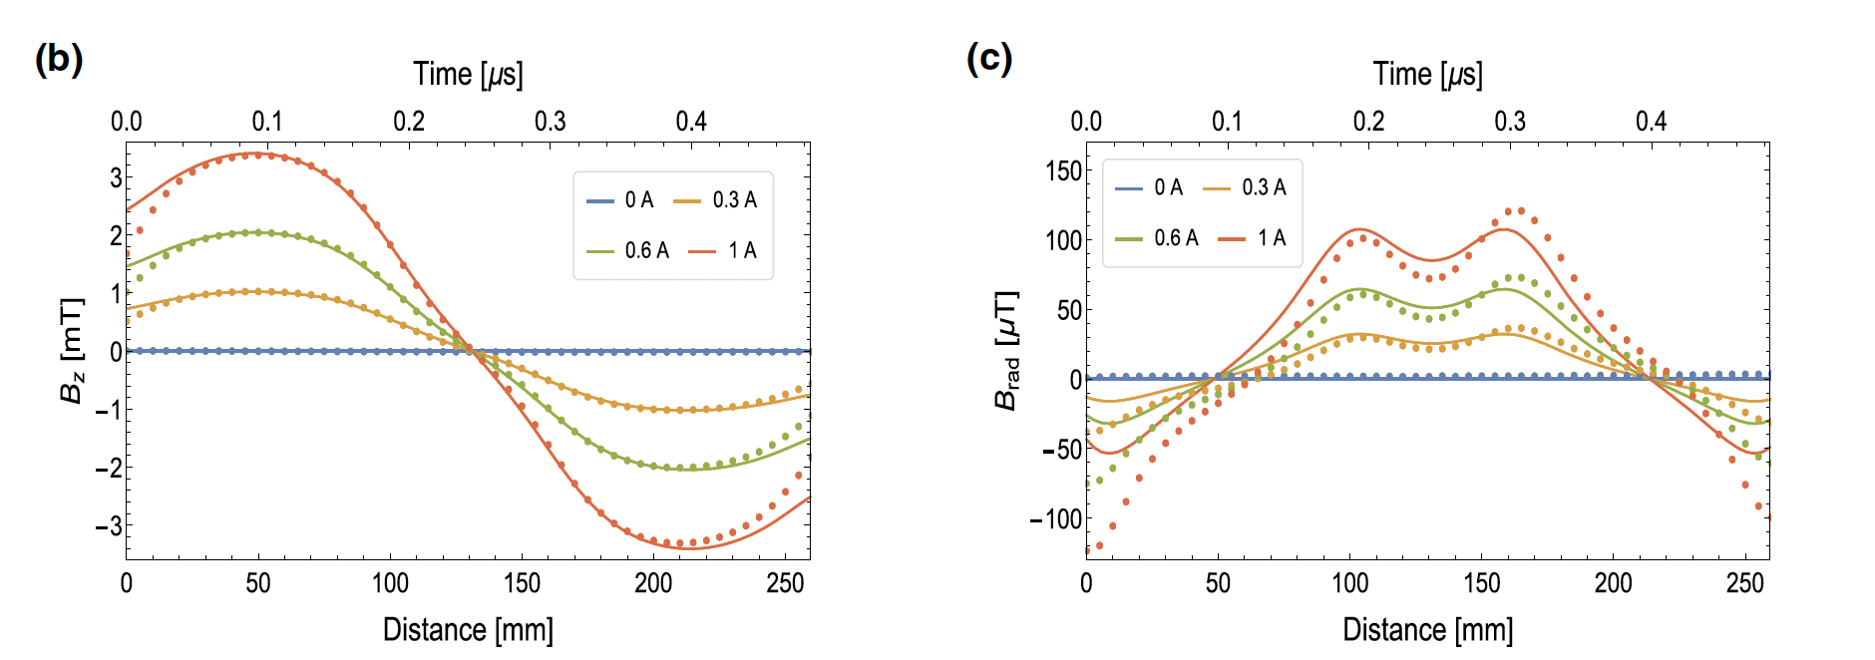
Exploiting the adiabatic transitions.
... zero filed crossing is less effective at radial distance on the left at r= 3 mm
By estimating properly of the seen field, considering it in the Schrödinger equation,
as perturbative terms, unexpected transitions can be understood and simulated.
If we understand how to control these transitions, we can use the Sona configurations
to prepare beam in defined quantum states.

Slide 13
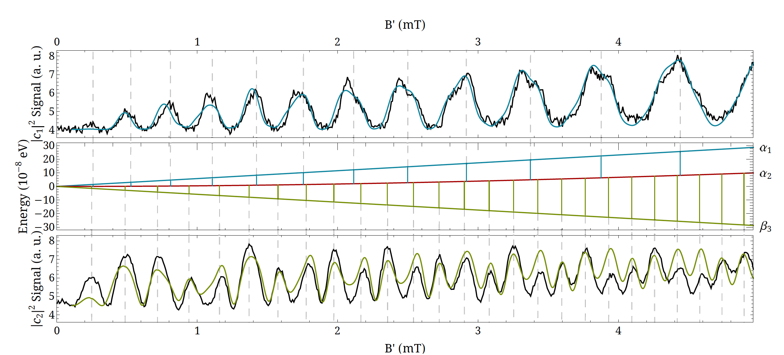
Theory and experiments
R. Engels et al. Eur. Phys. J. D 75 (2021) 75
Injecting |α₁> in Sona transition it goes to |β₃> , but adiabatic transition and
are also induced.
L. Faatz talk on Monday for ³He+ V. Kannis talk today for atoms, molecules.

Slide 14
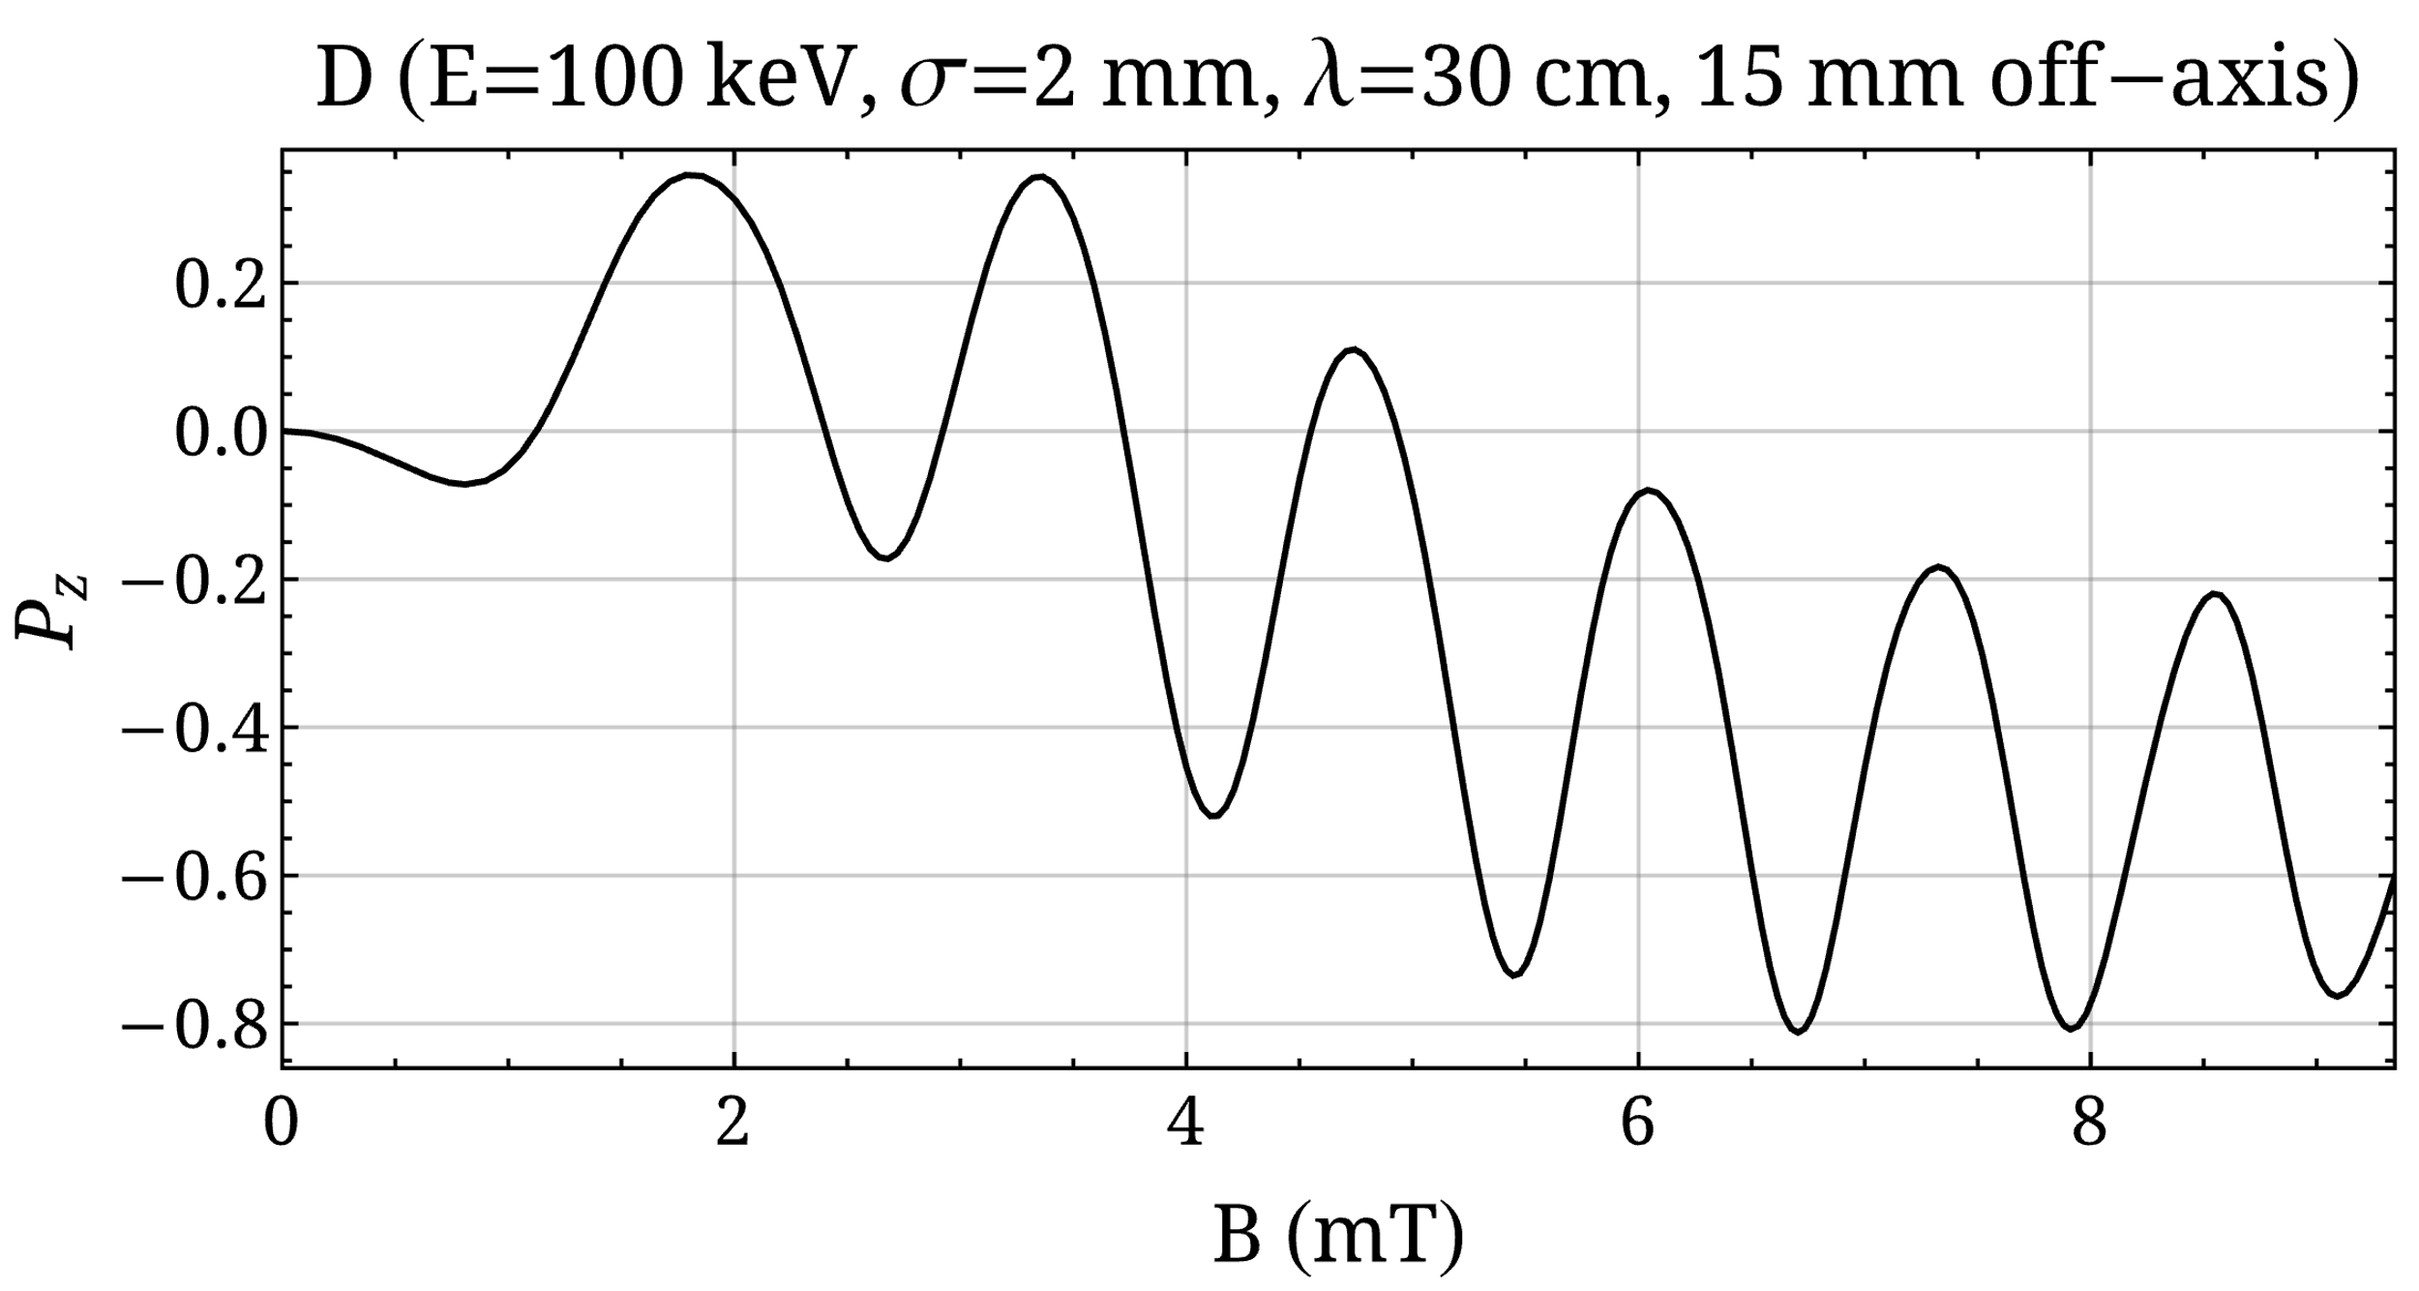
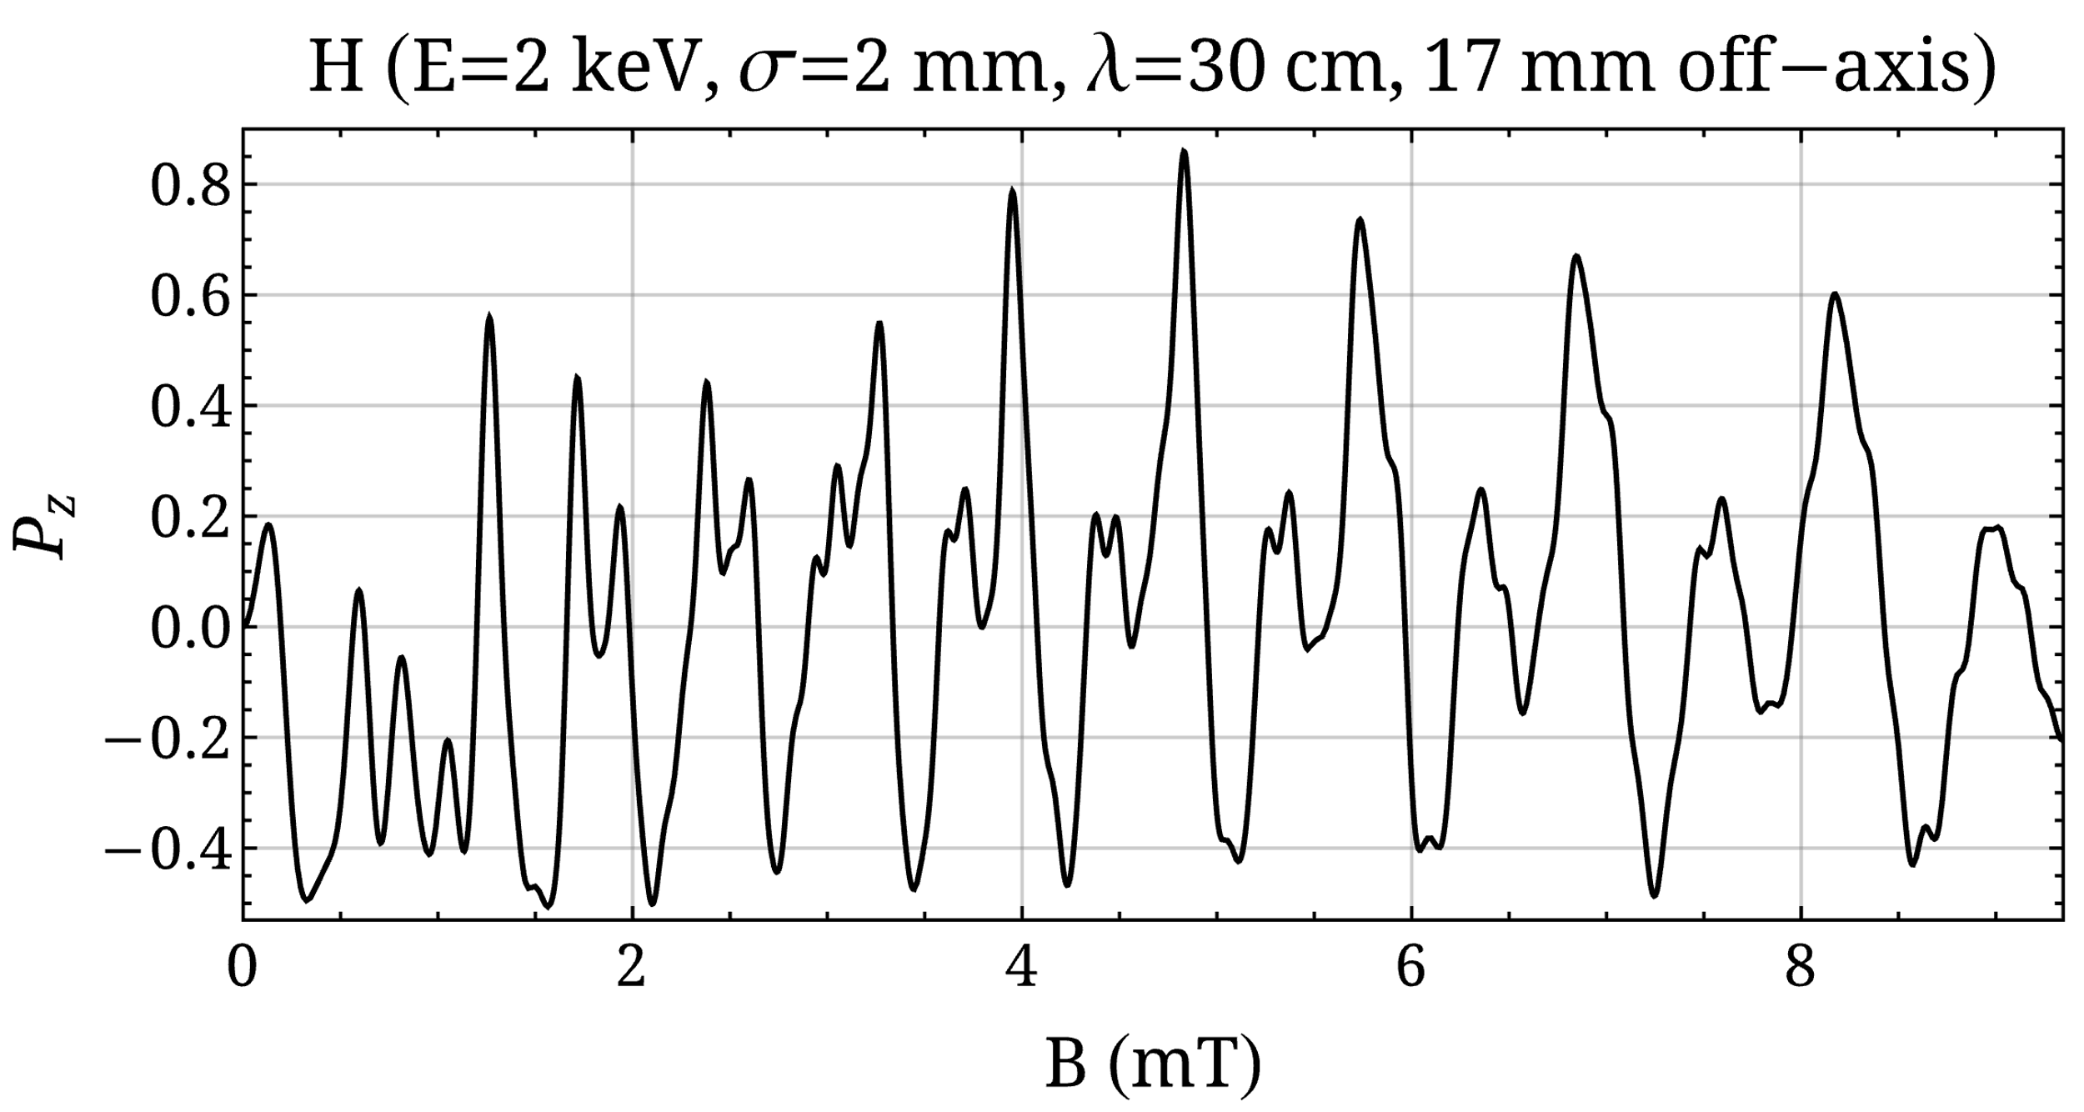
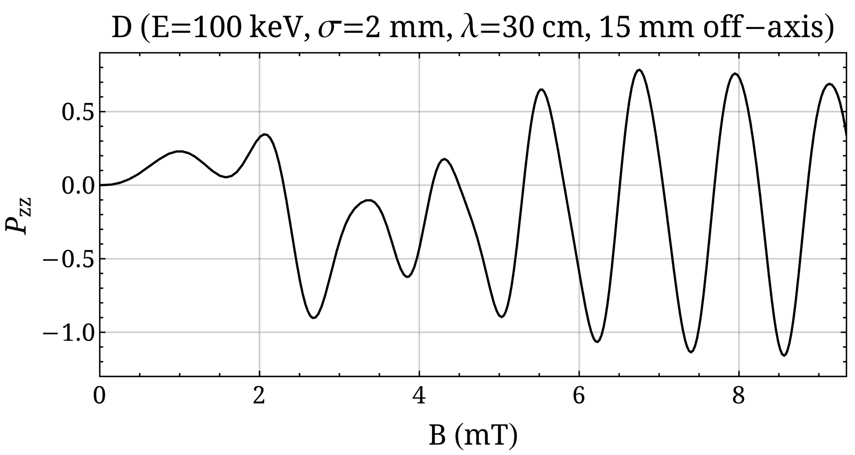
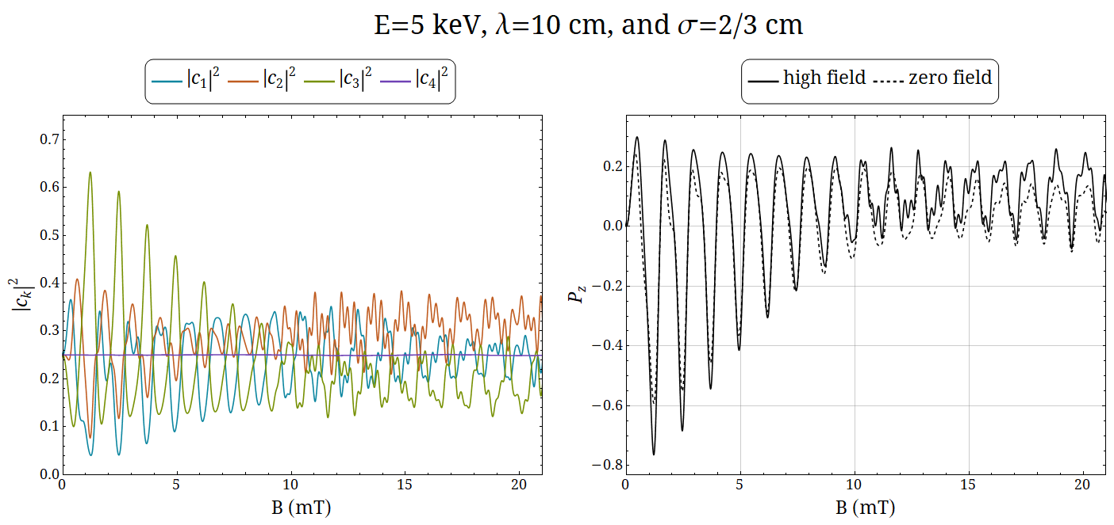
Simulation for H, D & ³He+ ...
V. Kannis talk on 26/9
V. Kannis talk on 26/9
L. Faatz talk on 25/9

Slide 15

Challenge objectives of PREFER
  @IKP-FZJ - Production of polarized fuel: from pABS, and a renewed proposal.
  @ IESL-FORTH – Production polarized fuel by Laser IR-Quantum Beat (QB) excitation and Ultra Violet (UV) dissociation.
  @PGI-FZJ/HHDU - Laser Induced Plasma LIP: production, acceleration and reaction studies.
  @FE Magnets for holding, manipulating and transporting polarized fuel .
Institute of Electronic Structure and Laser (IESL)

Slide 16
@ IESL-FORTH QB excit. and UV dissoc.
The idea: ‘‘Highly nuclear-spin polarized deuterium atoms
from the UV dissociation of Deuterium Iodide”
Sofikitis et a.; Phys. Rev. Lett. 118 (2017) 233401.
Pulsed Nozzle
DI
D atoms
LSP of Jülich Type
Laser
Excitation
Laser
Dissociation
Electron-Polarization = 1
Deuteron-Polarization ~ 2/3
HI
(Proton-Polarization = 1)
Proof-of-principle
(Univ. of Crete/FORTH, IKP/PGI in FZJ/HHUD).
Proof-of-principle V
D. Sofikitis et al. Phys. Chem. Chem. Phys. 21 (2019) 14000.

Slide 17
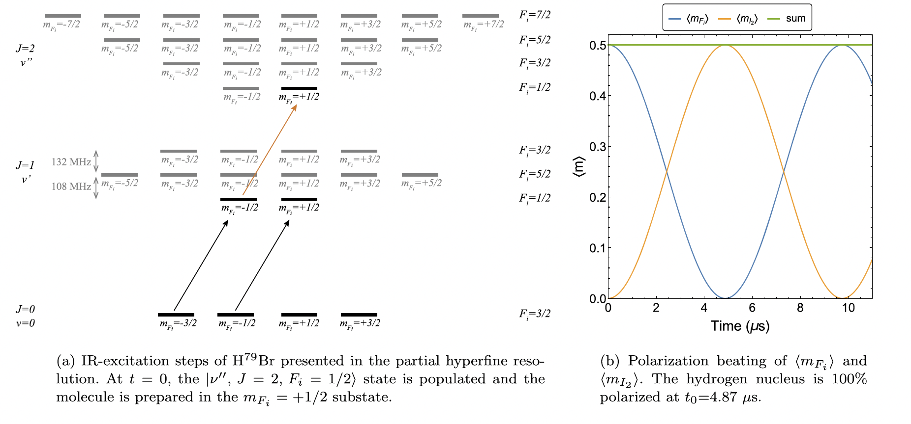
Accurate timing of shooting
HBr
HBr excited with σ+ IR.
HBr excited with σ+ IR.
H isotope -Y dimolecules
C. S. Kannis et al. Mol. Phys. 120 (2022) e1975053.
Notation: I₁ (Y nuclear spin) I₂ (H isotope nuclear spin) J (rotational angular momentum,
F_{i}=J + I₁ and F=F+I_{2.}
After the IR excitation the UV shooting after the trasfer of polarization to p,
which can be «frozen» by a magnetic field.

Slide 18
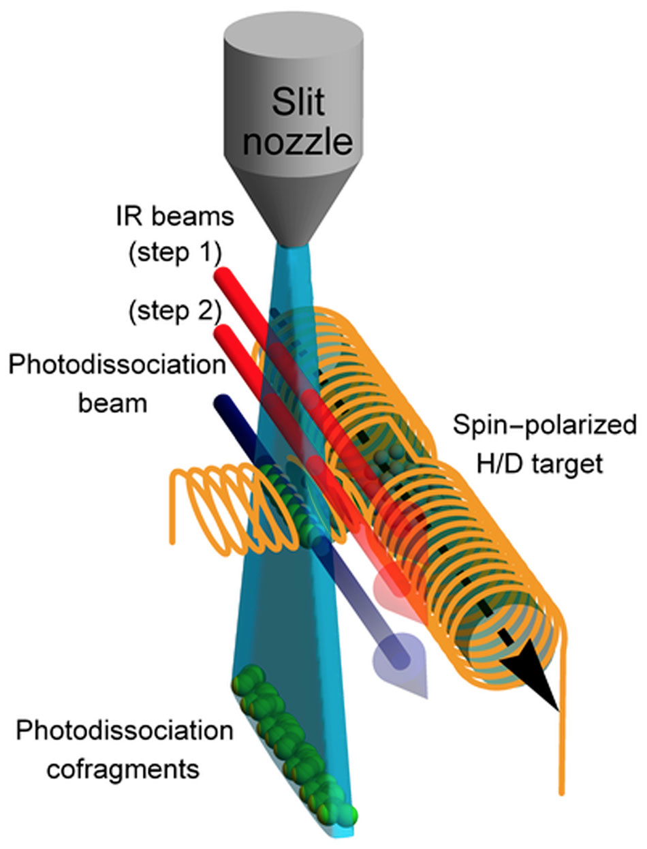
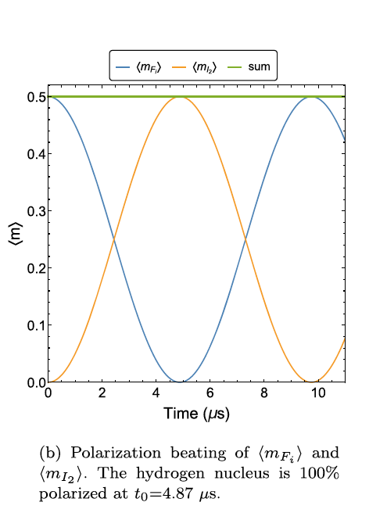
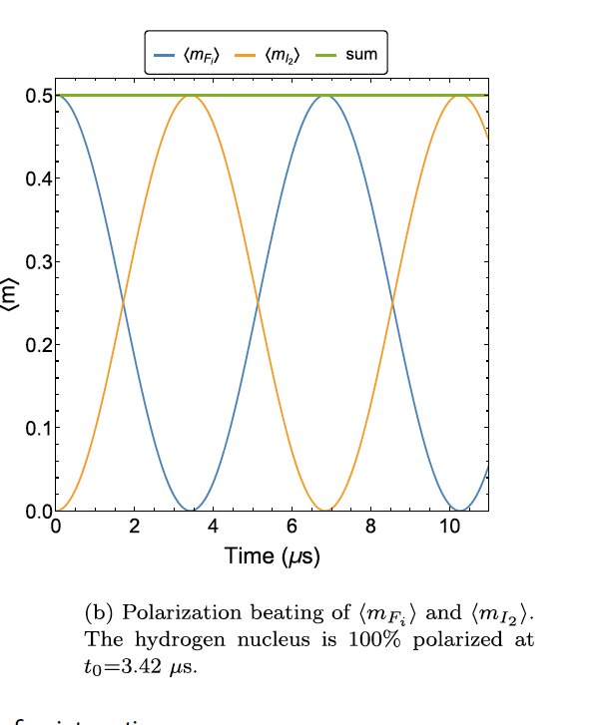
@ IESL-FORTH QB excit. and UV dissoc.
HBr
I₂ proton spin and F_{i}=J+I₁
I₂ proton spin and F_{i}=J+I₁
HI
Possible D polarization
till 100 % from DBr,
depending on efficieny
of IR-excitation
and
UV dissociation.
C. S. Kannis and T. Peter Rakitzis, Chem. Phys. Lett. 784, 139092 (2021)
C. S. Kannis et al. Mol. Phys. 120 (2022) e1975053.

Slide 19

Challenge objectives of PREFER
  @IKP-FZJ - Production of polarized fuel: from pABS, and a renewed proposal.
  @ IESL-FORTH – Production polarized fuel by Laser IR-Quantum Beat (QB) excitation and Ultra Violet (UV) dissociation.
  @PGI-FZJ/HHDU - Laser Induced Plasma LIP: production, acceleration and reaction studies.
  @FE Magnets for holding, manipulating and transporting polarized fuel .

Slide 20
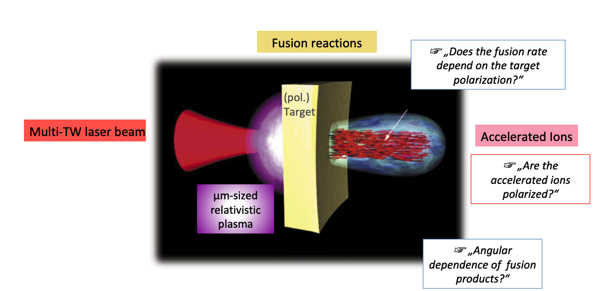
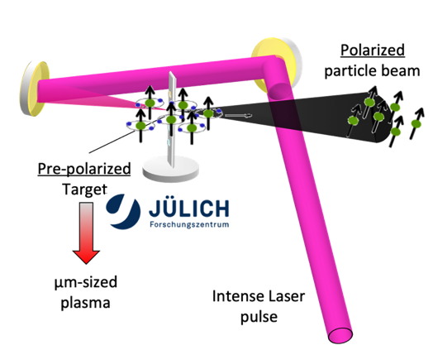
@ PGI-FZJ Laser Induced Plasma ...
N. Raab et al. «Polarization measurements of laser-accelerated protons» Physics of Plasma 21 (2014) 023104

Slide 21
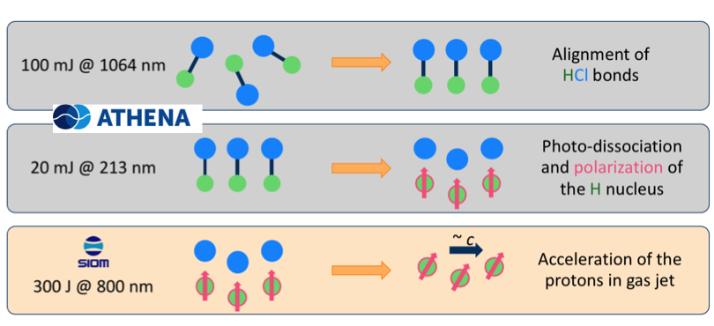
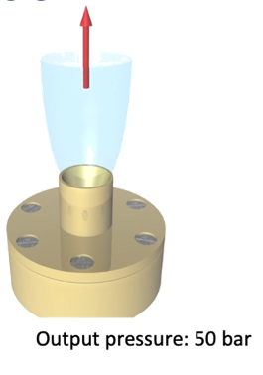
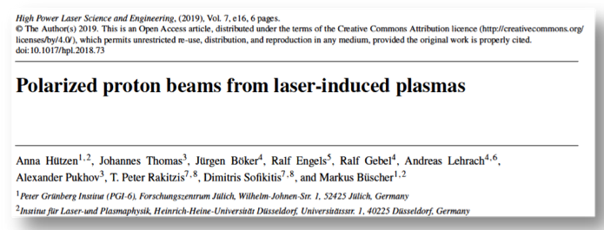
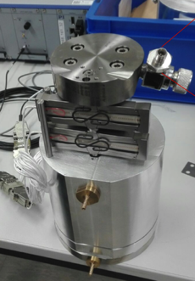
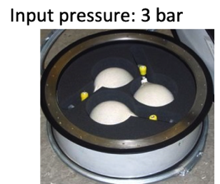
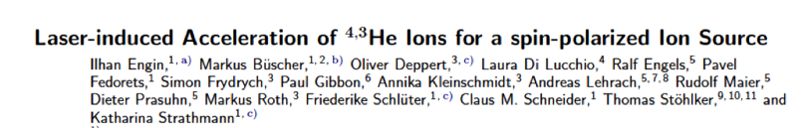
@ PGI-FZJ Polarized beams from LIP
Polarized He beams
From compressed polarized ³He
Polarized proton beams on IR-polarization
and post UV dissociation
compressor
A. Hützen et al. High Power Las. Sci. Eng. 7 (2019) E16.
LIP techniques can be applied to polarized molecules
From MBS OR
from recombined molecules
from ABS

Slide 22

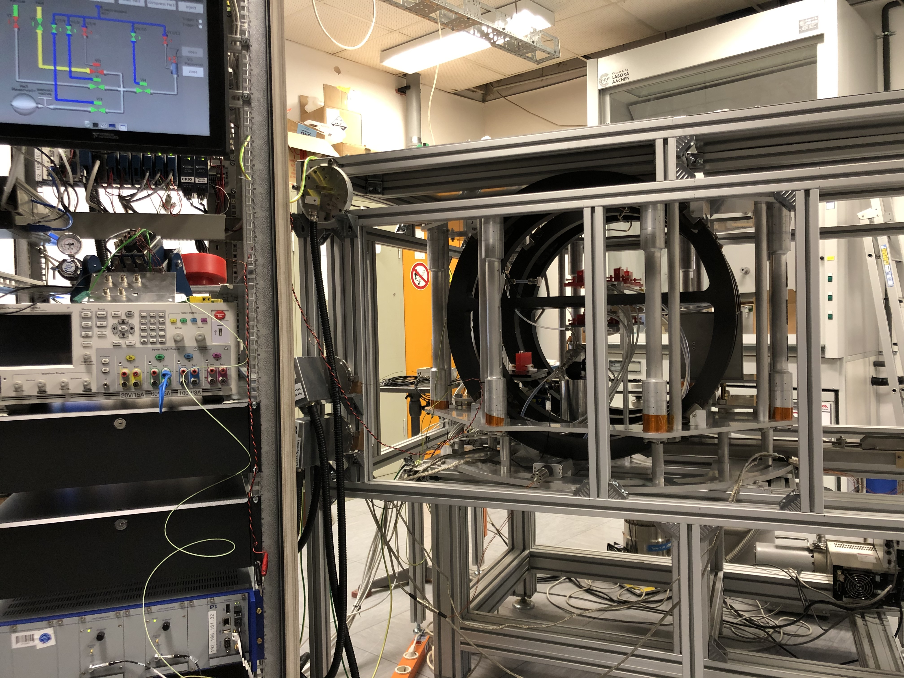
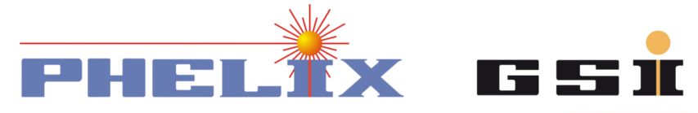
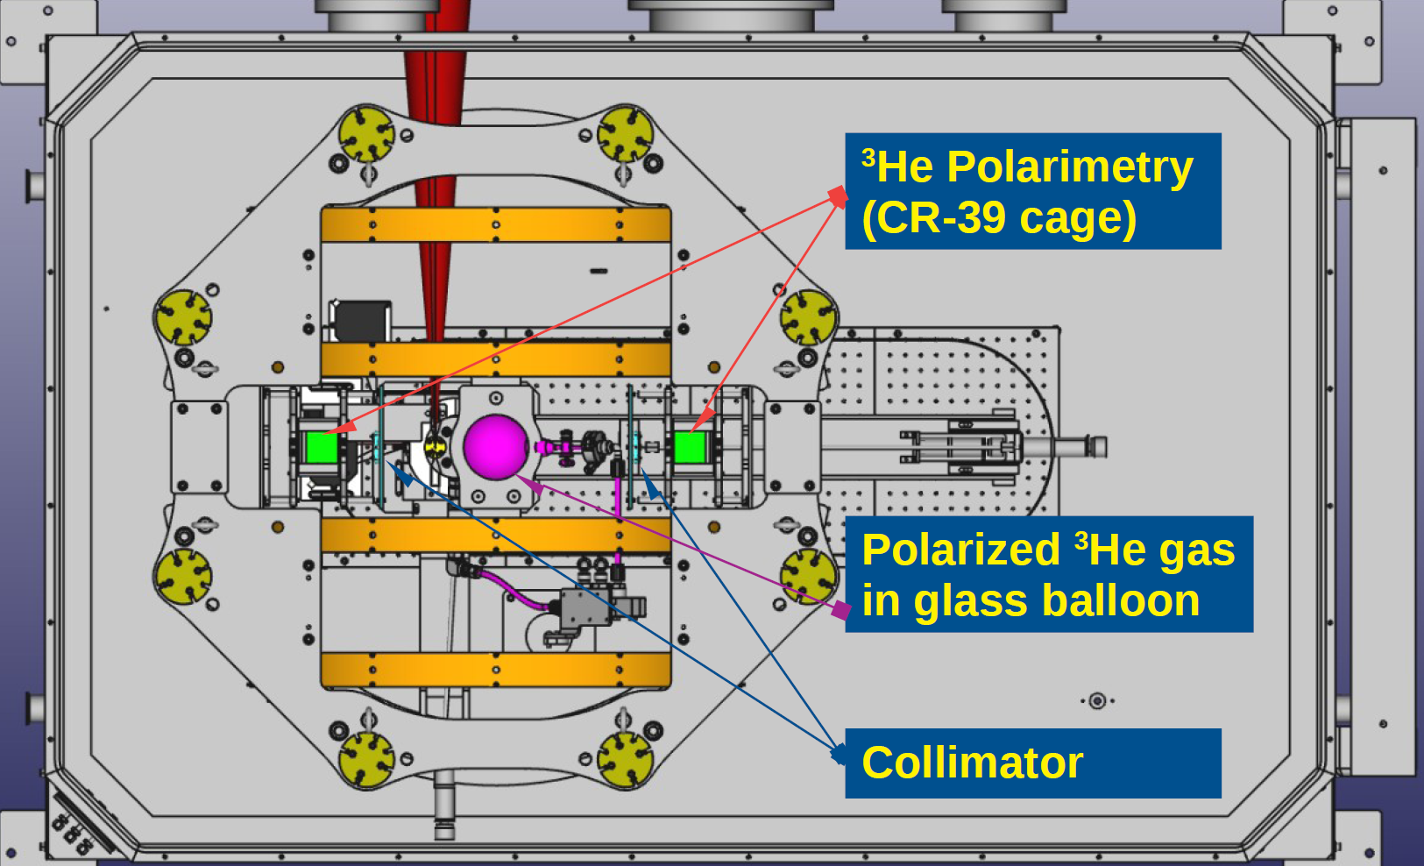
Polarized ³He gas-jet
Up to 80% nuclear polarization
magnetic holding field
for storing pre-polarized
³He gas @3 bar
compressor increases pressure of
³He gas to ~30 bar
non-magnetic nozzle provides the desired gas-jet target
Target @
First Test of laser induced acceleration on ⁴He
I. Engin et al.,
Plasma Physics and Controlled Fusion 61 (2019) 115012
High density polarized ³He Gas-Jet Target 3/4 10¹⁹ cm⁻³
P. Fedorets et al.
Instruments 6 (2022) art.n. 18

Slide 23
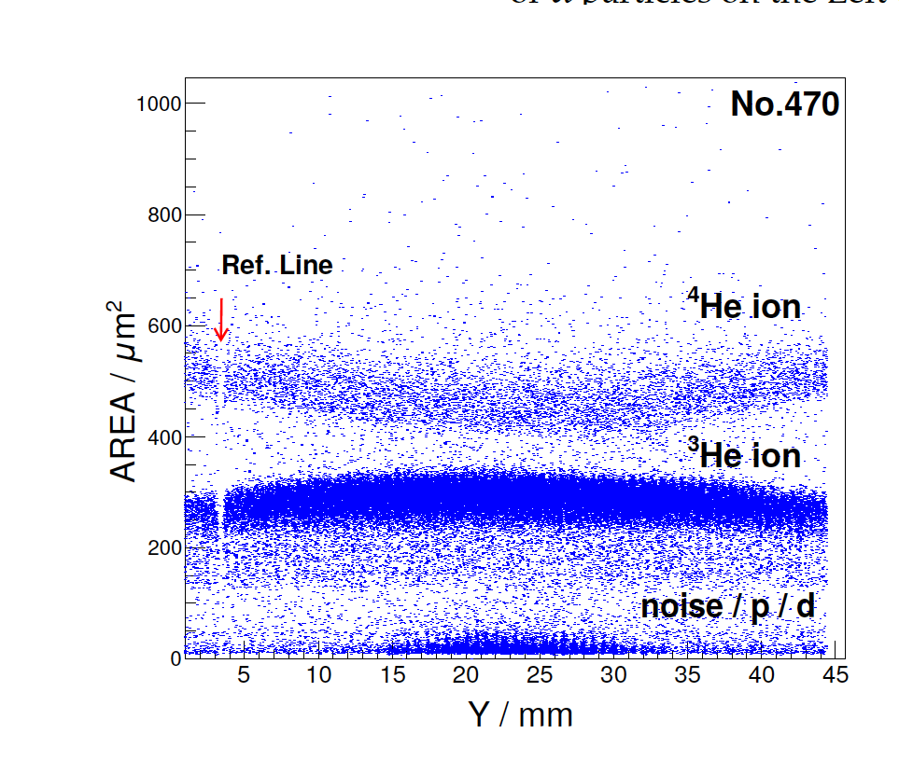
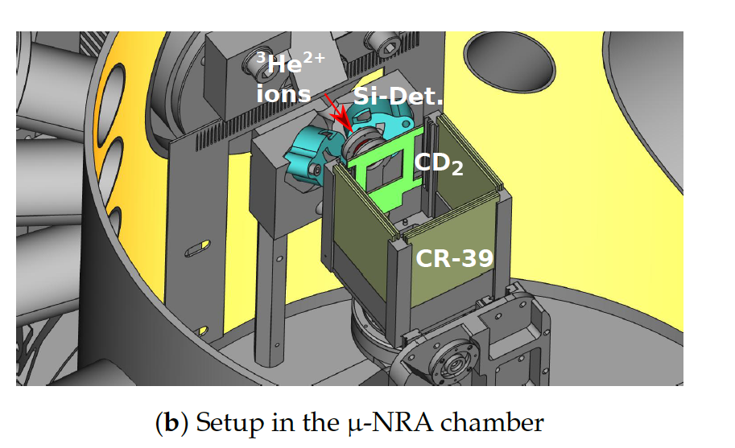
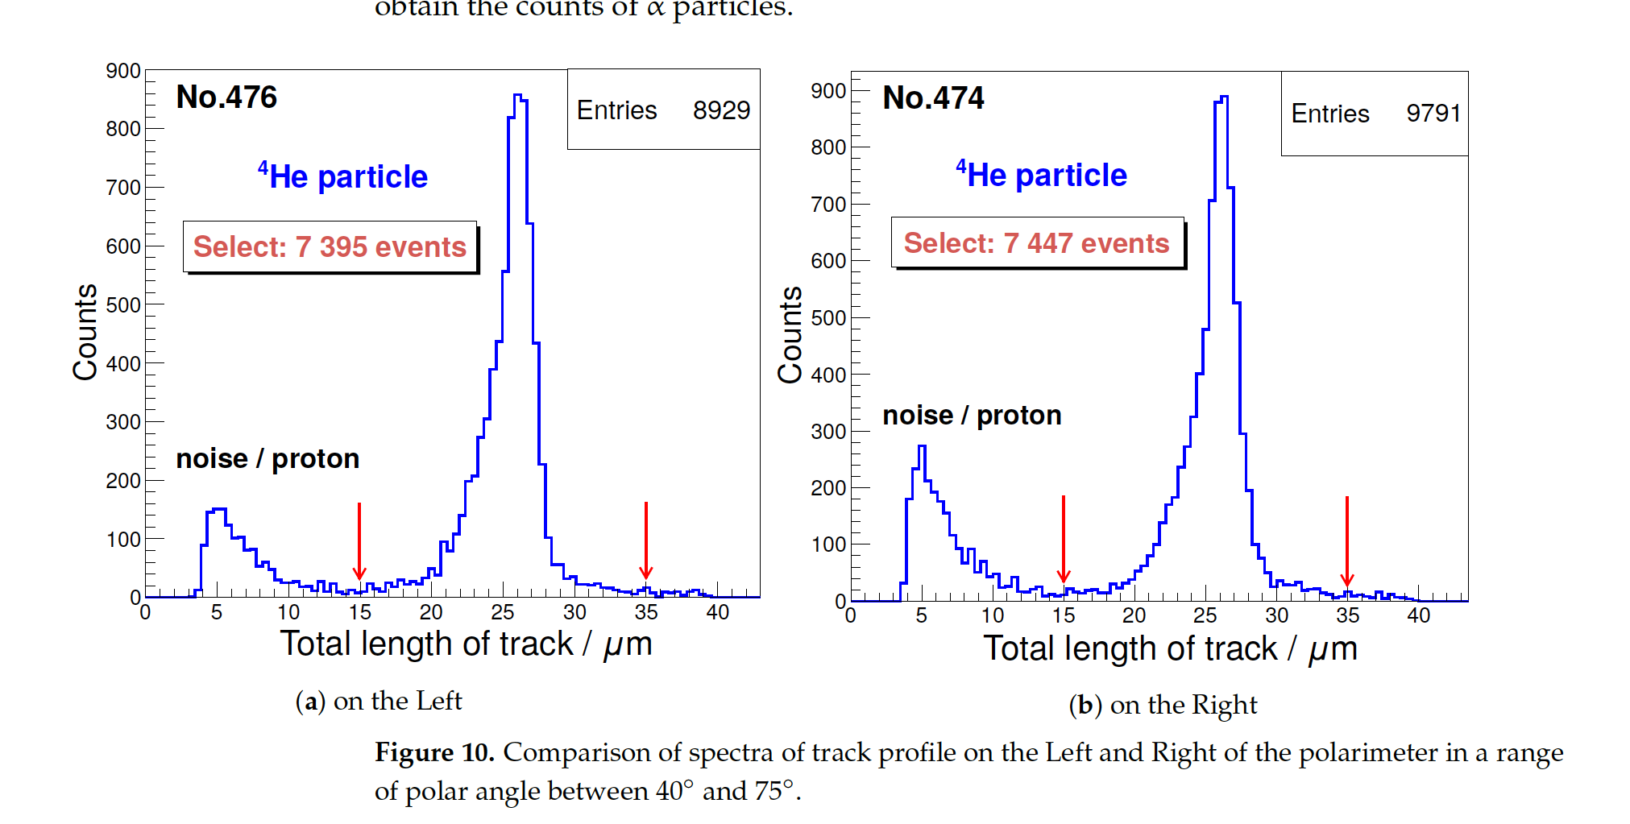
Polarimetry for ³He from LPI
Identification of the products of reaction of ³He⁺⁺ beam on CD₂, at lower energy till 0.64 MeV (fusion reaction resonance) on left, right CR-39 (SSNTD detectors) and forward (beam detection).
Minimal detectable polarization 21 % at 10⁹ ³He ions
entering the polarimeter.
forward
left
left
right
right
Forward

Slide 24
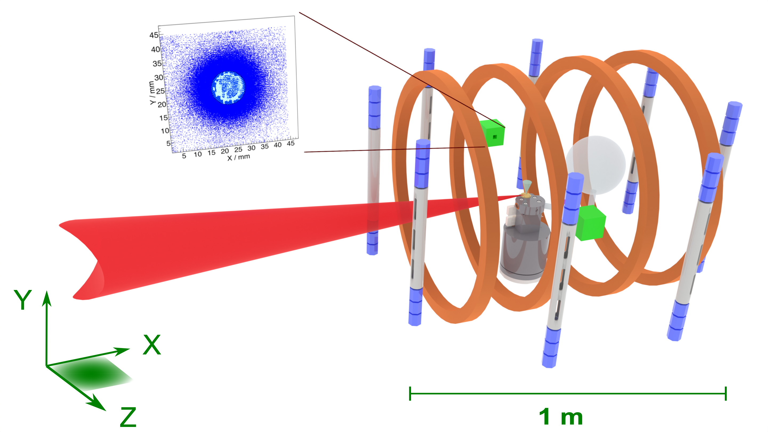

Experimental setup @Phelix
Polarimeter
${}_{ }^{3}{\vec{He}}$ gas
Phelix laser beam
³He jet
Pressure booster

Slide 25
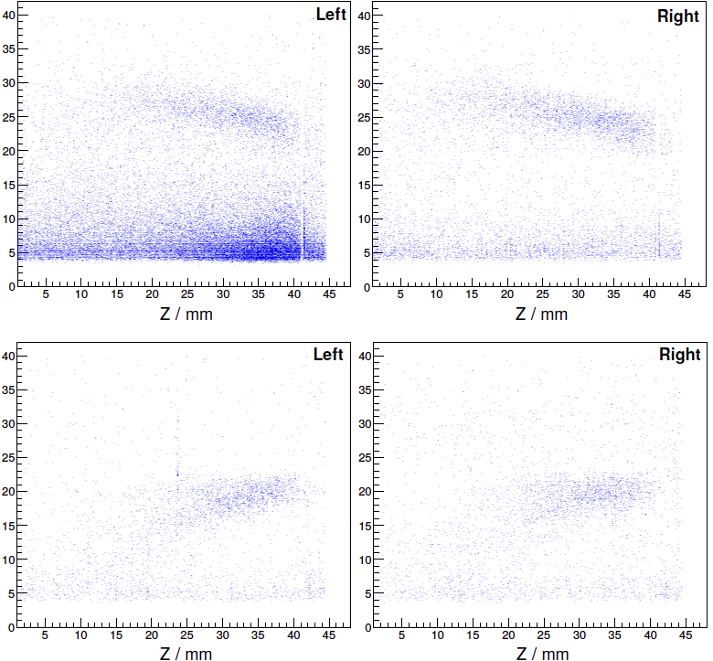

Measured (a-)symmetry
Unpolarized ³He gas
$D\left({}_{ }^{3}{\vec{He}},α\right)p$
x
z
Long. polarized ³He gas
Change of 𝛼-distribution: modified kinematics for polarized ³He gas
In both cases no left/right (up/down) asymmetry ➔ polarimeter works as expected.

Slide 26
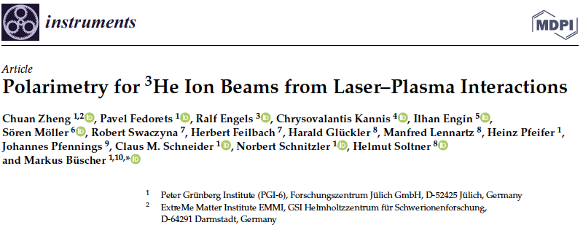
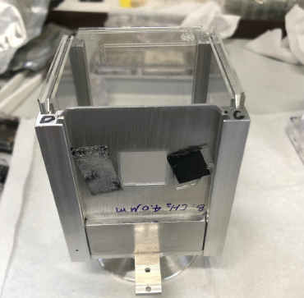
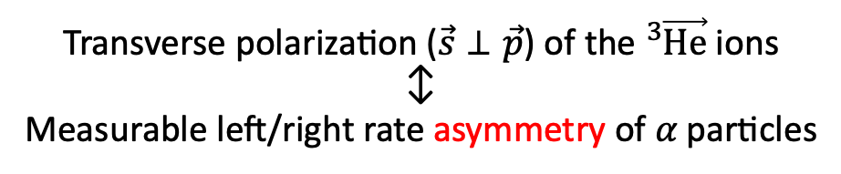
Asymmetry evidence transv. pol.
on
CD₂ foil
Helmholtz coils
off
− on
Transverse polarization ($\vec{s}⊥\vec{p}$) of the ${}_{ }^{3}{\vec{He}}$ ions
↕︎
Measurable left/right rate asymmetry of 𝛼 particles

Slide 27
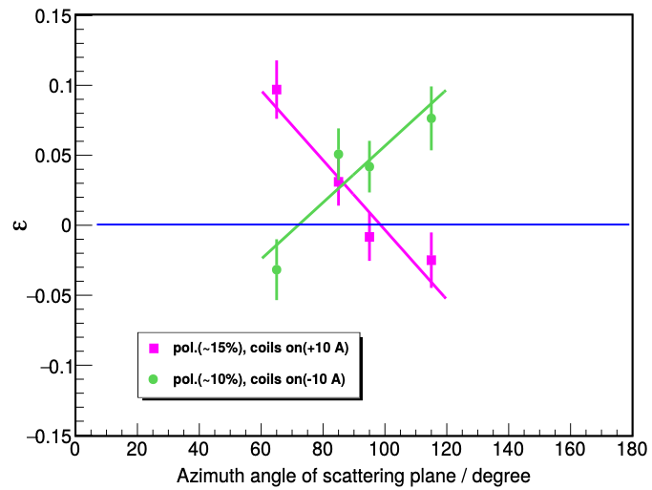
Preliminary evidence of asimmetry
³He-ion polarization conserved after acceleration
2 x increased ³He-ion flux from pol. plasma (reason unclear)
Our concept (polarized target @ PW laser) works
Plasma acceleration of polarized beams (e–, p, ions) feasible
Models/simulation codes incomplete
Asymmetry
expected signal for unpol. ions

Slide 28
Challenge objectives of PREFER
  @IKP-FZJ - Production of polarized fuel: from pABS, and a renewed proposal.
  @ IESL-FORTH – Production polarized fuel by Laser IR-Quantum Beat (QB) excitation and Ultra Violet (UV) dissociation.
  @PGI-FZJ/HHDU - Laser Induced Plasma LIP: production, acceleration and reaction studies.
  @FE Magnets for holding, manipulating and transporting polarized fuel .

Slide 29
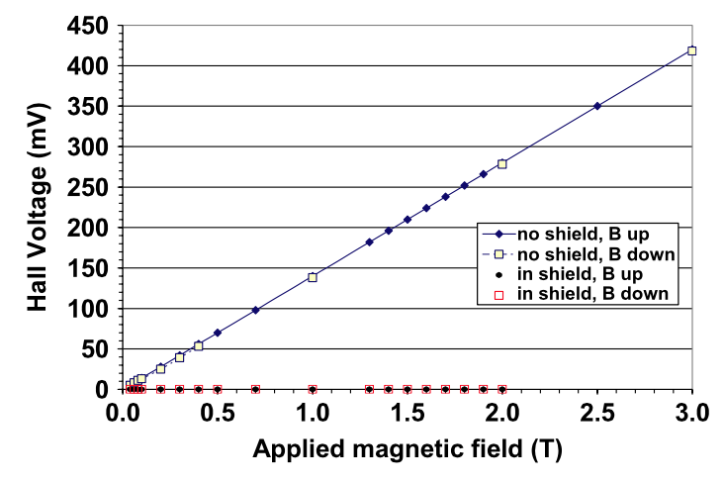
Fuel confinement for tranportation and test
Field Cooling (FC), early cooling with applied field of 2 T, lowering down the applied field B_{appl} , B_{hall} measures the self field.
B_{Hall}
B_{appl}
P100 MgB₂ L = 70 mm
R_{ext}=17.75 mm, R_{int}=9 mm
J. J. Rabbers et al. “Magnetic shielding capability of MgB2 cylinders” Supercond. Sci. Technol. Vol. 23, 2010
29
29

Slide 30
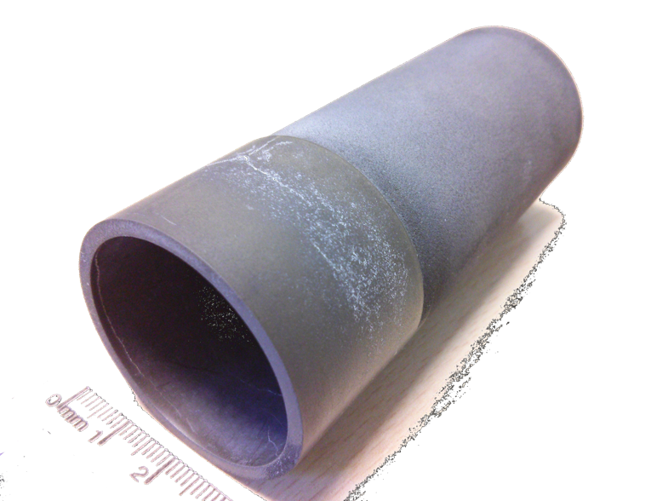
Fuel confinement for tranportation and test
Cylinder
MgB₂
(Mg Reactive Liquid Infiltration)
Shielding longitudinal fields
Mantaining transverse fields.
By
Bz
Advantages
No Power feeding
No Copper and Coils
Auto tuning
Semplicity
Low cost of production
few mm of thickness
External Magnet
M. Statera et al. (2015). IEEE Trans. Appl. S. C., vol. 115(3): 1 - DOI: 10.1109/TASC.2015.2388855
Available Waste Material Machinable ( G. Giunchi)
diameter 39 mm - length 90 mm
thickness ~1 mm
30
30

Slide 31
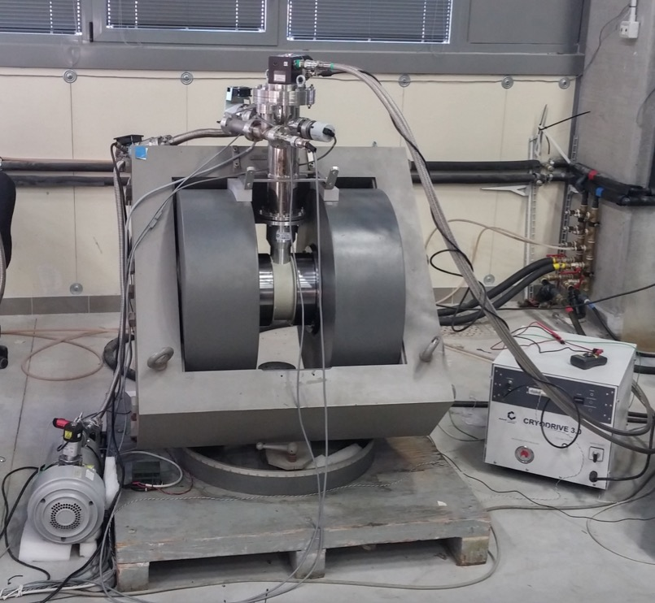
Experimental feasibility studies
turbo pumps
cold head
Resistive magnet
Transverse Field
Polar expansion modified
Estimated field (at 110 A) 1 T
Vacuum chamber (316L e Al)
Cold Head
T control of the cylinder
Minimum Expected T ≈ 13 K
316L chamber
Al chamber
Cu coil
nylon support
pole Fe ARMCO
yoke
Scroll pump
cylinder
coldhead used Edwards 6/30 (10 K, 70 K)

Slide 32
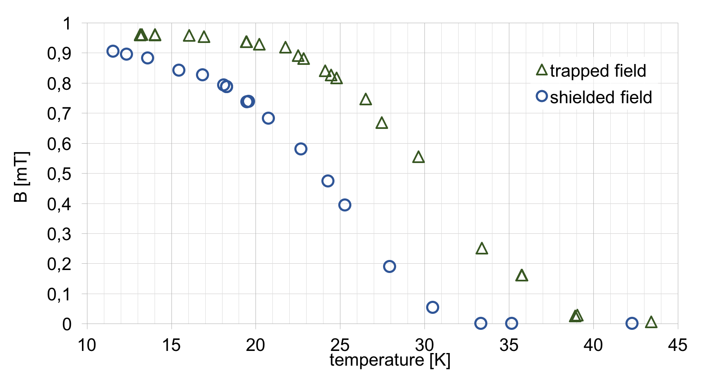
Trapped (shielded) field measured
M. Statera et al. NIM 882 (2018) 17.
B [T] field
promising feasibility study with one Hall probe
in the center and the middle of the cylinder.

Slide 33
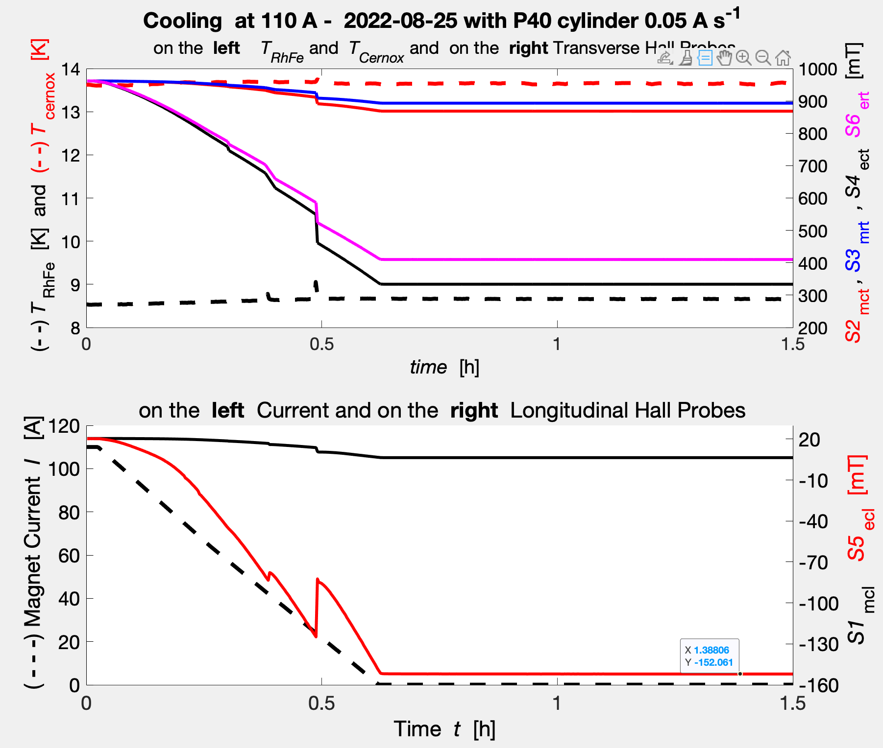
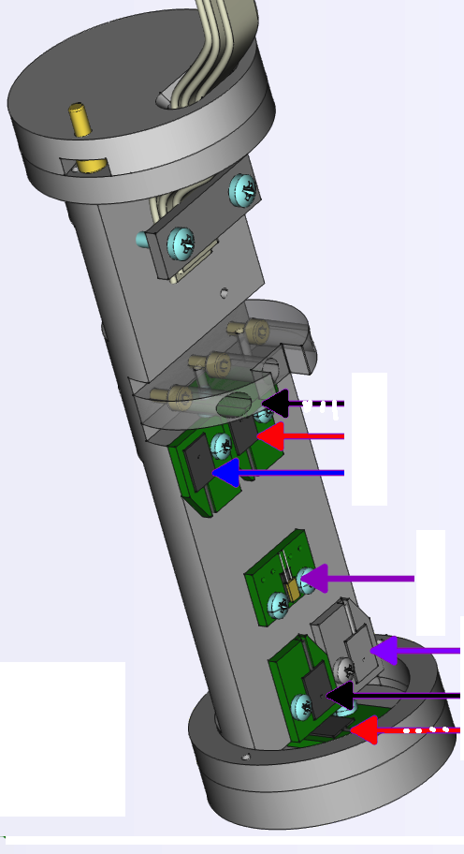
Upgraded system
B_{fed} = 962.5 mT
11 mm }
B_{mrt} = 893 mT
B_{mct} = 868 mT
}
T_{cernox} = 13.6 K
{48 mm
B_{ert} = 410 mT
11 mm }
}
B_{ect} = 334 mT
T_{RhFe} = 8.6 K
B_{mcl} = 6.4 mT
59.2 mm }
B_{ecl} = -152 mT
field map radial and long.
ColdHead 1.4/45 1.4 K/40 K)
33

Slide 34



Overcoming the flux jumps on P40
Higher field trapped
@ T_{ITC –set}= OFF, B_{trap} (U.C) = 853.9 mT
@ T_{ITC –set}=13 K B_{trap}=864.5 mT *

Slide 35

Plan: find the better one
2.75 mm ?
P40
3 mm
P160
P100
3 mm
Problems:
homogeneity
of bulk?
Rotation of
the cylinder ?
P160
P160
3 mm
1.75 mm
4 mm
P100
P100
Waste
feasibiliy
studies
3 mm
Roughly lower size of the precursor (Pnn - nn sieve mesh) B grains higher the critical current and
more instability. we tested P40, P100 and P160, but they perform worse than the waste feas, cyl..

Slide 36

redoing the P100
@ T_{ITC –set}= OFF, B_{trap} (U.C) = 957 mT
@ T_{ITC –set}= 9 K , B_{trap} (U.C) = 947 mT
@ T_{ITC –set}= 11 K , B_{trap} (U.C) = 947 mT
Flux jump observed also at higher
temperature (till 24 K)

Slide 37

no succeeded to overcome flux jump
@ T_{ITC –set}= 13 K , B_{trap} (U.C) = 293 mT
@ T_{ITC –set}= 15 K , B_{trap} (U.C) = 243 mT
@ T_{ITC –set}= 17 K , B_{trap} (U.C) = 228 mT
@ T_{ITC –set}= 19 K , B_{trap} (U.C) = 249 mT

Slide 38

Remaking the one @ lowest T
B_{trap} (U.C) = 957 mT
B_{trap} (U.C) = 952 mT

Slide 39


Also in case of flux jump
Powering the external magnete to 962 mT (T. C.)
937 mT (T.C.) are trapped in the center.
Neverthless better than the P40, also with
flux jump.
T correction of Hall S₂

Slide 40
Conclusions of PREFER activities
W.W. Heidbrink on monday in his presentation asked the audience to provide him intense Deuterium polarized.
PREFER is keeping mind and hands on the requirement
investigating different ways to do it.

Slide 41



Comparison: ABS and QB IR/UVdiss.
Comparison of spin polarized hydrogen obtained from atomic beam source (the most intense) and UV dissociation
 | BNL ABS | UV dissociation (Crete)
Density of SPH (cm⁻³) | 10¹² | 10¹⁹
Intensity (s⁻¹) | 10¹⁶ (continuous) | 10²¹ (pulsed)
Polarization | 0.92 | 0.42 (0.90 attainable)
The intensity is correlated to the number of impinging photons,
one photon -one proton then for available laser source of 10²¹ photons s⁻¹.
Excitation by 1026 nm 10¹⁴ W cm-², Ionization by 5th harmonic (213 nm) 10¹² W cm⁻²
D. Sofikitis et al. Phys. Chem. Chem. Phys. 21 (2019) 14000.

