Slide 1
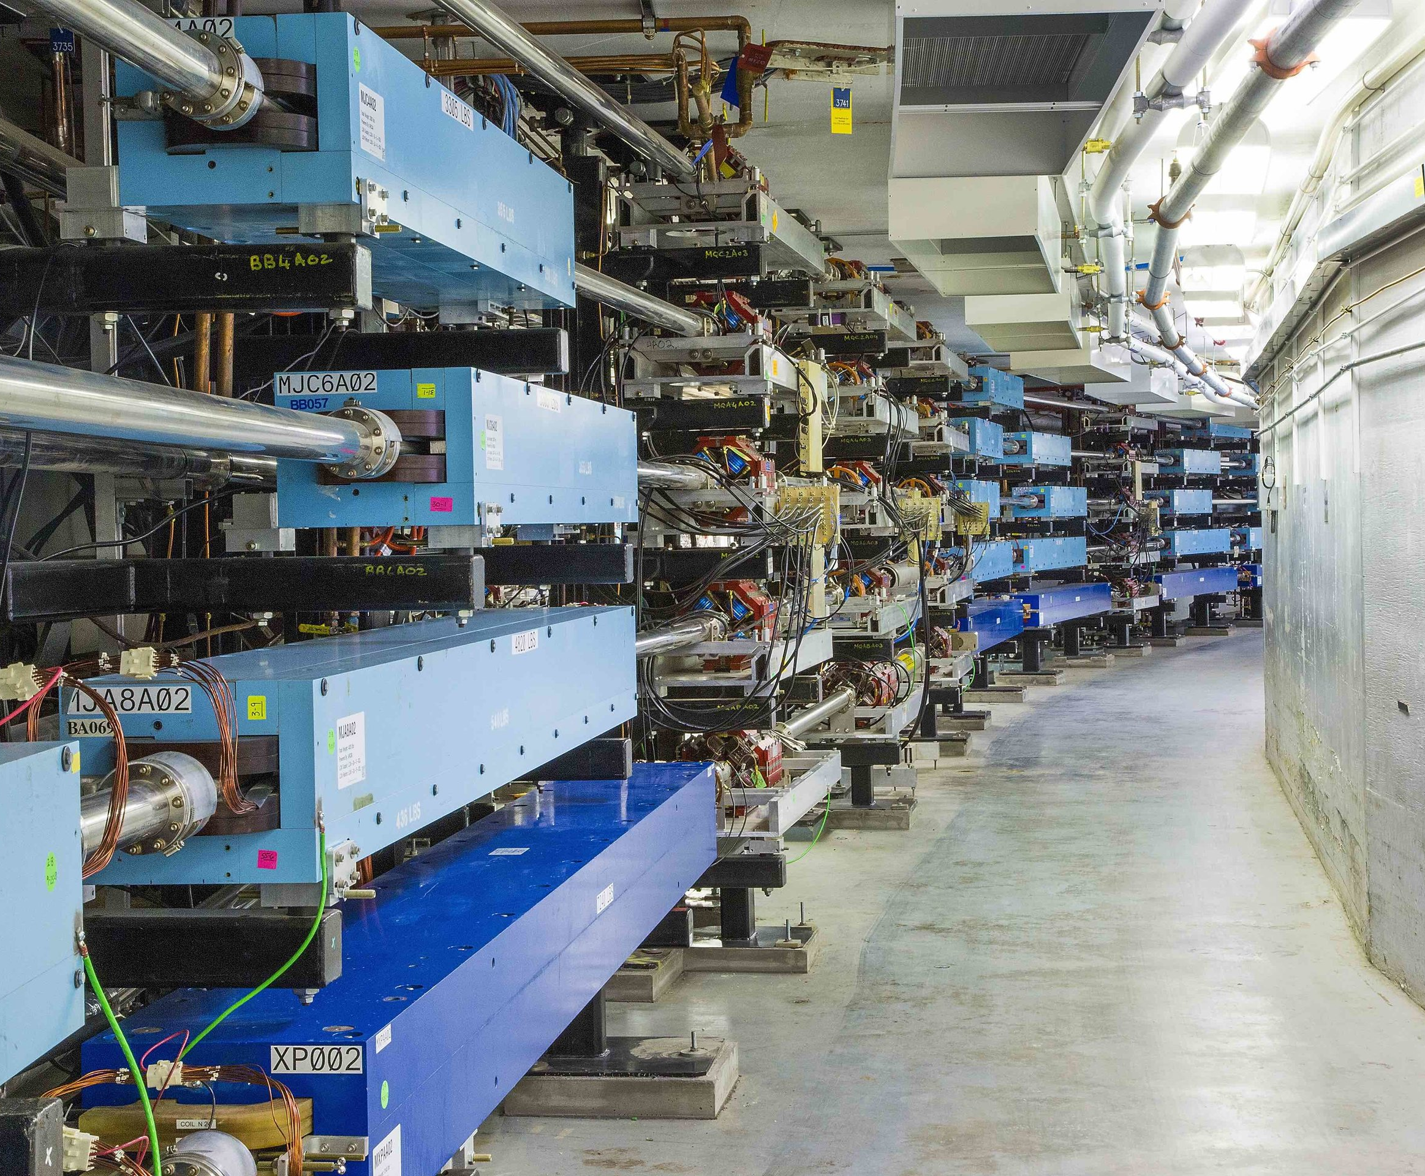

22 GeV CEBAF with Novel FFA* Design
Feasibility of increasing CEBAF energy to about 22 GeV by additional recirculations through compact FFA* arcs
*FFA (Fixed Field Alternating-Gradient)
Alex Bogacz
on behalf of FFA@CEBAF Working Group

Slide 2
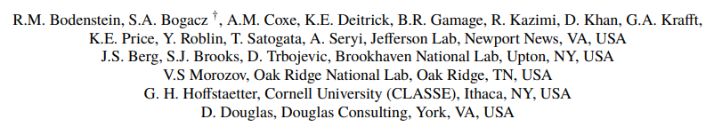




The FFA@CEBAF Collaboration

Slide 3
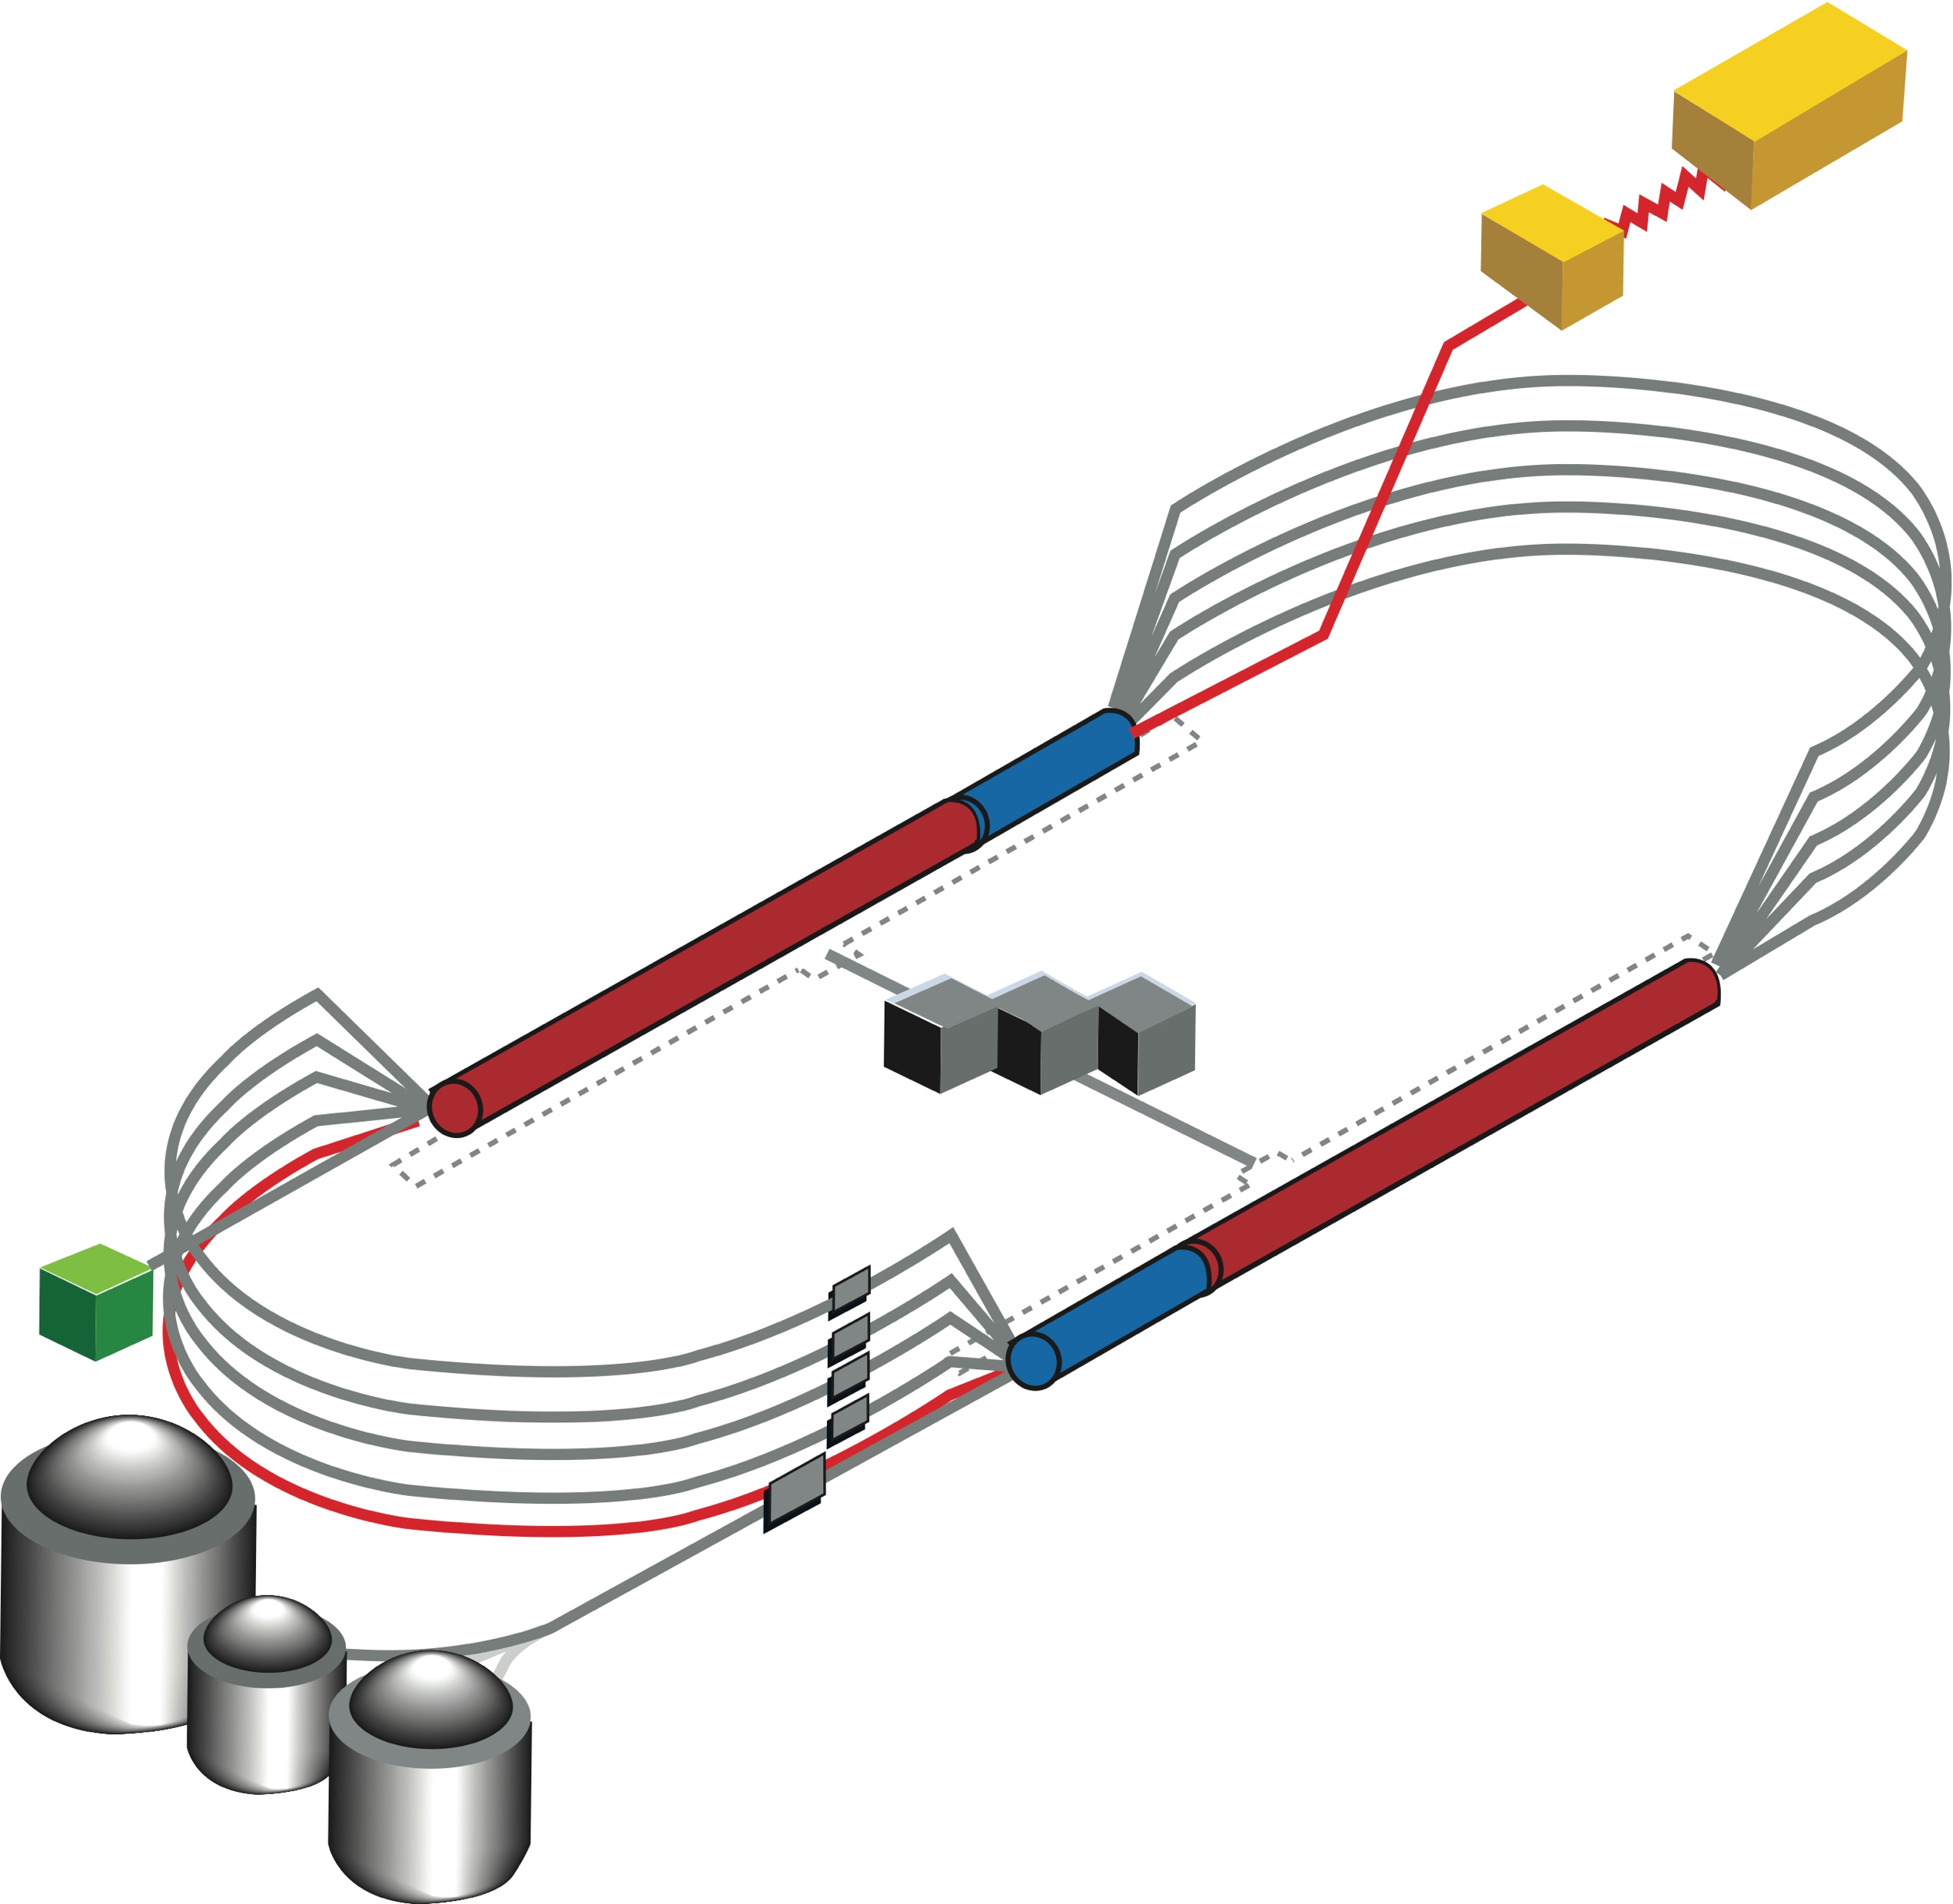

CEBAF FFA Upgrade – Baseline under Study
  Starting with 12 GeV CEBAF
  NO new SRF (1.1 GeV per linac)
  New 650 MeV recirculating injector
  Remove the highest recirculation pass (Arc 9 & A) and replace them with two FFA arcs including time-of-flight chicanes
  Recirculate 4 + 6.5 times to get to 22 GeV
TOF
650 MeV
TOF
Enabling Technology:
Novel permanent magnets, -like used for power and cost savings
Pass Arithmetic: 5 -1 + 6.5 = 10.5

Slide 4
Overview
Current baseline: 650 MeV inj + 4-pass CEBAF + 6.5-pass FFA
FFA Arc Architecture – -style
  Non-scaling FFA based on high-gradient permanent magnets
  Compact merger to control orbits, beta functions and dispersion at arc ends
  Error sensitivity studies
Multi-pass linac optics
  650 MeV injector upgrade
  Strongly focusing triplet lattice periodic optics for lower passes
Modified CEBAF ‘switchyard’, Arcs 1-8 and TOF correction ‘splitters’
Synchrotron radiation impact on beam quality, mitigations
Summary, Outlook

Slide 5
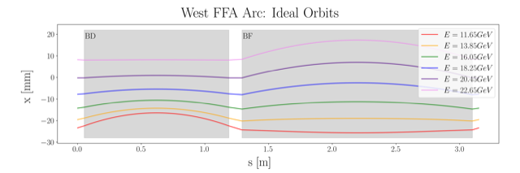
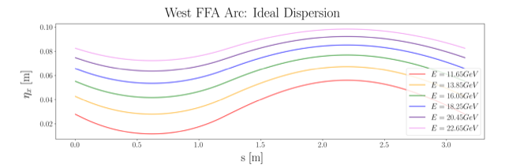
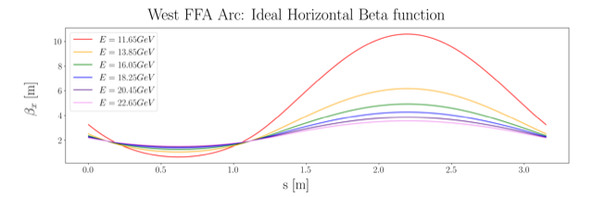
Non Scaling FFA Arc − Compact FODO Cell
orbits
Large momentum acceptance FFA cell, configured with combined function magnets capable of transporting six beams with energies spanning a factor of two
Arc composed of 75 cells, L_{cell} = 3.15 m
Closely spaced orbits for all six beams (~ 4 cm)
Low betas (~ a few m)
Extremally low dispersions (a few cm) - Virtue of combined function FFA magnets
dispersions
beta functions

Slide 6
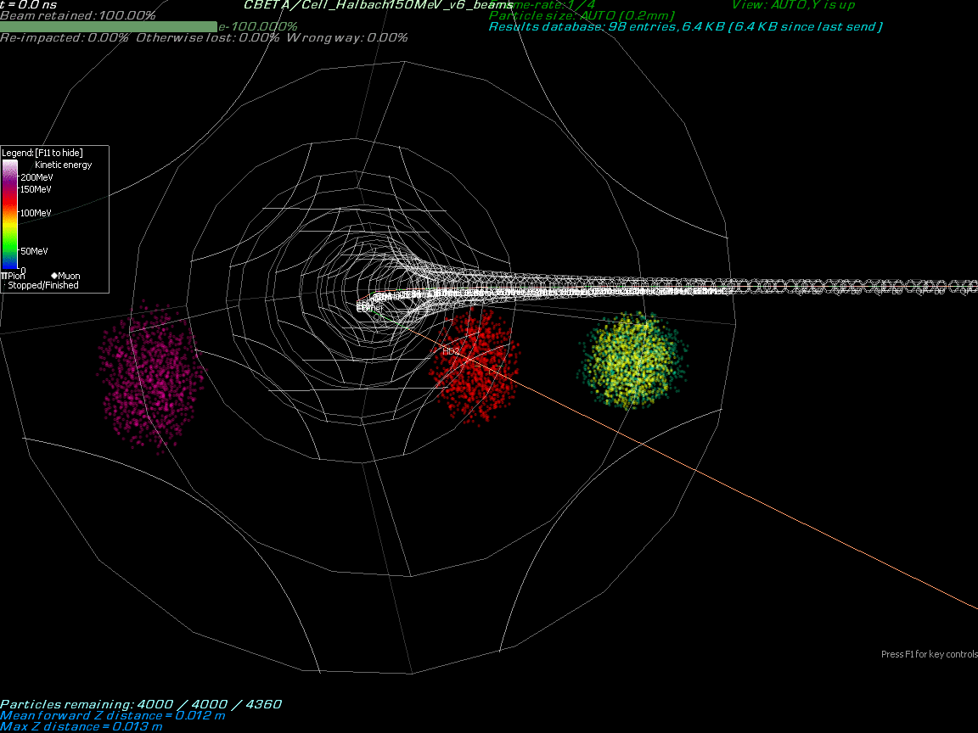
Stephen Brooks

Slide 7
Permanent Magnet Design – Open Mid-plane Geometry
10 cm
10 cm
10 cm
10 cm
Focusing Magnet BF
G_{F}= -41.13 T/m
L_{QF}= 1.67 m
B_{F}= -0.812 T
Defocusing Magnet BD
G_{D}= 43.44 T/m
L_{BD}= 1.24 m
B_{D}= -0.593 T
magnets: from 38cm² to 78cm²

Slide 8
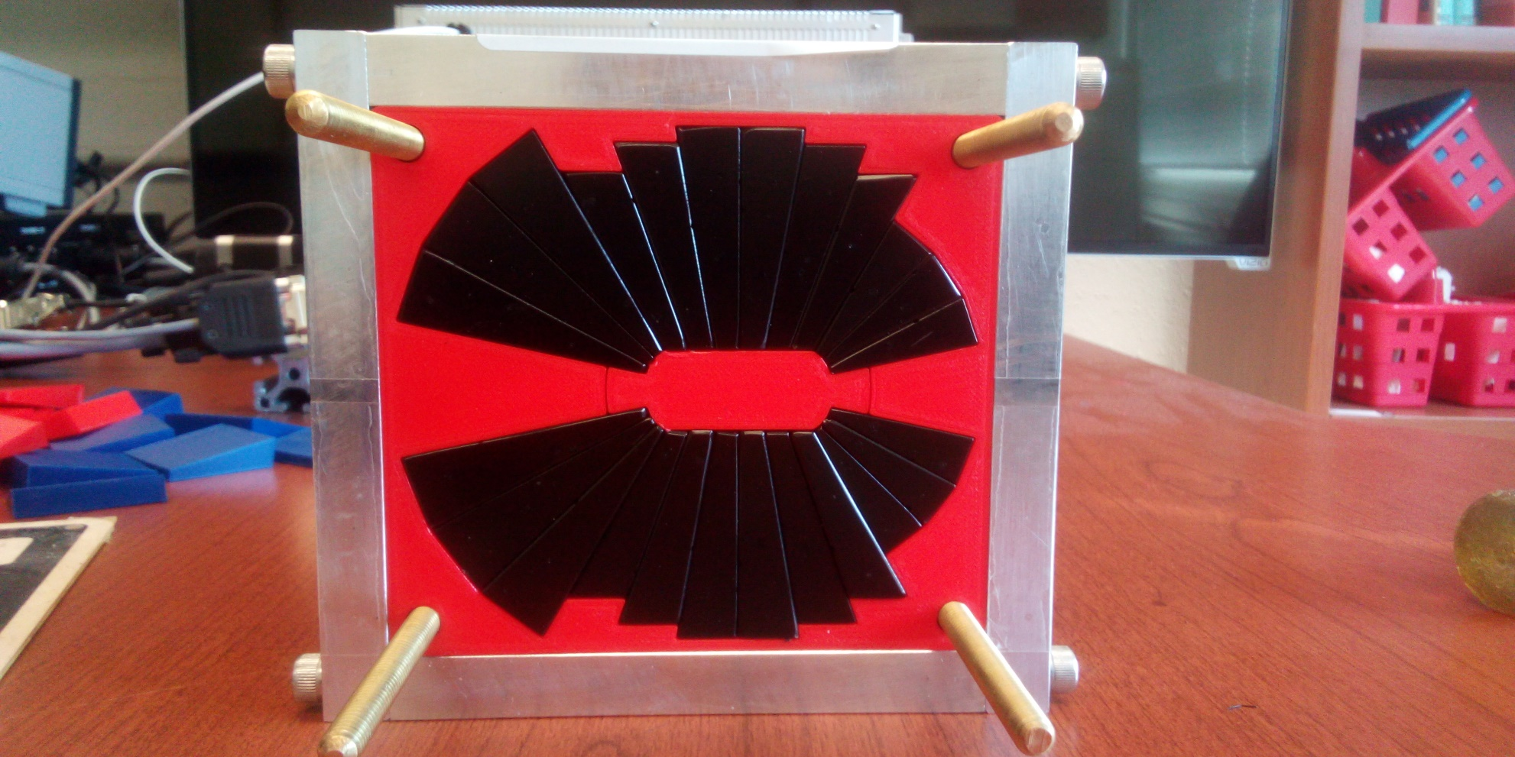
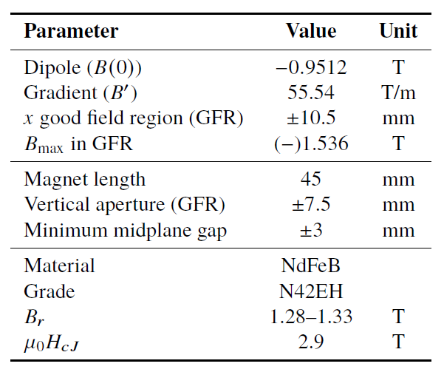
Assembled Prototype Magnet
A prototype open midplane BF magnet was built and evaluated for mechanical integrity. Magnetic measurement confirmed a robust design with >1.5 Tesla in good field region, 10⁻³ field accuracy. Radiation resilience tests will be carried out at CEBAF.
Open midplane design with >1.5 Tesla in good field region, 10⁻³ field accuracy

Slide 9
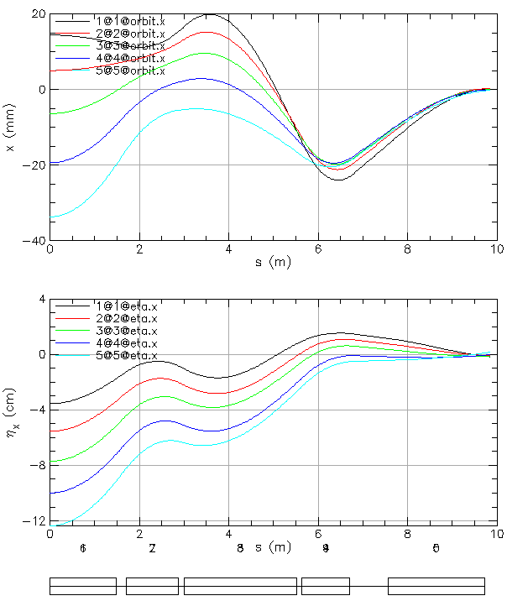
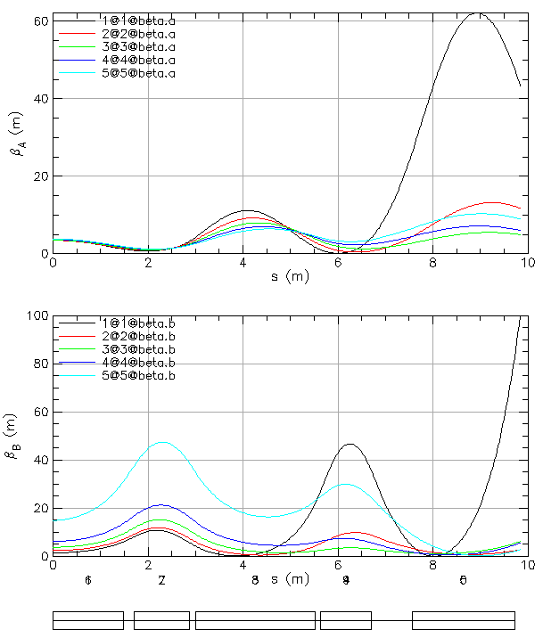
FFA Arc to Straight – Compact Merger
Breaking cell symmetry by altering (length, bend) of a few magnets to merge different energy orbits at arc ends.
Simultaneously, the dispersion and its derivative are suppressed at arc ends.
Furthermore, small beta functions (~5 m) need to be matched to higher-bets of the linacs (~90 m).
This simplifies switchyard and reduces its functionality to pathlength and momentum compaction adjustment.

Slide 10
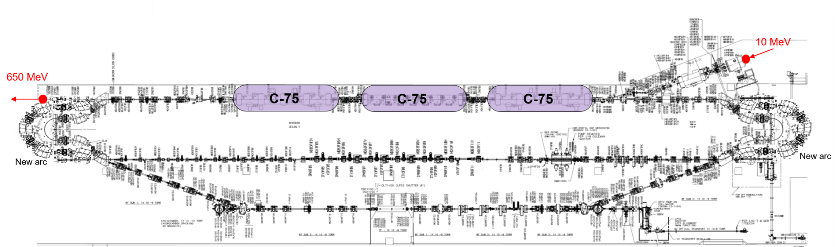
Injector Upgrade − 650 MeV Recirculating Injector
With the present 123 MeV injector, the difference in the first and final pass energies in the North Linac is too large (1:175) to effectively control the beam.
650 MeV recirculating injector (3-pass) based on LERF will allow a manageable difference in energies (1:33)

Slide 11
Recirculating Injector Based on LERF (3-pass)
10 MeV + 3 × 3 × 71 MeV = 650 MeV
10 MeV
436 MeV
C-75
C-75
C-75

Slide 12
Recirculating Injector Based on LERF (3-pass)
10 MeV + 3 × 3 × 71 MeV = 650 MeV
10 MeV + 3 × 3 × 71 MeV = 650 MeV
10 MeV
650 MeV
436 MeV
C-75
C-75
C-75
C-75
C-75
C-75
New arc
New arc

Slide 13
Synergy Between the Positron Source and 650 MeV Injector
Joe Grames
Positron program ends prior to 22 GeV FFA, so LERF can be repurposed for 650 MeV electrons.
Compact 10 mA P-Gun, Wien filter, 10 MeV e- injector
SRF to accelerate e⁻ to 120 MeV
SRF to accelerate e+ to 123 MeV

Slide 14
Electron/positron injector vault is required for 12 GeV e⁺ and 22 GeV e⁻
123 MeV e⁺ and 650 MeV e⁻
Joe Grames
‘Green beamline’ is a cost effective option for staging positron and energy upgrades:
123 MeV e⁺ for 12 GeV CEBAF
650 MeV e⁻ for 22 GeV CEBAF Energy Upgrade

Slide 15
Multi-pass Linac Optics (11 passes, 1:33 Energy Ratio)
Present FODO linac offers periodic optics only for the lowest energy pass with large beta beating for higher passes (beta ~1000 m), which is not compatible with small betas (~10 m) in the FFA arcs.
Replacing FODO (alternating singlets) with alternating triplets – more uniform beam envelope
30
Triplet Cells, phase advance: 150⁰ per cell
pass 1
0.65 GeV
BETA_X&Y[m]
0
0
BETA_X
BETA_Y
DISP_X
DISP_Y
243.507
0
pass 4
60
7.25 GeV
BETA_X&Y[m]
0
0
BETA_X
BETA_Y
DISP_X
DISP_Y
243.507
0

Slide 16
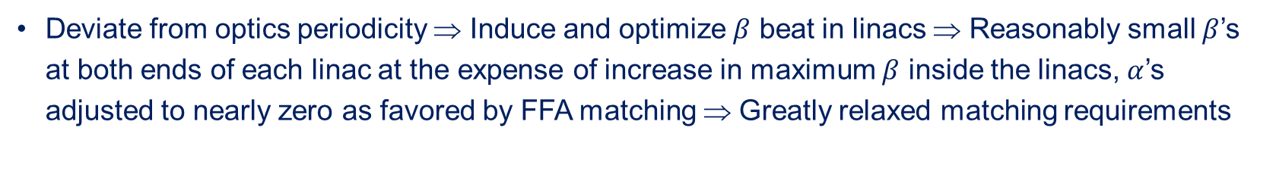
Transition to ‘Drift’ Linac Optics for FFA Passes
Deviate from optics periodicity ⇒ Induce and optimize $β$ beat in linacs ⇒ Reasonably small $β$’s at both ends of each linac at the expense of increase in maximum $β$ inside the linacs, $α$’s adjusted to nearly zero as favored by FFA matching ⇒ Greatly relaxed matching requirements
pass 6
180
11.6 GeV
BETA_X&Y[m]
0
0
0
BETA_X
BETA_Y
DISP_X
DISP_Y
284.877
.
.
.
pass 10
300
20.5 GeV
BETA_X&Y[m]
0
0
0
BETA_X
BETA_Y
DISP_X
DISP_Y
284.877

Slide 17
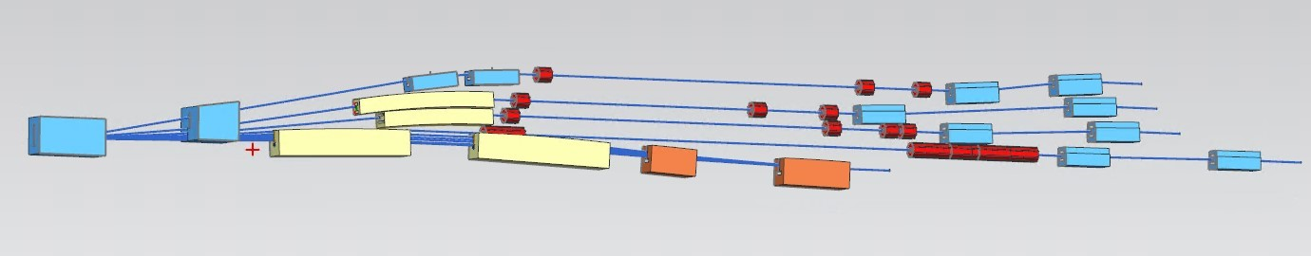
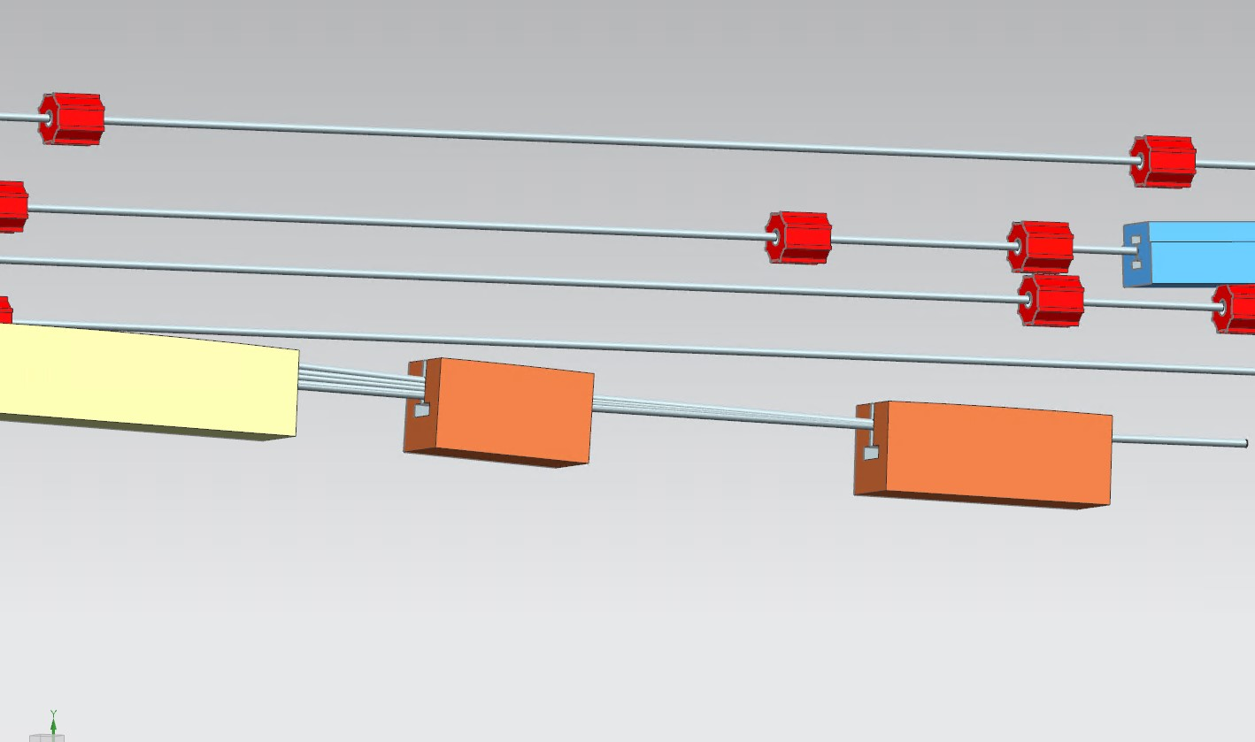
Modified Switchyard to Accommodate Six FFA Passes
pass 1
pass 2
pass 3
pass 4
FFA passes 5-10
FFA passes 5-10

Slide 18


Energy loss, Emittance dilution and Energy spread
  Doubling the energy, while staying within current CEBAF footprint, makes the synchrotron radiation effects of paramount importance.
  Quantum nature of a ‘recoil’ effect on electrons due to photon emission makes significant impact on both the transverse and longitudinal beam dynamics, leading to cumulative emittance growth (transverse and longitudinal).
Energy loss
Emittance dilution
Natural energy spread
Maximize $ρ$, minimize H
  Cumulative emittance dilution (transverse and longitudinal) at 22 GeV (4 CEBAF + 6 FFA passes)
Projected value from the Spr/Rec contribution

Slide 19

Summary
Present Baseline (1.1 GeV per linac):
  650 MeV Recirculating Injector (additional three C-75 cryomodules)
  Recirculate 4 passes with the current CEBAF
  Plus Additional 6 passes via a single FFA: 10 – 22 GeV
Non Scaling FFA Arc Architecture configured with compact FODO cells
  Beta and dispersion matching to the linacs through cell-by-cell variation (length, bend)
  Open mid-plane permanent magnet design: B-field ≤ 1 T, Gradient ≤ 50 T/m
Synchrotron Radiation impact on beam quality:
  Net transverse emittance dilution (normalized): 80 mm mrad
  Net natural energy spread: 1.5×10⁻³
  Net synchrotron radiated energy: 1 GeV
$$σ=\sqrt{β\frac{ε_{N}}{γ}}$$
at 22 GeV, β = 20 m → σ = 175 microns
at 22 GeV → ΔE = 33 MeV

Slide 20
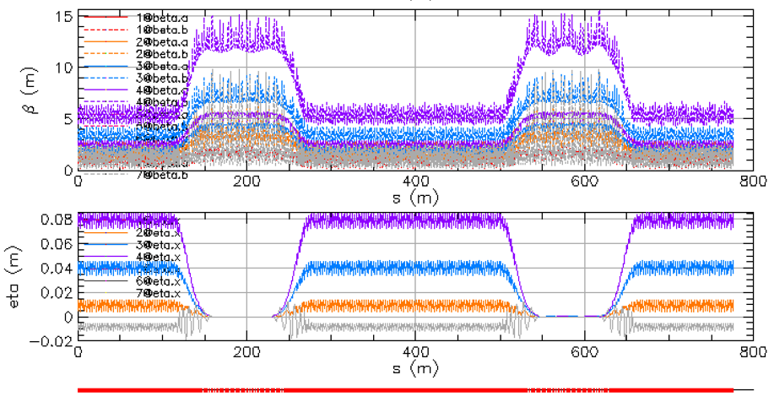
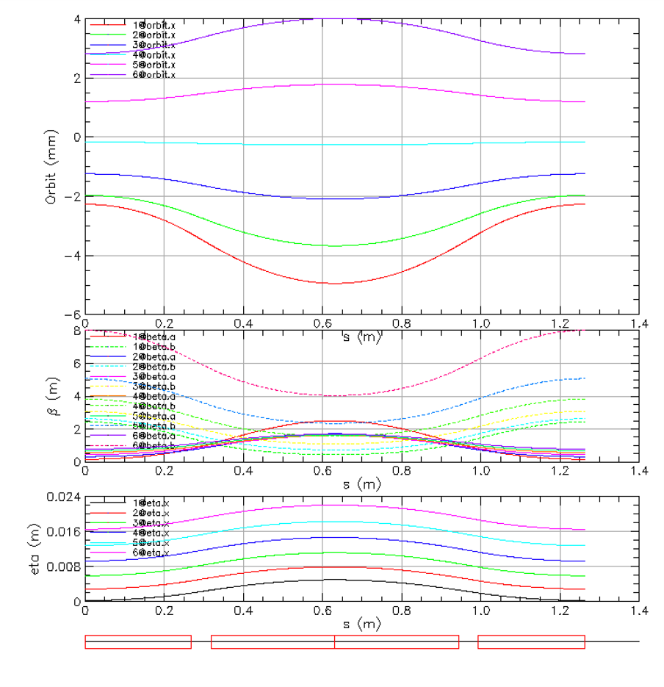
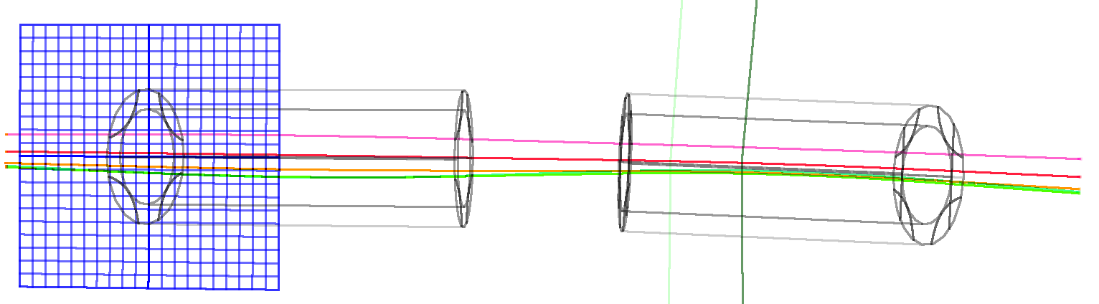

Thanks for your attention!
22 GeV CEBAF with Novel FFA Design

Slide 21
Backup Slides

Slide 22
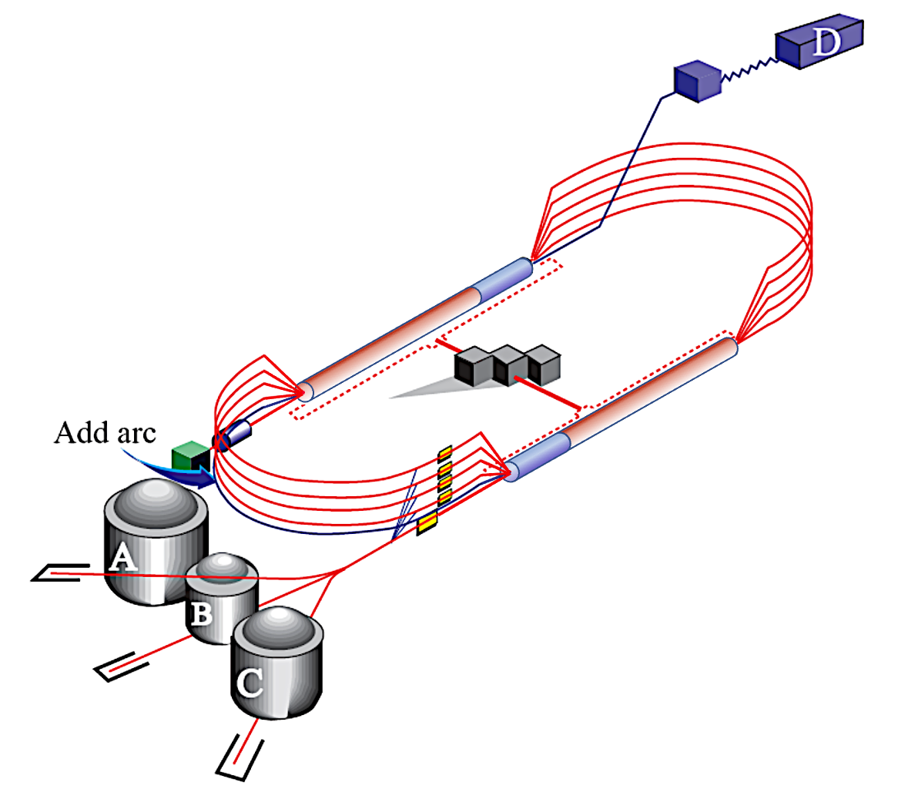
CEBAF Energy Upgrade 10.55 → 23.75 GeV
4 existing lines + 6 FFA turns
12 GeV
23.75 GeV
Injector at 650 MeV
1.75 GeV
3.95 GeV
6.15 GeV
23.75 GeV
8.35 GeV
EAST FFA
Energy range
80.6 m
#1-10.55 GeV
#2-12.75 GeV
#3-14.95 GeV
#4-17.15 GeV
#5-19.35 GeV
#6-21.55 GeV
1.75
3.95
6.15
1.1 GeV
8.35
0.65 GeV
2.85 GeV
5.05 GeV
7.25
1.75 GeV
9.45
1.1 GeV
0.650
80.6 m
2.85 GeV
Energy range
5.05 GeV
7.25 GeV
22.65 GeV
9.45 GeV
WEST FFA
#1-11.65 GeV
#2-13.85 GeV
#3-16.05 GeV
#4-18.25 GeV
#5-20.45 GeV
#6-22.65 GeV
22 GeV CEBAF with Novel FFA Design
22

Slide 23
Current Baseline Design: Layout
N
FFA Transition
Recombiner
North Linac
Spreader
Splitter
Line to Hall D
FFA Cells
LERF Injector
FFA Cells
EM Arcs
EM Arcs
Splitter
Spreader
South Linac
Recombiner
FFA Transition
BSY to xABC
Extraction Region (EM)

