Slide 1
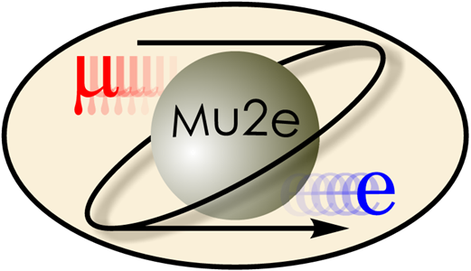
Mu2e: Using Rare Muon Decays to Probe the Frontiers of Physics
E. Craig Dukes
(for the Mu2e Collaboration)
University of Virginia
SPIN 2023
September 27, 2023

Slide 2

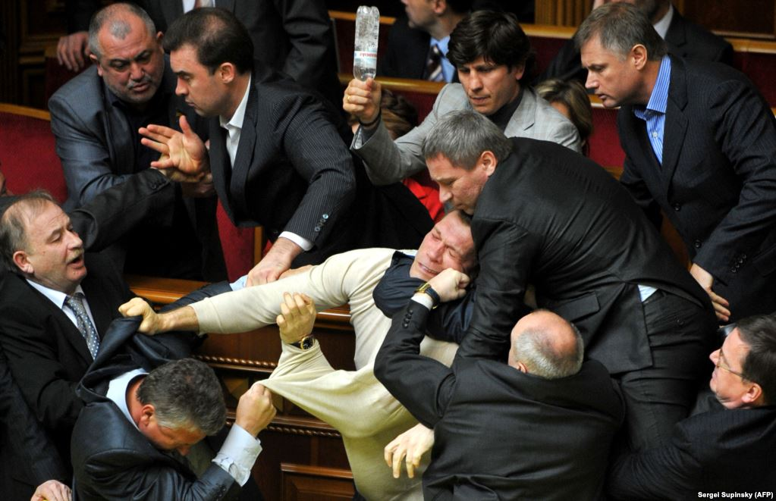
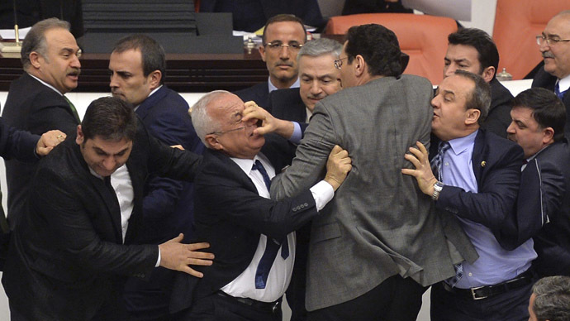
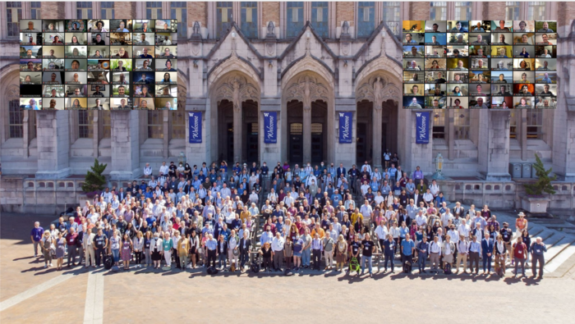
Planning the Future of Particle Physics
Last summer about several thousand particle physicists gathered together in Seattle to plan the future of particle physics in the United States for the next decade.

Slide 3
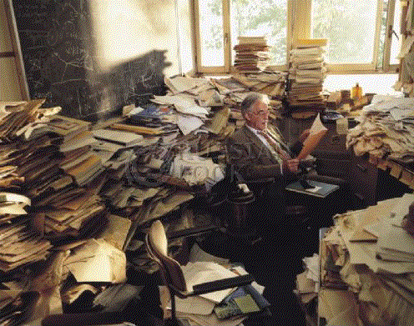
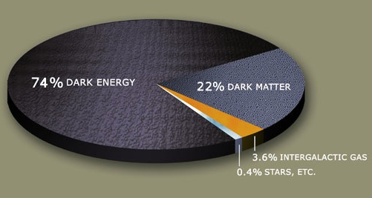
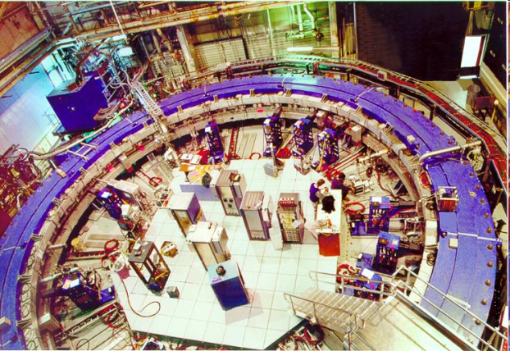
The Standard Model is Incomplete
Theory
Quantum theory of gravity
Origin of neutrino mass hierarchy
Solution to hierarchy problem ⇨ supersymmetry, something else?
Cosmology
Matter-antimatter asymmetry in the universe
Dark matter
Dark energy
Experiment
Neutrino mass ⇨ first evidence of physics beyond the standard model
Only occasional hints appear and often disappear: muon g-2, B⁺ → l⁺l⁻, NuTeV, CP phases in B_{s} mixing, D_{s} decay rates, W+jets, Top AFB
Notes:
The cause of our excitement is the almost certainty we have that there is New Physics beyond what we call the Standard Model, that the Standard Model is incomplete, and that some of this New Physics lies just around the corner.
The reasons we think there is New Physics are several. There are theoretical reasons, such as our understanding of how the electromagnetic and weak interactions are separated, which presumes a new particle called the Higgs, which actually is the last missing piece of the Standard Model, and the particle that provides the origin of mass, so it holds a really special place in the Standard Model. Solutions to several so-called mass hierarchy problems, for example, why we think the Higgs is so light compared to the scale at which all the forces are unified, and why the neutrinos have the masses they do, also suggest new physics.
There is also evidence from cosmology that our Standard Model is incomplete. For example, the Standard Model seems unable to explain why there is no longer any antimatter in the universe, and provides few clues as to the origin of dark energy and dark matter, which dominate the energy budget of the universe.
There are just a few experimental hints, and they are all marginal. Of course the recent discovery of neutrino mass, through neutrino oscillations, has led to the first evidence that there is indeed physics not explained by the Standard Model. Experimental studies of the weak interaction imply that the Higgs particle, is just within our grasp. And there are other tantalizing experimental hints that suggest New Physics, but nothing that is compelling.
However, before we get too euphoric, I should caution you that some of this New Physics may appear at energies too high for the Large Hadron Collider.

Slide 4
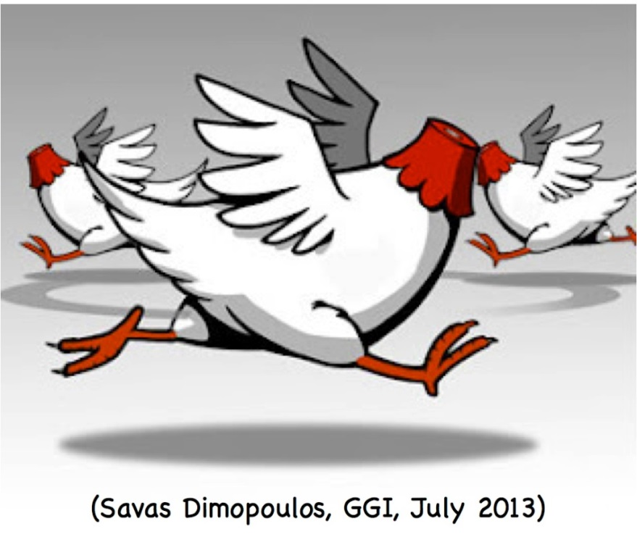
Current State of Theoretical Physics
We have a Standard Model that explains (almost) everything we see in our accelerator-based particle experiments.
It does not explain very gross features we unambiguously observe in the universe: dark matter, dark energy, antimatter asymmetry.
How do we proceed from here?

Slide 5
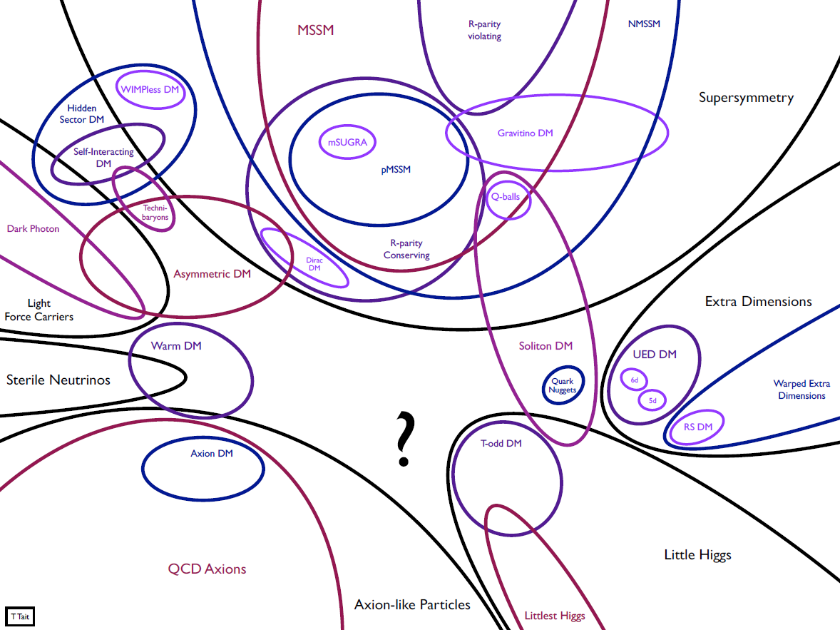
No Lack of Theoretical Ideas, but Little Guidance

Slide 6
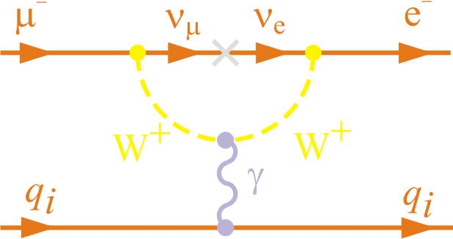
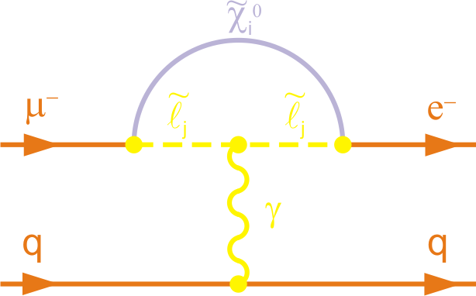
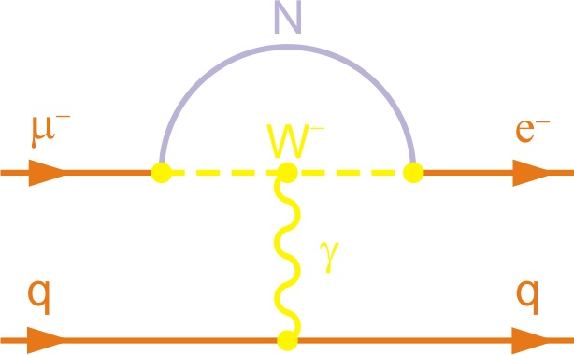
Why Search for Charged Lepton Flavor Violation?
In Standard Model not there ⇨ neutrino mass discovery implies an unobservable 10⁻⁵² rate
Hence, any signal unambiguous evidence of new physics
Exquisite sensitivities can be obtained experimentally
  sensitivities that allow favored beyond-the-standard-model theories to be tested
Lepton flavor conservation
accidental
in the extended Standard Model
New heavy neutrino
Supersymmetry

Slide 7
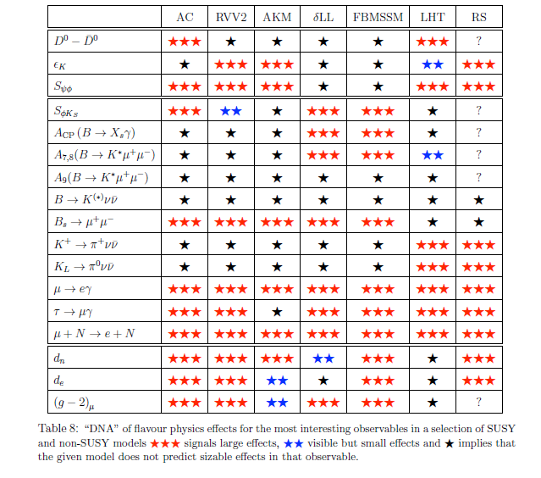
Why Muon-to-Electron Conversion? Sensitive Probe of New Physics
Probes of different SUSY and non-SUSY BSM models
Large effects
Visible, but small
No sizable effect
Altmannshofer et al., NPB 830, 17 (2010)

Slide 8
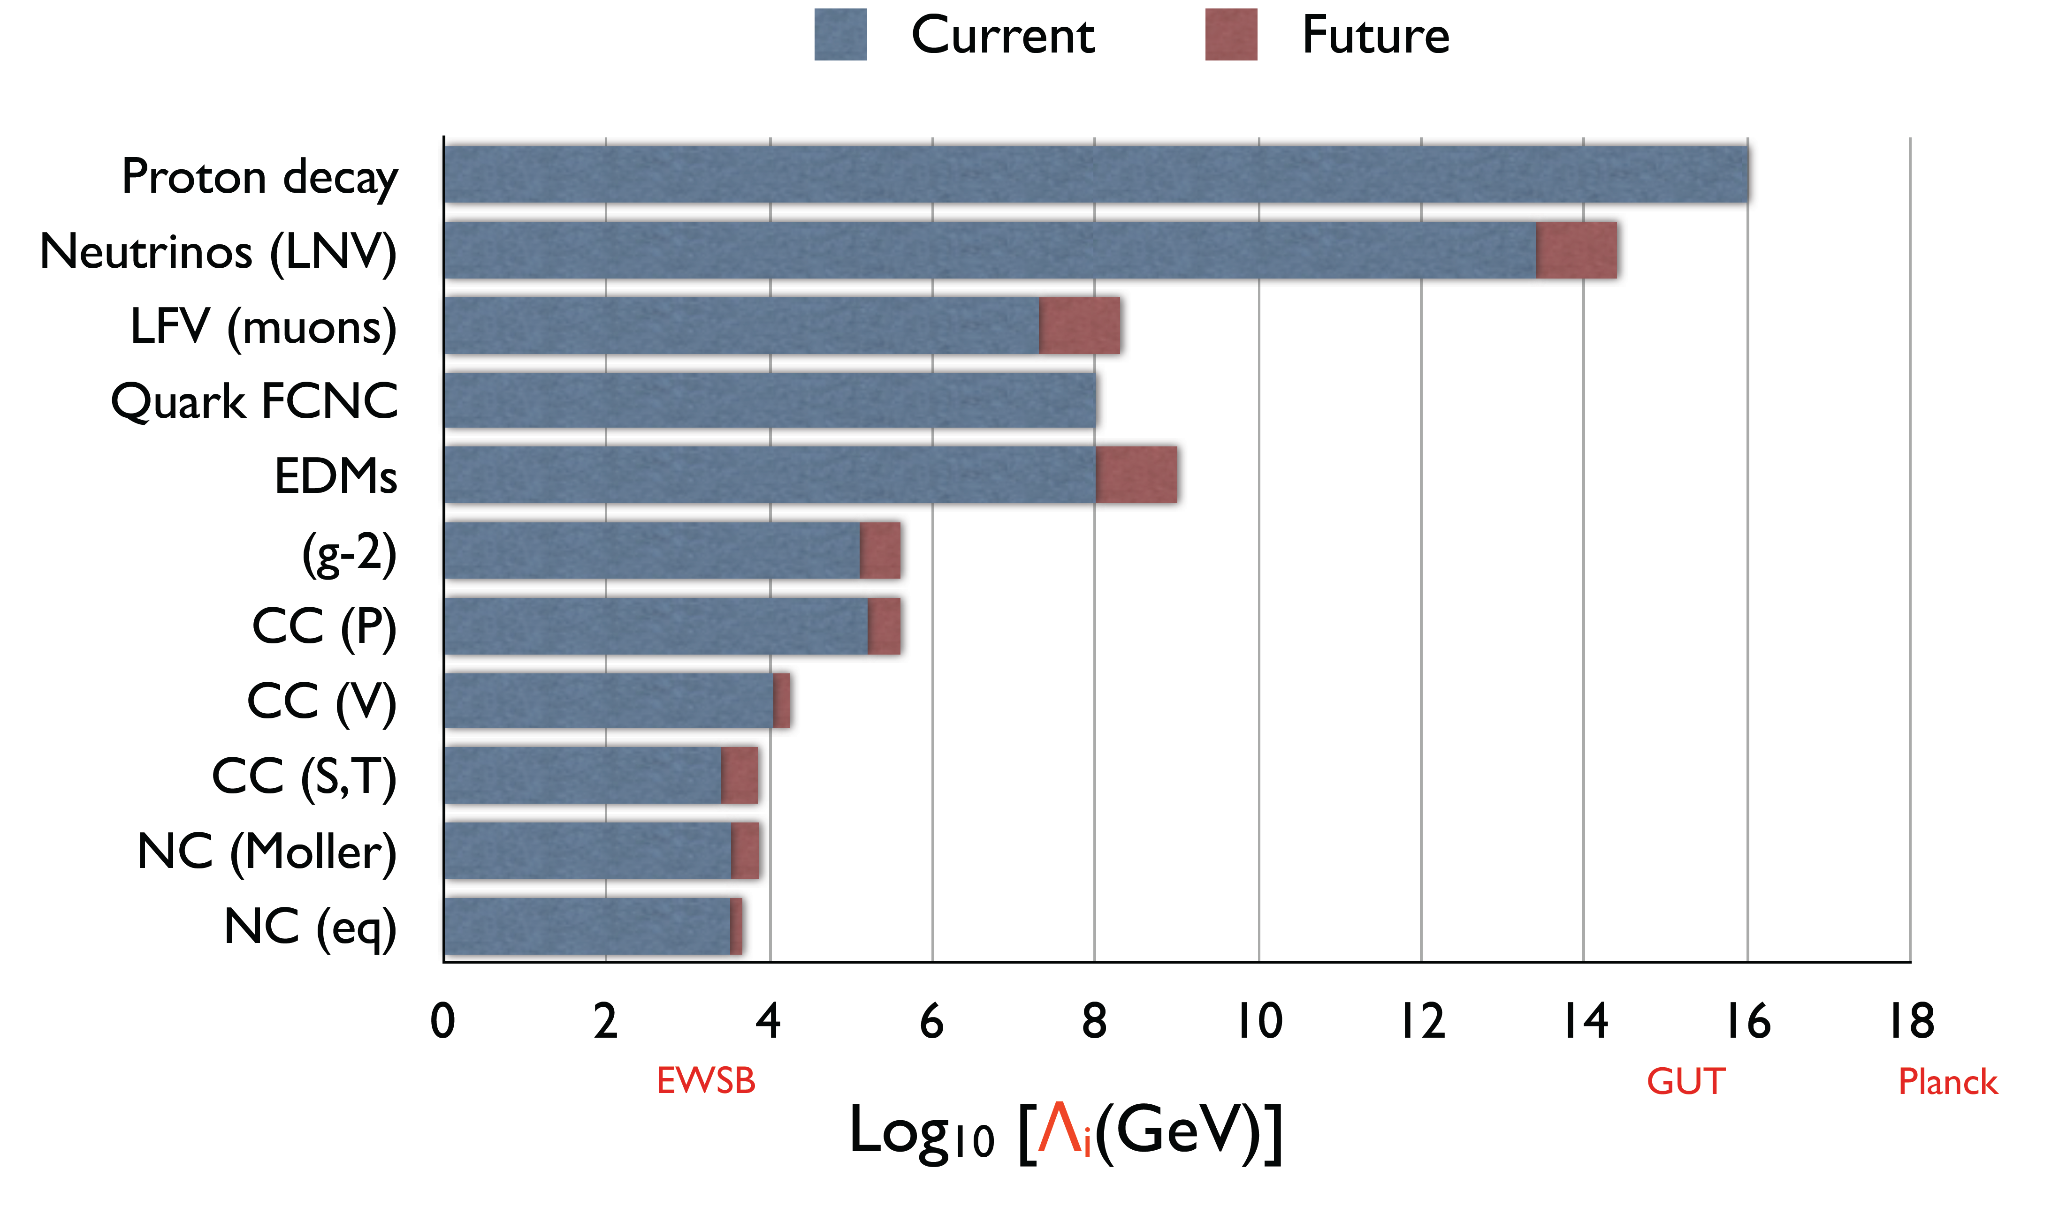
Why Muon-to-Electron Conversion? Probes High Mass Scales
Cirigliano and Ramsey-Mussolf, ArXiv: 1304.0017, 2013

Slide 9
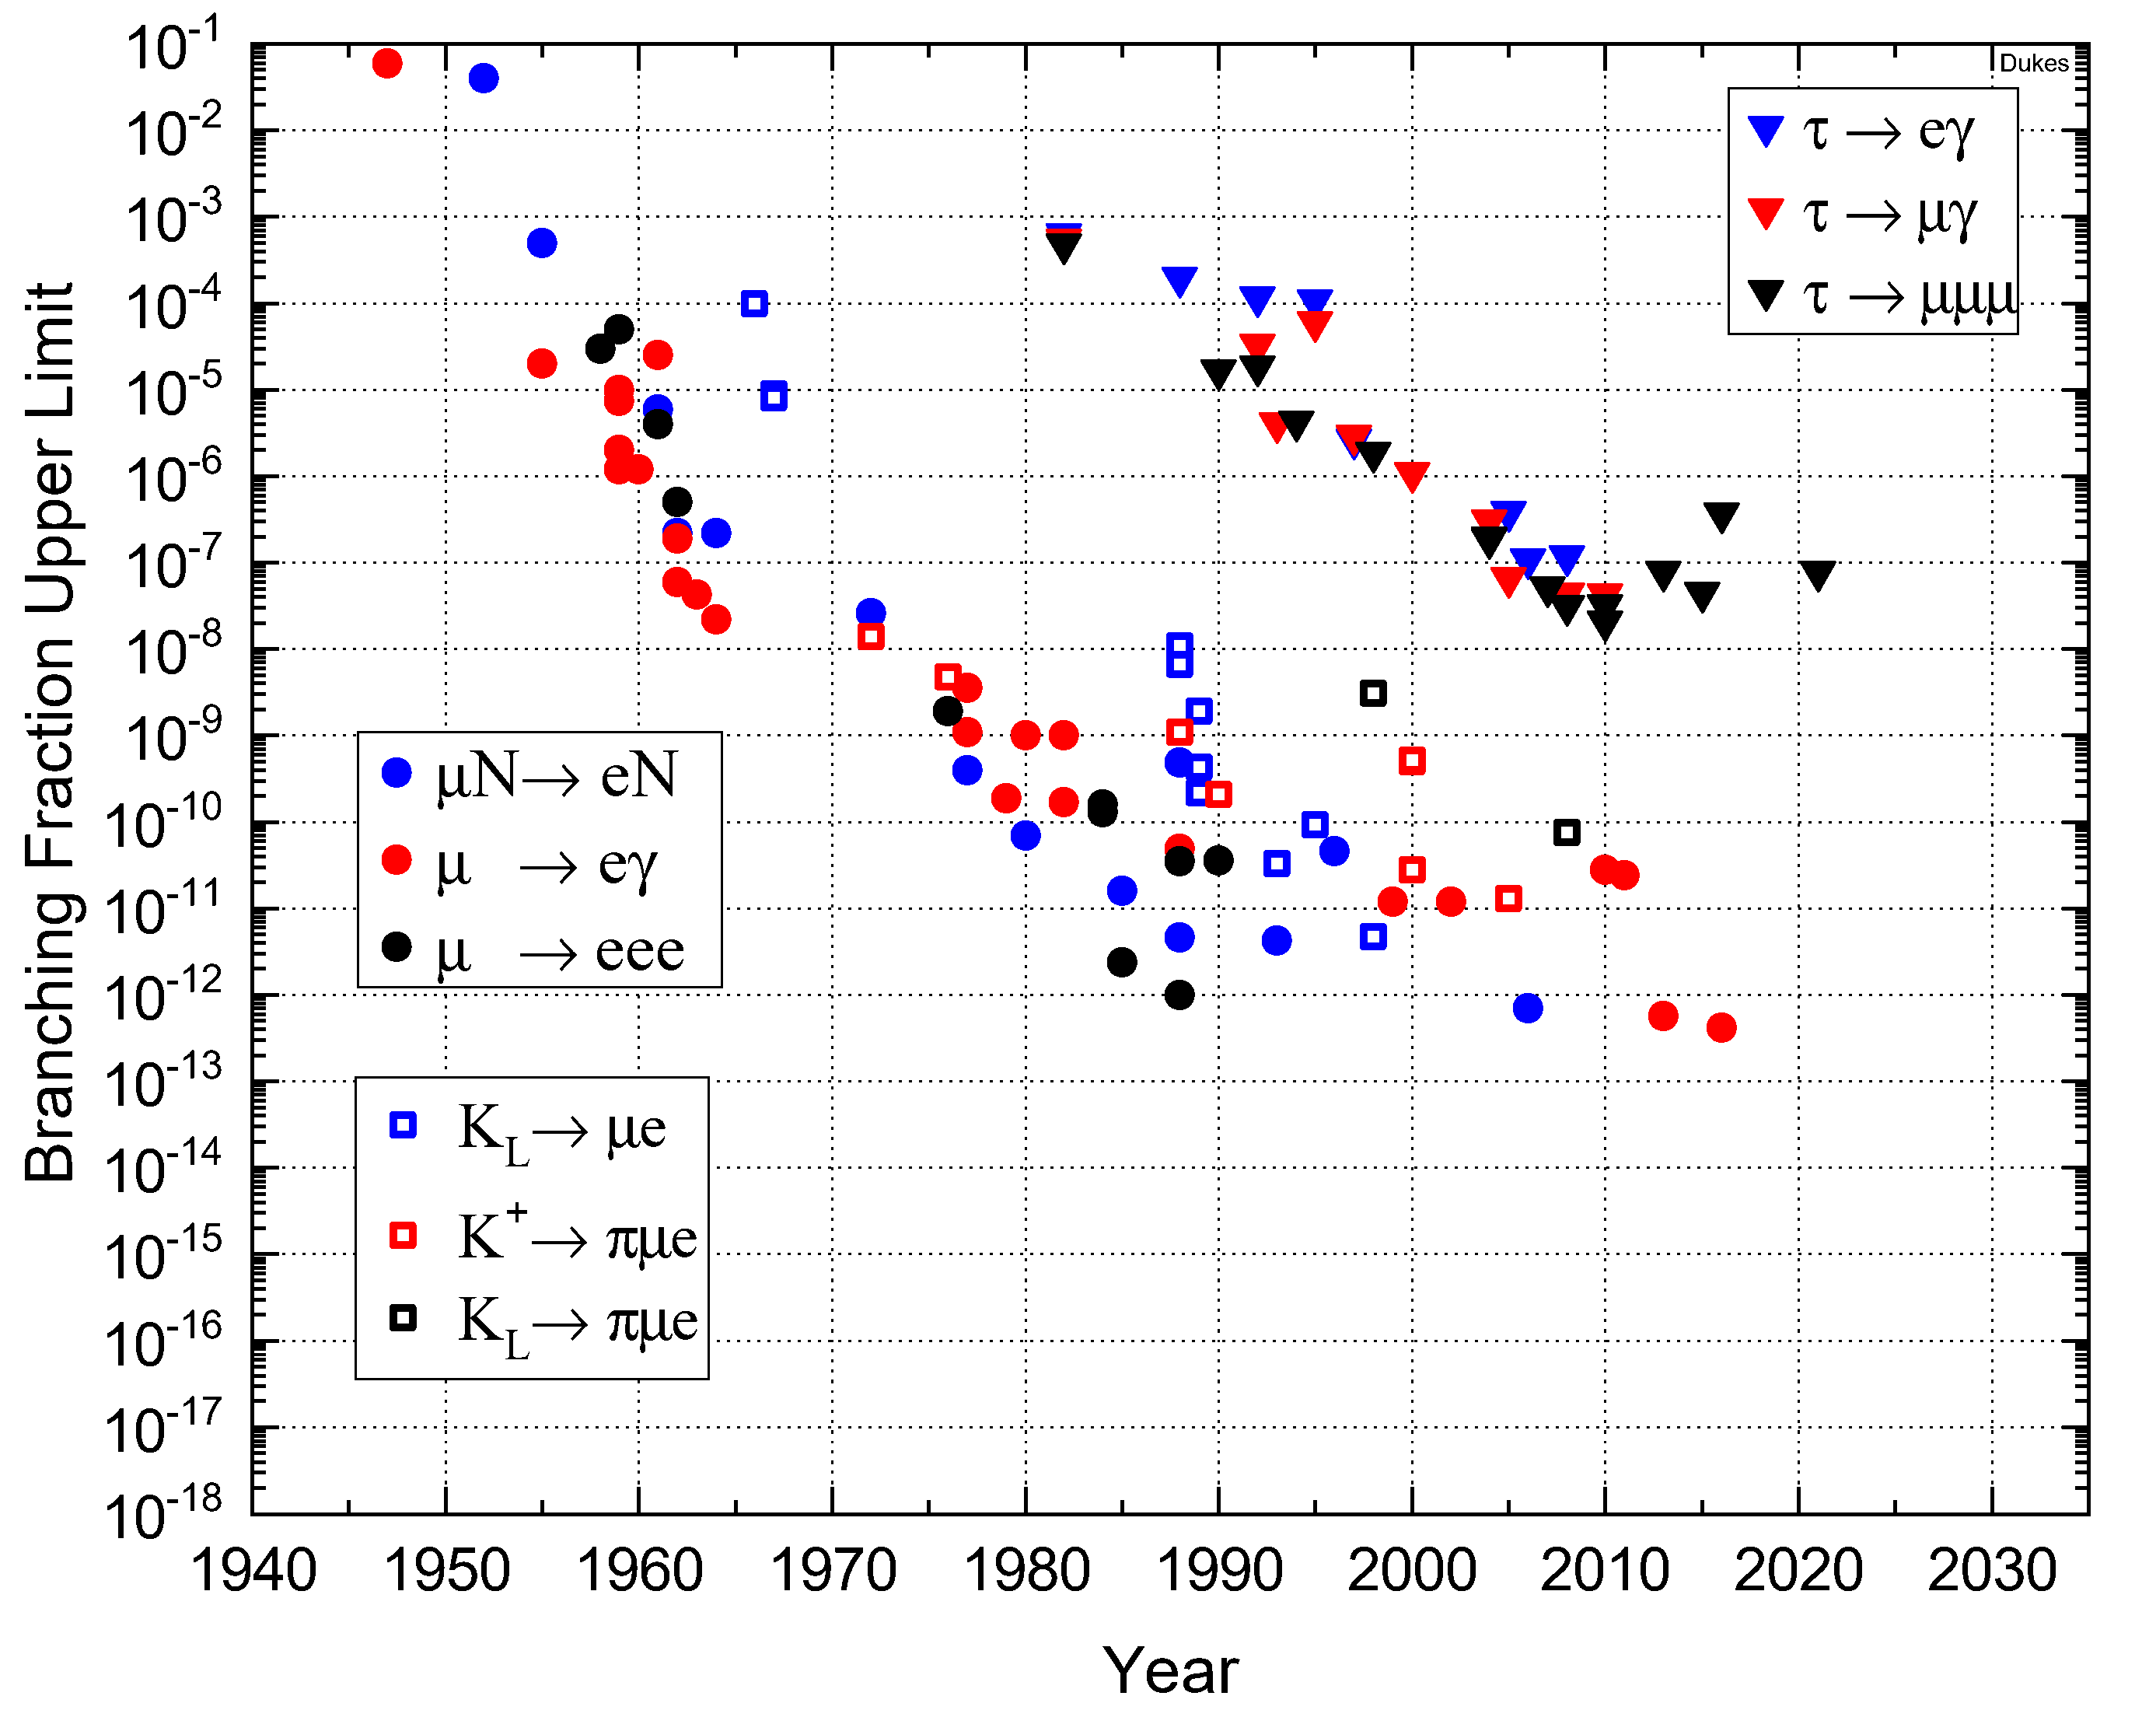
(Incomplete) History of CLFV Searches

Slide 10
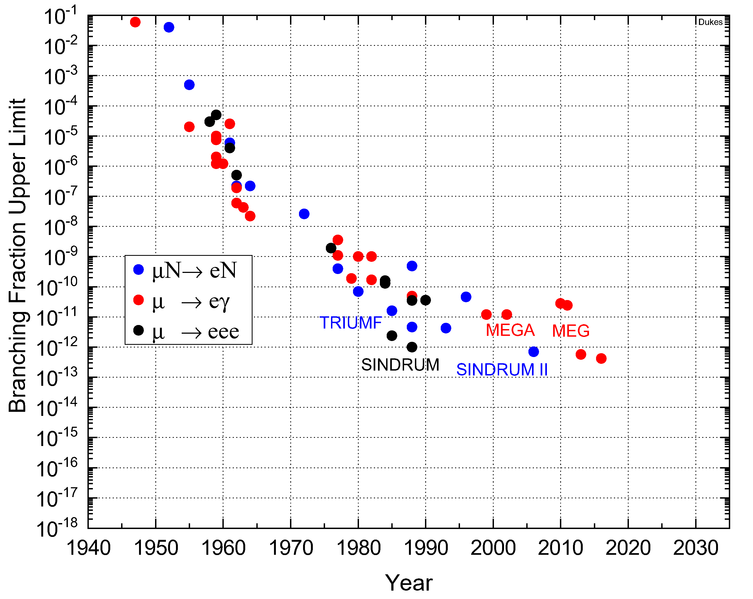
History of Muon CLFV Searches

Slide 11
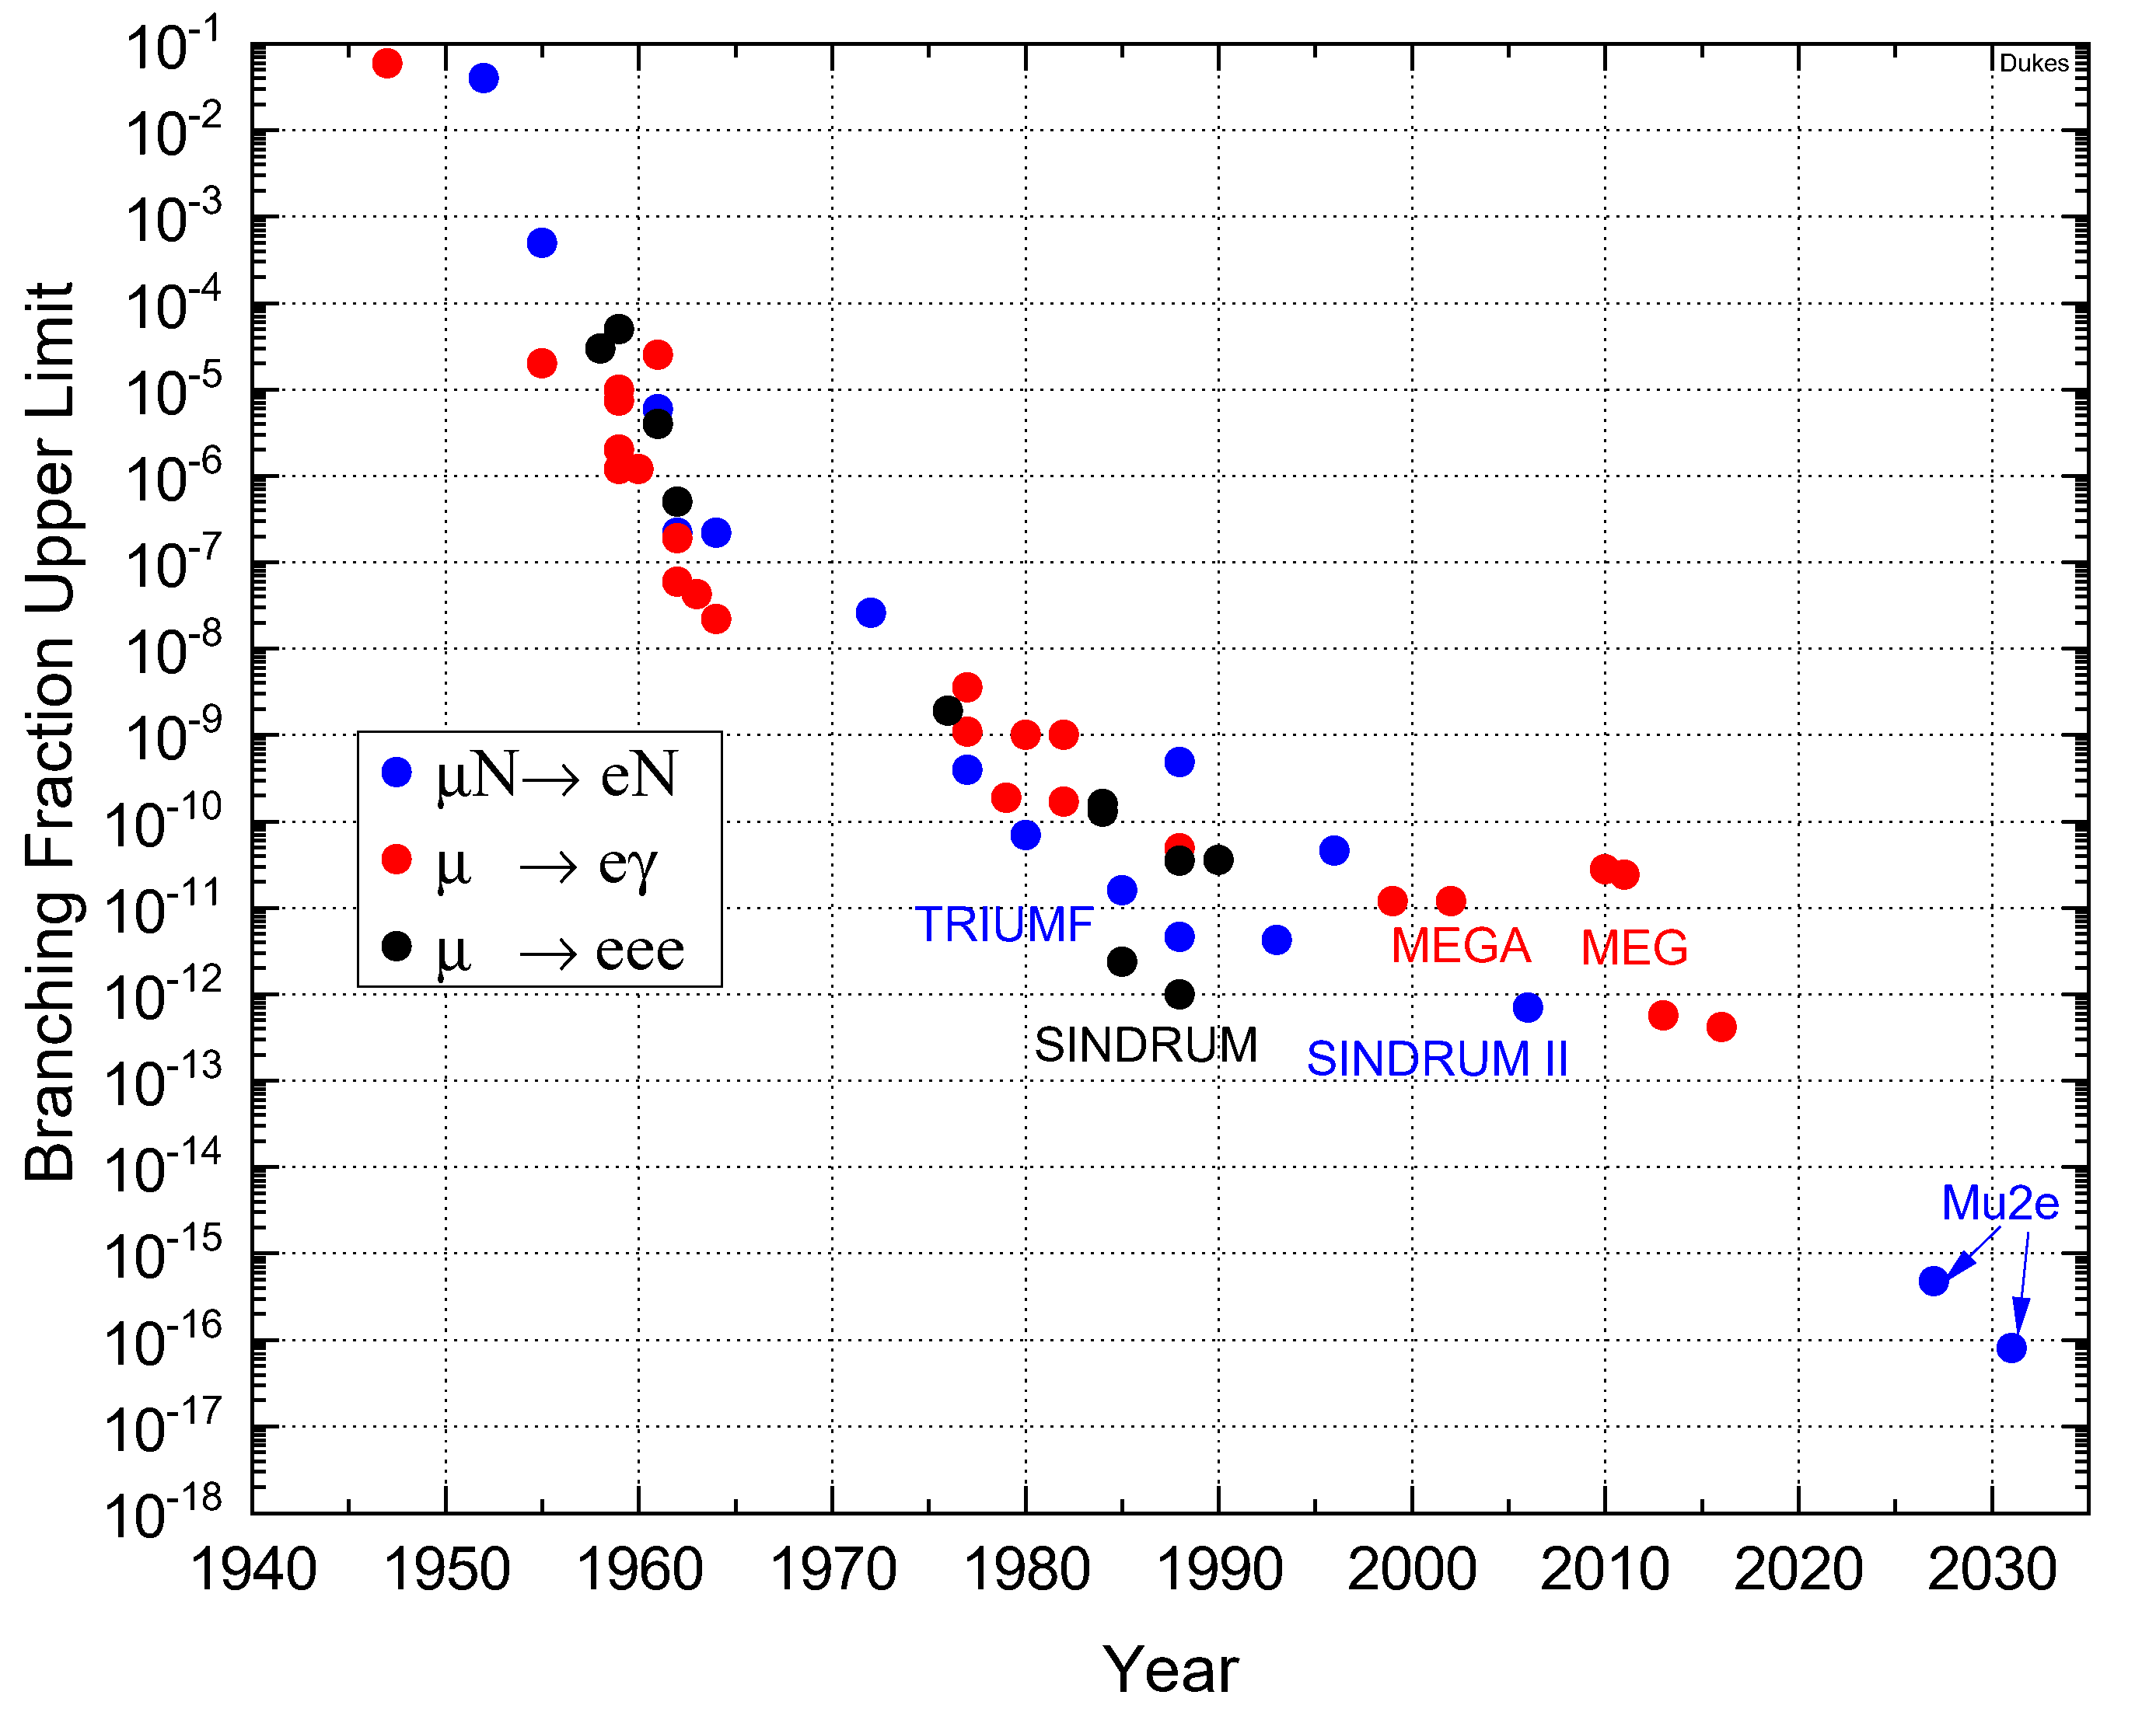
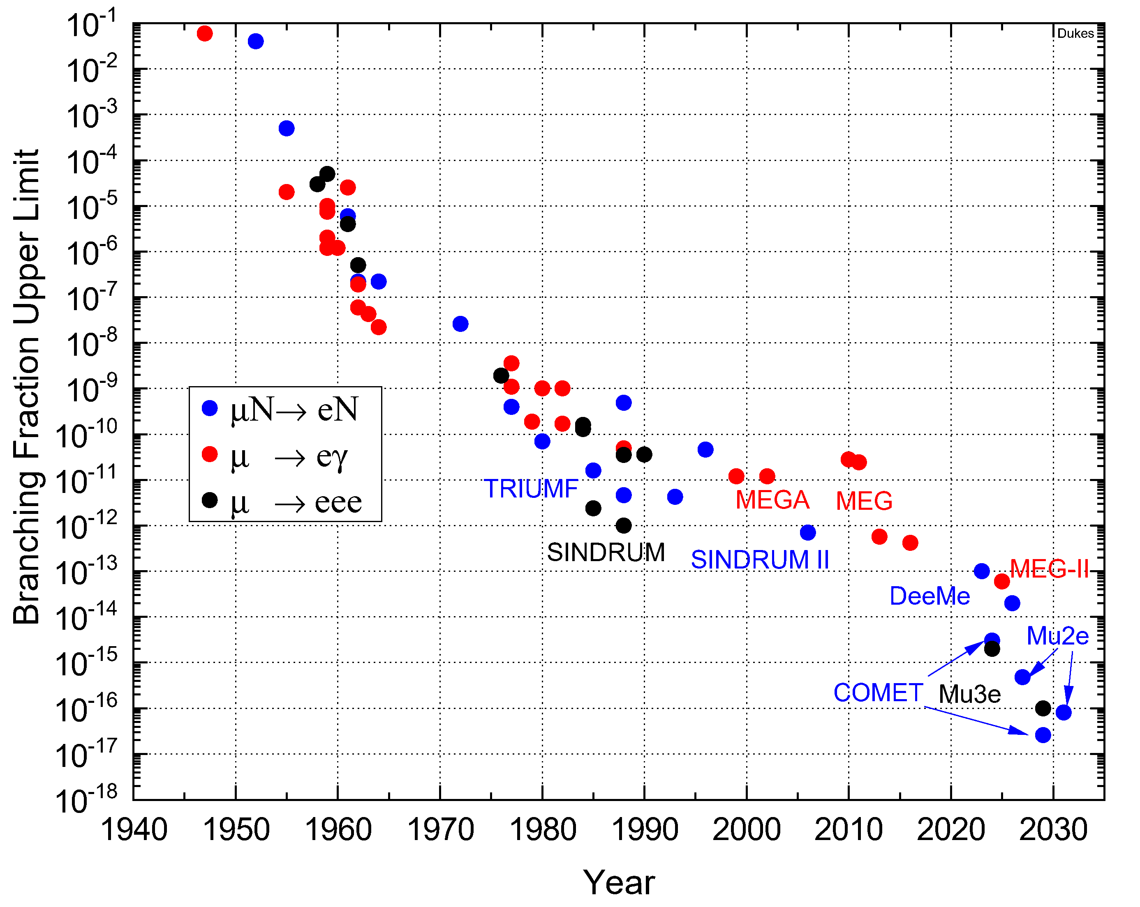
Future Searches of Muon CLFV

Slide 12
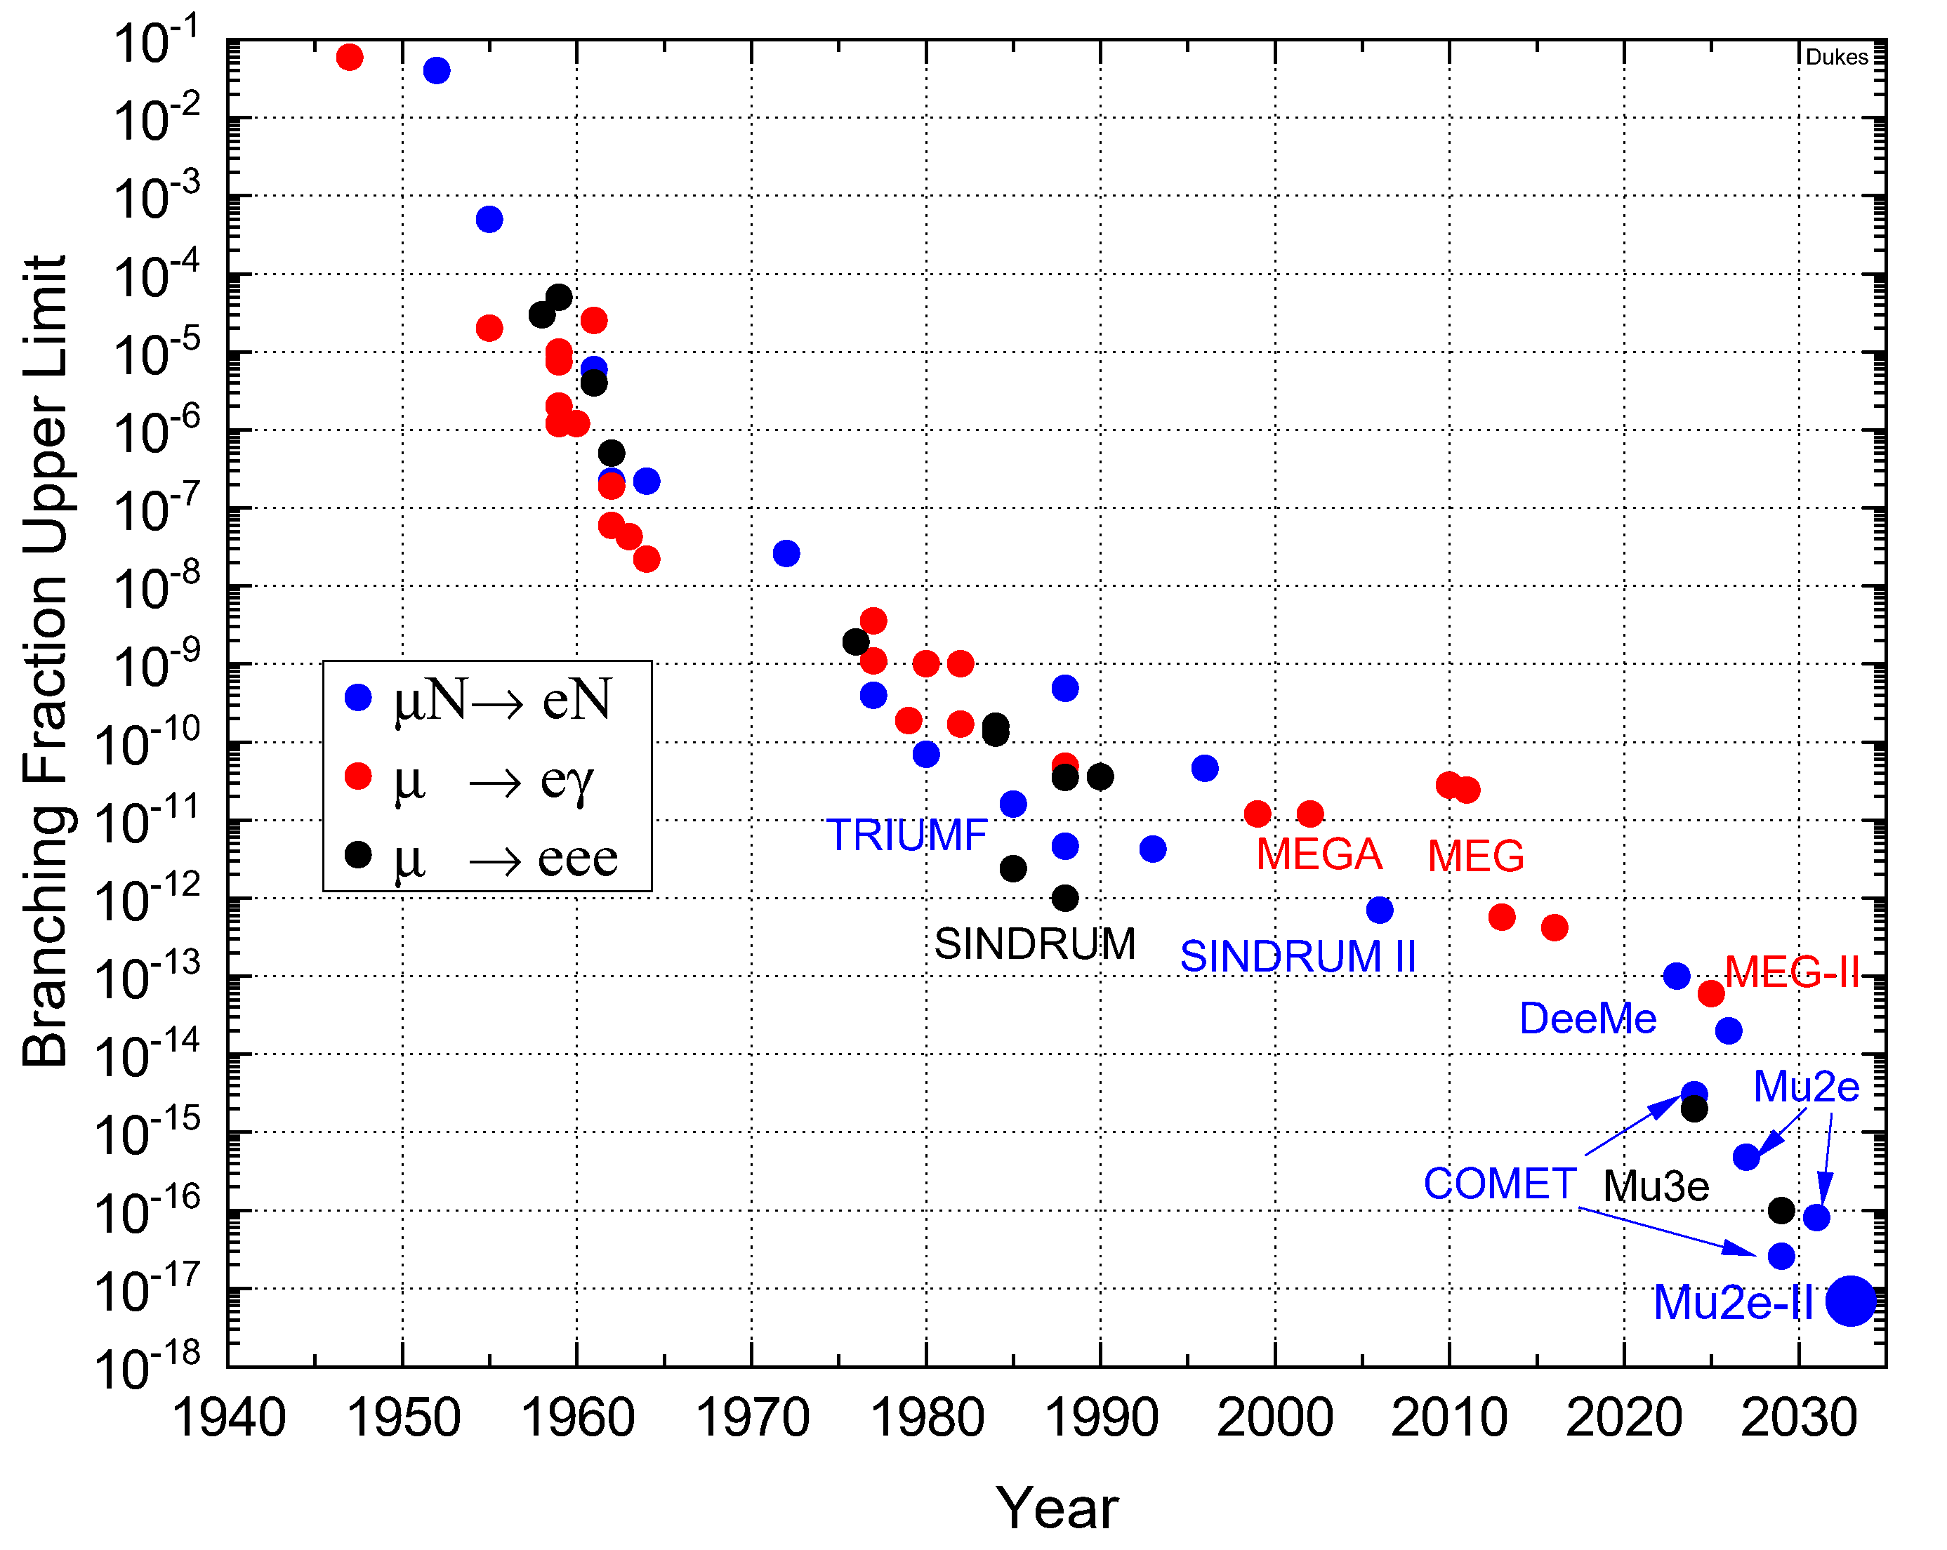
Mu2e-II Goal: O(10⁻¹⁸) Single Event Sensitivity

Slide 13
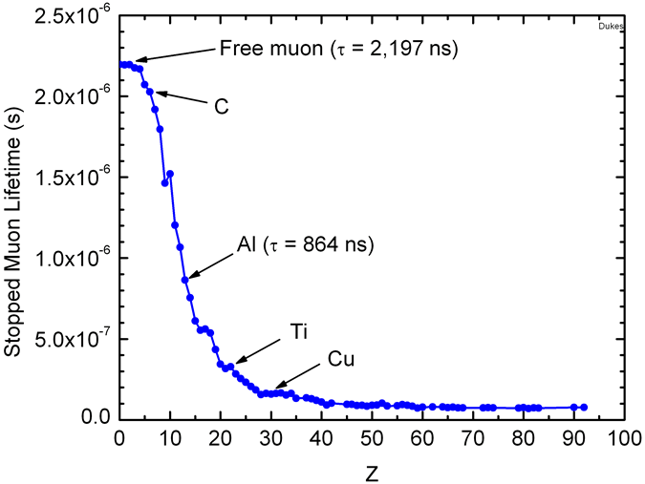
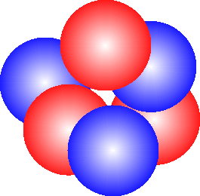
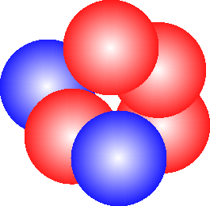
How to Search for μ⁻N→e⁻N
Stop muon in atom
Muon rapidly (10⁻¹³s) cascades to 1S state
Circles the nucleus for up to ~2 μs (in Al τ = 864 ns)
Two things most likely happen:
  muon is captured by the nucleus: μ⁻N_{A,Z}→ν_{μ}N_{A,Z-}
Single atom luminosity:
~ 1 x 10⁴⁴ cm⁻²s⁻¹
ν_{μ}
μ⁻
Mg²⁷
Al²⁷

Slide 14
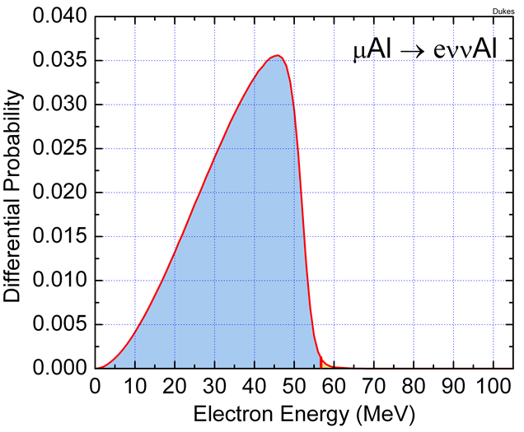
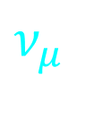
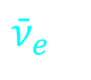
How to Search for μ⁻N→e⁻N
Stop muon in atom
Muon rapidly (10⁻¹⁶s) cascades to 1S state
Circles the nucleus for up to ~2 μs
Two things most likely happen:
  muon is captured by the nucleus: μ⁻N_{A,Z}→ν_{μ}N*_{A,Z-1}
  muon decays in orbit: μ⁻N_{A,Z}→e⁻ν_{μ}ν_{e}N_{A,Z}
$$ν_{μ}$$
Al²⁷
$${\bar{ν}}_{e}$$
e⁻

Slide 15
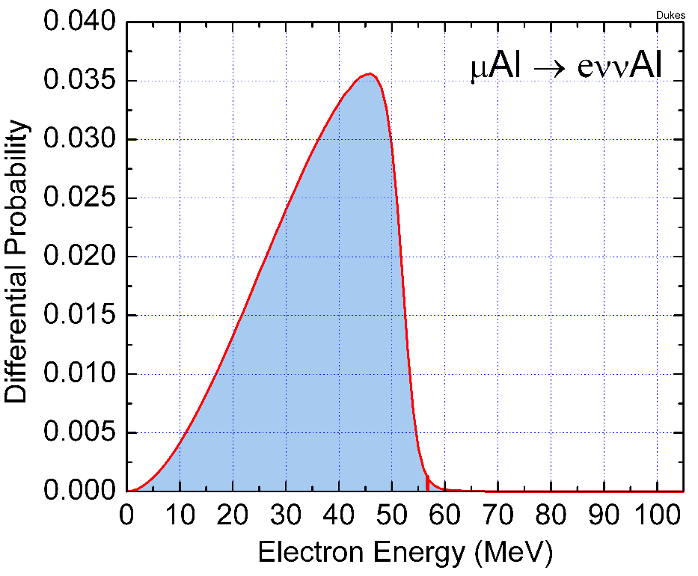
Mu2e Searching for a Third Process: μ⁻N→e⁻N
The muon turns into an electron μ⁻N→e⁻N leaving the nucleus in ground state
  signature single delayed (τ = 864 ns in Al) isolated electron
  Electron energy given by the rest mass of the muon minus the nucleus recoil energy and the binding energy:
  E_{e} = m_{μ} – E_{NR} - E_{b} ~ 104.97 MeV (Al)
Al²⁷
Our signal!
DIO background
e⁻

Slide 16
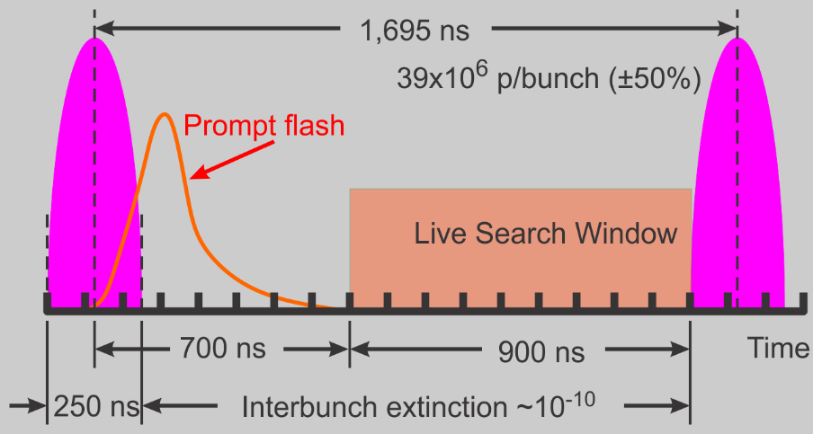
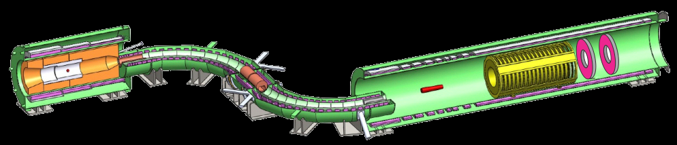



Mu2e Apparatus
Salient Features
Pulsed beam: 8 GeV Booster beam
Graded solenoidal field for pion capture
Muon transport in curved solenoid to eliminate neutral and positive particles
No detector elements in muon beam
39 x 10⁶ protons every 1.7 μs
74 x 10³ μ⁻ stops every 1.7 μs
43 billion μ⁻ stops/s
25 m
Muon Beam
Spectrometer
Production Solenoid
Transport Solenoid
Detector Solenoid
1.0T
2.5T
4.6T
2.0T
Stopping Target
Production Target
Collimators
Tracker
Calorimeter
$$π^{±}→μ^{±} + ν_{μ}$$
$$p + W→π^{±}+X$$

Slide 17
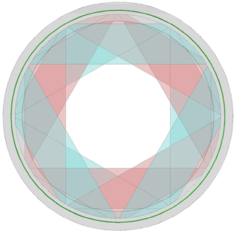
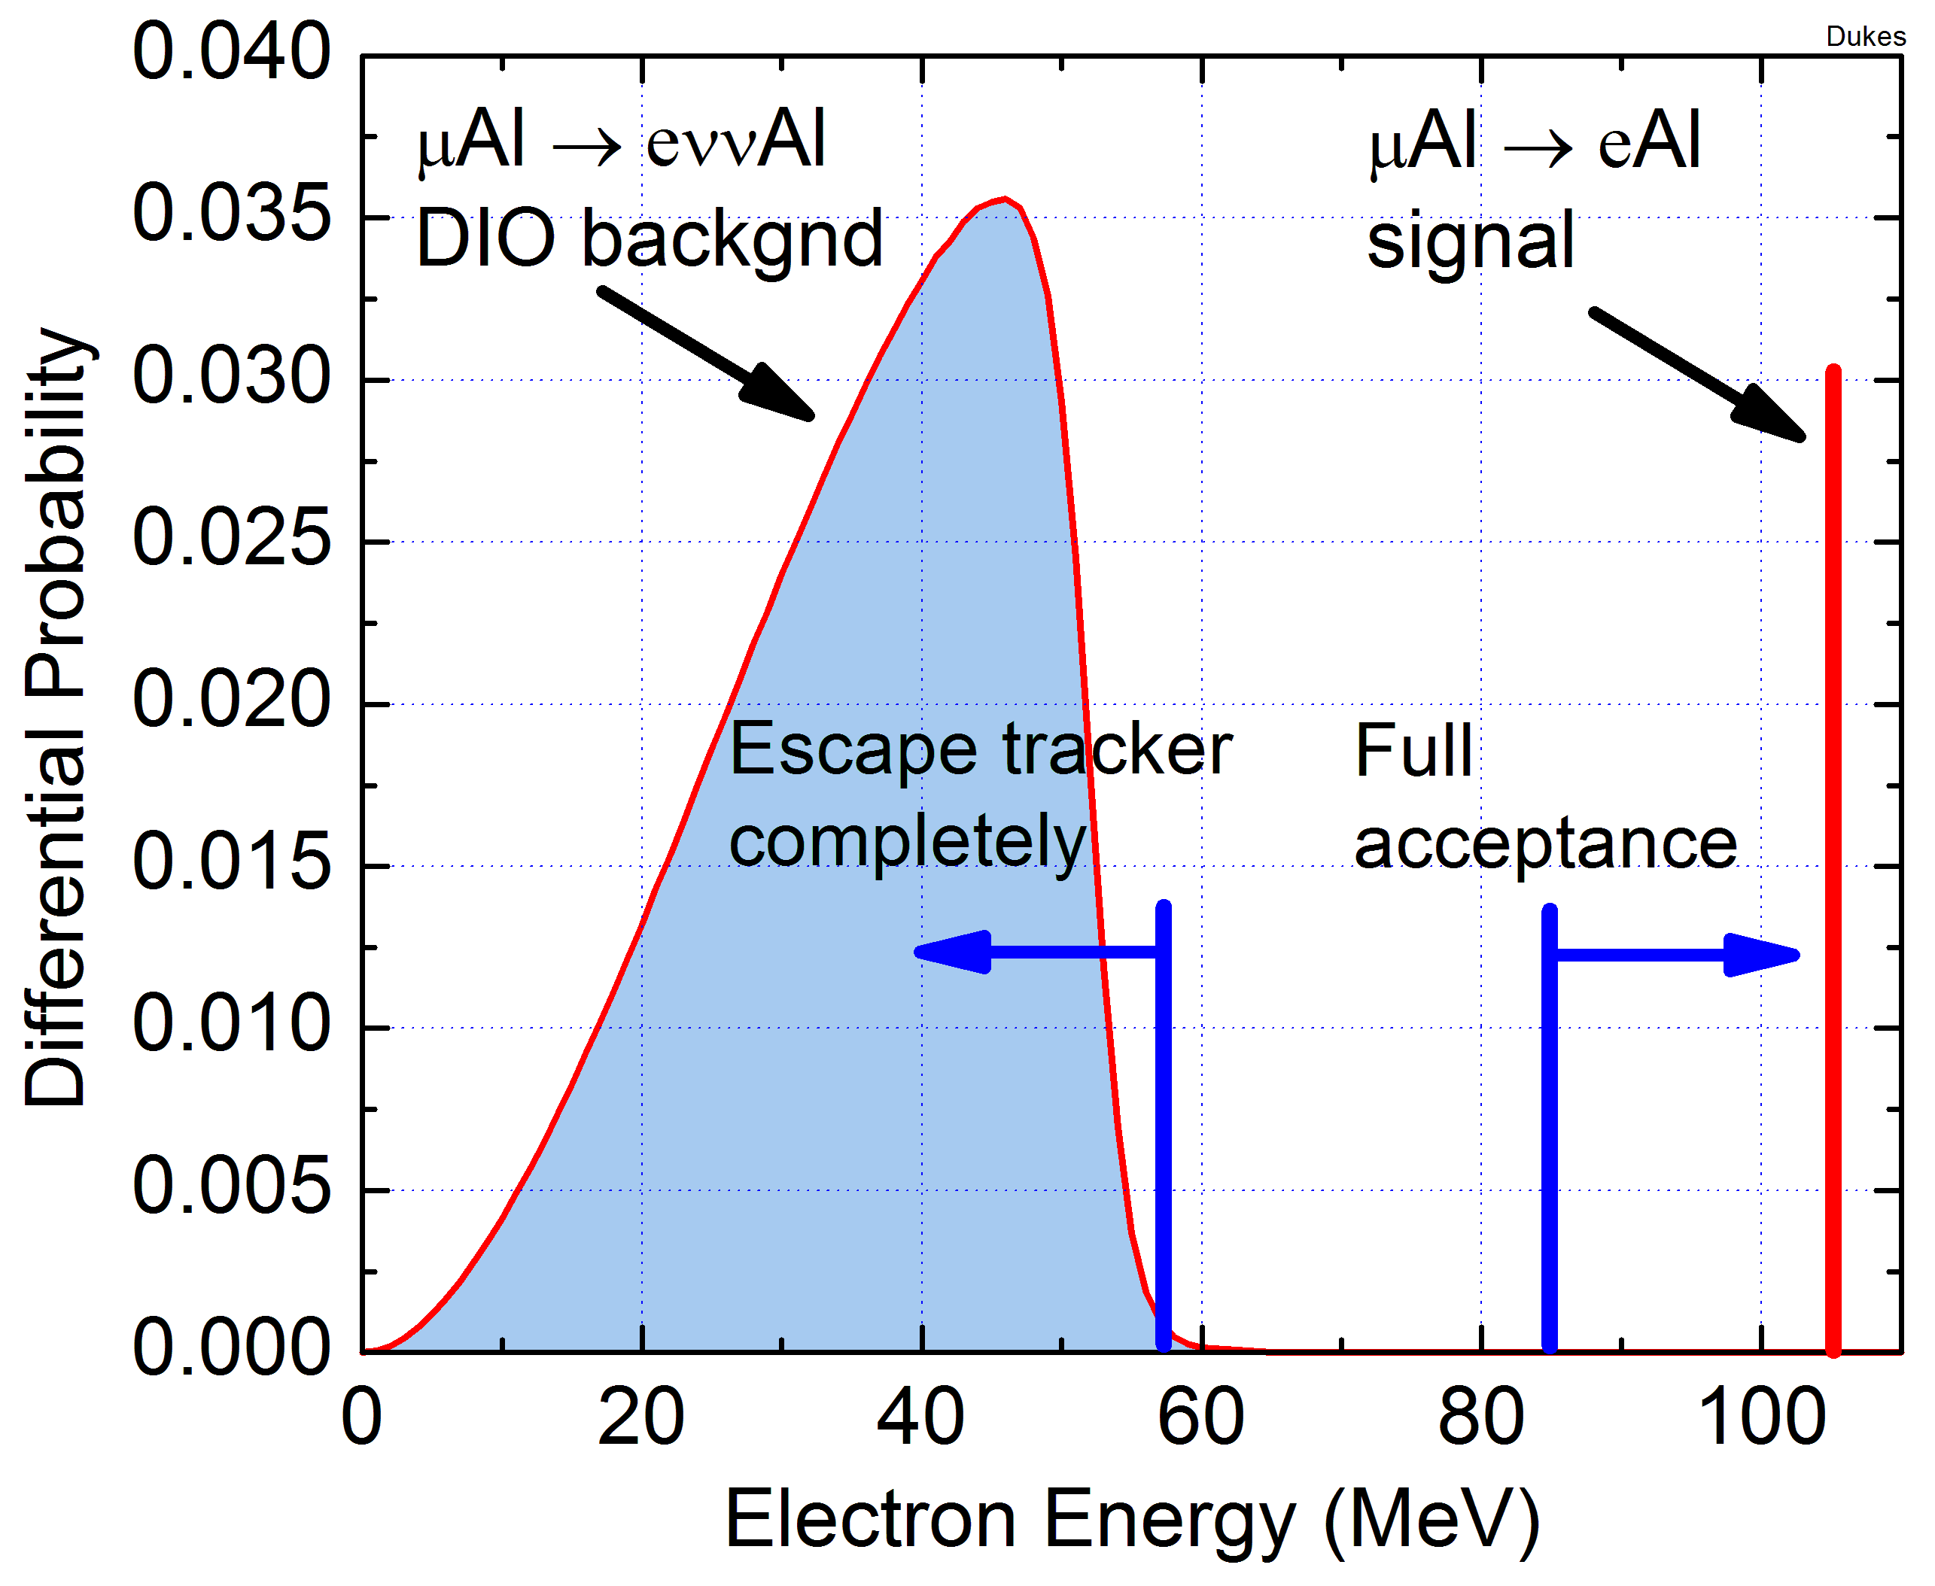
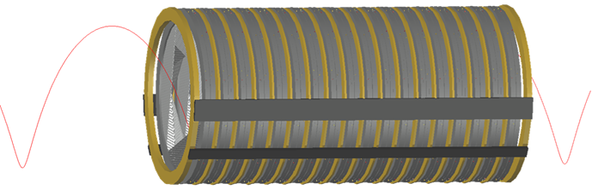
Heart of the Spectrometer: Straw Tracker
Beam View
20,736 5-mm straws in octangonal geometry (36 planes)
Center high-rate beam region empty
Signal/DIO acceptance: >20%/<10⁻³
Excellent momenum resolution
Flash: 3 MHz/cm² Live window: 20 kHz/cm²
Low energy DIO tracks
Target Foils
Trajectories
P_{t} > 90 MeV
90°±30°
85 cm
R=57 MeV
38 cm
~3 m / 1% X₀
Notes:
17

Slide 18
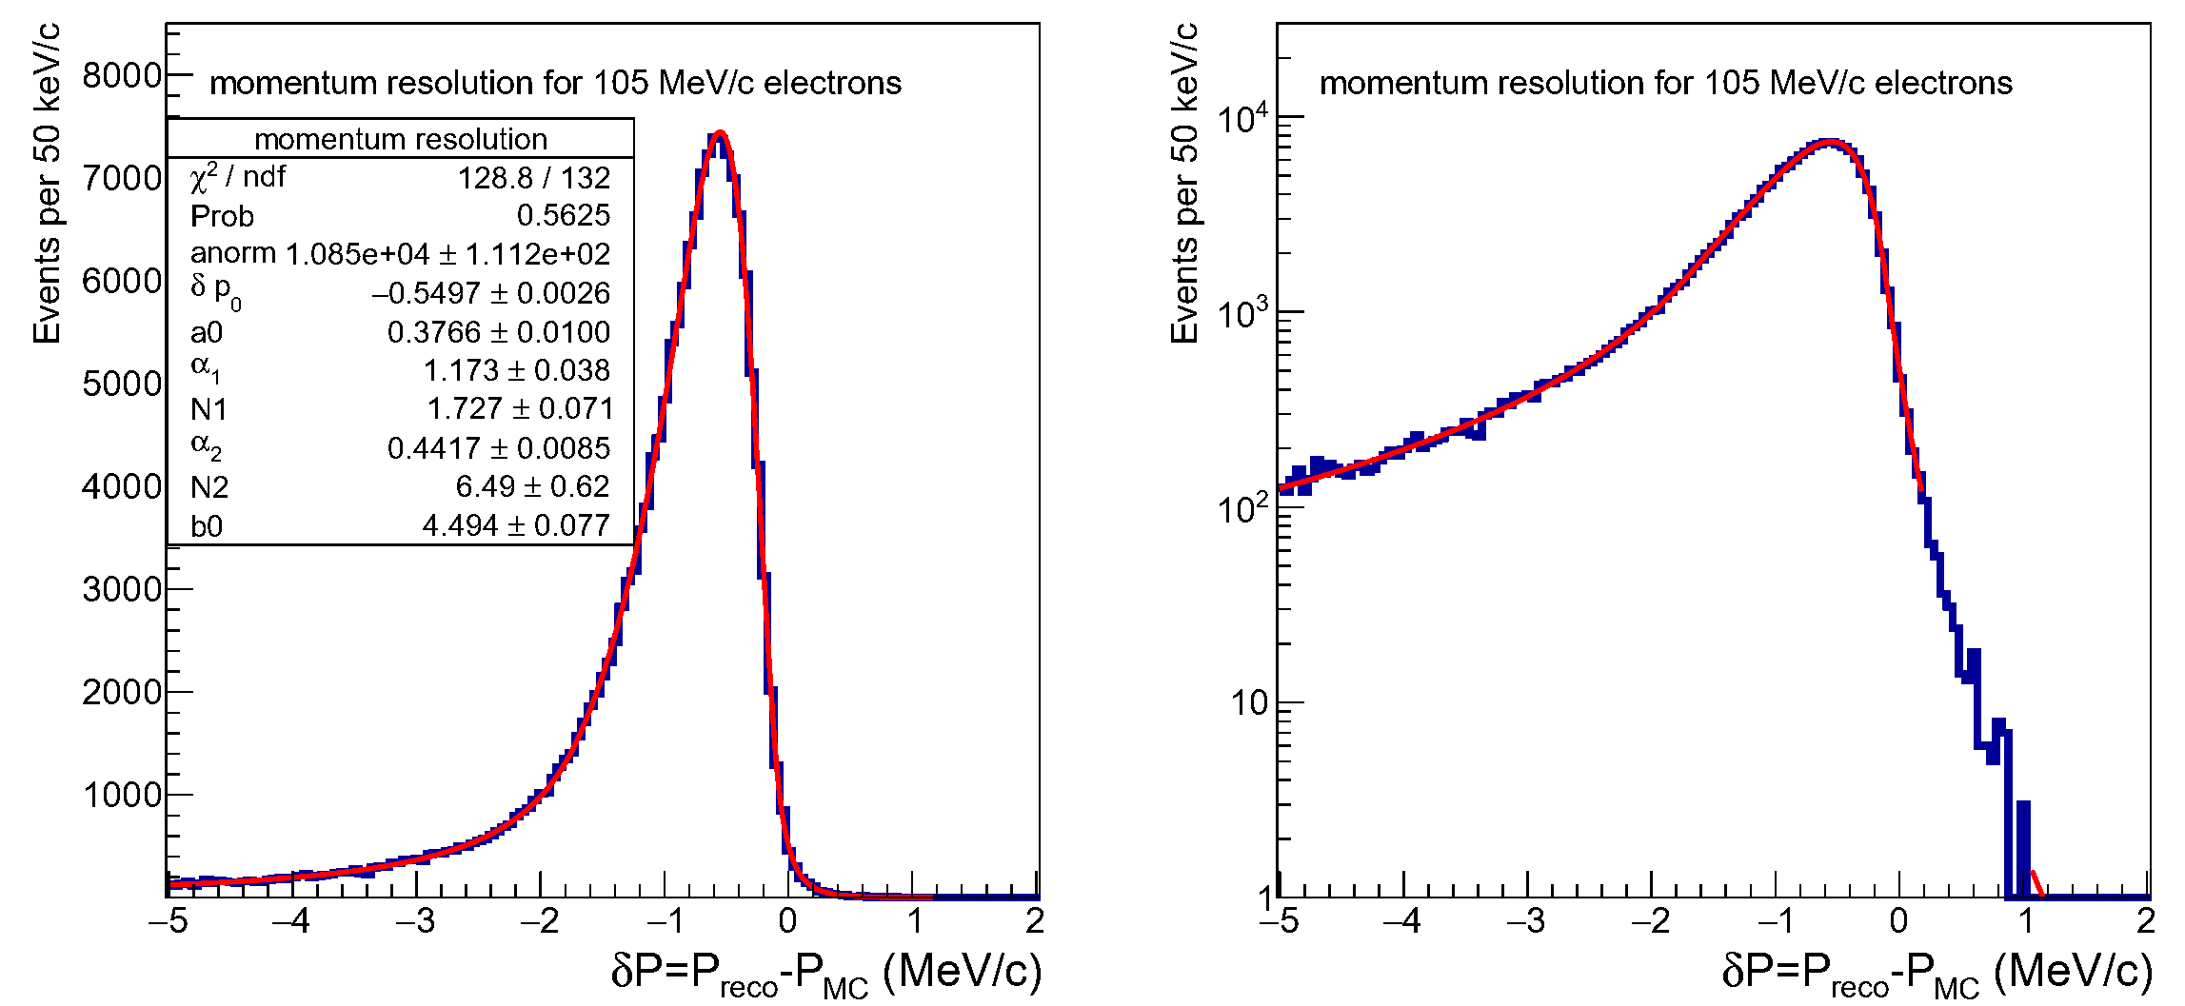
Tracker Performance
Tracker resolution for 105 MeV/c electrons
3 m long
Low mass: 1% X₀
Straws:
  5 mm diameter
  15 μm thick
  330-1170 mm length
18 stations:
  1,152 straws/station
  20,736 total
ArCO₂ 80:20
10⁻⁴ T vacuum
ADC/TDC readout
20kW cooling
Energy loss in target and tracker
Misreconstruction
Excellent momentum resolution: ~110 keV/c (no target energy loss)
No high side tail

Slide 19
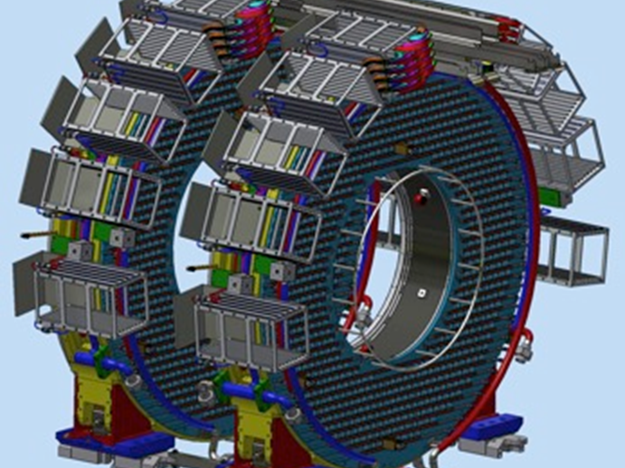
Electromagnetic Calorimeter
Beam View
Needed for:
  Seeding track finder
  Particle ID: e vs μ
  Standalone trigger
Two disks separated by ½ λ of helix
2 x 674 un-doped CsI crystals: 34 x 34 x 200 mm³ (10X₀)
Dual UV-extended SiPM readout
Rad hard: 90 krad γ; 3 x 10¹² n/cm²
Conversion electron resolution: σ_{E}/E O(5%)
Timing: σ_{t} = 110 ps
Calibration/monitoring using 6 MeV radioactive source and laser system

Slide 20
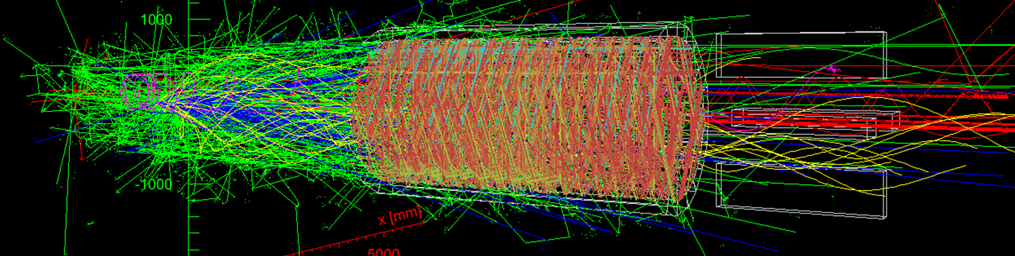
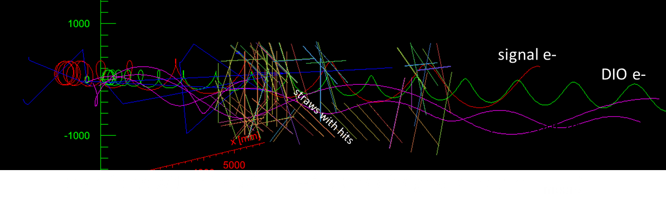
Calorimeter Performance: Track Seeding
Live Gate Window
±50 ns Around Conversion Electron

Slide 21
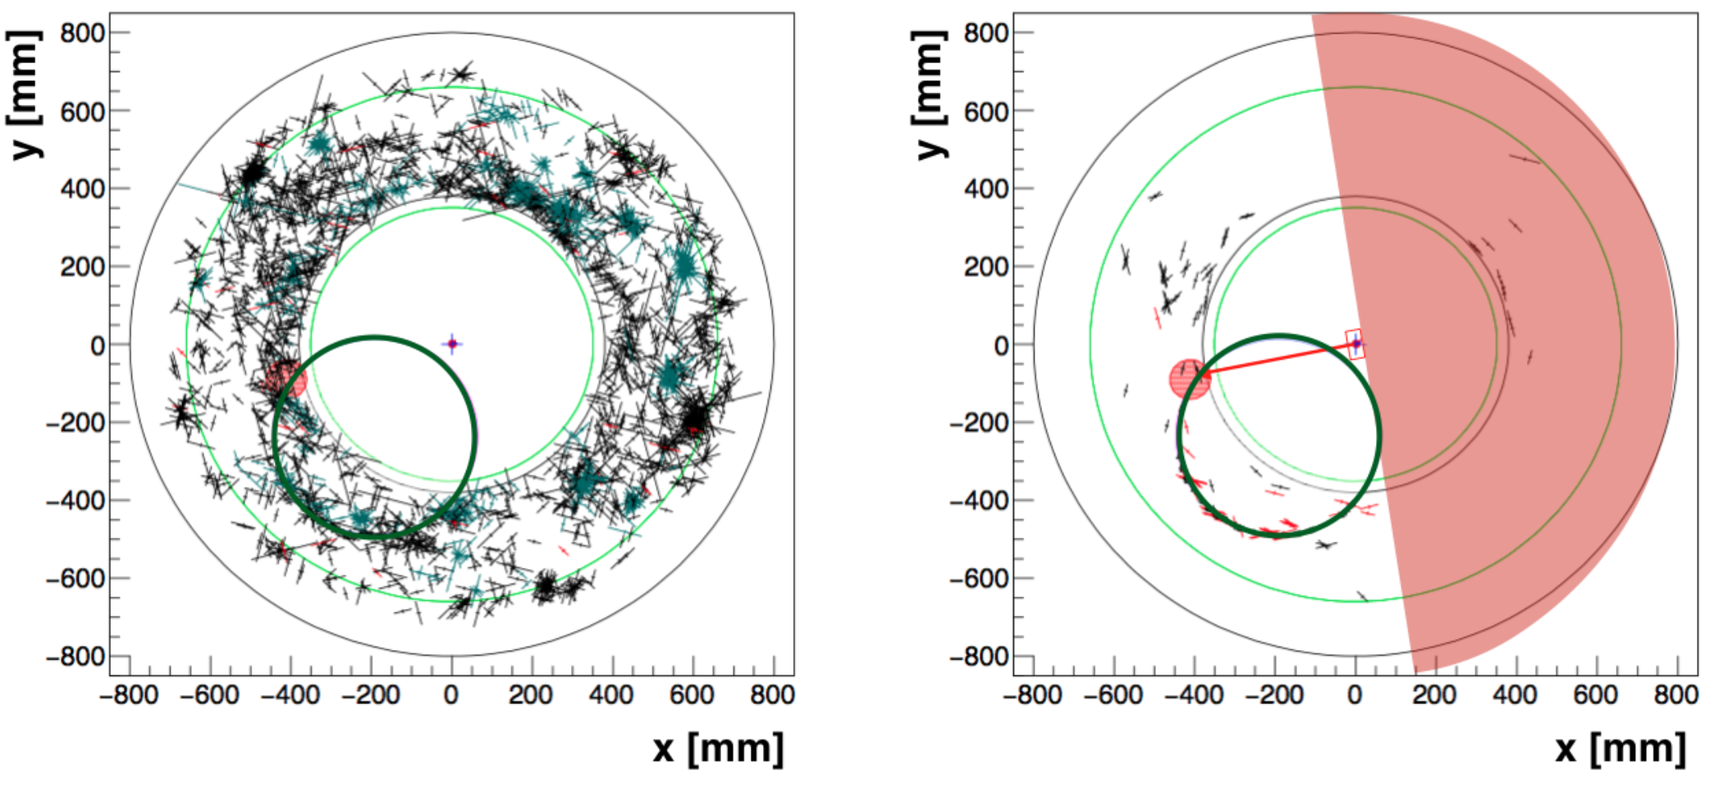
Calorimeter Performance: Track Seeding
No calorimeter seeding
±80 ns around calorimeter hit
Black crosses are straw hits, red circle - the calorimeter cluster, and dark-green circle – conversion electron trajectory.

Slide 22
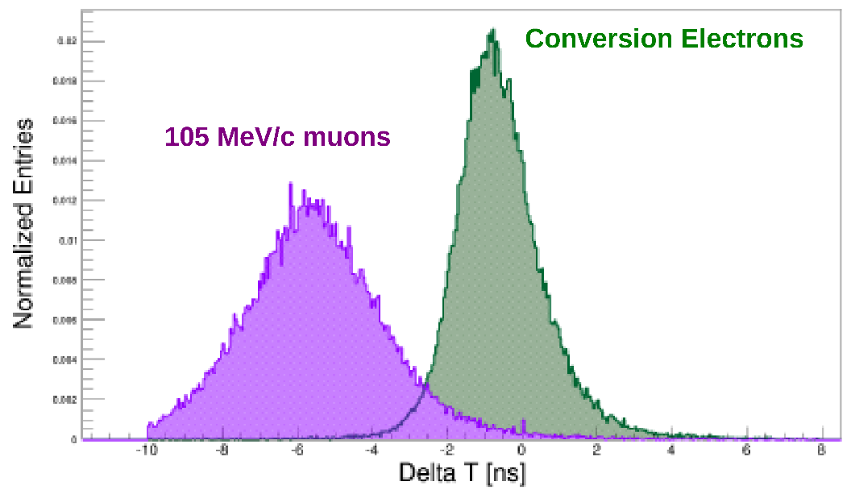
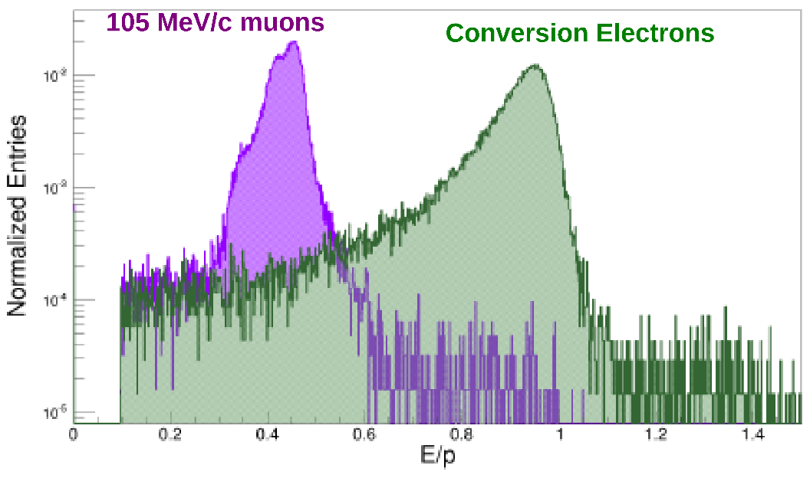
Calorimeter Performance: Particle Identification
Tracker – Calorimeter Time Difference
Tracker timing is not sufficient to separate 105 MeV muons from electrons and there are ~10,000 cosmic-ray muons per second raining down on apparatus: calorimeter does
Combining TOF and E/P gives rejection of 200X with 95% electron efficiency
Energy / Momentum
Muon Rejection Factor
Signal only
Signal + Overlays (x1)
Signal + Overlays (x2)
Electron Efficiency

Slide 23
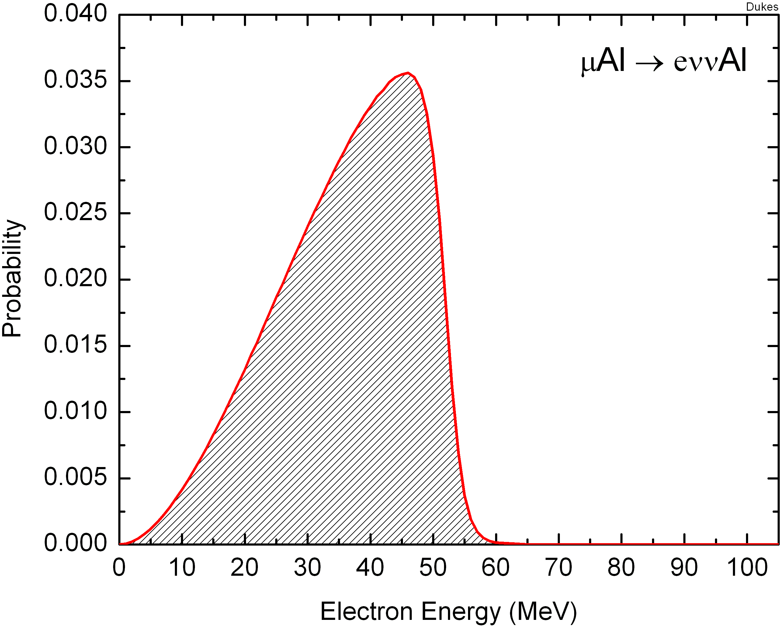
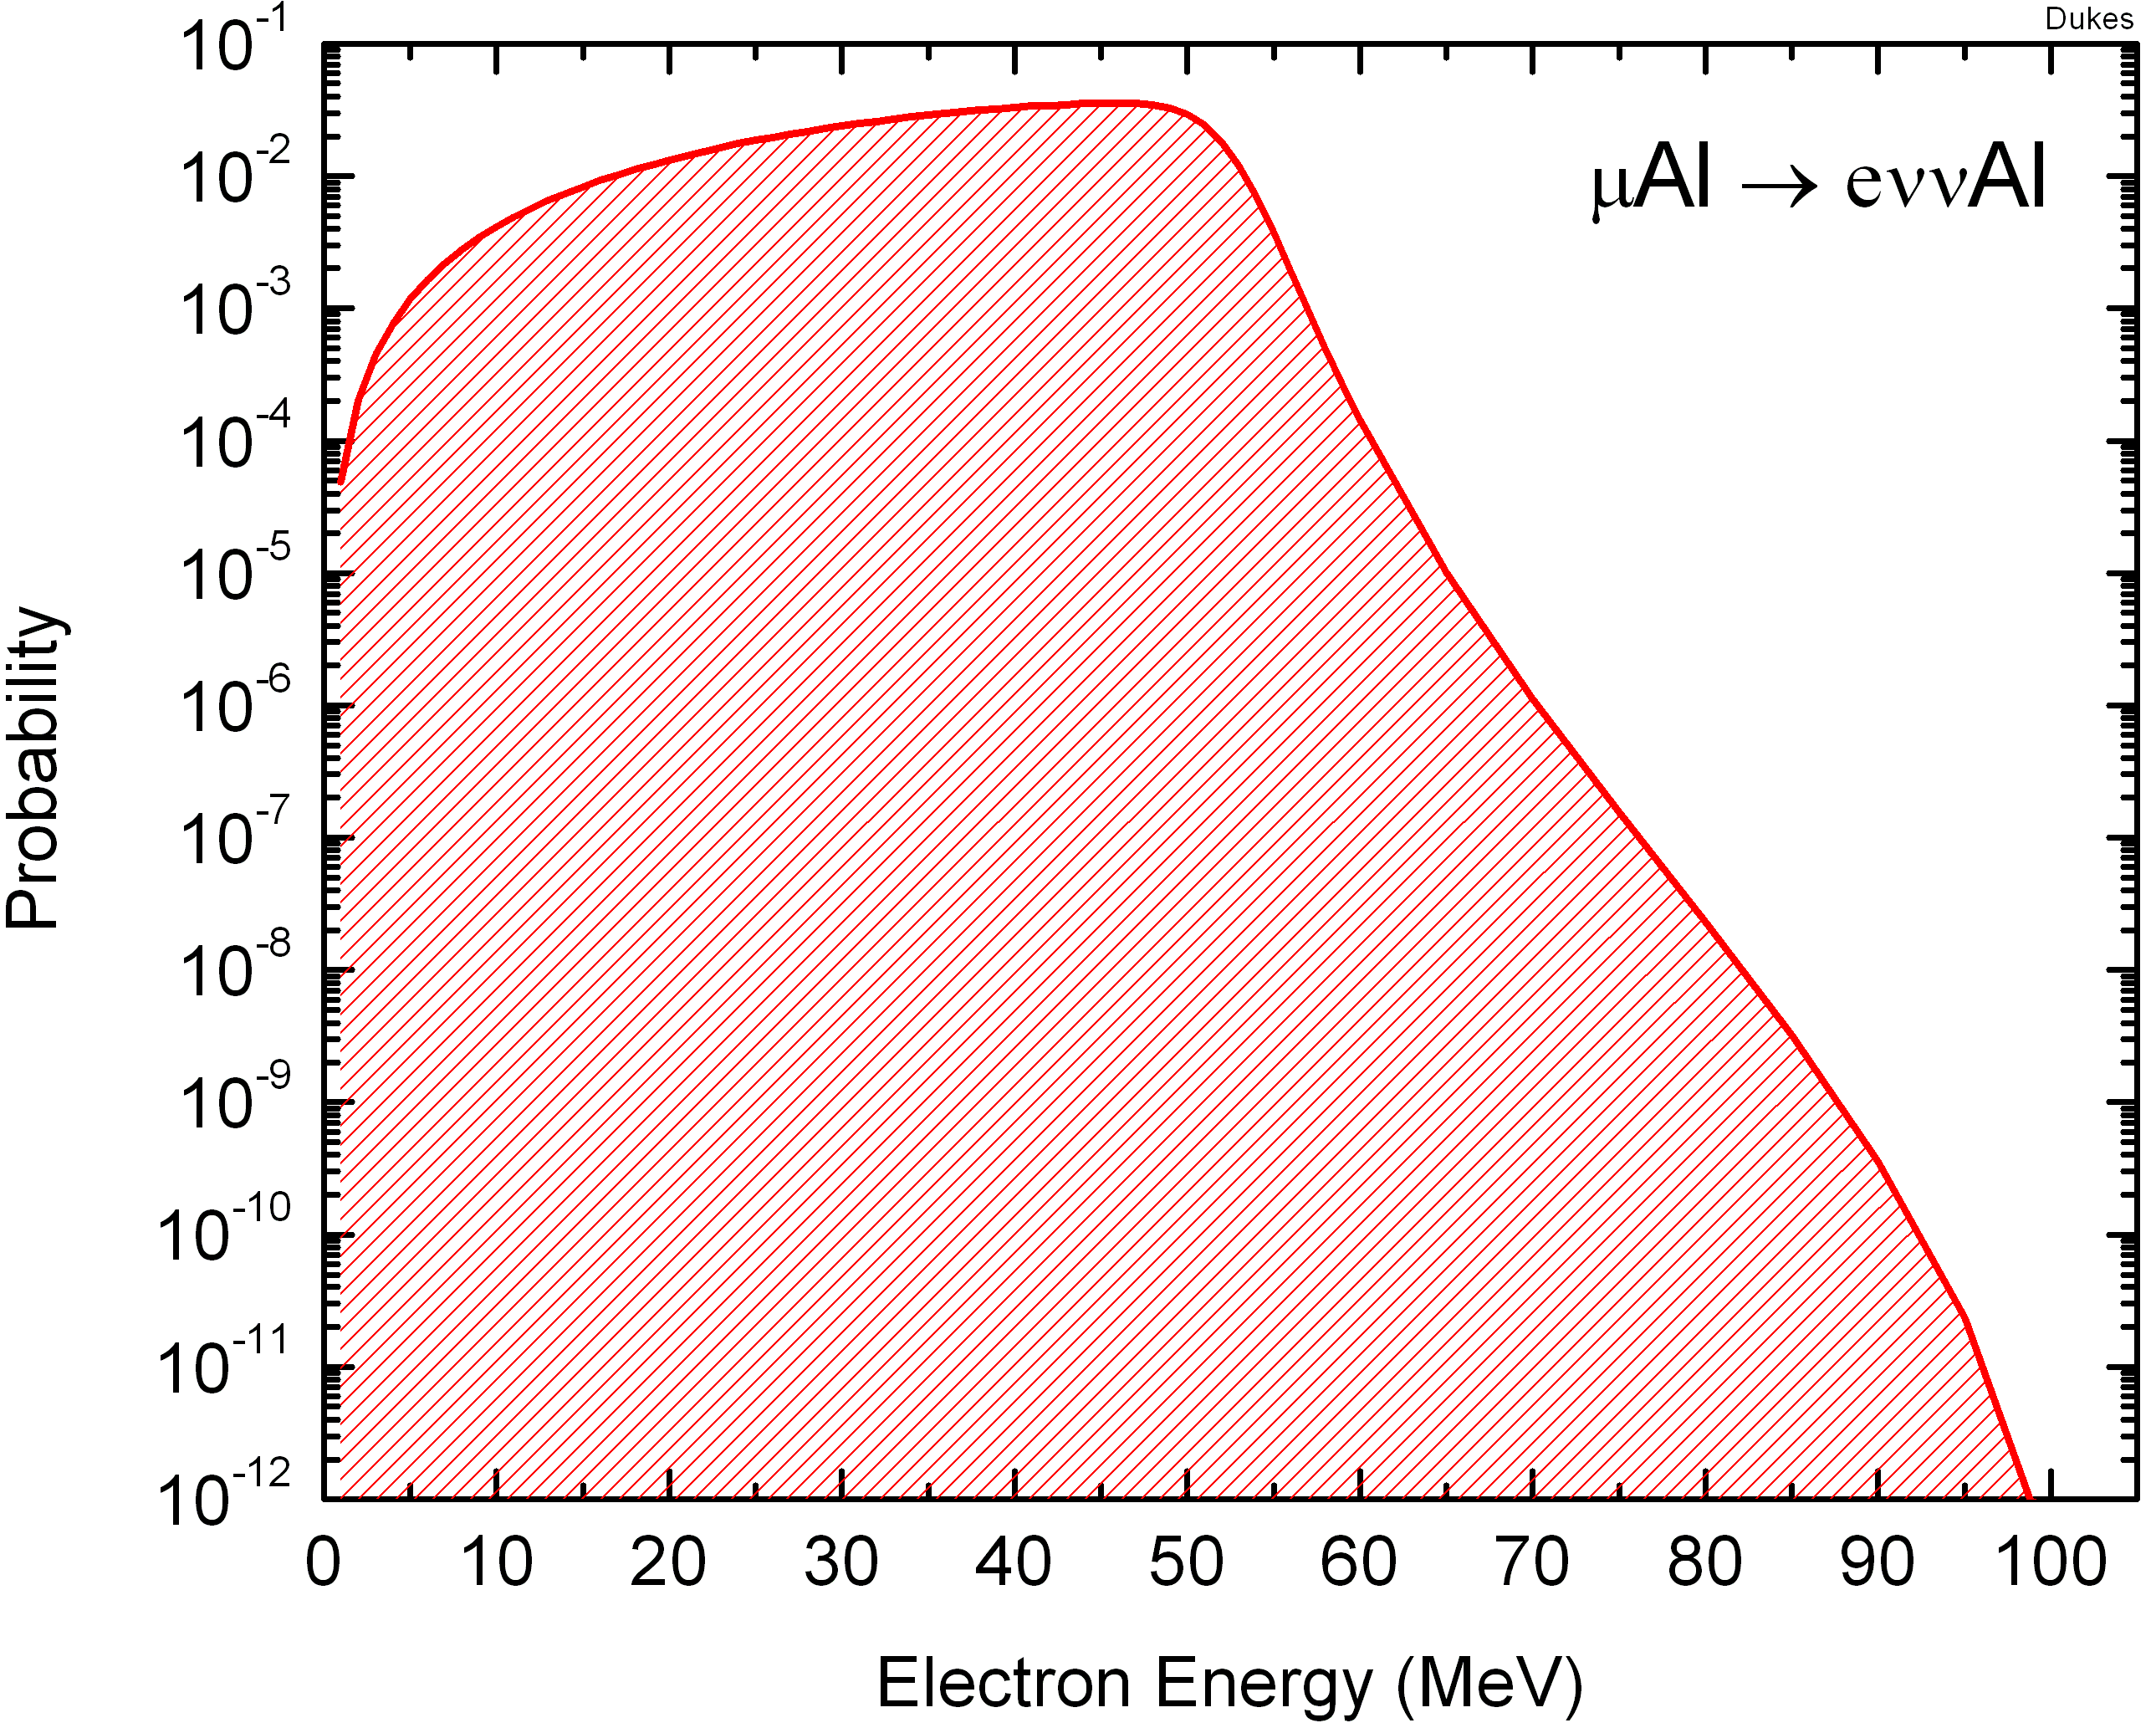


Backgrounds, Backgrounds, Backgrounds . . .
$$ν_{μ}$$
Stopped Muon Backgrounds
e⁻
Muon decay in orbit (DIO):
μ⁻N_{A,Z}→e⁻ν_{μ}ν_{e}N_{A,Z}
defeated by good energy resolution
Radiative muon capture (RMC):
μ⁻N_{A,Z}→ν_{μ}γN_{A,Z-1}, γ→e⁺e⁻
defeated by m_{Z} < m_{Z-1}
defeated by good energy resolution
Al²⁷
$${\bar{ν}}_{e}$$
E~(E-E₀)⁵

Slide 24

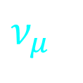
Backgrounds, Backgrounds, Backgrounds . . .
e⁺
Stopped Muon Backgrounds
e⁻
Muon decay in orbit (DIO):
μ⁻N_{A,Z}→e⁻ν_{μ}ν_{e}N_{A,Z}
defeated by good energy resolution
Radiative muon capture (RMC):
μ⁻N_{A,Z}→ν_{μ}γN_{A,Z-1}, γ→e⁺e⁻
defeated by m_{Z} < m_{Z-1}
defeated by good energy resolution
$$γ$$
Mg²⁷
$$ν_{μ}$$

Slide 25
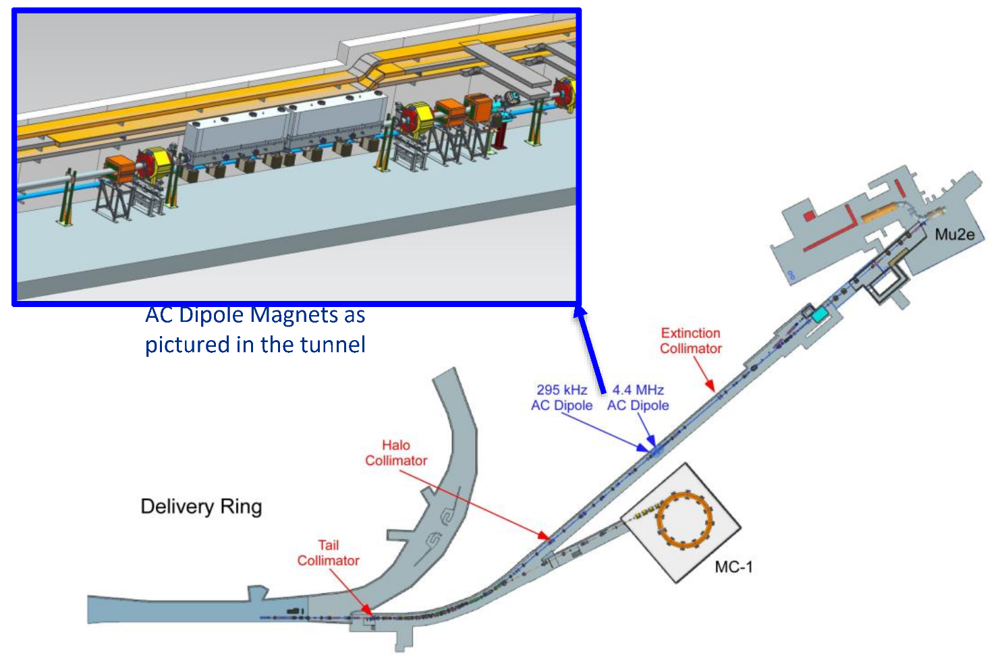
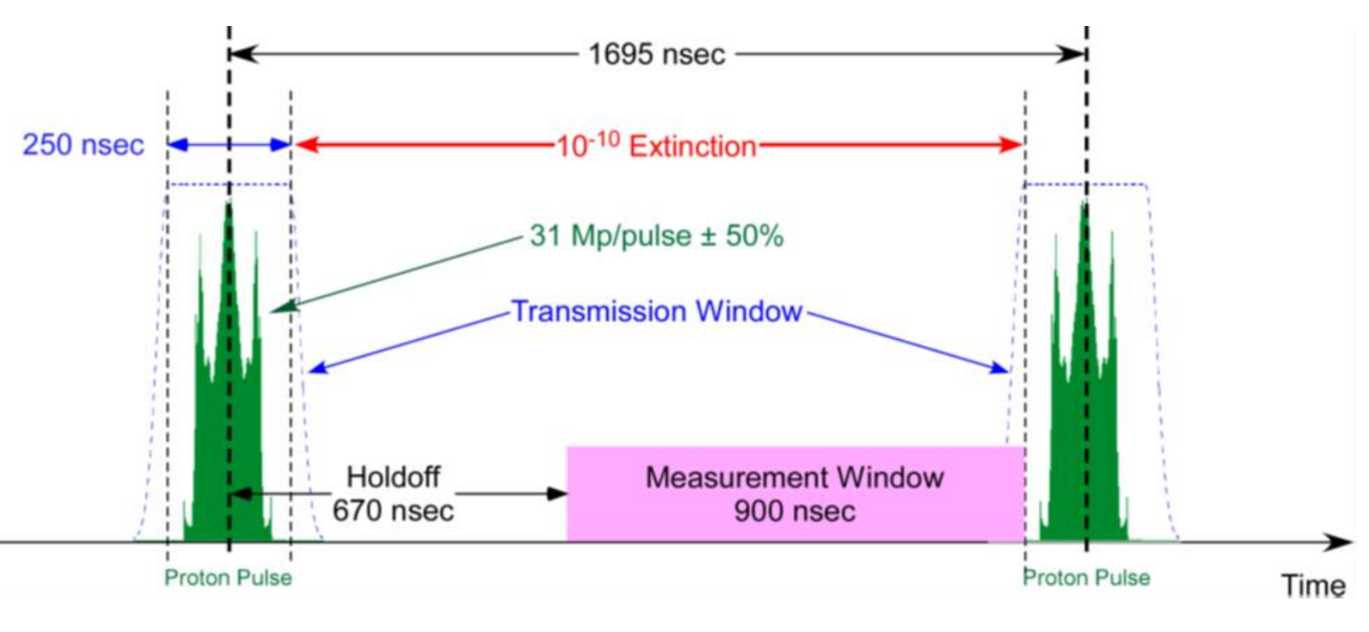
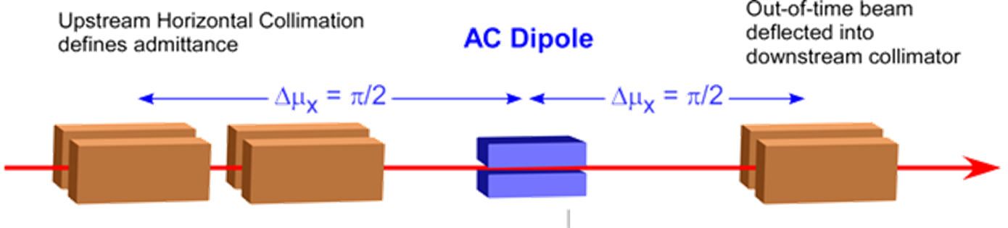
Backgrounds, Backgrounds, Backgrounds . . .
Prompt Beam Related Backgrounds
Radiative pion capture (RPC):
π⁻N_{A,Z}→γN_{A,Z-1} , γ→e⁺e⁻
Note: 1.2% have E_{γ} > 105 MeV
Muon decay in flight:
μ⁻ → e⁻νν
  Note: p_{μ} > 77 MeV/c
Pion decay in flight:
π⁻ → e⁻ν_{e}
Beam electrons scattering in target
Defeated by delayed search window
Defeated by 10⁻¹⁰interbunch extinction
Defeated by hard cuts on momentum
Antiprotons annihilating
Defeated by thin absorber

Slide 26
Backgrounds, Backgrounds, Backgrounds . . .
Prompt Beam Related Backgrounds
Radiative pion capture (RPC):
π⁻N_{A,Z}→γN_{A,Z-1} , γ→e⁺e⁻
Note: 1.2% have E_{γ} > 105 MeV
Muon decay in flight:
μ⁻ → e⁻νν
  Note: p_{μ} > 77 MeV/c
Pion decay in flight:
π⁻ → e⁻ν_{e}
Beam electrons scattering in target
Defeated by delayed search window
Defeated by 10⁻¹⁰interbunch extinction
Defeated by hard cuts on momentum
Antiprotons annihilating
Defeated by thin absorber
Particles from target
Proton
Beam

Slide 27
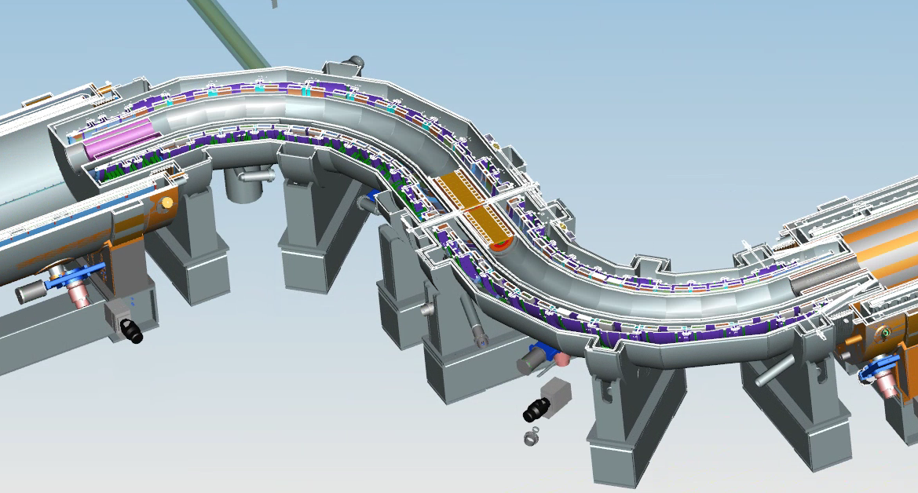
Backgrounds, Backgrounds, Backgrounds . . .
Beam View
Prompt Beam Related Backgrounds
Radiative pion capture (RPC):
π⁻N_{A,Z}→γN_{A,Z-1} , γ→e⁺e⁻
Note: 1.2% have E_{γ} > 105 MeV
Muon decay in flight:
μ⁻ → e⁻νν
  Note: p_{μ} > 77 MeV/c
Pion decay in flight:
π⁻ → e⁻ν_{e}
Beam electrons scattering in target
Defeated by 10⁻¹⁰interbunch extinction
Defeated by hard cuts on momentum
Antiprotons annihilating
Defeated by thin absorber
Antiproton Absorber

Slide 28
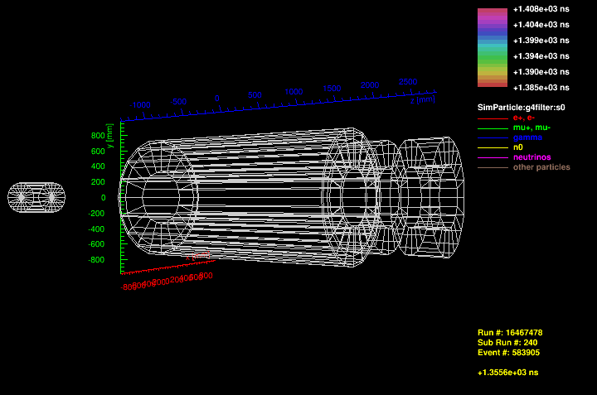
Backgrounds, Backgrounds, Backgrounds . . .
We get one such event every day of running!
Time Dependent Backgrounds
Cosmic Rays
Defeated by active shield

Slide 29
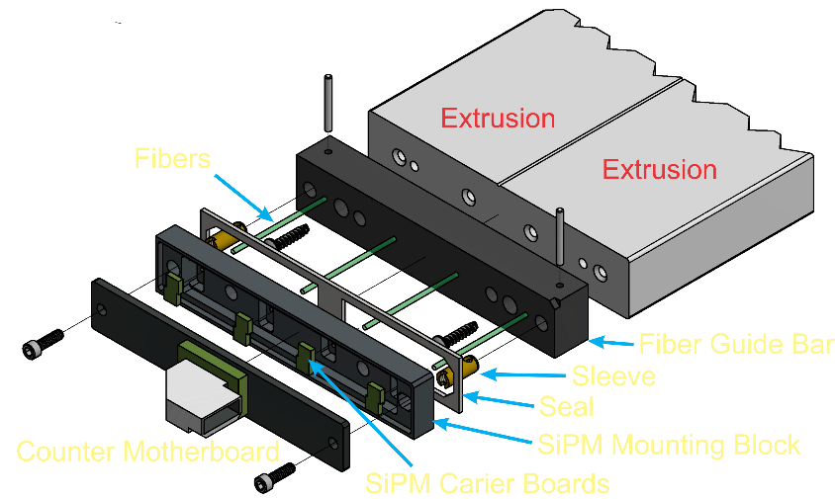
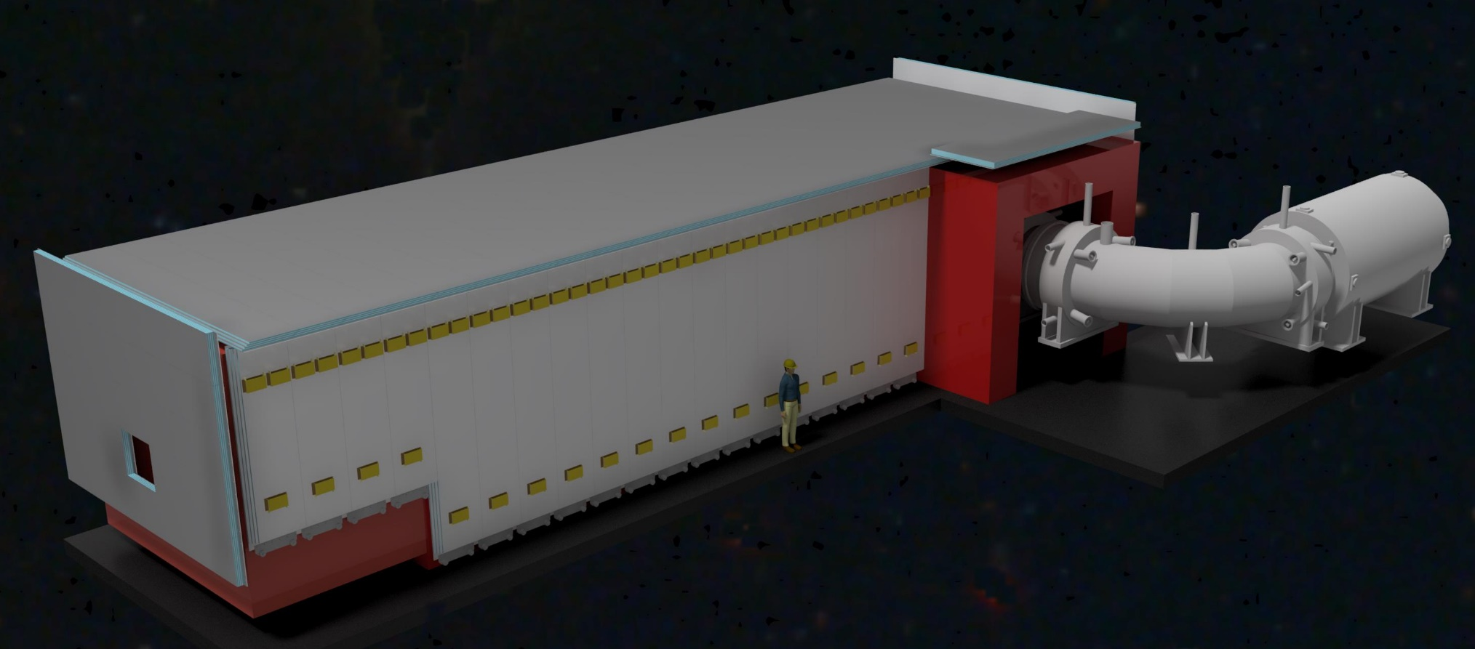
Cosmic Ray Veto
One fake event/day from cosmic-ray muons
Need to reduce that rate by 10,000X
Surround Detector Solenoid by 4 layers of scintillator read out by waveshifting fibers, and silicon photomultipliers
Veto done in offline analysis!

Slide 30
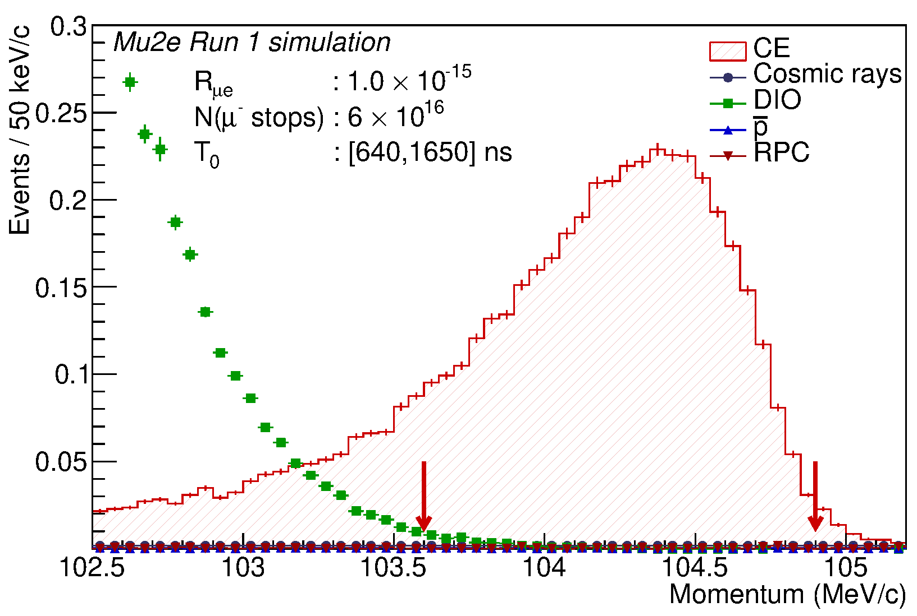

What we Get
Two running periods separated by a 2-year shutdown for PIP-II accelerator upgrade
First run: 2026
Second run: 2029-2031 with an order of magnitude more sensitivity: 10,000X improvement over present limit (SINDRUM-II)
Run I Parameters
Proton flux | 3.8 x 10¹⁹ POT
Run 1 single event sensitivity | 2.4 x 10⁻¹⁶
Discovery Reach (5σ) | R_{μe} ≥ 1.2 x 10⁻¹⁵
Exclusion power (90% CL) | R_{μe} ≥ 6.2 x 10⁻¹⁶
Estimated background events | 0.11
DIO Tail
Radiative muon capture, beam electrons, muon and pion decay in flight < 1%

Slide 31








Status
Project 90% complete
Accelerator
Beam successfully delivered to diagnostic absorber
Solenoids
Production Solenoid & Transport Solenoid arrive at the detector hall in late 2023
Detector Solenoid: expect delivery in early 2024
Tracker
All 20,736 straws produced
26/36 planes fabricated
Calorimeter
One disk completed, second disk being assembled
Cosmic Ray Veto
All 83 modules have been fabricated & at Fermilab
Electronics
COVID supply-chain delays: will be completed in 2024
Expect beam in 2026

Slide 32
Back to the Future: Mu2e-II
Goal: Increase sensitivity by order of magnitude: SES O(10⁻¹⁸)
Mean: Use high-intensity PIP-II 0.8 GeV LINAC proton beam; with its tunable bunch spacing
Expression of Interest (EOI) written and submitted as part of the Snowmass 2022 process
Snowmass 2022 study very promising: but R&D needed to handle higher rates and lower beam energy 8 GeV → 0.8 GeV
x3 instantaneous beam power (30X more protons)
X3 better duty factor: 90% duty factor (27% Mu2e-I)

Slide 33


Slide 34
Backup Slides

Slide 35
A “Short” History of Mu2e
1992 | Solenoidal collection scheme first proposed by MELC collaboration at Moscow Meson Factory: Lobashev and Djilkibaev (1989)
1997-2005 | MECO proposed for the AGS at Brookhaven; killed for funding reasons
2006 | Steering committee investigates mounting experiment at Fermilab
June/October 2007 | Mu2e EOI and LOI submitted to Fermilab
May 2008 | P5 “recommends pursuing the muon-to-electron conversion experiment, subject to approval by the Fermilab PAC, under all budget scenarios considered by the panel.”
Fall 2008 | Proposal submitted to Fermilab and receives Stage I approval
November 2009 | Approval of mission need by DOE (CD-0) granted
FY2010 | Mu2e receives first R&D funding
Fall 2011 | Approval of preliminary baseline range by DOE (CD-1)
March 2015 | Approval of baseline and funds for long lead elements (CD-2/3b): solenoids
June 2016 | Approval for construction (CD-3a)
2016 | Detector hall and beamline fabrication begins
2017 | Detector construction begins
2020 | COVID-19: Supply chain problems delay fabrication by several years
2024 | Detector and beamline commissioning
2024 | Data taking

Slide 36







We are not the Only Game in Town
MEG
COMET
Mu3e
DeeMe

Slide 37


Extinction
Note: we get a factor of ~10⁴ for free by the bunching of the beam in the Delivery ring.
The remaining 10⁶ comes from downstream a set of resonant dipoles in the beam deflects beam such that only in-time beam is transmitted through a system or collimators.

Slide 38



What we get at the Stopping Target
34 Al disks
each 100 μm thick
83 mm to 65 mm radius
in graded magnetic field
1/230 incident protons produce a muon at the stopping target
51% of muons stop in target
43x10⁹ μ stops per spill second
73,500 μ stops per microbunch

Slide 39



Choice of StoppingTarget Material
Large Z:
  rate ∝Z|F_{n}|² (F_{n} is the form factor)
  can reveal nature of interaction
Small Z:
  longer lifetime
  higher endpoint energy
Note: Need m_{Z-1} > m_{Z} to place max. energy of radiative capture muons below signal electrons
S, V, D dependence
unique to μN→eN
Initial Choice

Slide 40


Target and Heat Shield
Produces pions which decay into muons
Tungsten Target
  7 kW beam
  700 W in target
  Radiatively cooled
Heat Shield
  Bronze insert
  3.3 kW average heat load
Remember, this is inside a superconducting magnet
Target rod

Slide 41



Mu2e Probes Extremely High Mass Scales
Model independent effective CLFV Lagrangian
Up to
10,000 TeV
or about ~10,000
times that probed
directly by
the LHC
loop dominated
contact dominated

Slide 42
Production Solenoid

Slide 43
Production Solenoid
Axially graded (~5T➔2.5T) solenoid captures low energy backward and reflected pions, directing to the Transport Solenoid
Magnetic Gradient
Magnetic reflection
(pinch confinement)

Slide 44

Transport Solenoid
Transports muons from production target to capture target
Curved solenoid eliminates line-of-sight backgrounds
Collimator in center selects low momentum negative muons
  RxB drift causes sign/momentum dependent vertical displacement
μ⁻
μ⁺

Slide 45
Detector and Detector Solenoid
μ Stopping Target(s)
Muon Absorber
Proton Absorber
Tracker
EM Calorimeter

Slide 46

Extinction
Downstream
Extinction
< 10⁻¹⁰
Upstream
Extinction
< 10⁻⁴
The AC Dipole excitation is a superposition of three harmonics: 300 kHz, 900 kHz, and 4.5 MHz.

Slide 47

The Extinction Monitor
Scintillators coupled to PMTs for triggering and additional timing information
Silicon pixels for fast, high resolution tracking
Spectrometer Magnet:
Repurposed dipole magnet bends out low energy elections generated by muons stopping in the upstream silicon
47

Slide 48


Target Dependence is Important
Rate depends on target Z, and is different for μN→eN and μ →eγ
Cirigliano, Kitano, Oada, Tuzon, arXiv:0904.0957
Cirigliano, Grinstein, Isidori, NPB728, 121 (2005)

Slide 49


Tracker
panel
panel
panel
plane
station
Self-supporting “panel” consists of 100 straws
6 panels assembled to make a “plane”
2 planes assembled to make a “station”
Rotation of panels and planes improves stereo information
>20k straws total

Slide 50

Performance Robust With Rate
+/- 5%
9.2%
Total acceptance after track selection criteria (%)
Momentum resolution parameter (keV/c)
116 keV/c
Variations in accidental hit rate

