Slide 1
Spin-Dependent Fifth-Force Search and Measurement of Compensated Ferrimagnetism in Terbium Iron Garnet using Neutron Spin Echo Spectroscopy and Neutron Radiography
Caleb Hughes
INDIANA UNIVERSITY BLOOMINGTON
Notes:
Talk today about work we've done with neutrons and a candidate spin-source material that we hope to use to put lmits on exotic spin dependent potentials

Slide 2
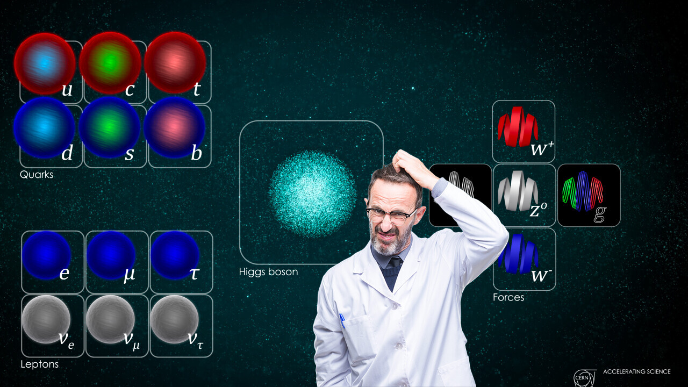
Open Questions
Search for Physics Beyond the Standard Model:
Spin-Dependent Fifth-Forces^{1,2}
Characterize electron spin samples for other spin-dependent exotic force searches
Internal B fields in a compensated ferrimagnet near T_{C} for the first time
McGowan, A. (2021) 2021 was a big year for physics: We finally peeked beyond the standard model, TNW | Science. Available at: https://thenextweb.com/news/physics-beyond-standard-model-syndication (Accessed: April 14, 2023). Image: Daniel Dominguez/CERN
1. Dobrescu, B. A. & Mocioiu, I. Spin-Dependent Macroscopic Forces from New Particle Exchange. J. High Energy Phys. 2006, 005–005 (2006).
2. Leslie, T. M., Weisman, E., Khatiwada, R. & Long, J. C. Prospects for electron spin-dependent short-range force experiments with rare earth iron garnet test masses. Phys. Rev. D 89, 114022 (2014).
Caleb Hughes
Notes:
_ SM a success but leaves unanswered questions: dark matter, baryon asymmetry, etc
Some proposed particles result in predictions of spin dependent forces BSM
We search for these signatures
Have materials with polarizable electron spins
Goal was to further characterize those samples and better understand the ferrimagnetism that makes these ideal materials
Also a first investigation of internal b fields ….
search for possible exotic spin-dependent neutron electron interactions, including momentum-dependent interactions
Point: we want to search for signatures of new force carriers by direct force detection, mention that Thomas has the details., axion like particles
Part of goal of nuclear physics group is indirect detection of new particles by fifth-force detection
Some Solutions:
- Detection of Decay Products
- High Precision Measurements
- High Energy Measurements
- Force Measurements

Slide 3
Spin-Dependent Potentials^{1,2,3}
S = 0 m ≥ 0
S =1 m > 0
S =1 m = 0
Fadeev, P. et al. Revisiting spin-dependent forces mediated by new bosons: Potentials in the coordinate-space representation for macroscopic- and atomic-scale experiments. Phys. Rev. A 99, 022113 (2019).
Dobrescu, B. A. & Mocioiu, I. Spin-Dependent Macroscopic Forces from New Particle Exchange. J. High Energy Phys. 2006, 005–005 (2006).
Moody, J. & Wilczek, F. New macroscopic forces? Phys. Rev. D 30, 130–138 (1984).
Caleb Hughes
Notes:
- Following foundational work of Moody and Wilczek as well as expansion by Dobrescu and Mociou, Fadeev et al derive 9 non-relativistic, Lorentz Invariant potentials from the Lagrangians shown (spin-0 boson, massive spin-1 boson, massless spin-1 boson), arranged based on combinations of coupling types: s and p, V and A, T and PT
Which potentials are we sensitive to? Asssume from Thomas' talk, but get more info for sure

Slide 4
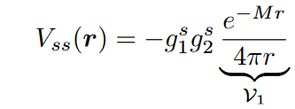
Spin-Dependent Potentials^{1,2,3}
S = 0 m ≥ 0
S =1 m > 0
S =1 m = 0
Caleb Hughes
Notes:
- Following foundational work of Moody and Wilczek as well as expansion by Dobrescu and Mociou, Fadeev et al derive 9 non-relativistic, Lorentz Invariant potentials from the Lagrangians shown (spin-0 boson, massive spin-1 boson, massless spin-1 boson), arranged based on combinations of coupling types: s and p, V and A, T and PT
Which potentials are we sensitive to? Asssume from Thomas' talk, but get more info for sure

Slide 5
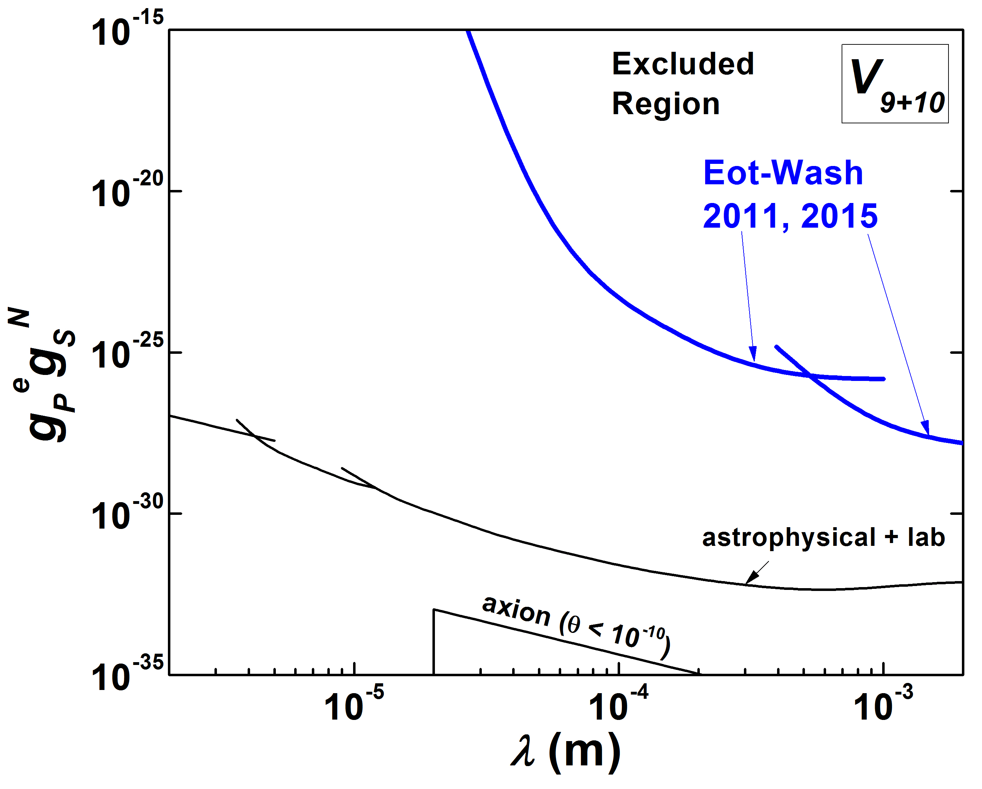
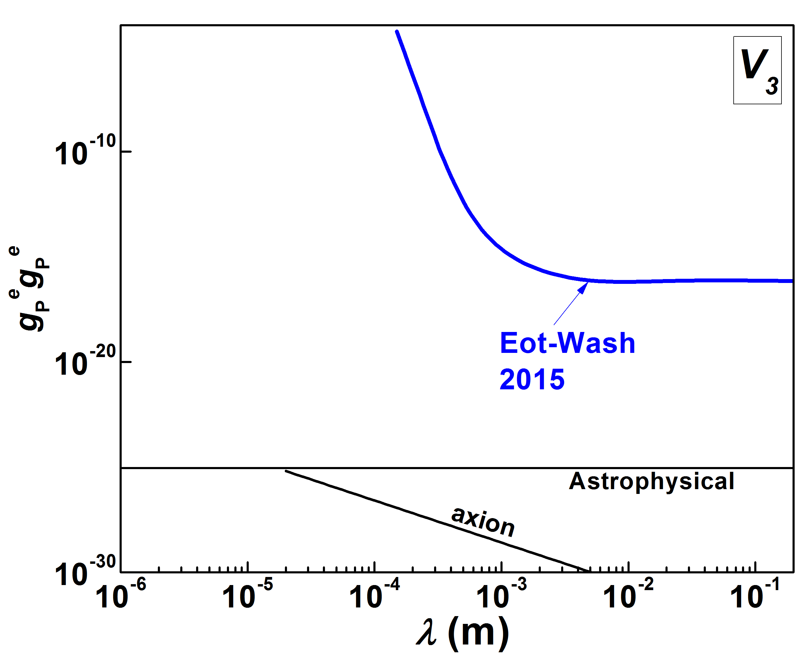
Constraint Examples
S. Hoedl et al., PRL 106 041801 (2011)
W. Terrano et al., PRL 115 201801 (2015)
[axion] R. J. Crewther, et al., Phys. Lett. B91, 487 (1980);
[astro] G. Raffelt PRD 86, 015001 (2012)
C. Baker, et al., Phys. Rev. Lett. 97, 131801 (2006)
Caleb Hughes
Notes:
CITE GRENOBE
CITE DOBRESCU AND MOCIOIU
V_1 is spin-independent Yukawa interaction
Here, juxtapose 16 spin-dependant potential forms and source-mass/test-mass combinations for testing (may take a few slides, try and match at least 4 to a slide and will need to move through these somewhat quickly)
May only do spin-dependant ones here with axial polarization, save in-plane polarizations for later section

Slide 6
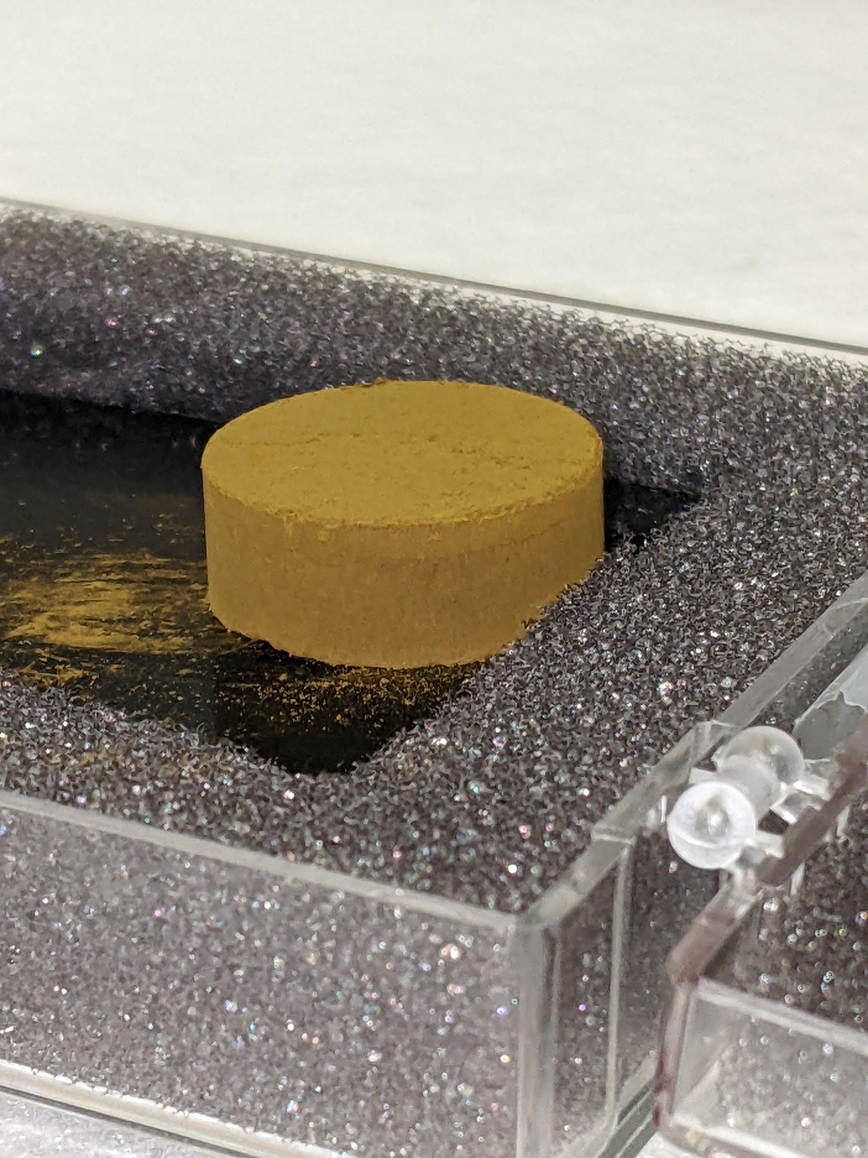
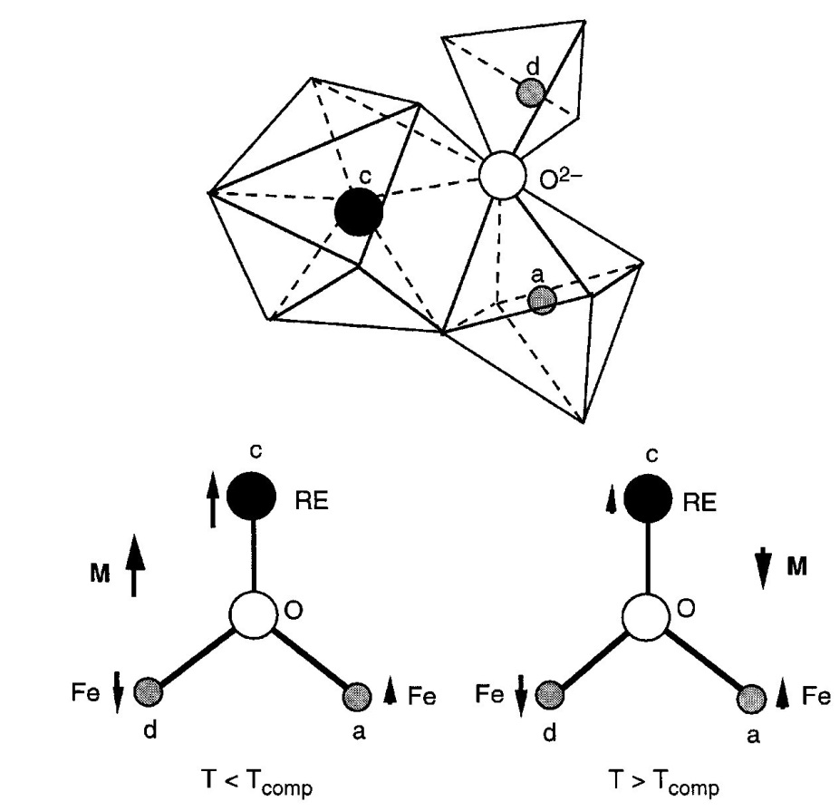
Rare-Earth Iron Garnets (RIG)
Ferrimagnets of the form $R_{3}Fe_{5}O_{12}$ where R is Dy, Tb, Gd ,Yb, Ho, Er
Temperature dependent orbital compensation of magnetism associated with spin
Below room temperature but accessible with LN2 (Dy, Tb)
G. Dionne, Magnetic Oxides (N.Y., Springer, 2009)
Caleb Hughes
Notes:
Replace with photo of tbig

Slide 7
Orbital Compensation
T₀
μ₁
μ_{Total}
Arrows are magnetic moments of each sublattice, iron in white and rare-earth in orange
Rare-Earth moment responds more strongly to T around T_{C}
At T_{C}, $M α μ$ drops to 0
μ₂
μ₁
T₁ < T₀
μ_{Total}
μ₂
μ₁
T_{C} < T₁
μ_{Total} = 0
μ₂
Caleb Hughes
Notes:
make clear it is orbital compensation of magnetization associated with the Fe spins.

Slide 8
Orbital Compensation
T₀
μ₁
s_{Total}
μ_{Total}
Arrows are magnetic moments of each sublattice, iron in white and rare-earth in orange
Rare-Earth moment responds more strongly to T around T_{C}
At T_{C}, $M α μ$ drops to 0 but net-spin non-zero due to L
μ₂
μ₁
T₁ < T₀
s_{Total}
μ_{Total}
μ₂
μ₁
T_{C} < T₁
s_{Total}
μ_{Total} = 0
μ₂
Caleb Hughes
Notes:
"...(theoretically) drops to zero."
this helps emphasize one of the motivations for our work: does it really happen microscopically?
Both lattices “contribute” to spin; more precisely Fe contribution is positive but Tb contribution is negative. But Tb spin magnitude is less, so spin cancellation is partial.

Slide 9
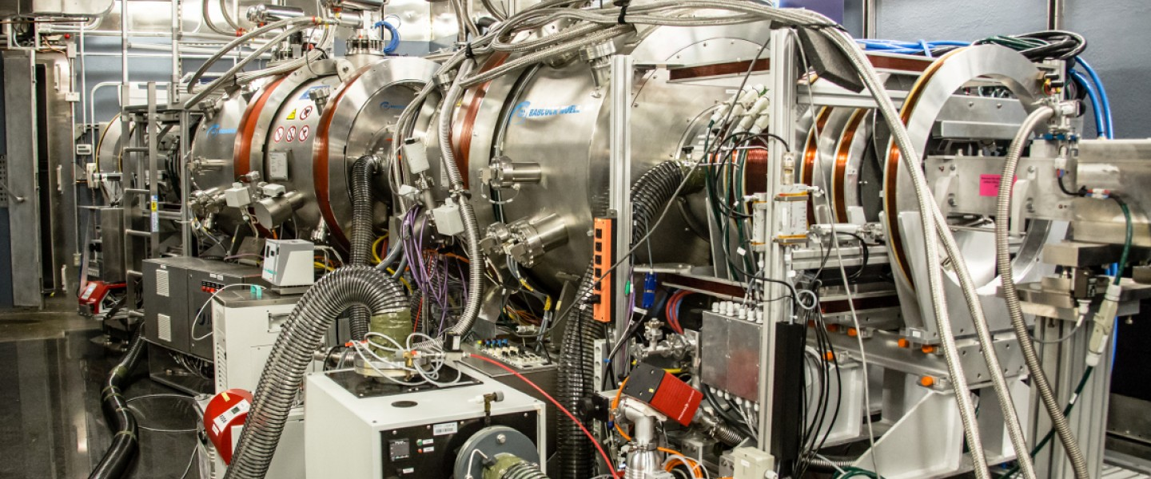
What Beams Available/ What Techniques?
Successful preliminary tests at IU
Need higher flux….
Neutron Spin Echo Technique
NSE Spectrometer: BL-15 at Oak Ridge Spallation Neutron Source
Neutron Sciences Directorate (no date) Neutron Spin Echo Spectrometer | Neutron Science at ORNL. Available at: https://neutrons.ornl.gov/nse (Accessed: April 14, 2023).
Caleb Hughes
Notes:
Include Walt’s design here
Have to replace Bell Jar
Wires coated for higher emissivity

Slide 10
Neutron Spin Echo Technique
Start with polarized ensemble of neutrons
Spin echo (2023) Wikipedia. Wikimedia Foundation. Available at: https://en.wikipedia.org/wiki/Spin_echo (Accessed: April 14, 2023).
Caleb Hughes
Notes:
Include Walt’s design here
Have to replace Bell Jar
Wires coated for higher emissivity

Slide 11
Neutron Spin Echo Technique
Polarized Ensemble
Induce non-adiabatic spin flip via π/2 coil
Spin echo (2023) Wikipedia. Wikimedia Foundation. Available at: https://en.wikipedia.org/wiki/Spin_echo (Accessed: April 14, 2023).
Caleb Hughes
Notes:
Include Walt’s design here
Have to replace Bell Jar
Wires coated for higher emissivity

Slide 12
Neutron Spin Echo Technique
Polarized
π/2 spin flip
Precession: Guide field allows Larmor Precession proportional to ω*t. Slower neutrons spend longer time in the field and thus rotate more.
Spin echo (2023) Wikipedia. Wikimedia Foundation. Available at: https://en.wikipedia.org/wiki/Spin_echo (Accessed: April 14, 2023).
Caleb Hughes
Notes:
Include Walt’s design here
Have to replace Bell Jar
Wires coated for higher emissivity

Slide 13
Neutron Spin Echo Technique
Polarized
π/2 spin flip
Larmor Precession 1
Induce non-adiabatic π-flip of spins.
Spin echo (2023) Wikipedia. Wikimedia Foundation. Available at: https://en.wikipedia.org/wiki/Spin_echo (Accessed: April 14, 2023).
Caleb Hughes
Notes:
About a different, orthogonal axis than pi/2 flip

Slide 14
Neutron Spin Echo Technique
Polarized
π/2 spin flip
Larmor Precession 1
π spin flip
Precession: Guide field allows spins to Larmor precess back to original position
Spin echo (2023) Wikipedia. Wikimedia Foundation. Available at: https://en.wikipedia.org/wiki/Spin_echo (Accessed: April 14, 2023).
Caleb Hughes
Notes:
Include Walt’s design here
Have to replace Bell Jar
Wires coated for higher emissivity

Slide 15
Neutron Spin Echo Technique
Polarized
π/2 spin flip
Larmor Precession 1
π spin flip
Larmor Precession 2
Echo: Spins realign
Spin echo (2023) Wikipedia. Wikimedia Foundation. Available at: https://en.wikipedia.org/wiki/Spin_echo (Accessed: April 14, 2023).
Caleb Hughes
Notes:
Make clear no sample here

Slide 16
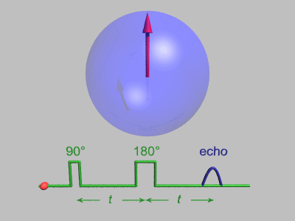
Neutron Spin Echo Technique
Spin echo (2023) Wikipedia. Wikimedia Foundation. Available at: https://en.wikipedia.org/wiki/Spin_echo (Accessed: April 14, 2023).
Caleb Hughes
Notes:
Include Walt’s design here
Have to replace Bell Jar
Wires coated for higher emissivity

Slide 17
NSE Advantages
Works over a range of wavelengths
Sample can cause change to echo
Useful for RIG Ferrimagnets as a high B-resolution check of internal domain strength
Proton Dynamics in Oxides: An Insight into the Mechanics of Proton Conduction from Quasielastic Neutron Scattering - Scientific Figure on ResearchGate. Available from: https://www.researchgate.net/figure/a-The-layout-of-a-generic-spin-echo-spectrometer-showing-its-principal-components-b_fig3_306254786 [accessed 15 Apr, 2023]
Caleb Hughes
Notes:
Include Walt’s design here
Have to replace Bell Jar
Wires coated for higher emissivity

Slide 18
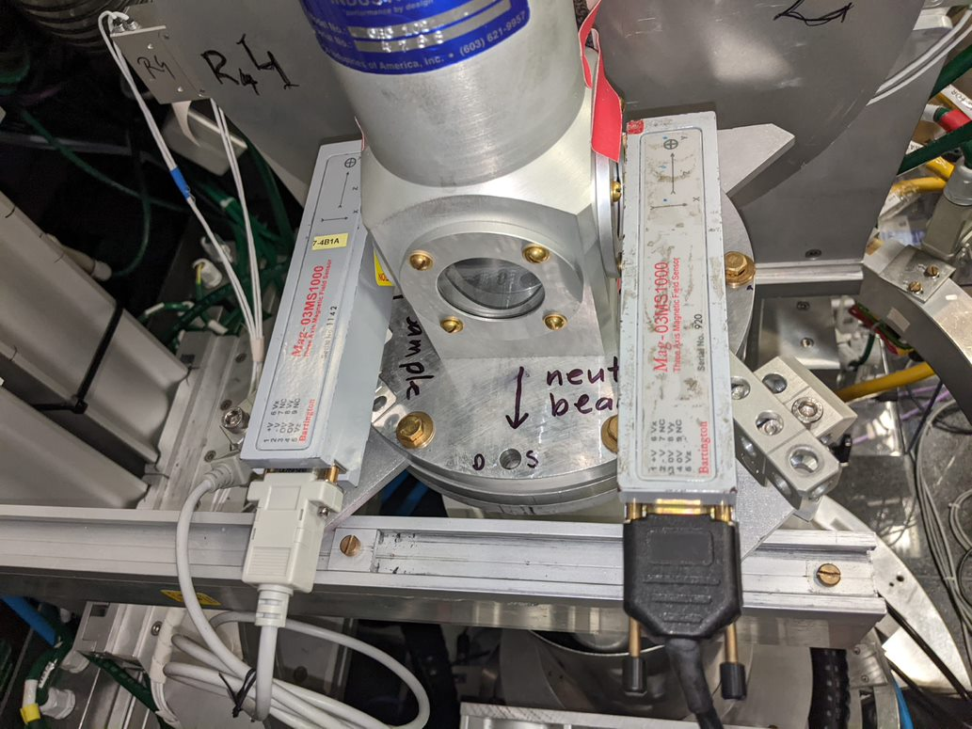
BL-15 NSE Setup
Sample in vacuum in small continuous-flow cryostat
Temperature control: two silicon diode thermometers, resistive heater in feedback loop: 30 mK accuracy typical
External field sensors: two fluxgate magnetometers flanking cryostat, Hall probe attached to sample on axis.
Caleb Hughes
Notes:
Include Walt’s design here
Have to replace Bell Jar
Wires coated for higher emissivity

Slide 19
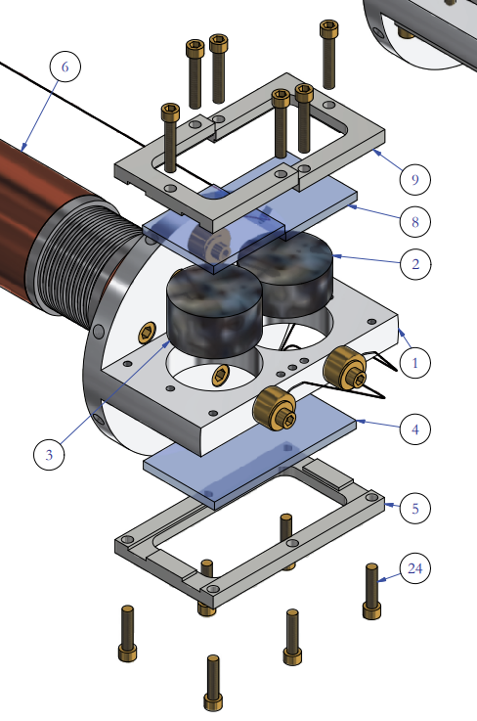
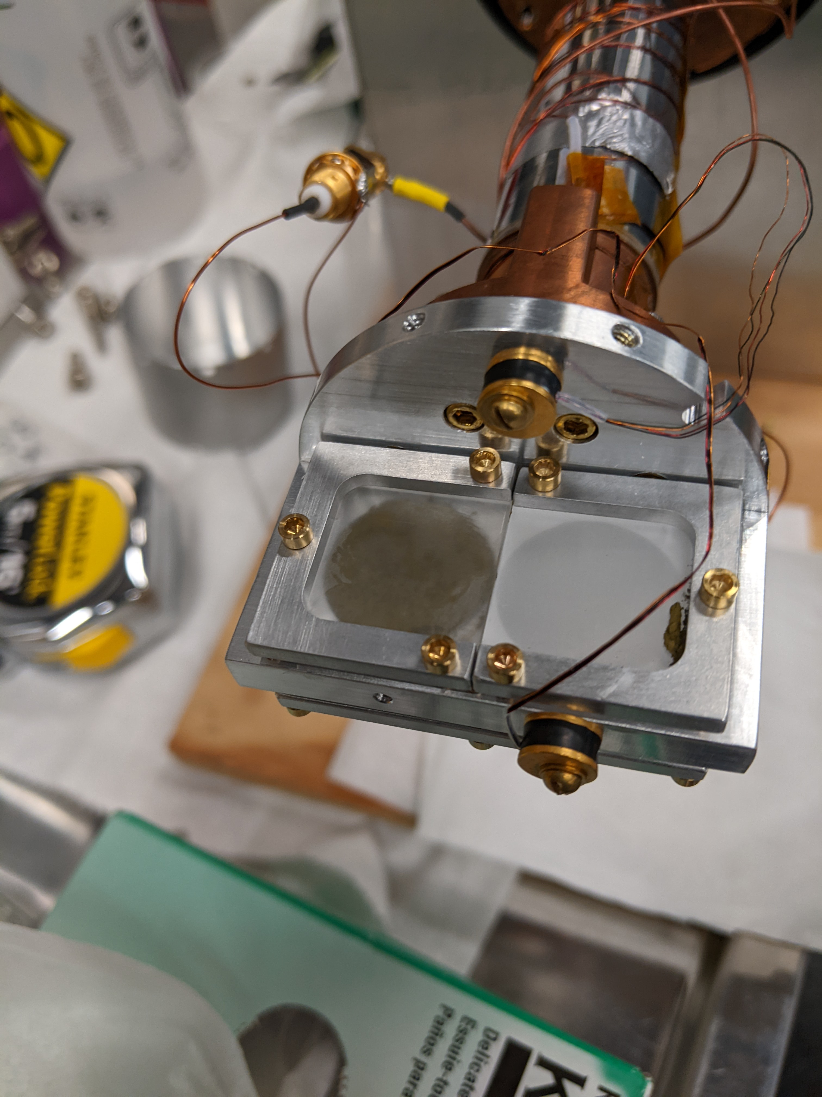
Sample Mounting
Caleb Hughes
Notes:
Include Walt’s design here
Have to replace Bell Jar
Wires coated for higher emissivity

Slide 20
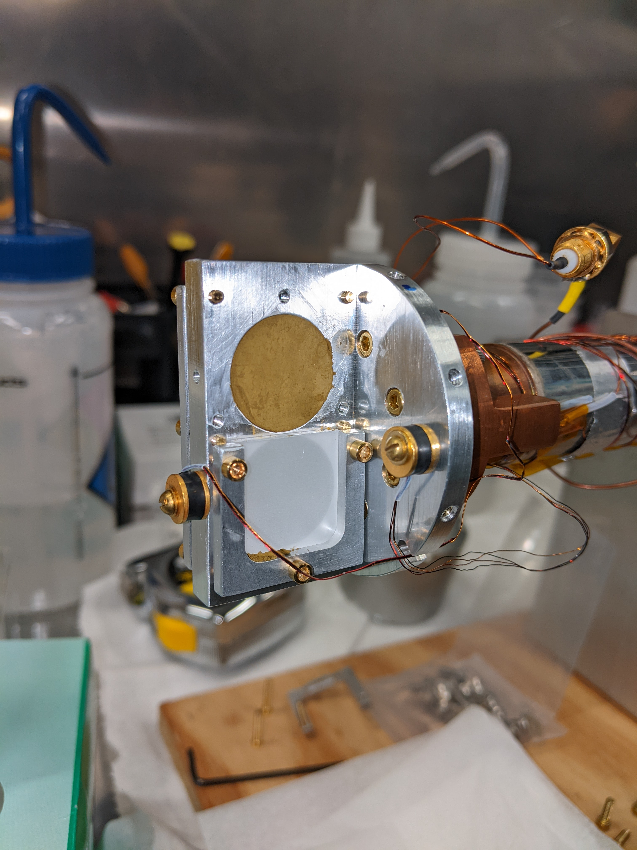
Measurements
Compensation Temperature
Transmission
Pi Coil Off
Small Q
Fifth-Force Search Trial Run
Caleb Hughes
Notes:
Include Walt’s design here
Have to replace Bell Jar
Wires coated for higher emissivity

Slide 21
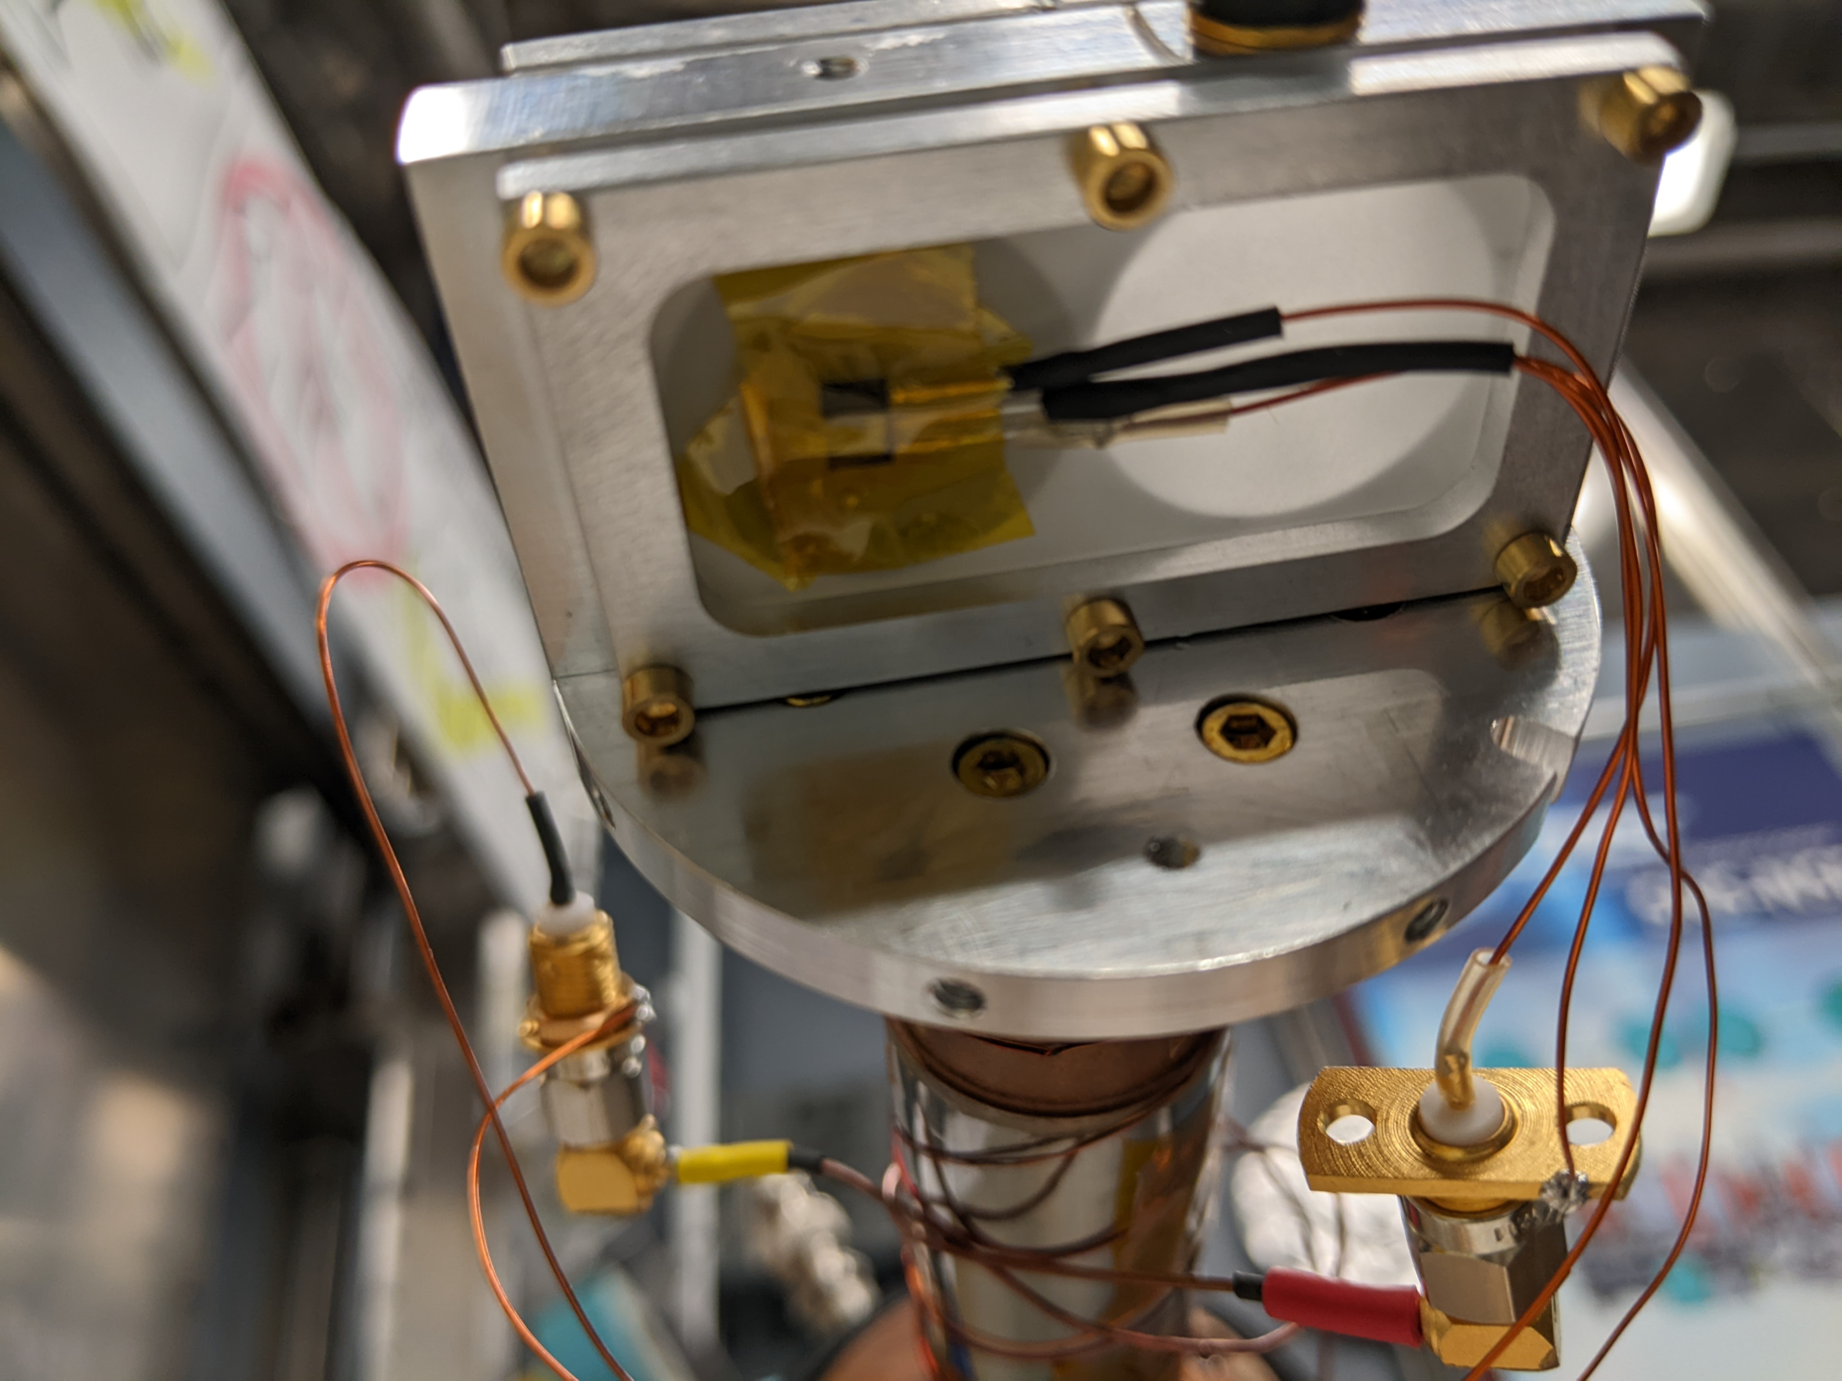
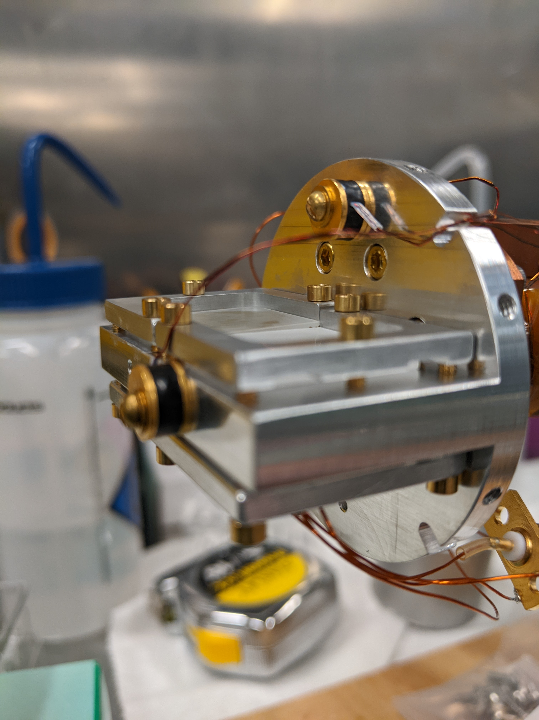
Compensation Temperature
Hall probe directly above sample
Tc (Hall sensor): (251.34 +/- 0.85) K
Fluxgates outside cryostat
Tc (fluxgate sensor): (251.02 +/- 0.62) K
Two lakeshore temperature sensors
Caleb Hughes

Slide 22
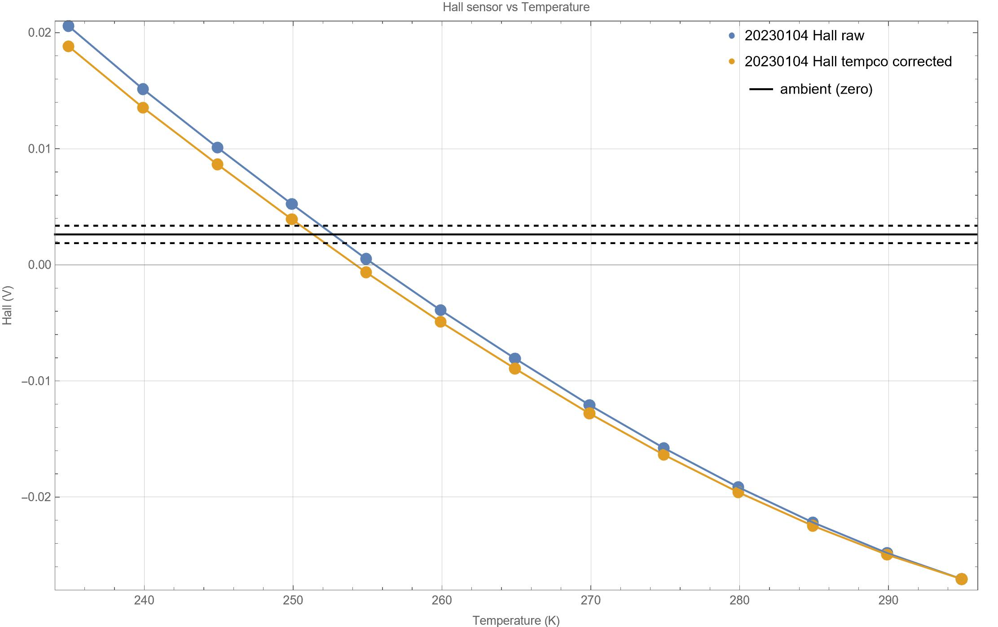
Compensation Temperature
Hall probe directly above sample
Tc (Hall sensor): (251.34 +/- 0.85) K
Fluxgates outside cryostat
Tc (fluxgate sensor): (251.02 +/- 0.62) K
Two lakeshore temperature sensors
Caleb Hughes

Slide 23
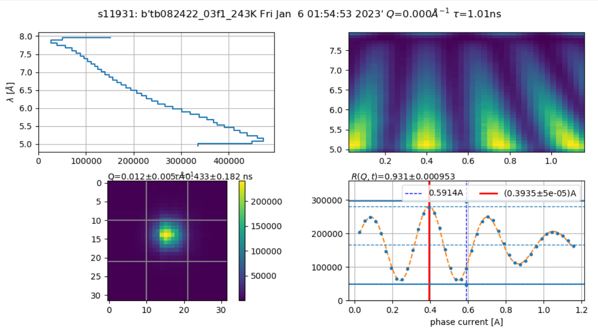
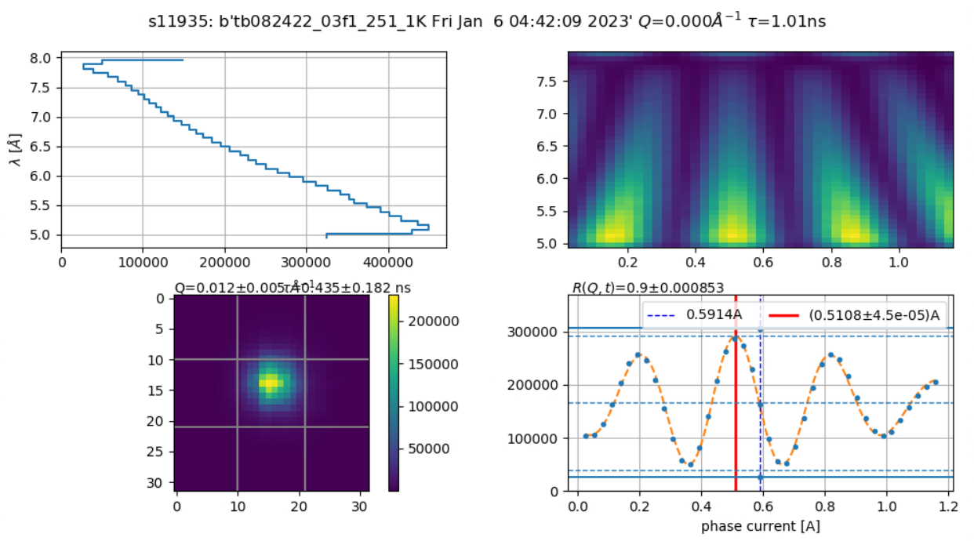
Transmission Mode
Precession
coil
Precession
Coil
π/2 Flipper
Sample
π/2 flipper
Analyzer
π flipper
Detector
Neutron Travel
S
T = 243 K
T = T_{C}
Caleb Hughes
Notes:
No decoherence
Top left: neutron spectrum
Top right: Atari plot, shows wavelength vs. current. Current is current of phase coil, which is swept to determine maxima and minima, which correspond to the heat map. An echo has occurred when you get a vertical line, i.e. maximum independent of wavelength
Bottom Left: ???? 30 pixel x 30 pixel intensity plot?
Bottomr right: Counts as a function of phase current?
Although capable of rotating the instrument, we operated mostly in “transmission” mode

Slide 24
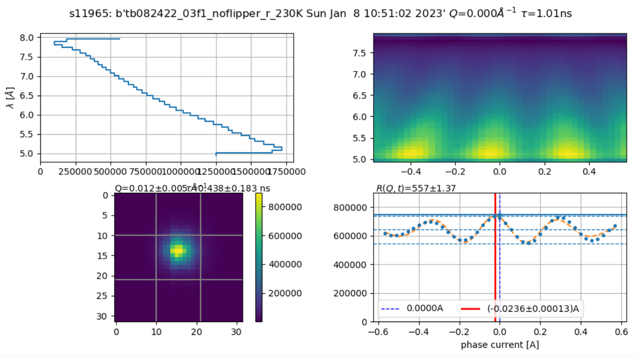
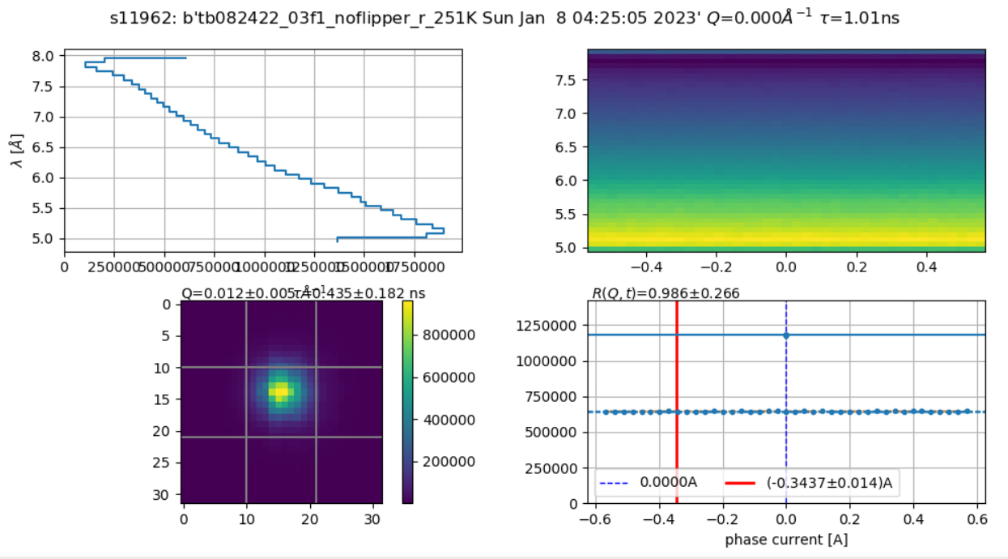
Paramagnetic Scattering: Pi Coil Off
Precession
coil
Precession
Coil
π/2 Flipper
Sample
π/2 flipper
Analyzer
π flipper
Detector
Neutron Travel
S
T = 230 K
T = T_{C}
Caleb Hughes
Notes:
Spin flip scattering goes away at Tc
Chatterji page 531, (See Mike’s Email) (Chapter 11, Section 4)
Discuss paramagnetic scattering: only magnetic field componenet perpendicular to q scatters; canted angle of magnetic moments? Check low q to confirm
No evidence in phase current amplitude plot

Slide 25
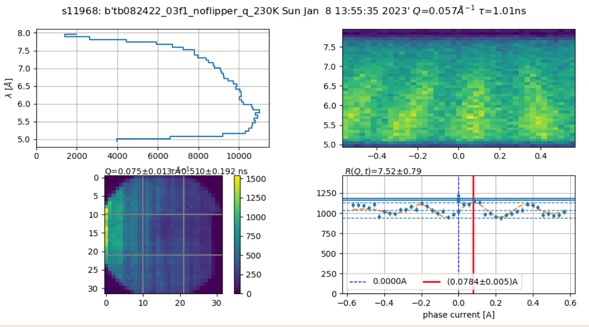
Low Q
π/2 flipper
Analyzer
Precession
coil
Precession
Coil
Detector
π/2 Flipper
π flipper
Sample
Neutron Travel
S
T = 230 K
T = 230 K
Caleb Hughes
Notes:
For similar integration time, get much, much worse (implies not small q scattering, i.e. more likely a canted spin angle than misalignment of polarization axis?)

Slide 26
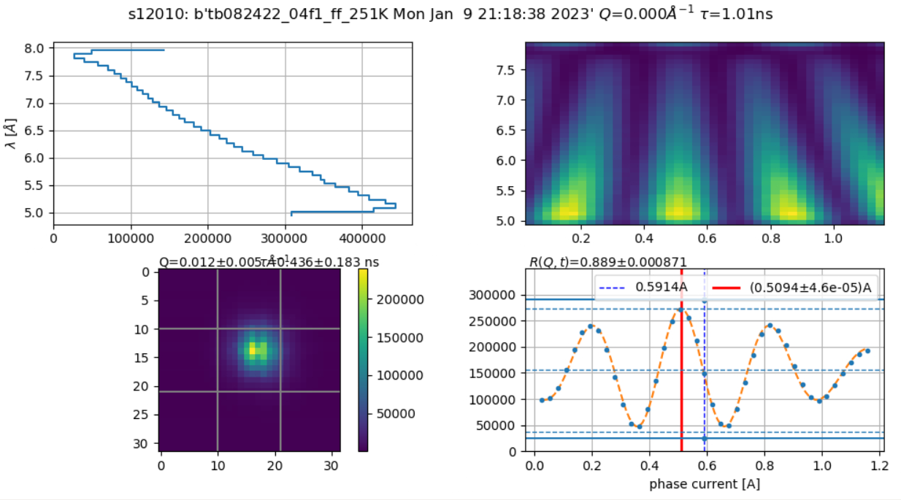
Spin-Dependent Fifth-Force Search
Precession
coil
Precession
Coil
π/2 Flipper
Sample
π/2 flipper
Analyzer
π flipper
Detector
Neutron Travel
S
S
T = T_{C}
T = T_{C}
Caleb Hughes
Notes:
Explicitly say why reversed direction

Slide 27
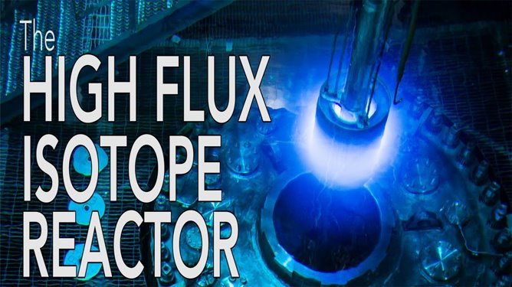
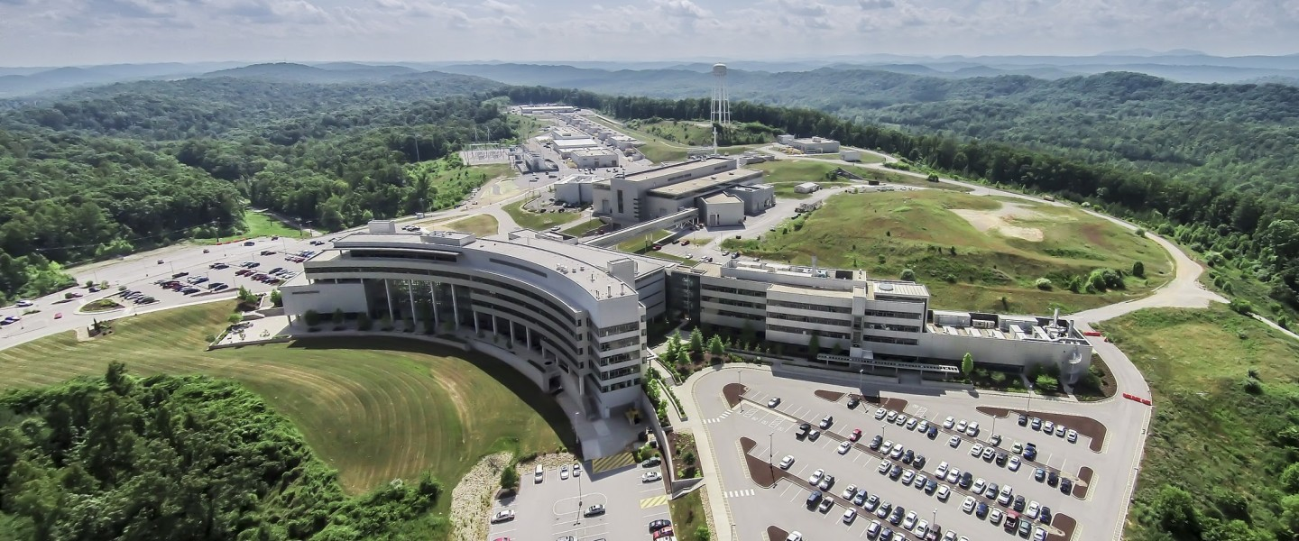
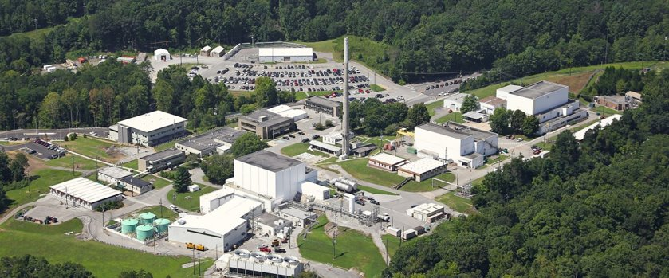
Sayonara, SNS : Hello, HFIR
 | SNS | HFIR
Number of Instruments | 20 | 13
Instrument Used | BL-15 (NSE) | MARS (Imaging)
Caleb Hughes
Notes:
https://commons.wikimedia.org/wiki/File:Spallation_neutron_source_logo.png
https://neutrons.ornl.gov/nse

Slide 28
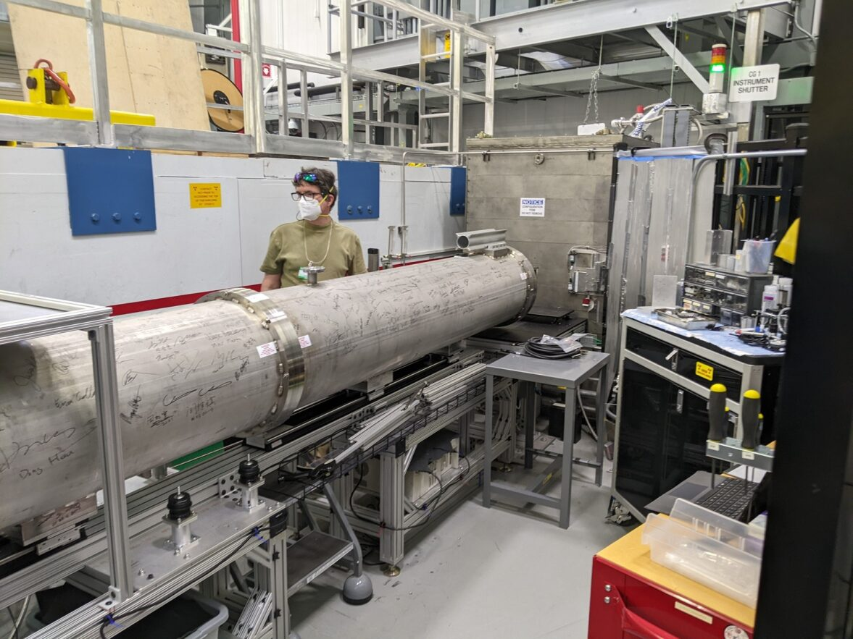
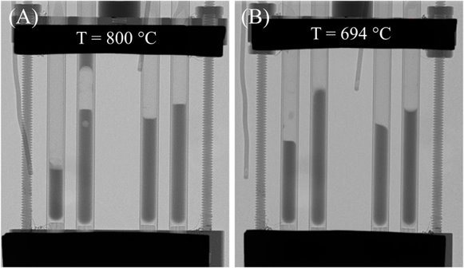
MARS
Multimodal Advanced Radiography Station (MARS)
HFIR beamline CG-1D
Radiography and computed tomography imaging capabilities
High spatial resolution, lower B field sensitivity
Use radiography to quantify n spin rotation
Caleb Hughes
Notes:
Camera info? More specifics? L/D?
https://www.frontiersin.org/articles/10.3389/fenrg.2022.1102466/full
https://www.frontiersin.org/articles/10.3389/fceng.2022.1046627/full

Slide 29
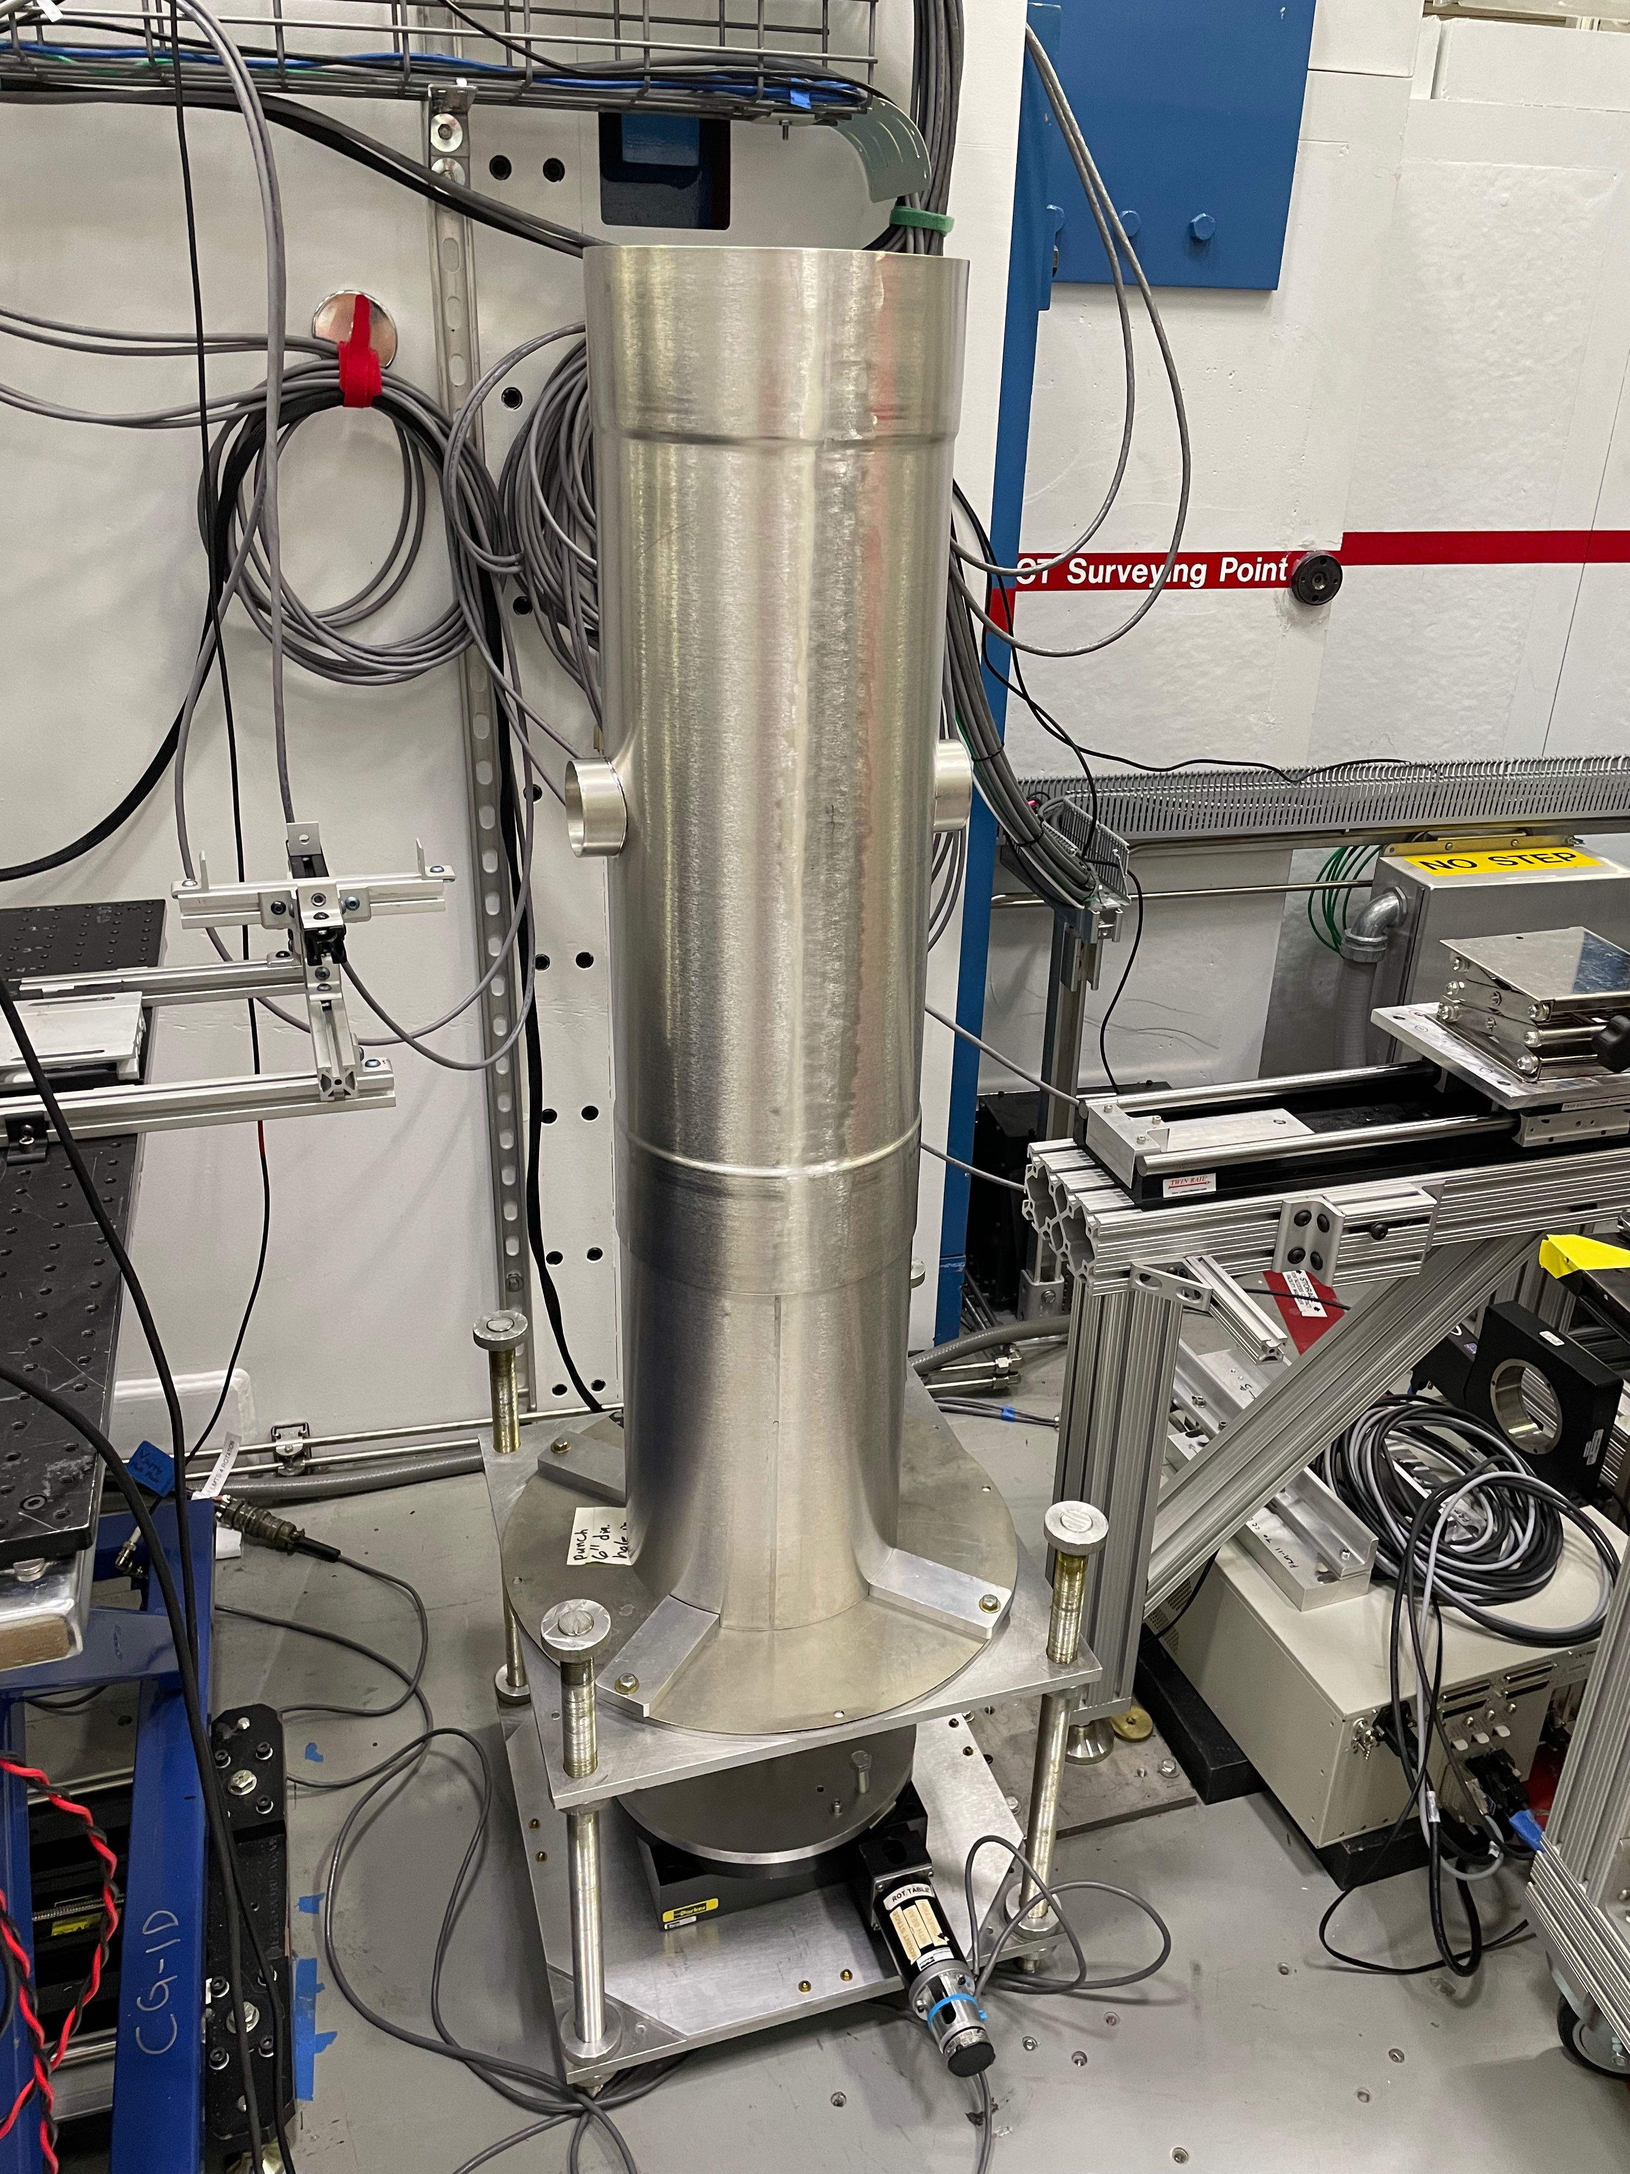
Magnetic Shielding
No ambient shielding in instrument area
Design Constraints:
4:1 length:diameter
Fits around cryostat
Doesn’t interrupt n travel
Minimized opening size
Shielding reduces field to acceptable levels
Caleb Hughes

Slide 30
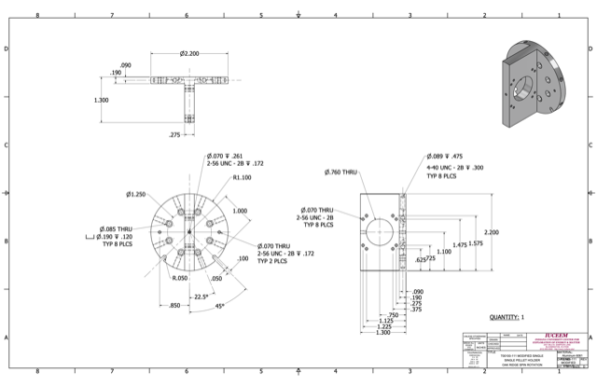
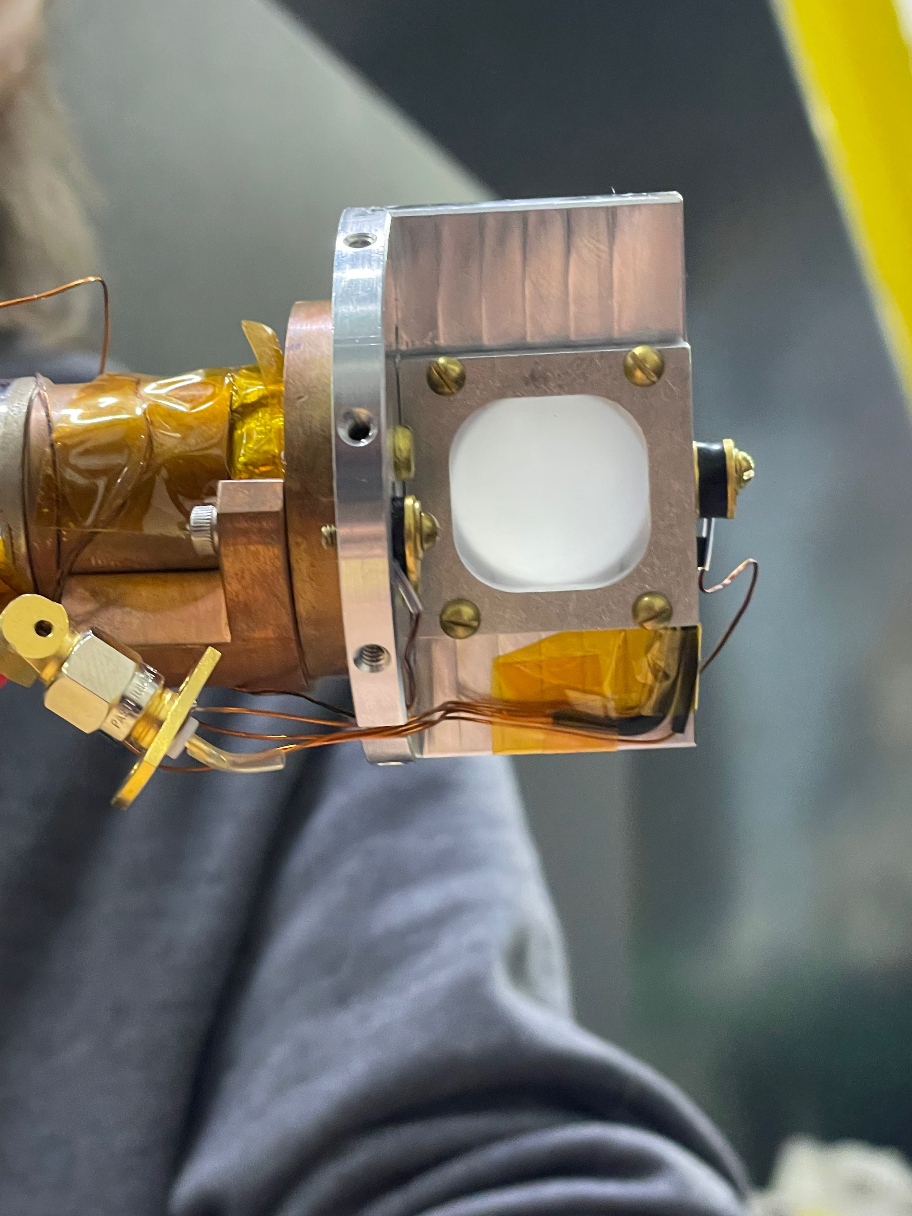
Samples
Reused main sample used in NSE experiment
Safety considerations
Redesigned holder for single sample
Caleb Hughes
Notes:
How much to say here? May work better as a bullet point, or perhaps mention alternative samples, lack of need for repolarization, challenges etc.

Slide 31
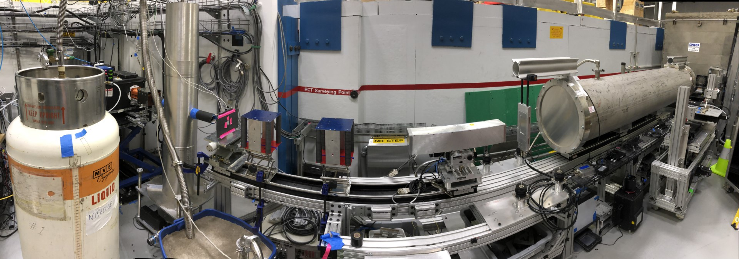
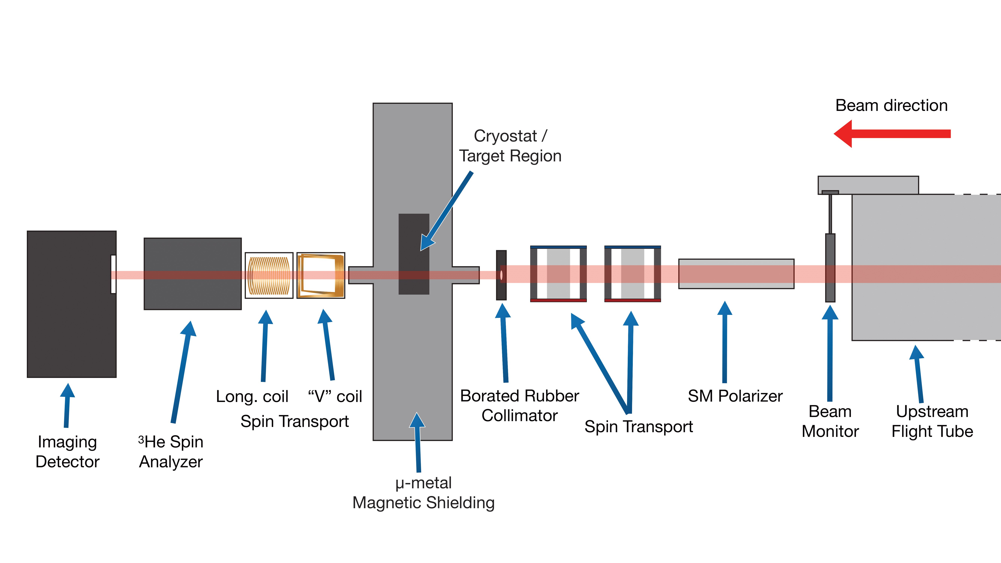
Neutron Flight Path
Graphic by Krystyna Lopez
Caleb Hughes
Notes:
Credit K. Lopze for image

Slide 32
Neutron Beam
Caleb Hughes
Notes:
Credit K. Lopze for image

Slide 33
Polarization
Caleb Hughes
Notes:
SM = Super mirror

Slide 34
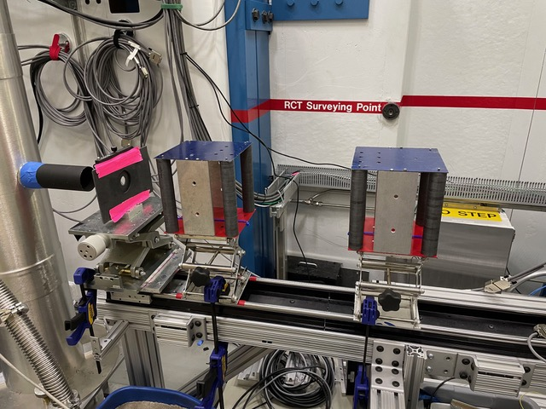
Spin Transport
Guide Field elements maintain polarization in the direction of n travel
Field of ~100 G
Caleb Hughes

Slide 35
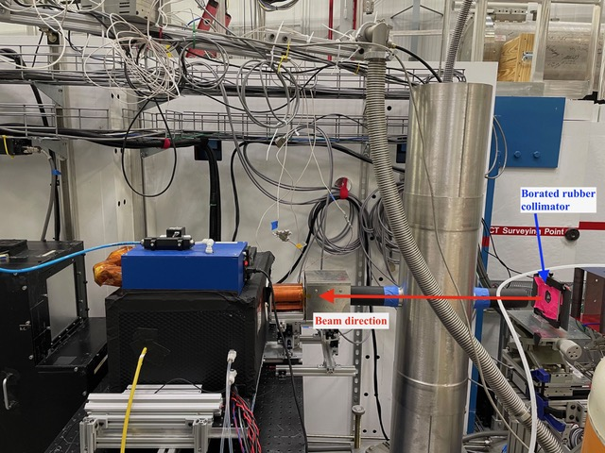
Spin Manipulation
Beam collimated
Neutrons pass through sample and spin rotate
Exit to V-Coil
(sudden rotation via current sheet)
Exit to longitudinal coil
Adiabatic rotation
Caleb Hughes

Slide 36
Spin Analyzer
Caleb Hughes

Slide 37
Neutron Imaging
Caleb Hughes

Slide 38
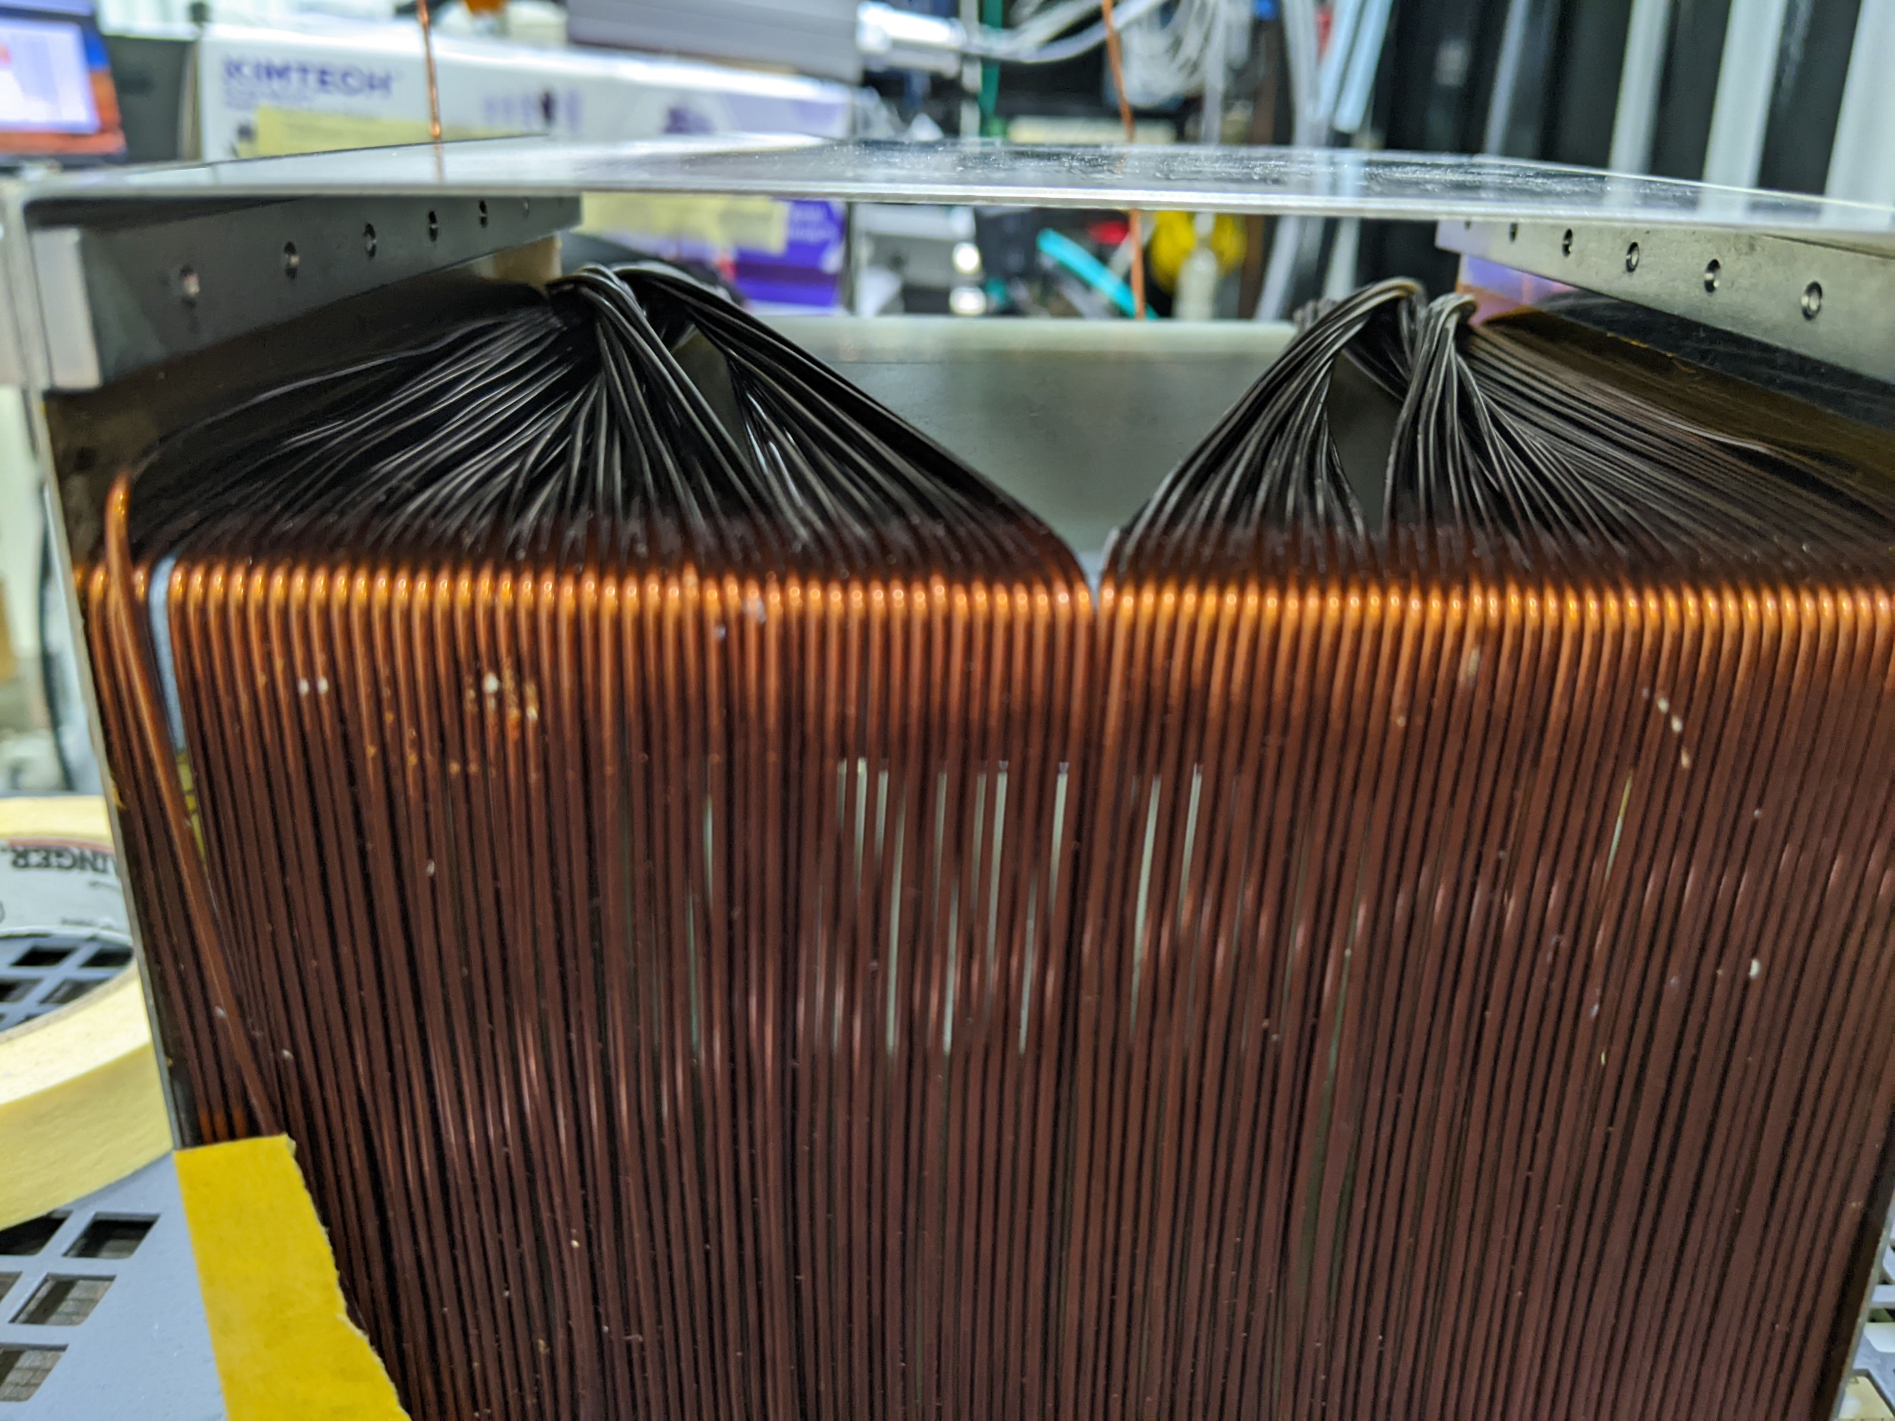
Measurement Strategy
Asymmetry measurement: spin-up vs. Spin-down
Coil current flipped
DATA SETS:
Ferrimagnetics checked by sweeping through temperatures
Fifth-Force data collected by 180 degree rotation
Caleb Hughes
Notes:
Resolution? Built in? Maybe make a bullet point

Slide 39
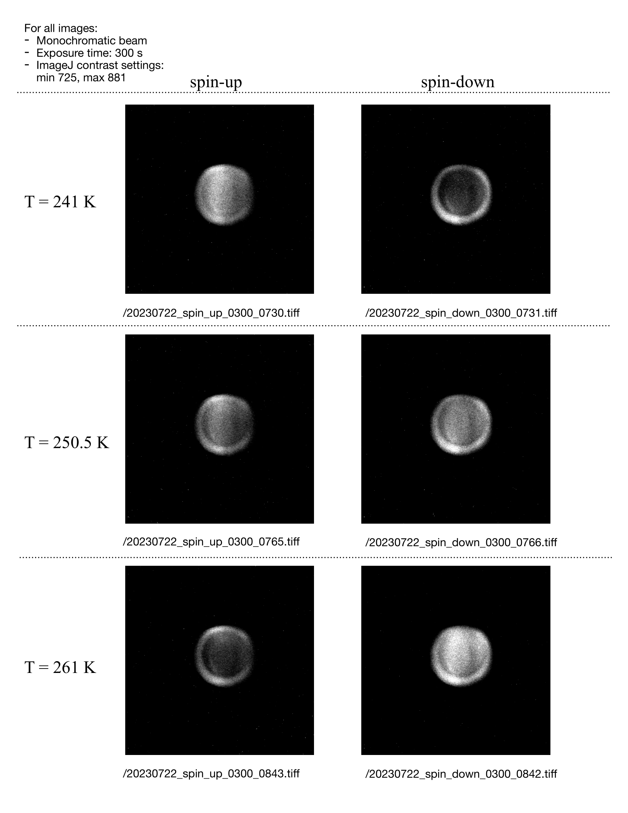
Temperature Sweep Data
Reversal of signal through Tc
Image from Krystyna Lopez
Caleb Hughes
Notes:
What about domain level cancellation effects? What would we expect through a nonmagnetic material?

Slide 40
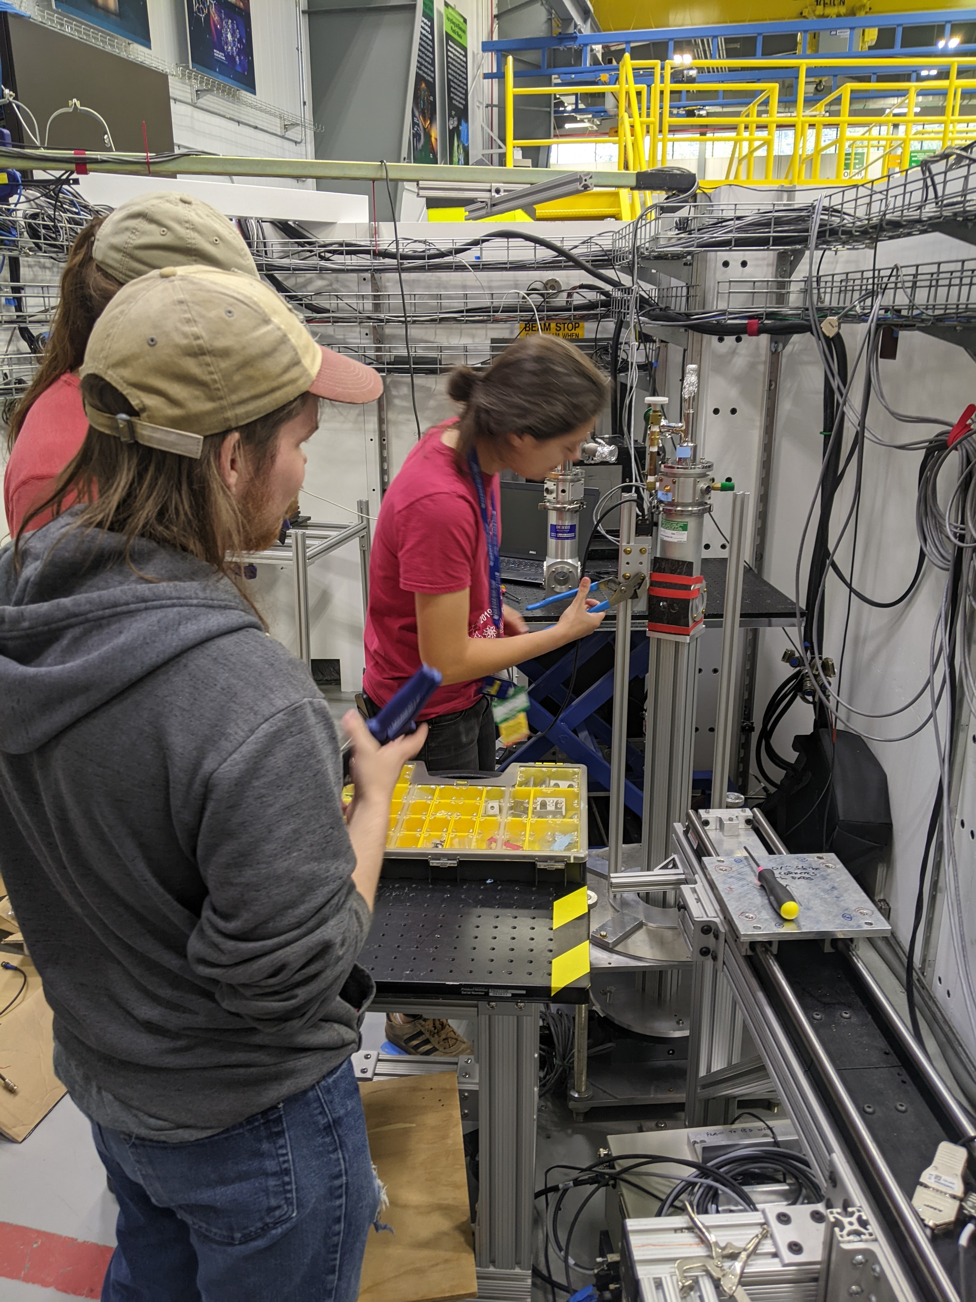
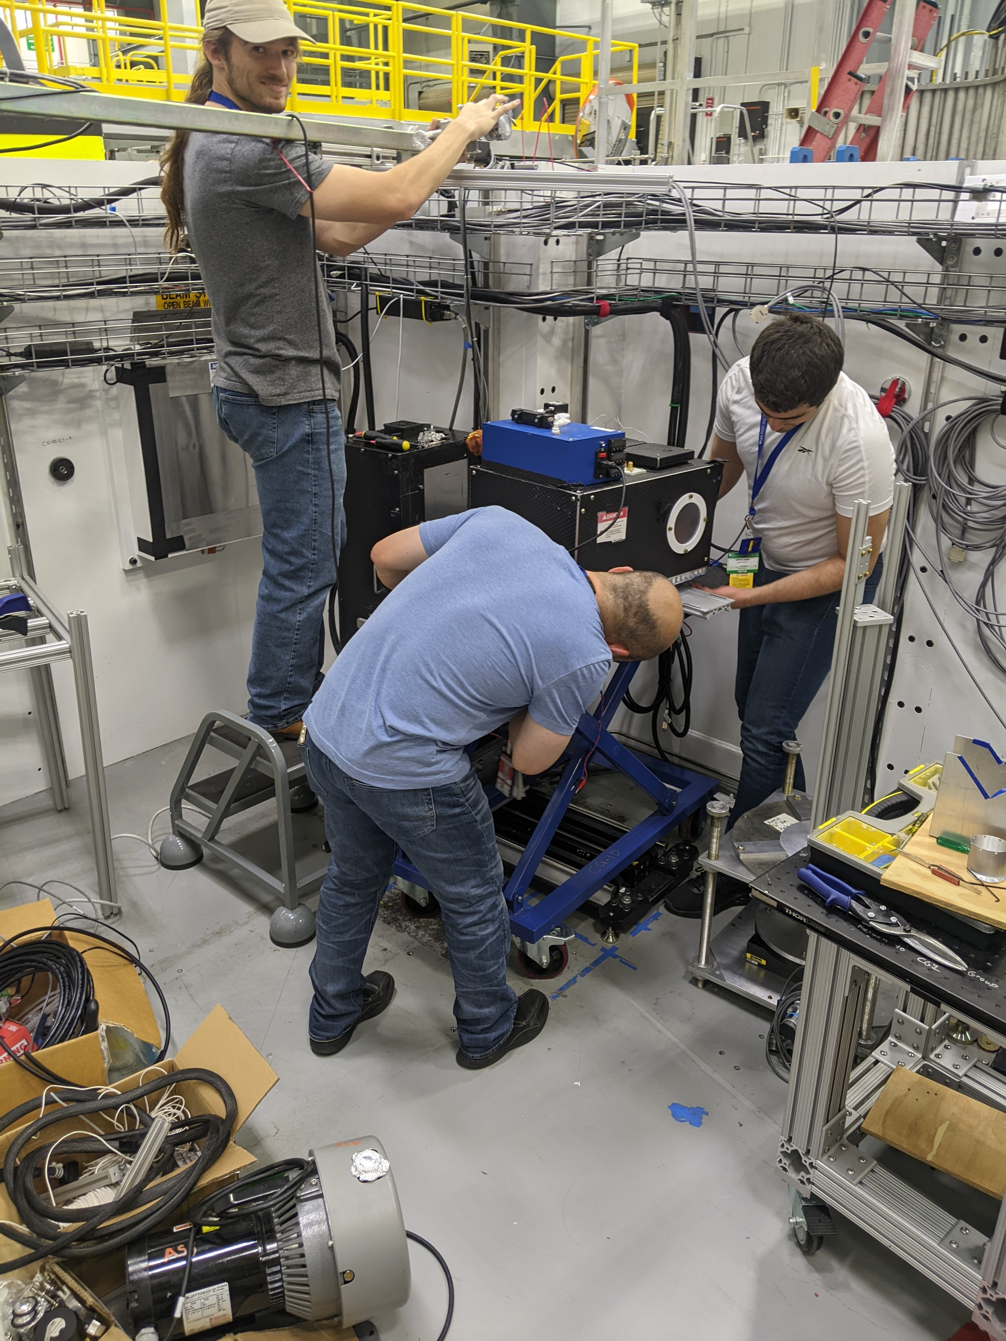
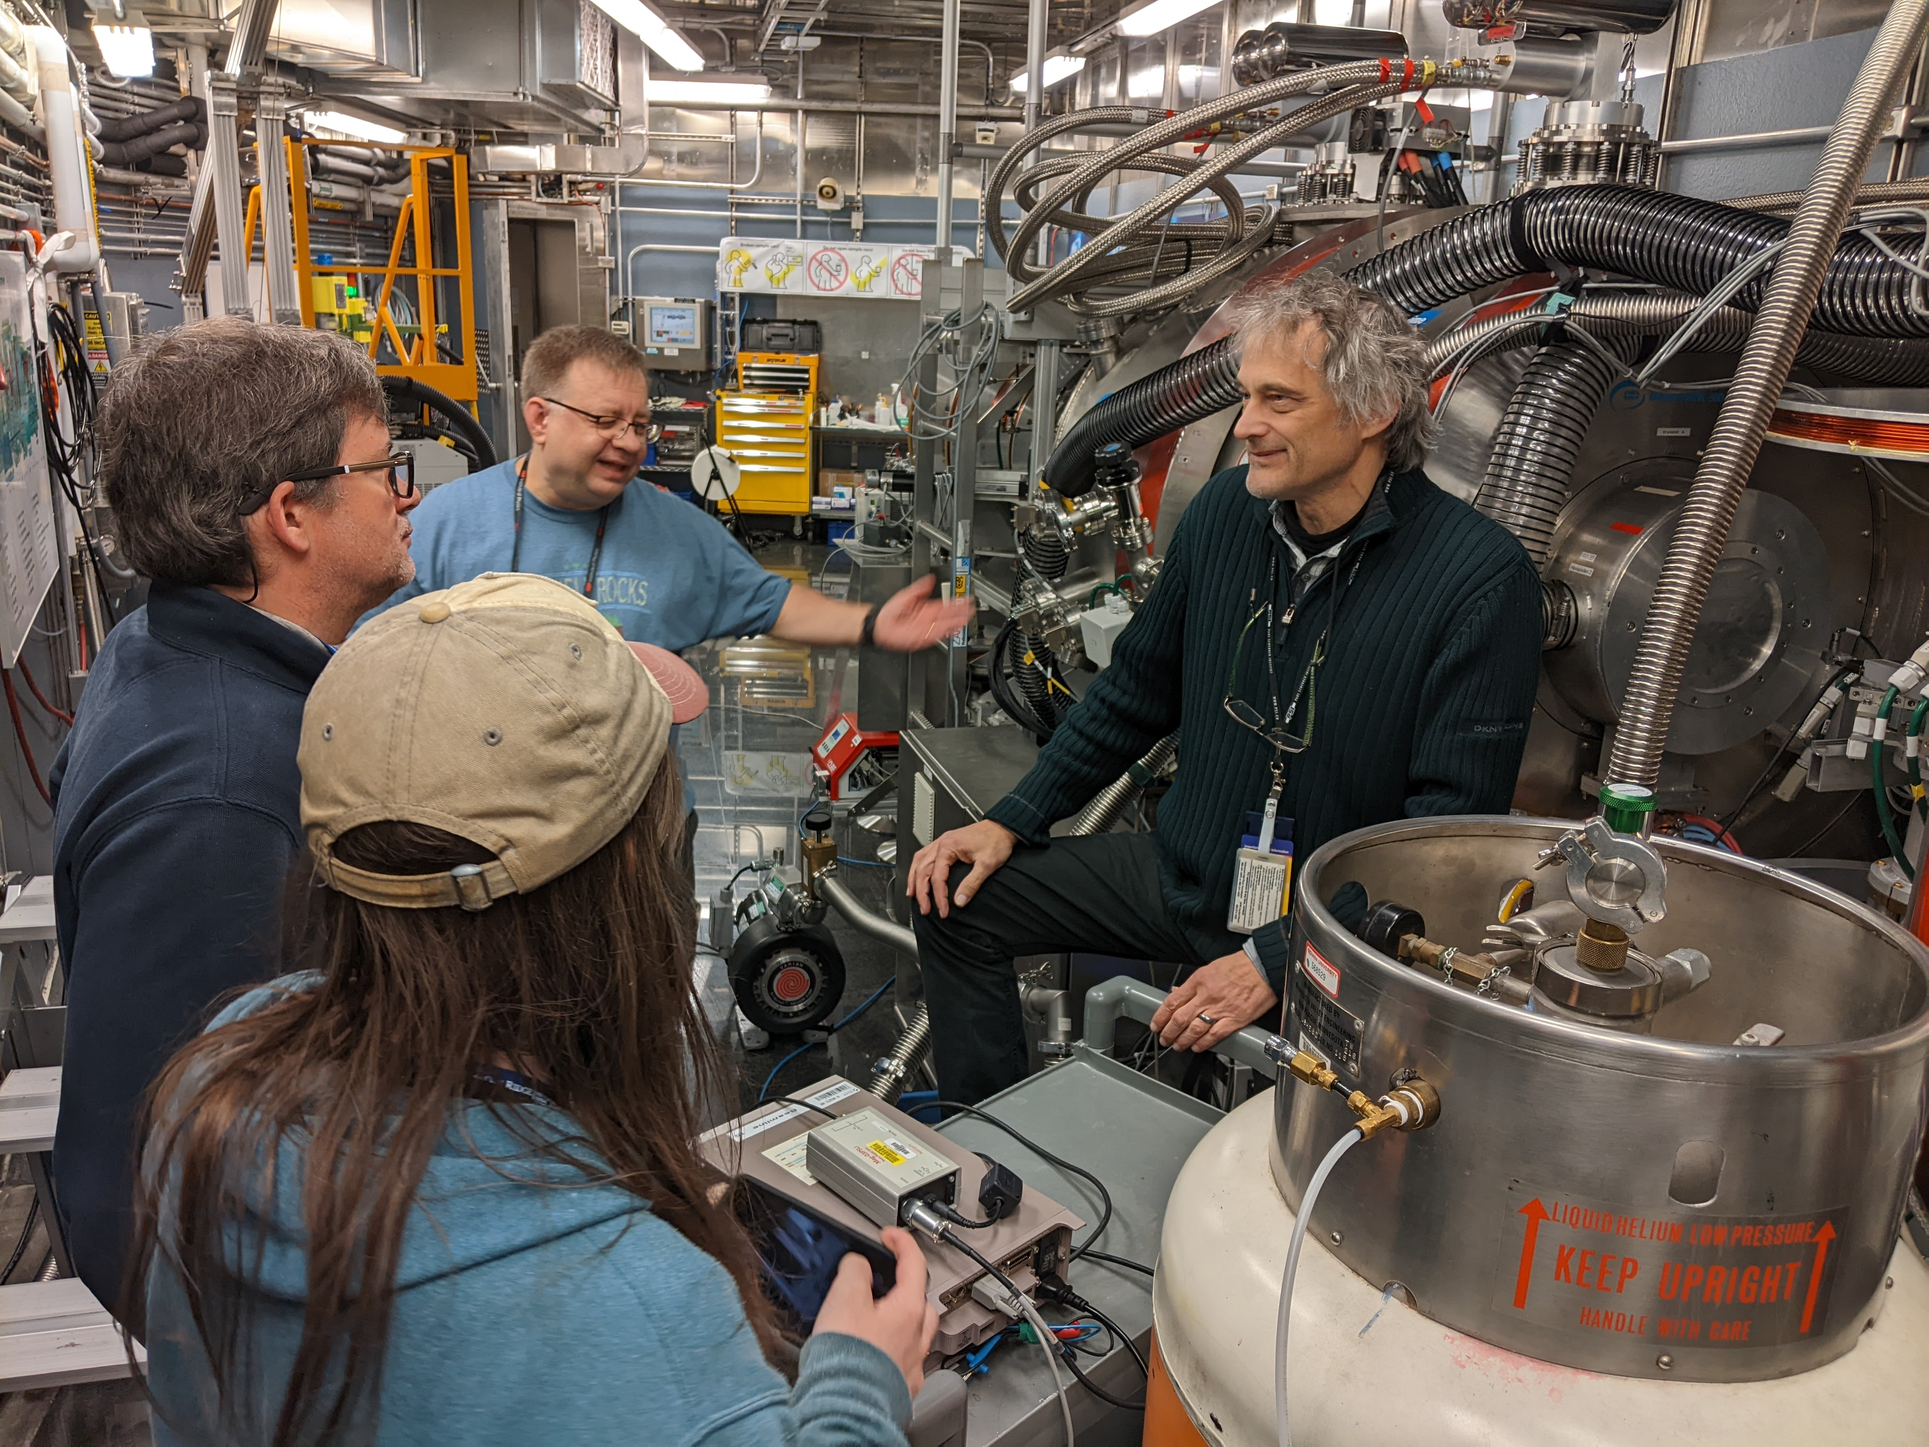
HFIR Future
Proposal submitted for HFIR 2024-A run cycle
Improved magnetometry
Improved thermometry
Improved statistics
Order of Magnitude bound improvement
Caleb Hughes
Notes:
Discuss upgrades for Gen 2 experiment (see dissertation)

Slide 41
Thanks!
Collaboration
Indiana University:
Caleb Hughes, Lili Lommel, Krystyna Lopez, Mike Snow,
Michael van Meter
University of Illinois Urbana-Champaign:
Josh Long
Georgia State University:
Thomas Mulkey, Murad Sarsour
ORNL:
SNS:
Matt Frost, Mary Odom, Piotr Zolnierczuk
HFIR:
Peter Jiang, Erik Stringfellow, Yuxuan Zhang
Questions?
This work supported by NSF grants
PHY-1707986 and PHY-2209481
This work supported by DOE grant
DE-SC0010443
Caleb Hughes
Notes:
Include lab photos, shed photos here

Slide 42
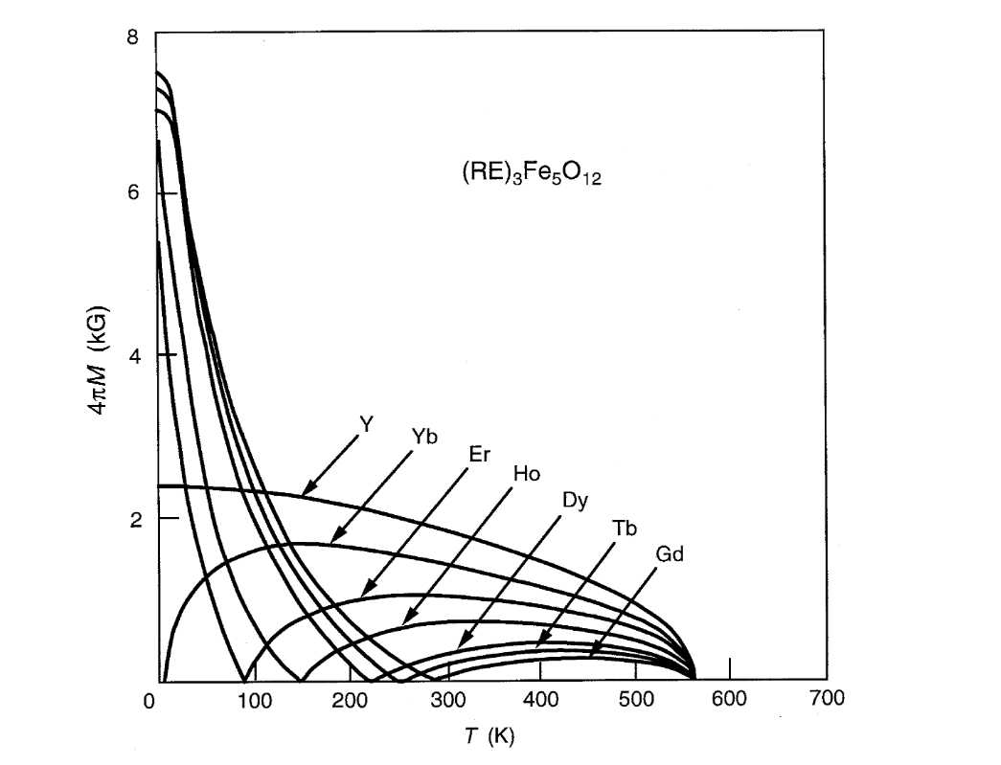
Why Terbium?
Easily accessible Tc (~250 K)
TbIG has ½x spin density of DyIG, but 0.1x neutron absorption cross section
Novel
G. Dionne, Magnetic Oxides (N.Y., Springer, 2009)
Caleb Hughes
Notes:
Need to test.

Slide 43
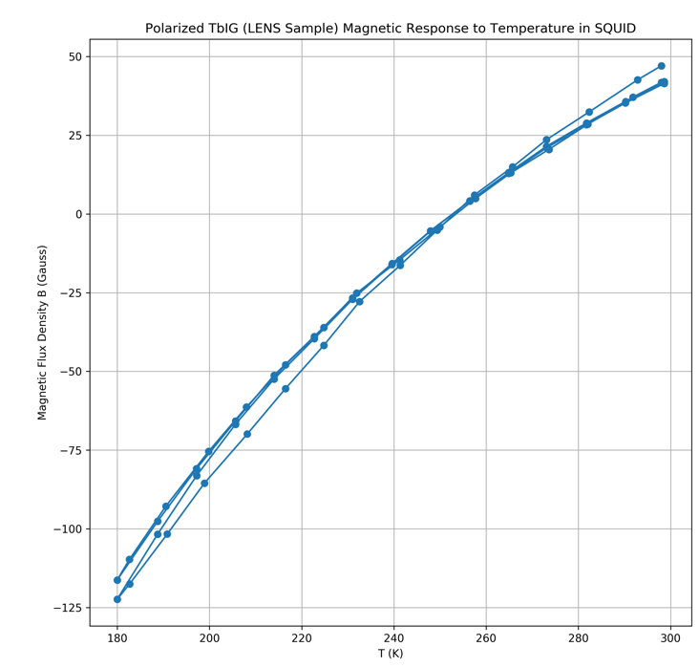
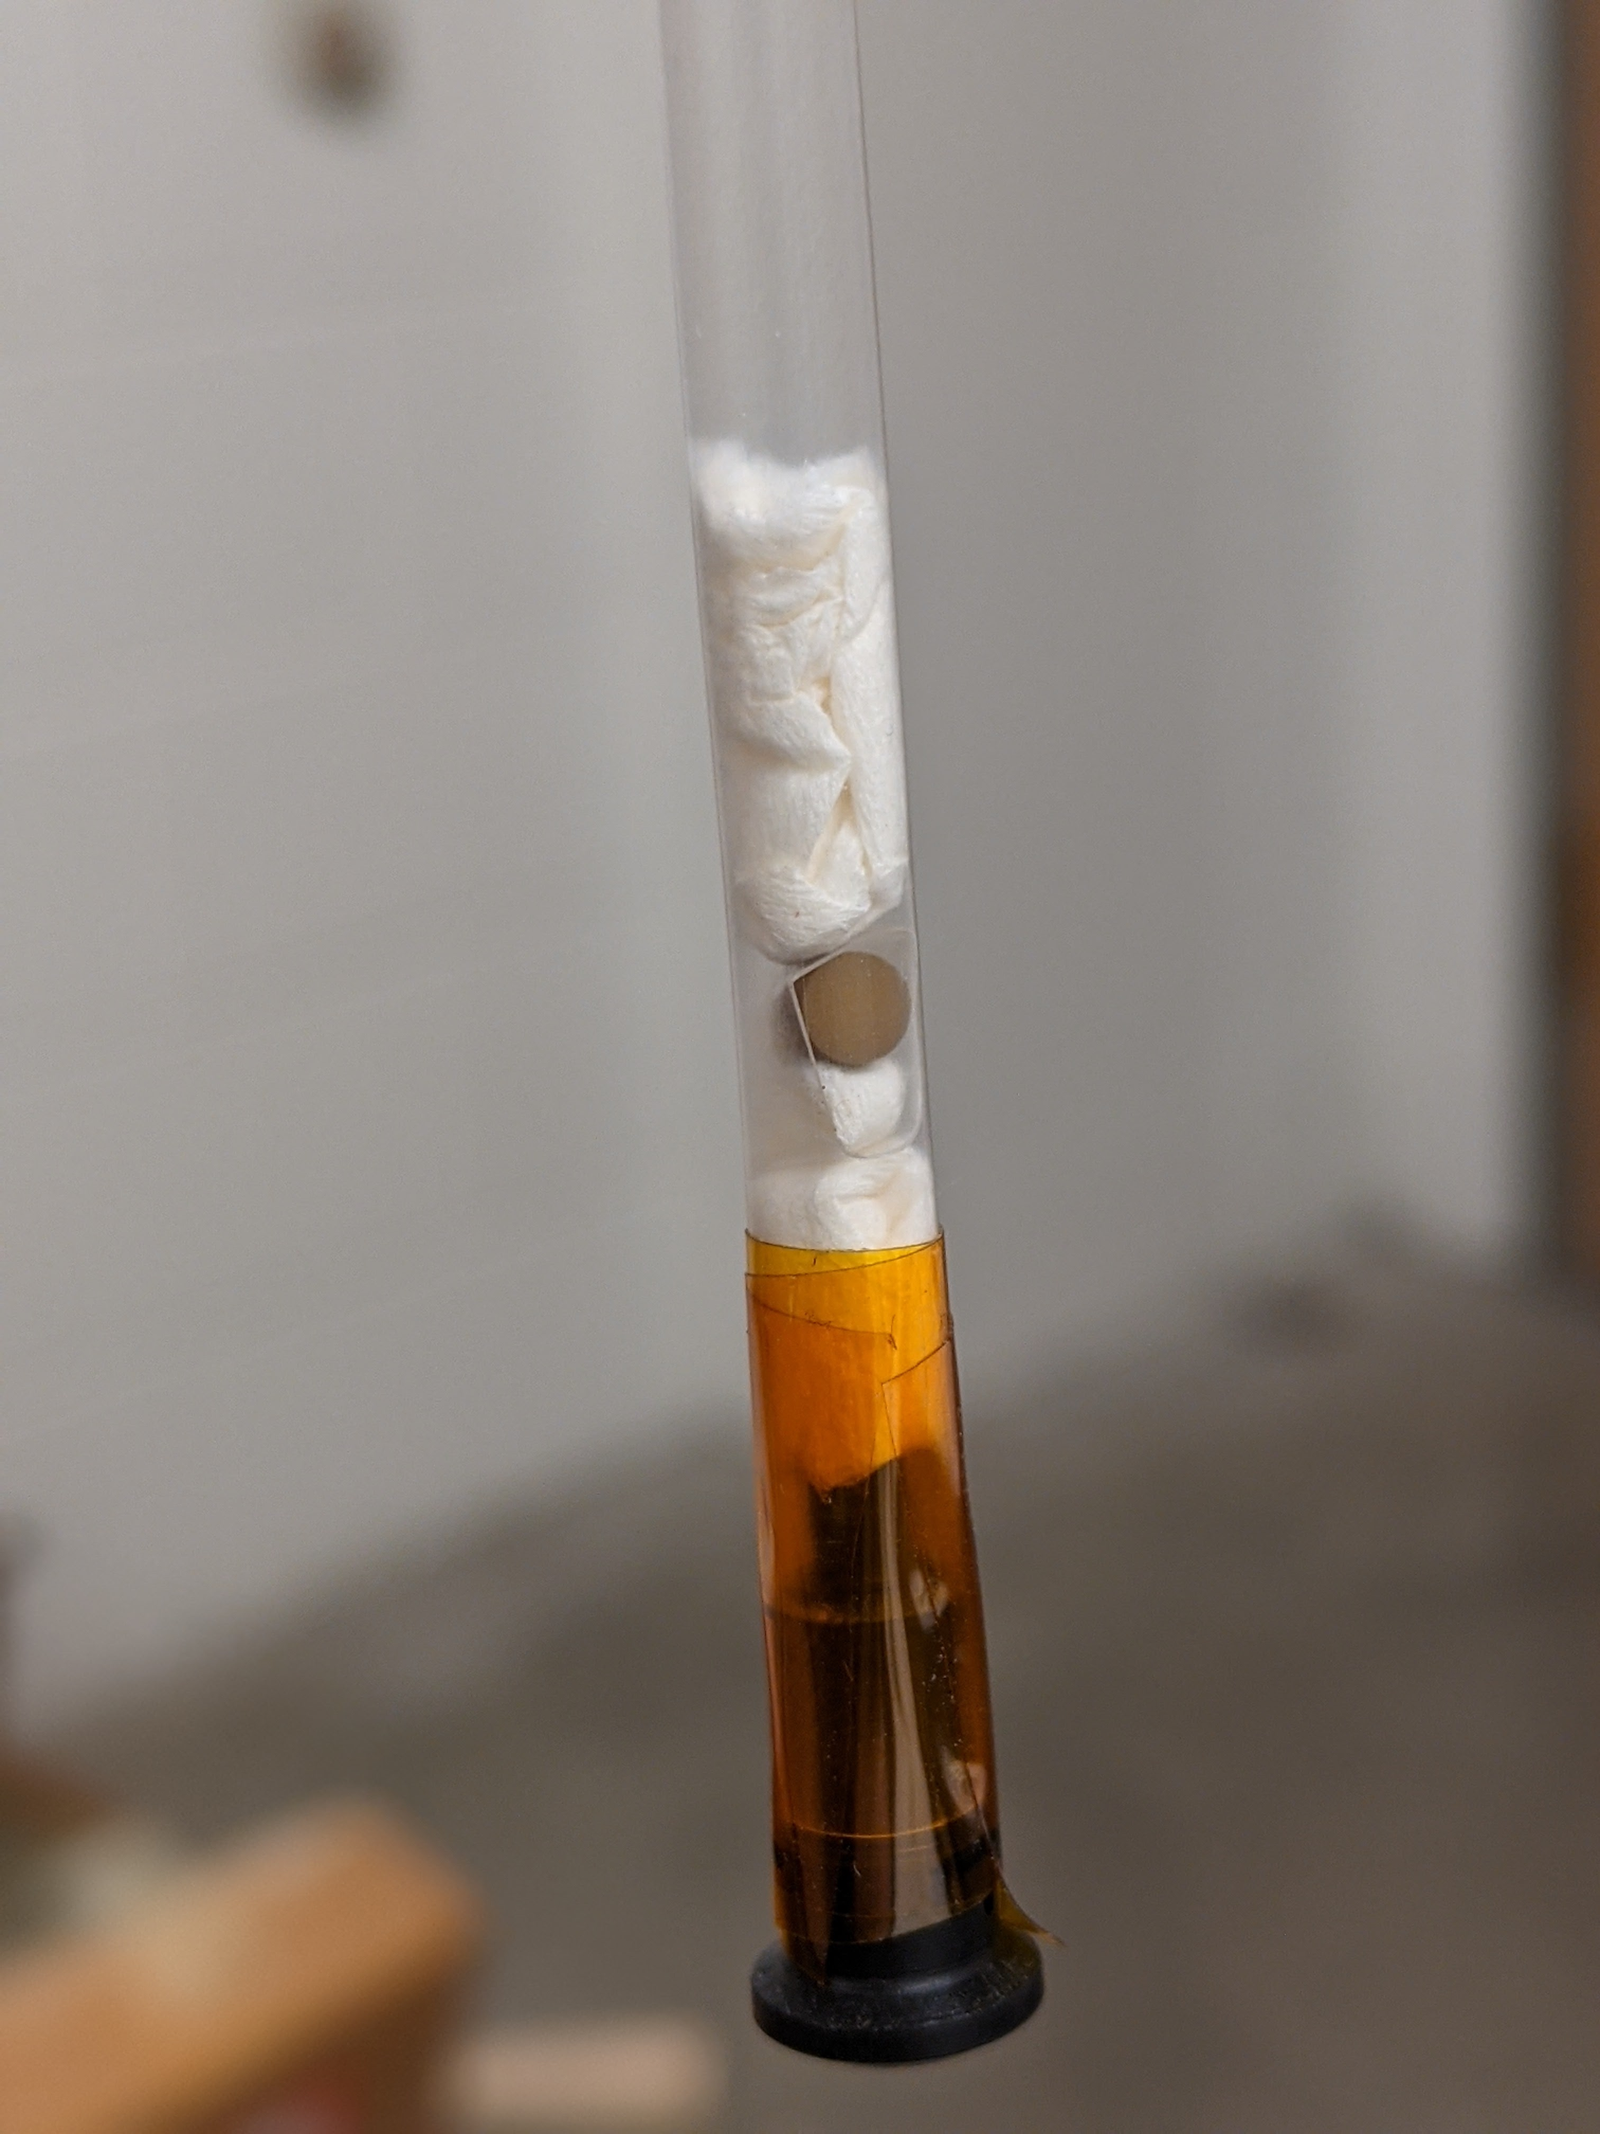
It Works! (Externally…)
MPMS Squid Magnetometer
Tc = 253 +/- 1 K
Now we just need an internal probe…..
Caleb Hughes
Notes:
Make sure to mention the plot is remnant magnetization of TbIG (that is, permanent magnetization of magnetized sample, with field removed) as a function temperature. There are several passes through Tc over (presumably) several hours, no degradation of room temperature magnetization, Tc very repeatable, etc.

Slide 44
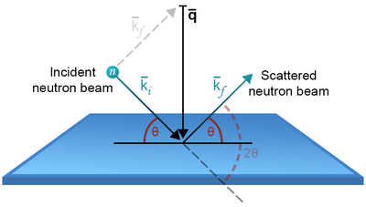
Neutrons as a Probe
Electrically Neutral
Non-destructive
Readily polarized spin
Low decoherence in matter
Basics of neutron scattering (no date) Basics of neutron scattering - eneutrons. Available at: https://e-learning.pan-training.eu/wiki/index.php/Basics_of_neutron_scattering (Accessed: April 14, 2023).
Caleb Hughes
Notes:
Mention domain size?

Slide 45
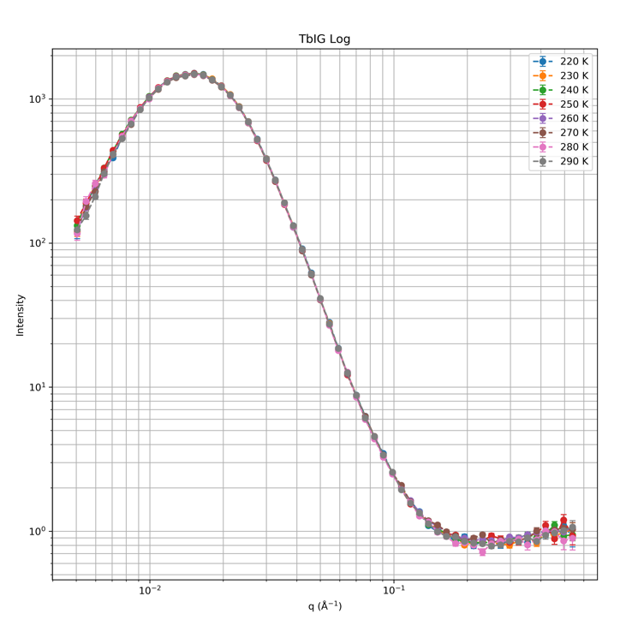
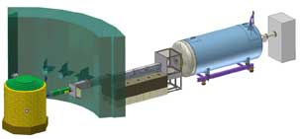
SANS
Tested samples for small-angle neutron scattering (SANS) using IU’s Low-Energy Neutron Source (LENS)
Multiple cycles through Tc; no change
No significant SANS as a function of T
Instruments (no date) Center for Exploration of Energy & Matter. Available at: https://ceem.indiana.edu/lens/instruments/index.html (Accessed: April 14, 2023).
Caleb Hughes
Notes:
Checked (and improved) phase purity of the sample (add graphic if time)

Slide 46
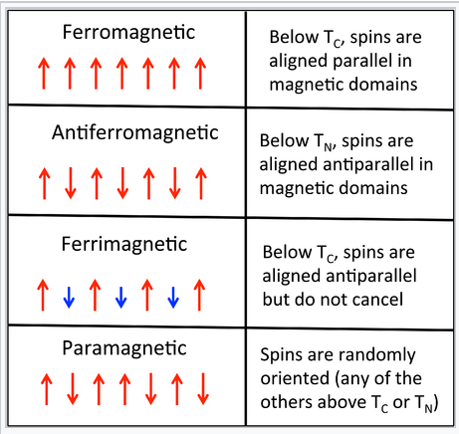
Ferrimagnets
Ferrimagnets exhibit anti-aligned sub-moments which contribute to a net moment
Temperature dependance of RIG ferrimagnets leads to cancelling of the net magnetic moment
Global or local?
Libretexts (2021) 6.8: Ferro-, ferri- and Antiferromagnetism, Chemistry LibreTexts. Libretexts. Available at: https://chem.libretexts.org/Bookshelves/Inorganic_Chemistry/Book%3A_Introduction_to_Inorganic_Chemistry_%28Wikibook%29/06%3A_Metals_and_Alloys-_Structure_Bonding_Electronic_and_Magnetic_Properties/6.08%3A_Ferro-_Ferri-_and_Antiferromagnetism (Accessed: April 14, 2023).
Caleb Hughes
Notes:
Include Walt’s design here
Have to replace Bell Jar
Wires coated for higher emissivity

Slide 47
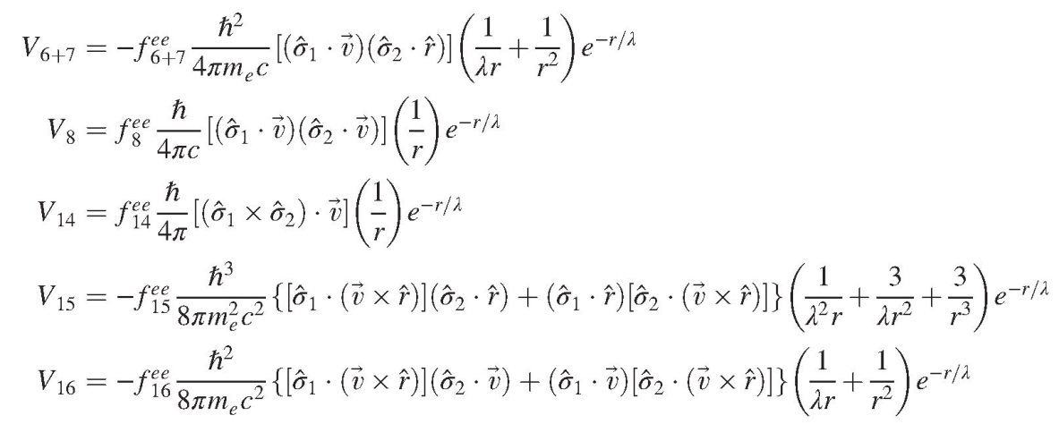
Spin-Dependent Potentials^{1,2,3}
72 Independent couplings $f_{i}^{1,2}$
Spin-Mass interactions
“Static” spin-spin interactions
Velocity-dependent spin-spin interactions
[1] J. E. Moody and F. Wilczek, Phys. Rev. D 30, 130 (1984)
[2] B. Dobrescu and I. Mocioiu, J. High Energy Phys. 0611, 005 (2006) [3] Fadeev, Pavel, et al. Phys. Rev. A, vol. 99, no. 2 , doi: 10.1103/physreva.99.022113(2019)
Caleb Hughes
Notes:
In this slide, Highlight potentials to be modified, maybe even show their contact terms, split?
CITE GRENOBE
CITE DOBRESCU AND MOCIOIU
V_1 is spin-independent Yukawa interaction
Here, juxtapose 16 spin-dependant potential forms and source-mass/test-mass combinations for testing (may take a few slides, try and match at least 4 to a slide and will need to move through these somewhat quickly)
May only do spin-dependant ones here with axial polarization, save in-plane polarizations for later section
Which depend on Spin-0 boson? Highlight them
Among those, V3 is the so-called dipole-dipole potential
The so-called monopole-dipole potential is given by V9 + V10.

Slide 48
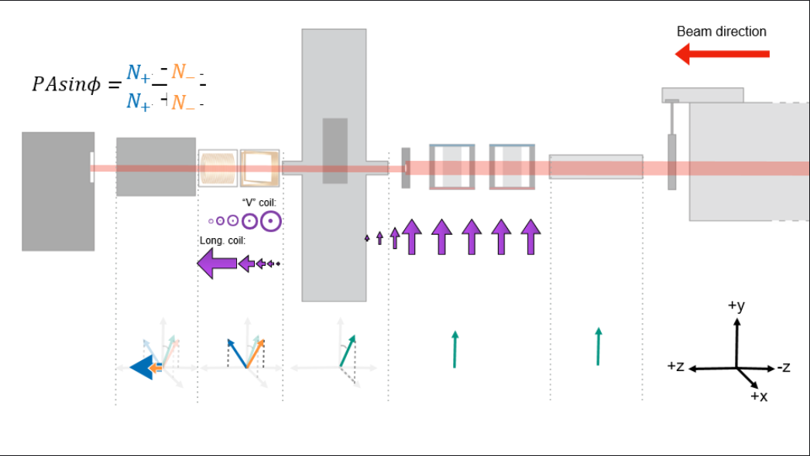
Neutron Spin Orientation
Slide by Krystyna Lopez
Caleb Hughes

Slide 49
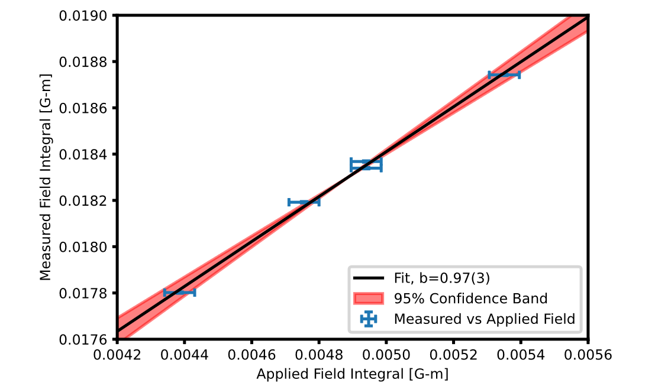
Field Integral
Accuracy 100nTm
Caleb Hughes
Notes:
Include Walt’s design here
Have to replace Bell Jar
Wires coated for higher emissivity

Slide 50
NSE Analysis
Preliminary Analysis Observable:
D(theta)/lamda dz = 6.18 +/- 0.114 rad/Angstrom m
Corresponds to a ~100 microT field
I- = 0.5095 A
I+ = 0.4621 A
I- = 0.5095 A
I+ = 0.4621 A
I+ = 0.4621 A
I+ = 0.4621 A
Analysis by Thomas Mulkey (GSU)
Caleb Hughes

Slide 51
TEMPLATE
Hall probe directly above sample
Tc (Hall sensor): (251.34 +/- 0.85) K
Fluxgates outside cryostat
Tc (fluxgate sensor): (251.02 +/- 0.62) K
Two lakeshore temperature sensors
Caleb Hughes

Slide 52
Calibration
Adjusted cryostat PID parameters
Leveled system wrt beam
Tested vacuum system
Caleb Hughes
Notes:
What calibrations were done? Checked the Hall probe, but ended up not needing that data. What did we calibrate before we had neutrons on target? Review logbook for this info.

Slide 53
Spin-Dependent Fifth-Force
Precession
coil
Precession
Coil
π/2 Flipper
Sample
π/2 flipper
Analyzer
π flipper
Detector
Neutron Travel
S
Caleb Hughes
Notes:
Include Walt’s design here
Have to replace Bell Jar
Wires coated for higher emissivity

Slide 54
INTENTIONALLY BLANK
T = 240 K
T = 251 K
T = 260 K

Slide 55
INTENTIONALLY BLANK
T = 240 K
T = 251 K
T = 260 K
Spin up
Spin down
Spin up
Spin down
Spin up
Spin down
T = 241 K
T = 250.5 K
T = 261 K

Slide 56
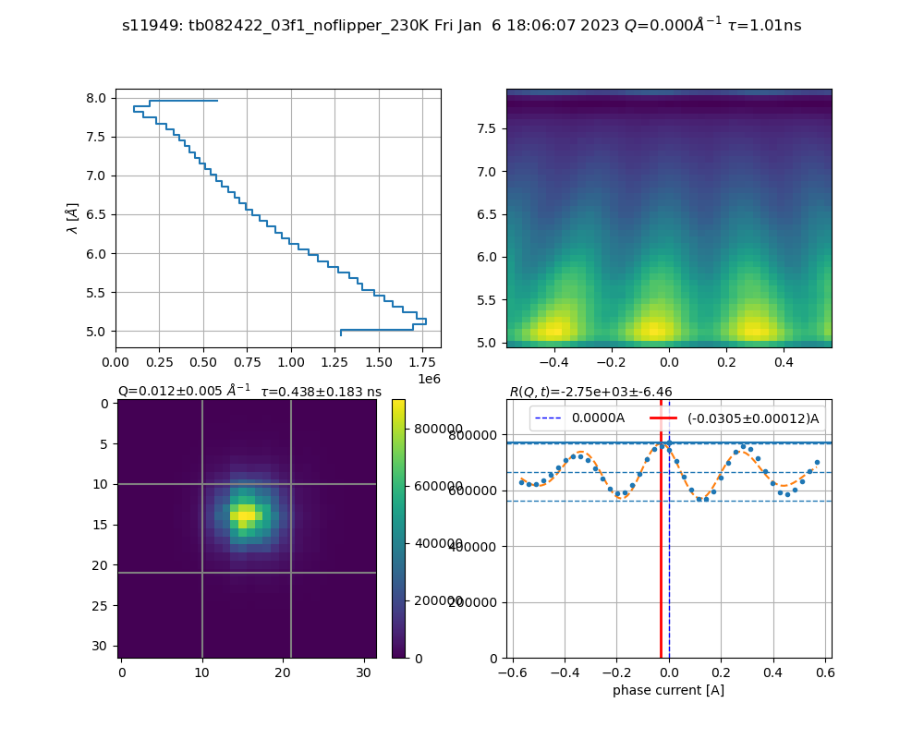
Analysis (NSE Compensation Temp)
T = 230 K
Allow Sample to Flip neutron Spins
Retain Echo (noisier, longer integration)
R = 2.75 * 10^3 +/- 6.46
Caleb Hughes
Notes:
Want to be able to explain this– probalistic process, less efficient than coil driven flips
Explain R

Slide 57
Analysis (NSE Compensation Temp)
T = 240 K
Interference Pattern Blurring
Decrease in signal amplitude
R = 48.4 +/- 0.402
Caleb Hughes
Notes:
Want to be able to explain this– probalistic process, less efficient than coil driven flips

Slide 58
Analysis (NSE Compensation Temp)
T = 251 K (Tc)
Interference Pattern Gone
Near Elimination of signal amplitude
R = 0.539 +/- 0.113
Caleb Hughes
Notes:
Want to be able to explain this– probalistic process, less efficient than coil driven flips

Slide 59
Analysis (NSE Compensation Temp)
T = 260 K
Interference Pattern Returning
Oscillations Returning
R = 19.4 +/- 0.179
Caleb Hughes
Notes:
Want to be able to explain this– probalistic process, less efficient than coil driven flips

Slide 60
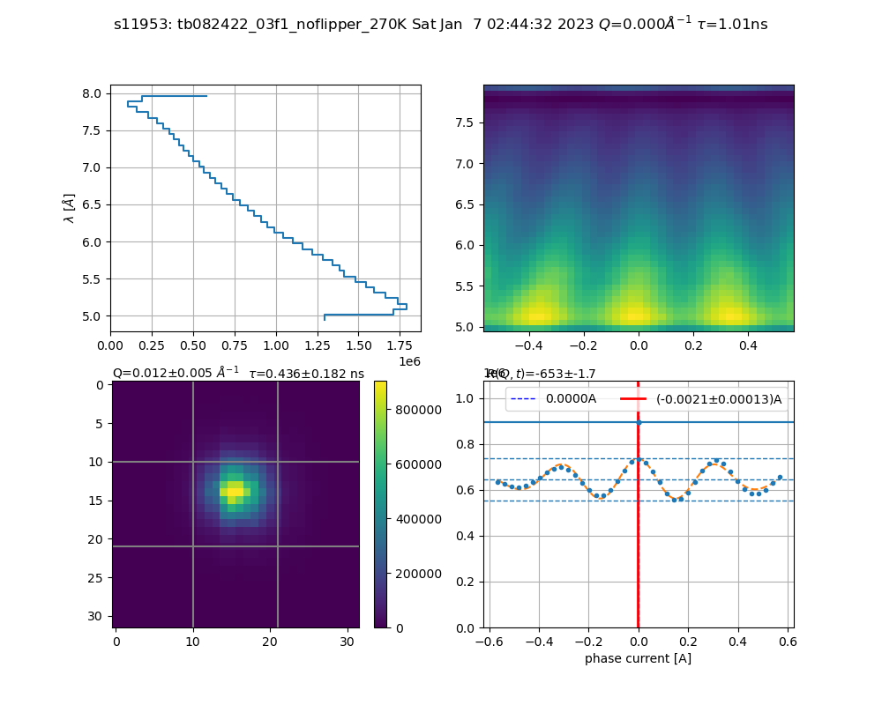
Analysis (NSE Compensation Temp)
T = 270 K
Interference Pattern Clear
Oscillations Clear
R = -653 +/- 1.7
Caleb Hughes
Notes:
Want to be able to explain this– probalistic process, less efficient than coil driven flips

Slide 61
Spin-Dependent Potentials^{1,2,3}
72 Independent couplings $f_{i}^{1,2}$
Spin-Mass interactions
“Static” spin-spin interactions
Velocity-dependent spin-spin interactions
[1] J. E. Moody and F. Wilczek, Phys. Rev. D 30, 130 (1984)
[2] B. Dobrescu and I. Mocioiu, J. High Energy Phys. 0611, 005 (2006) [3] Fadeev, Pavel, et al. Phys. Rev. A, vol. 99, no. 2 , doi: 10.1103/physreva.99.022113(2019)
Caleb Hughes
Notes:
Furthering the work of Moody and Wilczek, Dobrescu and Mocioiu lay out 16 potentials
Reread paper

Slide 62
Spin-Dependent Potentials^{1,2,3}
72 Independent couplings $f_{i}^{1,2}$
UNDER REVIEW
Spin-Mass interactions
“Static” spin-spin interactions
Velocity-dependent spin-spin interactions
[1] J. E. Moody and F. Wilczek, Phys. Rev. D 30, 130 (1984)
[2] B. Dobrescu and I. Mocioiu, J. High Energy Phys. 0611, 005 (2006) [3] Fadeev, Pavel, et al. Phys. Rev. A, vol. 99, no. 2 , doi: 10.1103/physreva.99.022113(2019)
Caleb Hughes
Notes:
In this slide, Highlight potentials to be modified, maybe even show their contact terms, split?
CITE GRENOBE
CITE DOBRESCU AND MOCIOIU
V_1 is spin-independent Yukawa interaction
Here, juxtapose 16 spin-dependant potential forms and source-mass/test-mass combinations for testing (may take a few slides, try and match at least 4 to a slide and will need to move through these somewhat quickly)
May only do spin-dependant ones here with axial polarization, save in-plane polarizations for later section
Which depend on Spin-0 boson? Highlight them
Among those, V3 is the so-called dipole-dipole potential
The so-called monopole-dipole potential is given by V9 + V10.

