Slide 1





The Polarized ⁷LiD Program at Jefferson Lab for Polarized Fusion Experiments at the DIII-D Tokamak
Xiangdong Wei¹, L.R. Baylor², W.W. Heidbrink³, G.W. Miller⁴, A.M. Sandorfi⁴, X. Zheng⁴
¹Jefferson Lab
²Oak Ridge National Laboratory
³University of California, Irvine
⁴University of Virginia
The Spin-Polarized-Fusion (SPF) collaboration
25th International Spin Symposium (SPIN2023)
Durham, NC, USA, 09/24/2023-9/29/2023

Slide 2




Jefferson Lab Fusion Program Motivations
Power!
Clean Power!!
Sustainable Clean Power!!!
(with least environmental impact)
DOE core mission objectives:
… to promote innovative research in clean energy sources, …
Fossil Fuels, Fission, Hydroelectric, Wind Turbine, Solar, Geothermal, Ocean Current, ……
and finally
Fusion!!!

Slide 3
Jefferson Lab Fusion Program Motivations
Heidbrink’s plenary talk on Monday showed the big picture of the SPF experiment.
(A research program to measure the lifetime of spin polarized nuclei in magnetically confined fusion plasmas)
Here I’ll offer a 2-minute version of the importance of SPF experiment and what would be JLab’s role in this matter.
A clean and sustainable energy source is needed urgently for saving today’s world resources and environments.
  ⇒Fusion.
  ⇒Major Issue: Ignition.
  ⇒Polarized Fuels can increase reaction rate by 50%, and Q (Q=P_{out}/P_{in}) by 75%.
  ⇒They are predicted to survive long enough to fuse in the hot (~10⁸ K) plasma.
  ⇒Running D+³He→α+p in a tokamak with polarized fuels will give the answer.*
  ⇒Polarizing ⁷LiD via DNP method requires irradiated pellets and a properly designed polarizer.
  JLab’s main contributions to the Spin Polarized Fusion experiment.
*Since the preferred fusion reaction, D + T → ⁵He → α + $n,$and the isospin mirror reaction, D + ³He → ⁵Li → α + $p,$have the same nuclear physics, we can use the latter to test polarization survivability in the fusion plasma, and avoid the tritium and neutron related issues.

Slide 4
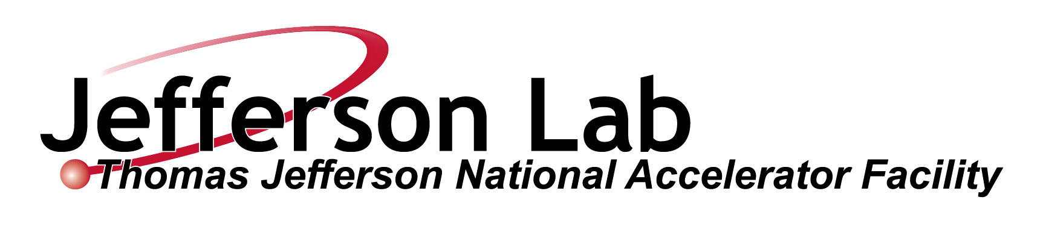
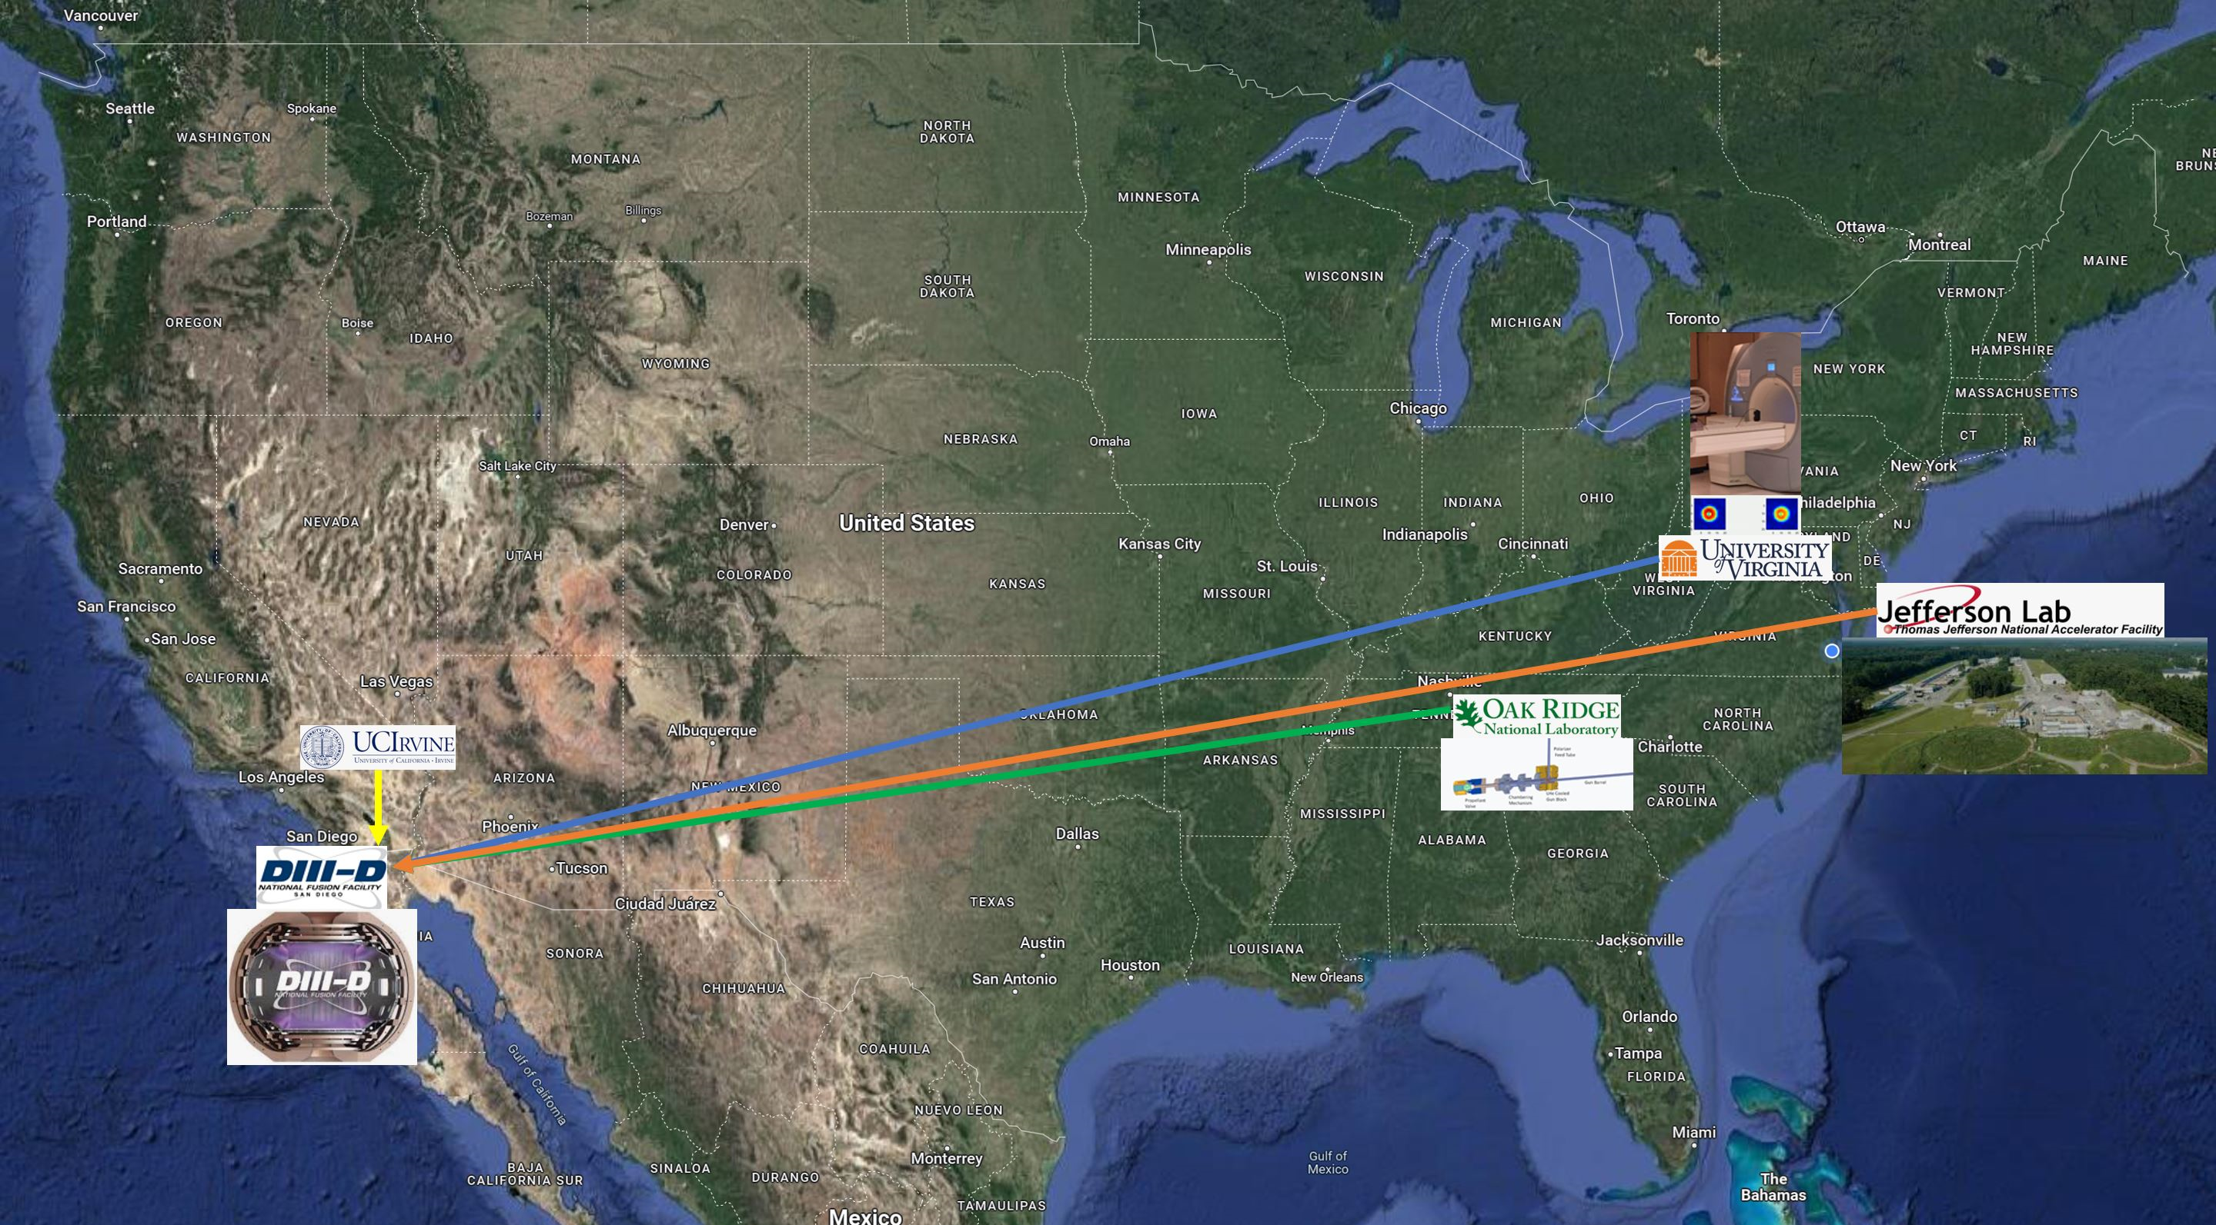



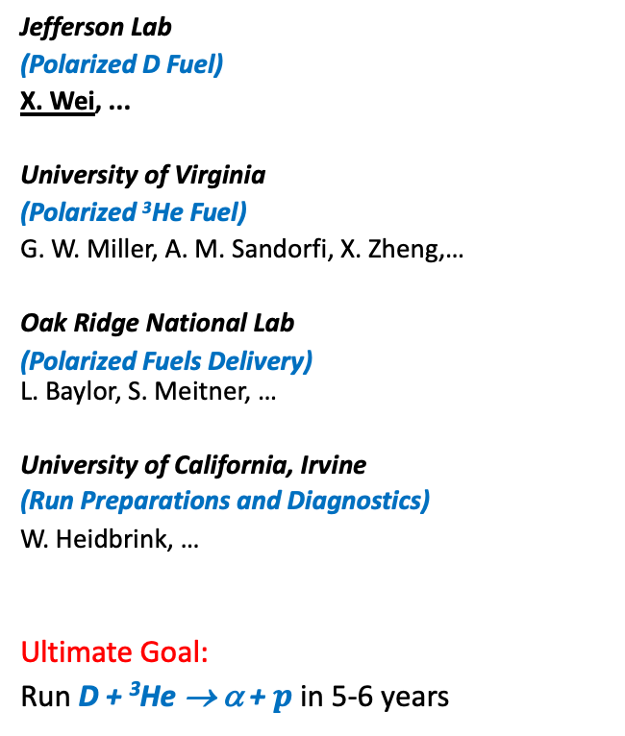
Jefferson Lab Fusion Program SPF Collaboration
Jefferson Lab
(Polarized D Fuel)
X. Wei, ...
University of Virginia
(Polarized ³He Fuel)
G. W. Miller, A. M. Sandorfi, X. Zheng,…
Oak Ridge National Lab
(Polarized Fuels Delivery)
L. Baylor, S. Meitner, …
University of California, Irvine
(Run Preparations and Diagnostics)
W. Heidbrink, …
Ultimate Goal:
Run D + ³He → α + $p$ in 5-6 years
The proposal, Spin Polarized Nuclei for Injection into DIII-D, is currently under DOE review.

Slide 5
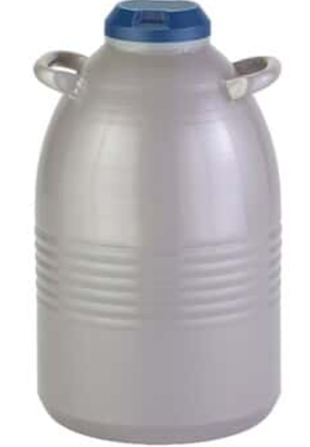
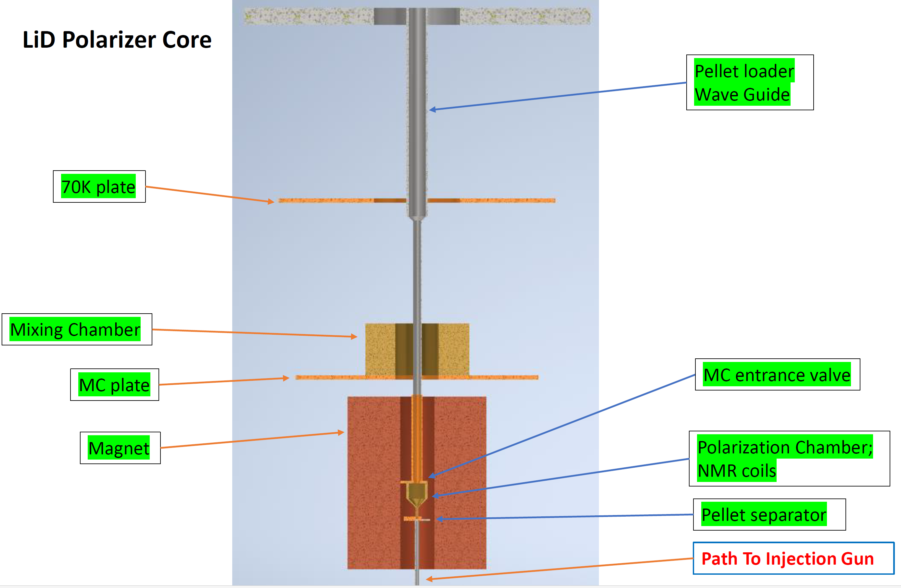
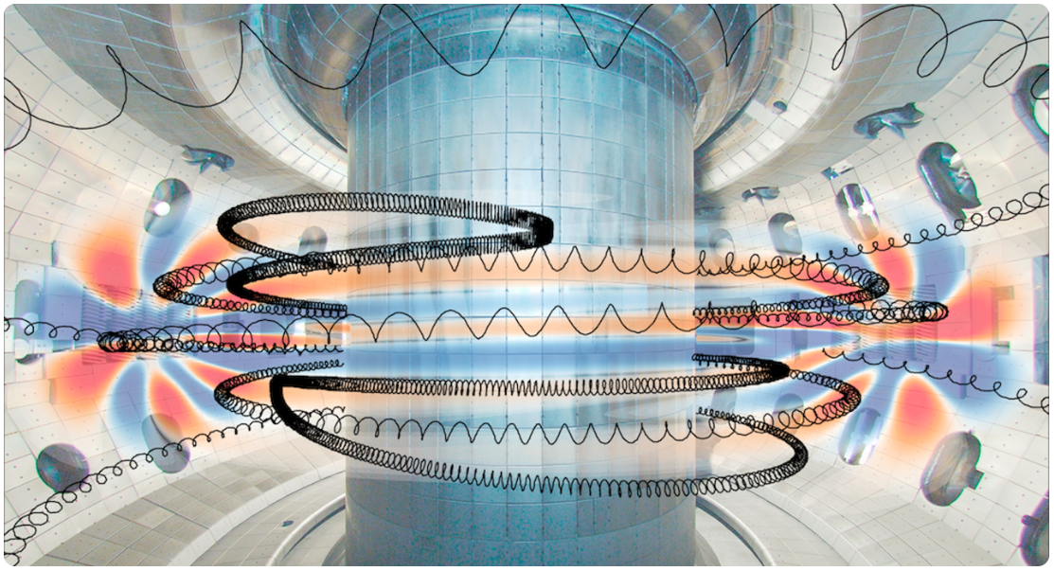
Jefferson Lab Fusion Program Polarized D Fuel at JLab
The life cycle of a polarized ⁷LiD pellet
Formation
Irradiation
Storage
Polarization
Size, shape, density
e-beam,
VT cryostat
Extraction
LN2 cryostat
Injection
D + ³He → α + p
Dilution refrigerator, polarization chamber, pellet loader,
μWave system,
NMR system
Pellet extractor, (or integrate DF with injection gun)
Injection gun,
link polarizer to DIII-D
DIII-D,
Production detection,
Data analysis
μWave
Current proposal
(for FY24 & FY25)
Subsequent proposals
(for FY26 to FY29)

Slide 6
Jefferson Lab Fusion Program The Unique Challenges
The DNP Method has been widely used to polarize targets in nuclear and particle physics experiments.
JLab Target Group operates DNP polarized targets for nuclear physics experiments routinely.
Polarized LiD targets have been used successfully.
JLab PAC approved experiments require polarized LiD/LiH targets.
But…
Special Requirements for fusion pellets:
  Precision engineering----Uniform shape, size, and density for providing ~10²⁰ deuterons per pellet.
  Cold pellet transporting----Pellets must be loaded, polarized and injected into tokamak in precise order.
Requirements for fusion pellets polarizer:
  A high cooling-power commercial dilution refrigerator with ~7 Tesla solenoid will be fitted with:
    A pellets handling insert to manipulate the pellets to right positions from entrance to exit.
    A polarizing chamber with NMR coils inside to determine the pellet polarization.
    A tuned waveguide to deliver microwave power for polarizing D.
    All added components are thermally anchored to ensure the low temperature (~100mK).
    A cold entrance interface to load 77K pre-irradiated pellets and an exit interface for injection gun.

Slide 7
Jefferson Lab Fusion Program The SPF Team@JLab
A team of scientist, engineer, technician, postdoc and student will be assembled at JLab to produce polarized ⁷LiD fuel for the fusion experiment, with the help from JLab Target Group (TG) which is also developing the polarized ⁷LiD/⁶LiH targets for Hall-B’s PAC approved experiment.
The combination of workforce brought in by the fusion proposal and expertise from Target Group will speedup the target development----the one development benefits both fusion energy (FES) and nuclear physics (NP) communities.
“One stone two birds”
Particularly, developing an onsite irradiation capability for polarized target materials for DNP will
solve the issues for both FES and NP communities.

Slide 8
Jefferson Lab Fusion Program Producing ⁷LiD Pellets
In order to deliver the consistent amount (~10²⁰ ) of deuterons per pellet for each fusion shot, the shape and weight of the pellet have to be well controlled, surfaces and edges have to be smooth for snug fit inside injection guide tube, a necessary condition for achieving high injection speed.
⁷LiD is chemically unstable, and will react with water, moisture, …; dangerous; …; has to be handled inside an inert-gas-filled glovebox.
⁷LiD pellets can be: fused from powder;
      casted;
      machined from solid chunks;
      purchased from a vender. (preferred)
⁷LiD Pellet size: cylindrical, φ~2.0mm, detail to be determined.
Totally ~200 ⁷LiD pellets will be used for developing, testing and running the SPF experiment.

Slide 9
Jefferson Lab Fusion Program Dosing ⁷LiD Pellets
The ⁷LiD pellets have to be irradiated with electron beams to create ~2x10¹⁷ e- /cm² (paramagnetic centers) for the DNP process.
Pellets will be irradiated at the (to be) restored LERF at JLab.
The pellets will be irradiated at ~185K with ~10mA electron beams (~10MeV) for several hours and stored/transported under 77K. The irradiation results will be validated by measuring achievable polarization with DNP at the Target Lab.
Since the total volume of the fusion pellets is < 1.5cc, they can be loaded in a small container which fits inside the TG’s Irradiation cryostat, which is designed and will be built/operated by the TG and fusion team.

Slide 10
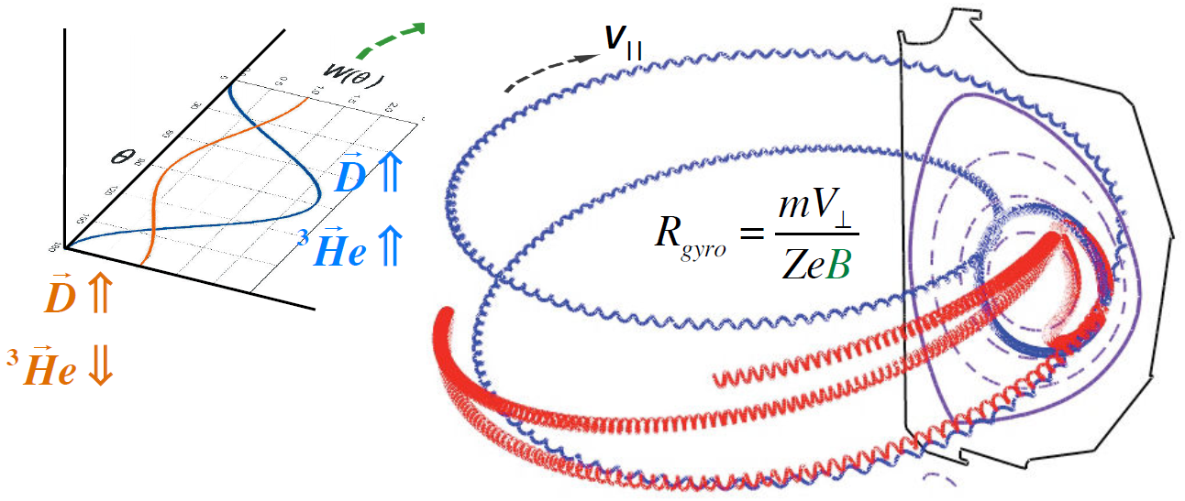
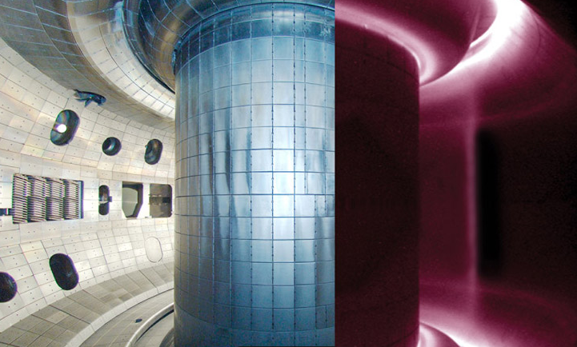
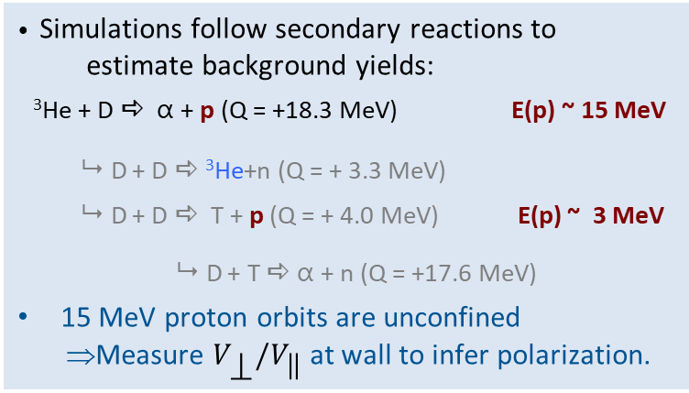
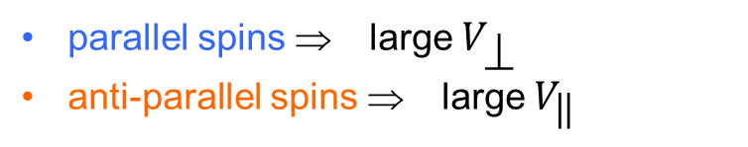
Jefferson Lab Fusion Program Running SPF at DIII-D
parallel spins ⇒ large $V_{\text{r}}$
anti-parallel spins ⇒ large $V_{\text{q}}$
  (While JLab is preparing the polarized D fuel):
  UVA will build the ³He polarizer.
  ORNL will design/build the cold pellet injection gun with continuous magnetic field.
  UCI will study fusion product detection and plasma diagnostics.
  If all goes well:
• Simulations follow secondary reactions to
estimate background yields:
³He + D a α + p (Q = +18.3 MeV) E(p) ~ 15 MeV
9 D + D a ³He+n (Q = + 3.3 MeV)
9 D + D a T + p (Q = + 4.0 MeV) E(p) ~ 3 MeV
9 D + T a α + n (Q = +17.6 MeV)
15 MeV proton orbits are unconfined
⇒Measure $V_{\text{r}}/V_{\text{q}}$ at wall to infer polarization.
⁷LiD
4K Injector
³He
77K Injector

Slide 11
Jefferson Lab Fusion Program Schedule
When the proposals go through, we are expecting to run the D + ³He test within 5-6 years.
Proposal for current funding cycle:
Year 1: Acquiring LiD material, Fabricating (or purchase) LiD pellets, Designing/Building Irradiation Cryostat.
Year 2: Testing Irradiation Cryostat, Producing Irradiated LiD pellets.
In subsequent funding cycles:
Year 3-4: Finishing subsystem constructions and then production test.
Year 5-6: System integration and final assembly.
Running polarized D + ³He fusion at DIII-D.

Slide 12
Jefferson Lab Fusion Program Summary
The project to Irradiate ⁷LiD pellets for DNP polarization will help to solve the issues for both FES and NP societies.
Fusion pellets will be irradiated at JLab.
The Fusion DNP Polarizer will be designed and build at JLab.
Test fuel polarization survivability inside a DIII-D tokamak plasma in 5-6 years.
The Fusion Project at JLab will also speed up the ⁷LiD/⁶LiH targets development.

Slide 13
Jefferson Lab Fusion Program SPF Related Publications
4 papers from the SPF collaboration:
• “Controlling Fusion Yield in Tokamaks with Spin Polarized Fuel, and Feasibility Studies on the DIII-D Tokamak",
D. C. Pace, M. J. Lanctot, G. L. Jackson, A. M. Sandorfi, S. P. Smith, X. Wei,
Journal of Fusion Energy, V35, pages 54–62 (2016), https://doi.org/10.1007/s10894-015-0015-4.
• “Encapsulation of Spin-Polarized 3He in Tokamak Fusion Pellets”,
S. Tafti, J. Liu, A.M. Sandorfi, K. Wei, X. Wei, X. Zheng, and G. W. Miller,
Nature Physics (2023 – currently under peer review)
• “Polarized Fusion and Potential in situ Tests of Fuel Polarization Survival in a Tokamak Plasma”,
L. Baylor, A. Deur, N. Eidietis, W.W. Heidbrink, G.L. Jackson, J. Liu, M.M. Lowry, G.W. Miller, D. Pace, A.M. Sandorfi, S.P. Smith, S. Tafti, K. Wei, X. Wei and X. Zheng,
Nuclear Fusion, 63, 076009 (2023), https://doi.org/10.1088/1741-4326/acc3ae
• “Conceptual design of DIII-D experiments to diagnose the lifetime of spin polarized fuel",
A.V. Garcia, W.W. Heidbrink and A.M. Sandorfi,
Nuclear Fusion, 63, 026030 (2023), https://doi.org/10.1088/1741-4326/acaf0d

