Slide 1
Willy’s Early Research: Developing and Using Accelerated Spin-Polarized Beams
Thomas B. Clegg
Professor of Physics Emeritus
University of North Carolina at Chapel Hill
and
Triangle Universities Nuclear Laboratory

Slide 2
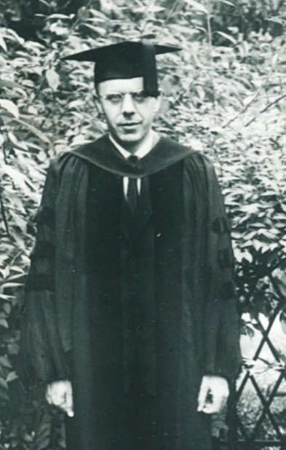
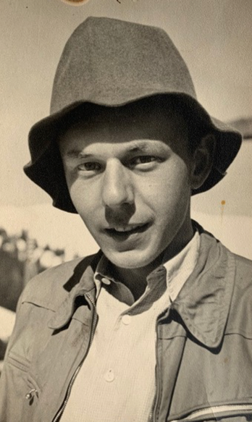
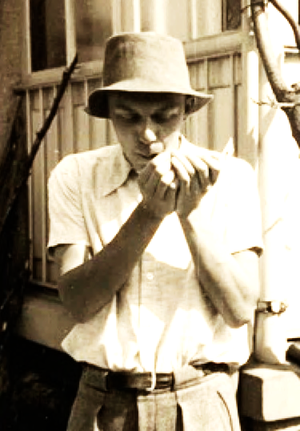
Willy’s Early Physics Education
Born in Zurich, June 17, 1925
Attended Gymnasium of Mathematics
and Natural Sciences in Basel
Entered University of Basel in 1944
Finished Ph.D. 1952.
Thesis topic: The Ionization of
Gas Mixtures by α-Particles from Radioactive Sources
Received post-doc offers from Stanford and Wisconsin.
Attracted to Madison because of its accelerator and experienced experimental nuclear physics faculty (Ray Herb, Heinz Barschall, and Hugh Richards).
https://www.tandfonline.com/doi/full/10. 180/10619127.2022.2029300
Notes:
Willy also liked Madison's lakes

Slide 3
Willy’s Activities at UW - 1952-54
Learned how to speak and communicate clearly in English.
Read widely about nuclear physics and nuclear reaction theory.
Collaborated with LOTS of graduate student research teams.
Biggest research questions? What is the internal structure of atomic nuclei? How do their protons and neutrons interact?
Means of investigation? Hit a nucleus with accelerated fast particles and watch what comes out to learn “how a nucleus rings.” Under different conditions, it can ring quite differently.
Based on WH AIP oral history interview with David Zierler, 7/2020
Notes:
When Willy first arrived in Madison, he was known among grad students as ‘the mute’ because of his lack of English communication skills.
Largely self-taught in nuclear physics and nuclear reaction theory as a result of extensive library reading.
He liked being heavily involved in a wide variety of experiments. The faculty liked this too, since they got to spend more time at home with their families.
Analogy of nuclear ringing with pushing kid in a swing
.
These are a few highlights I gleaned from Willy’s July 2000 oral history interview with David Zierler

Slide 4
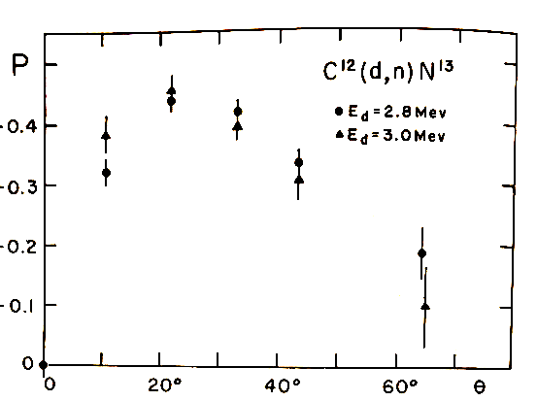
Willy’s 1st Spin-Physics Expt. - 1956
While at Duke as a research physicist,
Created polarized neutrons via the
¹²C(d,n)¹³N reaction.
Analyzed their polarization by scattering from a second ¹²C target.
Measured product P₁($⍬1$) • P₂($⍬$₂)
Counting rates were extremely low.
Unwanted experimental backgrounds caused big problems.
P($⍬$)
deuteron beam
neutrons
Detector
neutrons
$$⍬2$$
$$⍬1$$
$$⍬cm$$
T₁
T₂
W. Haeberli, Fast Neutron Physics, Part II,
J.B. Marion and J.L. Fowler, (Intersciece, 1963) 1379
“That was absolutely the hardest experiment I had ever attempted.”
Notes:
After 2 years in Madison, rules dictated that Willy had to seek a position elsewhere, so he went to Duke University where there was a new accelerator
Discuss the sketch and graph … what is plotted, what the data are, etc.
Willy returned to UW in 1956 as an Asst. Prof. of Physics and continued these double-scattering experiments for several years while developing his first actual device to produce and accelerate polarized ion beams
Willys doublw scattering pubicatiolns about those experiments were what I studied while working on my PhD at Rice.

Slide 5
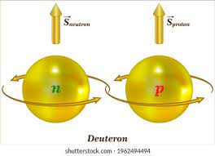
Ideas Motivating Willy’s Research
Little was known about the cause of spin, or about how forces between protons and neutrons inside nuclei depend on spin.
In a (d,p) stripping reaction, the neutron captured by the target nucleus ‘observes’ the residual proton moving by with orbital angular momentum.
Observer neutron
with spin down
If inside the nucleus there is a
‘magnet-like’ spin-orbit coupling ...
-1/2
Passing proton with orbital angular momentum
Notes:
Note the blue arrow is associated with orbital angular momentum direction; the black arrow is associated with the rotational angular momentum direction.
Caution: These simple pictorials are an over-simplification. Electrons, protons, and neutrons are extremely small, and can be described correctly only using the ideas of quantum mechanics.

Slide 6
Ideas Motivating Willy’s Research
Little was known about the cause of spin, or about how forces between protons and neutrons inside nuclei depend on spin.
In a (d,p) stripping reaction, the neutron captured by the target nucleus ‘observes’ the residual proton moving by with orbital angular momentum.
One needs ‘polarized’ deuteron beams with all their spins pointing in the same direction.
Flipping their spin direction can probe this nuclear spin-orbit force!
Observer neutron
with spin up
If inside the nucleus there is a
‘magnet-like’ spin-orbit coupling ...
+1/2
Passing proton with orbital angular momentum
Notes:
Note the blue arrow is associated with orbital angular momentum direction; the black arrow is associated with the rotational angular momentum direction.
Caution: These simple pictorials are an over-simplification. Electrons, protons, and neutrons are extremely small, and can be described correctly only using the ideas of quantum mechanics.

Slide 7
Sourcery - 1964
First production of polarized H or D negative ions
I _{beam} = 300 pA
Notes:
Following the lead of Swiss and German physicists, Willy first developed a beam of spin polarized D atoms, ionized them by electron bombardment to make D+ ions.
But, for the UW accelerator he needed H- or D- ion beams.
This publication reported his group’s production of the first beam of D- ions created by charge exchange in a thin carbon foil.
The figure at the right showed how the ratio of counts in the two detectors changed as the orientation of the B-field at the C foil was changed.

Slide 8
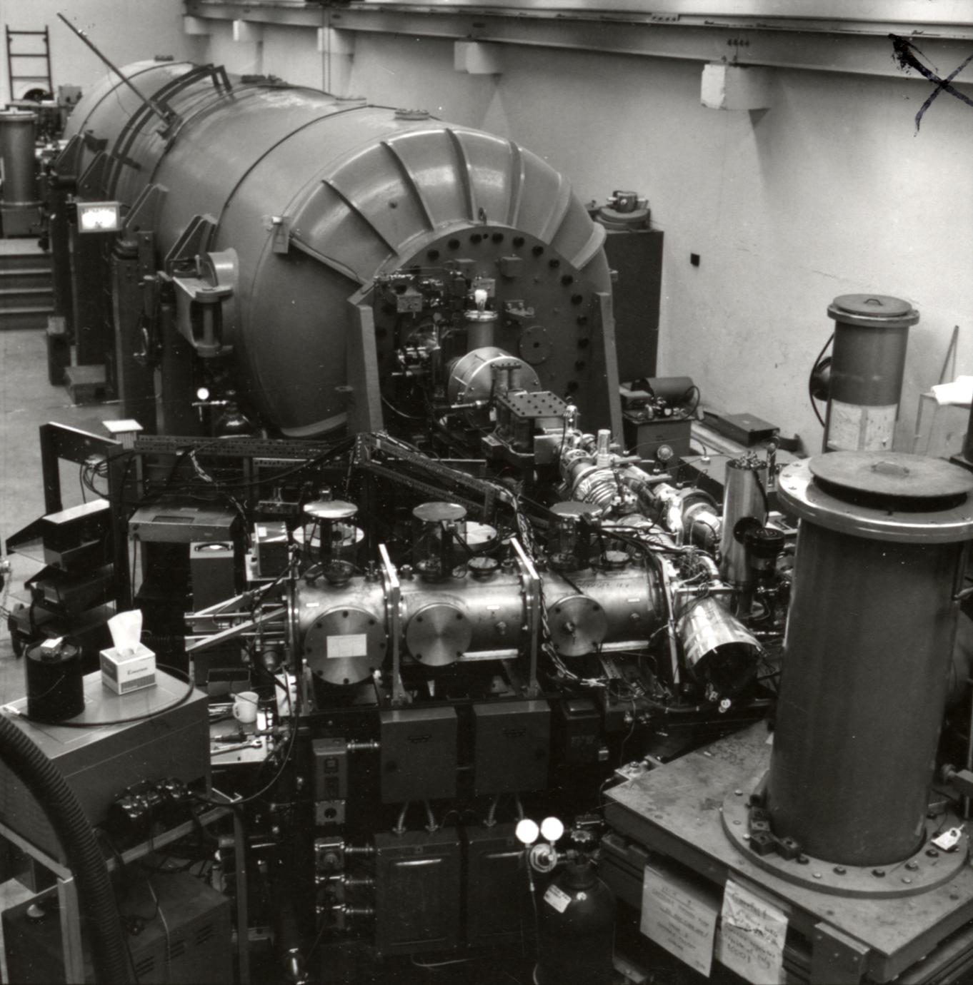

Slide 9
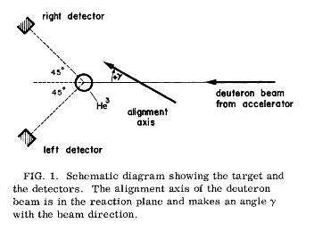
Sourcery - 1965
First acceleration of polarized ions in tandem accelerator
Polarization preserved with foil stripper
Foil Stripper
Gas Stripper
I_{beam} ≈ 10-20 pA
P_{beam} ≈ 0.45

Slide 10
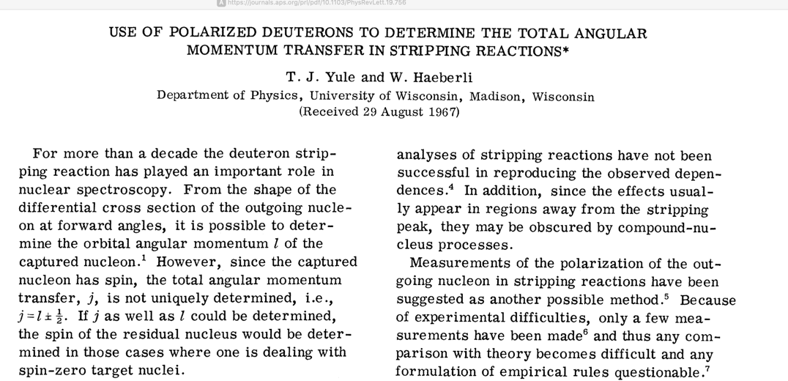
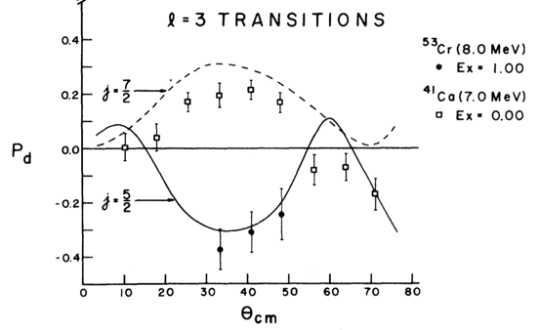
Spin-Orbit Coupling Evidence - 1967
⁴⁰Ca(d,p)
⁵²Cr(d,p)
“With unpolarized beams, we could determine only the orbital angular momentum of particles inside the nucleus, but not the spin direction relative to the orbit.”
With polarized deuteron beams, by measuring P_{d}($⍬$)= (N⁺-N⁻)/(N⁺+N⁻),
“our devices allowed us to determine the total nuclear angular momentum.”

Slide 11
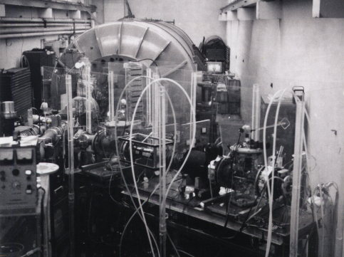
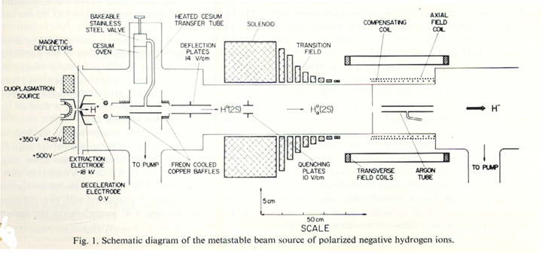
Sourcery – 1967/8
First Lamb-shift polarized source installed on an accelerator First purely vector- and tensor-polarized deuteron beams
I_{beam}= 2 to 4.5 nA
P_{protons} = 0.36
P_{deuteron}= 0.19
P_{protons} = 0.78
P_{deuteron}= 0.49
Notes:
Six months later we had made modifications to this source to improve the beam polarization by more than a factor of 2, to P = 0.78 for protons and 0.49 for deuterons

Slide 12
Sourcery - 1968
Begins long association with Wilmer Anderson et al.

Slide 13
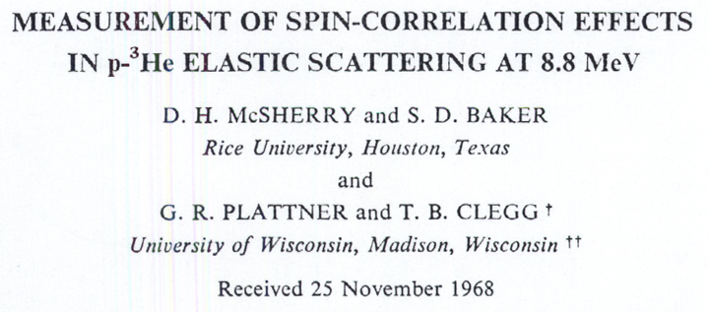
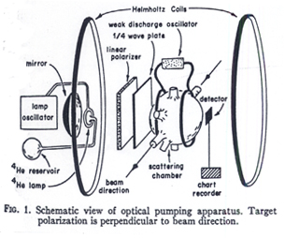
Targetry - 1968
First spin correlation measurement with polarized beam & target
P_{target} ≈ 0.1
I_{beam} ≈ 0.5 nA
Two points in 48 hours!
A_{xz}
θ_{cm}
Notes:
Here with scattering of two spin-1/2 particles, one needs this type of measurement to distinguish between different phase-shift solutions

Slide 14
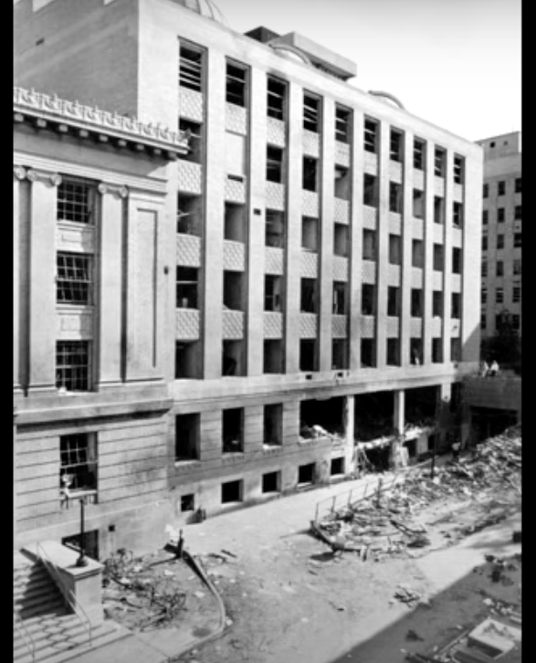
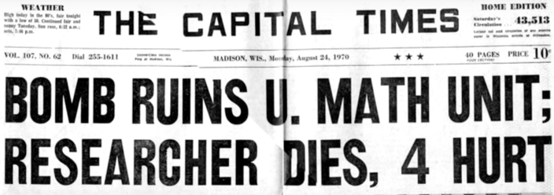
Wisconsin’s Sterling Hall Bombed!
3:42 AM, Aug. 24, 1970
3:42 AM, Aug. 24, 1970
At 3:42 AM on Aug. 24, 1970 the Nuclear Physics Program’s Accelerator Lab and Research Offices were Destroyed!
Entrance to Accelerator Vault

Slide 15
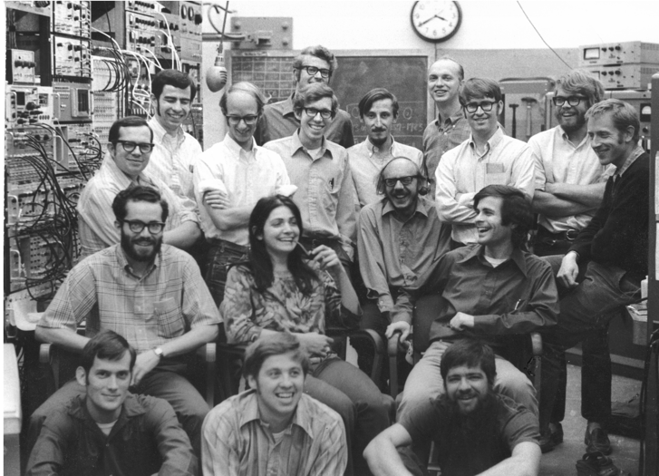
Willy’s Responses
Assure success of International Polarization Conference in Madison the following week!
Edit Conference Proceedings with Heinz Barschall
Organize 24/7 Clean-up and Repair Crews for 6 weeks.
Experiments restarted in Spring 1971
No students Ph.D. was delayed more than 1 year!

Slide 16
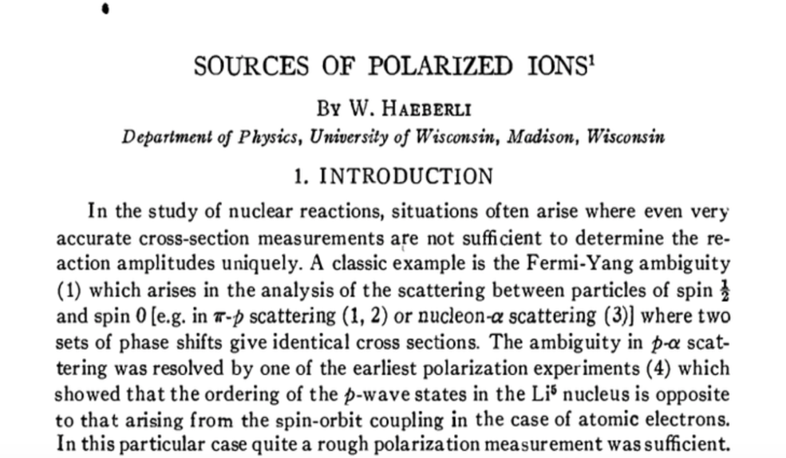
Seminal Publications – 1967-71
“The Bible”
Notes:
An amazing period of intense activity followed … building testing, and using new ion source hardware while running the accelerator for two days during every 8-day period.
All this was interrupted in August 1970 by the bombing of Sterling Hall that did immense damage to perhaps the world’s leading nuclear physics program at the time.

Slide 17
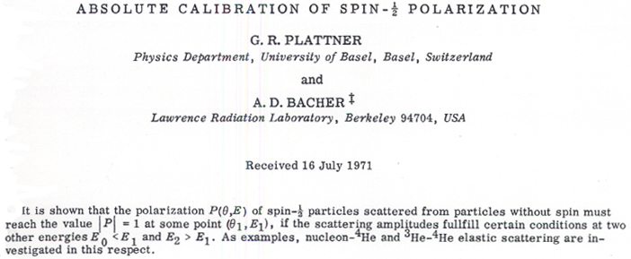
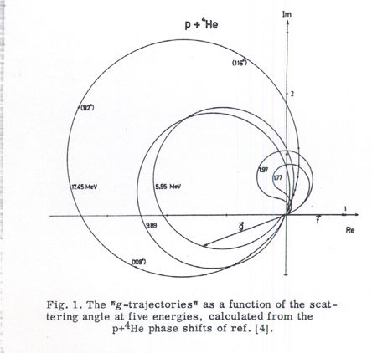
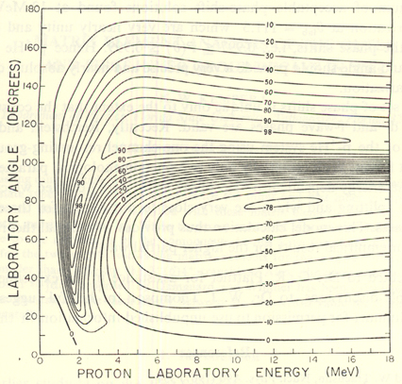
Polarimetry – 1968-71
First absolute calibration method for spin-1/2 particle polarization
p + ⁴He
A_{y}
A_{y} = 1 points
Proton Lab Energy

Slide 18
Sourcery - 1978
First ionization of polarized atoms with a cesium beam
Intensity larger by factor of 10⁵ in 12 years !
Extremely high beam polarization !
>
I_{beam} ≈ 3μA
P_{beam} ≈ 0.89 !!
Notes:
Beam intensity larger by 5 orders of magnitude in 12 years, and by a factor of 1500 over the Lamb-Shift source it replaced
Even more impressive was the extremely high beam polarization.

Slide 19
Willy’s Style
“After we developed these methods, a whole industry developed where some laboratories did nothing but these experiments, on and on for years and years. That was never my style. … When a method was well established, I would turn to some new idea.
Willy clearly preferred experiments in simple systems that studied fundamental physics ideas.
“I like protons on protons, with both of them spin polarized.”

Slide 20
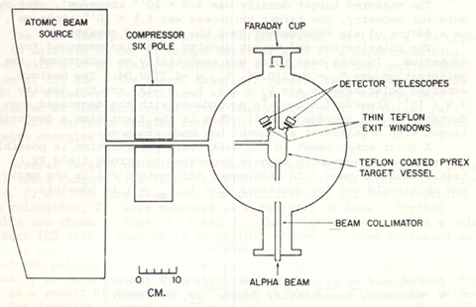
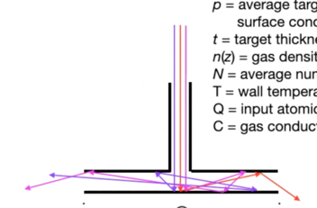
Polarized H & D Targets – 1965-1993
Willy first suggested storing spin-polarized atoms in 1965.
First test results with polarized atoms target cell in 1980.
Some target atom polarmaintained
after ~900 ization was wall collisions
Polarized
Atomic
Beam
Storage
Ring
Beam

Slide 21
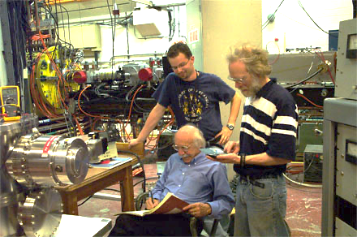
Storage Ring Collaborations
FILTEX – MPI/Heidelberg Test Storage Ring -1993-2004 Studies of target density and spin-filtering of stored beam
PINTEX --Indiana University Cyclotron Facility – 1993-2003 Polarized p-p & p-d scattering and reactions
BLAST – MIT Bates South Hall Charge distribution of neutron and tensor structure of deuteron
HERMES expt. – DESY/HERA - Hamburg – 1995-2007 Investigations of spin structure of the nucleon
RHIC Spin Program-BNL – 2004-2020 Investigations of gluonic contributions to nucleon spin structure
- Investigations of gluon contributions to nucleon spin structure
Alex Nass and Tom Wise (standing) with Willy

Slide 22
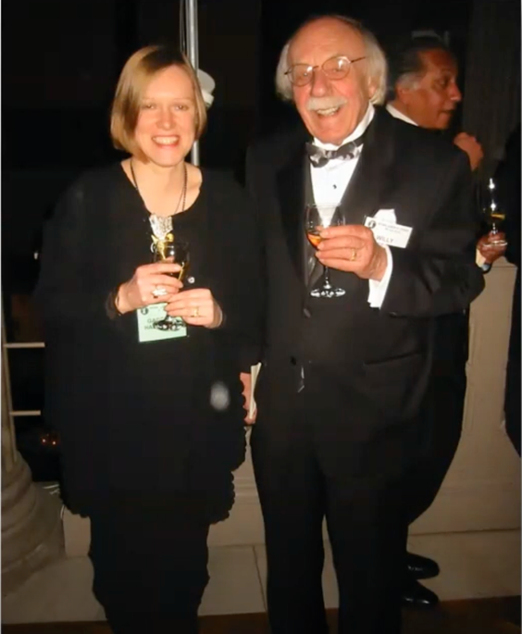
Willy’s Professional Honors
1979 – American Physical Society’s Tom W. Bonner Prize in Nuclear Physics
1998 – American Academy of Arts and Sciences
2002 – National Academy of Sciences
Notes:
The same Tom Bonner that was honored by that 1963 Fast Neutron Conference at Rice where Willy spoke and I showed his slides..

Slide 23
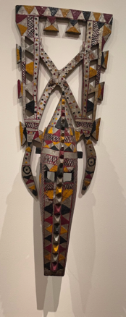
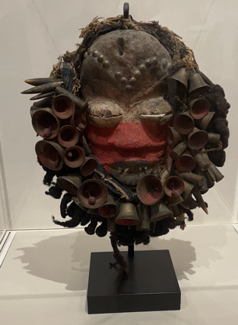
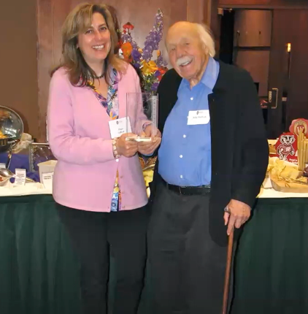
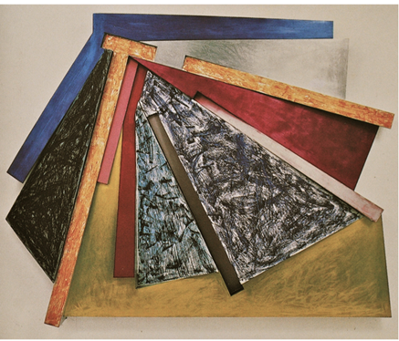
Scientist Teacher – Generous Patron
20th Century African celebratory art
Frank Stella - Montenegro II (1975)

Slide 24
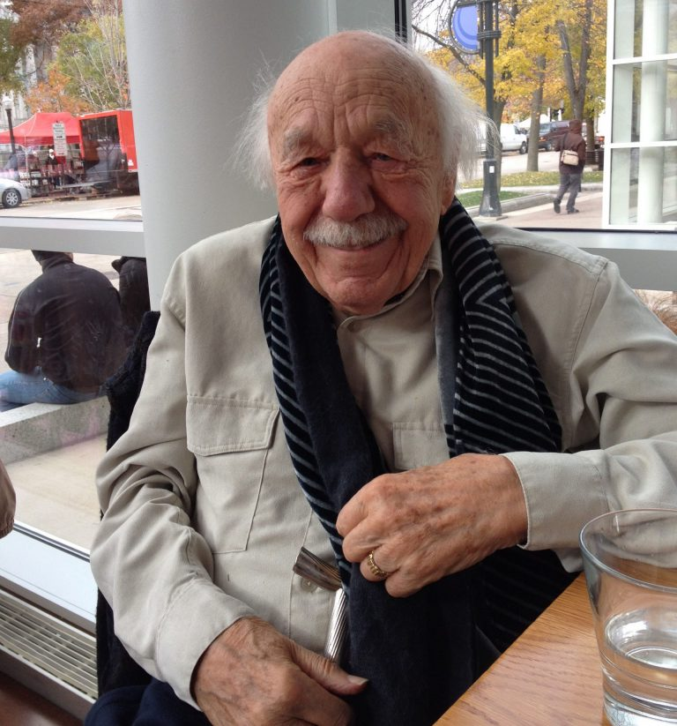
We All Stand on Your Shoulders. Thank You, Willy!

