Slide 1
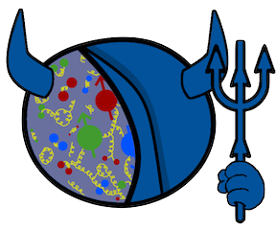



Global Analyses
of Polarized DIS & SIDIS
from Small-x Evolution
SPIN 2023
Matthew D. Sievert
9/29/2023
This work is supported by the U.S. Department of Energy, Office of Science, Office of Nuclear Physics
within the framework of the Saturated Glue (SURGE) Topical Theory Collaboration.
M. Sievert
Global (SI)DIS Analyses from Small-x Evolution
1 / 33

Slide 2










Collaborators
Wally Melnitchouk (JAM)
Nobuo Sato (JAM)
W. Melnitchouk
N. Sato
Y. Kovchegov
Yuri Kovchegov (SURGE)
Dan Pitonyak (SURGE)
Andrey Tarasov (SURGE: PD)
D. Pitonyak
M. Sievert
A. Tarasov
Yossathorn Tawabur (SURGE: PD)
Daniel Adamiak (SURGE: PD)
Nick Baldonado (SURGE: GA)
Y. Tawabutr
N. Baldonado
D. Adamiak
M. Sievert
Global (SI)DIS Analyses from Small-x Evolution
2 / 33

Slide 3


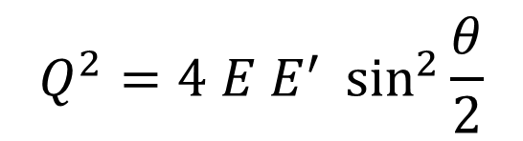

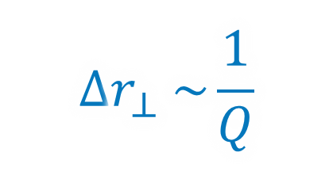
DIS: A Relativistic Femtoscope in Two Scales
Image Resolution:
$$Q^{2}=4 E E^{′} \sin^{2}{\frac{θ}{2}}$$
$${∆r}_{⊥} \sim \frac{1}{Q}$$
$${∆r}_{⊥}$$
M. Sievert
Global (SI)DIS Analyses from Small-x Evolution
3 / 33

Slide 4
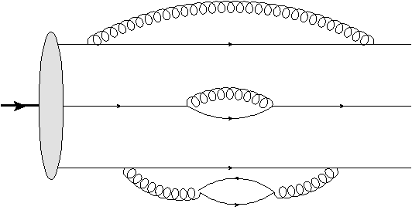
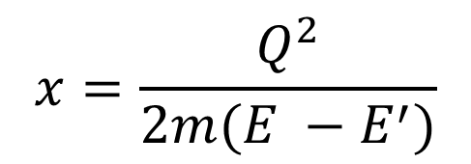

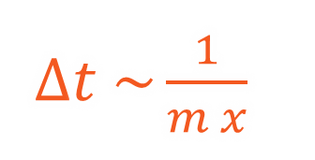
DIS: A Relativistic Femtoscope in Two Scales
Image Resolution:
Exposure Time:
$$x=\frac{Q^{2}}{2m(E −E^{′})}$$
$$Q^{2}=4 E E^{′} \sin^{2}{\frac{θ}{2}}$$
$∆t \sim \frac{1}{m x}$
$$∆t$$
$${∆r}_{⊥} \sim \frac{1}{Q}$$
$${∆r}_{⊥}$$
M. Sievert
Global (SI)DIS Analyses from Small-x Evolution
4 / 33

Slide 5
The Proton Spin Budget
Jaffe-Manohar Spin Sum Rule:
Jaffe and Manohar, Nucl. Phys. B337 509 (1990)
M. Sievert
Global (SI)DIS Analyses from Small-x Evolution
5 / 33

Slide 6
The Proton Spin Budget
Jaffe-Manohar Spin Sum Rule:
Jaffe and Manohar, Nucl. Phys. B337 509 (1990)
Quark Polarization:
Nonlocal generalization of the axial vector current $j_{5}^{μ}=\overline{ψ} γ^{μ}γ^{5}ψ$
M. Sievert
Global (SI)DIS Analyses from Small-x Evolution
6 / 33

Slide 7
The Proton Spin Budget
Jaffe-Manohar Spin Sum Rule:
Jaffe and Manohar, Nucl. Phys. B337 509 (1990)
Quark Polarization:
Nonlocal generalization of the axial vector current $j_{5}^{μ}=\overline{ψ} γ^{μ}γ^{5}ψ$
Gluon Polarization:
Circular azimuthal correlation of gluon field strengths
M. Sievert
Global (SI)DIS Analyses from Small-x Evolution
7 / 33

Slide 8
Dipole Degrees of Freedom at Small x
“Knockout” DIS at Large x:
Current Jet
Beam
Remnants
At large x, DIS resembles a knockout process in which a quark is ejected from the proton.
M. Sievert
Global (SI)DIS Analyses from Small-x Evolution
8 / 33

Slide 9

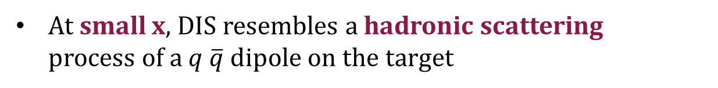
Dipole Degrees of Freedom at Small x
“Knockout” DIS at Large x:
“Dipole” DIS at Small x:
$${∆r}_{T} \sim 1/Q$$
Dijets
Current Jet
Beam
Remnants
Beam
Remnants
At large x, DIS resembles a knockout process in which a quark is ejected from the proton.
At small x, DIS resembles a hadronic scattering
process of a $q \overline{q}$ dipole on the target
M. Sievert
Global (SI)DIS Analyses from Small-x Evolution
9 / 33

Slide 10
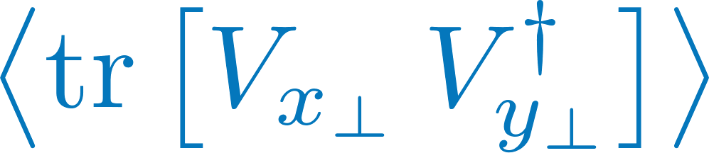
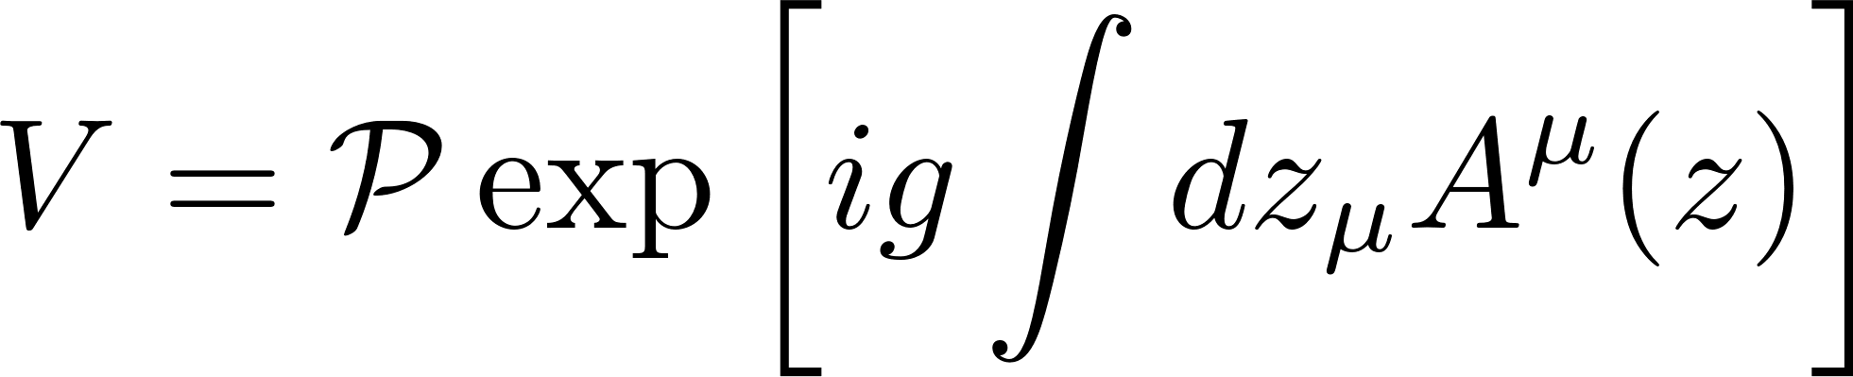
Dipole Degrees of Freedom at Small x
“Knockout” DIS at Large x:
“Dipole” DIS at Small x:
$${∆r}_{T} \sim 1/Q$$
Dijets
Current Jet
Beam
Remnants
Beam
Remnants
At large x, DIS resembles a knockout process in which a quark is ejected from the proton.
At small x, DIS resembles a hadronic scattering
process of a $q \overline{q}$ dipole on the target
Wilson lines: Boosted, coherent scattering in a background field
M. Sievert
Global (SI)DIS Analyses from Small-x Evolution
10 / 33

Slide 11
Spin at Small x versus Large x
The leading-power dipole scattering is
spin-independent
  It is not the ordinary eikonal Wilson lines that describe polarized physics at small x!
M. Sievert
Global (SI)DIS Analyses from Small-x Evolution
11 / 33

Slide 12
Spin at Small x versus Large x
The leading-power dipole scattering is
spin-independent
  It is not the ordinary eikonal Wilson lines that describe polarized physics at small x!
Spin at small x selects on different,
sub-eikonal dynamics than unpolarized observables
  Spin observables are sensitive to novel small-x physics
  Useful for gluon saturation, but
  broader than saturation alone
Small x: “Dipole” DIS
M. Sievert
Global (SI)DIS Analyses from Small-x Evolution
12 / 33

Slide 13
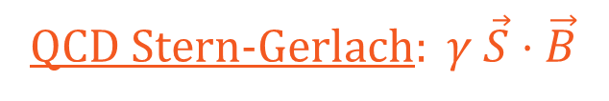
Building Blocks: Polarized Wilson Lines
See, e.g., Kovchegov, Pitonyak, MS: JHEP 01 (2016),
Phys. Rev. D95 (2017), Phys.Rev.Lett. 118 (2017)
QCD Stern-Gerlach: $γ \vec{S}⋅\vec{B}$
M. Sievert
Global (SI)DIS Analyses from Small-x Evolution
13 / 33

Slide 14
Building Blocks: Polarized Wilson Lines
See, e.g., Kovchegov, Pitonyak, MS: JHEP 01 (2016),
Phys. Rev. D95 (2017), Phys.Rev.Lett. 118 (2017)
QCD Stern-Gerlach: $γ \vec{S}⋅\vec{B}$
Flavor-changing Wilson line
Since m=0 in Bjorken kinematics: Quark helicity conservation
M. Sievert
Global (SI)DIS Analyses from Small-x Evolution
14 / 33

Slide 15
Cascading Polarized Dipoles at Small x
…
Spin-dependent branching
Kovchegov, Pitonyak, MDS,
JHEP 1601 (2016), Phys. Rev. D95 (2017)
Spin information from the valence sector (large x) is transmitted to small x by spin-dependent branching
Also G. Chirilli, JHEP 1901 (2019)
M. Sievert
Global (SI)DIS Analyses from Small-x Evolution
15 / 33

Slide 16
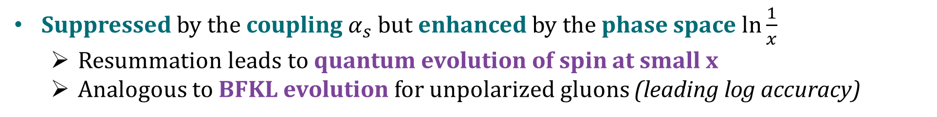
Cascading Polarized Dipoles at Small x
…
Spin-dependent branching
Kovchegov, Pitonyak, MDS,
JHEP 1601 (2016), Phys. Rev. D95 (2017)
Spin information from the valence sector (large x) is transmitted to small x by spin-dependent branching
Also G. Chirilli, JHEP 1901 (2019)
Suppressed by the coupling $α_{s}$ but enhanced by the phase space $\ln{\frac{1}{x}}$
  Resummation leads to quantum evolution of spin at small x
  Analogous to BFKL evolution for unpolarized gluons (leading log accuracy)
M. Sievert
Global (SI)DIS Analyses from Small-x Evolution
16 / 33

Slide 17


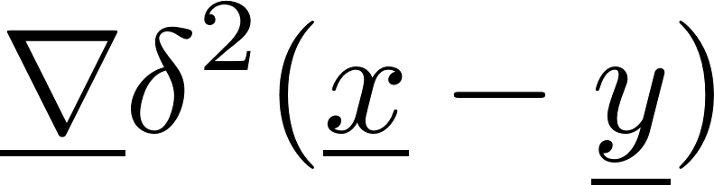
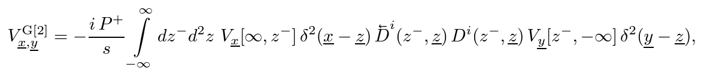
The Missing Link: Transverse Recoil
Spin-independent sub-eikonal operator contributes to evolution
New contribution not previously included in dipole helicity evolution
F. Cougoulic, Y. Kovchegov, A. Tarasov, Y. Tawabutr, JHEP 07 (2022)
Jump displacement in transverse position:
M. Sievert
Global (SI)DIS Analyses from Small-x Evolution
17 / 33

Slide 18
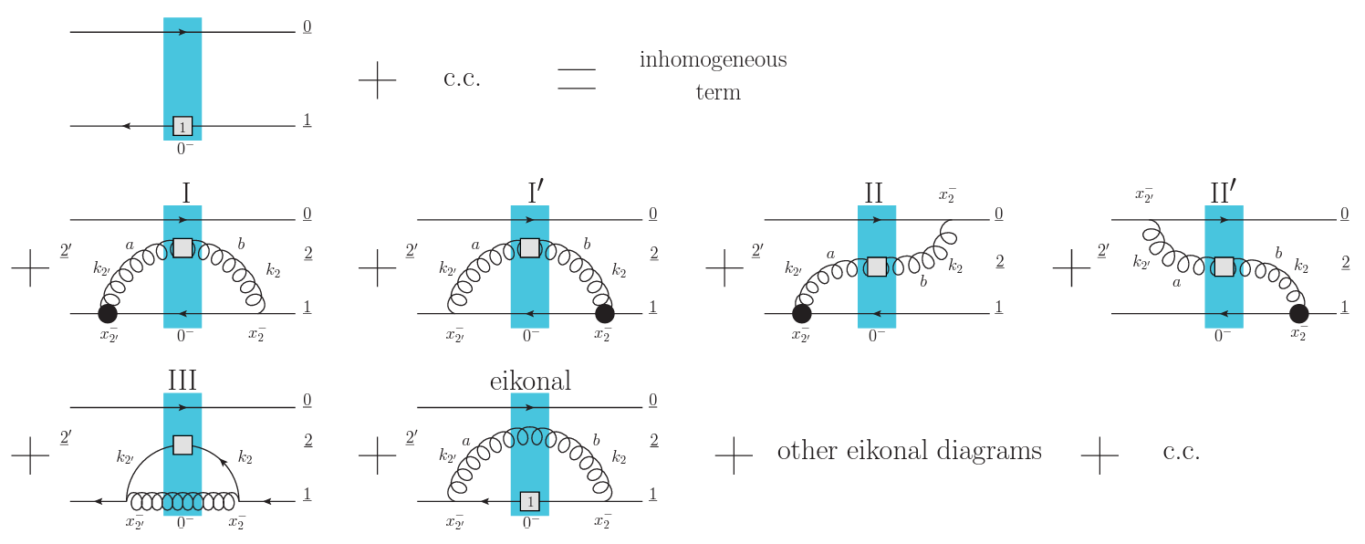
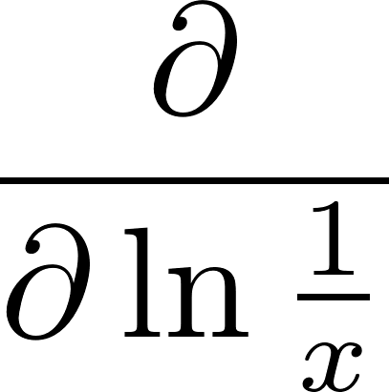


Small-x Helicity Evolution (KPS-CTT)
Includes recoil: KPS-CTT
No recoil: KPS
Spin-dependent
Wilson line
Spin-dependent
splitting vertex
Large Nc: Gluon dipoles only
Large Nc+Nf: Quark + Gluon dipoles
M. Sievert
Global (SI)DIS Analyses from Small-x Evolution
18 / 33

Slide 19
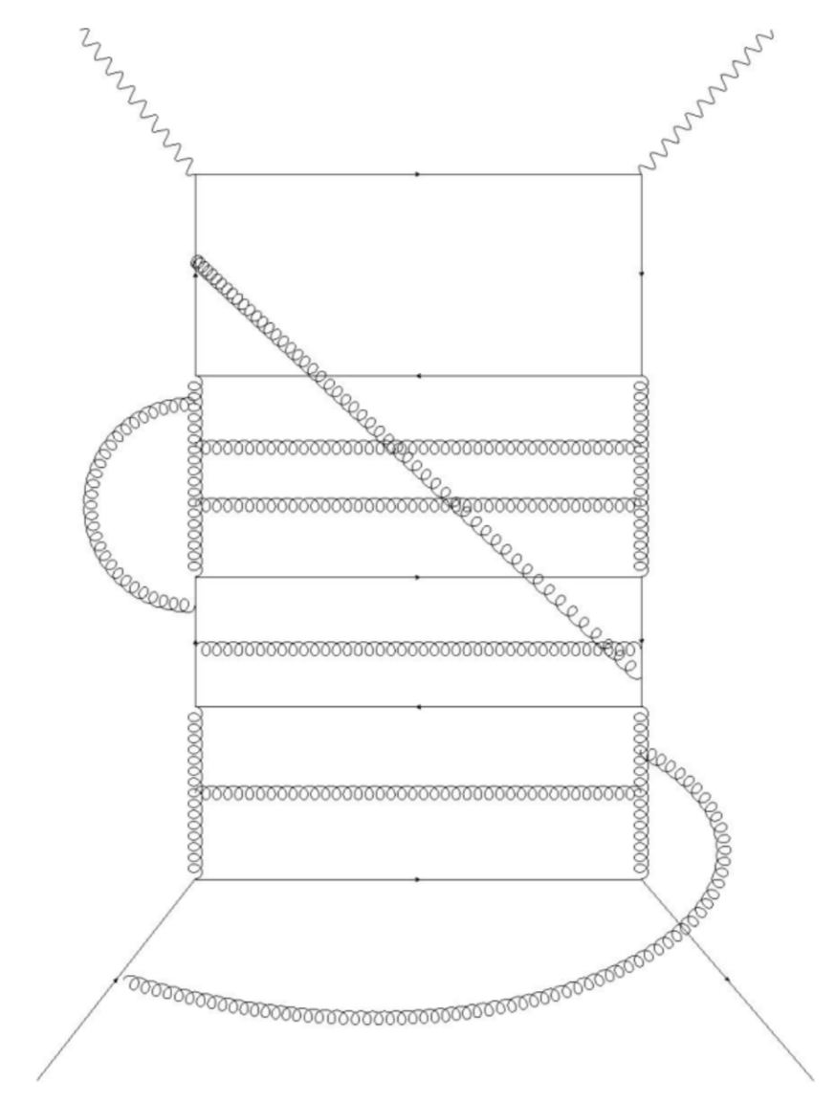
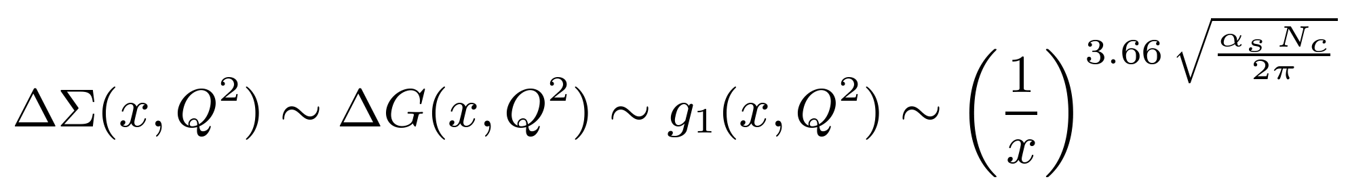
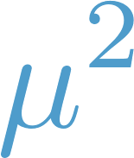

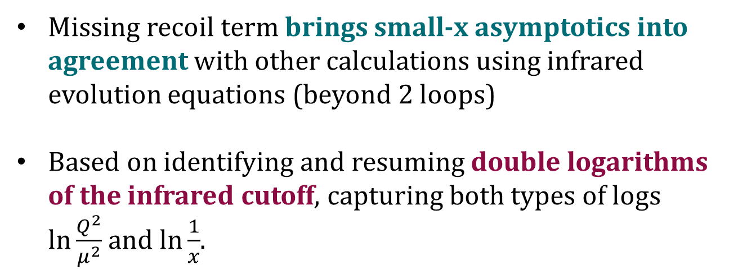
Method of Infrared Evolution Equations
Missing recoil term brings small-x asymptotics into agreement with other calculations using infrared evolution equations (beyond 2 loops)
Based on identifying and resuming double logarithms of the infrared cutoff, capturing both types of logs $\ln{\frac{Q^{2}}{μ^{2}}}$and $\ln{\frac{1}{x}}$.
Bartels, Ermolaev, & Ryskin,
Z. Phys. C70 (1996), Z. Phys. 72 (1996)
Asymptotically as $x→0$
Hatta & Yao, Phys. Lett. B798 (2019)
Boussarie, Hatta, & Yuan, Phys. Lett. B797 (2019)
Hatta & Yang, Phys. Lett. B781 (2018)
Hatta et al., Phys. Rev. D95 (2017)
M. Sievert
Global (SI)DIS Analyses from Small-x Evolution
19 / 33

Slide 20

Beyond Color Transparency and Into the UV
Ladder emissions from the unpolarized Wilson line possess color transparency at short distances
Cancels when $\underline{x_{2}}→\underline{x_{0}}$
M. Sievert
Global (SI)DIS Analyses from Small-x Evolution
20 / 33

Slide 21

Beyond Color Transparency and Into the UV
Ladder emissions from the unpolarized Wilson line possess color transparency at short distances
Cancels when $\underline{x_{2}}→\underline{x_{0}}$
But for ladder emissions from the polarized Wilson line, color transparency is violated by spin
Does NOT cancel when $\underline{x_{2}}→\underline{x_{1}}$
M. Sievert
Global (SI)DIS Analyses from Small-x Evolution
21 / 33

Slide 22
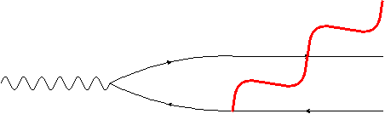
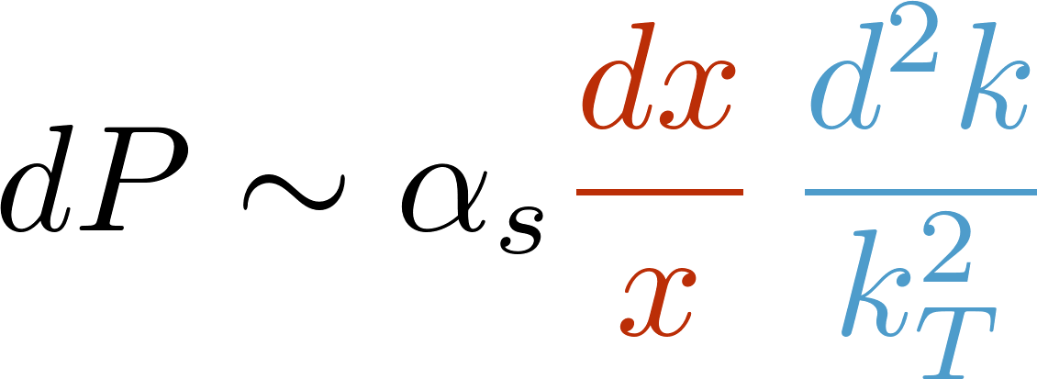

Double-Logarithmic Evolution at Small x
Longitudinal + transverse logarithmic phase space
Long wavelength/IR
Short wavelength/UV
M. Sievert
Global (SI)DIS Analyses from Small-x Evolution
22 / 33

Slide 23
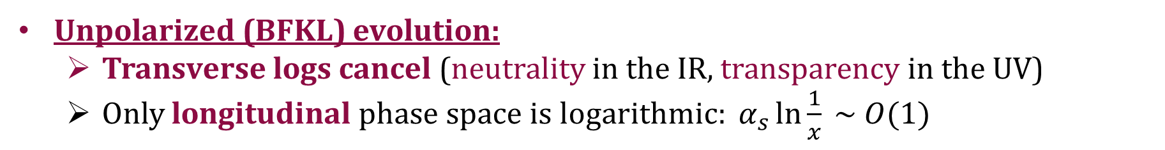
Double-Logarithmic Evolution at Small x
Longitudinal + transverse logarithmic phase space
Long wavelength/IR
Short wavelength/UV
Unpolarized (BFKL) evolution:
  Transverse logs cancel (neutrality in the IR, transparency in the UV)
  Only longitudinal phase space is logarithmic: $α_{s}\ln{\frac{1}{x}} \sim O(1)$
M. Sievert
Global (SI)DIS Analyses from Small-x Evolution
23 / 33

Slide 24
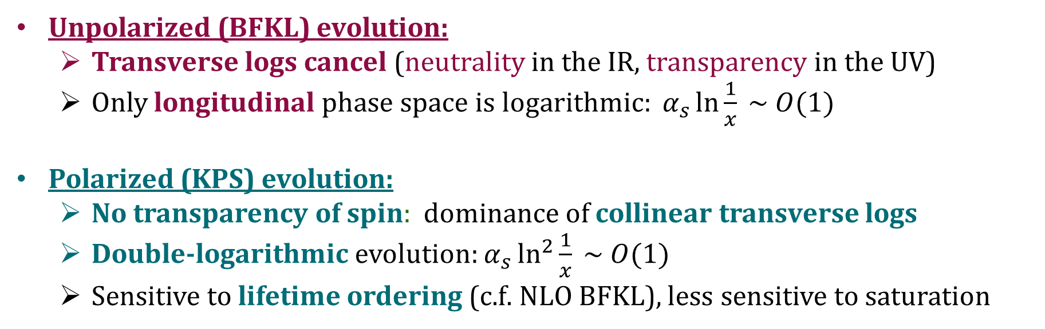
Double-Logarithmic Evolution at Small x
Longitudinal + transverse logarithmic phase space
Long wavelength/IR
Short wavelength/UV
Unpolarized (BFKL) evolution:
  Transverse logs cancel (neutrality in the IR, transparency in the UV)
  Only longitudinal phase space is logarithmic: $α_{s}\ln{\frac{1}{x}} \sim O(1)$
Polarized (KPS) evolution:
  No transparency of spin: dominance of collinear transverse logs
  Double-logarithmic evolution: $α_{s}\ln^{2}{\frac{1}{x}} \sim O(1)$
  Sensitive to lifetime ordering (c.f. NLO BFKL), less sensitive to saturation
M. Sievert
Global (SI)DIS Analyses from Small-x Evolution
24 / 33

Slide 25
First Global Analysis Using KPS Evolution
Global analysis of polarized DIS at small x using KPS formalism
D. Adamiak et al., Phys. Rev. D104 (2021)
M. Sievert
Global (SI)DIS Analyses from Small-x Evolution
25 / 33

Slide 26
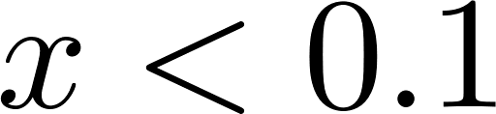
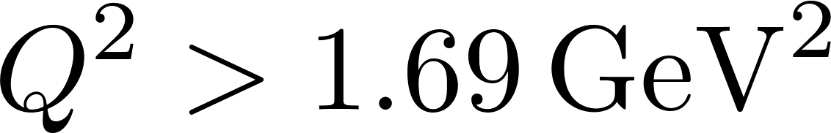
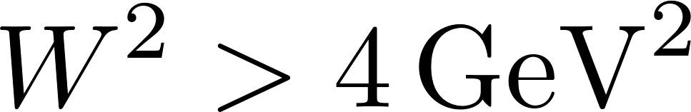
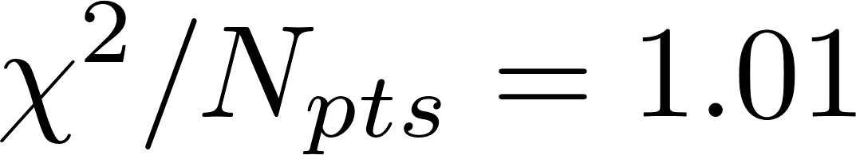
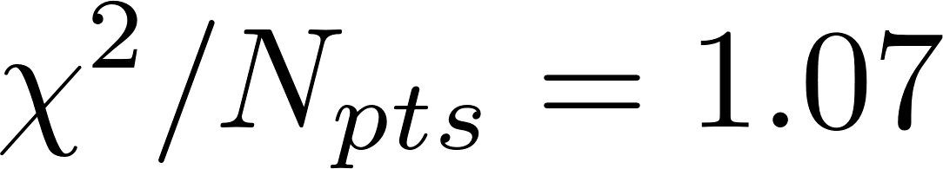

First Global Analysis Using KPS Evolution
Data Cuts: $N_{pts}=122$
JAM Small x 21:
c.f. JAM16:
Global analysis of polarized DIS at small x using KPS formalism
D. Adamiak et al., Phys. Rev. D104 (2021)
Bayesian analysis performed using JAM architecture
N. Sato et al., Phys. Rev. D93 (2016)
M. Sievert
Global (SI)DIS Analyses from Small-x Evolution
26 / 33

Slide 27
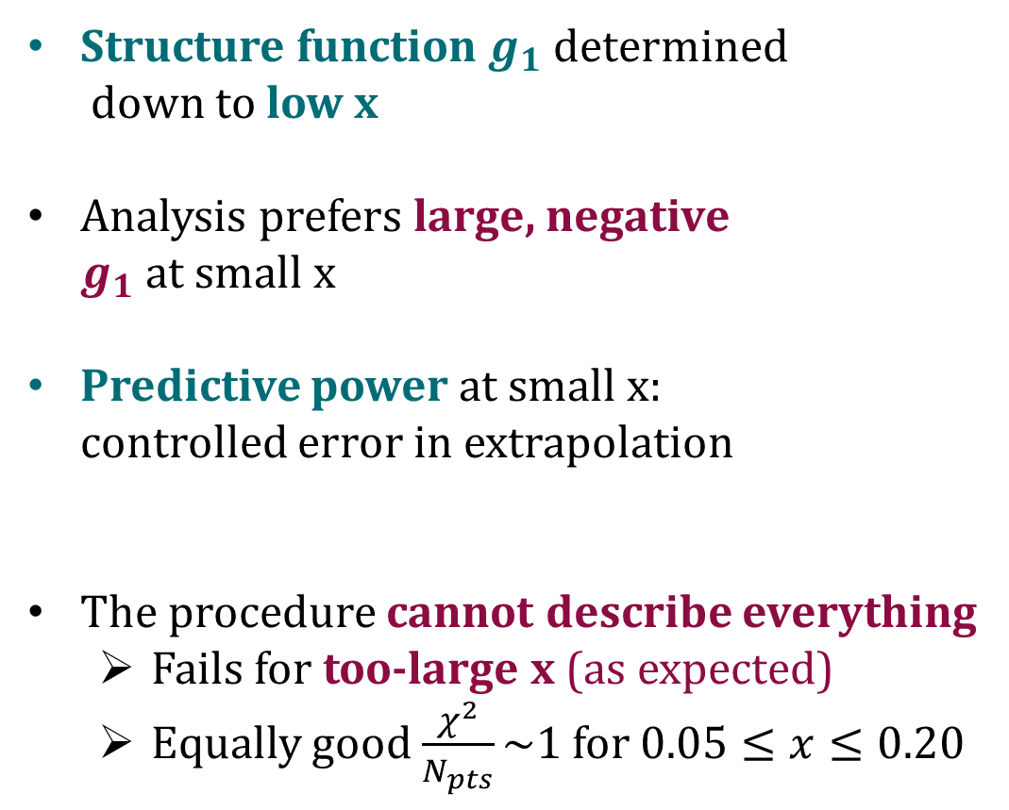
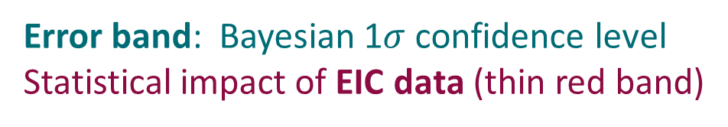
First Global Analysis Using KPS Evolution
Structure function $g_{1}$ determined
down to low x
Analysis prefers large, negative
$g_{1}$ at small x
Predictive power at small x:
controlled error in extrapolation
The procedure cannot describe everything
  Fails for too-large x (as expected)
  Equally good $\frac{χ^{2}}{N_{pts}}\sim 1$ for $0.05≤x≤0.20$
D. Adamiak et al., Phys. Rev. D104 (2021)
Error band: Bayesian 1$σ$ confidence level
Statistical impact of EIC data (thin red band)
DSSV: de Florian et al., Phys. Rev. Lett. 113 (2014), Phys. Rev. D100 (2019)
M. Sievert
Global (SI)DIS Analyses from Small-x Evolution
27 / 33

Slide 28
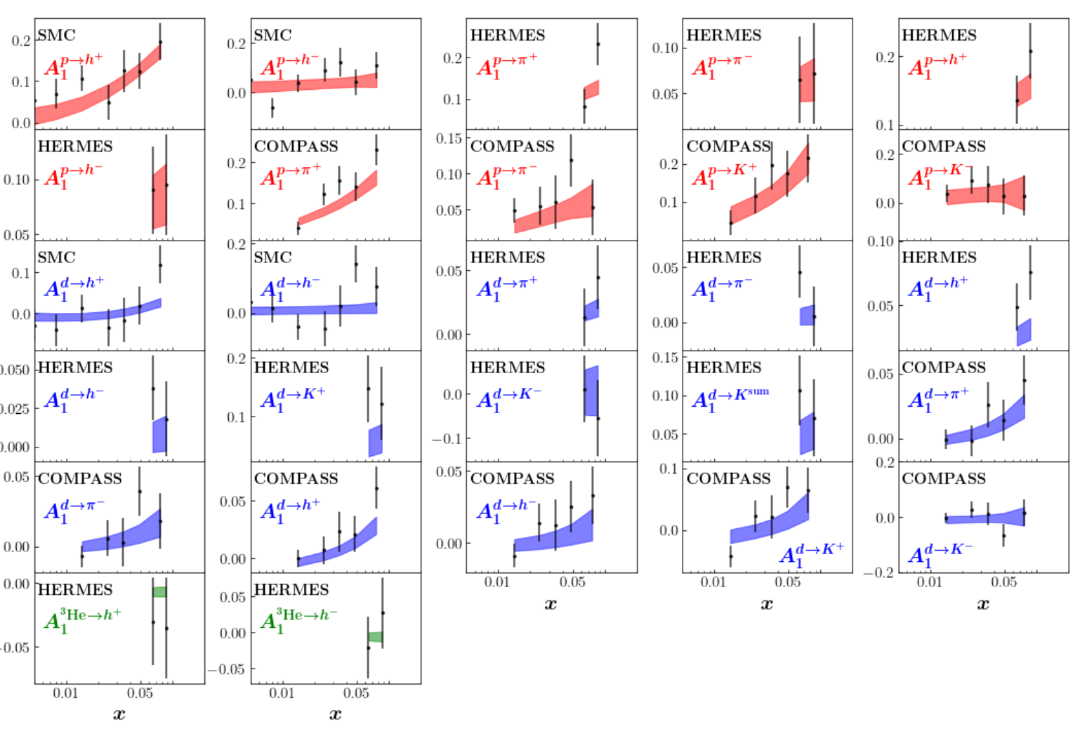
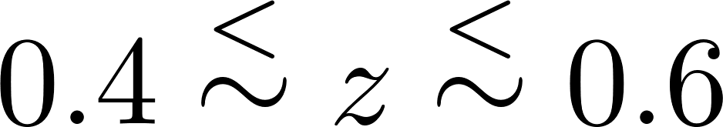
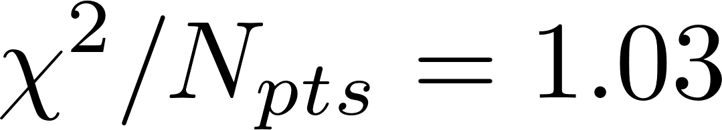

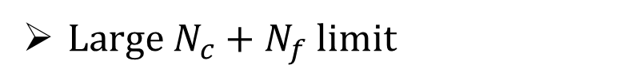

New Global Analysis
D. Adamiak et al., arXiv: 2308.07461
New, updated JAM Small x fit:
DIS + SIDIS data
Improved KPS-CTT evolution
Large $N_{c}+N_{f}$ limit
Data Cuts: $N_{pts}=226$
New evolution + large $N_{f}$ =
several new dipole functions included in fit
JAM Small x 23:
M. Sievert
Global (SI)DIS Analyses from Small-x Evolution
28 / 33

Slide 29
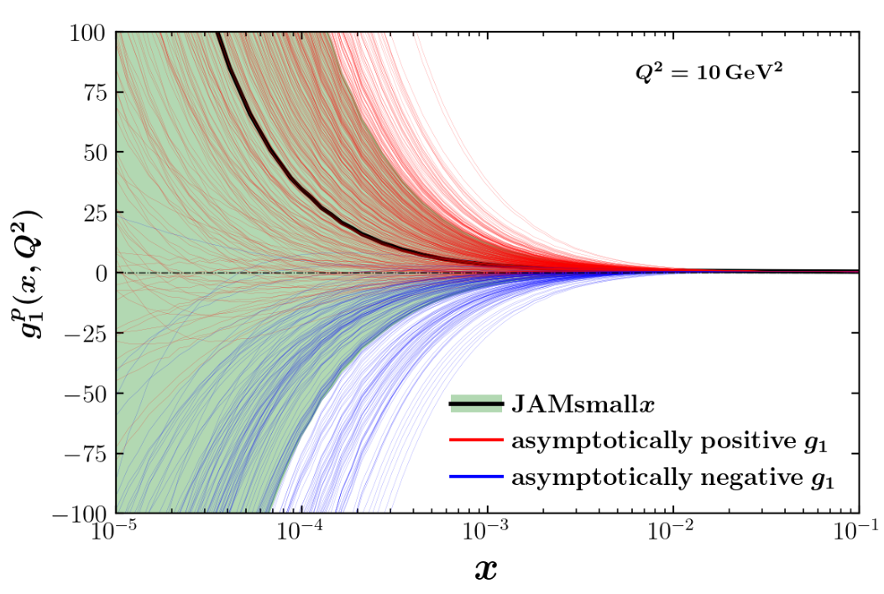
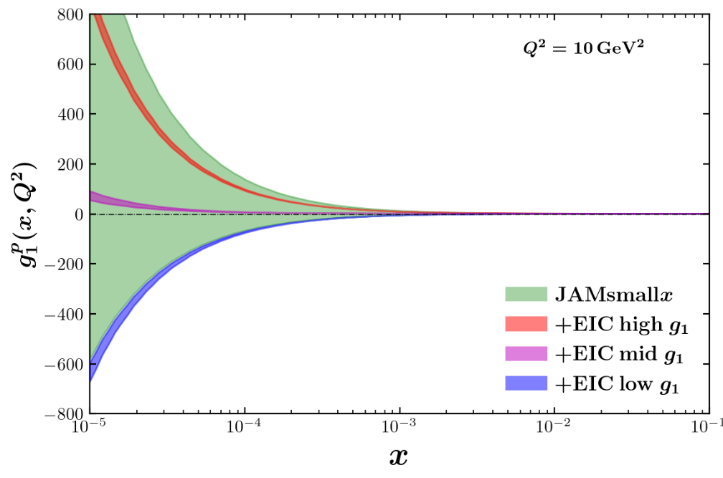
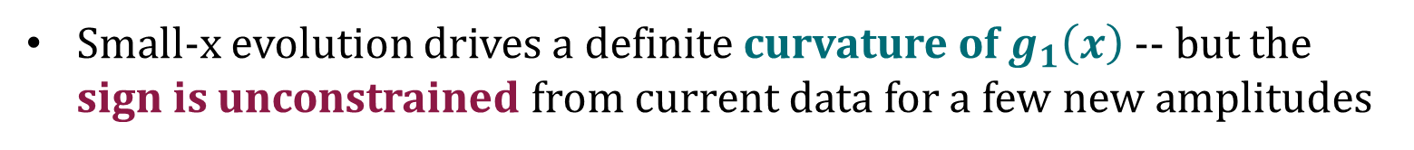
New Global Analysis
Small-x evolution drives a definite curvature of $g_{1}\left(x\right)$ -- but the
sign is unconstrained from current data for a few new amplitudes
Need some kind of additional input: smaller-x data, theory of small-x hadron production in polarized pp, or controlled matching to large x
M. Sievert
Global (SI)DIS Analyses from Small-x Evolution
29 / 33

Slide 30
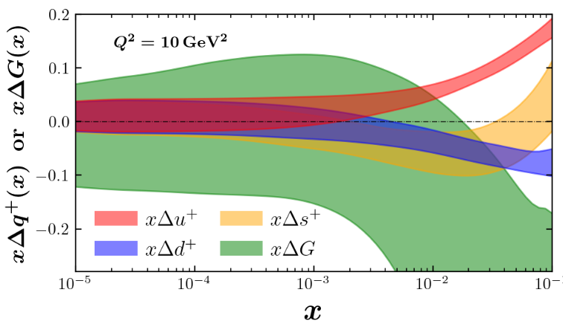
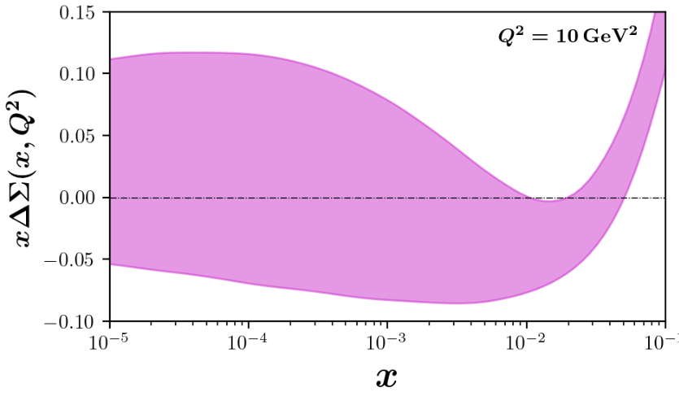
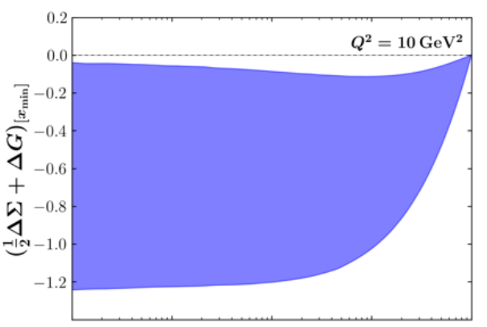

New Global Analysis
Small-x signs of most distributions span zero due to a few poorly-constrained amplitudes
Preference for negative spin contribution from small x?
Stay tuned!
M. Sievert
Global (SI)DIS Analyses from Small-x Evolution
30 / 33

Slide 31
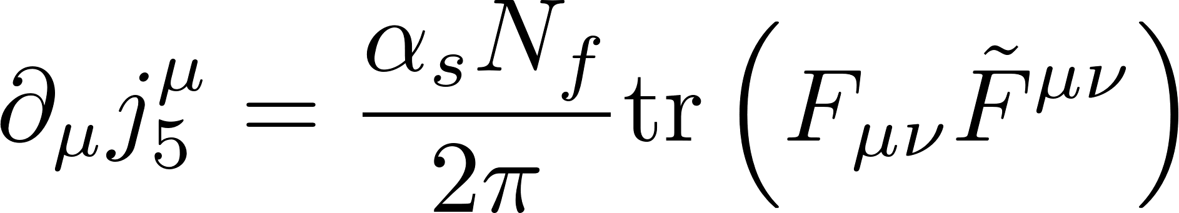
Parting Comment: The Roots of Spin are Chiral
Helicity shares an intimate connection with the axial vector current
Jaffe and Manohar, Nucl. Phys. B337 509 (1990)
A. Tarasov, R. Venugopalan,
Phys. Rev. D100 (2019), D102 (2020), D105 (2022)
The total quark helicity leads to a local matrix element of the axial vector current.
Opens the door to nonperturbative contributions from the axial anomaly
M. Sievert
Global (SI)DIS Analyses from Small-x Evolution
31 / 33

Slide 32
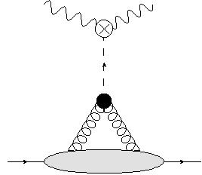
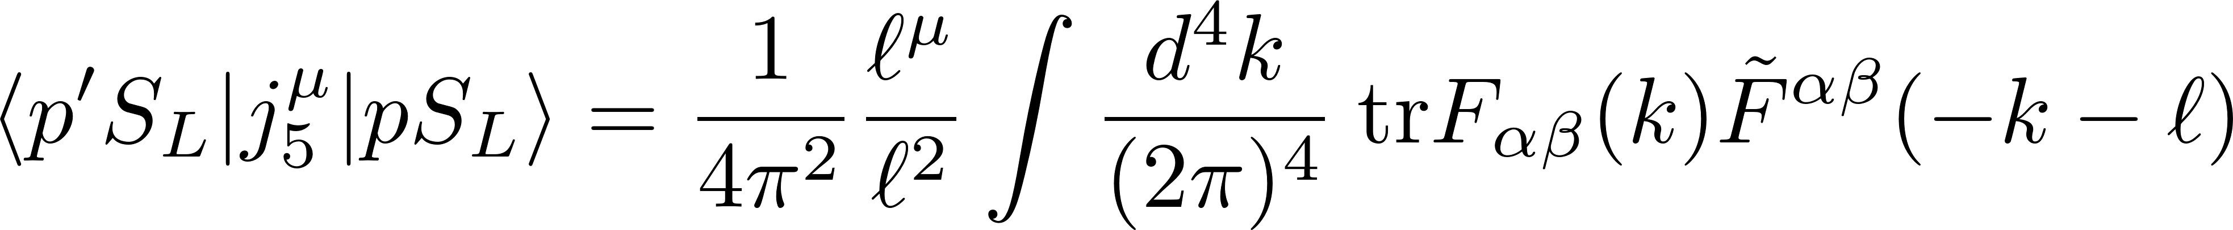
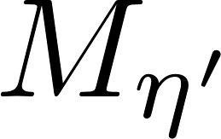
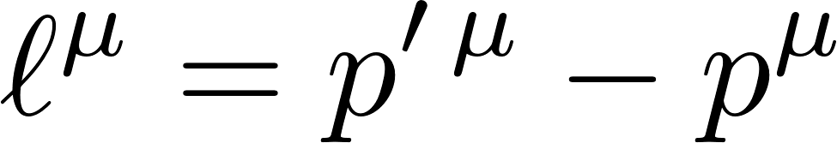
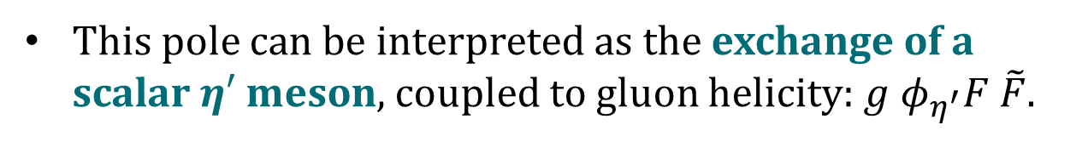
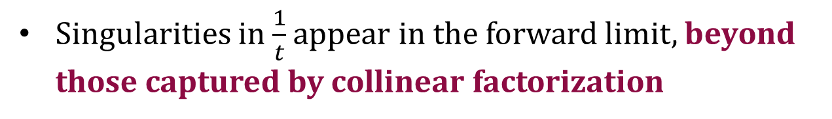
Parting Comment: The Roots of Spin are Chiral
Singularities in $\frac{1}{t}$ appear in the forward limit, beyond those captured by collinear factorization
S. Bhattacharya, Y. Hatta, W. Vogelsang,
Phys. Rev. D107 (2023), arxiv: 2305.09431
This pole can be interpreted as the exchange of a scalar $η′$ meson, coupled to gluon helicity: $g φ_{η^{′}}F \tilde{F}$.
A. Tarasov, R. Venugopalan,
Phys. Rev. D100 (2019), D102 (2020), D105 (2022)
Does collinear factorization capture all the contributions to $g_{1}^{p}$?
M. Sievert
Global (SI)DIS Analyses from Small-x Evolution
32 / 33

Slide 33
Conclusions
Spin at small x lies at the intersection of multiple frontiers in hadronic structure:
Small x: “Dipole” DIS
Longitudinal coherence
Sub-eikonal degrees of freedom (spin)
High density / saturation
Theory and phenomenology of spin at small x is developing rapidly!
M. Sievert
Global (SI)DIS Analyses from Small-x Evolution
33 / 33

