Slide 1
What are GPDs & how to access them in Lattice QCD?
Shohini Bhattacharya
RIKEN BNL
29th September 2023
Duke University

Slide 2
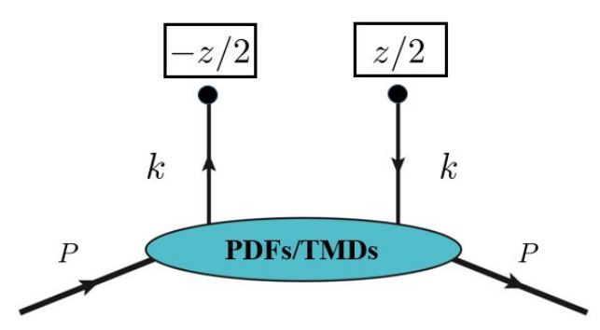
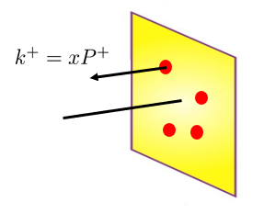
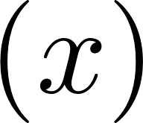
Non-perturbative functions in QCD
Parton motion
Nucleon motion
Parton Distribution Functions
PDFs

Slide 3
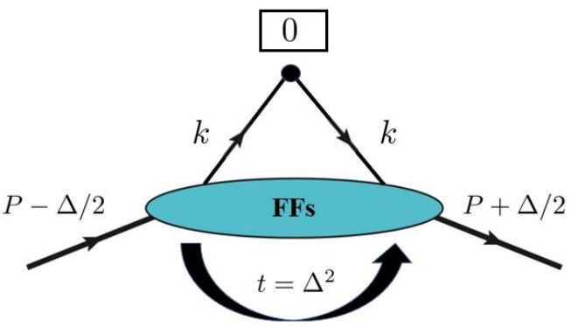
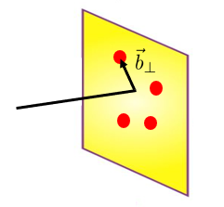
Non-perturbative functions in QCD
Parton motion
Nucleon motion
Form Factors
PDFs
FFs

Slide 4
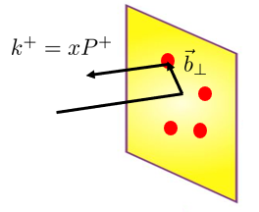
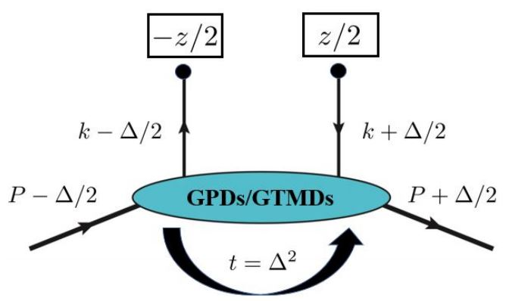
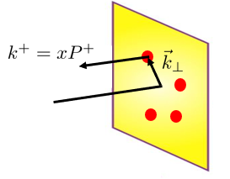
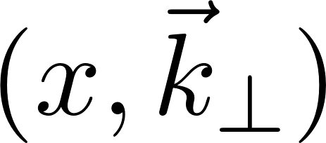
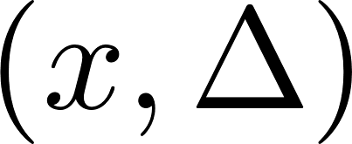
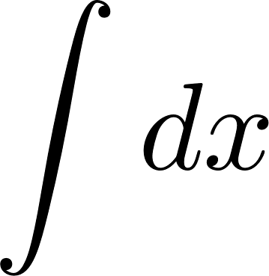
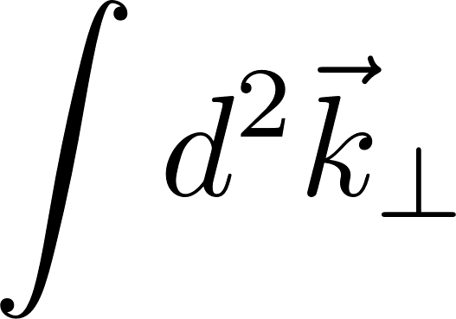
Non-perturbative functions in QCD
Parton motion
Nucleon motion
Generalized Parton Distributions
Transverse Momentum-dependent Distributions
TMDs
GPDs
PDFs
FFs

Slide 5
Non-perturbative functions in QCD
Parton motion
Nucleon motion
Generalized Transverse Momentum-dependent Distributions
GTMDs
TMDs
GPDs
PDFs
FFs

Slide 6
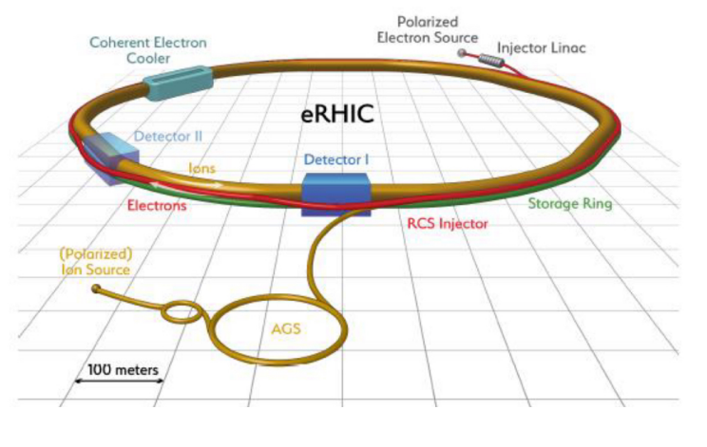
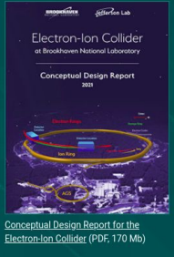
Non-perturbative functions in QCD
Parton motion
Nucleon motion
Generalized Transverse Momentum-dependent Distributions
GTMDs
TMDs
GPDs
PDFs
FFs

Slide 7
Outline
Non-perturbative functions in QCD
Parton motion
Nucleon motion
What are GPDs?
Generalized Transverse Momentum-dependent Distributions
GTMDs
Lattice results of GPDs: state-of-art
TMDs
GPDs
Summary
PDFs
FFs

Slide 8
What are Generalized Parton Distributions?
GPD
GPD correlator for quarks: Graphical representation
Definition of GPD correlator for quarks:

Slide 9
What are Generalized Parton Distributions?
GPD
GPD correlator for quarks: Graphical representation
Definition of GPD correlator for quarks:

Slide 10
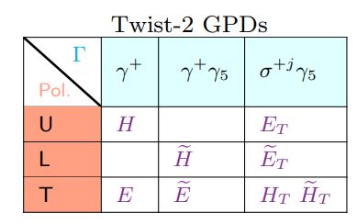
What are Generalized Parton Distributions?
GPD
GPD correlator for quarks: Graphical representation
Definition of GPD correlator for quarks:

Slide 11
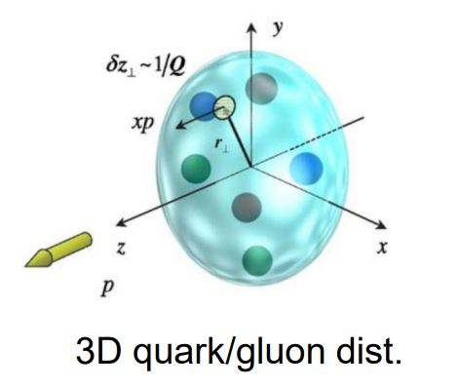
Motivation for studying GPDs
1)
FT

Slide 12
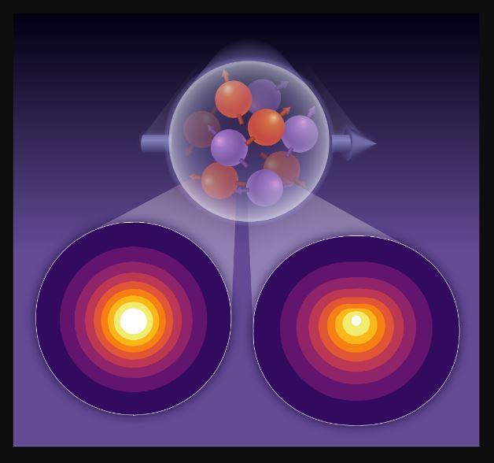
Motivation for studying GPDs
1)
Lattice QCD results of impact-parameter distributions:
Gao’s talk

Slide 13
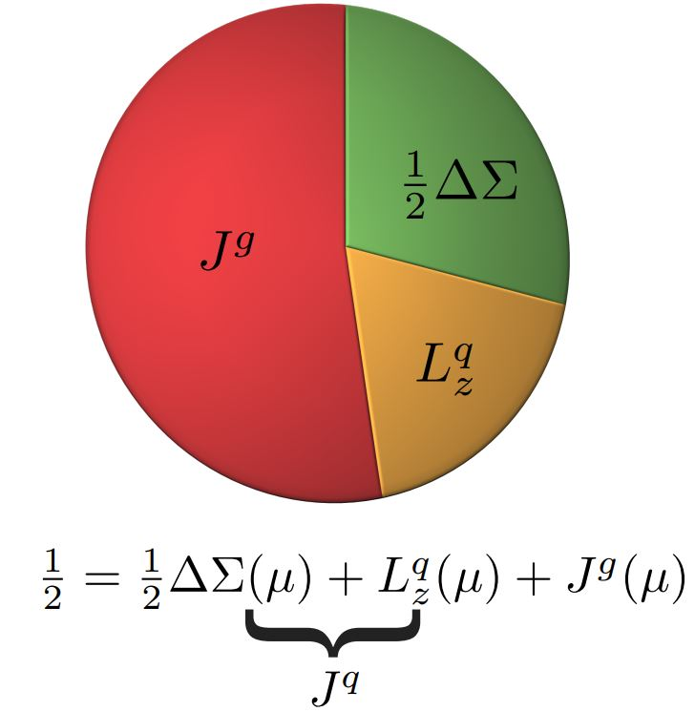
Motivation for studying GPDs
2)

Slide 14
Motivation for studying GPDs
3)
/
Exploits relations between GPDs & Gravitational Form Factors:
Lorce, Meziani’s talk

Slide 15
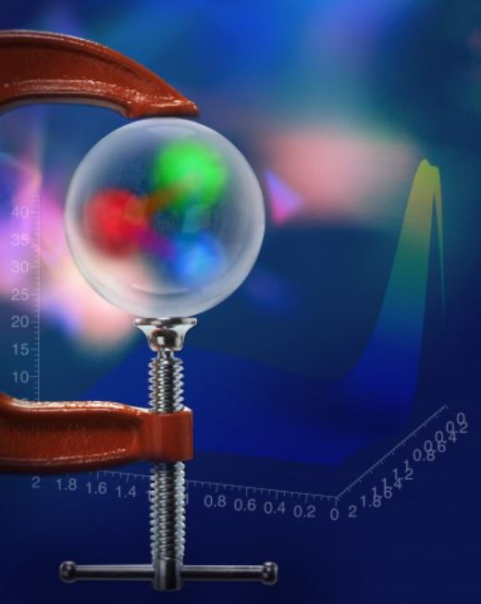
Motivation for studying GPDs
3)
Exploits relations between GPDs & Gravitational Form Factors:
Courtesy: JLab media

Slide 16
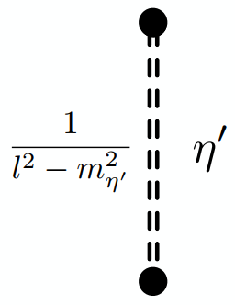
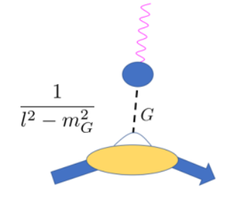
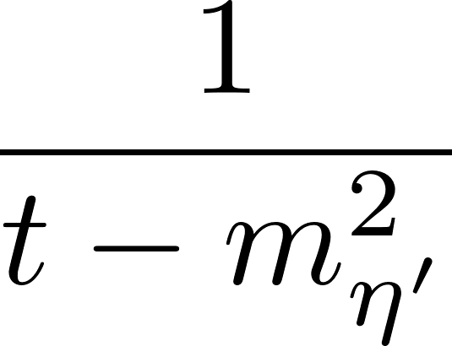
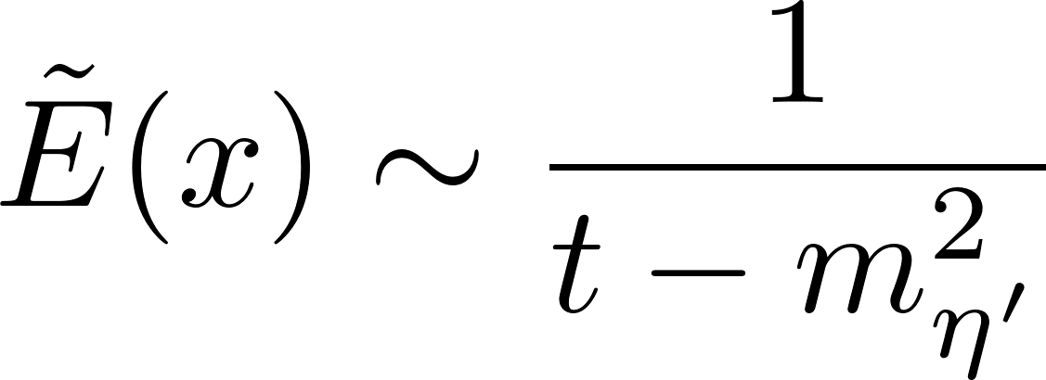
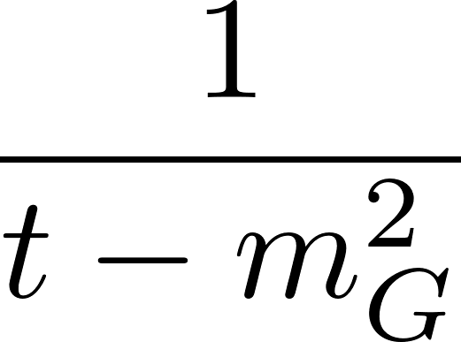
Motivation for studying GPDs
4)
:
Eta meson mass generation:
Glueball mass generation:

Slide 17
Motivation for studying GPDs
4)
:
Eta meson mass generation:
Glueball mass generation:

Slide 18
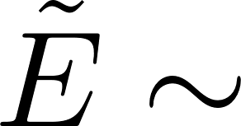
Motivation for studying GPDs
1)
2)
3)
4)

Slide 19
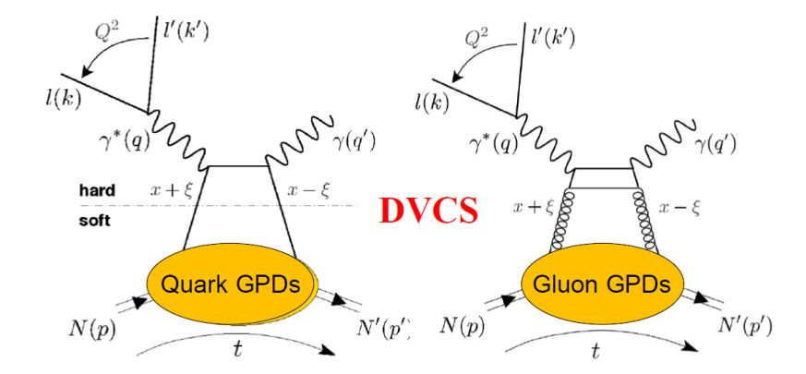
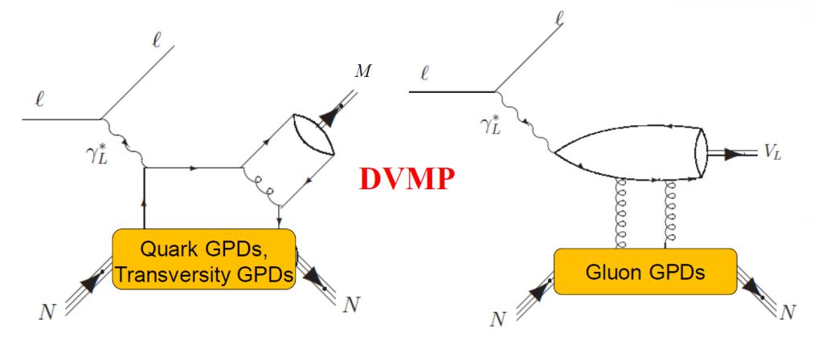
Physical processes sensitive to GPDs
See talks by Silvia, Spencer, Wim
DVCS
DVMP
Courtesy: Hyon-Suk Jo, KPS Meeting
No access to x-dependence of GPDs

Slide 20
Physical processes sensitive to GPDs
See talks by Silvia, Spencer, Wim
DVCS
DVMP
Courtesy: Hyon-Suk Jo, KPS Meeting
No access to x-dependence of GPDs
Complementarity: Lattice results can be integrated into global analysis of experimental data

Slide 21
Physical processes sensitive to GPDs
See talks by Silvia, Spencer, Wim
DVCS
DVMP
(References not exhaustive)
Access to x-dependence of GPDs

Slide 22
Physical processes sensitive to GPDs
See talks by Silvia, Spencer, Wim
DVCS
DVMP
Access to x-dependence of GPDs

Slide 23
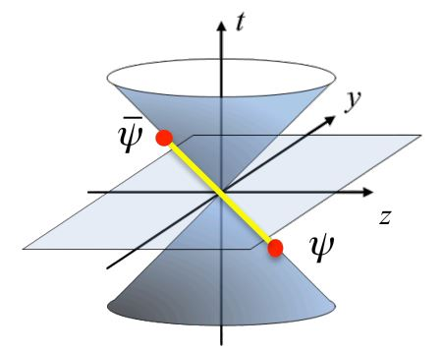
Calculating Parton Distributions in Lattice QCD

Slide 24
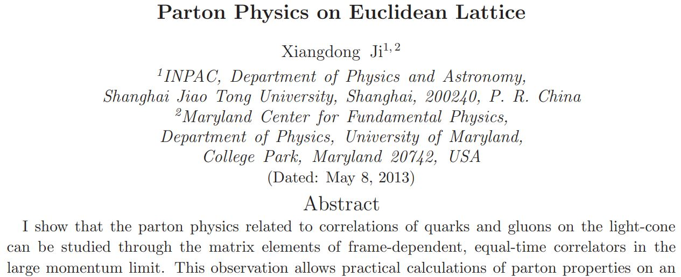
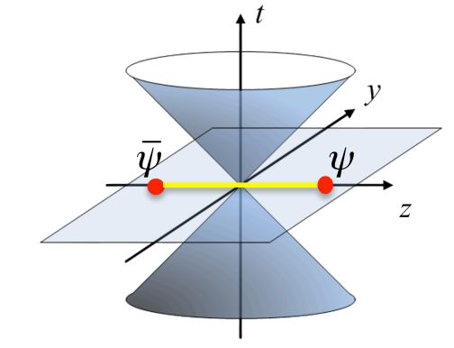
Calculating Parton Distributions in Lattice QCD

Slide 25
Calculating Parton Distributions in Lattice QCD
?

Slide 26
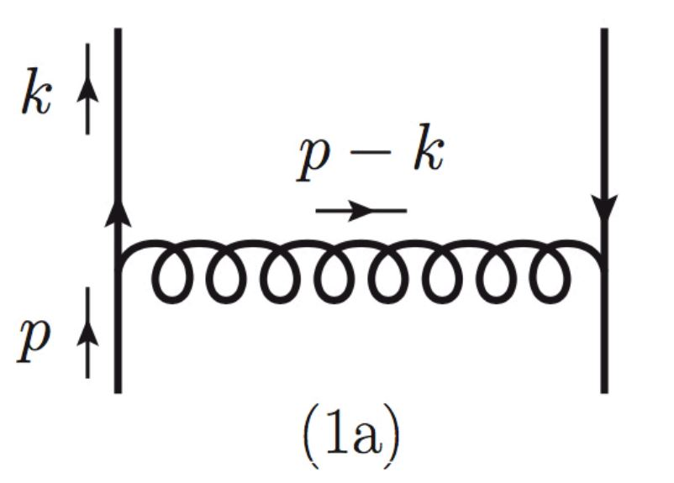
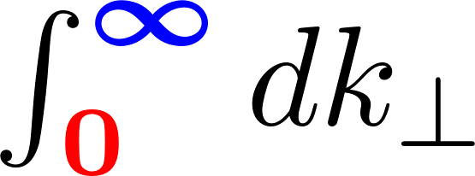
Calculating Parton Distributions in Lattice QCD
Essence of the quasi-distribution approach (Example: PDF)
Light-cone PDF:

Slide 27
Calculating Parton Distributions in Lattice QCD
Essence of the quasi-distribution approach (Example: PDF)
Light-cone PDF:
Quasi PDF:

Slide 28
Calculating Parton Distributions in Lattice QCD
Essence of the quasi-distribution approach (Example: PDF)
Light-cone PDF:
Quasi PDF:

Slide 29
Calculating Parton Distributions in Lattice QCD
Essence of the quasi-distribution approach (Example: PDF)
Light-cone PDF:
Quasi PDF:

Slide 30
Calculating Parton Distributions in Lattice QCD
Essence of the quasi-distribution approach (Example: PDF)
Light-cone PDF:
Quasi PDF:

Slide 31
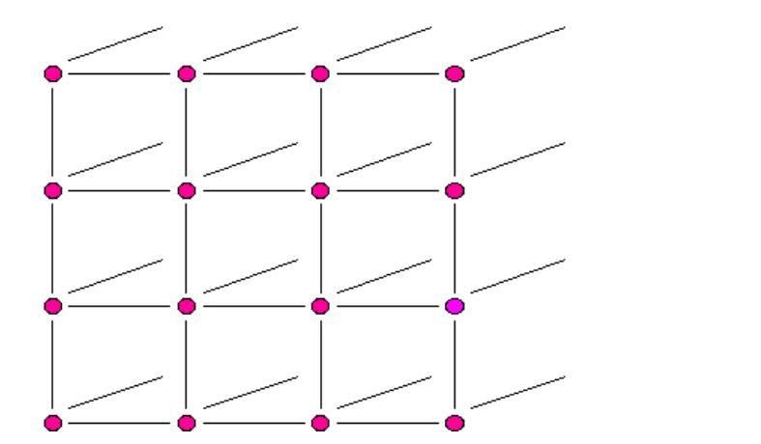
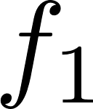
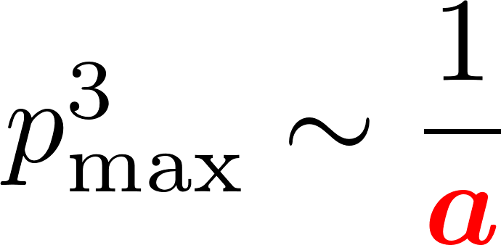
Calculating Parton Distributions in Lattice QCD
Essence of the quasi-distribution approach (Example: PDF)
Light-cone PDF:
Quasi PDF:

Slide 32
Calculating Parton Distributions in Lattice QCD
Essence of the quasi-distribution approach (Example: PDF)
Light-cone PDF:
Quasi PDF:

Slide 33
Calculating Parton Distributions in Lattice QCD
Essence of the quasi-distribution approach (Example: PDF)
(PDF)
Light-cone PDF:
Xiong, Ji, Zhang, Zhao/ Stewart, Zhao/
Izubuchi, Ji, Jin, Stewart, Zhao …
Quasi PDF:

Slide 34
Calculating Parton Distributions in Lattice QCD
Essence of the quasi-distribution approach (Example: PDF)
(GPD)
Light-cone PDF:
Quasi PDF:
References: (not exhaustive)

Slide 35
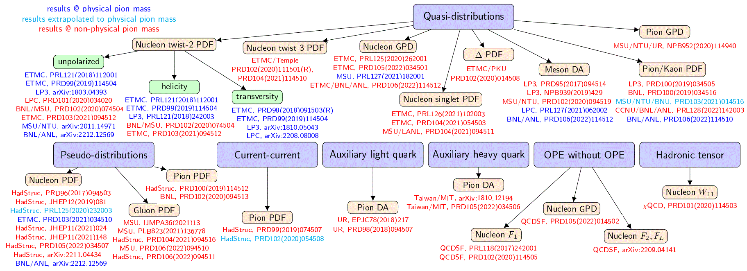
Dynamical Progress of Lattice QCD calculations of PDFs/GPDs
Lattice QCD calculations of x-dependence of PDFs & related quantities using Euclidean correlators:
Compilation by Cichy, 2110.07440

Slide 36
Dynamical Progress of Lattice QCD calculations of PDFs/GPDs
Lattice QCD calculations of x-dependence of PDFs & related quantities using Euclidean correlators:
Ongoing efforts:
See talks by Monahan, Richards
& Orginos
Compilation by Cichy, 2110.07440

Slide 37
Dynamical Progress of Lattice QCD calculations of PDFs/GPDs
Lattice QCD calculations of x-dependence of PDFs & related quantities using Euclidean correlators:
Compilation by Cichy, 2110.07440

Slide 38
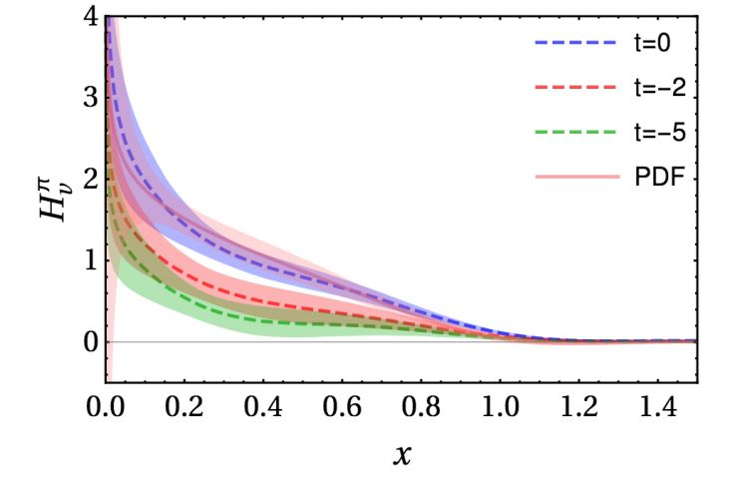
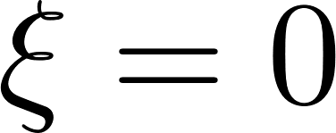
First Lattice QCD results of the x-dependent GPDs
Chen, Lin, Zhang, NPB 2019

Slide 39
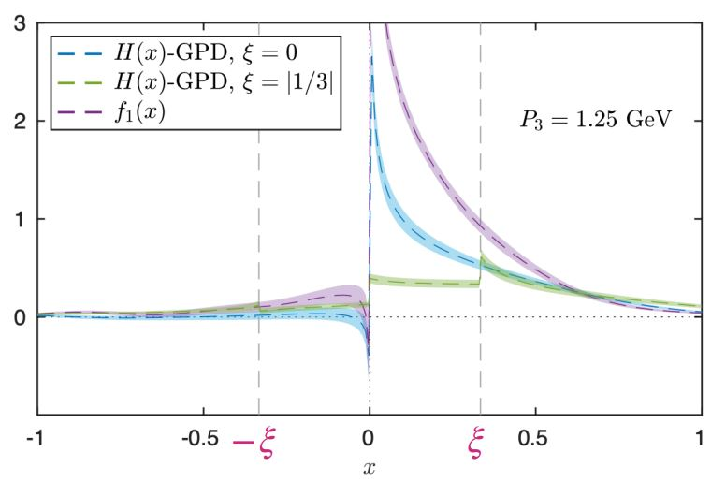
First Lattice QCD results of the x-dependent GPDs
Chen, Lin, Zhang, NPB 2019
C. Alexandrou et. al. (PRL 125 (2020) 26, 262001)

Slide 40
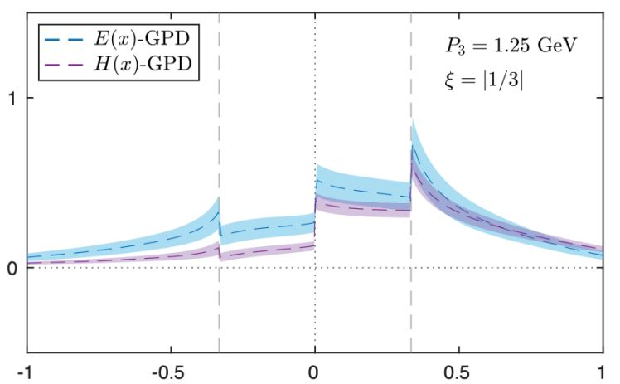
First Lattice QCD results of the x-dependent GPDs
Unpolarized
Chen, Lin, Zhang, NPB 2019
C. Alexandrou et. al. (PRL 125 (2020) 26, 262001)

Slide 41
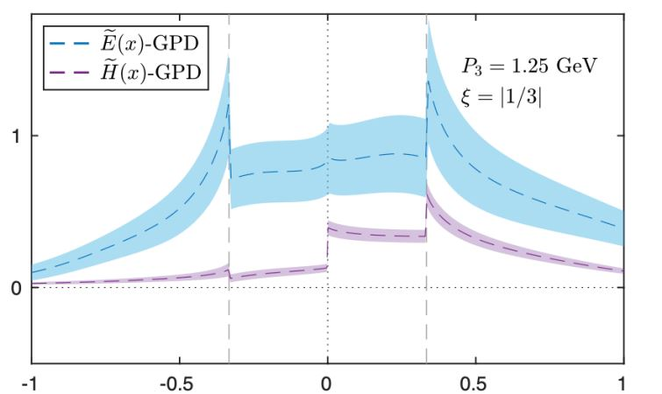
First Lattice QCD results of the x-dependent GPDs
Unpolarized
Chen, Lin, Zhang, NPB 2019
C. Alexandrou et. al. (PRL 125 (2020) 26, 262001)
Helicity
C. Alexandrou et. al. (PRL 125 (2020) 26, 262001)

Slide 42
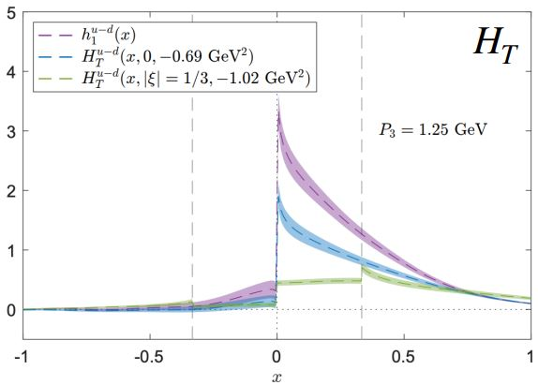
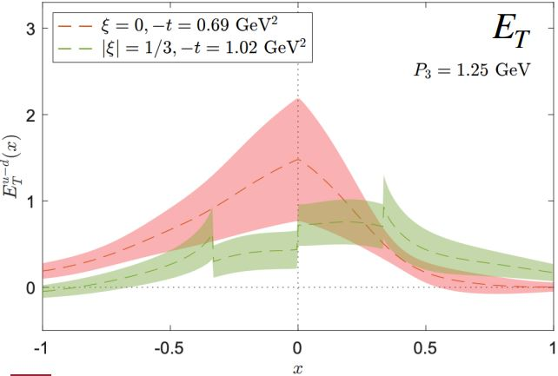
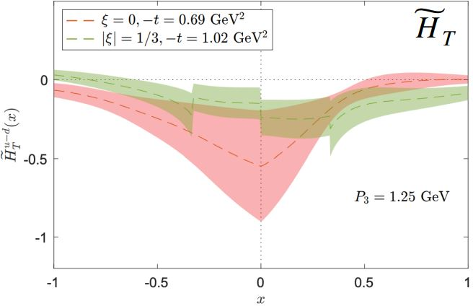
First Lattice QCD results of the x-dependent GPDs
Transversity
Unpolarized
Chen, Lin, Zhang, NPB 2019
C. Alexandrou et. al. (PRL 125 (2020) 26, 262001)
Helicity
C. Alexandrou et. al. (2108.10789)
C. Alexandrou et. al. (PRL 125 (2020) 26, 262001)

Slide 43
First exploration of twist-3 GPDs
Cichy’s talk
Why twist 3?
As sizeable as twist 2
Contain information about quark-gluon-quark correlations inside hadrons …

Slide 44
First exploration of twist-3 GPDs
Cichy’s talk
Definition:

Slide 45
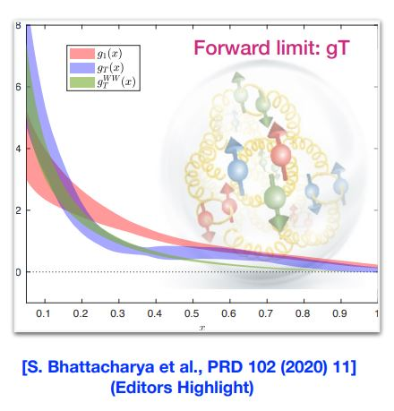
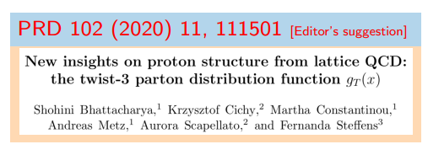
First exploration of twist-3 GPDs
Cichy’s talk
Definition:

Slide 46
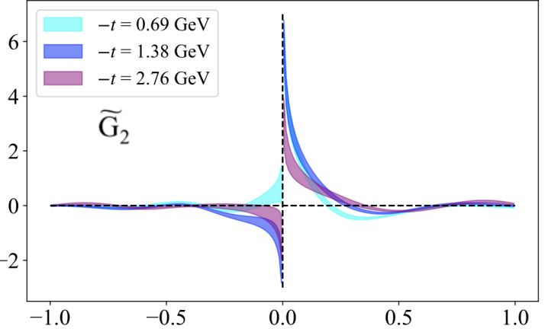
First exploration of twist-3 GPDs
Cichy’s talk
Definition:

Slide 47
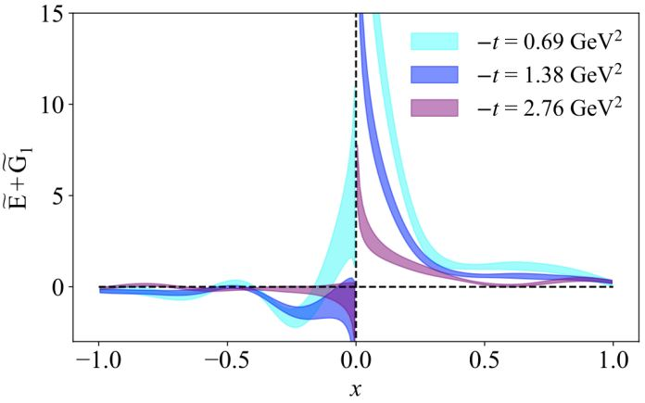
First exploration of twist-3 GPDs
Cichy’s talk
Definition:

Slide 48
First exploration of twist-3 GPDs
Cichy’s talk
Definition:

Slide 49
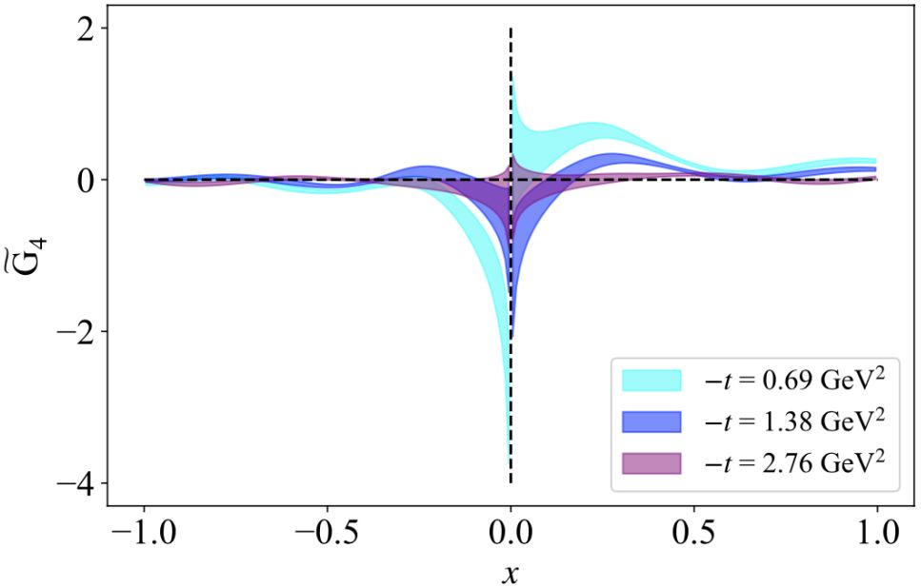
First exploration of twist-3 GPDs
Cichy’s talk
Definition:

Slide 50
GPDs from asymmetric frames
Definition:
GPD

Slide 51
GPDs from asymmetric frames
Resolution:
All
momentum transfer to source
GPD
Constantinou’s talk
Perform Lattice QCD calculations of GPDs in asymmetric frames:
Reduction in computational cost
Access to broad range of (enabling creation of high-resolution partonic maps)

Slide 52
GPDs from asymmetric frames
Resolution:
All
momentum transfer to source
GPD
Major theoretical advances (2209.05373):
Lorentz covariant formalism for calculating quasi-GPDs in any frame
Elimination of power corrections potentially allowing faster convergence to light-cone GPDs

Slide 53
GPDs from asymmetric frames
Resolution:
All
momentum transfer to source
GPD
Major theoretical advances:
Lorentz covariant formalism for calculating quasi-GPDs in any frame
Elimination of power corrections potentially allowing faster convergence to light-cone GPDs

Slide 54
GPDs from asymmetric frames
Lorentz covariant formalism
Novel parameterization of position-space matrix element: (Inspired from
Meissner, Metz, Schlegel, 2009)
Vector operator
8 linearly-independent Dirac structures
8 Lorentz-invariant (frame-independent) amplitudes
Features:

Slide 55
GPDs from asymmetric frames
Lorentz covariant formalism
Novel parameterization of position-space matrix element: (Inspired from
Meissner, Metz, Schlegel, 2009)
Vector operator
8 linearly-independent Dirac structures
8 Lorentz-invariant (frame-independent) amplitudes
Features:

Slide 56
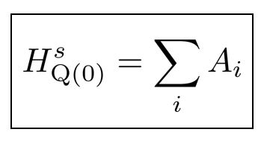
GPDs from asymmetric frames
Lorentz covariant formalism
Novel parameterization of position-space matrix element: (Inspired from
Meissner, Metz, Schlegel, 2009)
Vector operator
8 linearly-independent Dirac structures
8 Lorentz-invariant (frame-independent) amplitudes
Features:
v
v

Slide 57
GPDs from asymmetric frames
Resolution:
All
momentum transfer to source
GPD
Major theoretical advances:
Lorentz covariant formalism for calculating quasi-GPDs in any frame
Elimination of power corrections potentially allowing faster convergence to light-cone GPDs

Slide 58
GPDs from asymmetric frames
Relations between GPDs & amplitudes
Example: Symmetric frame
Quasi-GPD:

Slide 59
GPDs from asymmetric frames
Relations between GPDs & amplitudes
Light-cone GPD:
(Lorentz-invariant)
Quasi-GPD:
(Symmetric frame)

Slide 60
GPDs from asymmetric frames
Relations between GPDs & amplitudes
Light-cone GPD:
(Lorentz-invariant)
Quasi-GPD:
(Symmetric frame)

Slide 61
GPDs from asymmetric frames
Relations between GPDs & amplitudes
Light-cone GPD:
(Lorentz-invariant)
Quasi-GPD:
(Symmetric frame)

Slide 62
GPDs from asymmetric frames
Relations between GPDs & amplitudes
Light-cone GPD:
(Lorentz-invariant)
Quasi-GPD:
(Symmetric frame)

Slide 63
GPDs from asymmetric frames
New definition of quasi-GPDs
Light-cone GPD:
Lorentz-invariant definition of quasi-GPD:
Same functional
forms

Slide 64
GPDs from asymmetric frames
New definition of quasi-GPDs
Light-cone GPD:
Lorentz-invariant definition of quasi-GPD:
Feature:
Lorentz-invariant definition of quasi-GPDs may converge faster

Slide 65
GPDs from asymmetric frames
Traditional definition
Lorentz invariant definition
New definition of quasi-GPDs
Light-cone GPD:
Lorentz-invariant definition of quasi-GPD:
Feature:
Lorentz-invariant definition of quasi-GPDs may converge faster

Slide 66
Unpolarized
GPDs from asymmetric frames
New definition of quasi-GPDs
Light-cone GPD:
Lorentz-invariant definition of quasi-GPD:
Helicity
Feature:
Constantinou’s talk
Lorentz-invariant definition of quasi-GPDs may converge faster

Slide 67
GPDs from asymmetric frames
New definition of quasi-GPDs
Shi’s talk
Light-cone GPD:
Lorentz-invariant definition of quasi-GPD:
Feature:
Lorentz-invariant definition of quasi-GPDs may converge faster

Slide 68
Dynamical Progress of Lattice QCD calculations of PDFs/GPDs
Lattice QCD calculations of x-dependence of PDFs & related quantities using Euclidean correlators:
Compilation by Cichy, 2110.07440

Slide 69
Compton amplitude in Lattices
Example: Forward Compton amplitude
Courtesy: Utku Can

Slide 70
Compton amplitude in Lattices
Deep Inelastic Scattering (DIS)
DIS & Hadronic Tensor:

Slide 71
Compton amplitude in Lattices
Forward
Compton amplitude:
Same Lorentz decomposition as the Hadronic tensor

Slide 72
Compton amplitude in Lattices
Forward
Compton amplitude:
Dispersion relations connecting Compton SFs to DIS SFs:
Courtesy: Utku Can

Slide 73
Compton amplitude in Lattices
Forward
Compton amplitude:
Compton amplitude approach gives access to moments of DIS SFs:
Example:

Slide 74
Compton amplitude in Lattices
Forward
Compton amplitude:
This approach gives
access to moments GPDs:
Compton amplitude approach gives access to moments of DIS SFs:
Example:

Slide 75
Summary
Tremendous recent activity in studying parton structure of hadrons in lattice QCD through Euclidean correlators
Impact of approach(es) largest where experiments are difficult → GPDs

Slide 76
Summary
Tremendous recent activity in studying parton structure of hadrons in lattice QCD through Euclidean correlators
Impact of approach(es) largest where experiments are difficult → GPDs
Courtesy: Cichy

Slide 77
Significant
progress!
Summary
Tremendous recent activity in studying parton structure of hadrons in lattice QCD through Euclidean correlators
Twist 3
Impact of approach(es) largest where experiments are difficult → GPDs
Twist 2
Twist 2

Slide 78
Outlook
Improving perturbative calculations
Better understanding of power corrections
Synergy with phenomenology …

Slide 79
Backup slides

Slide 80
What are Generalized Parton Distributions?
GPD
GPD correlator: Graphical representation
Definition of GPD correlator:

Slide 81
Physical processes sensitive to GPDs
(list not exhaustive)
DVCS
DVMP
Courtesy: Hyon-Suk Jo, KPS Meeting
No access to x-dependence of GPDs
See talks by Silvia, Spencer, Wim

Slide 82
Dynamical Progress of Lattice QCD calculations of PDFs/GPDs
Lattice QCD calculations of x-dependence of PDFs & related quantities using Euclidean correlators:
Compilation by Cichy, 2110.07440

Slide 83
First Lattice QCD results of the x-dependent GPDs
Chen, Lin, Zhang, NPB 2019
C. Alexandrou et. al. (PRL 125 (2020) 26, 262001)
SB, Metz (2021)
SB, Metz (2021)

Slide 84
GPDs from asymmetric frames
Definitions of quasi-GPDs:
Traditional definition
(symmetric frame):
GPD
GPD

Slide 85
Dynamical Progress of Lattice QCD calculations of PDFs/GPDs
Lattice QCD calculations of x-dependence of PDFs & related quantities using Euclidean correlators:
Compilation by Cichy, 2110.07440

Slide 86
Pseudo-GPD approach
Quasi-PDF : Fixed
Pseudo-PDF : Fixed
Sketch of the approach:
( )
(Orginos, INT 2018)
( )

Slide 87
Pseudo-GPD approach
Quasi-PDF : (fixed )
Pseudo-PDF : (fixed )
Sketch of the approach:
(Orginos, INT 2018)

