Slide 1
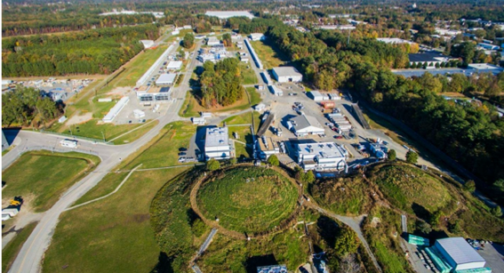
New Opportunities with Jefferson Lab at 22 GeV
Cynthia Keppel
SPIN 2023
Duke University, September 24-28, 2023

Slide 2
Jefferson Lab Accelerator PHASED Upgrade
A staged upgrade program at the luminosity frontier (up to 10³⁹ e-N /cm²/ s), capitalizing on novel accelerator science and technology
Phase 1: Polarized positrons in a former FEL (“LERF”) with transport to CEBAF (proposed 12 GeV science program)
Phase 2: Recirculating injector energy upgrade to 650 MeV electrons
Replace one set of arcs on each side with new FFA permanent magnet arcs to upgrade to 22 GeV – no new RF needed!
123 MeV e⁺ and 650 MeV e⁻

Slide 3
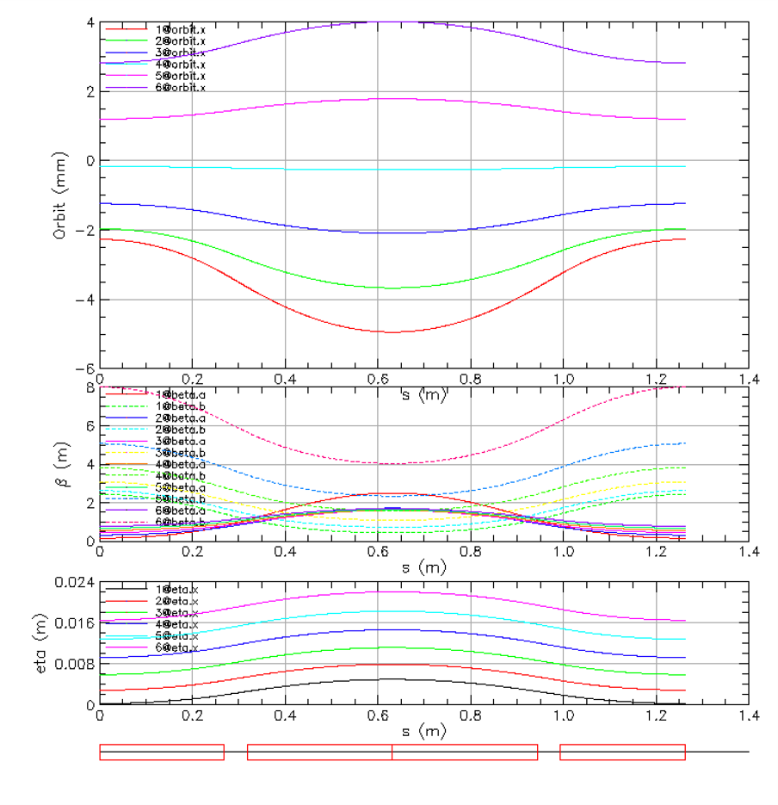

Compact FFA Cell – How Does it Work?
Large momentum acceptance FFA cell is configured with combined function permanent magnets capable of transporting multiple energy beams through the same string of magnets (six beams with energies spanning a factor of two)
magnets: from 38cm² to 78cm²
BD
BF
BD
1 T
50 T/m
1 T
50 T/m
Closely spaced orbits for all six beams (~ 1 cm)
Extremally low dispersion (a few mm) in a combined function lattice
Self similar beta functions for different energy beams
BD
BF
BD

Slide 4
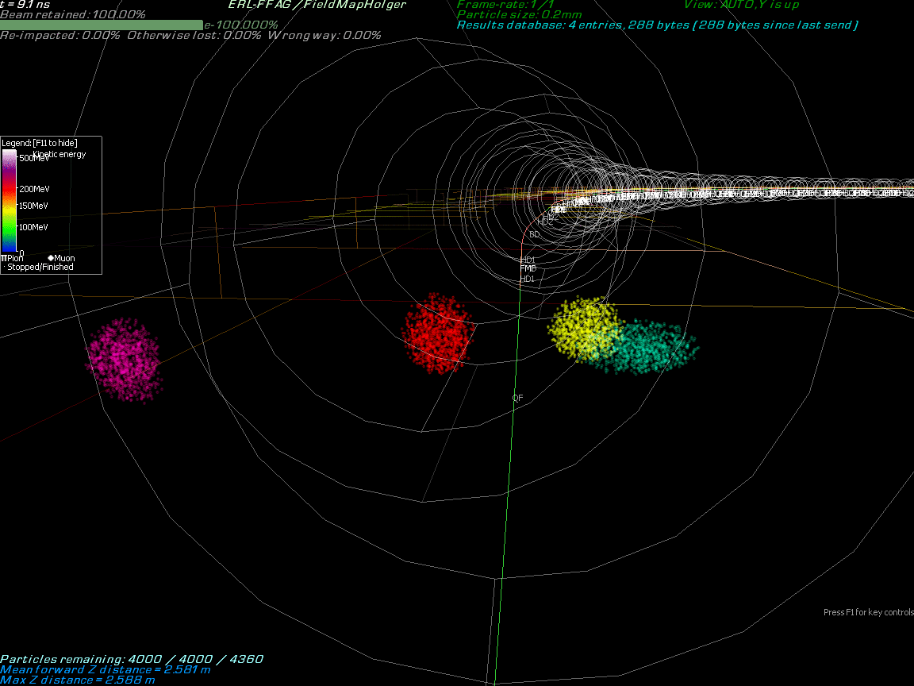
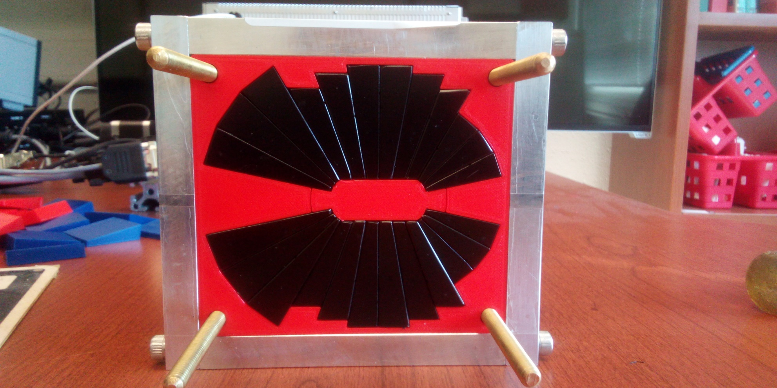

Multi-Energy Beam Dynamics in FFA Arc
2019-2022
A prototype open midplane BF magnet was built and evaluated for mechanical integrity. Magnetic measurement confirmed a robust design with >1.5 Tesla in good field region, 10⁻³ field accuracy. JLab LDRD for radiation resilience tests in CEBAF.
Stephen Brooks, BNL

Slide 5
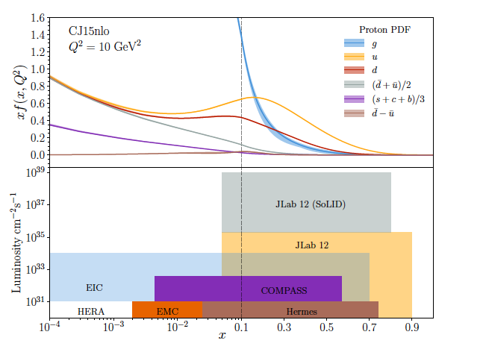
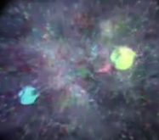
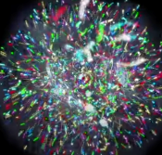
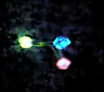
JLab 12 GeV:
Probing Nucleon Valence Structure at High Luminosity
Partonic structure in the valence region defines the hadron
Baryon number, charge, flavor content, total spin, …
Large x, low Q² evolves to low x, high Q² via pQCD, shape and strength from data
Precision measurements in the valence quark regime requiring high luminosity are the purview of JLab, providing overlap with EIC
into the sea quark region - keen discriminator of hadron structure models, test of QCD
Probability Distribution
Probability Distribution
JLab 22
Luminosity (cm⁻²s⁻¹)
2030s-2040s
Fraction of nucleon momentum
Physics with CEBAF at 12 GeV and Future Opportunities
Prog. Part. Nucl. Phys. 127 (2022) 103985

Slide 6
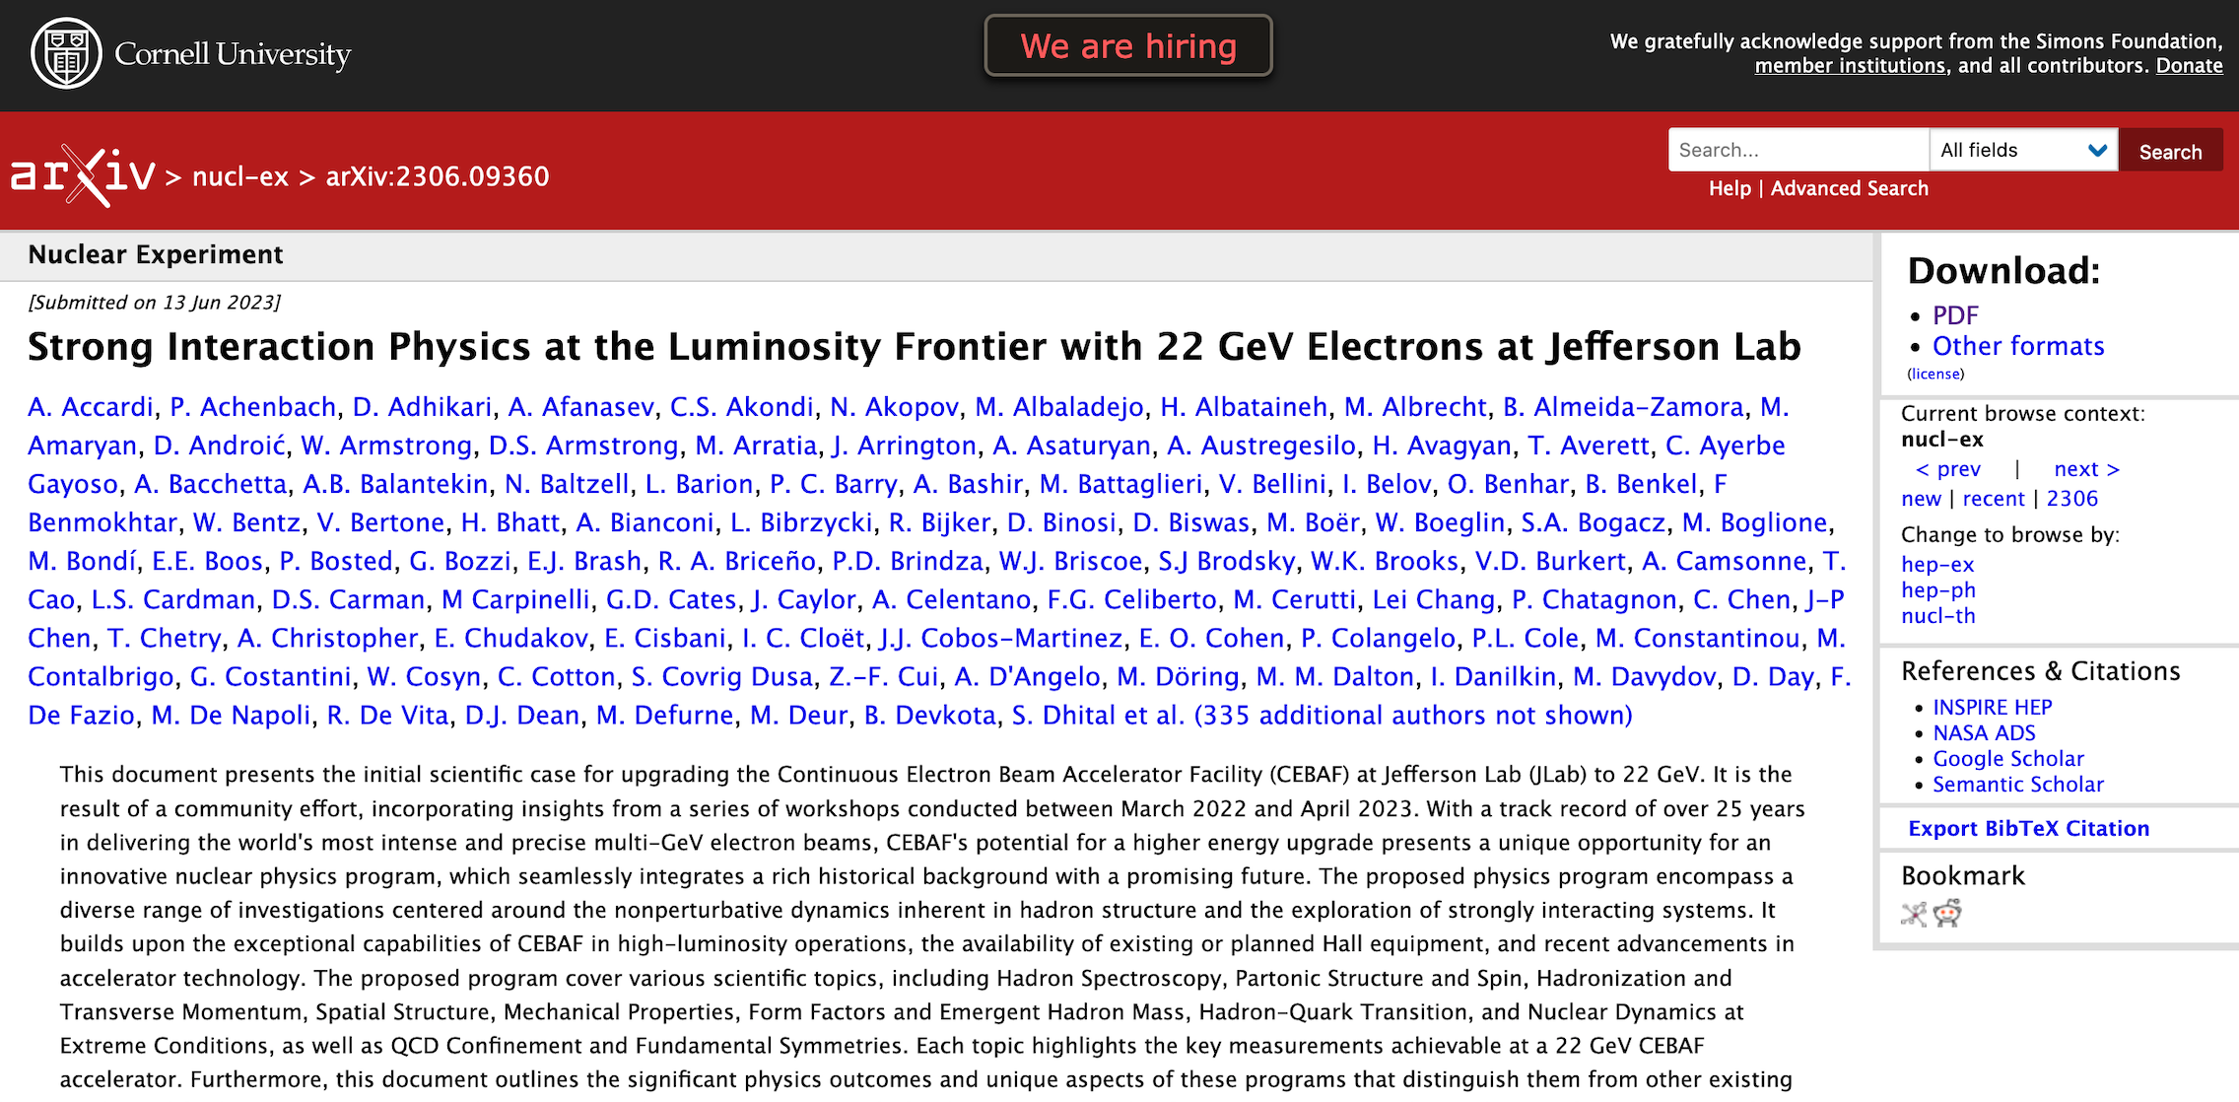
Strong Interaction Physics at the Luminosity Frontier with 22 GeV Electrons at JLab
arXiv:2306.09360v2 [nucl-ex], submitted to EPJA
141 pages with many powerful experiments using existing or planned equipment - just a few examples….

Slide 7
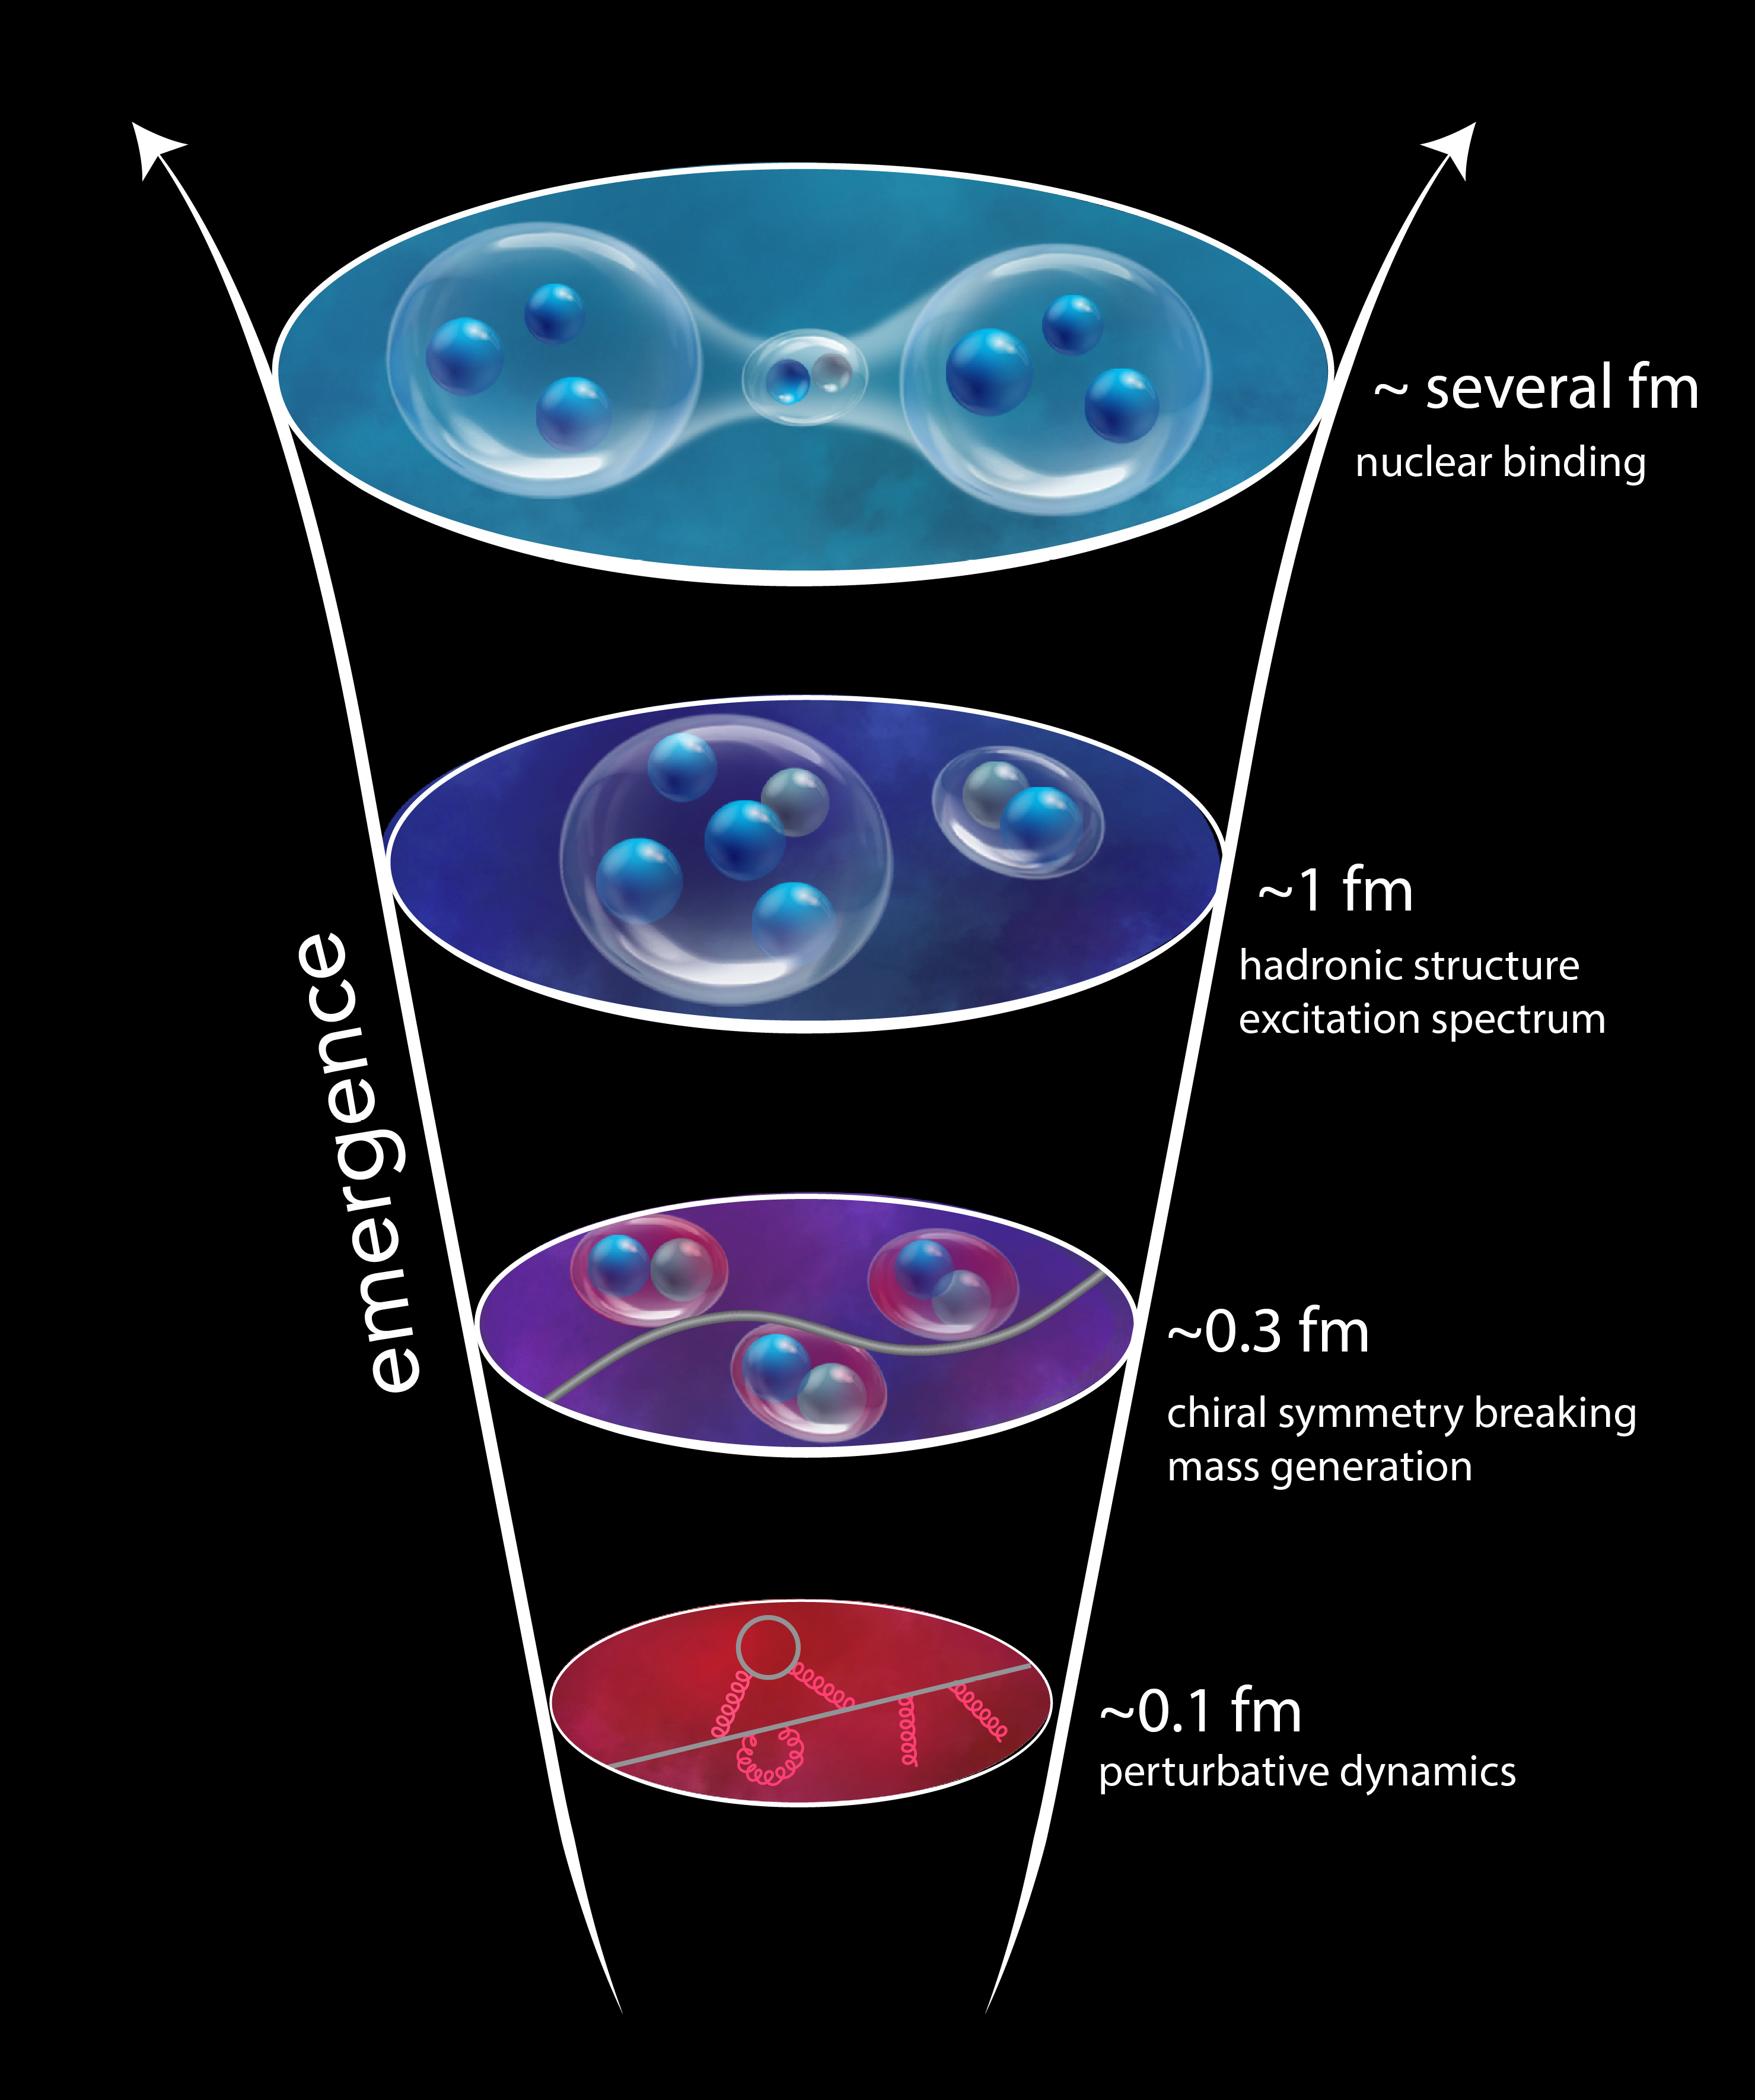
Why CEBAF @ 22 GeV?
“The ability to reduce everything to simple fundamental laws does not imply the ability to start from those laws and reconstruct the universe.” -- More is Different, P. W. Anderson [Science 177, 393 (1972)]
Need to understand strong interaction dynamics from asymptotically free fundamental quark and gluon constituents to the structure of bound nucleons to nucleon-nucleon interactions and the nuclear medium
Complex non-pQCD problem which demands different approaches and measurements to access multiple observables
7
7

Slide 8
What a 22 GeV Upgrade Brings
A NEW territory to explore ➜ cross the critical threshold into the region where cc states can be produced in large quantities, and with additional light quark degrees of freedom
A BETTER insight into our current program ➜ enhancement of the phase space
A BRIDGE between JLab @ 12 GeV and EIC ➜ testing and validation of QCD from lower to higher energy, through multiple phenomena, and with high precision
8
8

Slide 9
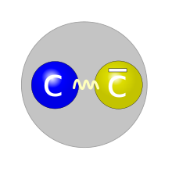
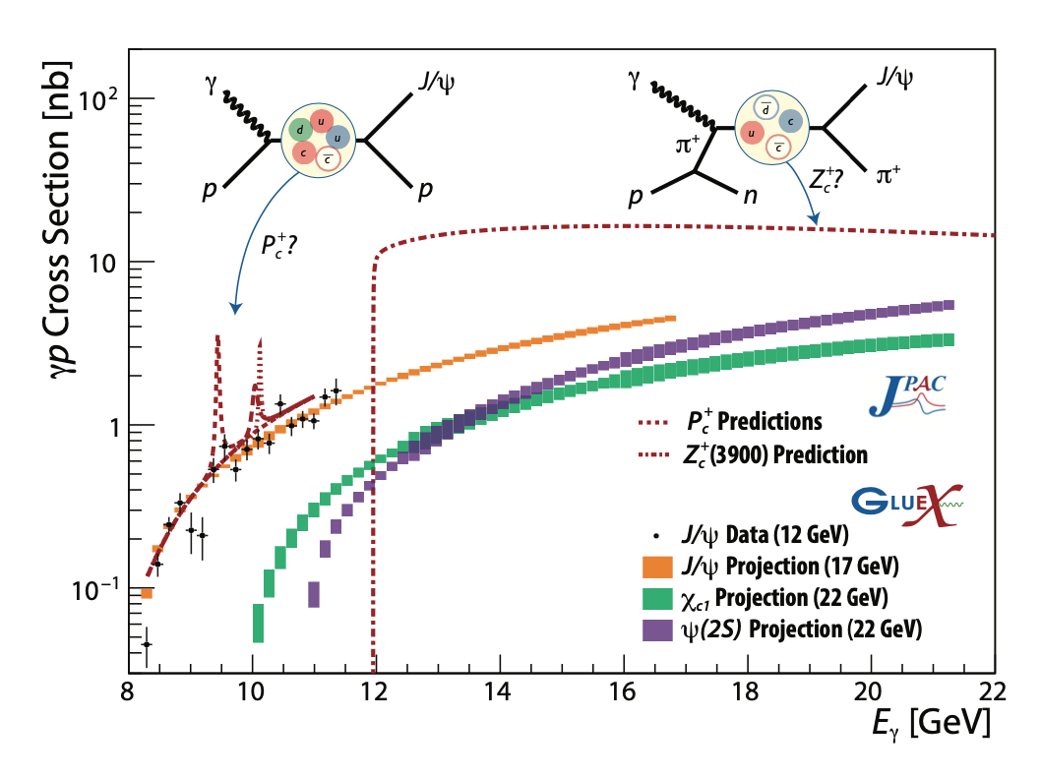
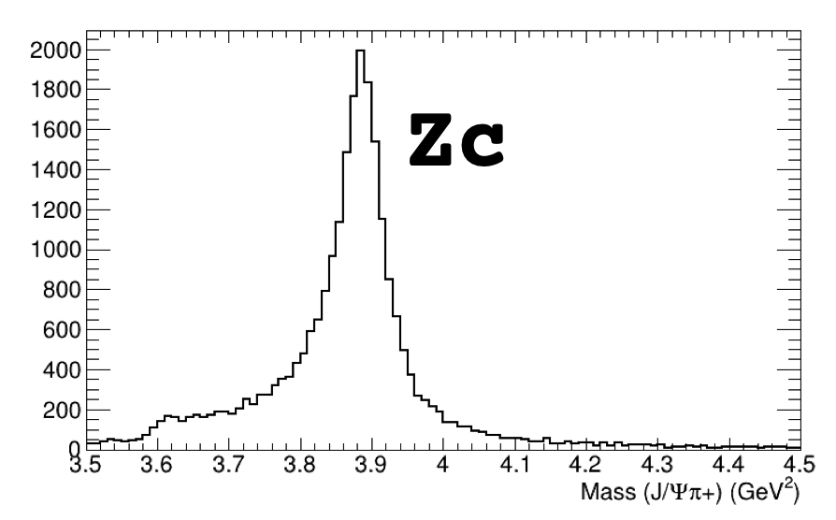
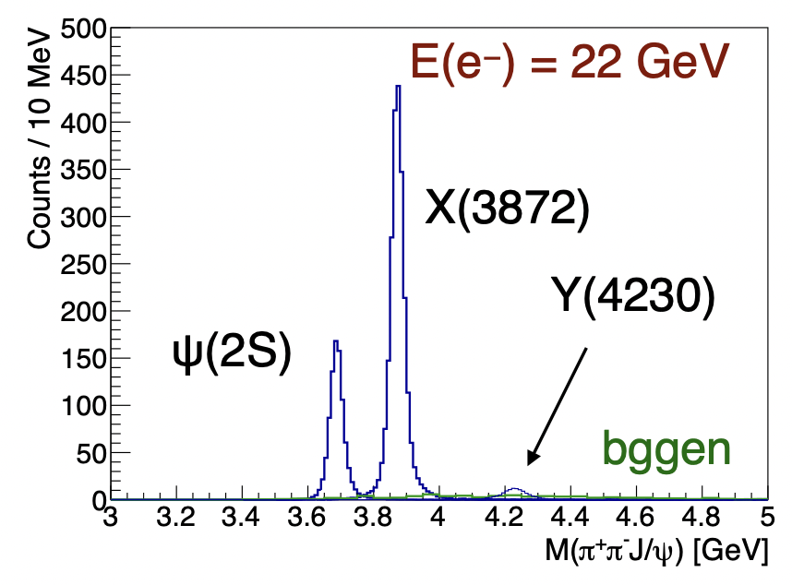
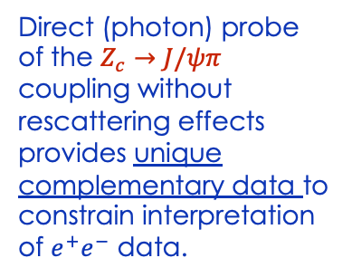

Spectroscopy of Exotic States with charm
Photoproduction of hadrons with charm quarks: a new tool for discovery in QCD
➜ a unique method to probe the gluonic structure of the proton
➜ potentially decisive information about the nature of some 5-quark and 4-quark candidates
Tetraquark candidates, XYZ states, observed in B decays, e⁺e⁻ colliders but their internal structure is not yet understood
Never direcly produced using γ/lepton beams ➞ Polarized photoproduction alternative mechanism to study such states
Direct (photon) probe of the $Z_{c}→J/ψπ$ coupling without rescattering effects provides unique complementary data to constrain interpretation of $e^{+}e^{−}$ data.
Initial simulations demonstrate the capabilities of the existing detectors to measure these reactions
$$γp→Jψπ^{+}n$$
Thresholds crossed and t range opens up at higher energy

Slide 10
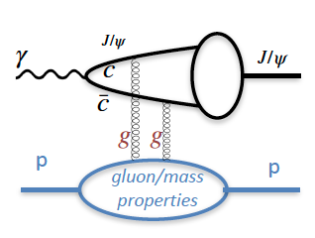
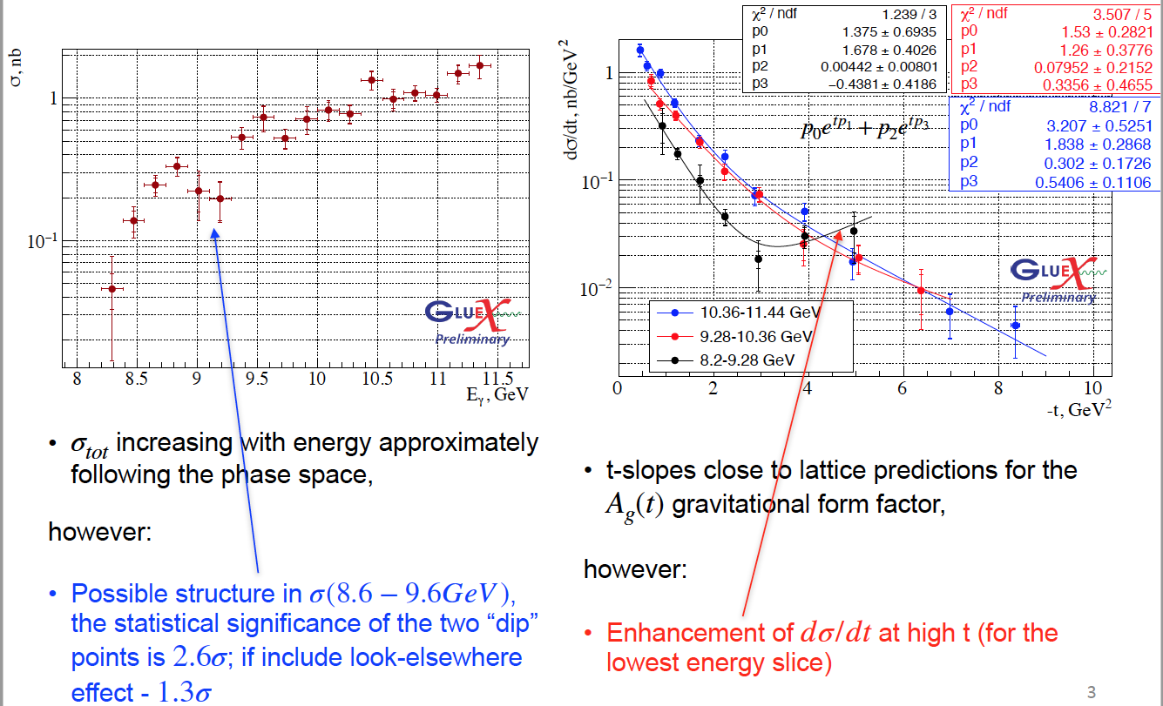
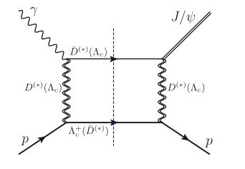
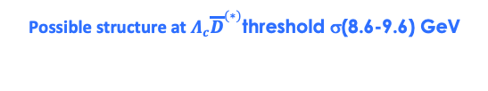
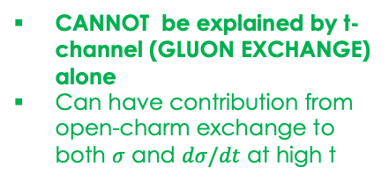
J/ψ photoproduction near threshold
Used to study important aspects of the gluon structure of the proton
gluon GPD, gravitational FF
mass radius of the proton,
anomalous contribution to the proton mass.
..based on some assumptions (mainly 2-g exchange)
Possible structure at $Λ_{c}{\overline{D}}^{(∗)}$threshold σ(8.6-9.6) GeV
CANNOT be explained by t-channel (GLUON EXCHANGE) alone
Can have contribution from open-charm exchange to both $σ$ and $dσ/dt$ at high t
Enhancement of dσ/dt at high t for the lowest energy slice
Can we interpret this as a possible evidence for a s-channel resonance (?) Pc
10
Phys. Rev. C 108 (2023) 2, 025201

Slide 11
Spectroscopy of Exotic States with charm
Photoproduction of hadrons with charm quarks: a new tool for discovery in QCD
➜ a unique method to probe the gluonic structure of the proton
➜ potentially decisive information about the nature of some 5-quark and 4-quark candidates
Tetraquark candidates, XYZ states, observed in B decays, e⁺e⁻ colliders but their internal structure is not yet understood
Never direcly produced using γ/lepton beams ➞ Polarized photoproduction alternative mechanism to study such states
Direct (photon) probe of the $Z_{c}→J/ψπ$ coupling without rescattering effects provides unique complementary data to constrain interpretation of $e^{+}e^{−}$ data.
Initial simulations demonstrate the capabilities of the existing detectors to measure these reactions
$$γp→Jψπ^{+}n$$
Thresholds crossed and t range opens up at higher energy

Slide 12
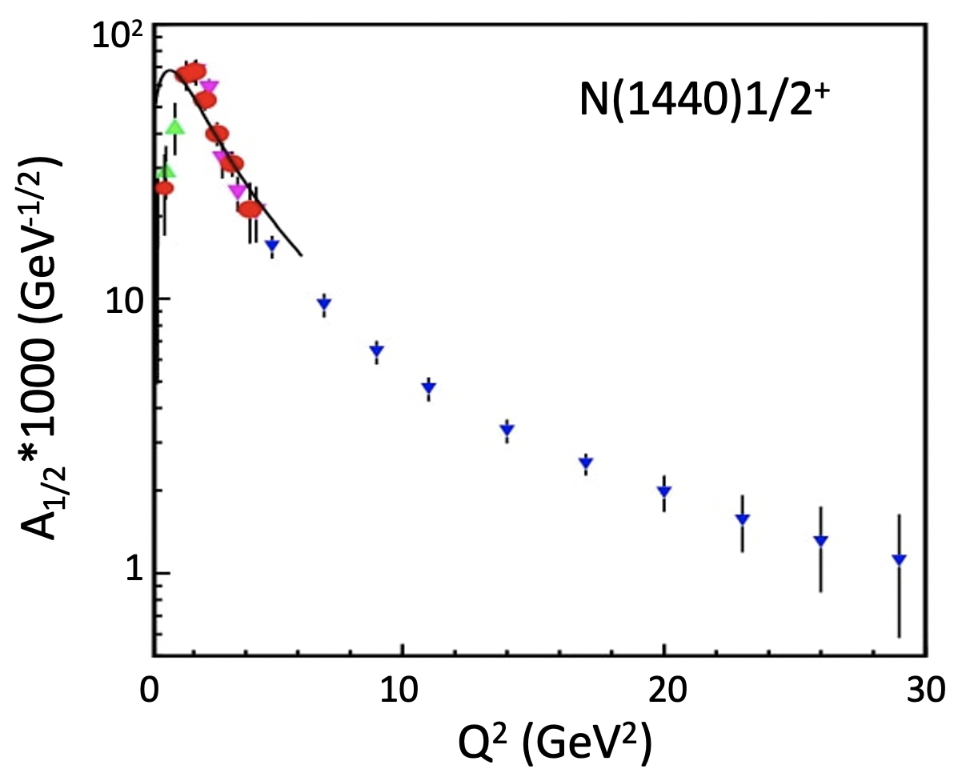
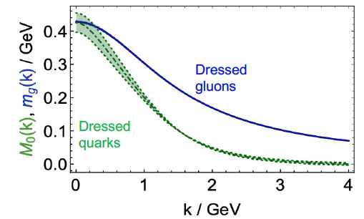
Bound 3 Quark Structure of N∗s and Emergence of Mass
Continuum Schwinger Method
  QCD equations of motion for q/g fields reveal existence of dressed q/g with momentum-dependent masses.
Q² evolution of the γ_{v}pN* electrocouplings could offer an insight into hadron mass generation and the emergence of the N* structure from QCD
Simulations indicate JLab22 is the only foreseeable facility to extend these measurements up to 30 GeV²
12
12

Slide 13
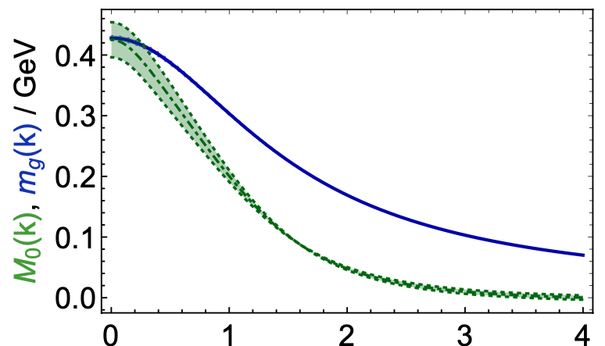
Bound 3 Quark Structure of N∗s and Emergence of Mass
Continuum Schwinger Method
  QCD equations of motion for q/g fields reveal existence of dressed q/g with momentum-dependent masses.
Dressed gluons
Dressed quarks
p _{quark} (GeV)
Q² evolution of the γvpN* electrocouplings could offer an insight into hadron mass generation and the emergence of the N* structure from QCD
15-20%
40-50%
>80%
6 GeV
12 GeV
22 GeV
Simulations indicate JLab22 is the only foreseeable facility to extend these measurements up to 30 GeV²
Q² range(<35 GeV²) where the dominant portion of hadron mass is expected to be generated
13
13

Slide 14

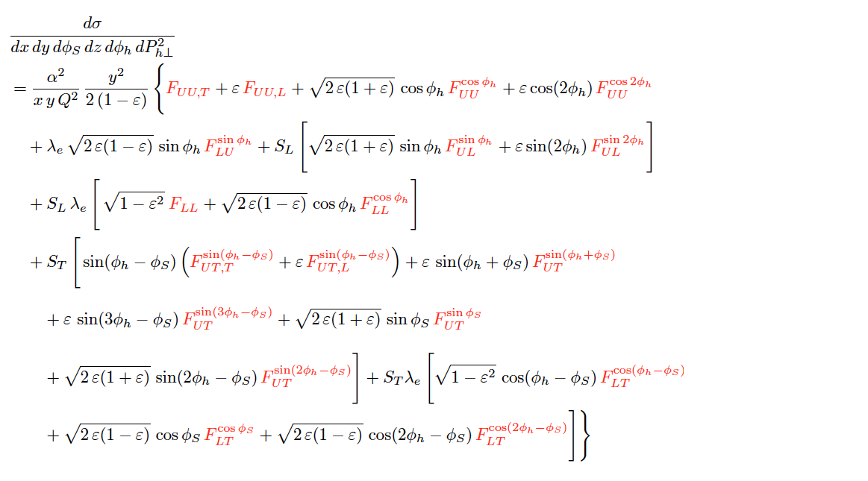
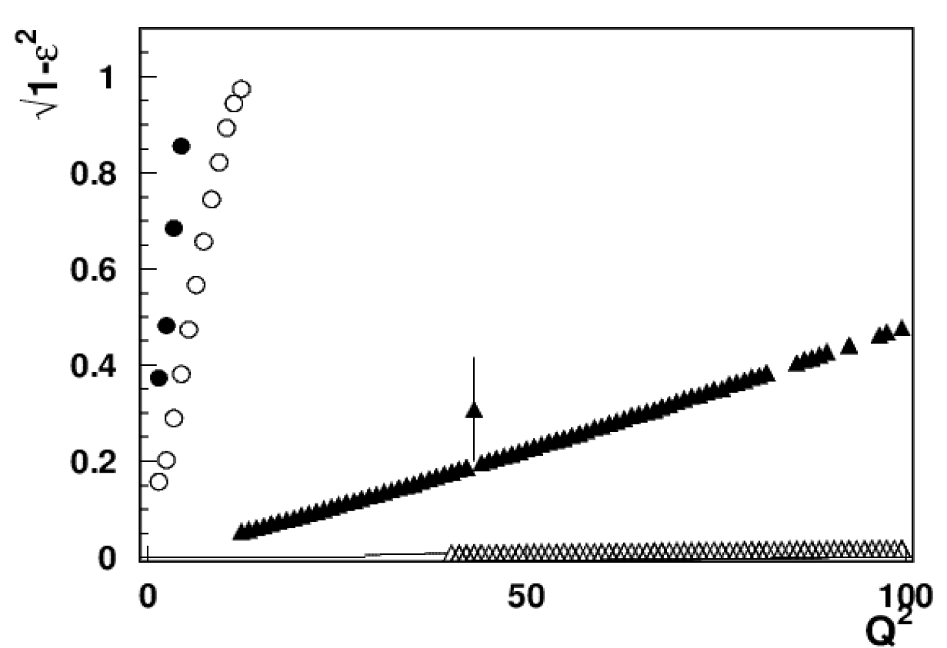
Nucleon Structure in 3D
SIDIS cross section
Separation of SFs highly non-trivial!
At large x fixed target experiments are sensitive to ALL structure functions
σ = f ( x , Q² , z , P_{T})
CLAS12
X=0.3
CLAS24
EIC 5x41
EIC 18x275
A combined 11, 22 GeV and EIC SIDIS program
will increase our ability to measure a variety of SIDIS SFs across an enhanced multidimensional phase space – the only way to test and validate our understanding and interpretation of SIDIS reactions.
14
14

Slide 15
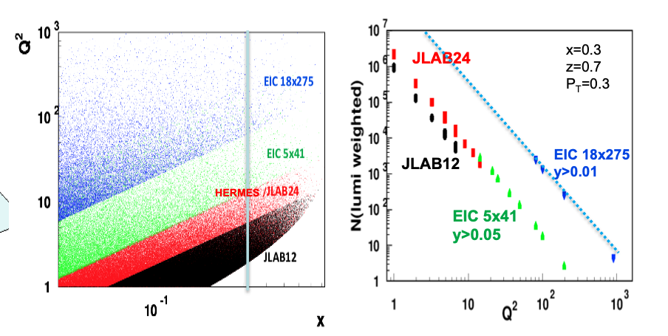
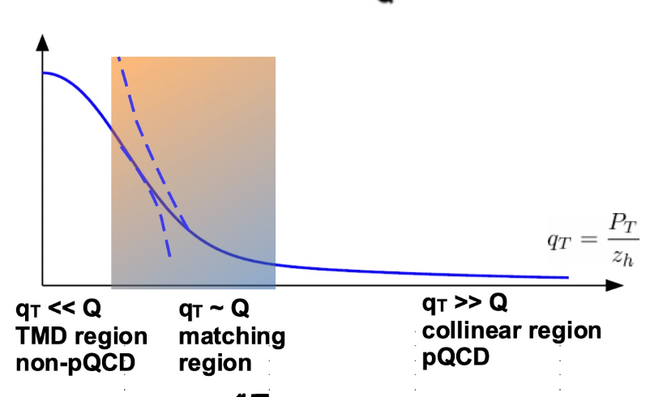
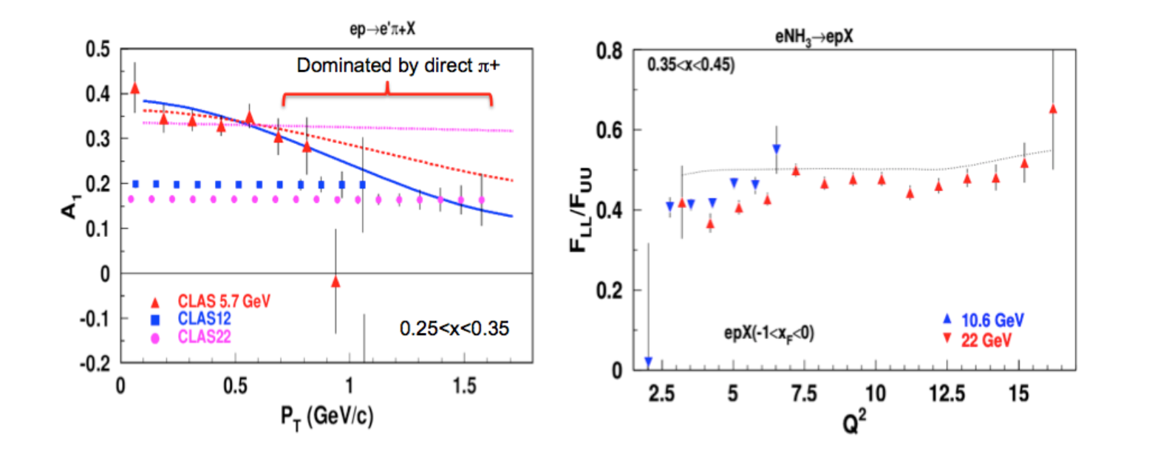
SIDIS Phase Space at 22 GeV
QCD predicts only the Q²-dependence
How is QCD manifested in the matching region?
2
double spin asymmetry

Slide 16
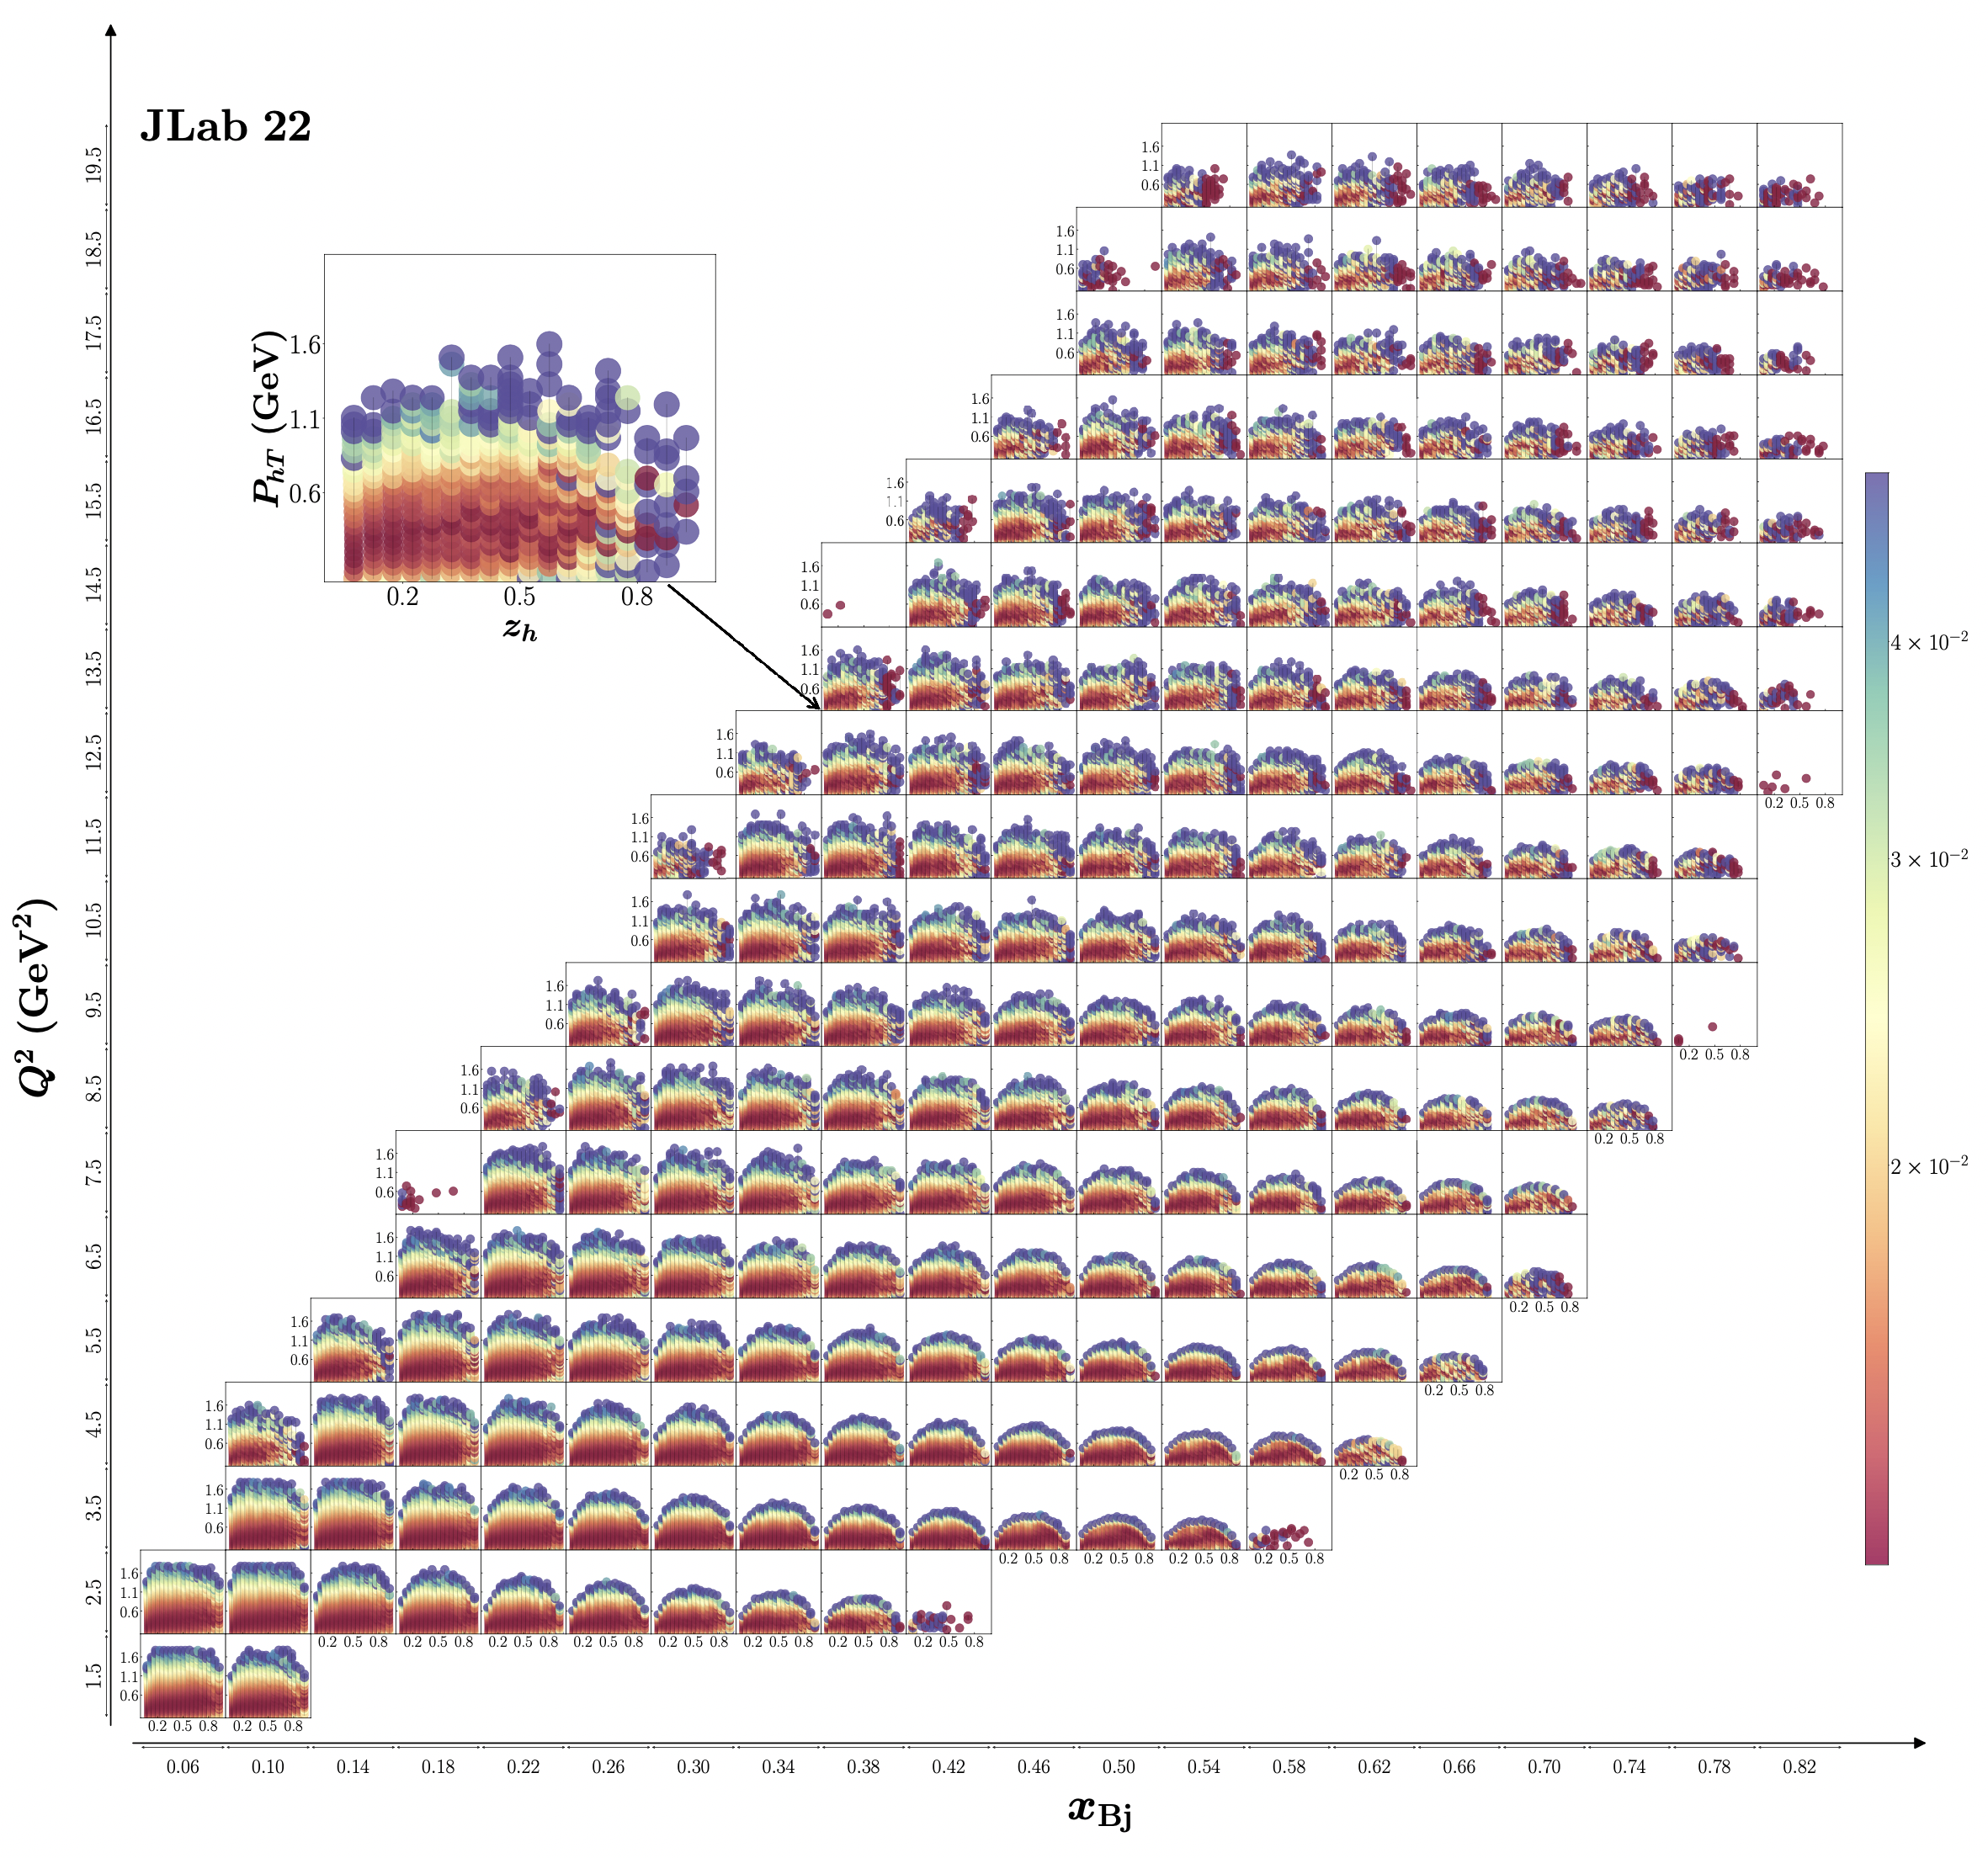
SIDIS Phase Space at 22 GeV
20
Expected uncertainties for SIDIS cross sections in 4D bins
P_{hT}
Significantly increase the kinematic range to validate/test the theory/phenomenology
Multi-dimensional coverage of P_{T} gives access to fine binning of all observables
Projections using the existing CLAS12 simulation/reconstruction chain for 100 days of running with L= 10³⁵ cm²s⁻¹
10⁻²
Q² (GeV²)
z_{h}
1
0
1
x

Slide 17
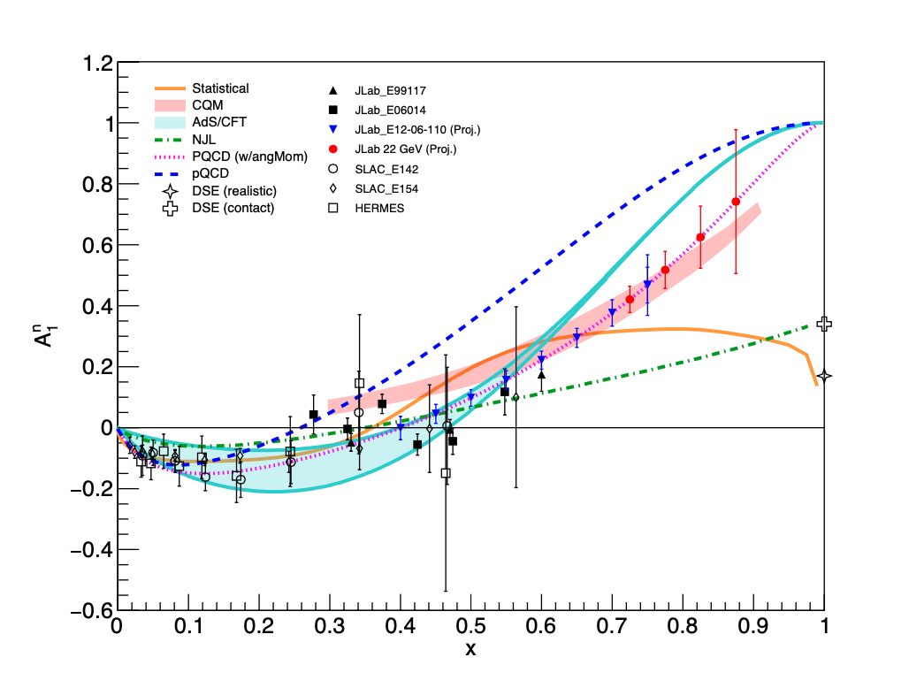
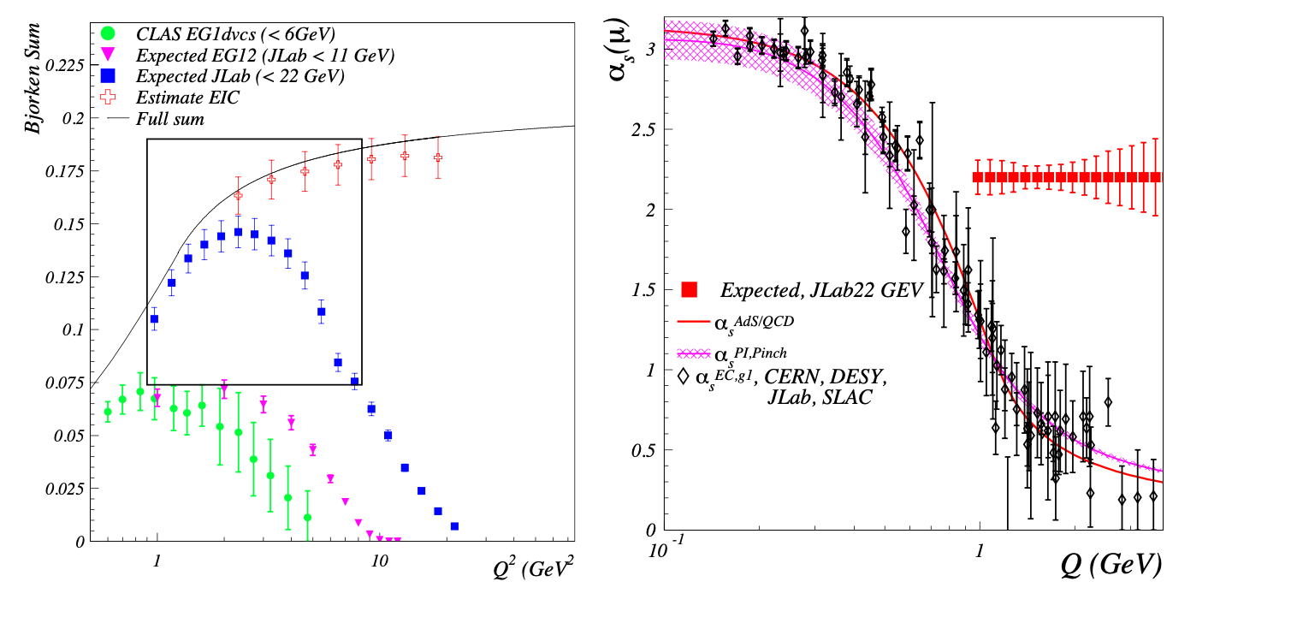
Polarized Structure Functions and α_{s}
Extend the precision and kinematic reach of polarized structure functions
Bjorken Sum Rule
A₁^{n}
The strong coupling constant is a key parameter of the Standard Model
Its current uncertainty is the least precise among all fundamental couplings
α_{s}
Q
1
Q²

Slide 18
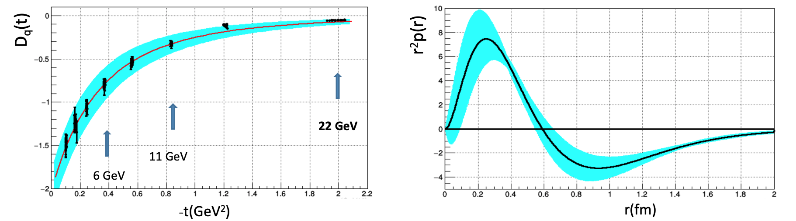
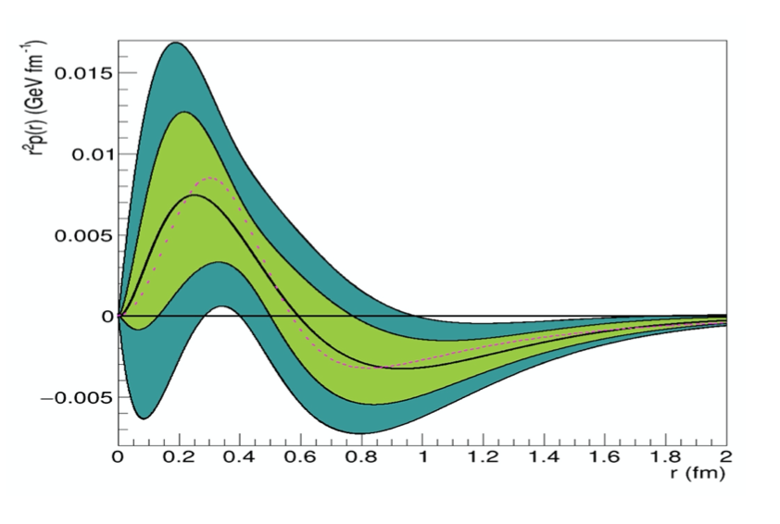
Spacial Structure & Mechanical Properties of the Proton
Form Factors: source of information on hadron structure
Gravitational FFs (GFFs) : describe how energy, spin, and various mechanical properties of hadrons are carried by q/g constituents.
GFF D(t): describes the pressure distribution in the nucleon. It is accessible through measurements of the Compton FFs measured in Deeply Virtual Compton Scattering
Simulation @ 22 GeV
data @ 6 GeV
A large -t range is required to perform the Fourier transform with controlled uncertainties ➜ high luminosity
➜
The 22 GeV beam energy is crucial to this program
22 GeV
18
18

Slide 19
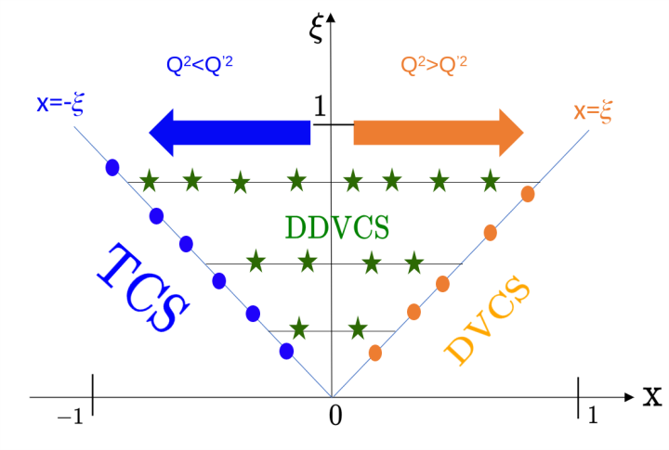
Spacial Structure & Mechanical Properties of the Proton
Form Factors: source of information on hadron structure
Gravitational FFs (GFFs) : describe how energy, spin, and various mechanical properties of hadrons are carried by q/g constituents.
GFF D(t): describes the pressure distribution in the nucleon. It is accessible through measurements of the Compton FFs measured in Deeply Virtual Compton Scattering
Simulation @ 22 GeV
data @ 6 GeV
A large -t range is required to perform the Fourier transform with controlled uncertainties ➜ high luminosity
➜
The 22 GeV beam energy is crucial to this program
Double DVCS (DDVCS)
NEVER been measured (very small cross section).➜ JLAB with high luminosity will be the only place to measure this reaction.
22 GeV
19
19

Slide 20
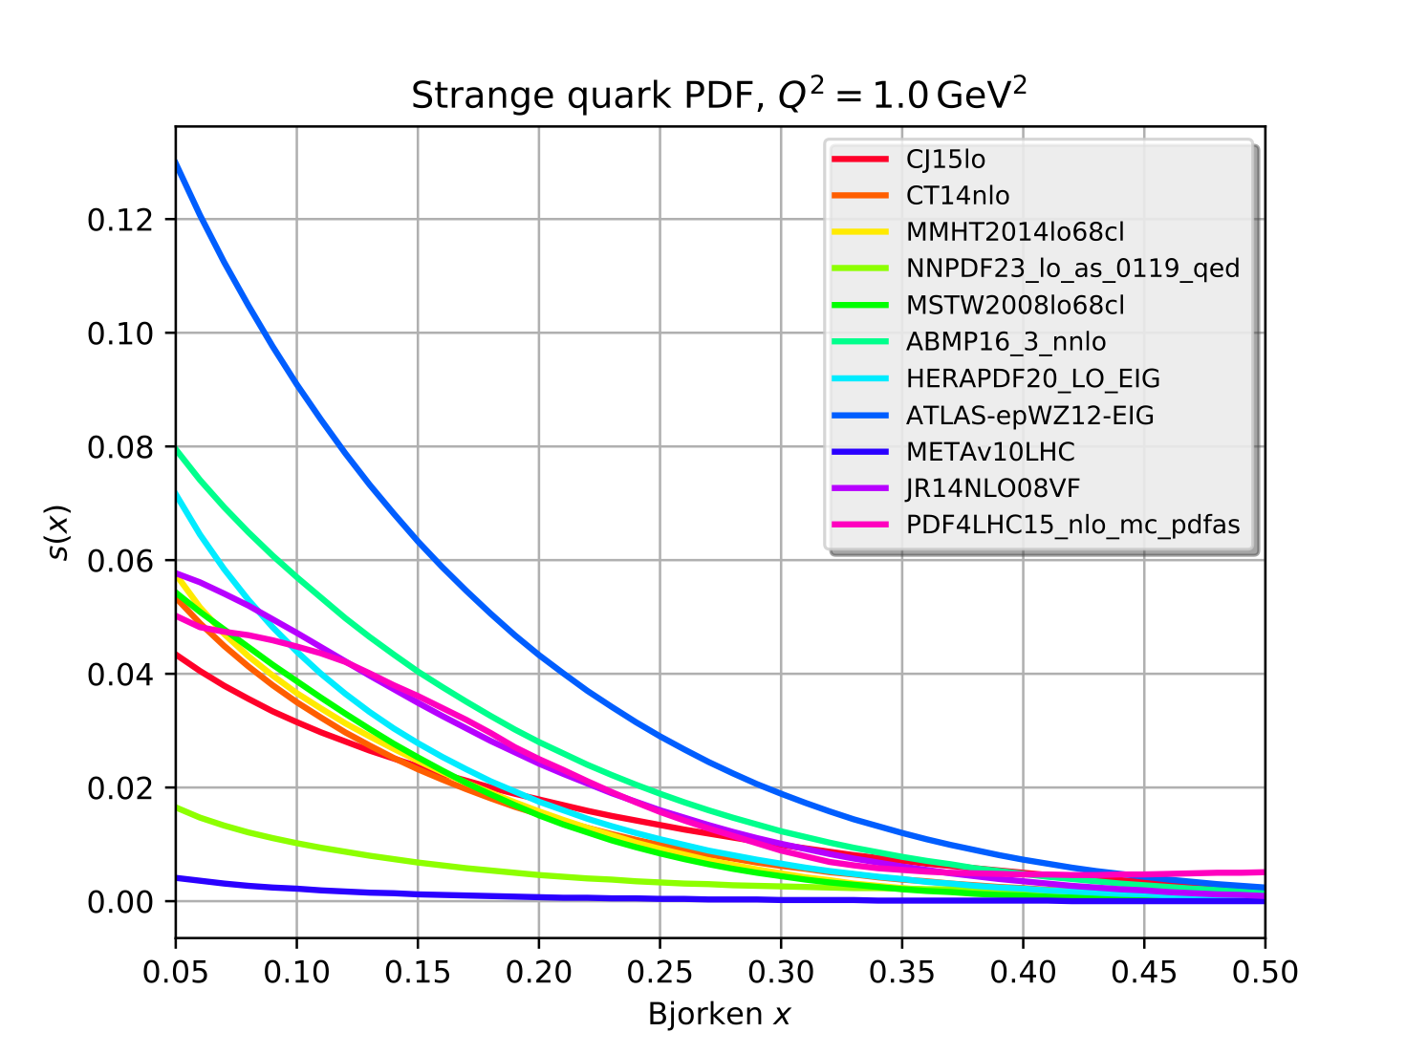
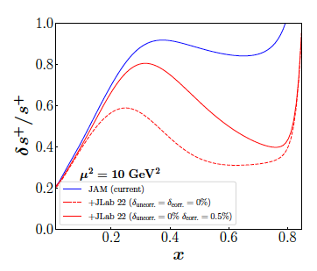
Unambiguous Access to Strange Quarks
Current Situation
Parity-violating DIS
di-muon production in neutrino-nucleus scattering – nuclear corrections introduce significant uncertainty
W and Z rapidity distributions
W+c production
Semi-inclusive K production: choice of fragmentation function negates inclusion in global fits
JLab12 Q² too low for PDF analysis
Parity-violating DIS allows strange contribution to be isolated when combined with p,n data
Valence regime provides strength and shape
Substantial improvement with a reduction in the uncertainty that can reach more than a factor two at large-x
LHC results inconclusive
LO
~100 days, 40 μA beam split between 40 cm D and H targets
Order of magnitude differences!
x
20

Slide 21
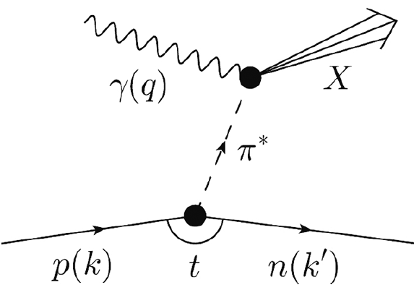
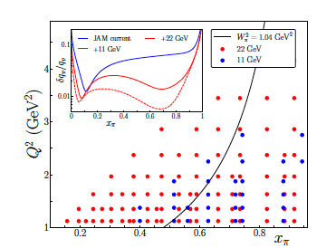
Partonic Structure of Mesons
Meson structure
Tagged deep inelastic scattering (TDIS) provides a mechanism to access the meson structure via the Sullivan process .
A cut of W² π > 1.04 GeV² (to avoid contributions from resonances in a pion analysis,) eliminates most of the data at 11 GeV.
At 22 GeV:
Available phase space significantly increased
➔ large improvement in the determination of the valence structure of the pion
➔ kin. coverage to smaller x_{π} region to probe the sea content of mesons
Overlap the existing π induced DY data
➔ test the universality of PDFs in the mid to large x_{π} region
➔ pion PDF predicted to be broader than the proton PDF
21
21

Slide 22
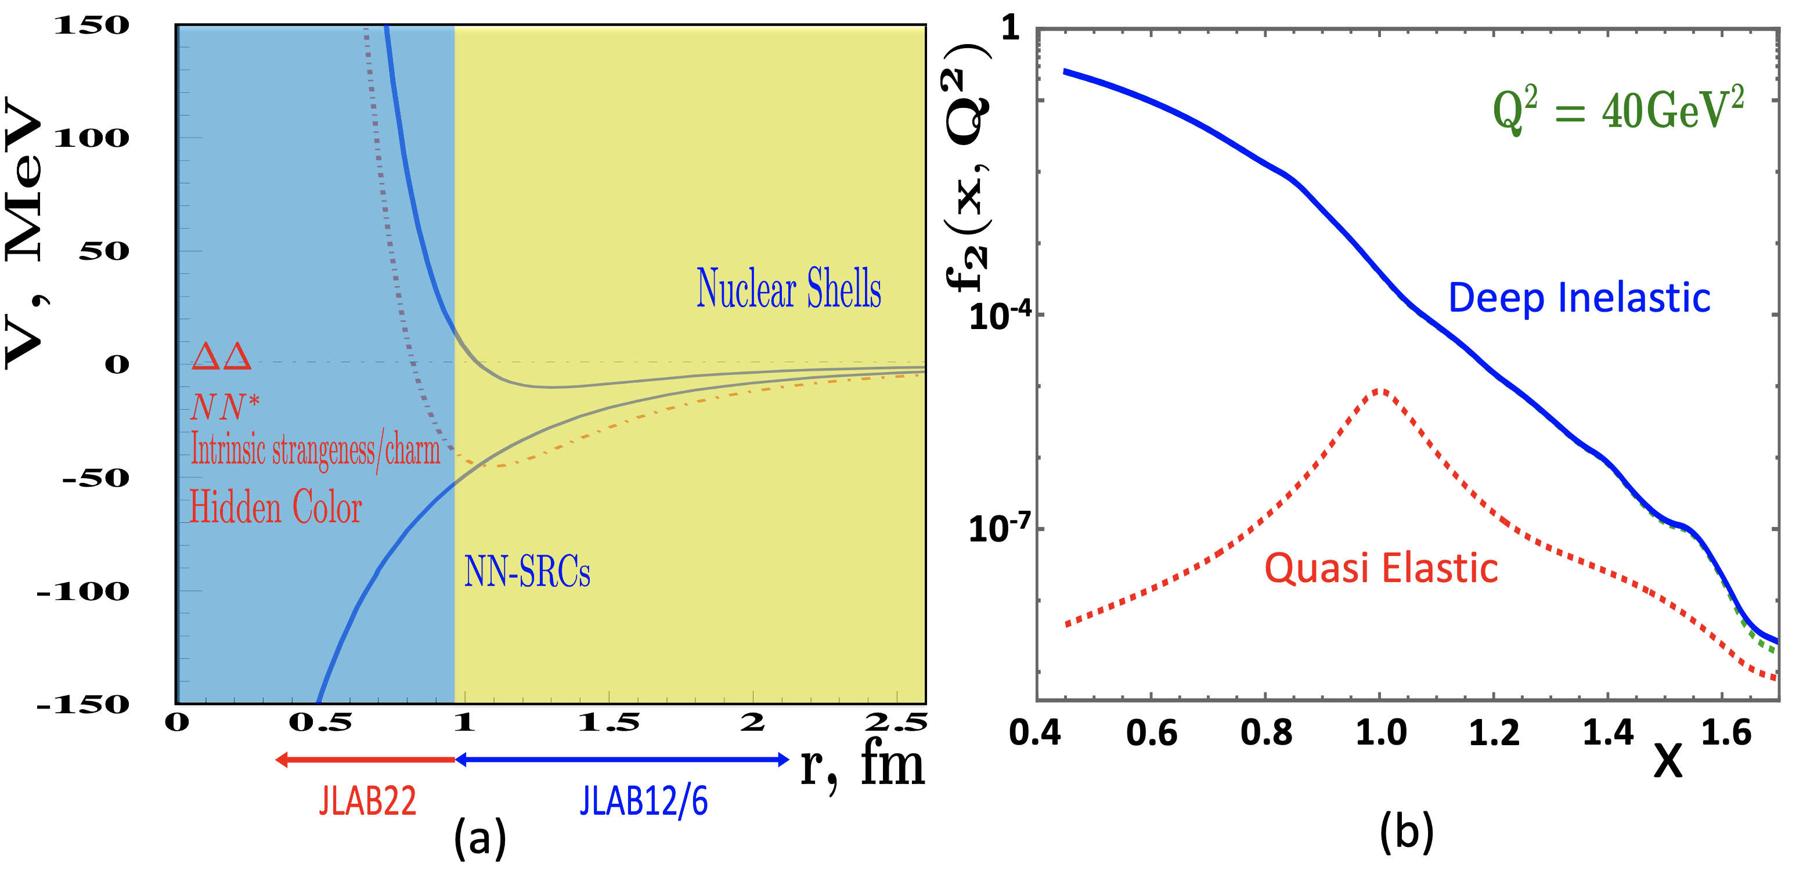
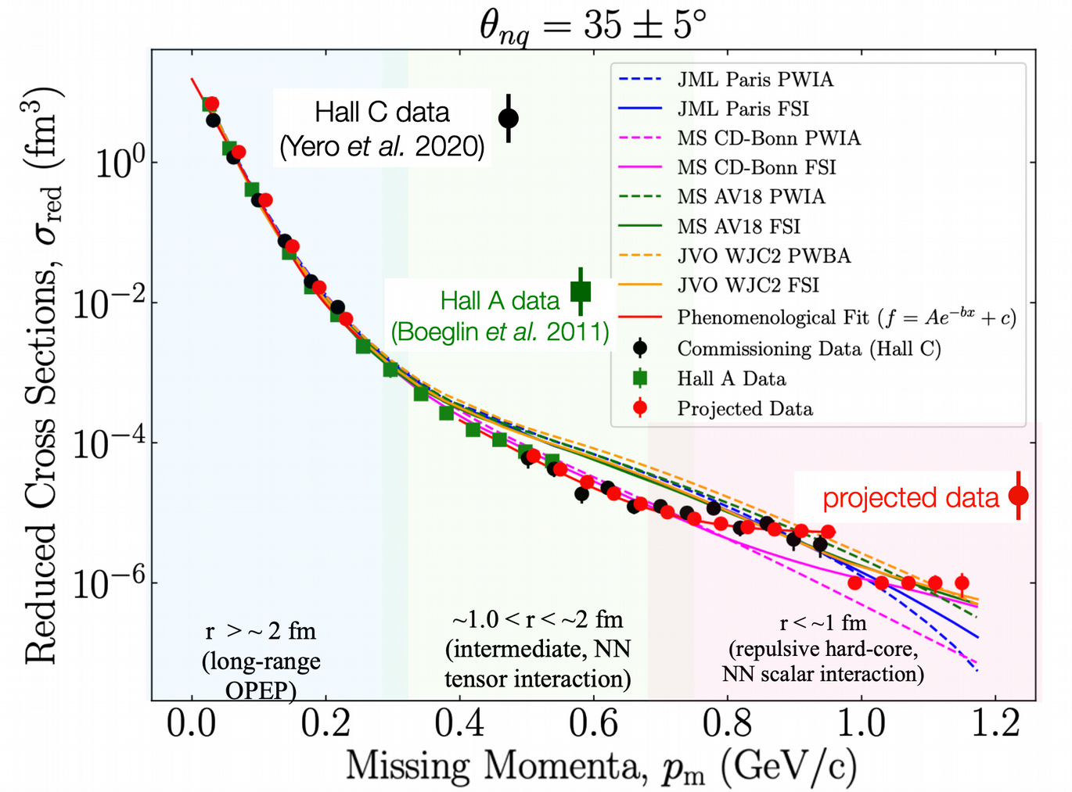
Nuclear Dynamics at Extreme Conditions
The dynamics of the nuclear repulsive core is still poorly understood
A 22 GeV upgrade will provide reach to the nuclear forces dominated by nuclear repulsion
Superfast Quarks
The high Q² reach will allow
  the suppression of quasi-elastic contributions,
  the first-ever study of nuclear DIS structure function at Bjorken x > 1.2 (r∼ 0.5 fm,)
Exploring Deuteron at Very Large Internal Momenta (> 800 MeV/c – non-nucleonic & hidden color components)
non-relativistic theory reproduces data up to pm ∼ 0.7 GeV/c
no model reproduces data (non-nucleonic degrees of freedom?, quarks?) pm > 0.7 GeV/c
22
22

Slide 23
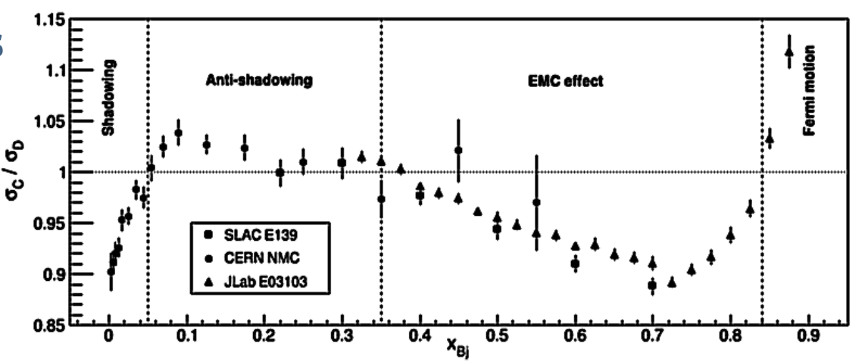
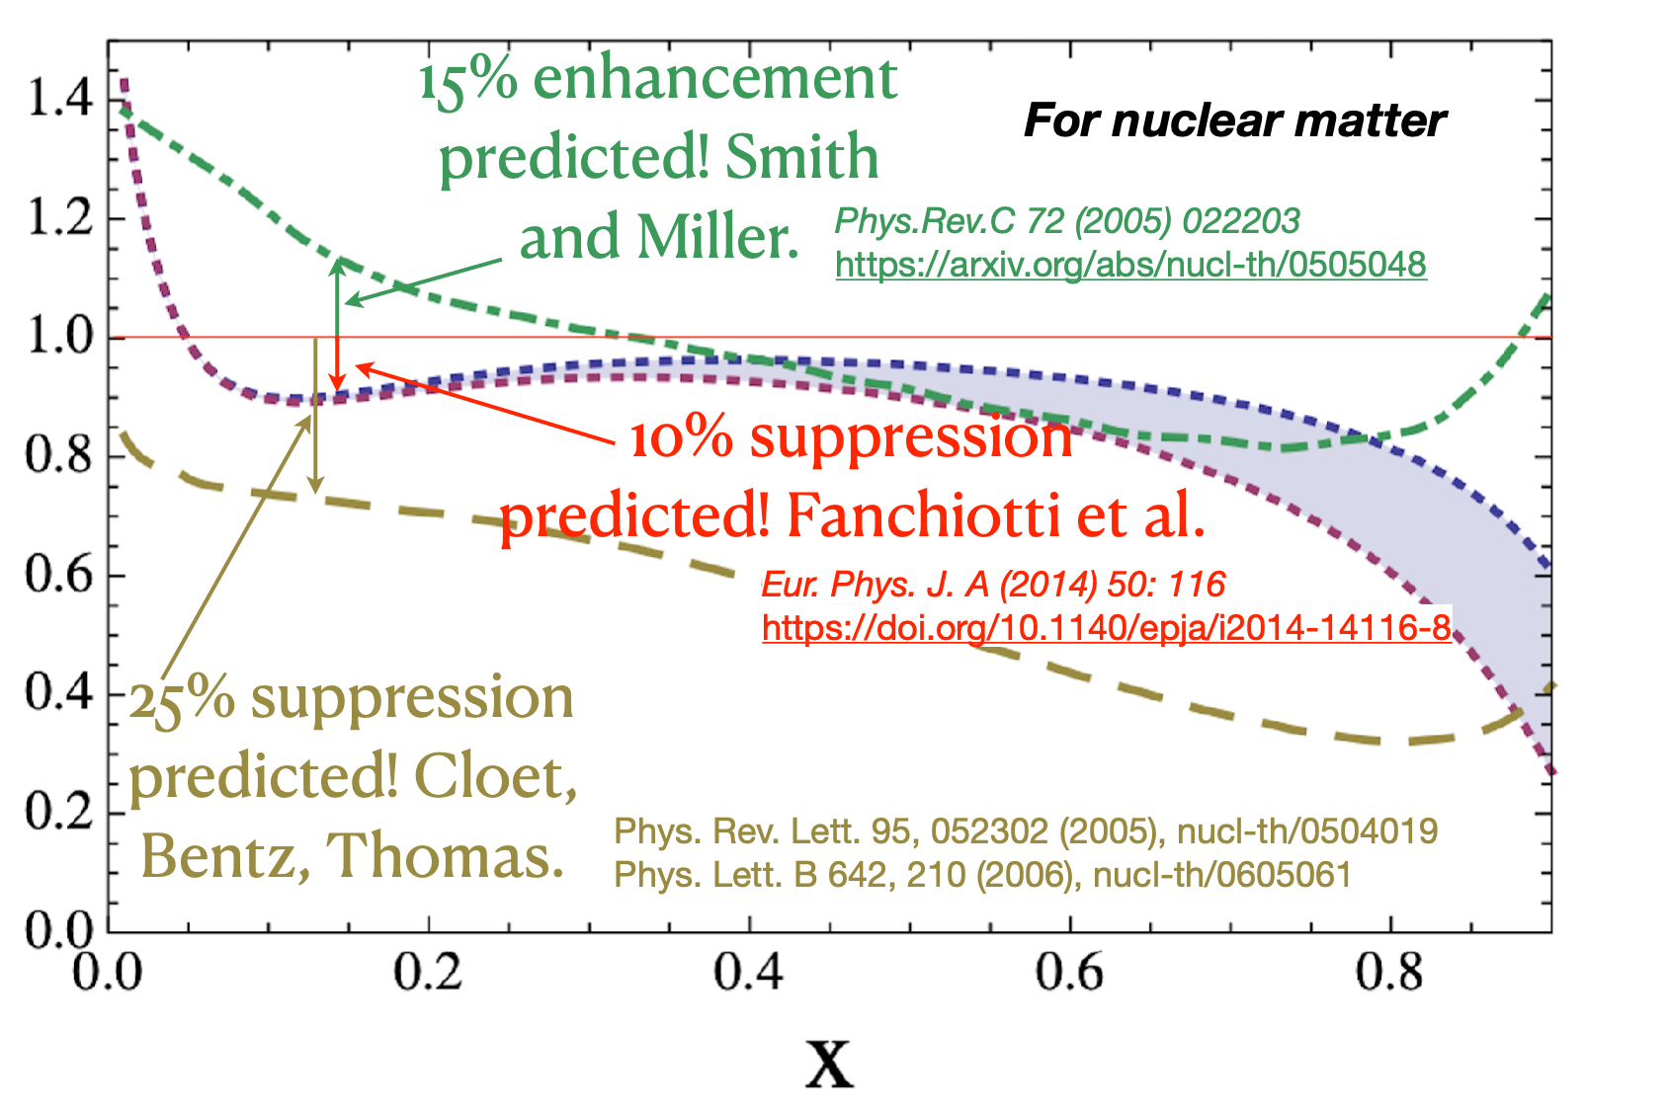
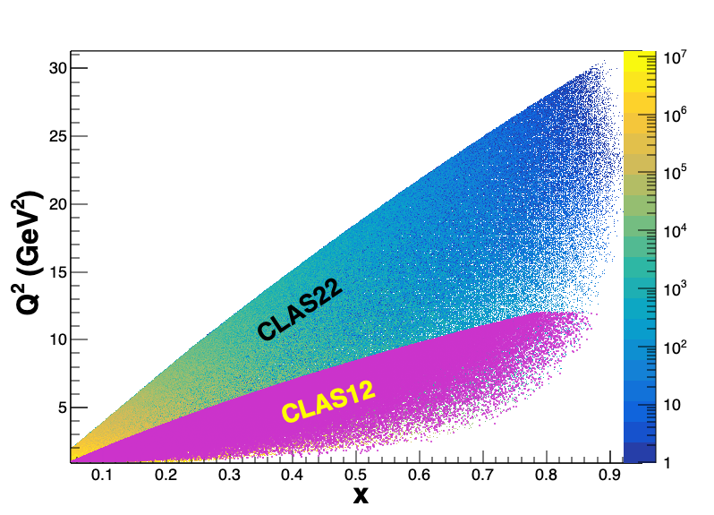
Anti-shadowing: solving a multi-decade puzzle
Small!
With a 22 GeV e- beam JLab can access the anti-shadowing region (x~0.1-0.3) at moderate Q²
Region extremely interesting, near-equally dominated by valence quarks, sea-quarks, and gluons → many many models!!
Anti-Shadowing is the least studied nuclear structure function effect experimentally – small effect requiring precision and high luminosity
  flavor dependence essentially uncharted
  spin dependence essentially uncharted (~50% differences in predictions)
  no tagged measurements
  no L/T separations
Theory predictions for polarized structure function A/D ratios
A rigorous testing ground between shadowing, EMC regimes – models and theory must describe ALL
23

Slide 24
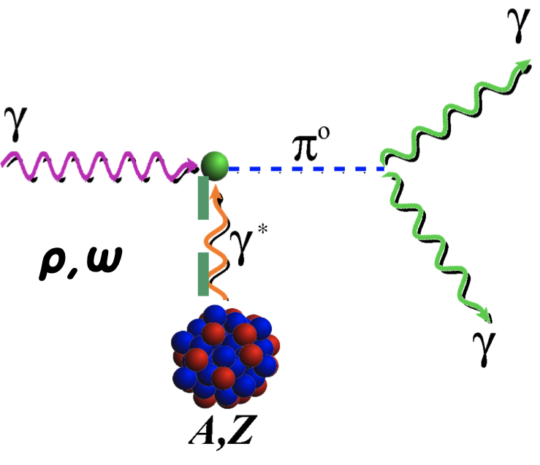
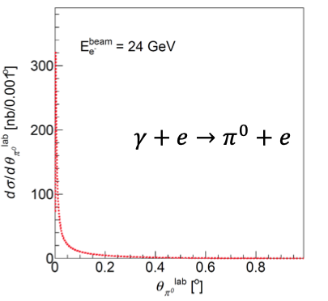
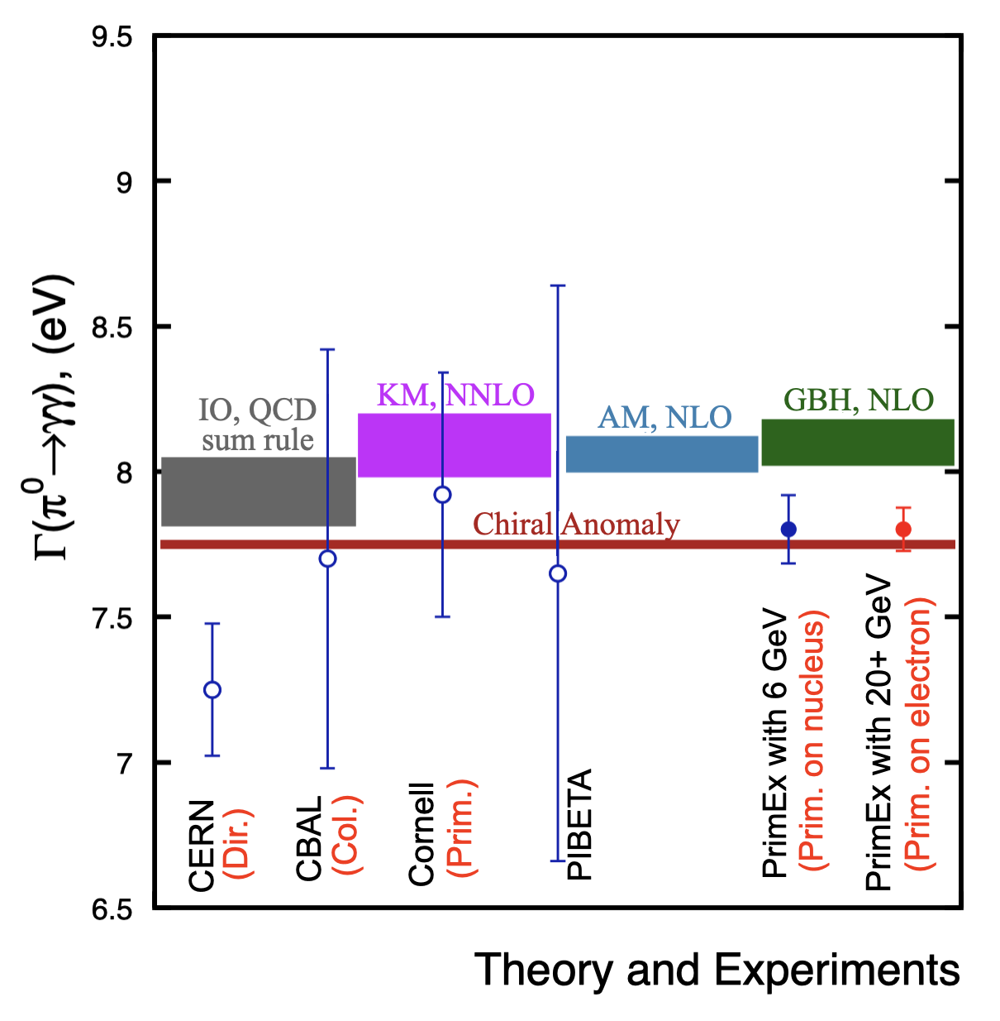
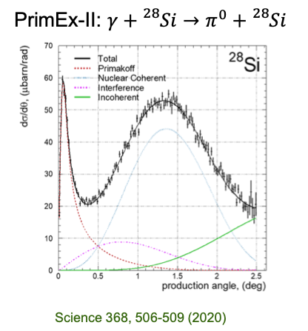
QCD Confinement and Fundamental Symmetries
π⁰ Primakoff production off an electron target
Γ(π⁰ → γγ) can be predicted at ≈ 1% precision
Higher energy will allow for η’
The threshold for photo- or electroproduction of π⁰ off an electron target is 18 GeV
Stringent test of low-energy QCD
Primakoff production off nuclear target
A 22 GeV upgrade will greatly enhance the Primakoff experiments for more massive mesons off nuclear target
first Primakoff measurement of Γ(η′ → γγ) with ∼3.5% precision to study the U(1)A anomaly coupling to the gluon field,
improve the measurement of Γ(η → γγ) to a 2% accuracy to determine the light-quark mass ratio
24
24

Slide 25
Conclusions and Outlook
Understanding the strong interaction dynamics of non-pQCD and ``how'' hadrons/nuclei emerge from fundamental QCD principles, is a complex problem
This complexity requires observation of the chromodynamic fields ``at work’’ through multiple observables using different approaches and measurements
With CEBAF at higher energy some important thresholds would be crossed and an energy window which sits between JLab @ 12 GeV and the EIC would be available. This, together with CEBAF uniqueness to run electron scattering experiments at the luminosity frontier, can provide powerful insight into non-pQCD dynamics.
A very strong science case for such an upgrade is emerging
Polarized gluon distribution, longitudinal/transverse separations, hadron formation in nuclei, meson form factors, probing the light quark sea,……. and more!
25
25

Slide 26
Thank you!
Thank you for listening, and thanks also to the scientific community (400+) working on developing this exciting science case
26

Slide 27
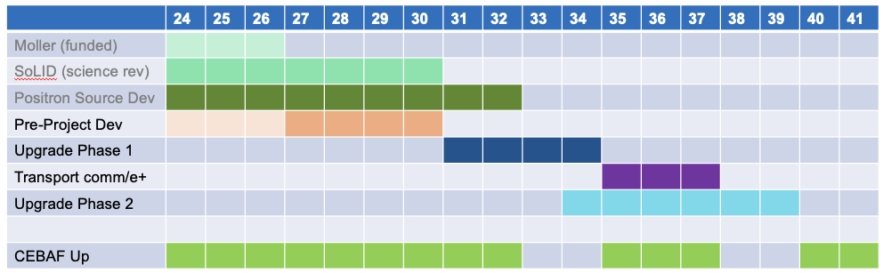
Notional CEBAF & upgrade schedule (FY24 – FY42)
Accelerator and engineering team have worked up an early schedule and cost estimate
  Schedule assumptions based on a notional timing of when funds might be available (near EIC ramp down based on EIC V3 profile)
  For completeness, Moller and SoLID (part of 12 GeV program) are shown; positron source development also shown
27

Slide 28
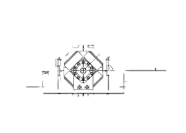
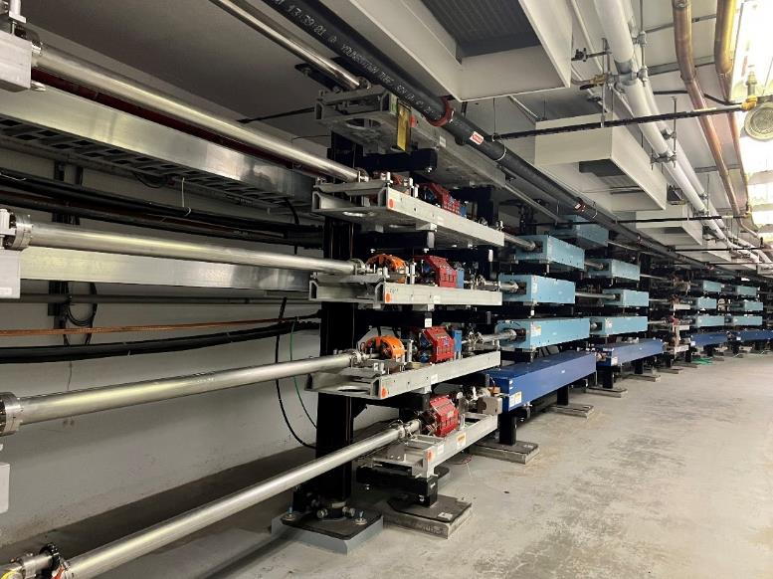


Transport and Upgrade CEBAF to 22 GeV
Remove top pass of Dipoles and Quad girders
All passes of Dipoles and Quad girders move up one level for FFA arc installation
Running girder transport line at aisle side corner of tunnel
Potential to use a “sit-in” style girder for smaller profile
after 6 FFA passes →

