Slide 1
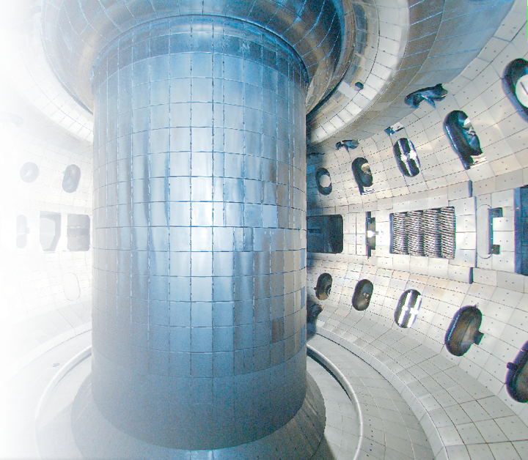

A research program to measure the lifetime of spin polarized nuclei in magnetically confined fusion plasmas
W.W. (Bill) Heidbrink¹, L.R. Baylor², M. Büscher^{3,4}, R.W. Engels^{3,5}, C.B. Forest⁶, A.V. Garcia¹, M. Gryaznevich⁷, G.W. Miller⁸, A.M. Sandorfi⁸, X. Wei⁹, X. Zheng⁸
¹University of California, Irvine
²Oak Ridge National Laboratory
³Forschungsszentrum Jülich
⁴Heinrich-Heine Universität Düsseldorf
⁵GSI Helmholtzzentrum für Schwerionenforschung ⁶University of Wisconsin, Madison
⁷Tokamak Energy, Milton, UK
⁸University of Virginia
⁹Jefferson Lab
The DIII-D Tokamak in San Diego

Slide 2
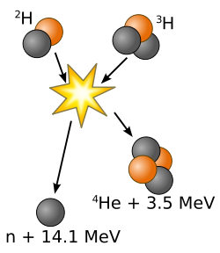
Spin polarized fuel relaxes the requirements for fusion energy
D-T fusion cross-section is increased by 50% when the spins of both nuclei are polarized along the magnetic field¹
Due to self-heating, >50% increase in fusion power with no additional requirement on plasma confinement²
Depolarization mechanisms are theoretically weak in the core,¹ but the polarization lifetime has never been measured
Polarized fuel is now available in sufficient quantities for experimental tests²
[1] R.M. Kulsrud et al., Nucl. Fusion 26 (1986) 1443.
[2] L. Baylor et al., Nucl. Fusion 63 (2023) 076009
Notes:
Cite PRO

Slide 3
Outline
Fusion in contemporary magnetic fusion experiments
Spin polarized fuel
Depolarization mechanisms
Planned & desired experiments
Notes:
Cite PRO

Slide 4
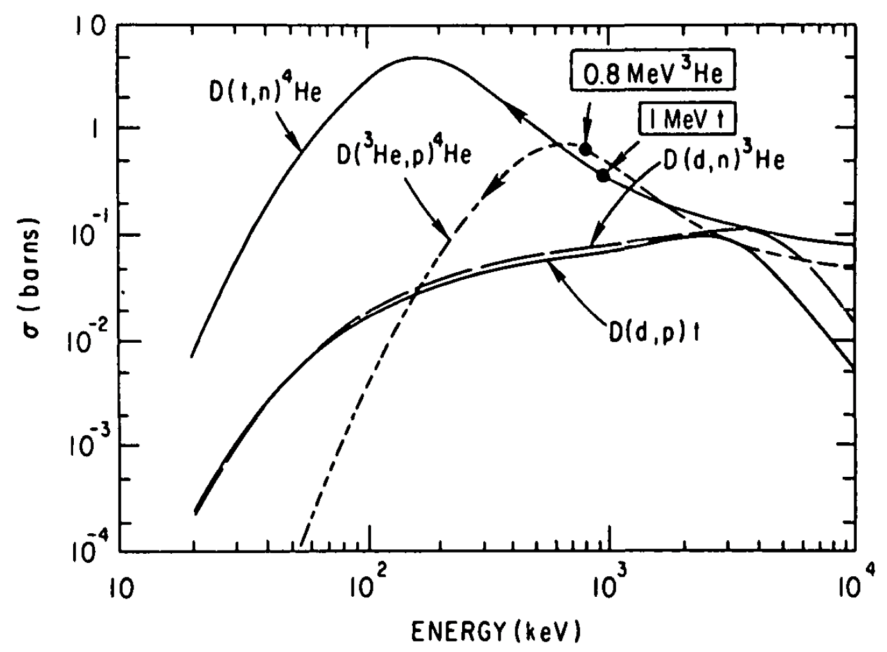
Three fusion reactions are often measured in fusion experiments
Deuterium is usually the main ion species
Many fusion reaction products are unconfined in a moderate-size tokamak
Heidbrink et al., Nucl. Fusion 23 (1983) 917
Notes:
Cite PRO

Slide 5
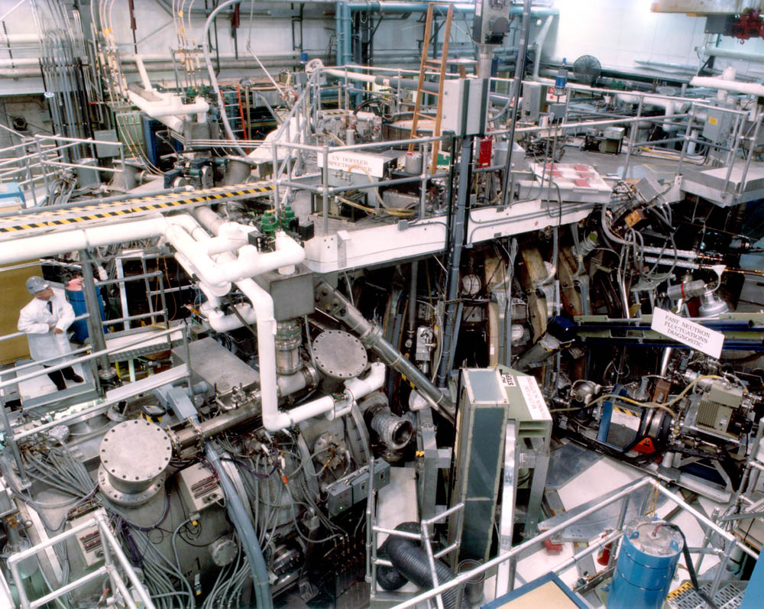
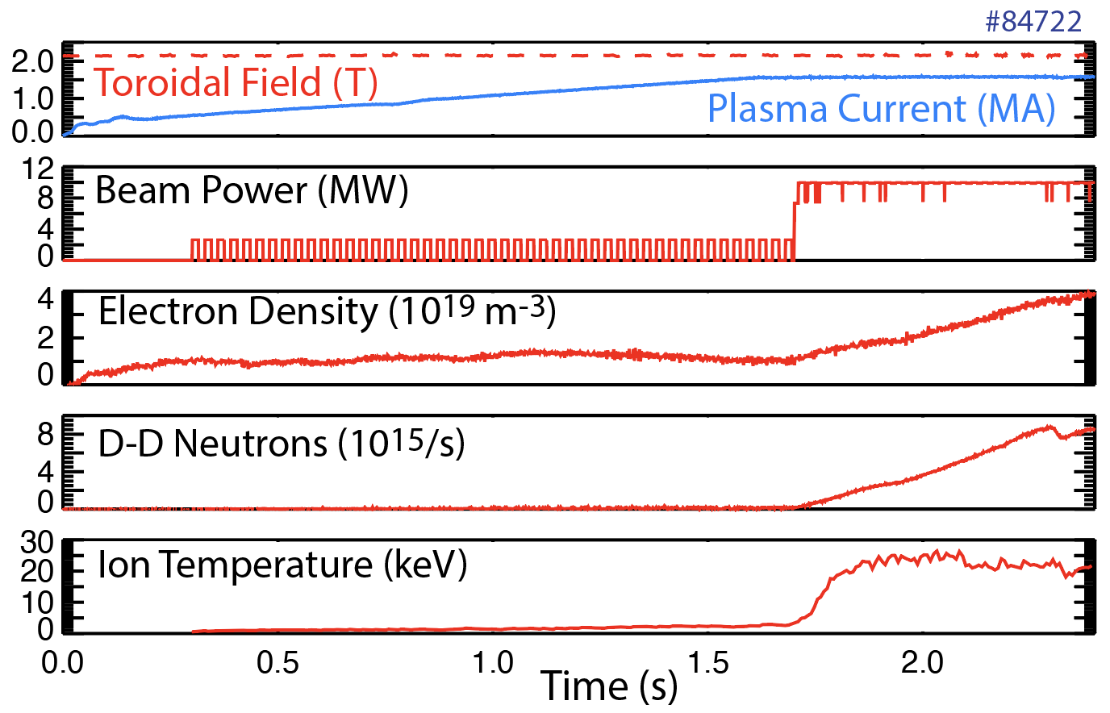

Many experiments are heated by neutral beams
Inject ~ 80 keV D neutrals
Beam ions take O(0.1 s) to thermalize
Routinely measure 2.45 MeV neutrons from d(d,n)³He
Notes:
Cite PRO

Slide 6
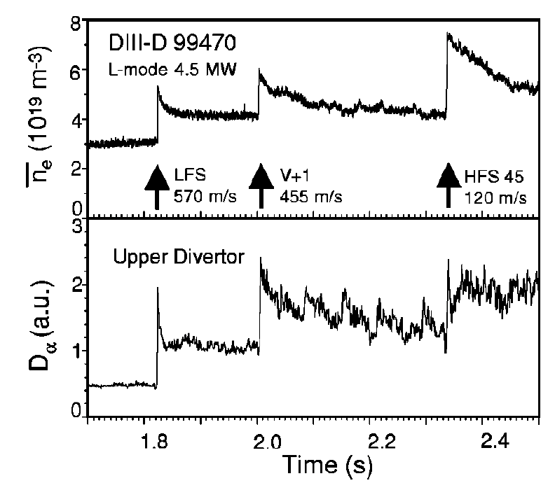
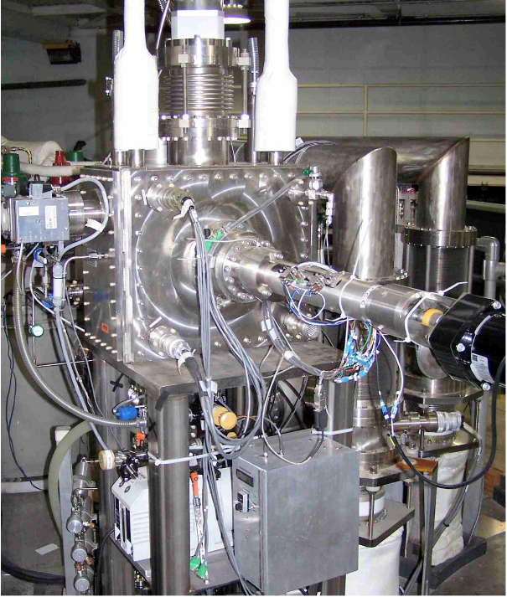
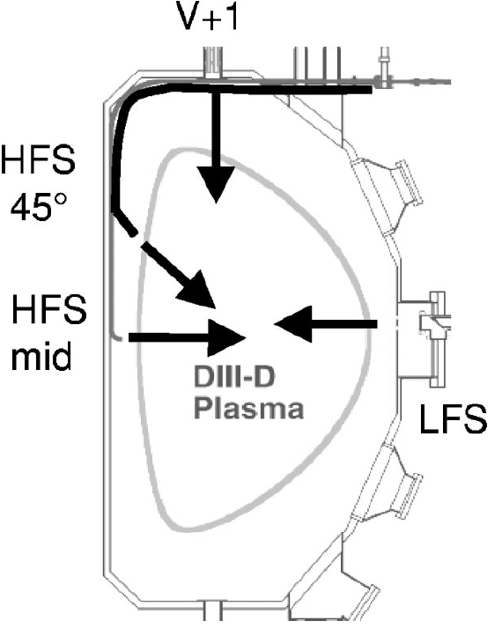

Some experiments are fueled by pellets that ablate & ionize in the plasma
Inject frozen D pellets
Inject ”shell pellets” with gas inside
Typical “particle confinement time” is O(0.1 s)
Electron density
Pellet injector above DIII-D
L. Baylor et al., Phys. Plasmas 7 (2000) 1878
Notes:
Cite PRO

Slide 7
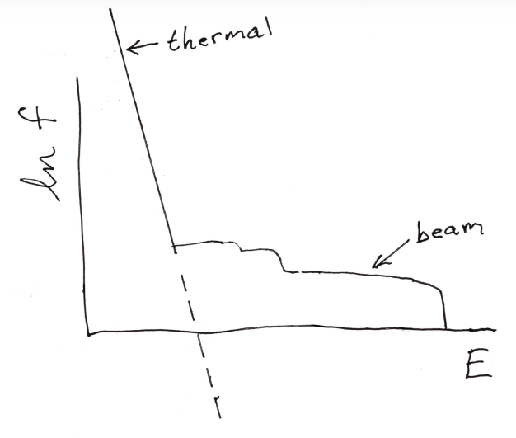
Distinguish between thermal & super-thermal distribution functions
Most of the plasma is thermal with ion temperatures T_{i} of a few keV
Neutral beams produce non-thermal, anisotropic populations with O(100 keV) energies
Beam-plasma
Typical D distribution function f
Notes:
Cite PRO

Slide 8
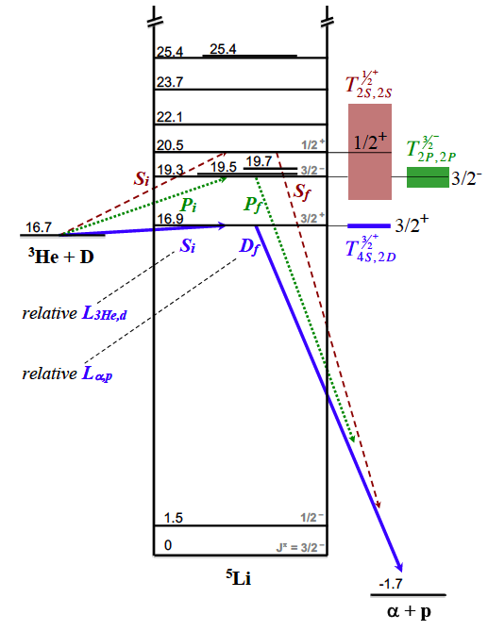
Use D-³He as a proxy for D-T
Mirror reaction virtually identical at O(100 keV) energies
Fusion products:
14.7 MeV proton
3.6 MeV alpha
L. Baylor et al., Nucl. Fusion 63 (2023) 076009
Notes:
Cite PRO

Slide 9
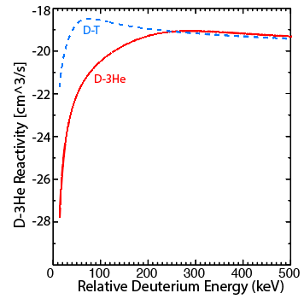
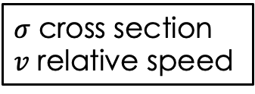

Relative reactant energies of ~100 keV are needed for a D-³He experiment
Semilog scale
$$σv$$
$σ$ cross section
$v$ relative speed

Slide 10

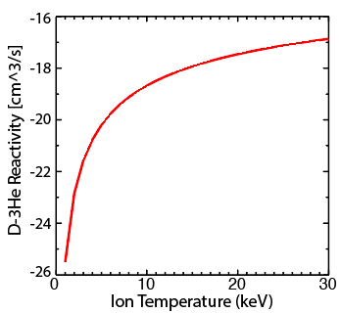
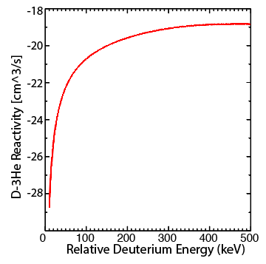
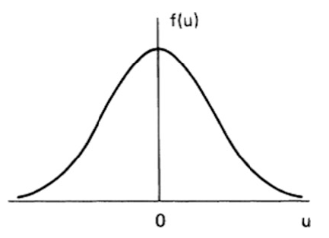


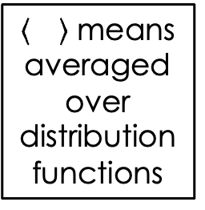
For adequate count rate, require either 100 keV fast ions or T_{i} > 10 keV
Semilog scale
Semilog scale
$$σv$$
$$\left\langle σv\right\rangle$$
means averaged over distribution functions
Beam-plasma
Thermonuclear
Beam-Plasma reactions
Thermonuclear reactions

Slide 11
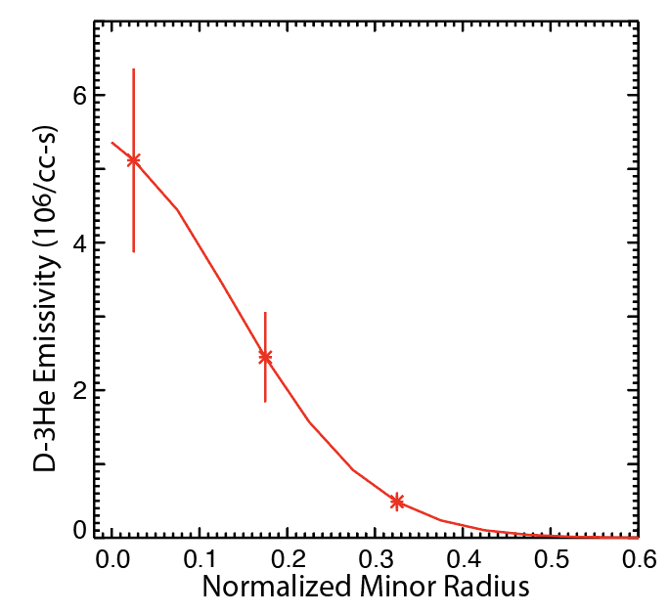
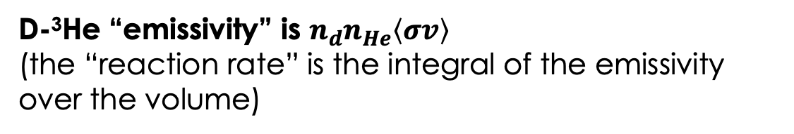

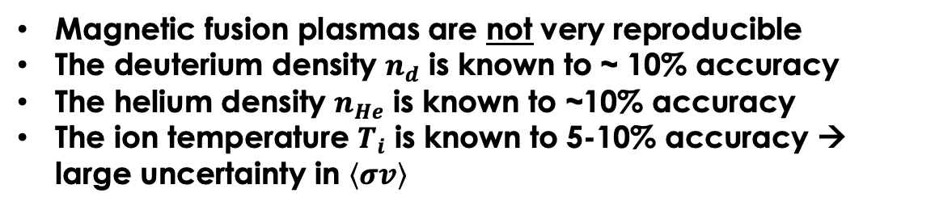
Must use relative measurements of the differential cross section to measure the polarization accurately*
D-³He “emissivity” is $n_{d}n_{He}\left\langle σv\right\rangle$
(the “reaction rate” is the integral of the emissivity over the volume)
$n_{d}n_{He}\left\langle σv\right\rangle$
Magnetic fusion plasmas are not very reproducible
The deuterium density $n_{d}$ is known to ~ 10% accuracy
The helium density $n_{He}$ is known to ~10% accuracy
The ion temperature $T_{i}$ is known to 5-10% accuracy → large uncertainty in $\left\langle σv\right\rangle$
→ Uncertainty in reaction rate > effect of polarization
*A.V. Garcia et al., Nucl. Fusion 63 (2023) 026030
Notes:
TODO: Not sure how to make this flow

Slide 12
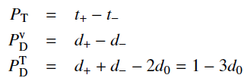

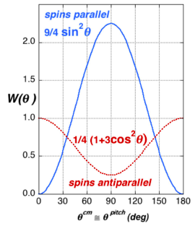
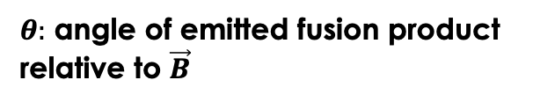
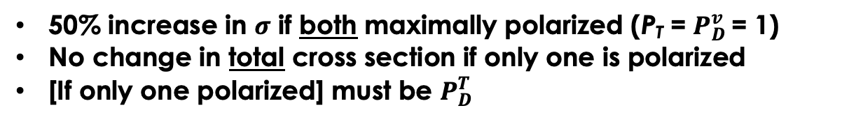
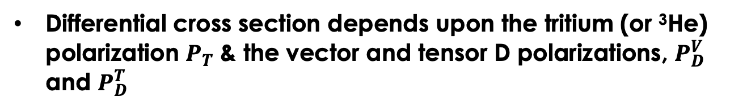
Use relative measurements of the differential cross section to measure polarization
Differential cross section depends upon the tritium (or ³He) polarization $P_{T}$ & the vector and tensor D polarizations, $P_{D}^{V}$ and $P_{D}^{T}$
$θ:$ angle of emitted fusion product relative to $\vec{B}$
50% increase in $σ$ if both maximally polarized (P_{T} = $P_{D}^{v}$ = 1)
No change in total cross section if only one is polarized
[If only one polarized] must be $P_{D}^{T}$
The relative change in emitted perp/parallel fusion-product signal is sensitive to polarization
isotropic
Persistence of polarized signal → lifetime measurement
L. Baylor et al., Nucl. Fusion 63 (2023) 076009
Notes:
TODO: Not sure how to make this flow

Slide 13
Outline
Fusion: Use D-³He differential cross section to test 50% enhancement in D-T cross section
Spin Polarized Fuel
Depolarization Mechanisms
Possible experiments
Notes:
Cite PRO

Slide 14
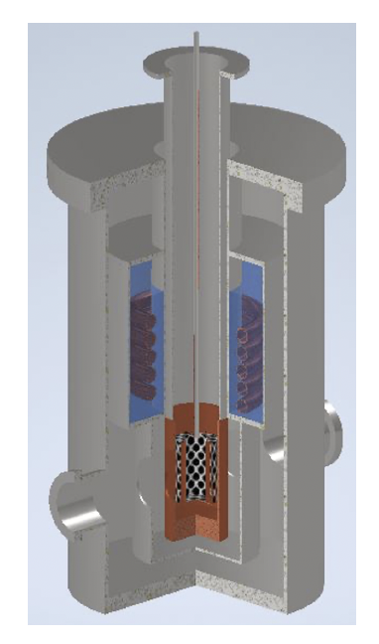

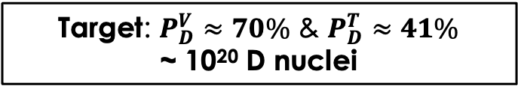
Deliver deuterium as a solid ⁷Li-D pellet*
Cryostat for e-beam bombardment of LiD pellets
Use dynamic nuclear polarization to transfer spin polarization from electrons to nuclei to align the D spins.
Electrons are aligned in a strong B field at low temperature
Microwaves drive a hyperfine transition that transfers spins to D nuclei.
Use lithium to avoid high Z contamination of the plasma
Use ⁷Li to avoid background fusion reactions
Spin transfer occurs on multi-hour timescale
Need cryogenic (<4K) pellet gas gun to interface with polarizer
Target: $P_{D}^{V}≈70\%$ & $P_{D}^{T}≈41\%$
~ 10²⁰ D nuclei
Xiangdong Wei, Wed. 11:30
*L. Baylor et al., Nucl. Fusion 63 (2023) 076009
Notes:
Cite PRO

Slide 15
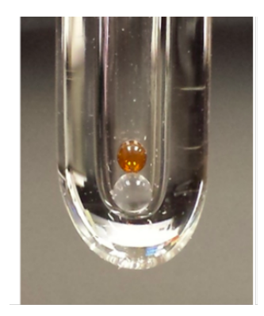


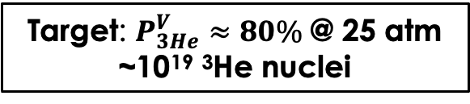
Deliver ³He as a shell pellet*
Photograph of amber GDP pellet
Hybrid spin-exchange optical pumping polarizes the ³He at high temperature
Polarized fuel is transferred to a glow-discharge polymer (GDP) capsule
Relaxation time is 3 days at 77K
Target: $P_{3He}^{V}≈80\%$ @ 25 atm
~10¹⁹ ³He nuclei
MRI images of ³He permeating a GDP capsule
*L. Baylor et al., Nucl. Fusion 63 (2023) 076009
0 8.5 min
Notes:
Cite PRO

Slide 16
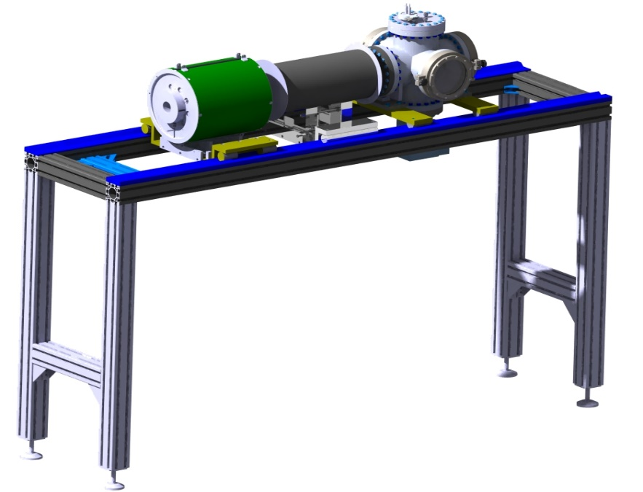


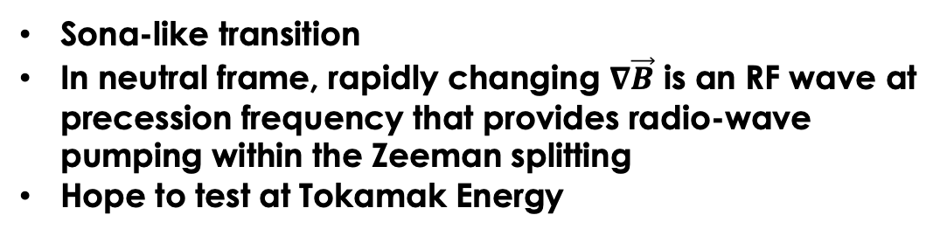

An intense polarized neutral beam is desirable
Sona-like transition
In neutral frame, rapidly changing $∇\vec{B}$ is an RF wave at precession frequency that provides radio-wave pumping within the Zeeman splitting
Hope to test at Tokamak Energy
Schematic of test apparatus
Injected neutrals
Target: O(10¹⁹) polarized D or ³He nuclei per second
Polarized beams would:
simplify DIII-D experiments
enable experiments on small flexible devices
Solenoid defines $\vec{B}$
Large gradient aligns nuclei
Faatz, Today 15:00
Kannis, Tuesday 9:00
Ciullo, Tuesday 12:00
Measure polarization
Notes:
Cite PRO

Slide 17
Outline
Fusion
Spin Polarized Fuel: Exists in quantities sufficient for a DIII-D experiment
Depolarization Mechanisms
Possible experiments
Notes:
Cite PRO

Slide 18
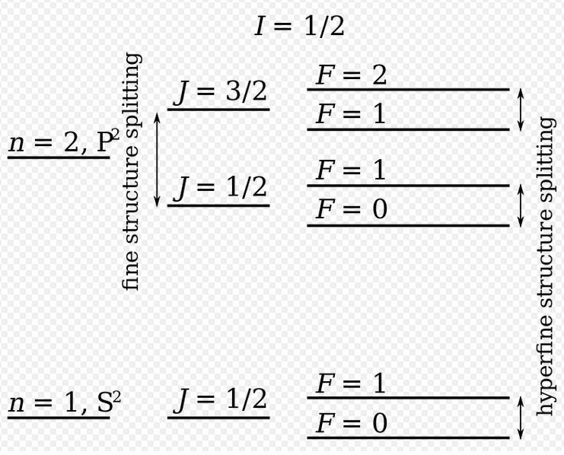


Two mechanisms can cause depolarization: resonances at the precession frequency & hyperfine interactions
Deuterium precession frequency is 0.43 $ω_{ci}$
³He precession frequency is 2.13 $ω_{ci}$
$$ω_{ci}=eB/m$$
proton cyclotron frequency
Hyperfine interactions with bound electrons also a depolarization mechanism.
Nuclei in a hot plasma are fully ionized, so this mechanism is irrelevant
Notes:
Cite PRO

Slide 19
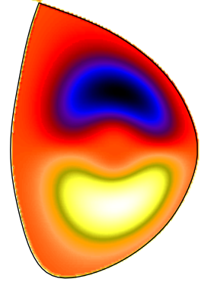
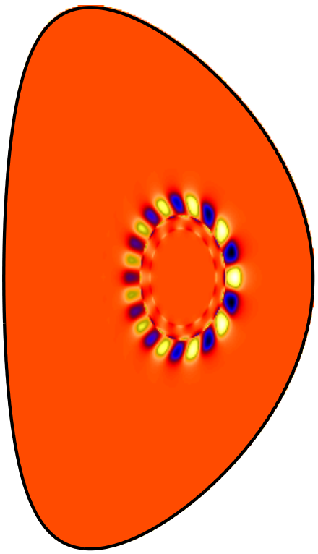
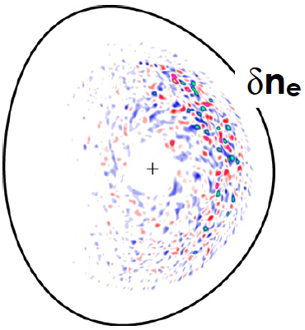
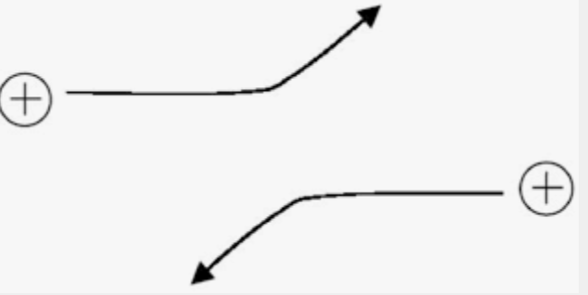
A fusion plasma is filled with waves—won’t they depolarize the nuclei?
Decreasing Spatial Scale; increasing frequency
Fluid (MHD) instabilities
Fast-ion driven instabilities
Thermal-gradient driven instabilities
Coulomb collisions
In detailed calculations*, Kulsrud et al argue that depolarization lifetimes are long but are they right?
*R.M. Kulsrud et al., Nucl. Fusion 26 (1986) 1443.

Slide 20
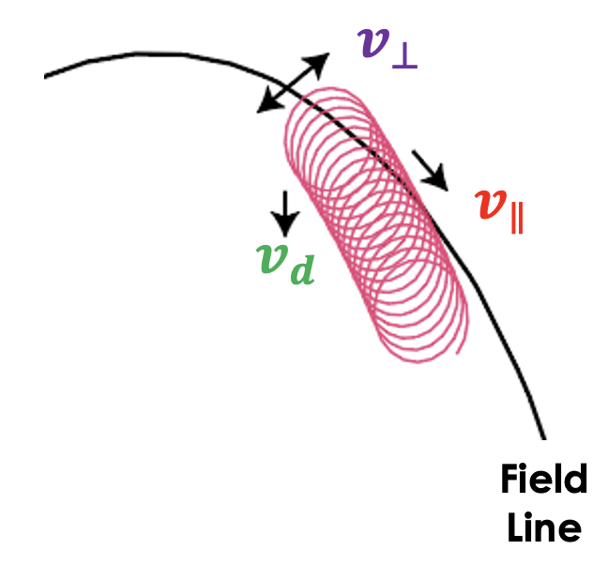
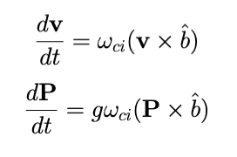
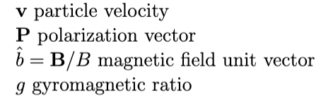
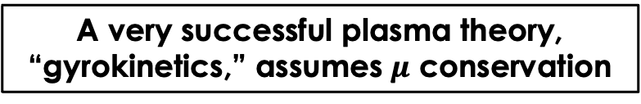

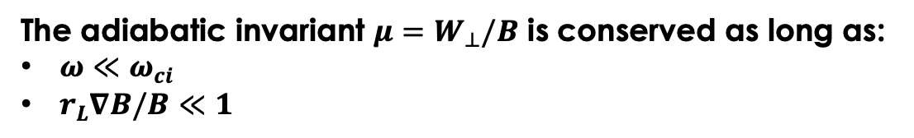
Magnetic moment $μ$ conservation is a cornerstone of plasma theory
The adiabatic invariant $μ=W_{⊥}/B$ is conserved as long as:
$ω≪ω_{ci}$
$r_{L}∇B/B≪1$
A very successful plasma theory, “gyrokinetics,” assumes $μ$ conservation
$${r_{L}=v_{⊥}/ω}_{ci}$$
gyroradius
The particle orbit and polarization (Bloch) equations are nearly identical:
→ if $μ$ is conserved, the polarization should be too!
Notes:
Cite PRO

Slide 21

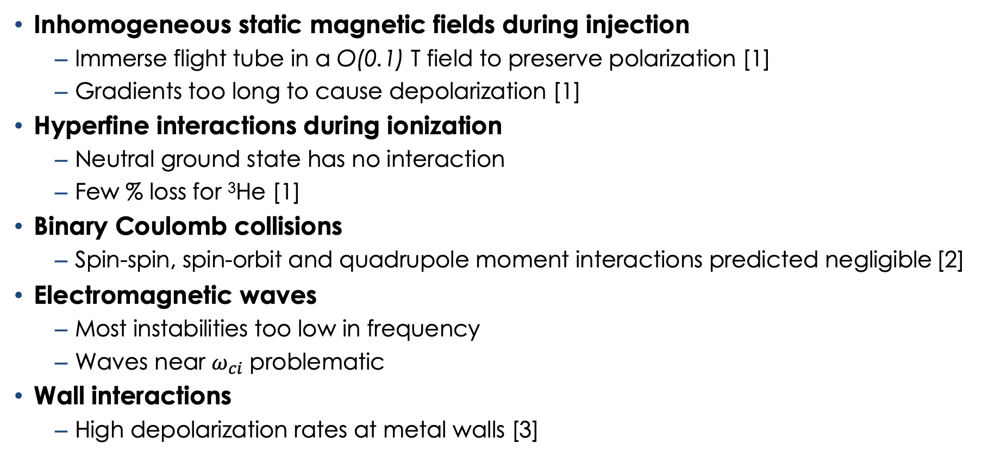
Experiments can assess most depolarization mechanisms
Inhomogeneous static magnetic fields during injection
  Immerse flight tube in a O(0.1) T field to preserve polarization [1]
  Gradients too long to cause depolarization [1]
Hyperfine interactions during ionization
  Neutral ground state has no interaction
  Few % loss for ³He [1]
Binary Coulomb collisions
  Spin-spin, spin-orbit and quadrupole moment interactions predicted negligible [2]
Electromagnetic waves
  Most instabilities too low in frequency
  Waves near $ω_{ci}$ problematic
Wall interactions
  High depolarization rates at metal walls [3]
Limited by particle confinement time
[1] L. Baylor et al., Nucl. Fusion 63 (2023) 076009.
[2] R.M. Kulsrud et al., Nucl. Fusion 26 (1986) 1443.
[3] Greenside, Journal of Vacuum Science & Technology A 2, 619 (1984).
Notes:
TODO: Animate the bottom

Slide 22
Outline
Fusion
Spin Polarized Fuel:
Depolarization Mechanisms can be tested in existing facilities
Possible experiments
Notes:
Cite PRO

Slide 23
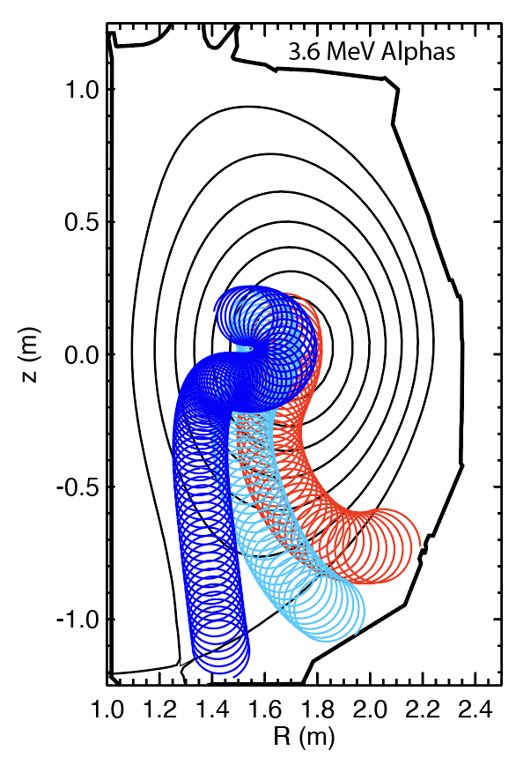
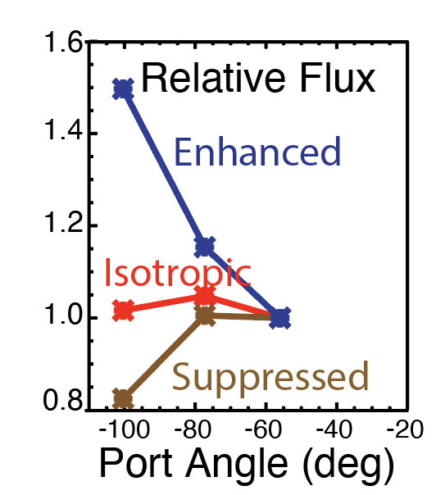

Use relative measurements of emitted 3.6 MeV alphas & 14.7 MeV protons to infer polarization*
Projected orbits
Complication: $v_{∥}/v$ changes along escaping orbit
Ideal thermonuclear case
Adequate accuracy despite:
counting statistics
realistic polarization fractions
orbit uncertainties
uncertainty in emissivity profile
*A.V. Garcia et al., Nucl. Fusion 63 (2023) 026030
Notes:
Cite PRO

Slide 24


Planned experimental scenarios on DIII-D
Scenario
$$dσ/dΩ$$
$$Operational challenge$$
1) T_{i} > 10 keV thermonuclear with H beams and LiD & ³He pellets.
Large sensitivity
Special operating conditions; very hard plasma to make
2) Beam-plasma with unpolarized ³He neutral beam and LiD pellets.
Weaker sensitivity
Special operating condition; adequate count rate easy
3) Beam-plasma with unpolarized D neutral beam and LiD pellets.
D-D Sensitivity unknown
D beam injection routine; adequate count rate easy
4) Thermonuclear with LiD pellets.
D-D Sensitivity unknown
Easy operational regime; adequate count rate
Notes:
Cite PRO

Slide 25

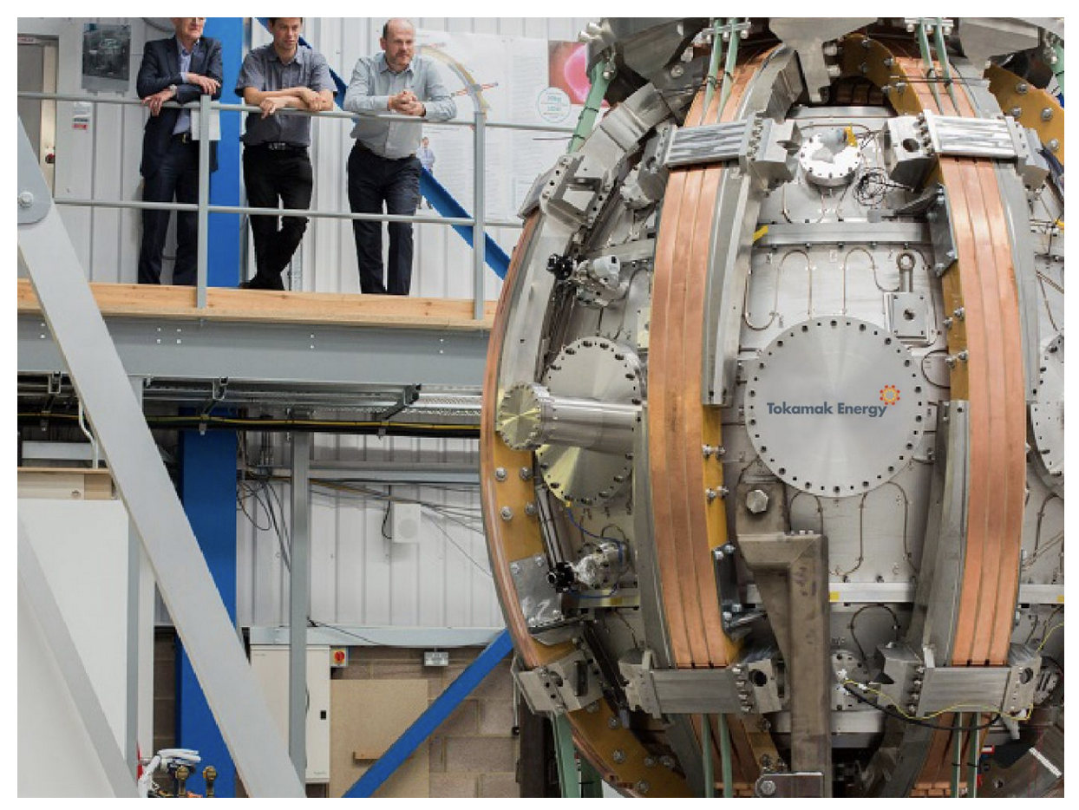
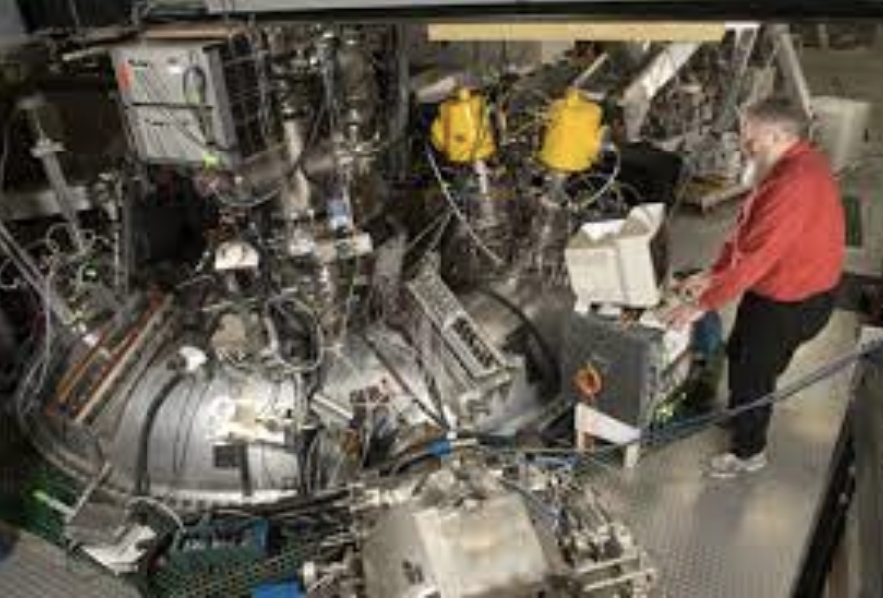
With intense polarized beams and/or D-D differential cross sections experiments on many other facilities become feasible
Polarized D and ³He injection into WHAM
Polarized D injection w/ polarized ³He pellet in Tokamak Energy’s ST40
D-D experiment on the Madison Symmetric Torus

Slide 26





Conclusions & Opportunities
Fusion: Use D-³He differential cross section to test 50% enhancement in D-T cross section
Spin Polarized Fuel: JLab and UVa are preparing LiD and ³He pellets for injection into DIII-D
Depolarization Mechanisms can be tested in existing devices
DIII-D polarization lifetime measurements are anticipated in ~ 5 years
$$\vec{B}$$
$${\vec{s}}_{2}$$
$${\vec{s}}_{1}$$
³$He$
$$D$$
Opportunities
Provide ~ 1 Amp polarized neutral beam
Polarization dependence of D-D differential cross sections at ”low” energy
1) “Polarized Fusion and Potential in situ Tests of
Fuel Polarization Survival in a Tokamak Plasma,”
L. Baylor, A. Deur, N. Eidietis, W.W. Heidbrink, G.L. Jackson, J. Liu, M.M. Lowry, G.W. Miller, D. Pace, A.M. Sandorfi, S.P. Smith, S. Tafti, K. Wei, X. Wei and X. Zheng, Nucl. Fusion 63 (2023) 076009.
2) “Conceptual design of DIII-D experiments to
diagnose the lifetime of spin polarized fuel”
A.V. Garcia, W.W. Heidbrink and A.M. Sandorfi, Nucl. Fusion 63 (2023) 026030.
Notes:
Cite PRO

Slide 27
Backup

Slide 28
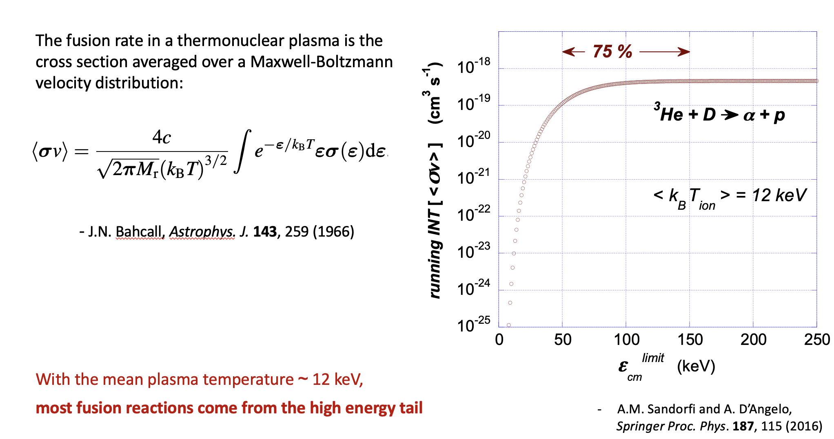
Backup

Slide 29
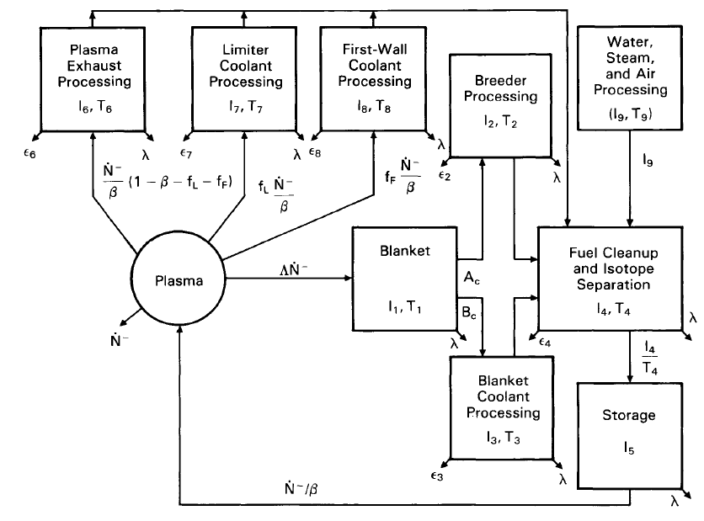
What about a reactor?
Q: (70% D) * (65% ³He) only increases the cross section by 23%. Is it worth it?
A: High flux laser driven polarization techniques¹ should achieve 100% D and T polarization
Q: Is the added complexity of polarization practical?
& Polarization
¹ Kannis (2021) Chem. Phys. Lett.
² Abdou (1986) Fusion Technology.
Notes:
Cite PRO

Slide 30
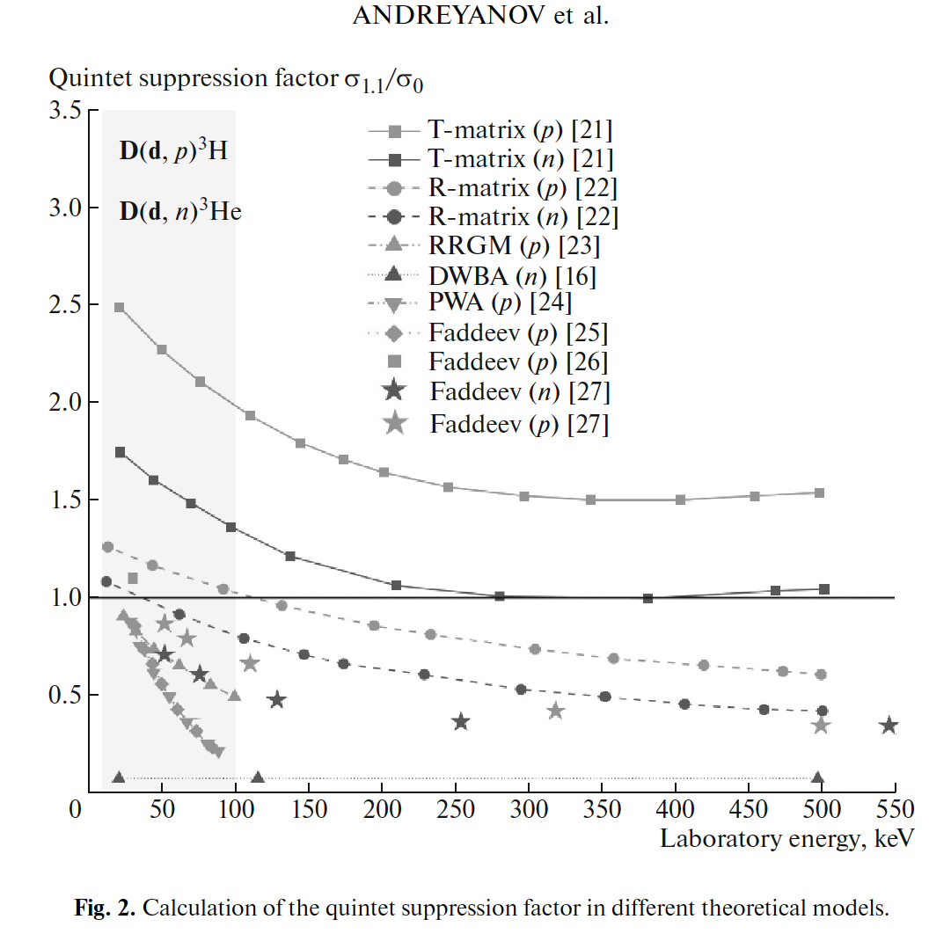
A beam-target D-D experiment is attractive but …
Use unpolarized D beam; tensor polarized D pellet
Cross section is larger at low energy than for D-³He
3.0 MeV protons have nearly the same orbits as 3.6 MeV alphas
Can also measure energy shift in silicon detectors
No theoretical expression available for the effect of polarization!
However, there probably is some effect--the unpolarized cross section is anisotropic
If we measure an effect of polarization, we can measure how long it persists!

Slide 31
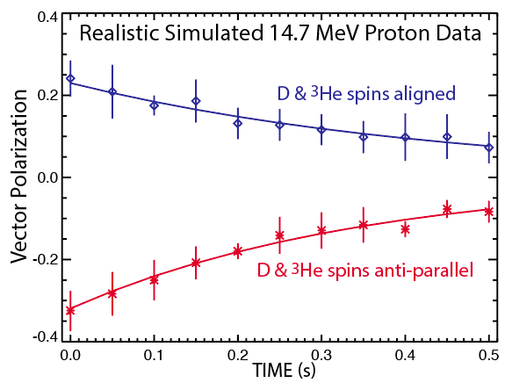
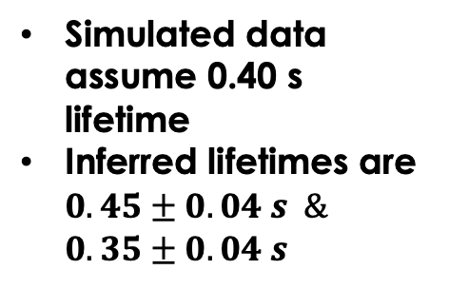
The polarization lifetime can be accurately determined*
Thermonuclear Scenario
Simulated data assume 0.40 s lifetime
Inferred lifetimes are $0.45±0.04 s \&$ $0.35±0.04 s$
*Garcia (2022).

Slide 32




Complication #2: Pellets not deposited in core
Use shell pellet with ³He payload
³He deposited around $ρ=0.5$
Deuterium ice pellet mostly deposits at $ρ>0.5$
Izzo
[1] Hollmann AIP Conference (2009).
Must rely on inward transport to take fuel to core

Slide 33

Use gamma-ray detector for an independent measurement of the total reaction rate
The D-³He reaction produces gammas at 16.9 MeV and 15.4 MeV with a branching ratio of approximately 4.5 x 10⁻⁵
Different polarization dependence than main branch*
Wide solid angle detector needed for adequate counting rate
Kiptily, PPCF (2006)
*Garcia (2022)

Slide 34




Measure the pitch, energy & poloidal distribution to diagnose reaction anisotropy
Relative changes in escaping CFP pitch, poloidal/axial position, and energy all sensitive to changes in $dσ/dΩ$
Pitch = $v_{∥}/v$
Pitch at a FILD¹
Multiple poloidal locations
ψ
Energy at a silicon diode²
[1] Zweben, Nucl. Fusion (1989)
[2] Heidbrink, Nucl. Fusion (1984)
Notes:
1. , while the reaction rate is not

Slide 35

Inject pellets with spin polarized nuclei
If using only one pellet: use D pellet and ³He fast ions
Two pellets requires a hot thermonuclear plasma
Prepare polarized D pellet
Prepare polarized ³He pellet (for thermonuclear experiment)
How long will the fuel stay polarized?
Preserve polarization during injection
¹L. Baylor et al.
Notes:
Cite PRO

Slide 36

Direct detection of polarization (like in NMR) is attractive but seems very challenging

