Slide 1
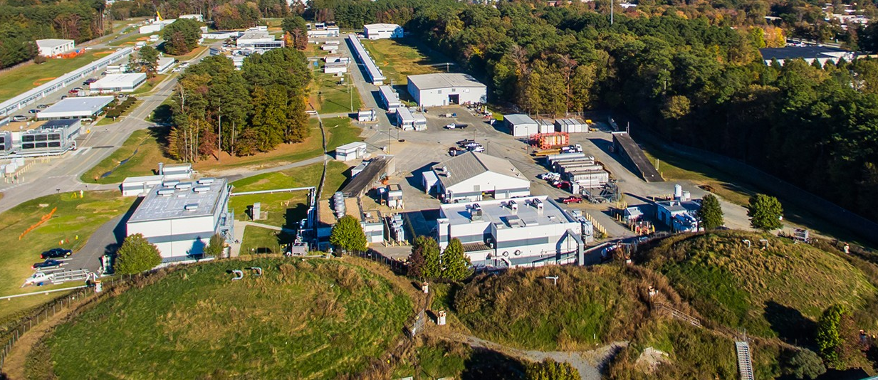


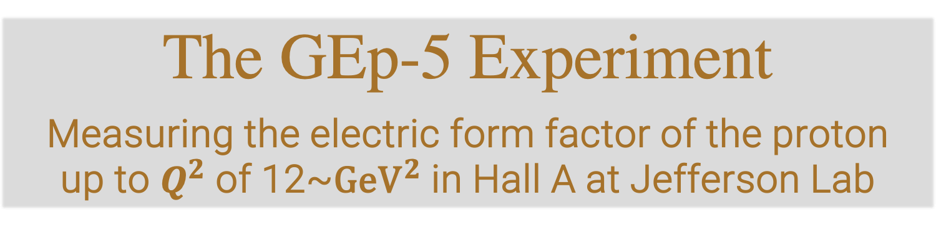
The GEp-5 Experiment
Measuring the electric form factor of the proton up to $Q^{2}$of 12~${\text{GeV}}^{2}$in Hall A at Jefferson Lab
Don Jones
for the GEp collaboration
SPIN Conference 2023
Sept. 2023
Notes:
The experiment will continue the main stream of JLab physics with hadron form factors.

Slide 2
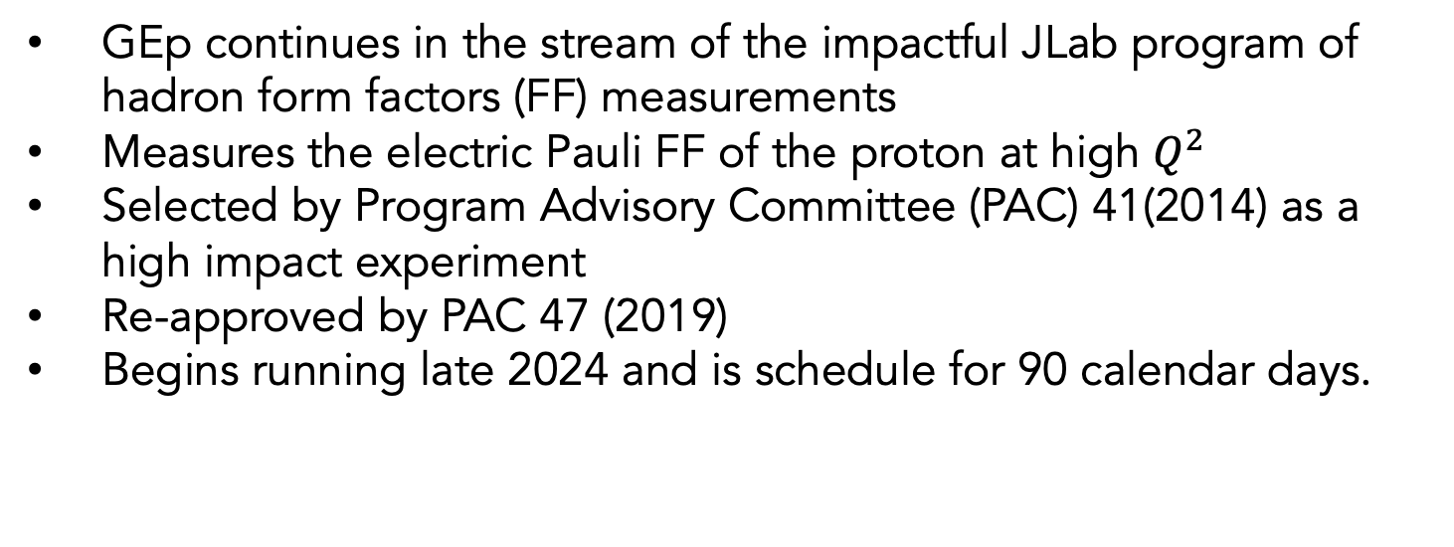
GEp experiment
GEp continues in the stream of the impactful JLab program of hadron form factors (FF) measurements
Measures the electric Pauli FF of the proton at high $Q^{2}$
Selected by Program Advisory Committee (PAC) 41(2014) as a high impact experiment
Re-approved by PAC 47 (2019)
Begins running late 2024 and is schedule for 90 calendar days.
GEp Spokespersons: E.Cisbani, M.Jones, N.Liyanage, L.Pentchev, A.Puckett, B.Wojtsekhowski

Slide 3
Sachs Form Factors
The proton’s shape described by electric and magnetic form factors GEp and GMp
  momentum space representations of charge and current distributions in the proton.
  To lowest order in the Breit frame the Fourier transforms of GEp and GMp are spatial distributions of charge and current (this interpretation prohibited in rest frame due to recoil)
Measured using elastic electron scattering
Early results used Rosenbluth separation technique

Slide 4
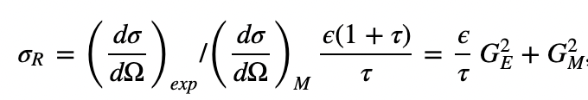
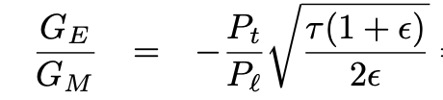
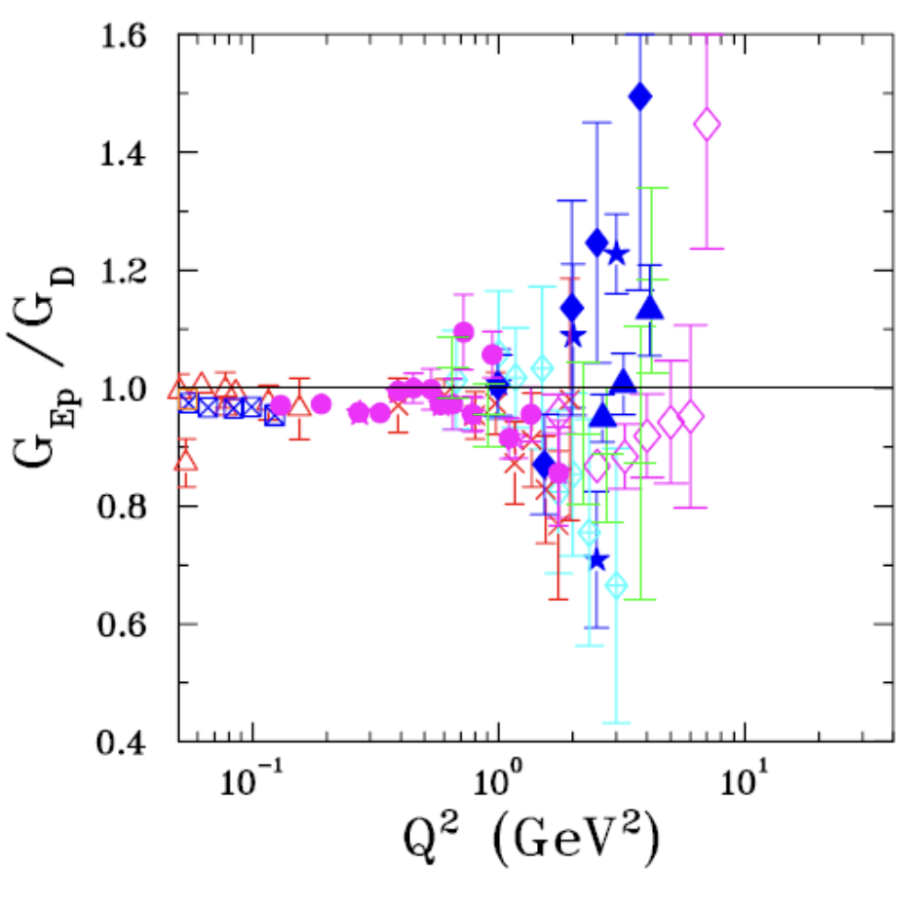
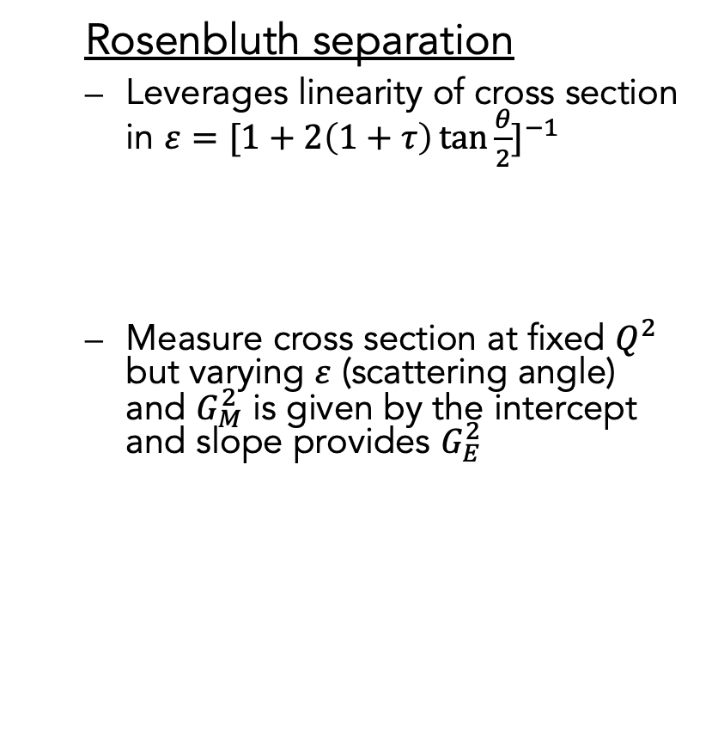
Measuring Form Factors
  Rosenbluth separation
  Leverages linearity of cross section in $ε={[1+2\left(1+τ\right)\tan{\frac{θ}{2}}]}^{−1}$
  Measure cross section at fixed $Q^{2}$ but varying $ε$ (scattering angle) and $G_{M}^{2}$ is given by the intercept and slope provides $G_{E}^{2}$
  Polarization transfer
  Measures polarization transferred to hadron from electron which is sensitive to the ratio of the form factors
  Measure ratio of hadron polarization along (Pl) and transverse (Pt) to momentum transfer provides
  Many systematics cancel in the ratio
  First employed at MIT-Bates and then systematically at Jlab in their GEP measurements

Slide 5
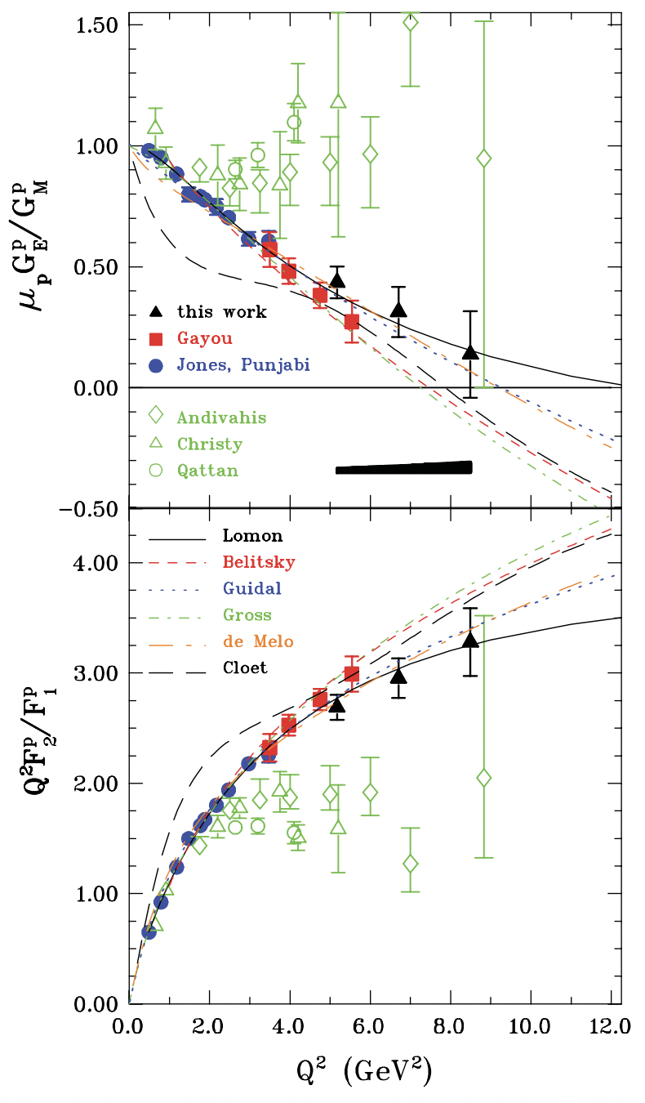
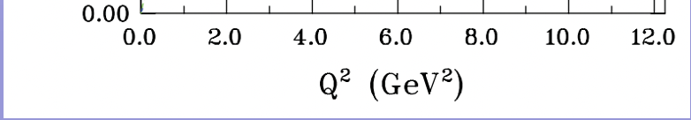
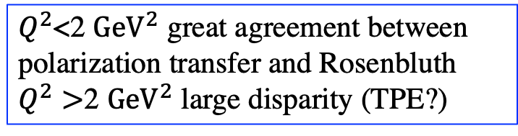
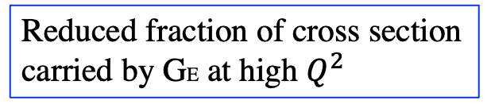
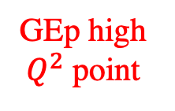
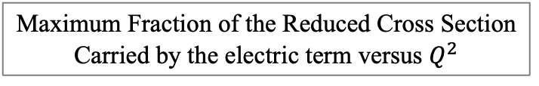
Issues with Rosenbluth Separations
PRL 104, 242301 (2010)
Maximum Fraction of the Reduced Cross Section
Carried by the electric term versus $Q^{2}$
GEp high
$Q^{2}$ point
$Q^{2}$<2 ${\text{GeV}}^{2}$ great agreement between polarization transfer and Rosenbluth
$Q^{2}>$2 ${\text{GeV}}^{2}$ large disparity (TPE?)
Reduced fraction of cross section carried by GE at high $Q^{2}$
Also large $ε$–dependent radiative corrections required
Notes:
Strategy for Rosenbluth is to vary epsilon while keeping Q^2 (and tau) constant. Slope of cross section vs epsilon is proportional to GE^2 and slope is proportional to GM^2.

Slide 6
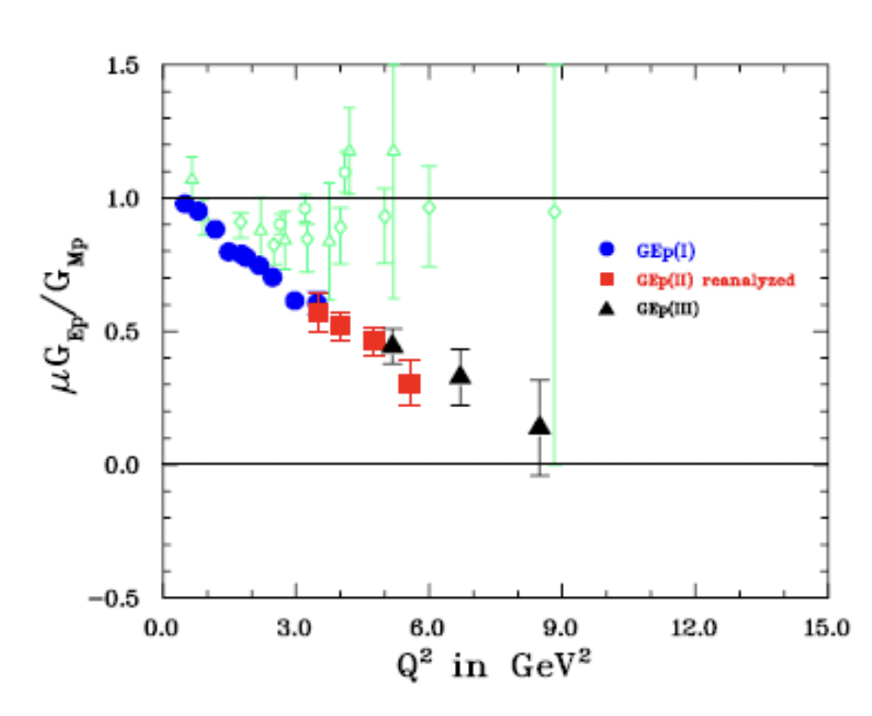
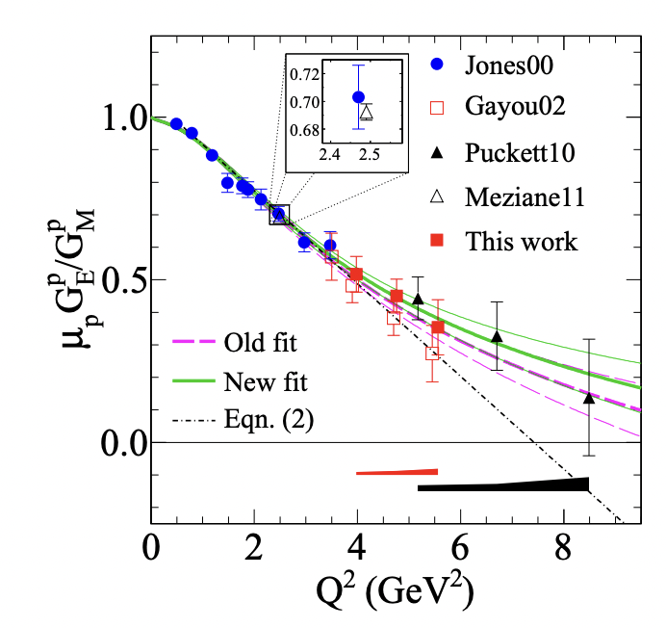
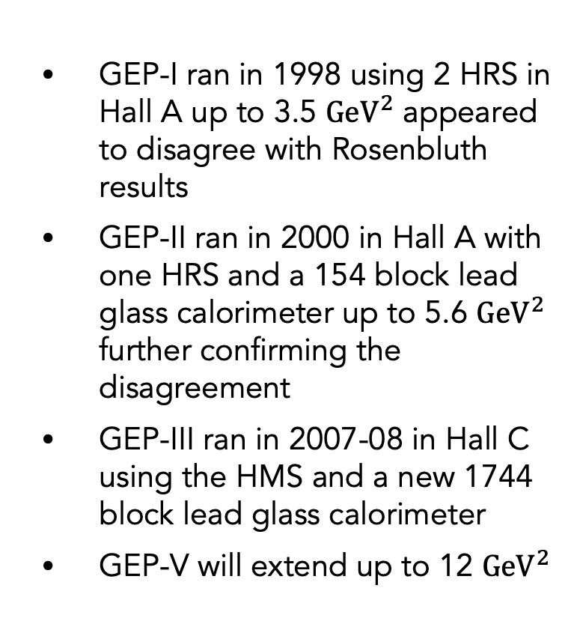
GEP historical measurements at JLab with polarization transfer
GEP-I ran in 1998 using 2 HRS in Hall A up to 3.5 ${\text{GeV}}^{2}$ appeared to disagree with Rosenbluth results
GEP-II ran in 2000 in Hall A with one HRS and a 154 block lead glass calorimeter up to 5.6 ${\text{GeV}}^{2}$ further confirming the disagreement
GEP-III ran in 2007-08 in Hall C using the HMS and a new 1744 block lead glass calorimeter
GEP-V will extend up to 12 ${\text{GeV}}^{2}$
GEP-I
GEP-II
GEP-III
M.K. Jones et al. P.R.L. 84, 1398 (2000)
V. Punjabi et al. P.R. C 71, 055202, 2005
O. Gayou et al., Phys.Rev. Lett., 88 (2002) 092301
A.J.R. Puckett et al. Phys. Rev. Lett. 104, 242301 (2010)

Slide 7
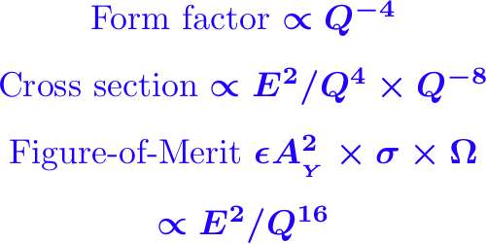
Increasing difficulty with each iteration
Need large statistics, max luminosity and solid angle
Max luminosity -> large background
Large solid angle -> small bend -> huge background
Critical to this experiment is the maturing technology of high rate tracking with GEMS
Q² increases from 8.5 to 12.0 GeV² but higher beam energy 10.5 vs. 6 GeV => a factor of 5-6 of the FOM loss, but the SBS larger solid angle helps.
Notes:
Q² increases from 8.5 to 12.5 GeV² but higher beam energy 11 vs. 6 GeV => a factor of 7 of the FOM loss, but the SBS larger solid angle helps.

Slide 8
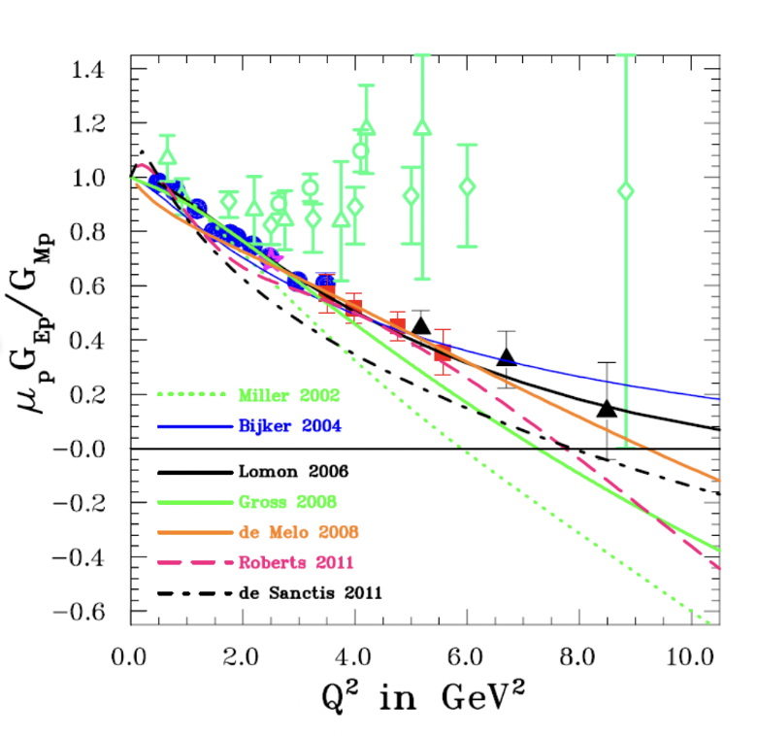
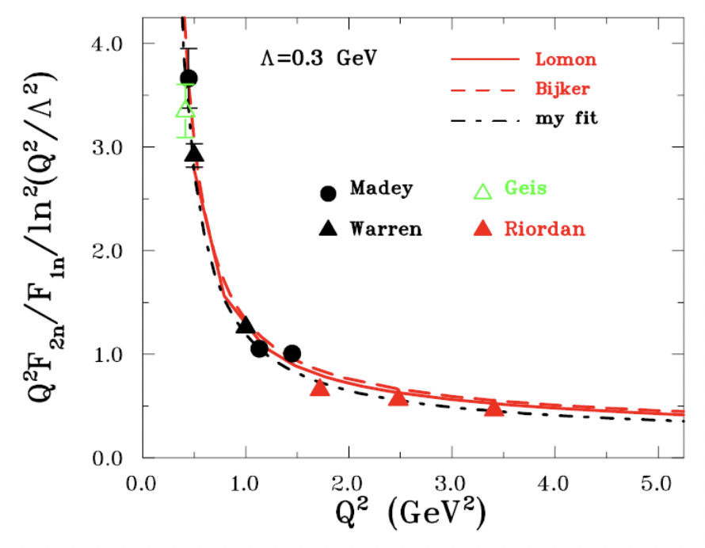
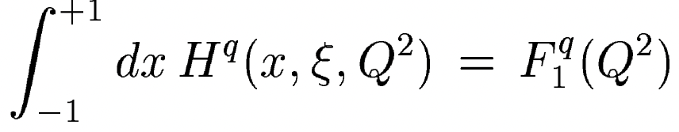
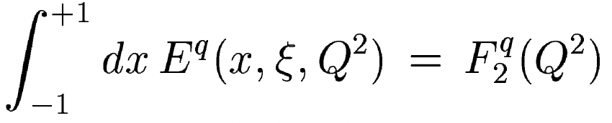
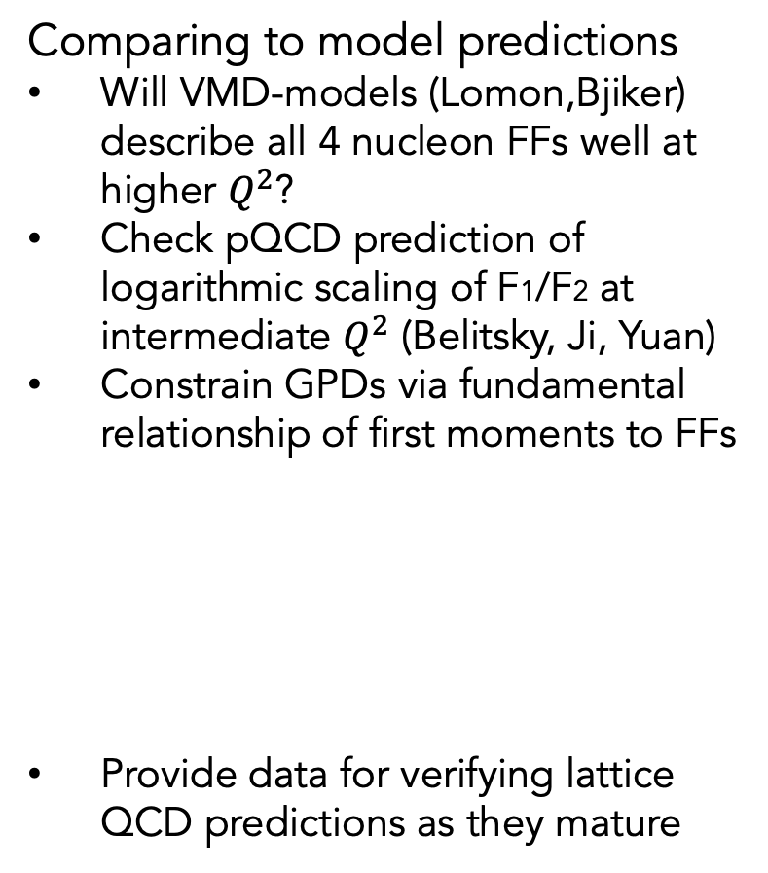
Motivation for measuring form factors
Comparing to model predictions
Will VMD-models (Lomon,Bjiker) describe all 4 nucleon FFs well at higher $Q^{2}$?
Check pQCD prediction of logarithmic scaling of F1/F2 at intermediate $Q^{2}$ (Belitsky, Ji, Yuan)
Constrain GPDs via fundamental relationship of first moments to FFs
Provide data for verifying lattice QCD predictions as they mature

Slide 9
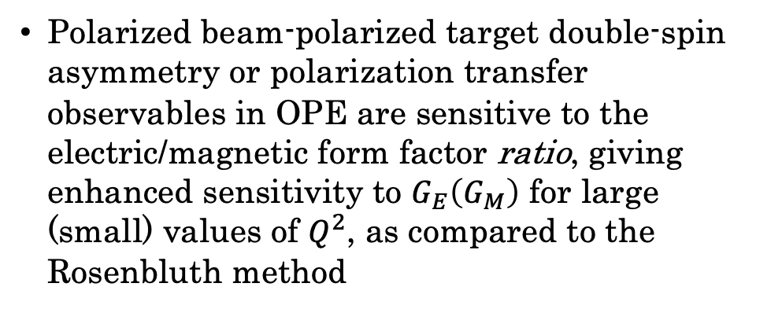
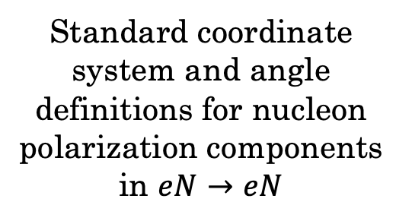
Polarization Observables in Elastic $eN→eN$ Scattering
Standard coordinate system and angle definitions for nucleon polarization components in $eN→eN$
Polarized beam-polarized target double-spin asymmetry or polarization transfer observables in OPE are sensitive to the electric/magnetic form factor ratio, giving enhanced sensitivity to $G_{E}\left(G_{M}\right)$ for large (small) values of $Q^{2}$, as compared to the Rosenbluth method
Notes:
Akhiezer

Slide 10
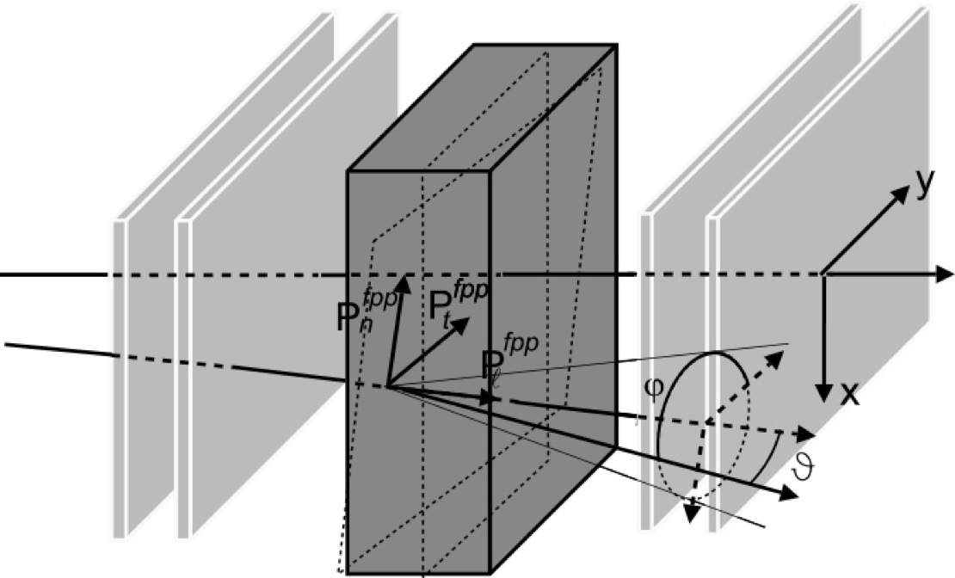
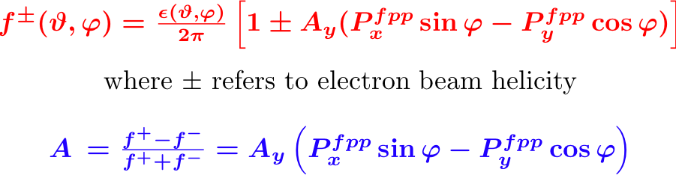
Method: Focal Plane Polarimeter
A_{Y} analyzing power vs.
inverse proton momentum
Track in
Track out
p will be ~ 7 GeV/c
fringe field correction
Notes:
The key element is a Focal Plane Polarimeter and the analyzing power of secondary scattering. Needs a well understood A_{Y}.

Slide 11
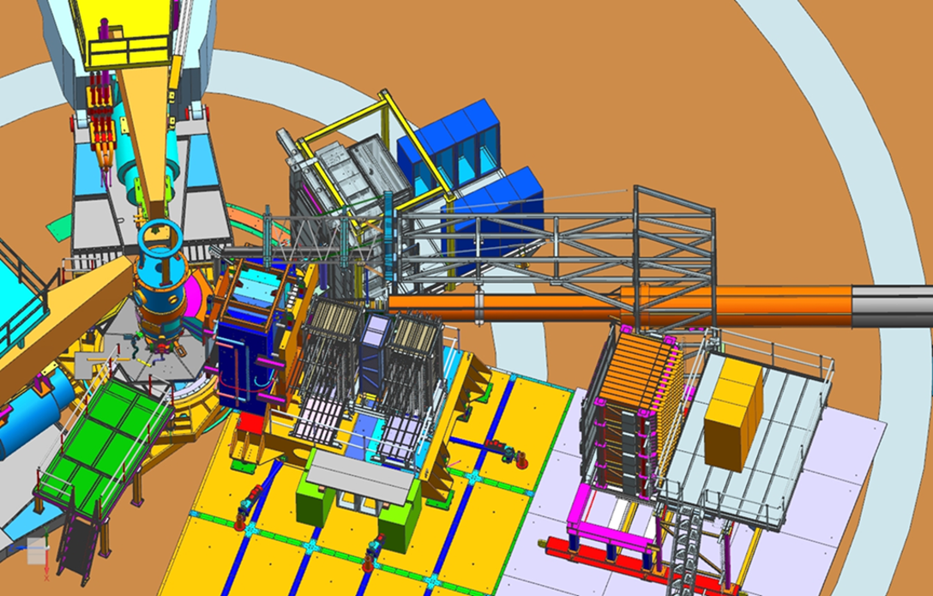
Experimental layout in the model
30cm LH2 target
Electron arm
CDet + ECal
SBS dipole
beam
Hadron arm
Proton
polarimeter
HCal

Slide 12
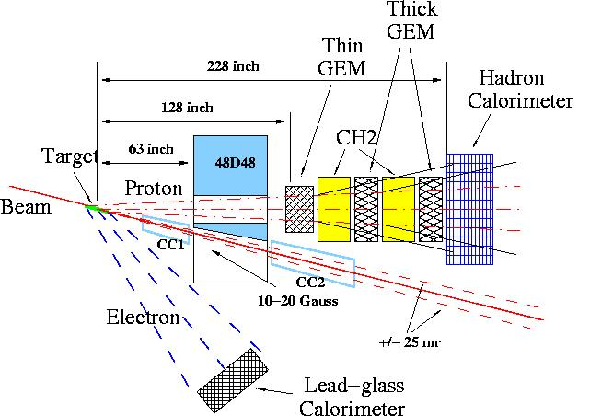
Experiment: Layout and Parameters
Beam: 75uA, 85% polarization
Target: 30 cm liquid H₂
Electron arm at 30º, covers Q² range from 10 to 14 GeV²
Proton arm at angle 17º,
Ω = 35 msr
Spin precession angle is ~ 90º
(it is optimum)
Event rate is 10 times higher
than with standard spectrometer
45 PAC days of production time gives resulting accuracy
Notes:
The same layout as 12 years ago, no competitors.
45 days approved in January 2010 by PAC35.

Slide 13
The proton GEp form factor
2, 11, 32 PAC days
Notes:
The latest experiment data on GEp-III were in PRL 2010 and
the final results were published in PRC 2017.
Our goal is an accurate measurement up to 12.5 GeV²

Slide 14
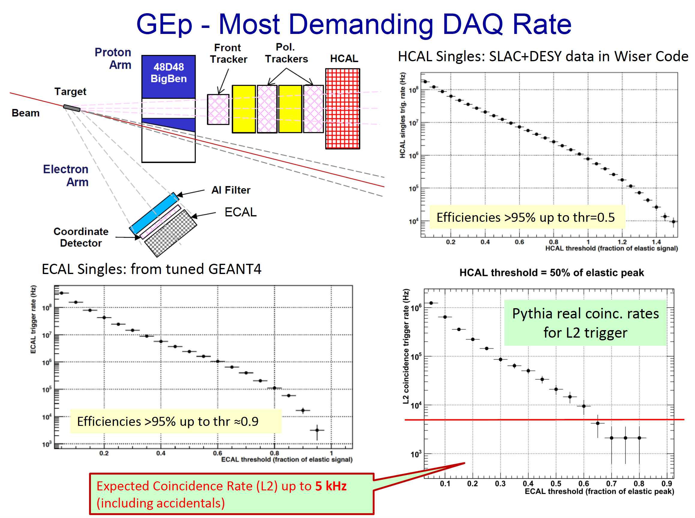

Slide 15
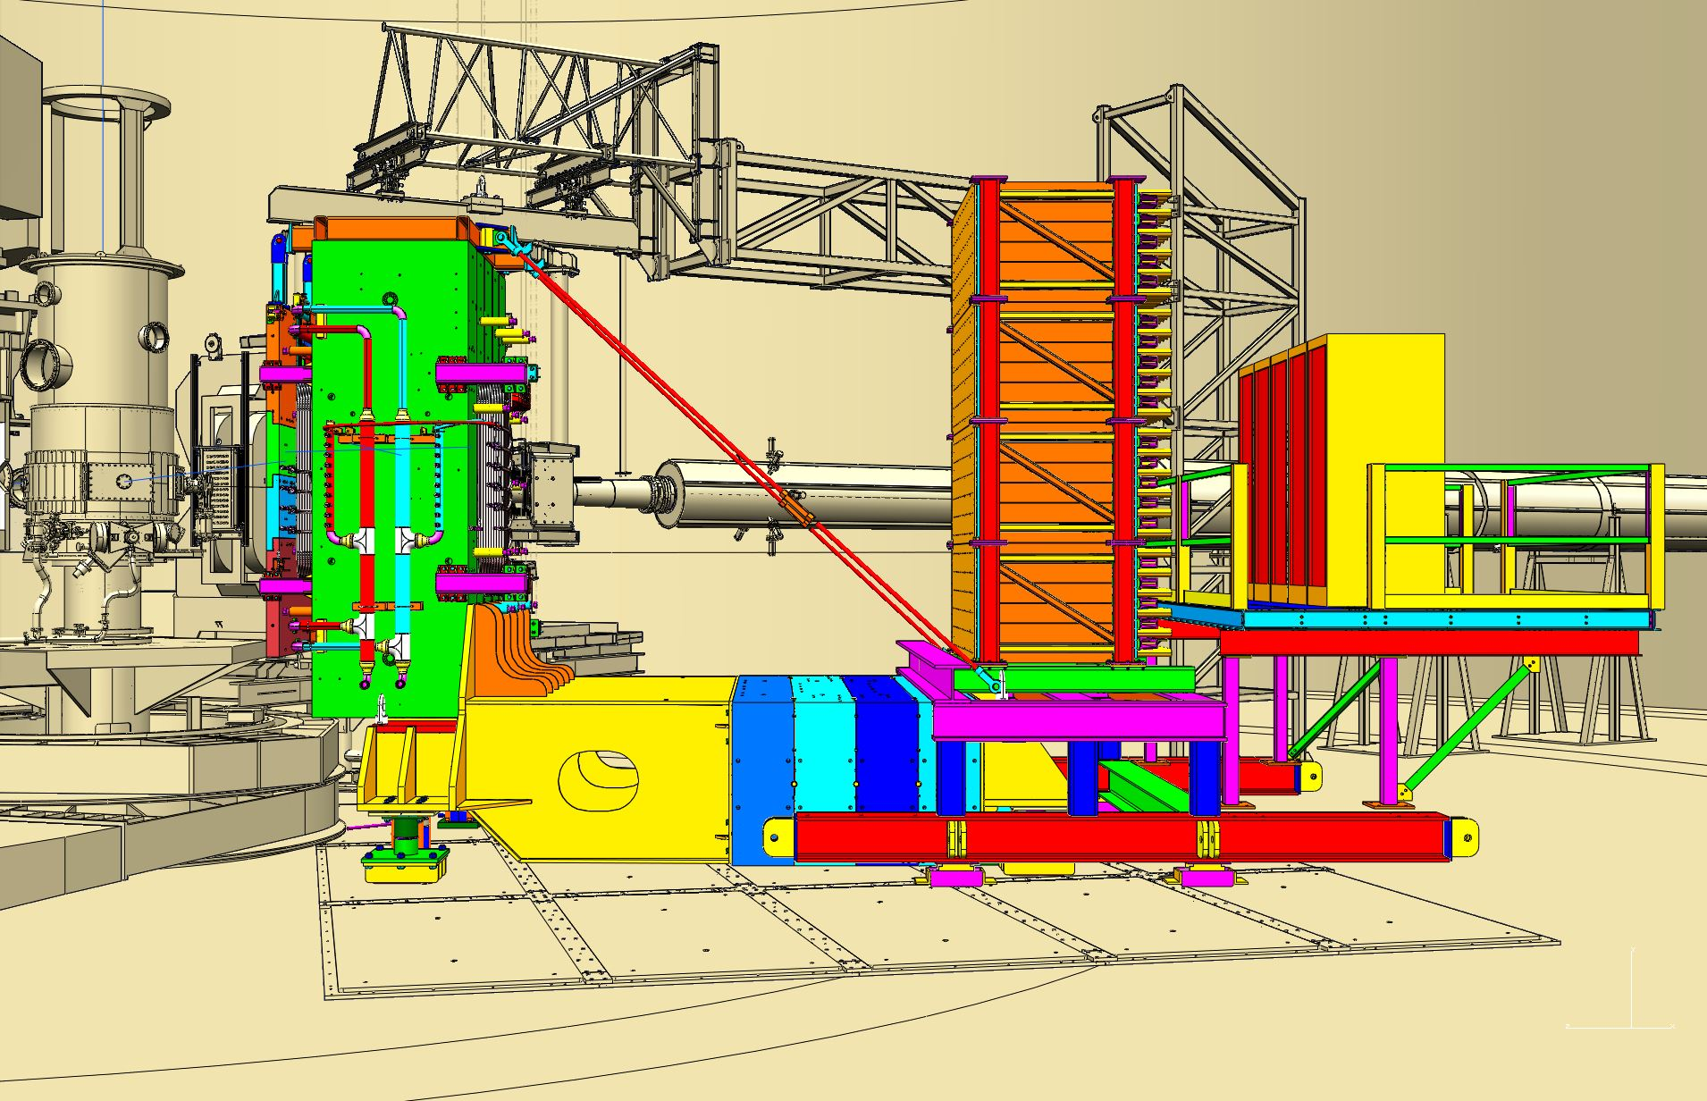
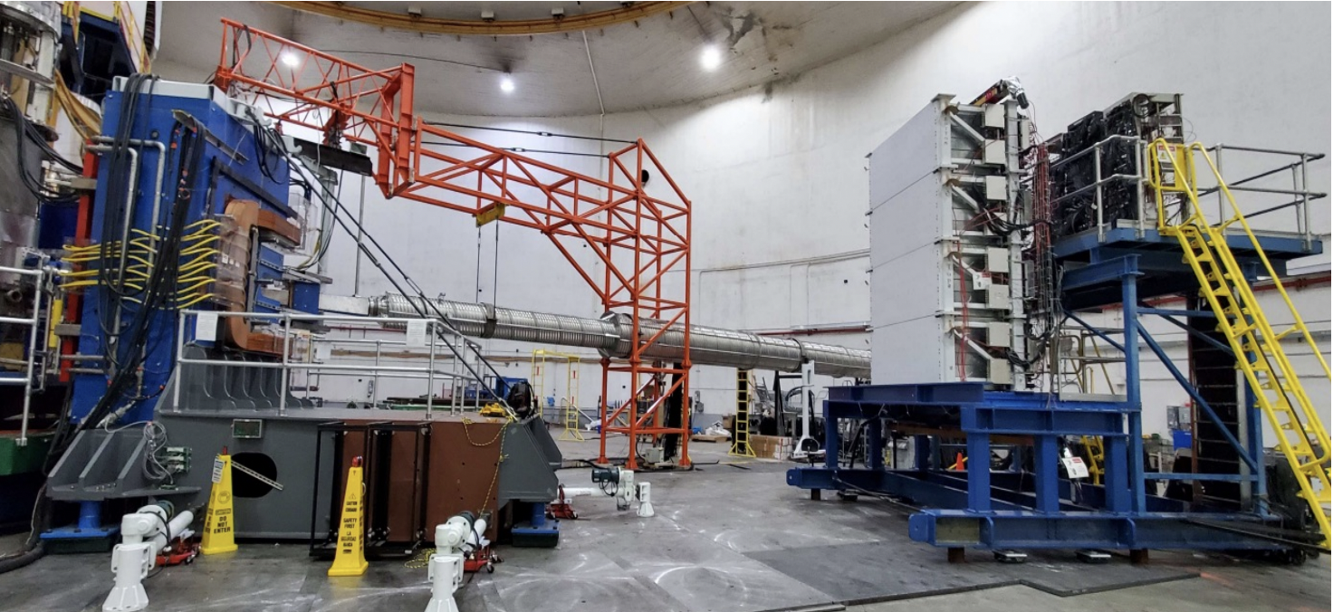
Proton arm calorimeter HCAL
Notes:
The hadron calorimeter. Novel feature is sub ns time resolution.

Slide 16
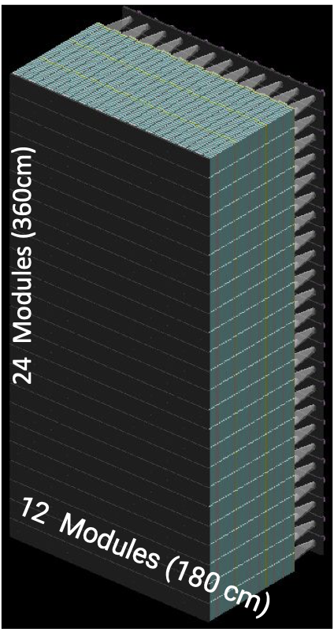
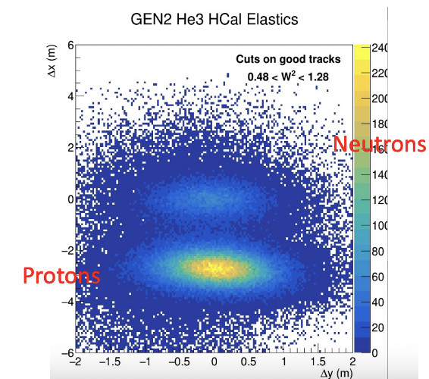
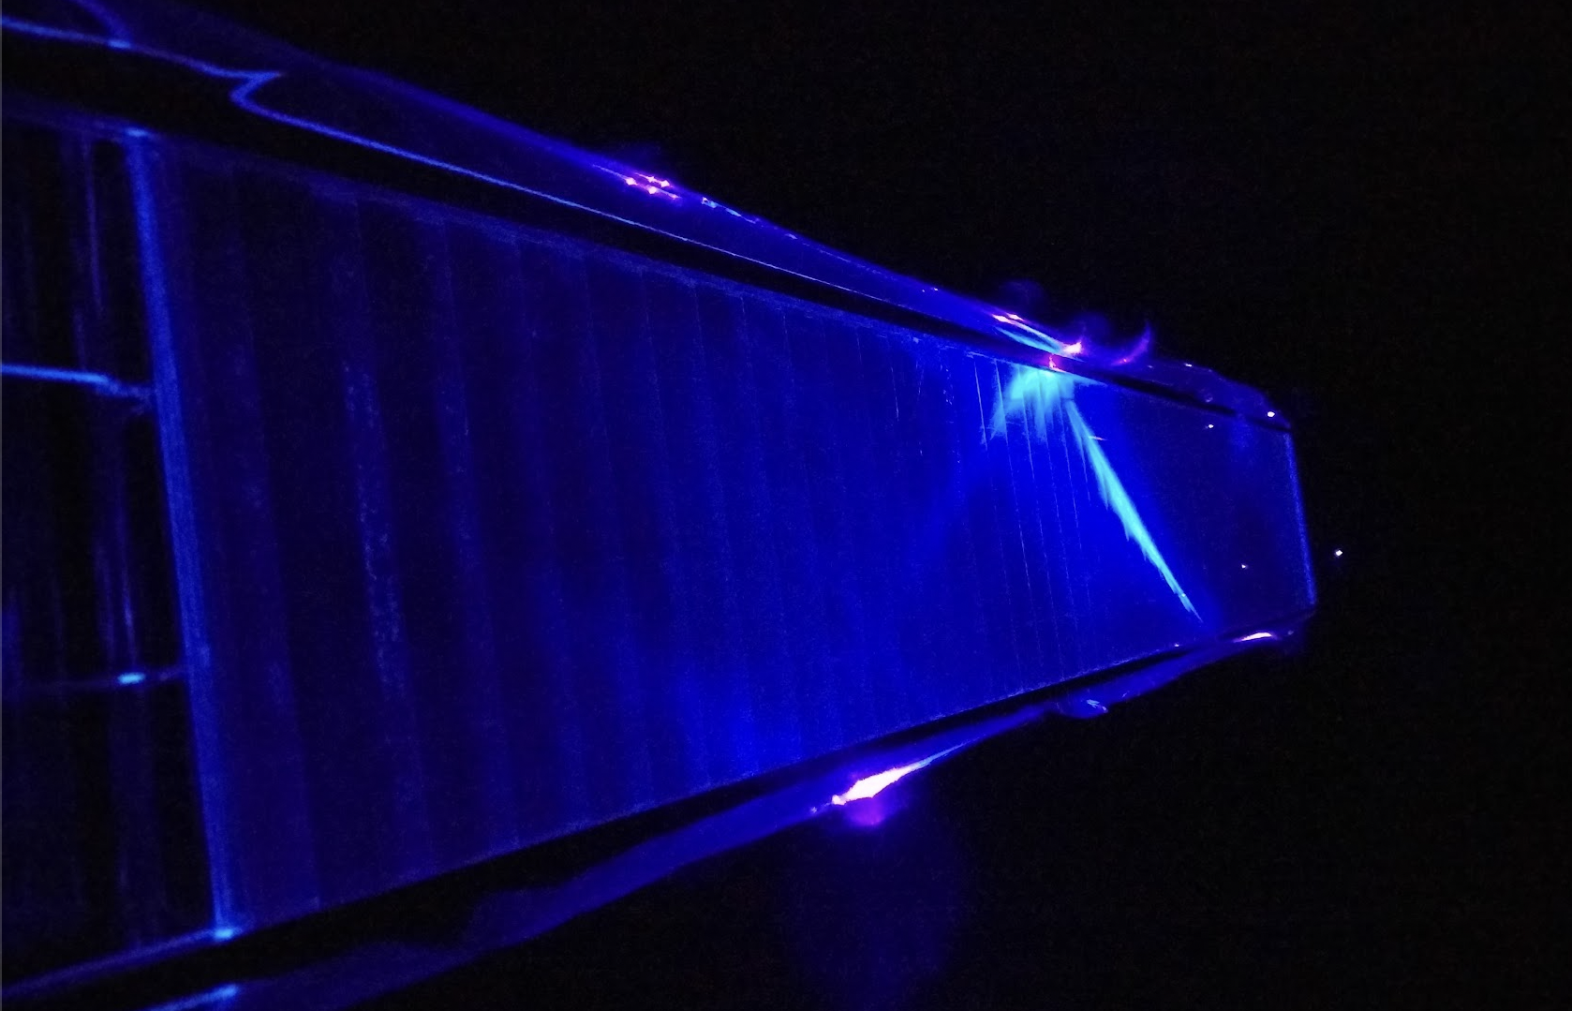
HCal Overview
Single module with blue LED
Notes:
The hadron calorimeter. Novel feature is sub ns time resolution.

Slide 17
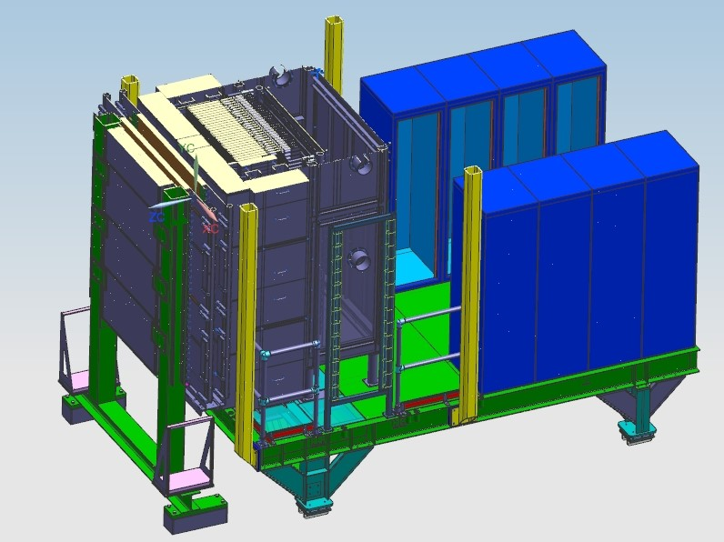
Electron arm calorimeter ECAL
Front end electronics
ECal
Oven wall
CDet
Notes:
Electron arm is based on old technology with innovative addition of continuous thermal annealing. Fully tested. Construction is 2/3 completed.

Slide 18
ECal Overview
56
1692 active lead-glass modules
Elevated temperature of the glass (225-185 C)
provides continuous annealing of radiation damage
Notes:
Electron arm is based on old technology with innovative addition of continuous thermal annealing. Fully tested. Construction is 2/3 completed.

Slide 19
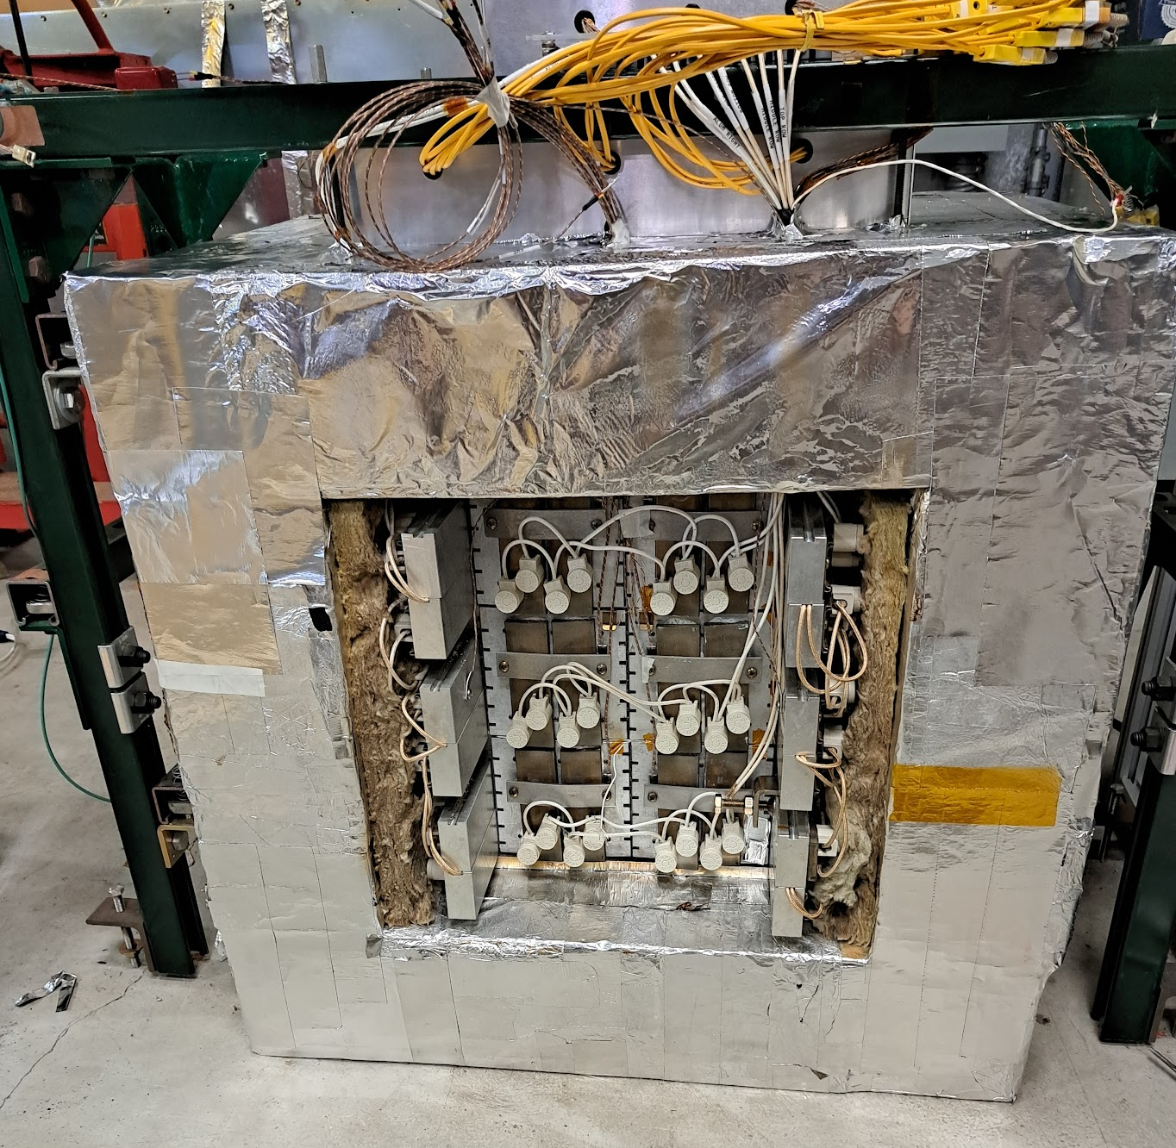
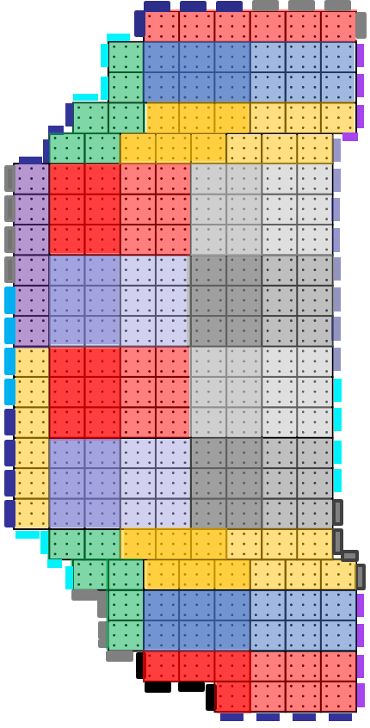
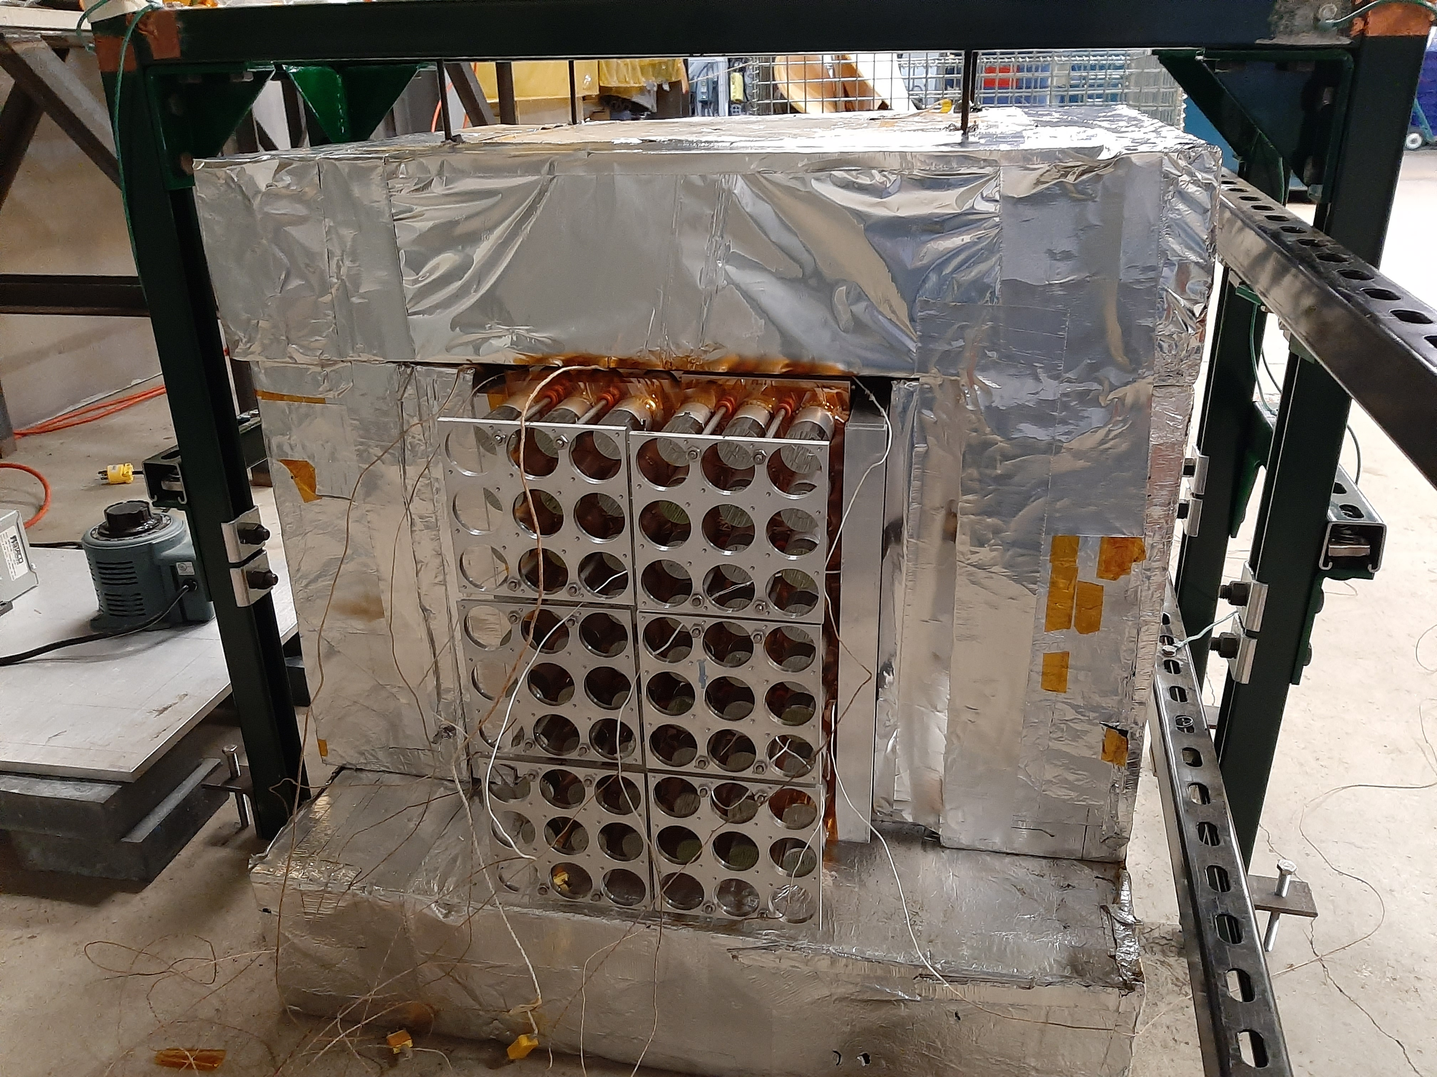
Heater system
Prototype demonstration
Previous prototype in beam demonstrated 225-185 degC front to back profile provides sufficient annealing
Final design has 48 zones running at 0-48VDC up to 27kW
Active cooling on light guides
Detector front
Detector back
Notes:
Electron arm is based on old technology with innovative addition of continuous thermal annealing. Fully tested. Construction is 2/3 completed.

Slide 20
Conclusion
After 15 years of development the GEp/SBS experiment is on track for installation in Spring 2024 and running late 2024.
Exciting potential. Who knows what we will measure at high Q-squared?
Advertisement. We are still looking for collaborators on this experiment. It’s a great time to have students join. There is still a lot of hardware work that needs to be done and it is a great opportunity to get access to thesis data quickly.
Thank you!
Notes:
Thank you for your time and attention.

Slide 21
Backup slides

Slide 22
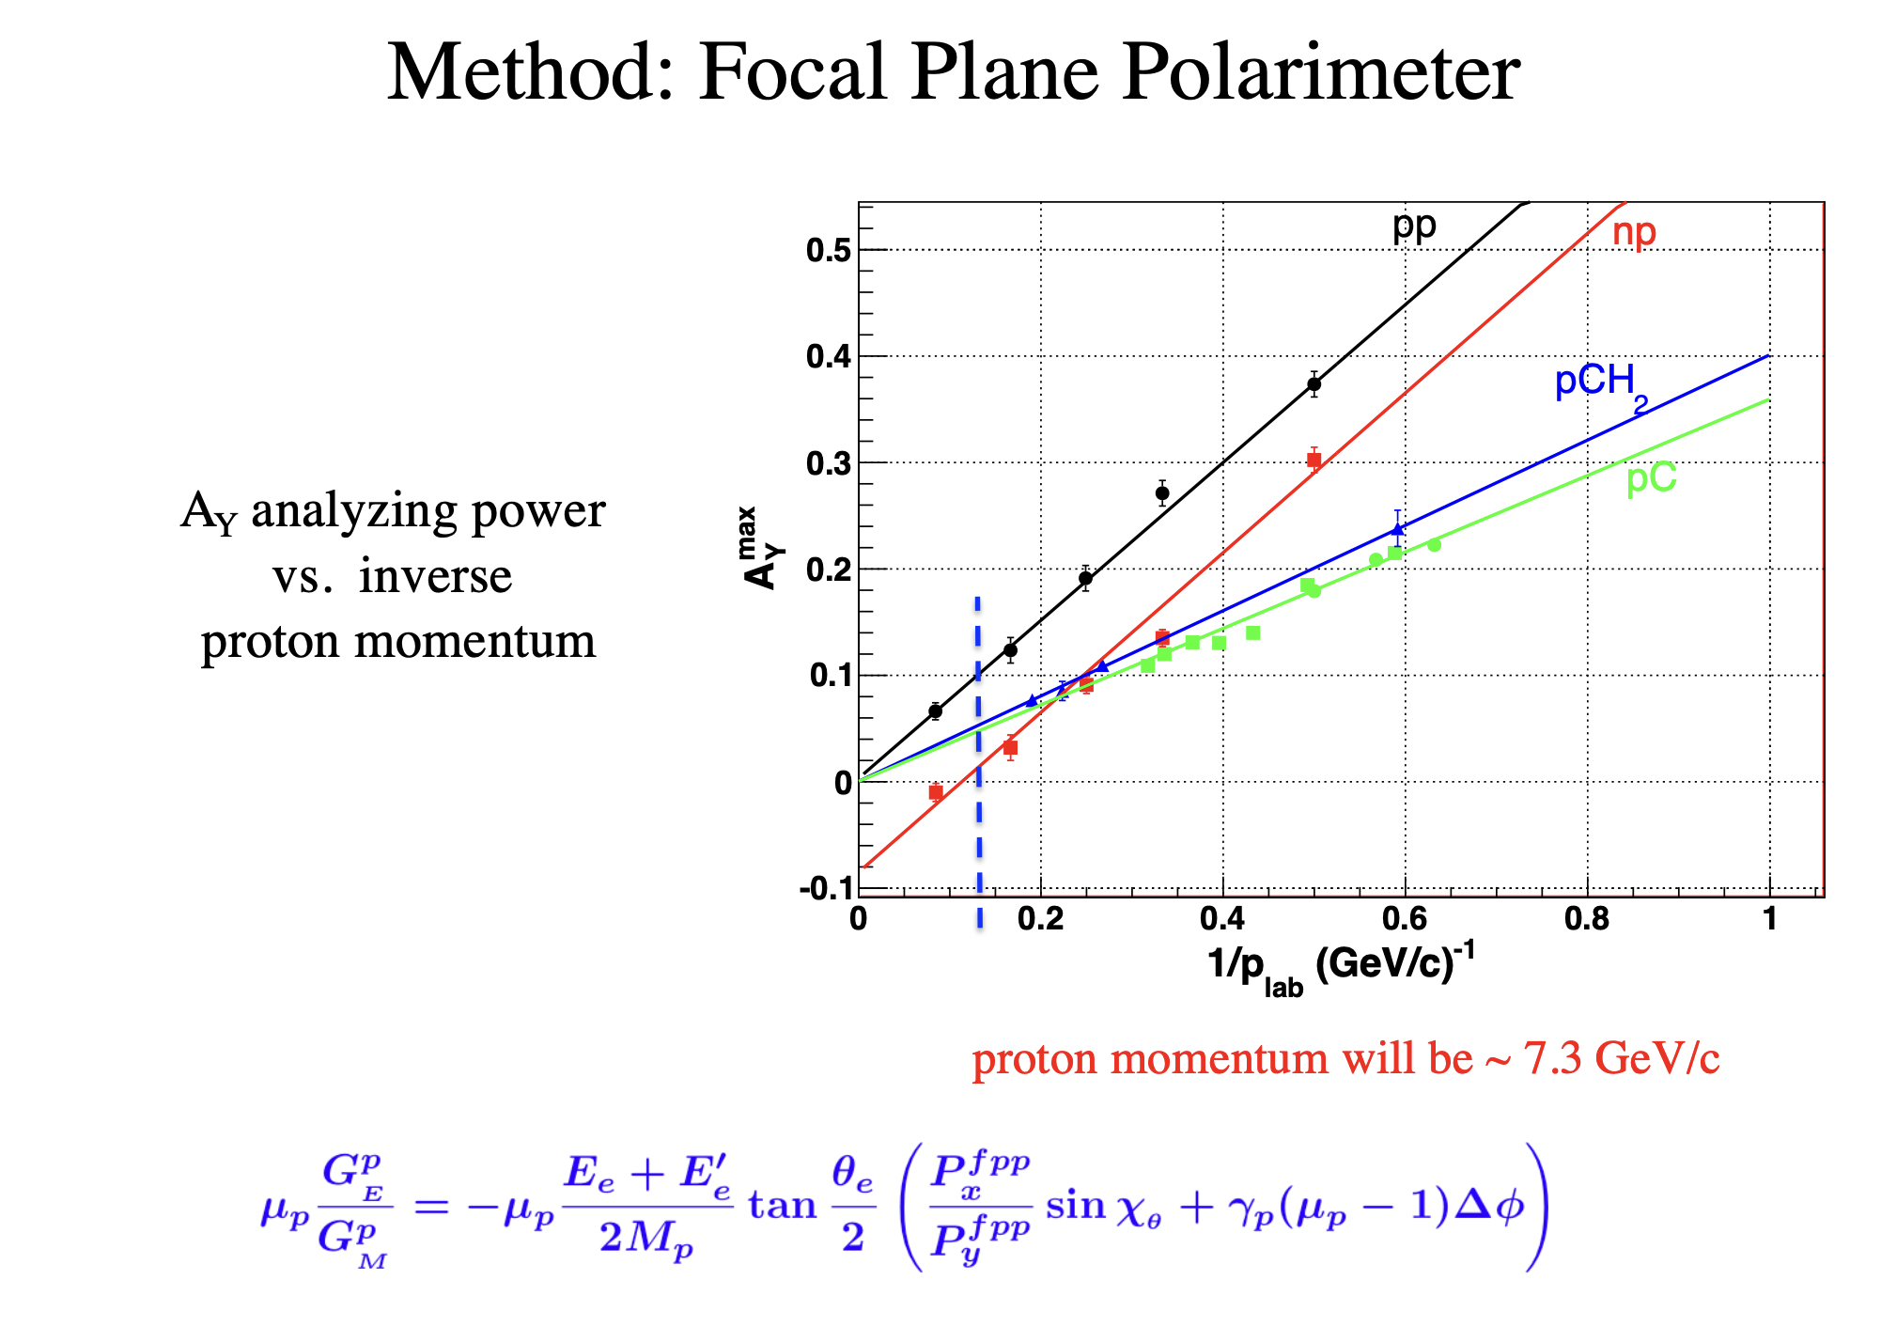

Slide 23
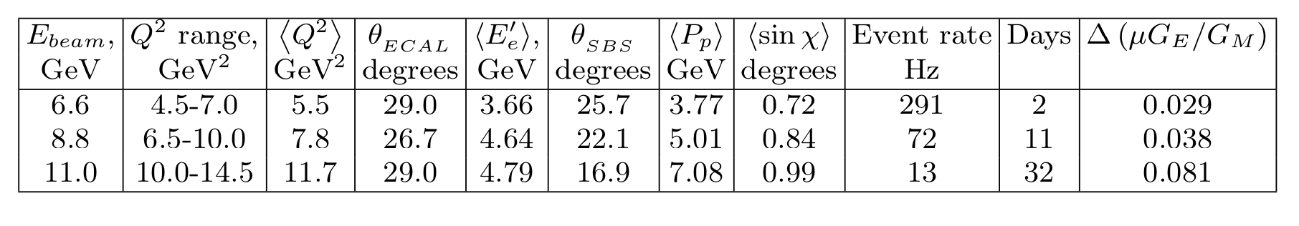
GEp/SBS Q² acceptance, projected accuracy, and beam time request
Total 45 days
Notes:
We updated the data points. As PAC35 recommended, we limited the Q² range by 12.5 GeV² and the total beam time is 45 days. About 20M events per data point.

