Slide 1



N➞N* Transition Form Factors in Continuum QCD
Adnan Bashir
Institute of Physics and Mathematics
University of Michoacán, Morelia, Michoacán, Mexico
Fulbright Visiting Scientist
Jefferson Laboratory, Newport News, Virginia, USA
25th International Spin Symposium (SPIN 2023)
September 26, 2023, Duke University, NC
3D Structure of the Nucleon: GPDs and Form Factors

Slide 2
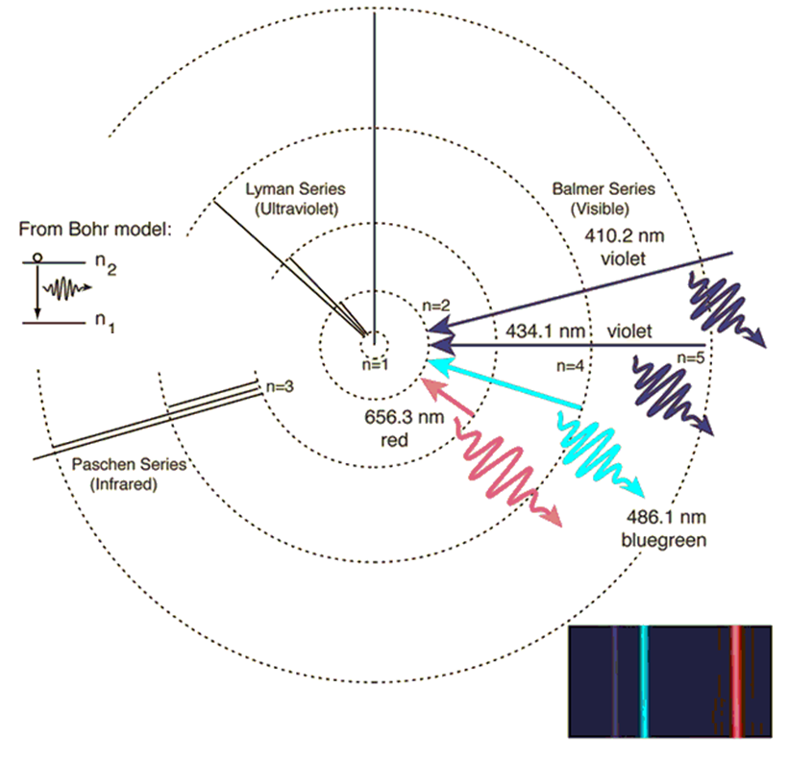
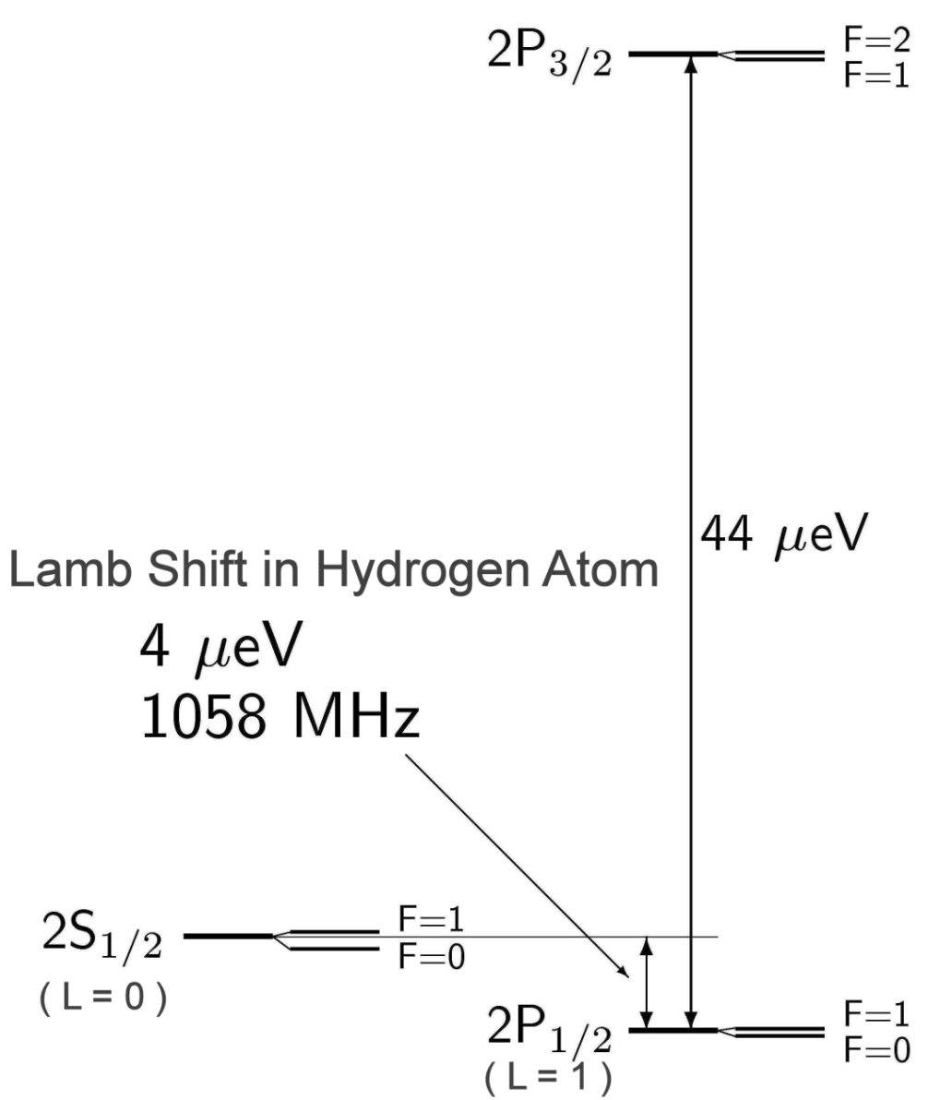
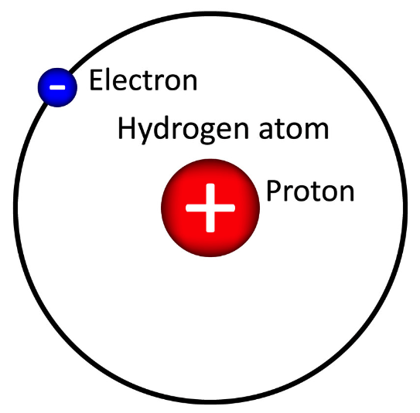
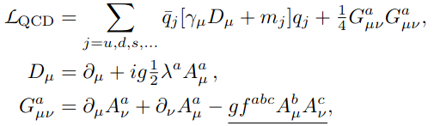
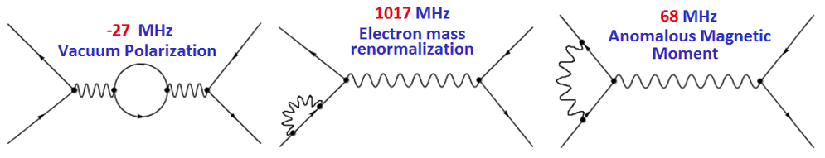
N ➞ N*: Footprints of QCD
Similarly, hadronic bound states, mesons
and baryons and their transition to the excited states should provide us insight into the dynamics of QCD which is a bigger challenge.
Dyson: If you don’t understand the Hydrogen
atom (in QED) you don’t understand anything.
QCD is characterized by two novel
infrared phenomena:
confinement
emergent hadron mass (EHM).
1940s: Renormalized QED

Slide 3
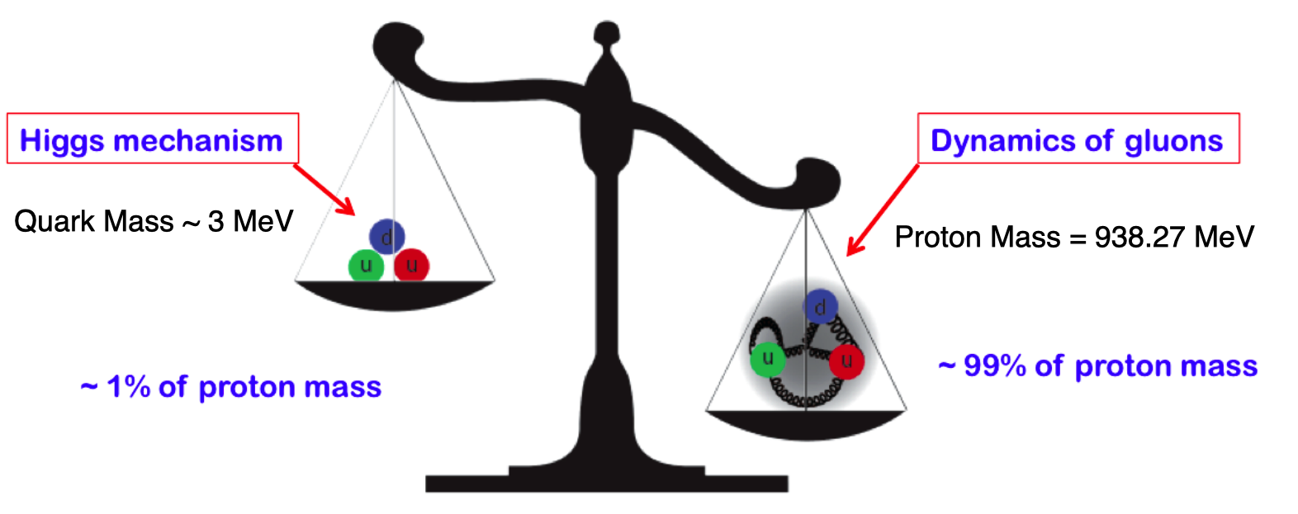
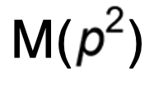
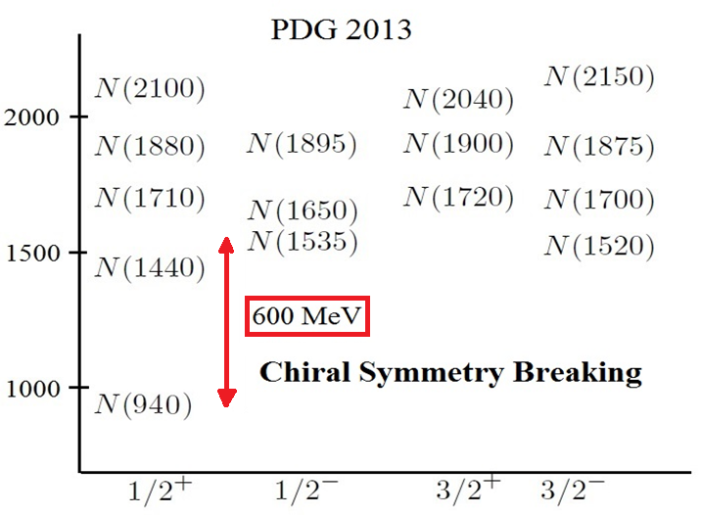
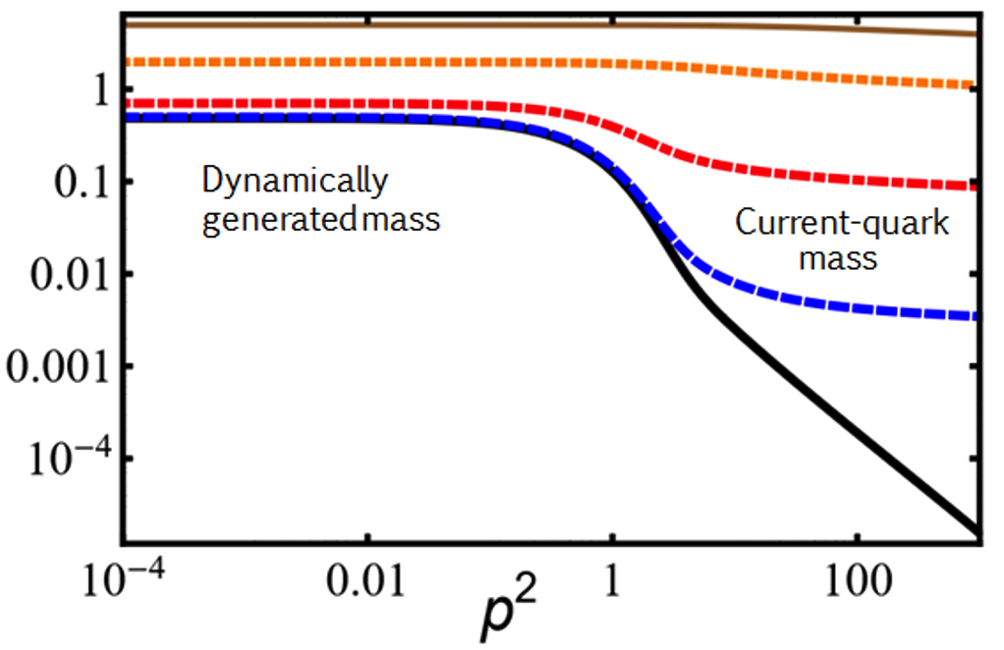
QCD: Quarks ➞ Nucleon Transition Form Factors
Infrared QCD entails confinement and dynamical chiral symmetry breaking (DCSB).
The strength of the DCSB is reflected in the mass spectrum of hadrons.
The pattern of DCSB is traceable in momentum dependent observables measured at the JLab.

Slide 4
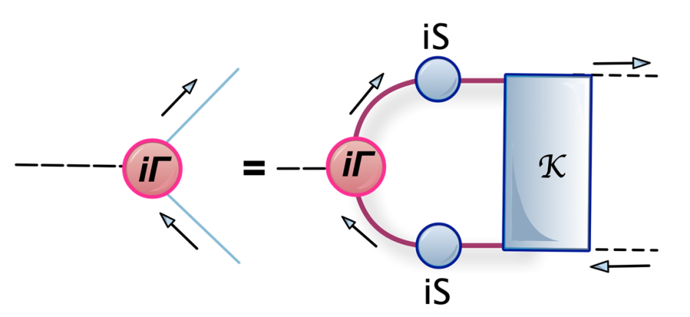
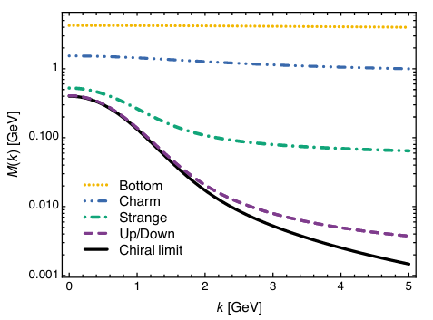
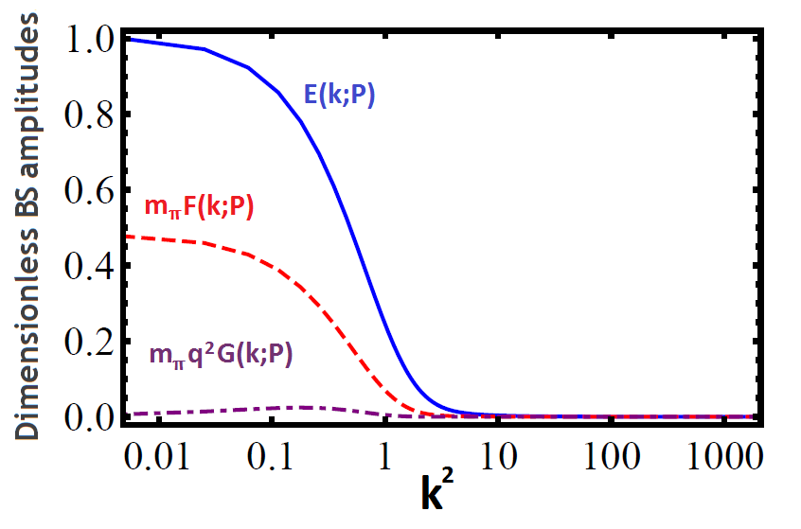
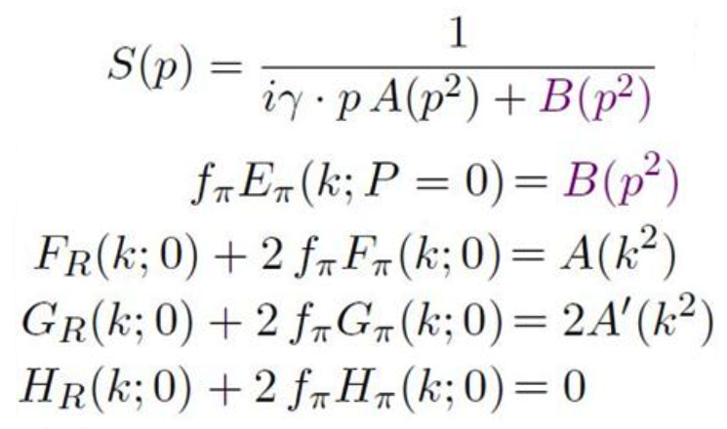
DCSB: From Quarks to Mesons
Pattern of dynamical chiral symmetry breaking is observed again in the Bethe-Salpeter amplitudes computed by solving the Bethe-Salpeter equations.

Slide 5
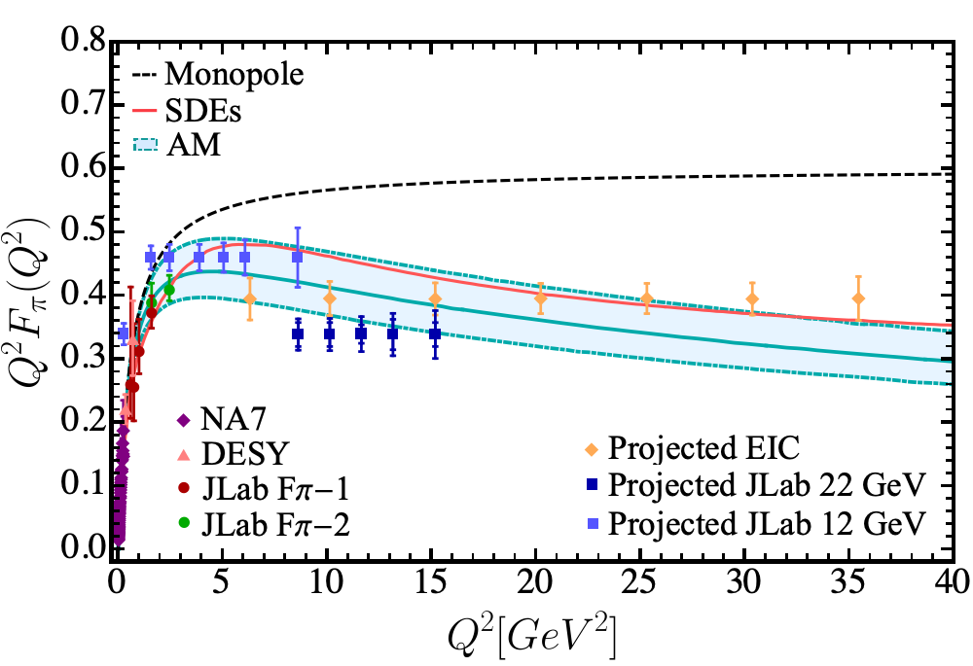
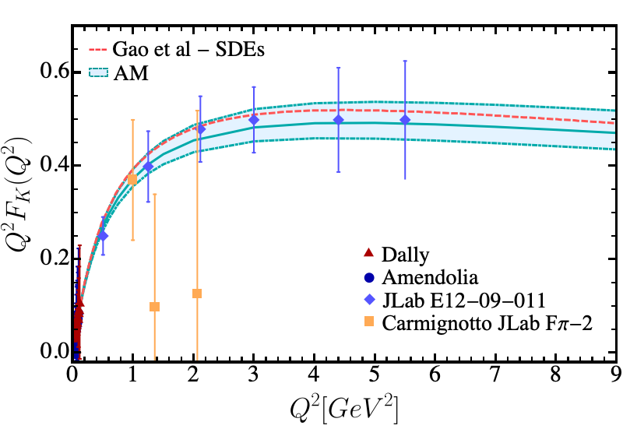
DCSB: From Quarks to Mesons
The Q²-dependence of the pion and kaon electromagnetic form factors to larger Q² range of photon virtualities accessible to the JLab12, JLab22 and the EIC programs:
L. Albino, M. Higuera, K. Raya, AB Phys. Rev. D 106 (2022) 3, 034003
M. Higuera, AB, R. Hernández, K. Raya, in progress.

Slide 6
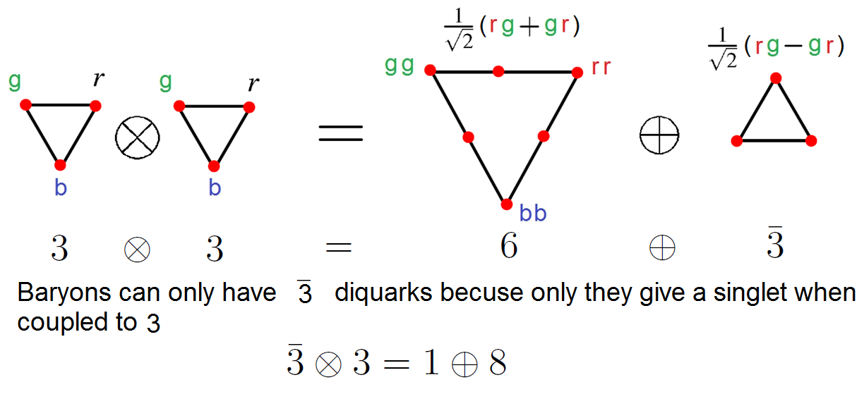
From Mesons to Diquarks
Any interaction capable of creating pseudo-NG modes as bound-states such as 𝜋, K reproducing the measured value of their leptonic decay constants, will necessarily also generate strong color-antitriplet correlations between any two dressed quarks contained within a hadron.
M. Yu, Barbanov et. al., Prog. Part. Nucl. Phys. 116 (2021) 103835
A scalar, [ud]₀+ diquark is generated in the presence of DCSB, in correspondence with the
pion and axial vector {ud}₁+ diquark would result from the Bethe-Salpeter equation along
with the theory’s ρ-meson.

Slide 7
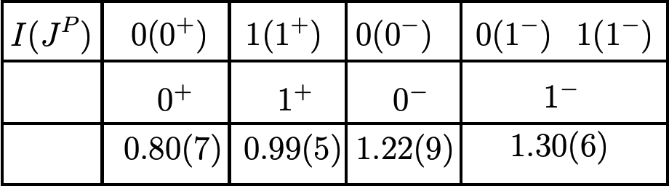
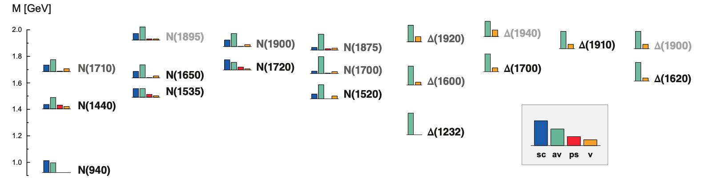
From Mesons to Diquarks
In a nucleon scalar and axial-vector diquark correlations are the strongest.
Associated diquark mass-scales are bounded below by
the partnered meson’s mass: see Table (GeV).
Electromagnetic size of diquarks is bounded below
by that of analogous mesonic system.
Mass
GeV
It is important to appreciate that these fully dynamical diquark correlations are different from the
static, pointlike diquarks which featured in early attempts to understand the baryon spectrum.
M. Yu, Barbanov et. al., Prog. Part. Nucl. Phys. 116 (2021) 103835

Slide 8
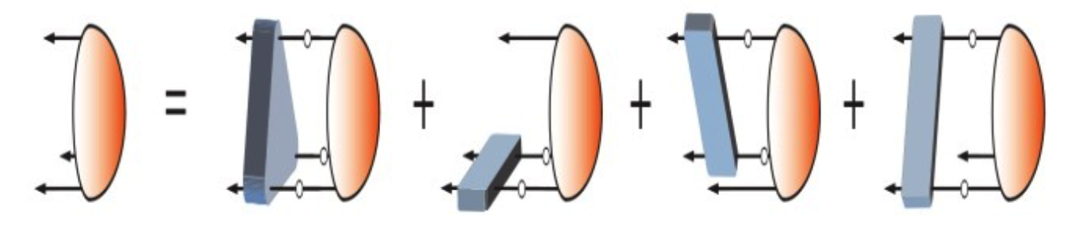
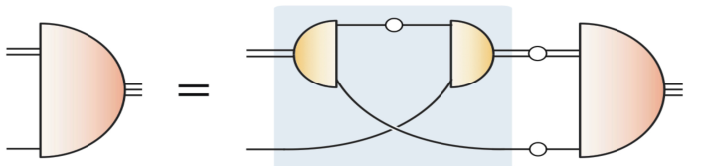
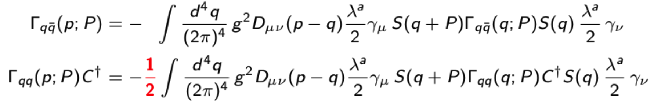
From Diquarks to Baryons
Faddeev equation for a
baryon:
G. Eichmann, Phys. Rev. D 84 (2011) 014014; G. Eichmann et. Al. Prog. Part. Nucl. Phys. 91 (2016) 1-100
The quark-diquark picture of baryon reproduces
results within 5% of the 3-body problem:
Dynamical quark-diquark picture
Less tightly bound:

Slide 9
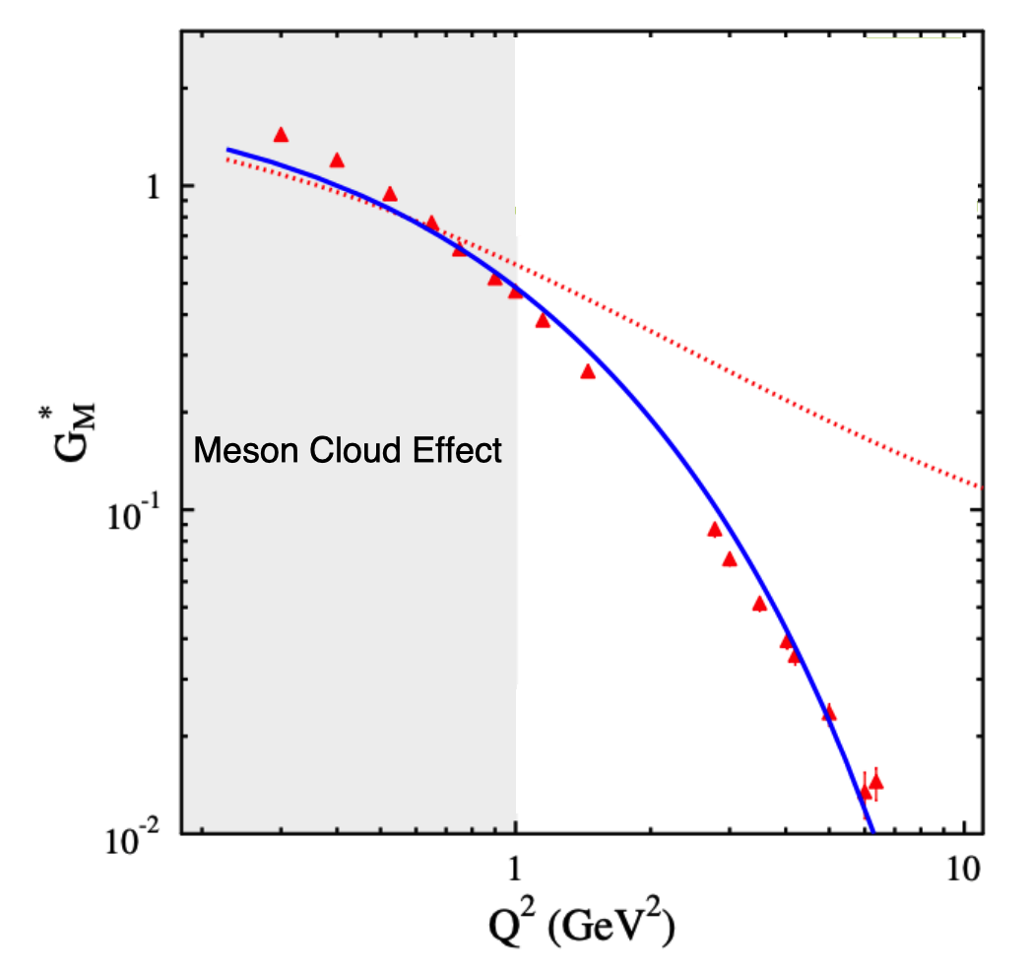
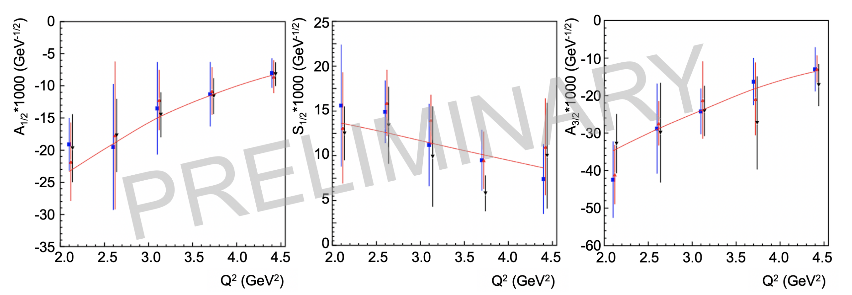
N→∆(1232), ∆(1600) Transition Form Factors
The SDE results reported for N → ∆(1232) and N → ∆(1600) are
compatible with experiment where meson cloud effect does not
contaminate the Q² evolution. N → ∆(1232):
N → ∆(1232)
J. Segovia, C. Chen, C.D. Roberts, S. Wan Phys. Rev. C88 (2013) 032201(R)
J. Segovia et. al., Few-Body Syst. 55 (2014) 1-33
I. Aznauryan et al., Phys. Rev. C 80, 055203 (2009)
N → ∆(1600):
Ya Lu et al., Phys. Rev. D 100, 034001 (2019)
CLAS results on ∆(1600)3/2+
electrocouplings confirmed
the SDE prediction based
on QCD kindred calculation.
D.S. Carman, R.W. Gothe, V.I. Mokeev, C.D. Roberts, Particles 6 (2023) 1, 416-439.

Slide 10
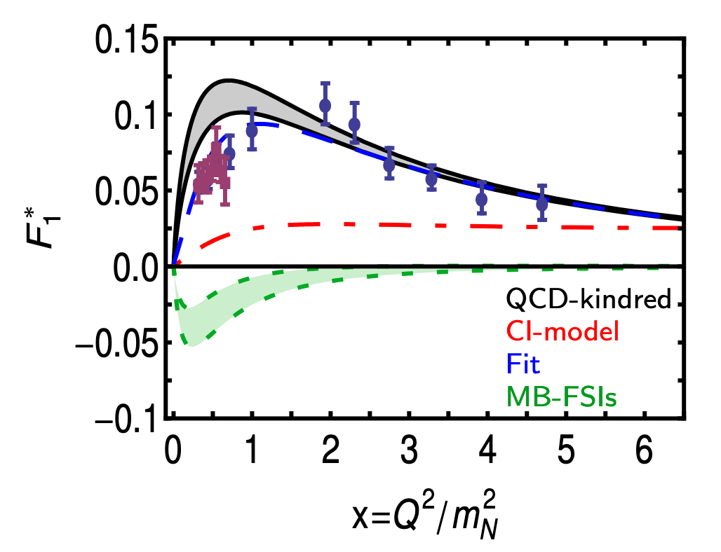
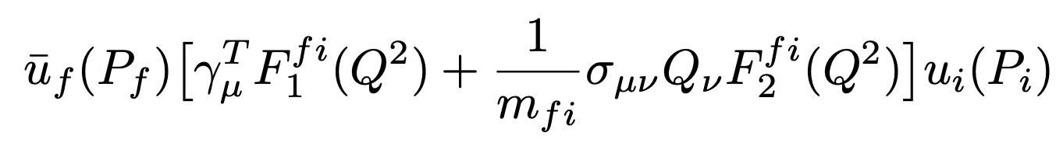
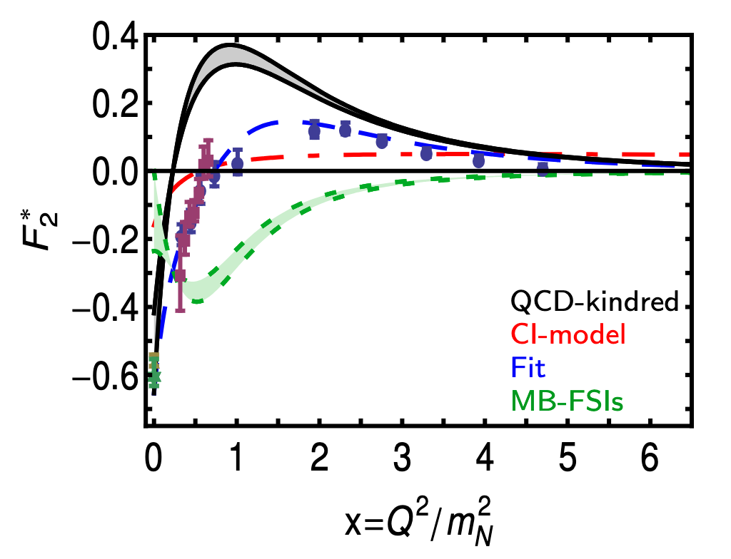
N → N(1440) Transition Form Factors
SDE computation of Dirac and Pauli transition form factors:
It agrees quantitatively in magnitude and qualitatively in trend
with data above x ≿ 2.
The mismatch between the SDE prediction and the data on the
domain x ≲2 is attributed to the meson cloud contribution.
The dashed-green band is the inferred form of the meson cloud
contribution from the fit to the data.
I. Aznauryan et al., Phys. Rev. C 80, 055203 (2009)
V. I. Mokeev et al., Phys. Rev. C 86, 035203 (2012)
V. I. Mokeev et al., Phys. Rev. C 93, 025206 (2016)
C. Chen et. al. Phys. Rev. D 99 (2019) 3, 034013
C. Chen et. al. Phys. Rev. D97 (2018) 3, 034016
J. Segovia, C.D. Roberts, Phys. Rev. C94 (2016) 4, 042201
J. Segovia, et. al., Phys. Rev. Lett. 115 (2015) 17, 171801

Slide 11
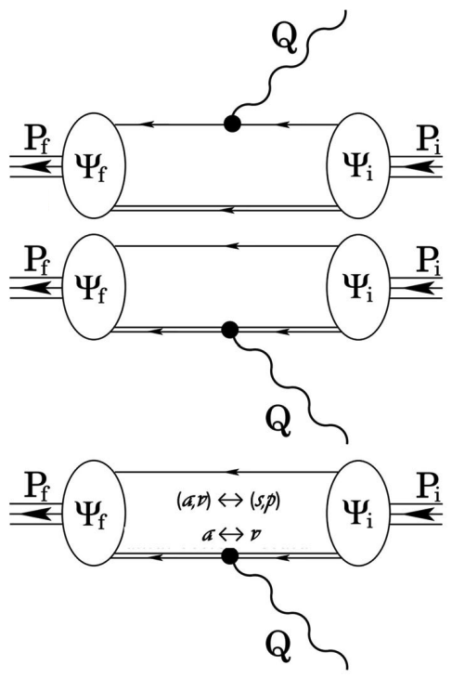
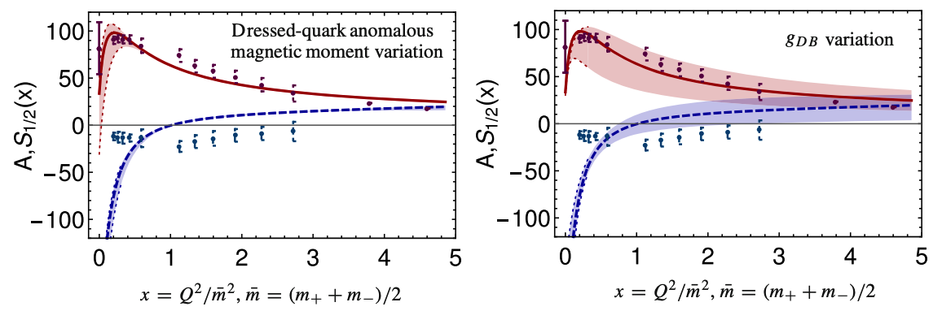
SCI: N ➔ N*(1535) Transition Form Factors
Spin ½ initial and final states but with opposite parity.
I. Aznauryan et al., Phys. Rev. C 80, 055203 (2009)
K. Raya, L.X. Gutiérrez, AB, L. Chang, Z-F. Cui, Y. Lu, C.D. Roberts, J. Segovia, Eur. Phys. J. A 57 (2021) 9, 266

Slide 12
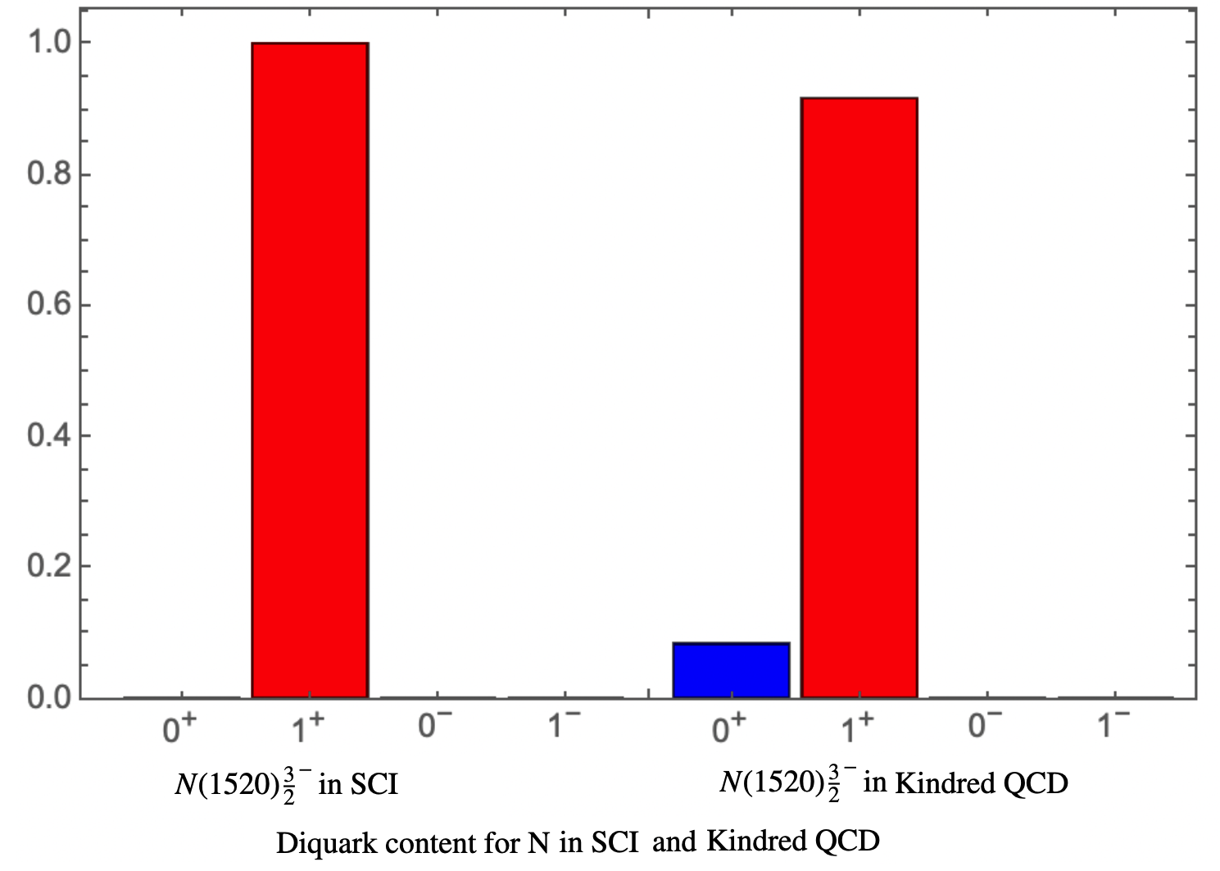
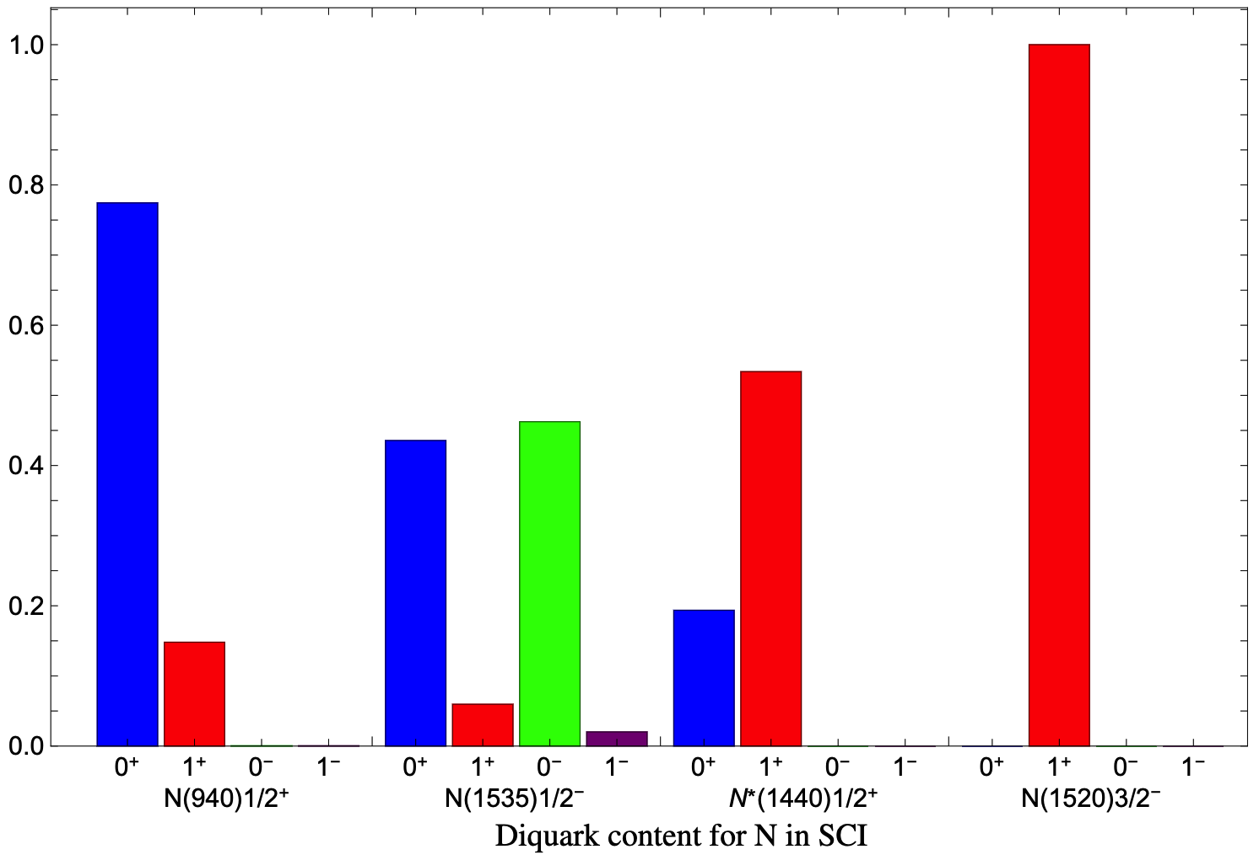
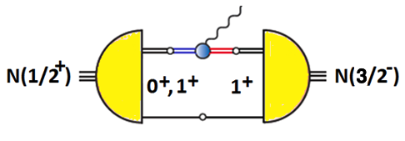
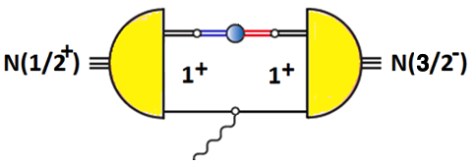
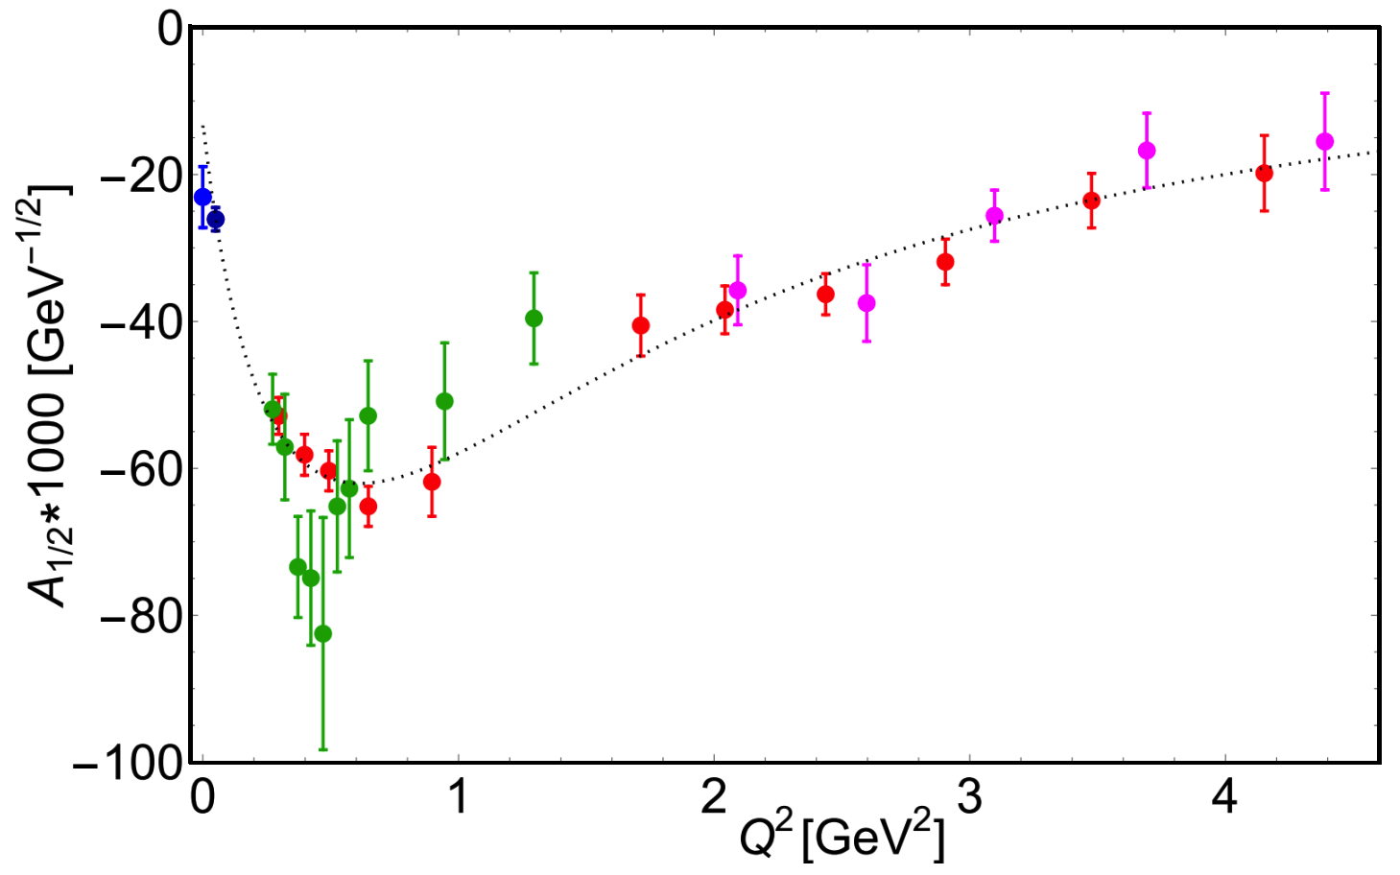
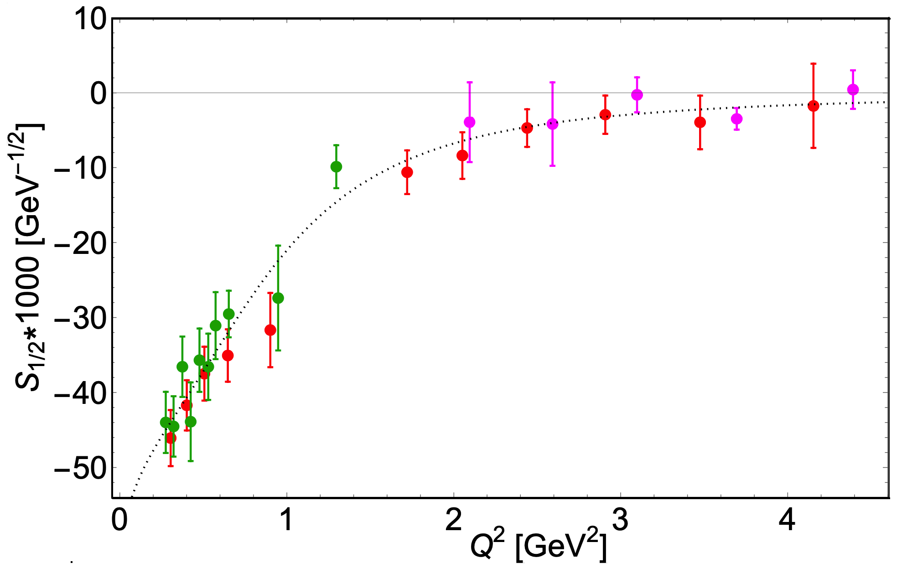
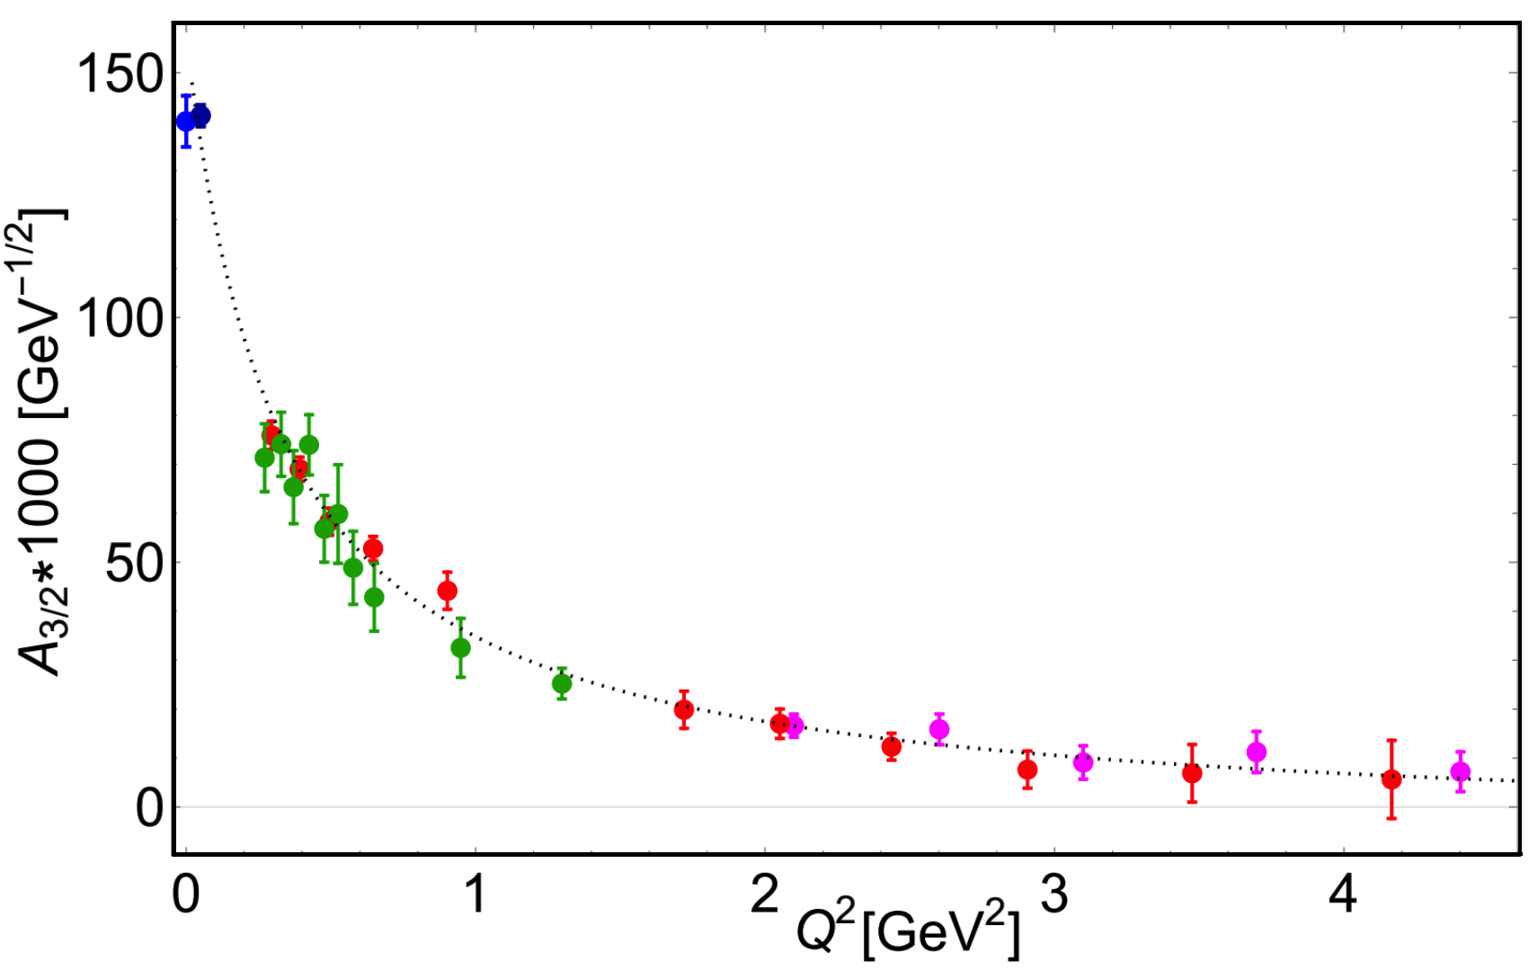



SCI: Towards N*(1520)
G. Paredes, K. Raya,
V. Mokeev
C. Carlson, Phys. Rev. D 34, 2704 (1986).

Slide 13
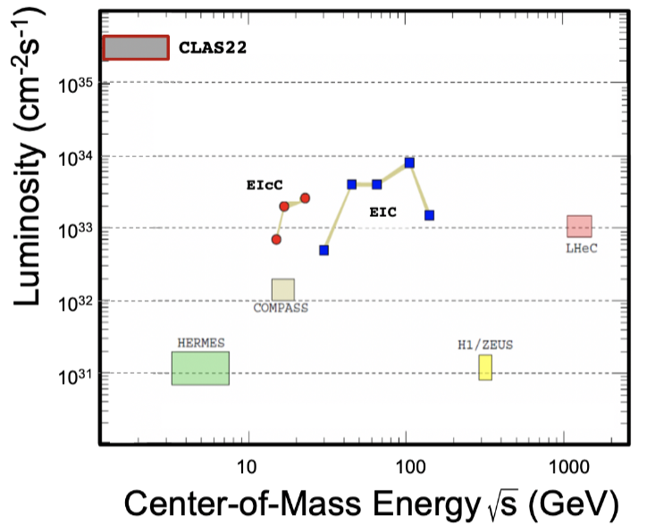
JLAB CLAS22: Promise and Opportunities
Simulations of 𝜋N, KY, and 𝜋⁺𝜋⁻p electroproduction with CEBAF@22 GeV show that
𝛾_{v}pN* electrocouplings can be determined up to Q² ~ 30 GeV² for 𝓛 ~ 2 - 5 ⨉ 10³⁵ cm⁻²s⁻¹
Talk by V. Mokeev, Hadron 2023, Genoa, Italy.
The high luminosity frontier provides JLab a special advantage in comparison with EIC or EIcC.
It offers a unique opportunity to study Nature’s simplest
3-body bound state and its electrocouplings with its resonances in a large domain of momentum transfer.
CLAS22 will map out the working of QCD from its non-perturbative behavior at low Q² to its asymptotic regime
where perturbative QCD can provide predictions, charting
out the pattern of dynamical chiral symmetry breaking.
Strong Interaction Physics at the Luminosity Frontier with 22 GeV Electrons at Jefferson Lab
A. Accardi et al., e-print:2306.09360[nucl-ex]

