Slide 1
Non-nucleonic degrees of freedom and the
spin structure of the deuteron
Misak Sargsian
Florida International University, Miami
The 25th International Spin Symposium, Durham, NC,
September 24-29th, 2023

Slide 2
Polarization states in the deuteron give new degrees of freedom in
exploration of dynamical structure of the deuteron in particular and
strong interaction in general.
Most important advancement in this respect is possibility of measuring
polarization states at fixed and larger values of internal momenta of
the deuteron
These studies will allow to answer to several unresolved questions:
- what is the deuteron wave function below the pn inelastic threshold
- how much the structure of nuclear core reflected in polarization observables
- how the relativistic effects modify the polarization states
- implication of non-nucleonic states on polarization observables

Slide 3
Vc, MeV
QCD
Intrinsic strangeness/charm
Hidden Color
r
~80% hidden color
Brodsky,Ji, Lepage, PRL 83

Slide 4
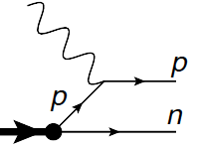
Considering mainly high Q² d(e,e’N)N reaction
Theory of high energy semi-inclusive electro-nuclear processes:
Deuteron consist of proton and neutron
d
Exclusiveness of the reaction as an advantage in probing unintegrated density matrix
of the deuteron at given missing momentum
not entirely true: final state hadronic interactions are never dynamically small
In High Energy and Momentum Transfer limit: Q² > 1GeV²: MEC is dynamically
suppressed, Delta is possible to suppress both kinematically and dynamically
For FSI eikonal regime is established: allowed to develop self-consistent theoretical
framework that allows to account for the short distance nuclear dynamics
Generalized Eikonal Approximation (GEA)

Slide 5
MS PRC 2010

Slide 7
Generalized Eikonal Approximation (GEA)
W. Ford, J.W. Van Orden
S. Jeschonnek PRC 2013
e + d → e’ + p + n reactions:
MS PRC 2010
Some interesting features of GEA: (i) differs from conventional Glauber theory for the case of
large internal momenta being probed in the nucleus ,
(ii) demonstrated the existence of the window in probing
the internal nuclear momenta beyond 300 MeV/c
Frankfurt, MS, Strikman PRC 2010, GEA
K. Egiyan et al PRL 2008
GA

Slide 8
Probing Deuteron at Small Distances at large Q²
JLab, Q² = 3.5 GeV²
Boeglin et al PRL 2011, deuteron probed at up to 550MeV/c

Slide 9
Currently: Probed NN structure up to > 0.8fm
Probed distances
Probed
Next: NN – Repulsive Core

Slide 10
Vc, MeV
QCD
Intrinsic strangeness/charm
Hidden Color
r
~80% hidden color
Brodsky,Ji, Lepage, PRL 83

Slide 11
Probing NN interaction at very short distances
d
M.Sargsian & F. Vera, PRL 2023

Slide 13
For the Deuteron it means, at Short Distances
The NN repulsive core can be due to the orthogonality of

Slide 14
Some Paradigm Shift
Our current mindset about deuteron is fully non-relativistic, the observation that it has
total spin, J=1 and parity, P=+, together with the relation that
for non-relativistic wave function, P= (-1)^{l}, one concludes that the deuteron consists of S- and D- partial waves for proton-neutron system.
Paradigm Shift: The above reaction at high Q², measures the probability of observing proton and neutron in the deuteron at very large relative momenta.
In such a formulation the deuteron is not a composite system consisting of proton and neutron but it is a composite pseudo - vector (J=1, P=+) ``particle" from which one extracts proton and neutron.
How such a proton and neutron produced at such extremal conditions is related
to the dynamical structure of Light-Front deuteron wave function, which may include internal elastic as well as inelastic , or
transitions.

Slide 15
- consider a deuteron not a nucleus that consist of proton and neutron
- but pseudovector composite particle from which we extract proton and neutron
- Light-Front Deuteron wave function
- Absorbing the energy denominator into the vertex function and using crossing symmetry

Slide 16
Vc, MeV
pn
pn
Hidden Color
r

Slide 17
Electron
Nucleon
Proton
Neutron

Slide 18
-
is a four-vector, which can be constructed in a most general form satisfying
time reversal, parity and charge conjugate symmetries
Because the deuteron is a bound system, in addition to on-shell p₁ and p₂ four momenta
one introduces
Constructed vertex:

Slide 19
High Momentum Transfer Kinematics
For large Q² limit, Light-Front momenta for the reaction are chosen as follows:
- One observes that for fixed x,

Slide 20
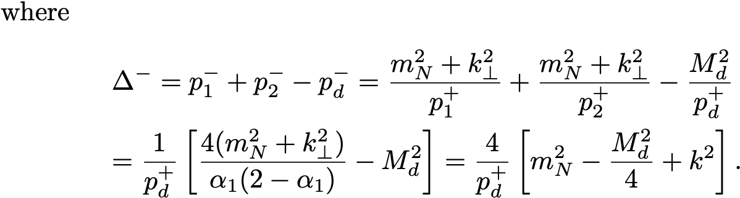
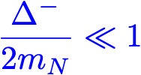
In high Q² limit

Slide 21
Consider:
Since:
and
then
Leading Oder!
where

Slide 22
Where:
fully relativistic: in addition to
term
has additional
term

Slide 23
Light Front Density Matrix and Momentum Distribution
Baryonic and Momentum Sum Rules

Slide 24
Non-Nucleonic Components and the New Structure
- Momentum distribution depends on
separately
- This is impossible for non-relativistic quantum mechanics of the deuteron since
in this case the potential of the interaction is real (no inelasticities) and the solution
of Lippmann-Schwinger (or Schroedinger) equation for partial S- and D-waves
satisfies ``angular condition", according to which the momentum distribution
in unpolarized deuteron depends on the magnitude of relative momentum only.
- On the other hand, in the relativistic domain the definition of the interaction potential is not straightforward to allow to use quantum-mechanical arguments in claiming that momentum distribution should satisfy the angular condition (i.e. depends on magnitude of k only).

Slide 25
- However, for the Light-Front, there is a remarkable theorem by Frankfurt and Strikman
which states that if one considers only pn component in the deuteron, then for most
acceptable forms of NN potential – constructed from elastic pn pn scattering, the angular
condition should be satisfied also for LF momentum distribution.
-The realization of the angular condition for relativistic case will require that light-front
potential to satisfy a condition
- Lorentz invariance for on-shell NN amplitude requires

Slide 26
- Existence of the Born term indicates that
- Iterating the equation around the on-shell kinematic point.
- will result in:
for the general case
V_{NN} – analytic function of angular momentum and it does not diverge exponentially in the
complex-angular momentum space it was shown that also for the off-shell case

Slide 27
- For Non-nucleonic components no such iteration can be done

Slide 28
Estimate of the effect

Slide 29
Estimate of the effect

Slide 30
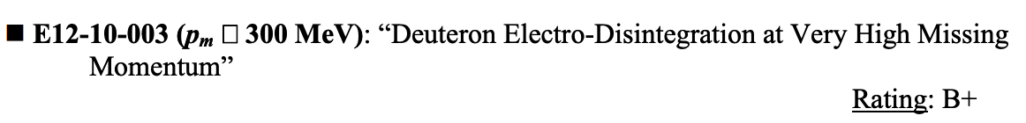
Possibility of Experimental Verification
PAC-36, 2010

Slide 31
Probing Deuteron at Small Distances at large Q²
JLab, Q² = 3.5 GeV²
Boeglin et al PRL 2011

Slide 32
Possibility of Experimental Verification
3-days of commissioning measurement,
JLab experiment Q² = 4 GeV²
C. Yero, et al Phys.Rev.Lett. 125 (2020) 26, 262501

Slide 33

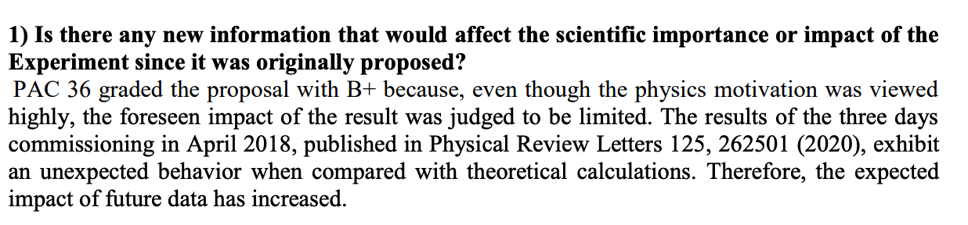
Possibility of Experimental Verification
PAC-49, 2021

Slide 34
Outlook on Experimental Verification of the Effect
analysis of the experiment will require careful account for competing nuclear effects
most importantly final state interactions
understand the shape of the deuteron momentum distribution at > 700MeV/c
- check if angular condition is violated at > 700MeV/c
predicted new structure of the deuteron results in a very different polarization
properties of the deuteron at > 700MeV/c
If the new structure is found it will motivate new area of research
a: modeling non-nucleonic components in the deuteron,
b: understanding their origin and nature
c: evaluating parameters that can be used for Equation of State of high density
Nuclear Matter

Slide 35
Different Potentials
Sensitive to the NN Core

Slide 37
Compressing the deuteron

Slide 38
Miss-match of nonRelativistic and Relativistic descriptions of the deuteron
No concept of off-shellness in NR description
- Number of particles are conserved in NR description
However in Relativistic description number and the type of the
particles are not conserved
One has thresholds:
pion threshold
Delta-Delta threshold
However, the direct exploration of ``cold-dense" transitions is severely restricted.

Slide 39
Considering mainly high Q² d(e,e’N)N reaction
Theory of high energy semi-inclusive electro-nuclear processes:
d
Exclusiveness of the reaction as an advantage in probing unintegrated density matrix
of the deuteron at given missing momentum
not entirely true: final state hadronic interactions are never dynamically small
In High Energy and Momentum Transfer limit: Q² > 1GeV²: MEC is dynamically
suppressed, Delta is possible to suppress both kinematically and dynamically
For FSI eikonal regime is established: allowed to develop self-consistent theoretical
framework that allows to account for the short distance nuclear dynamics

Slide 41
Generalized Eikonal Approximation (GEA)
The theory is formulated in the form of the effective Feynman diagram rules with
effective vertices that can be parameterized based on NN elastic scattering amplitudes.
Frankfurt, Sargsian, Strikman PRC 1997
Sargsian (review) IJMP 2001
For the case of
e+ A → e’ + p_{f} + X
Small Parameter:
M. Sargsian PRC 2010
For the case of
e+ d → e’ + p_{f} + p_{s}

Slide 44
Generalized Eikonal Approximation (GEA)
W. Ford, J.W. Van Orden
S. Jeschonnek PRC 2013
e + d → e’ + p + n reactions:
M. S PRC 2010
Some interesting features of GEA: (i) differs from conventional Glauber theory for the case of
large internal momenta being probed in the nucleus ,
(ii) demonstrated the existence of the window in probing
the internal nuclear momenta beyond 300 MeV/c
K. Egiyan et al PRL 2008
GA

Slide 45
Probing Deuteron at Small Distances at large Q²
JLab, Q² = 3.5 GeV²
Boeglin et al PRL 2011, deuteron probed at up to 550MeV/c

Slide 46
A_{zz} in d(e,e’p)n Reaction: Large FSI Effects

Slide 47
A_{zz} in d(e,e’p)n Reaction

Slide 48
Azz in d(e,e’p)n Reaction: Relativistic Effects: Suppress FSI
Solid – Light Cone
Dashed – Virtual Nucleon
Curves with triangles
Include FSI
M.S & M.Strikman, 2002
Work in Progress

Slide 49
Some Summary and Outlook
Detailed measurement of tensor polarized cross section of the deuteron in high Q2
d(e,e’N)N reaction at p< 500 MeV/C
Will allow to extract tensor polarized density matrix of the deuteron
This, together with unpolarized measurement will allow to constrain the
deuteron wave function dominated by pn component only
Combined with unpolarized measurement it may be possible to verify the
crossing zero point of the S-wave which is sensitive to the nuclear core

Slide 50
Impossibility to Probe Deuteron at Small Distances at low Q²
Mainz, Q² = 0.33 GeV²
JLab, Q² = 0.66 GeV²

Slide 51
At Large Q² > 1-2 GeV² Eikonal Regime is Established)
For the case of
e+ d → e’ + p_{f} + p_{s}
K.Egiyan at al 2008
M.Sargsian, PRC 2010

Slide 52
Probing Deuteron at Small Distances at large Q²
JLab, Q² = 3.5 GeV²
Boeglin et al PRL 2011, deuteron probed at up to 550MeV/c

