Slide 1
Polarized Ion Sources at BNL
D. Raparia, G. Atoian, E. Beebe, S. Ikeda, T. Kanesue, S. Kondrashev, J. Maxwell, R. Milner, M. Musgrave, M. Okamura, A.A. Poblaguev, J. Ritter, A. Sukhanov, S. Trabochi, A. Zelenski
SPIN 2023
September 26, 2023

Slide 2
Outlines
Introduction
Polarized proton source , OPPIS
- Upgrades
- OPPIS components
- Performance
Development of Polarized ³He⁺⁺ source
- ³He⁺⁺ Source based on EBIS
- Gas purification system
- ³He Gas Cell
- Spin Rotator Chicane
- 6 MeV Polarimeter
Conclusion

Slide 3
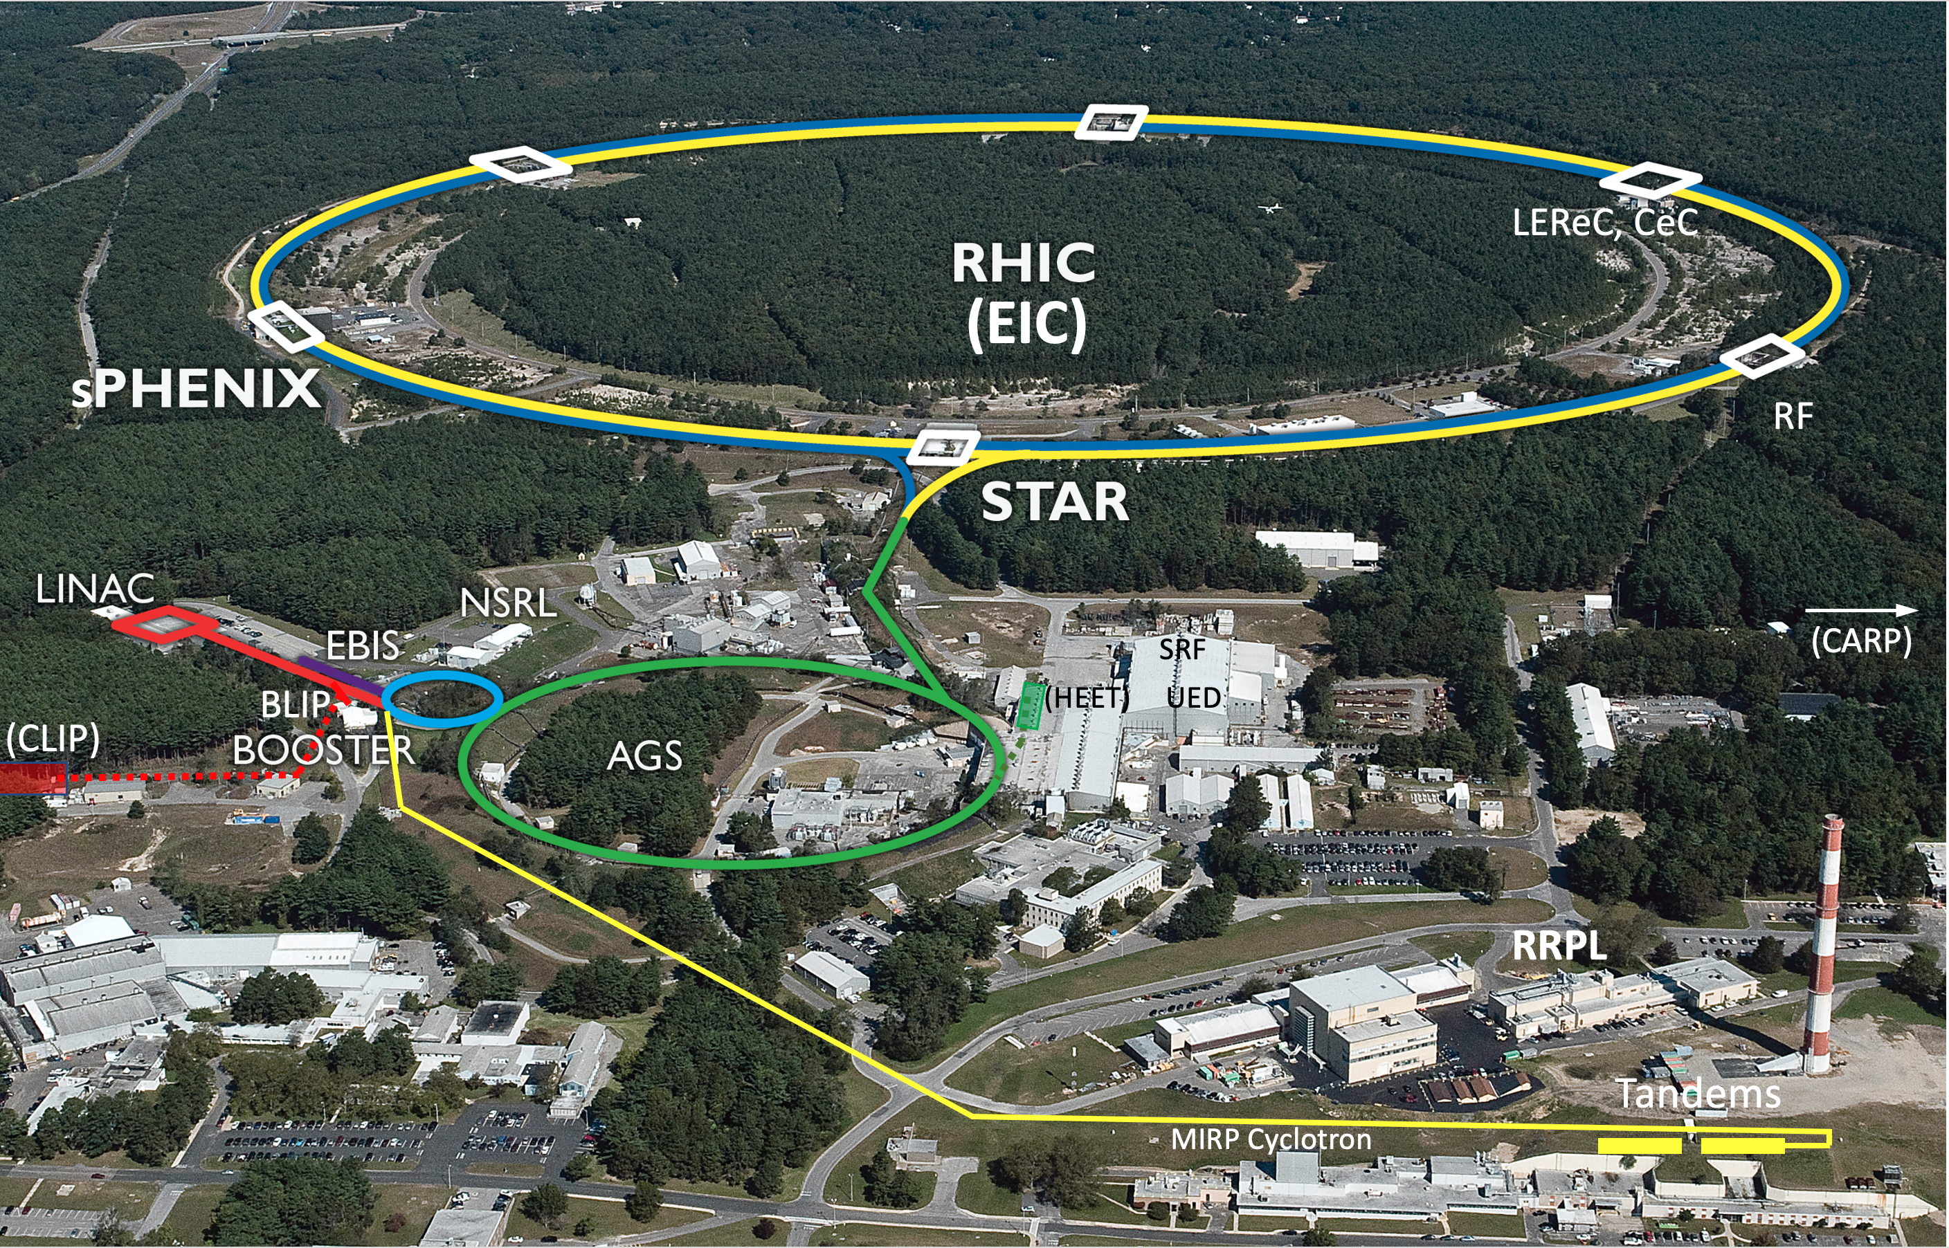
Overview of the BNL Hadron Complex
Uniquely flexible and
only hadron collider in
US for exploration of
QCD phase diagram
and proton spin
Injectors also used for
application programs:
- Linac/BLIP for
isotope production
- Booster/NSRL for
space radiation studies
- Tandem for
industrial/academic users
R&D for future facilities
and application
sources, pol. beams, …

Slide 4
Polarization Facilities at RHIC
EBIS

Slide 5
Optically Pumped Polarized Proton Source
OPPIS (Optically Pumped Polarized Ion Source) Since 2000, H⁻ ion source has been upgraded several times to higher intensity and polarization.
Prior to Run-13(2013), the ECR-type source was used to generate the primary proton beam. The ECR-source was originally developed to operate on DC current and placed inside a super conductive solenoid (SCS).
In 2013, the ECR-source was replaced with a high-brightness source “Fast Atomic Beam Source” (FABS) operating in a pulsed mode. The FABS-source improved source parameters such as beam current density, angular divergence and stability.
In 2022, We reduced the LEBT portion of the beam line by about 5feet, modify polarization part of OPPIS (He-cell, Rb-cell and Na-cell) and the extractor-transformer system.

Slide 6
LEBT (35 keV) Upgrade with 3 Sources
The Low Energy Beam Transport (LEBT) lines combine three beams. The first line is the polarized OPPIS beam-line, and the second and third lines are the high-intensity unpolarized beam lines.
The LEBT line has been modified twice; the first modification was the addition of another high-intensity unpolarized H-beam line and the second modification was the reduction of the transport line of the OPPIS line by more than 5 feet).
Slits for energy discrimination
Switching Magnet (50 ms)
OPPIS
RHIC, NSRL
500 𝝻A, 500 𝝻 s
0.15 -1 HZ
Magnetron S-2
To RFG
Laser
Room
RFQ
OPPIS
Magnetron S-1
Chopper
Magnetron S-1,2
High intensity
BLIP, NSRL
130 mA, 1000 𝝻 s
6.67 Hz

Slide 7
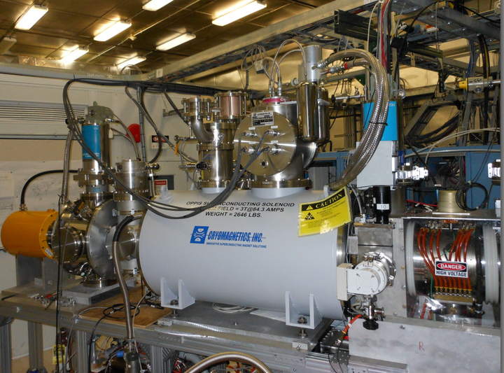
OPPIS

Slide 8
OPPIS Layout
OPPIS produces 3-5 mA Polarized H⁻ ion pulse current
81-84% polarization @200 MeV , 0.5 mA

Slide 9
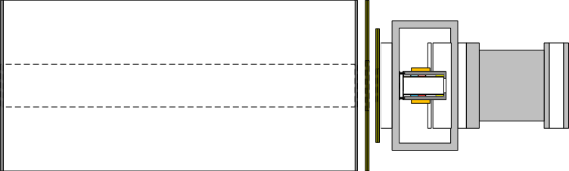
Polarization Transfer Technique
Polarized light
Polarized electron
Polarized proton
(Quarks? Gluons ? Sea quarks?
Production of circular polarized tunable wavelength (~795nm) laser beam
Polarization of the outer electron of Rb-atom by a laser
Ionization of hydrogen atom at He-cell.
Production of electron spin polarized hydrogen atoms by capture electron from Rb
Polarization transfer from electron to proton by “Sona-transition” technique
Ionization of hydrogen atoms by capture of second electron in Na-jet for acceleration
H^{0*}
H⁺
H^{0*}
H⁰
Na-jet
&
Solenoid
H⁻
He-cell
Rb-cell
SC-solenoid
9
Sona-transition with 3 corr. coils in it

Slide 10
Polarization Dilution due H⁰
In FABS-source
Inside of the SCS
Ionizer & Extractor
H⁺
7keV
>90%
0.72%
H₂-cell
40%
H⁰
7keV
2%
H⁻
7keV
Neutralize
H⁰
7keV
H⁻39keV
Na-jet
Extr.
60%
Ionize
Accelerate
32keV
Ionize
He-cell
H⁺
7keV
He-cell
Decelerate, ΔE=4.0keV
H⁺
3keV
70%
Rb-cell
H⁰
3keV
Neutralize
8%
Na-jet
H⁻
3keV
Ionize
Dilution of polarization (0.72/3 =0.24) can be reduced by the energy separation of the H⁻ beam (~25-30 times) to 0.24/25~ 0.01
3%
Extr.
H⁻
35keV
Accelerate
32keV

Slide 11
Fast Atomic Beam Source

Slide 12
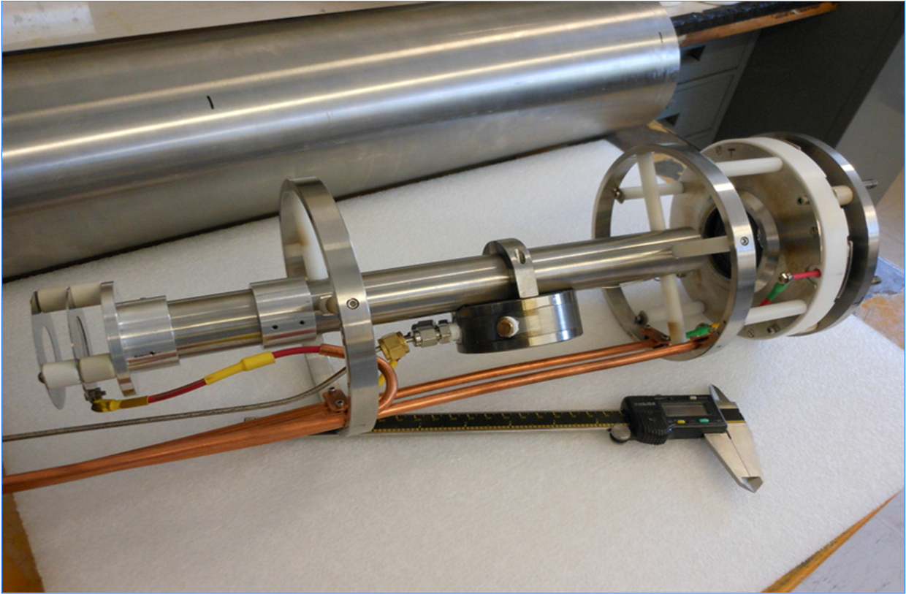
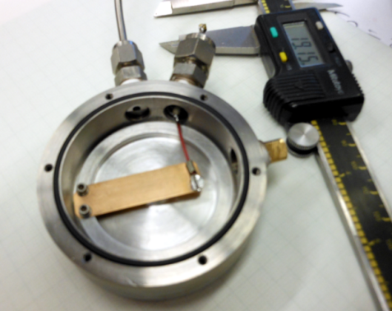
He-Ionizer Cell with 3-grid Energy Separation System
Two functions of the new He-cell with pulsed valve:
Ionization of the injected neutral beam
Deceleration of the ionized part of the beam to separate from the no-ionized part
He-valve
Operating in high magnetic field ~1-3T
He-cell
He-pulsed
valve
3-grid beam
Deceleration system

Slide 13
Optically –Pumped Rb- vapor Cell

Slide 14
4-Grid Sperical Ion Optical System

Slide 15
Sodium –Jet Ionizer Cell

Slide 16
H- Beam Acceleration to 35 keV

Slide 17
Depolarization Factors
Depol. factor |  | Process | Estimate
1 | E_{H}⁰ | Dilution due H⁰ part of the beam (LEBT) | 0.99 - 0.99
2 | P_{Rb} | Rb-optical pumping (Laser system) | 0.99 - 0.99
3 | S | Rb polarization spatial distribution (Collimators) | 0.97 - 0.98
4 | B_{RG} | Proton neutralization in residual gas (Vacuum) | 0.98 - 0.99
5 | E_{LS} | Depolarization due to spin-orbital interaction | 0.98 - 0.98
6 | E_{ES} | Dilution due to incomplete energy separation not polarized component of the beam (LEBT) | 0.98 - 0.99
7 | E_{Sona} | Sona-transition efficiency (Adjustment) | 0.96 - 0.98
8 | E_{ion} | Incomplete hyperfine interaction breaking in the ionizer magnetic field | 0.98 - 0.99
P = E_{H2} ∙ P_{Rb}∙ S ∙ B_{RG}∙ E_{LS}∙ E_{ES} ∙ E_{Sona}∙ E_{ion} ~ 85-90%
Total: 0.85 - 0.90
Notes:
17

Slide 18
H- Current at 200 MeV-1.05 mA

Slide 19
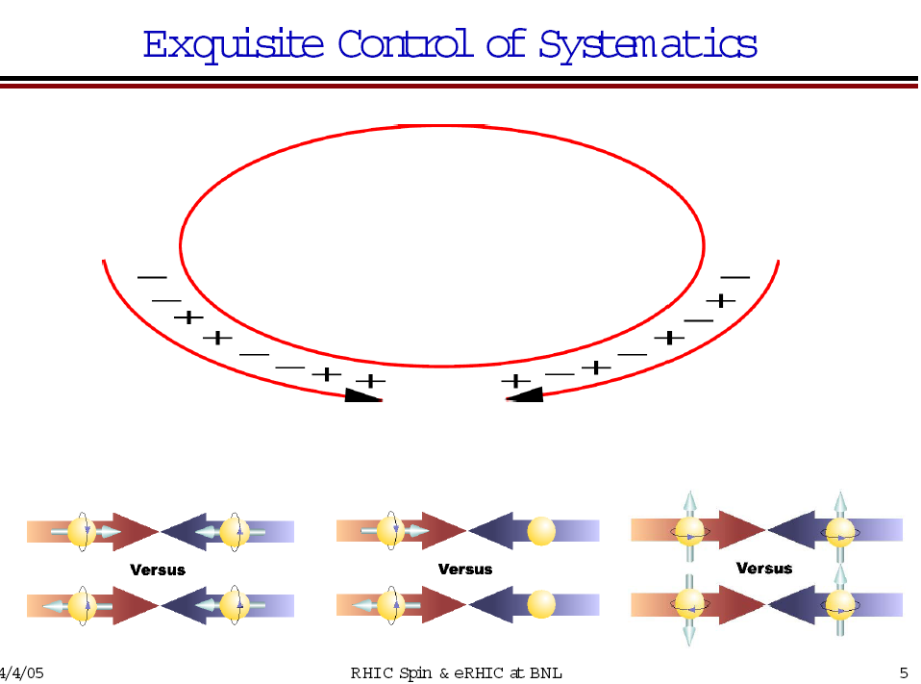
Polarized beams in RHIC
OPPIS
6.3∙10¹¹(maximum 40∙10¹¹) polarized H⁻ /pulse.
LINAC
3.6∙10¹¹ polarized H⁻ /pulse at 200 MeV, P=80-82%
200 uA X300us
Booster
2.5∙10¹¹ protons /pulse at 2.3 GeV
Scraping in Booster
AGS
2.2∙10¹¹ p/bunch, P ~65%
RHIC
~2∙10¹¹ p/bunch, P~60-65% at 100GeV
P ~ 50% at 250 GeV
Notes:
19

Slide 20
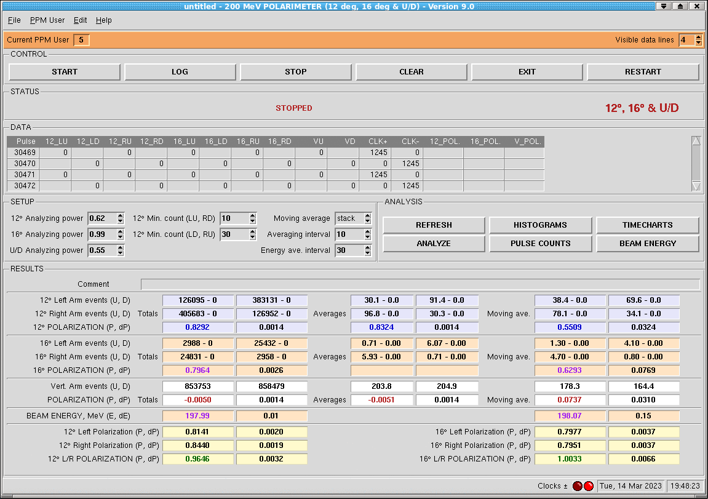
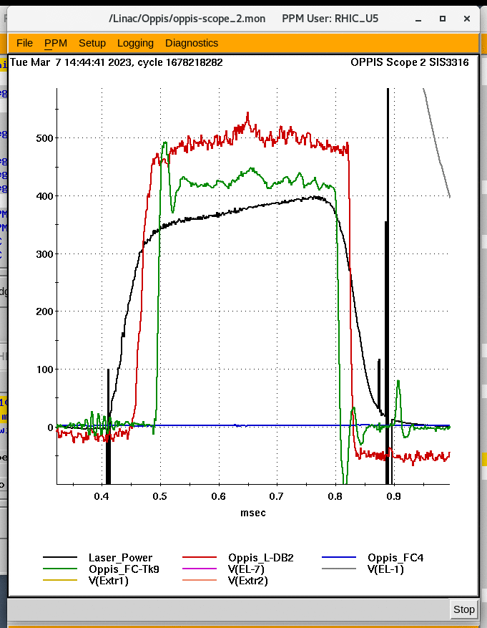
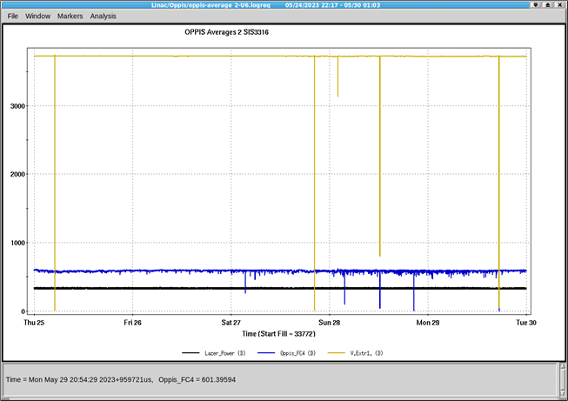
Beam Intensity in 2023 @ 200 MeV: 420𝝻A ( ~7*10^11)

Slide 21
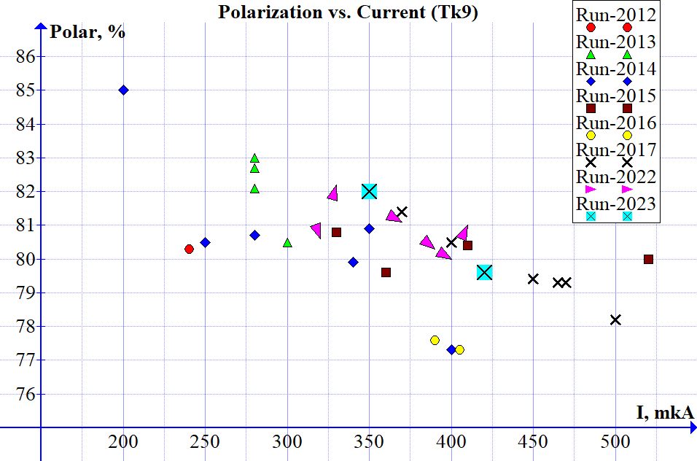
Beam Performance
ECR
𝞵A

Slide 22
Polarized ³He⁺⁺ Source development
U. S. Department of Energy
Office of Science | Nuclear Physics FY 2018
Research and Development for Next Generation Nuclear Physics Accelerator Facilities
… A doubly polarized electron-ion collider (EIC) is the best way to examine the internal structure of the proton and neutron. The technology to accelerate polarized proton beams has been well established at RHIC. However, studying the structure of the neutron requires the acceleration of polarized ³He⁺⁺, which carries ~90% of its polarization in the neutron, and to match the unprecedented statistical precision an EIC will provide, it is indispensable to have high precision measurements of the hadron beam polarization. For this reason, development of a polarized ³He ion beam has been identified as an R&D priority by the EIC Advisory Committee in 2009 and the Office of Nuclear Physics Community Review in 2017.
In 2003 A. Zelenski, J. Alessi proposed a production polarized ³He⁺⁺ beam in EBIS.
(A. Zelenski, J. Alessi, “Proposal of production of polarized ³He⁺⁺ beam in EBIS” , ICFA Beam Dynamics Newsletter 30, p.39, (2003)
Polarized ³He⁺⁺ source is a part of the ongoing EBIS upgrade project.
The development of the polarized ³He ion source is being done as a collaboration between BNL and Massachusetts Institute of Technology (MIT).

Slide 23
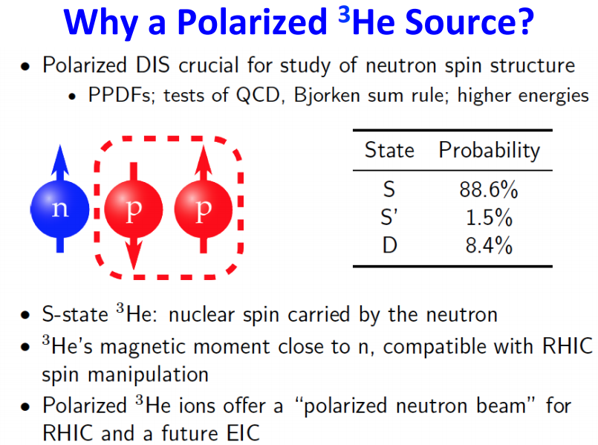
Polarized 3He++ beam can be accelerated in the AGS and RHIC using existing “Siberian snakes

Slide 24
Requirements to the 3He⁺⁺ Source at BNL
Intensity ~ 5∙10¹¹ 3He⁺⁺ ions in 20 us pulse ~10.0 mA-peak current
Maximum polarization > 80%
Compatibility with the operational EBIS for heavy ion physics.
Spin flip for every source pulse in the beam transport line.

Slide 25
Principle of EBIS Operation
10A, 10-20 keV
Radial trapping of ions by the space charge of the electron beam.
Axial trapping by applied electrostatic potentials at ends of trap.
The total charge of ions extracted per pulse is ~ (0.5 – 0.8) x ( number electrons in the trap ~1.0∙10¹² )
Ion output per pulse is proportional to the trap length and electron current.
Ion charge state increases with increasing confinement time.
Output current pulse is independent of species or charge state!
Notes:
25

Slide 26
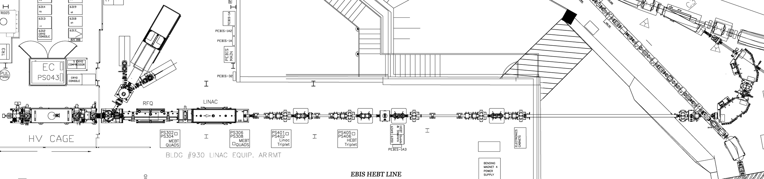
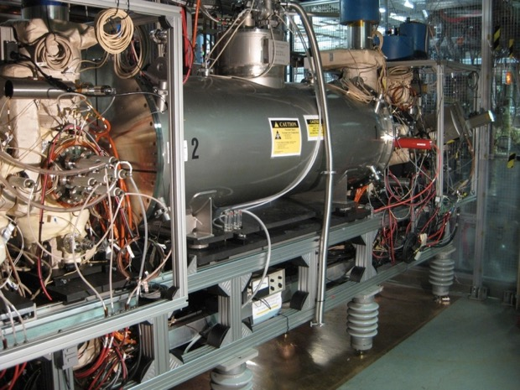
EBIS Preinjector (2 MeV/u)
BOOSTER
BIG BEND
EBIS
RFQ
IH LINAC
BEAM TRANSPORT LINE
LION
Ions | He - U
Q / m | ≥1/6
Current | > 1.5 emA (20 μs)
Pulse length | 10-40 μs
Rep rate | 5 Hz
Output energy | 2 MeV / u
Time to switch species | 1 second
HCIS1
HCIS2
EBIS
TOF
RFQ
IH LINAC

Slide 27
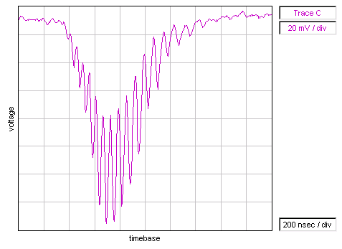
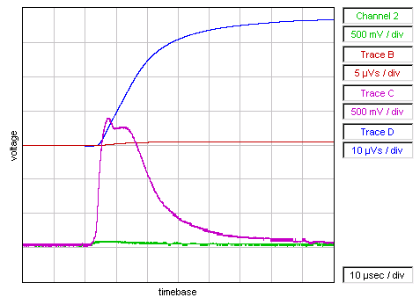
EBIS is an Accumulator and Charge State Multiplier with a widely programmable output pulse width and is capable of working with Internal gas Injection.
Typically operation is with ion injection from external sources:
Fast injection: Laser Ion Source (LION) , ~100’s uA – 1mA , 10-200 us
Slow injection: HCIS, 1-10’s uA, 10-40 ms
Widely variable extraction pulse width 5uS to greater than 50ms
Booster/AGS/Rhic injection typically 5-40 us (High Intensity)
Pure Beams (low contamination by unwanted ion species)
High utilization of relatively low charge capacity
Lower space charge beam transport to RFQ
Note very low background contamination characteristic of EBIS
Above: Au Time-of-Flight Spectrum
(Reflex mode – channeltron EM)
Max peak is Au32+
Au pulse (all charge states)
With external Au1+ ion injection:
ChC Magenta3.5mA, 1 mA/div, 10 µs/div
ChD Blue: 70nC , 20uVs/div
Without external ion injection
Ch2 Green: 0.2mA, 1 mA/div, 10 µs/div
ChB Red: 1nC , 10uVs/div

Slide 28
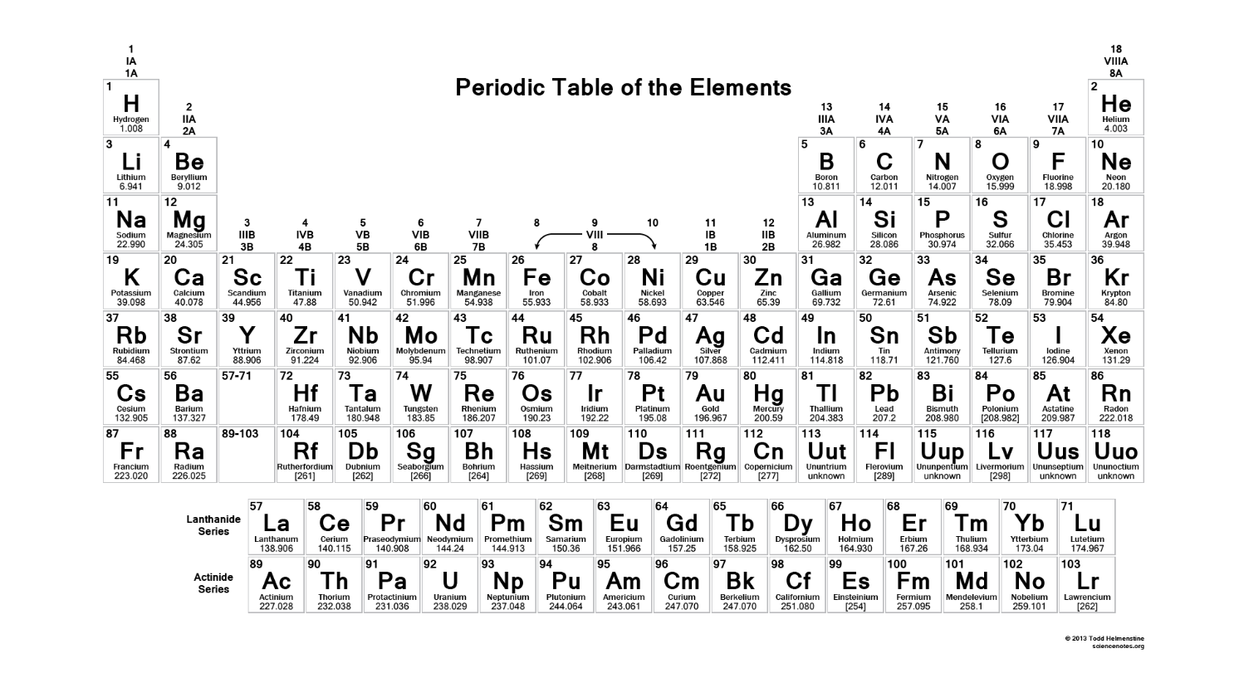
EBIS beams run to date on RHIC EBIS
D, ³He²⁺, ⁴He^{1+,2+}, Li³⁺, C^{5+,6+}, O⁷⁺, Ne⁵⁺, Al⁵⁺, Si^{11+,12+}, Ar¹¹⁺, Ca¹⁴⁺, Ti¹⁸⁺, Fe^{20+,24+}, Cu¹¹⁺, Kr¹⁸⁺, ⁹⁰Zr¹⁵⁺, ⁹⁶Zr¹⁶⁺, Nb¹⁶⁺, Xe²⁷⁺, Ta³⁸⁺, ¹⁸⁴W³¹⁺, Au³²⁺, Pb³⁴⁺, ²³²Th³⁹⁺, U³⁹⁺
1 second switching between species (2, or more), alternating
<30 second switching among almost any 10, if loaded into external sources

Slide 29
Challenges and Key Development for the Extended EBIS
Early work with injection of ³He into EBIS showed that it would be difficult to polarize the ³He gas external to the EBIS and then transport the gas into the EBIS for ionization to ³He^{++,} while maintaining both high intensity and maintaining polarization.
The concept of an in-bore gas / high field polarization cell has been developed. This necessitates the development of a highly efficient gas injection system and led to the development of a hybrid vacuum system using both conventional internal drift tubes and a new modular “external” drift tube system to accommodate placement of the gas reservoir and polarization equipment.
Pumping Ultra-High Vacuum Regions
  -Custom heated linear high capacity NEG
3He Polarization for EBIS
  -Gas Purification, and pulsed valve
  developments
  - Development of the fast valve

Slide 30
Production of Polarized ³He⁺⁺ in EBIS
³He polarization by optical pumping and metastability-exchange technique inside the EBIS in high (5.0T) magnetic field. No polarization losses in 3He⁺ state.
EBIS is used for efficient ionization and accumulation of polarized 3He⁺⁺ ions to the full capacity of about (2.5-5.0)∙10¹¹ , ³He⁺⁺ ions.
Notes:
30

Slide 31
Extended EBIS for 3He⁺⁺
The polarized ³He ion source will be mounted on the Solenoid-1.
The atoms of the ³He gas will be polarized by Metastability Exchange Optical Pumping (MEOP) technique and
After injected through a fast pulse valve in the ion trap region of the EBIS.
There the ³He ions will be trapped and bred to the ³He⁺⁺ state.

Slide 32
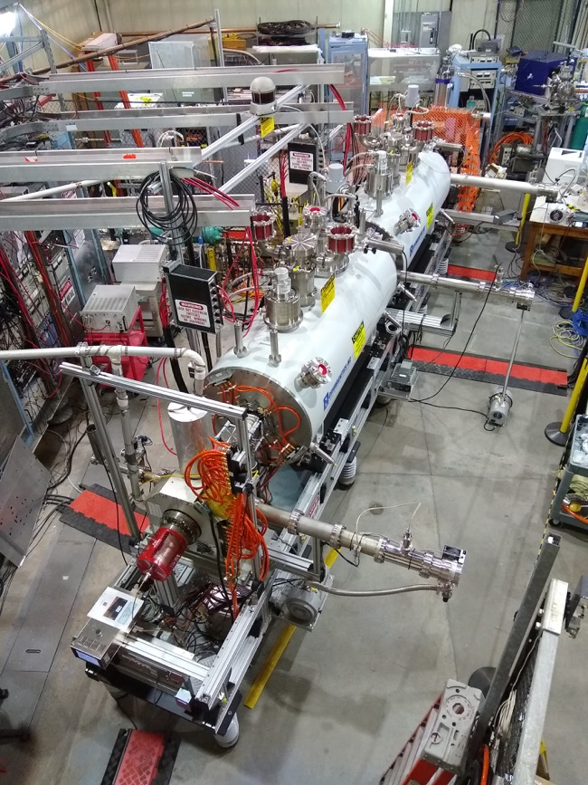
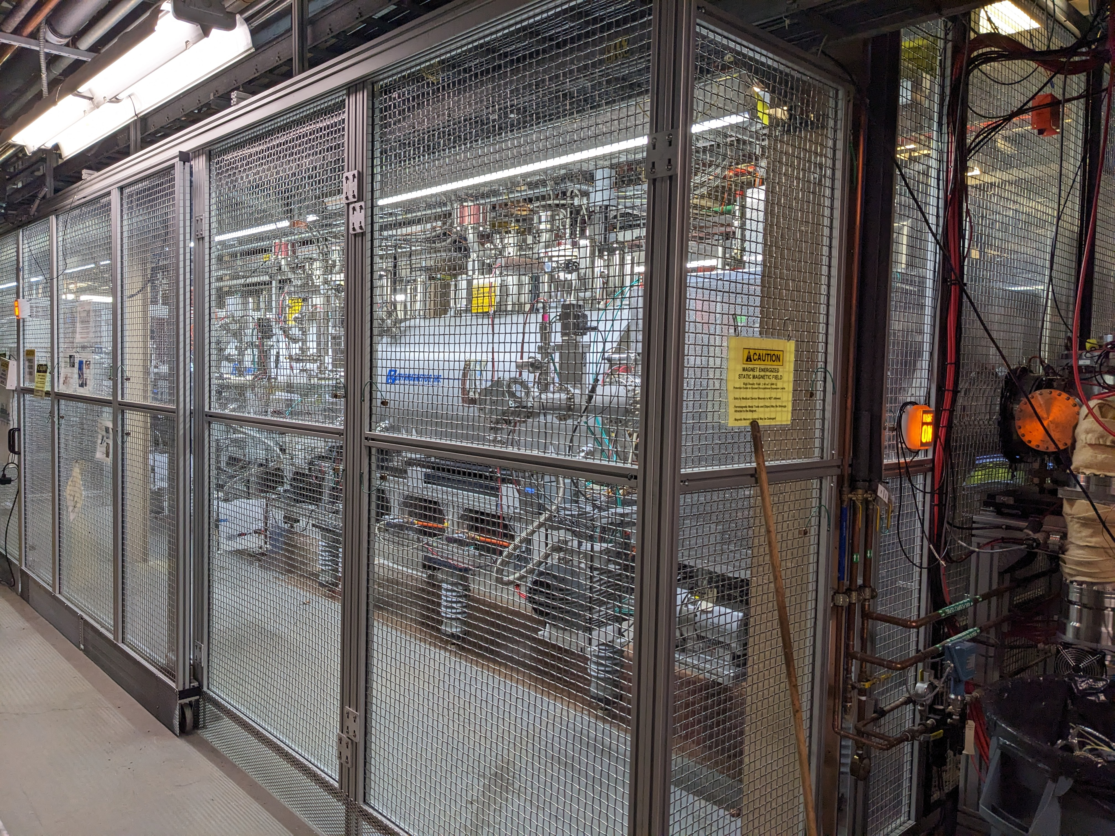
EEBIS
At the site
In the test Lab

Slide 33
Polarized ³He⁺⁺ Source Development
3He optical pumping polarization in the high magnetic field.
3He purification and filling system for the “open” cell configuration.
3He injection valve development
Spin rotator and 3He-4He polarimeter development in 6.0 MeV beam line.

Slide 34
Optical Pumping and Probe Lasers Layout
WS6-200
wavemeter
Pumping laser
Probe laser, Toptica, DL-100, diode laser
Detector
Pumping laser-Keopsys 10 W 1083 nm- fiber laser

Slide 35
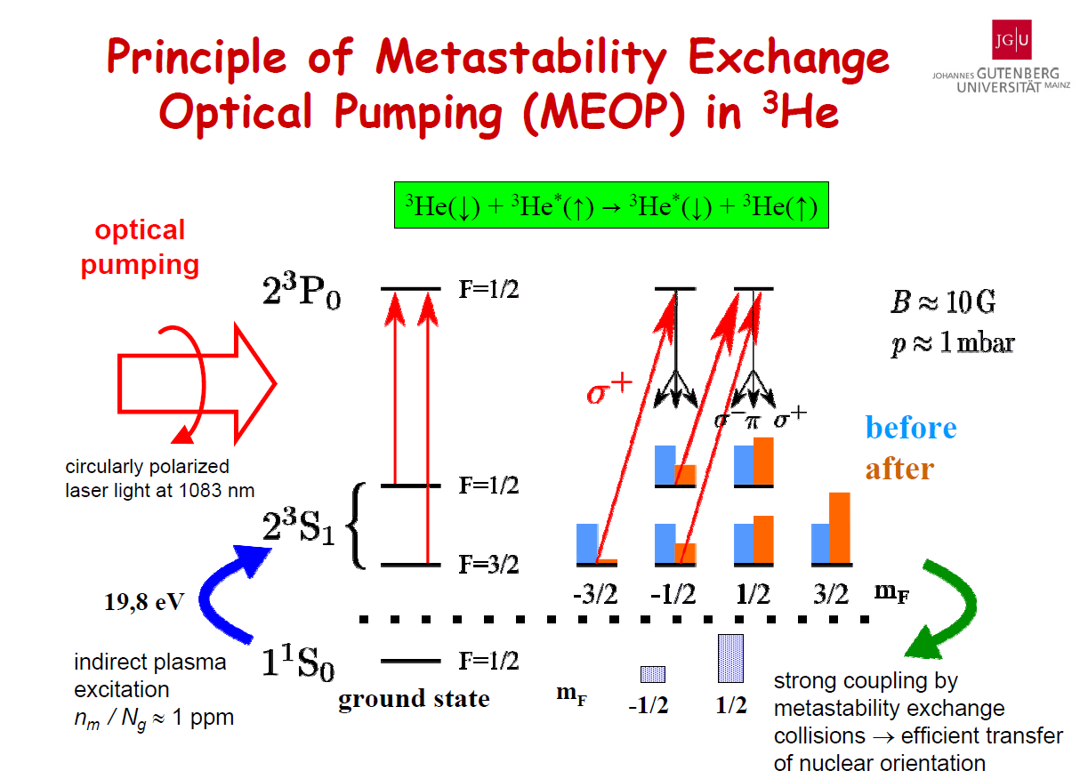
Circular polarized
Laser light at 1083 nm

Slide 36
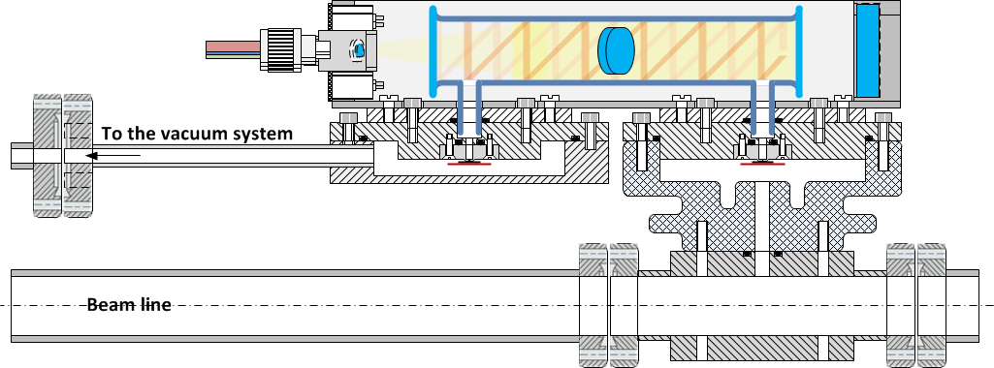
Holder ³He-cell with filling and injection valves inside the EBIS SC Solenoid-1
Procedure to polarize the ³He gas at high magnetic field:
Prepare the ³He gas for polarization by the purification system; Valve1-open/ Valve2-close
Polarize the ³He gas inside the glass-cell by a MEOP technique; Valve1-close/ Valve2-close
Continually control the polarization of the injected ³He gas by using the Optical Probe polarimeter;
Inject a polarized ³He portions into drift tube (beam line) through the pulsed valve ( ~2-3*10¹² atoms/pulse); Valve1-close/ Valve2-open
Ionize the polarized atoms of ³He by electron beam (~10 A).
³He-cell
Rf –discharge
To the purification system
³He Injection pulse Valve2
³He Filling Valve1
HV isolator
e-beam ~10A
Drift tube (20-40 kV)

Slide 37
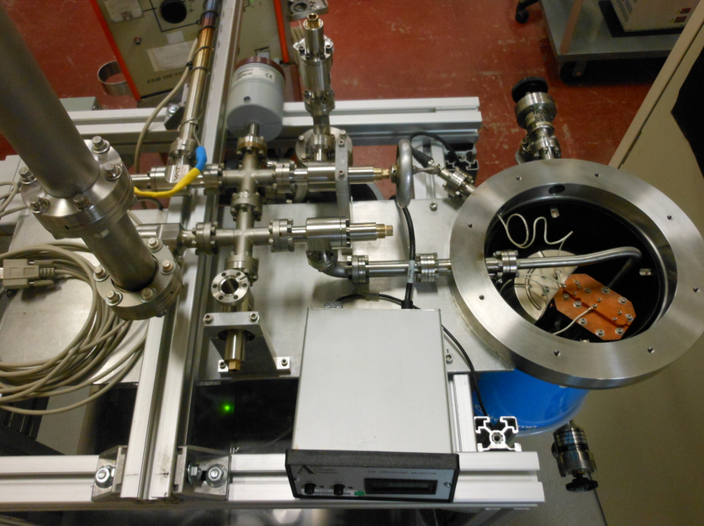
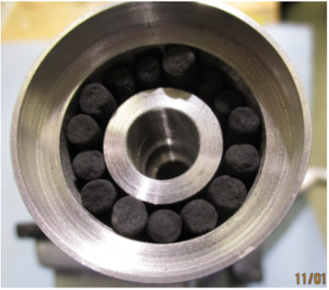
³He-gas purification and filling system
Modified Cryo-pump for 3He
purification and storage
Vessel filled with charcoal granules
The pump also absorbs quite a significant amount of ³He gas (of about 100 scc).
The absorbed gas is released by the pump vessel heating ~20K.
This provides gas storage and supply for ³He-cell operation at the optimal pressure value (3-5 Torr).

Slide 38
³He Contamination Monitoring
The hydrogen Balmer-alpha line intesty at 656 nm is strongly reduced <0.4%
Relative to the 668 nm 3He line after 10 hours of RF discharge with the
isolation valve closed

Slide 39
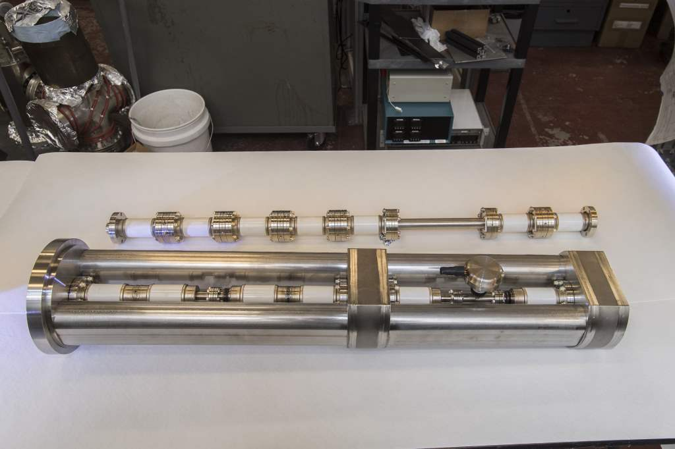
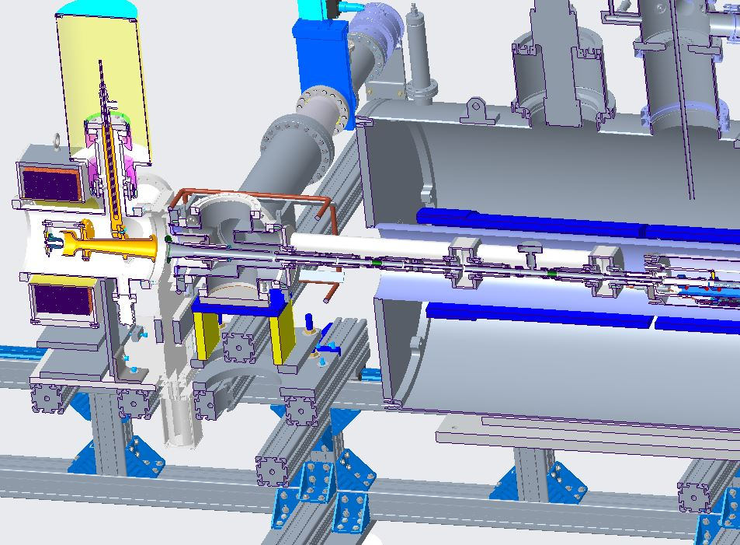
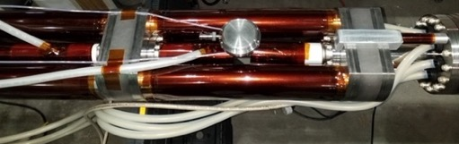
Gas Cell with pump out manifold and external drift tube connections

Slide 40
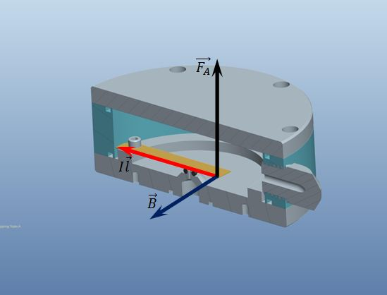
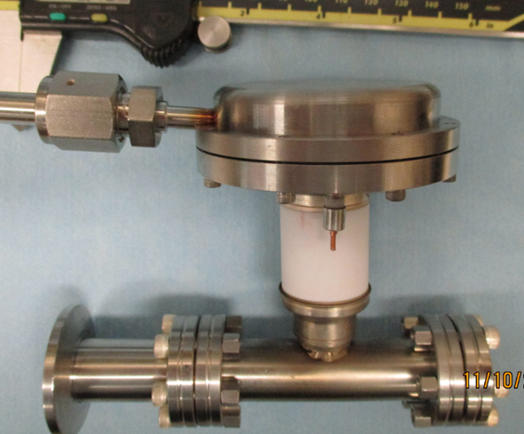
Fast Pulsing Gas Valve
“Electro-magnetic”, [IxB] valve operation principle
Lorentz (Laplace) force moves the flexible conducting plate in the high (~ 3-5 T) magnetic field.
For I=10 A, L=5 cm, F=2.5 N. Current pulse duration ~100-500 us
F
Pulsed valve for
Un-polarized gas
Injection to the EBIS
I
B
A prototype valve test at 2.5 T , a gas flow of 2.10^12 atom/pulse
was measured at 12 A. Also test for consecutive pulse 4 ms apart
producing 10^13 atoms/cycle.

Slide 41
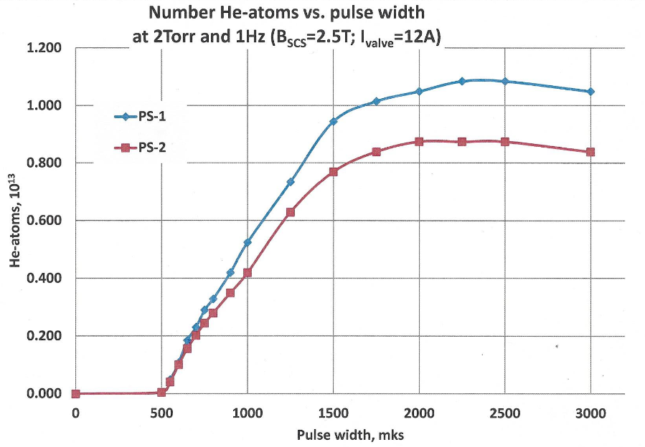
Pulsed ³He Valve Operation in 2.0T Solenoid.
4∙10¹¹ 3He
Atoms per/pulse
1000 𝝻 s
Pulsed current width (𝝻 s)

Slide 42
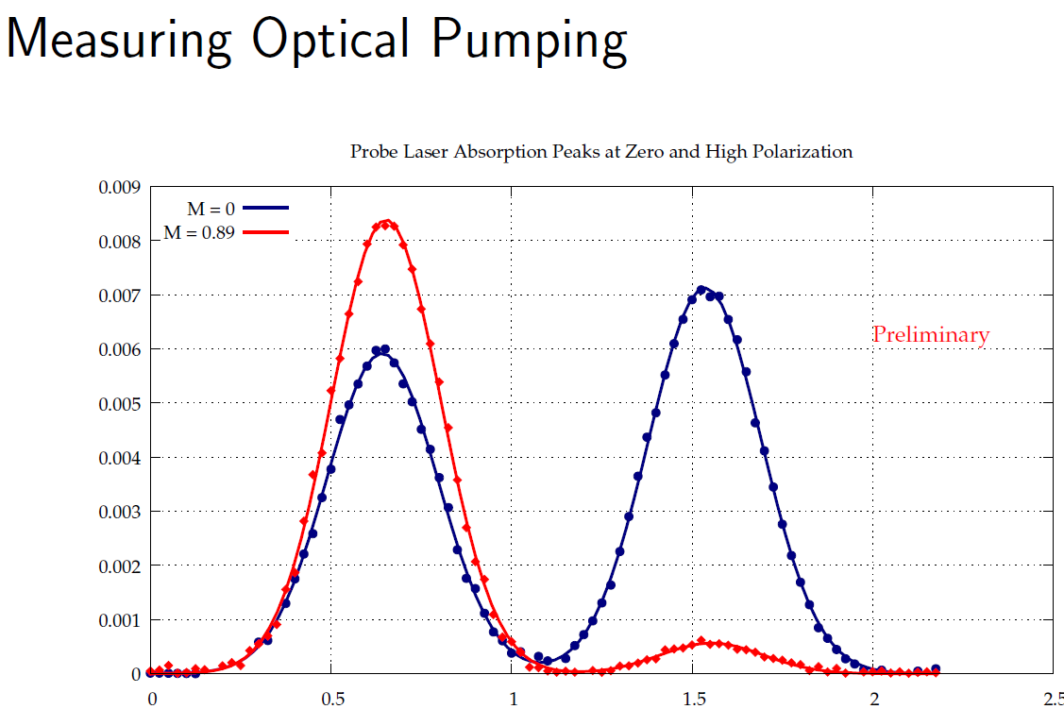
Polarization Measurements by the Probe Laser Absorption
Closed cell
Open cell
89% polarization in. sealed
³He cell at 3 Torr pressure
Polarization build-up time .
0-4 min: Valve open
5-27 min: valve closed
29 min: laser off and valve opened
(3 Torr valve closed)

Slide 43
³He⁺⁺ Spin-Rotator in the at 6.0 MeV Beam Energy
After acceleration by EBIS LINAC, the polarized ³He⁺⁺ beam will have an energy of 6MeV with a longitudinal spin direction.
The longitudinal polarization of beam is at first rotated to transverse direction using the 21.5 deg bending magnet (Dipole-1) and after
The Spin- solenoid will change the spin direction to the vertical . It is a pulsed solenoid with reversible field to enable spin-flip on an EBIS pulse-by-pulse basis.
Vertically polarized beam will return to the straight HEBT line by the system of dipole magnets (2,3,4).
The polarimeter will install in the straight section after the Dipole-3 magnet. With a spin-flip, we can measure polarization of the beam with a standard configuration of left/right symmetric Si-strip detectors).
2
3
1
4

Slide 44
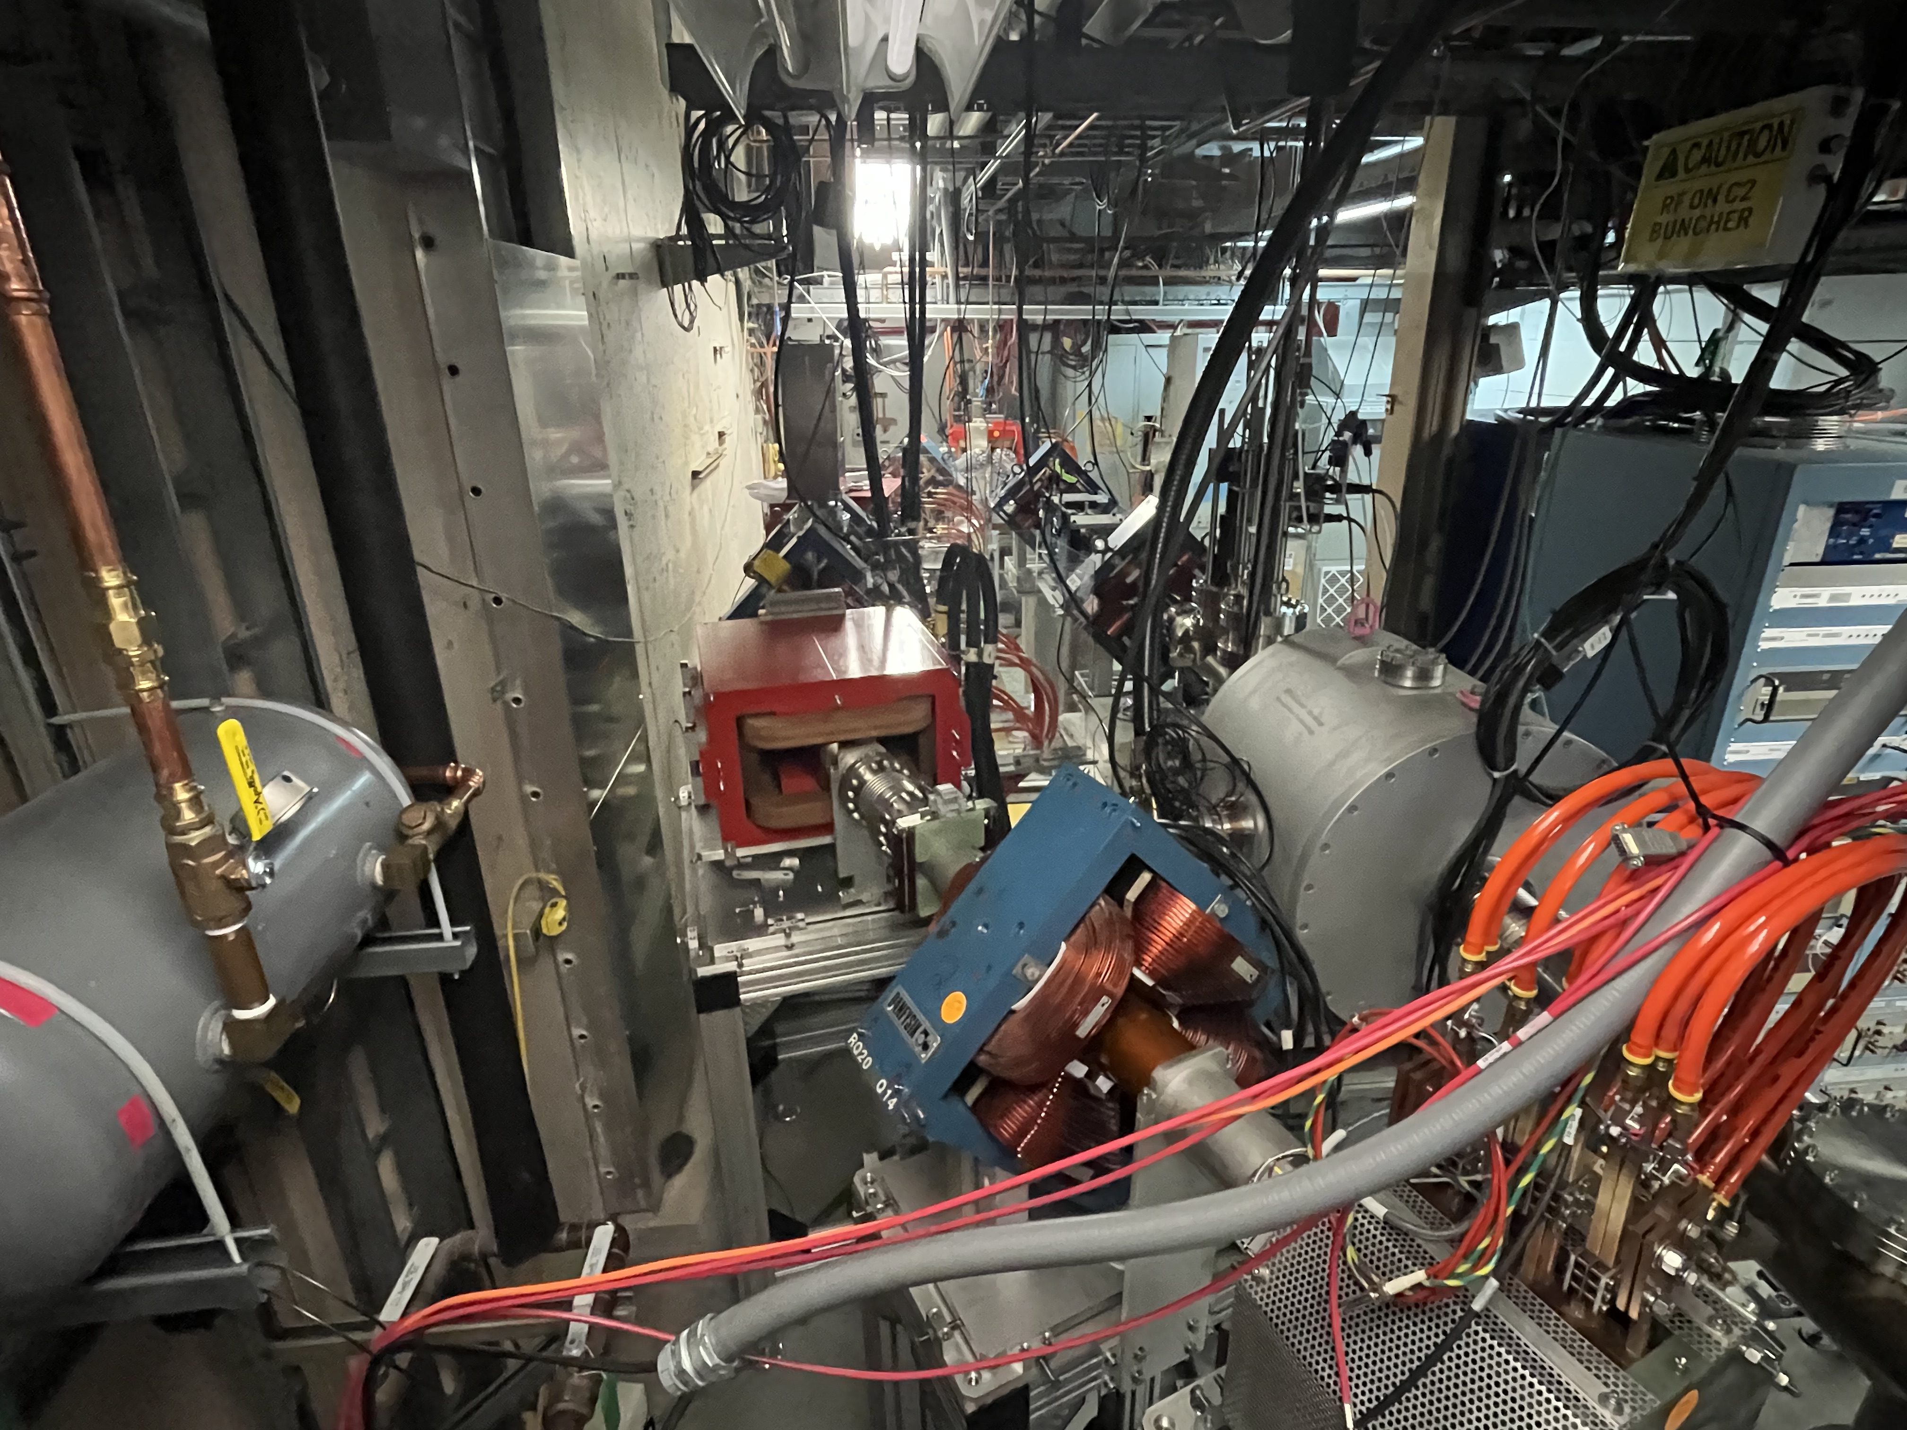
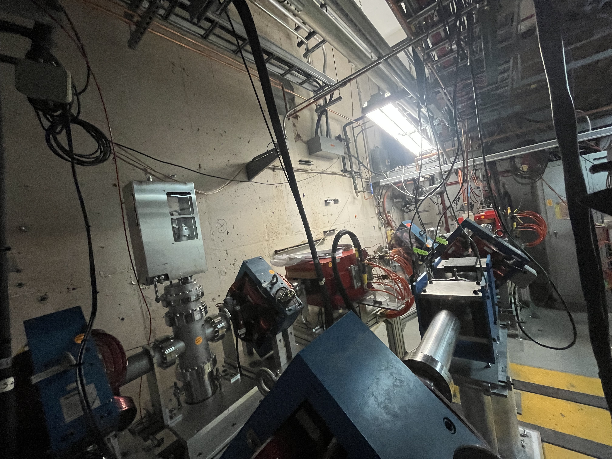
Spin Rotator -Chicane

Slide 45
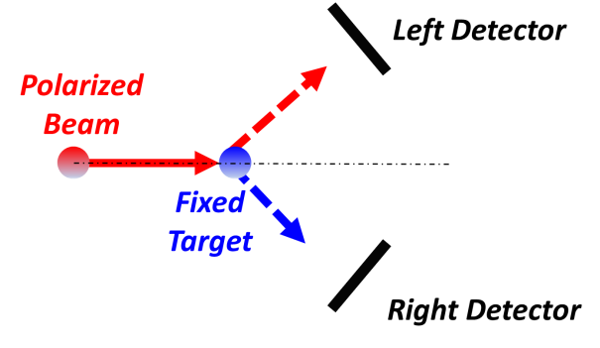
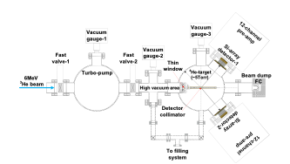
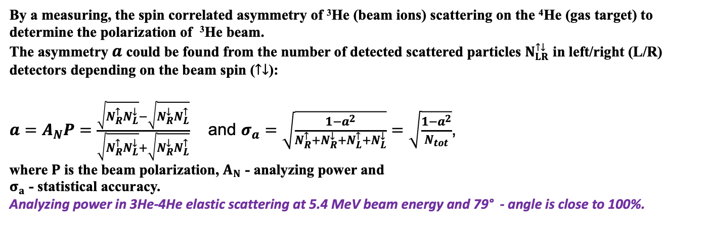
³He-⁴He scattering polarimeter at 5.3 MeV beam energy
By a measuring, the spin correlated asymmetry of ³He (beam ions) scattering on the ⁴He (gas target) to determine the polarization of ³He beam.
The asymmetry $a$ could be found from the number of detected scattered particles $N_{LR}^{↑↓}$ in left/right (L/R) detectors depending on the beam spin ($↑↓$):
$a=A_{N}P=\frac{\sqrt{N_{R}^{↑}N_{L}^{↓}}−\sqrt{N_{R}^{↓}N_{L}^{↑}}}{\sqrt{N_{R}^{↑}N_{L}^{↓}}+\sqrt{N_{R}^{↓}N_{L}^{↑}}}$ and $σ_{a}=\sqrt{\frac{1−a^{2}}{N_{R}^{↑}{+N}_{R}^{↓}+N_{L}^{↑}{+N}_{L}^{↓}}}=\sqrt{\frac{1−a^{2}}{N_{tot}}}$,
where $P$ is the beam polarization, $A_{N}$ - analyzing power and
$σ_{a}$ - statistical accuracy.
Analyzing power in 3He-4He elastic scattering at 5.4 MeV beam energy and 79° - angle is close to 100%.

Slide 46
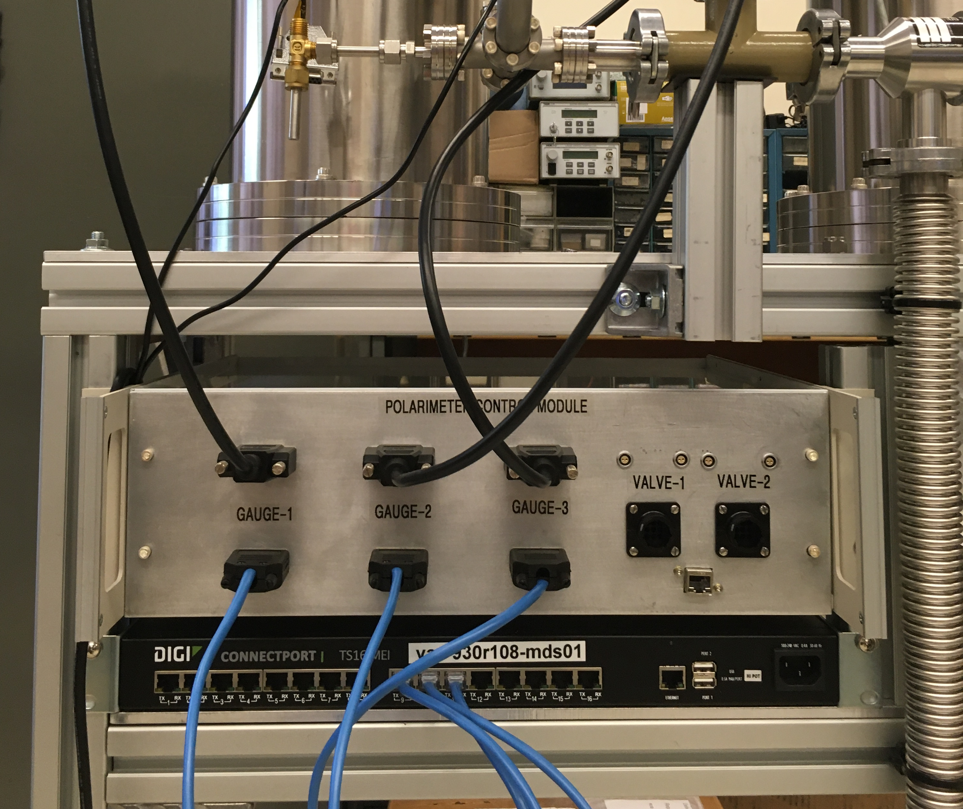
Setup of 6 MeV polarimeter
We have prepared a complete detector with the requirement geometry, measured the energy range and is ready for installation in the EBIS beam line.
Gauge-3
Gauge-2
Valve-2
Turbo pump
Gauge-1
Valve-1
Polarimeter Control Module
12-ch End-Off electronics
Beam dump (FC)
Chamber-2
Control Module
Target (He4) filling system
Chamber-1
Connect port
With the beam we plan to study:
Kinematics of elastic ³He-⁴He scattering;
energy distribution of the ³He-⁴He pair;
energy and time resolution;
electronics and DAQ;
data collection and analysis of events;
controlling and monitoring the detectors;
vacuum control system;
communication system;
…
Scroll pump

Slide 47
Summary
Polarized H⁻
OPPIS reliably (>95%) providing polarized H⁻ ions for RHIC
OPPIS has gone though couple of successful upgrade and is ready for next run.
Polarized ³He⁺⁺
Polarized ³He⁺⁺ production is important part of the ongoing extended EBIS “upgrade" project.
High polarization of He was achieved in the "open" cell in the high magnetic field. This is a significant step forward to achieve its goals.
A new technique of ³He purification system (based on cryo-pumping) was developed to meet the strict requirements for high polarization.
A new type of pulsed electromagnetic valve was developed for ³He injection into the drift tube. This new valve will improve the efficiency and reliability of the injection process.
Design of gas cell is progressing well; first cell will be finish by end of this year
In addition, the spin rotator chicane will be tested with unpolarized ³He by the end of this year. This is a critical step in developing the full functionality of ³He source.
Notes:
47

