Slide 1
Spin polarized electron beams production beyond III-V semiconductors
L. Cultrera
SPIN 2023

Slide 2
Outline
GaAs and III-Vs layered structure review
Recent developments on robust activation coating
III-Nitrides and Alkali Antimonides
Half metals and spin filters

Slide 3
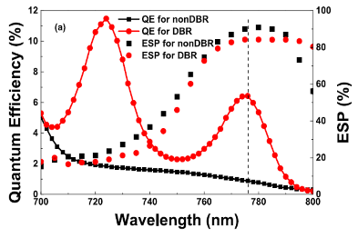
GaAs based photocathodes
Bulk GaAs
(no layer - 1 material)
Strained GaAs
(2 layer – 2 materials)
III-V GaAs SuperLattices
(~30 layers – 3 materials)
III-V GaAs SL with DBR
(~60 layers – 5 materials)
QE> 10%
P> 40%
QE> 0.1%
P> 80%
QE> 1%
P> 90%
QE> 6%
P> 85%
E
E
Conduction band
Circularly polarized
hν~Eg
Eg=1.42 eV
Eg=1.46 eV
Heavy holes
Heavy holes
Valence band
Light holes
Light holes
Split off band
Split off band
k
k
Difficult to realize
Low rate of success (~20%)
Polarization limited by energy degeneracy
QE and P limited by optical absorption and crystal defects
QE limited by optical absorption and crystal defects
State-of-the-art
Unmatched result
D.T. Pierce et al., Phys. Lett. 51A, 465 (1975)
W. Liu et al., Appl. Phys. Lett. 109, 252104 (2016)
X. Jin et al.,Appl. Phys. Lett. 105, 203509 (2014)
T. Maruyama et al., Phys. Rev. B, 46 , 4261 (1992)
Extracting electrons requires Negative Electron Affinity conditions

Slide 4
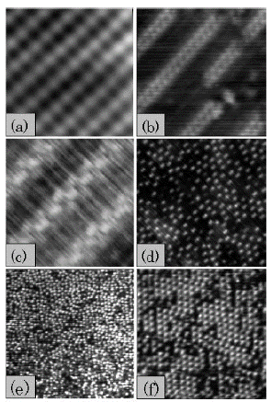
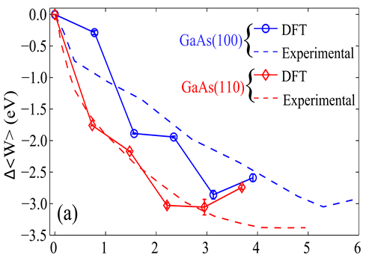






Negative Electron Affinity
All GaAs based photocathodes operated at photon energies near the band gap must be activated to Negative Electron Affinity (NEA) condition using Cs and O to form a strong surface dipole that lowers the electron affinity
T. Yamada et al., Surface Science 479 (2001) 33-42
Vacuum level
$$3nm×3nm$$
No Cs
11$nm×11nm$
0.1ML Cs
4-5 eV
CBM
4$nm×4nm$
0.23ML Cs
28$nm×28nm$
0.35ML Cs
~0.5 eV
Band Gap = 1.42 eV
59$nm×59nm$
0.5ML Cs
22$nm×22nm$
0.6ML Cs
VBM
Fermi level
Cs surface density (nm⁻²)
GaAs – Vacuum interface
S. Karkare et al., Phys. Rev. B 91, 035408 (2015)
Less than 1 monolayer to achieve NEA
Extremely vacuum sensitive and vacuum levels <10⁻¹¹ Torr are required to achieve sufficient lifetime

Slide 5
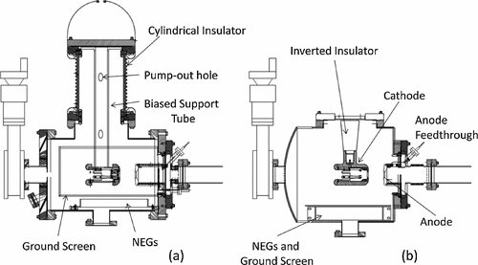
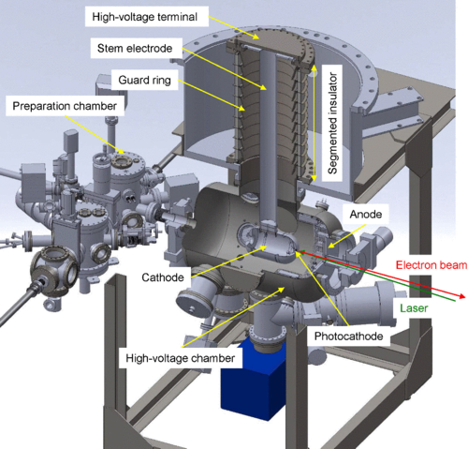
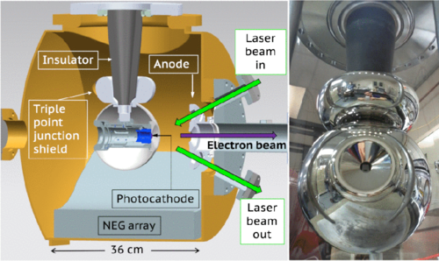
Electron guns for NEA photocathodes
Given the vacuum requirements GaAs based photocathodes are operated in DC gun
P.A. Adderley et al., Phys. Rev. ST Accel. Beams 13, 010101 (2010)
Large number of NEG vacuum pumps allows for vacuum in 10⁻¹² Torr range
N. Yishimori et al., Phys. Rev. Accel. Beams 22, 053402 (2019)
C. Hernandez-Garcia et al., Rev. Sci. Instr. 88, 093303 (2017)

Slide 6
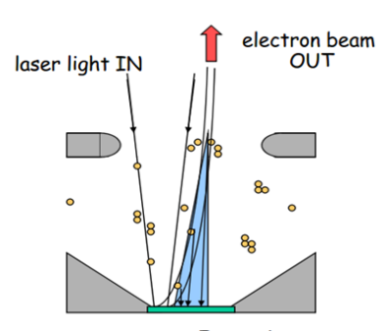
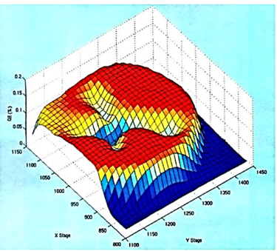
GaAs QE degradation
Photocathode QE degradation is induced by the following mechanisms:
Chemical poisoning
Alkali desorption
Ion back bombardment
Exposure in Langmuir
1L = 10⁻⁶ Torr*s
H. Iijima et al., Proc. of IPAC 2010, 2323 (2010)
Oxygen is a killer
Especially relevant for high average power or tightly focused lasers beams
N. Chanlek et al., J. Phys. D: Appl. Phys. 47, 055110 (2014)
J Grames et al., AIP Conf. Proc. 980, 110 (2008)

Slide 7
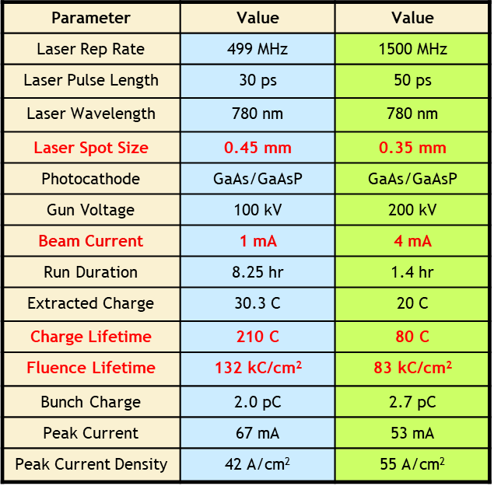
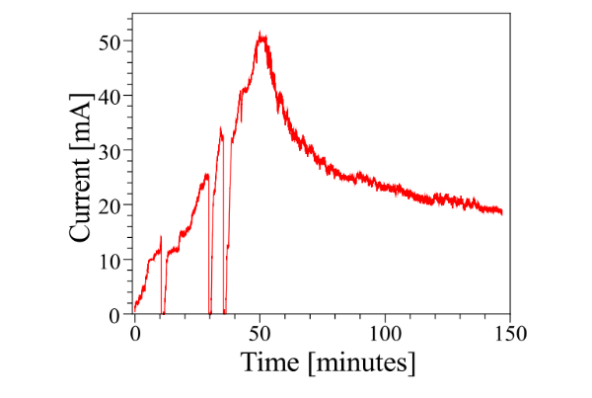
GaAs @ high average current
SL Spin polarized e-beam
Bulk GaAs Unpolarized e-beam
Laser power is increased until the maximum power is reached
Laser power maxed out
GaAs
photocathode
QE decaying
B. Dunham, et al Appl. Phys. Lett. 102 (2013) 034105
J. Grames et al., PAC07, THPMS064
R. Suleiman et al., PAC11, WEODS3
QE is now a factor 6 larger
Less laser power, less heat to dissipate
Challenges of growth process are an issue
SL with DBR
Is the ideal candidate
QE> 6%
P> 85%

Slide 8
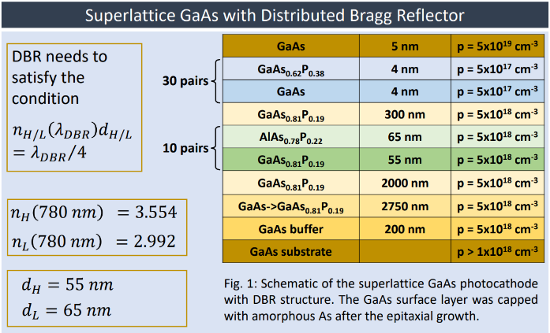
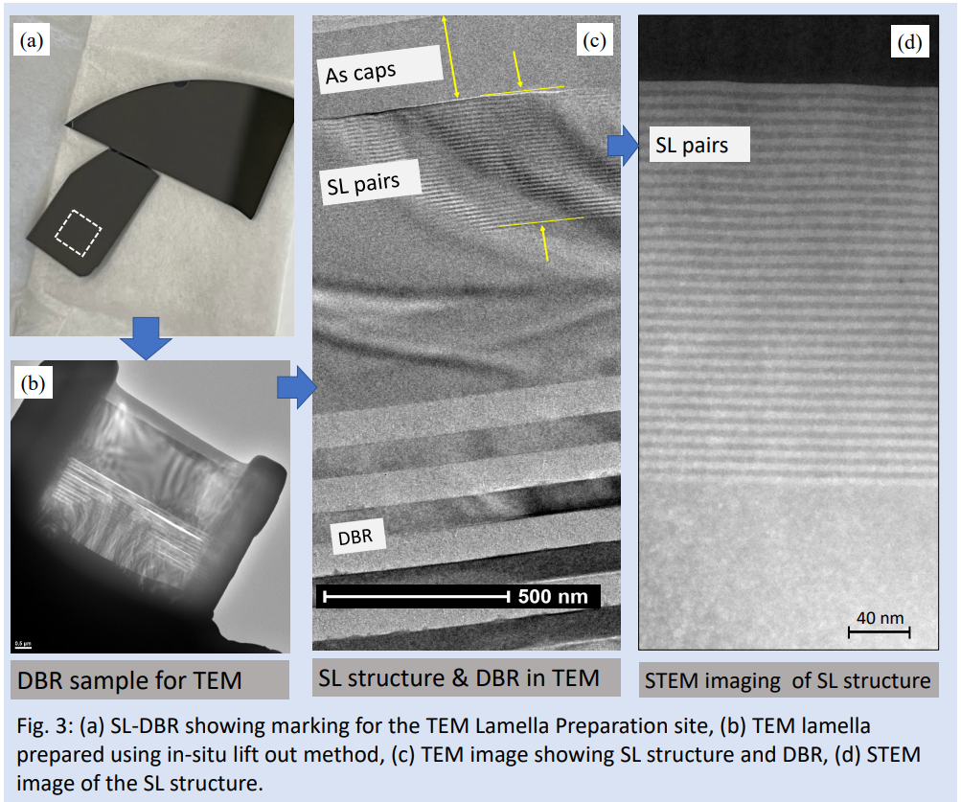
SL-DBR GaAs/GaAsP
BNL has designed a SL-DBR that may yield
ESP of >85% and QE in excess of 10%
https://napac2022.vrws.de/papers/wepa68.pdf
84 layers!!
Expected P> 85%
and QE ~ 10%
>4x larger than SL absorption!

Slide 9
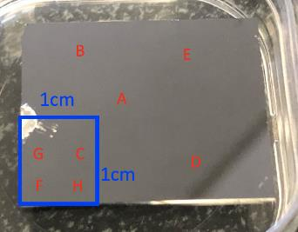
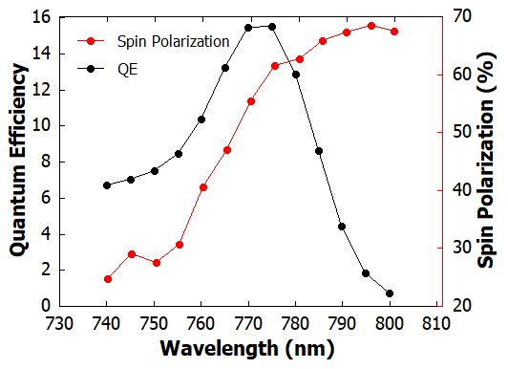
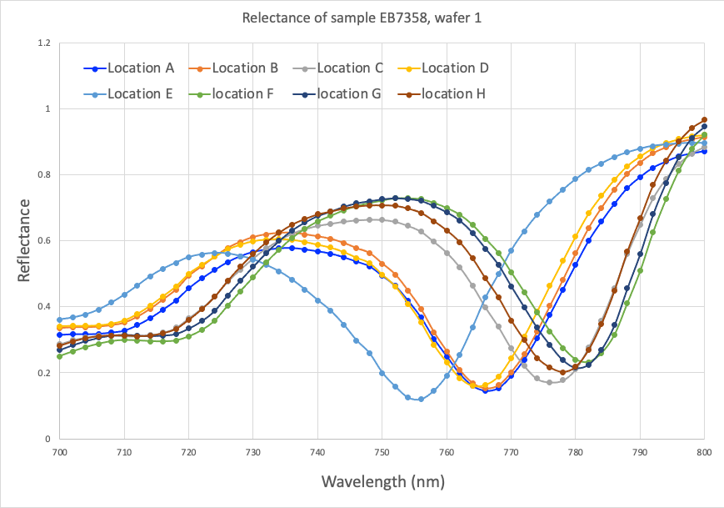
TEM, QE and ESP
This are result from the first and only sample that was grown and tested
Need to improve the spatial uniformity!!
Original 3” wafer center
MBE growth @ Sandia National Laboratories – DOE HEP funded
Up to ~16% QE
J. Biswas et al., AIP Advances 13, 085106 (2023)

Slide 10
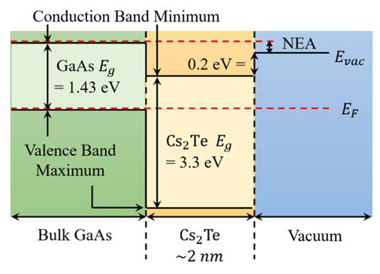
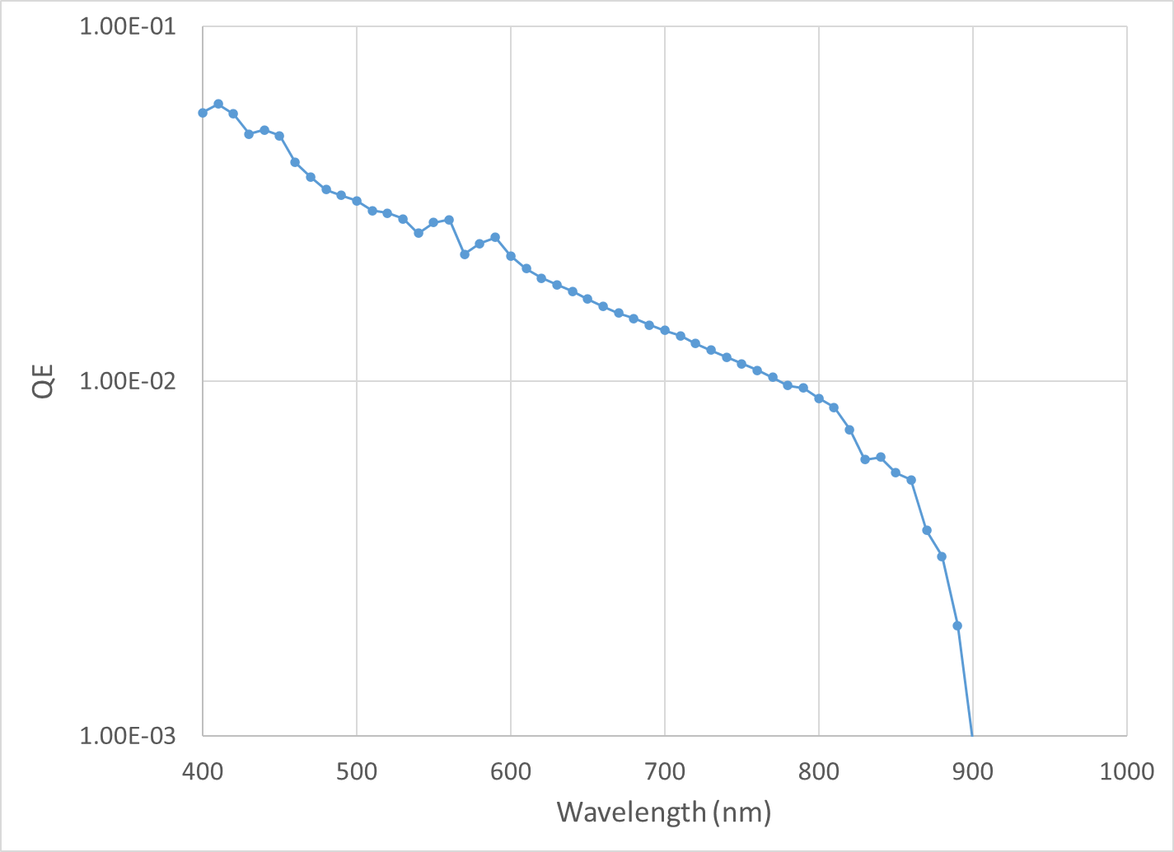
Cs-Te activated GaAs (1)
1.4 eV
p-type
n-type
A NEA condition is established as indicated by the photoemission at photon energy larger that 1.4 eV
The growth was performed in a system with base pressure in 10⁻⁹ Torr
J.K. Bae et al., Applied Physics Letters 112 (2018) 154101
Notes:
The band diagram of the hetero junction is shown in the picture. In order to have the bands aligned as in this picture an n-type layer of Cs-Te is required. Such doping could be achieved by incorporating excess Cs into the film during the growth but given the limited Cs-Te layer thickness (~2nm) a fine control of the doping level is not easy and is usually performed using the photocurrent as feedback.
Details of the growth condition can be found in this reference. What is important is that after the growth of the Cs-Te layer the spectral response showed photoemission at photon energies equal to the band gap confirming that NEA condition was achieved.

Slide 11
Cs-Te activated GaAs (2)
Initial surface’s condition it’s critical
to obtain the largest QE
As is
300 C
580 C
Cs-O
J. Biswas et al., J. Appl. Phys. 128, 045308 (2020)
J. Biswas et al., AIP Advances 11, 025321 (2021)
Notes:
An important aspect to maximize QE is the the quality of the GaAs surface in terms of cleanliness. Also, because the Cs-Te is very thin it is important that to achieve a uniform coverage of the surface the surface should be as smooth as possible.
A recent set of experiment evidenced that a heat heating treatment at 580 for 2 hours to give a surface that can meet the specification required to achieve high QE.
Indeed a modified deposition procedure performed at room temperature using a Cs-O layer before and after the Te evaporation allowed to reach much larger QE than the Cs-Te alone.

Slide 12
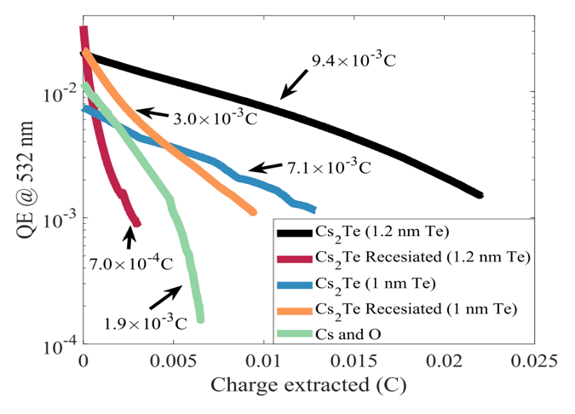
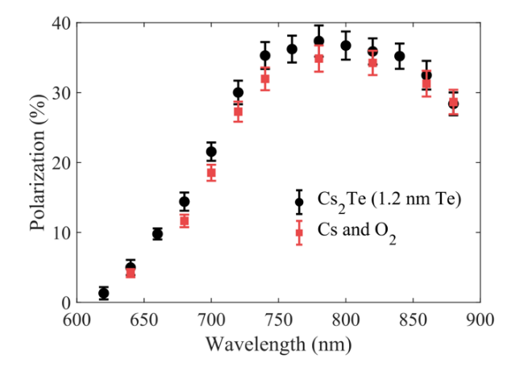
Cs-Te activated GaAs (3)
Charge lifetime was measured at 532nm
Samples were re-cesiated after the first decay to study rejuvenation
Rejuvenated samples have shorter lifetime than fresh ones
5-fold Lifetime!
The same bulk GaAs specimen was activated first with Cs-O and later with Cs₂Te and electron spin polarization was measured
Same spin polarization!
J.K. Bae et al., Applied Physics Letters 112 (2018) 154101
Notes:
What about the lifetime:
The lifetime of the GaAs samples activated with Cs-Te was characterized and compared with samples activated with the standard Cs-O method.
The reactivation of the sample with Cs after the initial decay was also attempted.
Rejuvenation of the cathode seems possible, levels of QE similar to those of freshly activated cathodes are achieved after additional Cs exposure, but the lifetime is shorter.
On the overall a freshly Cs-Te activated sample has been measured to have a factor 5 longer lifetime than the sample activated with Cs and oxygen.
The other very important observation is that the electron spin polarization remains unaffected by the Cs-Te method used to generate the NEA.

Slide 13
Cs-Sb-O activated GaAs (1)
0.7 to 3 nm
Cs-O₂ layer
Cs-O₂ layer
as we increase the layer thickness:
QE decreases
Lifetime increases
DL was estimated at 2% duty cycle as 1/e of QE vs. time
CL was estimated at 100% duty cycle as 1/e of QE vs. charge
L. Cultrera et al., Phys. Rev. Accel. Beams 23 (2020) 023401
Notes:
Another set of experiments focused on the role of the thickness of the activating layers (which was derived from the amount of Sb evaporated over the surface)
As the Sb thickness is increased the NEA is always achieved but efficiency of the photoemission decreases (about one order of magnitude was reported).
On the other hand, the robustness of the photocathode increases and longer and longer lifetimes are measured as the thickness of the layer is increased.
Up to 10x increase dark lifetime and up to 60X increase of charge lifetimes have been estimated from measurement carried out with different duty cycle.

Slide 14
Cs-Sb-O activated GaAs (3)
@780 nm
Spin polarization is essentially preserved
(up to ~1 nm thickness)
L. Cultrera et al., Phys. Rev. Accel. Beams 23 (2020) 023401
Notes:
As the Sb layer is increased the maximum electron spin polarization is seen to decrease. The same happens to the quantum efficiency.
A simplified model which take into consideration the increase of the equivalent thickness of effective surface barrier width with the increase of the Sb layer thickness seems to qualitatively be able to reproduce the experimental observations.
The experimental results indicate that at 780 nm, corresponding to the photon energy where the electron spin polarization is maximal, the QE decreases by a rough factor 2 but the spin polarization is unaffected.
With this thickness about one order of magnitude longer charge and dark lifetime are expected.

Slide 15
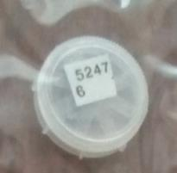
Cs-Sb-O activated SL
SL GaAs/GaAsP non DBR
with P>80% @780nm
From Jlab injector group
J. K. Bae et al., Journal of Applied Physics 127 (2020) 124901

Slide 16
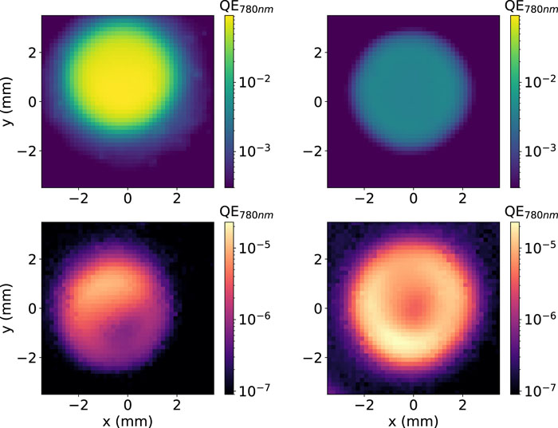
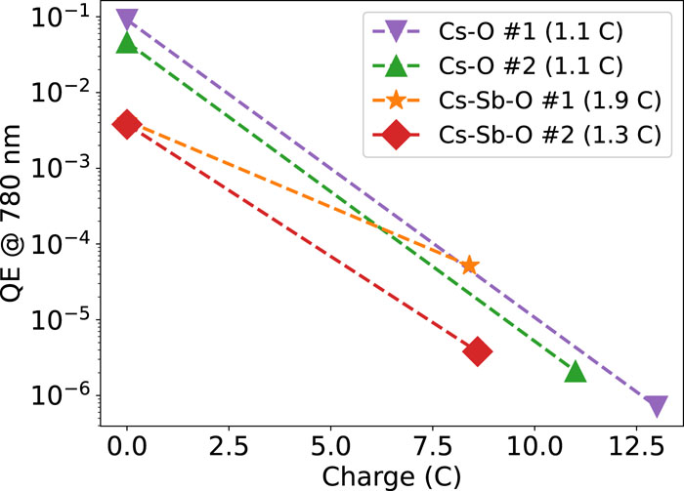
Cs-Sb-O activated GaAs in HV DC gun
CsO in situ activated GaAs
Cs-Sb-O activated GaAs transported
Robust coating seems not much effective against ion back bombardment damage
(beam average current 1 mA, energy 250 keV)
J.K. Bae et al., AIP Advances 12, 095017 (2022)

Slide 17

What’s out there beyond GaAs?
What properties a good spin polarized photocathode alternative to GaAs must have:
Large spin-orbit coupling;
Low spin depolarization rates;
Low Electron affinity;
High QE;
Long lifetime;
E
Conduction band
$$P=\frac{3−1}{3+1}=50\%$$
+1/2
-1/2
Circularly polarized
hν~Eg
Eg=1.42 eV
3
1
+3/2
+1/2
-1/2
-3/2
Heavy holes
E_{so} = 0.34 eV
Light holes
+1/2
-1/2
Split off band
k

Slide 18
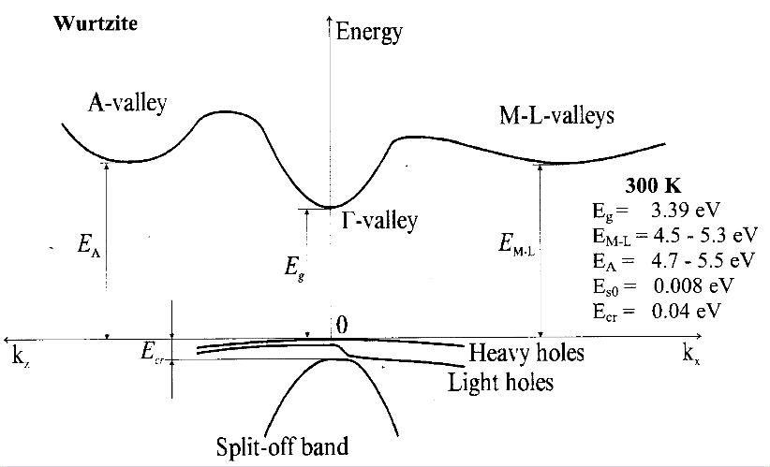
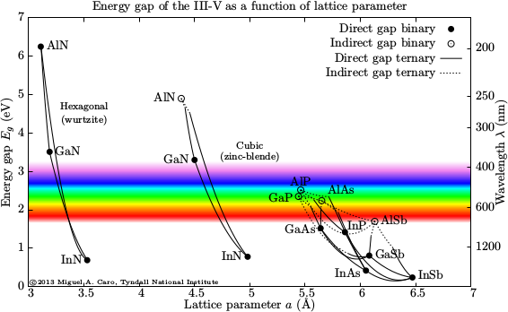
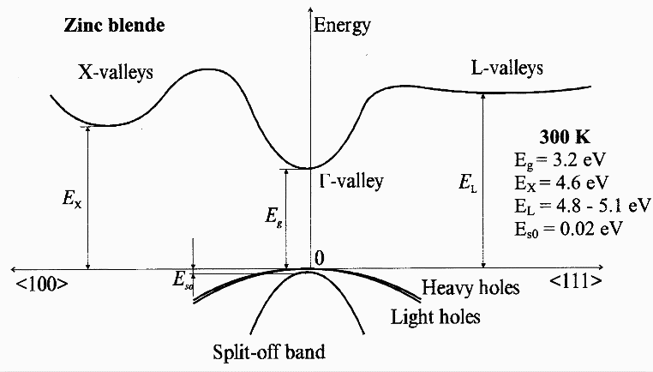
III-Nitrides
Wide range of wavelength tunability with ternary alloys
Notes:
The family of III-Nitrides might represent a new candidate for the production of high average photocurrent.
The growth technology of III-N is well established and in use for LED and high power electronics
As photocathodes III-N have been studied mostly for application as solar blind detectors.
They offer with ternary alloys the possibility to tune their band gap between DUV and IR to match different drive laser wavelengths
Modern growth techniques allow multilayered structures for developing MQW, DBR and RTB
III-N can be grown in two crystal structure hexagonal and cubic

Slide 19
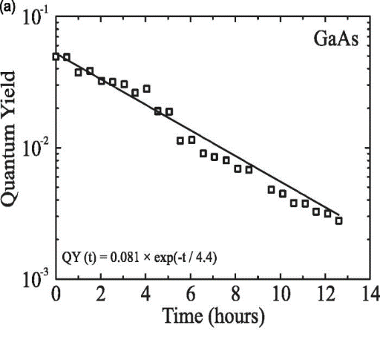
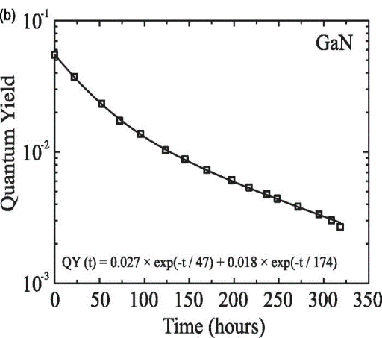
QE and robustness for NEA GaN
THG of IR lasers
QEs of several percent already at the bandgap
III-Nitride materials are stable with temperatures
GaN decomposes above 750 C
Cs:GaN is 20x more stable than III-Vs
~355 nm
QE of several % already at the band gap energy ~3.4 eV
T. Nishitani et al., J. Vac. Sci. & Technol. B 32, 06F901 (2014)
765 nm
1/e ~ 4.4 hours
365 nm
1/e ~ 82 hours
GaN
O. Siegmund et al., Nucl. Instr. and Meth. in Phys. Res. A 567, 89 (2006)
Notes:
Activated to NEA GaN shows already at the band gap QE of several percent, these materials are inherently stable at thig temperatures (GAN decomposing above 700C) and activated to NEA they appear more robust than GaAs.

Slide 20
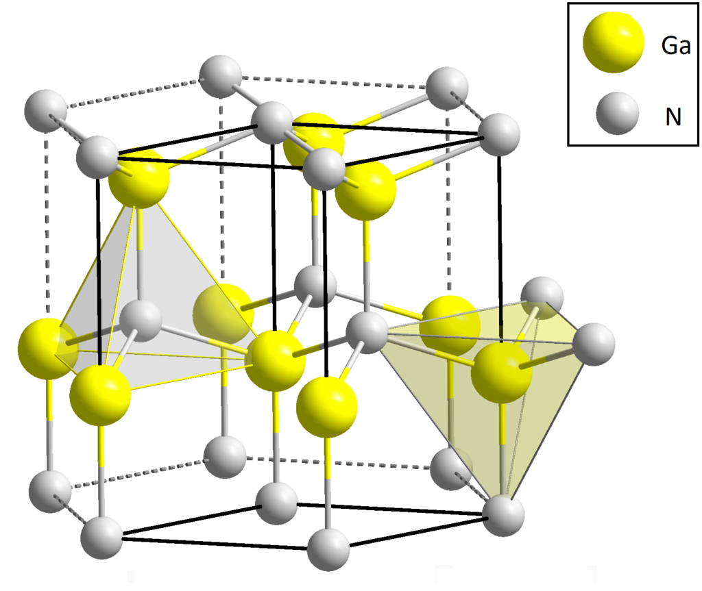
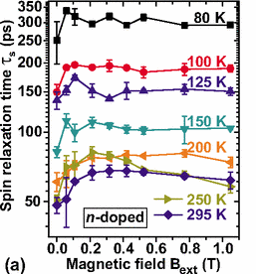
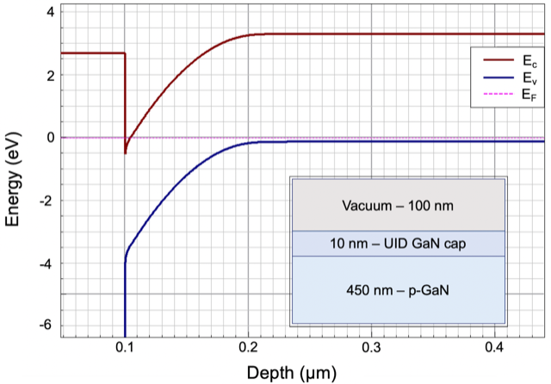
Cs-free engineered high QE cathodes
Asymmetry in the bonds result in large polarization fields (1-10 MV/m)
P_{sp}
P_{sp}
(0001)
(0001)
(000-1)
u-GaN cap
AlN
Cryocooling increase spin relaxation times of bulk GaN to 250 ps – compatible with operation in electron guns
N-polar
p-GaN
N-polar
u-GaN
sapphire
J. H. Buß, et al., Phys. Rev. B 81, 155216 (2010)
(000-1)
Mild HCl chemical etch required to remove surface oxide after air exposure
Peak QE of Cs-free AlGaN up to 23% at 6 eV
L. Cultrera et al., J. Appl. Phys. submitted; also available as arXiv:2110.01533
J. Marini et al., J. Appl. Phys. 124, 113101 (2018)
Notes:
In the wirtzitic structure III-nitride offerthe advantage of large polarization fields arising from the symmetry in the bons between atoms in the lattice
The orientation of the polarization can be tuned by choosing between N- or G-Polar during the growth
With N-polar orientation AlGaN phtocathode was demonstrated with a QE of 23% at 6 eV without the need of exposing it to Cs vapors.
Recent result on GaN demonstrated that it should be possible to achieve NEA also on GaN structures with N-polar orientation,
The structure grown demonstrated stable QE up to 1e-3 level. Further studies with ternary alloys might be able to further increase QE and tune the photon energy for operation at shorter wavelength.

Slide 21
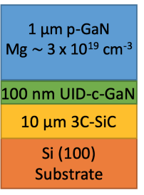
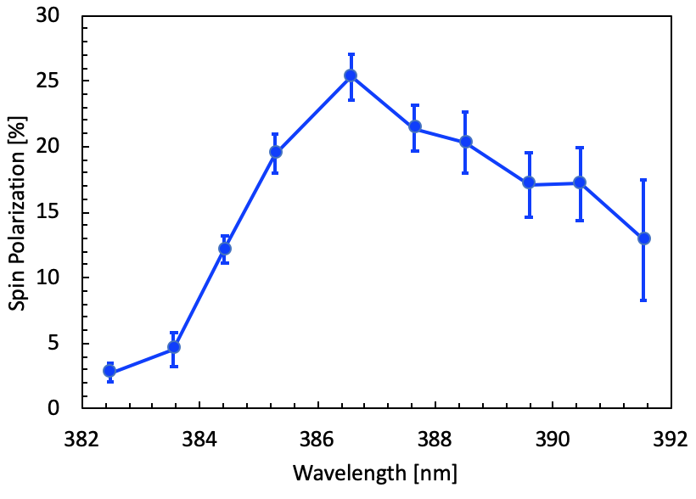
Spin polarized photoemission from c-GaN
Epitaxial zinc-blende GaN photocathode grown
Spin polarization measured in Mott polarimeter at Cornell
Small spin-orbit splitting required narrow-band light for measurements
S.J. Levenson, M.B. Andorf, I.V. Bazarov, J. Encomendero, D. Jena, J.M. Maxson, V.V. Protasenko, H.G. Xing, "First demonstration of spin-polarized electrons from gallium nitride photocathodes", Proceedings of the 14th International Particle Accelerator Conference, Venice, Italy (2023) paper TUODB3.

Slide 22
Layered Alkali Antimonides
Δ_{so}=0.55eV
Bulk Na₂KSb similar to bulk GaAs
Increasing ESP requires straining and expitaxial growth to remove degeneracy of HH-LH
Potential for very robust cathode for high average current

Slide 23
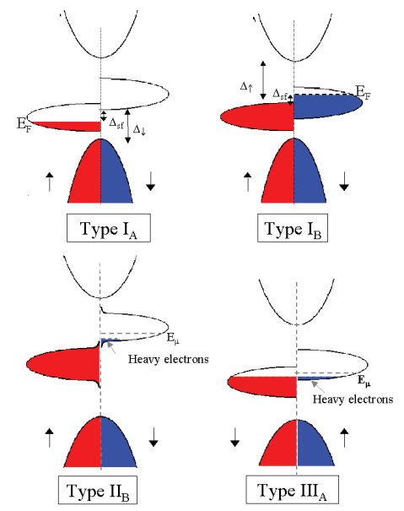
Half metals
Are multi layered strained structure our only option to generate spin polarized photo-currents?
Half-metal can be resourceful!
Electronic band structure depends on spin polarization
Polarization up to 100% are possible
Within the conduction band

Slide 24
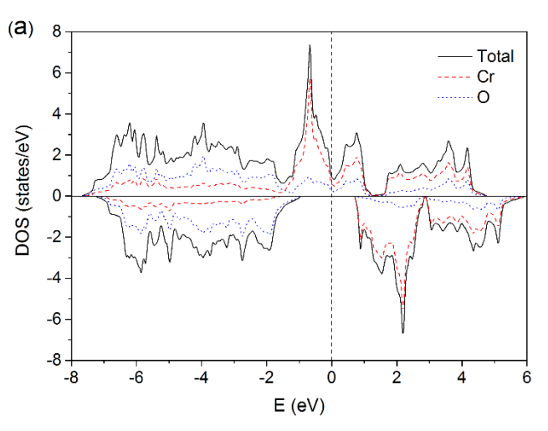
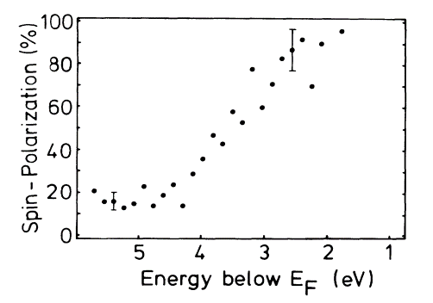
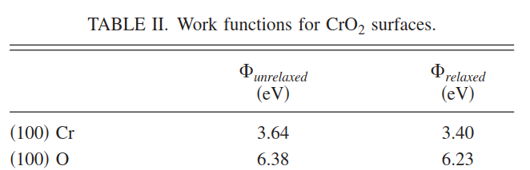
CrO₂
Kamper et al, PRL 59, 2788 (1987)
Mustonen et al, PRB 93, 014405(2016)
Ef
φ
Stable material
Lowest workfunction is 3.4eV
Require UV light
Up to 4.4 eV photon energy only one spin can be photoexcited => 100% polarization
Attema et al, PRB 77, 165109 (2008)

Slide 25
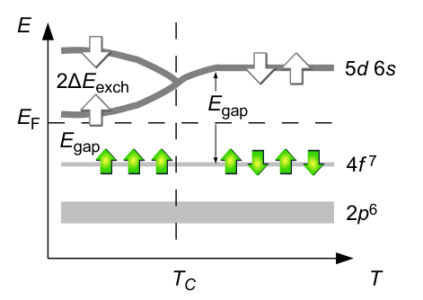
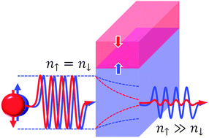
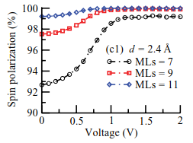
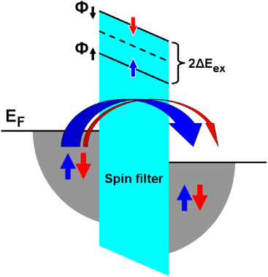

Spin filters
Spin dependent barrier below Tc
Jutong et al, PRB 86, 205310 (2012)
Cu
EuO
Cu

Slide 26
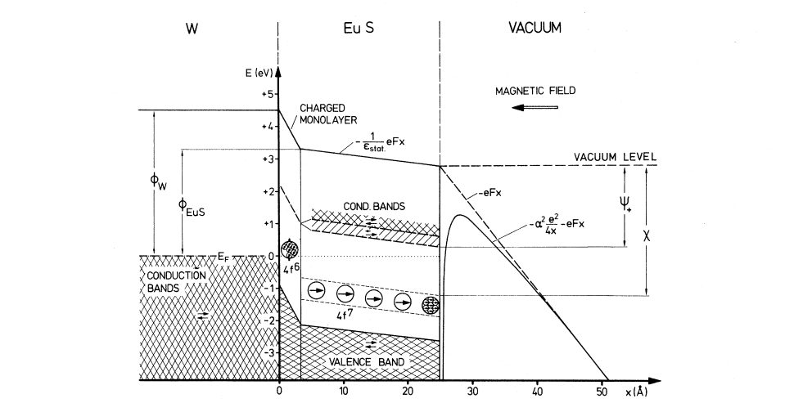
Will they work?
Muller et al, PRL 29, 1651 (1972)
Field emission experiment W/EuS dates back in 1972
Required operation at cryo-temperatures to get EuS<Tc
Polarization of 89±7 % was measured at 21K

Slide 27
Conclusions
Exciting progress on the III-Vs SL-DBR development
  Robust coating may enable vacuum suitcase transport
  Ion Back Bombardment still an issue
New materials potentially more robust are being investigated
  III-Nitrides
  Alkali antimonides
Potentially interesting solution from half-metals and spin filters
THANK YOU!!
Work supported by Brookhaven Science Associates, LLC under Contract No. DE-SC0012704 with the U.S. Department of Energy

