Slide 1
Simulating Real-Time Electron Impact Ionization Within the CEBAF Photo-gun Using a General Particle Tracer (GPT) Custom Element
J. T. Yoskowitz, J. Grames, C. Hernandez-Garcia, G. A. Krafft, G. Palacios-Serrano, M. Poelker, M. L. Stutzman, R. Suleiman, S. B. van der Geer, S. Wijethunga
LA-UR-23-30859
This material is based upon work supported by the U.S. Department of Energy, Office of Science, Office of Nuclear Physics under contract DE-AC05-06OR23177.

Slide 2
Outline
Background and Motivation
Biased Anode Experiments
Ion Back-Bombardment Modelling with GPT
Conclusions & Ongoing Work

Slide 3
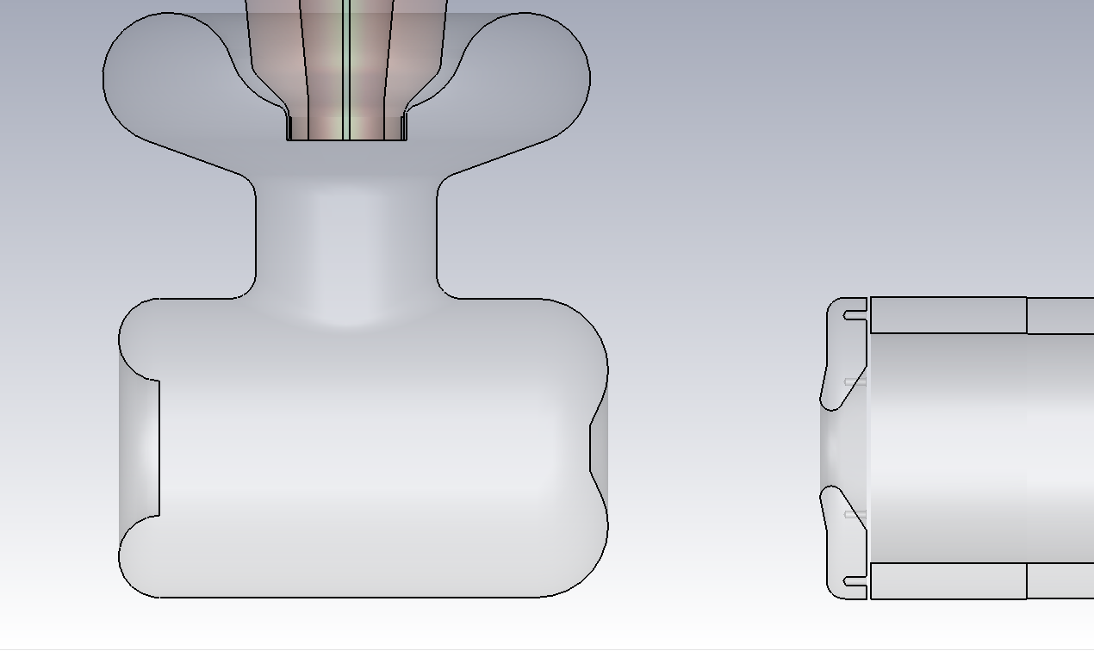
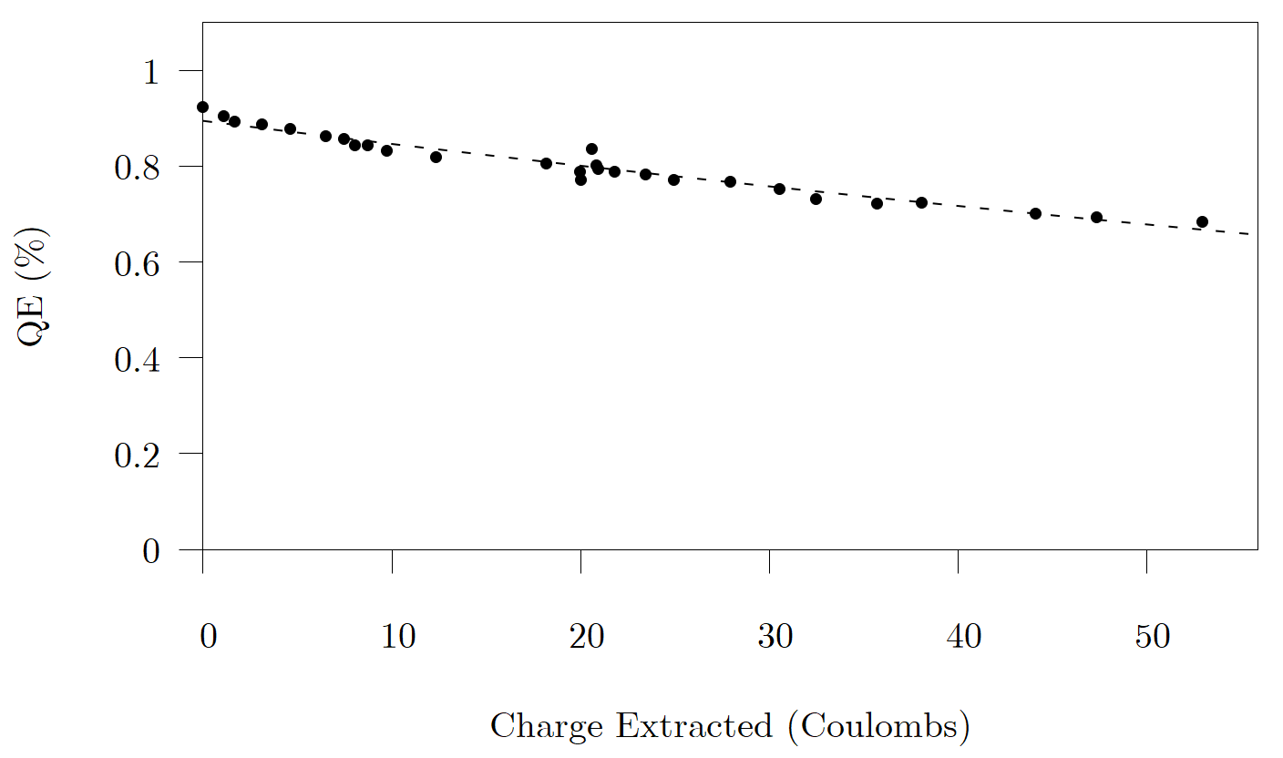
Ion Back-Bombardment
Photocathode charge lifetime is determined by ion back-bombardment.
GaAs photocathodes, used to create polarized electron beams, are particularly susceptible to ion back-bombardment.
Charge lifetime: amount of charge extracted before QE falls to 1/e (~37%) of the initial value.
$$QE(q)=QE_{0}exp\left(−\frac{q}{τ}\right)$$
$QE_{0}=$ Initial QE
$q=$ Charge Extracted
$τ=$ Charge Lifetime
Grounded Anode
Cathode
Anode
Ions
Ions
e-beam
Photocathode
6 cm Gap
Photocathode QE vs Charge Extracted

Slide 4
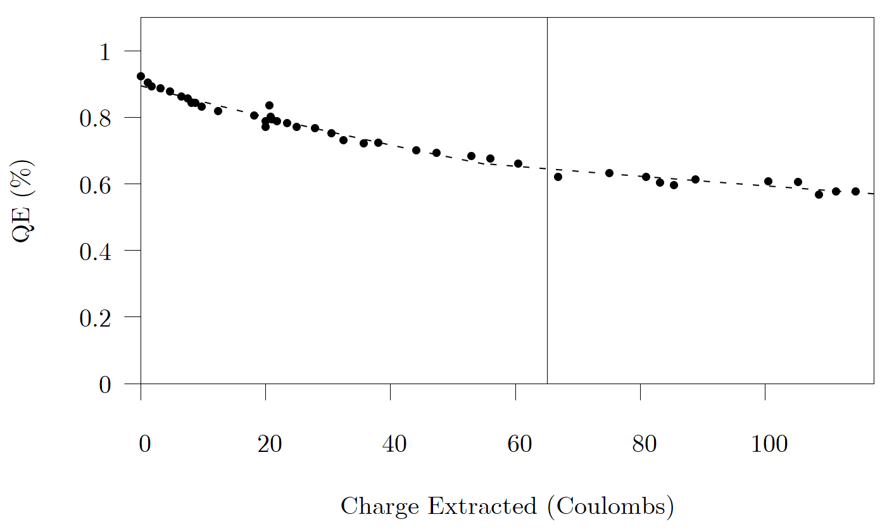
Biasing the Anode
Biasing the anode with a positive voltage repels ions downstream of the anode, increasing charge lifetime.
Higher charge lifetime → higher current in the same amount of time, or same current for longer time.
Developed a realistic model to explain the charge lifetime improvement with the biased anode.
Biased Anode
Cathode
Anode
Ions
Ions
e-beam
6 cm Gap
Photocathode
Photocathode QE vs Charge Extracted
Grounded Anode
Biased Anode

Slide 5
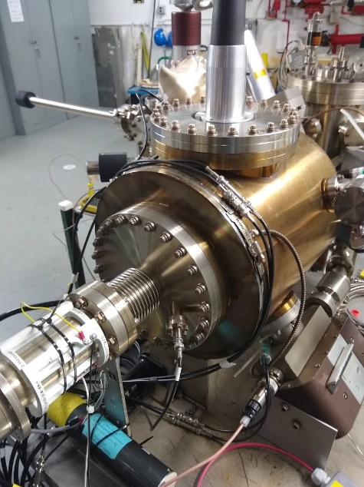
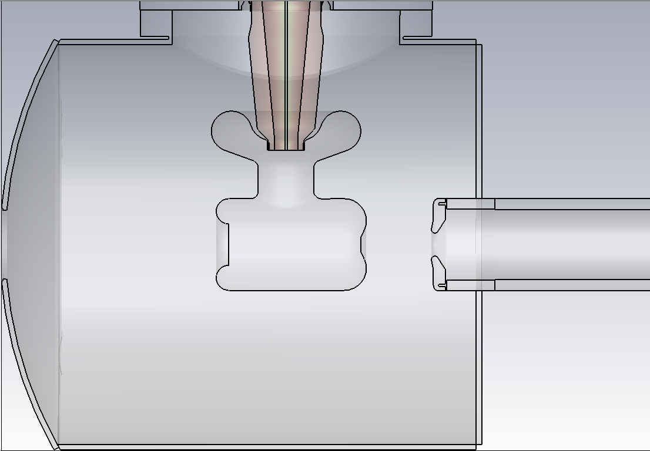
CEBAF Photo-gun
Triple-Point Junction Shield
HV Cable
Cathode Electrode
Inverted Insulator
Anode Electrode
Support Tube
HV Cable
Beam Pipe
Gun Chamber
E-Beam Direction
6 cm Gap
Laser Direction
Anode Bias Feedthrough
Gun Chamber
E-Beam Direction
Photocathode
Ceramic Spacers

Slide 6
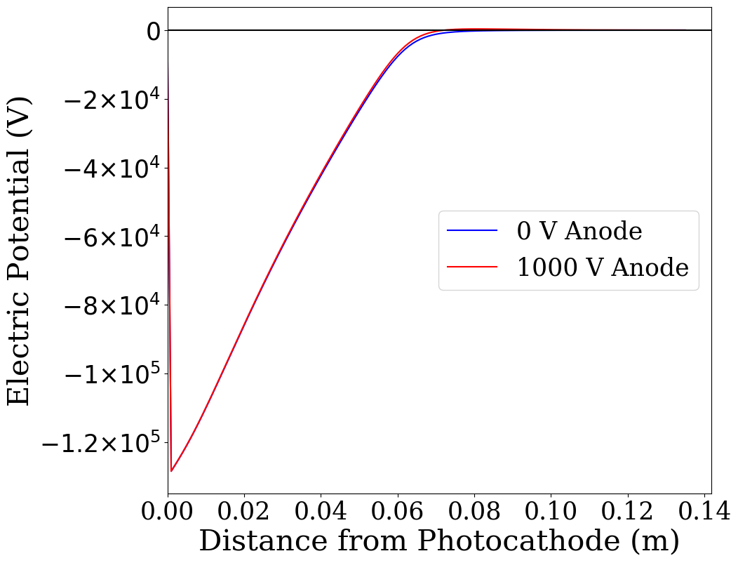
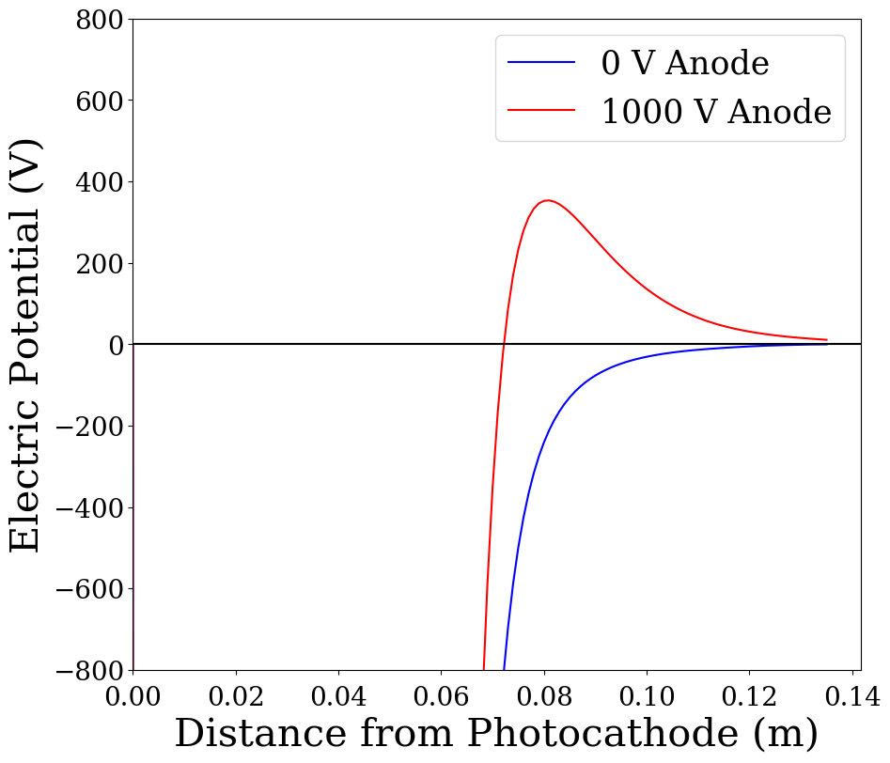
Grounded vs Biased Anode Configurations
Cathode: -130 kV
Grounded anode: 0 V
Biased anode: +1000 V
Peak: ~ 350 V at 8 cm
Photocathode
Anode
Electric Potential On Axis
Photocathode
Anode
Electric Potential On Axis
(Zoomed in)

Slide 7
Biased Anode Experiments
Experiments took place parasitically to three run periods at the CEBAF accelerator.
Anode alternated between grounded and biased configurations (RP1 and RP2).
Daily QE measurements to track degradation and calculate charge lifetime.
Periodic QE scans to measure spatial degradation.
 | Run Period 1 | Run Period 2 | Run Period 3
Dates | June 2019 – Sept 2019 ($\sim$12 weeks) | Jan 2020 – Mar 2020 ($\sim$11 weeks) | July 2020 – Sept 2020 ($\sim$11 weeks)
Lasers/halls used | A, B, C | A, B, C, D | A, B, C, D
Total charge extracted | 245 C | 390 C | 247 C
Total beam current | 50 – 100 μA | 150 – 225 μA | 150 – 225 μA
Rep Rate | 499 MHz | 499 MHz | 499 MHz
Initial bunch size | 0.5 mm (rms) | 0.5 mm (rms) | 0.5 mm (rms)
Bunch length | 50 ps (rms) | 50 ps (rms) | 50 ps (rms)
Cathode bias | -130 kV | -130 kV | -130 kV
Anode bias | 0 V or 961 V | 0 V, 961 V, or 1000 V | 1000 V

Slide 8
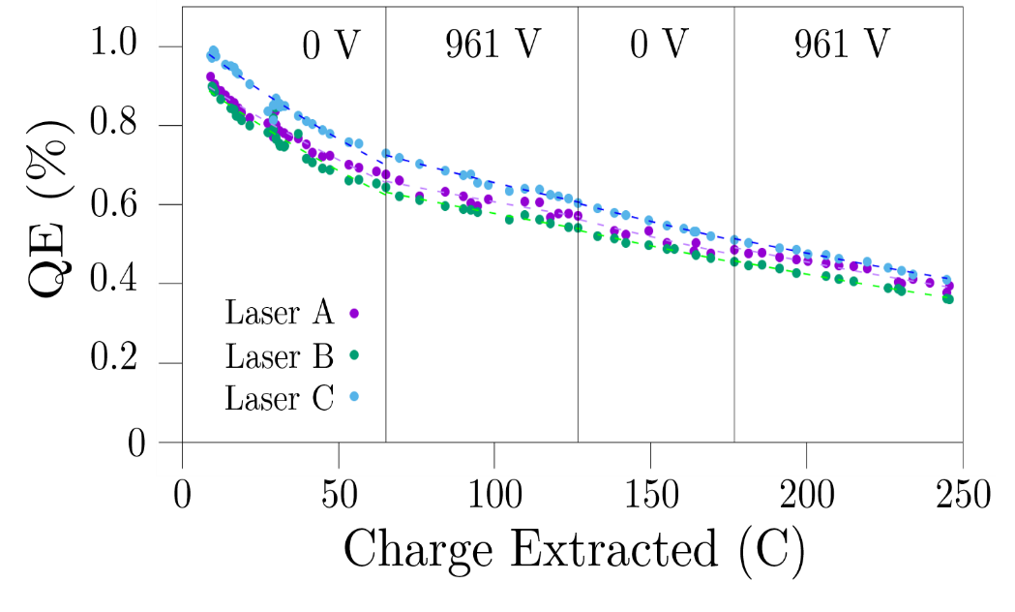
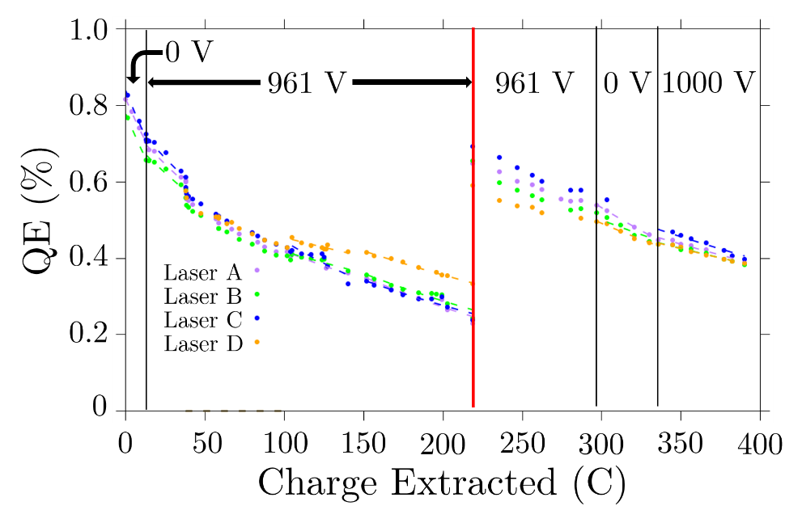
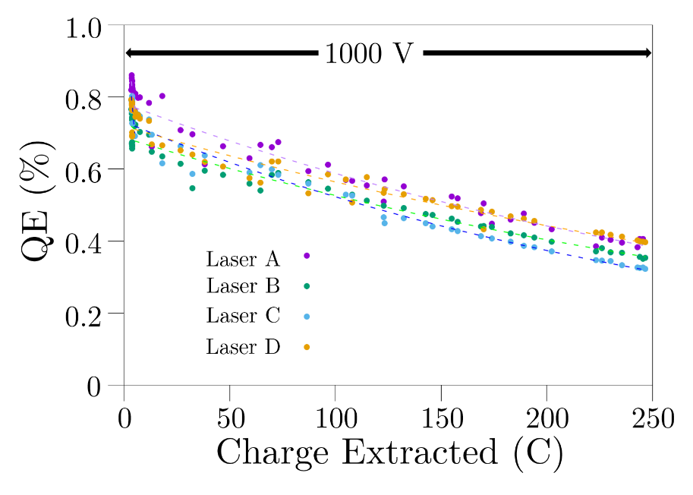
QE Measurements
QE measurements measure the QE at the laser spot on the photocathode.
Laser spot shifted in run period 2 when the QE was too low.
Run Period 1
Laser Spot 1
Laser Spot 2
Run Period 2
Run Period 3

Slide 9
Charge Lifetime and Improvement Ratios
Charge Lifetime Table
Improvement Ratios
Run Period | Anode Bias (V) | Charge Lifetime (C)
1 | 0 961 0 961 | 181 ± 8 424 ± 53 288 ± 39 303 ± 18
2 | 0 961 961 0 1000 | 85.9 ± 0.1 211 ± 9 401 ± 10 208 ± 4 370 ± 29
3 | 1000 | 350 ± 14
Run Period | Improvement Ratio | Ratio Value
1 | $$τ_{2}/τ_{1}$$ | $$2.34±0.31$$
 | $$τ_{4}/τ_{3}$$ | $$1.05±0.16$$
2 | $$τ_{2}/τ_{1}$$ | $$2.28±0.22$$
 | $$τ_{3}/τ_{4}$$ | $$1.93±0.06$$
 | $$τ_{5}/τ_{4}$$ | $$1.78±0.14$$
Average Improvement Ratio
$$\frac{\left\langle τ_{biased}\right\rangle }{\left\langle τ_{grounded}\right\rangle }=\frac{343±66}{191±40}≈1.80±0.51$$
Charge lifetime improved by $1.80±0.51$ on average with anode biased.
Interestingly, charge lifetimes for a given anode bias change throughout each run period.

Slide 10
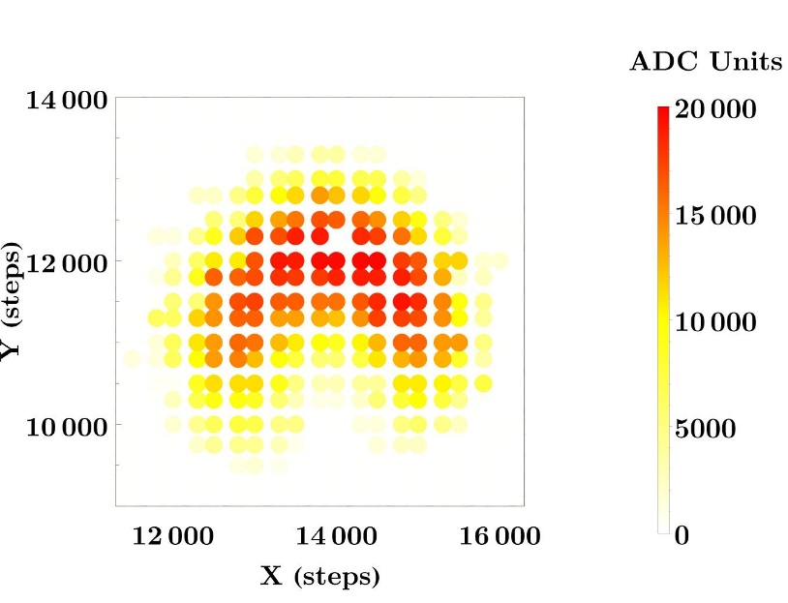
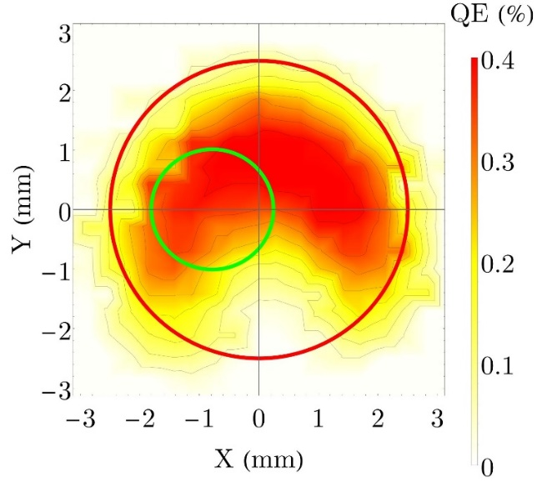
QE Scan
Series of QE measurements in a gridded pattern.
X/Y stepper motor moves laser spot.
Interpolate measurements to generate QE contour plot.
Compare successive scans to visualize QE degradation.
Raw Data
QE Scan
Red Circle: Photocathode Active Area, 5 mm diameter
Green Circle: Laser Spot, 2 mm diameter

Slide 11
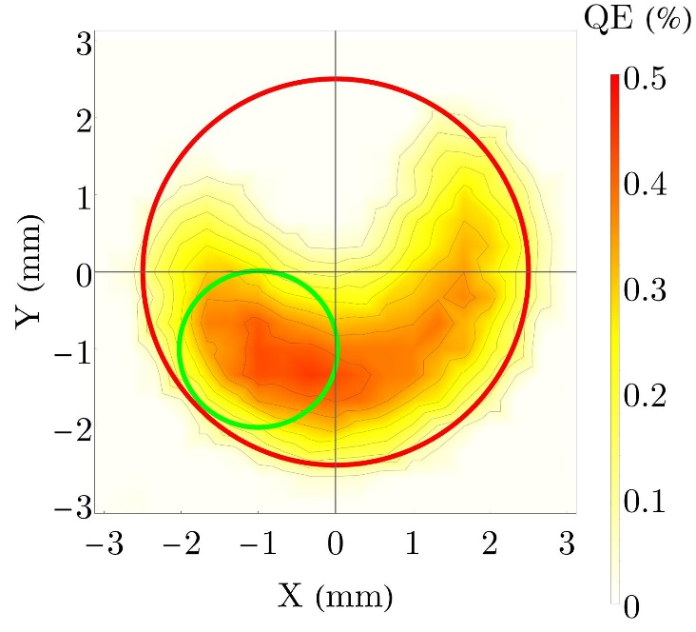
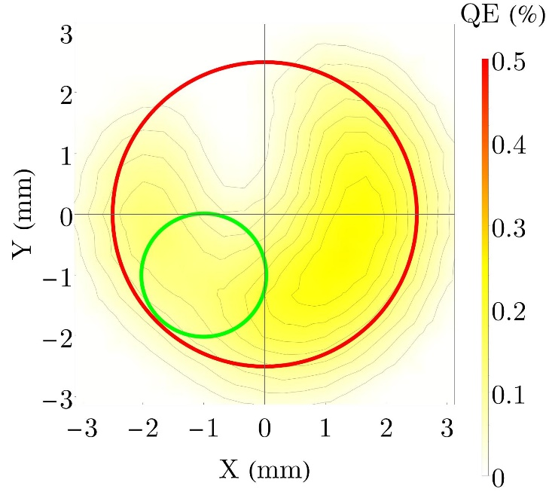
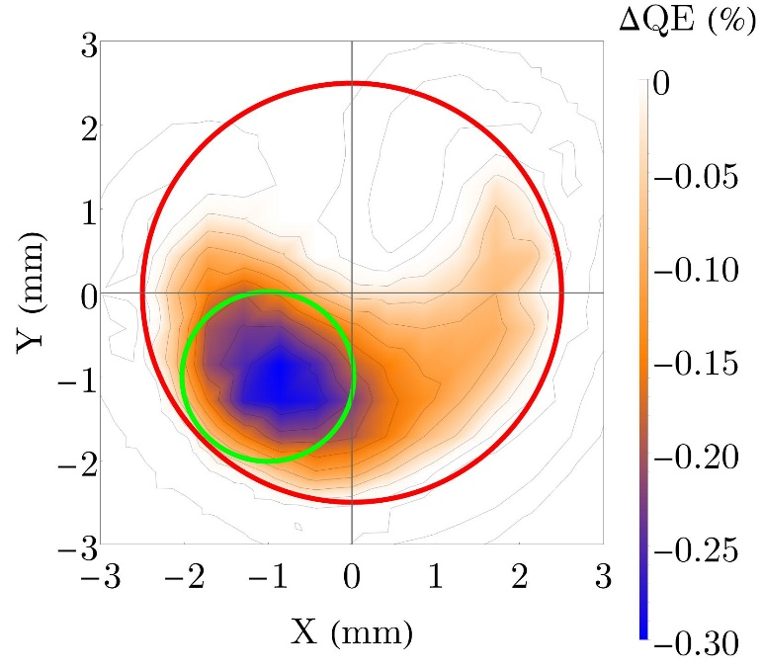
QE Scans: Run Period 1
Laser spot position: (-1.0 mm, -1.0 mm)
Time elapsed between scans: 111 days
Charge extracted between scans: 245.7 C
1 (Initial)
2 (Final)
$Δ=$ 2 - 1
Red Circle: Active Area Green Circle: Laser Area

Slide 12
QE Scans: Run Period 2
Laser spot #1 : (-0.78 mm, 0 mm)
Laser spot #2: (1.63 mm, 0.57 mm)
Total time elapsed: 81 days
Total charge extracted: 404 C
Note: Scans are not correlated with bias or laser spot
QE Scans
1
2
3
4
5
QE Difference Scans
2-1
3-2
4-3
5-4
5-1

Slide 13
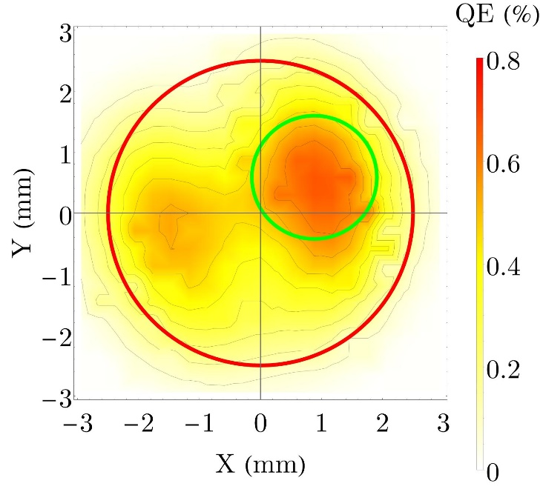
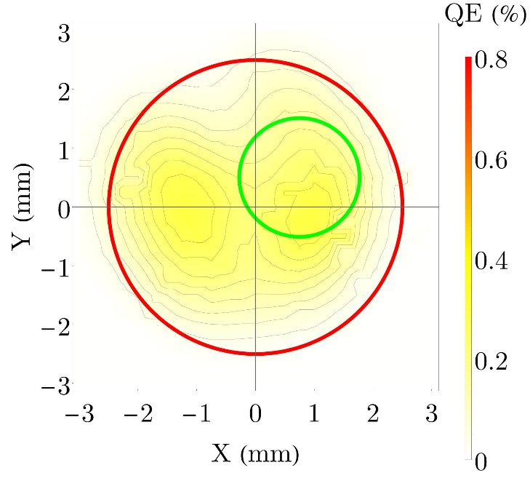
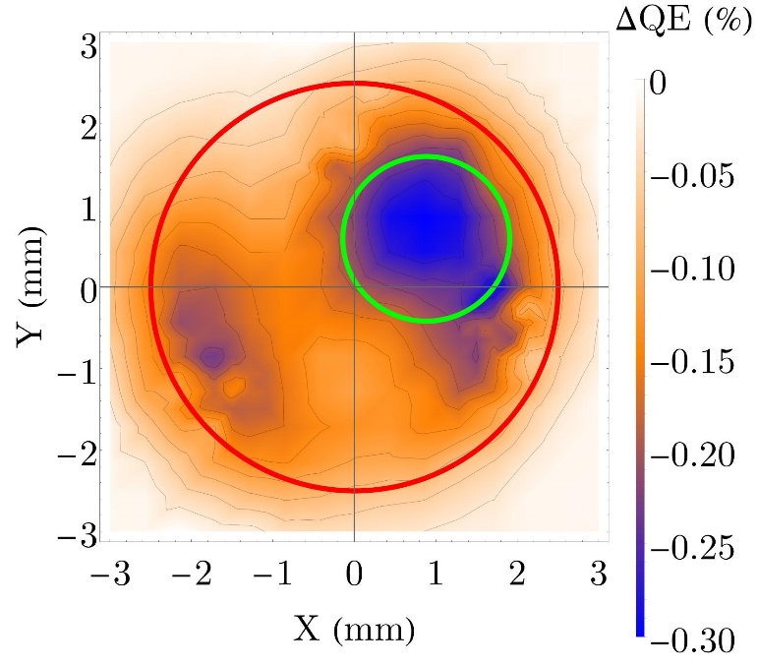
QE Scans: Run Period 3
Laser spot position: (0.88 mm, 0.59 mm)
Time elapsed between scans: 81 days
Charge extracted between scans: 241 C
1 (Initial)
2 (Final)
$Δ=$ 2 - 1
Red Circle: Active Area Green Circle: Laser Area

Slide 14
General Particle Tracer (GPT) Simulations with IONATOR
GPT is a particle tracking code.
Created the C++ custom element IONATOR to model electron impact ionization.
Features:
Implements cross sections using Monte Carlo algorithms.
Includes prevalent residual gases: H₂, He, CO, CH₄.
User-defined gas densities and temperatures.
Generates ionization statistics (particle energies, momenta, ionization cross sections) in a separate output file.

Slide 15
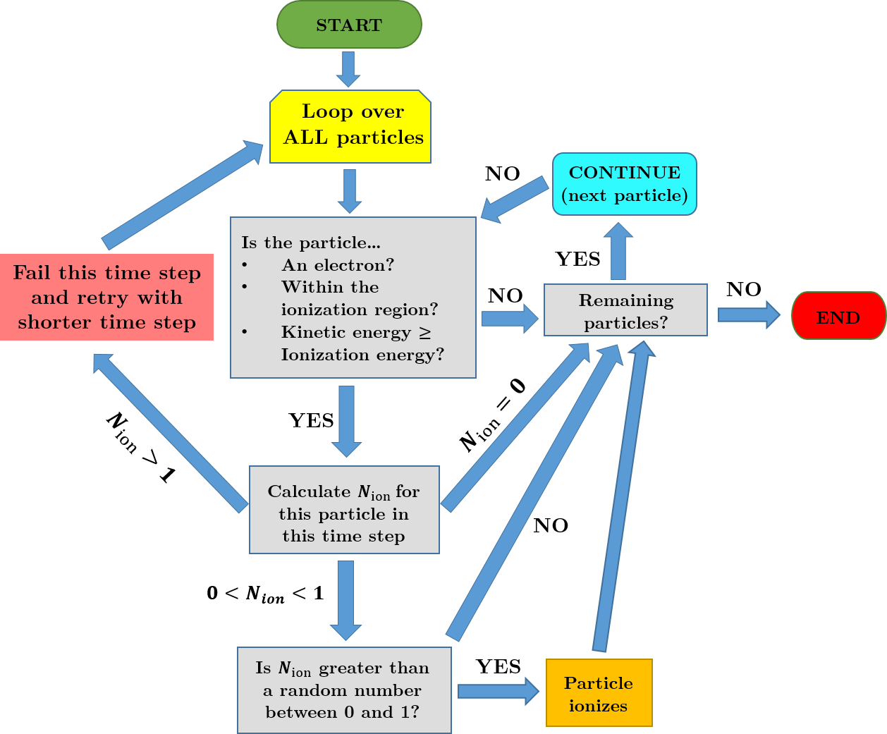
IONATOR Flow Chart
The number of ions each macro-particle creates in a time step is given by $N_{ion}=ρσdN_{e}$
$ρ=$Gas density
$σ=$Ionization cross section
$d=$Distance travelled in time step
$N_{e}=$Number of electrons per macro-particle
Monte Carlo algorithm ensures ionization simulations are probabilistic, instead of deterministic.

Slide 16
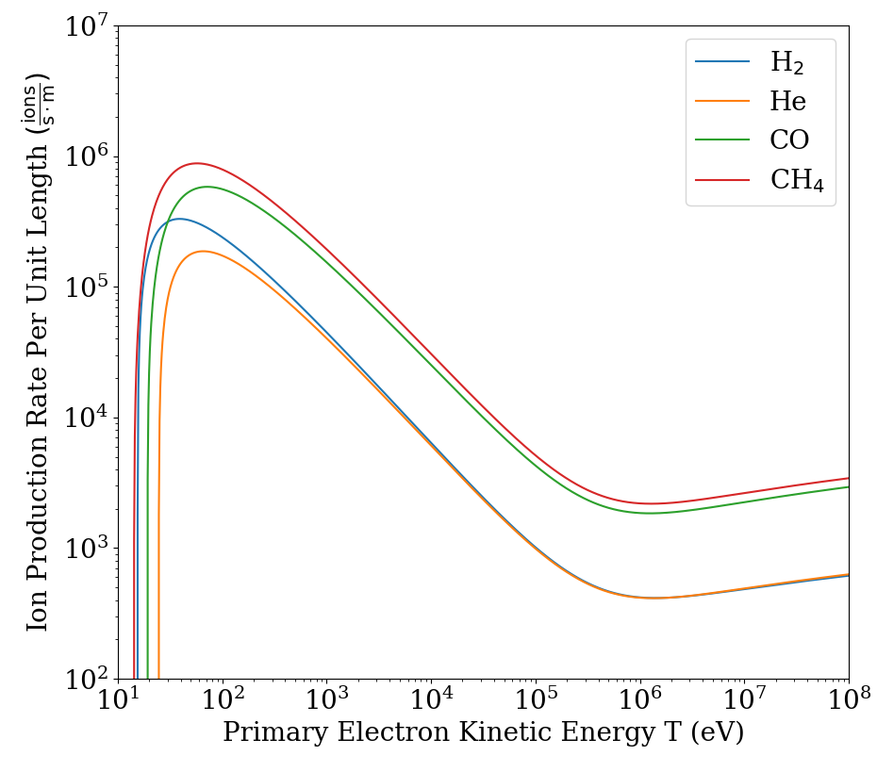
Ion Production Rate
Ion Production Rate Per Unit Length
$$\frac{dN}{dt}\left(\frac{1}{l}\right)=ρσ\frac{I_{e}}{e}$$
Ion Production Rate Per Unit Length
$ρ$ = Gas density (m⁻³)
$σ$= Ionization cross section (m²)
$l$ = Distance traveled by electron (m)
$I_{e}$ = Electron current (A)
$e$ = Elementary charge (C)
Example Calculations for H₂ Gas
Assuming $ρ_{H_{2}}=3.56×{10}^{10} {\text{m}}^{−3} ({10}^{−12} \text{Torr})$ and $I_{e}=100 \text{μA}$
Electron Energy | IPR per length
$$100 \text{eV}$$ | $$2.4×{10}^{5} \frac{H_{2}^{+}}{\text{s}\text{⋅}\text{m}}$$
$$100 \text{keV}$$ | $$1.0×{\text{10}}^{3} \frac{H_{2}^{+}}{\text{s}\text{⋅}\text{m}}$$

Slide 17
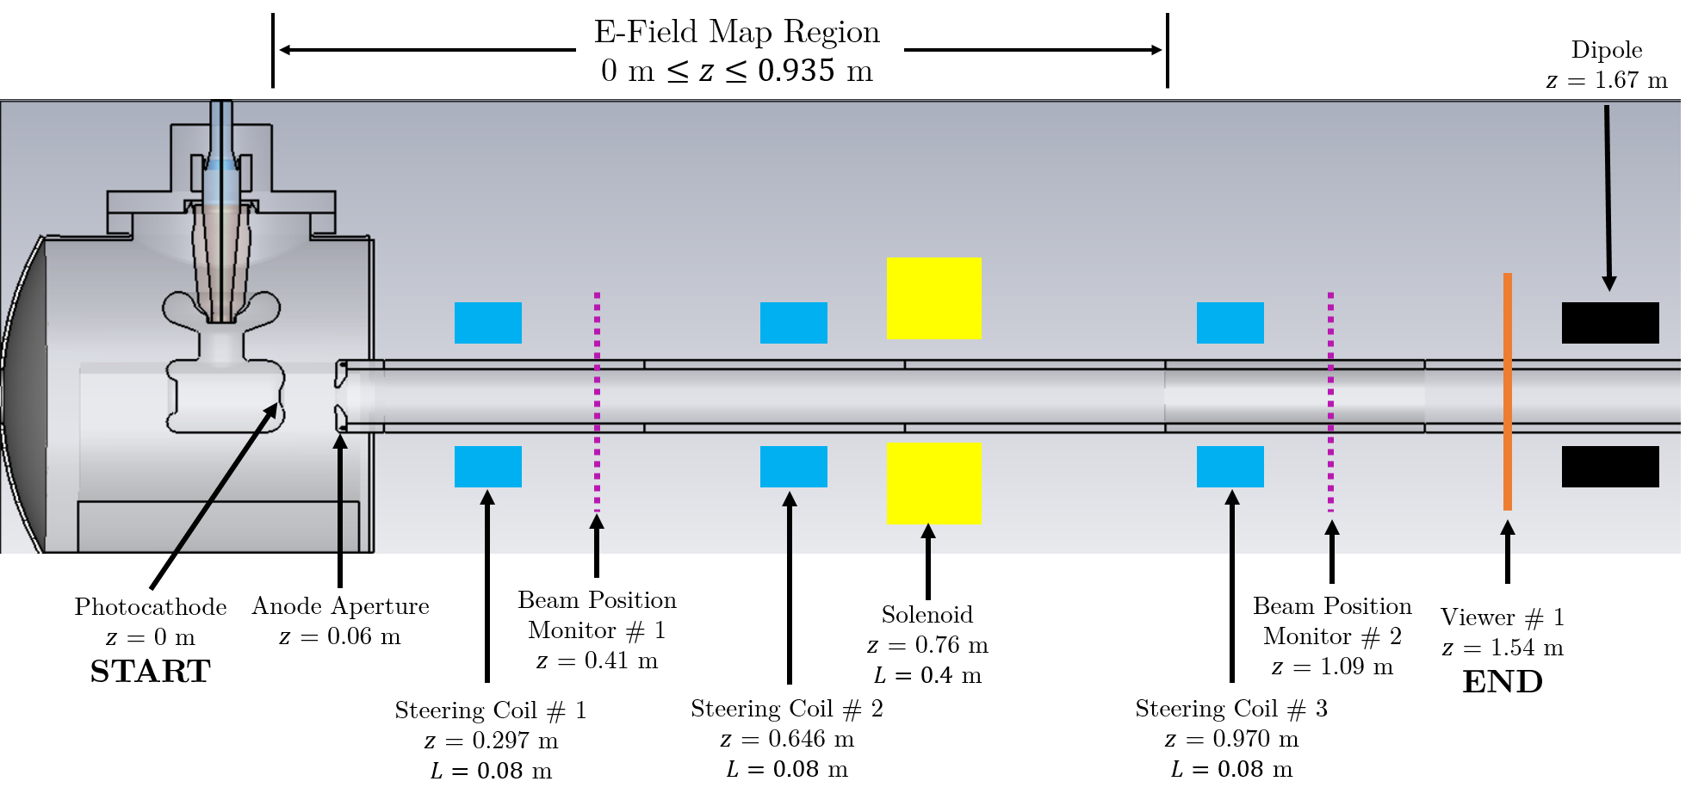
Modelling the CEBAF Beamline
Created GPT simulations for each anode bias configuration in each run period.
Single electron bunch is tracked to a viewer 1.54 m away from photocathode.
Used a CST 3D electric field map of the CEBAF photo-gun.
Used GPT field maps for magnetic elements.

Slide 18
Grounded vs Biased Anode Simulations
Primary Electron
Ion
Secondary Electron
Scattered Electron
Photocathode
Anode
Grounded Anode Simulation
Parameter | Value
# Macro Particles | $${10}^{4}$$
Total Bunch Charge | $0.13$mC
Bunch Length | 50 ps (rms)
Transverse Diameter | 2 mm
Cathode Voltage | -$130$ kV
Anode voltage | 0 V (grounded) +1 kV (biased)
H₂ density | $3.56×{10}^{10}$ m⁻³ ($≈{10}^{−12}$ Torr)
Simulation Region | $z∈[0, 1.54]$ m
Simulation Stages | $t_{1}∈\left[0 \text{ns}, 10 \text{ns}\right],$ $0.1$ns $t_{2}∈[10 ns, 0.5 μs]$, $10$ ns $t_{3}∈\left[0.5 μs, 0.1 ms\right], 0.5 μ$s
Biased Anode Simulation

Slide 19
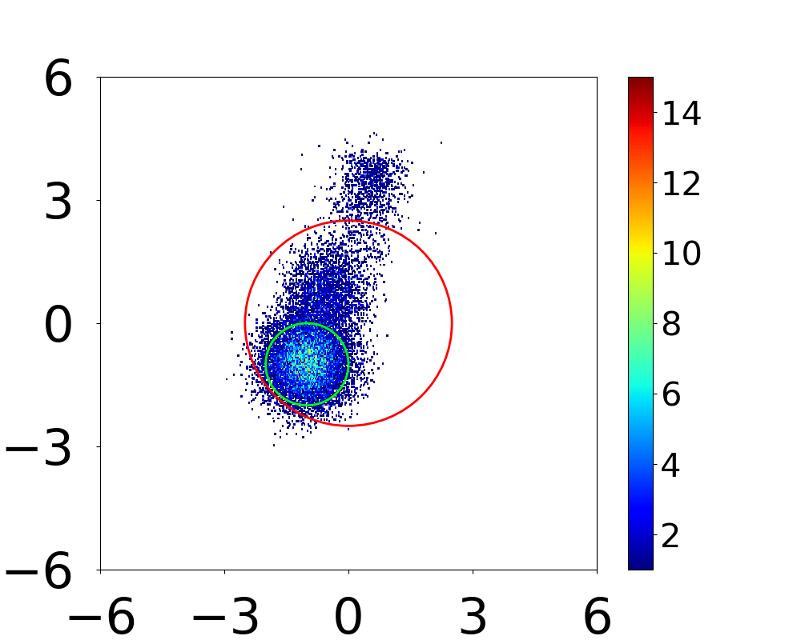
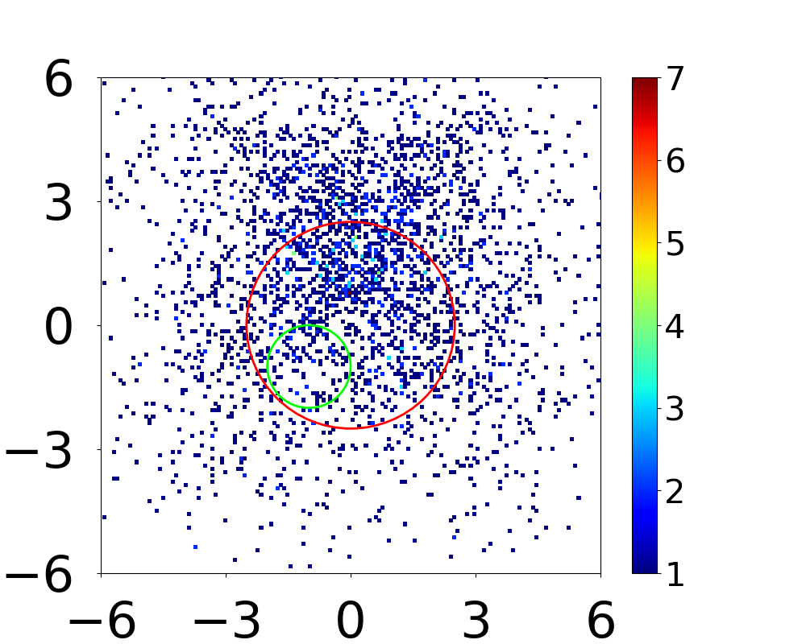
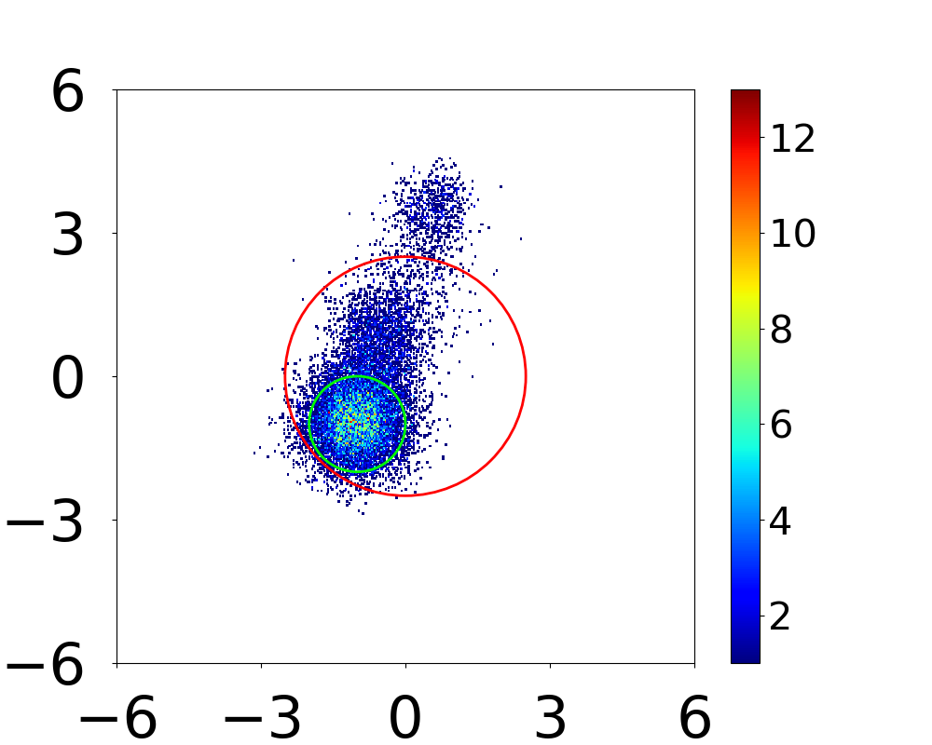
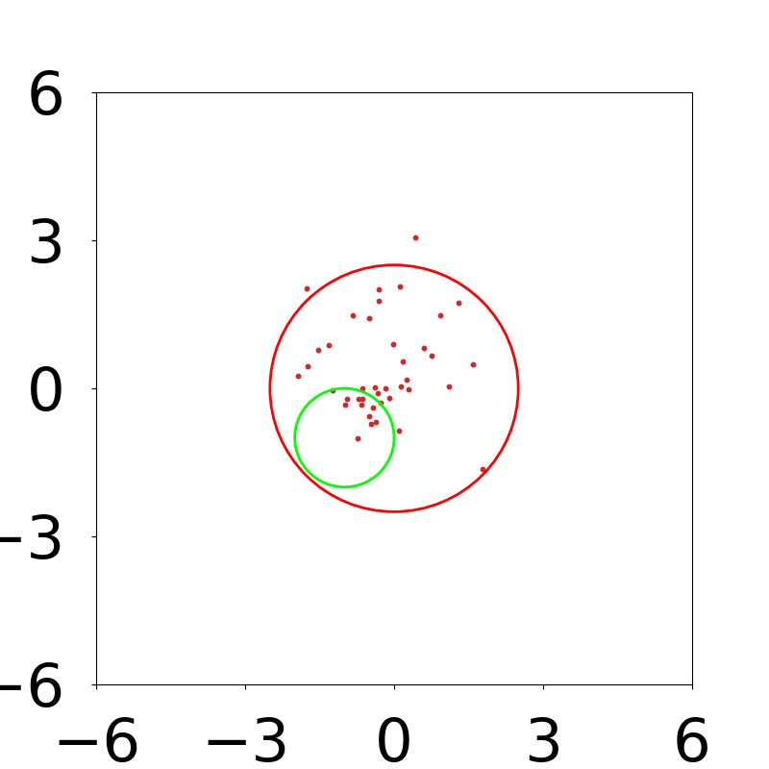
Back-Bombarding Ion Density Distributions: Grounded vs. Biased Anode (Run Period 1)
Upstream of Anode
Downstream of Anode
Grounded Anode (0 V)
Y (mm)
Ion Density (mm⁻²)
Ion Density (mm⁻²)
Y (mm)
X (mm)
X (mm)
Biased Anode (961 V)
Y (mm)
Ion Density (mm⁻²)
(Scatter Plot)
Y (mm)
X (mm)
X (mm)

Slide 20
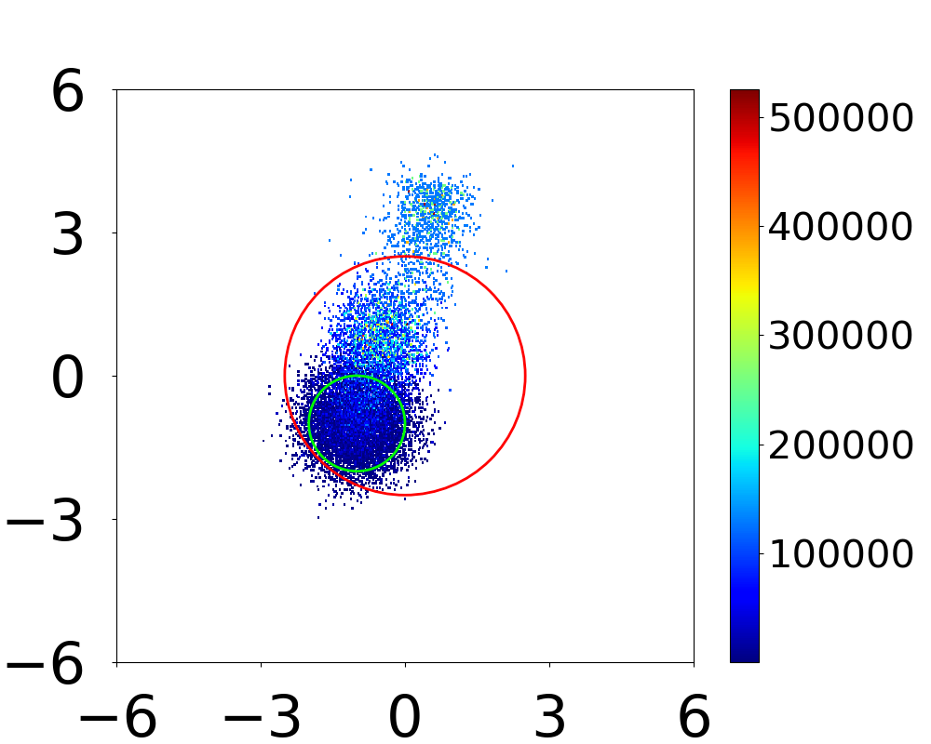
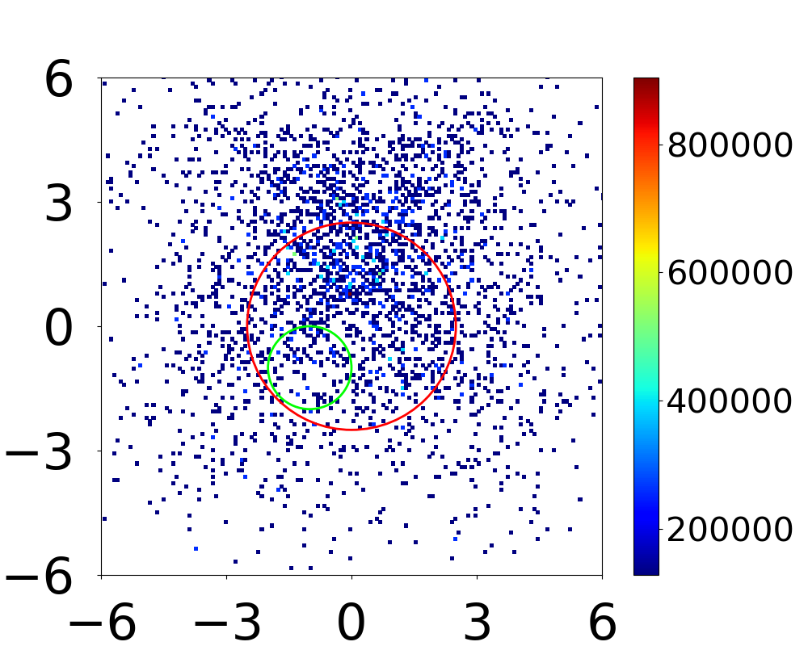
Back-Bombarding Ion Energy Density Distributions: Grounded vs. Biased Anode (Run Period 1)
Upstream of Anode
Downstream of Anode
Grounded Anode (0 V)
Y (mm)
Ion Energy Density (eV/mm²)
Y (mm)
Ion Energy Density (eV/mm²)
X (mm)
X (mm)
Biased Anode (961 V)
Y (mm)
Ion Energy Density (eV/mm²)
Y (mm)
(Scatter Plot)
X (mm)
X (mm)

Slide 21
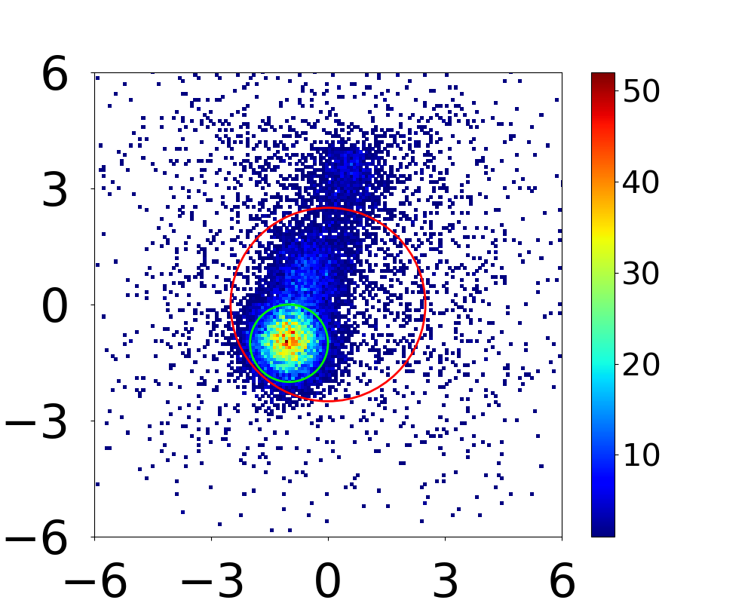
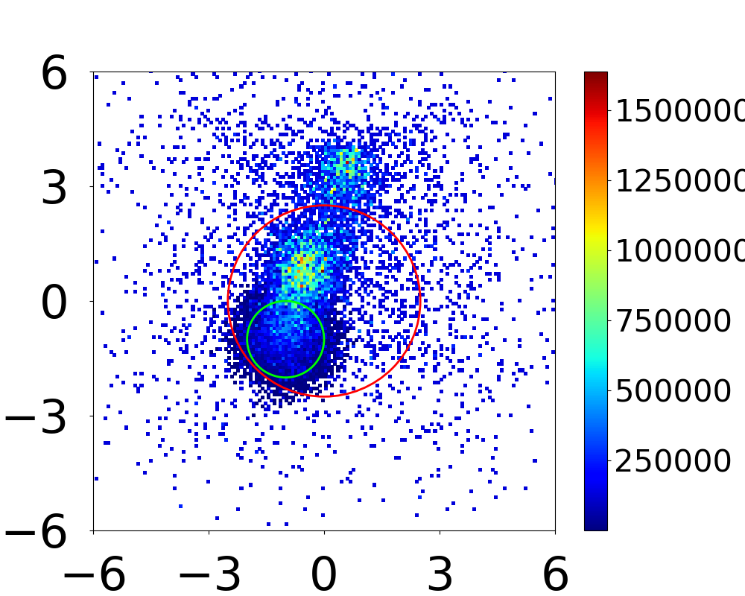
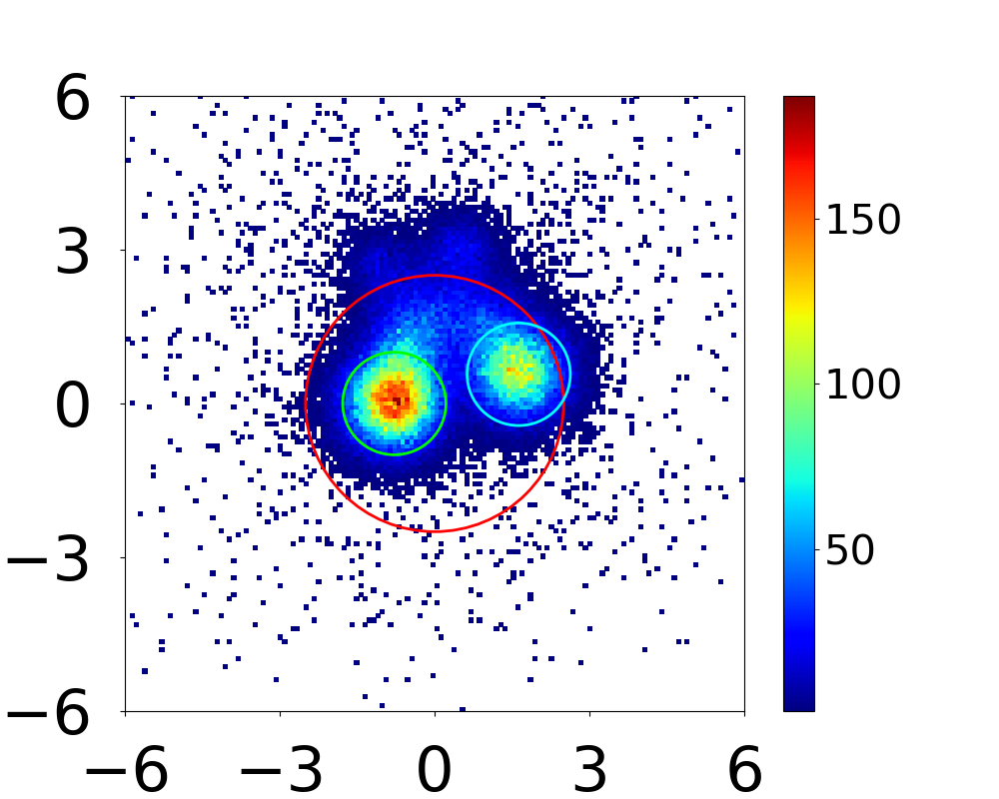
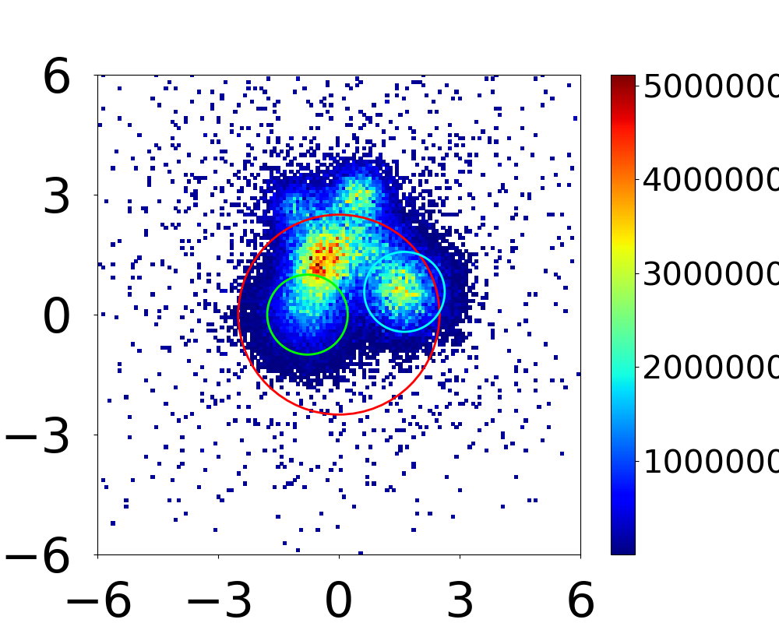
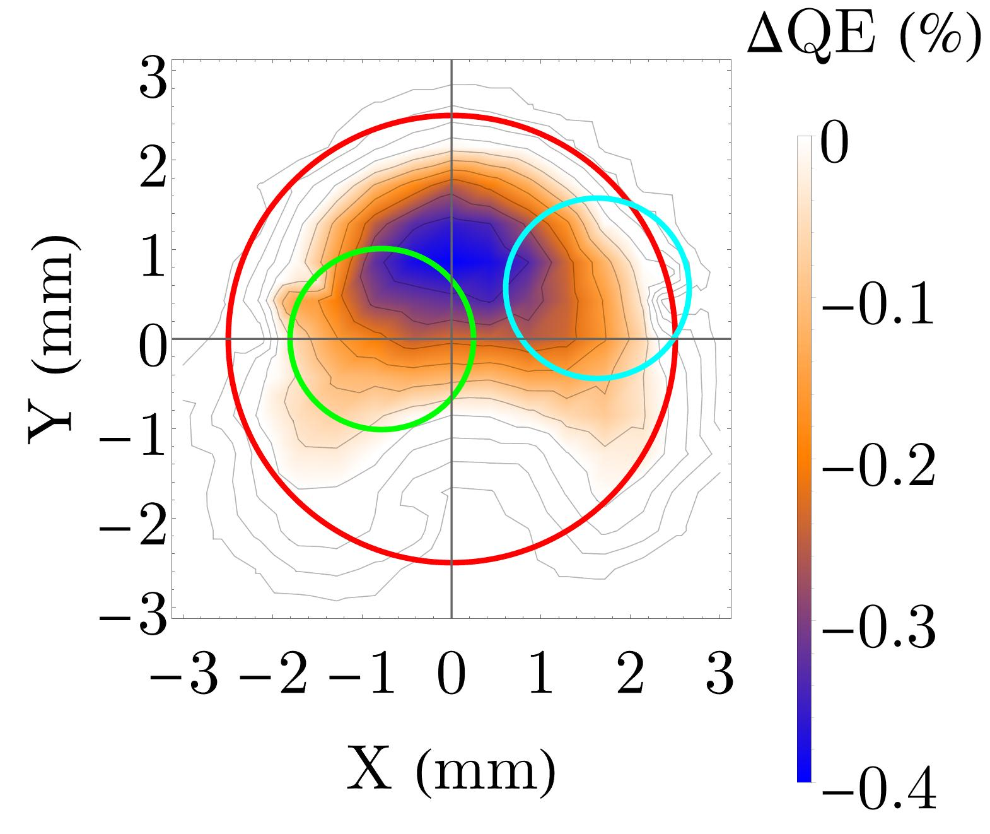
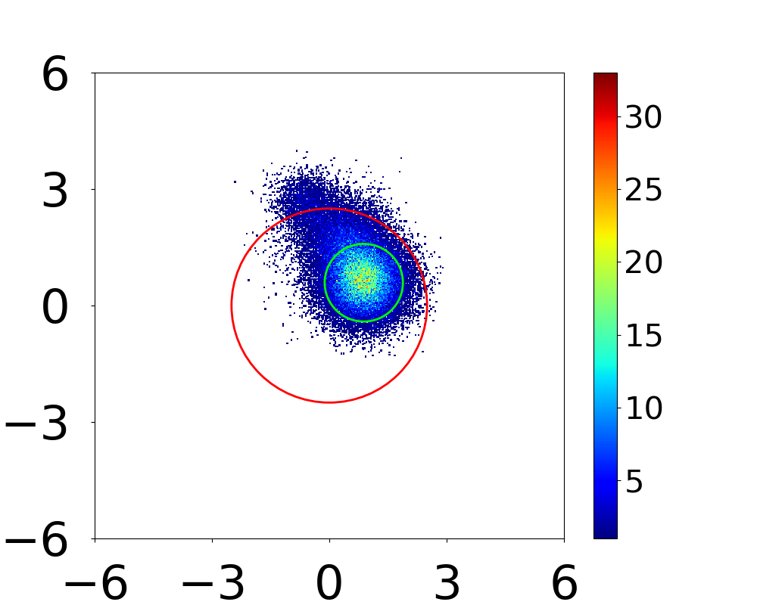
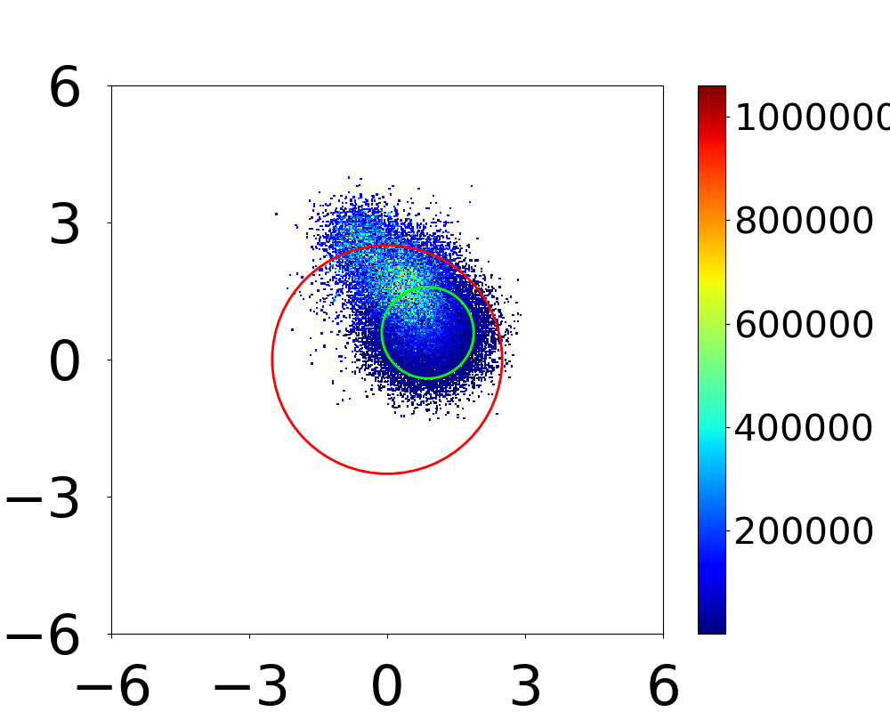
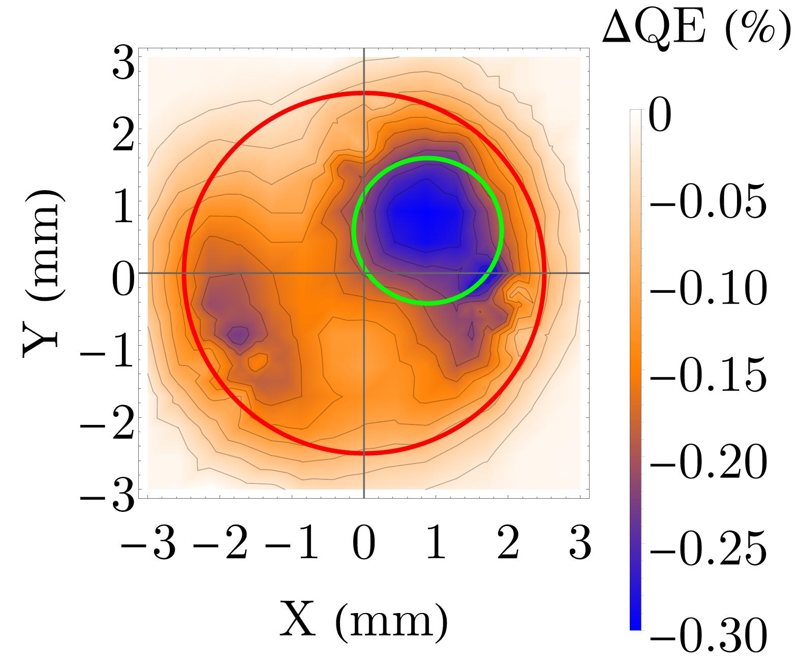
Back-Bombarding Ion Distributions vs QE Difference Scan
Ion Density
Ion Energy Density
QE Difference Scan
Run Period 1
Ion Density (mm⁻²)
Ion Energy
Density (eV/mm²)
Y (mm)
Y (mm)
X (mm)
X (mm)
Run Period 2
Y (mm)
Ion Energy
Density (eV/mm²)
Y (mm)
Ion Density (mm⁻²)
X (mm)
X (mm)
Run Period 3
Y (mm)
Ion Energy
Density (eV/mm²)
Y (mm)
Ion Density (mm⁻²)
X (mm)
X (mm)

Slide 22
Conclusions
Biasing the anode increases the charge lifetime of the CEBAF photo-gun by 1.80±0.51.
Created IONATOR to model electron-impact ionization and simulate ion back-bombardment.
Back-bombarding ions created upstream of the anode are concentrated at the laser spots.
Back-bombarding ions created downstream of the anode are spread out over the active area.
Biasing the anode repels the vast majority of ions created downstream of the anode.
Back-bombarding ion distribution patterns correlate to the QE degradation patterns in all three run periods.

Slide 23
Ongoing Work
Currently using IONATOR to predict ion back-bombardment for the 200 kV CEBAF photo-gun.
Determining how ion damage mechanisms (sputtering, implantation, etc.) contribute to QE degradation.
Studying time-dependence of charge lifetime improvement.

Slide 24
J. T. Yoskowitz, J. Grames, C. Hernandez-Garcia, G. A. Krafft, G. Palacios-Serrano, M. Poelker, M. L. Stutzman, R. Suleiman, S. B. van der Geer, S. Wijethunga
jty@lanl.gov

Slide 25
Backup Slides

Slide 26
Photoemission and Quantum Efficiency
Incident Photon
Photo-emitted Electron
Photo-guns produce electron beams via photoemission.
Photoemission is described as a three-step process¹:
Photons excite electrons in the photocathode.
Electrons diffuse through the material; some reach the surface.
Electrons overcome electron affinity and escape the photocathode.
Quantum efficiency (QE): Ratio of # photo-emitted electrons to # incident photons.
e-
3
1
e-
e-
2
Excited Electron
Photocathode
$$QE=\frac{N_{e^{−}}}{N_{γ}}=\frac{hc}{e}\frac{I}{Pλ}$$
$I=$ Beam Current
$P=$ Laser Power
$λ=$ Laser Wavelength
¹ W. E. Spicer, “Photoemissive, photoconductive, and optical absorption studies of alkali-antimony compounds”, Phys. Rev., vol. 112, pp. 114–122, Oct. 1958, doi:10.1103/PhysRev.112.114

Slide 27
CEBAF Polarized Electron Source Beamline
PHOTOCATHODE PREPARATION CHAMBER
PHOTO-GUN VACUUM CHAMBER
STEERING COILS
BEAMLINE VALVE
STEERING COILS
STEERING COILS
VIEWER
FARADAY CUP
SOLENOID
LASER
BEAM POSITION MONITORS
$−15^{∘}$ DIPOLE MAGNET
BEAM POSITION MONITORS
(VIEWER)
BEAM POSITION MONITORS

Slide 28
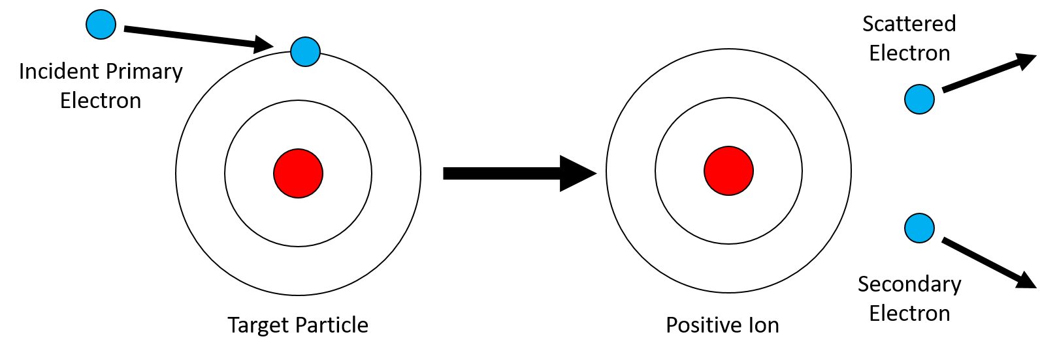
Electron-Impact Ionization
A primary electron scatters off a target particle and ejects an electron.
The target particle becomes a positive ion.
The ejected electron is called the secondary electron.
The primary electron scatters away and is called the scattered electron.
The primary electron must overcome the ionization (binding) energy of the target particle.
Both the secondary electron and scattered electron can continue to ionize, provided they have sufficient kinetic energy.
-
Shell electron
-
-
+
+
-

Slide 29
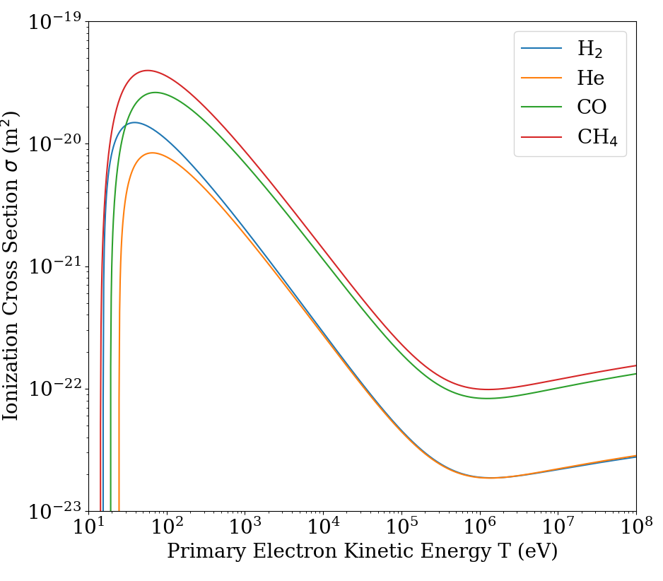
Ionization Cross Section
Ionization Cross Section
Probability of ionization given by the ionization cross section²:
$$σ\left[m^{2}\right]=\frac{1.872×{10}^{−24}A_{1}}{β^{2}}\left(\frac{B}{T}\right)\left(\frac{T}{B}−1\right)[ln\left(7.515×{10}^{4}A_{2}β^{2}γ^{2}\right)−β^{2}]$$
$T$: Primary electron kinetic energy
$B$: Ionization energy
$β,γ$: Relativistic factors
$A_{1},A_{2}$: Ion-specific parameters
Low energy electrons are more likely to ionize.
Electron Energy | Ionization Cross Section (H₂)
$$100 \text{eV}$$ | $$1.08×{10}^{−20} {\text{m}}^{2}$$
$$100 \text{keV}$$ | $$4.56×{10}^{−23} {\text{m}}^{2}$$

Slide 30
Ion Production Rate
Ion Production Rate Per Unit Length
Ion Production Rate Per Unit Length
$$\frac{dN}{dt}\left(\frac{1}{l}\right)=ρσ\frac{I_{e}}{e}$$
$ρ$ = Gas density (m⁻³)
$σ$= Ionization cross section (m²)
$l$ = Distance traveled by electron (m)
$I_{e}$ = Electron current (A)
$e$ = Elementary charge (C)
Example Calculations for H₂ Gas
Assuming $ρ_{H_{2}}=3.56×{10}^{10} {\text{m}}^{−3} ({10}^{−12} \text{Torr})$ and $I_{e}=100 \text{μA}$
Electron Energy | IPR per length
$$100 \text{eV}$$ | $$2.4×{10}^{5} \frac{H_{2}^{+}}{\text{s}\text{⋅}\text{m}}$$
$$100 \text{keV}$$ | $$1.0×{\text{10}}^{3} \frac{H_{2}^{+}}{\text{s}\text{⋅}\text{m}}$$

Slide 31
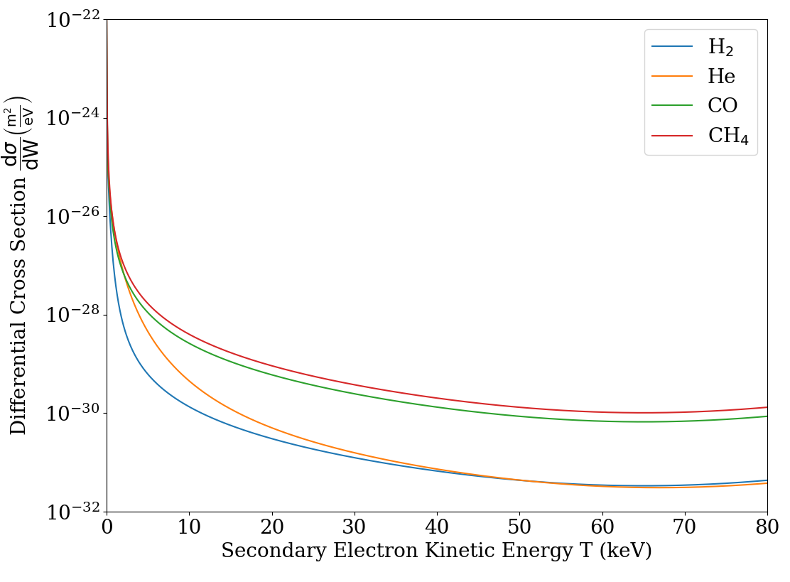
Secondary Electron Energy Distribution
In the Binary Encounter Dipole Model³, the distribution of possible secondary electron energies is given by the differential cross section:
$$\frac{dσ}{dW}\left(T,W\right)=\frac{S}{B\left(t+u+1\right)}\left[\frac{\left(\frac{N_{i}}{N}\right)−2}{t+1}\left(\frac{1}{w+1}+\frac{1}{t−w}\right)+\left(2−\frac{N_{i}}{N}\right)\left(\frac{1}{{\left(w+1\right)}^{2}}+\frac{1}{{\left(t−w\right)}^{2}}\right)+\frac{lnt}{N\left(w+1\right)}\frac{df\left(w\right)}{dw}\right]$$
$T$: Primary electron energy
$W$: Secondary electron energy
$B$: Ionization energy
$U$: Average electron energy in a subshell
$N$: Number of electrons in a subshell
$t=\frac{T}{B}, u=\frac{U}{B},w=\frac{W}{B}$
$S=4πa_{0}^{2}R^{2}N/B^{2}$
$\frac{df}{dw}$: Differential oscillator strength
$N_{i}=\int_{0}^{∞}{\frac{df}{dw}dw}$
Secondary electrons are likely to have low energy compared to the scattered electron.
Secondary Electron Differential Cross Section

Slide 32
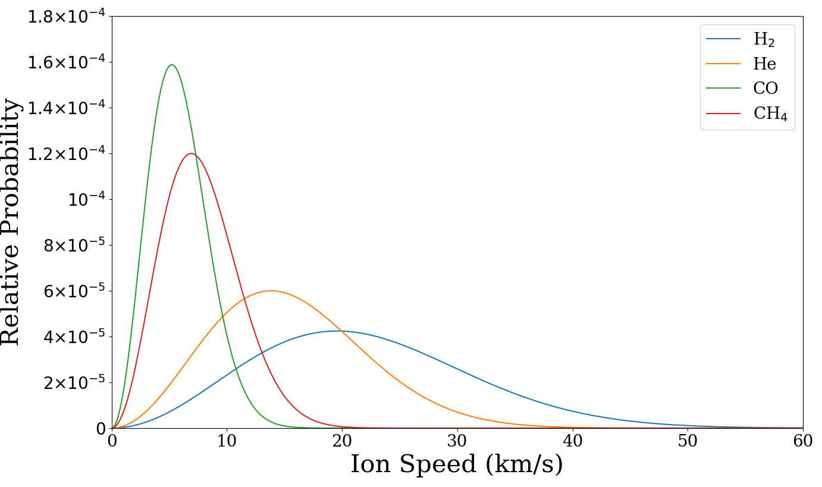
Ion and Scattered Electron Energies
The distribution of speeds of an ideal gas with temperature $T$ is given by the Maxwell-Boltzmann distribution (38 meV at 293 K):
$$F\left(v\right)dv=\sqrt{\frac{2}{π}}\frac{v^{2}e^{−\frac{v^{2}}{2a^{2}}}}{a^{3}}$$
$$a=\sqrt{\frac{kT}{m}}$$
$$v_{prob}=a\sqrt{2}$$
The parameters of the scattered electron can be calculated from conservation of momentum and energy.
Maxwell-Boltzmann Distribution
($E_{prob}=4 eV)$

Slide 33
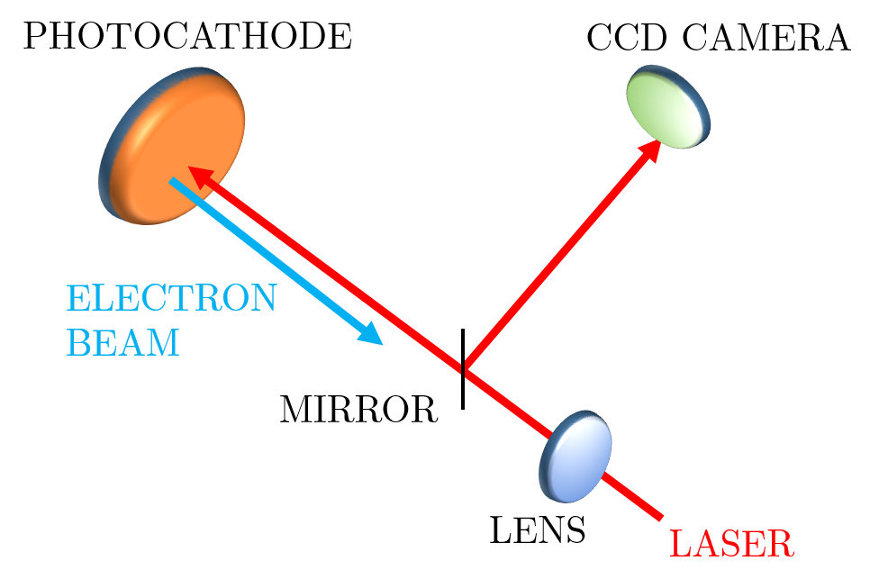
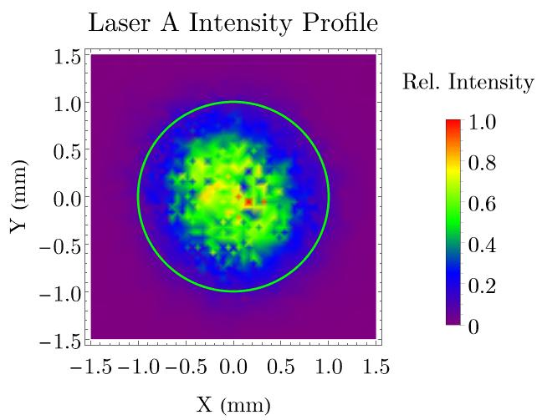
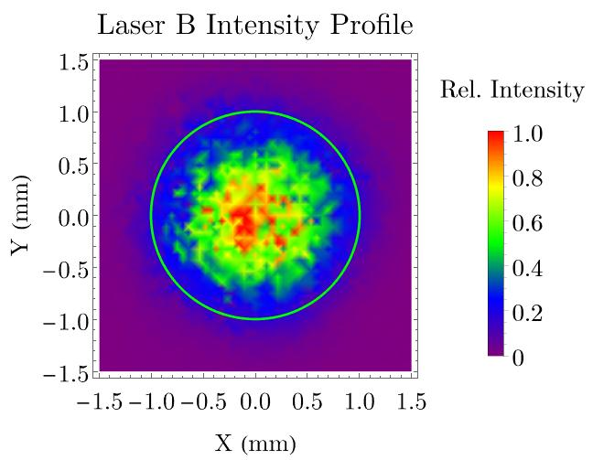
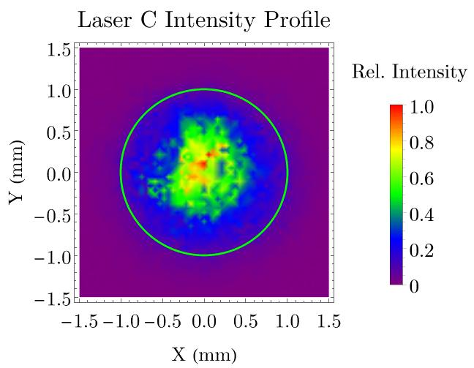
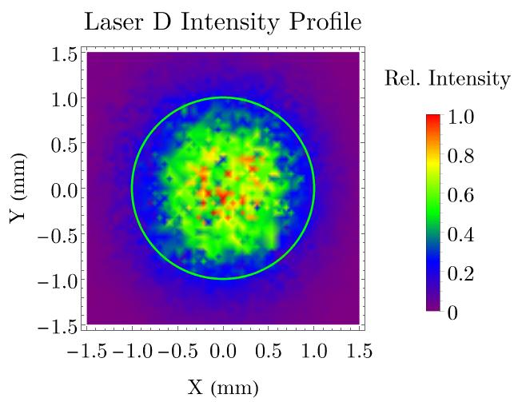
Laser Profile Measurements
Four 780 nm lasers (A, B, C, D) illuminate the photocathode.
Transverse intensity profiles were measured using a CCD camera and analyzed using BeamGage software⁵.
Laser diameter is $±2σ$ ($=4σ$).
Laser Diameters (4$σ)$
Laser | A | B | C | D
$x$-diameter (mm) | 2.14 | 2.23 | 2.05 | 2.84
$y$-diameter (mm) | 1.97 | 2.15 | 2.02 | 2.38
(Assume 2% uncertainty)

Slide 34
Effect of Anode Bias on Electron Beam
Beam deflection: Compare transverse beam positions using BPM’s.
Beam size: Compare transverse beam size using viewers.
Time of flight: Compare time of flight using RF chopper cavities.

Slide 35
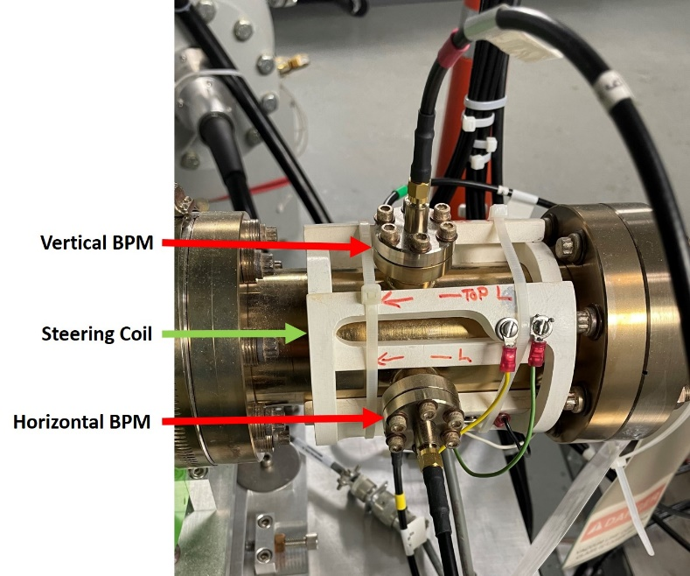
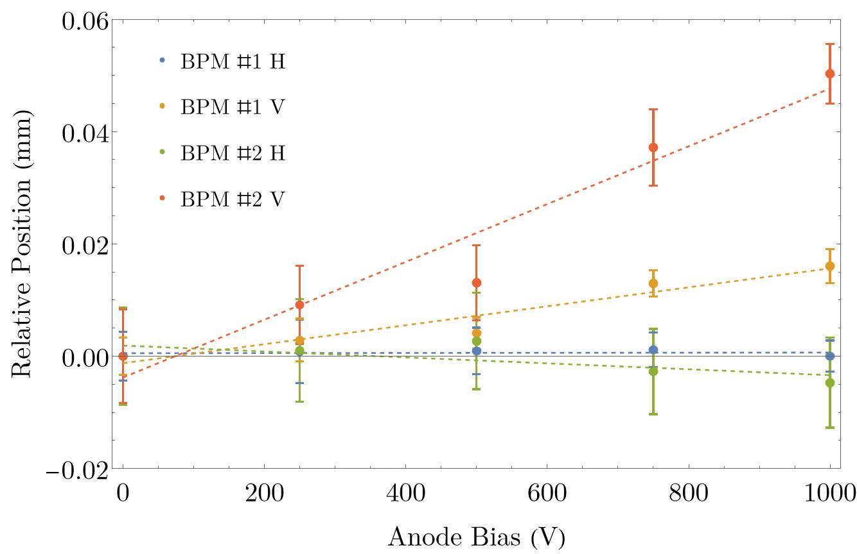
Beam Deflection vs Anode Bias
Used first two BPM’s to measure transverse beam position vs anode bias.
Predicted a $0.10±0.07$ mm total displacement at BPM #2 with 1000 V anode bias.
Measured $0.05±0.02$ mm total displacement at BPM #2 with 1000 V anode bias.
Can easily correct for displacement with steering coils.
Relative Beam Deflection vs. Anode Bias

Slide 36
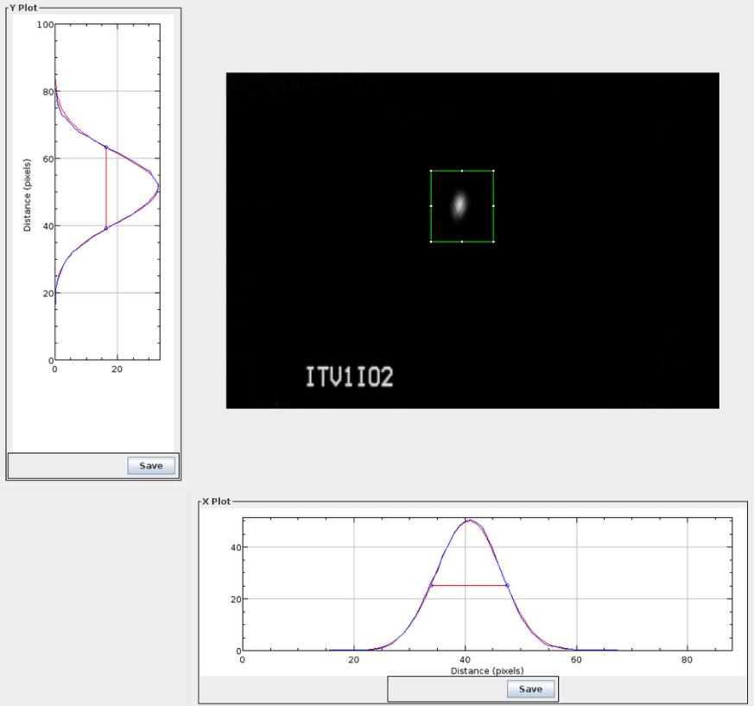
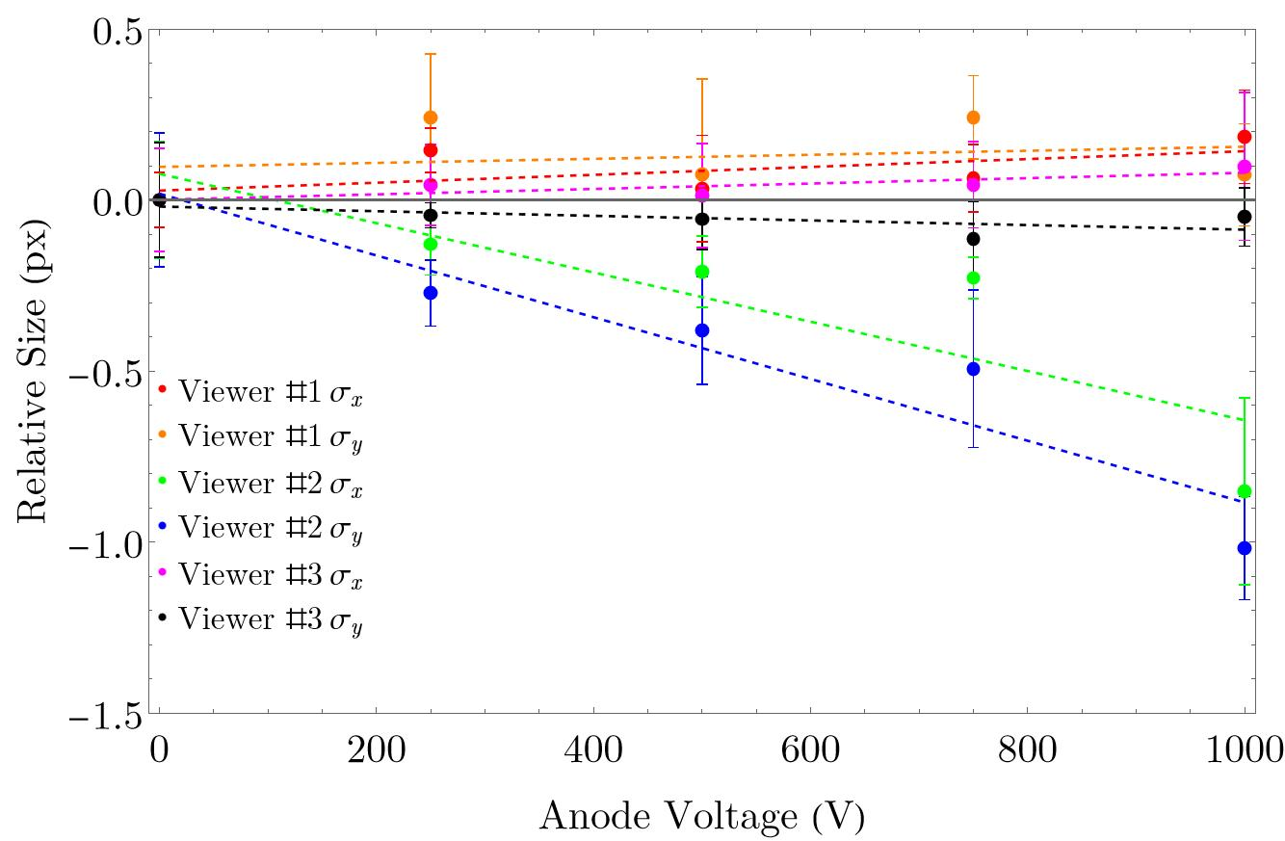
Beam Size vs Anode Bias
Used three viewers to measure transverse beam size vs anode bias.
Expect small change in beam size due to anode behaving as an electrostatic lens.
Resolution of CCD camera is $\sim 4.4$μm/px
Beam size decreased by $1.33±0.46$ px ($5.8$ μm) on viewer #2 with 1000 V anode bias.
Relative Beam Size vs. Anode Bias

Slide 37
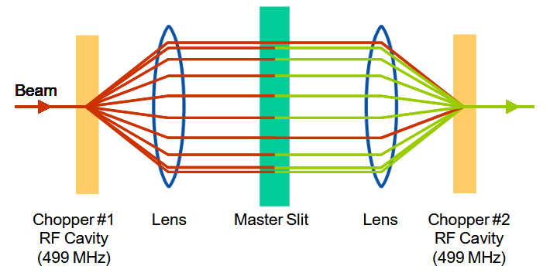
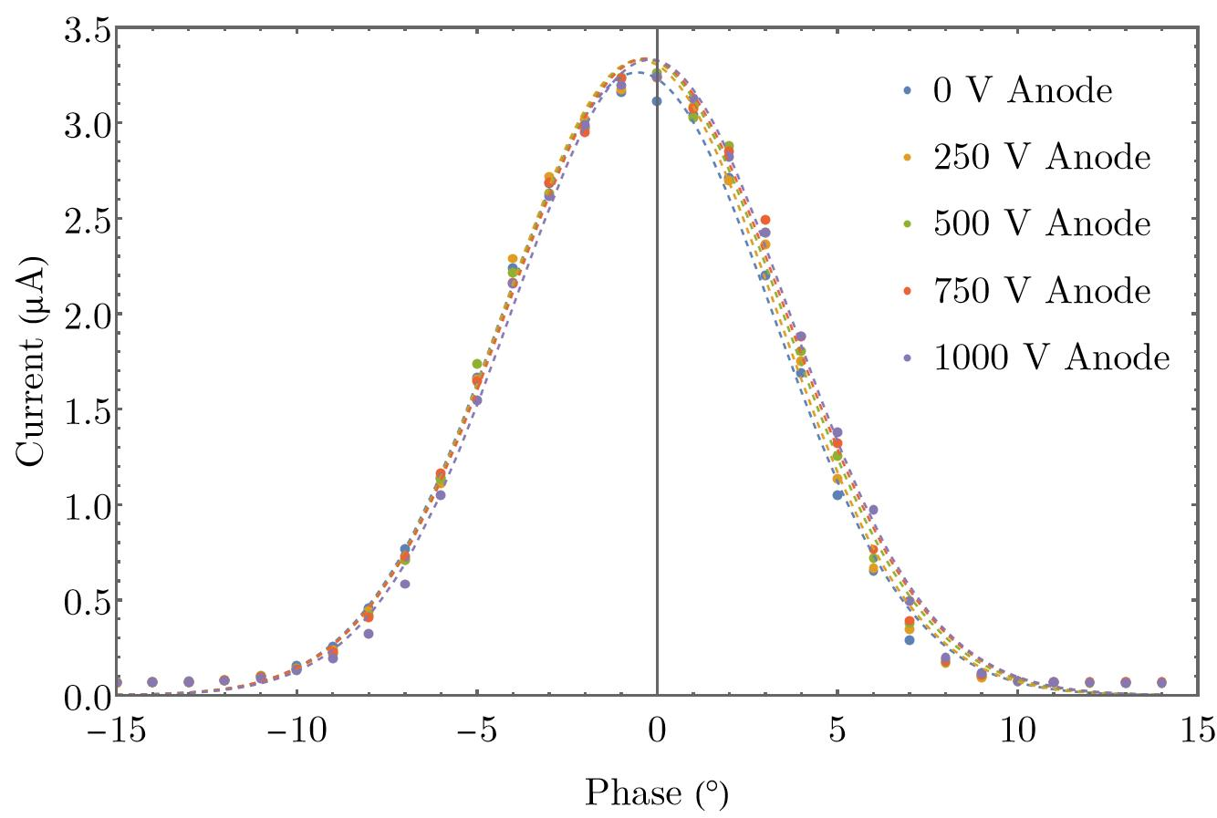
Time of Flight vs Anode Bias
B
C
A
Took chopper scans across one slit to measure time of flight vs anode bias.
Slit width: ${3.3}^{∘}$ at $499$ MHz.
Fit each set of chopper scan data with Gaussian function to determine phase of peak current.
Anode bias increases beam energy → shorter time of flight → positive phase shift.
Peak phase difference between 0 V and 1000 V is ${0.35}^{∘}±{0.06}^{∘}$ (499 MHz).
RF Chopper Scans vs. Anode Bias

