Slide 1
High voltage DC gun using DBR superlattice GaAs photocathode for EIC polarized electron source
Erdong Wang on behalf of electron source team
Electron Ion Collider, BNL
SPIN 2023
Sep. 25th 2023

Slide 2

EIC needs high intensity high polarized electron source
E_{cm} = 20 GeV -141 GeV
High luminosity goal: L = 10³⁴cm⁻²s⁻¹
Electron Ion Collider (EIC)
Hadron storage Ring is existing, and electron storage ring and injector are new.
We need polarized electron bunches with spin up & spin down, stored simultaneously
Sokolov-Ternov self-polarization too slow, produces only polarization anti-parallel to the main dipole field.
Polarized electron bunches are produced and accelerated in the injector chain and injected at collision energy in the electron storage ring
Sokolov-Ternov works against spin-down polarization, spin diffusion reduces average polarization. All bunches be exchanged frequently (every 6 minutes on average) to achieve 70% average polarization .

Slide 3
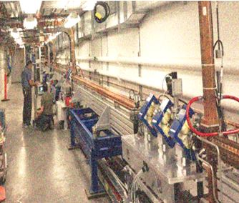
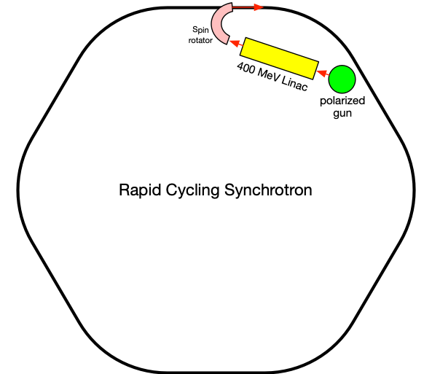
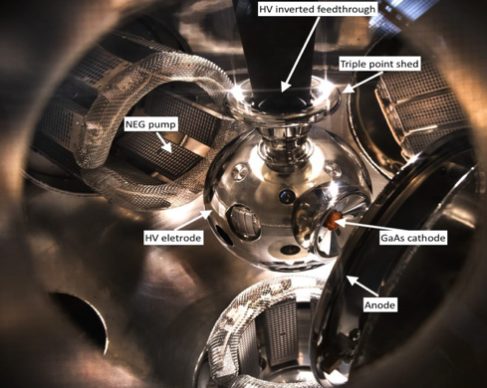
EIC Electron Pre-Injector
EIC injector: 400 MeV Linac + Rapid Cycling Synchrotron (RCS).
  300 kV polarized HVDC gun generates 7nC x 4 polarized electron beam every second and booster energy up to 400 MeV
  Four bunch merge in the RCS and inject a 28 nC bunch into EIC
  Rotate the electron spin direction at end of Linac from longitudinal to vertical

Slide 4
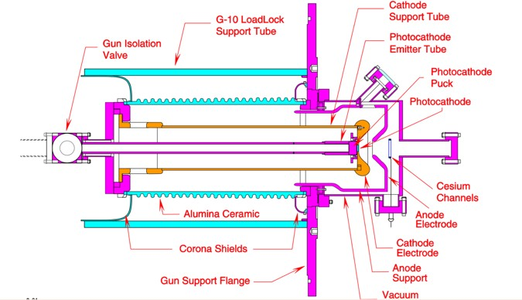
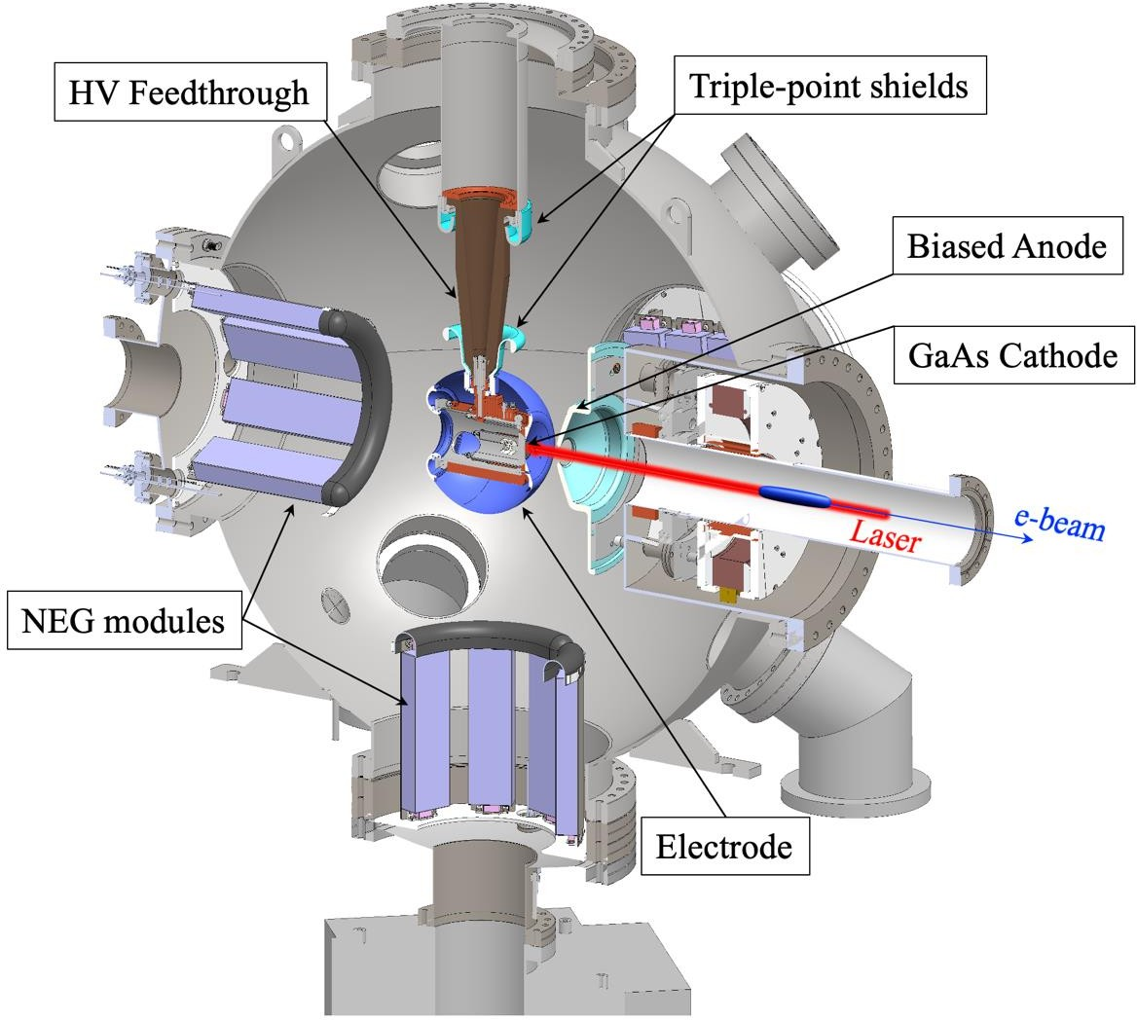
Overview of polarized guns in the world
SLC PES 120 kV gun
Laboratory | Voltage | Bunch charge | I_pk | I_avg
JLab | 100, 200kV | 2 or 2.7pC | 67~53m A | Up to 4mA
SLC | 120kV | 8-16 nC | 3 A | 2uA
MAMI | 100kV | 0.02 pC |  | 50uA
Bonn- ELSA | 50kV | 100 nC | 100mA | 5uA
MIT- BATES | 60kV | 250 nC | 10mA | 20 or 120uA
Nagoya | 200kV | 1.25 nC | 2A | NA
NIKHEF | 100kV | 2us | NA | 0.04uA
EIC | 300kV | 7-16 nC | 4.8 A | 20 uA, up to 67 uA
BNL EIC inverted 300 KV gun
In operation Retired
EIC gun

Slide 5
Polarized gun design considerations
Bunch
Charge
Depends on application. For example –
  EIC – high bunch charge (7 nC)
  LHeC – 0.5 nC high bunch charge, 20 mA high average current
  CEBAF – low bunch charge, 100’s uA high average current
Good/long lifetime is always wanted !
  Good vacuum
  Field emission free
  Cool the cathode if laser power is high
Long
Lifetime
Low
Emittance
Average
Current

Slide 6
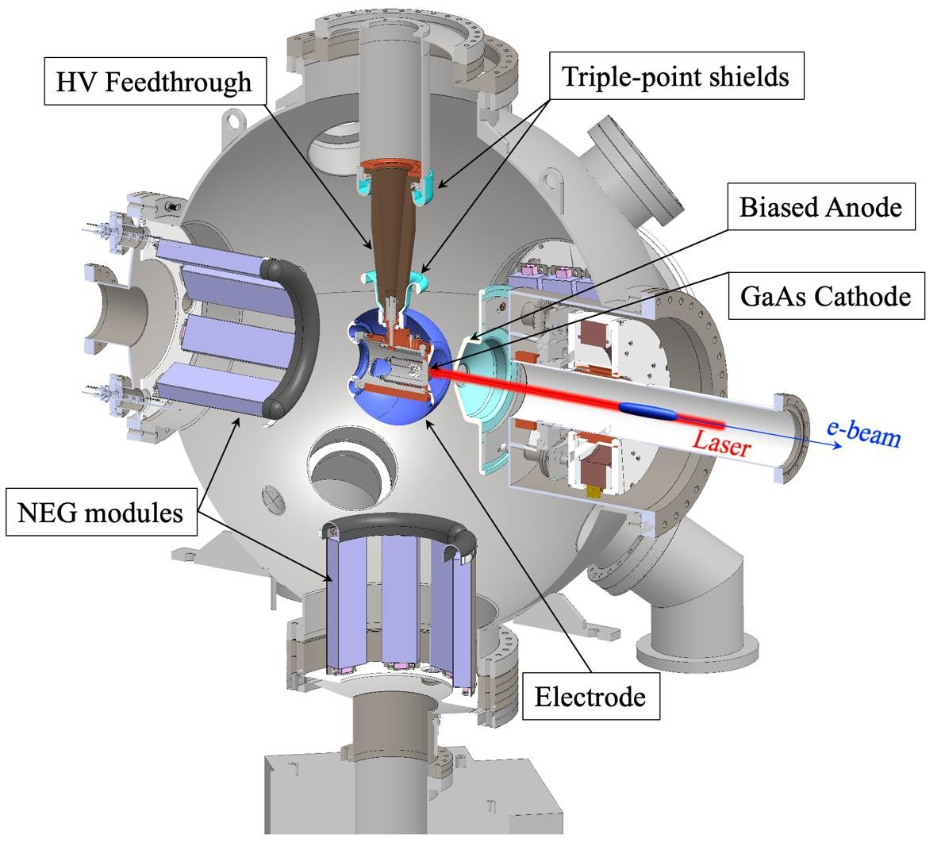
EIC polarized gun overview
EIC polarized gun needs:
High charge
Long lifetime
High polarization
High peak current
Maintenance free
No existing gun can meet all EIC needs.
EIC gun includes new features:
Active cathode cooling
Large cathode
High gradient
Semiconductor jacket HV cable
3D moveable electrically insulated anode.
Notes:
Let me give you an overview of EIC polarized gun overview.
EIC needs a source that can provide high charge, high polarization, high peak current electron beam with a cathode long lifetime. Electron source has to be maintenance-free. no existing gun can meet all the EIC needs.
In the last four years, we developed the EIC polarized HVDC gun at BNL. I proposed the idea, then involves in the design, construction, and commission of this system.
The gun 3D model is like here. Here is the cathode, anode, and HV feedthrough to deliver up to 400 kV to the gun. We have pumps to maintain a good vacuum.

Slide 7
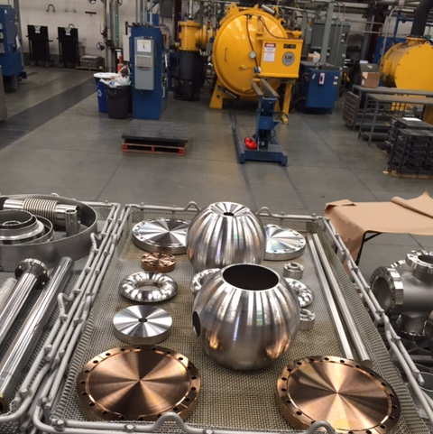
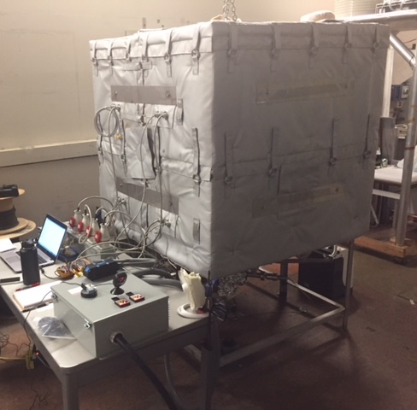
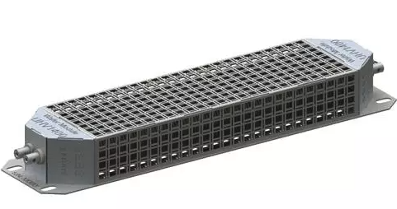
Achieve extremely good Vacuum
Lowering the out-gassing speed, and increasing the pumping speed can get a good vacuum.
  Choose thin wall
  10 hours high-temperature fire Lowering the out-gassing
  A week bake
  Many non-evaporate getter increasing the pumping speed
30000 L/s
Non-evaporate getter (gas absorber)
Notes:
Let me tell you how to get an extremely good vacuum. Of course, you will need a pump to pump the molecules out from a chamber, but that cannot give you a good vacuum.
Because the vacuum chamber will keep releasing gas. Why? We use Stainless steel as our vacuum chamber. Actually, any metal, more or less, will have trapped gas. For example, SS trapped many gas atoms., like Hydrogen atoms. When they diffuse to the surface of the surface, two H atoms will combine and release as H2 molecules. That is a simple picture of how out-gassing happens.
Two strategies to achieve an extremely good vacuum. 1. lower the outgassing speed and 2. increase the pumping speed.
We reducing the chamber thickness which will help to reduce the trapped atoms and reduce the diffusion time. Baking the chamber is a way to enhance the diffusing.
Our system had a 10 hours 900 C fire, then a week 400 C bake to remove the trapped gases atom, then add many gas absorbers in the chamber.
electro slag remelt (ESR) processes

Slide 8
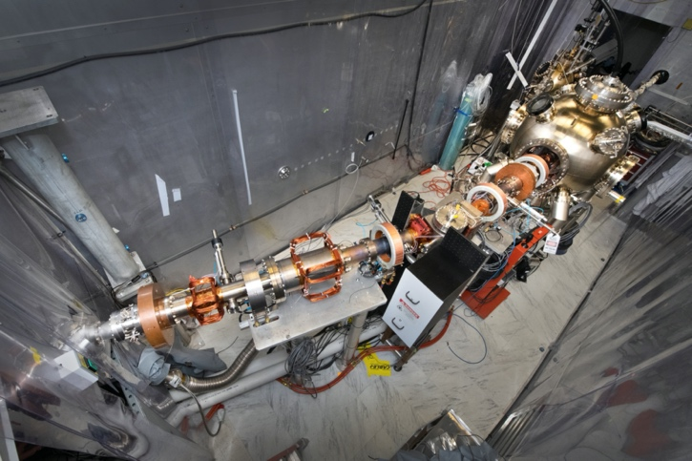
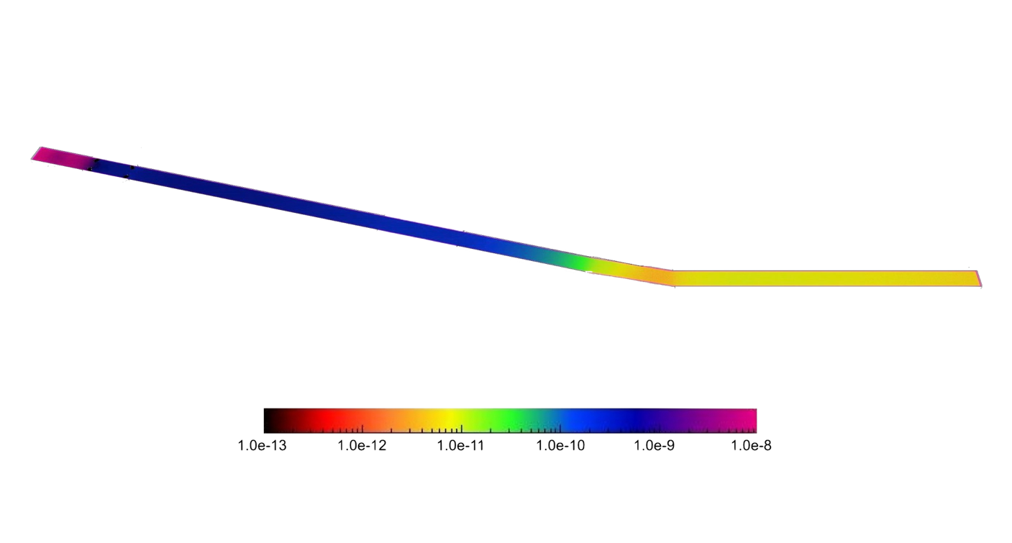
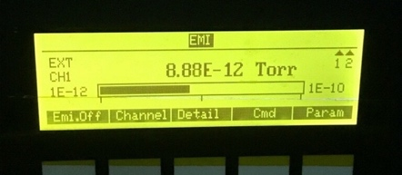
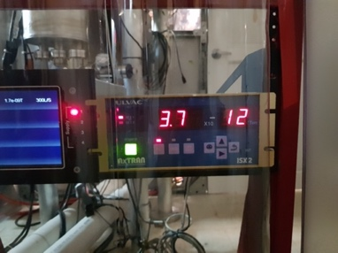
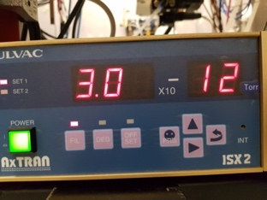
Beam-Line Vacuum in Experiment
Gun Vacuum
3BG gauge
3BG gauge | Gun
Baseline | 5-8 e-12
3uA | Low (c.c)
67.5 uA | 2e-11,Low (c.c)
Beam dump
ULVAC gauge | Beam dump
Baseline | 3-4 e-12
3 uA | 3e-10
67.5 uA | 1e-9
ULVAC gauge | Beam Line
Baseline | 3-4 e-12
3 uA | 5e-12
67.5 uA | 1.5-3 e-11
Beamline
We added gap in between the anode and the gun chamber to get extra conductivity

Slide 9
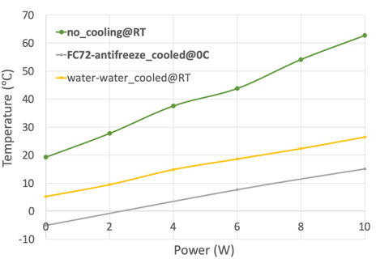
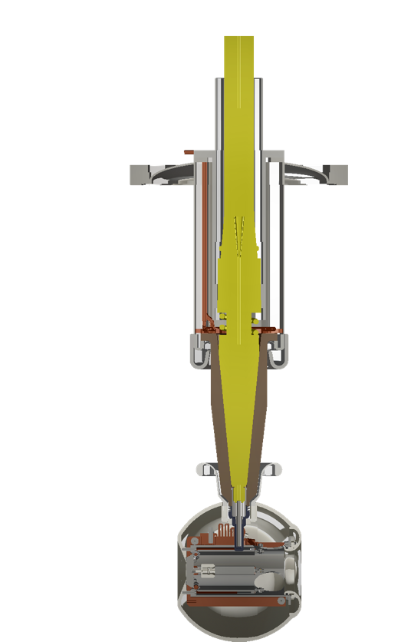
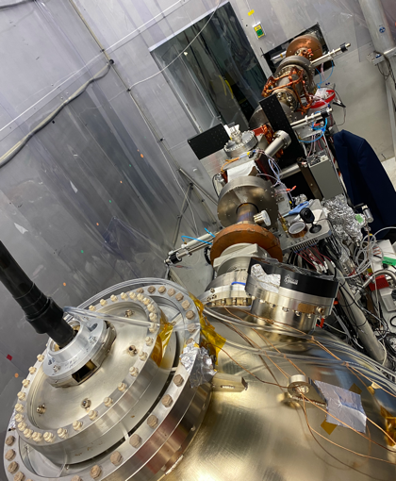
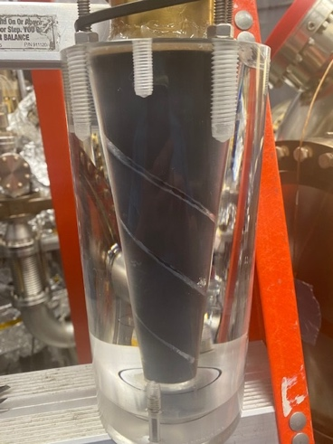
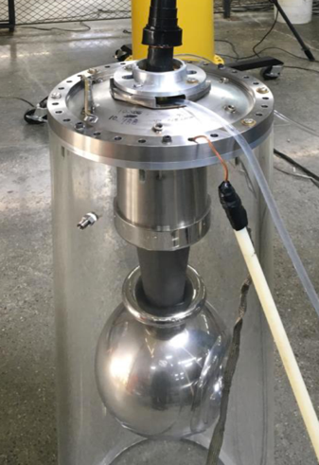
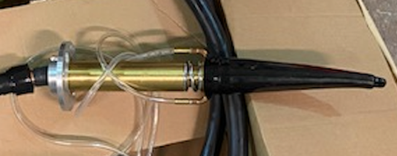
Active Cooling Cathode using HV feedthrough
We developed the active cooling HV feedthrough which can absorb the laser power up to 10 W.
Tested up to 410 kV with flow
HV cable
FC72 inlet
Spiral grooves
Cathode puck
Heat exchanger
Tested in the gun with FC 72. Operate @300-350 kV for more than 500 hrs . No failure.
Maintain every 6 months.
Customer designed HV plug with cooling channel
Copper
heat sink
It was designed for high current operation. Not necessary for EIC polarized source. Beneficial towards any high current polarized/unpolarized gun.

Slide 10
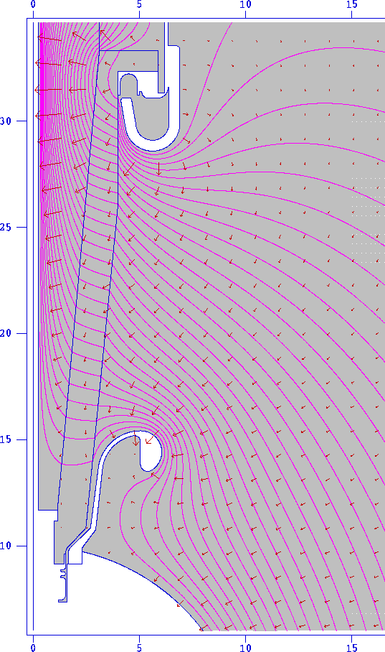
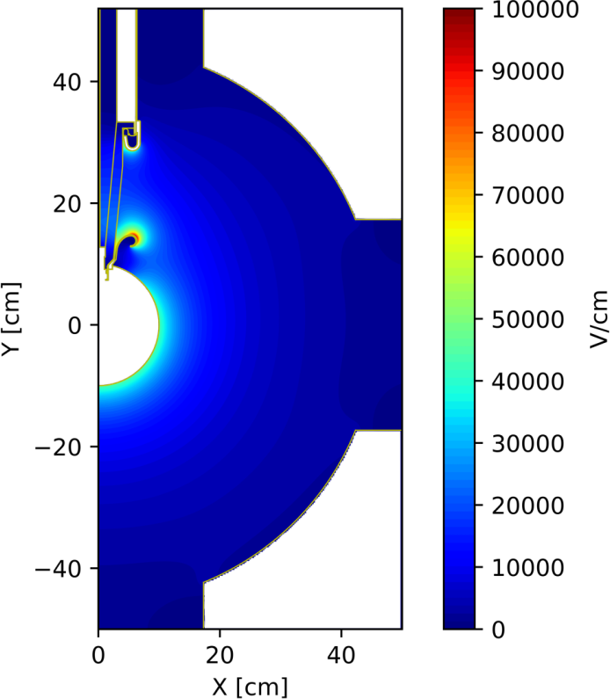
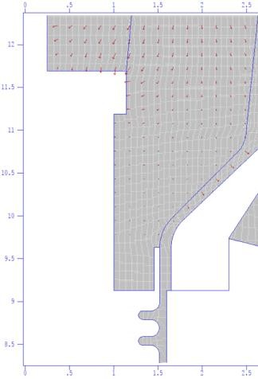
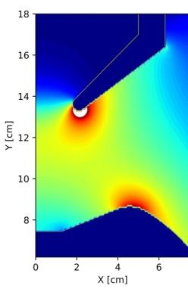
Gun HV design
(b)
Maximum gradient is 9.8 MV/m at 350 kV.
Triple-point shields (TPS) are applied both on HV and ground side to prevent HV breakdown
Tweak TPS geometry to minimize wanted beam deflection
2.32 MV/m
^{9.86 MV/m}0.045 MV/m

Slide 11
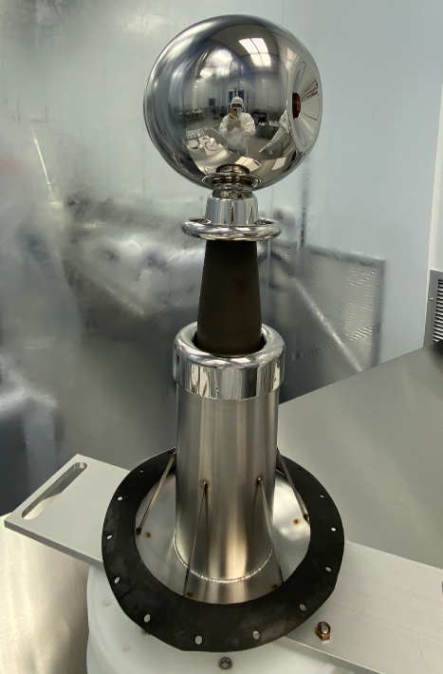
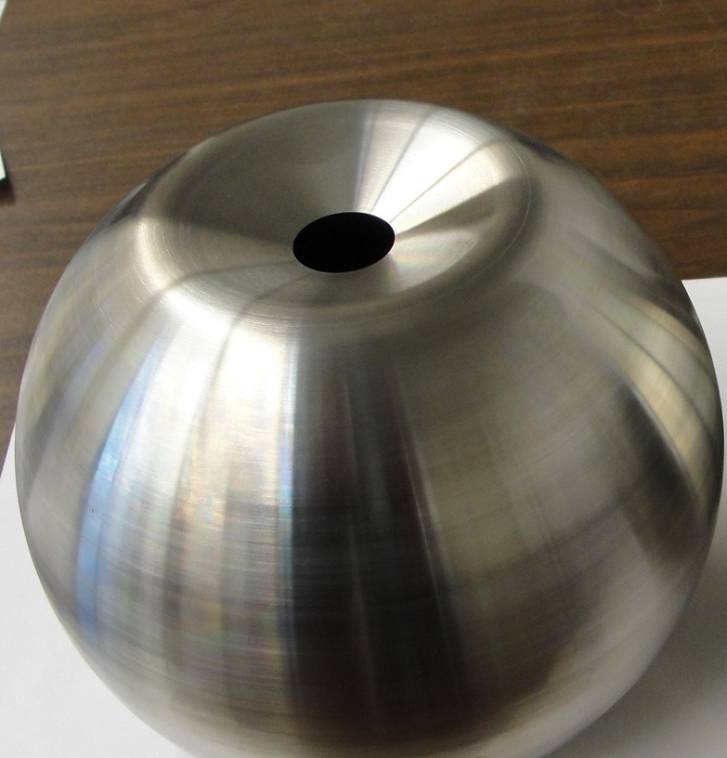
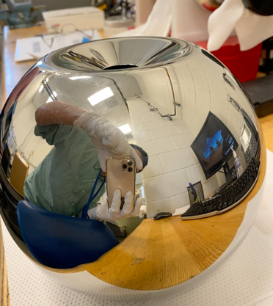
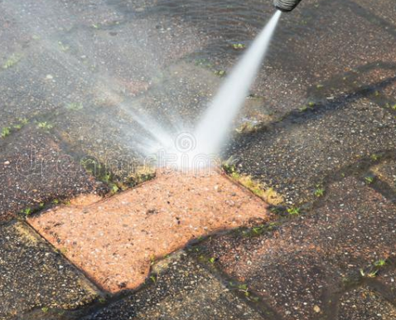
HV Electrode Polish and Clean
crushed corncob
High pressure rinsing
Original electrode
Mirror Polish
Particulate free
Rough surfaces or particulates will easily generate unwanted electrons in the high voltage (field emission)
Mirror surface polishing and particles free cleaning are the key of gun fabrication towards high voltage and high gradient.
Notes:
Now we have a fantastic vacuum as our baseline. But when bringing the gun to high voltage, that may degrade the vacuum as well.
How does it happen? When a metal is in a very high gradient field, electrons can be emitted, we call it field emission. It will be enhanced if the metal has a sharp shape such as particulates on the surface or rough surface. The field emission will generate unwanted electrons, because these electrons will have no way to control and useless. Finally these electrons will stop on the beam pipe and generate outgassing from the vacuum chamber.
We did mirror polish using crushed corncob for 2 hours. You see here we got mirror-like surface. That is not enough. The surface has many particles still. Then we use high-pressure rinsing, similar as what you did high-pressure rinsing for your backyard trail or your house exterior. But we use ultra clean water and very high pressure.
After these processes, finally give us particles-free, mirror-smooth HV electrodes. These steps are the key of gun fabrication towards high voltage and high gradient.

Slide 12
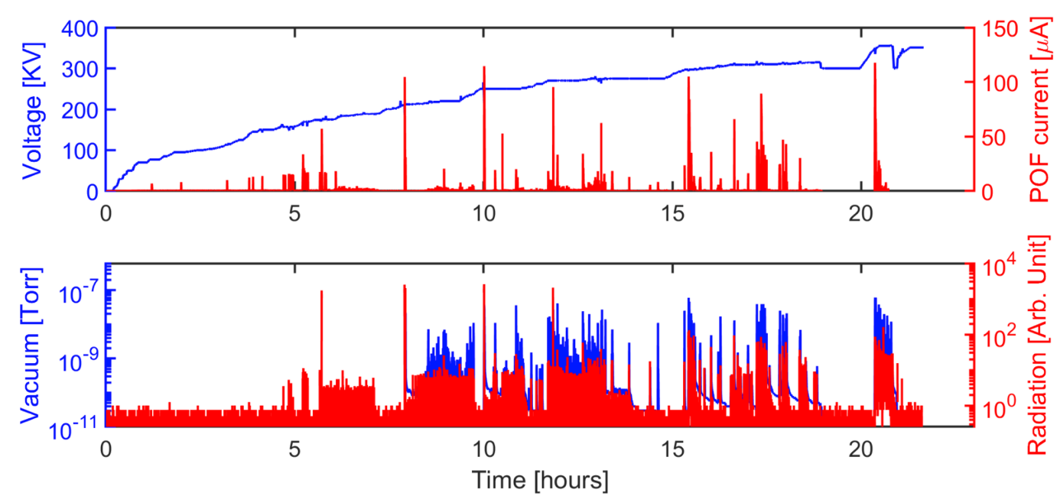
HV Conditioning
352kV
No field emission
Radiation noise level
Vacuum into 10e-12 torr
Gun conditioned in Dec 2020 (vacuum conditioning, total takes 23 hrs, Cooling is on):
  Achieved gun design value 352 kV without field emission (without activated GaAs)
  Achieved gun design value 325 kV without field emission (with activated GaAs)
In 2023, we improved the puck clean procedure. The new puck with new SL-GaAs(ODU) sample can achieve 350 kV without any conditioning. We don’t need extra conditioning to use new samples/puck.

Slide 13
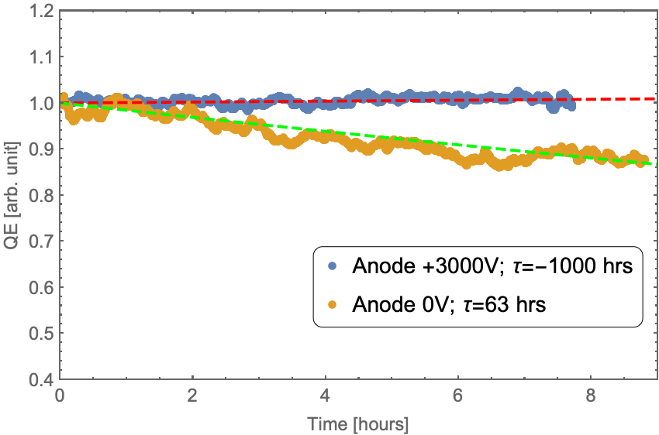
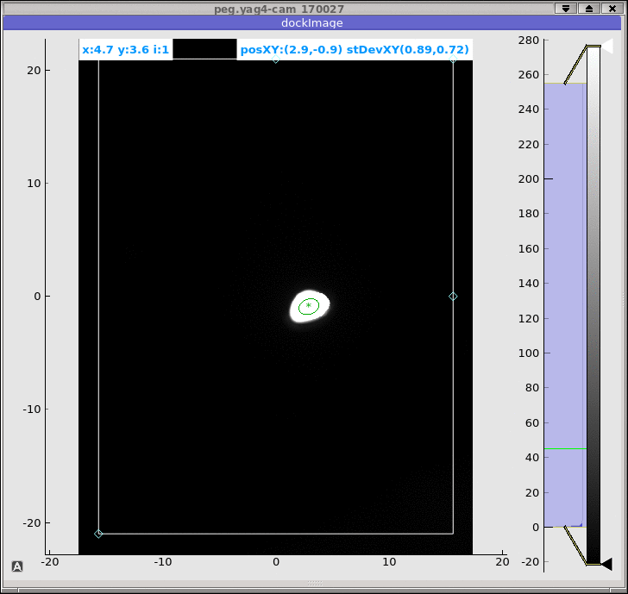
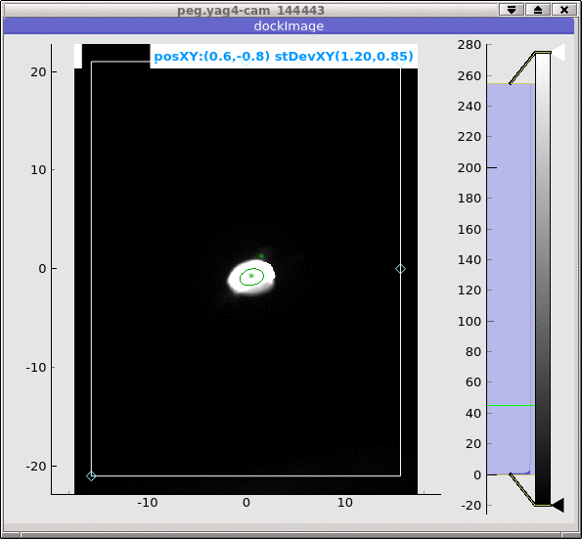
Bunch Charge and Cathode Lifetime
SLC starts from 12 nC
Nominal size
Smaller size
Beam image before the dump
Bulk GaAs with 785 nm polarized laser; Gun operates at 300 kV. Run up to 67.5 uA.
7.5 nC bunch charge polarized beam, 5000 pulses/s ~37.5 uA;
  With anode bias, we didn’t observe QE drop.
  Without anode bias 1/e lifetime is 63 hrs. Dominated by the outgassing from FC.
1 nC
8 nC
E. Wang et.al PHYSICAL REVIEW ACCELERATORS AND BEAMS 25, 033401 (2022)

Slide 14
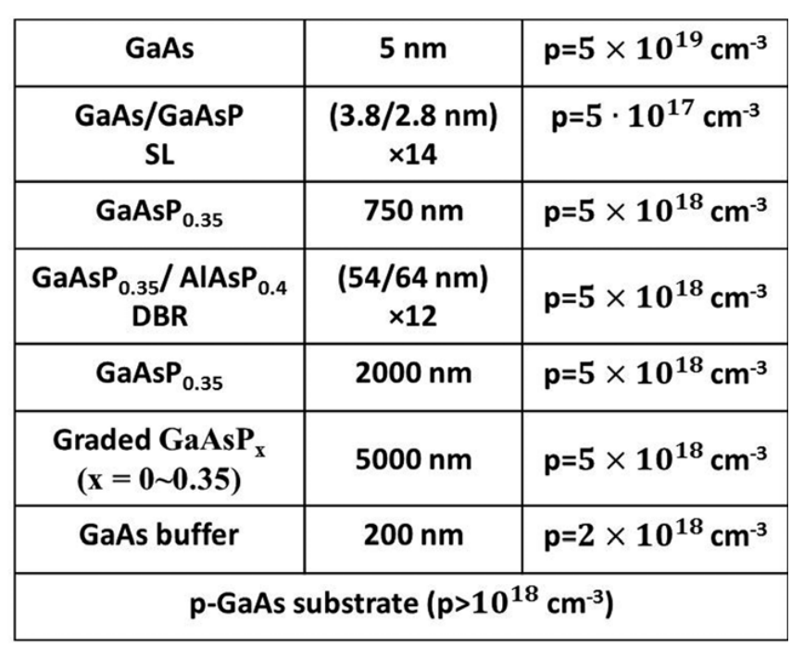
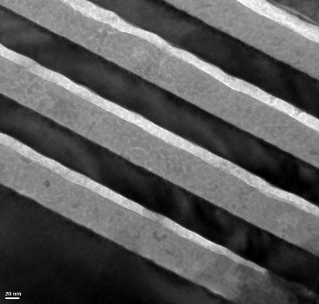

High Polarization Photocathode
Distributed Bragg reflector (DBR) layer was added to the GaAs photocathode, resulting in a Fabry-Perot resonance in between the surface-vacuum interface and DBR layer that significantly enhances the QE. We are the first successfully used DBR cathode in the HVDC gun.
ODU/Jlab/BNL: GaAs/GaAsP SL with AlAsP/GaAsP DBR
Cathode performance: QE=2.35%, ESP=92%
14 SL Pair
$$96 nm$$
12 DBR Pair

Slide 15
Observed Surface Charge Limit(SCL)
Surface Charge Limit(SCL) was the main issue towards high bunch charge polarized beam.
At Feb 2023, we extracted 6 nC maximum bunch charge, limited by SCL :
trapped electrons
Cathode
Vacuum
Surface Charge Limit
Surface charge limit can be suppressing by:
Increasing surface doping
Laser size
Gun voltage
15

Slide 16
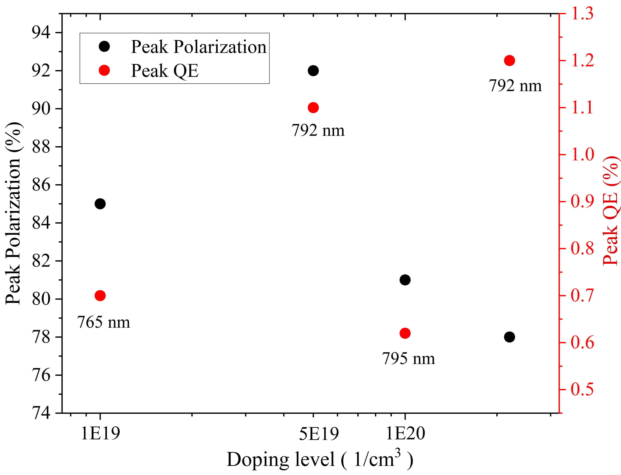
Suppression of Surface Charge Limit
Various surface doping levels of the cathodes.
Secondary Ion Mass Spectrometry (SIMS) was used to test doping level changes at different temperatures. We found that 450°C is the optimal temperature.
Used a new sample with minimal surface defects and a surface doping level of 5e19 atom/c.c was obtained from ODU. The resonance QE of 1.2% and spin peak of 92% were measured at 790 nm at BNL.
The cathode puck underwent a high-pressure rinsing clean.

Slide 17
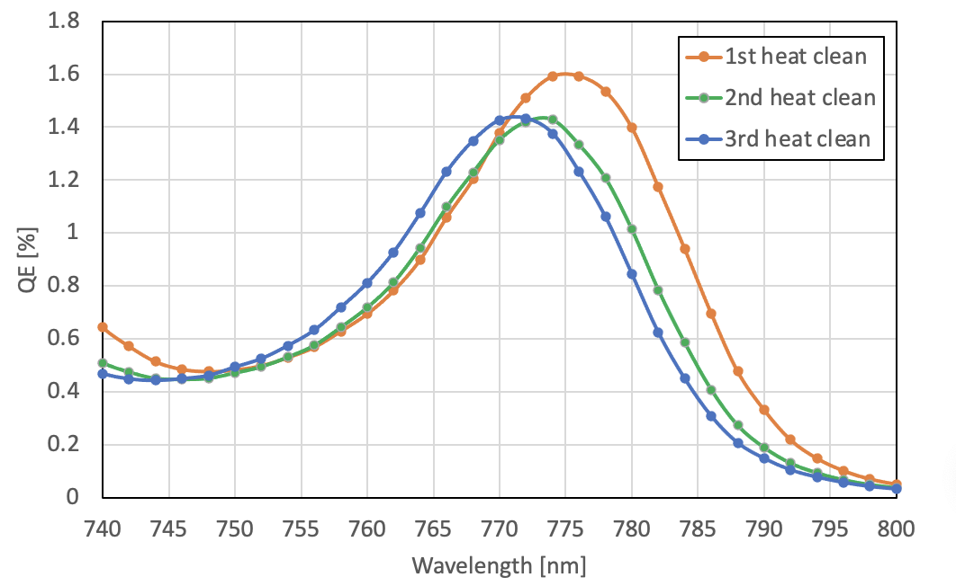
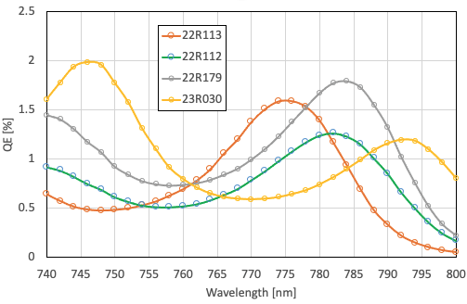
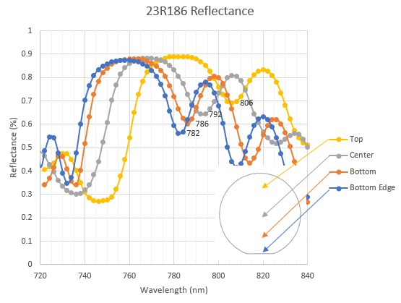
DBR samples resonance frequency variation
Third figure is provided by A. Master
Vary the DBR resonance frequency(~20 nm):
  Iterations of heat clean and QE (same sample, same location, same temperature)
  Different samples
  Same sample on different location

Slide 18
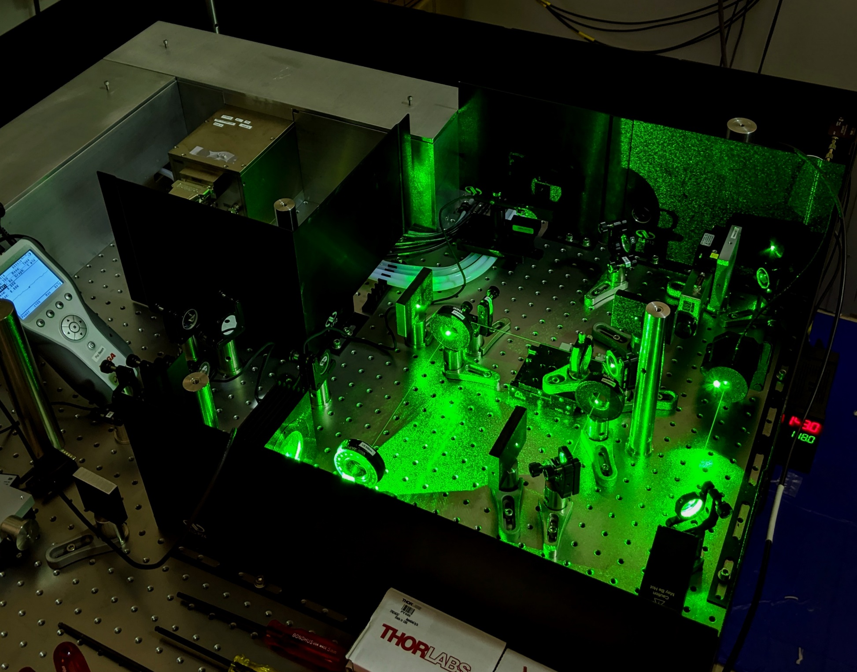
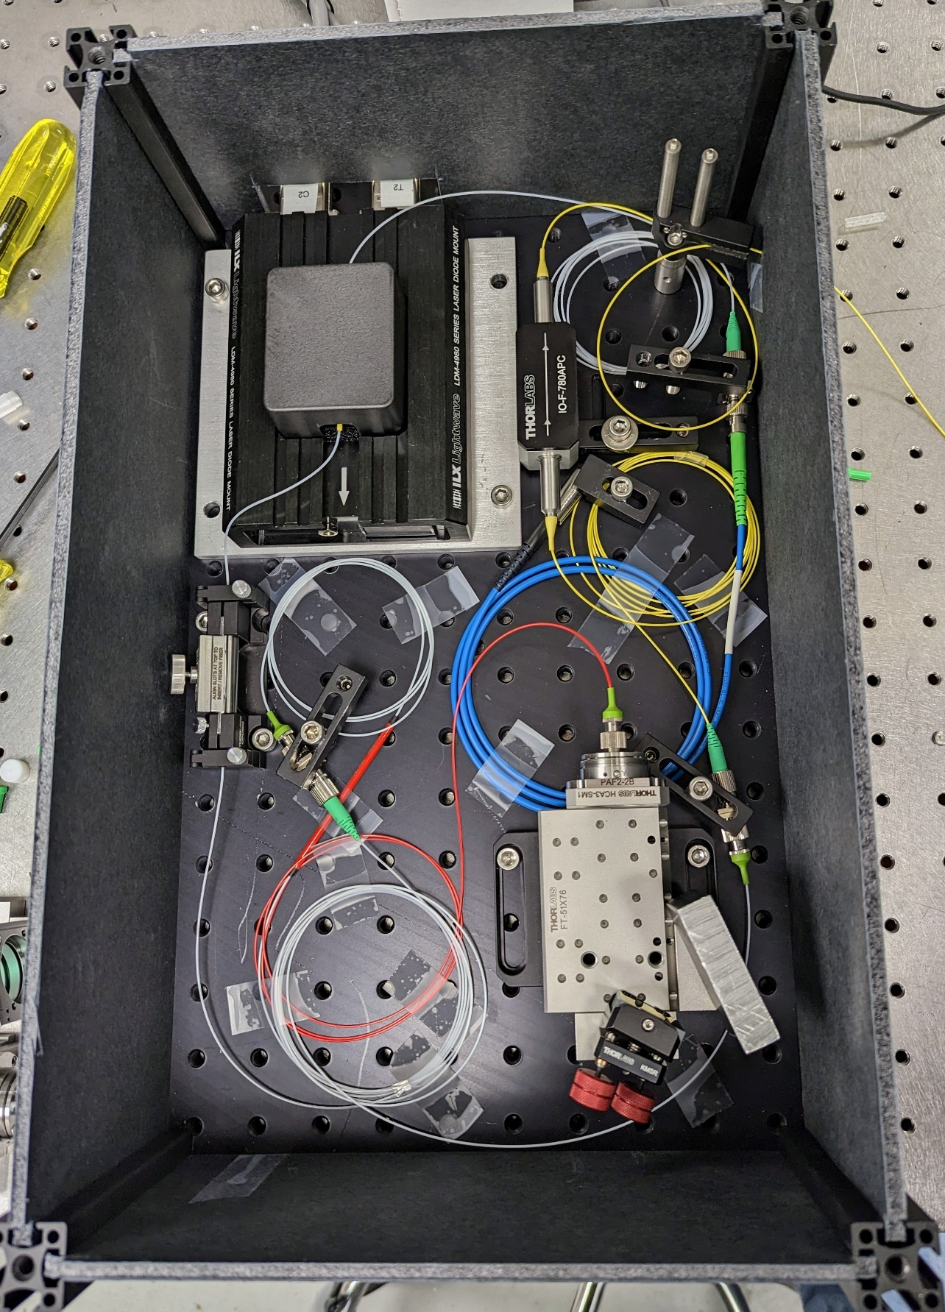
Tunable, Solid State, Nd:YAG OPA Laser
Overview
Amplifier
Seed
OPA Pump Laser
Intensity Fdbk
Oscillator Output
SHG
Pulse Picking
Seed Laser
2ns Flat-Top Pulses
Collimation Lens
OPA
OPA Pump Laser
Pulse Picking
Pol. Beamsplitter
SHG
Output
10kHz, 300µJ,
tunable output
Intensity Control
Isolator
½ WP
¼ WP
760-790nm tunable
CW/Pulsed OPA Seed
Cavity Mirror
Gain Module
Pockels Cell
Rep. Rate: 10 kHz
Pulse Energy: 340 µJ
Tunability: 760nm – 790 nm
Spectral Bandwidth: ~50 pm
Nd:YAG Regenerative Amplifier
10kHz, 1.7mJ output
Tunable seed Laser

Slide 19
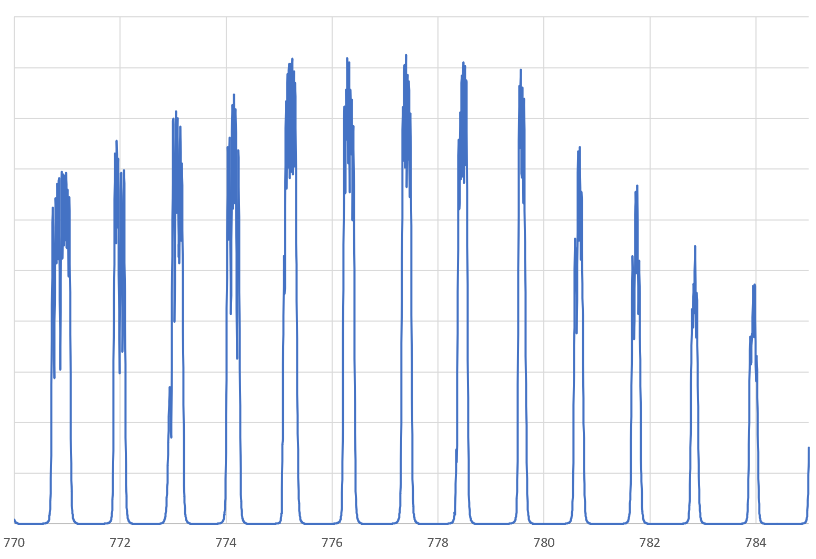
DBR-SL GaAs Performance in the Gun
Intensity [a.u.]
Surface charge limit: 10 nC
Wavelength [nm]
We developed circular polarized laser with tunable wavelength for DBR-SL-GaAs cathode.
We tested DBR-SL-GaAs in the gun at 310 kV, generated 11 nC bunch charge(1.6 ns length, and 8 mm laser spot).
Charge from 9 hours , 20 uA operation, Decay 10 %.
E. Wang IPAC 23 TUPA131

Slide 20
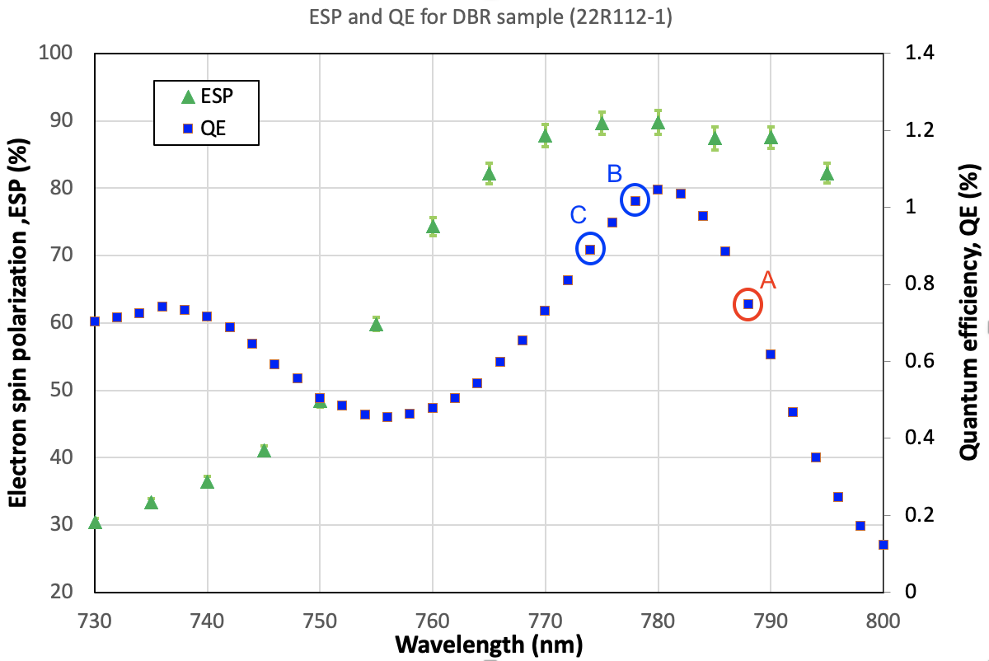
Lifetime observation from DBR SL cathode
For working point A. The QE drops 75% in < 2 hours with 1 uA average current.
For working point B. The QE drops ~ 3% in 4 hours with 20 uA average current.
For working point C. The QE is no decay in 2 hours with 20 uA average current.
The lifetime is wavelength dependence.

Slide 21
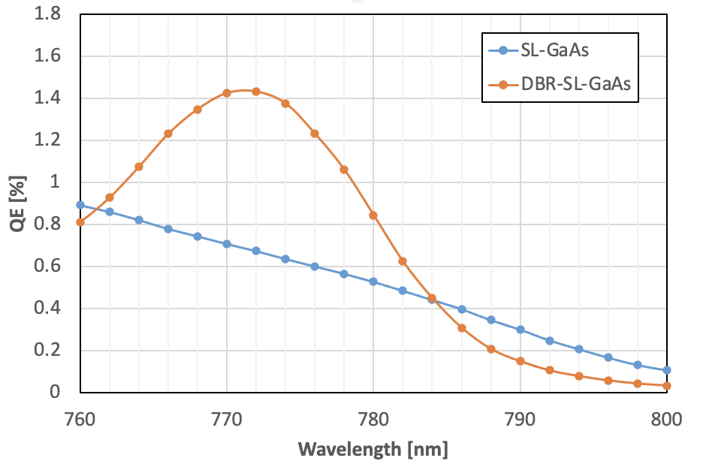


Wavelength dependence lifetime
DBR sample has much large slope than SL-GaAs at right edge, causing the short lifetime.
Long time operation is increasing effective work function due to losing activation material or chemical poisoning.
It is approximately equal to shift the spectrum to the left, but laser photon energy is fixed.
The large slope has fast QE drop.
$$QE∝{(hv−φ_{eff})}^{2}$$

Slide 22
DBR cathode working zone
Working zone=
Resonance wavelength - ESP drop threshold
Working
zone
Fast QE
decay zone
Low polarization zone
The working zone is from the left edge of the DBR resonance peak, while with good polarization
A good DBR cathode:
High polarization
High QE
Large working zone

Slide 23
Summary
  A prototype High Voltage DC polarized electron gun was designed and constructed to fulfill all the requirements for the EIC polarized electron source e-beam.
  This cutting-edge gun incorporates several innovative concepts, notably a cathode cooling system that holds potential in future high current electron sources, large cathode and new HV cable.
  The gun has been successfully conditioned up to 350 KV without any field emission and has maintained consistently operated at 310 KV.
  Exceeding 11 nC,with spin polarization > 90% , electron beam was generated from DBR SL-GaAs photocathode that had good lifetime. Beyond the EIC requirements.
    We found optimal doping level and heat treatment temperature to suppressing Surface charge limit
    We observed DBR resonance shift due to various samples, different locations and various activation
    Lifetime is strongly wavelength dependence. We proposed a working zone for DBR cathode operation.

Slide 24
Thanks!
Questions?
Acknowledgement:
BNL: O. Rahman, P. Inacker, J. Biswas, J. Skaritka, C. Degen, B. Lambiase, R. Napoli, M. Paniccia
Chong Qing University: W. Liu
Jlab: M. Poelker, C. Hernandez- Garcia, the late D. Bullard
Old Dominion University: S. Marsillac and A. Masters

Slide 25
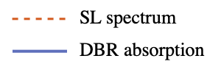
Peak frequency change also relevant to activation
DBR SL spectrum=
DBR layer absorption x SL spectrum
When the SL spectrum shift to the left due to increase work function, the DBR resonance peak will shift to left as well.
By using DBR-SL GaAs for long time, the QE will drop faster and faster if the initial working point on the peak?

