Slide 1
First test of a polarized ${}_{ }^{3}{{He}^{+}}$- ion source
25th september 2023 R.W.Engels/Jan Wirtz
25th International spin symposium
Polarized Ion and lepton sources and targets

Slide 2
First test of a polarized ${}_{ }^{3}{{He}^{+}}$- ion source
25th september 2023 R.W.Engels/Jan Wirtz Nicolas Faatz
25th International spin symposium
Polarized Ion and lepton sources and targets

Slide 3
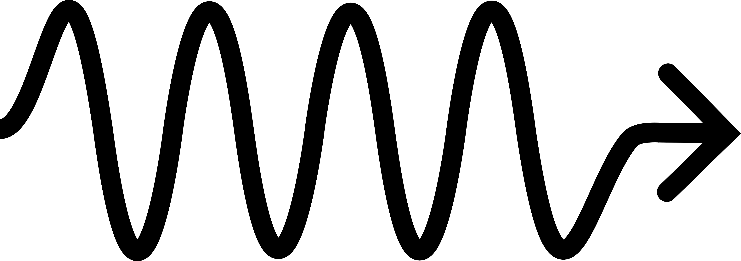
motivation
$$E_{n}$$
Polarized neutron-like source for accelerators
$$p$$
$$γ$$
Polarized nuclear fusion
$${}_{ }^{3}{{He}^{2+}}$$
$${}_{ }^{4}{{He}^{2+}}$$
$${}_{ }^{3}{{He}^{2+}}$$
$$γ$$
Medical applications
$$p$$

Slide 4
Polarization methods
Brute force
$$p$$
$$p$$
$$p$$
$$p$$
Stern-Gerlach
Optical pumping (OP)
$$p$$
$$p$$
$$p$$
Dynamic nuclear polarization (DNP)
$$p$$
$$p$$
New method

Slide 5
Polarization methods
$$ΔN\sim e^{−\frac{ΔE}{k_{B}T}}$$
$$ΔE$$
Brute force
Stern-Gerlach
Optical pumping (OP)
Dynamic nuclear polarization (DNP)
New method

Slide 6
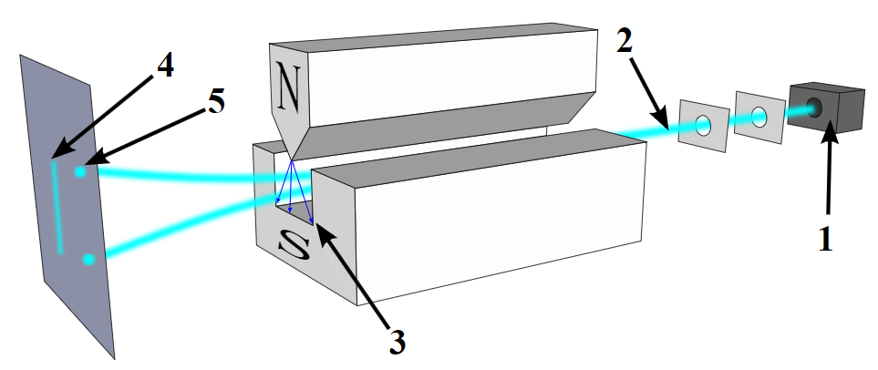
Polarization methods
Brute force
Stern-Gerlach
Optical pumping (OP)
Dynamic nuclear polarization (DNP)
https://en.wikipedia.org/wiki/Stern%E2%80%93Gerlach_experiment#/media/File:Stern-Gerlach_experiment_svg.svg
New method

Slide 7
optical pumping and dnp
Spin-exchange OP
Rb
$${5P}_{1/2}$$
$$≈1.5 eV$$
$$γ$$
$${5S}_{1/2}$$

Slide 8
optical pumping and dnp
SEOP
Metastability exchange OP
Rb
$${}_{ }^{3}{He}$$
$${5P}_{1/2}$$
$$2^{3}P^{ }$$
$$≈1.5 eV$$
$$≈1.14 eV$$
$$γ$$
$$γ$$
$${5S}_{1/2}$$
$${2^{3}S}_{ }$$

Slide 9
optical pumping and dnp
SEOP
MEOP
DNP
Rb
$${}_{ }^{3}{He}$$
$$T≈1−2 K$$
Radicals
$${5P}_{1/2}$$
$$2^{3}P^{ }$$
$$B≈3.4 T$$
$$α_{1S}$$
$$≈1.5 eV$$
$$≈1.14 eV$$
$$≈0.12 meV$$
$$γ$$
$$γ$$
$$γ$$
$$β_{1S}$$
$${5S}_{1/2}$$
$${2^{3}S}_{ }$$

Slide 10
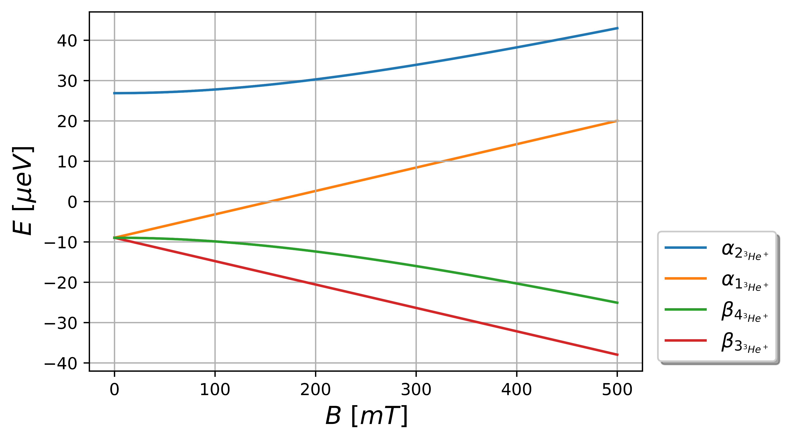
${}_{ }^{3}{{He}^{+}}$ Breit-Rabi diagram
$$\left.|↑,↓\right\rangle$$
$$H=A\frac{\overset{⃑}{J}⋅\overset{⃑}{I}}{ℏ^{2}}+\left(g_{j}μ_{B}\frac{\overset{⃑}{J}}{ℏ}−g_{I}μ_{k}\frac{\overset{⃑}{I}}{ℏ}\right)⋅\overset{⃑}{B}$$
$$\left.|↑,↑\right\rangle$$
$$\overset{⃑}{B}=B_{0}{\hat{e}}_{z}$$
$$\left.−|↓,↑\right\rangle$$
$$\left.|↓,↓\right\rangle$$

Slide 11
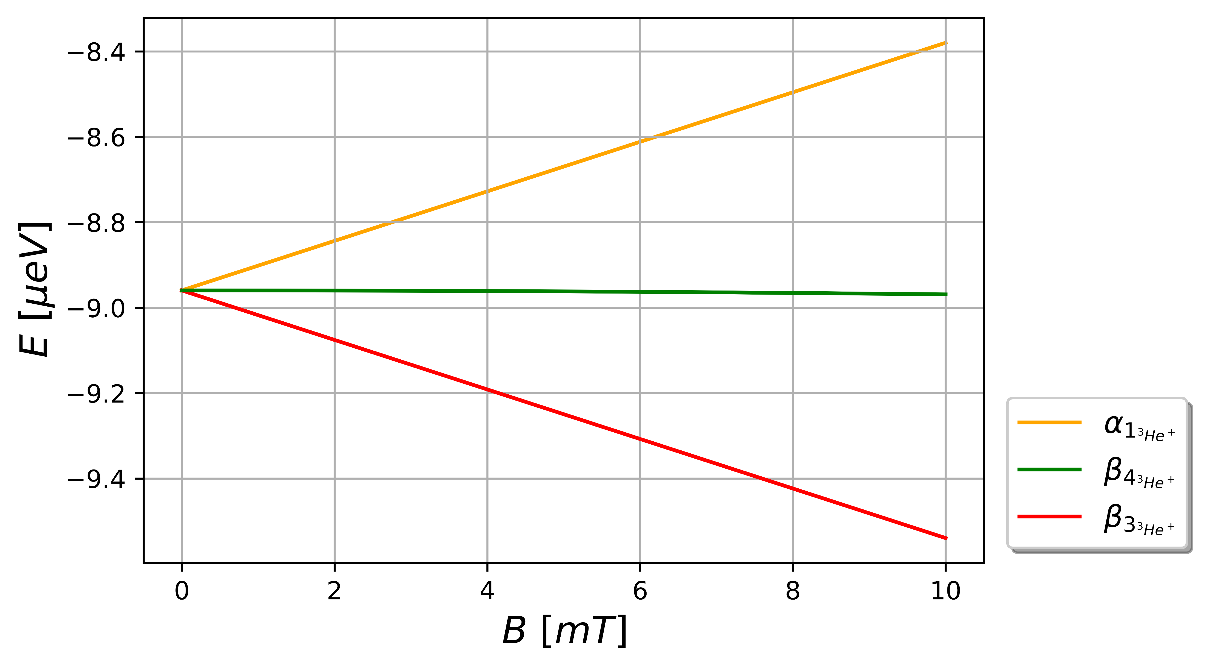
${}_{ }^{3}{{He}^{+}}$ Breit-Rabi diagram
$$≈310 neV$$

Slide 12
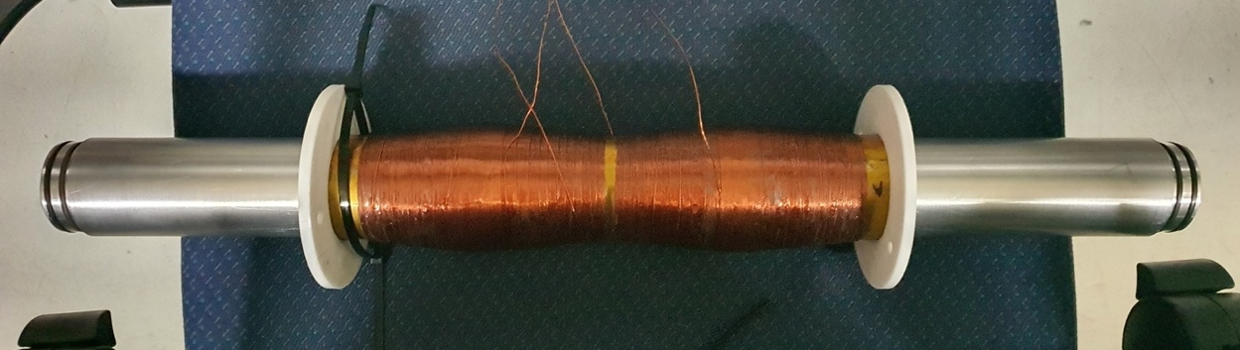
Sona transition unit
B
B
S. Aswani, Bachelor thesis, (2022)

Slide 13
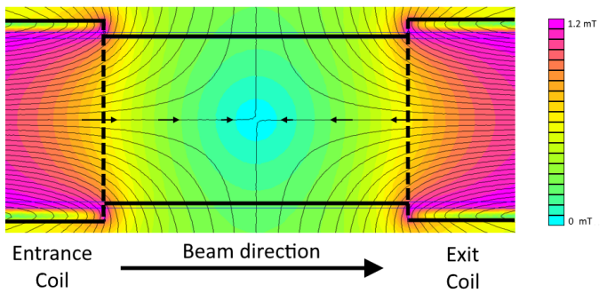
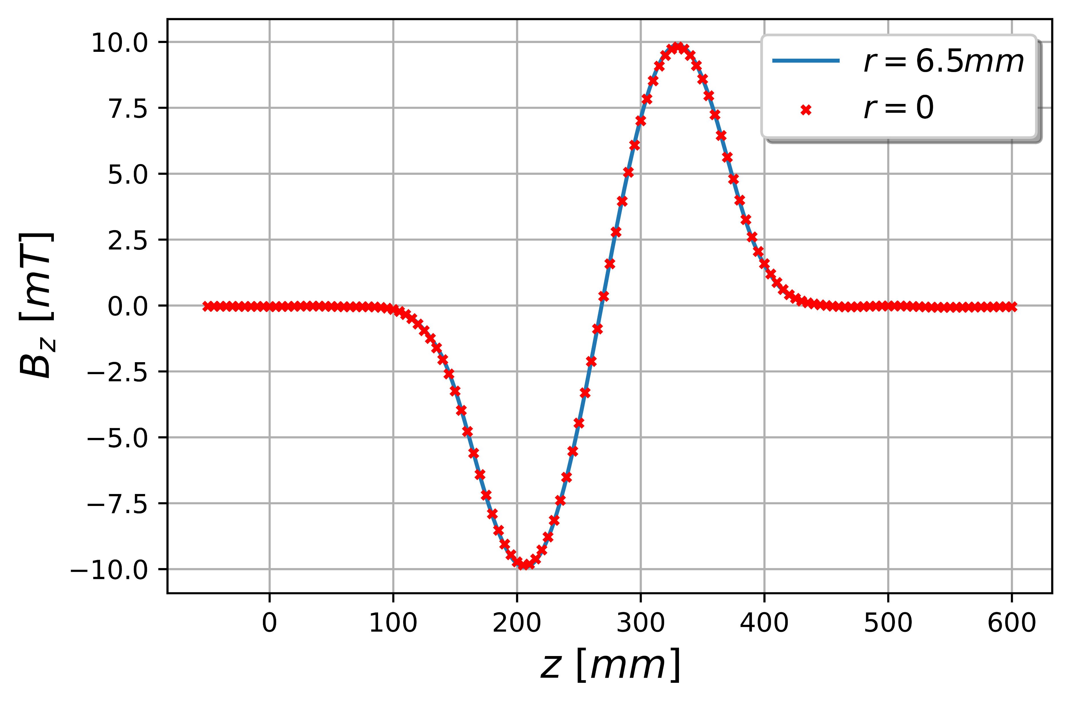
Photon model
Static magnetic field
$$\overset{⃑}{B}∙\overset{⃑}{∇}=0$$
$$⇒$$
$$B_{r}=−\frac{r}{2}\frac{∂B_{z}}{∂z}$$
$$B_{z}=B_{0}\sin\left(kz\right)$$
$$B_{r}=−\frac{r}{2}B_{0}k\cos\left(kz\right)$$
P. Buske, Bachelor thesis, (2016)

Slide 14
Photon model
Static magnetic field
$$\overset{⃑}{B}∙\overset{⃑}{∇}=0$$
$$⇒$$
$$B_{r}=−\frac{r}{2}\frac{∂B_{z}}{∂z}$$
$$B_{z}=B_{0}\sin\left(kz\right)$$
$$B_{r}=−\frac{r}{2}B_{0}k\cos\left(kz\right)$$
P. Buske, Bachelor thesis, (2016)
Beam enters the Sona transition unit

Slide 15
Photon model
Static magnetic field
$$\overset{⃑}{B}∙\overset{⃑}{∇}=0$$
$$⇒$$
$$B_{r}=−\frac{r}{2}\frac{∂B_{z}}{∂z}$$
$$B_{z}=B_{0}\sin\left(kz\right)$$
$$B_{r}=−\frac{r}{2}B_{0}k\cos\left(kz\right)$$
P. Buske, Bachelor thesis, (2016)
Beam enters the Sona transition unit
Lorentz transformation into the rest frame of the beam
$$F^{μ′ν′}={Λ^{μ′}}_{μ}{Λ^{ν′}}_{ν}F^{μν}$$
$$⇒$$
$${B′}_{z}=B_{0}\sin\left(k′z′\right)$$
$${B′}_{r}=−\frac{r}{2}B_{0}k\cos\left(k′z′\right)$$
$${E′}_{φ}={−\frac{vr}{2γ}B}_{0}k\cos\left(k′z′\right)$$

Slide 16
Photon model
Static magnetic field
$$\overset{⃑}{B}∙\overset{⃑}{∇}=0$$
$$⇒$$
$$B_{r}=−\frac{r}{2}\frac{∂B_{z}}{∂z}$$
$$B_{z}=B_{0}\sin\left(kz\right)$$
$$B_{r}=−\frac{r}{2}B_{0}k\cos\left(kz\right)$$
P. Buske, Bachelor thesis, (2016)
Beam enters the Sona transition unit
Lorentz transformation into the rest frame of the beam
$$F^{μ′ν′}={Λ^{μ′}}_{μ}{Λ^{ν′}}_{ν}F^{μν}$$
$$⇒$$
$${B′}_{z}=B_{0}\sin\left(k′z′\right)$$
$${B′}_{r}=−\frac{r}{2}B_{0}k\cos\left(k′z′\right)$$
$${E′}_{φ}={−\frac{vr}{2γ}B}_{0}k\cos\left(k′z′\right)$$
Electromagnetic fields ➔ Photon pulse ➔ lead to magnetic dipole transitions

Slide 17
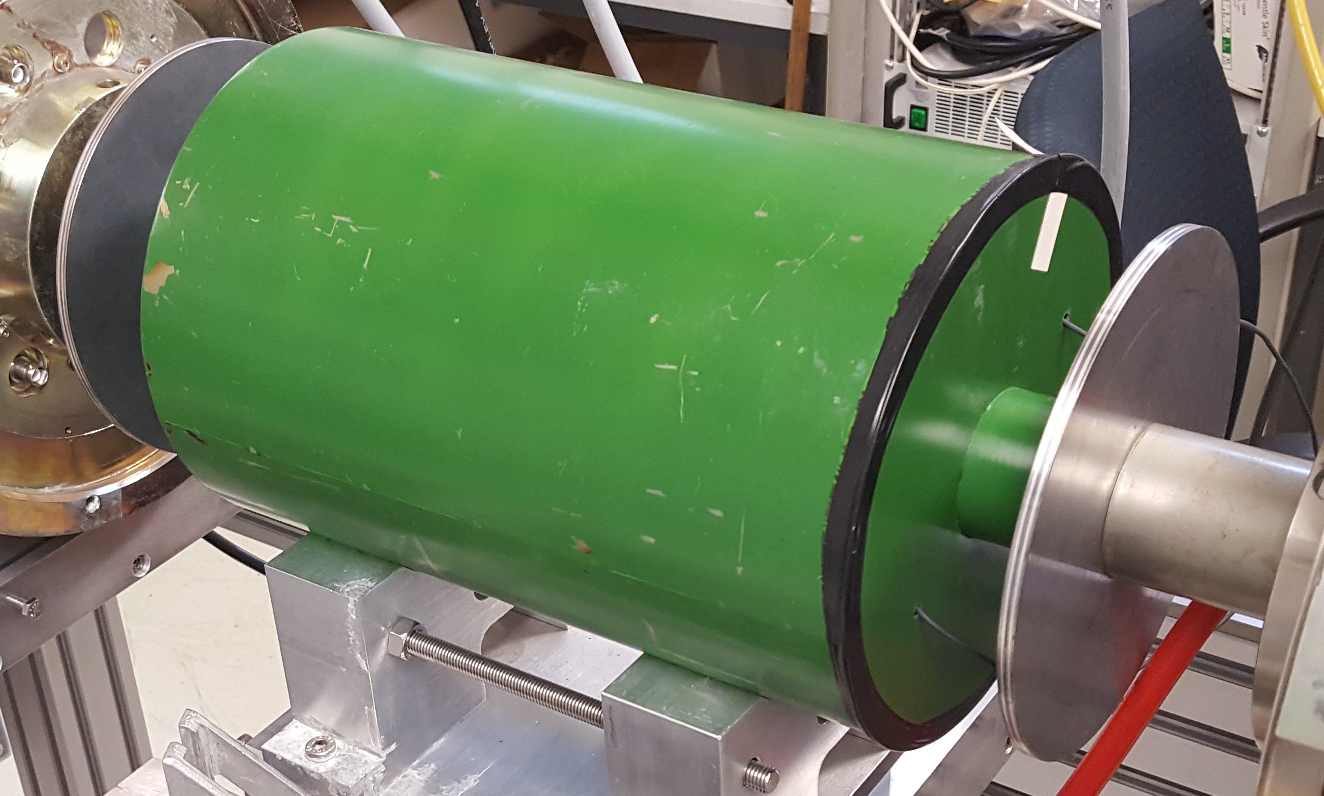
Photon model
$$λ=\frac{v}{f}=v∙Δt$$
$$E_{n}=(2n−1)hf$$
$$n∈ℕ$$

Slide 18
Theoretical approach
Hamiltonian
$$H=H_{Hyp}+V_{B}\left(t\right)$$
$$H_{Hyp}=A\frac{\overset{⃑}{I}∙\overset{⃑}{J}}{ℏ^{2}}$$
$$V_{B}\left(t\right)=\left(g_{j}μ_{B}\frac{\overset{⃑}{J}}{ℏ}−g_{I}μ_{K}\frac{\overset{⃑}{I}}{ℏ}\right)∙\overset{⃑}{B}\left(t\right)$$

Slide 19
Theoretical approach
Hamiltonian
$$H=H_{Hyp}+V_{B}\left(t\right)$$
$$H_{Hyp}=A\frac{\overset{⃑}{I}∙\overset{⃑}{J}}{ℏ^{2}}$$
$$V_{B}\left(t\right)=\left(g_{j}μ_{B}\frac{\overset{⃑}{J}}{ℏ}−g_{I}μ_{K}\frac{\overset{⃑}{I}}{ℏ}\right)∙\overset{⃑}{B}\left(t\right)$$
Time-dependent perturbation
$$\left.|ψ\right\rangle =\sum_{F=|J−I|}^{J+I}{\sum_{m_{F}=−F}^{F}{c_{m_{F},F}(t){∙e}^{−{iE_{m_{F},F}∙t}/ℏ}}}\left.|m_{F},F\right\rangle$$
$$H_{Hyp}\left.|m_{F},F\right\rangle =E_{m_{F},F}\left.|m_{F,}F\right\rangle$$
$${\dot{c}}_{{\tilde{F},m}_{\tilde{F}}}=−\frac{i}{ℏ}\sum_{F=\left|J−I\right|}^{J+I}{\sum_{m_{F}=−F}^{F}{c_{F,m_{F}}}}e^{−i{\left(E_{F,m_{F}}−E_{\tilde{F},m_{\tilde{F}}}\right)t}/ℏ}\left\langle {\tilde{F},m}_{\tilde{F}} | V\left(t\right) | {F,m}_{F}\right\rangle$$

Slide 20
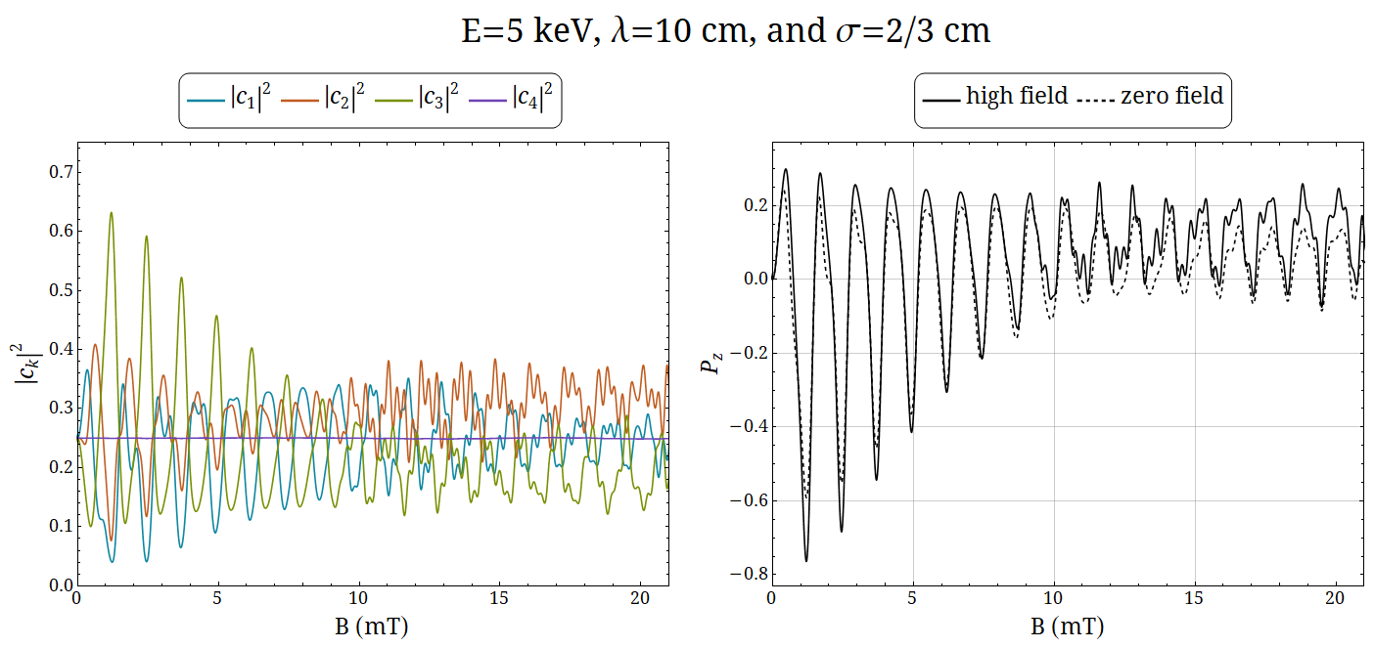
Simulation

Slide 21
Experimental set-up
➔${}_{ }^{3}{{He}^{+}}$

Slide 22
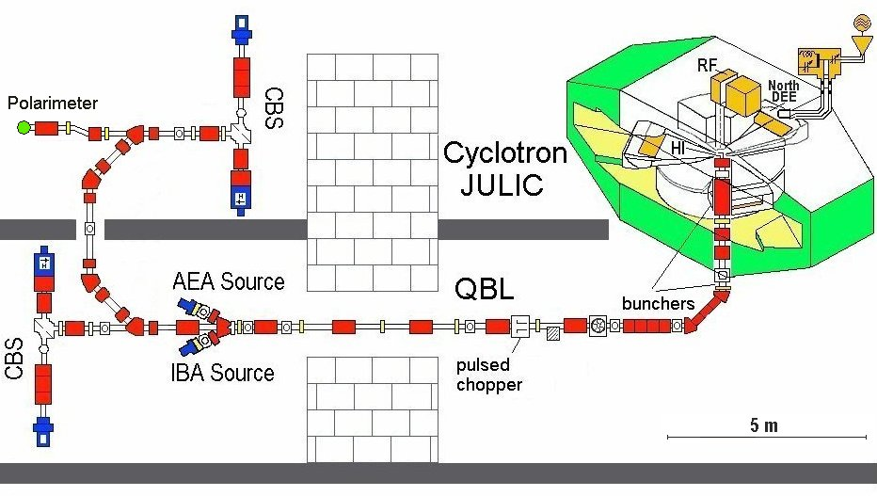
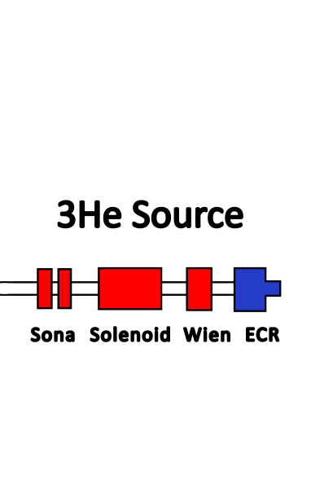
Low energy Beam line
6 Dipoles
15 Quadrupoles
10 Solenoids

Slide 23
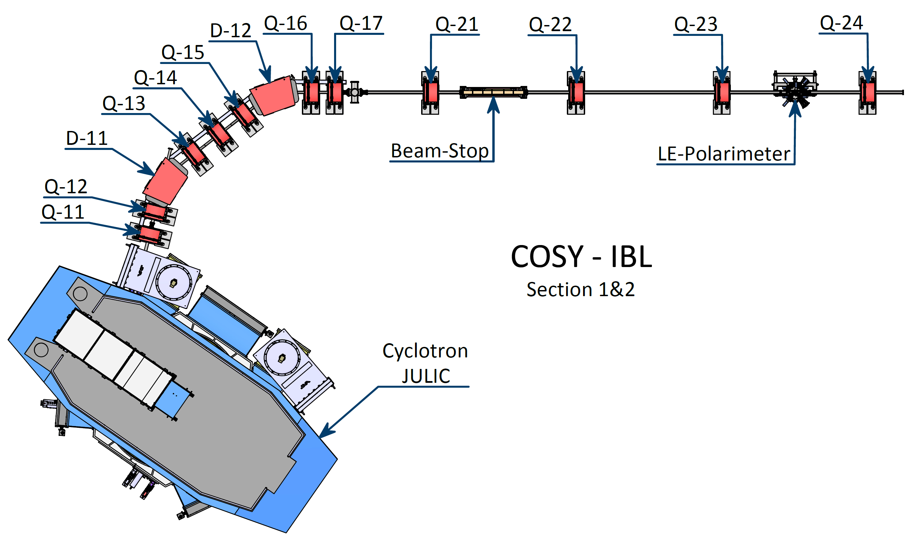
High energy Beam line
2 Dipoles
10 Quadrupoles
5m

Slide 24
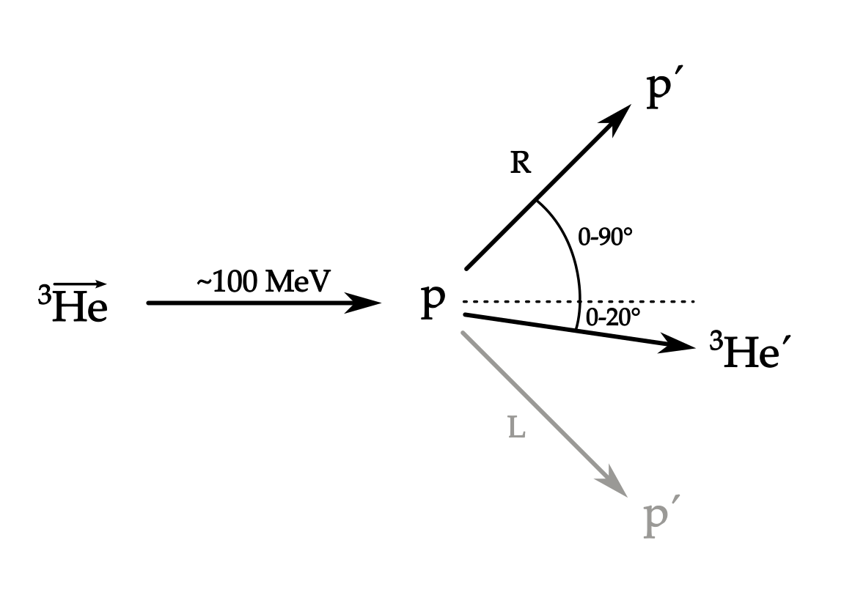
theory for the polarimeter
Elastic scattering at protons
$$\frac{dσ}{dΩ}=\frac{dσ_{0}}{dΩ}\left(E,θ\right)⋅(1+P⋅A_{y}\left(E,θ\right)\cos\left(φ\right))$$
$$⟹P=\frac{1}{A_{y}\left(E,θ\right)} \frac{N_{L}−N_{R}}{N_{L}+N_{R}}$$

Slide 25
theory for the polarimeter
Elastic scattering at protons
$$\frac{dσ}{dΩ}=\frac{dσ_{0}}{dΩ}\left(E,θ\right)⋅(1+P⋅A_{y}\left(E,θ\right)\cos\left(φ\right))$$
$$⟹P=\frac{1}{A_{y}\left(E,θ\right)} \frac{N_{L}−N_{R}}{N_{L}+N_{R}}$$
Analyzing power $A_{y}$

Slide 26
theory for the polarimeter
Elastic scattering at protons
$$\frac{dσ}{dΩ}=\frac{dσ_{0}}{dΩ}\left(E,θ\right)⋅(1+P⋅A_{y}\left(E,θ\right)\cos\left(φ\right))$$
$$⟹P=\frac{1}{A_{y}\left(E,θ\right)} \frac{N_{L}−N_{R}}{N_{L}+N_{R}}$$
Analyzing power $A_{y}$
Estimate counts and background

Slide 27
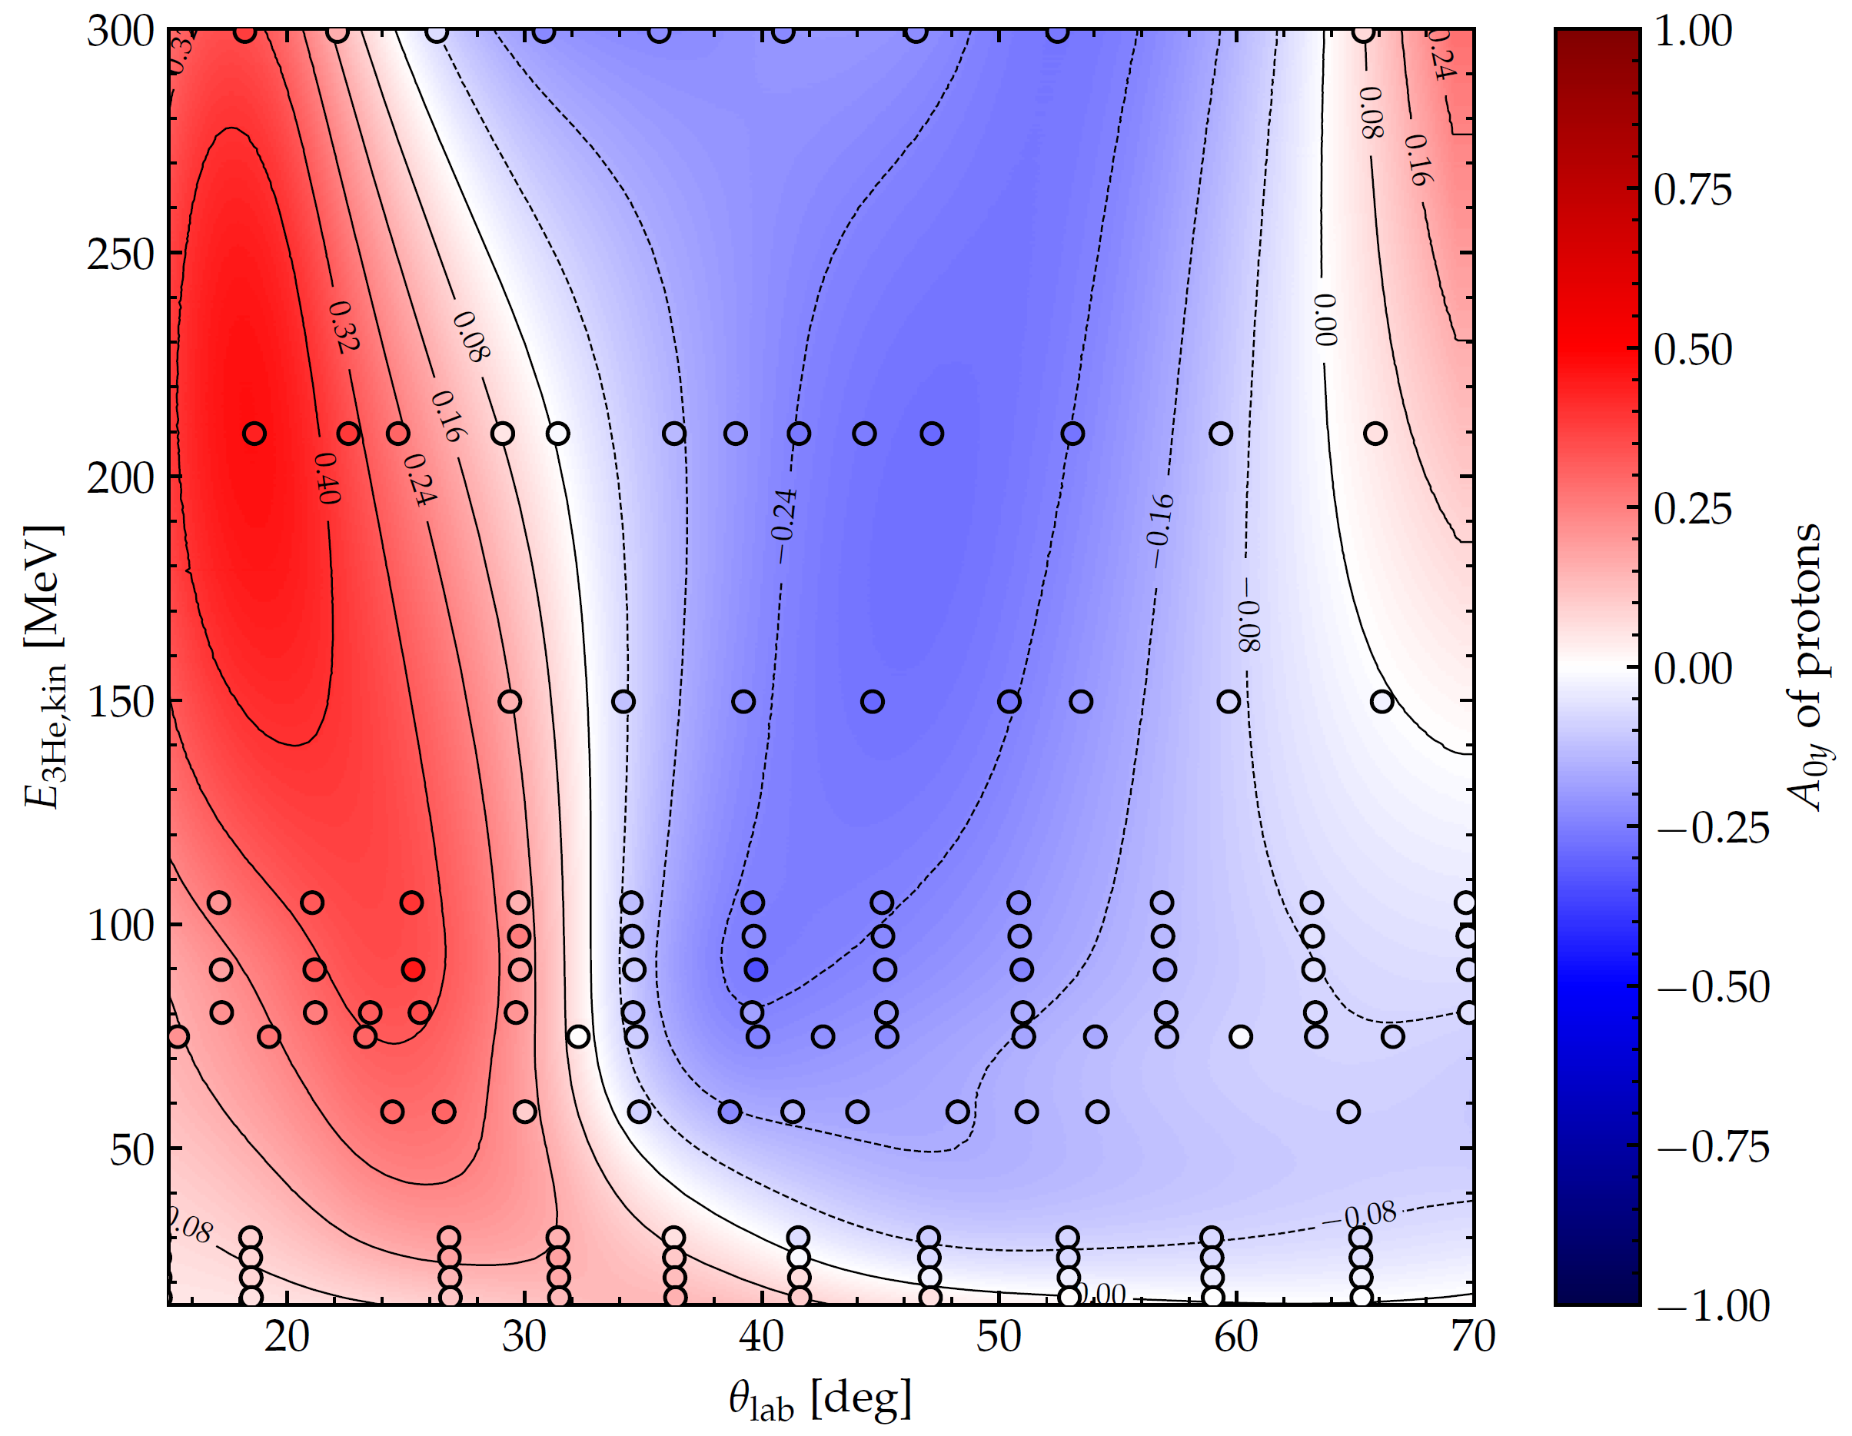
Analyzing power distribution
Analysis powers from proton scattering on polarized ${}_{ }^{3}{He }$targets
Lorentz-boost
Mirrored coordinate system
Statistical uncertainties below 10% in relevant regions

Slide 28
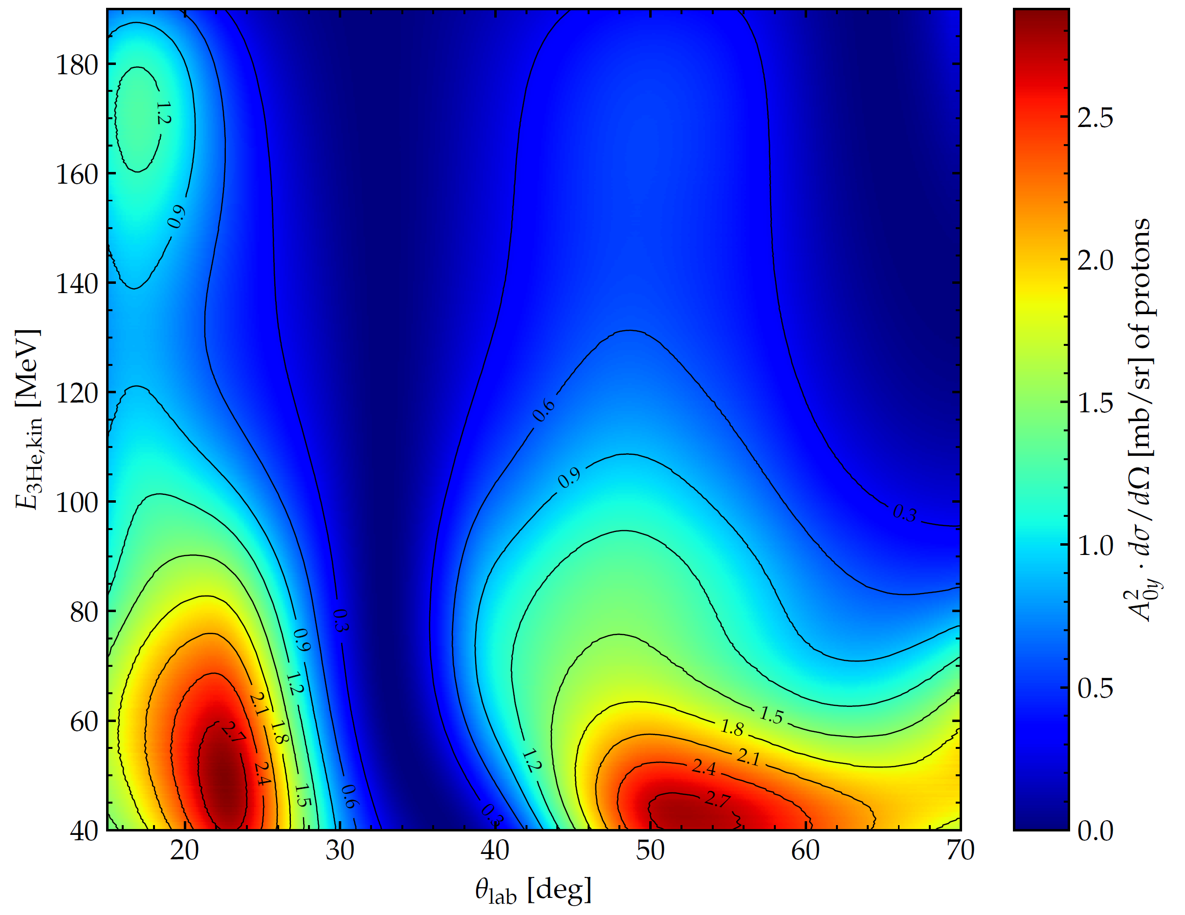
Figure of merit
Max of FOM=best point of measurement
Lower beam energies favored
${25}^{°}$ and${50}^{°}$ optimal

Slide 29
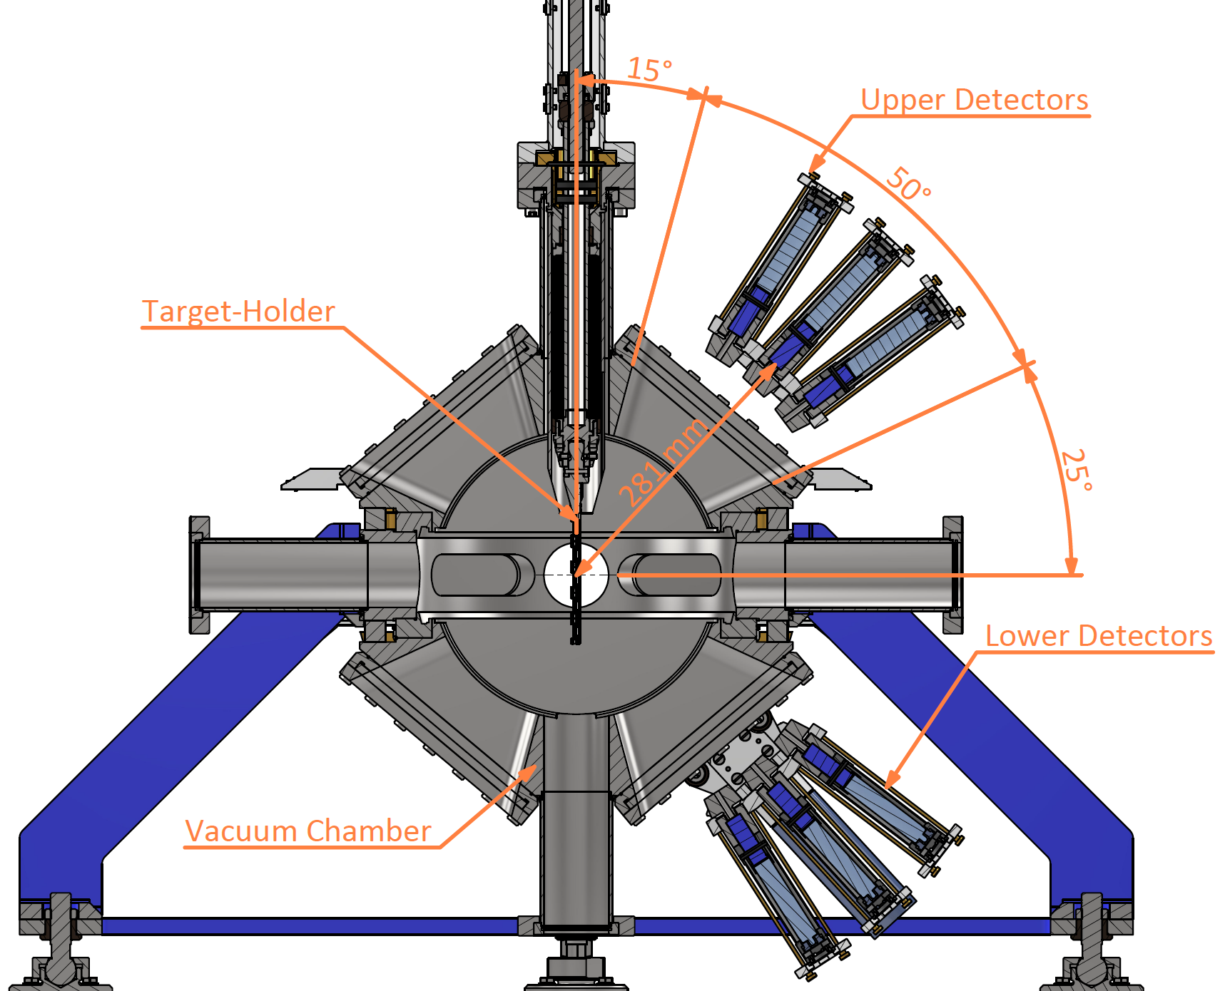
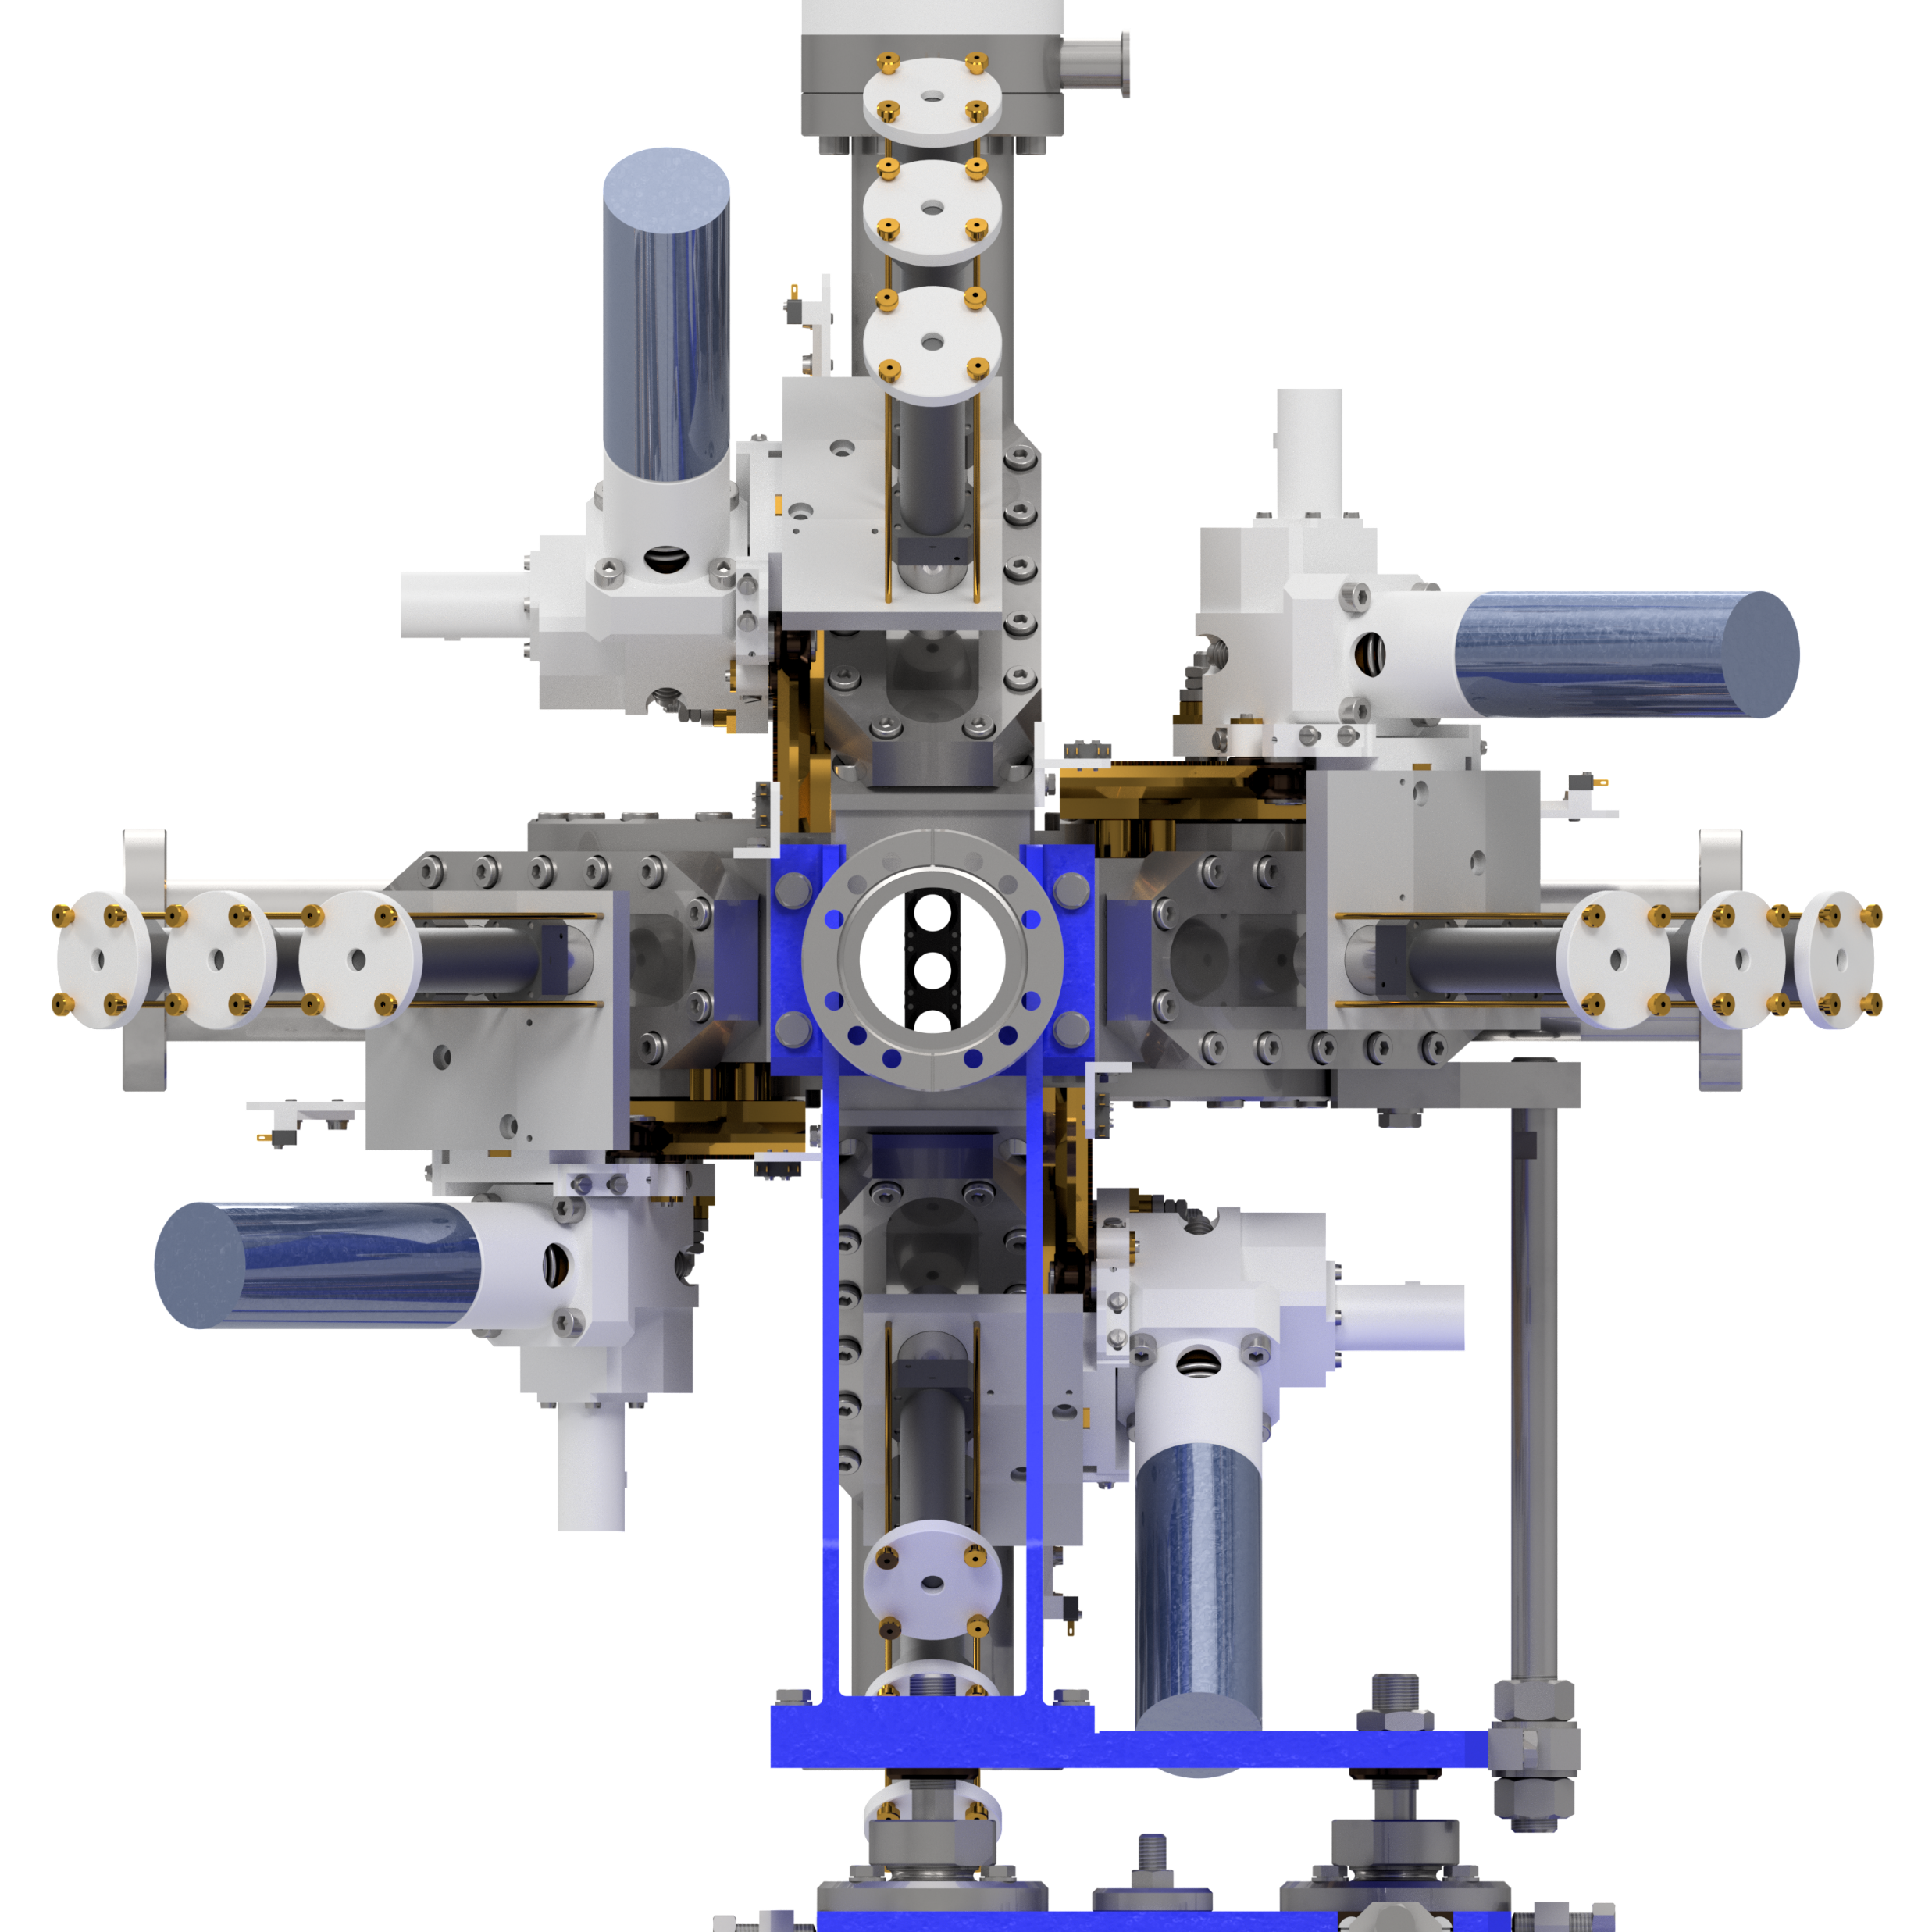
LE-Polarimeter
12 Detectors: 3 Left/Right/Up/Down
Only on forward-facing windows
0.5 mm Polyethylene ($C_{2}H_{4}$) target
Plastic scintillators with Photomultipliers
Up
➔${}_{ }^{3}{{He}^{+}}$
Left
Right
Down

Slide 30
Outlook to beam time
Beam time: CW40 – CW41
Problem:
Polarization loss during beam transportation: Quadrupoles
Possible solutions:
Stripping to ${}_{ }^{3}{{He}^{2+}}$ ➔ $H^{−}$ passes
Using the solenoids in front of the cyclotron JULIC
➔ Stripping after cyclotron necessary

Slide 31
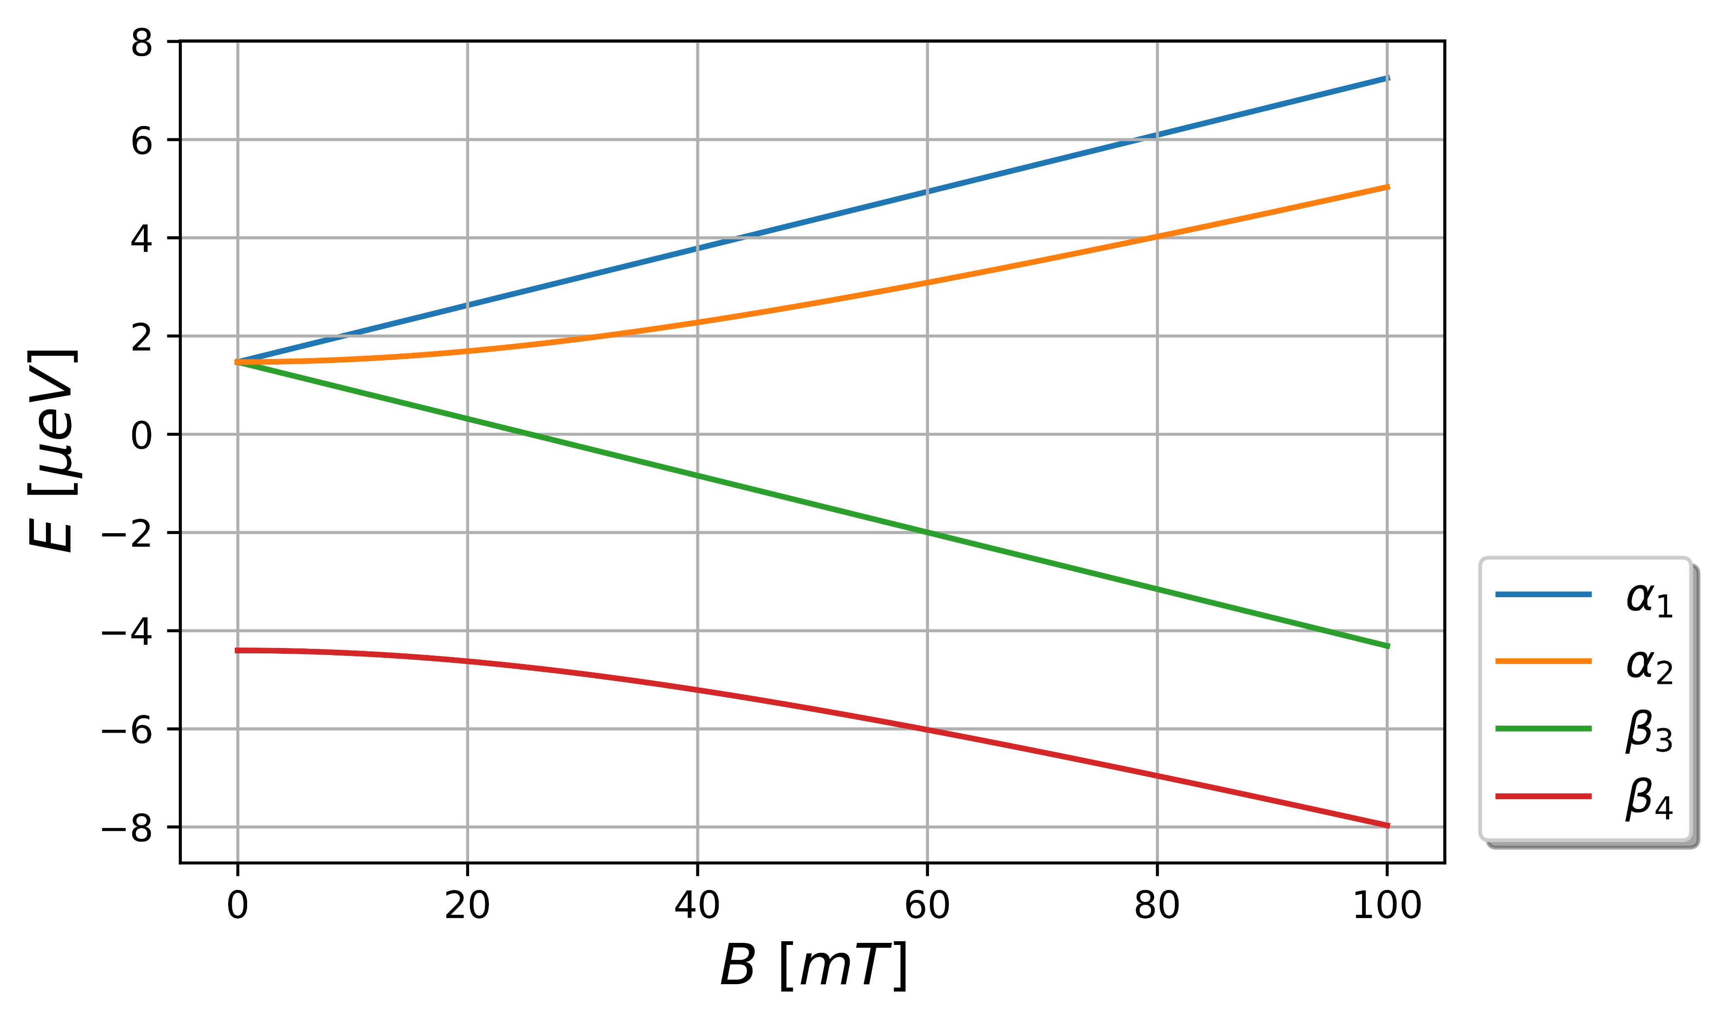
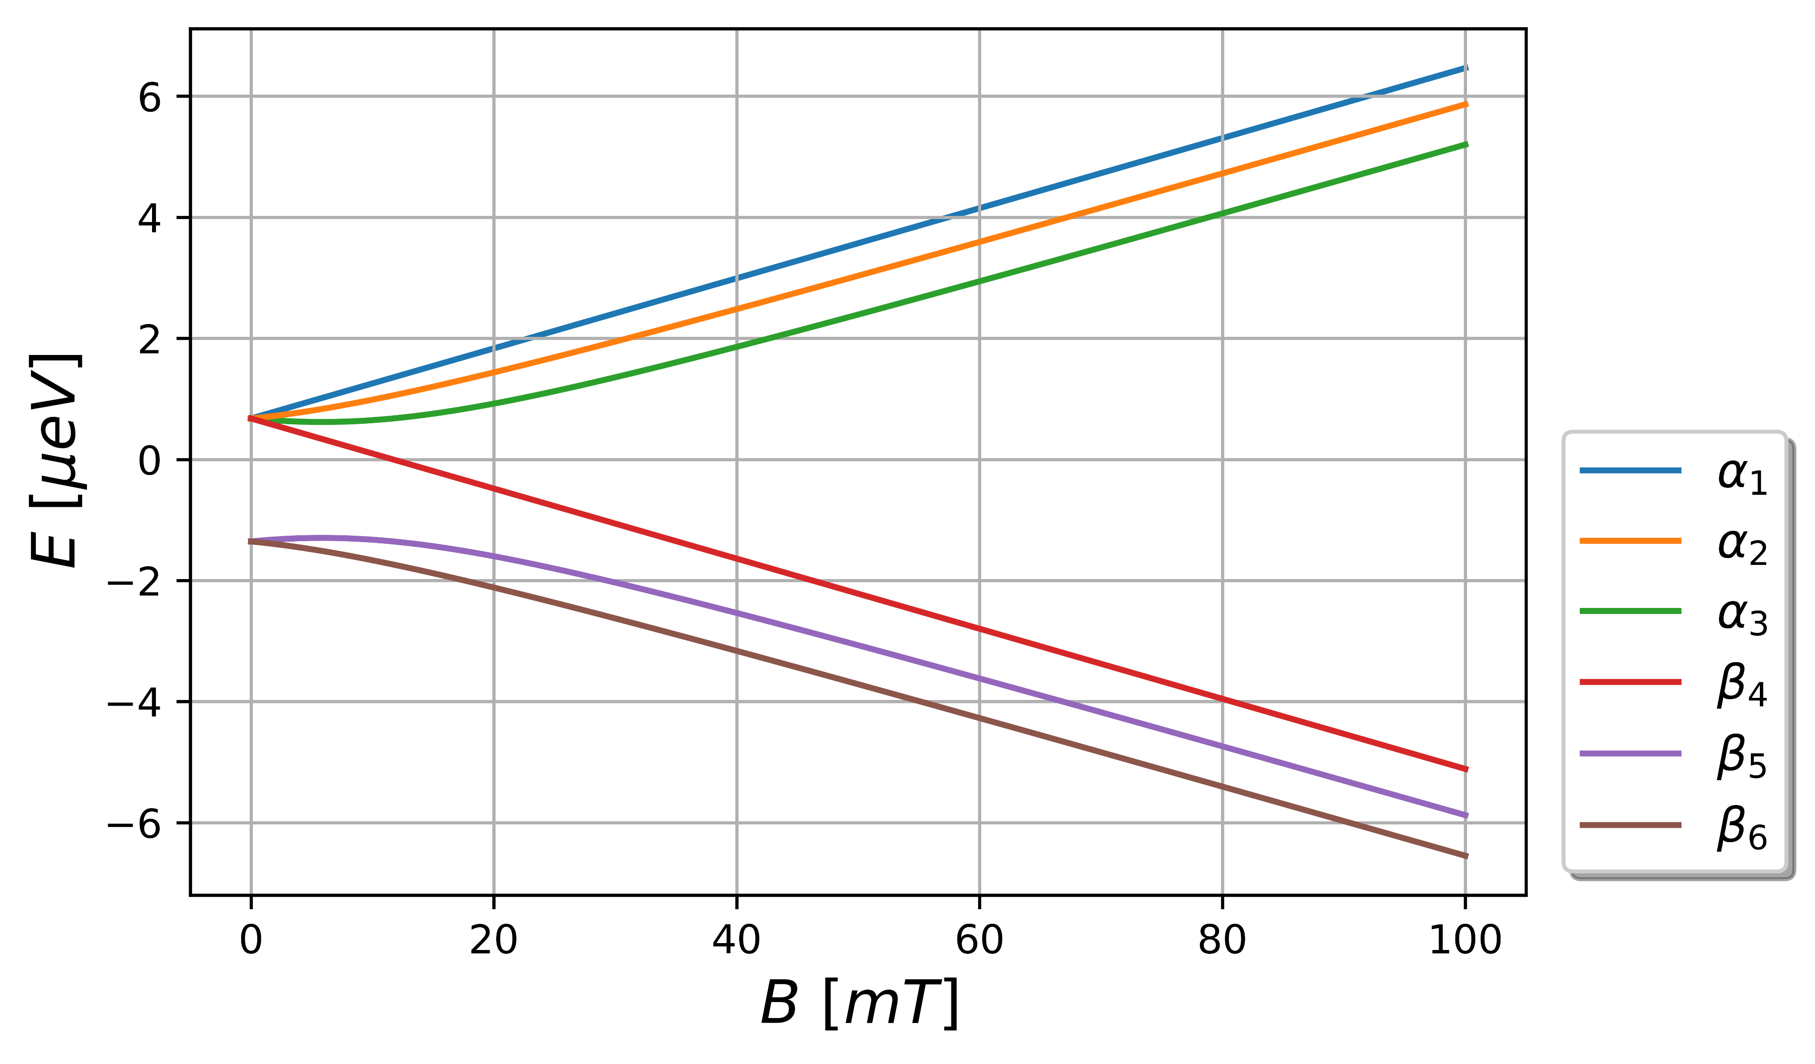
Conclusion
Polarization for any kind of system with a hyperfine-splitting
C. Kannis „A universal method to polarize“ , Tuesday 9:00-9:30

