Slide 1
A universal method to polarize atoms, Molecules, and their ions
for accelerators, nuclear fusion, or medical applications
26 September 2023 I Chrysovalantis Kannis
25th International Spin Symposium (SPIN 2023)
Parallel Session: Polarized Ion and Lepton Sources and Targets

Slide 2
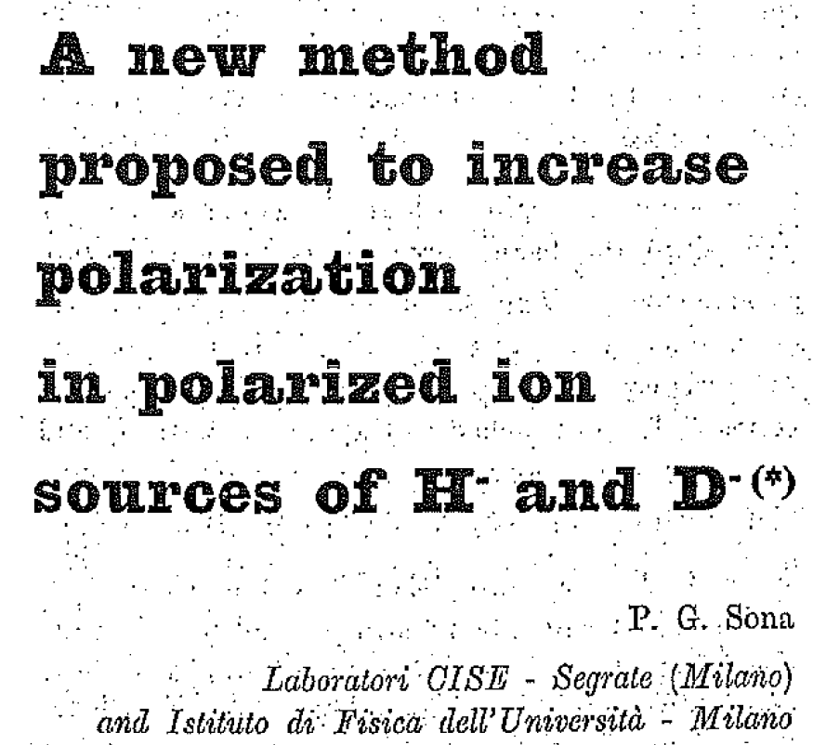
Sona transitions
General concept and theoretical framework
P. G. Sona, Energ. Nucl. 14, 295 (1967)
Non-thermal beams
Quantization axis parallel to the beam axis
Static magnetic field with direction reversal along the quantization axis
Metastable H: nuclear polarization $P_{z}^{H}=1$
Metastable D: nuclear vector polarization $P_{z}^{D}=\frac{2}{3}$,
Metastable D: nuclear tensor polarization $P_{zz}^{D}=0$
Definition of vector ($P_{z}∈\left[−1, 1\right]$) and tensor ($P_{zz}∈\left[−2, 1\right]$) polarization:
For spin-1/2 particles, $P_{z}=\frac{N_{+1/2} − N_{−1/2}}{N_{+1/2} + N_{−1/2}}$
For spin-1 particles, $P_{z}=\frac{N_{+1} − N_{−1}}{N_{+1} + N_{−1} +{ N}_{0}}$ and $P_{zz}=\frac{N_{+1} + N_{−1} − 2N_{0}}{N_{+1} + N_{−1} + N_{0}}$

Slide 3
Sona transitions
General concept and theoretical framework
Metastable H and D atoms in an external magnetic field
Effective Hamiltonian of H ($I=J=1/2$) and D ($I=1$, $J=1/2$) in a static magnetic field $B=B\hat{z}$:
$$H_{H\left(D\right)}=A_{H\left(D\right)} I⋅J −\left(g_{J} μ_{B} J + g_{I} μ_{N} I\right)⋅B$$
with
$A_{H\left(D\right)}$ is the hyperfine-structure constant $\left\{\begin{aligned}A_{H}=177.56 MHz \\ A_{D}=40.92 MHz\end{aligned}\right.$
$g_{J}$ is the electron g-factor $g_{J}=−2.002$
$g_{I}$ is the nuclear g-factor $\left\{\begin{aligned}5.586 for proton \\ 0.857 for deuteron\end{aligned}\right.$
$μ_{B,N}$ are the Bohr and nuclear magnetons $\left\{\begin{aligned}μ_{B}=9.274×{10}^{−24} J/T \\ μ_{N}=5.051×{10}^{−27} J/T\end{aligned}\right.$

Slide 4
Sona transitions
General concept and theoretical framework
Metastable H and D atoms in an external magnetic field
Effective Hamiltonian of H ($I=J=1/2$) and D ($I=1$, $J=1/2$) in a static magnetic field $B=B\hat{z}$:
$$H_{H\left(D\right)}=A_{H\left(D\right)} I⋅J −\left(g_{J} μ_{B} J + g_{I} μ_{N} I\right)⋅B$$
Critical magnetic field $B_{c}=\frac{A_{H\left(D\right)}}{−\left(g_{J} μ_{B} + g_{I} μ_{N}\right)}=\left\{\begin{aligned}6.34 mT for H \\ 1.46 mT for D\end{aligned}\right.$
Two “natural” representations to describe these systems:
Coupled (for $B≪B_{c}$): $F=J+I$ and projection along the quantization axis $m_{F}$, yielding |$\left.F, m_{F}\right\rangle$
Uncoupled (for $B≫B_{c}$): |$\left.m_{J}, m_{I}\right\rangle$
The eigensystem can be written in terms of the above representations for any value of $B$.

Slide 5
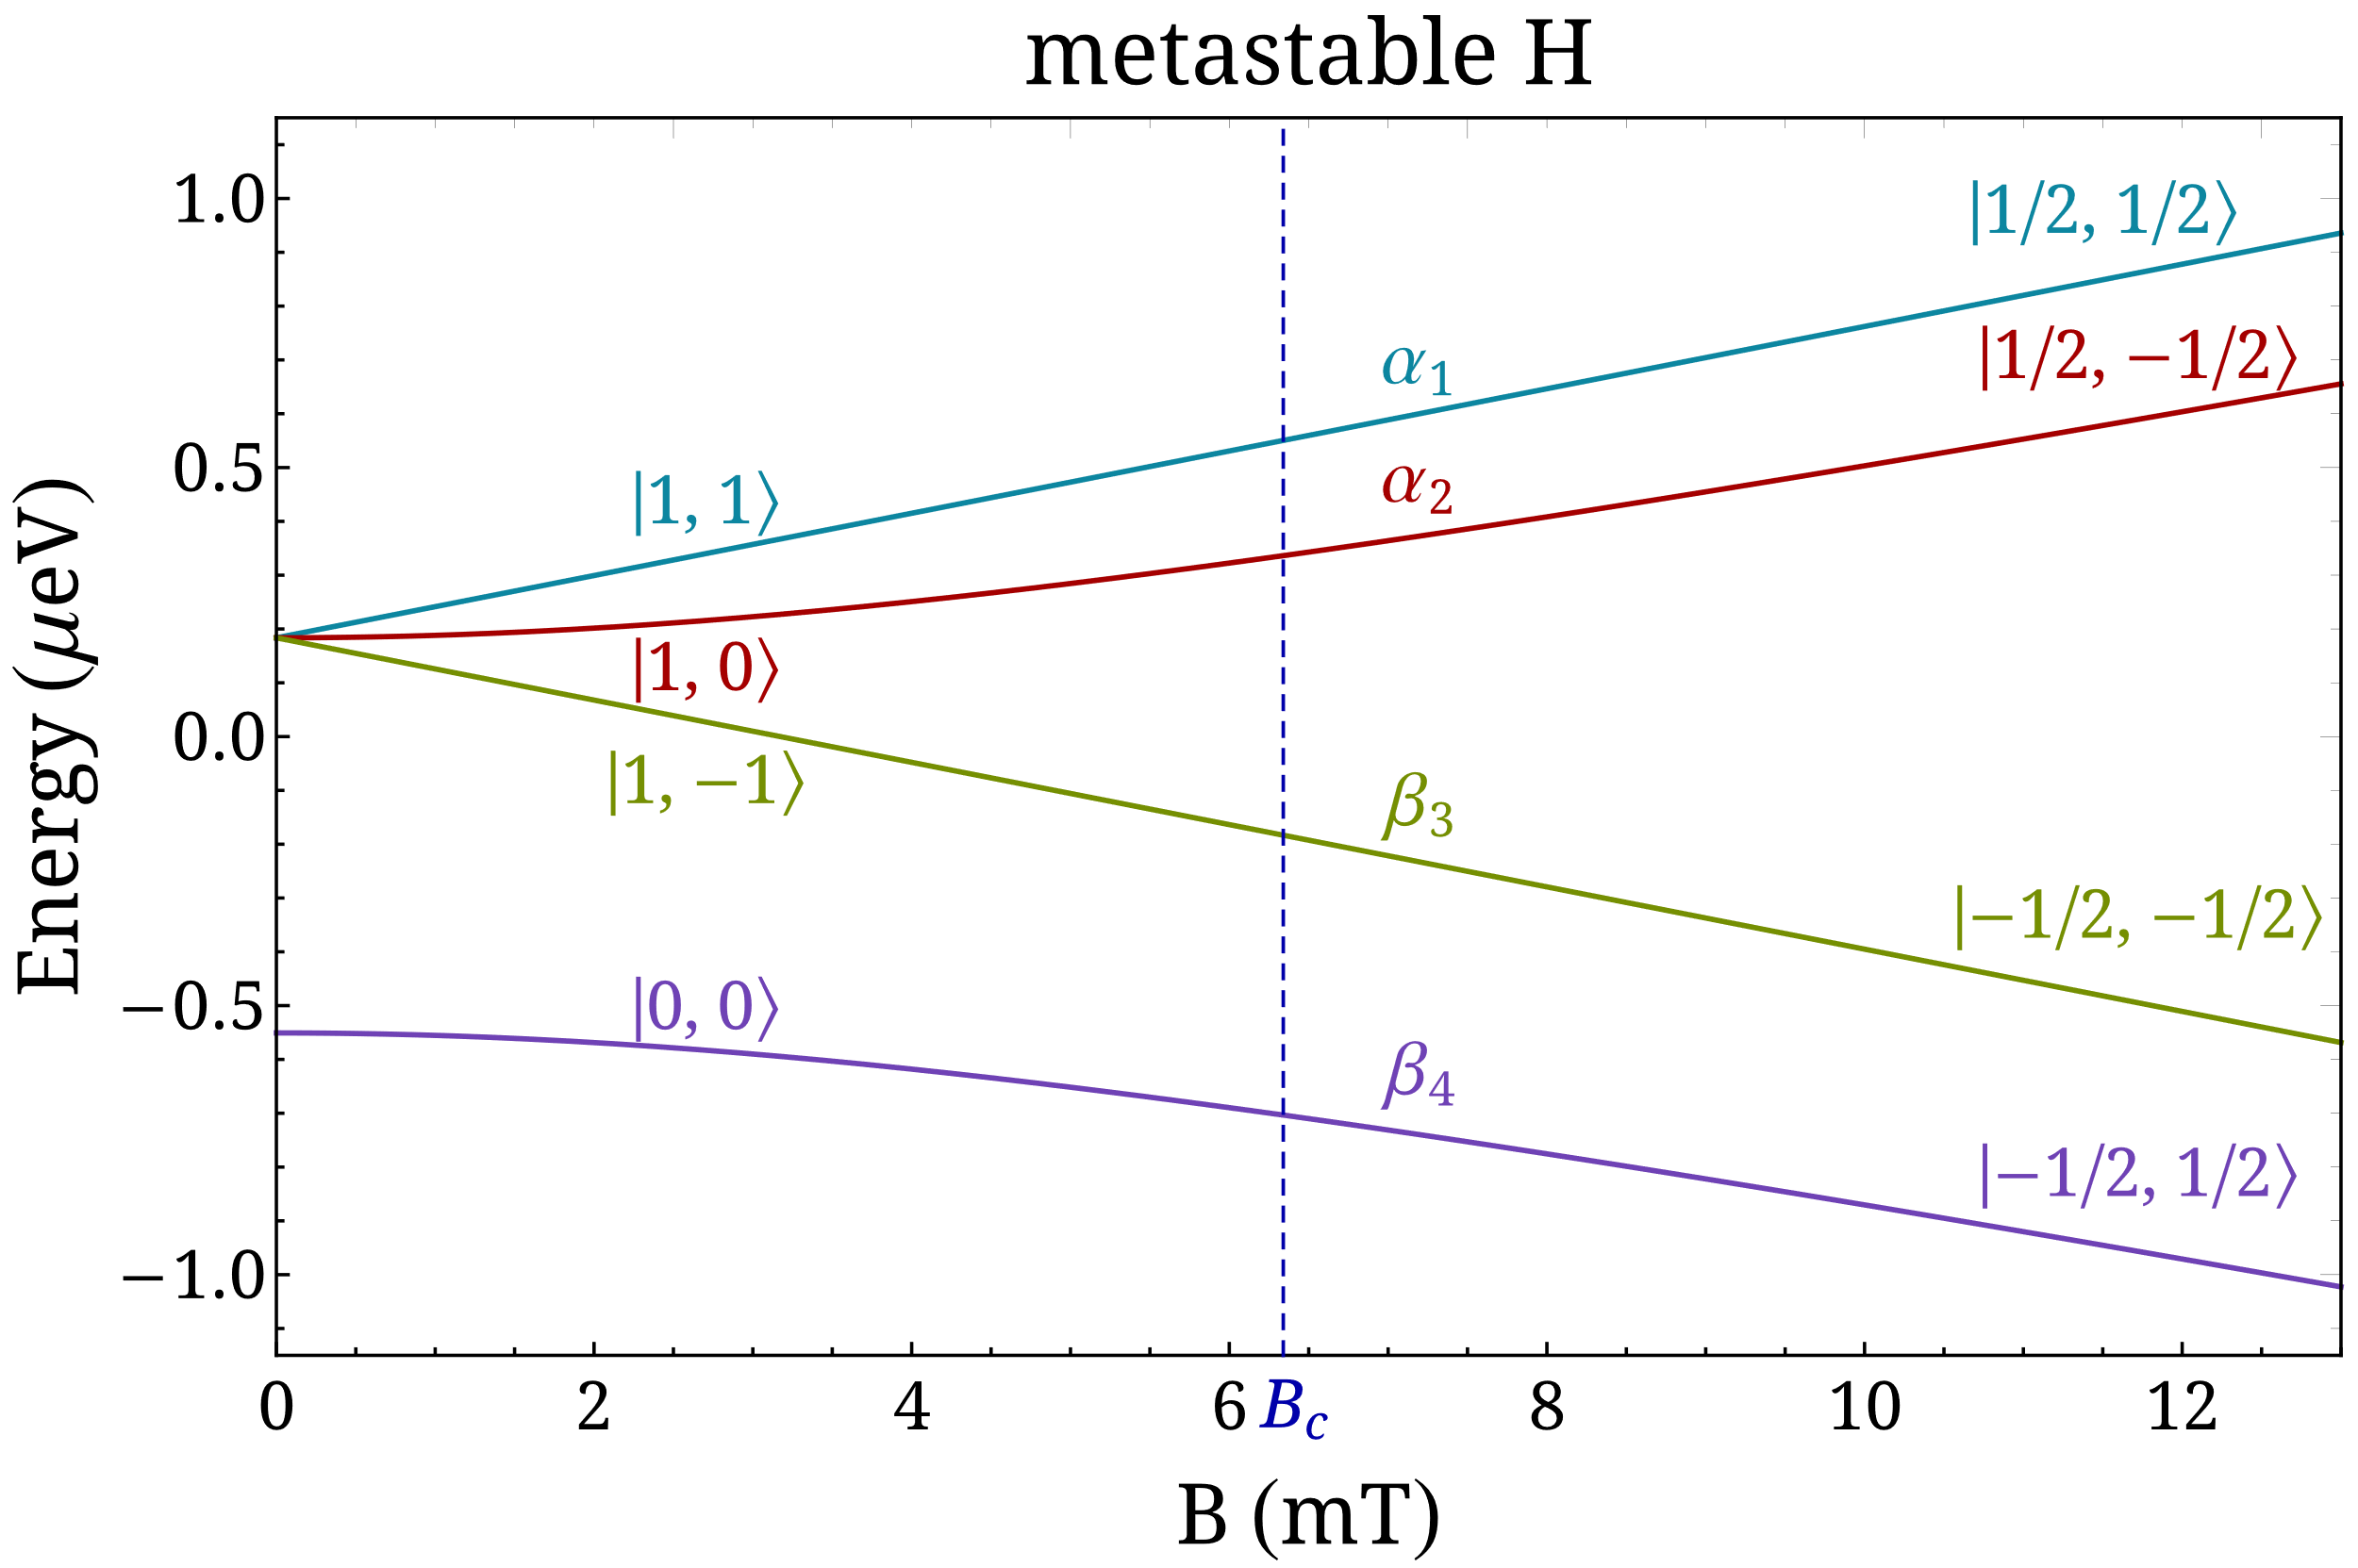
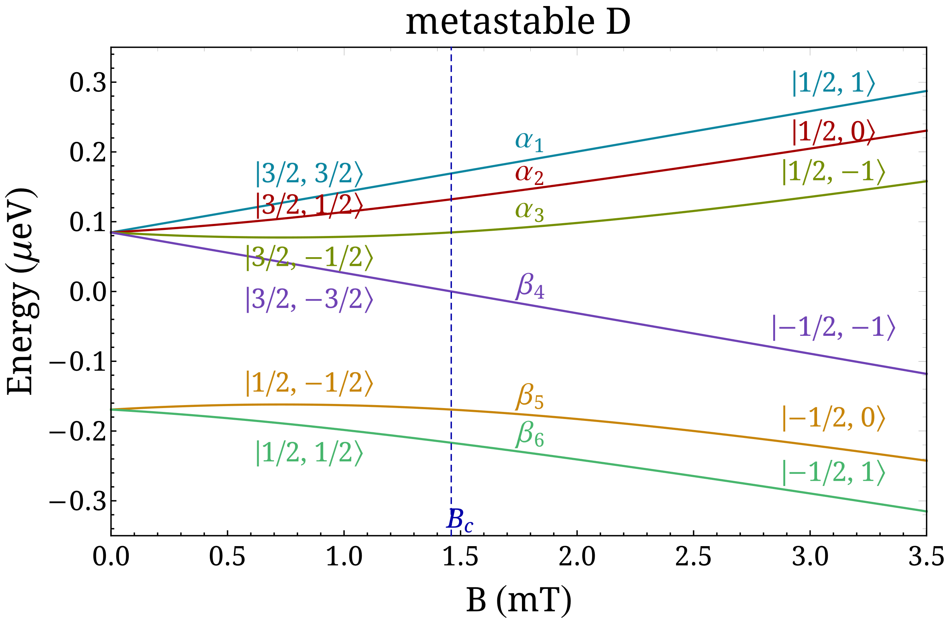
Sona transitions
General concept and theoretical framework
Metastable H and D atoms in an external magnetic field

Slide 6
Sona transitions
General concept and theoretical framework
Sona’s concept for metastable H

Slide 7
Sona transitions
General concept and theoretical framework
$$P_{z}^{H}=0$$
Sona’s concept for metastable H

Slide 8
Sona transitions
General concept and theoretical framework
$$P_{z}^{H}=0$$
Sona’s concept for metastable H
$$P_{z}^{H}=1$$

Slide 9
Sona transitions
General concept and theoretical framework
$$P_{z}^{D}=0$$
$$P_{zz}^{D}=0$$
Sona’s concept for metastable D
$$P_{z}^{D}=\frac{2}{3}$$
$$P_{zz}^{D}=0$$

Slide 10
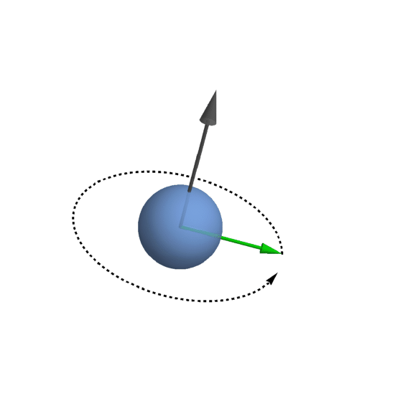
Sona transitions
General concept and theoretical framework
$$B_{r}$$
Zero-crossing requirements and non-adiabaticity
Radial magnetic field component (at $r≠0$):
$∇⋅B=0$
$B_{z}=B_{z}\left(z\right)$
$B_{φ}=0$
In the low field region ($−B_{c}≪B≪B_{c}$), a sudden zero-field crossing is required:
$τ_{B}≪τ_{L}$ or $ω_{B}≫ω_{L}$, where $ω_{B}=2\frac{v}{r}$ and $ω_{L}=\frac{μ_{B}}{ℏF}B_{r}$
Upper limit for the magnetic field gradient: $\frac{dB_{z}}{dz}≪\frac{8m_{e}v}{er^{2}}\left(\frac{3}{2}\right)$
This semiclassical approach neglects the hyperfine interaction that dominates at low fields!
$$B_{r}=−\frac{r}{2}\frac{dB_{z}}{dz}$$

Slide 11
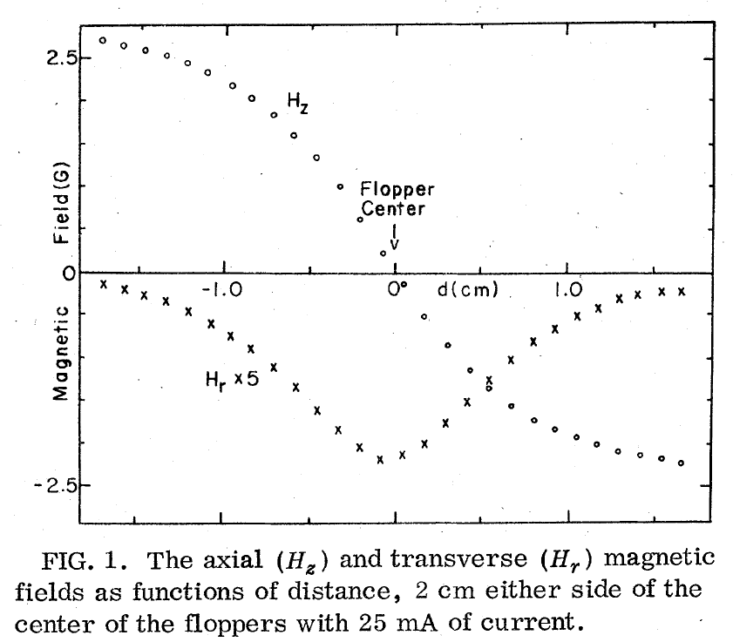
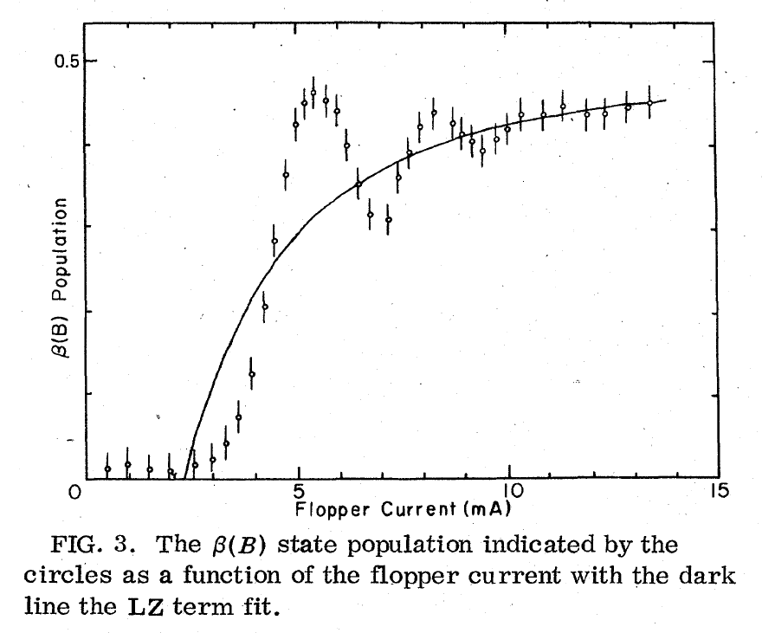
Sona transitions
Unexpected oscillations and polarization loss
Brief literature search
Experiment: R. D. Hight and R. T. Robiscoe, “Nonadiabatic transition in n=2 atomic hydrogen”, Phys. Rev. A 17, 56 (1978).
initial states: $a_{1}$and $α_{2}$
measured state: $β_{3}$
$v∼{10}^{4}$ m/s

Slide 12
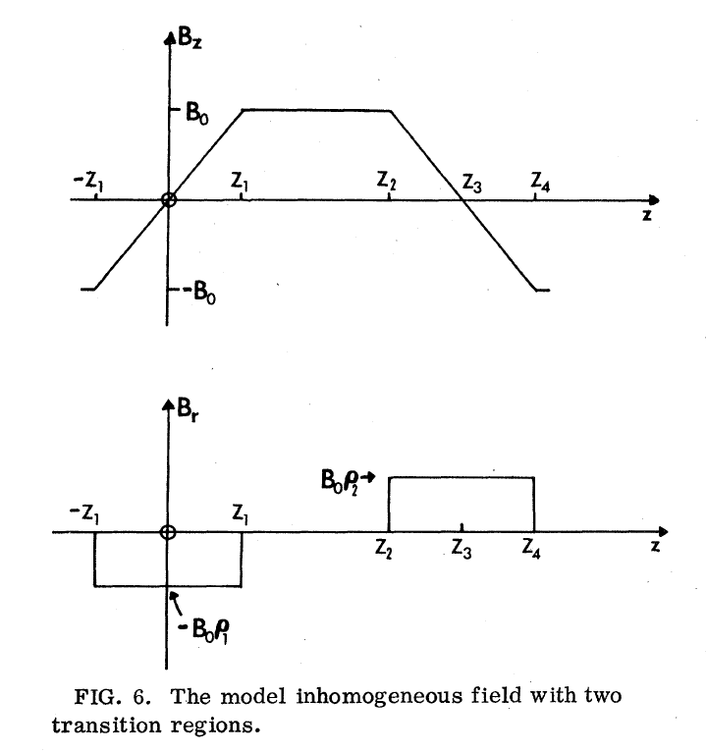
Sona transitions
Unexpected oscillations and polarization loss
Brief literature search
Theory: F. Garisto and B. C. Sanctuary, “Spin transitions in time-dependent magnetic fields”, Phys. Rev. A 23, 3 (1981).
Two non-adiabatic regions or incoherent initial conditions are concluded.
The hyperfine interaction is systematically neglected!

Slide 13
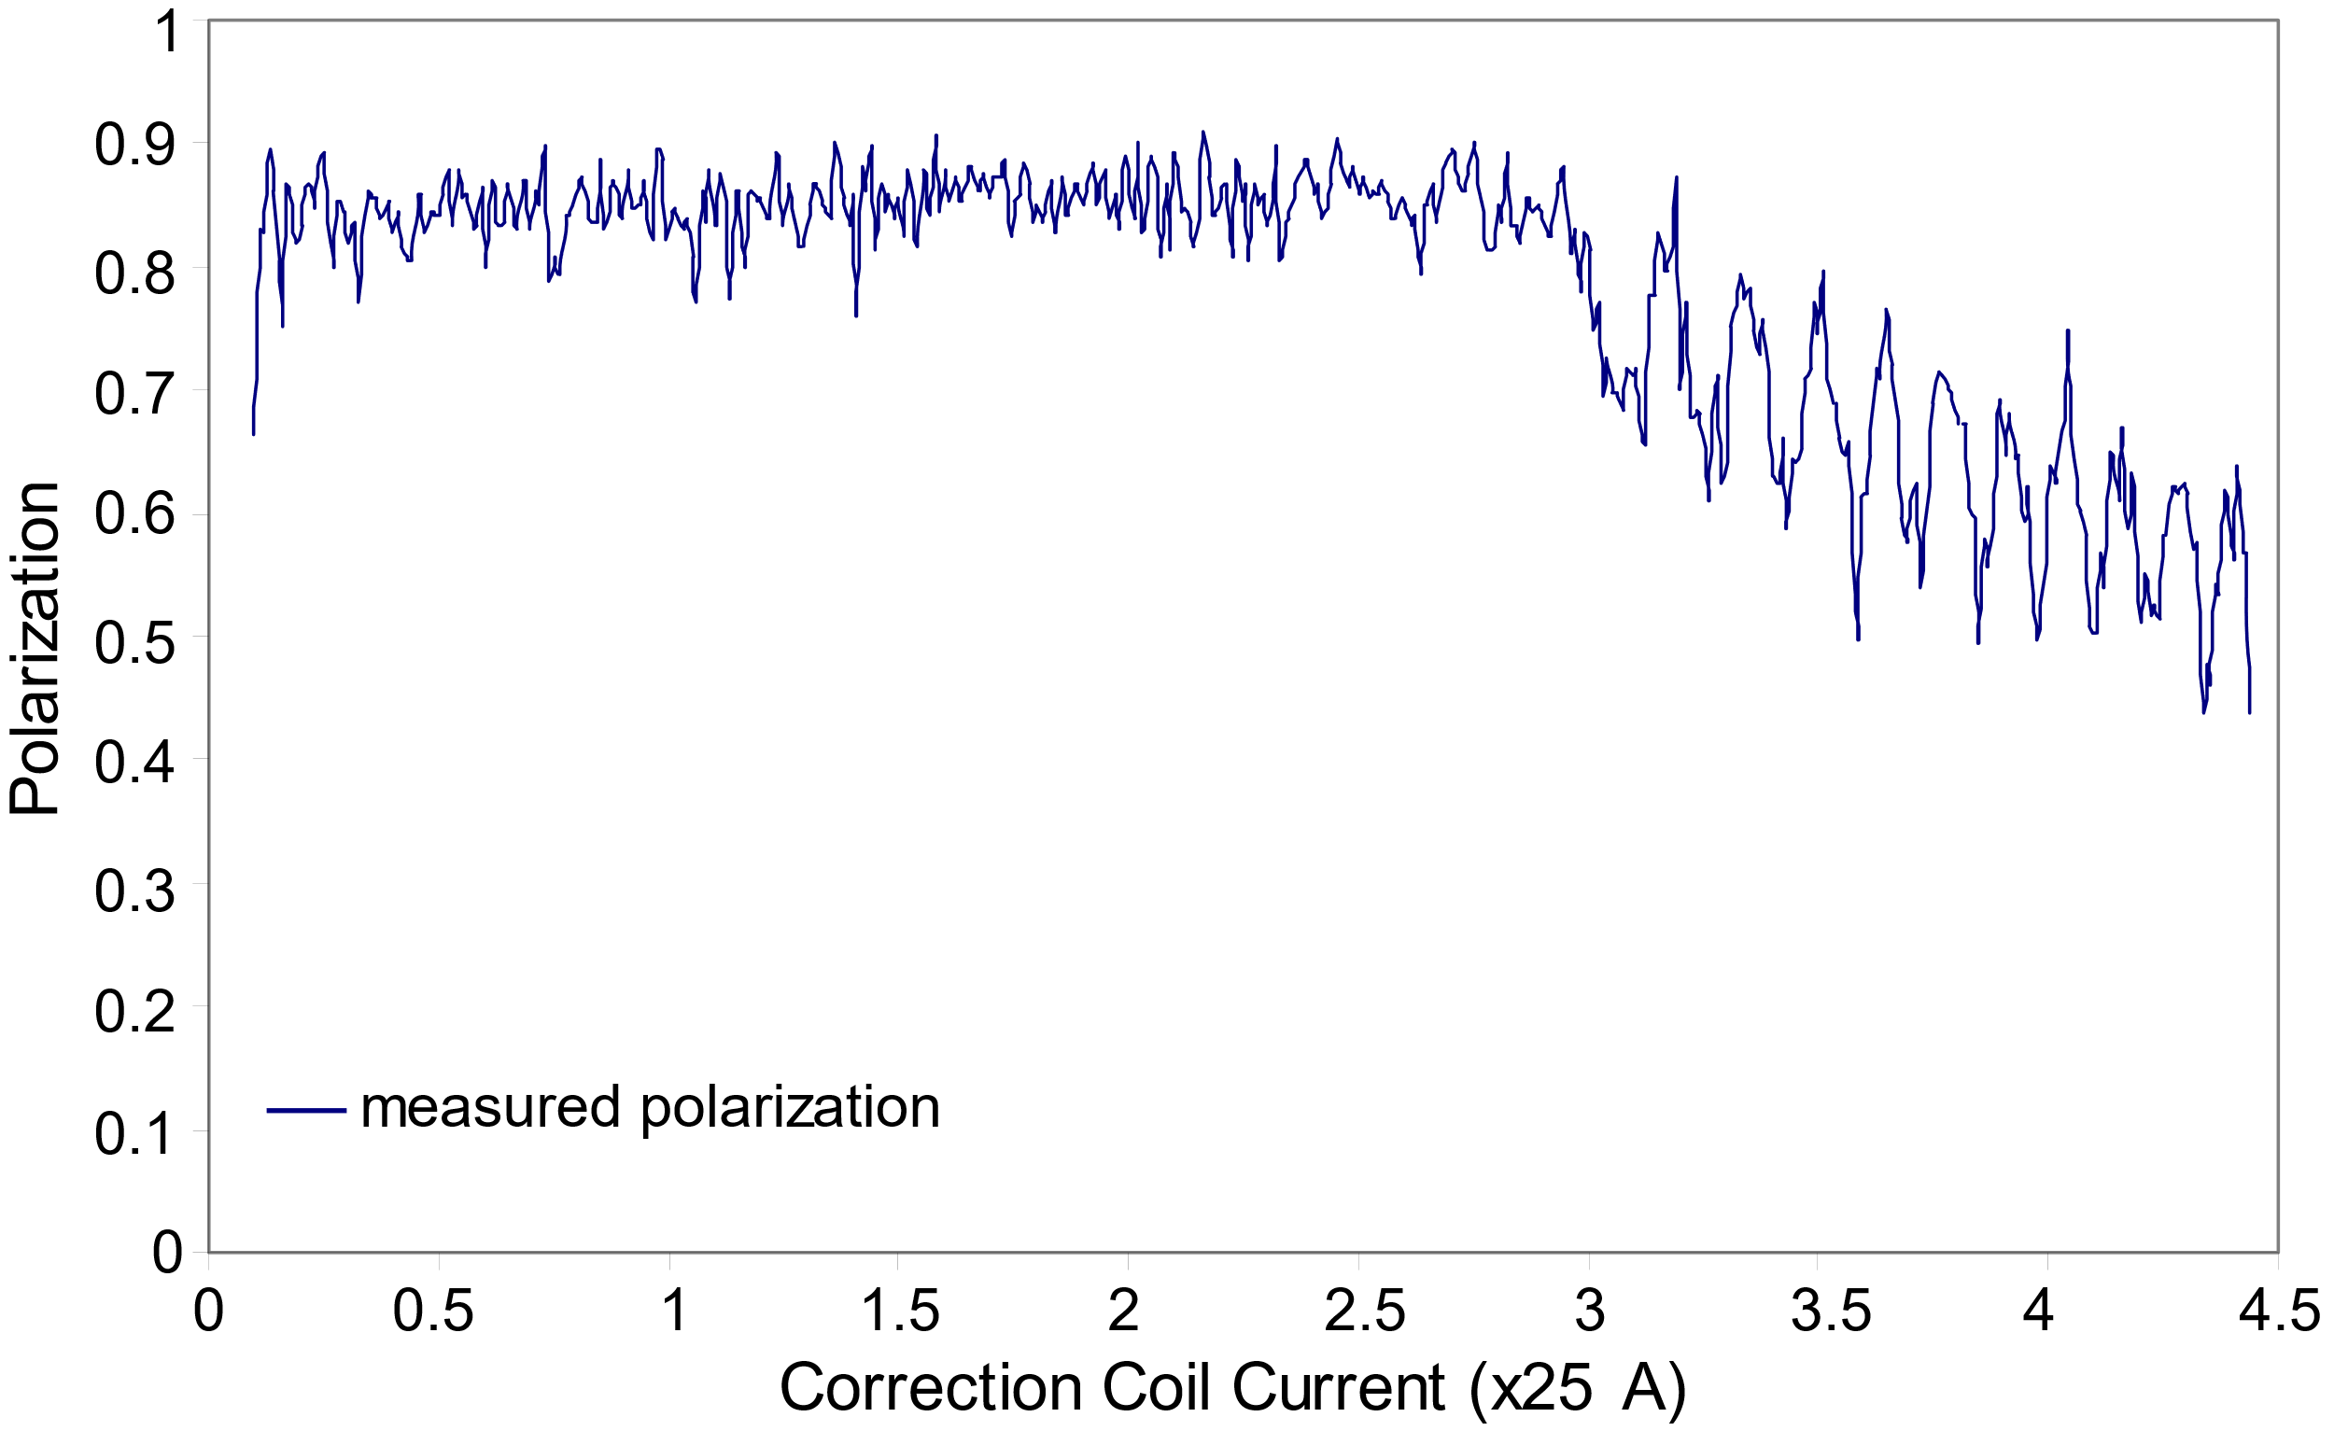
Sona transitions
Unexpected oscillations and polarization loss
Brief literature search
Optically Pumped Polarized Ion Source (BNL OPPIS)
The zero-crossing requirements were fulfilled for a 3 keV beam and a diameter of 2 cm.
Qualitative explanation: Rotation of the electron spin about the radial field axis.
even multiple of $2π$ radians peaks
odd multiples of $π$ radians troughs
A. Kponou et al., AIP Conf. Proc. 980, 241 (2008).

Slide 14
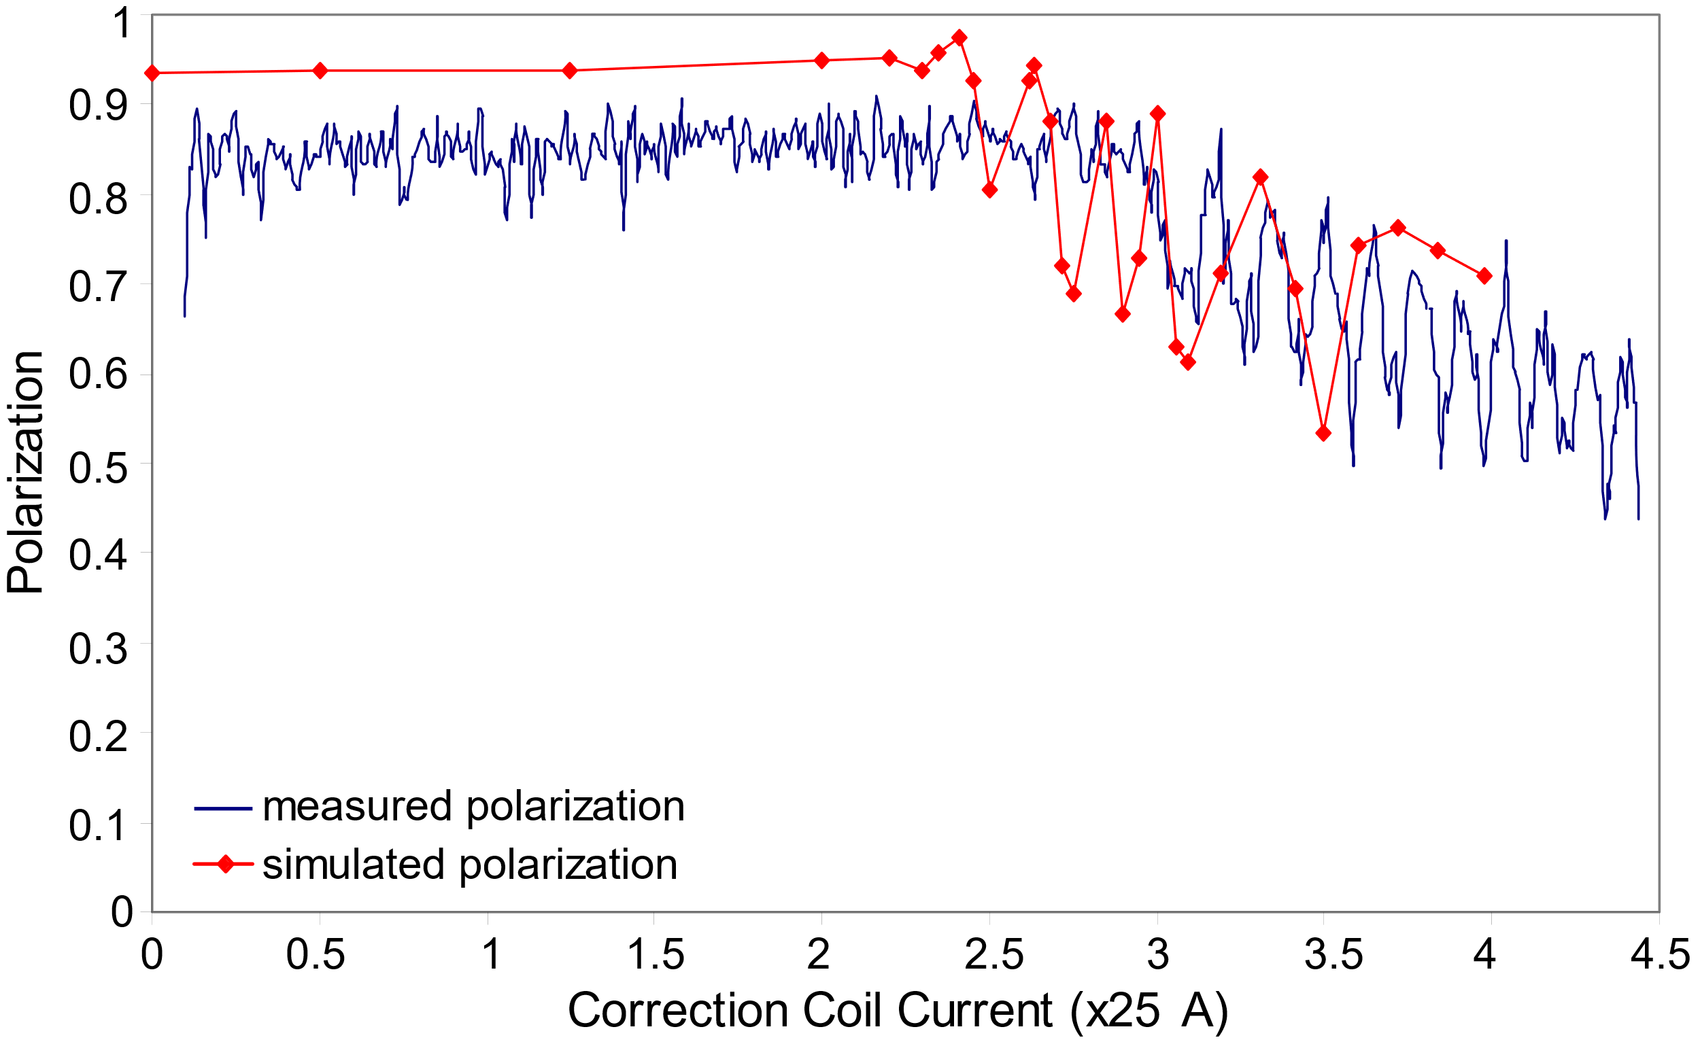
Sona transitions
Unexpected oscillations and polarization loss
Brief literature search
Optically Pumped Polarized Ion Source (BNL OPPIS)
The zero-crossing requirements were fulfilled for a 3 keV beam and a diameter of 2 cm.
Qualitative explanation: Rotation of the electron spin about the radial field axis.
even multiple of $2π$ radians peaks
odd multiples of $π$ radians troughs
Numerical calculations of non-adiabatic passage through the employed Sona transition unit:
simulated starting value is higher than observed
fewer and slower oscillations
E. P. Antishev and A. S. Belov, AIP Conf. Proc. 980, 263 (2008).
A. Zelenski et al., EPAC TUOBM03, 1010 (2008).

Slide 15
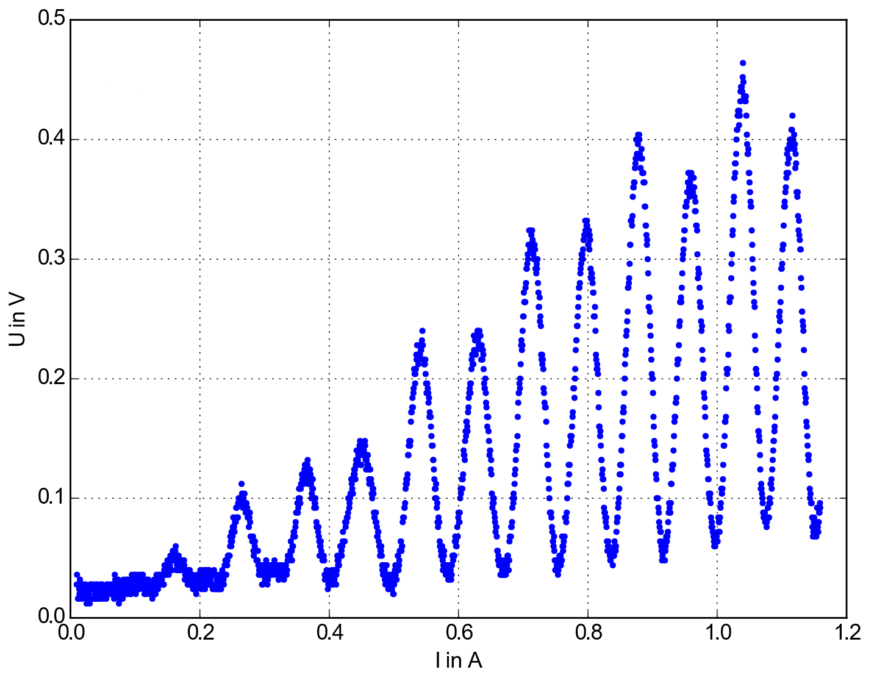
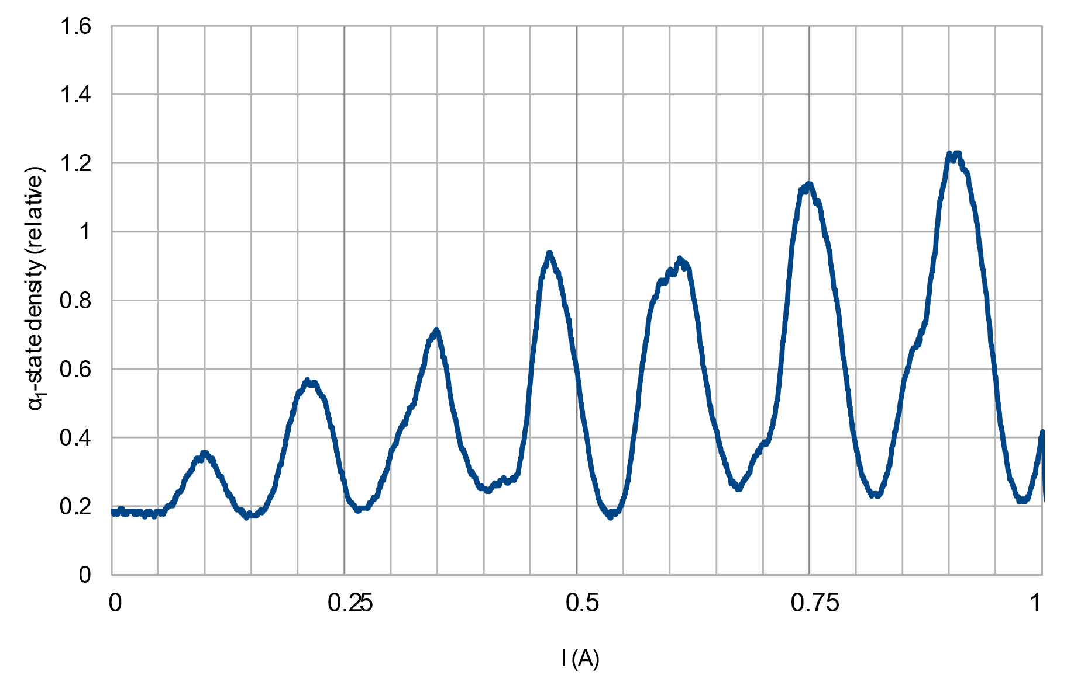
Sona transitions
Unexpected oscillations and polarization loss
Early studies at Forschungszentrum Jülich
Neutron Bound Beta decay (BoB project): Magnetic field direction reversal for the detection of H atoms in the $β_{3}$ state with a Lamb-shift polarimeter.
P. Buske, B.S. Thesis (2016).
Y. Gan, B.S. Thesis (2017).

Slide 16
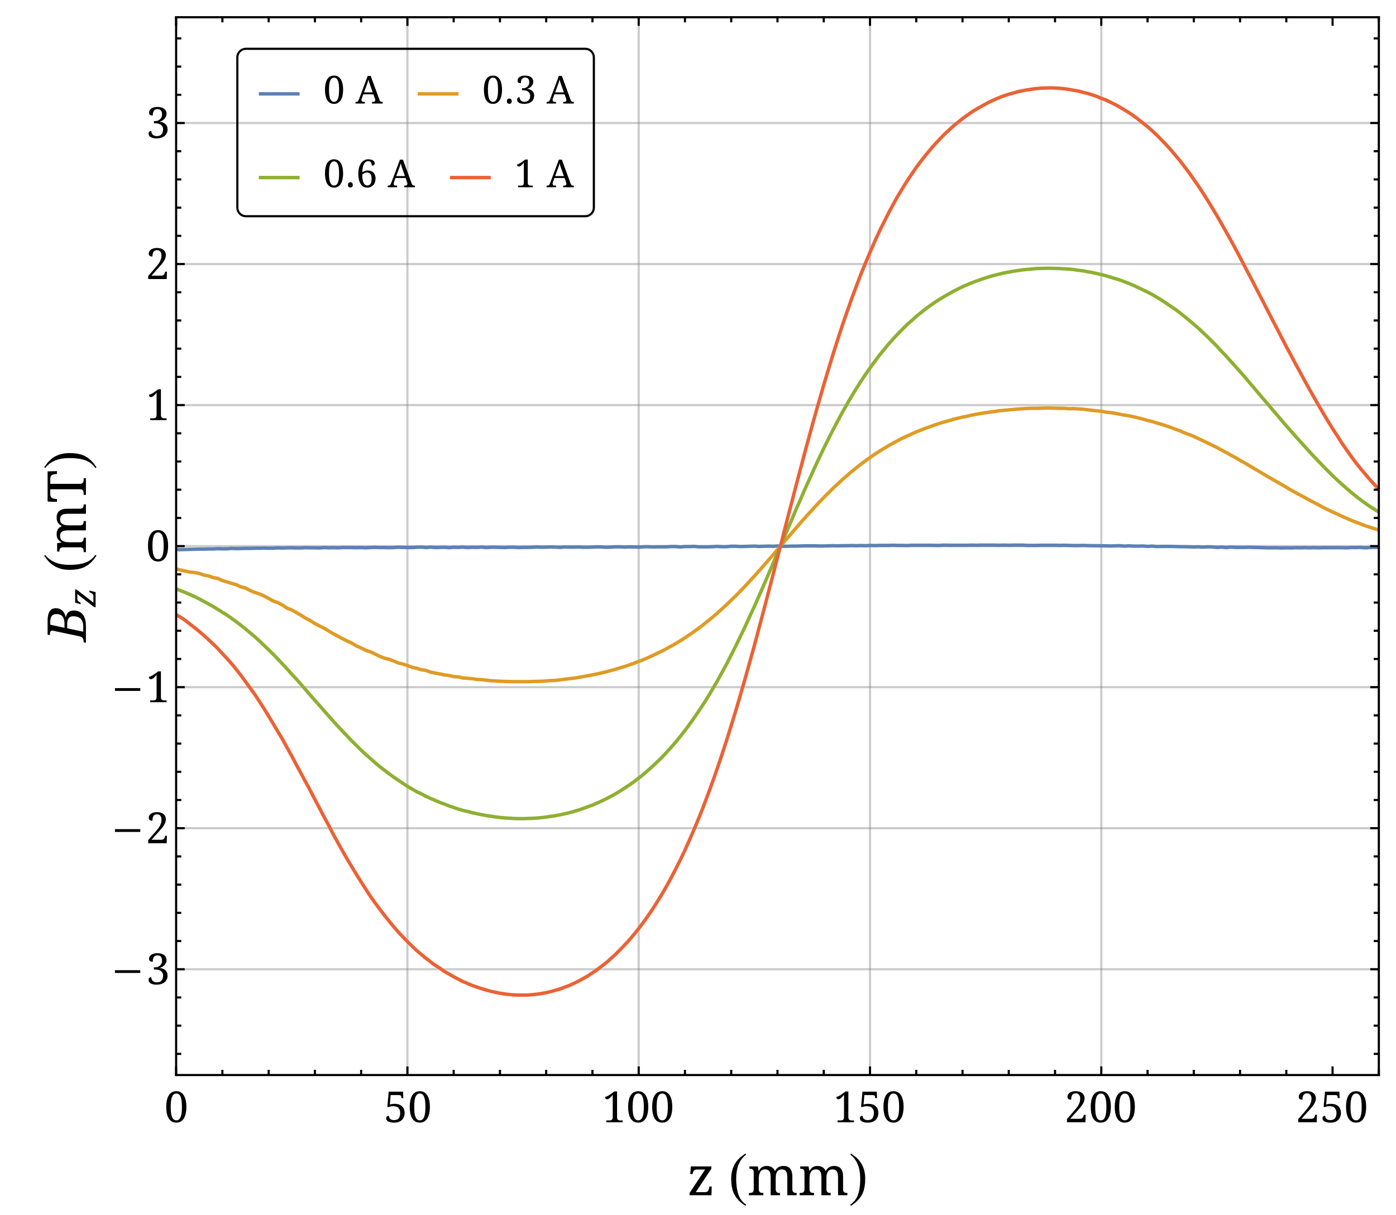
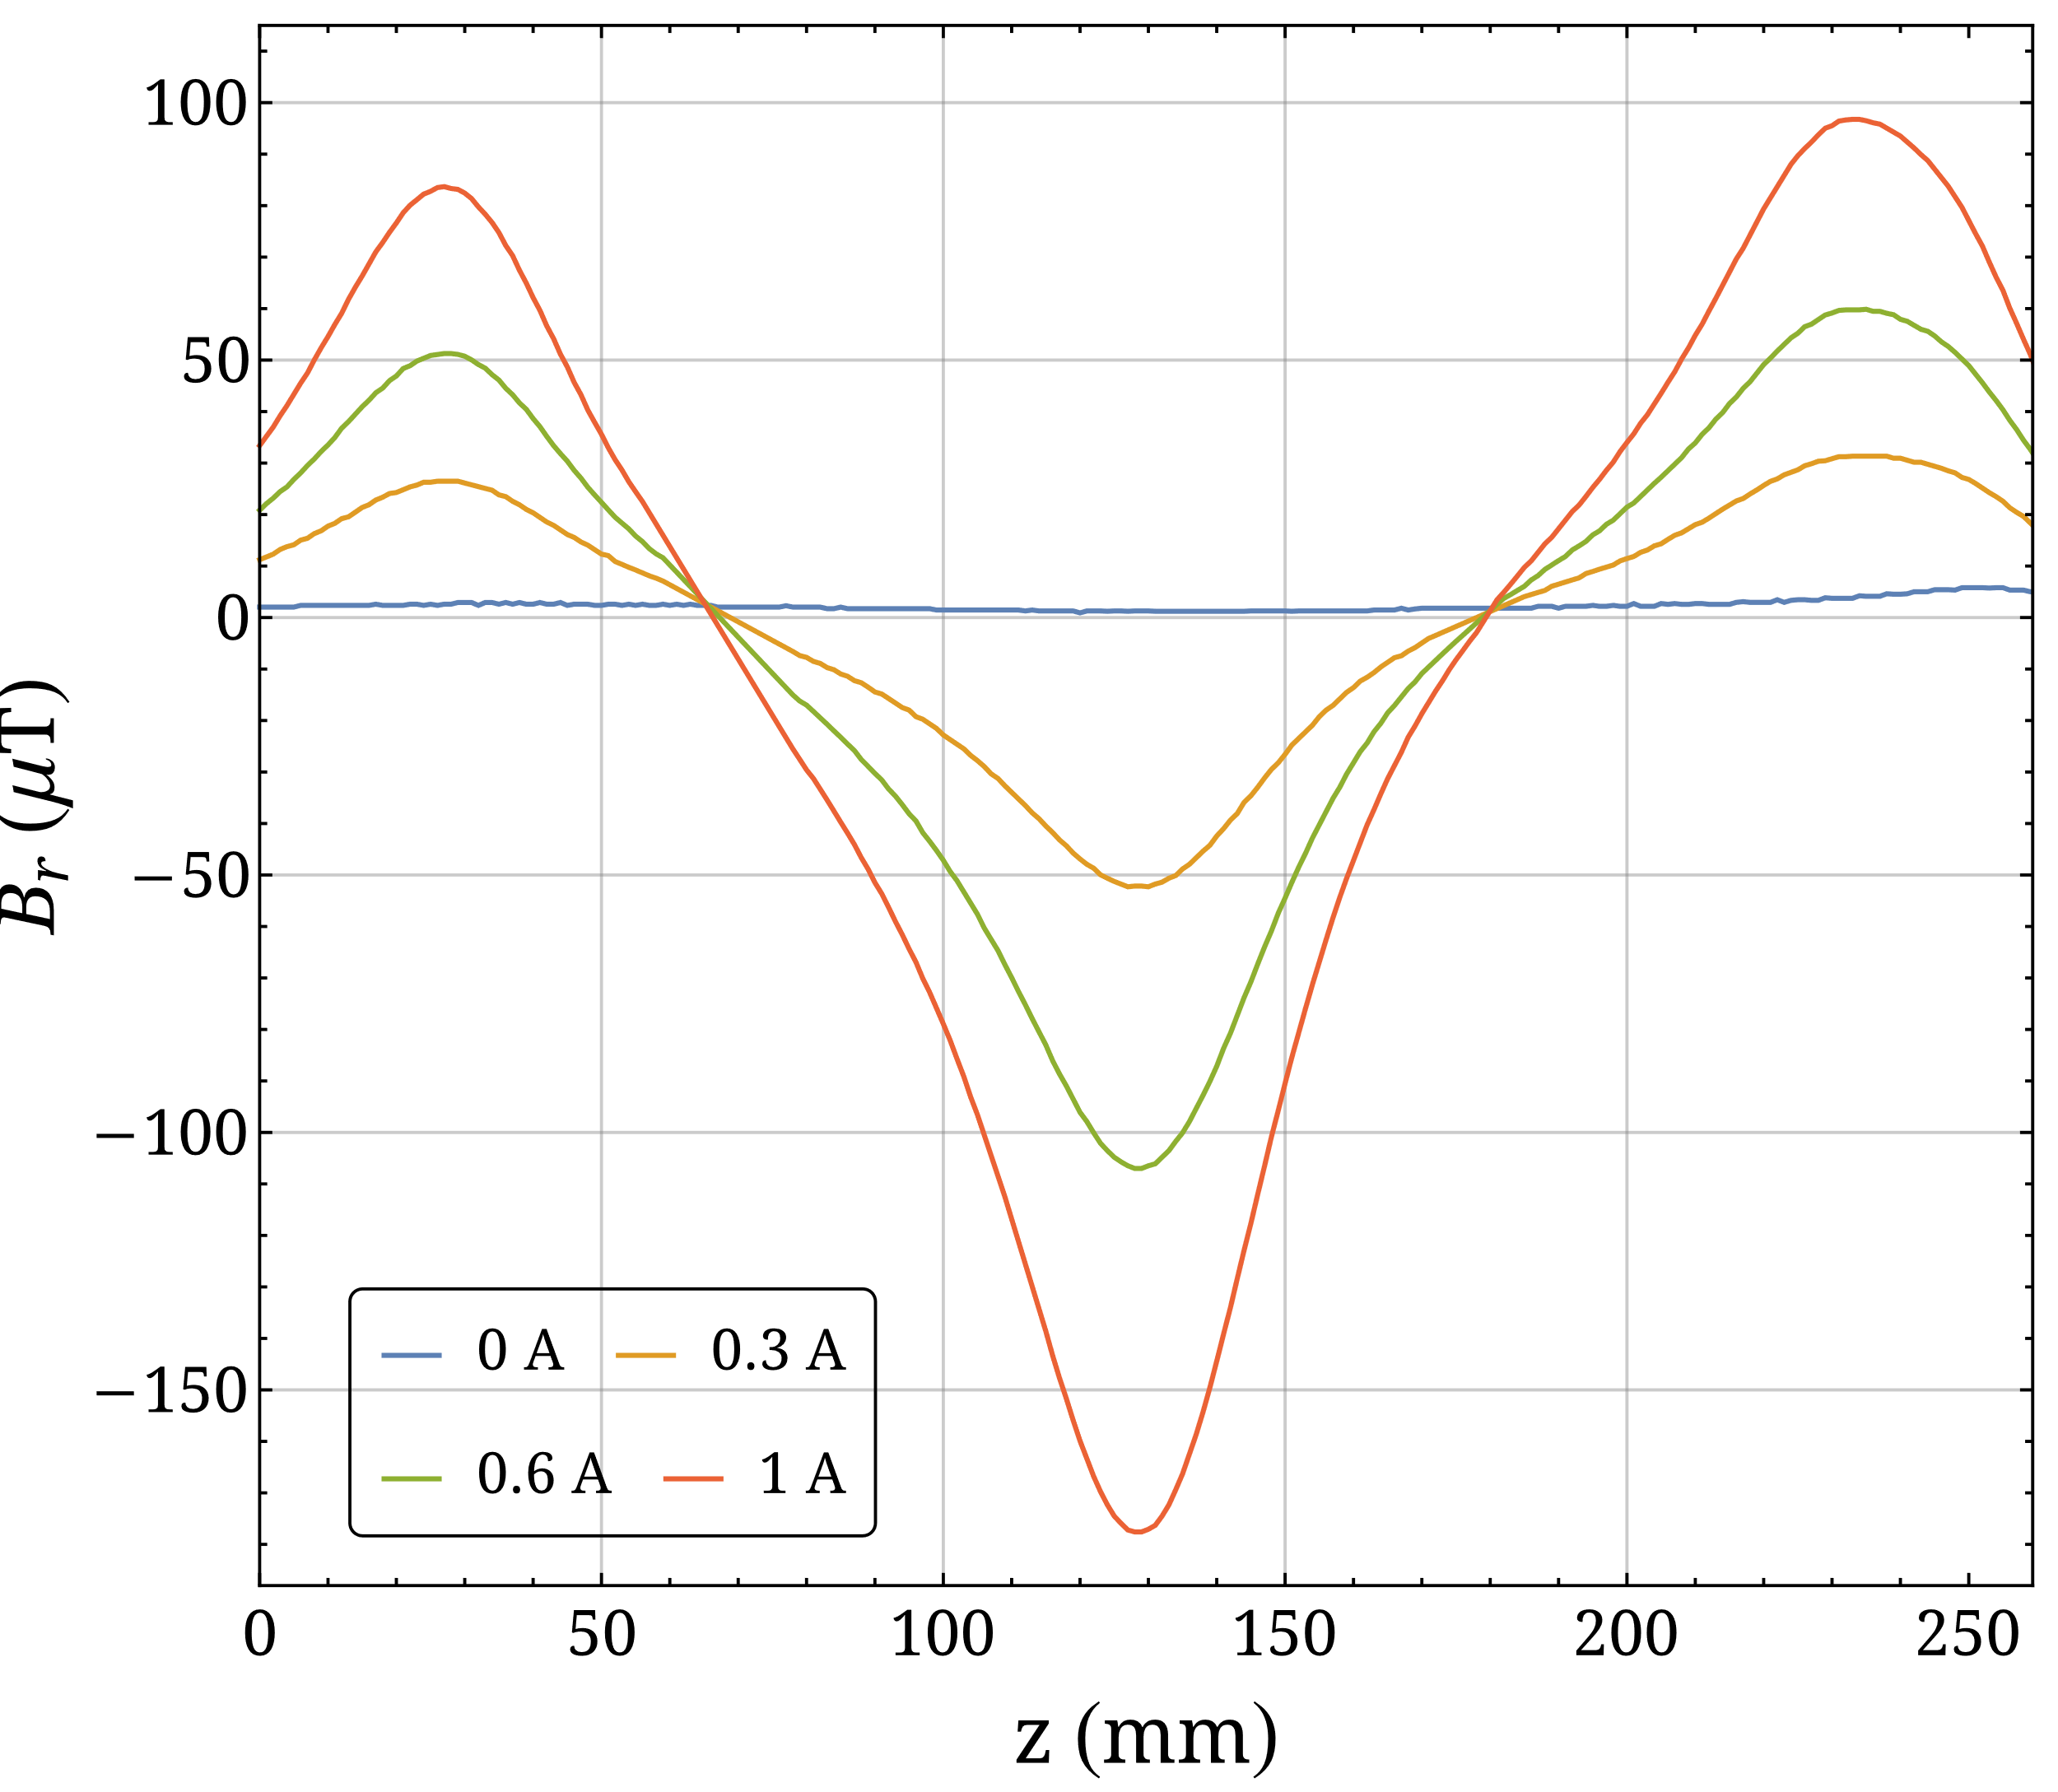
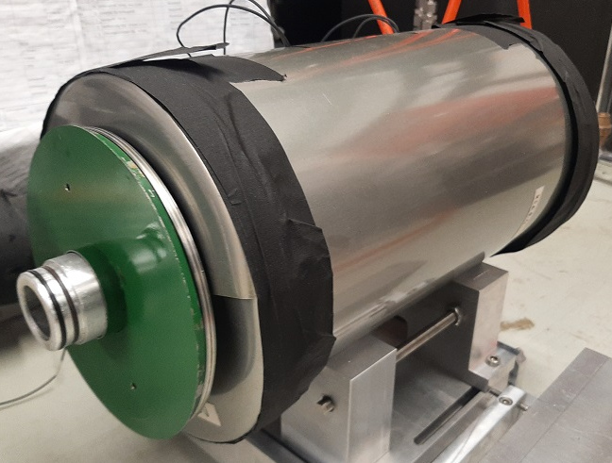
Sona transitions
Present studies
Experimental setup
Preliminary Sona transition unit
$$I$$
$$B_{z}$$
$$B_{z}$$
$$I$$

Slide 17
Sona transitions
Present studies
Experimental setup
$H_{2}$ $H_{2}^{+}, p$ $p$ $H(2S_{1/2})$ $α_{1}\text{−}state$ $β_{3}\text{−}state$ (?) $α_{1}/α_{2}\text{−}state$ $Ly\text{−}α$

Slide 18
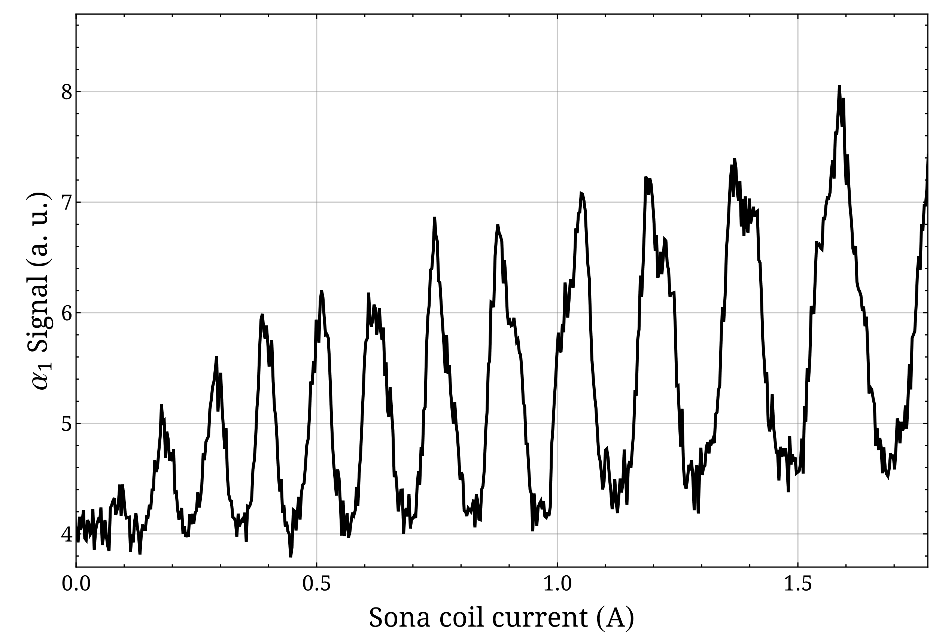
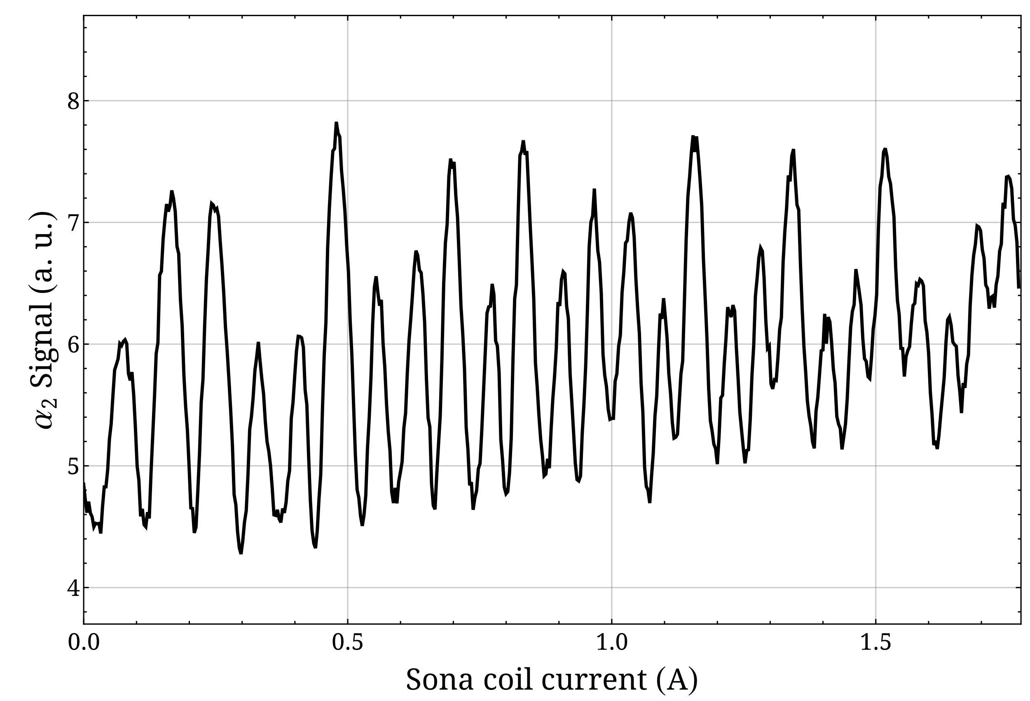
Sona transitions
Present studies
Measurements (metastable hydrogen)

Slide 19
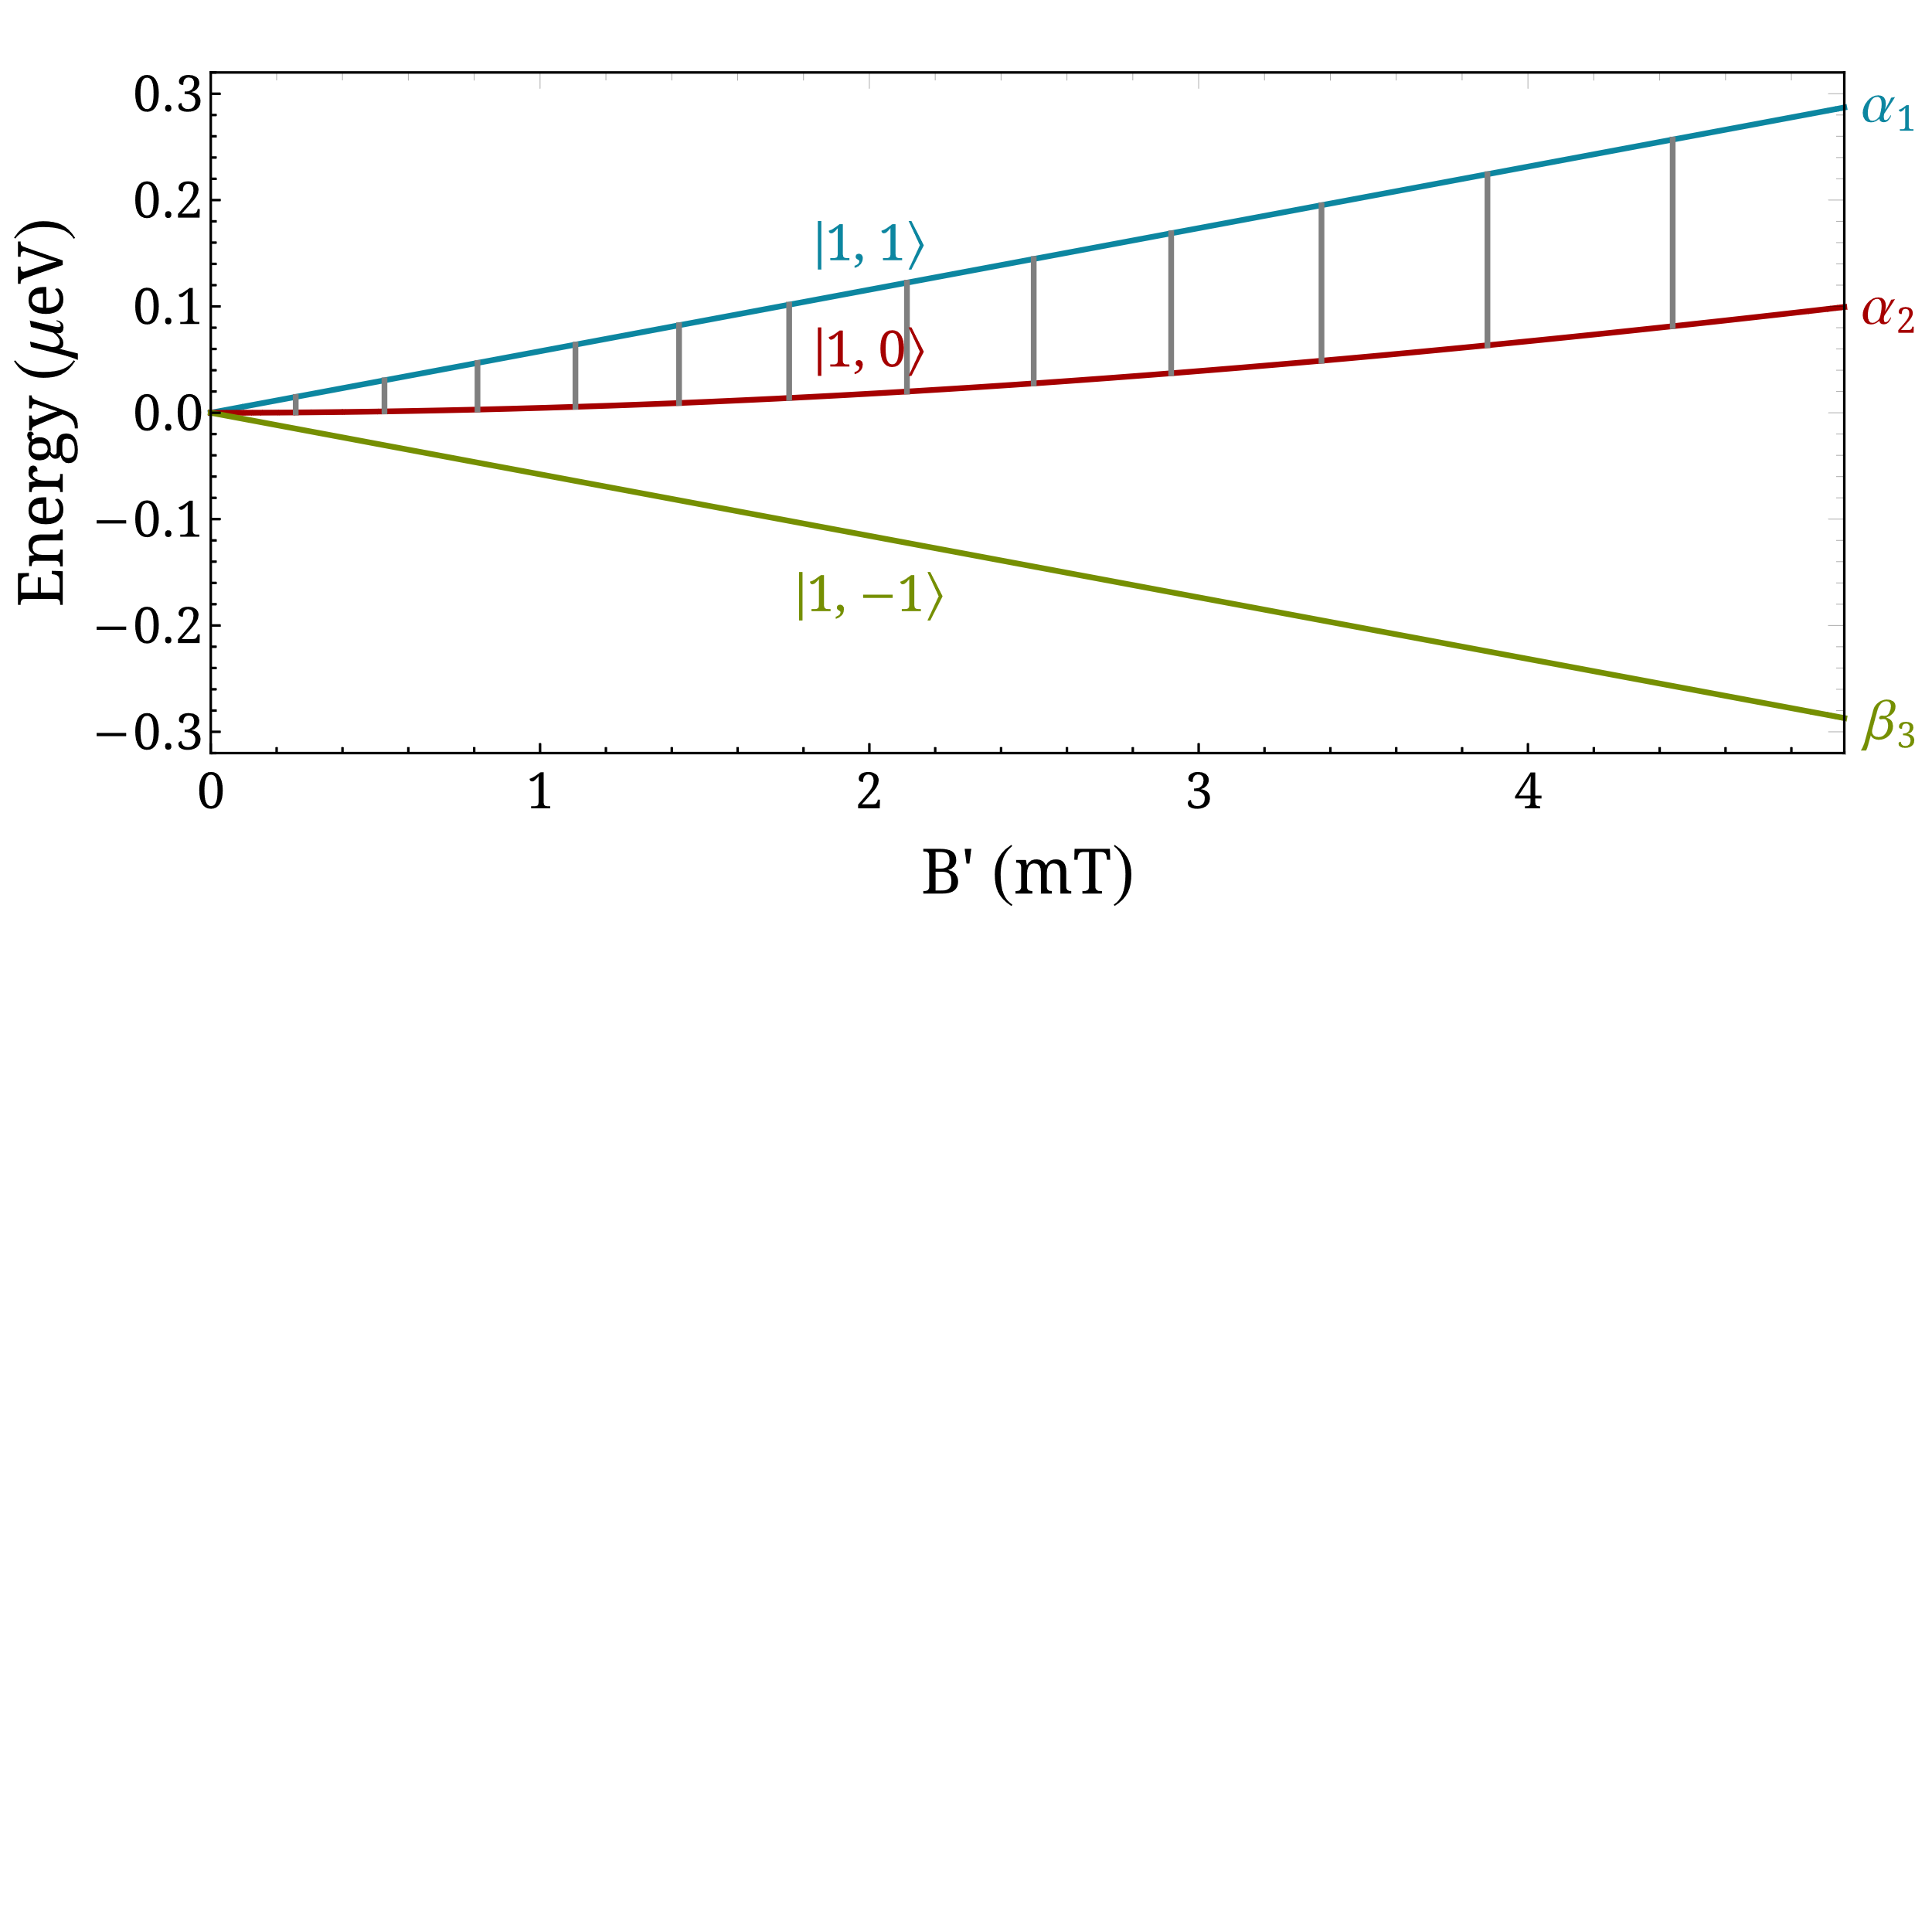
Sona transitions
Present studies
Photon model
Magnetic dipole transitions: $Δm_{F}=±1$
Sign change of $B_{z}$: $α_{1}→β_{3}$
Time-varying $B_{r}$ (at the rest frame, for $r≠0$): $α_{2}⇄β_{3}$ and $α_{1}⇄α_{2}$
The definite shape of $B_{r}$ determines the wavelength $λ$, and the velocity $v$ of the atoms determines the frequency: $v=\frac{λ}{Δt}=λf$ or $f=v/λ$
Energy of absorbed photons: $ΔE_{n}=\left(2n+1\right)hf$, for $n∈ℕ$
$λ∼20$ cm, $f∼2$ MHz, $ΔE_{0}∼10$ neV

Slide 20
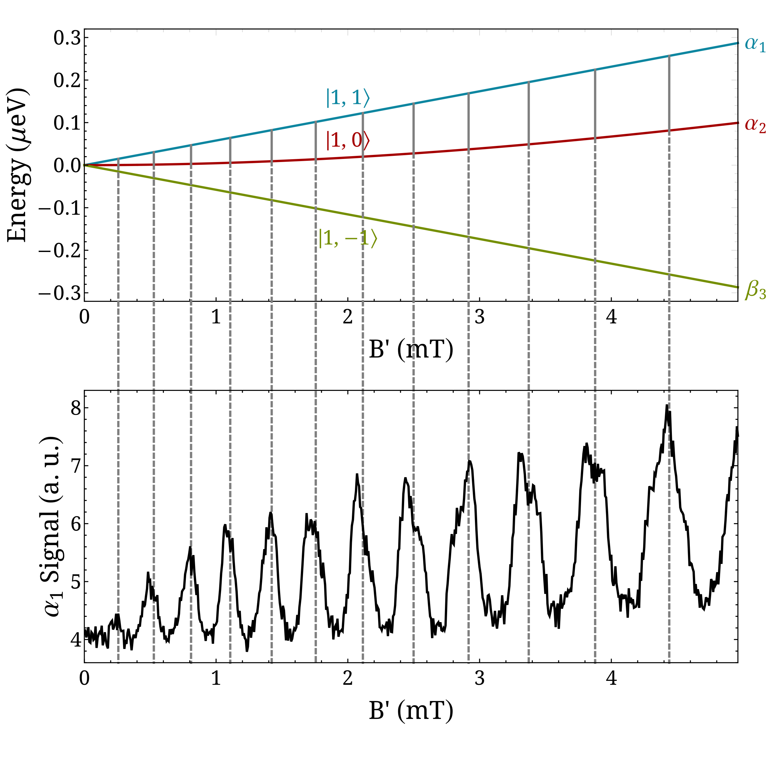
Sona transitions
Present studies
Photon model
Magnetic dipole transitions: $Δm_{F}=±1$
Sign change of $B_{z}$: $α_{1}→β_{3}$
Time-varying $B_{r}$ (at the rest frame, for $r≠0$): $α_{2}⇄β_{3}$ and $α_{1}⇄α_{2}$
The definite shape of $B_{r}$ determines the wavelength $λ$, and the velocity $v$ of the atoms determines the frequency: $v=\frac{λ}{Δt}=λf$ or $f=v/λ$
Energy of absorbed photons: $ΔE_{n}=\left(2n+1\right)hf$, for $n∈ℕ$
$λ∼20$ cm, $f∼2$ MHz, $ΔE_{0}∼10$ neV

Slide 21
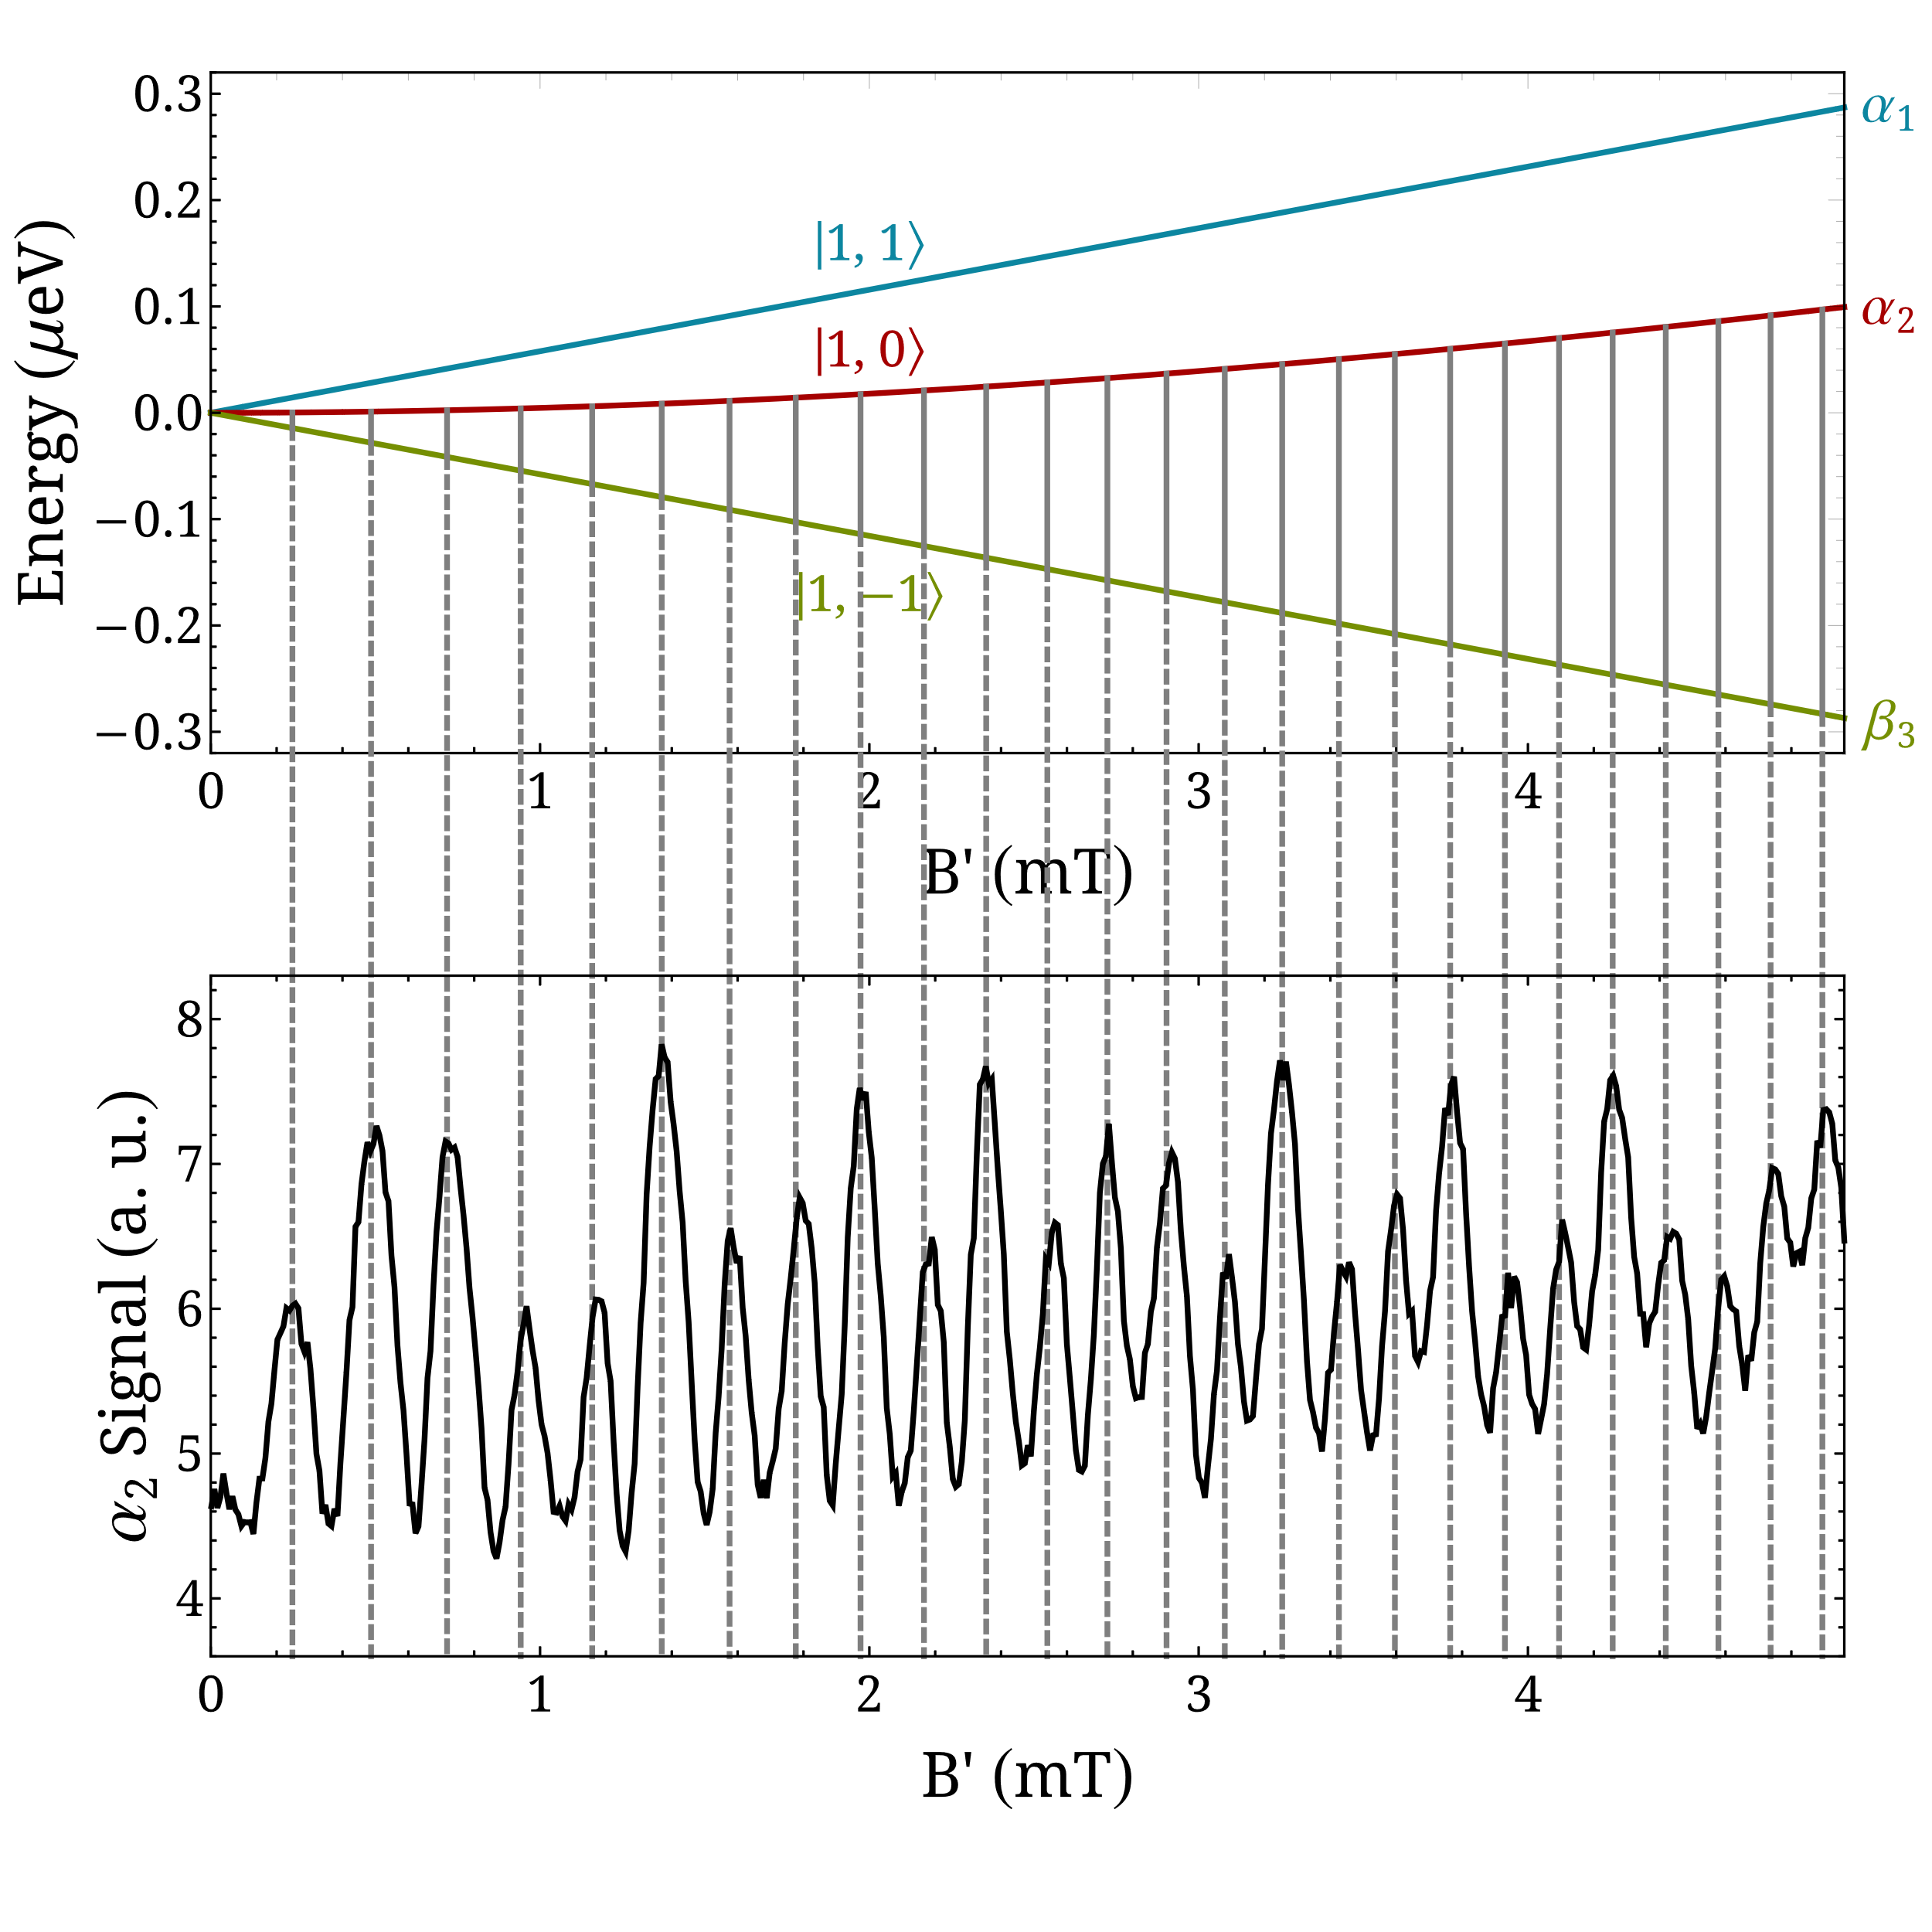
Sona transitions
Present studies
Photon model
Magnetic dipole transitions: $Δm_{F}=±1$
Sign change of $B_{z}$: $α_{1}→β_{3}$
Time-varying $B_{r}$ (at the rest frame, for $r≠0$): $α_{2}⇄β_{3}$ and $α_{1}⇄α_{2}$
The definite shape of $B_{r}$ determines the wavelength $λ$, and the velocity $v$ of the atoms determines the frequency: $v=\frac{λ}{Δt}=λf$ or $f=v/λ$
Energy of absorbed photons: $ΔE_{n}=\left(2n+1\right)hf$, for $n∈ℕ$
$λ∼20$ cm, $f∼2$ MHz, $ΔE_{0}∼10$ neV

Slide 22
Sona transitions
Present studies
Numerical simulations
Study of the system in its rest frame: The spatial dependence of the magnetic field is transformed into time dependence $\left(t=\frac{z}{v}\right)$.
The dynamics is obtained by solving the Schrödinger equation:
$$H\left(r,t\right) \left|\left.ψ\left(r,t\right)\right\rangle \right.=iℏ \frac{∂\left|\left.ψ\left(r,t\right)\right\rangle \right.}{∂t}$$
with
$$H\left(r,t\right)=H_{0}+V\left(r,t\right),$$
where
$$H_{0}=A I⋅J$$
$$V\left(r,t\right)=−μ_{atom}⋅B\left(r,t\right)=−\left(g_{J} μ_{B} J + g_{I} μ_{N} I\right)⋅B\left(r,t\right)$$

Slide 23
Sona transitions
Present studies
Numerical simulations
Use the eigensystem $\left\{E_{n}, \left|\left.n\right\rangle \right.\right\}$ of the unperturbed $H_{0}$ to express any quantum state $\left|\left.ψ\left(r,t\right)\right\rangle \right.$:
$$\left|\left.ψ\left(r,t\right)\right\rangle =\right.\sum_{n=1}^{\left(2J+1\right)\left(2I+1\right)}{c_{n}\left(r,t\right) \left|\left.n\left(t\right)\right\rangle \right.}=\sum_{n=1}^{\left(2J+1\right)\left(2I+1\right)}{c_{n}\left(r,t\right) e^{−\frac{iE_{n}t}{ℏ}} \left|\left.n\right\rangle \right.}$$
The Schrödinger equation yields:
$$iℏ{\dot{c}}_{k}\left(r,t\right)=\sum_{n=1}^{\left(2J+1\right)\left(2I+1\right)}{c_{n}\left(r,t\right) e^{−\frac{i{(E}_{n}−E_{k})t}{ℏ}} \left\langle \left.k\right|\right.V\left(r,t\right)\left|\left.n\right\rangle \right.} \text{for} k=1, 2, …, \left(2J+1\right)\left(2I+1\right)$$
Calculation of the interaction potential matrix:
No magnetic dipole coupling between the first and the third state, i.e., no direct magnetic dipole transitions between these states are allowed.

Slide 24
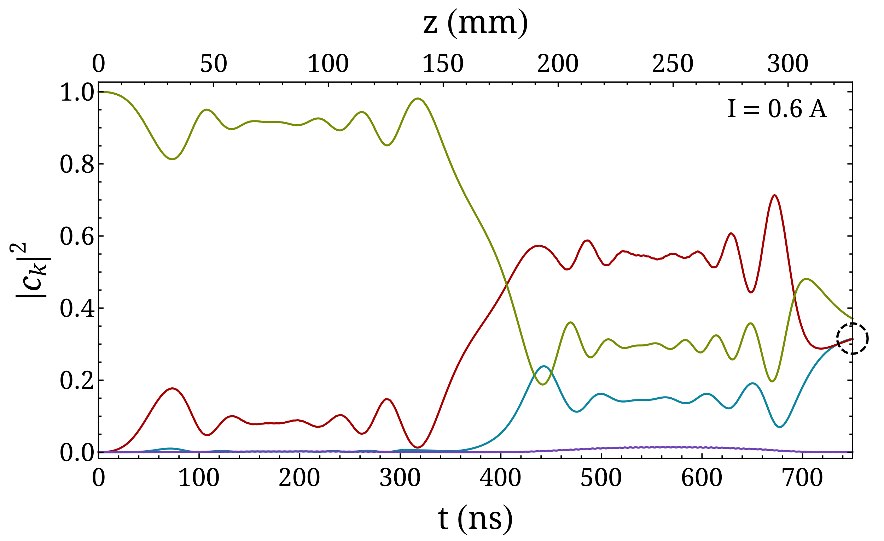
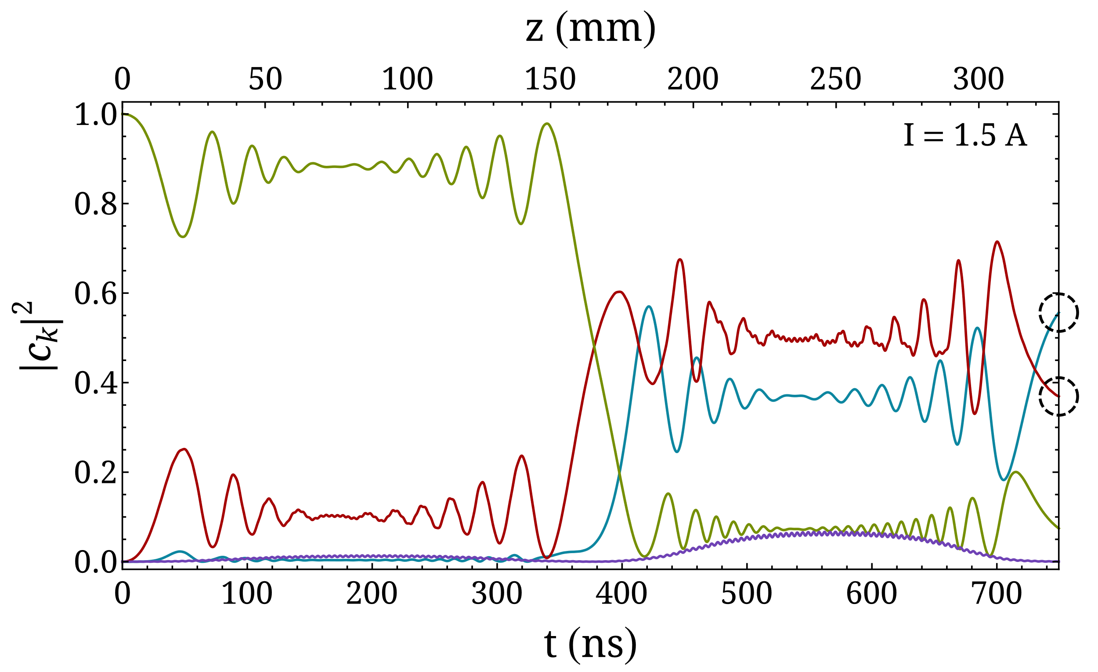
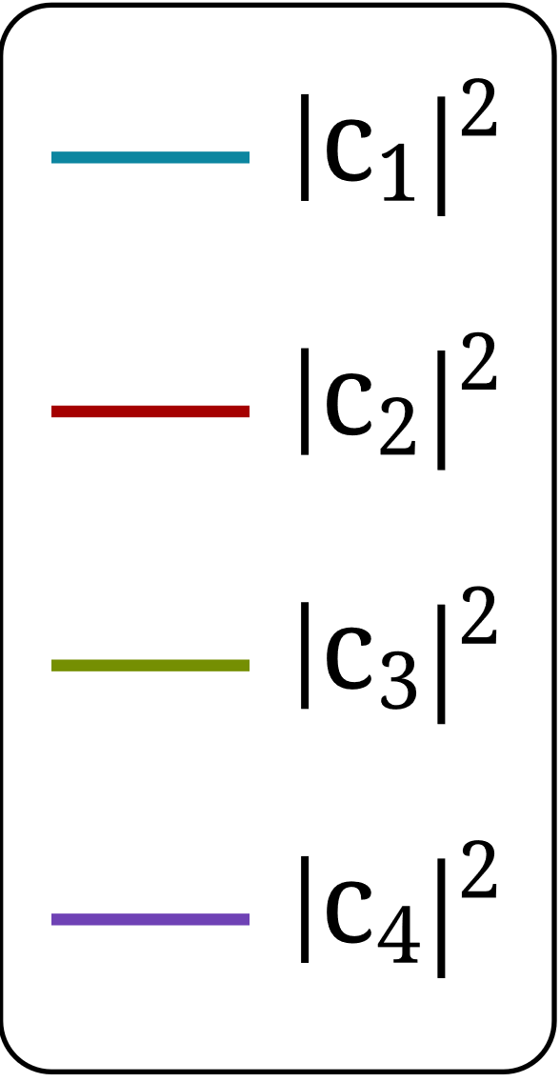
Sona transitions
Present studies
Numerical simulations
Solving $iℏ{\dot{c}}_{k}\left(r,t\right)=\sum_{n=1}^{\left(2J+1\right)\left(2I+1\right)}{c_{n}\left(r,t\right) e^{−\frac{i{(E}_{n}−E_{k})t}{ℏ}} \left\langle \left.k\right|\right.V\left(r,t\right)\left|\left.n\right\rangle \right.} \text{for} k=1, 2, …, \left(2J+1\right)\left(2I+1\right)$ gives the probabilities $p_{k}={\left|c_{k}\right|}^{2}$.

Slide 25
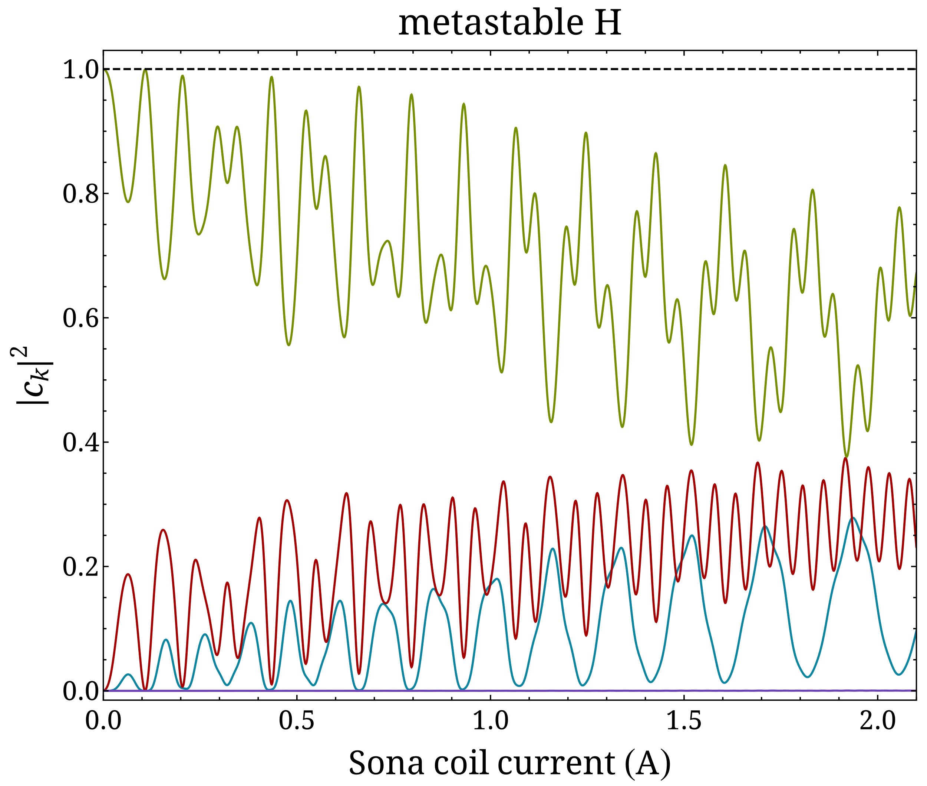
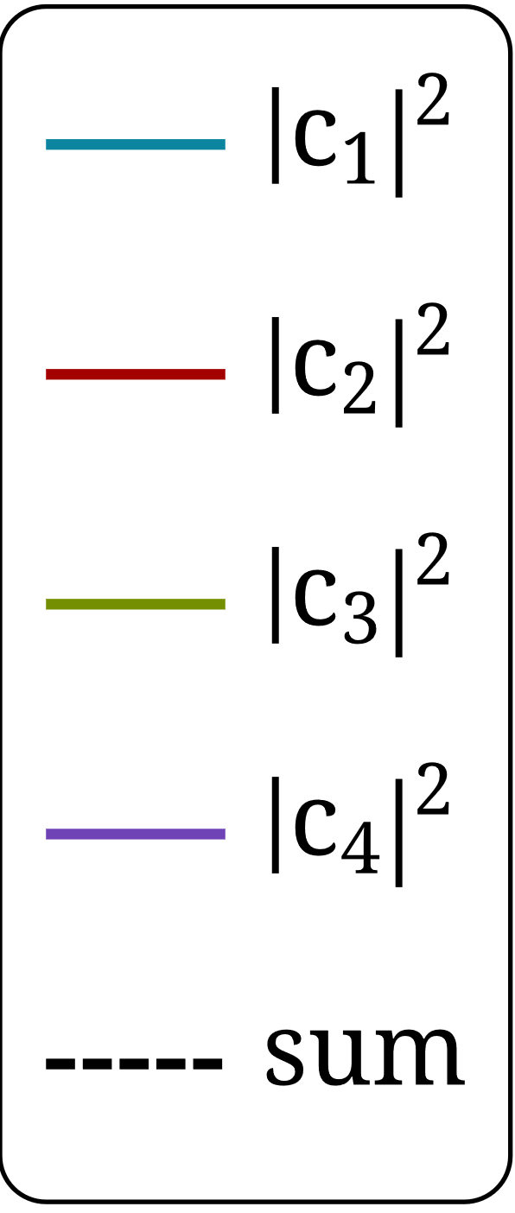
Sona transitions
Present studies
Numerical simulations
Integration over the beam profile, e.g., Gaussian distribution spanning on the x-y plane:
centered at the origin $\left(0, 0\right)$ with $σ=σ_{x}=σ_{y}=5$ mm
axially symmetric magnetic field and beam distribution
use of polar coordinates
$f\left(r\right)=\frac{1}{2πσ^{2}}e^{−\frac{r^{2}}{2σ^{2}}}$

Slide 26
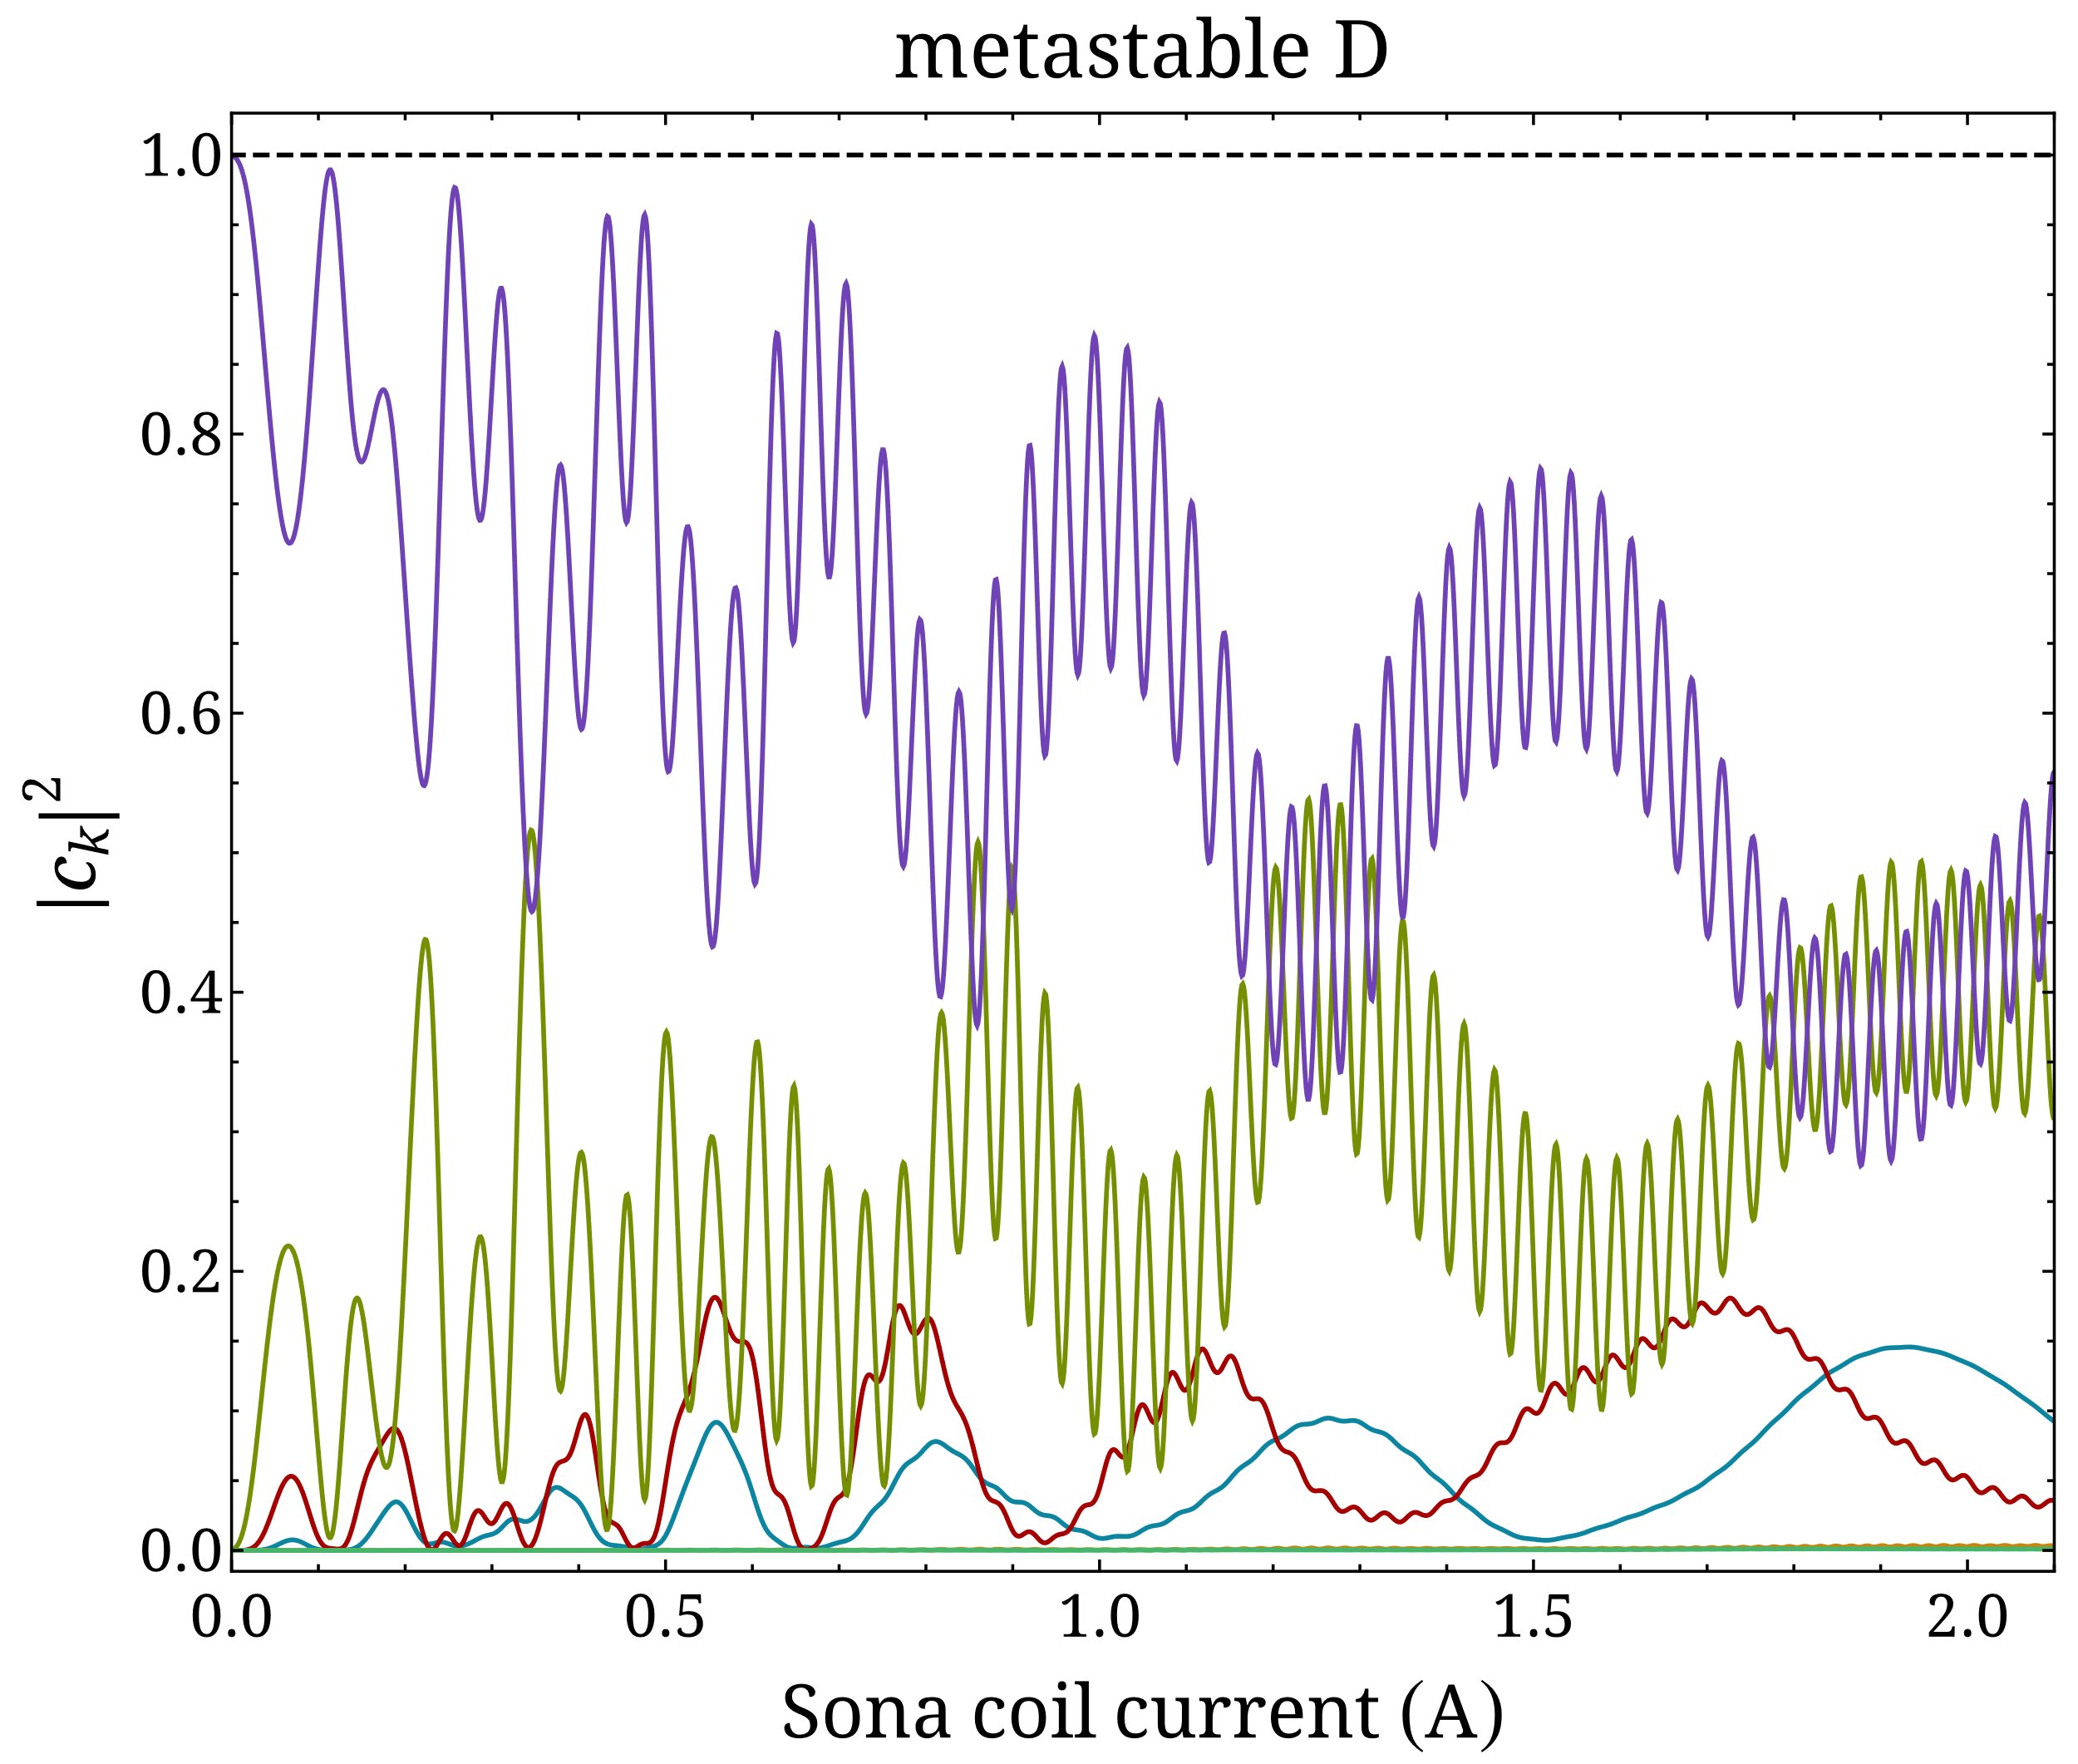
Sona transitions
Present studies
Numerical simulations
Integration over the beam profile, e.g., Gaussian distribution spanning on the x-y plane:
centered at the origin $\left(0, 0\right)$ with $σ=σ_{x}=σ_{y}=5$ mm
axially symmetric magnetic field and beam distribution
use of polar coordinates
$f\left(r\right)=\frac{1}{2πσ^{2}}e^{−\frac{r^{2}}{2σ^{2}}}$

Slide 27
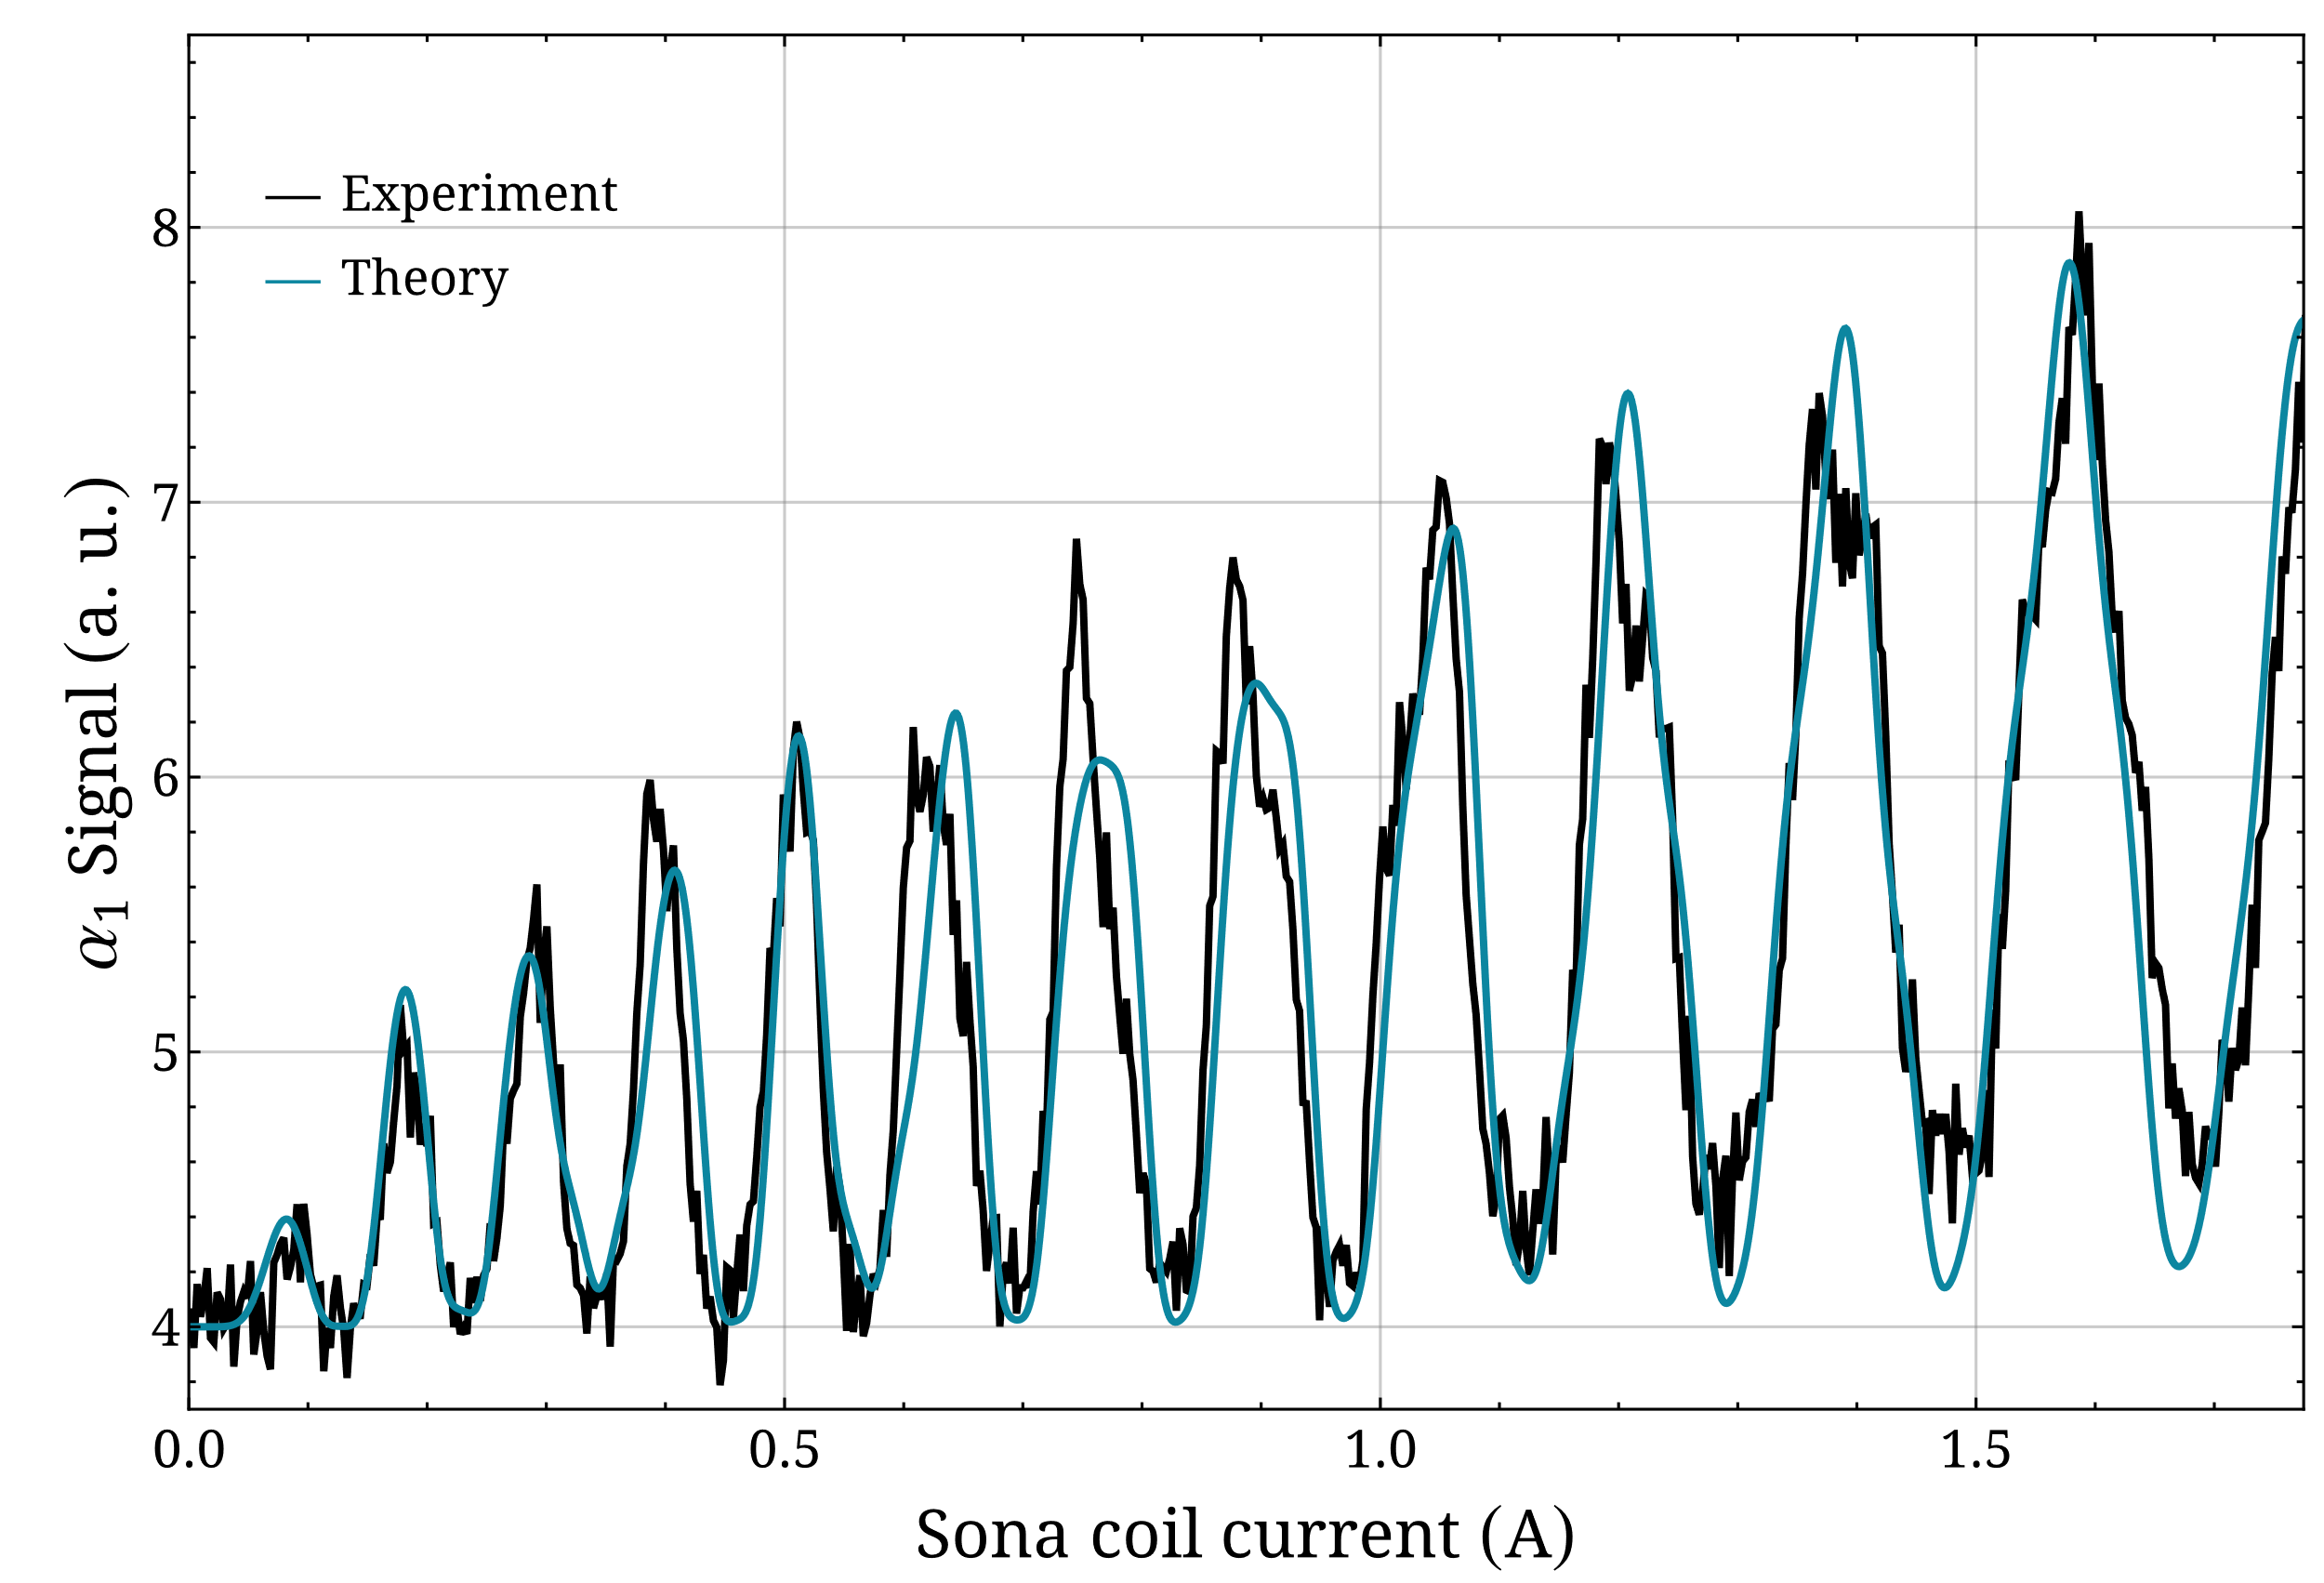
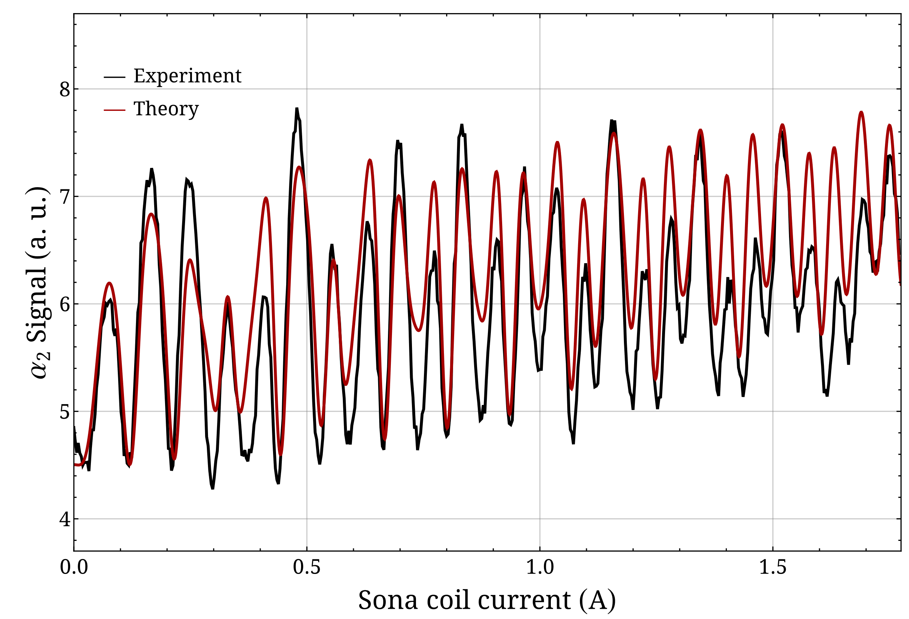
Sona transitions
Present studies
Comparison between measurements and numerical simulations
R. Engels et al., Eur. Phys. J. D 75, 257 (2021).

Slide 28
Sona UNIT AS polarizer
Present studies
Probability oscillations without initial polarization

Slide 29
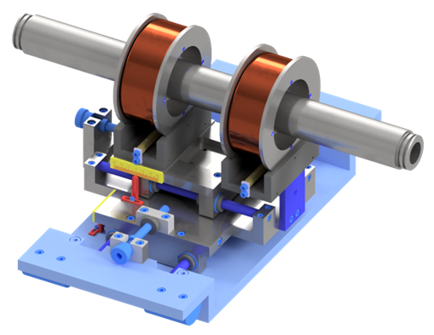
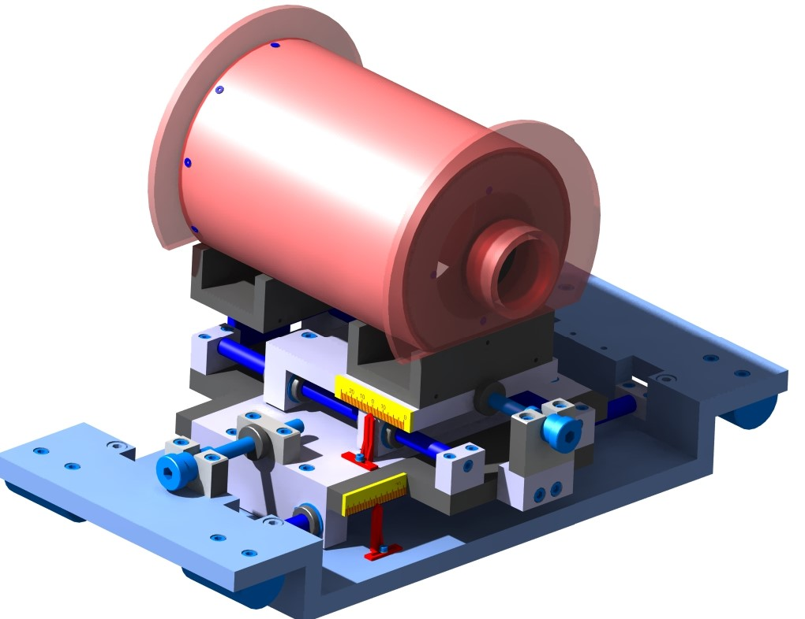
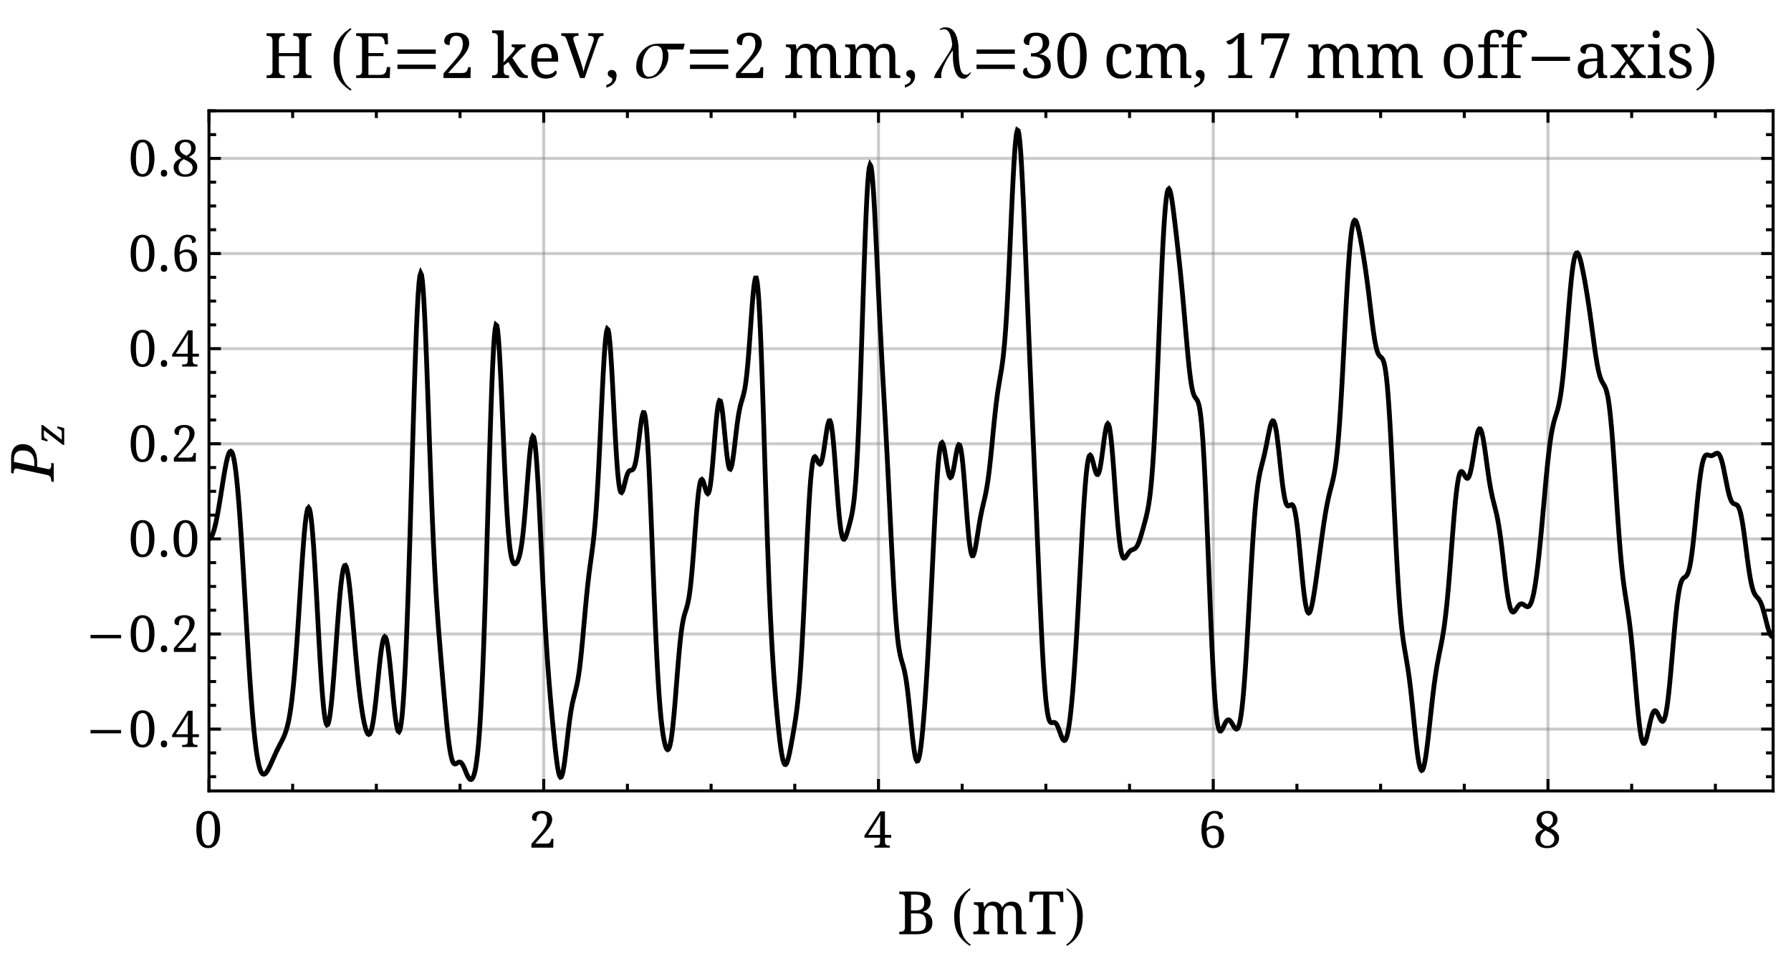
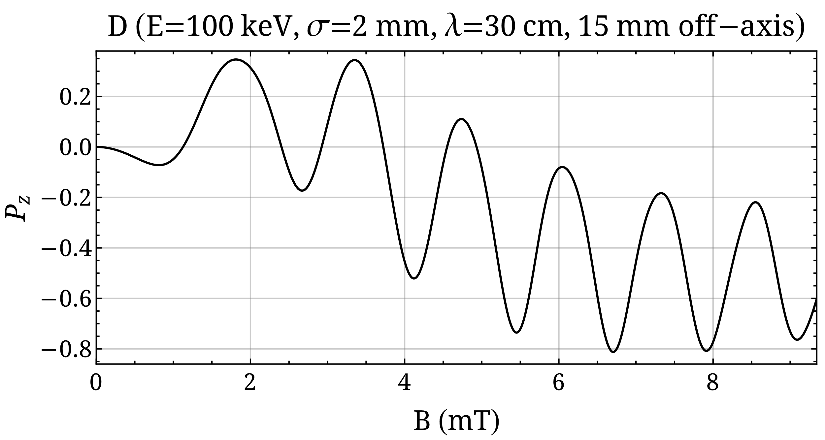
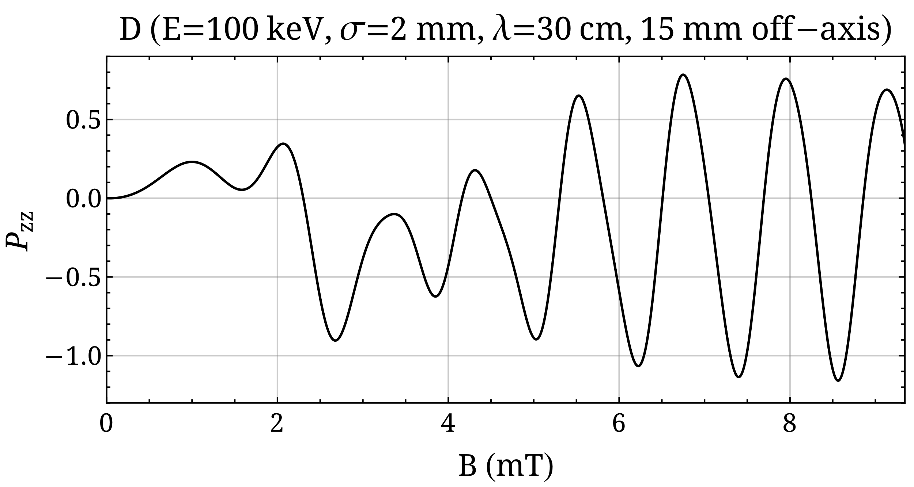
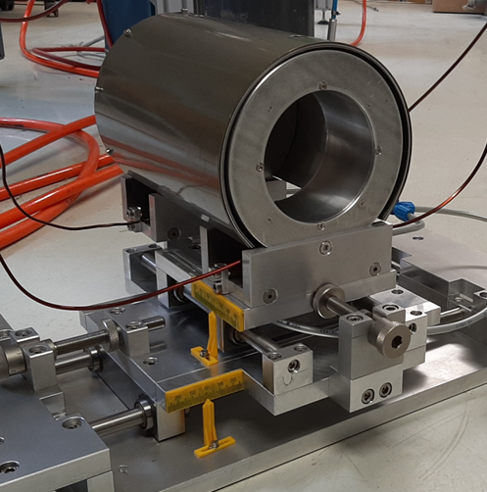
Sona UNIT AS polarizer
Future directions
Probability oscillations without initial polarization
New Sona unit designs to exploit the off-axis radial field for metastable H and D atomic beams.
N. Hanold, B.S. Thesis (2023).

Slide 30
Sona UNIT AS polarizer
Future directions
Possible applications and polarization schemes
Patent filed in December 2022: “Verfahren und eine Vorrichtung zur Erzeugung von polarisierten Atomen, Molekülen und deren Ionen”, Ref. No.: 102022213860.0
Applied to any type of interacting angular momenta in atoms, molecules, or ions.
The simpler the hyperfine structure is, the higher the polarization values can be.

Slide 31
Sona UNIT AS polarizer
Future directions
Possible applications and polarization schemes
Patent filed in December 2022: “Verfahren und eine Vorrichtung zur Erzeugung von polarisierten Atomen, Molekülen und deren Ionen”, Ref. No.: 102022213860.0
Polarized ³He⁺ ion beam [“First test of a polarized ³He⁺ ion source” by N. Faatz (25 September 2023, 5:00 PM)]

Slide 32
Sona UNIT AS polarizer
Future directions
Possible applications and polarization schemes
Patent filed in December 2022: “Verfahren und eine Vorrichtung zur Erzeugung von polarisierten Atomen, Molekülen und deren Ionen”, Ref. No.: 102022213860.0
Polarized ³He⁺ ion beam [“First test of a polarized ³He⁺ ion source” by N. Faatz (25 September 2023, 5:00 PM)]
Polarized fuel for nuclear fusion (polarized D beam for injection into a tokamak) [“A research program to measure the lifetime of spin polarized nuclei in magnetically confined fusion plasmas” by W. W. Heidbrink (25 September 2023, 11:30 AM), “Polarization REsearch for Fusion Experiments and Reactors - The PREFER collaboration: Goals and present status” by G. Ciullo (26 September 2023, 12:00 PM)]
$d + t \underset{→}{ } n + α + 17.58 MeV$
$d + h \underset{→}{ } p + α + 18.34 MeV$
increased efficiency by 50%
control the angular distribution of products

Slide 33
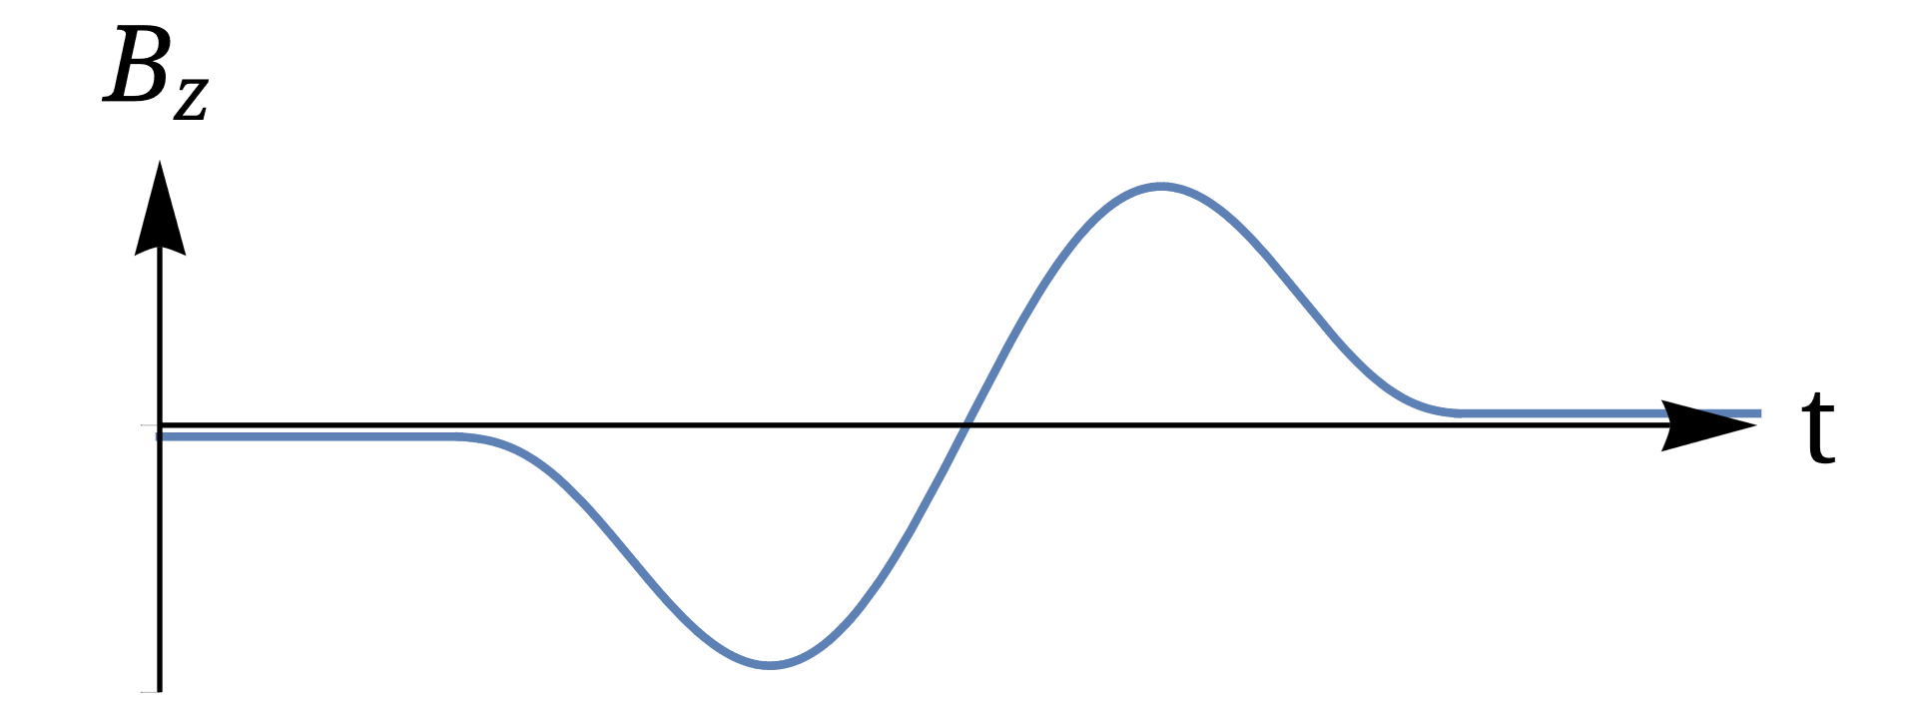
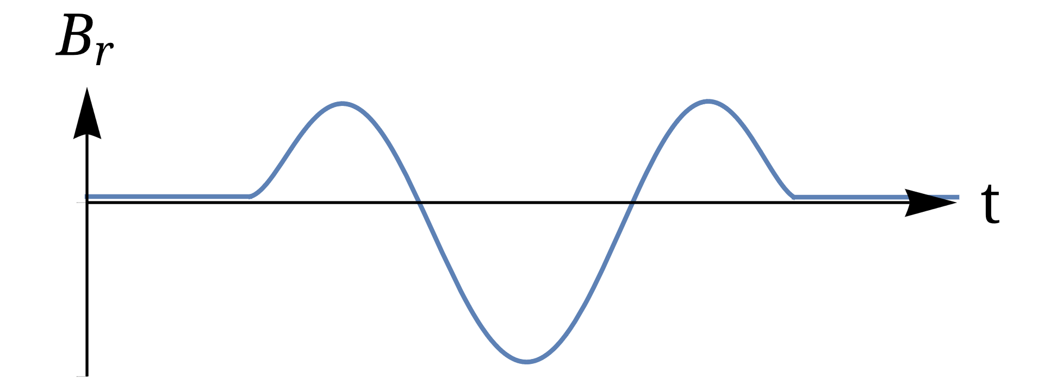
Sona UNIT AS polarizer
Future directions
Possible applications and polarization schemes
Patent filed in December 2022: “Verfahren und eine Vorrichtung zur Erzeugung von polarisierten Atomen, Molekülen und deren Ionen”, Ref. No.: 102022213860.0
Polarized ³He⁺ ion beam [“First test of a polarized ³He⁺ ion source” by N. Faatz (25 September 2023, 5:00 PM)]
Polarized fuel for nuclear fusion (polarized D beam for injection into a tokamak) [“A research program to measure the lifetime of spin polarized nuclei in magnetically confined fusion plasmas” by W. W. Heidbrink (25 September 2023, 11:30 AM), “Polarization REsearch for Fusion Experiments and Reactors - The PREFER collaboration: Goals and present status” by G. Ciullo (26 September 2023, 12:00 PM)]
Polarize a system at rest with time-dependent B-field pulses (needs to be investigated)

Slide 34
Sona UNIT AS polarizer
Future directions
Possible applications and polarization schemes
Patent filed in December 2022: “Verfahren und eine Vorrichtung zur Erzeugung von polarisierten Atomen, Molekülen und deren Ionen”, Ref. No.: 102022213860.0
Polarized ³He⁺ ion beam [“First test of a polarized ³He⁺ ion source” by N. Faatz (25 September 2023, 5:00 PM)]
Polarized fuel for nuclear fusion (polarized D beam for injection into a tokamak) [“A research program to measure the lifetime of spin polarized nuclei in magnetically confined fusion plasmas” by W. W. Heidbrink (25 September 2023, 11:30 AM), “Polarization REsearch for Fusion Experiments and Reactors - The PREFER collaboration: Goals and present status” by G. Ciullo (26 September 2023, 12:00 PM)]
Polarize a system at rest with time-dependent B-field pulses (needs to be investigated)
e.g., D₂ pellets and other molecules (e.g., HD, H₂O, etc.) in solid phase
molecular or atomic samples that serve as a diagnostic tool in MRI

