Slide 1
SpinQuest evaporation refrigerator
Vibodha Bandara , Dustin Keller
This work was supported by the U.S. Department of Energy (DOE) Contract No. DE-FG02-96ER40950

Slide 2
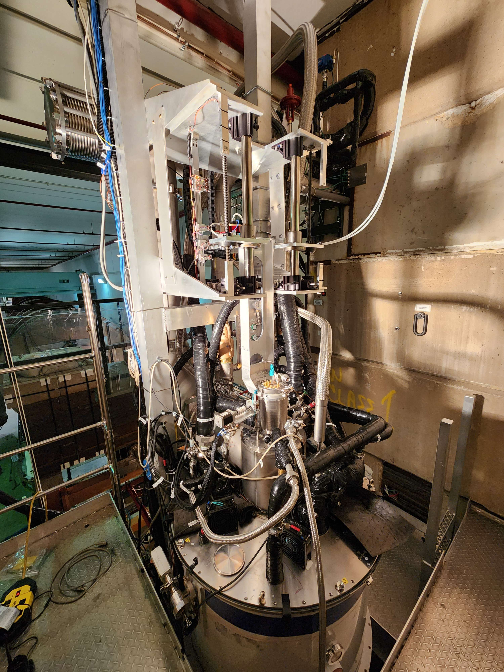
Overview
Introduction
Structure of the refrigerator
Safety requirements
Operation of the refrigerator in brief
Flow controlling
Sensor locations of the refrigerator
Test Cooldown Plots
Summary

Slide 3
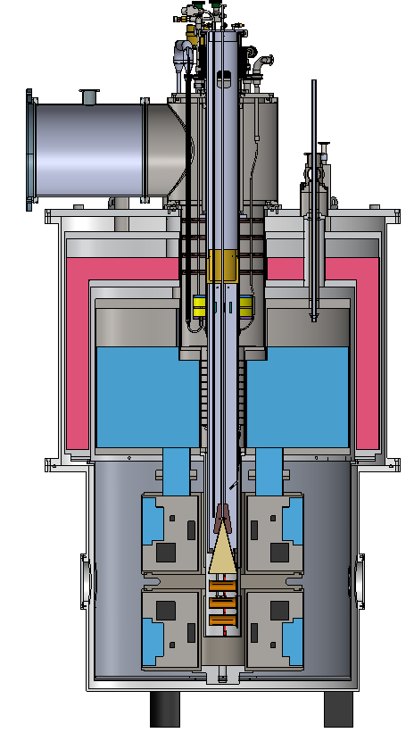
Introduction
The SpinQuest experiment use 120 GeV proton beam
provides the required cooling power for the target materials during the during beam interaction and the dynamic nuclear polarization (DNP)
Estimated heat load 0.7 W and maximum cooling power 1.25W at 1 K
Operation principle : liquid helium evaporation
located at the center axis of the SpinQuest super conducting magnet
The target materials are loaded into the bottom of the refrigerator using the target insert

Slide 4
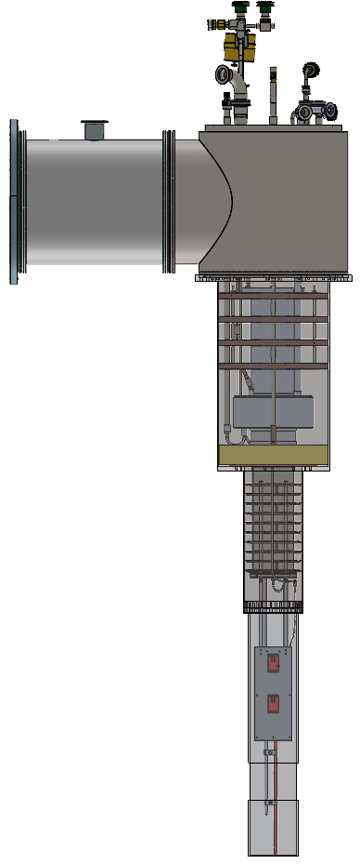
The structure of the refrigerator
Top Flange
Baffles
Phase separator
Shell
Heat Exchanger
Nose
Liquid helium delivery line to the nose
Beam window
10 mil (0.25 mm)

Slide 5
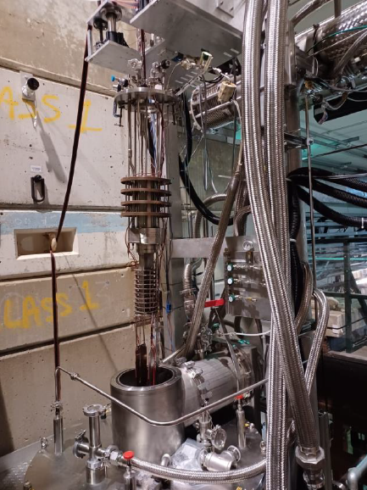
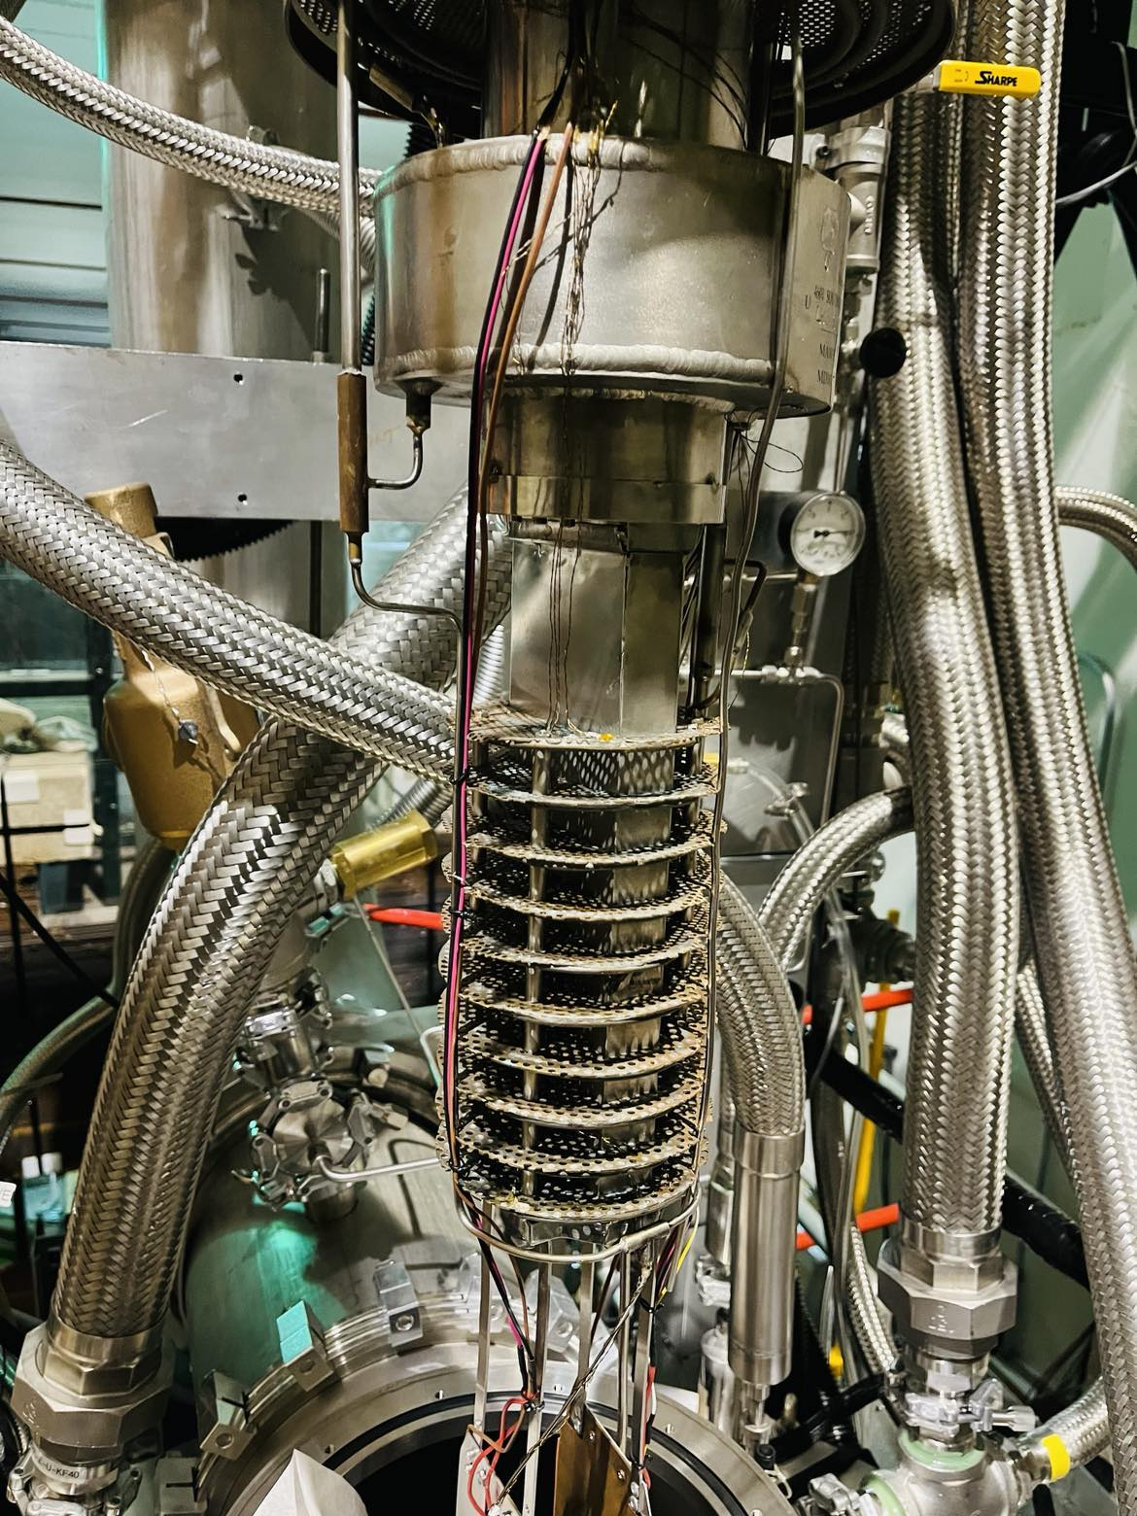

Slide 6
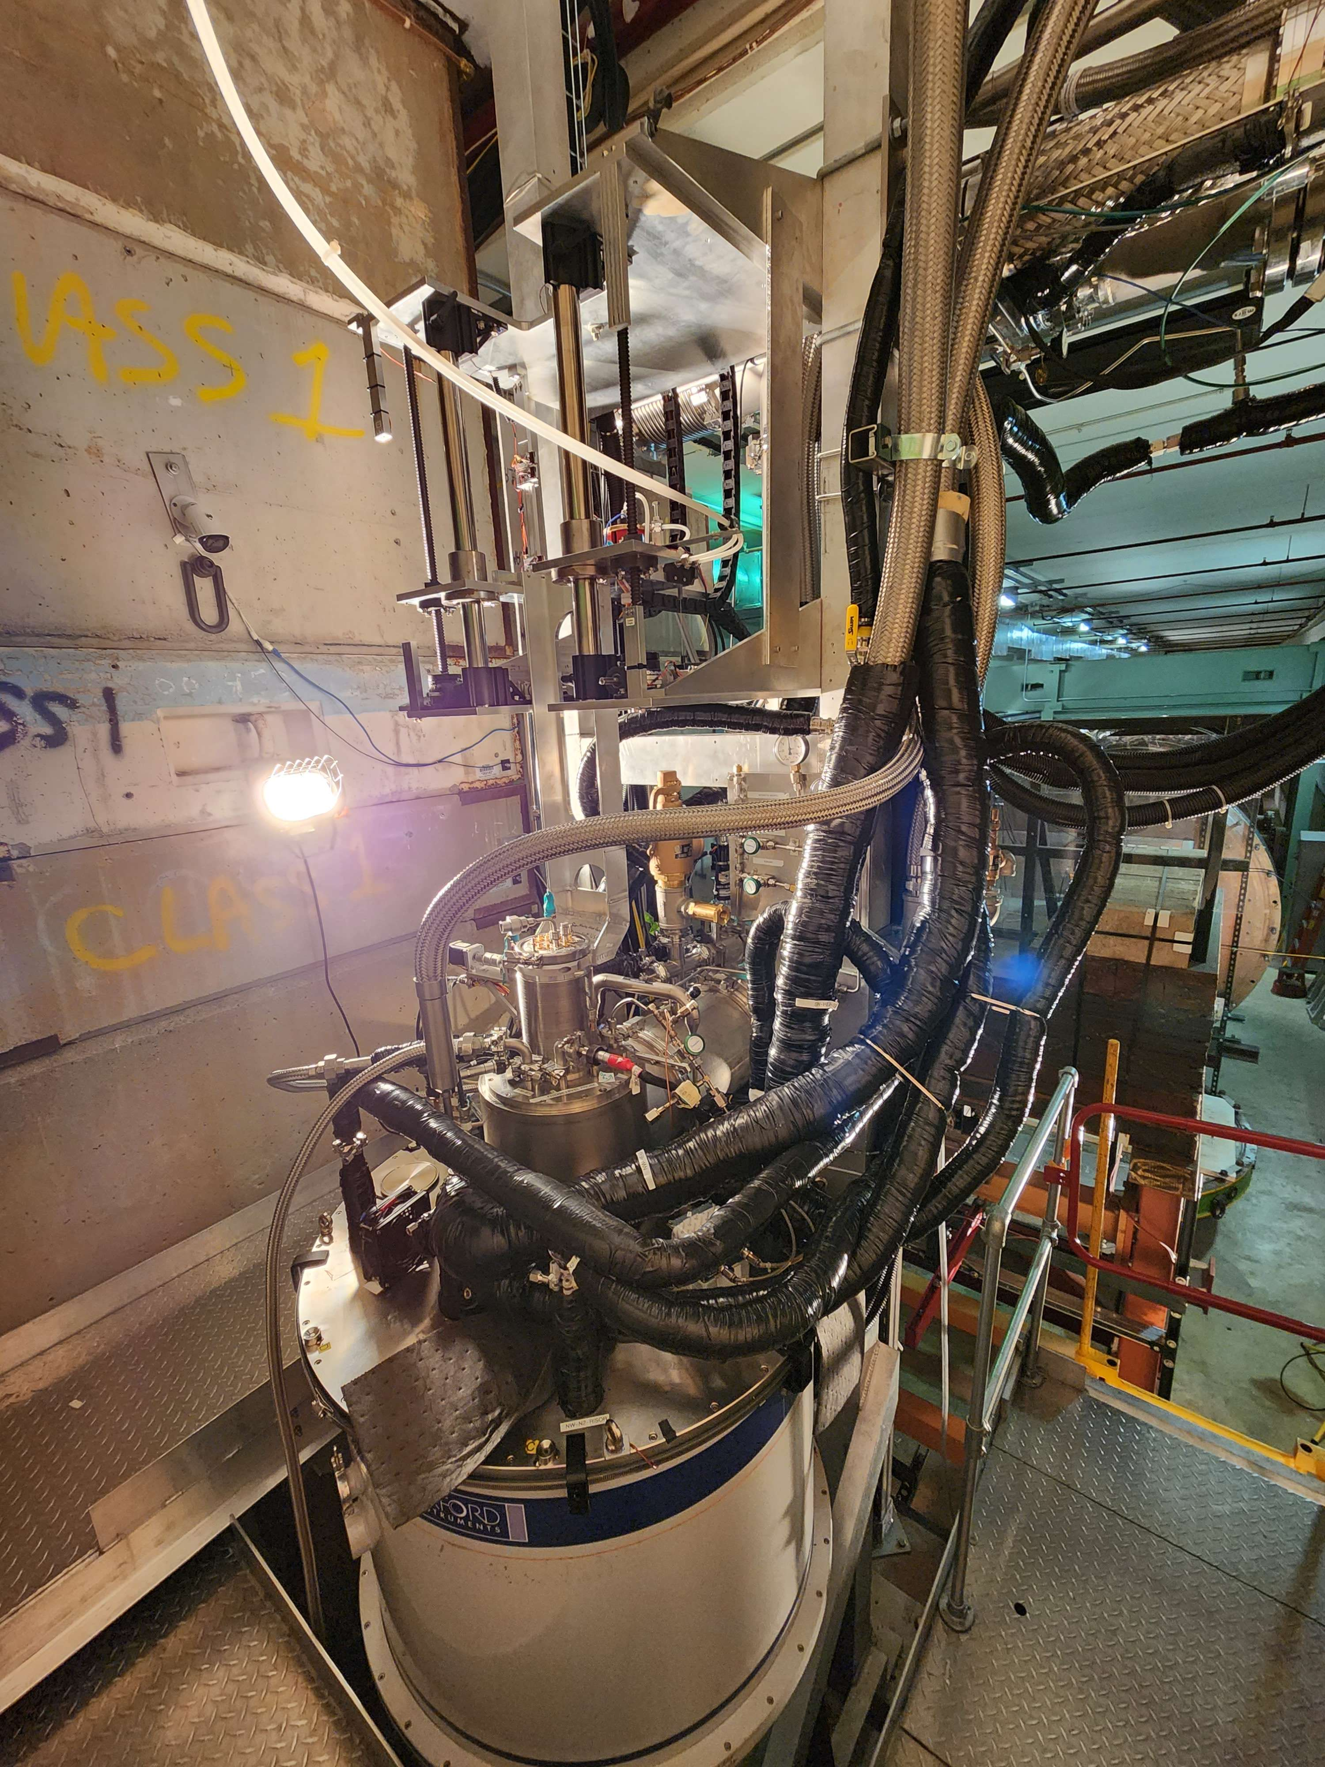

Slide 7
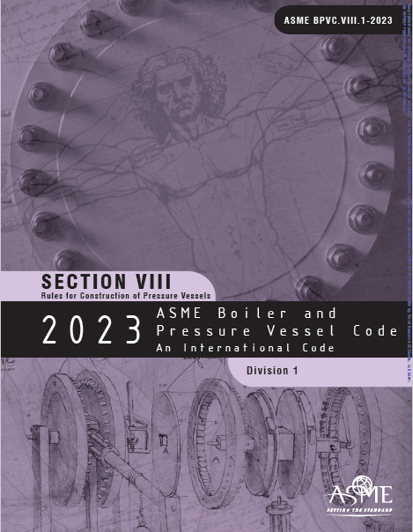
Fermilab safety requirements
Fermilab cryogenic safety recommended to have ASME certification for the refrigerator to use in our experiment
ASME : American Society of Mechanical Engineers
According to the ASME BPVC.VIII , the separator was categorized as an individual pressure vessel
Re-manufactured from an ASME certified fabrication shop and stamped

Slide 8
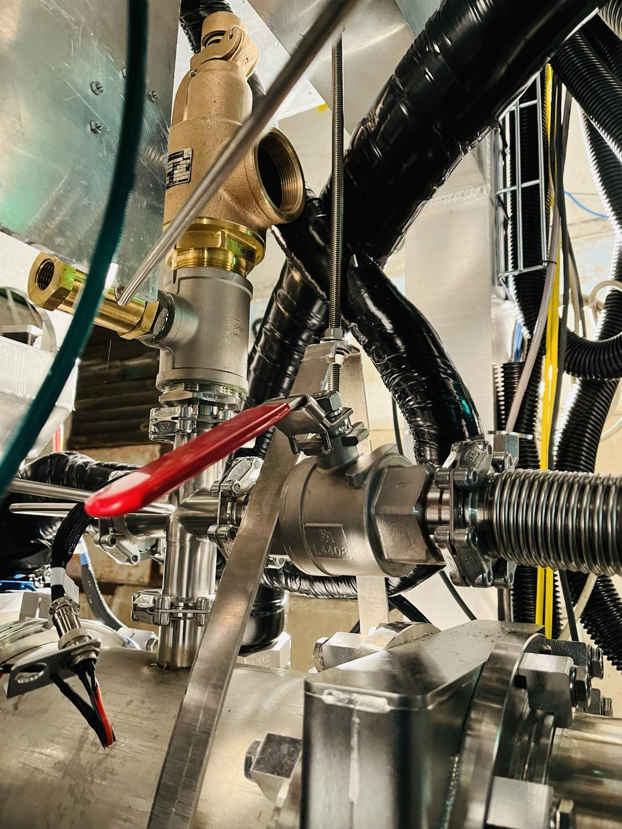
15 psi safety relief valve
As a Fermilab requirement, two types of relief valves were added to the separator and the Shell space
Vessel | Safety relief | Operational relief
Separator vessel | 15 psig (103 kPa) | 6 psi (41 kPa)
Shell space | 15 psig (103 kPa) | 0.5 psi (3.4 kPa)
0.5 psi check valve

Slide 9
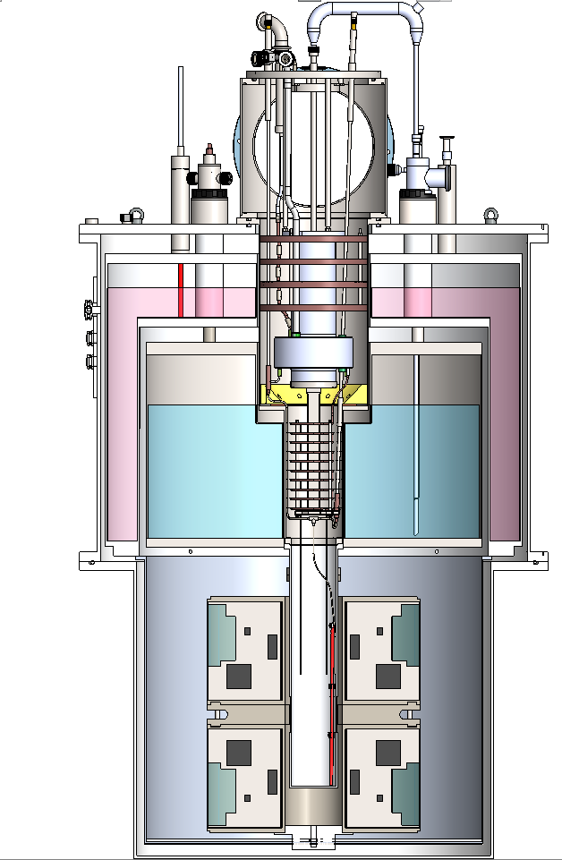
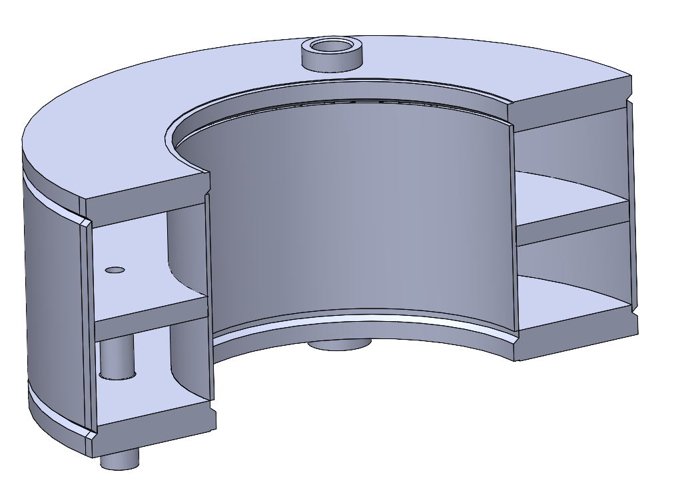
Operation in Brief
Liquid helium enters the phase separator from the magnet helium reservoir along a vacuum isolated transfer line.
The separator is pumping out from KNF pump which create the required pressure difference
The middle layer of the separator is a sintered plate. The liquid helium drizzle down to the lower portion of the separator and the vapor comes to the upper portion.
LHe
Sintered plate

Slide 10
The liquid in the separator can reach the nose reservoir through two paths
Run-valve path Liquid pass through the heat exchanger and come into the fridge nose
This the path for the normal fridge operation
Bypass-valve path Liqui bypass the heat exchanger and reach the fridge nose
To fill the nose quickly
The liquid level of the nose is controlled by the run/bypass valves
Bypass
Valve
Run
Valve

Slide 11
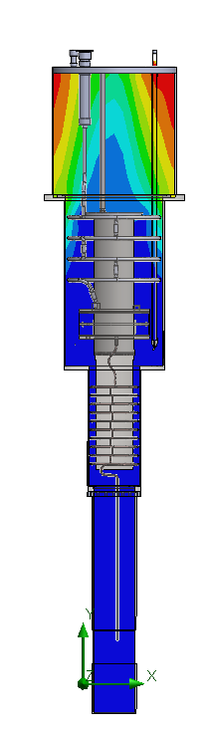
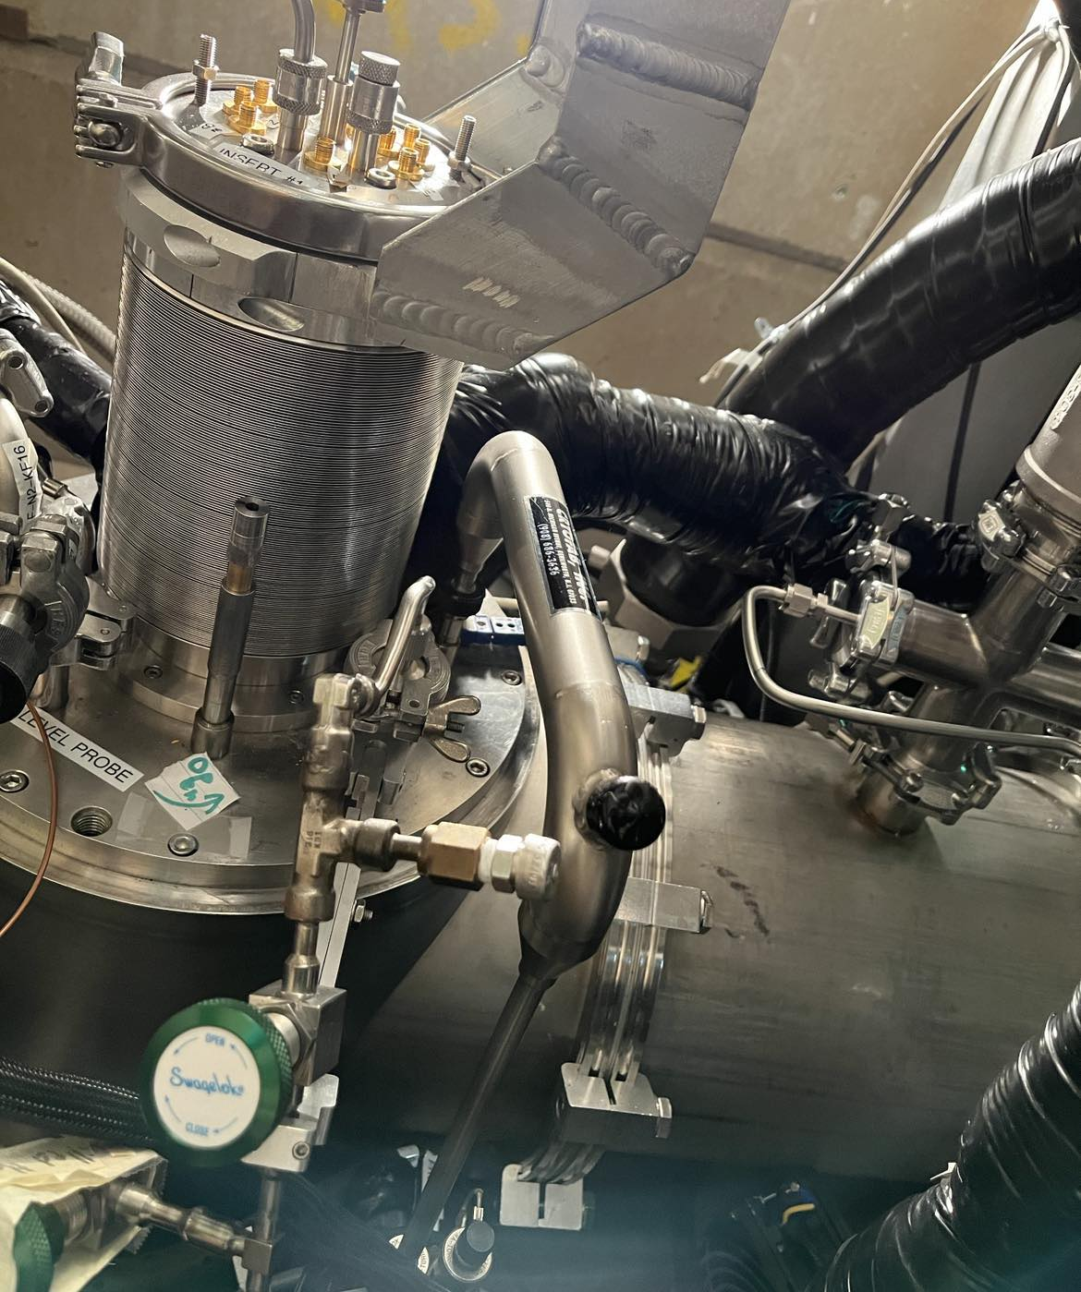
Liquid transfer U-Tube between the magnet and the fridge

Slide 12
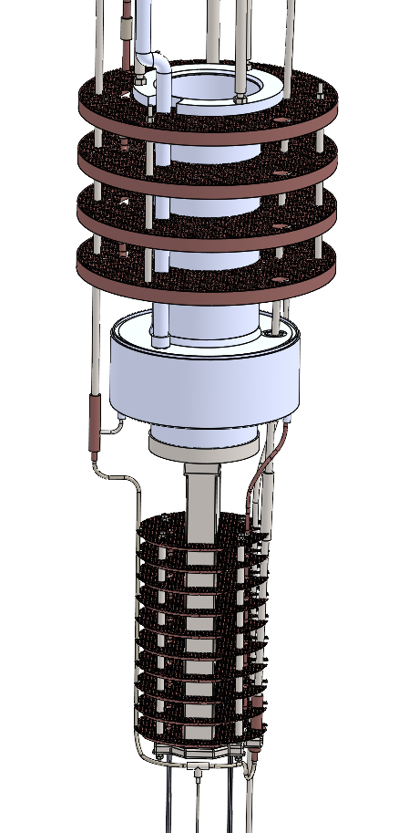
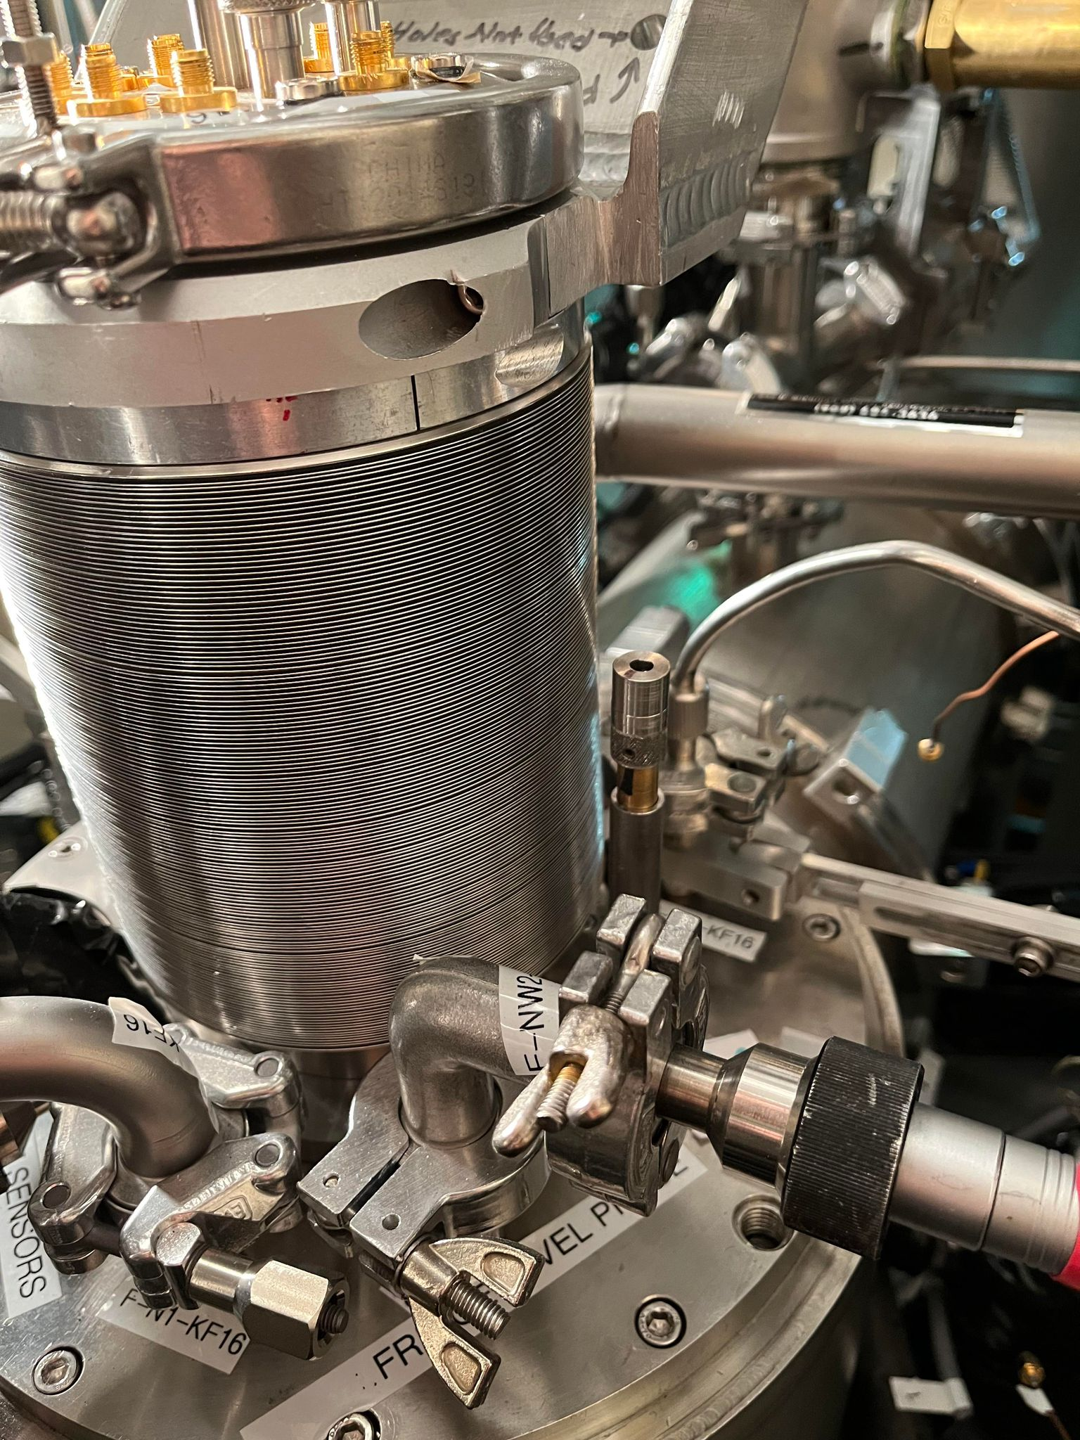
Two controlling shafts go all the way up to the top flange of the refrigerator
Bypass valve
Run valve

Slide 13
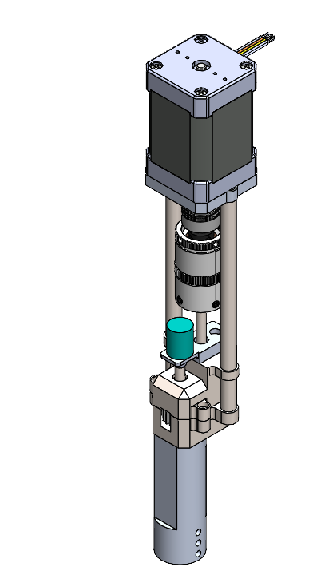
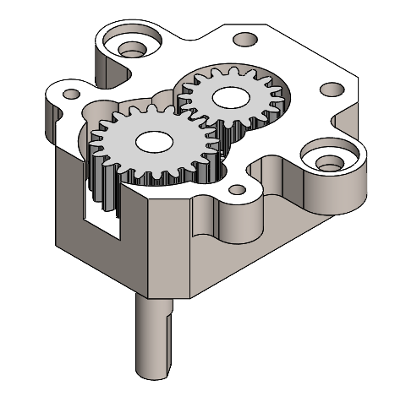
The Run and bypass valves are two needle valves manufactured by Oxford Instruments.
The motorized actuator was designed and made by UVA & U. Colombo
Clutch set to 3.5 lb.in and prevent over tightening the valve
Potentiometer gives the absolute position feedback
No electronics components due to the radiation damage
Stepper motor
Friction clutch
Potentiometer
Gear box
Gear ratio : 1.25
The run valve will be operated in a PID loop to maintain a constant liquid level in the fridge nose
The liquid in the nose is continuously pumped out by the roots pump stack and the temperature of the liquid reach 1K .
The evaporated helium vapor cools down the heat exchanger and improves the cooling cycle further

Slide 14
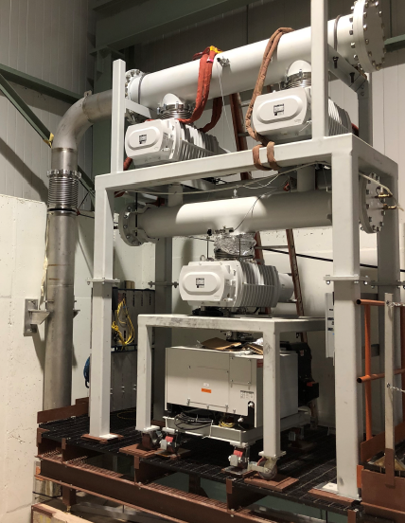
Inlet pipe of the pump stack
The roots pump stack
Top three roots booster pumps:
Rotary vane pump : Sogavac SV 630
The total pumping speed of the of the roots stack is 17000 m³/h
The 12” (30 cm) inlet of the roots is connected to the refrigerator through a large pneumatic gate valve.
Oerlikon Leybold RUVAC WH7000
Sogavac SV 630

Slide 15
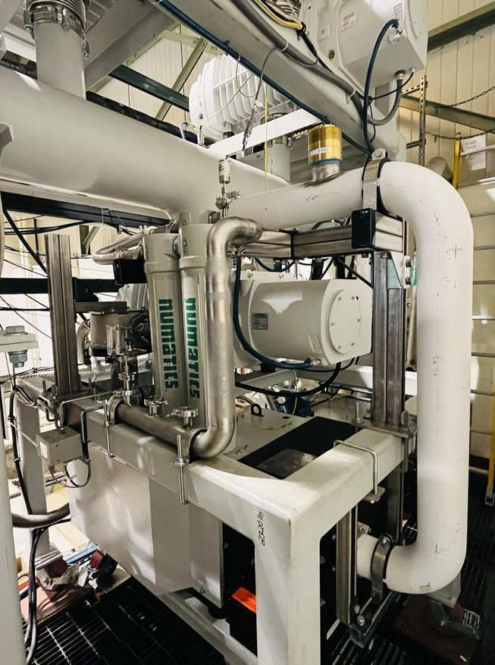
The exhaust of the roots connected to the helium recovery manifold
through a series of filters to capture the oil contaminants from the pumps
A mass flow monitor and a purity meter to monitor the incoming flow from the refrigerator

Slide 16
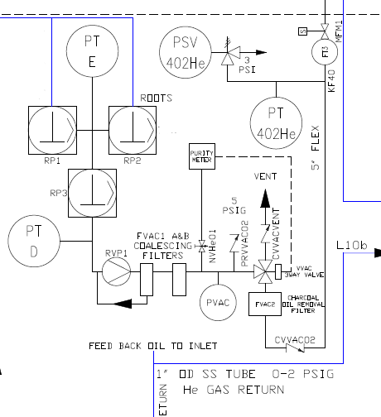
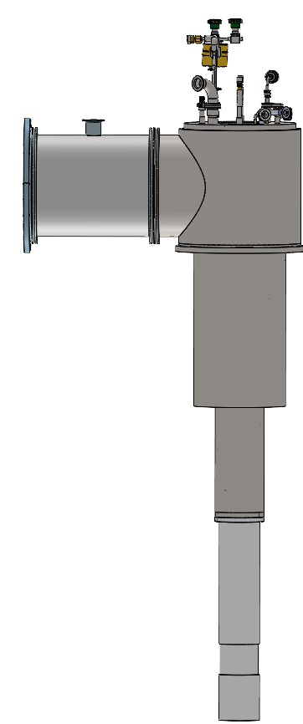
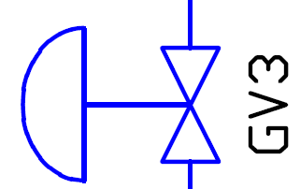
This is how the roots and the refrigerator are connected

Slide 17
flow controlling of the refrigerator
Why need to control the flow ?
By changing the pumping rate on the liquid helium in the fridge nose, different liquid temperatures can be achieved.
Thermal equilibrium (TE) measurements between 1-3 K are extremely important in characterizing the calibration constants of the NMR.
The polarization at thermal equilibrium is given by
Measured polarization : NMR signal area $A_{TE}=\int_{0}^{∞}{S_{TE}\left(ω\right)dω}$
$$P_{TE}=tanh\left(\frac{μB}{KT}\right)$$
The NMR calibration constant $C= \frac{P_{TE}}{A_{TE}}$
Calibration constant at different TE temperatures will improve the absolute polarization measurement
More information : Ishara Fernando https://indico.jlab.org/event/663/contributions/13298/
Muhammad Farooq https://indico.jlab.org/event/663/contributions/13095/

Slide 18
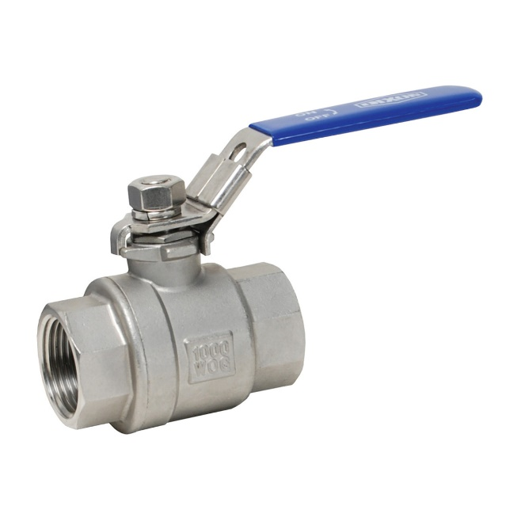
How the flow is controlled
The refrigerator is located in a high radiation area. Therefore, a radiation hard flow controller is needed .
Two valves are located between the roots and the refrigerator
GV3 : Pneumatic gate valve. Not a control valve (Open/ Close)
MV1 : Manual valve (Gate valve bypass)
Roots
Motorized actuator was designed to control the existing manual valve

Slide 19
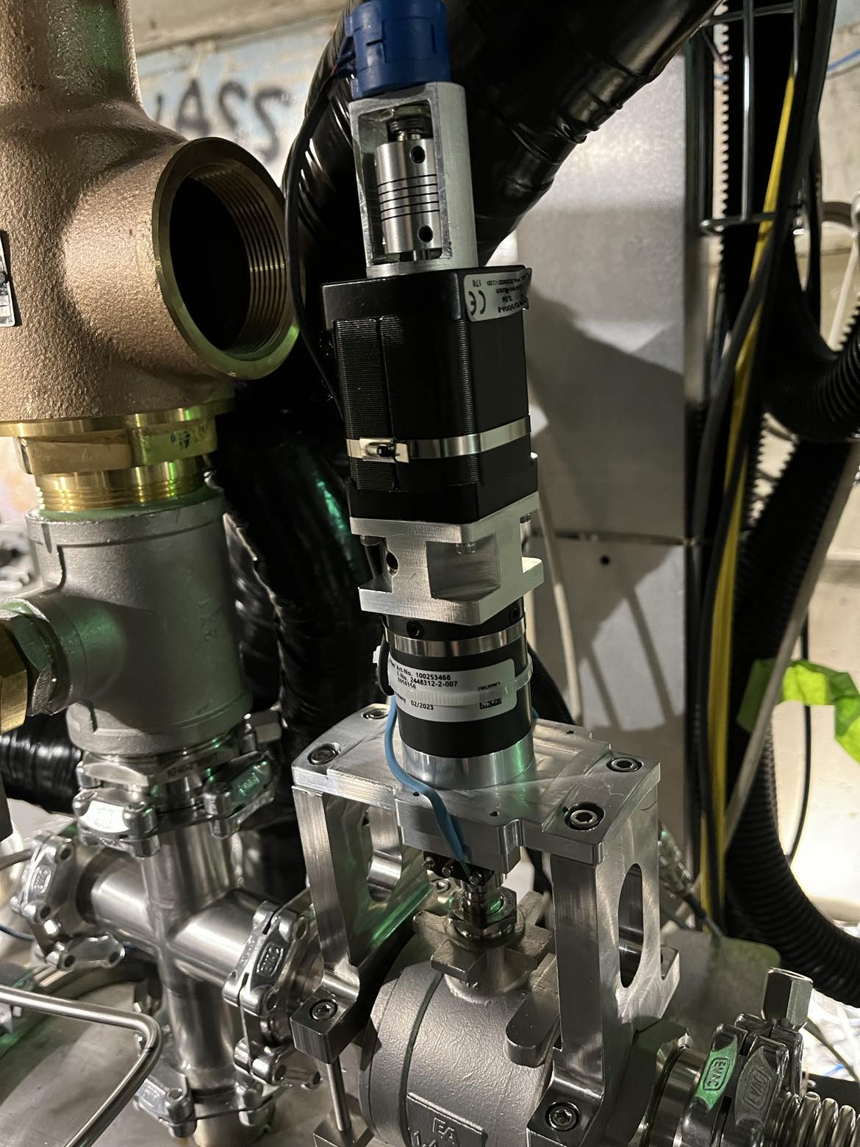
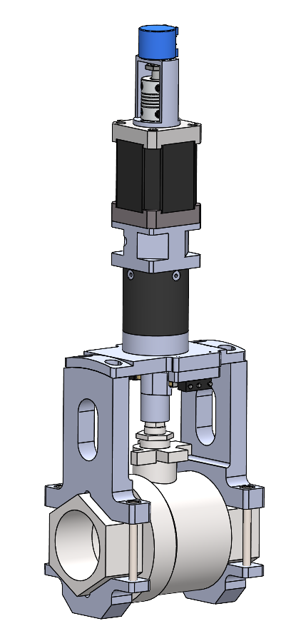
Potentiometer
Stepper Motor
Gear head
Limit Switch X 2
This control valve will be operated in a PID loop to maintain a constant pressure in the refrigerator.

Slide 20
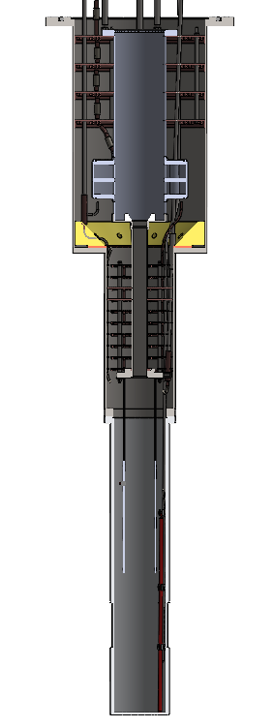
Sensors locations
Liquid level in the nose
Super conducting level probe by American Magnetics. Shows the liquid level by percentage
Readout by AMI1700
Eight chip resistors (Vishay 1K Ohm resistor) are installed in various locations on the refrigerator to identify the liquid level. The eight channels are read by LakeShore218
The primary measurement of pressure and temperature in the nose is taken with a manometer MKS 690
As a backup Helium-3 pressure probe is used to estimate the pressure and temperature of the fridge nose. MKS 615A
The mass flow rate of the refrigerator is measured by Teledyne Hastings
Sensor 1- 1
Sensor 1- 2
Sensor 1- 3
Sensor 1- 4
Sensor 1- 5
Sensor 1-6
Sensor 1-7
Sensor 1- 8
Level probe max

Slide 21
Test Cooldown/Filling Plots of the refrigerator
1 . Fill LHe from fridge nose to the “heat exchanger Top”
Initial conditions : The magnet and the separator was filled with LHe
Filling steps in Brief :
Open the fridge bypass valve and transfer LHe from separator to the nose
Fill liquid up to “heat exchanger top”
heat exchanger Top
Nose bottom

Slide 22
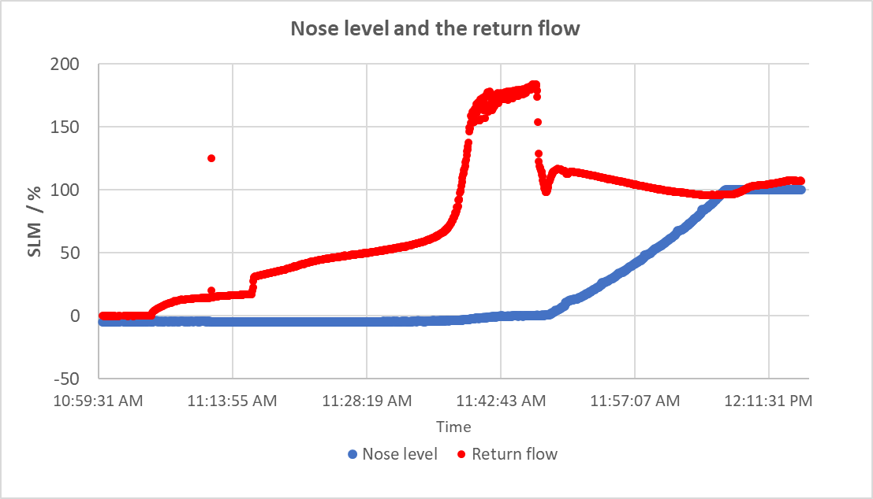
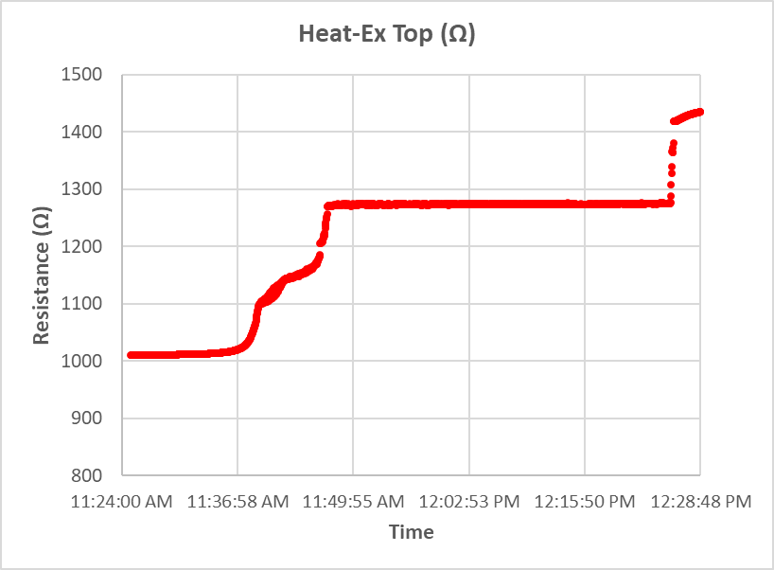
Change of resistant of the heat exchanger bottom chip resistor with the liquid helium
The nose liquid level and the return flow
Drop in return flow
Bypass valve crack open
Liquid accumulated in the nose

Slide 23
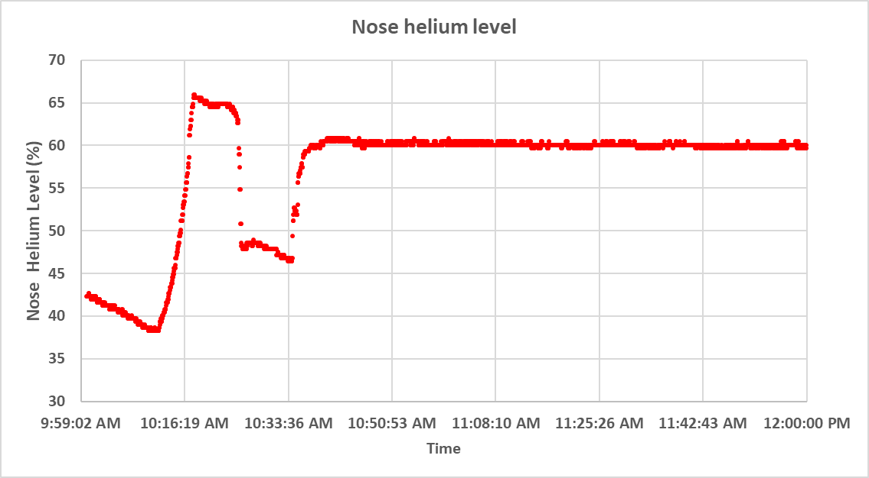
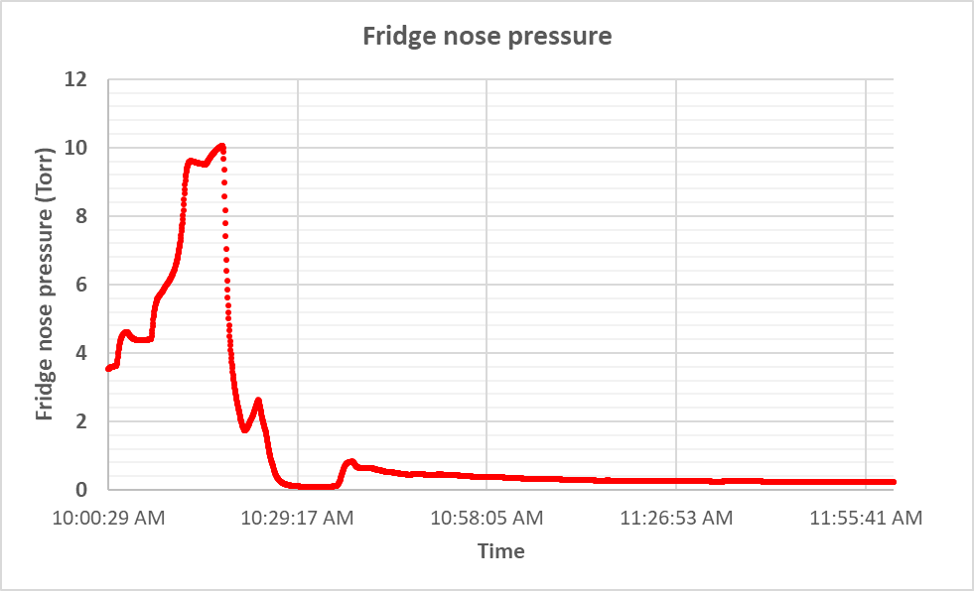
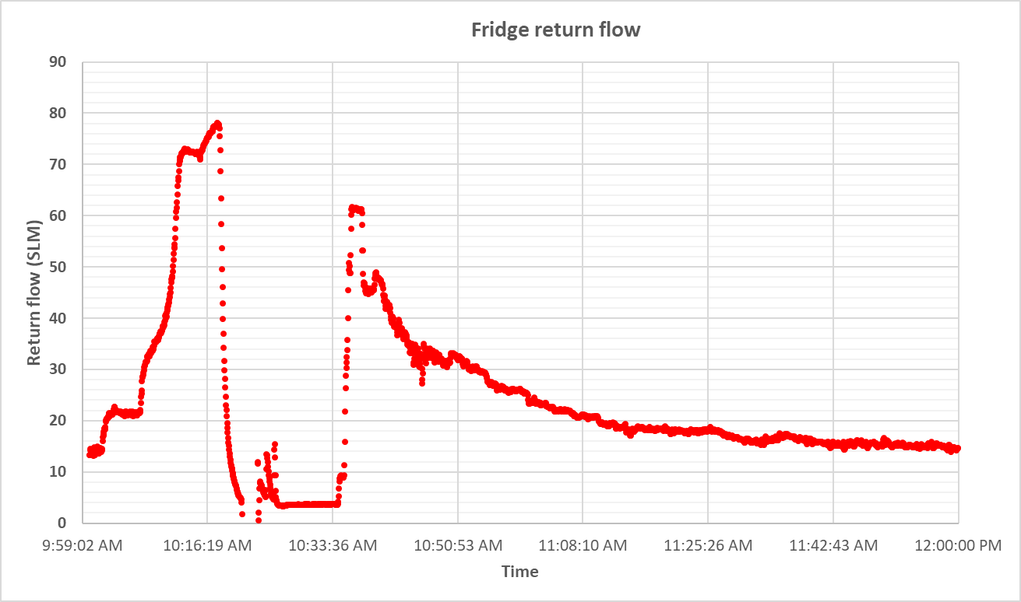
2 . The liquid level in the nose is maintained at 60 % using the PID controller of the run valve.
The full roots stack is running, and the pneumatic gate valve is open
0.25 Torr

Slide 24
Summary
The refrigerator design is approved by FNAL
Successfully cooldown
The newly designed control valves are operational
to do next
Configure the new valves with PID loops to maintain the fridge pressure and the nose helium level
Run the refrigerator in full flow and test the maximum cooling power

Slide 25
Thank You
This work was supported by the U.S. Department of Energy (DOE) Contract No. DE-FG02-96ER40950

