Slide 1
A positron beam at Ce⁺BAF
Joe Grames
Group Leader, Center for Injectors & Sources, JLab
25th International Spin Symposium
Duke University
September 24-29, 2023

Slide 2
Outline
Polarized e+ @ Jefferson Lab
Ce⁺BAF : start-to-end concept
Technical challenges
Forecast

Slide 3

CEBAF 12 GeV : polarized-cw electron accelerator
Spin polarized electron beams for over 25 years...
Parameter | Requirement
Topology | Recirculating LINACS (5.5 pass)
Multiplicity | 4 halls
Energy | 11 GeV (ABC) / 12 GeV (D)
Duty Factor | 100% (1.497 GHz)
Intensity | 1 nA - 150 μA (1 MW dumps)
Polarization | electrons >85%
Helicity | 30 Hz - 2 kHz (reversal)
Photoinjector (123 MeV SRF)
1.1 GeV SRF LINAC
D
A
5.5x
5x
B
1.1 GeV SRF LINAC
C

Slide 4



Exploit electron beam polarization to produce polarized e+
Polarized Bremsstrahlung
Polarized Pair Creation
P_{circ}(γ) / P_{z} (e⁻)
P_{z} (e⁺) / P_{circ} (γ)
When a longitudinally polarized e⁻ beam strikes matter, e⁺ produced carrying >50% of the e⁻ beam energy are significantly longitudinally spin polarized…
E_{γ} / T_{e-}
T_{e+} / (E_{γ} – 2m_{e+})
E.A. Kuraev, Y.M. Bystritskiy, M. Shatnev, E.Tomasi-Gustafsson, PRC 81 (2010) 055208

Slide 5

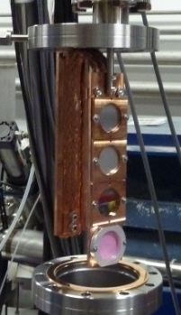
PEPPo (2012)
Gives credibility to developing a spin polarized e+ beam source
J. Grames, E. Voutier et al.,JLab Experiment E12-11-105 (2011)
8 MeV, 1μA, 85% polarization
Record for linac positron polarization.
P(e+) = 82.2 %
Tungsten (1mm)
Efficiency >95%
PEPPo possible due to support from SLAC E166, DESY, Princeton, Cornell, International Linear Collider Project and the Jefferson Science Associates
D. Abbott et al., Phys. Rev. Lett. 116 (2016) 214801

Slide 6
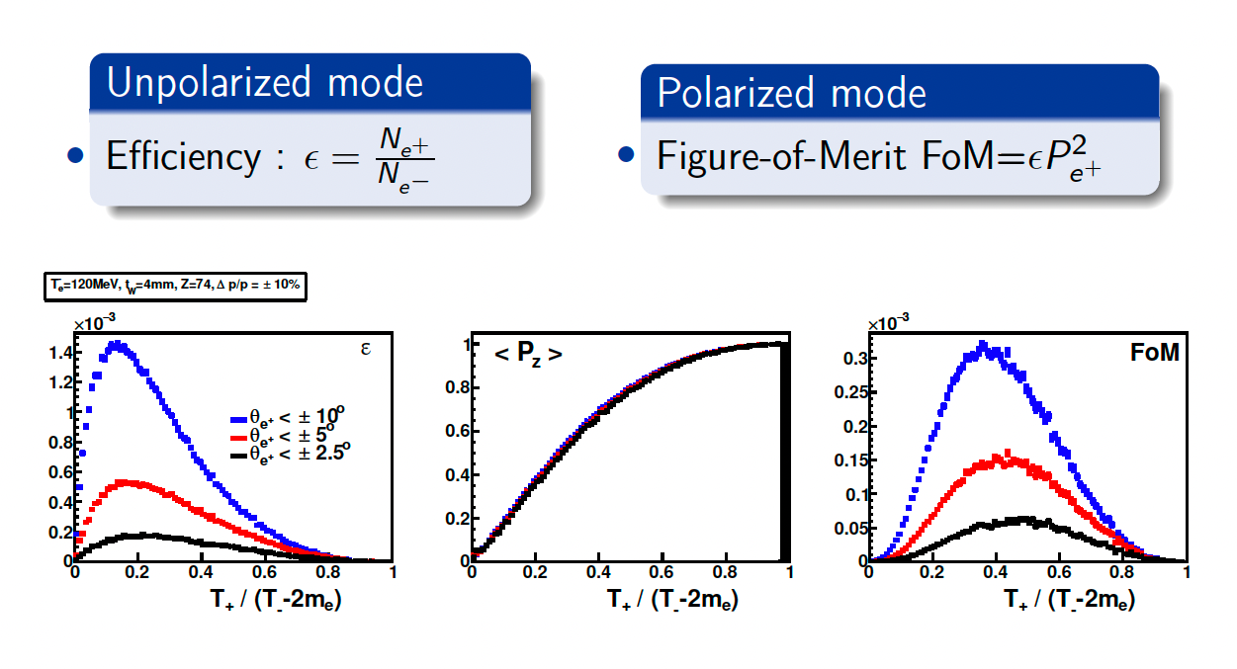
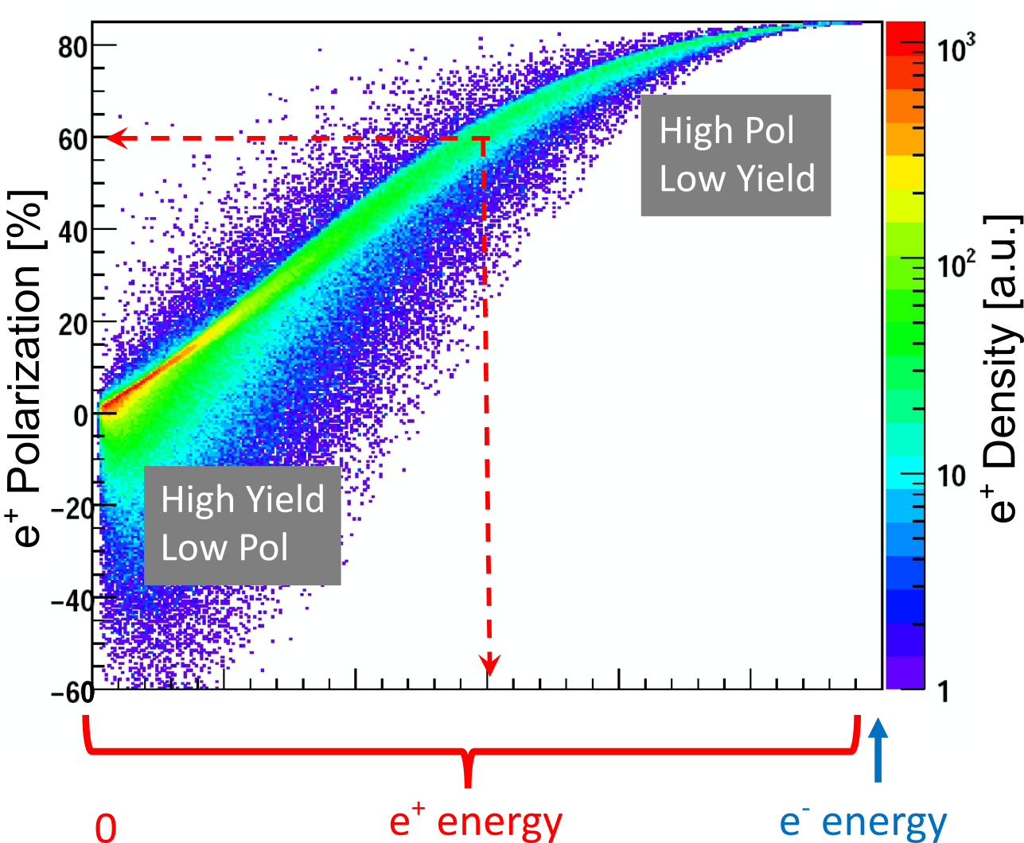
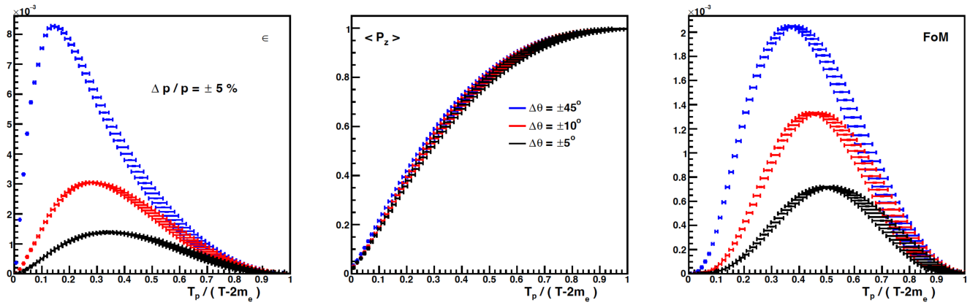
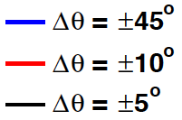
“Tunable” e⁺ source
e⁺ Polarization vs Energy
4 mm Tungsten Target
120 MeV e‒
Efficiency
FoM
e⁺
e‒
e⁺
e‒
Positron beamline has to be designed
for efficient capture and transport of e⁺ with different energies

Slide 7
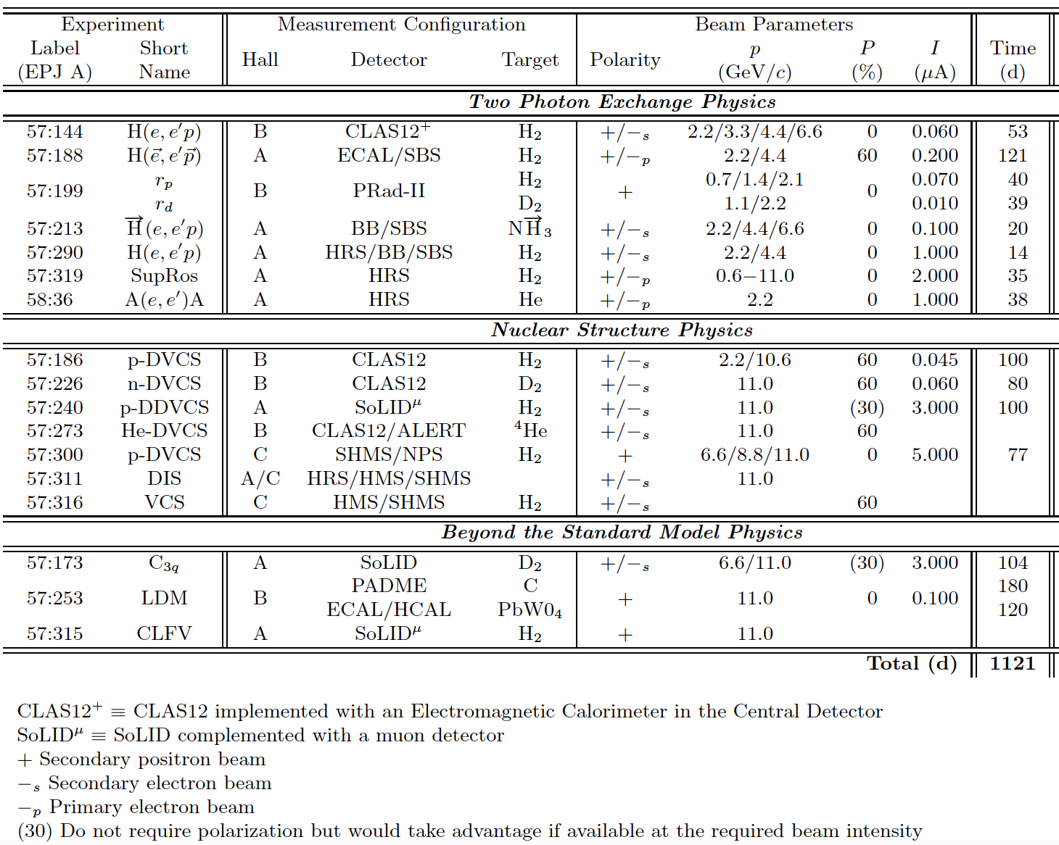
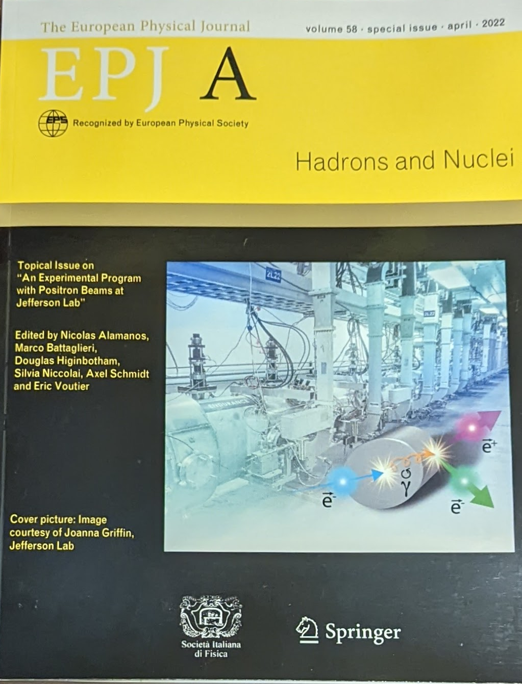
Positron Program White Paper Published 2022
https://doi.org/10.1140/epja/s10050-022-00699-6

Slide 8
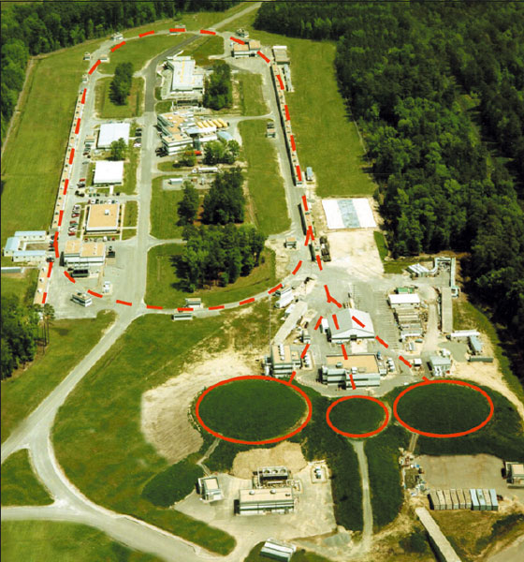
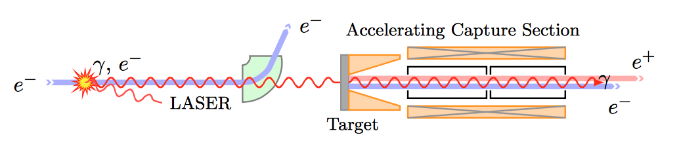
Ce⁺BAF concept
Positron sources have been built and operated successfully
SLAC – Stanford Linear Accelerator Center (US)
HERA – Hadron Electron Ring Accelerator (Germany)
BELLE/KEK – National Laboratory for High Energy Physics (Japan)
CESR – Cornell Electron Storage Ring (US)
VEPP – Budker Institute of Nuclear Physics (Russia)
BEPCII – Beijing Electron Positron Collider (China)
?

Slide 9
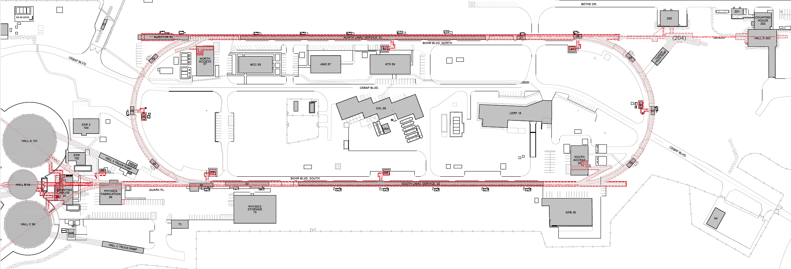
Options are good, but too many can be overwhelming…
During the pandemic a Lab Directed R&D project was funded to evaluate the e⁺ concept
We explored e⁺ production at 10, 100, 1000, 10000 MeV supported by a LDRD…
We didn’t think much about using this smaller accelerator because it’s not attached to CEBAF

Slide 10

LERF Framework (2022)
Framework
  Utilize LERF infrastructure (300 MeV SRF e- ERL)
  Staged approach (e+ then 22 GeV)
S2E – implies finding solutions for three things
  Design two injectors (e- and e+)
  Develop a scheme to inject into CEBAF
  Flexibility to provide either e- or e+ on-demand

Slide 11
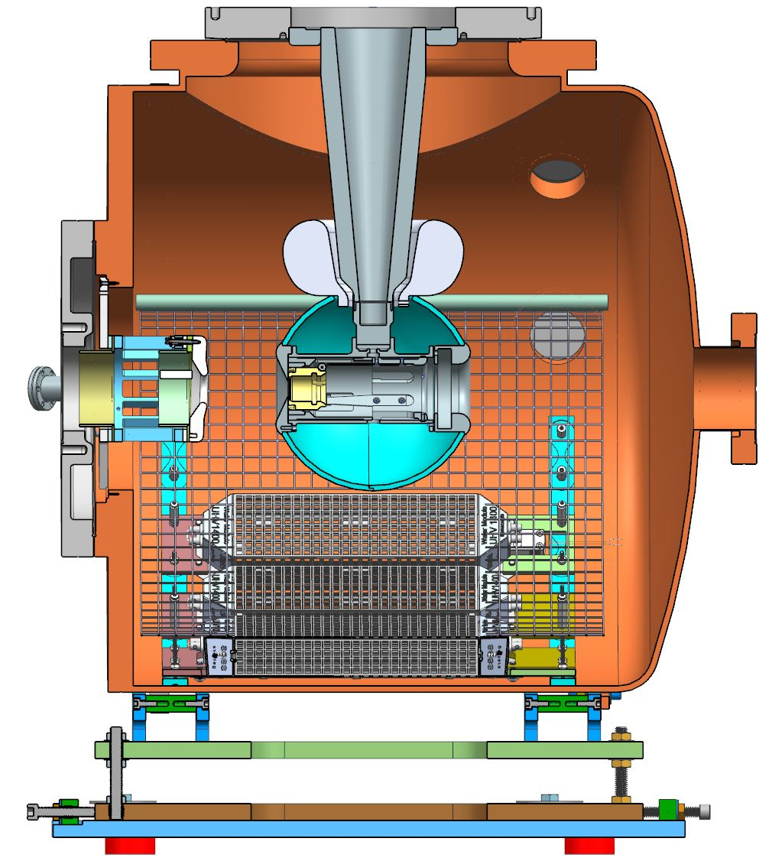
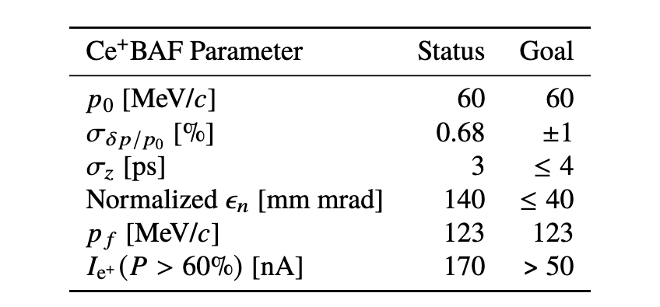
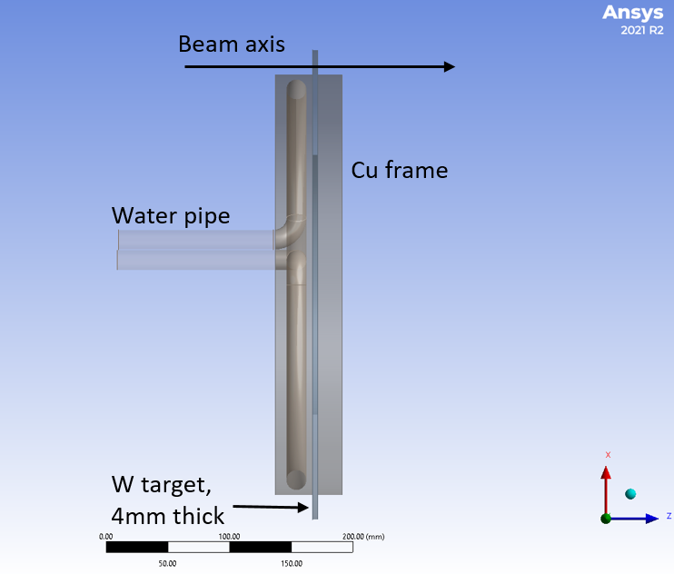
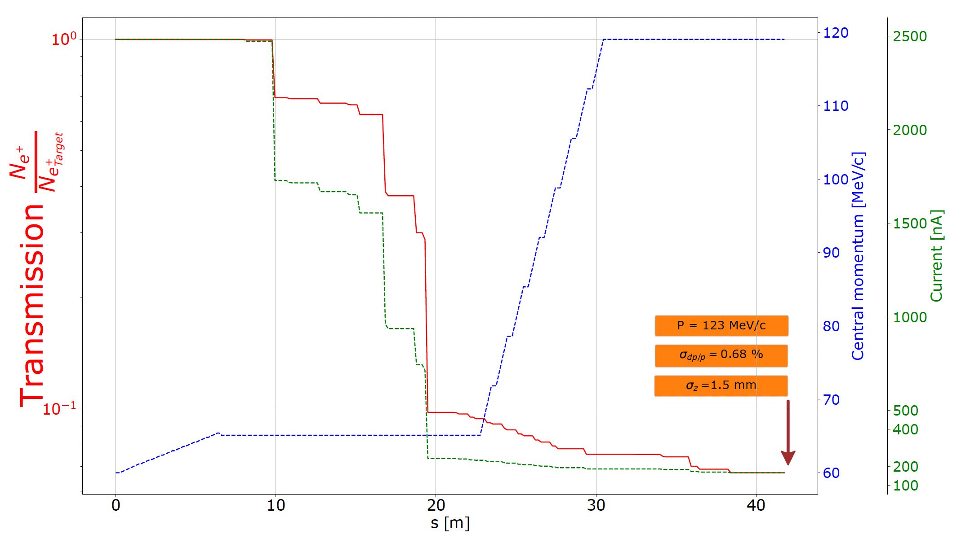
Design two new injectors (e- and e+)
>300 kV dc-high voltage GaAs photogun generates milliAmp e⁻ beam with polarization ~90%
Two challenging injectors have to be built
  >1 mA polarized e- injector >150 MeV
  >100 kW target & cw-collection beam line
+ Solenoid
120 kW e⁻ beam irradiates water cooled spinning tungsten target,

Slide 12
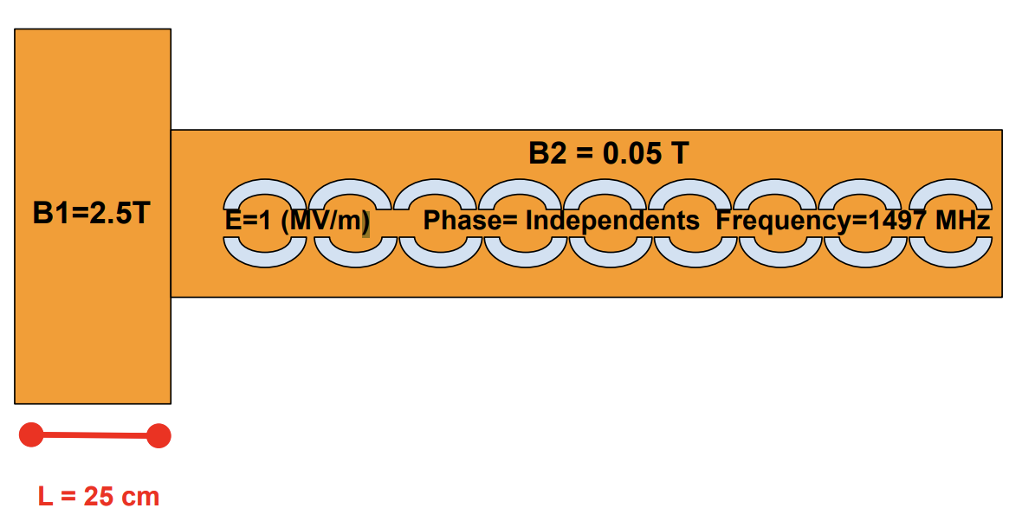
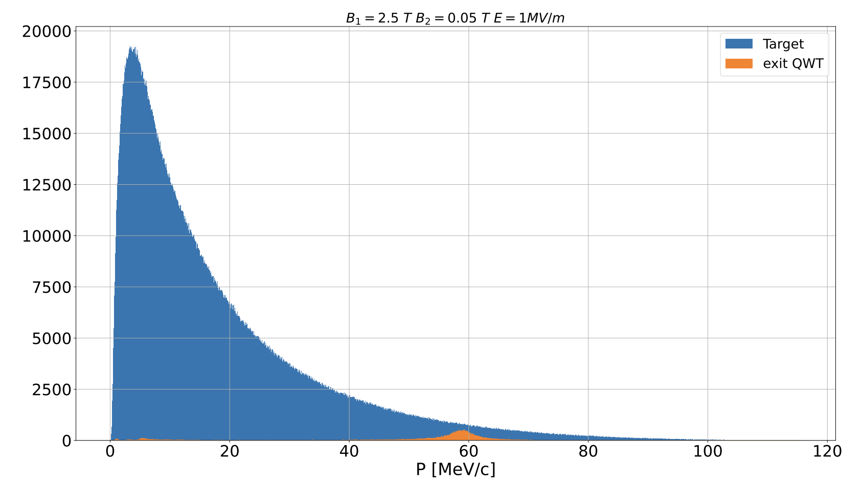
e+ source is a sophisticated integrated system
  ”source” integrates high power target, high field solenoid, RF capture
  CW operation will be unique, >2.5 Tesla dc field adjacent to spinning target
Efficiency of < 10⁻⁴ requires a polarized e⁻ intensity of >1 mA
SuperKEKB Pulsed e+ Source
12

Slide 13
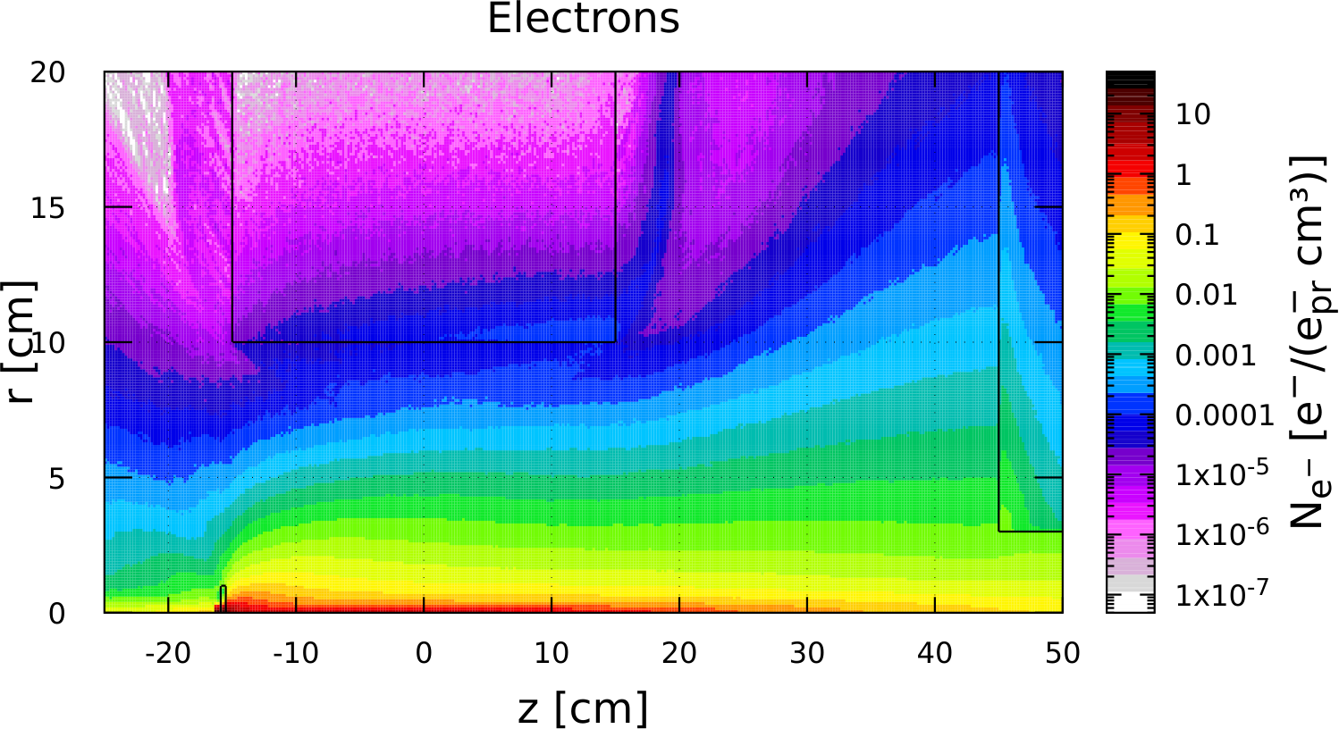
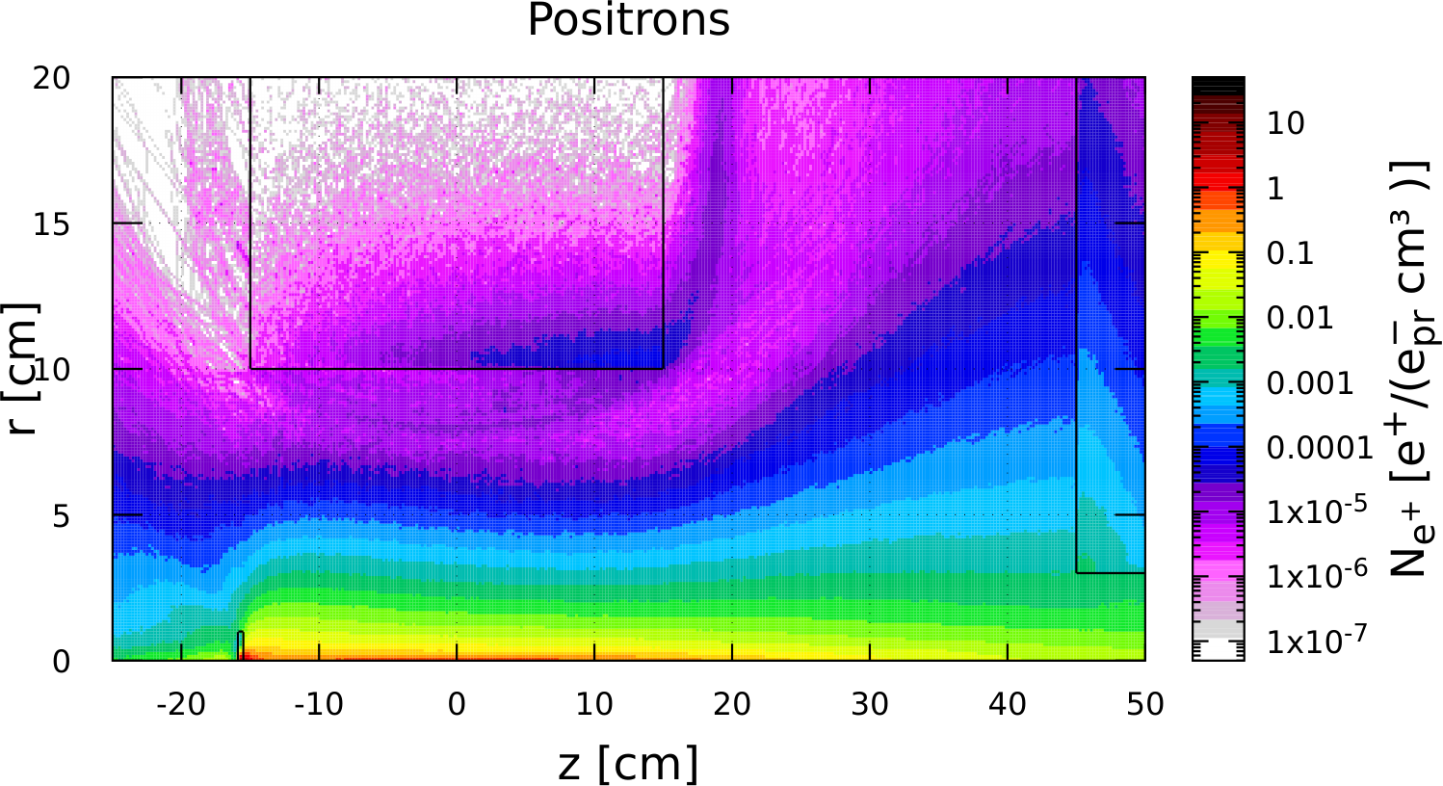
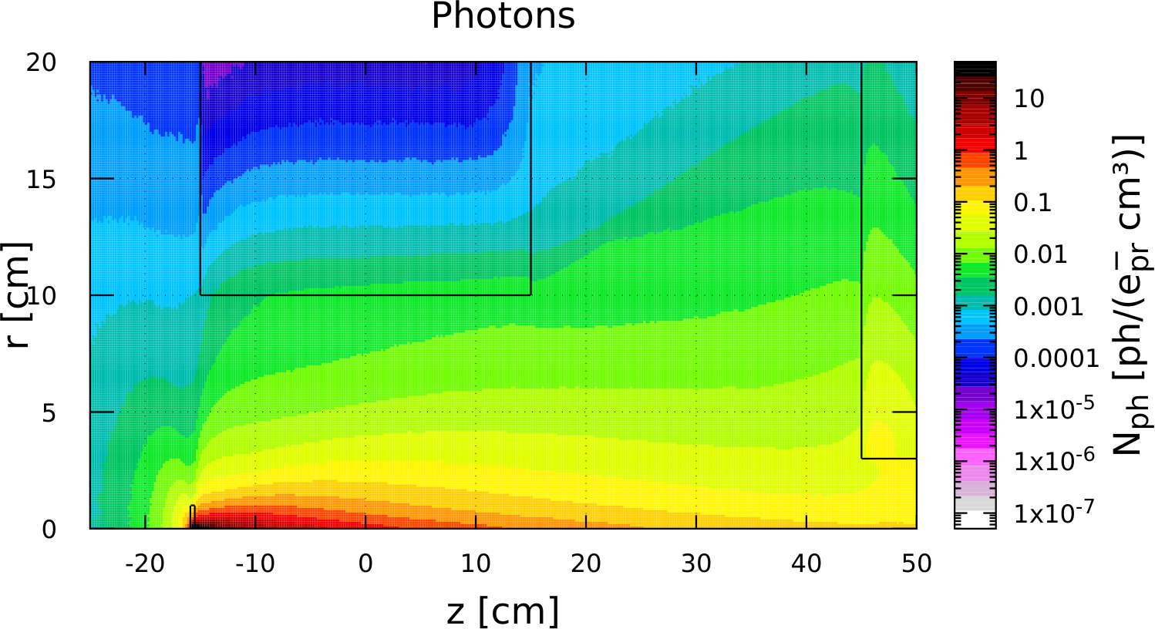
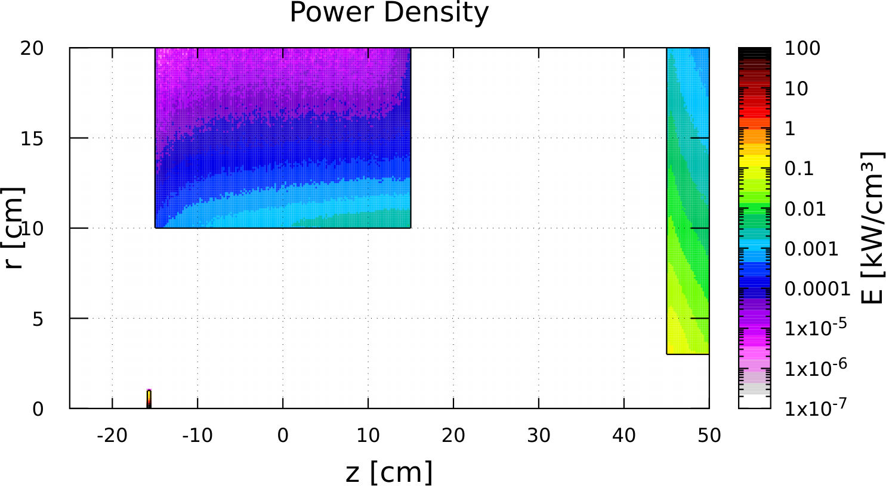
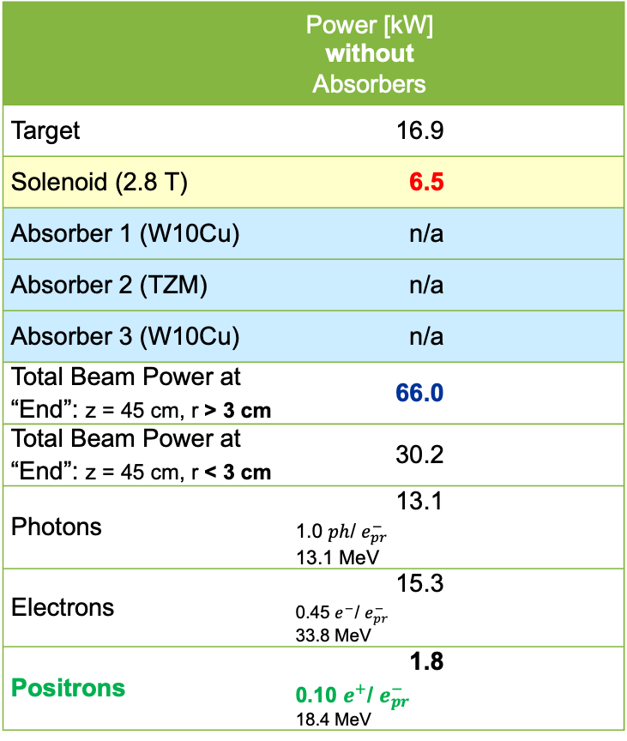
Managing ~120 kW electromagnetic shower
Thick target is needed to get enough positrons
Shielding beam power is needed to put focusing magnet with small field on target
We need some space for shieling in front of RF cavities
Our focus is to make design of first meters of e⁺ source realistic
 | Power [kW] without Absorbers | Power [kW] with Absorbers
Target | 16.9
Solenoid (2.8 T) | 6.5 | 0.047
Absorber 1 (W10Cu) | n/a | 42.9
Absorber 2 (TZM) | n/a | 29.3
Absorber 3 (W10Cu) | n/a | 11.6
Total Beam Power at “End”: z = 45 cm, r > 3 cm | 66.0 | 2.1
Total Beam Power at “End”: z = 45 cm, r < 3 cm | 30.2 | 30.5
Photons | 13.1 1.0 $ph$/ $e_{pr}^{−}$ 13.1 MeV | 14.1 1.4 $ph$/ $e_{pr}^{−}$ 9.9 MeV
Electrons | 15.3 0.45 $e^{−}$/ $e_{pr}^{−}$ 33.8 MeV | 14.4 0.49 $e^{−}$/ $e_{pr}^{−}$ 29.4 MeV
Positrons | 1.8 0.10 $e^{+}$/ $e_{pr}^{−}$ 18.4 MeV | 2.0 0.12 $e^{+}$/ $e_{pr}^{−}$ 16.1 MeV
2.8 T Solenoid
Target

Slide 14
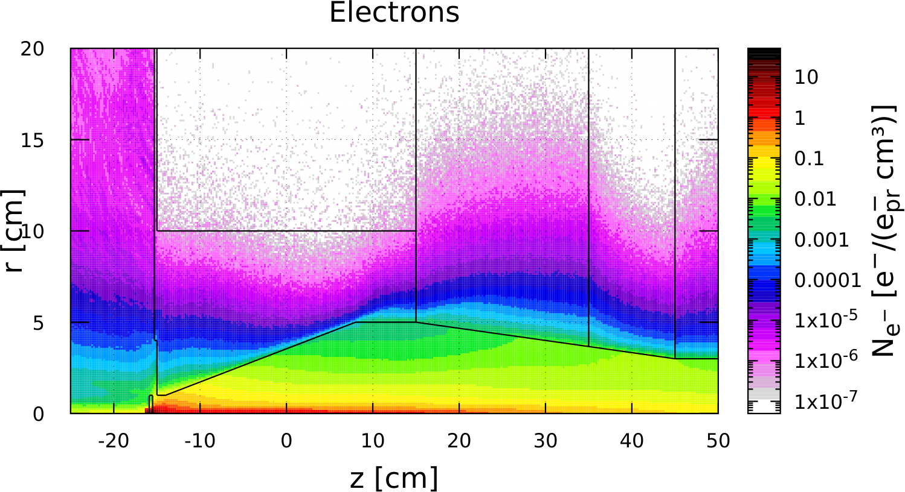
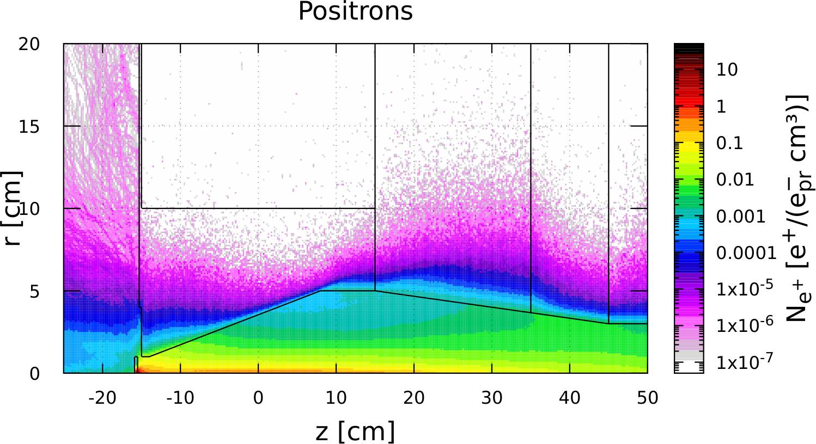
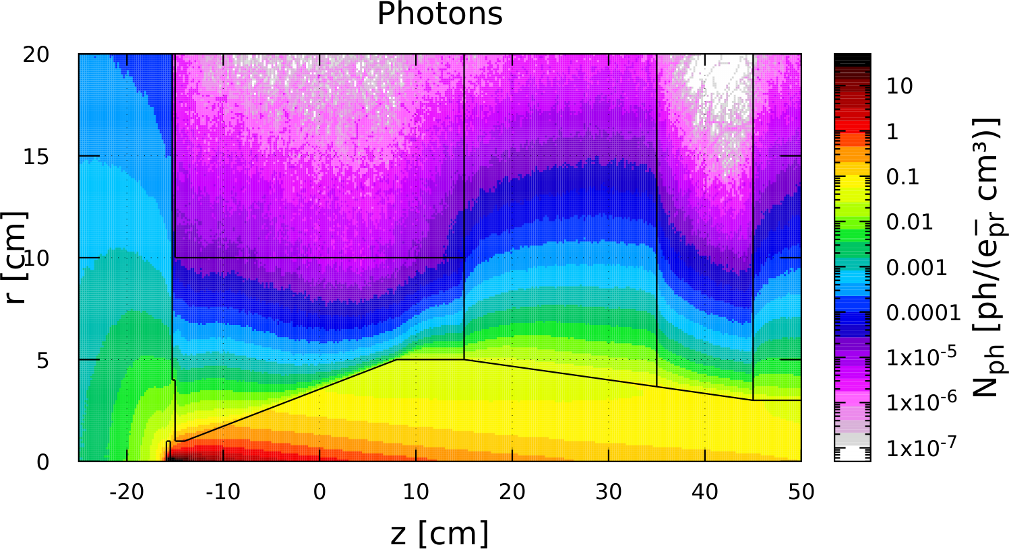
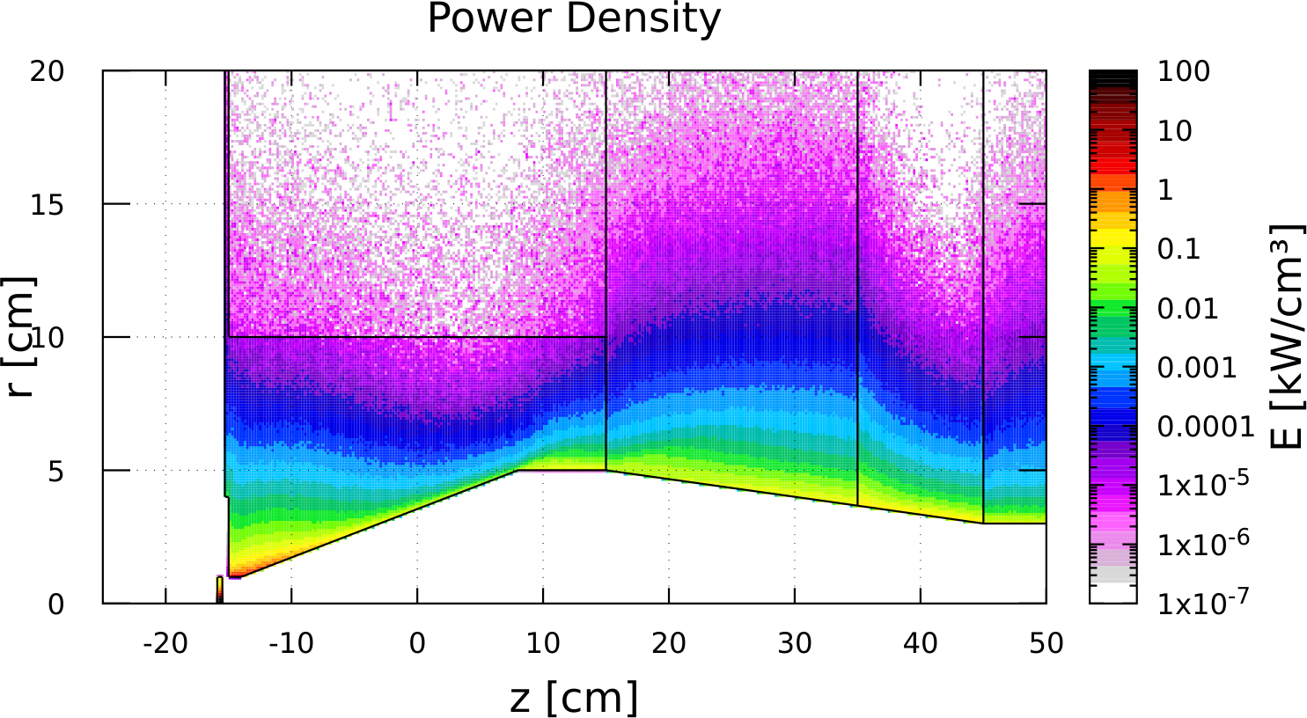
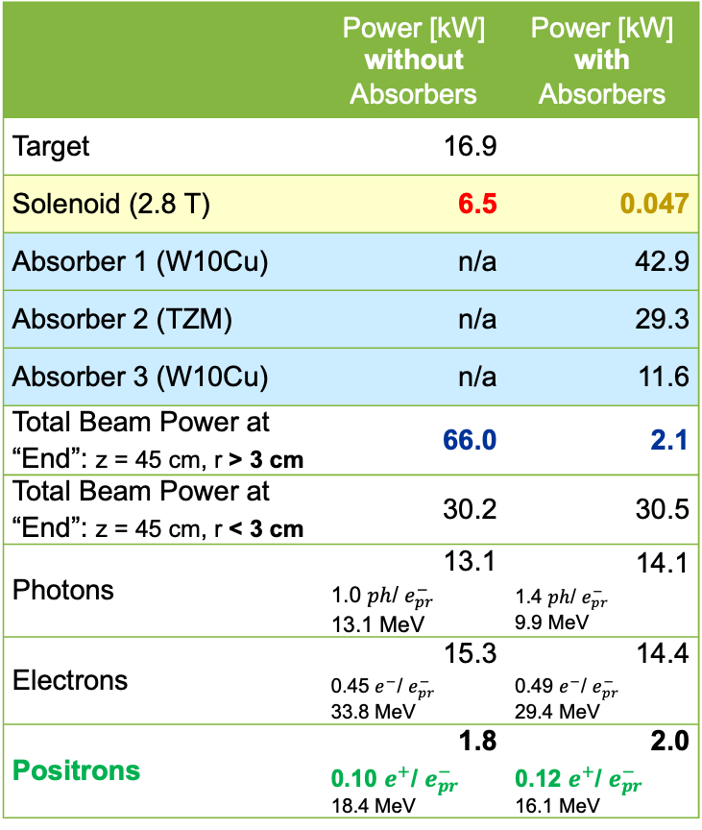
Managing ~100 kW electromagnetic shower
Thick target is needed to get enough positrons
Shielding beam power is needed to put focusing magnet with small field on target
We need some space for shieling in front of RF cavities
Our focus is to make design of first meters of e⁺ source realistic
 | Power [kW] without Absorbers | Power [kW] with Absorbers
Target | 16.9
Solenoid (2.8 T) | 6.5 | 0.047
Absorber 1 (W10Cu) | n/a | 42.9
Absorber 2 (TZM) | n/a | 29.3
Absorber 3 (W10Cu) | n/a | 11.6
Total Beam Power at “End”: z = 45 cm, r > 3 cm | 66.0 | 2.1
Total Beam Power at “End”: z = 45 cm, r < 3 cm | 30.2 | 30.5
Photons | 13.1 1.0 $ph$/ $e_{pr}^{−}$ 13.1 MeV | 14.1 1.4 $ph$/ $e_{pr}^{−}$ 9.9 MeV
Electrons | 15.3 0.45 $e^{−}$/ $e_{pr}^{−}$ 33.8 MeV | 14.4 0.49 $e^{−}$/ $e_{pr}^{−}$ 29.4 MeV
Positrons | 1.8 0.10 $e^{+}$/ $e_{pr}^{−}$ 18.4 MeV | 2.0 0.12 $e^{+}$/ $e_{pr}^{−}$ 16.1 MeV
2.8 T Solenoid
Absorber 2
TZM
Absorber 3
W10Cu
Absorber 1
W10Cu
Target

Slide 15
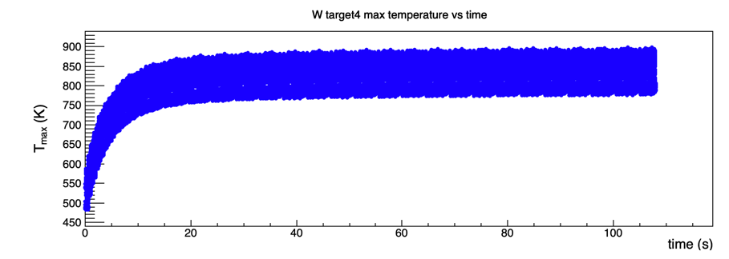
Spinning high power target R&D
We expect a 4mm thick tungsten target with 120 kW of beam power (120 MeV x 1 mA)
Approximately 17 kW will be deposited in the target.
Target concept is a rotating cooled W disc of with diameter >30 cm
Computational fluid dynamics calculations predicts the equilibrium temperature rise will be < 1000 K
  (W melts 3700 K)
We anticipate this will be a major design effort of the project
W target rotating 2 Hz with 4x4 mm² beam area at radius of 18 cm; water flow is 0.3 kg/s, water pressure loss is 1.5 psi.

Slide 16
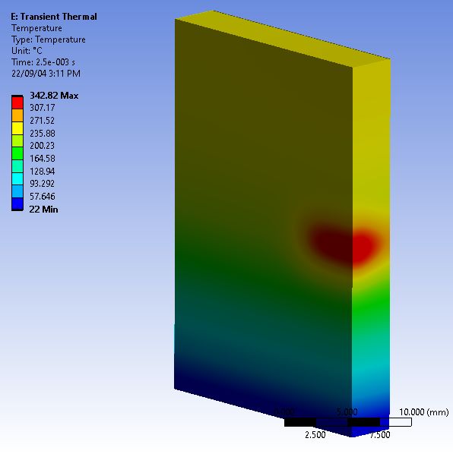
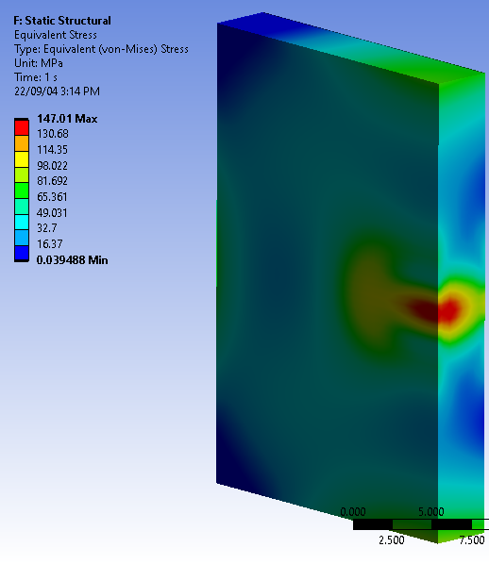
Spinning high power target R&D
How many thermal cycles at elevated temperature are possible?
Heating Phase
Temperature and Stress at the End of Heating Phase
Thermal Cycle

Slide 17
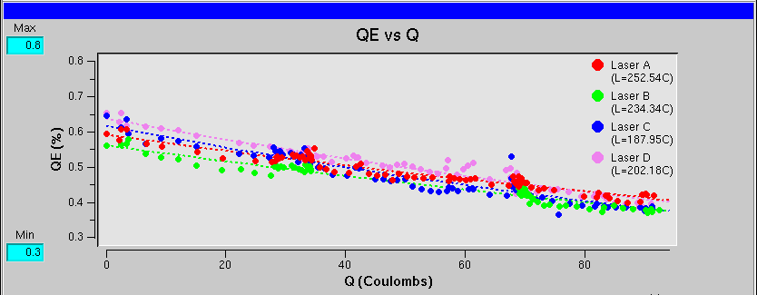
CEBAF polarized e- source @ 1 mA?
GaAs/GaAsP strained superlattice (MBE/SVT)
[µA]
Gun2 Photocathode (Fall 2016 – Spring 2017)
QE = QE₀ e ^{-(Q/Lifetime)}
We have demonstrated polarization from the CEBAF PES remains steady up to 1 mA/499 MHz
The charge lifetime (at 0.2 mA) is about 200 C
This would provide only 2-3 days of positrons
Gun vacuum ~ 1x10⁻¹² Torr
Lifetime ~200 C (σ_{4D} ~ 1mm, I~200 μA)

Slide 18
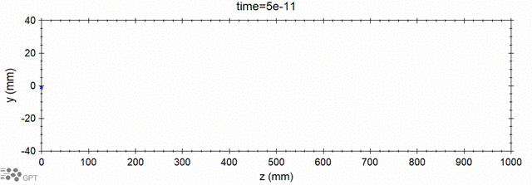
GaAs/GaAsP lifetime improvement with biased anode
Improving charge lifetime
of CEBAF photogun
Please see Josh Yoskowitz’s contribution to SPIN’23
GPT custom element IONATOR simulates electron-impact ionization of residual beam line gasses and tracks outgoing particles.
~2x
e- beam
ions
ejected e-
scattered e-
Simulation of biased anode
With a >400 C lifetime we could operate at 1 mA for almost 1 week

Slide 19
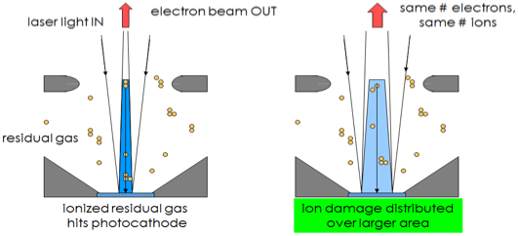
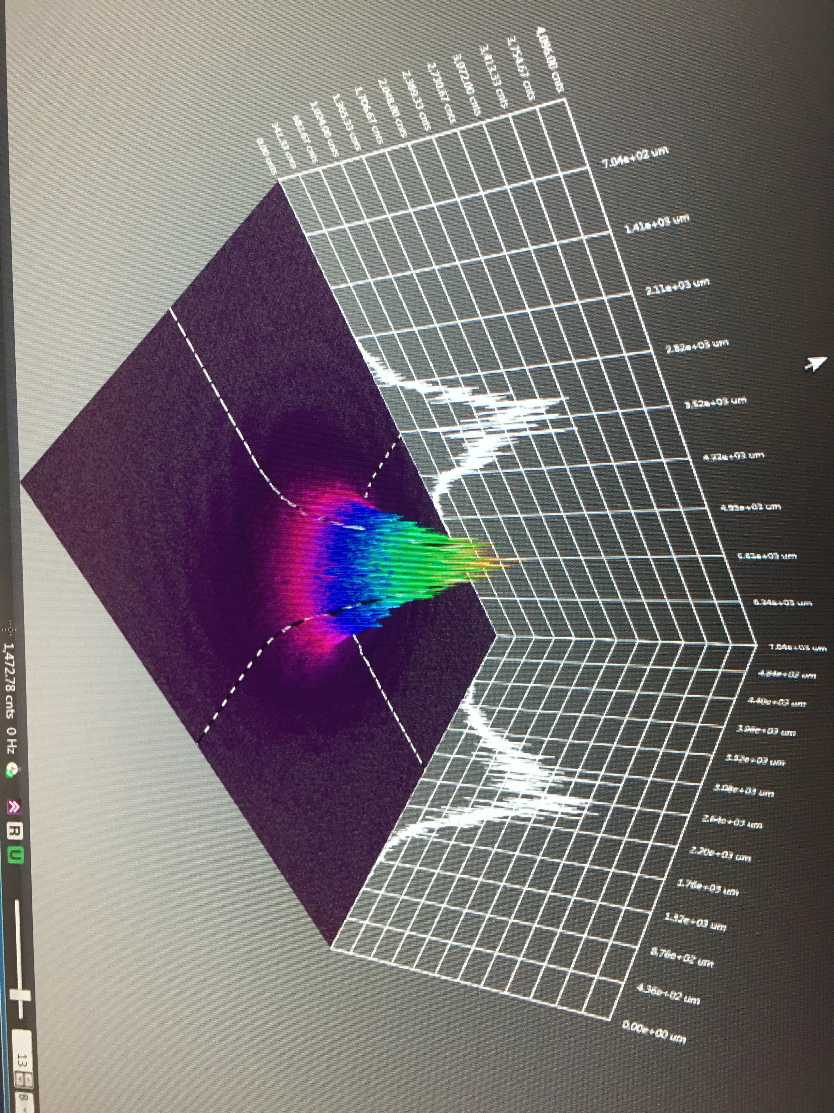

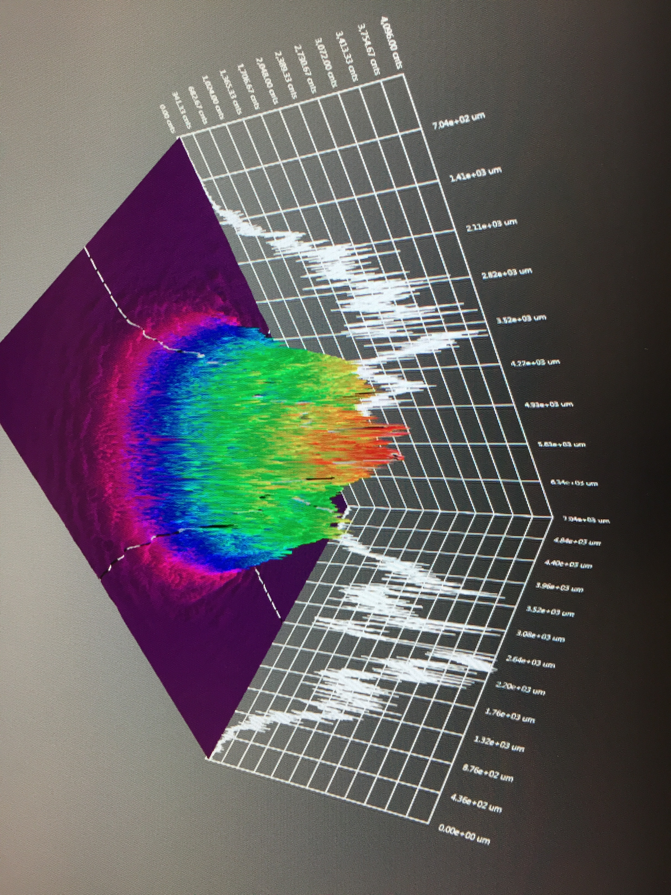
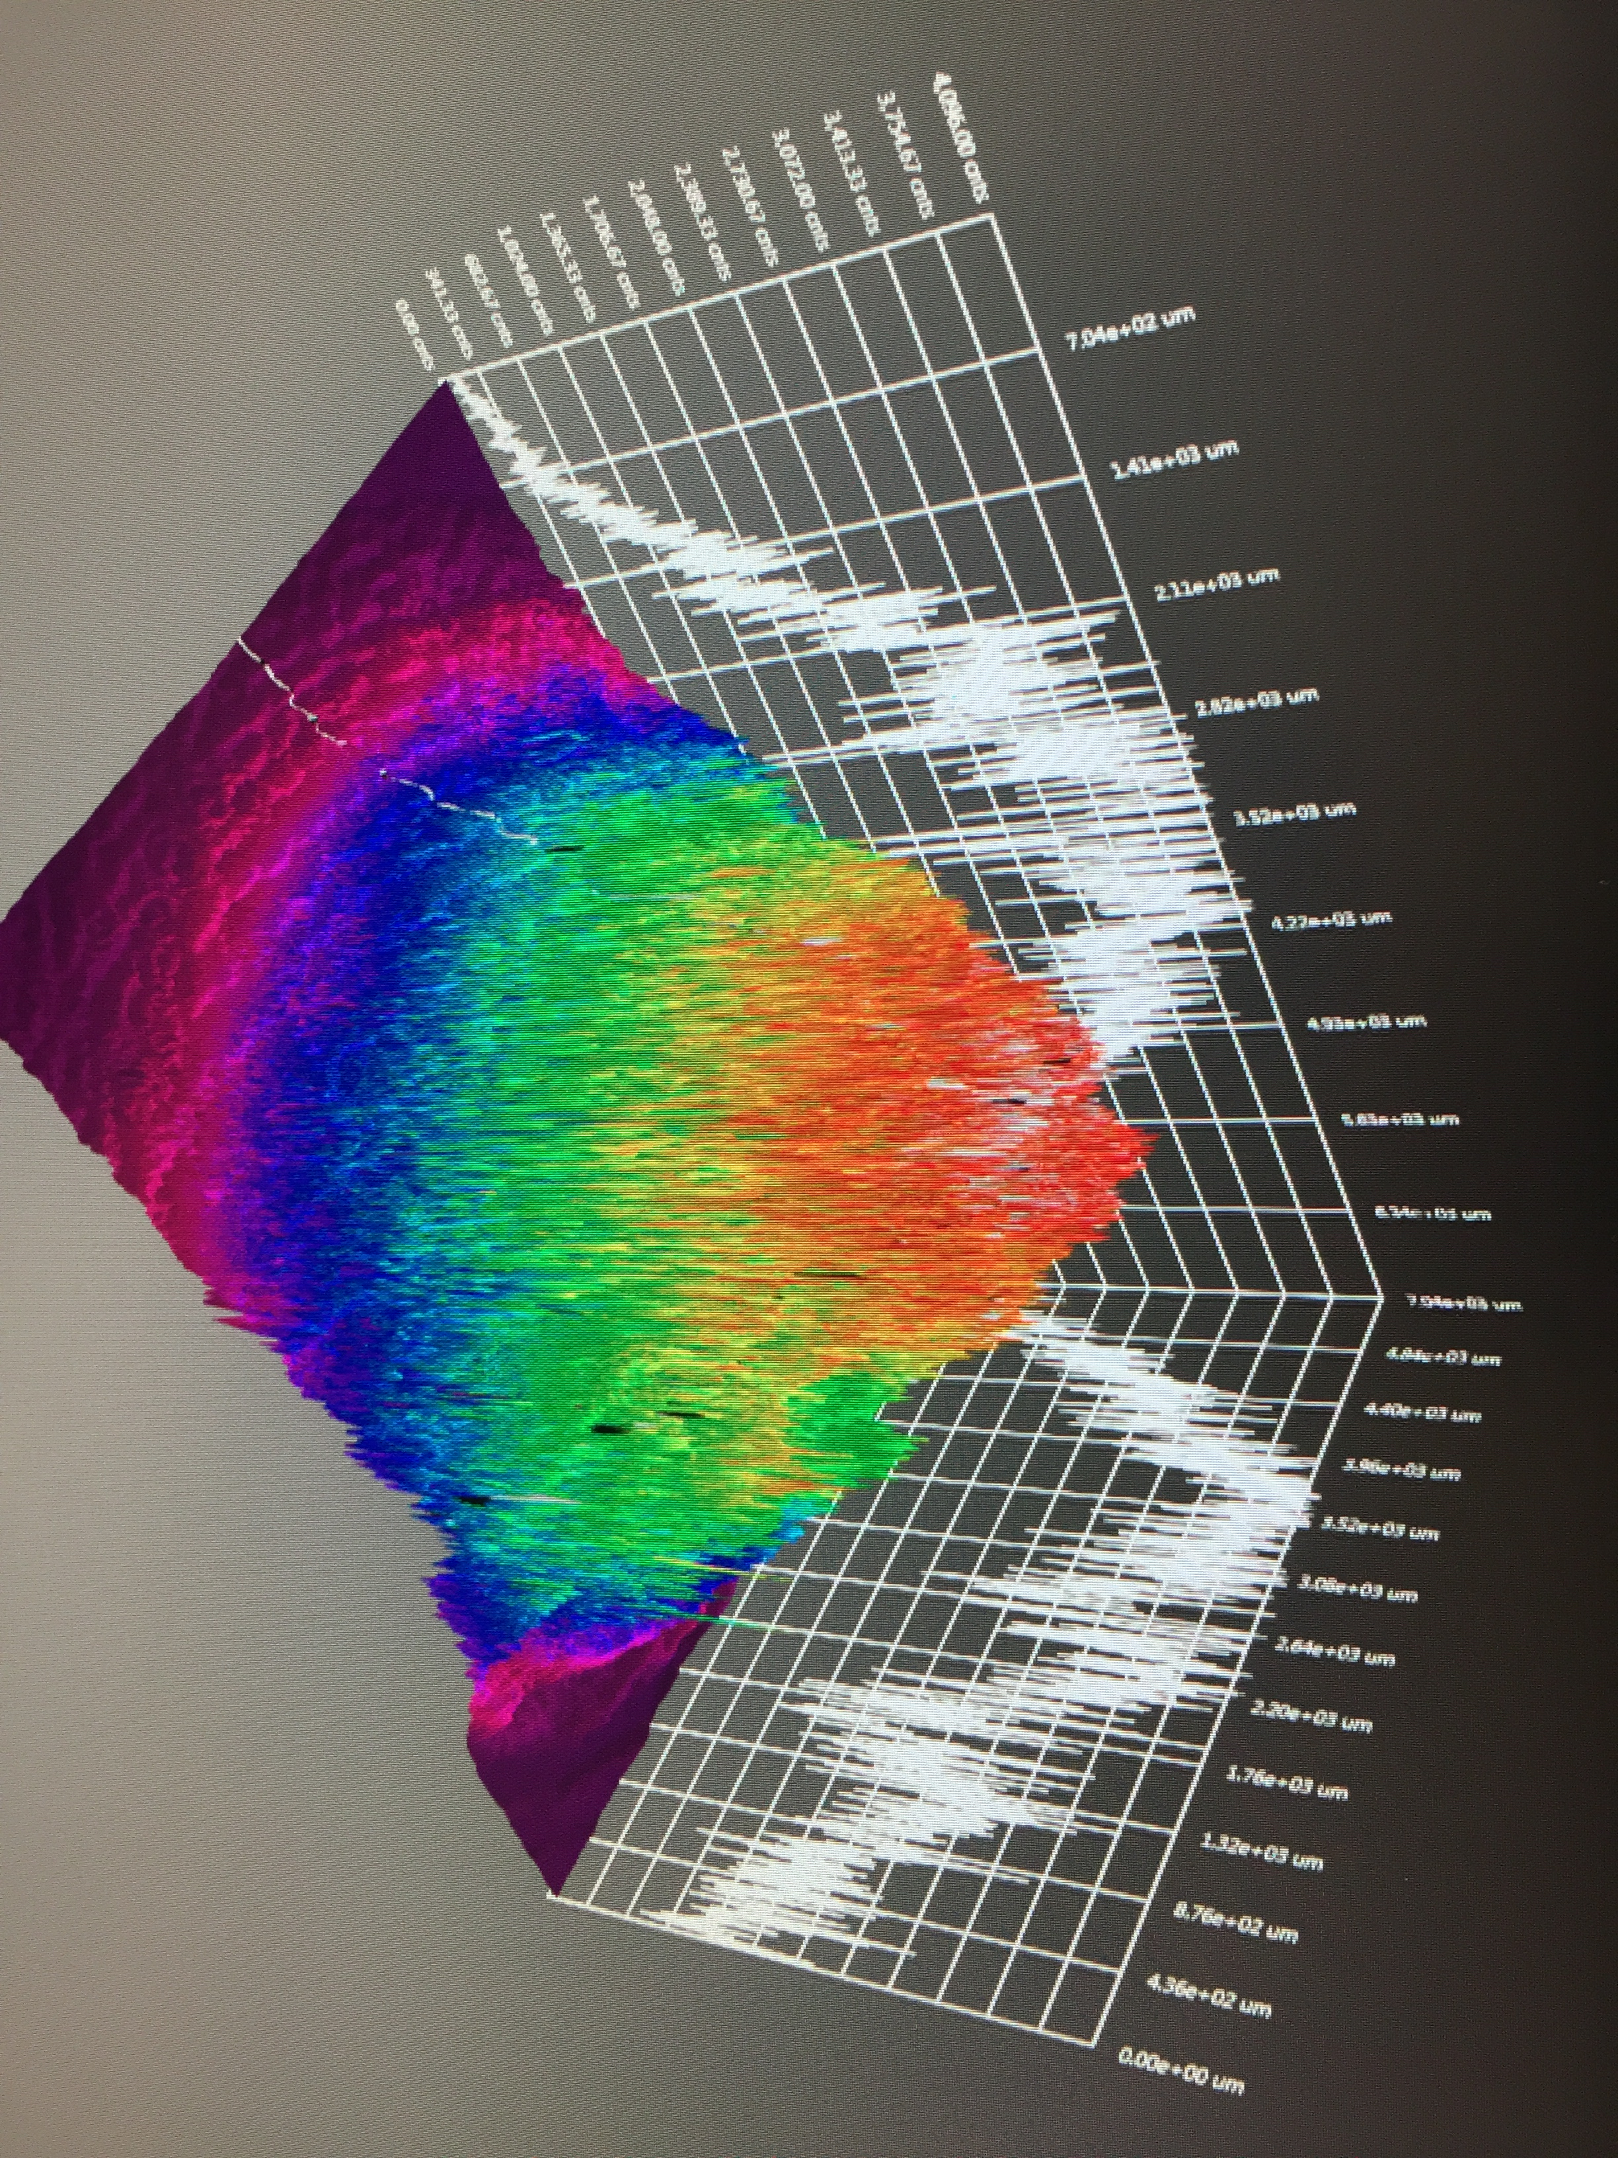
GaAs/GaAsP charge lifetime at milliamp current
Results from PSTP’17 suggests increasing laser spot size is viable to exceed >500 C lifetime; however we need to build another gun to test this assertion.
J. Grames, P. Adderley, J. Hansknecht, R. Kazimi, M. Poelker, D. Moser, M. Stutzman, S. Zhang, “Milliampere beam studies using high polarization photocathodes at the CEBAF Photoinjector” Polarized Sources, Targets and Polarimeters Workshop, Dajeon South Korea (2017)
Days
Trend we want to realize
CEBAF (<1 mm²)

Slide 20
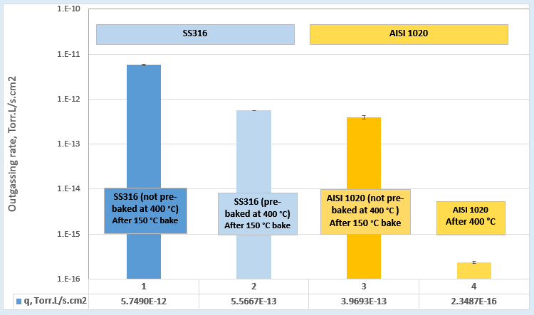
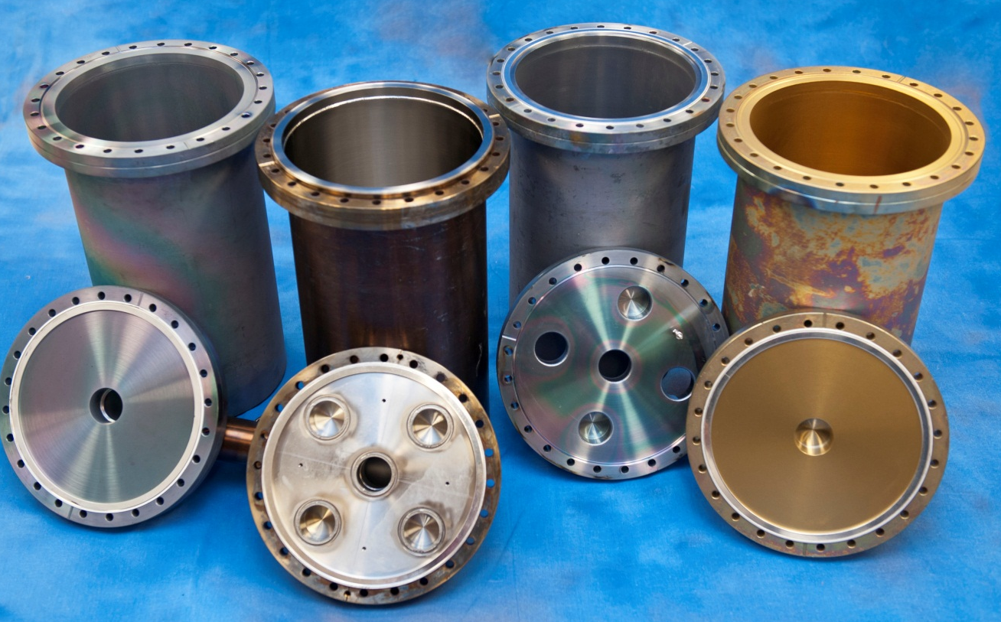
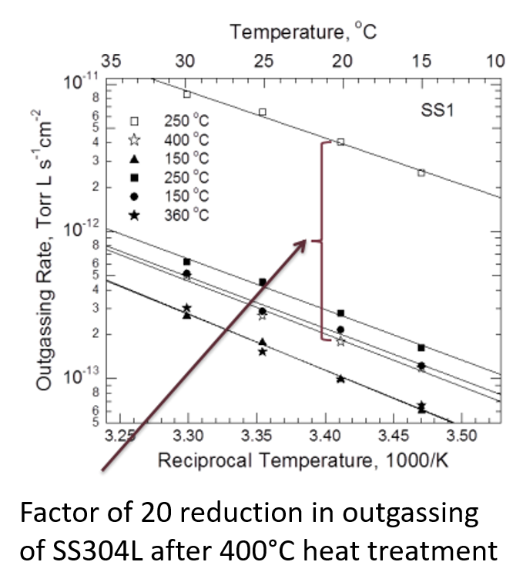
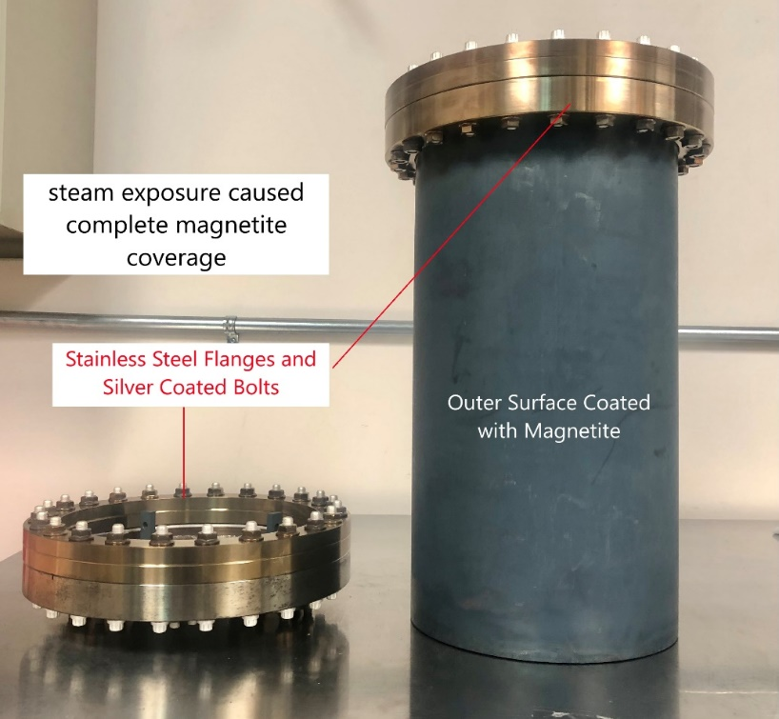
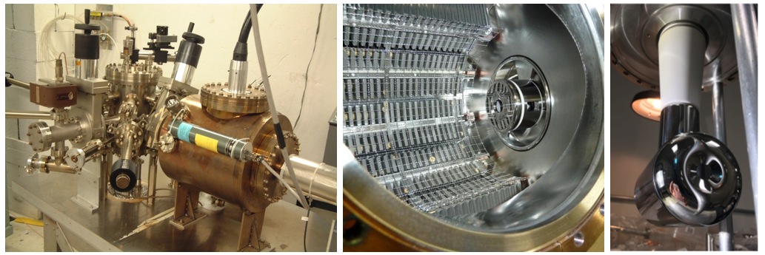
Best solution – lower pressure!
Stainless steel: bare, Silcotek and TiN
Low-carbon steel:
1000x smaller outgassing rate. Does that mean 1000x lower pressure?
Black magnetite coatings easy to produce, will reduce background light levels in gun
Magnetic material could be beneficial, eliminating stray B fields at photocathode
400ºC bakeout - that’s why our photoguns are golden and providing -12 Torr vacuum
Slide courtesy M. Poelker

Slide 21
PES for Ce⁺BAF
We want to deliver >1 mA for weeks on end…
Two weeks @ 1 mA ≈ 1 kC
By increasing the laser size and biasing the anode charge lifetimes of 1kC might be possible
However, we should aim higher by lowering the pressure in the photogun
Better
vacuum
”bias
trick”
Ce⁺BAF
Gun Charge in 2 weeks [Coulombs]
”laser
trick”
CEBAF
Gun Current to make positrons [mA]

Slide 22
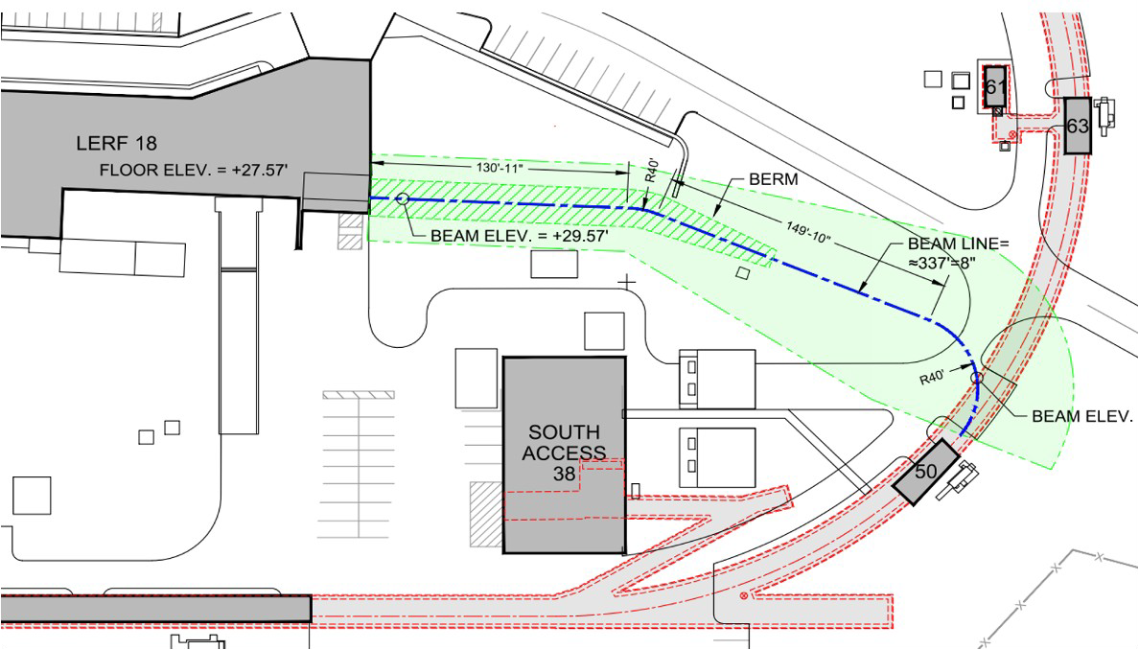
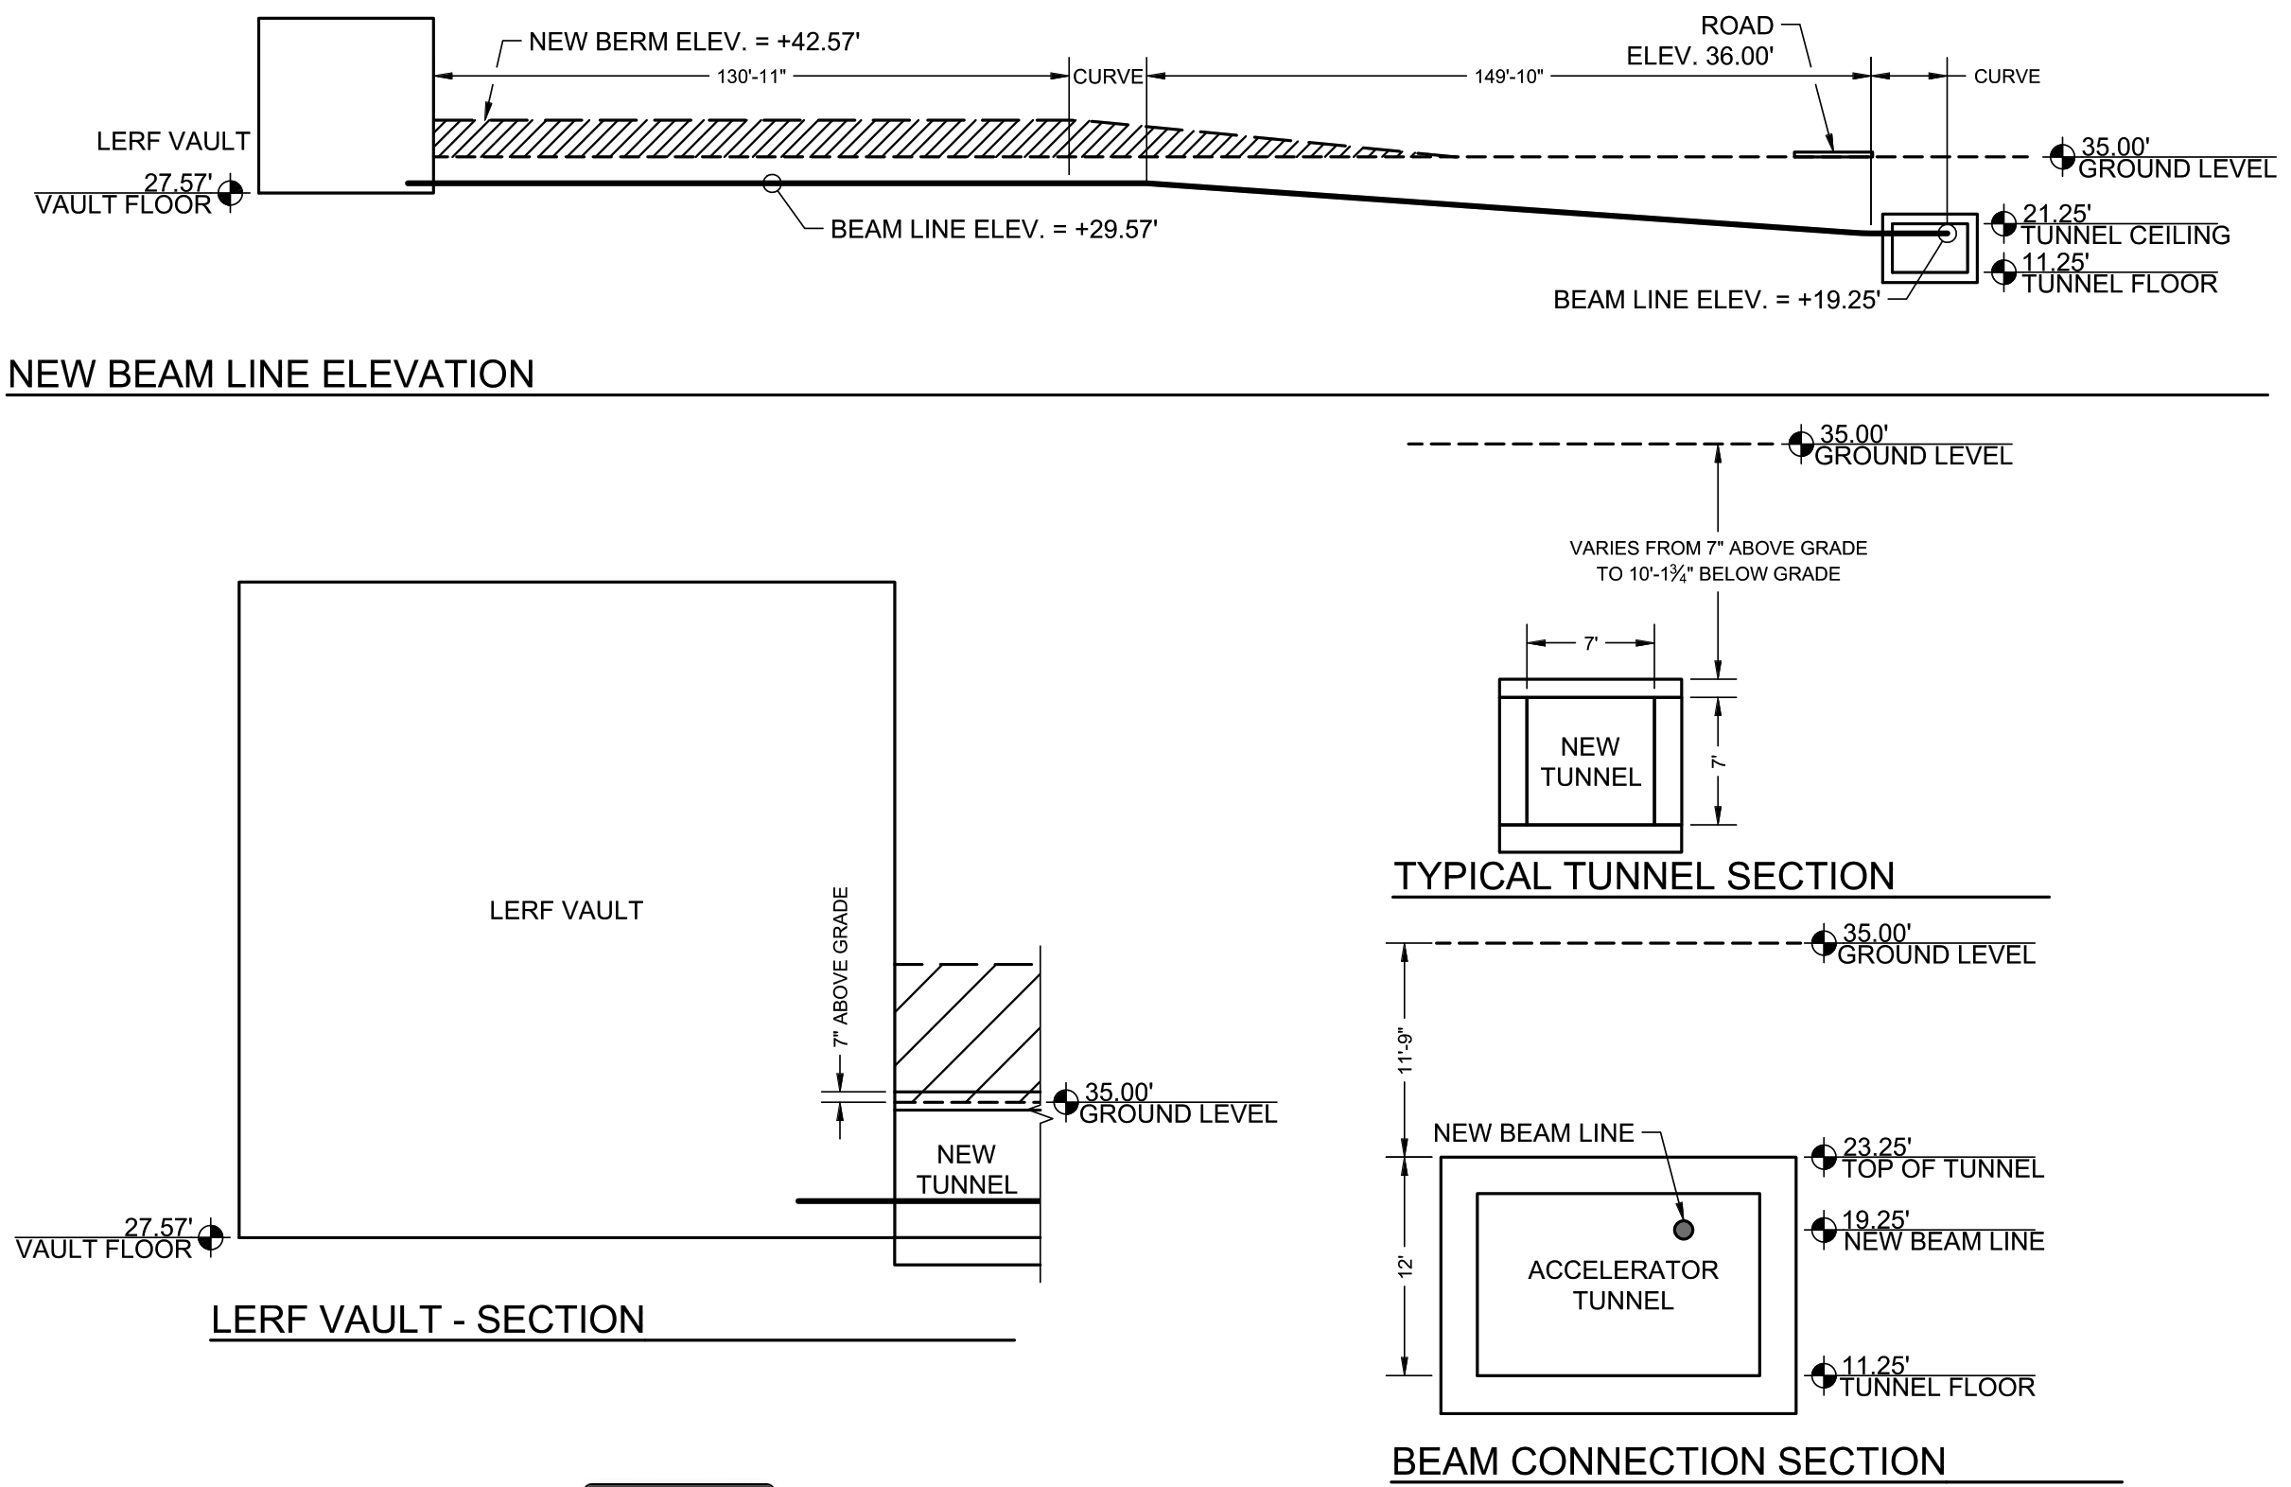
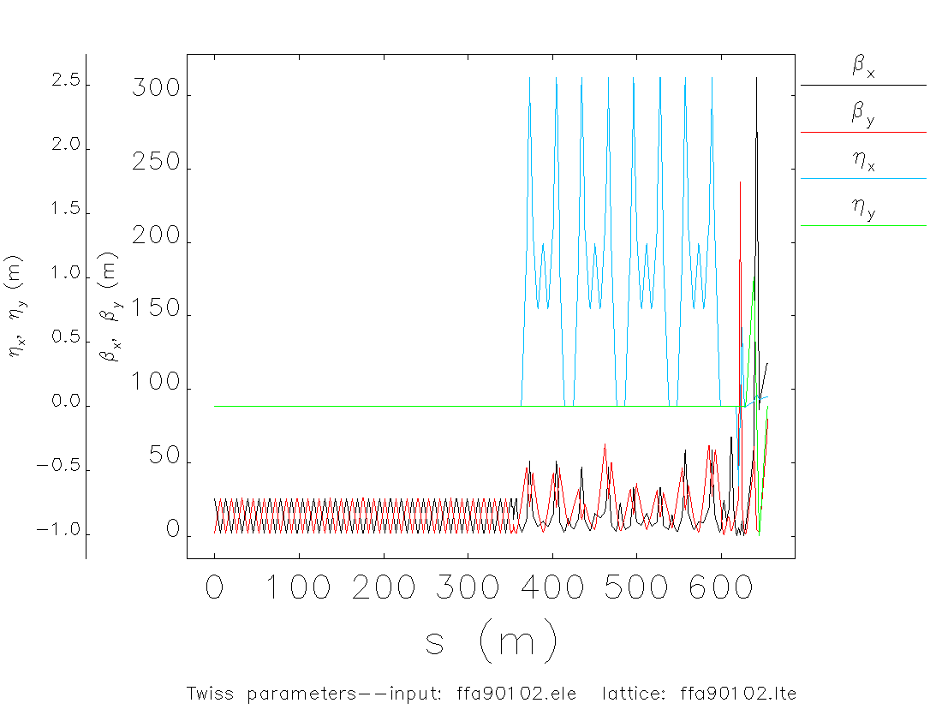
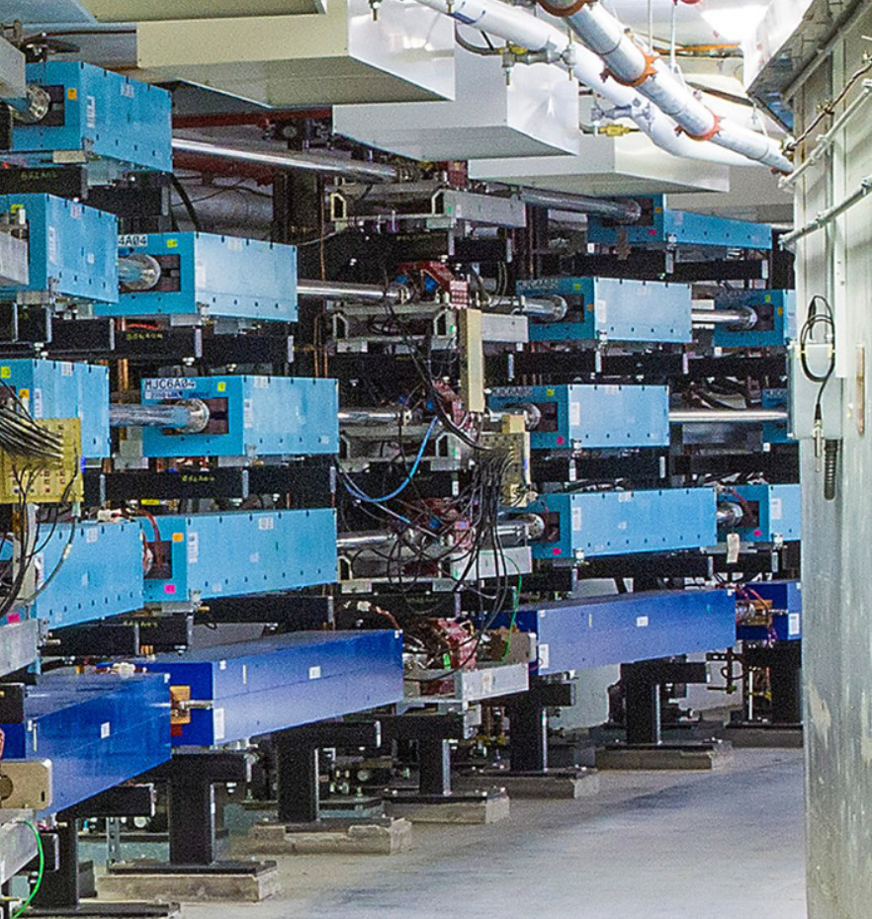
Injecting e+ to CEBAF 12 GeV
Once e⁺ source is ready, civil construction connects the LERF by a new tunnel to CEBAF. The transport line will maintain the e⁺ polarization in plane.
e⁺ transported in new beamline and injected to CEBAF for 12 GeV, with magnet polarities reversed
(an LDRD is exploring the transport of large emittance beams at CEBAF)

Slide 23
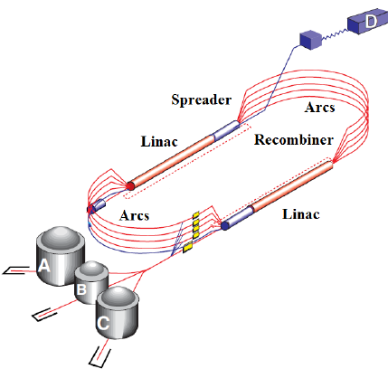
CEBAF 12 GeV : Transverse Emittance* and Energy Spread†
Use n-bend acrobats and large aperture quads for 123 MeV injection line to CEBAF
Modify low-energy CEBAF arcs to have smaller dispersion (beam size)
SR radiation damping benefits e+ emittances more than e-
6 GeV
12 GeV
* Emittances are geometric, † Quantities are rms

Slide 24
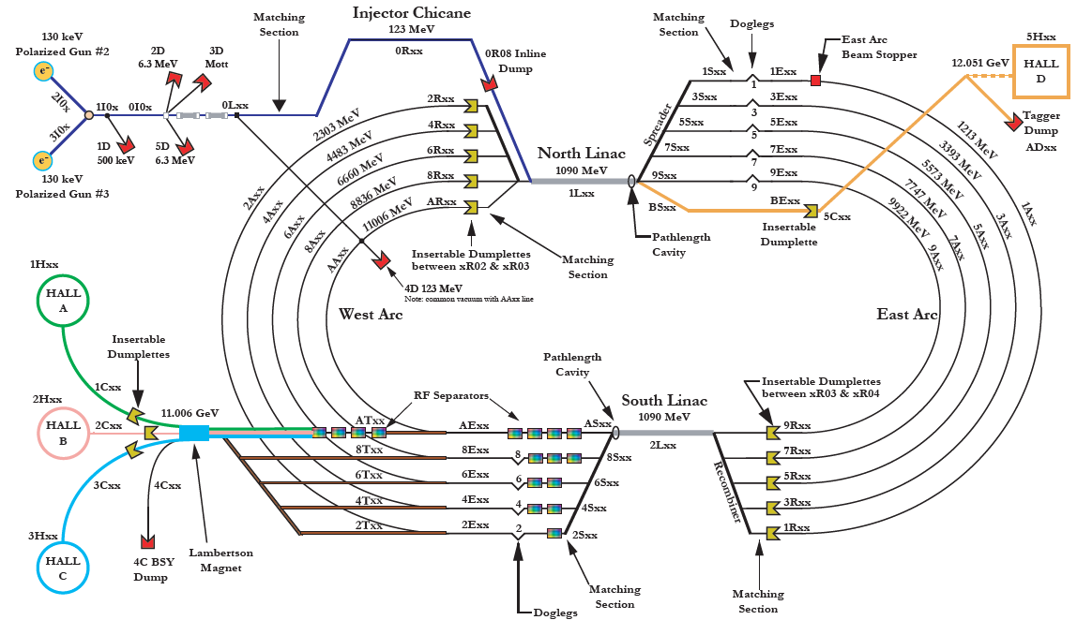
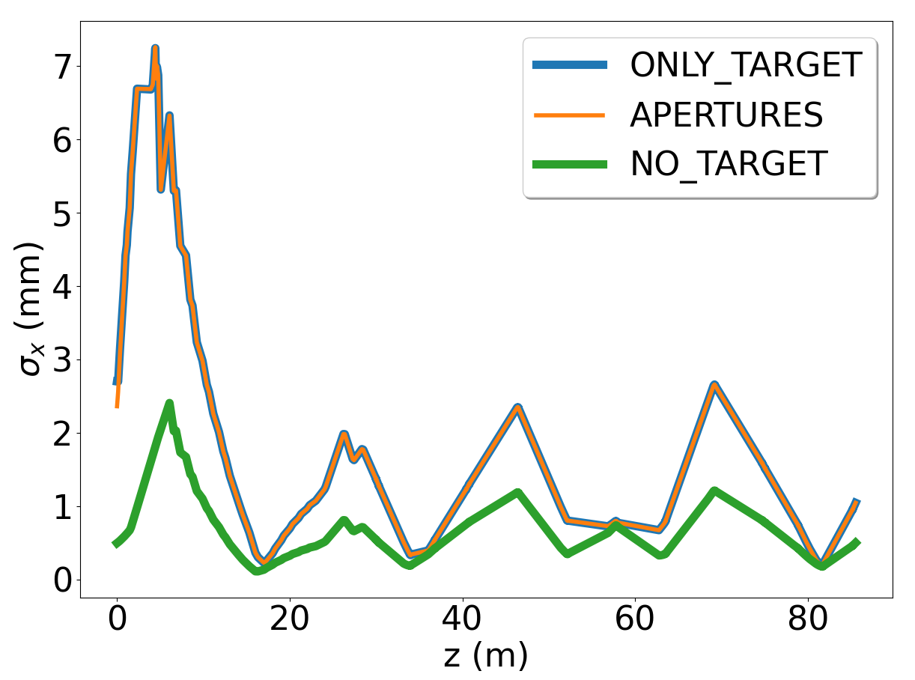
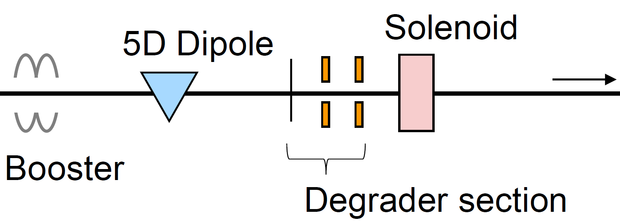
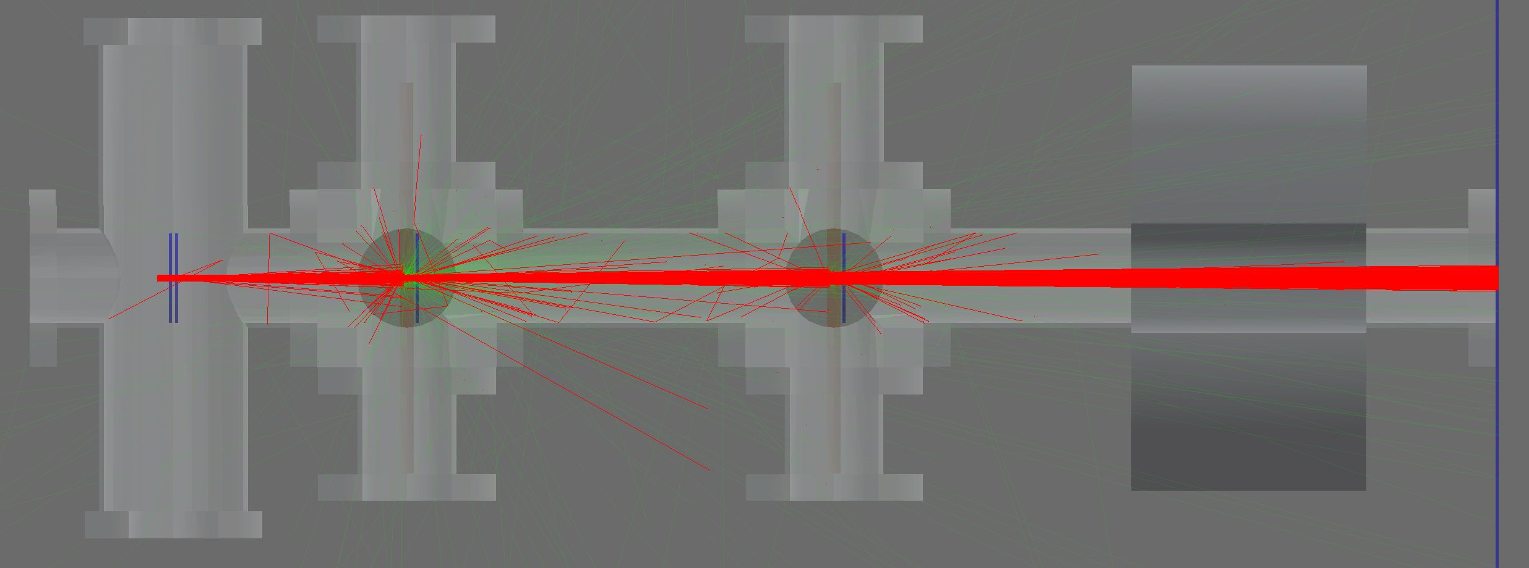
Degraded electrons
Slide courtesy A. Sy
Positron beams will be larger in phase space than CEBAF electron beams
We want to understand limitations of current CEBAF machine in transporting these larger phase space beams
CEBAF injector to ARC1
Beyond this LDRD: the positron physics program envisions utilizing electrons with parameters similar to the positron distributions; this looks like degraded electrons!
Integration of a degrader device into the LERF could provide these beams to users
Several differences in current degrader and a “production” degrader, namely beam intensity and greater flexibility in generated distributions
Feasibility and implementation could be explored with another LDRD
Year 1: design and simulation
Year 2: install and measurement
Beam size along injector
Make CEBAF electron beams “look like” positron beams through multiple scattering in thin target foils
Refine extent of “degraded” electron beam with apertures
Transport degraded electron beams in CEBAF injector and measure acceptance at ARC1 entrance
Measure beam loss, emittance evolution at higher energies

Slide 25
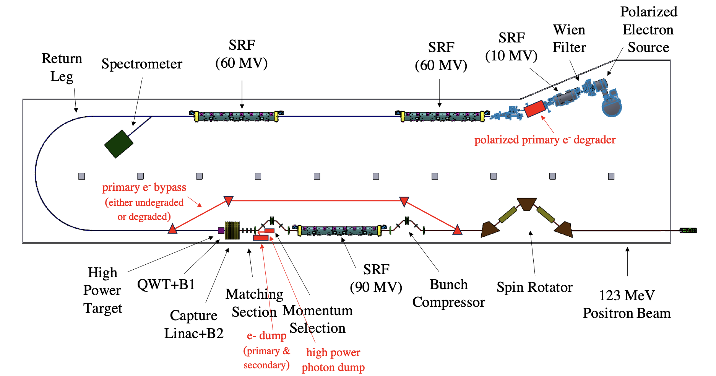
Flexibility to provide e- or e+ on-demand
  Positrons (polarized or unpolarized)
  Polarized e- beam
  ”Degraded” polarized e- beam (mimics e+ beams)

Slide 26
12 GeV CEBAF vs. Ce⁺BAF – 2023
Machine Parameter | CEBAF e- | Ce+BAF
 |  | e+ | Degraded e- | e-
Multiplicity | 4 | 1 or 2
Max. Energy (ABC/D) | 11/12 GeV | 11/12 GeV
Beam Repetition | 250/499 MHz | 250/499 MHz
Duty Factor | 100% cw | 100% cw
Unpolarized Intensity | 170 μA** | > 1 μA | >> 1 uA | 170 μA**
Polarized Intensity | 170 μA** | > 50 nA | >> 1uA | 170 μA**
Beam Polarization | > 85% | > 60% | >85% ? | >85%
** Total beam power at Jefferson Lab is limited to 1.1 MW with a max. of 0.9 MW to individual high power dumps.

Slide 27

Rough timeline for 12 GeV positron beams at Ce⁺BAF
Moller
SoLID
Ce+BAF
Phase 1 includes building a positron source and the tunnel & beamline connecting the source to main machine.
Phase 2 includes the new permanent magnets to allow 22 GeV within current CEBAF footprint.

Slide 28

Positron Workshop in Charlottesville 7-8 March 2023
https://indico.jlab.org/event/680/

Slide 29
PAC51 Awarded Days to Positron Proposals
NUMBER | TITLE | CONTACT PERSON | HALL | DAYS REQUESTED | DAYS AWARDED | SCIENTIFIC RATING | PAC DECISION
PR12+23-002 | Beam Charge Asymmetries for Deeply Virtual Compton Scattering on the Proton at CLAS12 | Eric Voutier | B | 100 | 100 | A- | C1
PR12+23-003 | Measurement of Deep Inelastic Scattering from Nuclei with Electron and Positron Beams to Constrain the Impact of Coulomb Corrections in DIS | Dave Gaskell | C | 9.3 | 9.3 | A- | C1
PR12+23-006 | Deeply Virtual Compton Scattering using a positron beam in Hall C | Carlos Munoz Camacho | C | 137 | 137 | A- | C1
PR12+23-008 | A Direct Measurement of Hard Two-Photon Exchange with Electrons and Positrons at CLAS12 | Axel Schmidt | B | 55 | 55 | A | C1
PR12+23-012 | A measurement of two-photon exchange in unpolarized elastic positron–proton and electron–proton scattering | Michael Nycz | C | 56 | 56 | A- | C1
C1 = Conditionally Approved w/Technical Review by the Lab
Approved 155 PAC days in Hall B and 202 PAC days in Hall C for a total of 357 PAC days!
Three years of single hall running at 34 weeks per year. (One PAC day = Two calendar days)

Slide 30
Conclusions
Demonstrated need for e+ beams at Jefferson Lab
Using the LERF to stage the e-/e+ injectors
Feasible S2E concept for 12 GeV Ce+BAF developed
Next year’s focus will be to develop
  concept for radiation shielding and managing radioactivity
  detailed and realistic design of the for e⁺ source (target – solenoid – RF – dumps)
Rough timeline plans for 12 GeV e⁺ beams in 10 years

Slide 31







Acknowledgments
I would like to acknowledge the Ce⁺BAF Working Group, the Jefferson Lab Positron Working Group and all those who have been supportive to this progression of activity.
J. Benesch, A. Bogacz, L. Cardman, J. Conway, S. Covrig, S. Habet, C. Hernandez-Garcia,
D. Higinbotham, J. Gubeli, S. Habet, A. Hofler, R. Kazimi, F. Lin, V. Kolstrum, V. Lizarraga-Rubio,
S. Nagaitsev, M. Poelker, Y. Roblin, A. Seryi, K. Smolenski, M. Spata, R. Suleiman, A. Sy, D. Turner,
A. Ushakov, C. Valerio, E. Voutier, J. Yoskowitz, S. Zhang

