Slide 1
EIC's HSR Rotator and Snake Swap Study
Vahid Ranjbar Scott Berg and Francois Meot
Brookhaven National Laboratory
September, 26th 2023

Slide 2
Importance of 6 Snake Configuration
Six snakes are needed in the EIC’s Hadron Storage Ring
To achieve 70% polarization (Currently 2 snakes can achieve 60%)
To manage He3 at 70% polarization
Proper location of snakes very important: need 60 degrees between snakes to work best.
Space in HSR is very tight so current configuration violates this rule while still maintaining 180 degrees between +/- 45 snake axis orientation. Might work but lowers total possible polarization aperture.
I was asked to consider the possibility of swapping snake and rotator to the right of IP6

Slide 3
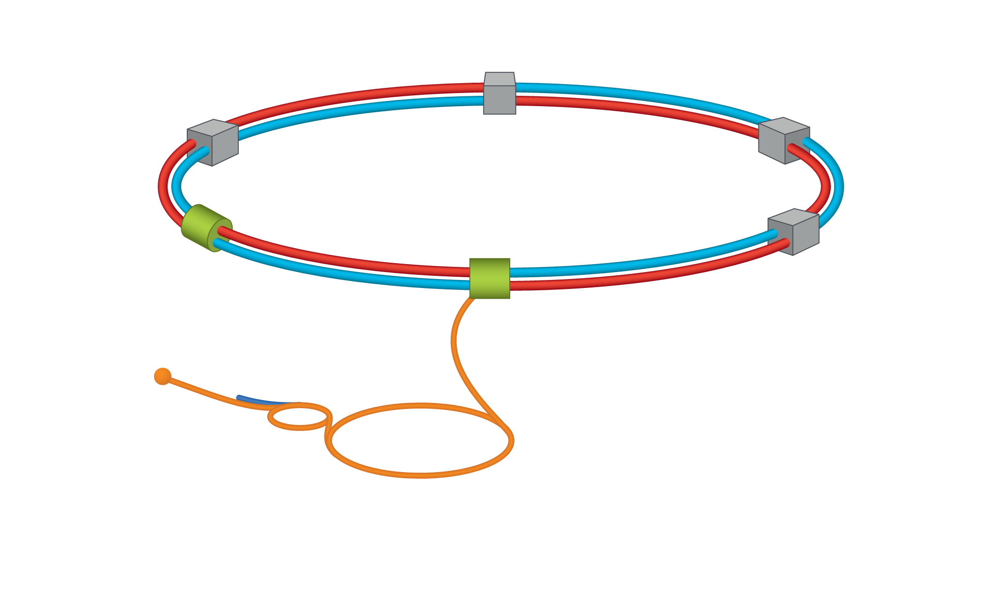
HSR Rotator and Snake Layout
Current layout
Proposed layout
rotator
rotator
rotator
snake
snake
rotator

Slide 4
Rotator and Snake Configuration at IP6
Beam direction
IP6
Rotator_beg
Θ₁ = 61.35e-3 rad
snake
Θ₂ = 38.924e-3 rad
Rotator_end
Θ₀ = 17e-3 rad
Snake is placed such that between it and the previous and succeeding snake is 60 degrees. Here we can accelerate using it as part of a six snake set.
However when we reach top energy to obtain longitudinal polarization while maintaining the function of the snake, we propose tuning the snake and two rotators such that the spin Transport Matrix through the whole line at exit of rotator are the same as if we had an ideal snake and the rotators were off. We call this matrix the STM0 matrix.
As well at IP6 the polarization should be longitudinal.

Slide 5
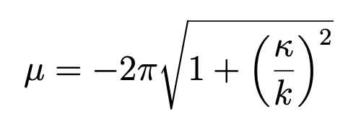
Fitting Simplified Helical Dipole Model
Using Model developed in M. Syphers and E. Courant:
→ Rotator Style Helix
→ Snake Style Helix
$$k=\frac{2π}{L}$$

Slide 6
Settings for 275 GeV
For this energy, the STM0 matrix in the ( x, y, z) or (horizontal, vertical and longitudinal) basis is:
[[[ 0.95643894 0. -0.29193243]
[ 0. -1. 0. ]
[-0.29193243 0. -0.95643894]]]
Using the field for the two currents for the snake, beginning and end rotator as:
b = [Rotator_beg, snake, Rotator_end] which is given as a six element array
b = [2.816, 3.107, -0.41332, -1.725, 2.6339, 2.552] (T)
Achieves a STM0 matrix of:
[[ 9.56438944e-01 1.44751832e-09 -2.91932435e-01]
[-7.88083970e-13 -1.00000000e+00 -4.96098246e-09]
[-2.91932435e-01 4.74510686e-09 -9.56438944e-01]]
Spin at IP6 = [-0.00787843 0.01496793 0.99985694]

Slide 7
Settings for 100 GeV
For this energy, the STM0 matrix in the ( x, y, z) or (horizontal, vertical and longitudinal) basis is:
[[ 0.94902352 0. 0.31520527]
[ 0. -1. 0. ]
[ 0.31520527 0. -0.94902352]]
Using the field for the two currents for the snake, beginning and end rotator as:
b = [Rotator_beg, snake, Rotator_end] which is given as a six element array
b =[-1.7177, -3.0292 ,-3.933, -3.643,, 1.67338, 3.0326] (T)
Achieves a STM0 matrix of:
[[ 9.49023519e-01 -5.94975558e-10 3.15205266e-01]
[ 4.42585551e-10 -1.00000000e+00 -3.22012267e-09]
[ 3.15205266e-01 3.19547725e-09 -9.49023519e-01]]
Spin at IP6 = [0.00858315 0.02527488 0.99964369]

Slide 8
Settings for 41 GeV
For this energy, the STM0 matrix in the ( x, y, z) or (horizontal, vertical and longitudinal) basis is:
[[ 0.05291137 0. -0.99859921]
[ 0. -1. 0. ]
[-0.99859921 0. -0.05291137]]
Using the field for the two currents for the snake, beginning and end rotator as
b = [Rotator_beg, snake, Rotator_end] which is given as a six element array
b = [-1.70116, -3.56313, 2.58481, -4.0, -3.355, -2.798] (T)
Achieves a STM0 matrix of:
[[ 5.29113693e-02 7.31696254e-10 -9.98599212e-01]
[-4.27697148e-09 -1.00000000e+00 -9.59340804e-10]
[-9.98599212e-01 4.32174032e-09 -5.29113693e-02]]
Spin at IP6 = [0.01825893 0.02319105 0.9995643 ]

Slide 9
Settings for He3 at 183.4 GeV
For this energy, the STM0 matrix in the ( x, y, z) or (horizontal, vertical and longitudinal) basis is:
[[ 0.97436538 0. -0.22497133]
[ 0. -1. 0. ]
[-0.22497133 0. -0.97436538]]
Using the field for the two currents for the snake, beginning and end rotator as :
b = [Rotator_beg, snake, Rotator_end] which is given as a six element array
b = [-2.68880,1.3333794, 0.85326, -2.140, 1.02, 2.878](T)
Achieves a STM0 matrix of:
[[ 9.74365384e-01 3.80032547e-17 -2.24971327e-01]
[ 2.13117349e-17 -1.00000000e+00 9.62943428e-17]
[-2.24971327e-01 9.46216820e-18 -9.74365384e-01]]
Spin at IP6 = [ 8.49386689e-17 -2.39672806e-16 -1.00000000e+00]

Slide 10
Ramping Studies: Want to ramp trying to keep spin tune = 0.5 and keeping fields <4T
We have beginning and ending currents which we want to connect so I tried to use a 3rd order polynomial to fit it:
b = m[0]*t+ m[1]*t^2 +m[2]*t^3
Here b is the field for one of the helices and t the time step and m[1-3] the polynomial coefficients. m[2] is determined by the initial and final values of b with N=total number of steps:
m[2]=(bf-bi)/(N^3) -m[0]/(N^2) - m[1]/N
I then optimize by varying m[0] and m[1] for all the b’s (fields) while keeping the spin tune fixed at 0.5

Slide 11
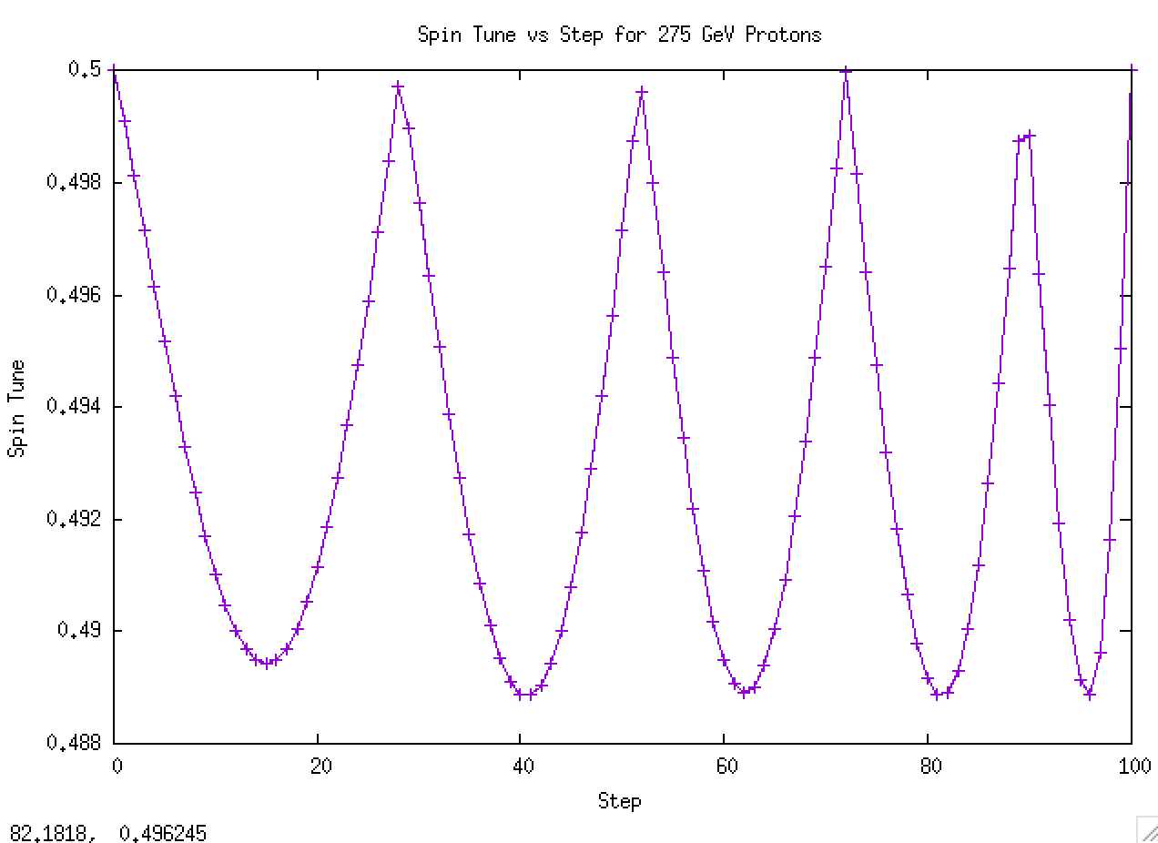
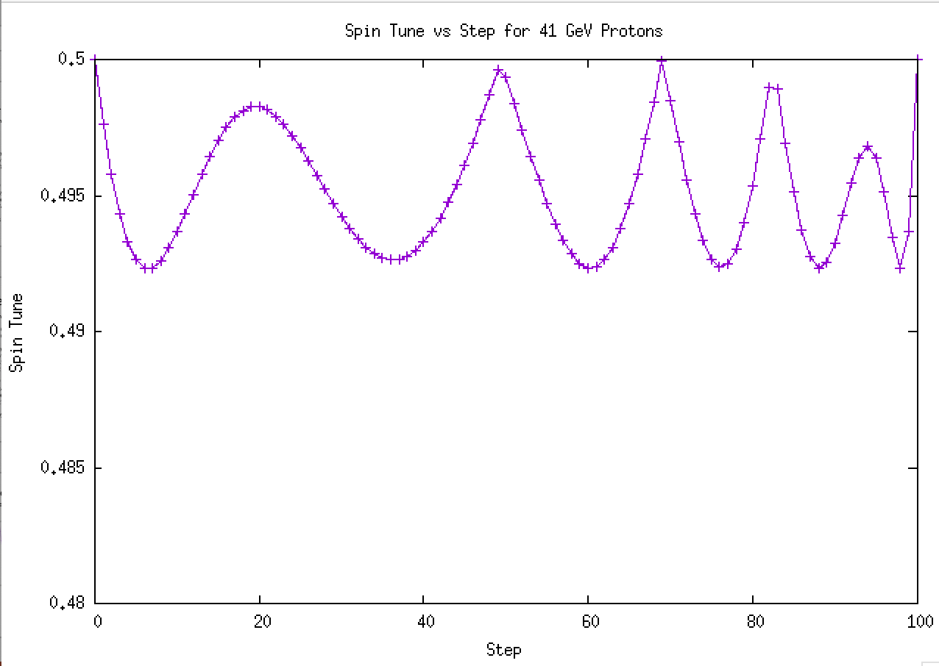
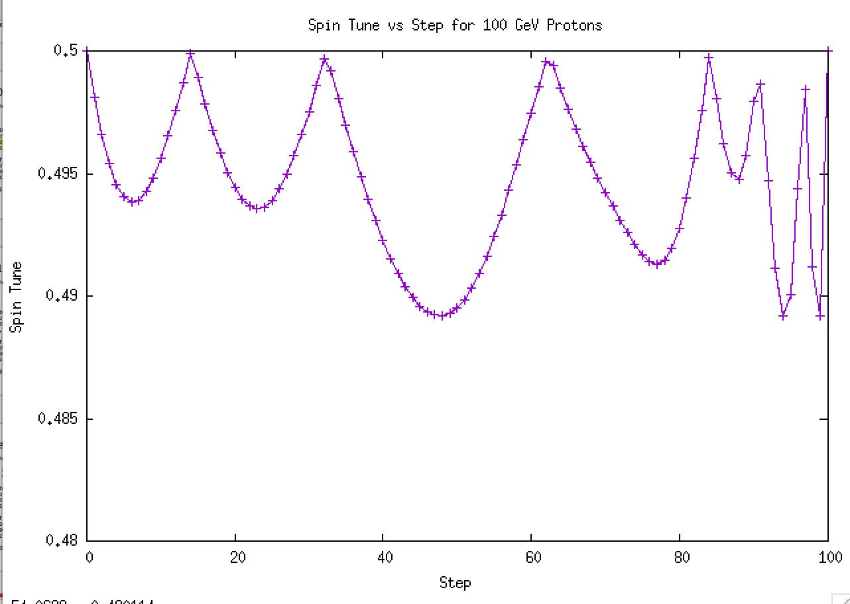
Spin Tune Trajectory during current ramp

Slide 12
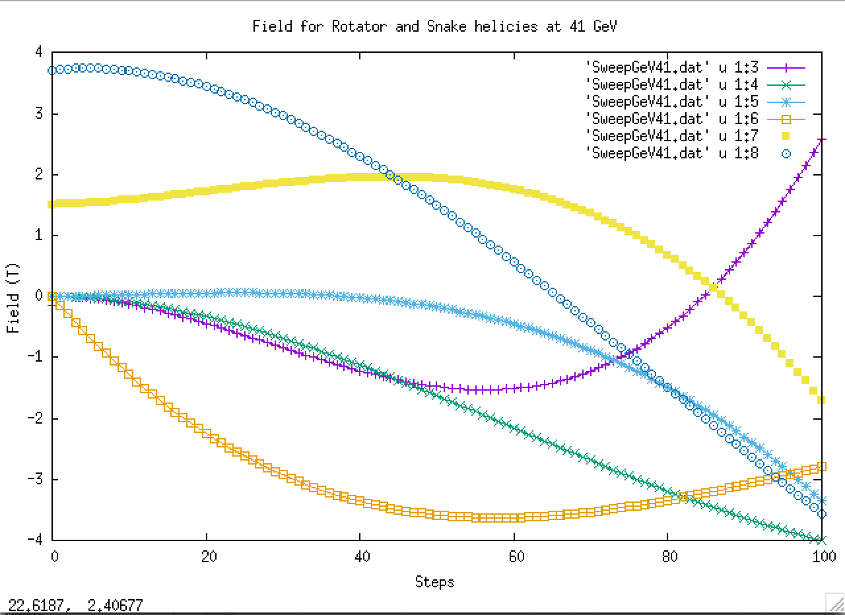
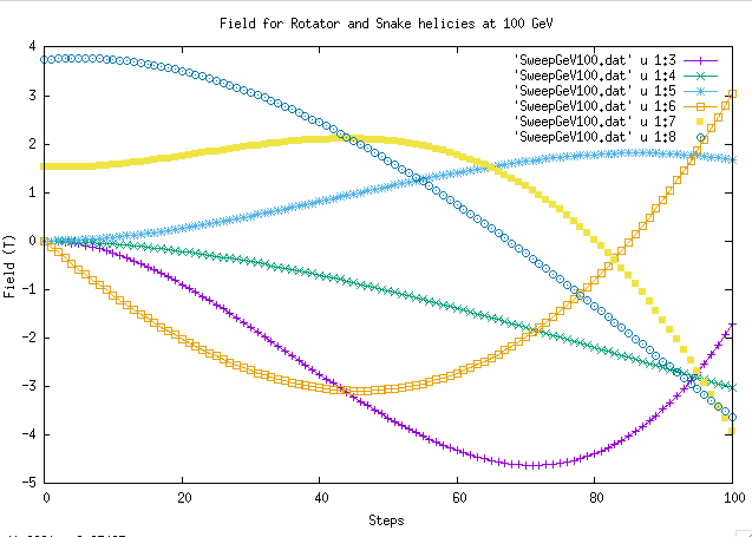
Field Ramp Plots for Snake and Rotators

Slide 13
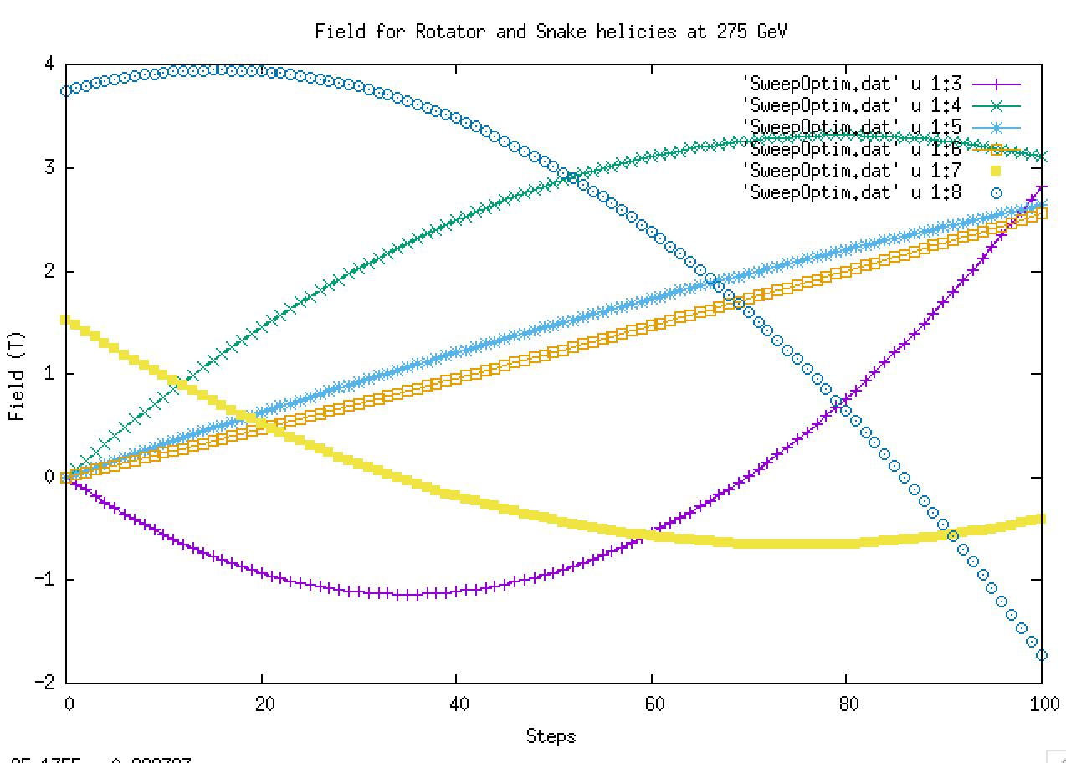

Slide 14
More Realistic Model:
Now try again using Zgoubi Spin-orbit tracking code with more exact field maps of helical dipole fields.
Coordinates in Zgoubi are (Long, horizontal, vertical)
Very difficult to optimize! Easily get stuck in local minimum:
Best approach was to use the Spin transport matrix for each Snake and Rotator from simple model and fit to that first.

Slide 15
Zgoubi Field Map fit: 275 GeV
Current Settings →
[-231.80, 350.9094, 123.3368, 283.1899, -198.963, -191.876] (Amps)
Target STM0 Matrix:
[[-0.954993, 0.296628, 0.000111802],
[0.296628, 0.954993, 8.504225e-05],
[-8.154423e-05, 0.0001143783, -1.0]]
Achieved STM0 Matrix:
[[-0.954993, 0.296628, 0.0001117815],
[0.296628, 0.954993, 8.504525e-05],
[-8.152193e-05, 0.0001143755, -1.0]]
Spin at IP6 →[ 1.000000e+00 -2.495691e-10 9.199597e-10]

Slide 16
Zgoubi Field Map fit: 100 GeV
Current Settings →
[-151.058, -218.025, 49.44, 356.247, -278.1867, -369.806] (Amps)
Target STM0 Matrix:
[[-0.9496, -0.313463, 3.901254e-05],
[-0.313463, 0.9496, 2.461823e-05],
[-4.476323e-05, 1.11485e-05, -1.0]]
Achieved STM0 Matrix:
[[-0.949598, -0.313471, 5.043524e-05],
[-0.313471, 0.949598, -2.010494e-05],
[-4.159092e-05, -3.490158e-05, -1.0]]
Spin at IP6 →[-0.999833 0.00803846 0.01638555]

Slide 17
Zgoubi Field Map fit: 41 GeV
Current Settings →
[275.604, 355.5366, 265.939, 132.680, -103.173, -346.504] (Amps)
Target STM0 Matrix:
[[-0.05184229, 0.998655, 0.000222751],
[0.998655, 0.05184232, -0.0001576043],
[-0.0001689403, 0.0002142809, -1.0]]
Achieved STM0 Matrix:
[[-0.05296619, 0.998596, -0.0007042412],
[0.998591, 0.05296811, 0.003073209],
[0.003106196, -0.0005404731, -0.999995]]
Spin at IP6 →[-0.999517 0.02097785 0.02290755]

Slide 18
Zgoubi Field Map fit: He3 183.4 GeV
Current Settings →
[-18.62974, -185.9855, -261.326, -154.1264, 167.476, 142.96] (Amps)
Target STM0 Matrix:
[[-0.976003, 0.217759, -0.0001192205], [0.217759, 0.976003, -3.171534e-06], [0.0001156688, -2.905685e-05, -1.0]]
Achieved STM0 Matrix:
[[-0.976003, 0.217758, -0.0001225517], [0.217758, 0.976003, -1.829506e-06], [0.0001192124, -2.847221e-05, -1.0]]
Spin at IP6 →[ 1.000000e+00 -5.818688e-08 2.135577e-07]

Slide 19
Conclusion
Possible solutions appear to exist for each case:
(p→ 275,100 and 41 GeV) and (He3 → 183.4)
However fields and current might not be achievable with the existing RHIC snakes
In my opinion this approach is not a preferred solution very challenging to tune, worry that in actually operation it will be a nightmare to get it to work.

