Slide 1
Application of Spin Canceling Cell Design to Several Lattices
Vahid Ranjbar

Slide 2
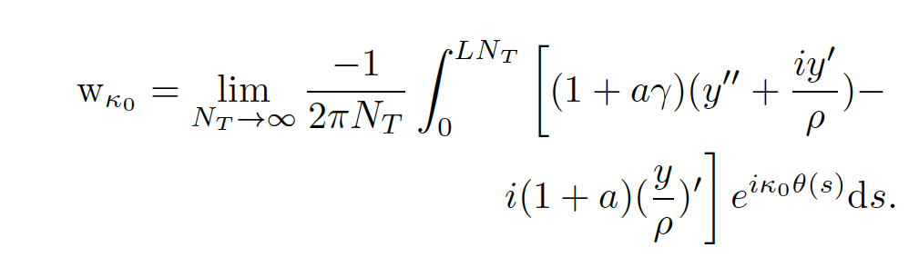
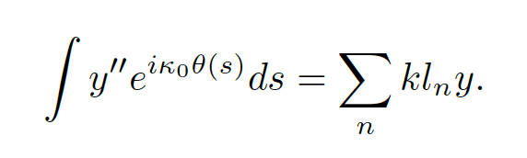
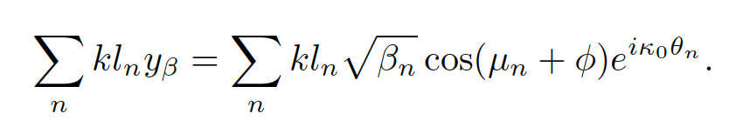
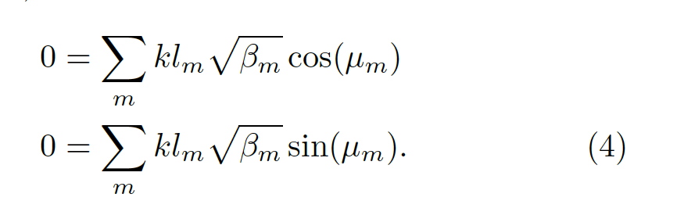
SPIN PROPERTIES OF FODO CELL
A standard FODO cell contains focusing and defocusing quadrupoles with a dipole placed between them. In this situation there is no possibility of cancellation of the spin kick between dipoles. Another type of FODO cell includes the dipoles on either end of the focusing and
defocusing string of quadrupoles.
Spin Resonance Strength:

Slide 3
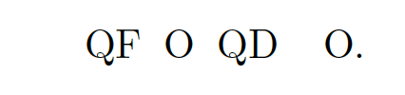
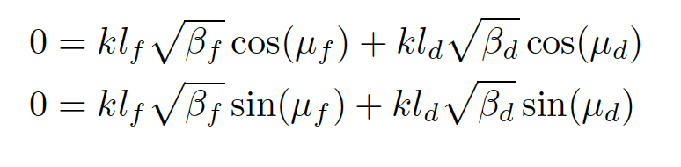
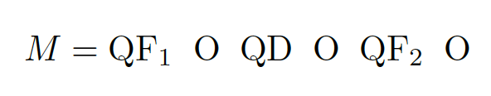
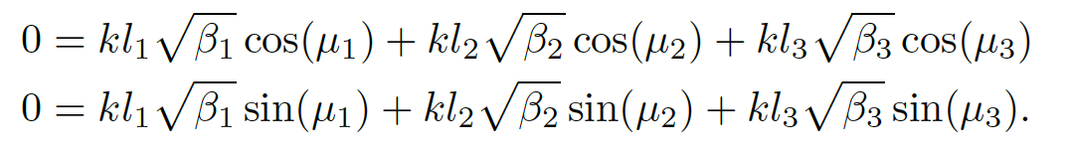
Quadrupole Configurations for Canceling
→ In order to cancel in this case phase advance across whole cell would need to be 2Pi
→ Introducing a third quadrupole makes canceling possible with a stable cell.
Eq. 8

Slide 4
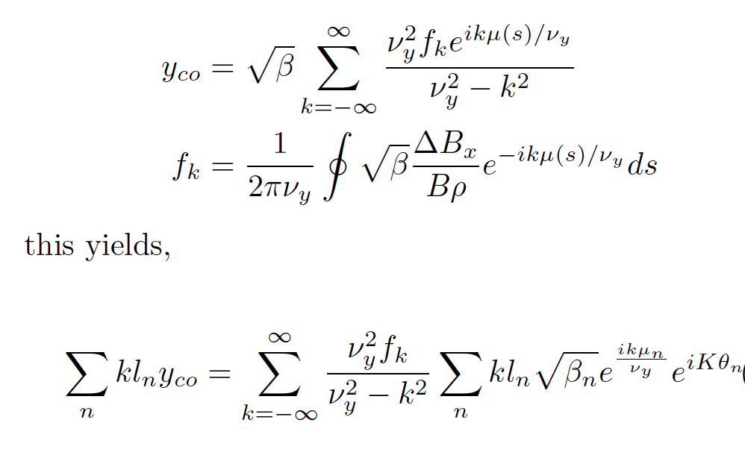
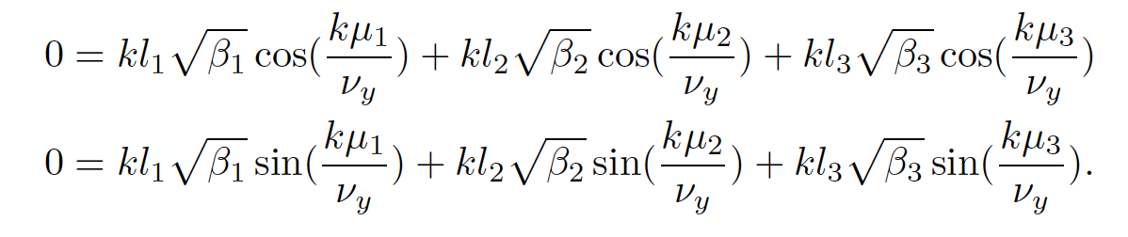
Cancelation of intrinsic also leads to Cancelation of Imperfection
Considering the case of vertical motion due to close orbit errors y_{co} it can be shown that it can be expressed as a sum of the Fourier amplitude of the error harmonic,
Since the strength of the imperfection spin resonance is dominated by values when k~ν_{y.} Thus minimizing intrinsic resonances will help minimize the net imperfection resonances.

Slide 5
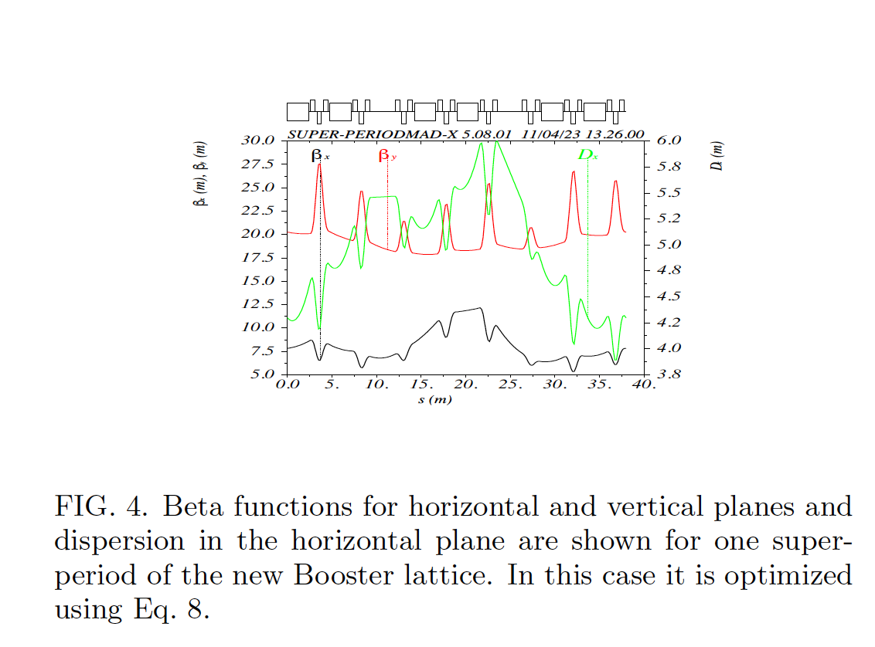
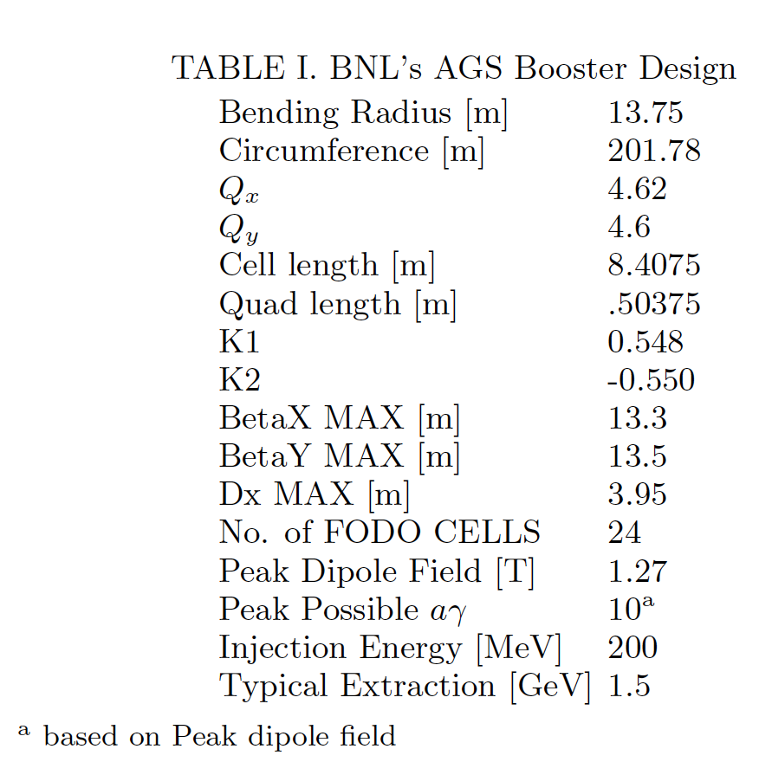
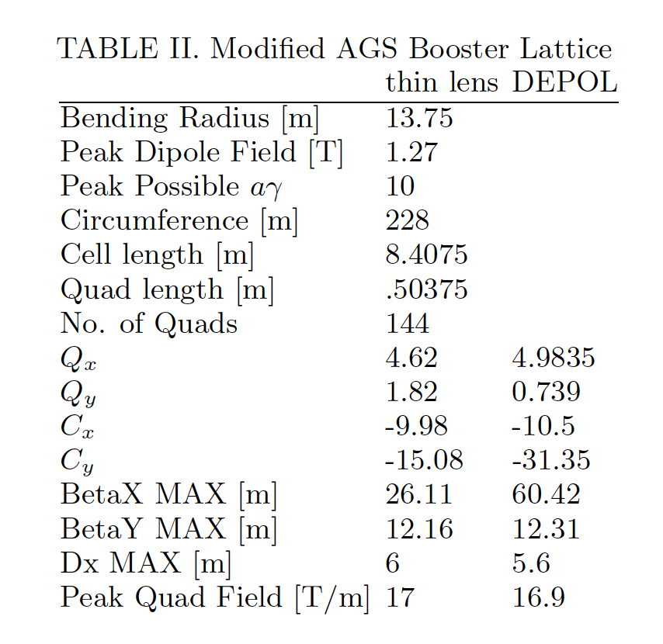
AGS-Booster Lattice Example
In our test case we inserted three quadrupoles families
into each half cell and increased the arc cell length from
8.4075 to 9.5 m to accommodate the new quadrupoles,
yielding a circumference of 228m.

Slide 6
AGS-Booster Spin Resonances

Slide 7
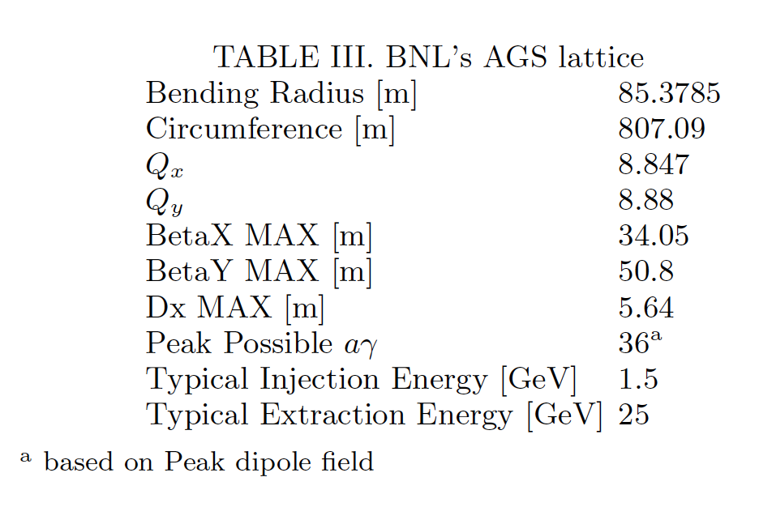
AGS sized machine
The AGS lattice parameters are listed in Table III, it is made up of twelve super-periods each containing twenty combined function magnets of long and short lengths. The use of combined function magnets makes the use of cancelation problematic since it mixes up the dipole spin precession with the quadrupole spin kicks. However one could propose a new lattice using separate dipoles and quadrupoles of the same periodicity and approximately the same circumference. In this case one could choose a higher periodicity and either a high or low vertical tune to completely avoid all the spin resonances in the energy range from 0 to 48.

Slide 8
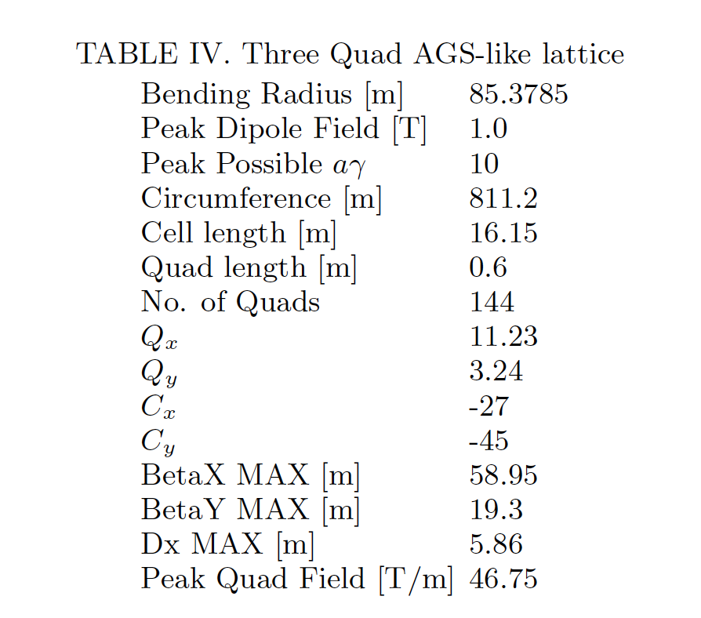
AGS like 12 Periodic lattice
To demonstrate the utility of spin resonance canceling cells, we consider the low 12 periodicity building a lattice using this approach. Here we use a lattice with super-periods made up of four dipoles with three quadrupoles between the dipoles and a 3 m straight connecting the super-periods. The key parameters of this lattice are listed in Table IV.

Slide 9
FCC-ee like machines
The proposed FCC-ee and Circular Electron Positron Collider (CEPC) are both positron and electron colliders with a circumference of around 100 km reaching top collision energies above 100 GeV. Considering the energy for the FCC-ee Booster with injection energy at 20 GeV and top extraction energy of 182.5 GeV in terms of aɣ, this ranges from 45 to 414. Choosing a periodicity of 500 if the arc tunes are kept above 45 units and the construction circular with straight section confined to the 200 m
long arc cell then all spin resonances can be avoided.

Slide 10
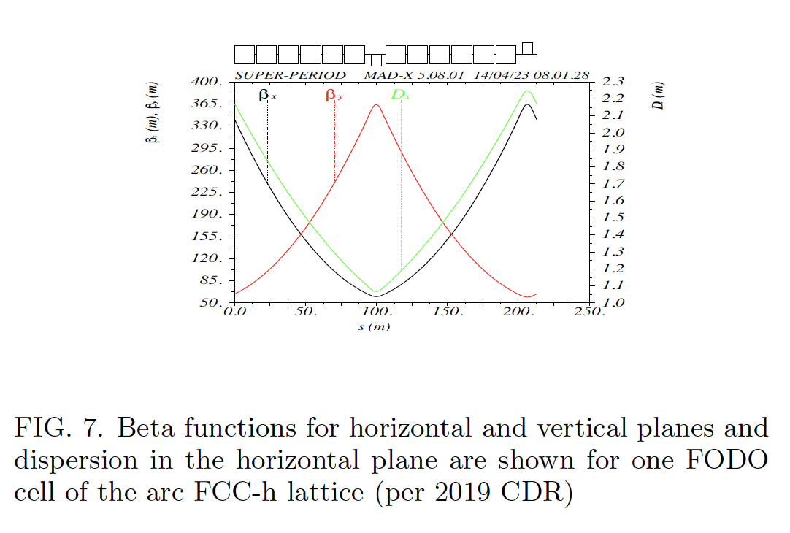
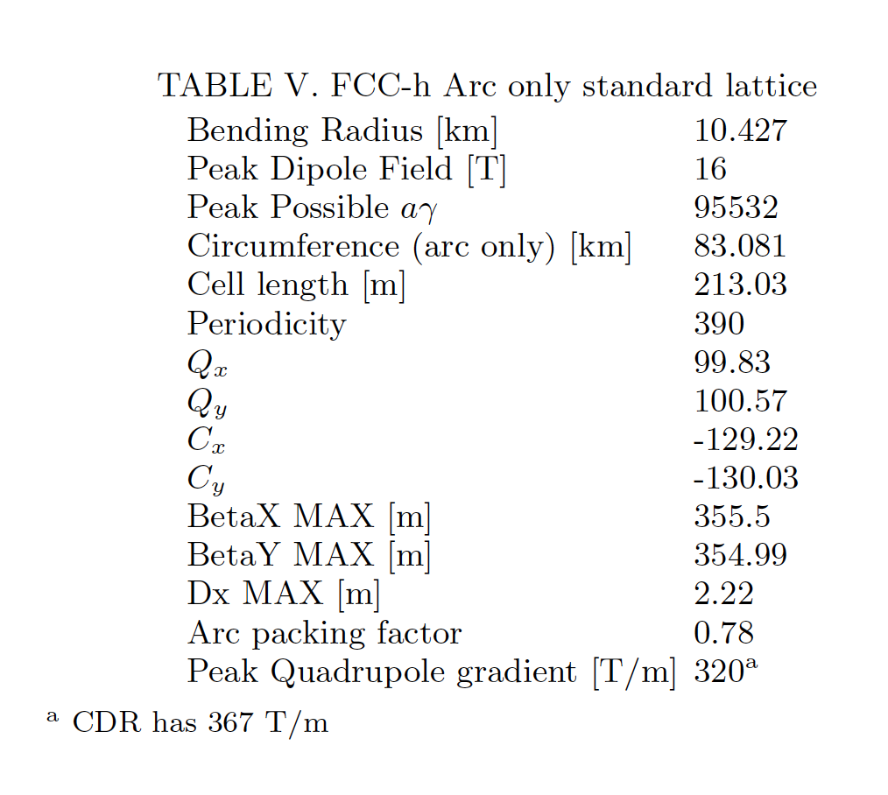
FCC-hh like machines
The FCC-hh is also proposed which will accelerate protons to energies from 3 TeV using the LHC as a booster to
50 TeV. The rough optics are shown for the arc FODO cell and in Table V the parameters for a simplified arc only model (no insertion sections) is shown. This simplified model only has dipoles and quadrupoles using the
same bending radius, magnet lengths of the dipoles and quadrupoles as described in “FCC-hh: The Hadron Col-
lider Future Circular Collider Conceptual Design Report Volume 3”. The energy range from 3 to 50 TeV in aɣ
space is 5732 to 95532. In this case a periodicity high enough to avoid spin resonances is not reasonable.

Slide 11
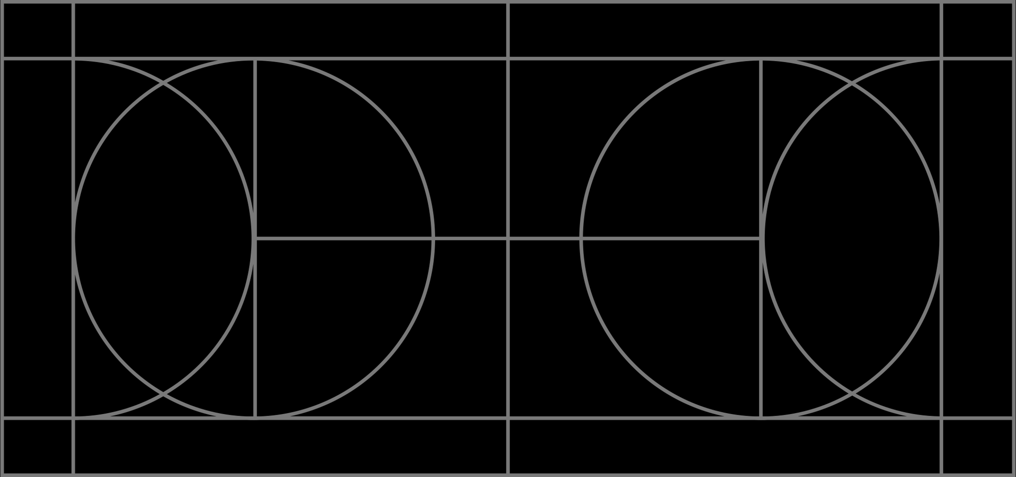
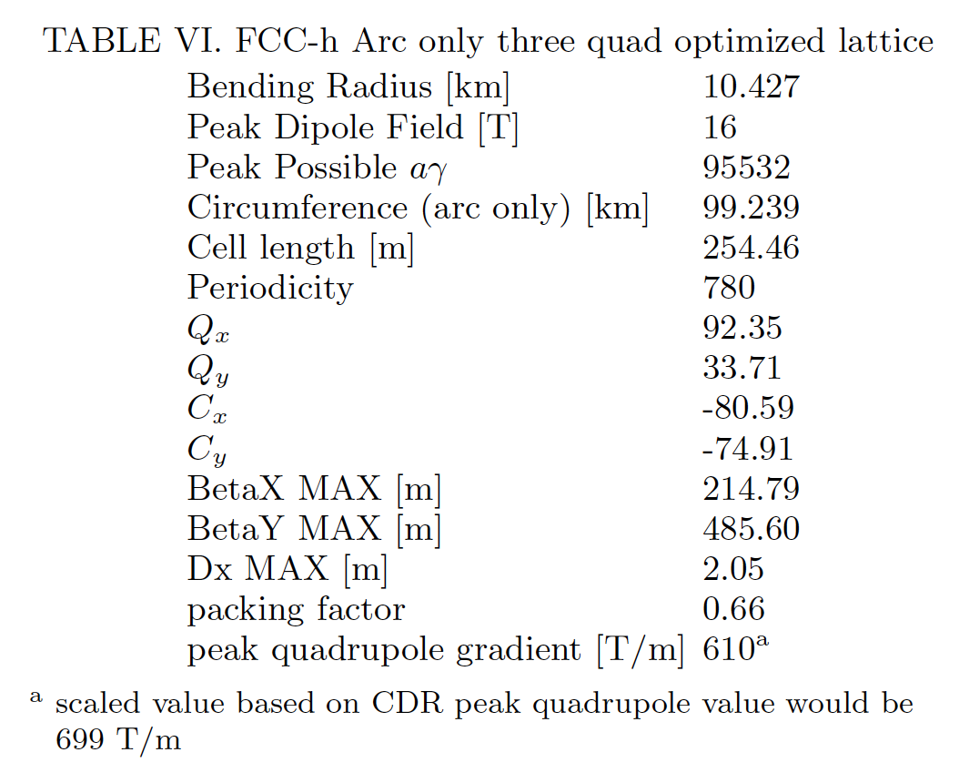
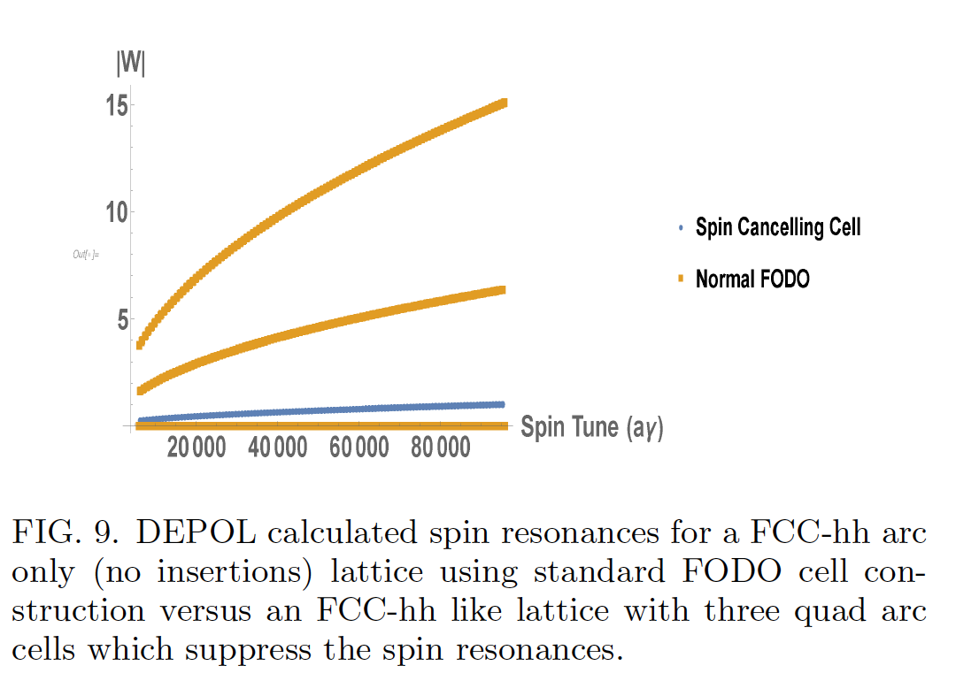
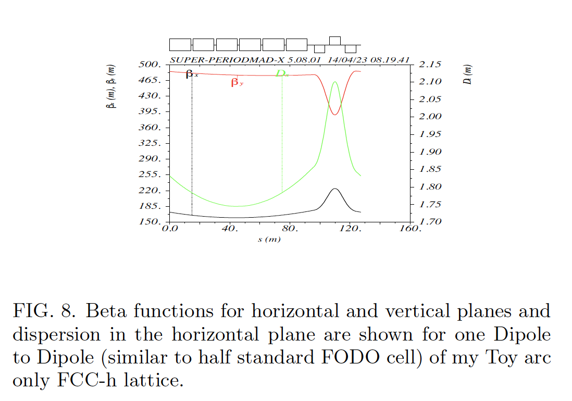
Proposed Spin Resonance Suppressed FCC-hh lattice
We use three quadrupoles between the dipoles to achieve a major suppression of the spin resonances. In this case using one focusing and 2 defocusing quadrupoles placed in a 1/2 arc cell of 127.23 m long with a 42.58 degree phase advance in the horizontal and 15.48 degree in the vertical plane kept all intrinsic resonances in the energy range less than 1 at 10 mm-mrad normalized emittance. This is low enough that six snakes should be sufficient to control the intrinsic spin resonances.

Slide 12
