Slide 1
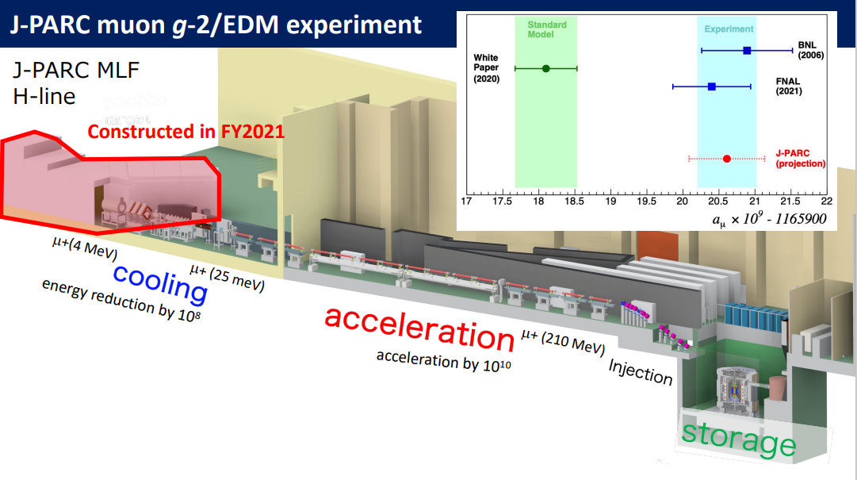
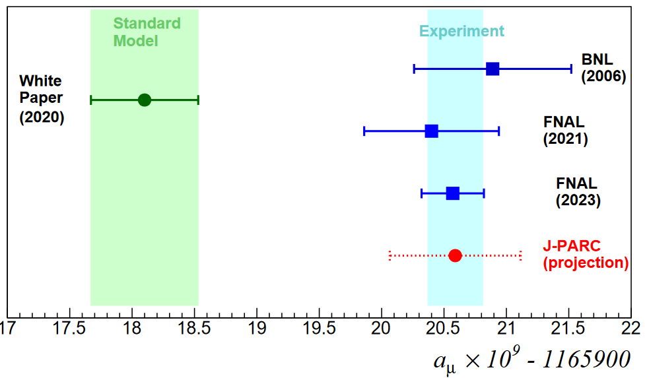

Three-dimensional beam injection scheme for the new
Physics motivation
Experimental method & three features
Six subsystems of J-PARC muon g-2/EDM experiment
3-D spiral injection and demonstration experiment
Schedule and summary
H.Iinuma (Ibaraki Univ.)
on behalf of the injection team/J-PARC muon g-2/EDM collaboration
@spin2023

Slide 2
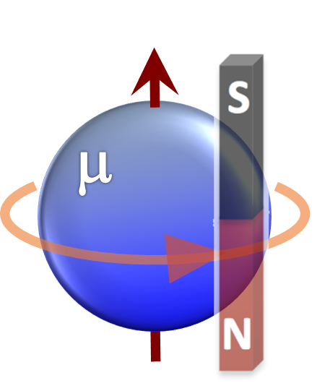
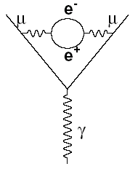
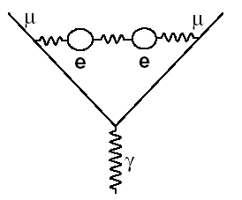
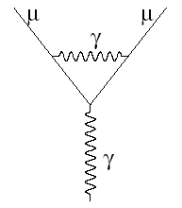
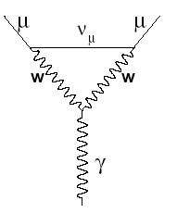
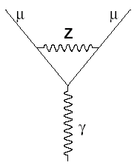
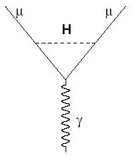
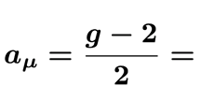
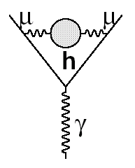
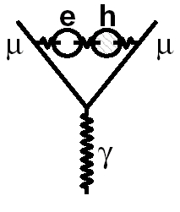
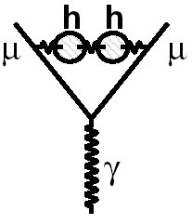
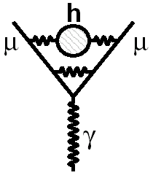
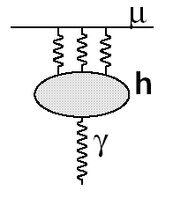
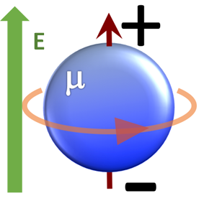
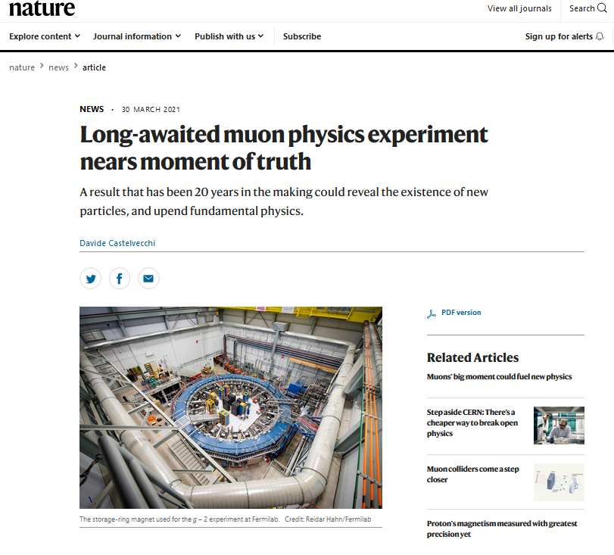
1.Physics motivation:
Muon spin presession tells what？
Anomalous magnetic moment
+?
Exp.
aμ(Exp) = 116 592 059(22) × 10⁻¹¹ (0.19 ppm), arXiv:2308.06230v1 [hep-ex] 11 Aug 2023
The.
aμ(The) =116 591 810(43) × 10⁻¹¹ (0.37 ppm), Phys. Rept. 887 (2020) 1-166.
https://muon-gm2-theory.illinois.edu/
Differ by 5 standard deviation
Electric Dipole Moment
https://www.nature.com/articles/d41586-021-00833-2
Direct evidence of new physics
2019年
2021 March
The SM ～ 2 x 10⁻³⁸ e･cm
Upper limit (E821) < 1.9 x 10⁻¹⁹ e･cm (90% CL)
米国
BNL E821, FNAL E989 (20年後)
FNAL E989’s first and second results are consistent with BNL E821 (20 years ago)
Different view by independent experimental method does help to judge these questions.

Slide 3
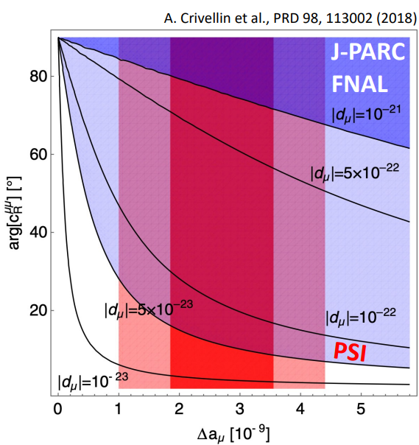
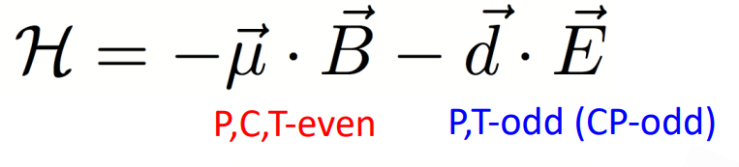
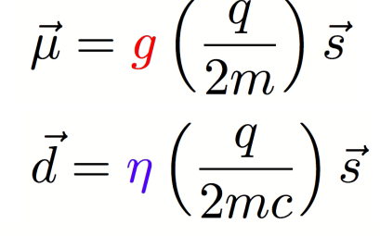
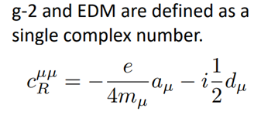
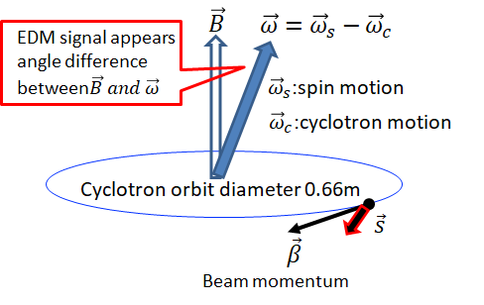
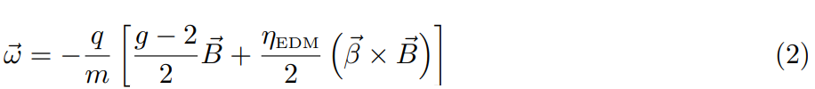
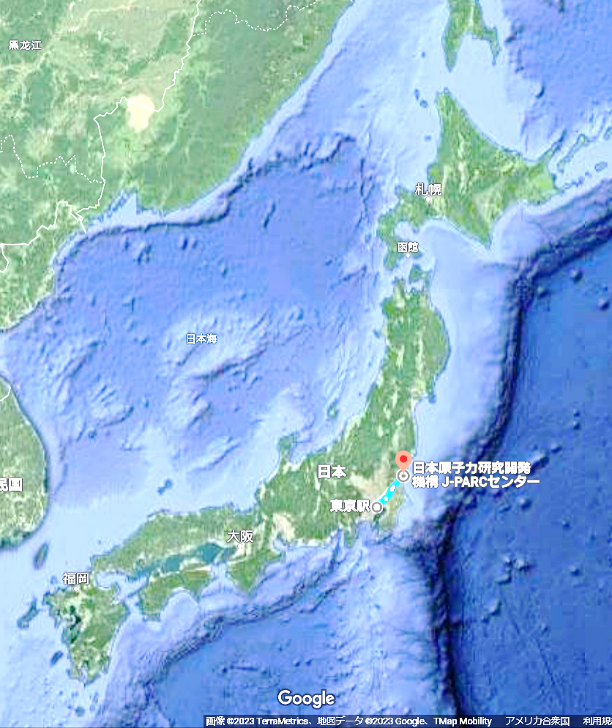
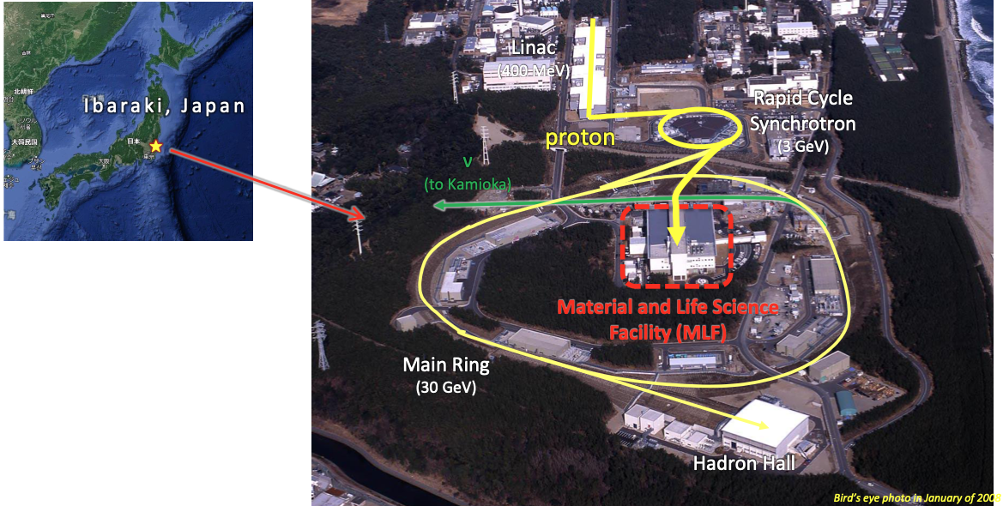
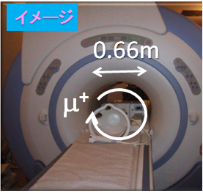
1.EDM($d_{μ}$) vs. $a_{μ}$ (model independent relation)
In general, g-2 anomaly suggests a large EDM unless the complex phase is unnaturally small.
Want to measure both quantities at a time but independently
Super precise compact ring
B=3[T], γ=3
Spin vector

Slide 4
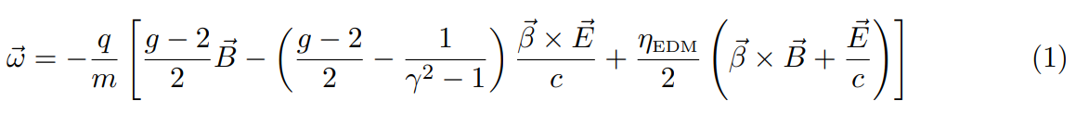
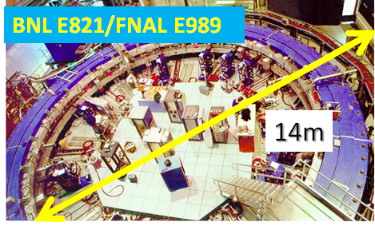
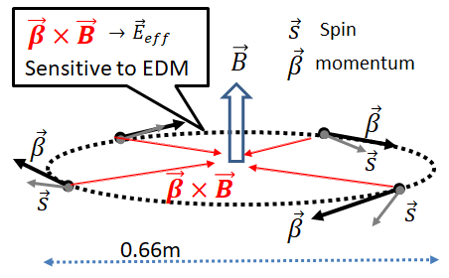
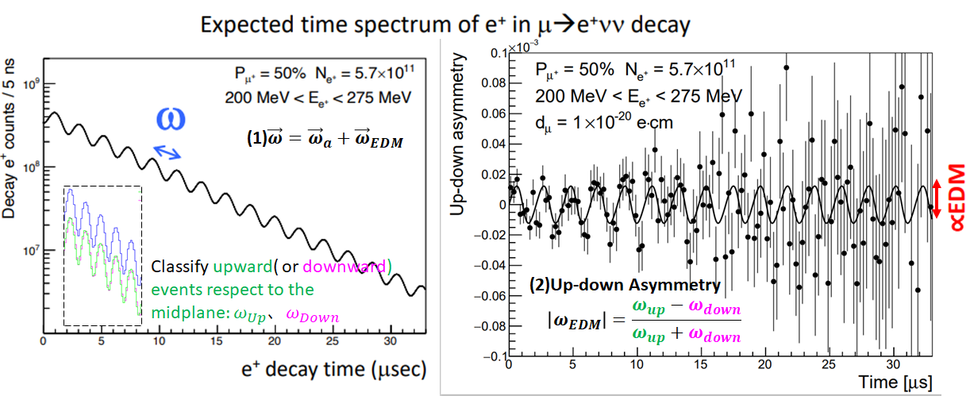
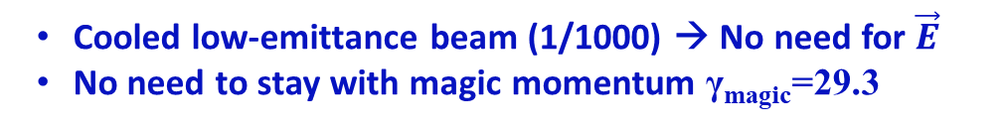
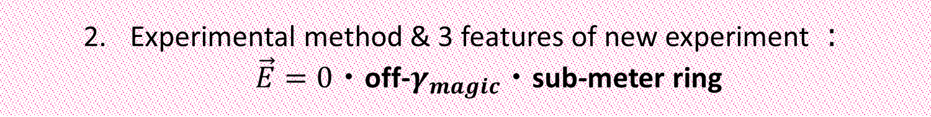

Experimental method & 3 features of new experiment ：
$\vec{E}=0$・off-$γ_{magic}$・sub-meter ring
B=1.45[T],γmagic=29.3
Cooled low-emittance beam (1/1000) → No need for $\vec{E}$
No need to stay with magic momentum γ_{magic}=29.3
Storage beam in compact orbit diameter =0.66m (1/20)
Very precise control of stored beam
Good injection efficiency (>80%)
B=3[T], γ=3,
$$ω_{g−2}=2.11μs$$
Measure g-2 and EDM at a time, with the same setup but independently!

Slide 5



New g-2/EDM experiment (E34) at J-PARC MLF
Muon g-2/EDM
Satellite-campus of Ibaraki Univ. is just next to the J-PARC site. university
(Main campus is at Mito)
Famous for a plum garden (Kairakuen)
Good sake and beer

Slide 6
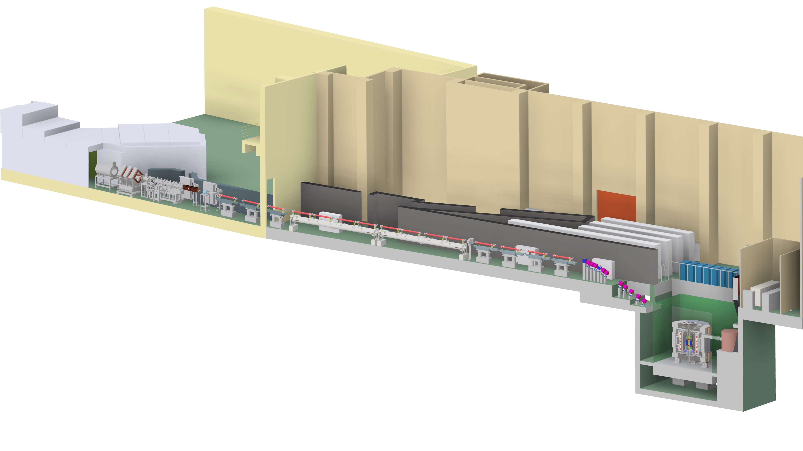
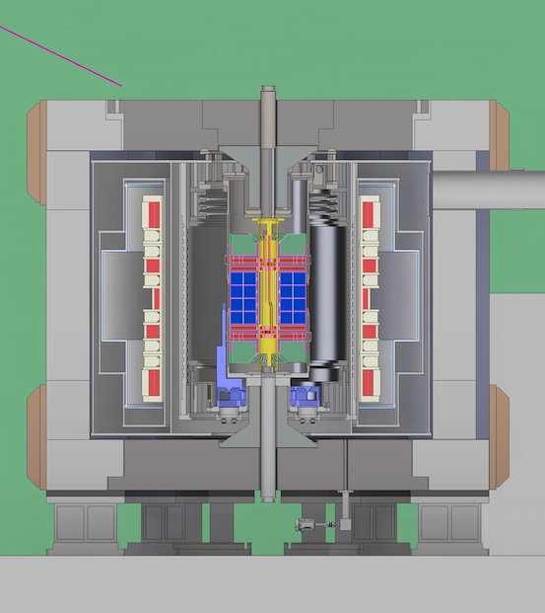

3. Six subsystems of J-PARC muon g-2/EDM experiment
This experiment consists of six subsystems.
All of them are important to realize
this experiment.
Surface muon beam
Muon acceleration
Muon cooling
Muon cooling and re-acceleration
  J-PARC MLF Muon H-Line
Super high precision uniformity $\vec{B}$
  Apply medical MRI technology for our super conducting storage magnet
Muon beam Injection and storage in the super adjusted magnetic field
  3-D spiral injection
Measure spin precession${\vec{ω}}_{a},{\vec{ω}}_{EDM}$
  Minimize systematic uncertainty
Injection
Storage magnet
Zoom
Positron detector

Slide 7
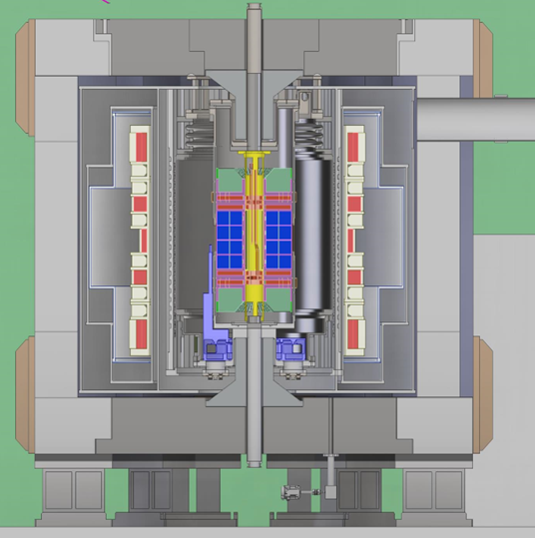
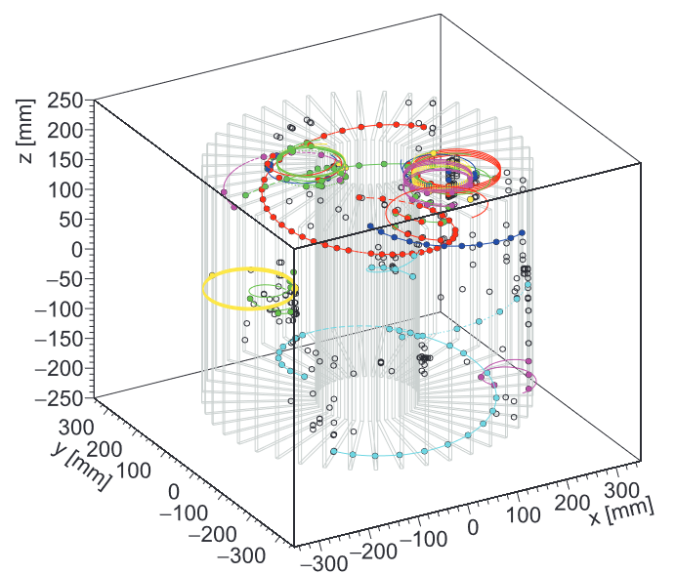
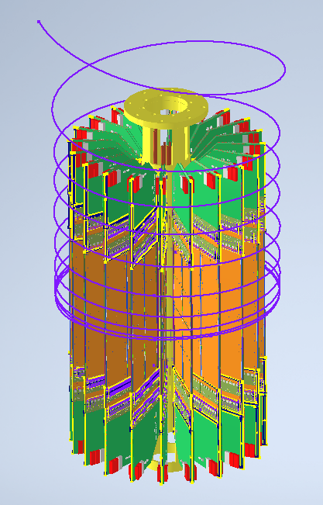
3-D tracking of decayed positron in compact storage ring
Super conducting magnet of main field flux = 3T (< 0.1 ppm uniformity), applying medical MRI technology
Spin precession vector is available by track-back of positron momentum
3-D tracking of decayed positrons

Slide 8

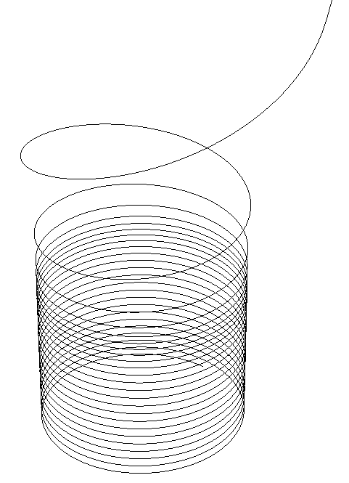
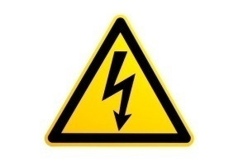
Why 3-D spiral injection and kicker?
66cm
Technical difficulties for compact 2-D injection:
3T is too high to cancel fringe field by inflector,
Required kick angle within a single turn is too fast and big.
7.4nsec
3-D spiral beam injection does help:
Smooth connection between injection and storage sections without any sources of error field
Apply vertical kick during “several turns”
2-D orbit
Vertical kick
Storage orbit plane
Storage orbit plane

Slide 9
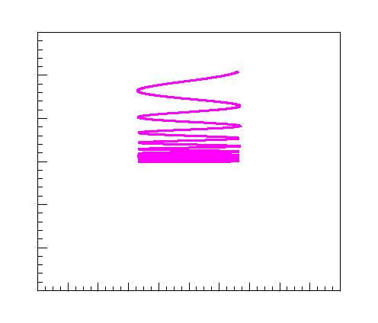
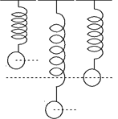
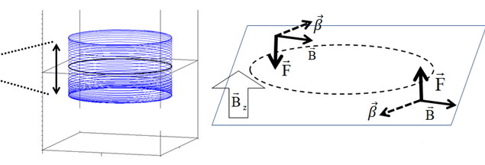
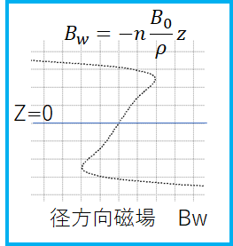
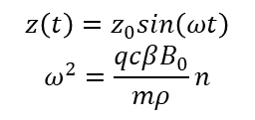
Outline of 3-D spiral beam injection
9
All-in-one solenoid magnet is suitable for super compact storage ring
NIM.A 832 (2016) 51-62.
https://doi.org/10.1016/j.nima.2016.05.126
Beauties：
Smooth connection between injection and storage sections,
A unit of magnet does work for this method and decrease sources of error field,
Vertical motion is controlled by pulsed radial field kicker
No electric field is required to control muon beam!
Utilize fringe field
Radial field B_{R} deflects beam direction and changes θ
B_{R}
θ
μ beam
$$z\left(t\right)=z_{0}sin\left(ωt\right)$$
$$ω^{2}=\frac{qcβB_{0}}{mρ}n$$
Main solenoid coil
Vertical Harmonic motion in fiducial volume
Z=0 plane
w
Pulsed radial field Kicker
w
Radial field
0<n<1:
Focus both vertical and horizontal direction at a time!!
New idea and unprecedented scheme!
Three major keys to be discussed today.
Target :n=1.5E-4 →0.6μs betatron period, well away from g-2 of 2.11μs

Slide 10
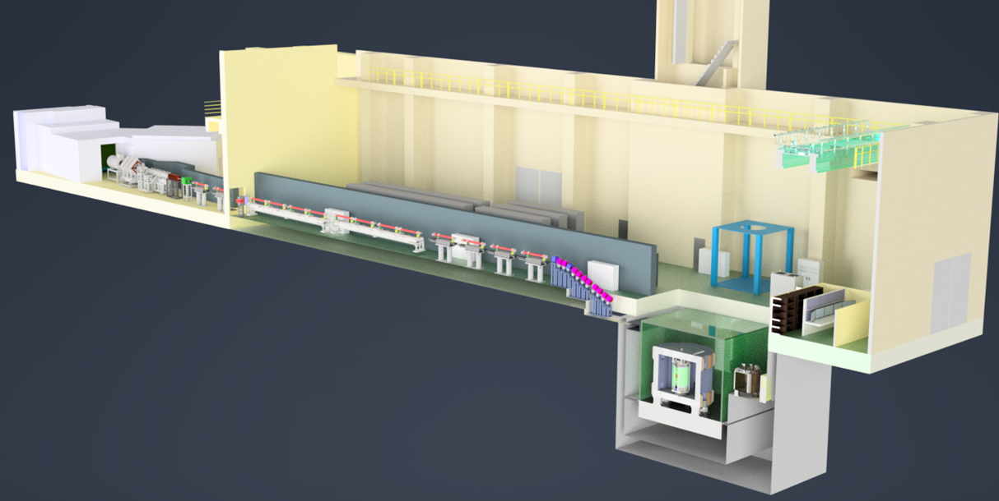
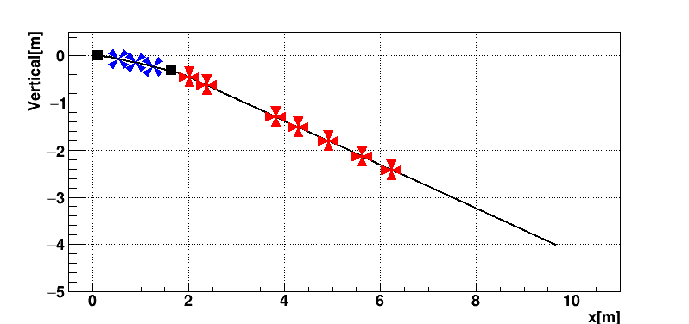
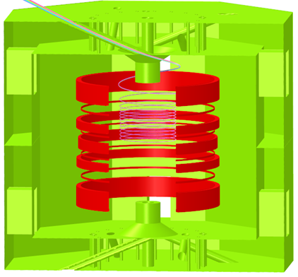
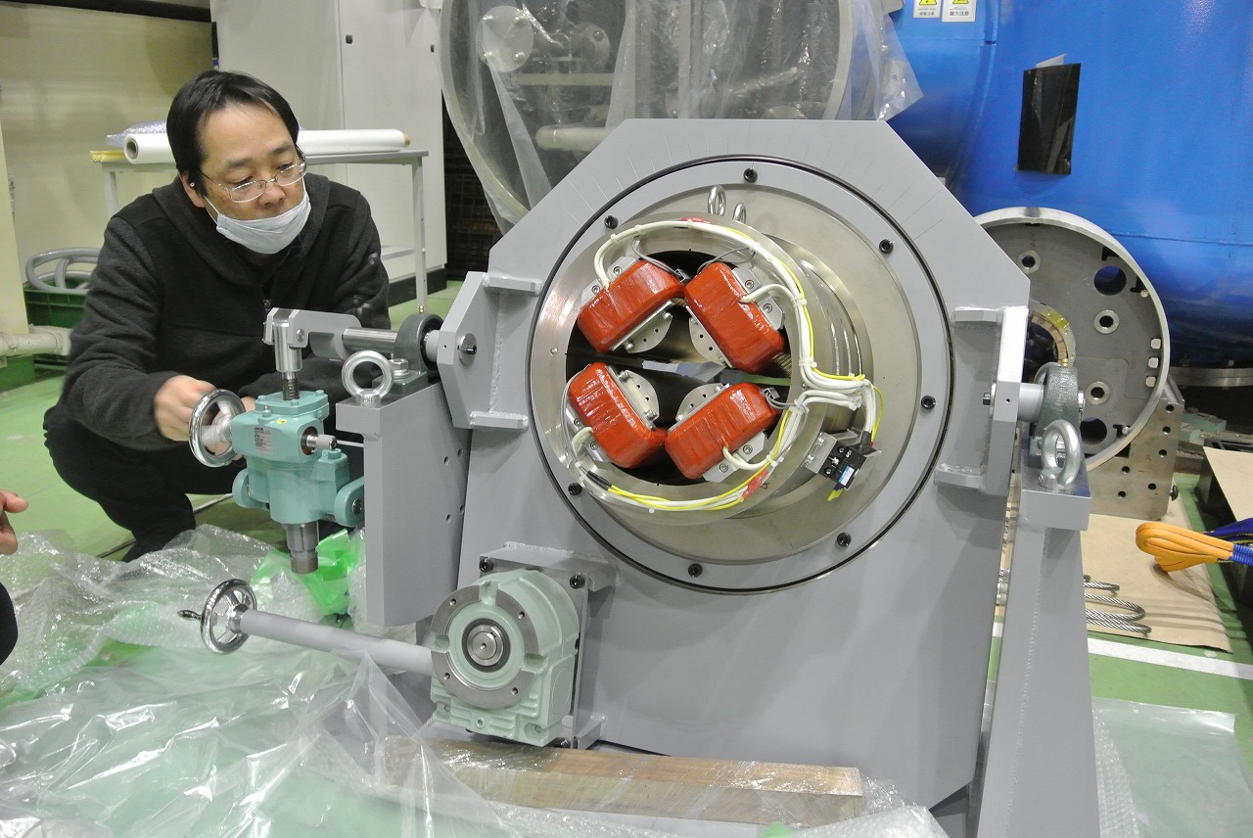
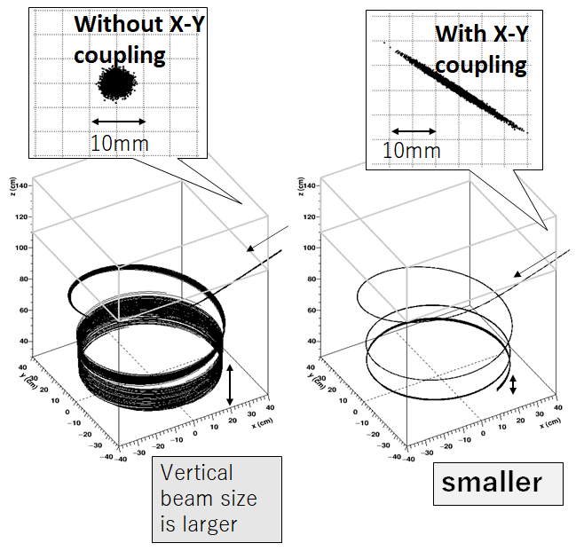

1st key: Strongly X-Y coupled beam at the beam transport line
To realize high injection efficiency (~80%), a strong X-Y coupled beam is required due to axial-symmetric field of solenoidal magnet.
J-PARC MLF
Muon H-Line ~50m length
Quads
Applopliate X-Y coupled beam
26 degree’s slope
Vertical position[m]
Bends
Seven Rotating Quads
Our team takes care of
transport line
Beam control in the magnet
3-D injection point
Challenges:
26 degrees slope transport line
With seven rotating quadrupoles
Seven rotating quadrupole magnets in the transport line control X-Y coupling at the injection point.
Horizontal position[m]
x-y
x-x’
y-y’
ID | angle | K-value
Q3 | 45.0 | 16.449
Q4 | 45.0 | -0.278
Q5 | 60.0 | 2.091
Q6 | -60.0 | 0.063
Q7 | -60.0 | 0.814
Q8 | 45.0 | -0.041
Q9 | -60.0 | -1.825
x’-y’
y-x’
x-y’

Slide 11








2nd key: Vertical kicker to control vertical beam phase space in the storage region
3-D spiral trajectory
120nsec
trajectory
Half-sine shaped kicker current
(shape only)
trajectory
①
Vertical position[cm] or [Gauss]
②
②B_{R}>0
①
①
①B_{R}<0
red：Kicker field B_{R}(z, t, R)
Blue：Static radial field
Gray：Effective radial field
pitch[rad]
Beam injection
broad
[μs]
|z|<0.1m
Vertical [cm]
squeeze
A pair of up/down kicker coil forms Radial field B_{R}
squeeze
|z|<0.03m
kick
|z|<0.03 m 30%
|z|<0.05 m 60%
|z|<0.1 m 85%
vertical beam phase space
Vertical phase space of time slice at the kick end
[μs]
$$×halfsin\frac{2π}{T_{kick}}\left(t−t_{0}\right)$$
Vertical[m]
Current kicker design with appropriate X-Y coupled beam is stored into |z|<0.1m region (e⁺ detector acceptance) with 85% efficiency. However, the smaller |z| is better for physics!

Slide 12







3rd key: Beam monitor inside the storage magnet: How do we control the beam?
(Ogawa/Kyushu-Univ.)
Detect vertical phase space by ④Stored beam monitor, and then control detect vertical beam motion by ②kicker and ①steering/focusing magnet
③Beam position/profile monitor
We can reconstruct z-z’ time snap by use of ④
Outside of vacuum
①Active Shield Steering Magnet: Control beam position/pitch angle at z~0.95m
Storage volume
|z|<0.03m
②Pulse Kicker
④stored beam monitor
0.66m
amplitude×2
Photon sensitive
MPPC
Scintillating fiber
※Not correct time scale, just for image
|z|<0.03m(45%)
Reconstructed vertical beam distribution
Silicon detector（Partial）
Kick failed
⑤ Pillar scintillator detector: detect time stamp of muon decay
→ Inflight muon lifetime measurement as byproduct
Kick failed

Slide 13












Shorter and stronger kick is better but,: Technical challenges to realize kicker
120ns, 1kA
80ns, 2kA
Simple LC circuit
A charged capacitor stores energy
= a coil carrying current stores energy
Realistic kicker with stable operation is crucial
$$t_{p}$$
$$\frac{1}{2}CV^{2}=\frac{1}{2}LI^{2}$$
$$I_{c}$$
1.5kA meas.
1kA meas.
Ideal half-sine
$$t_{p}=\frac{T}{2}=π\sqrt{LC}=120ns$$
Inside of the magnet, High voltage <30kV
Capacitor charging voltage
$$V_{c}=\frac{L∙I∙π}{t_{p}}$$

Slide 14





More details of 3-D spiral injection are discussed in these papers
19th International Spin Physics Symposium (SPIN 2010)
27 September-2 October 2010. Juelich, Germany (C10-09-27)
DOI 10.1088/1742-6596/295/1/012032
Idea of 3-D spiral injection
DOI: 10.1016/j.nima.2016.05.126
Conceptual design for beam transport line
DOI: 10.1109/TASC.2022.3162810
Vertical kicker design
DOI:10.18429/JACoW-IPAC2023-MOPA110
Details of beam monitor (Japanese) will be published (Ogawa/Kyushu-Univ.)

Slide 15





Demonstration experiment: 3-D injection and storage
 | J-PARC
Main field beam momentum | 3T (0.1ppm), 300MeV/c muon (γ=3) | 0.008 T (~100ppm), 80keV Electron (γ=?)
Radius, cycrotron period | 0.33m, 7.4ns | 0.11m, 5ns
Kicker period/current | 120ns, 1kA | 50ns, 40A
# of rotating Quads. | 7 | 3
Beam Cross-section monitor
Non-coupled
X-Y coupled
ionization luminescence signal
X-Y coupled
Non-coupled

Slide 16





Demonstration feasibility of 3-D spiral injection
80keV Electron beam (β=0.5), instead of muon, is adjusted “X-Y coupling”, injected into ϕ0.24m orbit.
Cyclotoron period is only 5nsec.
電子銃
DC 100kV
Learn how to control beam of “X-Y coupling”
Reflect studies on original experiment
Wakate B:2011～2013
Kiban-B:2014～2018
Kiban-Ａ2019～2022
Electron Gun
Electric
Deflector
Steering Coils
Collimator
Quad’s
Steering Coils
Bending
magnet1
2 m
Top view of wide-angle camera
16

Slide 17






Preliminary result of “stored” beam of 3-D spiral injection
17
DC beam with kicker coil
Injected beam (100ns width) is kicked and then we detected “stored signal” for few μs
Prompt signal from
injected beam
SciFi (above storage region)
Upper monitor
Very preliminary
PMT signal (mV)
Delayed signal from
stored electron
SciFi (storage region)
SciFi (below storage region)
Prompt signal from
injected beam
Lower monitor
Kicker
current (A)
Kicker current
Time from TRG (us)
https://www.ocha.ac.jp/danjo/op/ytp/20230221_yuasa.html
https://www2.kek.jp/kokusai/AIL/TYL/index.html

Slide 18


Summary
Muon g-2/EDM experiment at J-PARC aims to measure muon g-2/EDM by utilizing
  Low emittance muon beam stored by weak focusing magnetic field→No $\vec{E}$ focus
  Compact storage magnet with low momentum muon.→ No “magic” mom.
This will be an independent measurement from BNL/FNAL at different systematics.
Today, I focus on new beam injection scheme as a member of injection team
  introduce three keys:
    Strongly X-Y coupled beam, Vertical kicker to control vertical beam phase space, and Beam monitor inside the storage magnet
FY | ～2023 | 2024 | 2025 | 2026 | 2027 | 2028 ~
E34 J-PARC muon g-2/EDM
LINAC
Transport Line
New results
Magnet
Final design
fabrication
Alignment
Field shimming
X-Y coupling
R&D
Magnet fabrication
Field measurement
Adjust current shape
Beam ON
Kicker
R&D
Coils fabrication
PW1, PW2 fabrication
commissioning
Beam monitor
design
Prototype design
EM shield
production
Prototype fabricate
Test-bench is done
Expected data taking from JFY 2028.
After 2 years of data taking,
  muon g-2 measurement at 450ppb(stat.) : comparable to BNL.
  muon EDM sensitivity at $1.5 × {10}^{−21} e∙cm$(stat.): 2 orders of magnitude improvement.
Many technical challenges we are facing, but expecting new results from J-PARC!

Slide 20

Picture of MLF H2 beam line
MLF H2 beam line.
  Surface μ⁺ beam: 4MeV, 10⁸ μ+/s with 25Hz rep
  Beam line extension inside the (existing) MLF bldg. in this fiscal year.
  Construction of extension bldg. is also ready.
Extension for g-2/EDM

Slide 21

Schedule
Physics data taking expected from JFY 2028.

Slide 22



Expected sensitivity
Total efficiency of muon
will be $1.3 × {10}^{−5}$.
Muon g-2
Statistical uncertainty: 450 ppb (2 years of data taking)
  Uncertainty comparable to BNL can be reached
Systematic uncertainty: less than 70 ppb.
Muon EDM
Statistical uncertainty: $1.5 × {10}^{−21} e∙cm$
Systematic uncertainty: $0.4 × {10}^{−21} e∙cm$
  mainly from detector mis-alignment

Slide 23




Positron Detector
Silicon detector for momentum measurement of decay positrons.
  Silicon strip sensor: Hamamatsu S13804, 190um pitch.
  High hit rate capability (6 tracks/ns) and stability over rate changes (1.4 MHz ~ 10 kHz)
  High efficiency for positron in the analysis window (p=200-270 MeV/c).
φ: 66 cm
Number of detected positron (p: 200-275 MeV)
Up-down asymmetry of detected positron

Slide 24



Positron detector is in production
Major components are in or completed the mass-productions.
Assembly procedure is under R&D.
Quarter-vane: submodule of detector
FPGA
board
FPC
silicon strip sensor
ASIC

Slide 25





Muon cooling
Low emittance muon beam by reacceleration of thermal muon.
  Silica aerogel target : Surface muons stopped, and thermal muoniums emitted.
  Laser ablated aerogel to increase the efficiency.
Thermal muonium ionization by laser.
  Two scheme under consideration.
  1S-2P excitation by 122nm
  or 1S-2S excitation by 244nm

Slide 26




Muon acceleration
Muon reacceleration to 300MeV/c by muon LINAC.
  Series of 4 types of cavities depending on the muon β of each stage.
Acceleration test
with thermal μ
planned in 2023
Fabrication
completed
1st tank
under fabrication
Prototype fabrication
in JFY2022

Slide 27






Super precisely adjusted $\vec{B}$
27
Design work of superconducting magnet for muon storage is ongoing applying medical MRI technology
Test bench for superconducting magnet (dedicate for Mu HFS)
April, 2015
<500ppb
[1] M. Abe, K. Shibata, “Consideration on Current and Coil Block Placements with Good Homogeneity for MRI Magnets using Truncated SVD”, IEEE Trans. Magn., vol. 49, no. 6, pp. 2873-2880, June. 2013.
[2]阿部充志 他、特許第４９０２７８７号、「MRI装置用磁場調整」、
平成24年１月13日登録、日本国特許庁
27

Slide 28



Sensor alignment
Precise alignment between detector and B-field
is essential for muon EDM measurement.
  If rotated each other, “g-2 component” of spin
  precession comes into “EDM component”.
Goal of sensor alignment: 1um precision.
  Assembly procedure under development.
    sensor alignment jig under test
    sensor position/shape measurement by coordinate measuring machine.
  Precision of ~ 2um already achieved (near to the goal).
spin precession
by g-2
spin precession
by EDM
Sensor alignment jig
Glued position of each sensor (1st,2nd,3rd,4th)
Deviation from ideal (gray) position
sensor hold by vacuum chuck
Vertical shift/ tilt
Horizontal shift/ tilt
1 um

Slide 29


Slide 30



In case of E821/E989
1400cm
Kick 10mrad
Tkick = 400nsec
Ipeak=4200A
V at capacitor = 90kV
Coil inductance 1.6μH
149nsec
~100mm
Conventional injection scheme is not applicable in our case

Slide 31





WHY n=1.5E-4!?
31
Spin and Beam Dynamics in the Muon (g − 2) Experiments | Journal of the Physical Society of Japan (jps.jp)

Slide 32



μ粒子ビームが振動している領域を狭く（灰色→緑色）すると、
崩壊点を一意に特定できる。
陽電子
ミューオン軌道（広）
ミューオン軌道（狭）
真の崩壊点
偽の崩壊点

Slide 33




weak focus
33
Simple harmonic motion
n<1: focus radially
Z[m]
n>0 :focus vertically
Hold the beam within closed ellipse
Focus both direction at a time!!
Target :n=1.5E-4
Kicker shoots the beam in the very center!
Z[cm]

Slide 34




Because of weak focus field we have a “huge” closed orbit
(vertical betatron motion)
maximum vertical =0.313m
+/-0.3m
Mission:
Guide our beam into the very center of closed ellipse
Weak Factor 0.485
N=1.462E-4
+/-0.11rad

Slide 35



3.A quick check #31ME with LONGER TK (cont.)
Image of the time structure
(A)
(D)
Tk=239/2, Ipeak=0.9kA
(B) Tk=330/3, Ipeak=1.55kA
(C) Tk=430/2, Ipeak=1.55kA
(D) Tk=490/2 Ipeak=3.5kA
Effective kicker-field BR(z,t)
$$V=\frac{I_{peak}}{T_{K}}πL$$
(A)→ (B,C), (D) increase injection efficiency
But do not help to reduce HV

Slide 36





