Slide 1
A New Level of Accuracy for Electron Beam Polarimetry at Jefferson Lab
Donald Jones
for the Hall A polarimetry teams
Sept. 2023
SPIN2023

Slide 2
Electron beam polarimetry at Jefferson Lab
Electron beam polarization is measured at Jefferson Lab using 3 polarimetry techniques
Moller polarimetry (used in Halls A,B,C) scatters electrons off a thin magnetized iron foil and measures the scattering helicity-correlated(HC) asymmetry
Eric King PhD thesis for PREX2/CREX https://surface.syr.edu/etd/1464/
Compton polarimetry (used in Halls A and C) scatters electrons off a polarized photon (laser) beam and measures the HC scattering asymmetry in the halls
Allison Zec PhD thesis for PREX2/CREX https://www.osti.gov/biblio/1844333
Mott polarimetry (used in the low energy region of the electron injector) scatters electrons off a gold foil and measures the left-right Mott scattering asymmetry
1-3% asymmetry measurements sufficient for past experiments
Polarimeters have been designed and understood to function at this level of accuracy.
The MOLLER experiment (2025) and the SoLID (future) both in Hall A experimental program require polarimetry at the $±$0.4% level of accuracy
I will focus on efforts in Hall A to reach this level of accuracy in both Moller and Compton polarimeters independently

Slide 3
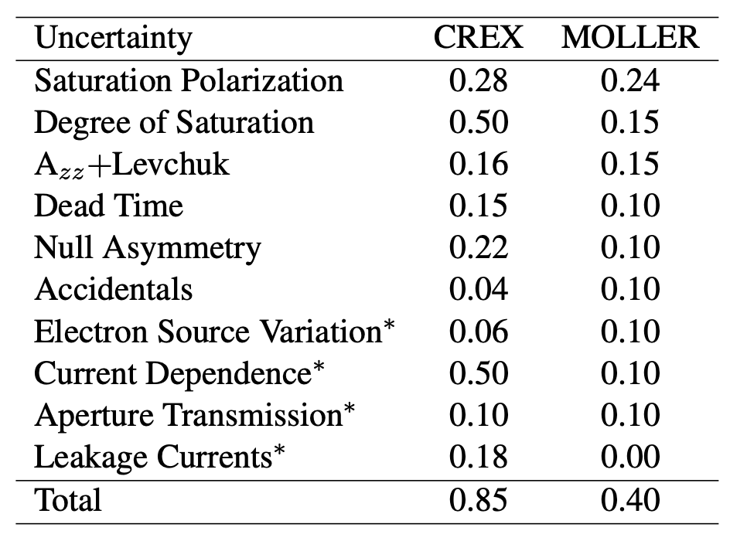
Moller polarimetry in Hall A
Learned a lot from PREX2/CREX (2019-2020) and GEn (2022-2023)
Elastic ee scattering from a Fe foil polarized || beam
Low current dedicated measurement (~1 μA) experiments run at tens of μA
Parity conserving Moller asymmetry
$$A=\frac{σ_{↑↑}−σ_{↓↑}}{σ_{↑↑}+σ_{↓↑}}$$
$$A_{meas}=\sum_{i,j=x,y,z}{P_{i}^{t}A_{ij}P_{j}^{b}}$$
Measured asymmetry
$$A_{long}=P_{z}^{t}A_{zz}P_{z}^{b}$$
(Foil)
(Foil)
Key
systematics
Beam time measurements needed to reduce/constrain these

Slide 4
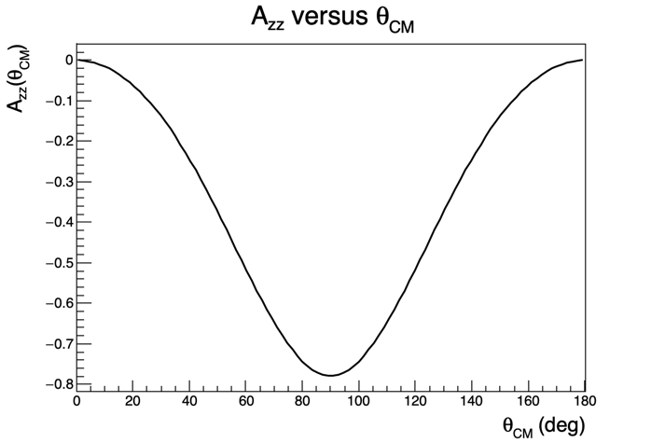
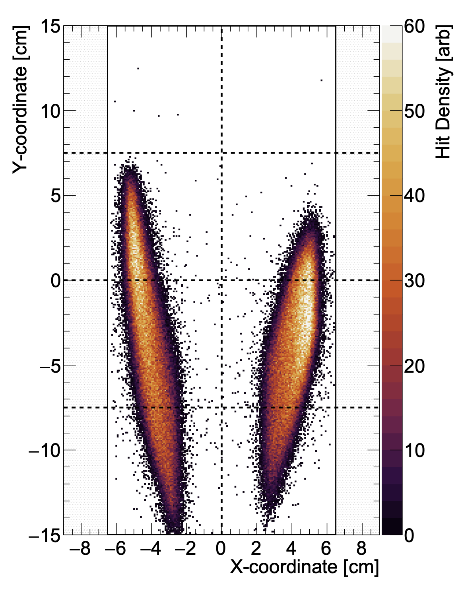
Moller Azz + Levchuk
Azz is a function of center of mass scattering angle
Must be averaged across the detector acceptance i.e. comes from simulation
Simulated event
distribution for
CREX experiment
arXiv 2207.02150
typical acceptance
Levchuk effect
Kinematic change to scattering angle (and thus Azz) from intrinsic motion of bound atomic target electrons
Inner unpolarized atomic electrons have higher intrinsic momenta → more likely to be scattered out of acceptance than low energy outer electrons
Biased sampling of polarized vs unpolarized electrons

Slide 5
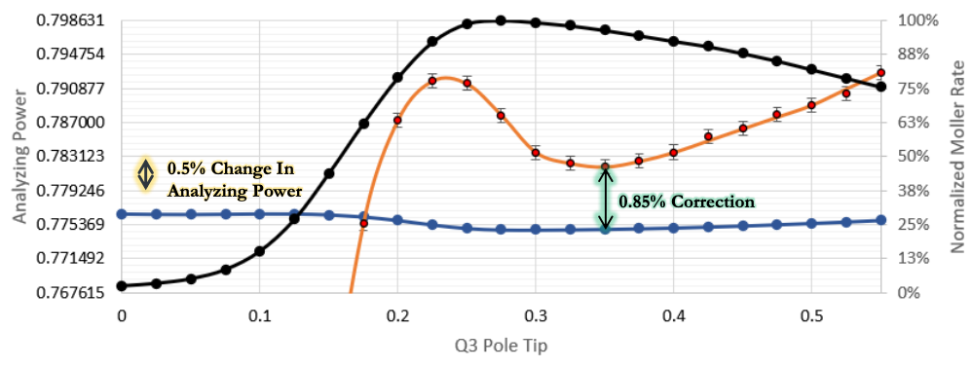
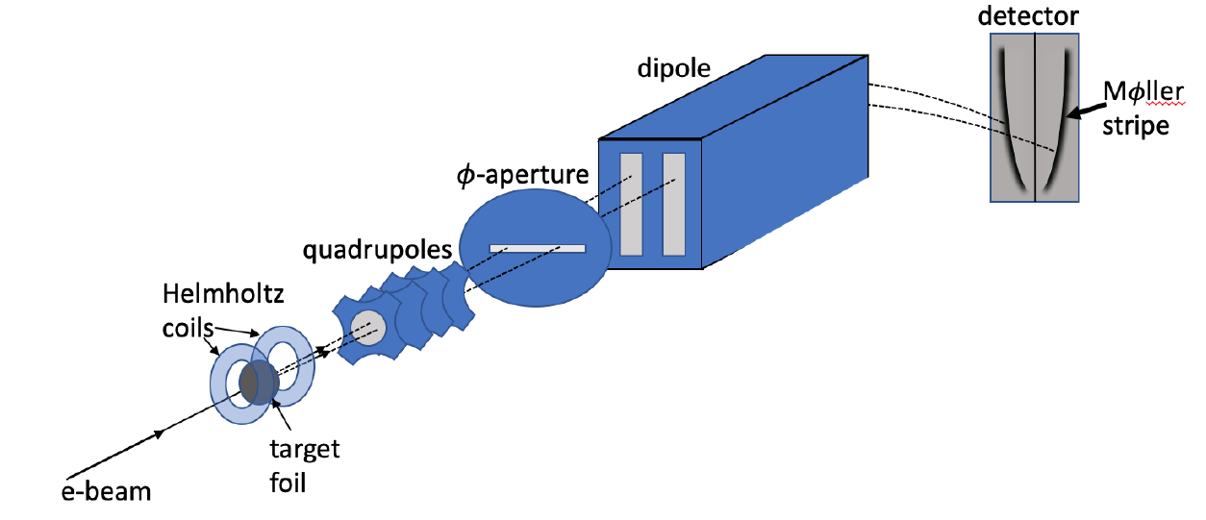
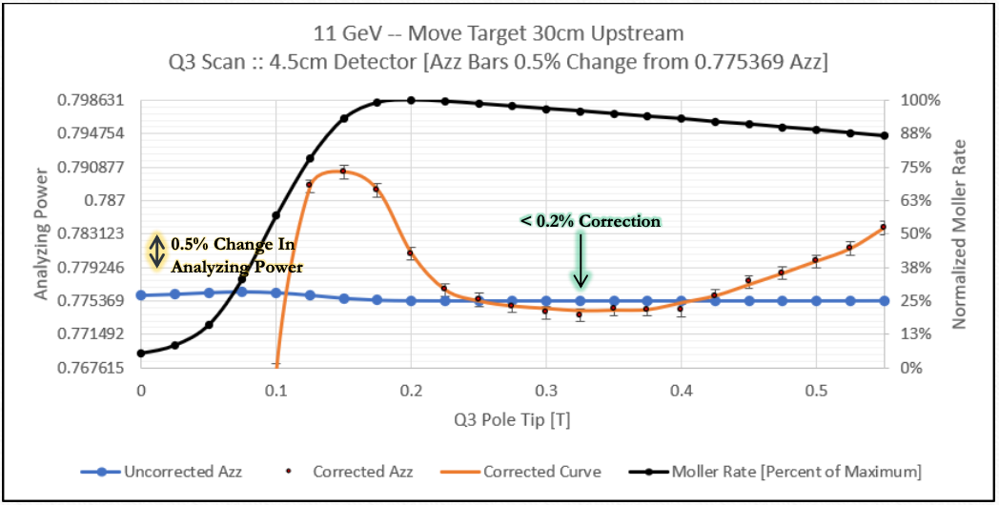
Moller Azz: two useful discoveries
Coincidence Rate
1. Our knowledge of spectrometer optics (field maps) is limited to several percent uncertainty, BUT simulation shows if we calibrate our settings relative to the rate maximum, we are highly insensitive to absolute knowledge of optics.
Levchuk Corr Azz
Simulated Azz
2. Limiting the vertical detector acceptance allows one to tune the Levchuk correction to nearly 0 AND create a large flat region of Azz.

Slide 6
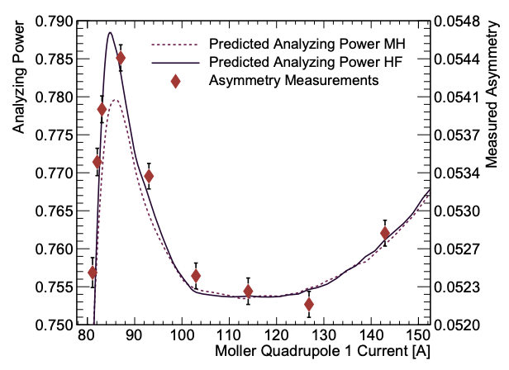
Levchuk correction improvement
Levchuk correction requires a model of the momentum distributions for polarized and unpolarized electrons in Fe
For past two decades this correction has been done using distributions from modified hydrogen wavefunctions (MH)
Data from CREX showed that this calculation predicted a 30% smaller “peak” than measured
Colleagues at Temple University suggested using a Hartree-Fock (HF) model (and provided the momentum distributions).
Exciting agreement!
arXiv 2207.02150

Slide 7
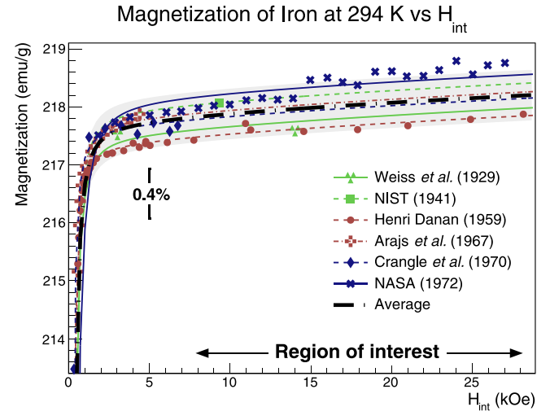
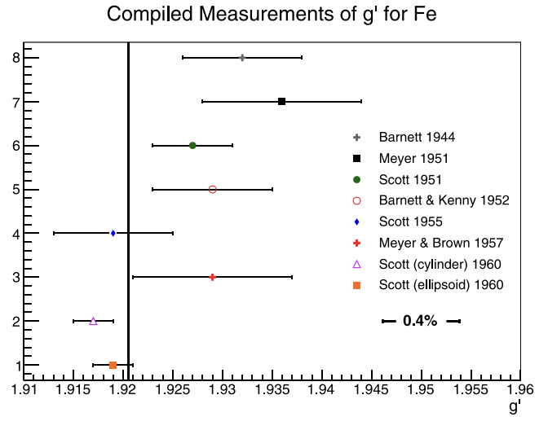
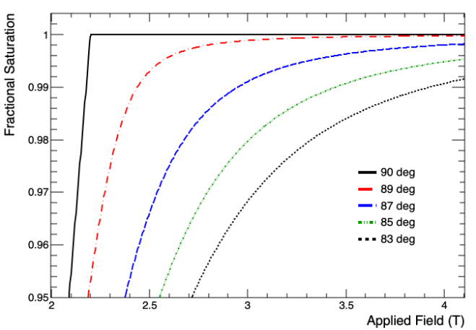
Fe foil target polarization
In a recent publication we demonstrate using world data on saturation magnetization and on the fraction of magnetization from spin that electron polarization in Fe foils is known to $±$0.24%.
Difficult to improve.
arXiv 2203.11238
arXiv 2203.11238
Stoner-Wohlfarth model of magnetization vs field
Degree of saturation: two key things prevent reaching full saturation magnetization
Magnetic field not strong enough
Difficult to magnetize out of plane
Crystal imperfections and stresses/strains create stubborn domain walls (ideal crystal fully saturated at 2.2T)
Imperfect alignment of foil (not taut, wrinkles, not precisely normal to magnetic field)

Slide 8
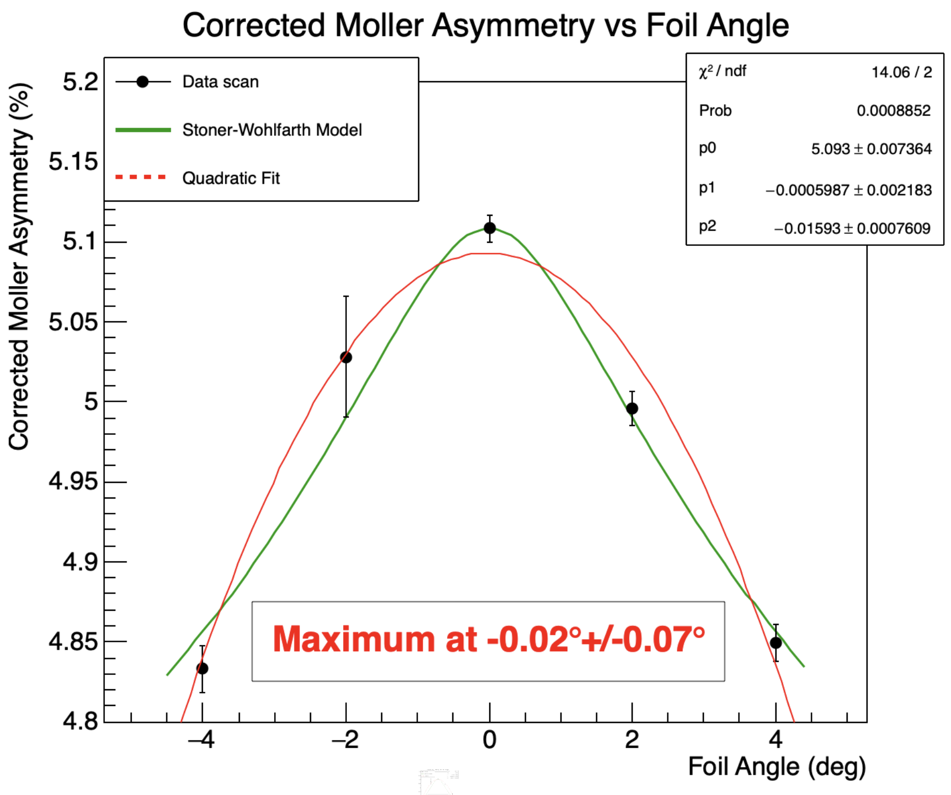
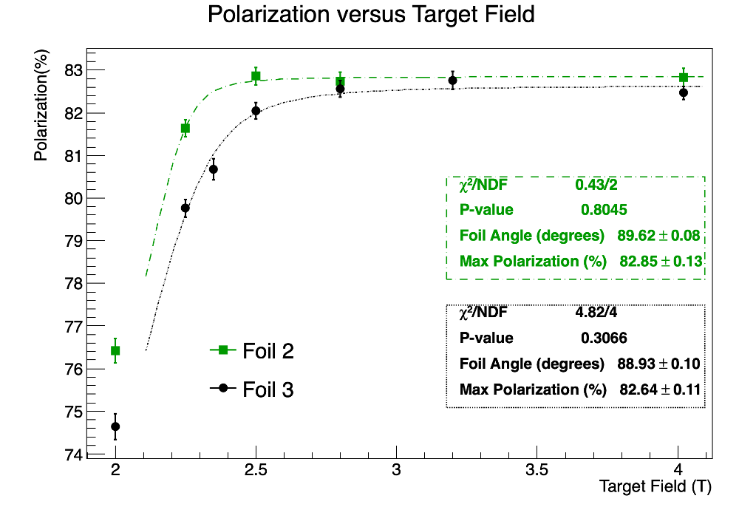
Fe foil target polarization
Ideal: demonstrate saturation precisely using an asymmetry vs. field scan
Previous scans/data have demonstrated
Apparent agreement with Stoner-Wohlfarth model and ability to align foils to within a fraction of a degree of normal using asymmetry vs foil angle scans
Difficulty interpreting results with two foils apparently aligned to within $±1°$ give different saturation magnetizations at 1.24σ
Wrinkle in foil during PREX2 showed 1% lower polarization
Also, loosely mounted foils may contribute to interpretation difficulties as the foil angle is not completely correlated with the ladder angle
Working on techniques to ensure foils mounted taut and flat and perpendicular to field

Slide 9
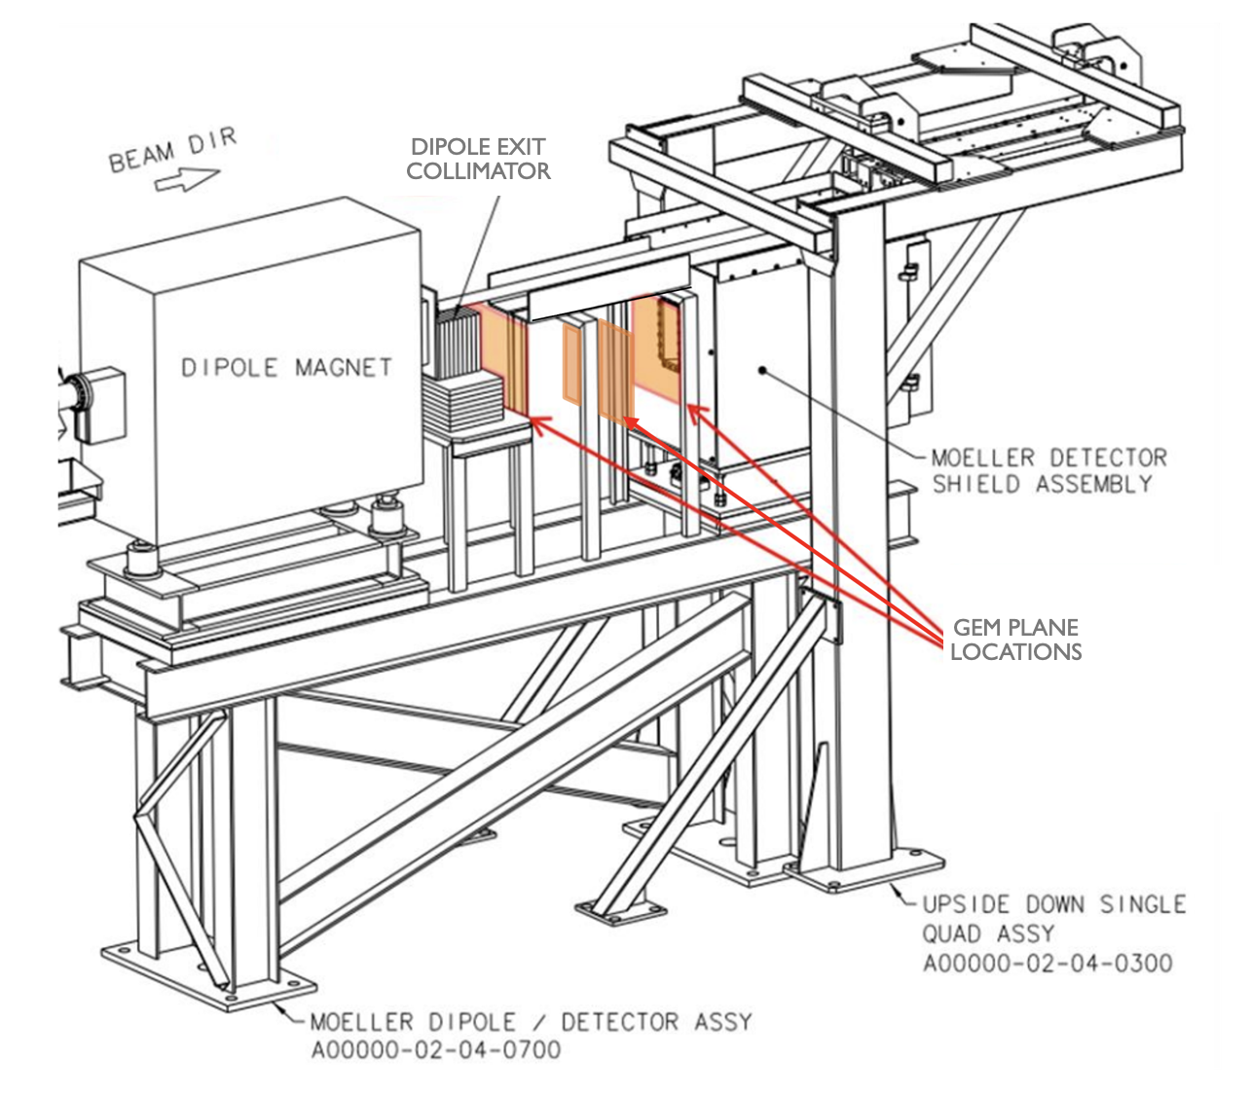
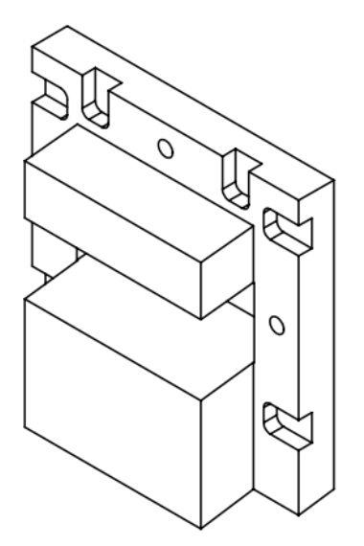
Improvements before MOLLER
Adding GEM tracking planes in drift region between dipole and detector to verify models for multiple scattering, radiative corrections and Levchuk effect
New FADC-based DAQ under development with ability to count events, integrate yields and produce energy spectra
New tungsten collimator in front of detector will limit acceptance and virtually eliminate sensitivity to the Levchuk correction
Utilizing a new CAEN detector emulator to directly measure dead time in the DAQ
No showstoppers at this point keeping us from reaching proposed 0.4% uncertainty

Slide 10
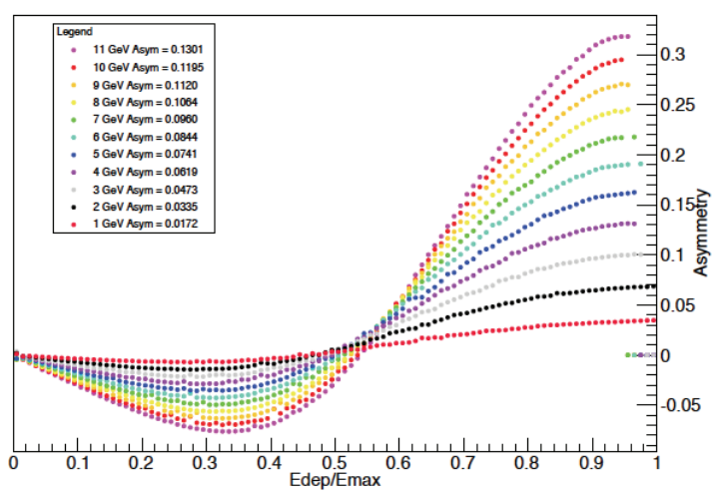
Compton polarimetry
Future e-det location
Scattering 2 kW circularly polarized green laser from electron beam and detecting both back-scattered $γ$and e-
$γ$-detector
Detects back-scattered photons from 0 to well above kinematic maximum
No-threshold integration 200 MHz
e-detector
3rd dipole momentum analyzes scattered electrons
Spectrum formed as function of displacement from beam
Current plans for both HVMAPS (high voltage monolithic active pixel sensor) and diamond strip detectors being developed
Mostly independent from photon detector but shares laser polarization systematic

Slide 11
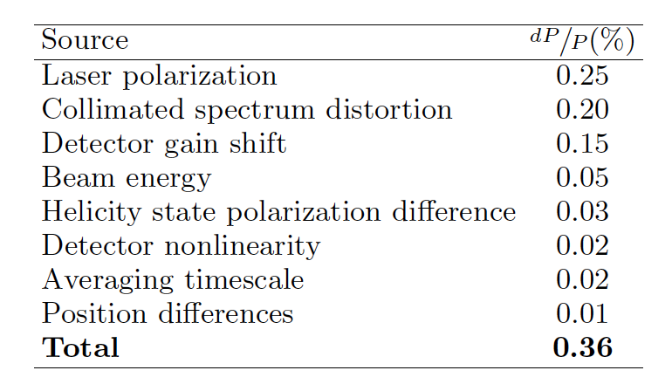
Compton polarimetry during CREX
Recent results for the CREX experiment in Hall A (soon to be published) already exceeded 0.4% goal!
Analysis uses photon detector only
Largest improvement comes from uncertainty in laser polarization
Electron detector to be added before MOLLER
CREX @ 2.2 GeV; MOLLER at 11 GeV where analyzing power at Compton edge >4x larger
Most accurate Compton polarimetry measurement we know of to date!

Slide 12
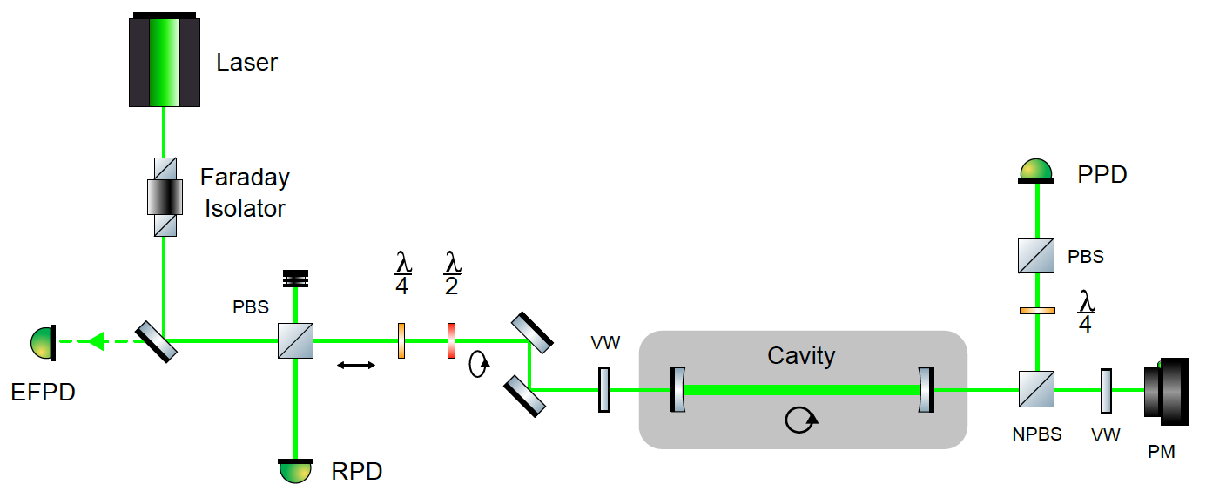
Compton polarimetry during CREX
Photon target from green laser in high finesse Fabry-Perot optical cavity
Previously inferred intracavity polarization by measurement in exit line while cavity locked
Required knowledge of optical transfer function through exit line elements which could only be measured with cavity open and not under vacuum
Significant uncertainty (~1%) from undetermined birefringence change in vacuum window after pump down.
New technique using $λ/4$ and $λ/2$ waveplates allows selection of polarization state such that 100% circular polarization occurs at cavity entrance
Achieved by minimizing light in EFPD
Increased accuracy and can be done in final configuration while system under vacuum
Can achieve 100% circular polarization at entrance to cavity

Slide 13
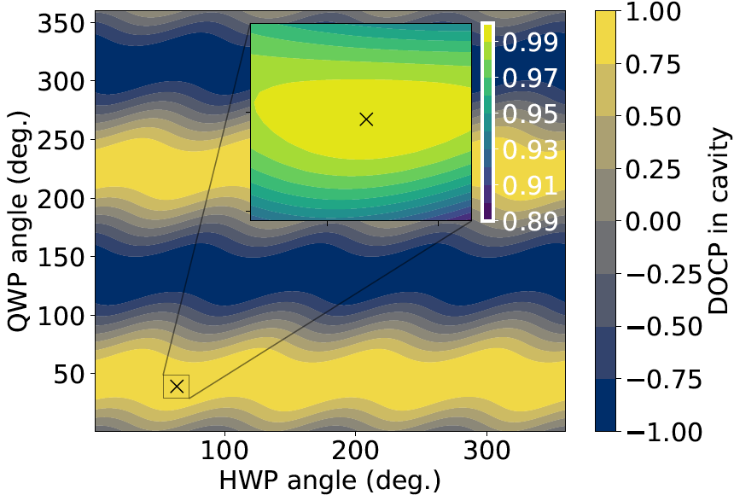
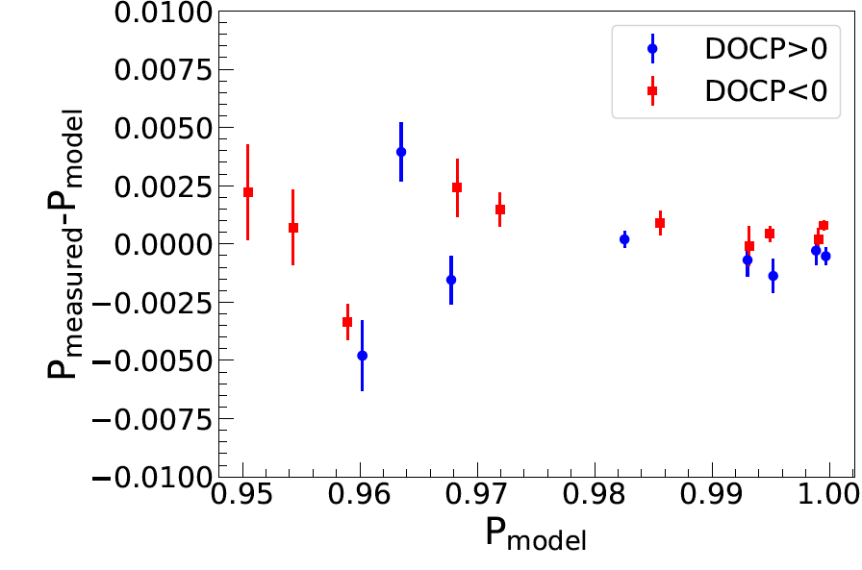
Limitations of laser polarization technique
Technique accurately sets 100% polarization entering cavity, but does not determine average polarization of light in locked cavity
Mirrors like those used here (R=99.98%) typically have birefringence ~1e-4 degrees per bounce
Measurements with the cavity locked gave $(1.45±0.13)×{10}^{−4}$ degrees per bounce
Adding measured cavity mirror birefringence to the model gave intracavity polarization of ${99.99}_{0.25}^{0.10}$%
Most of the uncertainty was from residuals between model and measurement
Some reduction in this uncertainty can is expected by placing the polarization analyzing optics closer to the cavity thereby reducing the difference between incident and reflected beam trajectories.
Residuals between model prediction and actual polarization and the transmitted beam with locked cavity measured just downstream of the second cavity mirror

Slide 14
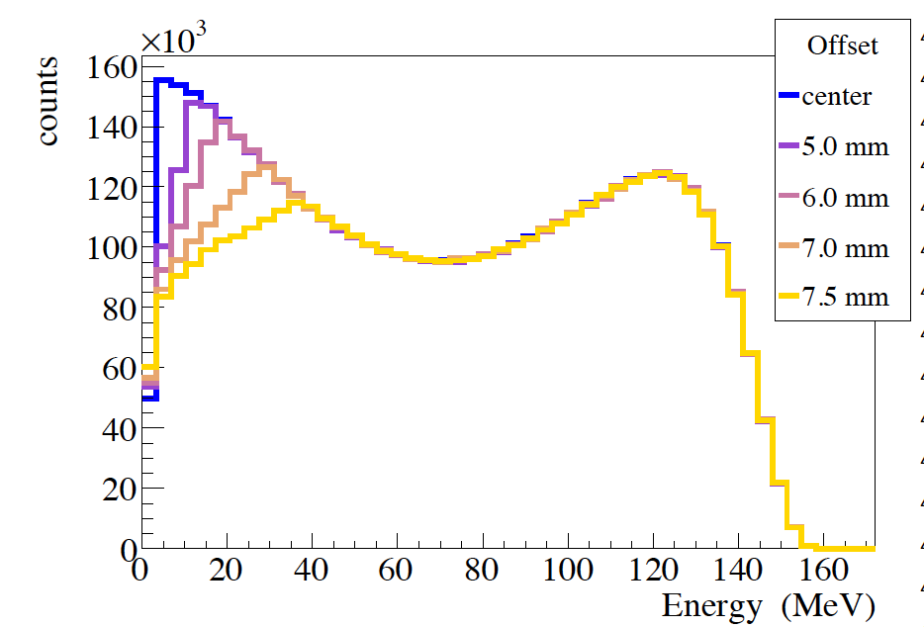
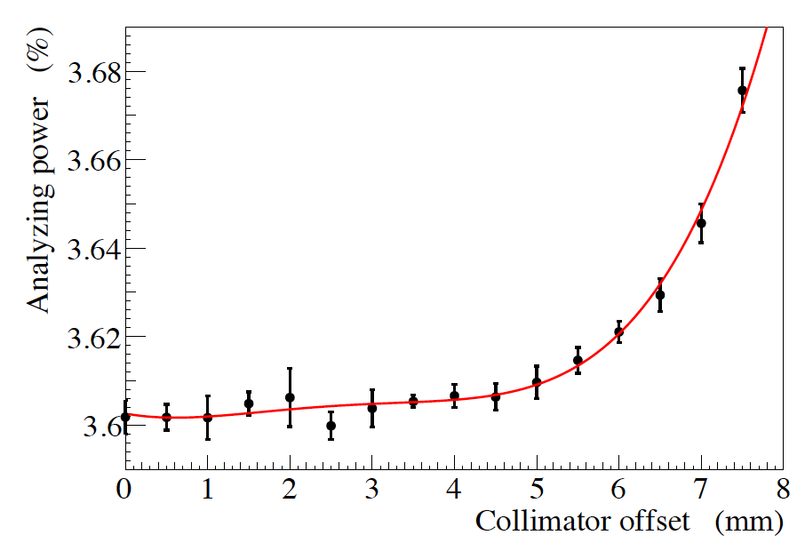
Collimator distortion
collimator
Lead collimator in front of photon detector GSO crystal with 2cm diameter aperture captures full “cone” of backscattered photons and shields against non-Compton backgrounds
If backscattered photon beam not centered on collimator, low energy photons preferentially cut off increasing analyzing power.
GEANT4 simulated spectrum for various collimator offsets
Measured spectra during the run were compared with simulation to provide estimate of effect on analyzing power with little sensitivity below 5mm
0.2% uncertainty assigned

Slide 15
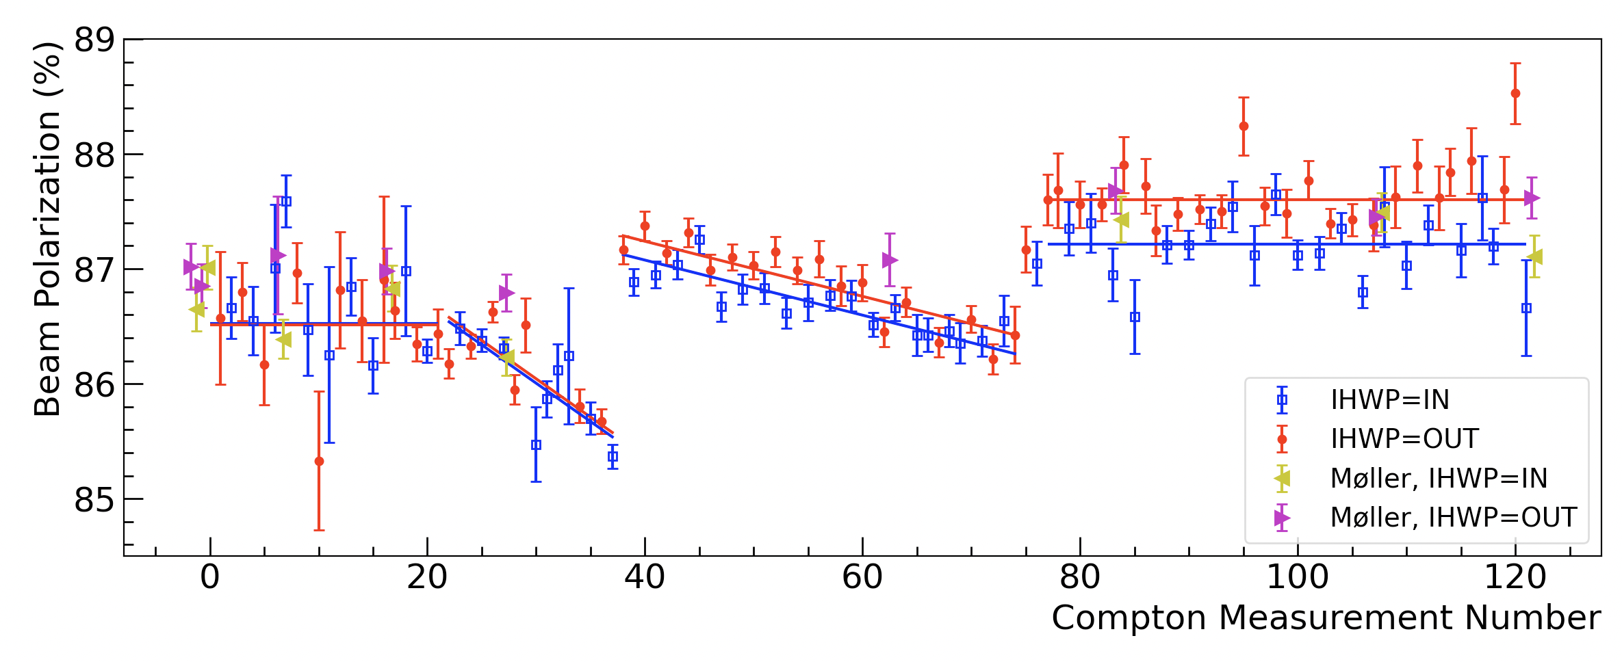
Compton/Moller comparison during CREX
Compton average: $86.90\%±0.31\%\left(\text{syst}\right)±0.02\%(\text{stat})$
Moller measurements on average $0.286±0.74\% ($percentage points) higher than Compton (0.85% relative error)
Polarization with Compton and Moller combined: $86.95\%±0.29\%$ (0.33% relative uncertainty!)

Slide 16
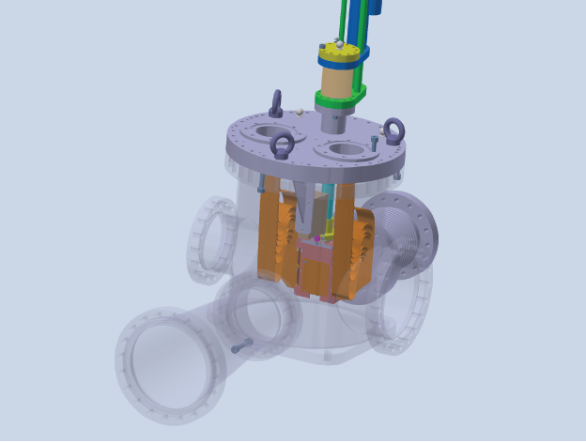
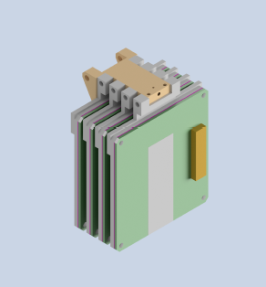
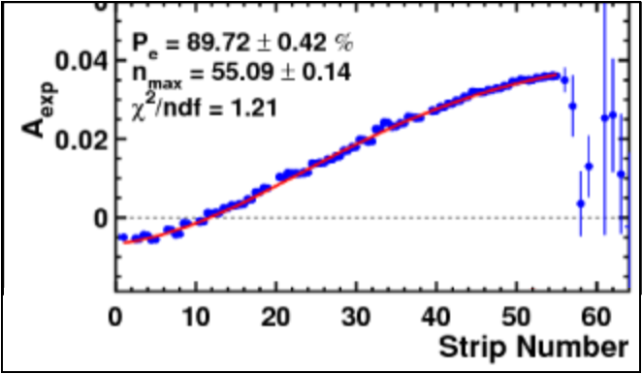
Further improvements before MOLLER
Two electron detector designs are being concurrently developed and tested. One will eventually be implemented.
Diamond detector: 4 thin diamond planes with metal alloy strips adhered to surface with a few hundred micron pitch (similar design successfully used in Qweak)
Bias voltage applied to metal strips causes electron holes from tracks to drift towards nearest strip
HVMAPS detector (high voltage monolithic active pixel sensors) used at CERN and Mu3e at PSI
4 planes would replace diamond planes and require much few readout signal lines
CAD model of diamond detector planes
Idea is to fit spectrum of scattered electron tracks as distance from beam trajectory (momentum analyzed by 3rd dipole) with beam polarization as fit parameter.
Example spectrum from Qweak

Slide 17
Conclusions
Stringent requirements from future experiments MOLLER and SoLID in Hall A at Jefferson Lab are pushing us towards a new level of accuracy in electron beam polarimetry with both Compton and Moller polarimeters aiming to attain 0.4% uncertainty
Significant progress has been made in understanding the Moller polarimetry and while only 0.85% uncertainty has been reached thus far, that is in large part due to the fact greater precision wasn’t required. Significant reductions can be achieved with a measurement program with beam time allocation.
Compton polarimetry has already achieved results at 0.36% well below the required level during CREX and further improvements are planned.
Thank you

